Slide 1


Development of the Monitoring System of computing resources
of Heterogeneous Platform HybriLIT
Belyakov D.V.¹, Zuev M.I.¹, Karpov G.A.², Skazkin M.A.², Lebedev M.P.², Dereza D.G.²
¹ Joint Institute for Nuclear Research, Dubna, Russia
² Department of Mathematical and Computer Modeling,
Institute of Mathematics and Computer Technologies,
Far Eastern Federal University, Vladivostok, Russia
11th International Conference
“Distributed Computing and Grid Technologies in Science and Education” (GRID-2025)
08 July 2025

Slide 2
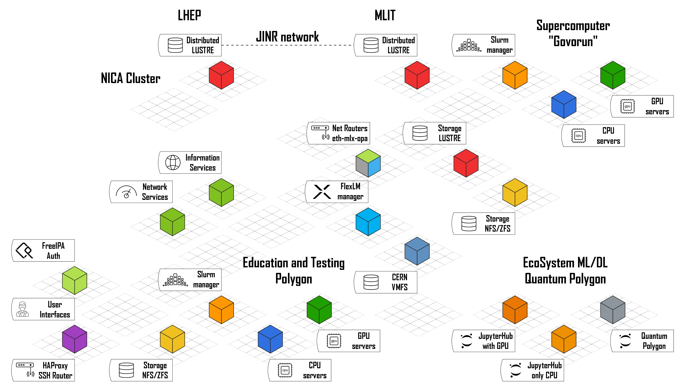
Heteroheneous platform HybriLIT
1/8

Slide 3
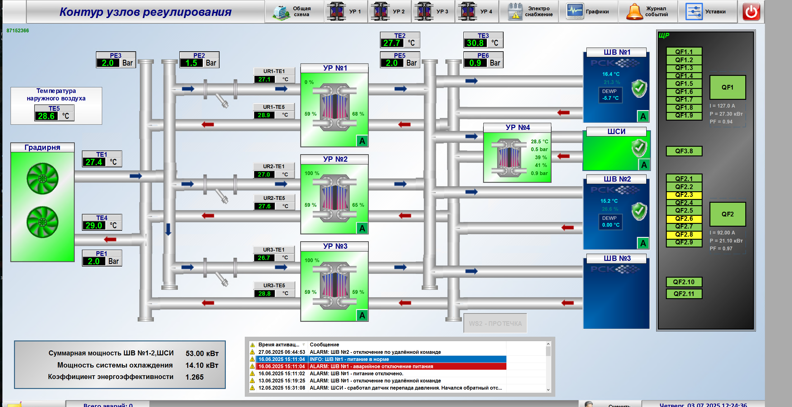
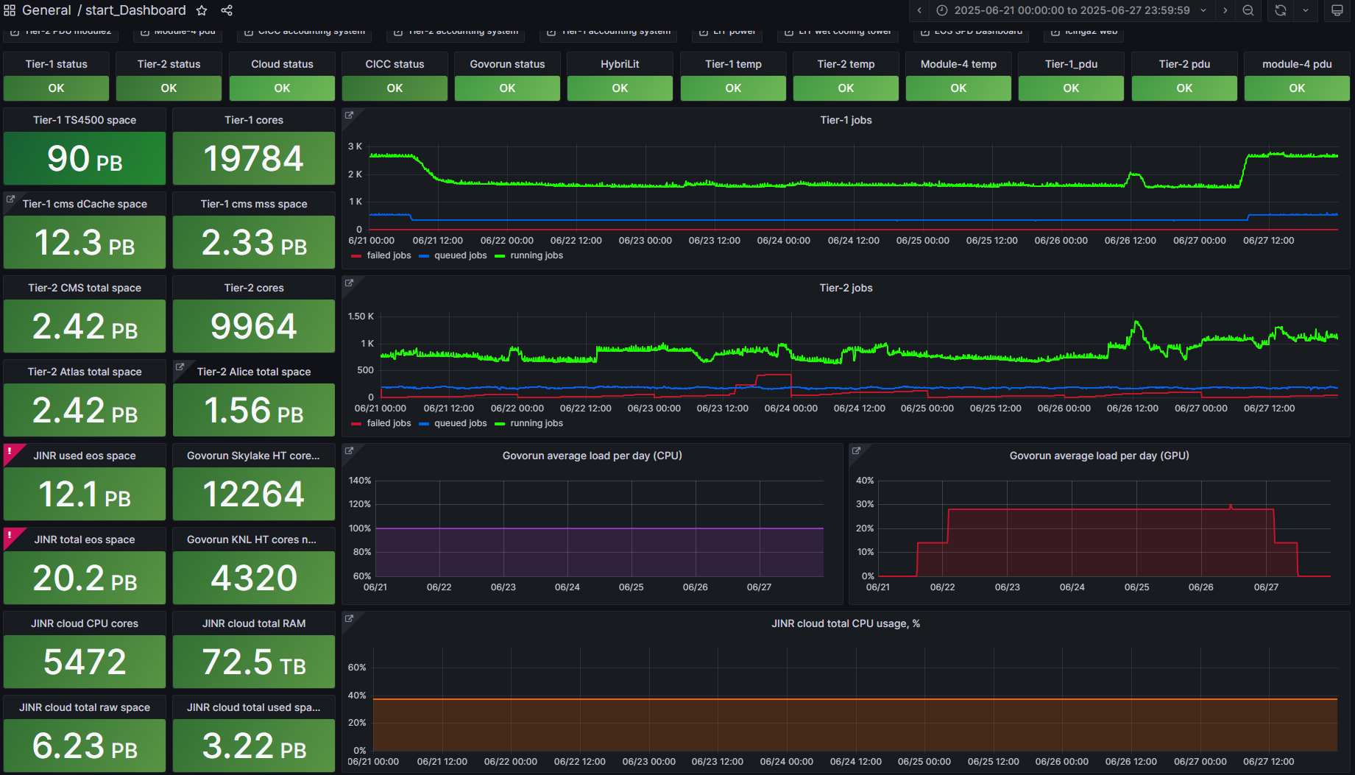
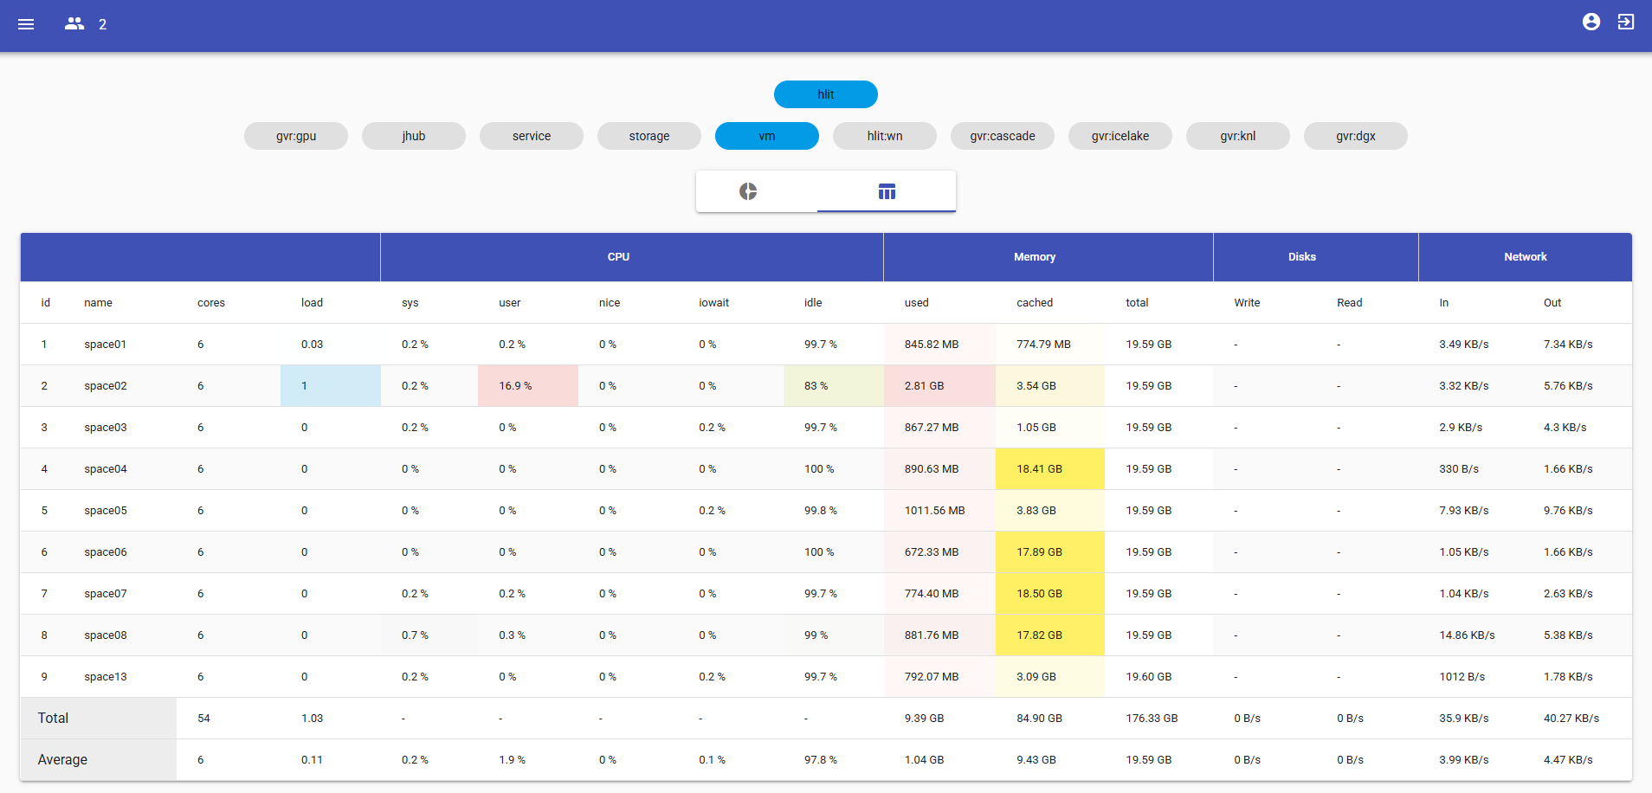
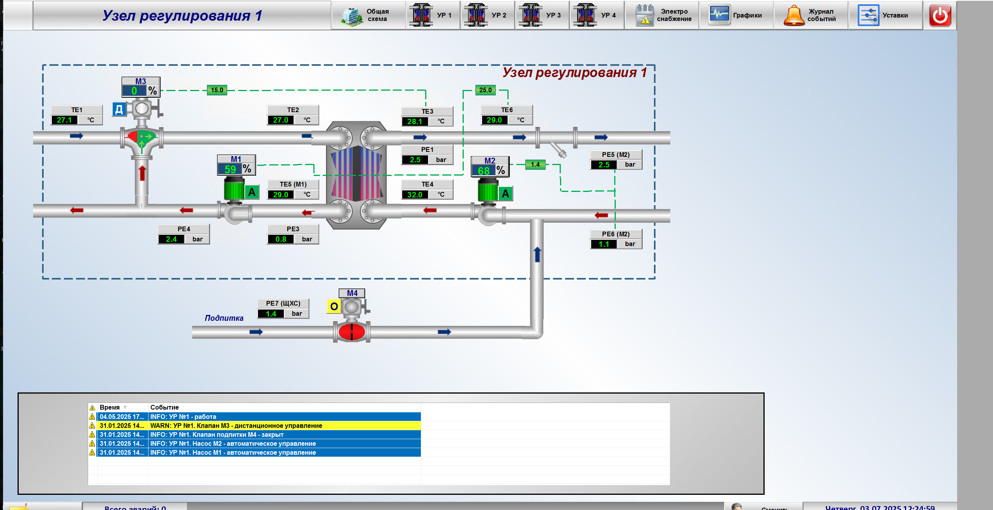
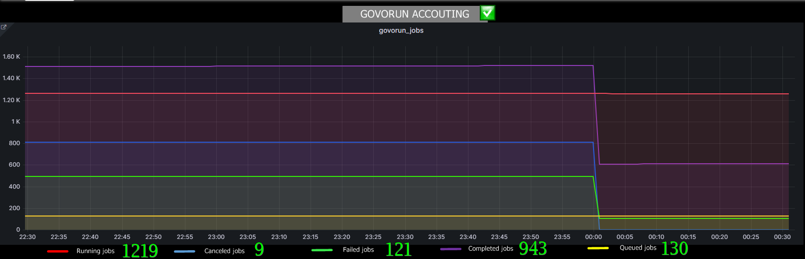
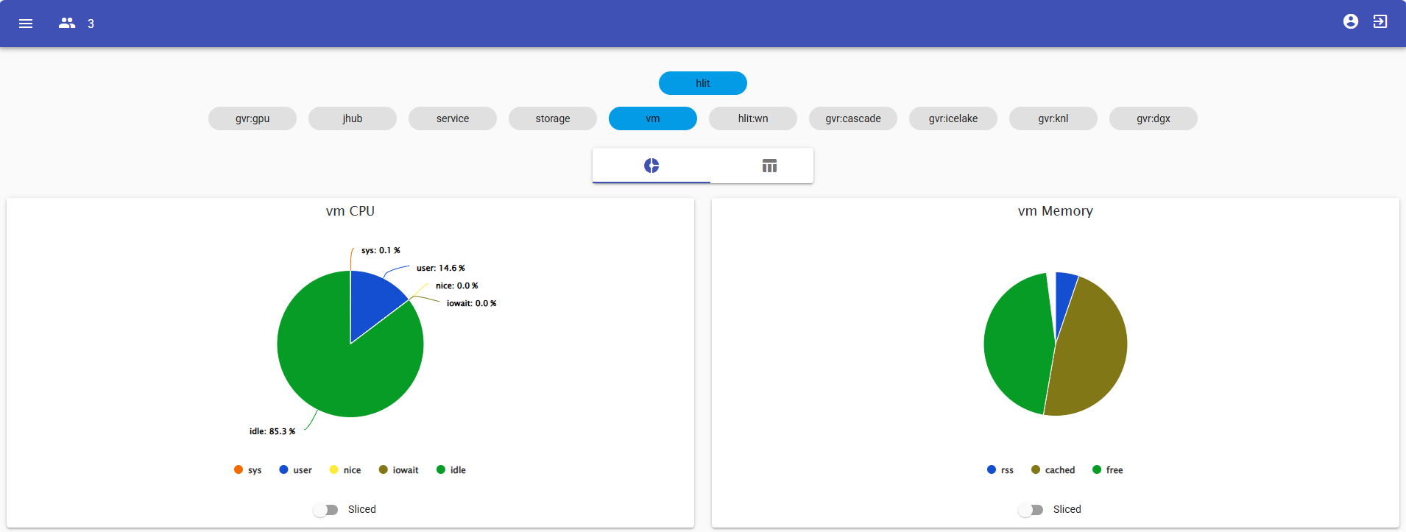
Monitoring Systems of Heterogeneous platform HybriLIT
2/8
Monitoring of Cooling System
of Supercomputer «Govorun» (RSC)
MICC Monitoring
of Supercomputer «Govorun» (MLIT)
«SALSA» Monitoring
of Computing Resources (HybriLIT)
The main purpose is
to monitor of cooling system work,
to control of cold and hot «water»
supply units.
The main purpose is
to monitor of payload on computing queues
of supercomputer «Govorun».
The main purpose is
to monitor of payload on computing resource of platform HybriLIT.

Slide 4
Tasks of Monitoring of Platform’s Computing Resources
3/8
}
Monitoring
«SALSA»
Payload of CPU and GPU Resources of servers and virtual machines;
RAM usage;
Tracking of I/O operations on data storages;
Tracking of network traffic;
+
}
?
New system
Monitoring «history» with window of 24 hours;
Monitoring of payload created by SLURM jobs;

Slide 5
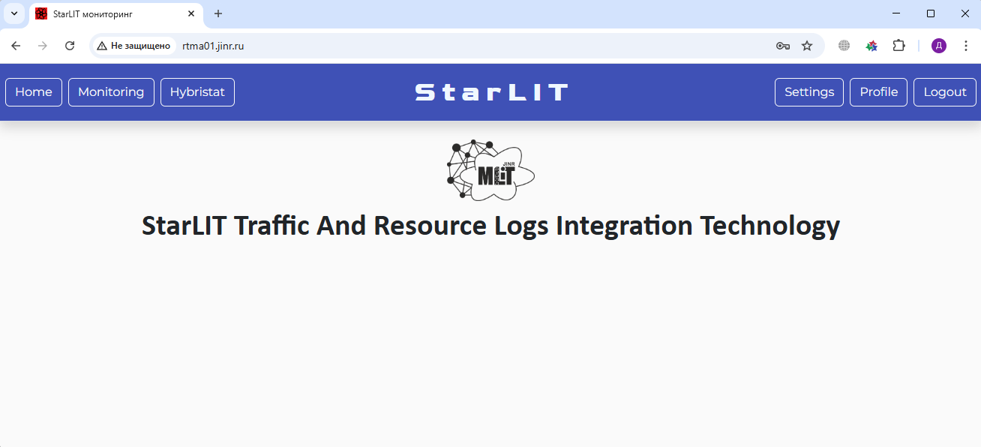
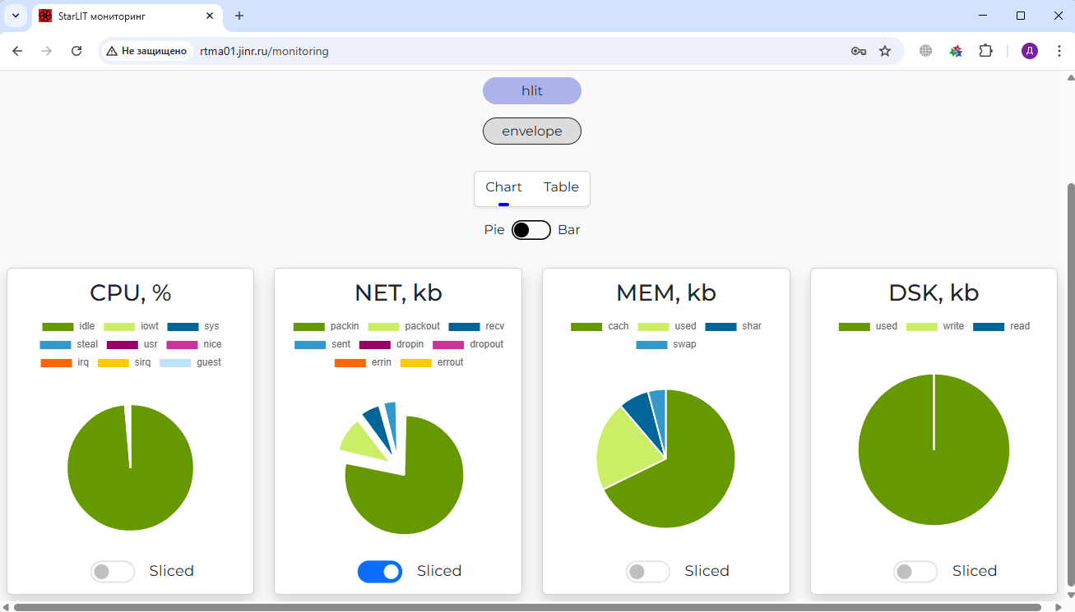
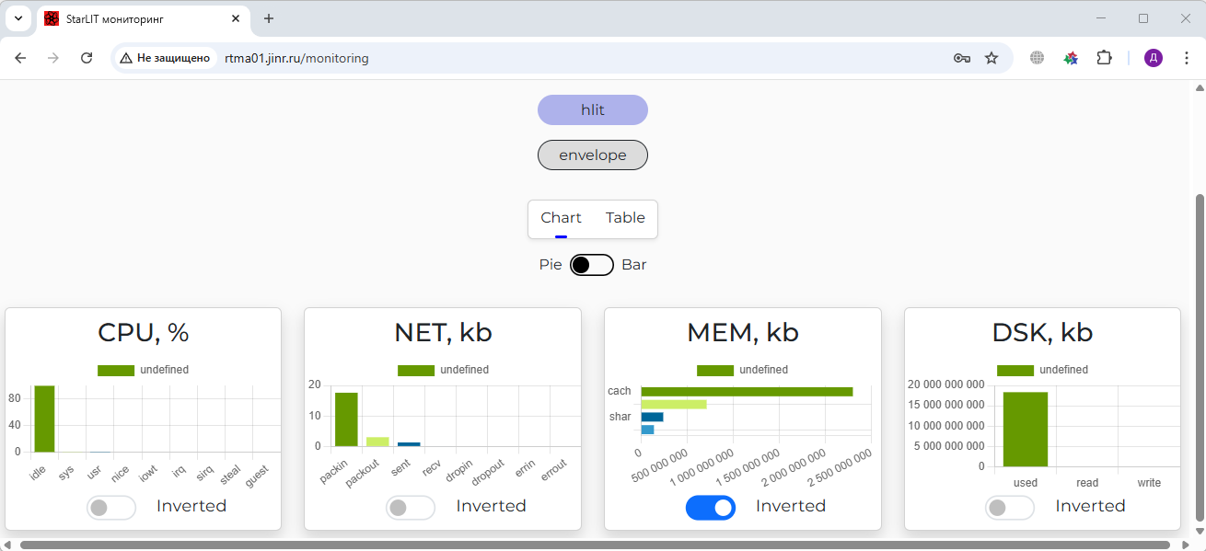
Development a new monitoring system
4/8
MLIT Cooperation with Far Eastern Federal University
The topic «Development and implementation of new systems for collection and analyzing statistics on the usage of computing resources and software of the Heterogeneous platform HybriLIT» was proposed within the scientific theme «JINR MICC Support and Development» at JINR Autumn School on Information Technologies (IT-School 2023).
16 – 23 October 2023
Task: Development of new monitoring system
In 2024 year FEFU’s students completed an internship provided by Winter session of START (STudent Advanced Training at JINR) student program at MLIT. The students actively participated on selected task of the development of a new system of monitoring computing resources of platform.
During the Summer working practice at MLIT and further during of Distance practice at JINR University Centre (UC) students continued to develop the project.
As the result of this cooperative work a new information system was developed to monitor of computing resources of the Heterogeneous platform HybriLIT.
Result of the work
New information system designed to monitor
of computing resources
of the Heterogeneous platform HybriLIT.
At current moment the system was deployed
on the local resources of HybriLIT for testing operation.

Slide 6
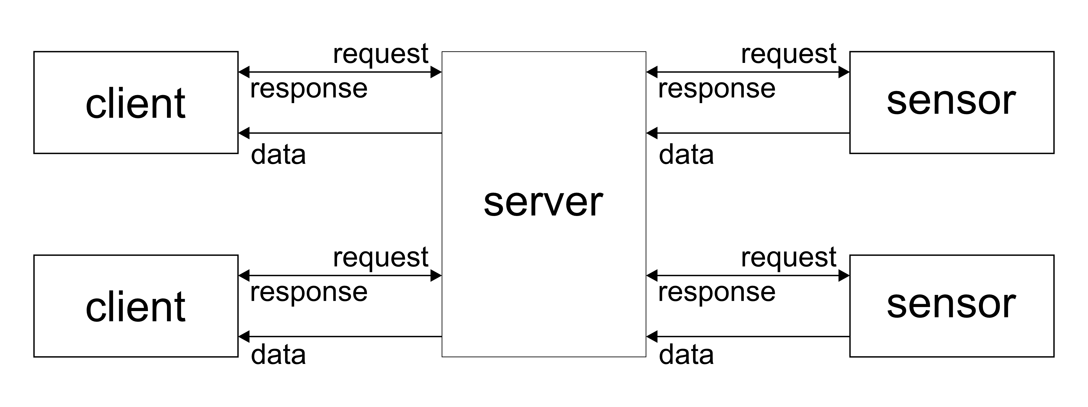
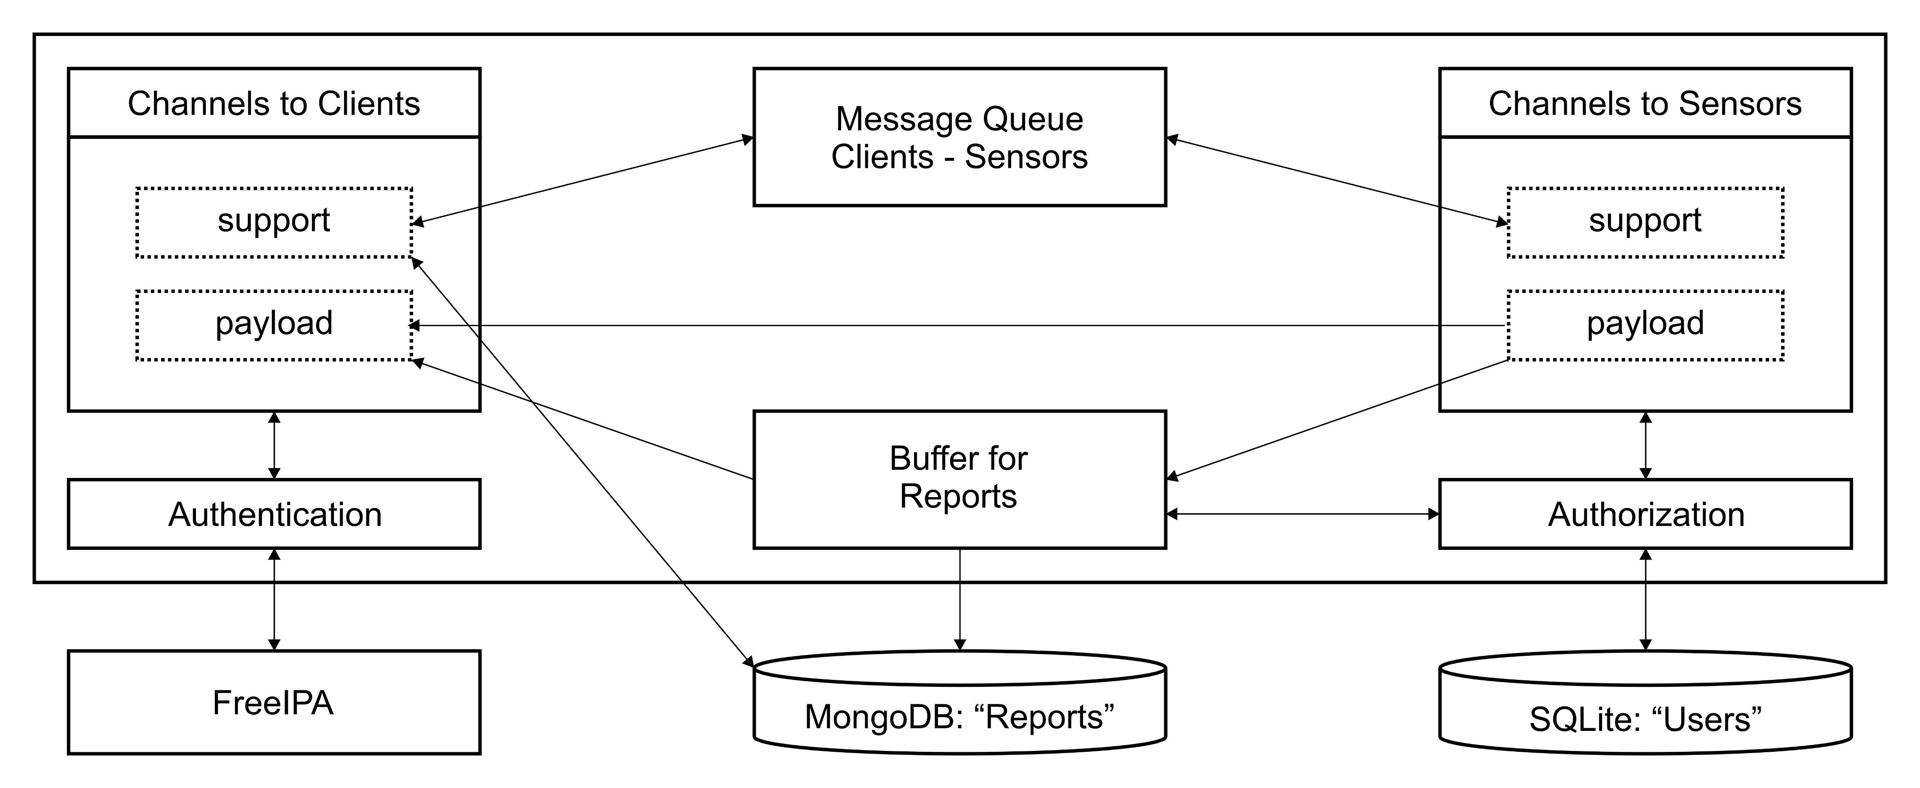
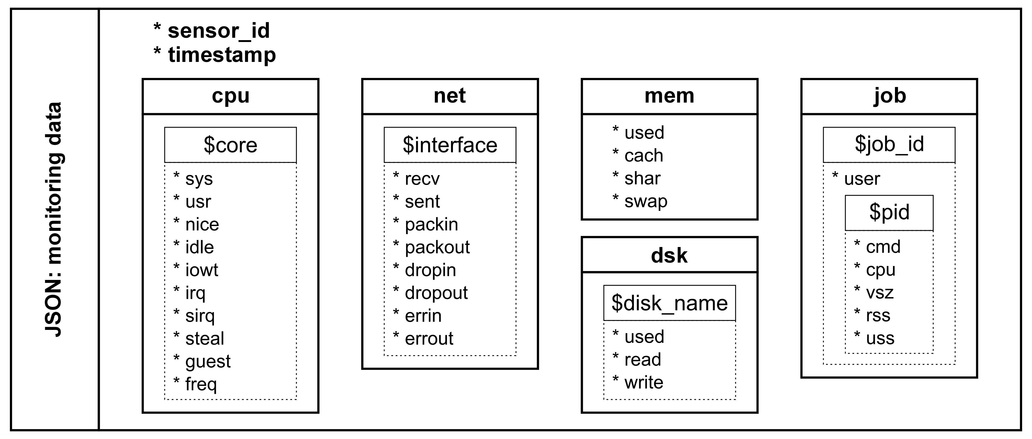
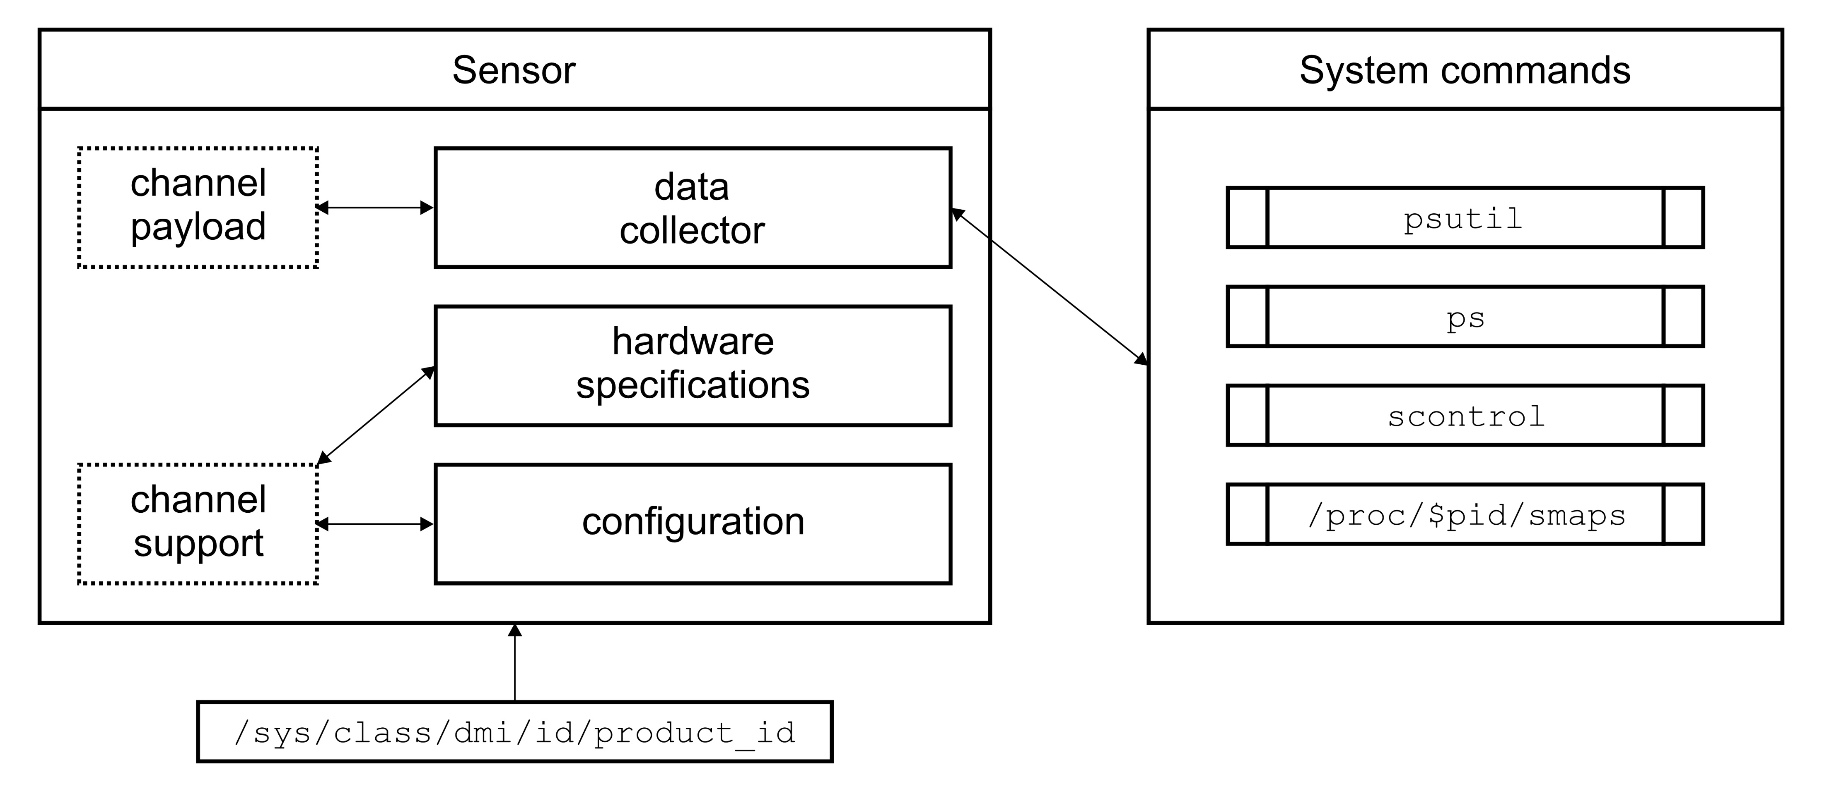
Architecture of a server part of system StarLIT (backend)
5/8
Scheme of a server part (backend)
Structure of a server
Monitoring report
Structure of a sensor

Slide 7
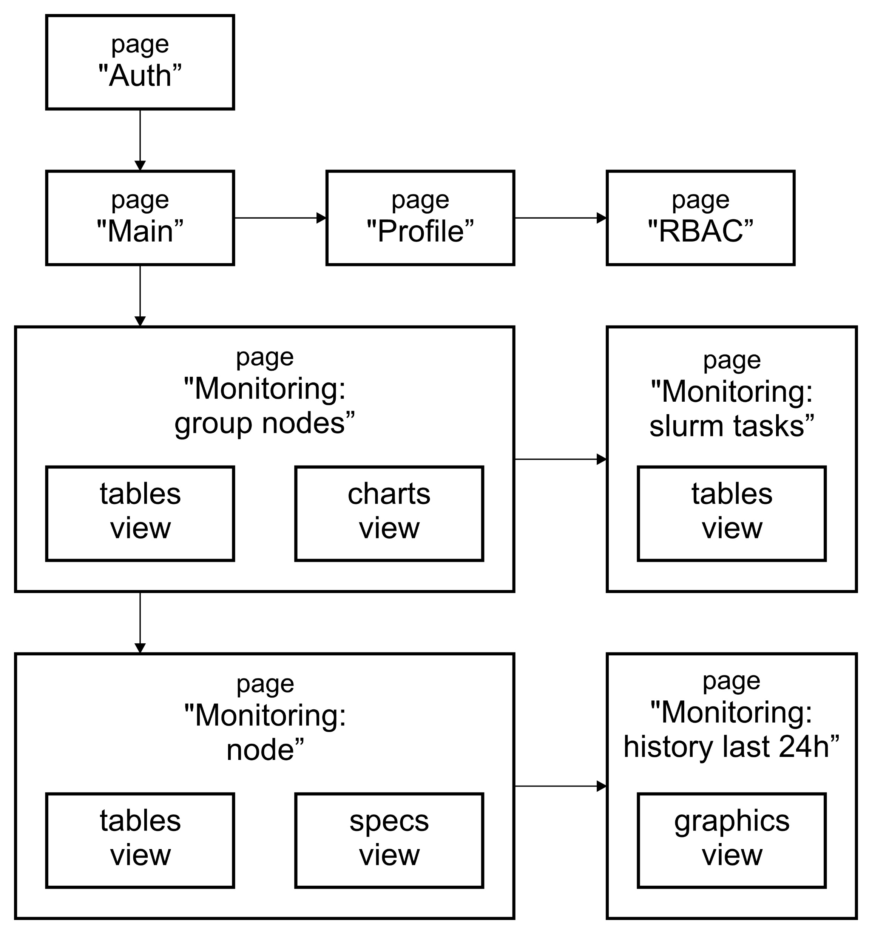
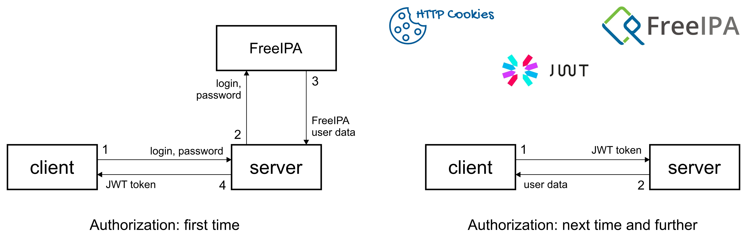
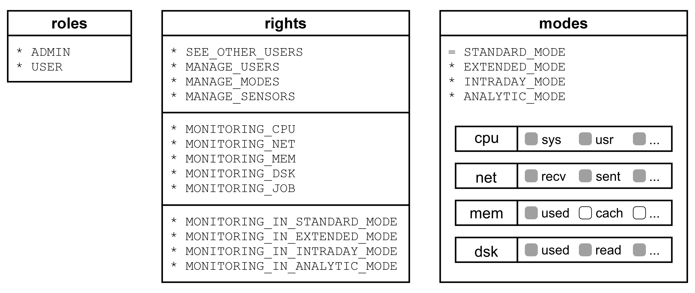
Architecture of a client part of system StarLIT (frontend)
6/8
Scheme of a client part (frontend)
Scheme of an Authorization process
RBAC settings

Slide 8
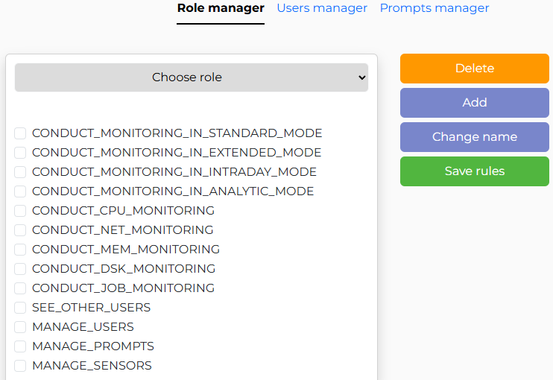
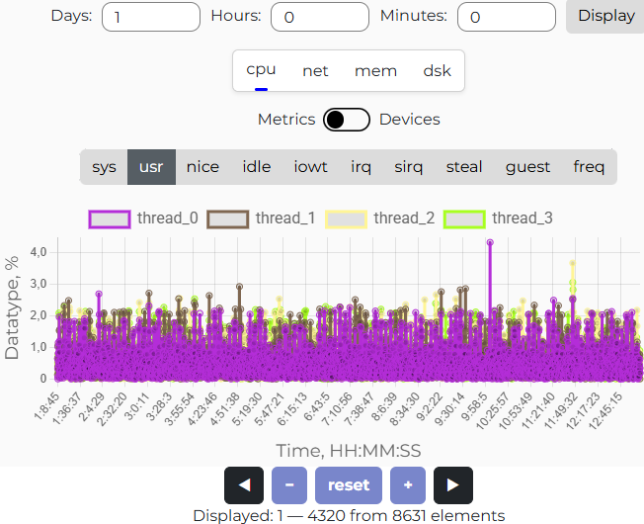
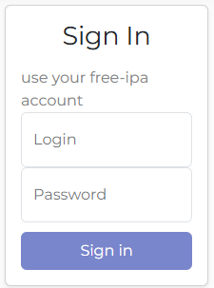
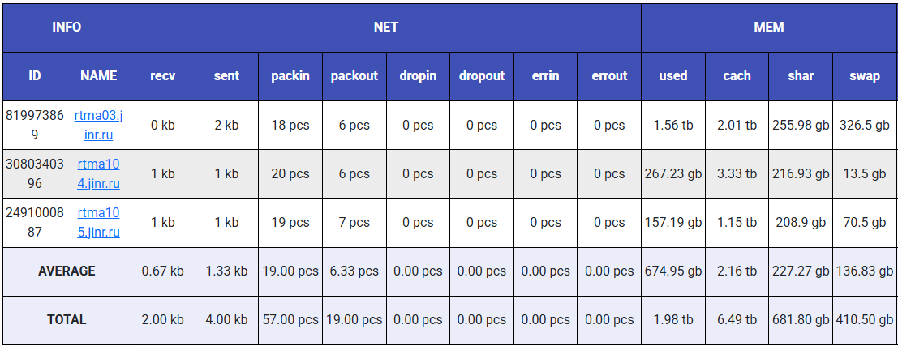
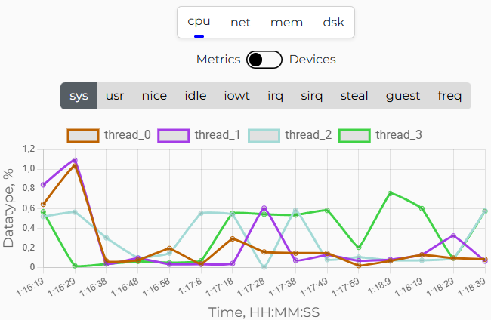
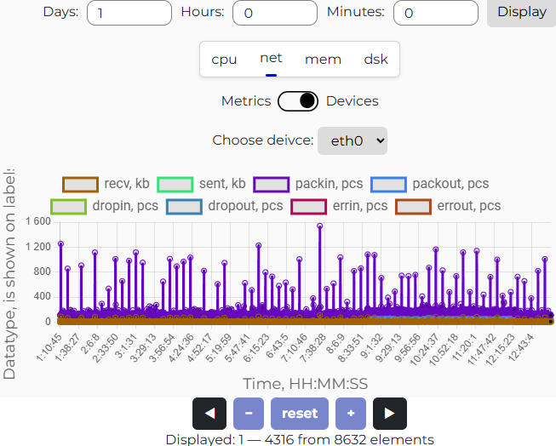
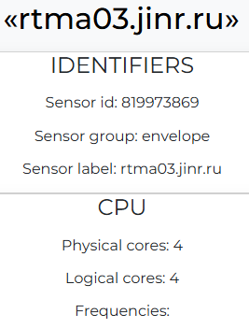
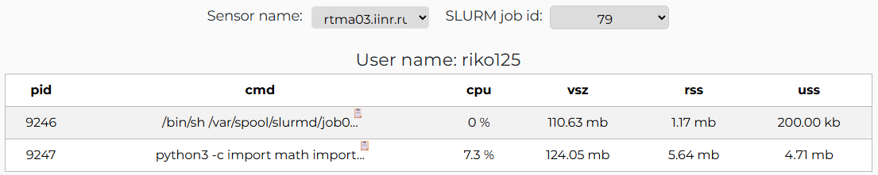
The User Interface of system StarLIT
7/8

Slide 9
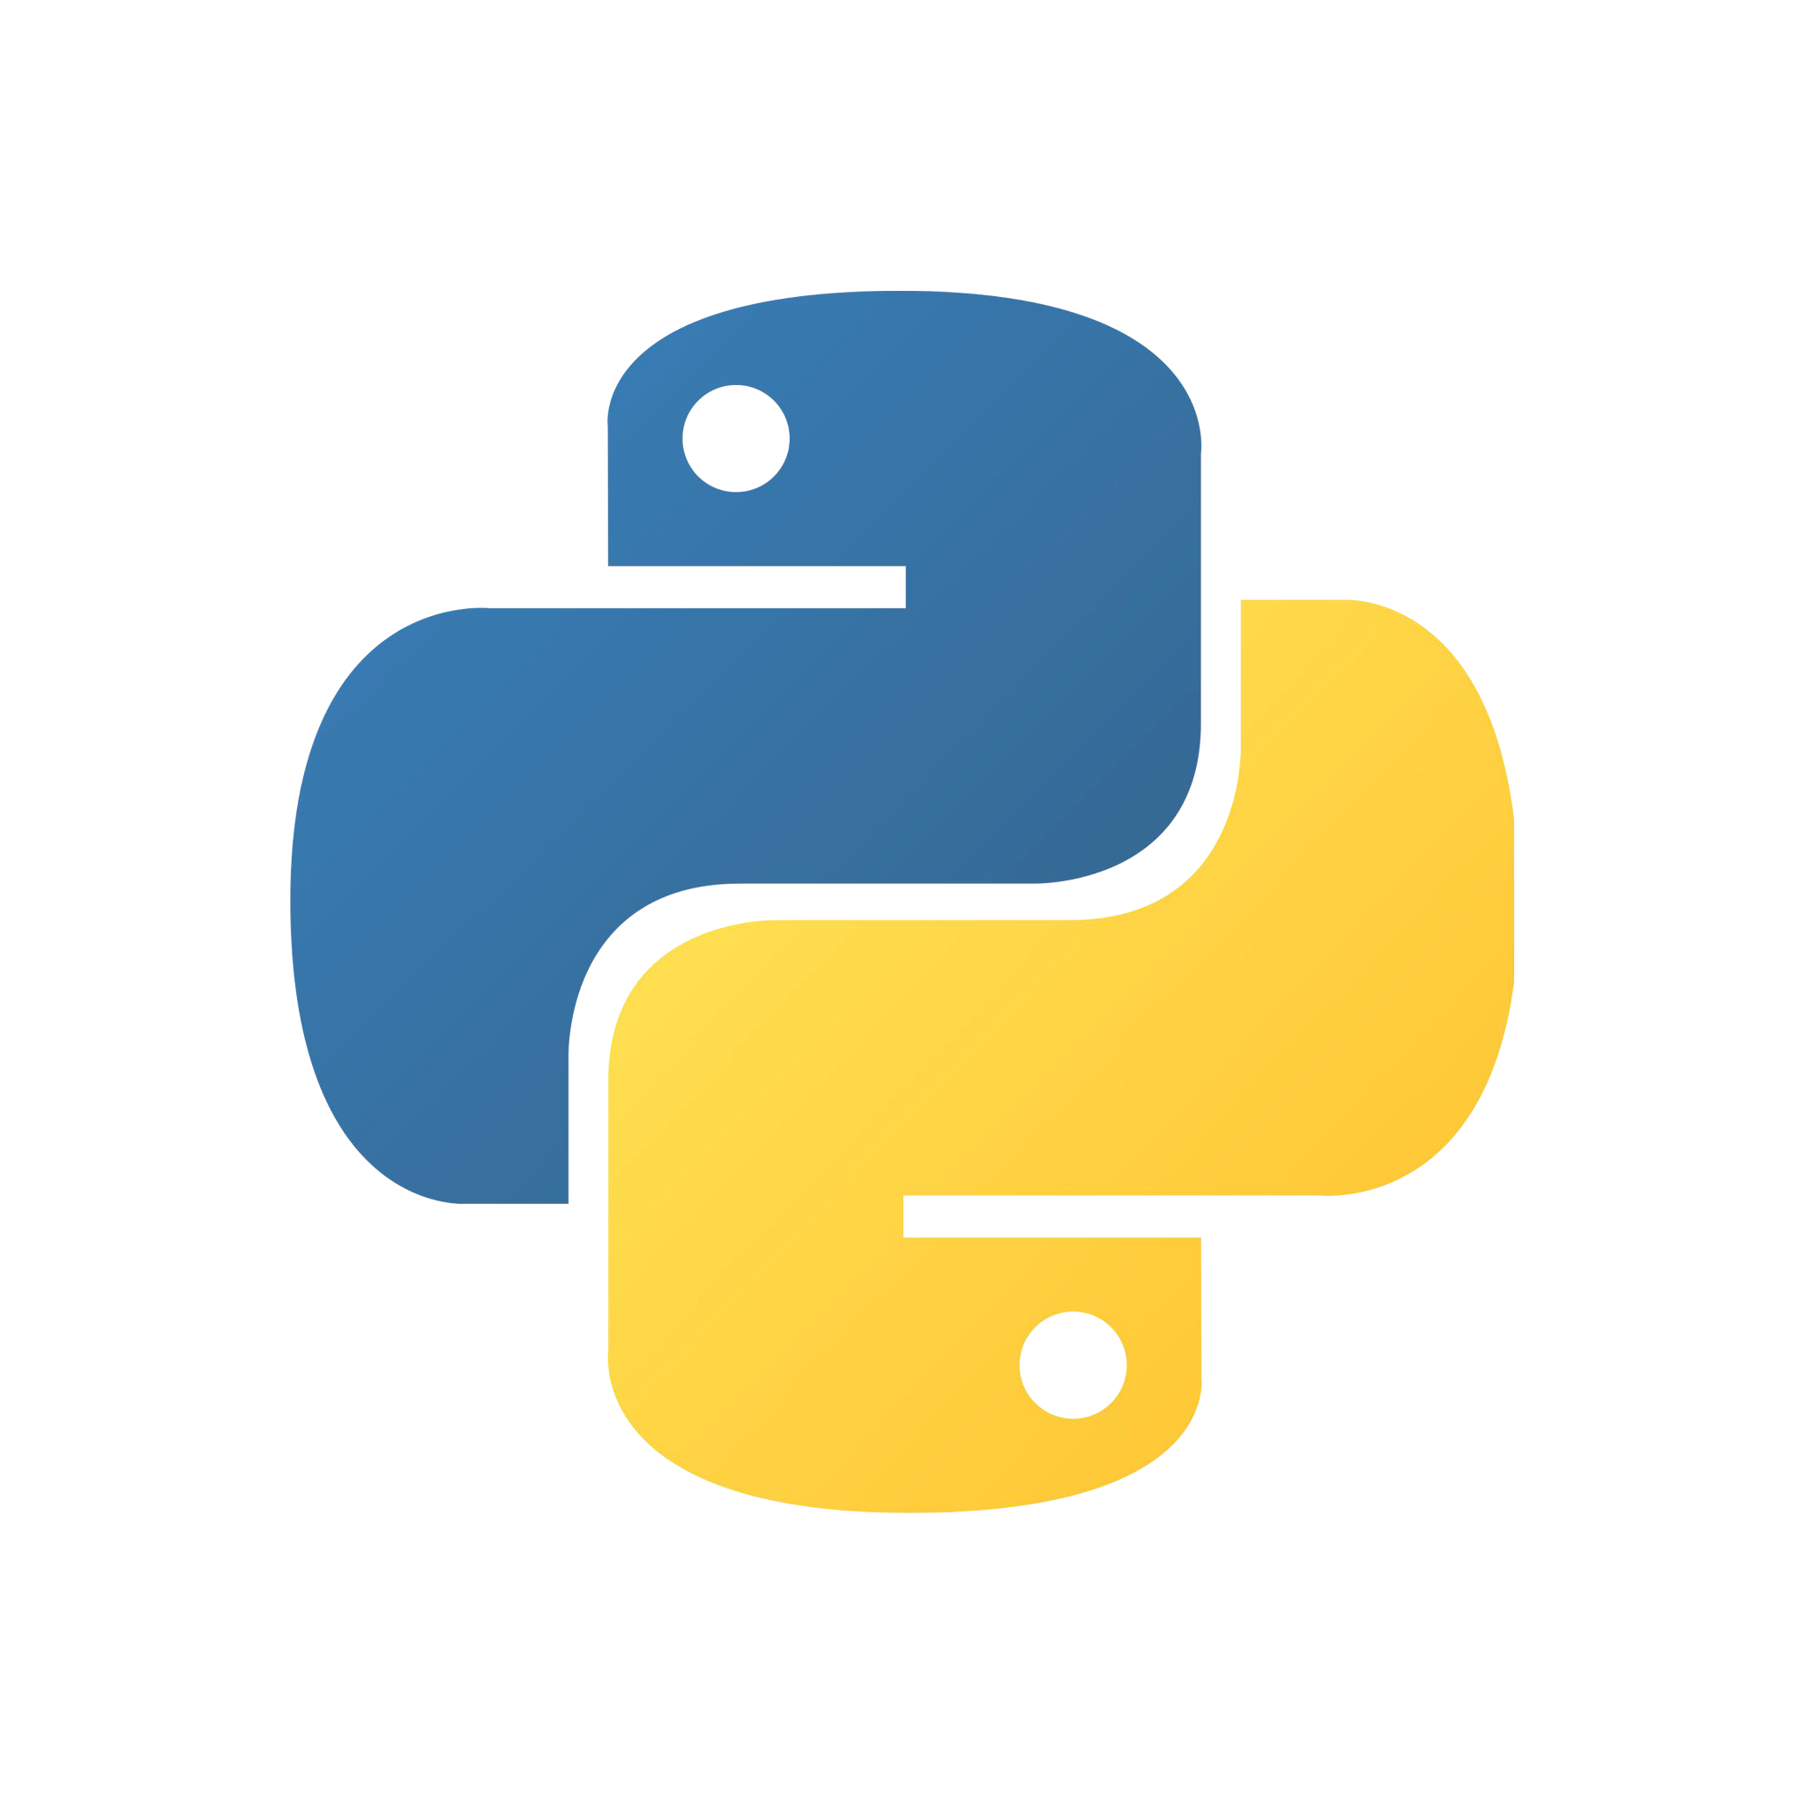






Conclusion
8/8
As the result of the work new information system StarLIT was developed to monitor the computing resources of the Heterogeneous platform HybriLIT.
The StarLIT system is built on microservice architecture using asynchronous data transfer between clients, server and sensors based on TCP and Web sockets.
The server part (backend) is implemented in Python 3 programming language using
FastAPI framework, SQLite and MongoDB databases and psutil library.
The client part (frontend) is implemented in JavaScript programming language using
Vue.js framework, Bootstrap CSS framework, Charts.js and Axios libraries.
At current moment the system was deployed on local resources of HybriLIT for testing operation.

Slide 10


