Slide 1
Development of an accounting system and processing of usage statistics for computing resources of the "Govorun" supercomputer
Dmitry Belyakov, Margarita Kirakosyan, Maria Lyubimova,
Dmitry Podgainy, Oksana Streltsova
11th International Conference
«Distributed Computing and Grid-technologies in Science and Education»
GRID'2025, Dubna, JINR, MLIT
7-11 July 2025

Slide 2
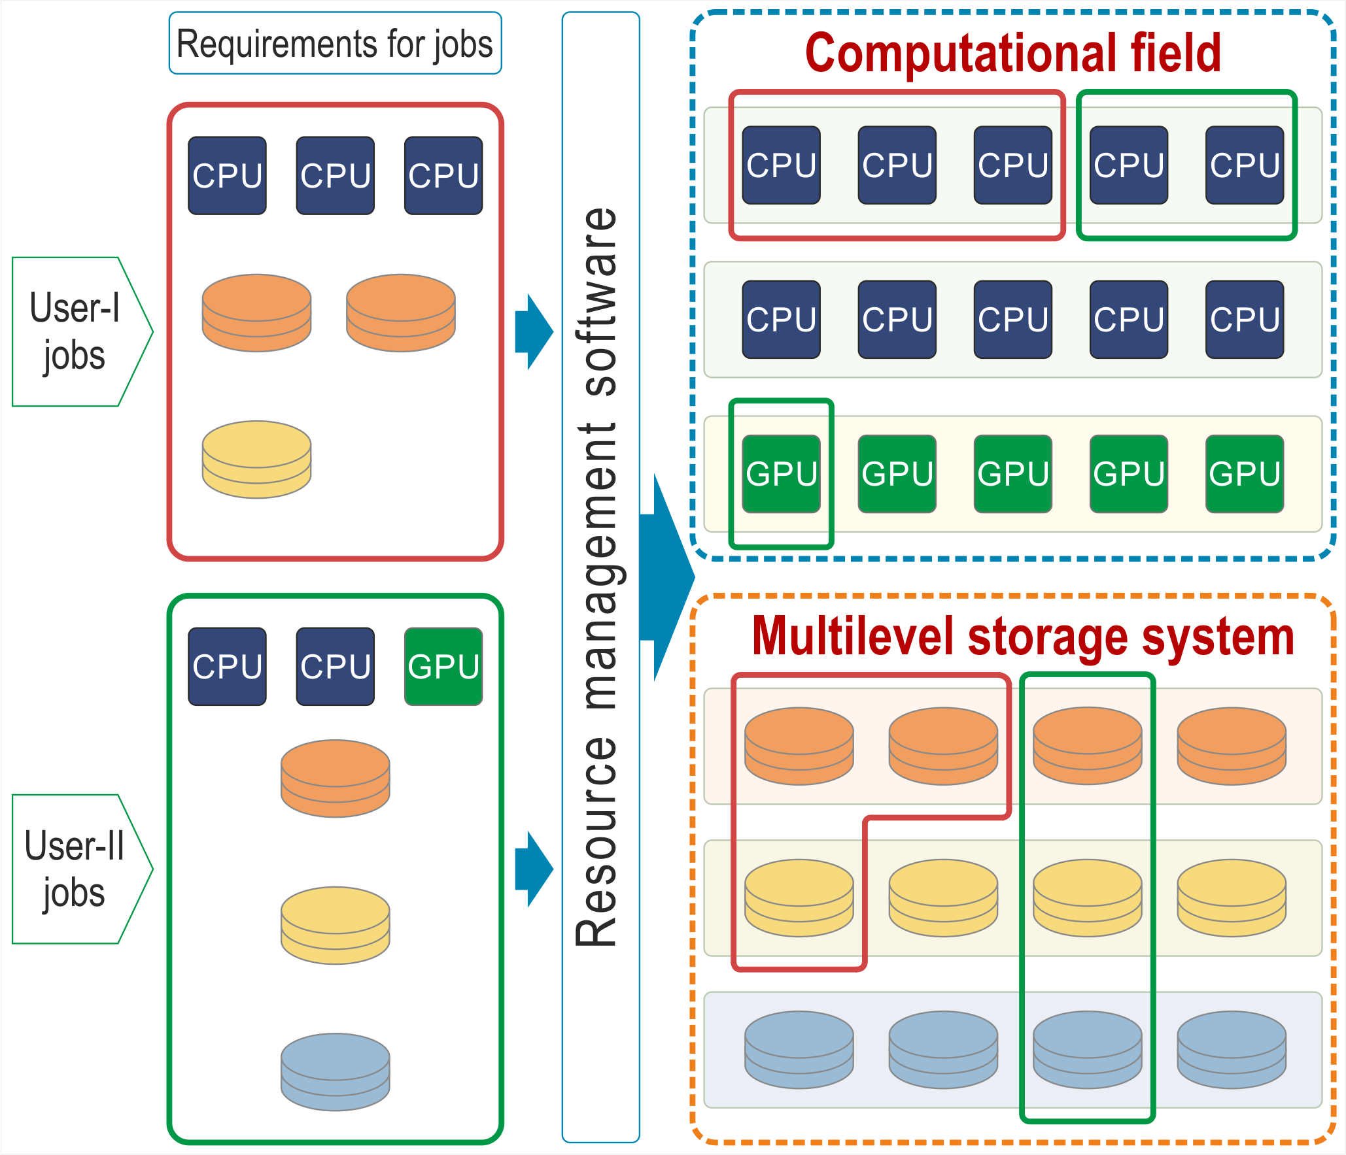
The task of visualization and analysis of statistics
on the use of computing resources
of the supercomputer «Govorun»
The “Govorun” supercomputer has unique properties for the flexibility of customizing the user’s job. For his job the user can allocate the required number and type of computing nodes and the required volume and type of data storage systems. This property enables the effective solution of different tasks, which makes the “Govorun” supercomputer a unique tool for research underway at JINR.
To control the efficiency of using supercomputer computing resources, it is necessary to monitor performance, accumulate and analyze statistics on the use of computing resources.
The report presents a toolkit for accounting, visualization, and analysis of usage statistics for the computational resources of the "Govorun" supercomputer, based on the Yandex DataLens Business Intelligence system.
Main parameters:
Total number of tasks launched on the account;
Total number of core-hours spent on task execution;
Number of CPU/GPU tasks launched on the account;
Number of CPU/GPU core-hours;
Used computing resources;
Linking task data to the user.
The system is intended for internal use:
By system administrators; it will improve monitoring and allow control of system performance;
By the management of SK "Govorun"; it will enable evaluation of how computing resources are used, how much they are in demand, and what contribution users make - both as groups and individually.

Slide 3
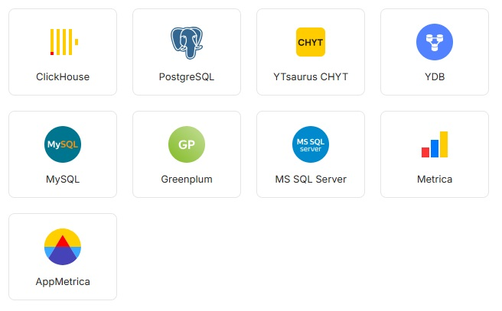
Yandex DataLens
Yandex DataLens is a business intelligence system and is a freely distributed commercial product.
The service allows to connect to various data sources, build data visualizations, and collect various types of visualizations in the form of interactive dashboards. Yandex DataLens provides both Yandex Cloud‑based and on-premise services.
The advantage of the service is working with various databases, while the service does not store data, but uses SQL queries directly to databases to build visualizations.
DataLens includes the following entities:
Connection: Parameters for accessing a data source.
Dataset: Description of a dataset from a source.
Chart: Data from a data source or a dataset visualized as tables, diagrams, or maps.
Dashboard: Charts, selectors for data filtering, and text blocks.

Slide 4
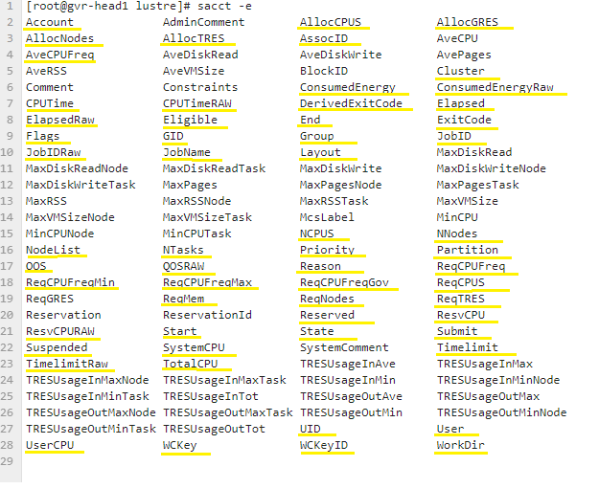
Data sources
The data source for the developed system is the SLURM task scheduler database and the database of users of the "HybriLIT" platform.
The SLURM version configured on the SK "Govorun" collects information according to the fields presented in the screenshot, which are the data actually available in the system. The "sacct" command displays information about jobs, execution stages, status, and completion codes.
Loading data from the Slurm DB into the accounting DB.
Upon request, data about the user (full name and laboratory) is taken from the database of users of the «HybriLIT» platform.
User database of the "HybriLIT" platform
Data Display Fields for Job Accounting (Slurm DB)
Accounting database.

Slide 5
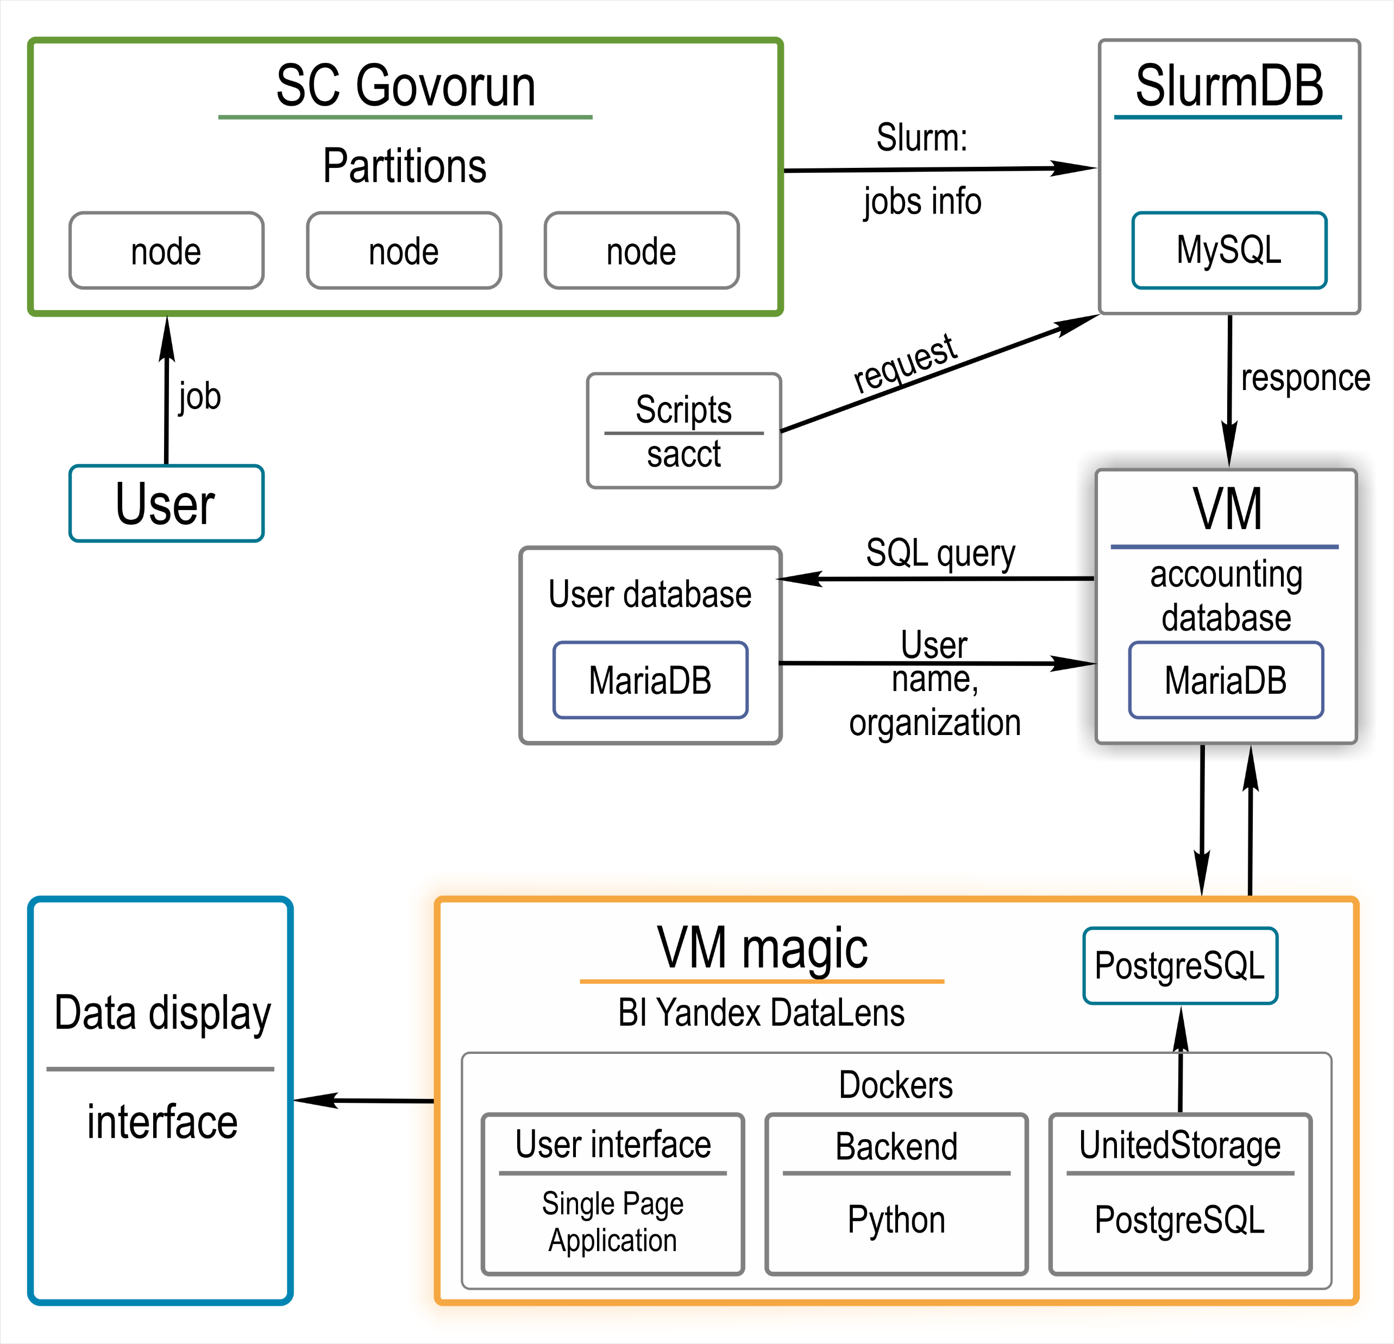
Structure of the accounting system and processing of statistics on the use of computing resources of the supercomputer "Govorun“
Yandex DataLens is distributed in the form of images for the Docker Compose containerization system.
Local installation of Yandex DataLens is performed on a virtual machine «magic».
The system is built on three components:
UI — a SPA application (Node.js) that provides a user interface, and nginx service that redirects requests from users to internal services.
Backend — a set of Python applications and libraries that is responsible for connecting to data sources, generating queries to them, and post-processing data.
UnitedStorage — a service (Node.js) that uses PostgreSQL to store metadata and configurations of all DataLens objects.
For the convenience of creating backups of metadata and configurations, the PostgreSQL database is installed locally, separately from the Docker system.

Slide 6
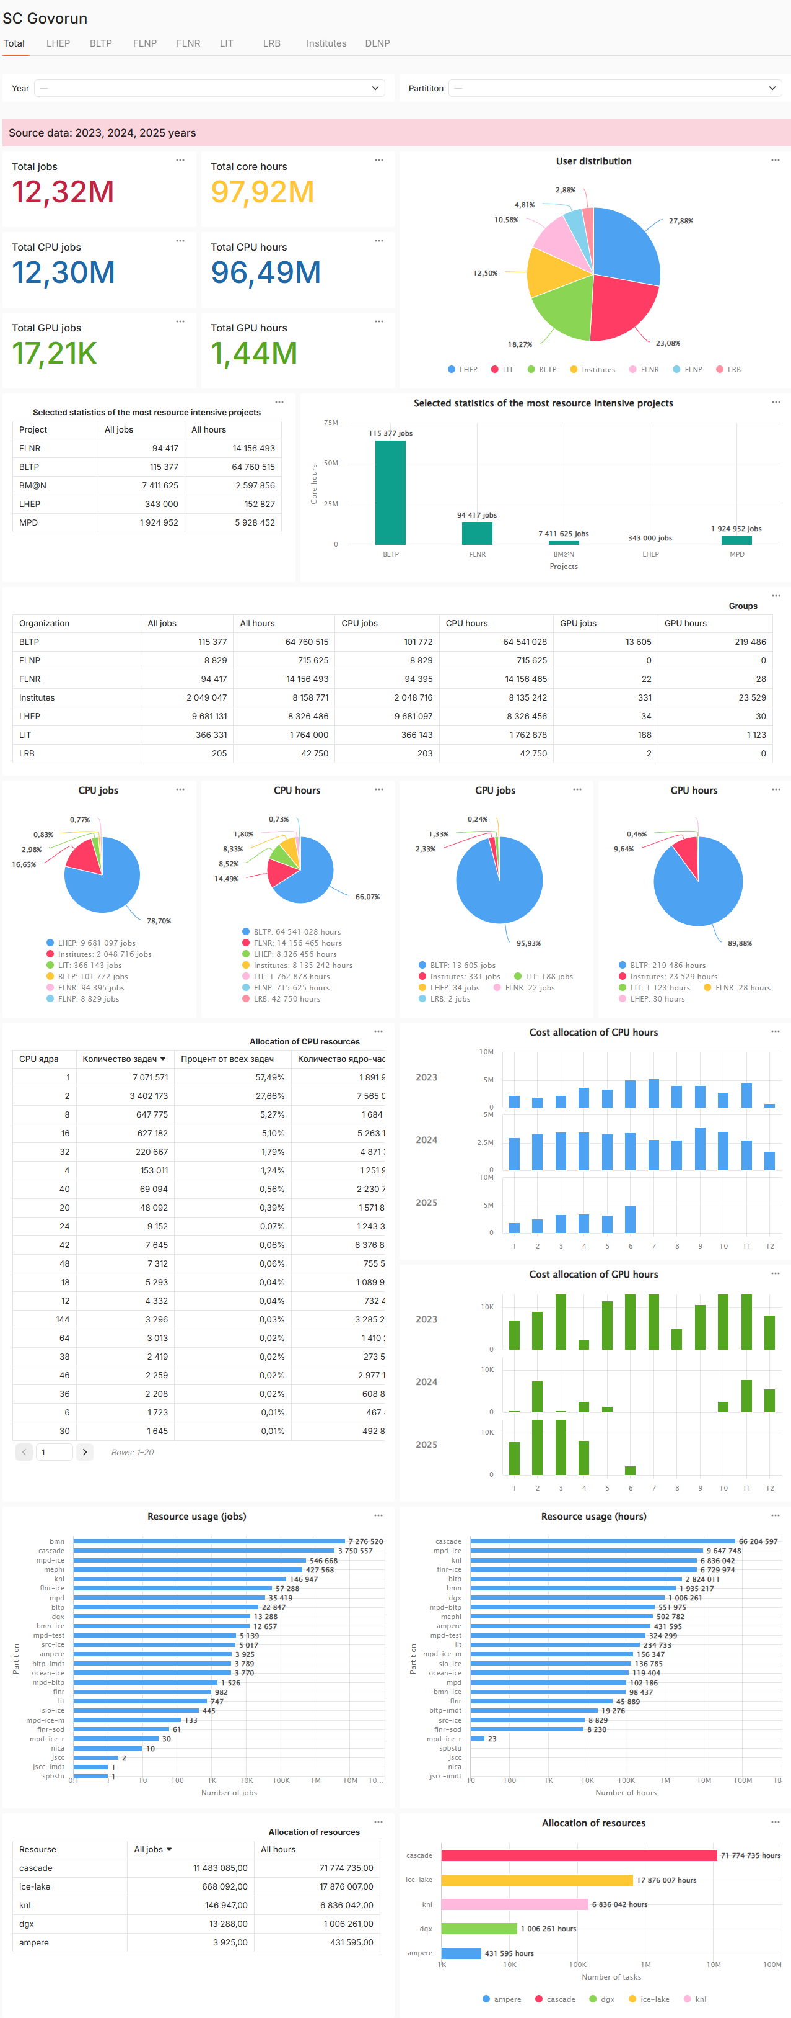
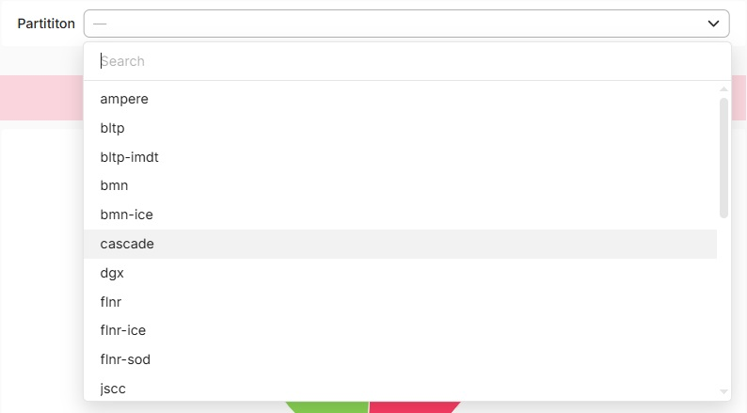
General view
Navigation menu. Tabs.
Selectors. Sorting by years and partition.
The home page features a summary statistics on the use of SK «Govorun» resources for all time across all user groups.
The statistics are presented in the form of interactive indicators, tables, and histograms.
Users are grouped by the laboratories they work in. External organizations are combined into the “Institutes" group.
Navigation is carried out through tabs with the name of the corresponding laboratory.
The active tab is highlighted in black font color and red underlining.
Home page. General view.

Slide 7
Indicators
Total jobs
Total number of tasks launched on the account on the resources of the supercomputer "Govorun"
Total core hours
Total number of core-hours spent on task execution.
Total CPU jobs
Total number of tasks launched on the account on the CPU resources of the supercomputer "Govorun"
Total CPU hours
Total number of CPU core-hours spent on task execution
Total GPU jobs
Total number of tasks launched on the account on the GPU resources of the supercomputer "Govorun"
Total GPU hours
Total number of GPU core-hours spent on task execution

Slide 8
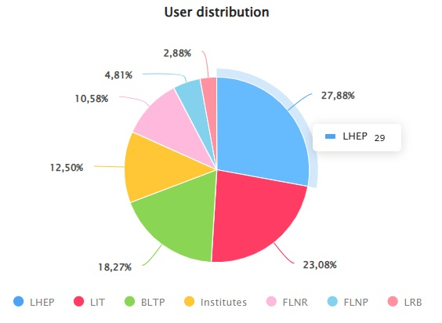
User groups
Pie chart showing the distribution of users (expressed as a percentage) across laboratories.
Summary table by user groups (by laboratories), number of tasks, and core-hours. The table is interactive and has sorting functionality by ascending/descending for each column.
Statistics on the most resource intensive projects. The table is interactive and has sorting functionality by ascending/descending for each column. The histogram is a visualization of the table. When hovering over a column, it shows the parameters in a pop-up window.

Slide 9
Resource usage
2
1
Pie charts – a visualization of the "Groups" table, allowing to assess the contribution of each user group in resource usage by the number of tasks and core-hours.
When the mouse hovers over the group name in the pie chart, the corresponding segment is highlighted.
When the mouse hovers over a segment of the pie chart, it is highlighted, and a window pops up with the name of the group and its indicator.
1
2

Slide 10
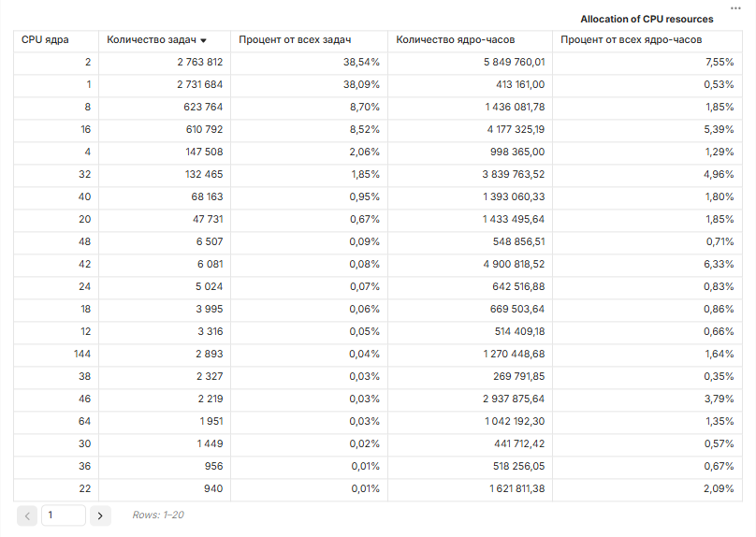
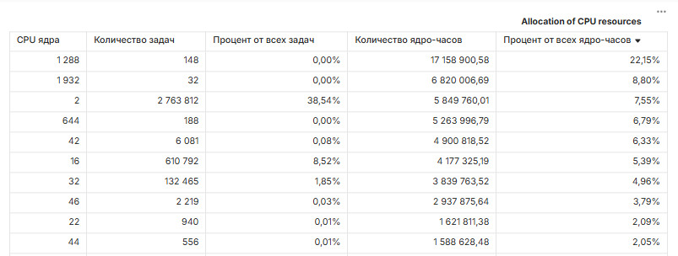
Allocation of CPU resources
The "Allocation of CPU resources" table represents the distribution of tasks across requested CPU cores and core-hours.
Sorting in descending order in the "Number of tasks" column shows how many cores users most frequently run tasks on.
The same sorting by the "Percentage of all core-hours" column indicates which tasks consumed the most core-hours.
The table is interactive and includes sorting functionality for each column in ascending/descending order.

Slide 11
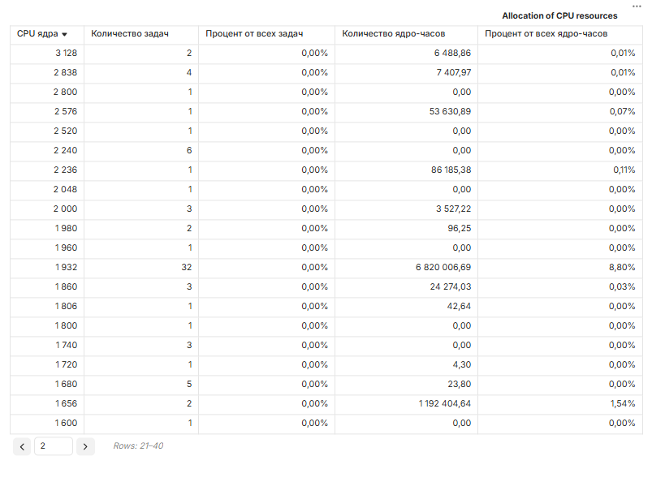
Allocation of CPU resources
Special attention should be paid to tasks with a large number of allocated cores, as they consume more resources from the moment of launch until completion.
Sorting by descending order in the "CPU cores" column shows the ranking of tasks with the highest number of cores. Tasks with 1932 cores stand out. With a minimum number of tasks, they consumed 8.8% of core-hours, placing 2nd in the ranking by the number of core-hours.
Table are depending with selectors, and their values can be sorted by «Year» and/or «Partition».

Slide 12
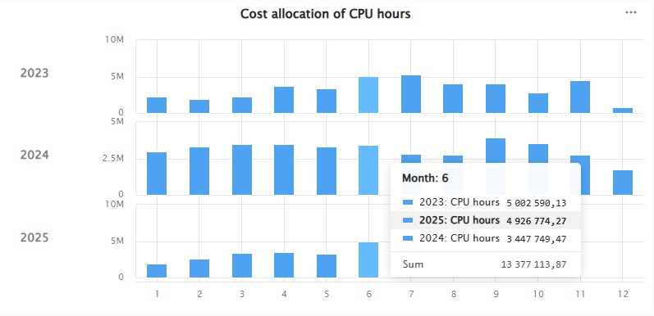
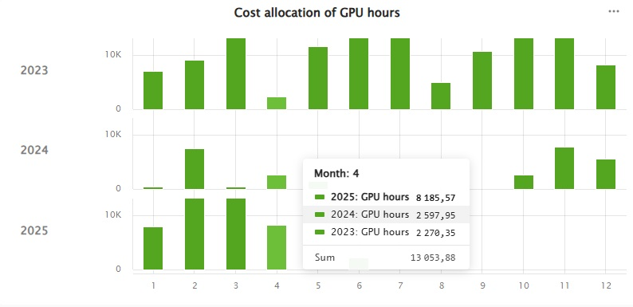
Cost allocation of CPU/GPU hours
Cost allocation of CPU hours
The histogram illustrates the distribution of the load on CPU resources by month.
Cost allocation of GPU hours
The histogram illustrates the distribution of the load on GPU resources by month.

Slide 13
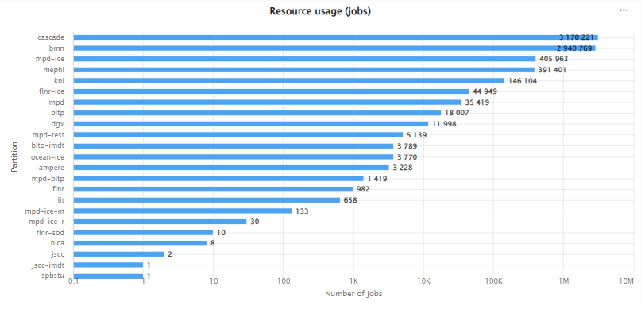
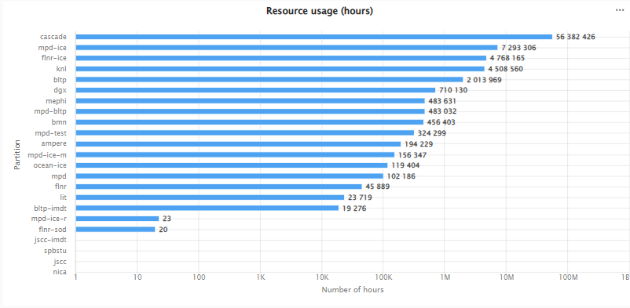
Resource usage
Resource usage (jobs)
The histogram illustrates the distribution of load partitions and the number of tasks running on them. For clarity, the x-axis is logarithmic.
Resource usage (hours)
The histogram illustrates the distribution of load partition and the number of core-hours spent.
For clarity, the x-axis is logarithmic.

Slide 14
Allocation of resources
The table shows the distribution of the counting load for each type of resource, is interactive, and has sorting functionality by ascending/descending for each column. The histogram is a visualization of the table. When hovering over a column, it displays parameters in a pop-up window.

Slide 15
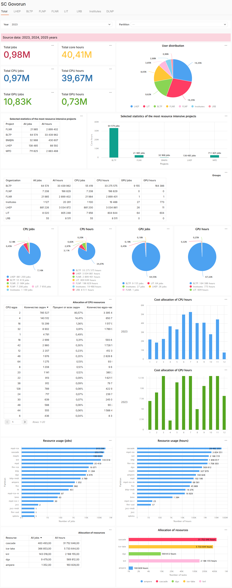
Sort by years
When you click on the selector, a dropdown list opens. Selection is made by clicking on the desired year. To reset the sorting, click "Clear" in the upper right corner of the selector.
Presented data on all elements of the dashboard are depended on selector «Year».
Home page.
Data for all time.
Home page.
Data for 2023 year.

Slide 16
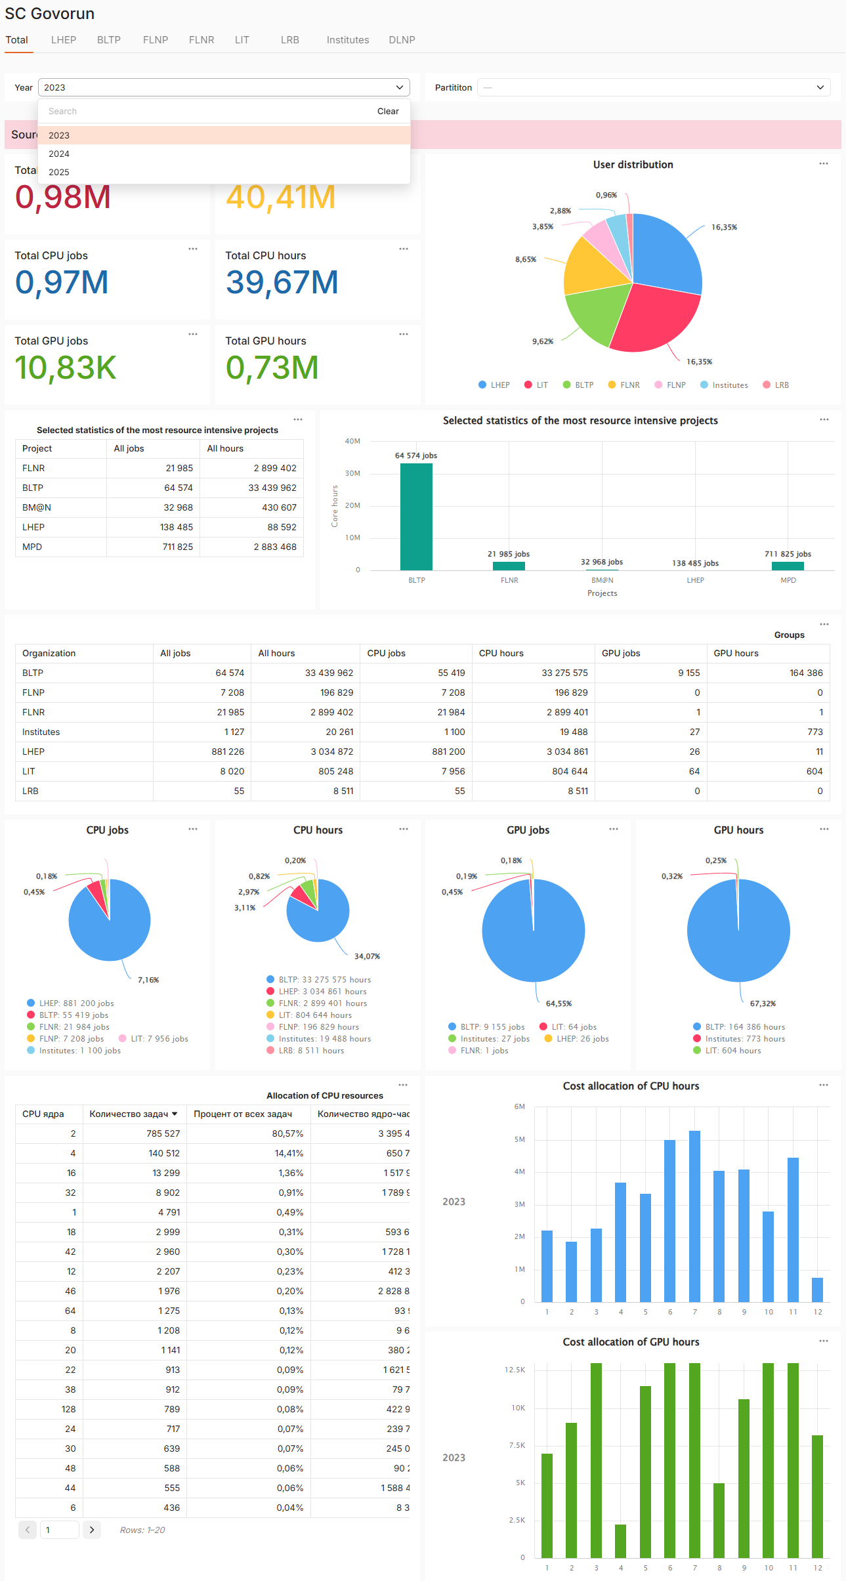
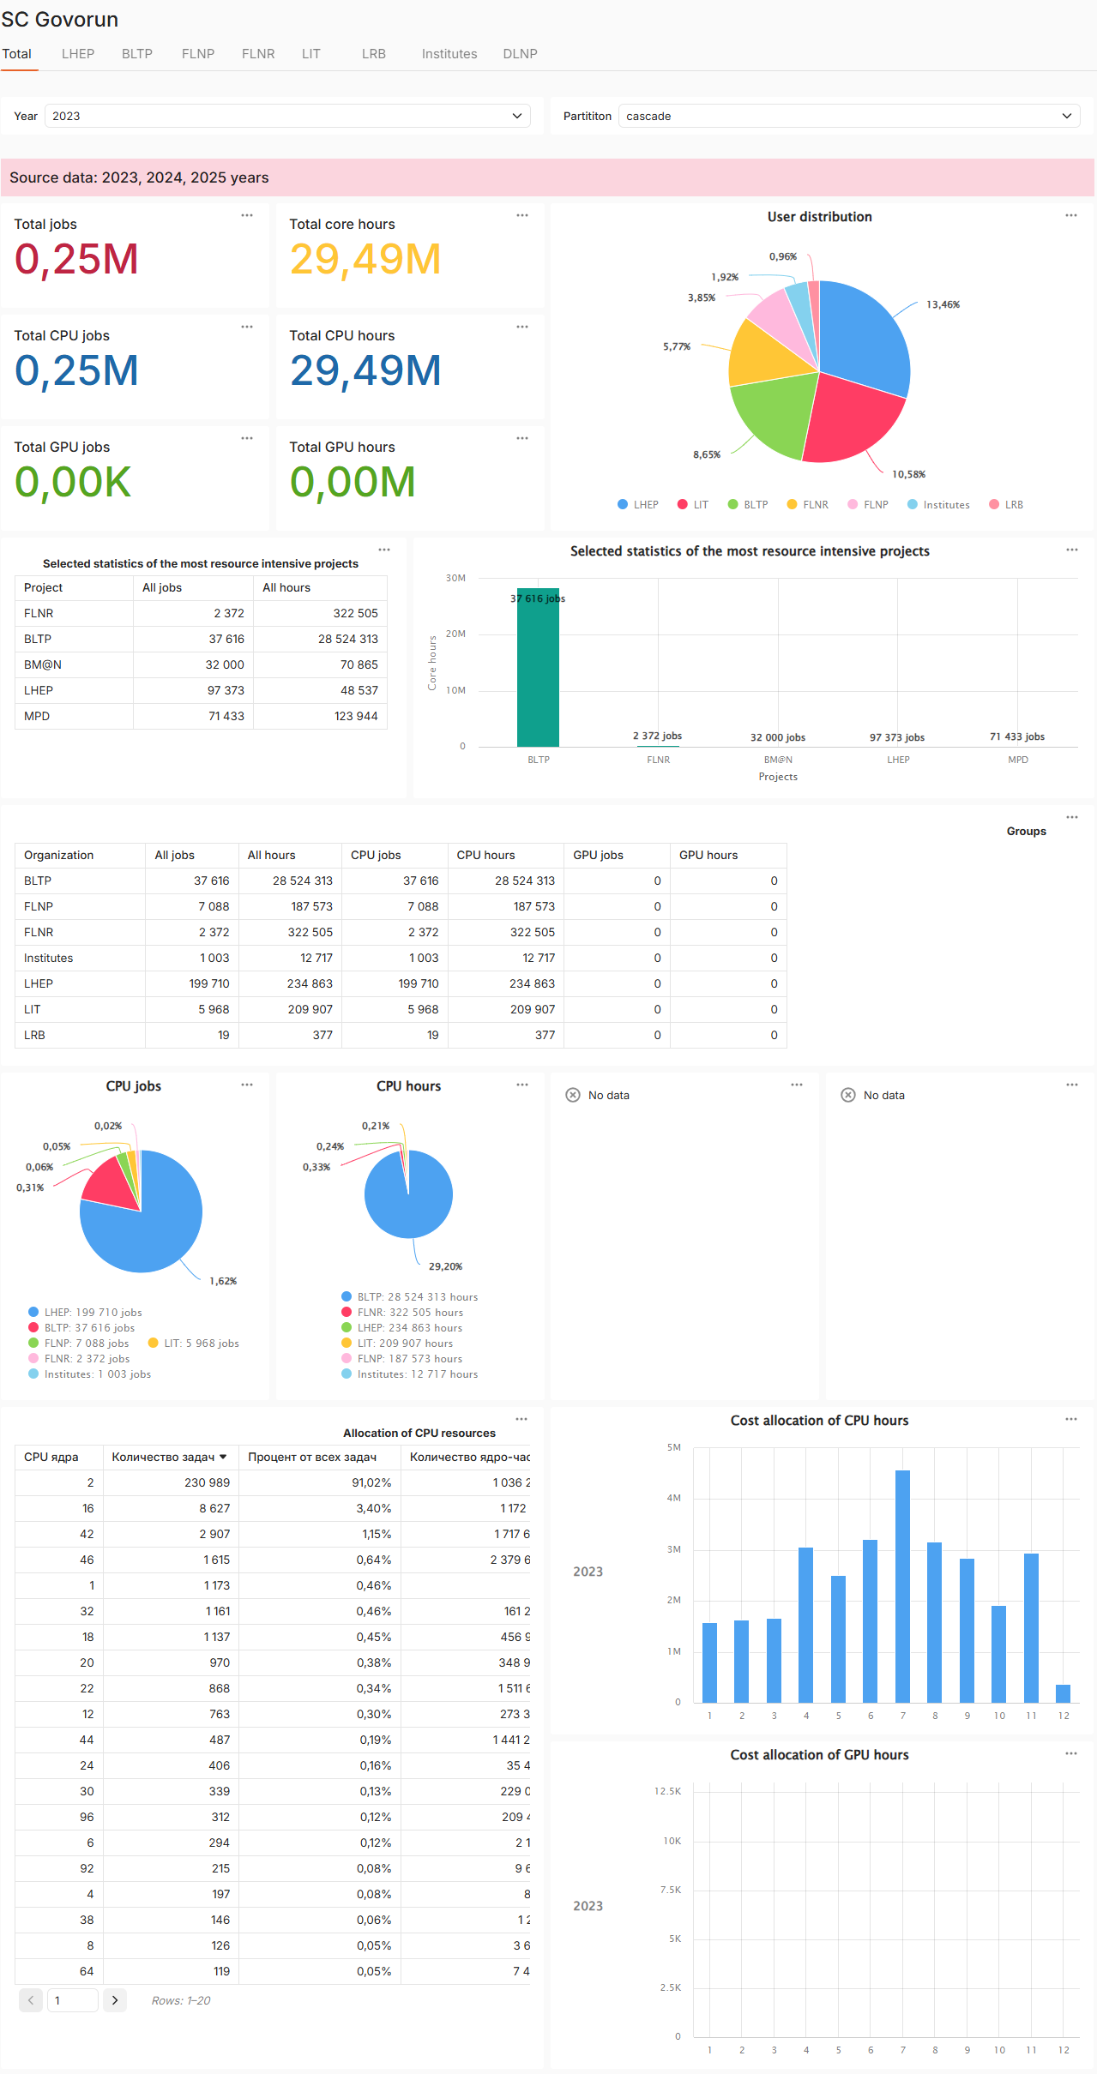
Sorting by partition
When you click on the selector, a dropdown list opens.
Selection is made by clicking on the desired partition name.
To reset the sorting, click "Clear" in the upper right corner of the selector.
Home page.
Data on all partition for 2023 year.
Home page.
«Cascade» partition data for 2023 year.

Slide 17
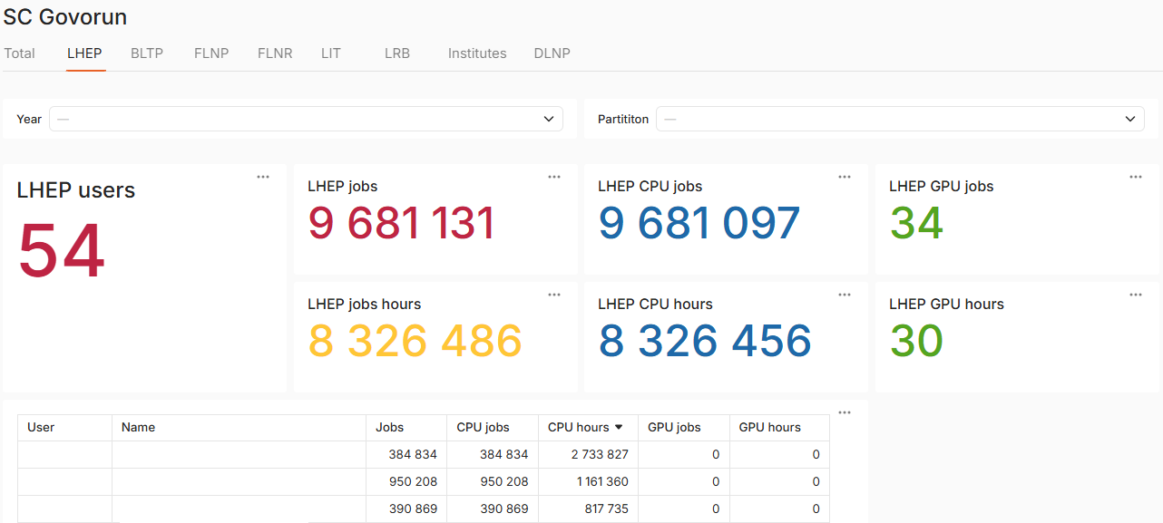
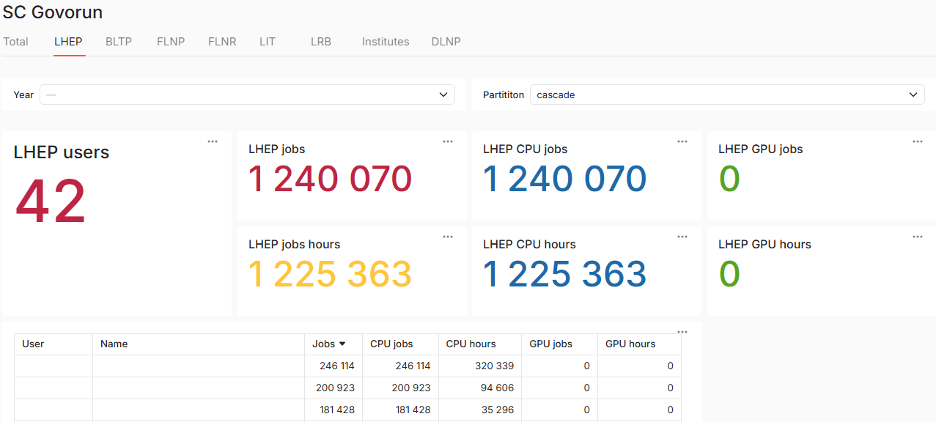
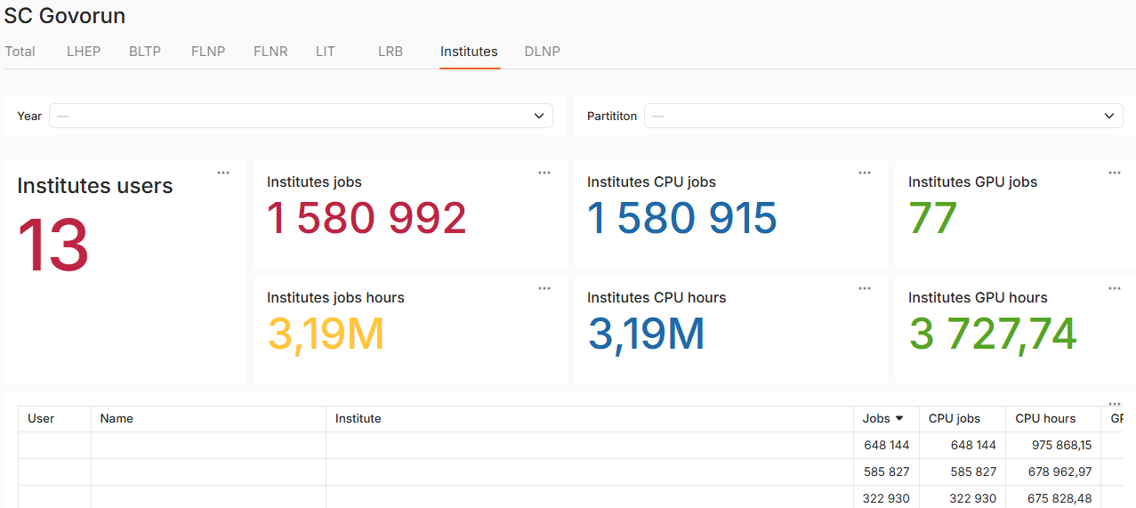
Tab: selected group
login
full name
login
full name
login
full name
login
full name
login
full name
login
full name
Group «LHEP»
Group «LHEP». «Cascade» partition data.
login
full name
full name of the institute
login
full name
full name of the institute
login
full name
full name of the institute
Group «Institutes»

Slide 18
Thank you for your attention!

