Slide 1
Design of the BM@N experiment data management system
Distributed Computing and Grid-technologies in Science and Education 2025
Igor Zhironkin,
Konstantin Gertsenberger
JINR

Slide 2
Topics
What is Data Management System
Why DIRAC?
Metadata service, overall concept
File transfer system
Monitoring and logging

Slide 3
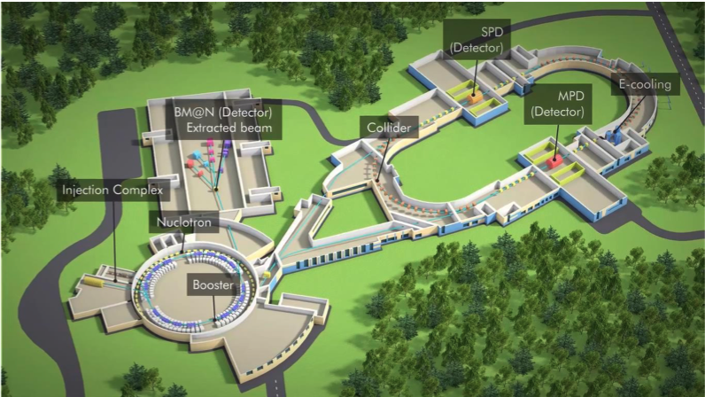
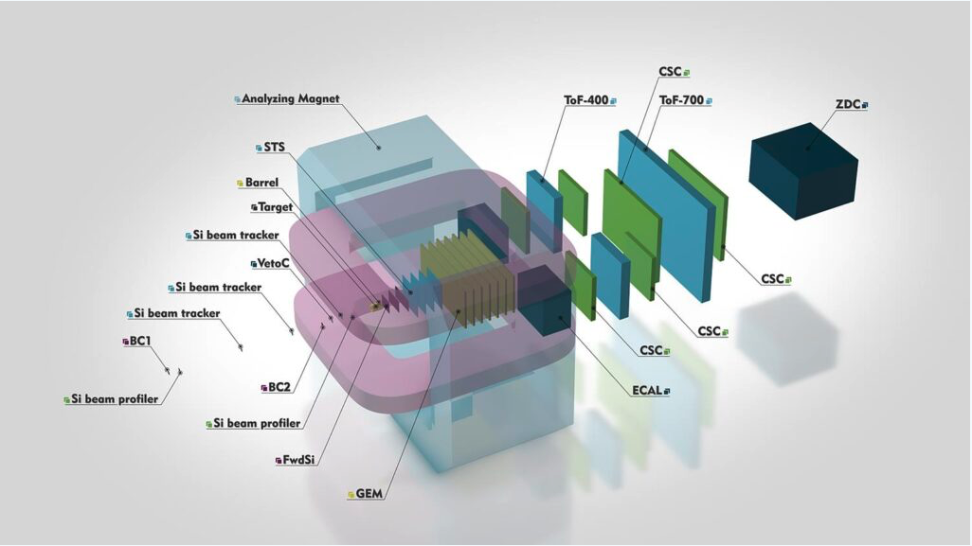
BM@N

Slide 4
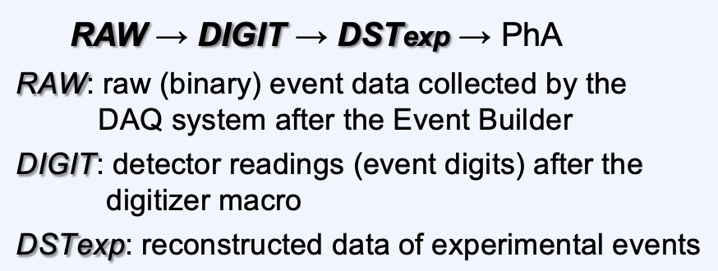
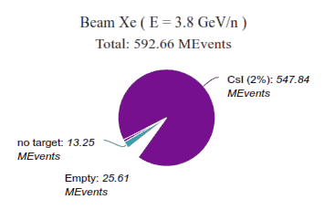
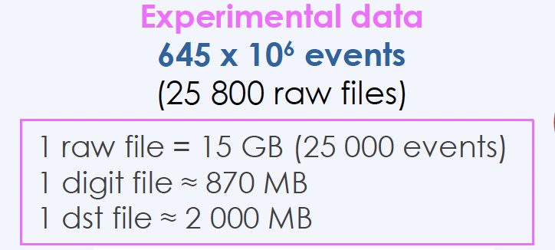
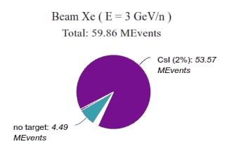
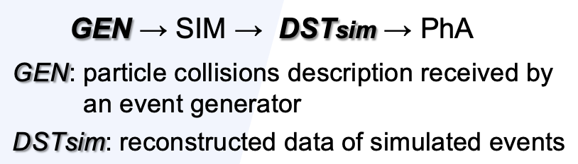
Amount of data
1st Physics BM@N Run
Two beam energy available for Xe-beam
CsI target is used as more similar to Xe
More than 600M events were collected

Slide 5
DMS Tasks
Provide dataset oriented, secure access to data
Managing data:
  Transfer data to/from/between sites
  Delete data from sites
Ensure data consistency at sites
Workflow integration

Slide 6

RUCIO
Rucio was originally developed to meet the requirements of the high-energy physics experiment ATLAS
Rucio now is continuously extended to support the LHC experiments and other diverse scientific communities.
Highly scalable
Policy driven
Good for big amount of data
Automated Data Rebalancing

Slide 7

DIRAC
An open source middleware for distributed computing
Started as an LHCb project.
Experiment-agnostic since 2009.
Developed by communities, for communities.
Workload management system integrated
Publicly documented, active assistance forum,
yearly users workshops, open developers
meetings and hackathons, already in JINR

Slide 8
DIRAC File Catalog
LFNs (Logical File Name): unique identifier of a file within DIRAC.
LFNs may have physical replicas, stored in SEs.
LFNs are registered in catalog(s). There exist multiple implementations of catalogs. Several of them can live in parallel:
DIRAC File Catalog: full replica and metadata catalog.
DMS integrates FTS3 to schedule and monitor efficient transfer of large amounts of data between SEs.

Slide 9
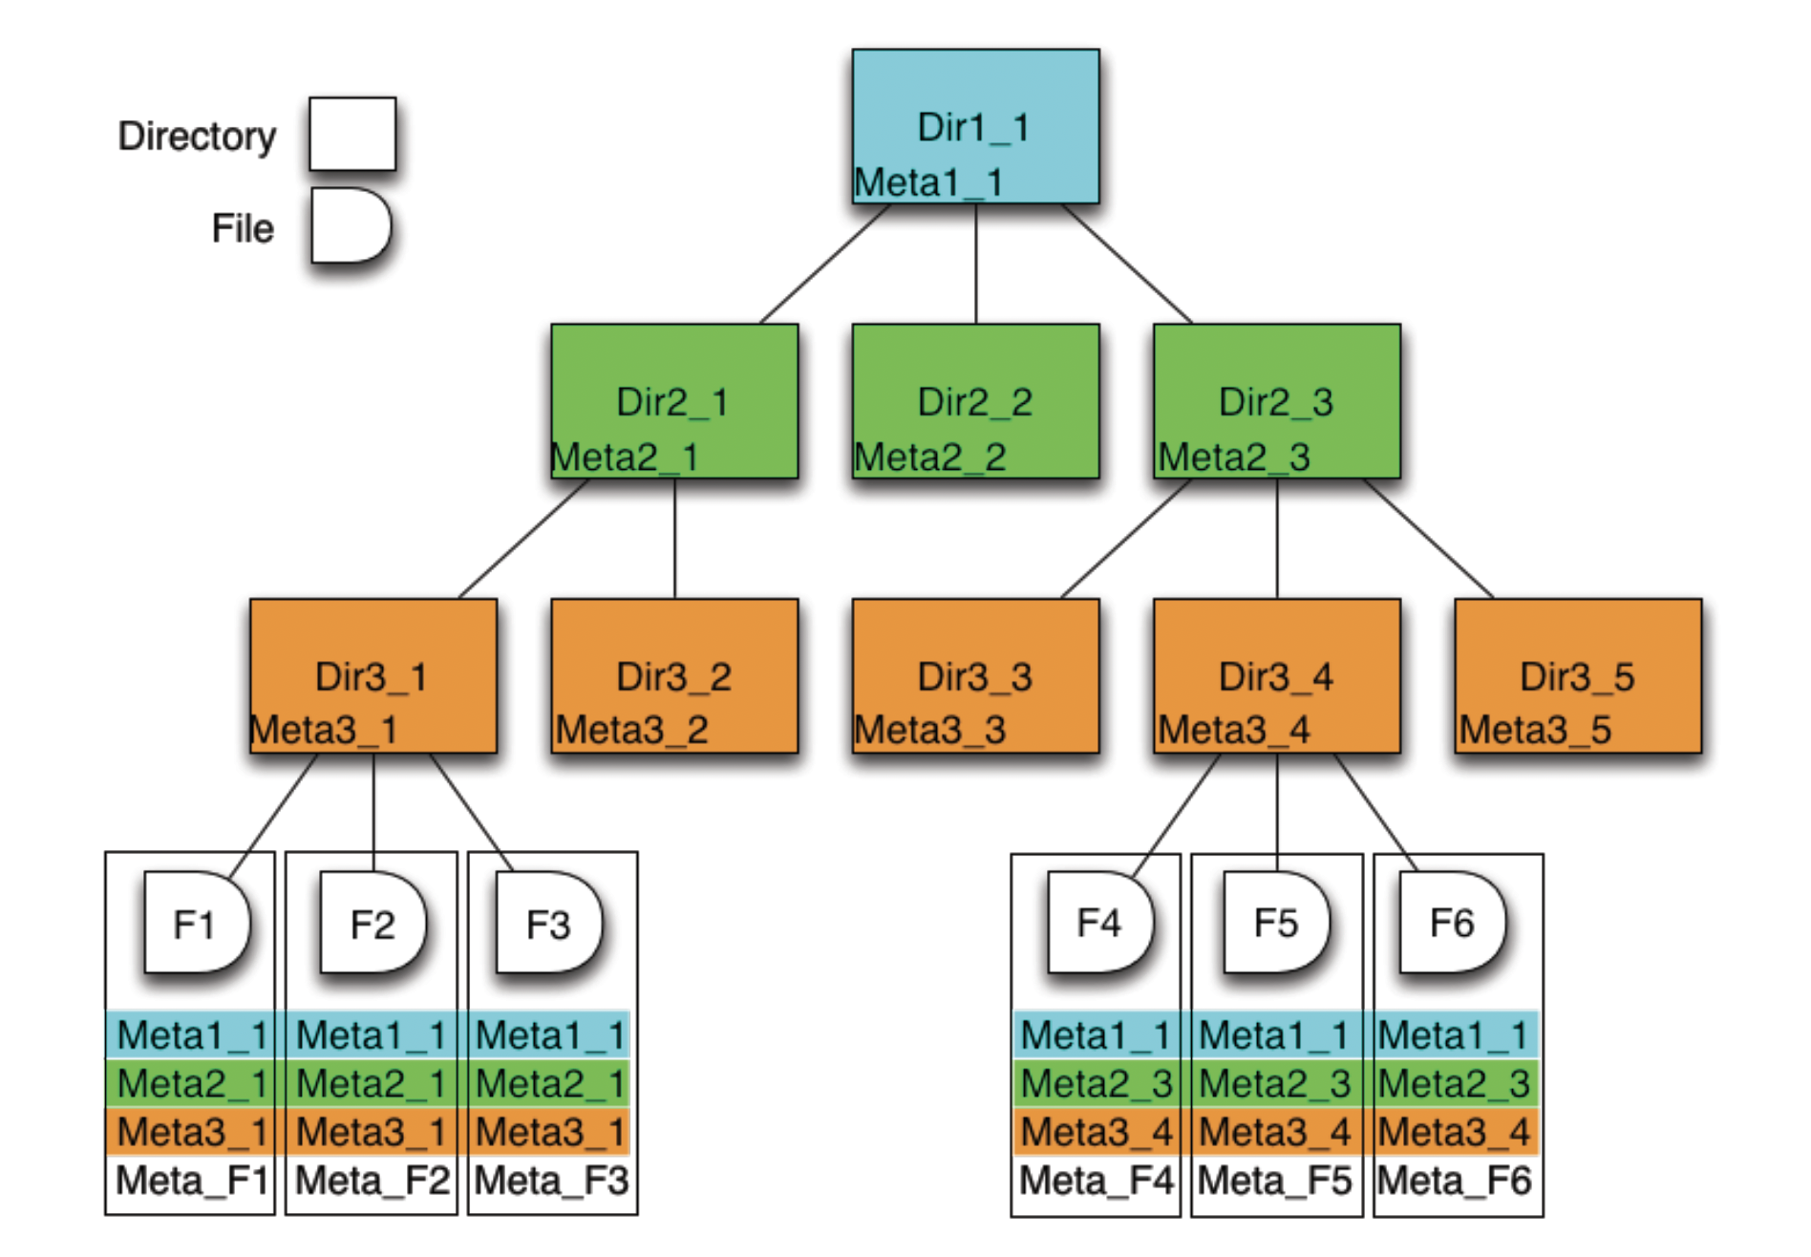
DFC: metadata
DFC is Replica and Metadata Catalog
  User defined metadata
  The same hierarchy for metadata as for the logical name space
  Metadata associated with files and directories
  Allow for efficient searches
Efficient Storage Usage reports
  Suitable for user quota management
Stored ancestor/successor file relations
  Simple provenance catalog

Slide 10
Current metadata
period_number - INTEGER
run_number - INTEGER
run_type - SMALLINT
start_datetime - TIMESTAMP
end_datetime - TIMESTAMP
beam_particle - VARCHAR
target_particle - VARCHAR
energy - FLOAT
field_voltage - FLOAT
start_event - INTEGER
end_event - INTEGER
event_count - INTEGER
file_size - LONG

Slide 11
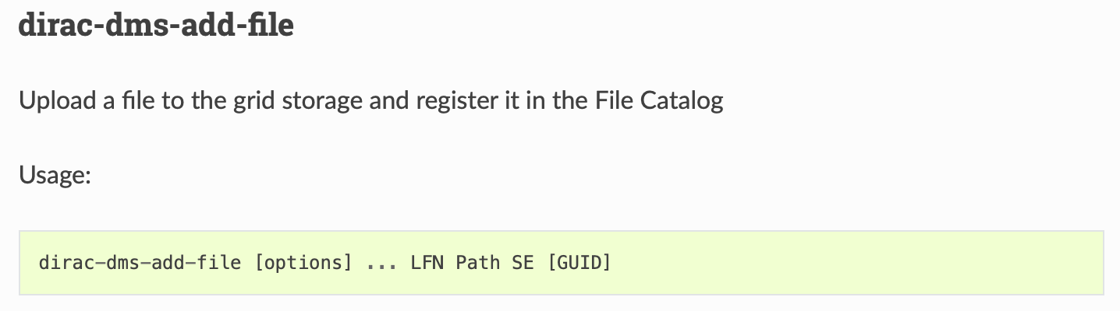
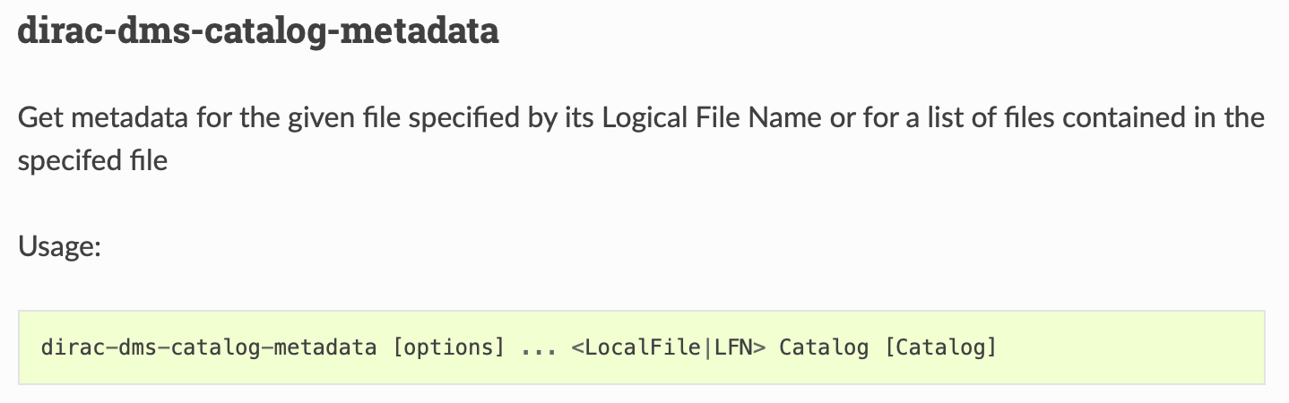
DFC through: command line
. . .

Slide 12
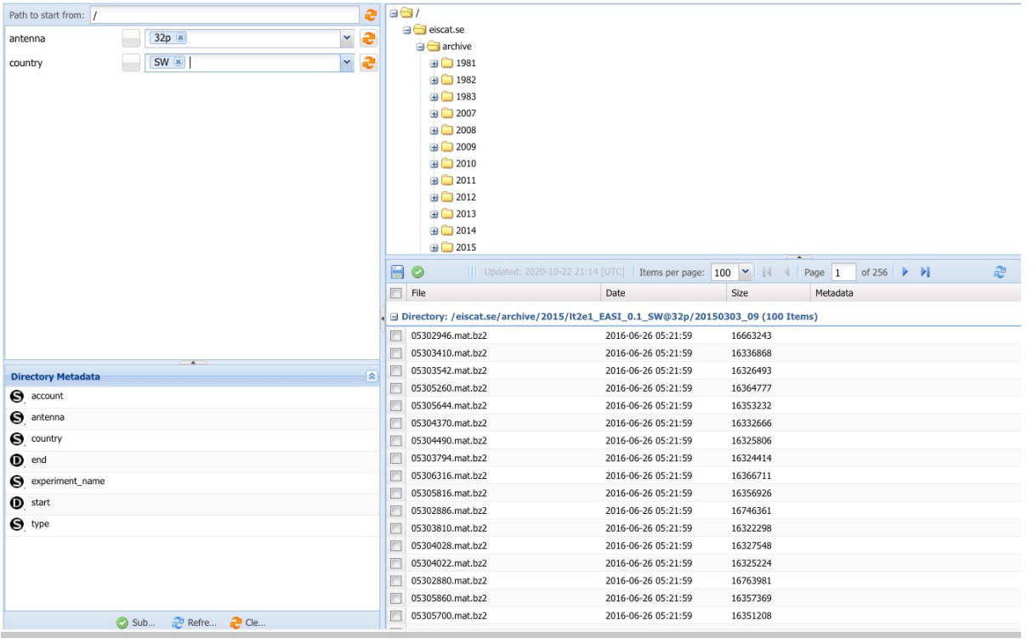
DFC through: web interface

Slide 13
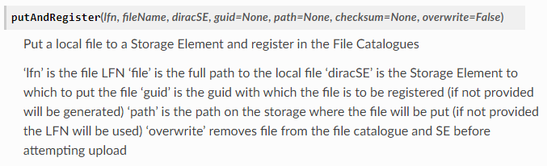
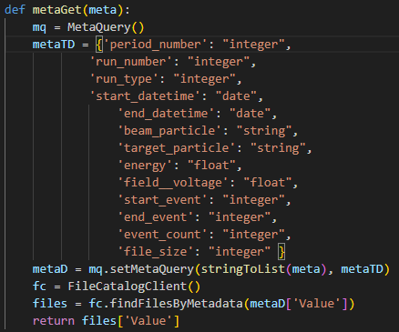
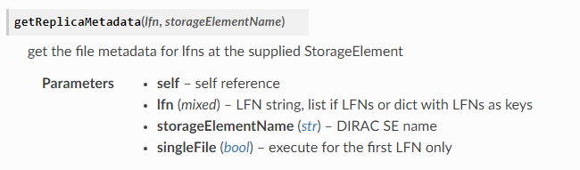


DFC through: python API

Slide 14




REST API
BmnRoot
login
pass
URL
login
pass
URL + token
+
OpenAPI specification
Swagger → Documentation
case-insensitive
GET
run_number=3950|4000&beam_particle=Ar
energy=3.16|3.18&target_particle=~Lead
https://10.220.18.61:6000/filecatalog_api/v1/filepath?
POST
HOSTNAME / SERVICE / VERSION / ENTITY?parameter_set
PUT
HOSTNAME=https://bmn-[SYSNAME].jinr.ru
parameters are separated by &
ranges: min|max → >=min AND <=max
min| → >=min |max → <=max
LIKE a string template: =~pattern
DELETE
SERVICE=[SYSNAME]_api
VERSION=v1 (v2…)
Unified Condition Database, SYSNAME = uniconda
Event Metadata System, SYSNAME = event
BM@N File Catalog, SYSNAME = filecatalog (prototype)
https://bmn-event.jinr.ru/event_api/v1/event?...
/eventFile?…
/eventFileRef?...

Slide 15


Keycloak
Open Source Identity and Access Management
Authorization using BM@N credentials
VM at 10.220.18.61
Credentials via CURL:
curl -u user:password -X GET "10.220.18.61:6000/filecatalog_api/v1/meta?filepath=/bmn.nica.jinr/vo/test/someFile.data"

Slide 16
Request types
POST - add new metadata field
GET - get file list matching specific metadata
- get specific file metadata
- get all metadata fields
- is file exist
- get file catalog stats. (Number of files/directories/replicas etc.)
- get status of the last consistency check
- get result of the last consistency check
PUT - update file metadata
- run consistency check. Return check ID, status can be verified through get
DELETE - delete specific file metadata
- remove specific metadata field

Slide 17
Consistency check
Basically goes through storages and compare existing files with registered ones in the File Catalog.
The output is two counters and two vectors of paths to files that doesn’t match
Missing from EOS 991567:
/bmn.nica.jinr/exp/dst/run8/24.12.0/mpd_run_Top_7327_ev1_p7.root
/bmn.nica.jinr/exp/dst/run8/24.12.0/mpd_run_Top_7327_ev1_p8.root
/bmn.nica.jinr/exp/dst/run8/24.12.0/mpd_run_Top_7327_ev1_p9.root
/bmn.nica.jinr/exp/dst/run8/24.12.0/mpd_run_Top_7328_ev0_p0.root
. . .
Missing from FC 4:
/eos/nica/bmn/exp/digi/run8/25.04.0/mpd_run_Top_7797_ev1_p2.root
/eos/nica/bmn/exp/digi/run8/25.04.0/mpd_run_Top_7797_ev0_p5.root
/eos/nica/bmn/exp/digi/run8/25.04.0/mpd_run_Top_8106_ev0_p70.root
/eos/nica/bmn/exp/digi/run8/25.04.0/mpd_run_Top_7444_ev1_p14.root

Slide 18
C++ API for BmnRoot
Choose one of the FileCatalog class functions that best suits your needs. Like: …GetFileList(…), GetFileInfo(…), UpdateFileInfo(…), DeleteMetadataField(…)
Depending on use case:
Prepare FileInfo object containing metadata info (int RunNumber, string BeamParticle etc.), or declare one if you need it as a result
Define FileCondition (less, greater, null, greaterOrEqual etc.) to specify a metadata range for the selection request

Slide 19
DMS design scheme

Slide 20
FTS/RMS
File transfer system (FTS)
The File Transfer System (FTS) is a bulk data mover responsible for queuing, scheduling, dispatching and retrying file transfer requests
Request management system (RMS)
It will receive the files to transfer, as well as the list of destinations. The files will then be grouped together and submitted as jobs to the fts servers. These jobs will be monitored, retried if needed, the new replicas will be registered, and the status of the files will be reported back to the RMS.

Slide 21
Monitoring
Continuously observing system metrics to identify real-time issues and anomalies, triggering alerts
CPU and memory usage
Cumulative transfer size
File transfer speed
Success/failure transfer amount
Queries duration
Telegraf/InfluxDB/Grafana stack as a solution

Slide 22
Logging
Logging involves recording detailed, timestamped events (like errors or user actions), primarily for historical analysis and troubleshooting
Authentication failures, file transfer errors, connection errors, file not found or already exists, consistency check results, etc.
OpenTelemetry is one of the option to choose. OpenTelemetry is a collection of APIs, SDKs, and tools to instrument, generate, collect, and export telemetry data. Open source, as well as vendor- and tool-agnostic, meaning that it can be used with a broad variety of observability backends

Slide 23
Web portal
Basically, for a visual representation of the results of the work of monitoring and logging systems. Graphs, tables, anything visually pleasing. As well as another convenient interface for access to the proxy service.

Slide 24
Thank you <3

