Slide 1


Применение машинного обучения для предсказания формирования атомной пары из трехатомного столкновения
Author: Stanislav Kim
ITMO University

Slide 2
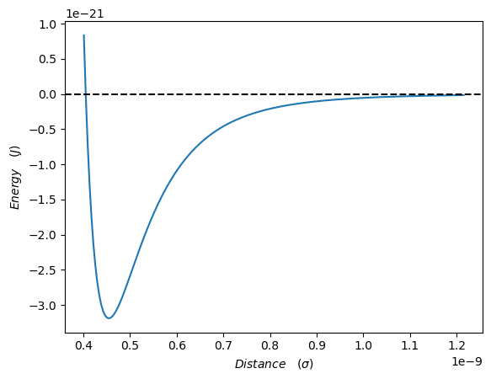
Motivation
Research field: «Theoretical researching phenomena long-term bond between atoms in the rarefied gas».
Assumption: Trapped atoms by van-der-Waals potential is one of the reasons thus.
Three atoms collision have been reviewed, due starting with this number of atoms is an opportunity to observe when one of the three atoms cooling other atoms, so they will set in trap.
Lennard-Jones potential

Slide 3
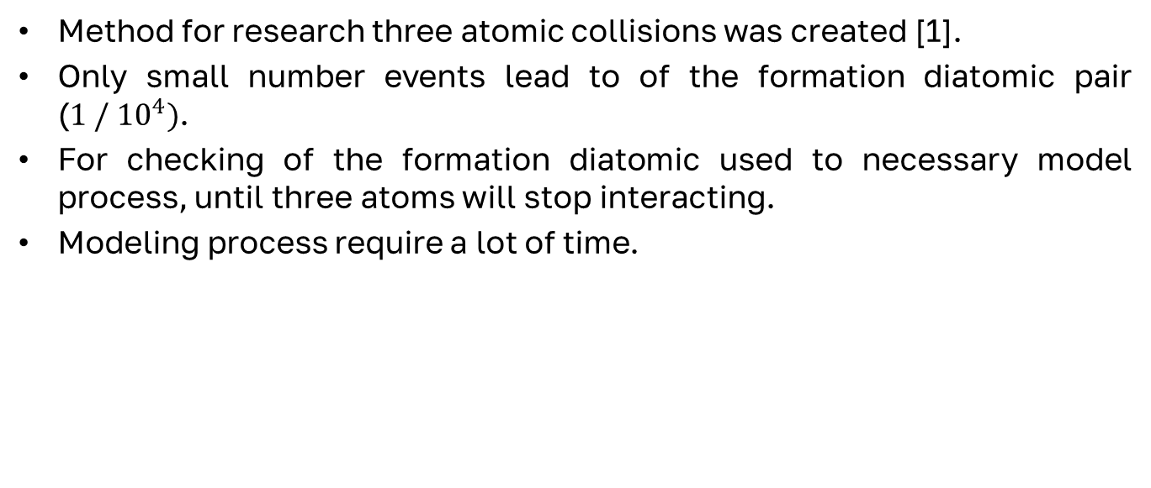
Challenge
Method for research three atomic collisions was created [1].
Only small number events lead to of the formation diatomic pair ($1 / {10}^{4})$.
For checking of the formation diatomic used to necessary model process, until three atoms will stop interacting.
Modeling process require a lot of time.
Ким С. Е., Попов Е. Н. Статистика двухатомных кластеров, образующихся при тройных столкновениях в одноатомном газе. // Журнал экспериментальной и теоретической физики – 2025. – Т. 167. - № 6. – C. 769-781

Slide 4
Goal
To apply a machine learning (ML) to simplify the search for formation diatomic pair from three atoms collisions.
Input data: Initial conditions of atoms (cords & speed) + time of the beginning interact of the third atom with other atoms.
Amount of data: 8`410`000 collision, and 4`570 have the formation diatomic pair. Data were split into train (60%), validation (20%) and test(20%) blocks.
Solution methods:
  Polynomial regression
  Decision tree, GRAD BOOSTING
  Deep ML (Perceptron)

Slide 5

Metrics
Important do not miss all the cases with the formation diatomic pairs
The more cases we discard, the better
$Recall=\frac{TP}{TP+FN}$
$Filtered=\frac{TN}{TN+FP}$
Reality Predict | True | False
True | TP | FP (The less the better)
False | FN (Important) | TN

Slide 6
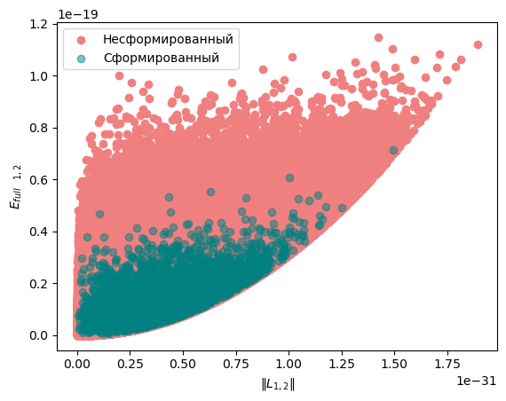
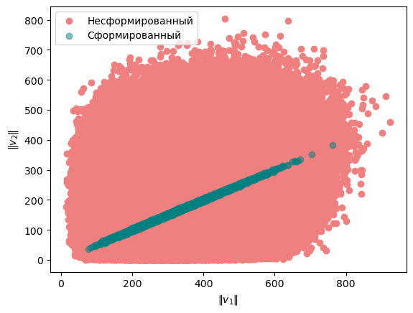
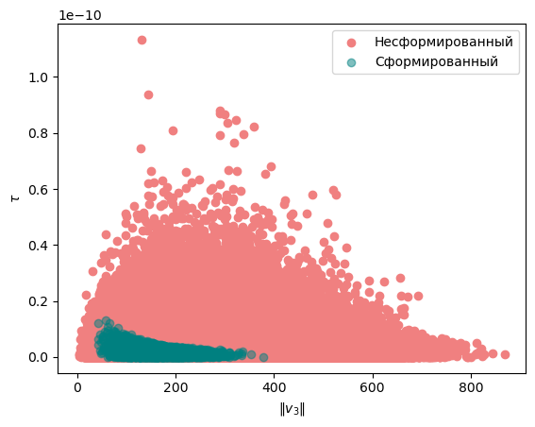
Raw data
Norm of angular momentum &
Energy (1,2)
Speed 1-st atom &
Speed 2-nd atom
Speed 3-rd atom &
Time arrived

Slide 7
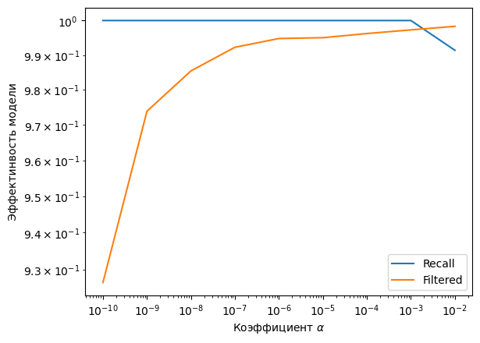

Regression for raw data
Using the regression second-degree led to a decrease in data to process from 8`410`000 to 40`000 ( ~ 200 times)
Parameter $α$ – characterizes the
Weight of classes:
$W=\left\{\begin{aligned}No formed:α; \\ Formed:1−α\end{aligned}\right\}$

Slide 8
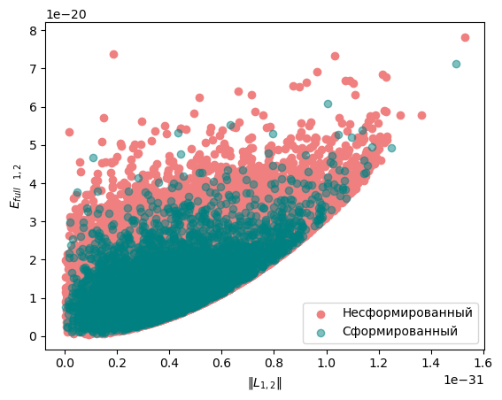
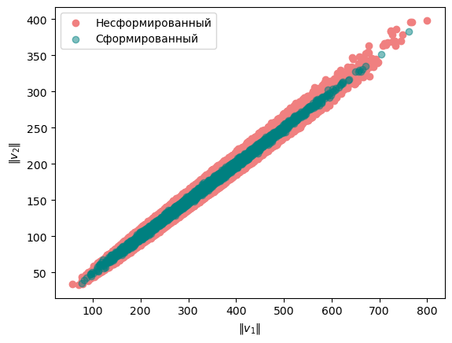
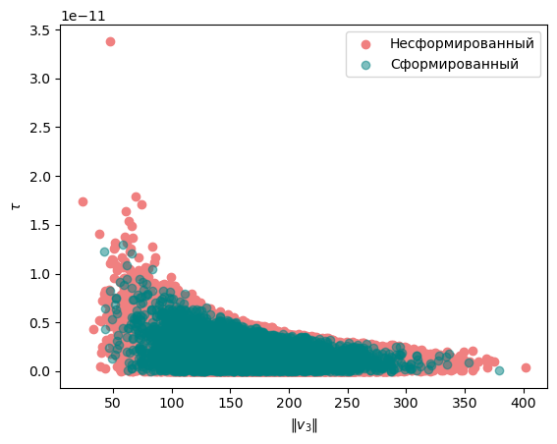
Filtered data
Norm of angular momentum &
Energy (1,2)
Speed 1-st atom &
Speed 2-nd atom
Speed 3-rd atom &
Time arrived

Slide 9
Comparisons of methods
For further research the filtered data was used, which were obtained from regression processing raw data.
Method | Recall (val) | Filtered (val) | Recall (test) | Filtered (test)
Reg 2-deg | 1 | 0.001 | 1 | 0.001
Reg 4-deg | 1 | 0.045 | 0.997 | 0.043
Reg 5-deg | 0.996 | 0.040 | 0.996 | 0.041
GradBoosting | 0.999 | 0.003 | 0.998 | 0.002
XGB | 0.999 | 0.008 | 1 | 0.007
CatBoost | 1 | 0.003 | 1 | 0.002

Slide 10
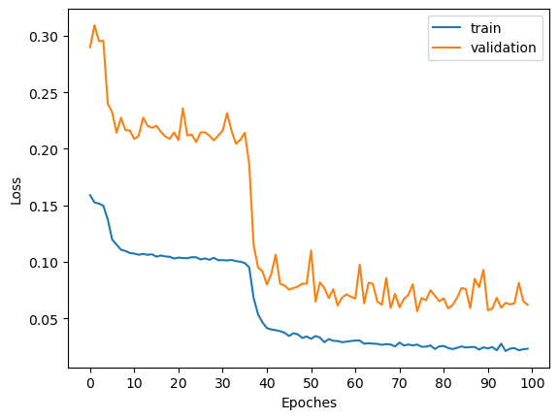
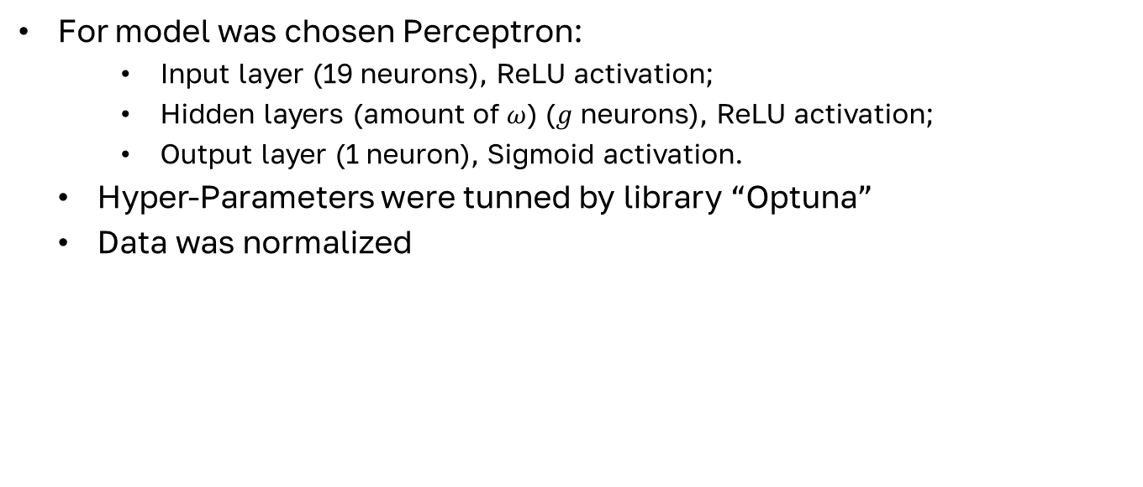

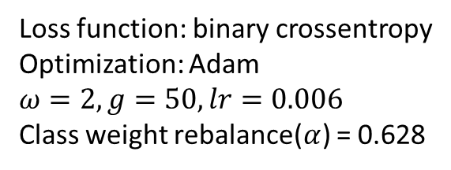
Deep ML
For model was chosen Perceptron:
  Input layer (19 neurons), ReLU activation;
  Hidden layers (amount of $ω$) ($g$ neurons), ReLU activation;
  Output layer (1 neuron), Sigmoid activation.
Hyper-Parameters were tunned by library “Optuna”
Data was normalized
Loss function: binary crossentropy
Optimization: Adam
$$ω=2, g=50, lr=0.006$$
Class weight rebalance($α$) = 0.628
$W=\left\{\begin{aligned}No formed:α; \\ Formed:1−α\end{aligned}\right\}$

Slide 11
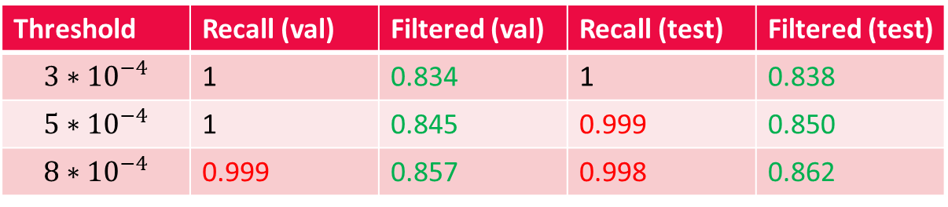
Results
Threshold | Recall (val) | Filtered (val) | Recall (test) | Filtered (test)
$$3∗{10}^{−4}$$ | 1 | 0.834 | 1 | 0.838
$$5∗{10}^{−4}$$ | 1 | 0.845 | 0.999 | 0.850
$$8∗{10}^{−4}$$ | 0.999 | 0.857 | 0.998 | 0.862
The best threshold is $5∗{10}^{−4}$, however metric Recall on test block is bad.

Slide 12
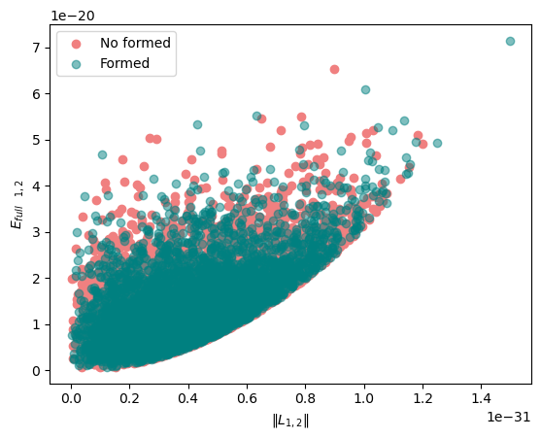
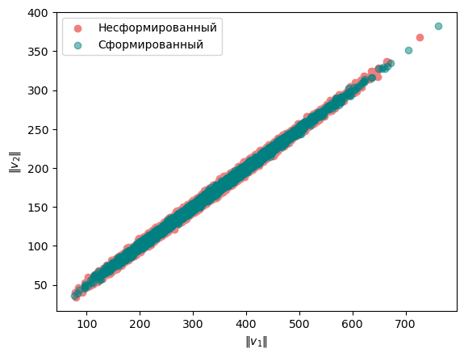
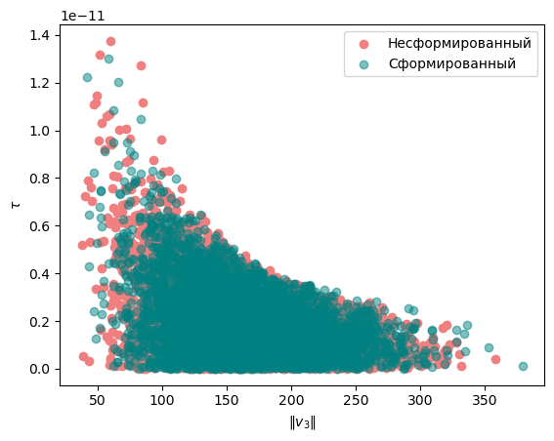
Filtered data after Deep ML
Norm of angular momentum &
Energy (1,2)
Speed 1-st atom &
Speed 2-nd atom
Speed 3-rd atom &
Time arrived

Slide 13
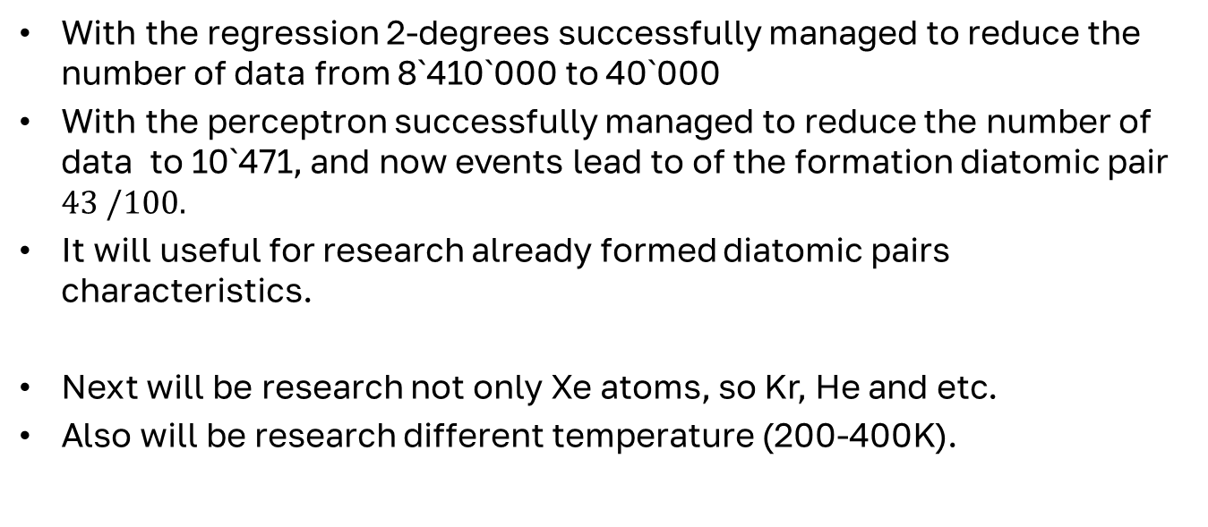
Conclusion and perspective
With the regression 2-degrees successfully managed to reduce the number of data from 8`410`000 to 40`000
With the perceptron successfully managed to reduce the number of data to 10`471, and now events lead to of the formation diatomic pair $43 /100.$
It will useful for research already formed diatomic pairs characteristics.
Next will be research not only Xe atoms, so Kr, He and etc.
Also will be research different temperature (200-400K).

Slide 14

Thanks for your attention!
codeilece@gmail.com

