Slide 1

a₀ baseline
Fast-vertexing code
C++ library NXV4

Slide 2




Contents
Vertexing - method
Loop track selection - results
CPU optimised
Conclusion - what’s next ?

Slide 3



Contents
Vertexing - method
loop track selection - results
CPU optimized
Conclusion - what’s next

Slide 4
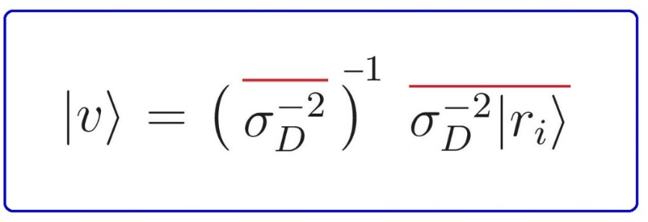
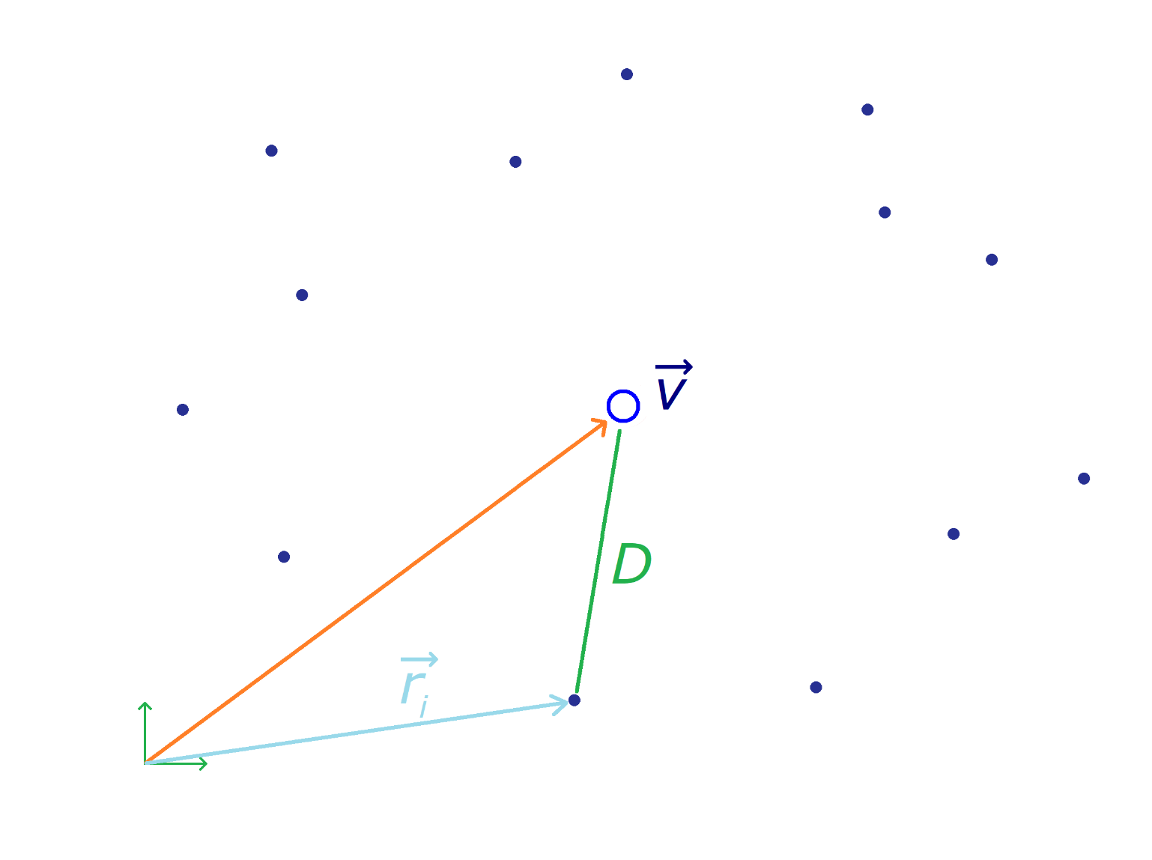
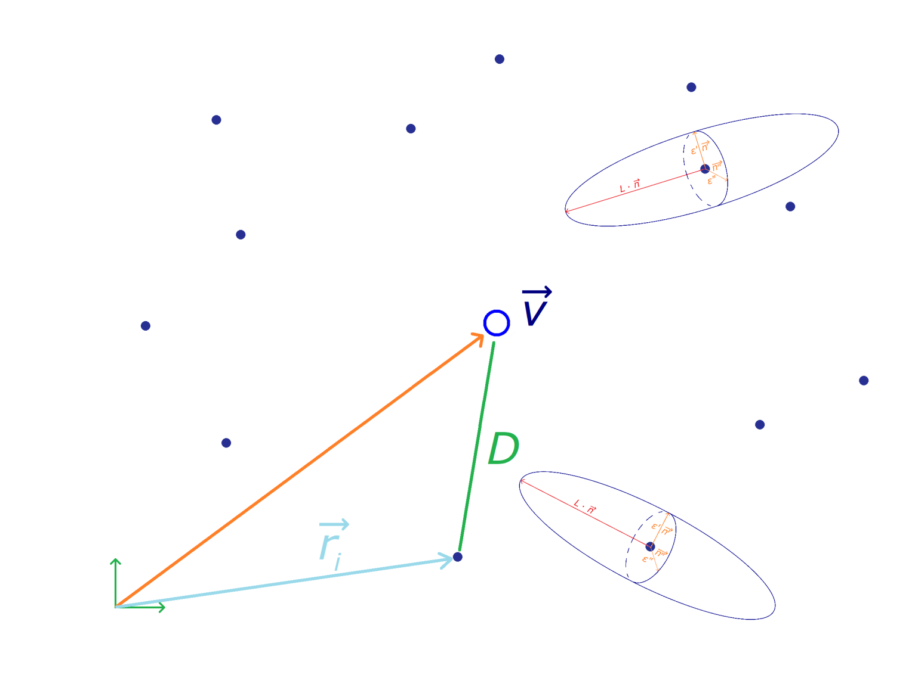
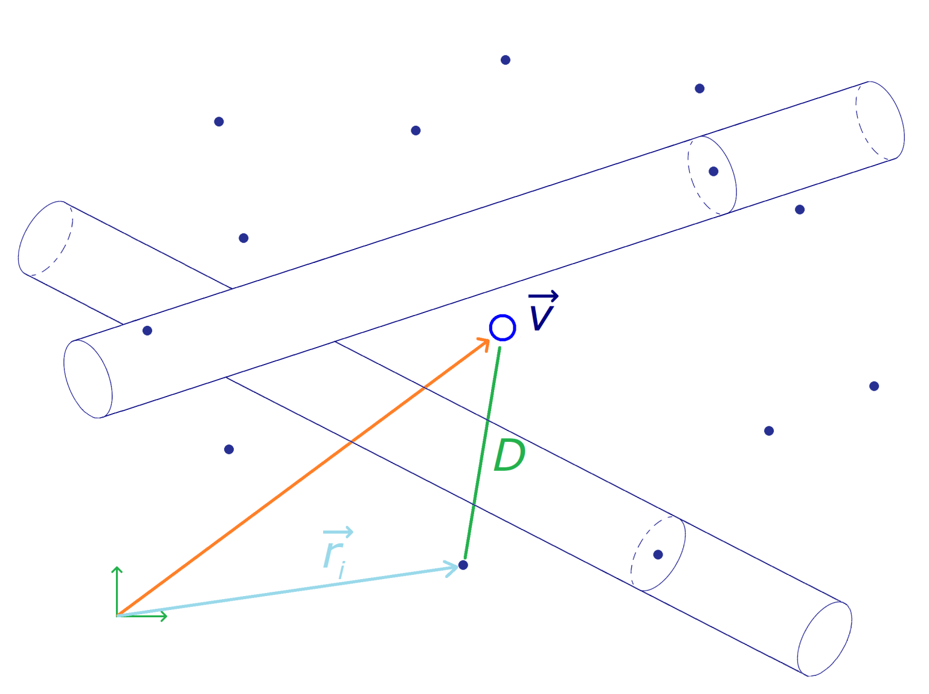
Vertexing method
outstanding problem since ZVTOP - 1997

Slide 5
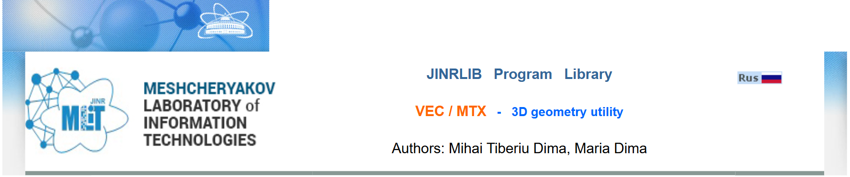
NXV4 - VEC/ MTX
- polymorphic 3D vec / mtx utility
- Authors: M.T. Dima, M. Dima (JINR)
- all algebraic op’s , ~v, (vec|vec), Z = a^b , fabs, > , ==, =!, etc
VEC
MTX
- all algebraic op’s, exp, log, sqrt, ~Z
- fabs, A|vec, (psi|A|chi), > , >=, ==, =!, etc
Available in JINRLIB: http://wwwinfo.jinr.ru/programs/jinrlib/nxv4/MTX/index.htm

Slide 6

Contents
Vertexing – method
loop track selection - results
CPU optimised
Conclusion - what’s next

Slide 7
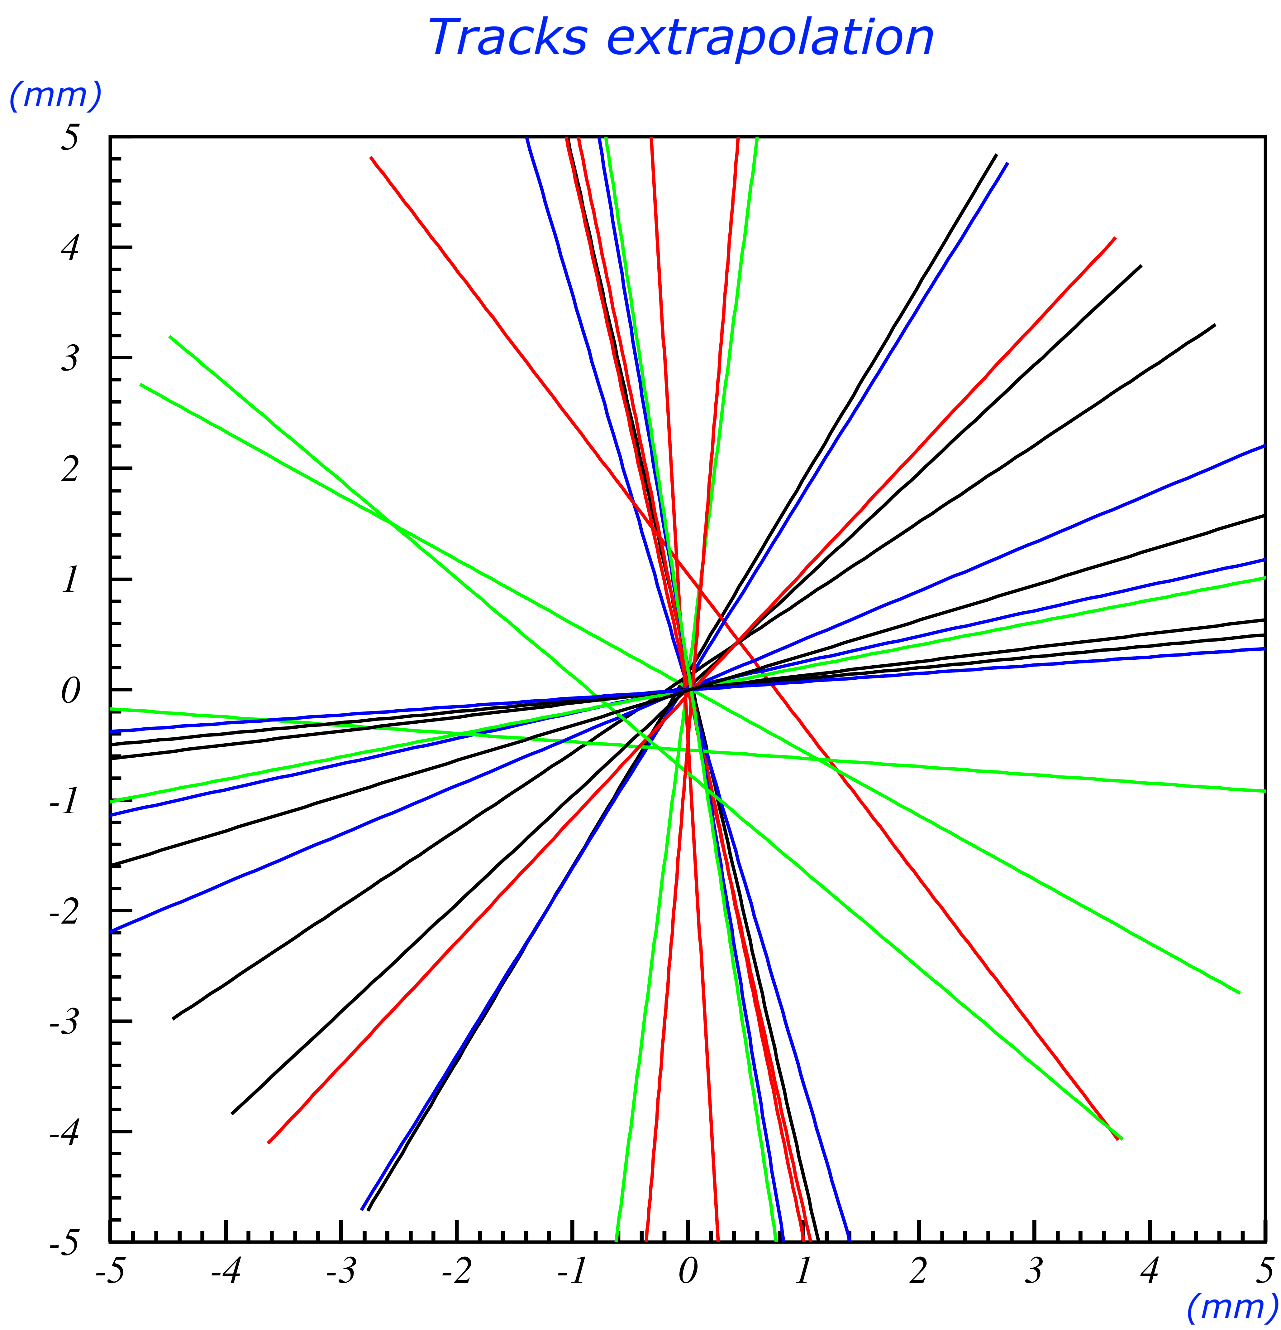
Track selection
- tracks that do not orriginate from the IP
bad tracks for my method
- ca. 0.2-0.5 mm DOCA
- low resolution tracks
w/ poor extrapolation
- less tracks ⇒ less resolution
- their DOCA = useless anyway

Slide 8
Results - resolution X, Y, Z
Track selection - Steps
- data - DOCA_{xyz} and p_{xyz}
- initial selection - calculates the first value of the vertex
- vertex loop - calculates the vertex again by adding tighter conditions
- loop stop condition = less than 3 tracks or 10 iterations
Working
- testing conditions - finding the best condition / iteration
- weights - bad tracks matter less than good tracks

Slide 9
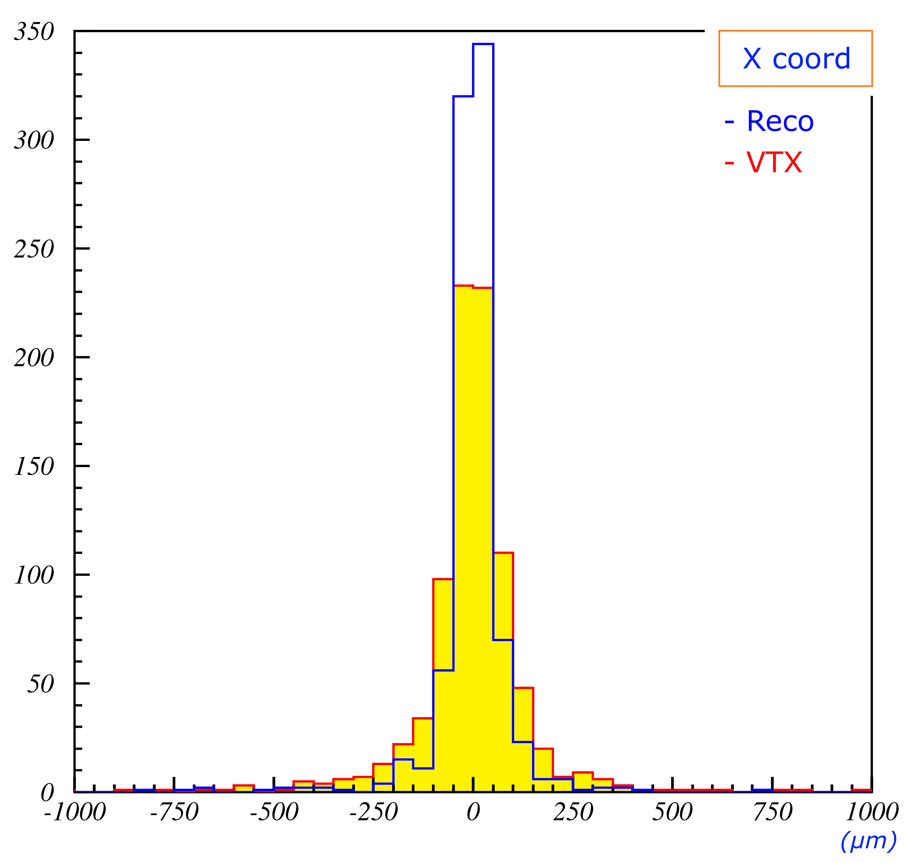
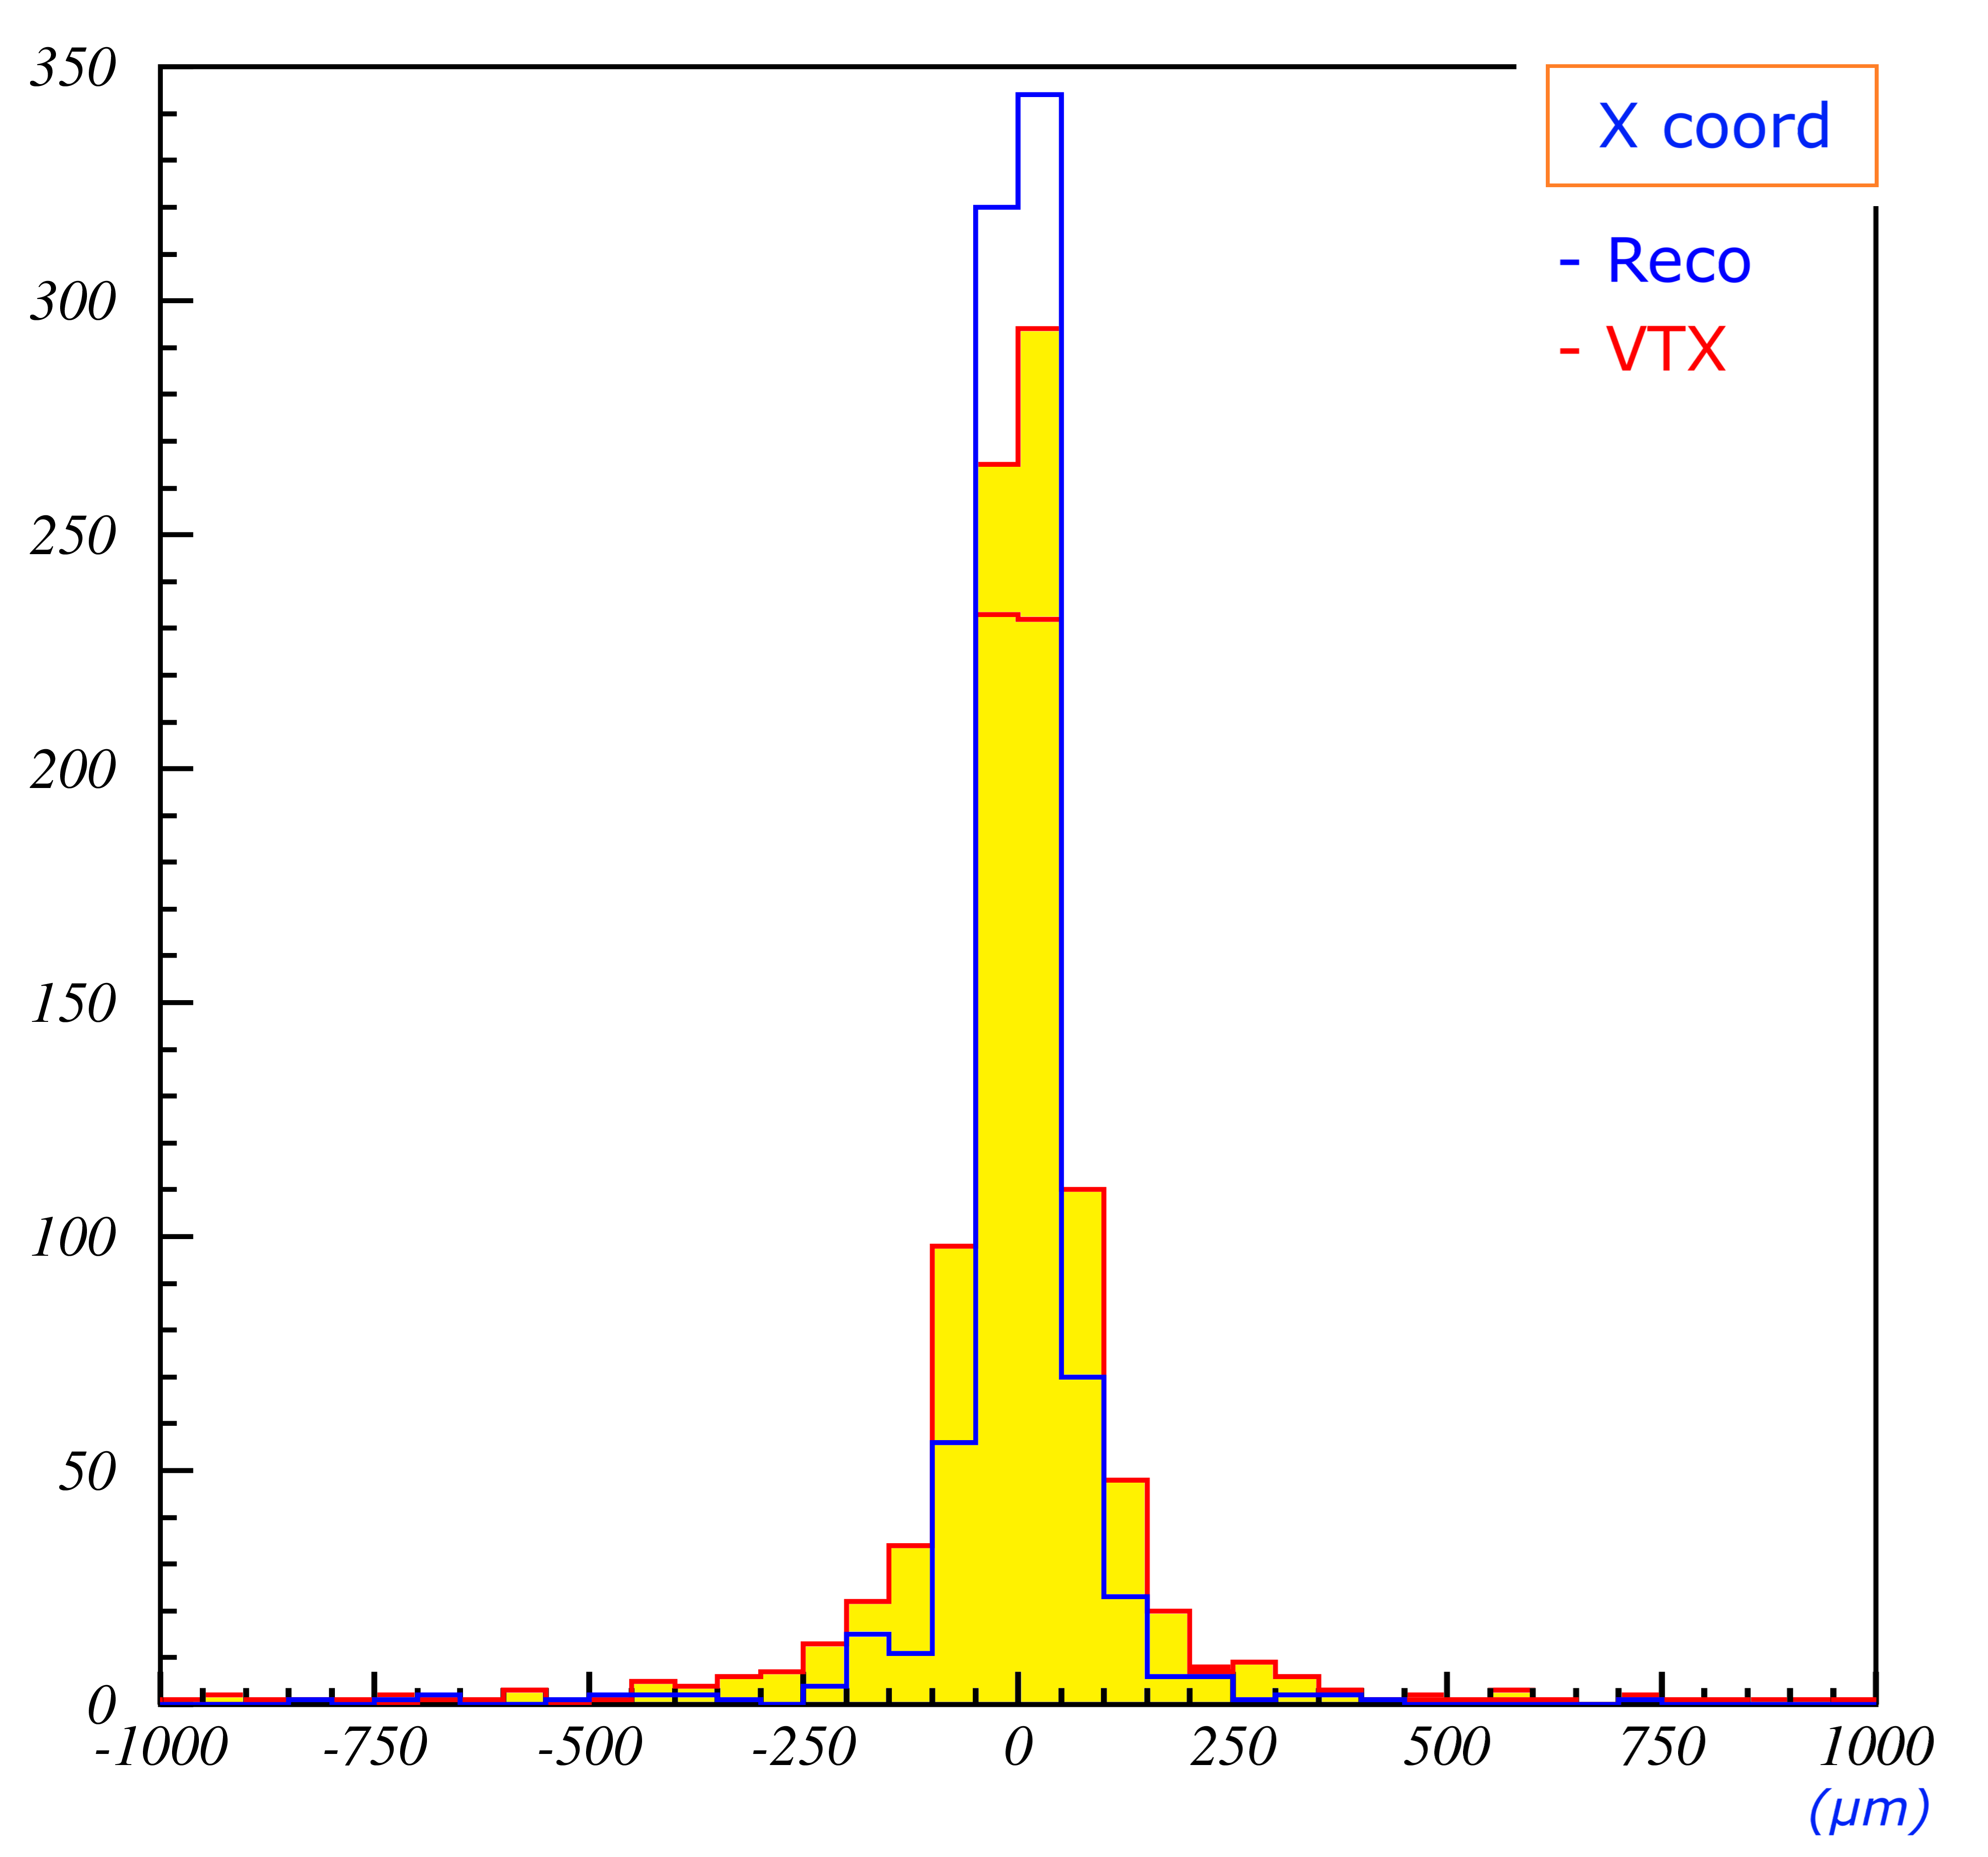
Results - resolution X, Y, Z
INIT selection
- DOCA_{xy} < 3mm
- DOCA_{z} < 10mm
- p⊥ > 0.5 GeV/c
SUBSQ selections
- DOCA_{xy} -= 0.3mm
- DOCA_{z} -= 1.0mm
- p⊥ += 0.05 GeV/c

Slide 10
Results - resolution X, Y, Z
- multiple vertexing (Primary Vertex)
- resolution is very good
+ can be improved (weights to tracks)

Slide 11
Contents
Vertexing – method
loop track selection - results
CPU optimised
Conclusion - what’s next

Slide 12
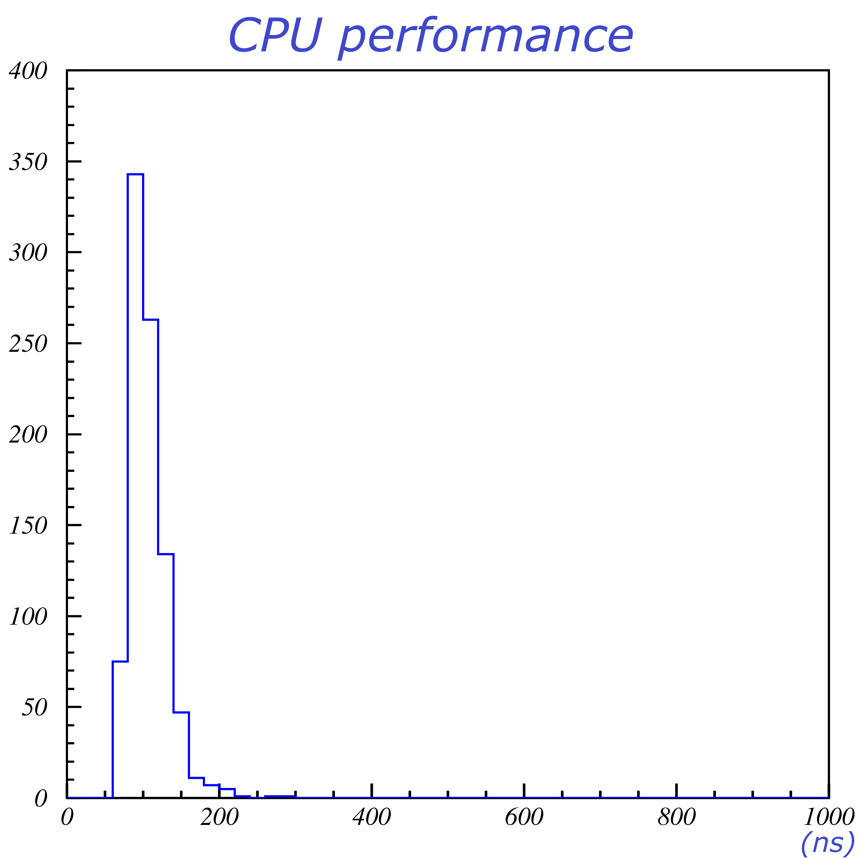
Results - CPU
progress:
1st : ~200ns / trk
2nd: ~140ns / trk
current: ~110 ns / trk

Slide 13
Contents
Vertexing – method
loop track selection - results
CPU optimised
Conclusion - what’s next

Slide 14
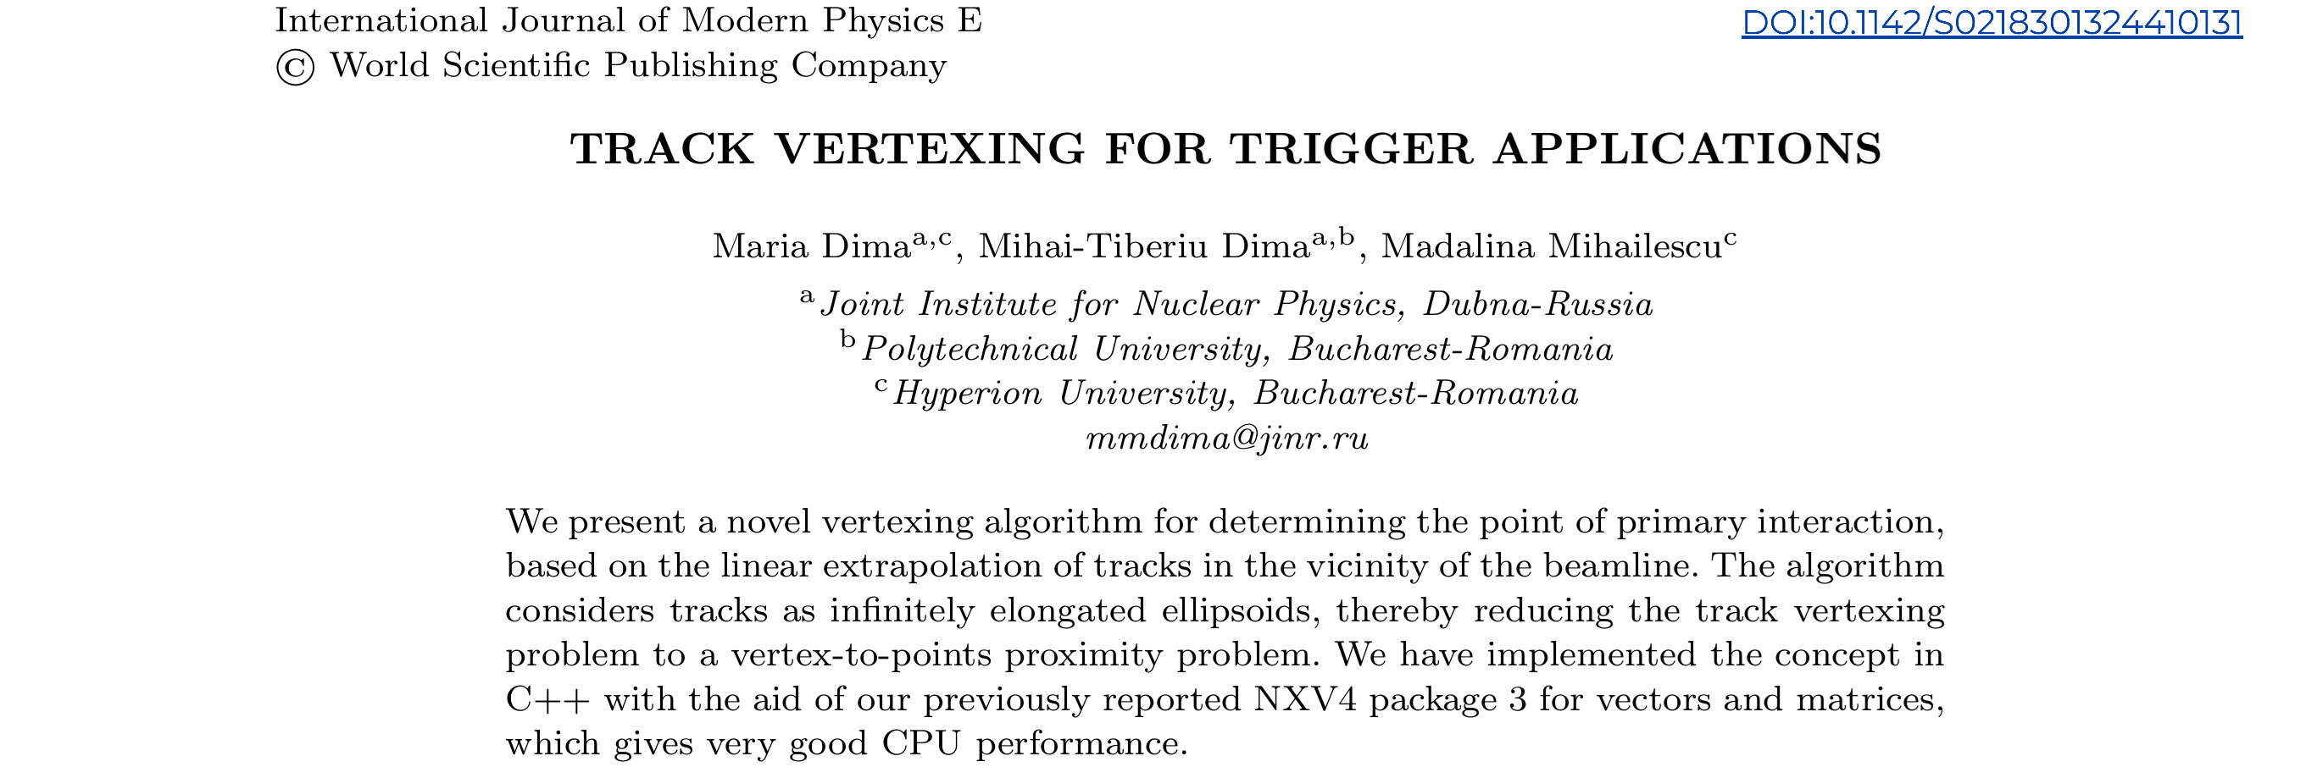
Conclusions
Testing - SPDroot data
track selection
already very good resolutions
vertex loop
better CPU performance 110ns / track
- very good speed
In preparation
weighting tracks
track re-fitting (w/ vtx)
thinking of adapting code for any vertex (secondary, tertiary)
Спасибо !

