Slide 1

JUNO distributed computing system
Xiaomei Zhang (IHEP)
On behalf of the JUNO collaboration
GRID’25, July 7-11, JINR, dubna
Notes:
Good morning, I am xiaomei from Institute of high energy physics.

Slide 2
JUNO experiment

Slide 3
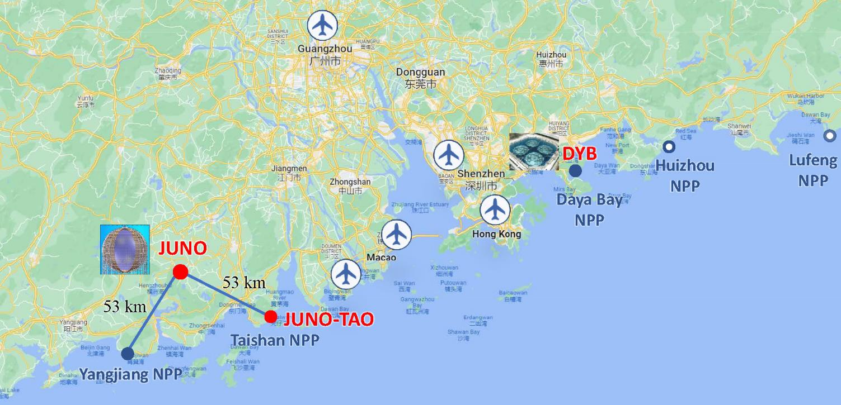
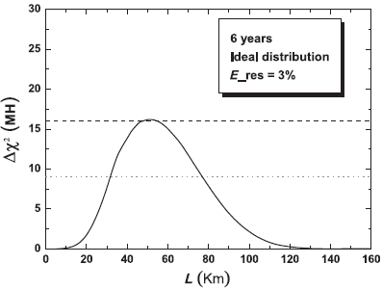
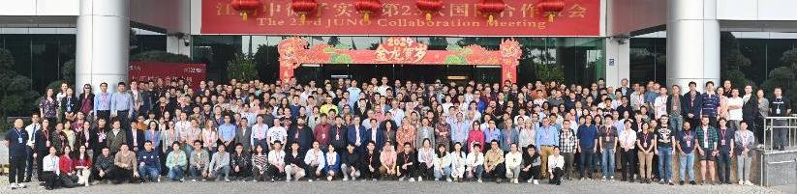
Jiangmen Underground Neutrino Observatory (JUNO)
Proposed as a reactor neutrino experiment for mass ordering in 2008 (PRD78:111103,2008; PRD79:073007,2009)
Project approved 2013, Construction started 2015
Located Kaiping, Guangzhou, south of China (west of HongKong)
JUNO baseline distance optimized to determine neutrino mass ordering
J.Phys.G43, 030401 (2016)
Optimal Baseline
74 institutions, >700 collaborators
Asia: China (34), Taiwan,China (3) Thailand (3), Pakistan, Armenia
Europe: Italy (8), Germany (7), France (5), Russia (3), Belgium, Czech, Finland, Latvia, Slovakia, UK
America: Brazil (2), Chile (2), USA (2)
2 cores, 9.2 GW_{th}
6 cores, 17.4 GW_{th}
Notes:
JUNO, Jiangmen Underground Neutrino Observatory was proposed as a reactor neutrino experiment for mass ordering in 2008. The project was approved in 2013, and construction was started in 2015. It is located Kaiping, Guangzhou, south of China. The JUNO baseline distance 53km is optimized to determine neutrino mass ordering. JUNO is an international experiment, which has 74 institutions, and more than 700 collaborators involved.

Slide 4
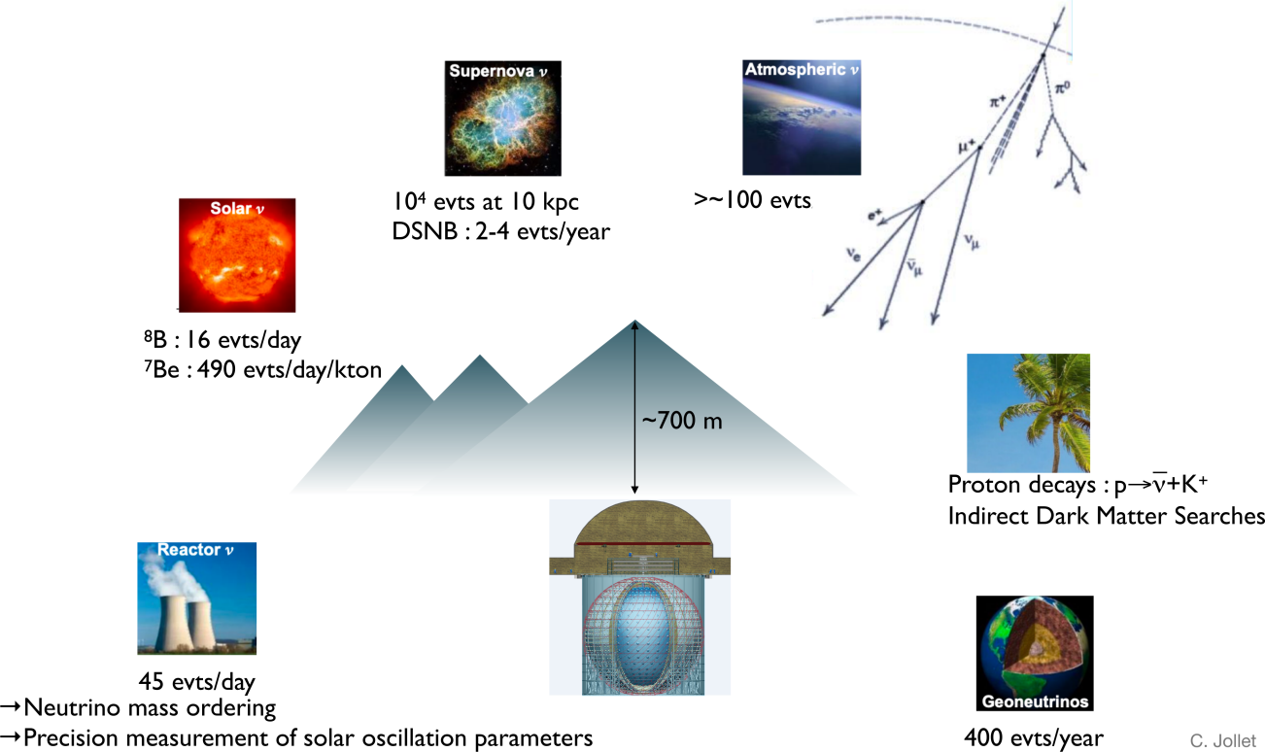
JUNO physics program
JUNO is a multipurpose Neutrino Observatory with a rich program in neutrino physics and astrophysics studying neutrinos over a large energy range
Include solar, supernova, atmospheric, geo-neutrinos, proton decay, exotic searches
Notes:
JUNO also is a multipurpose Neutrino observatory with a rich program in neutrino physics and astrophysics studying neutrinos over a large energy range. Beside rector neutrino, the study also include solar……

Slide 5
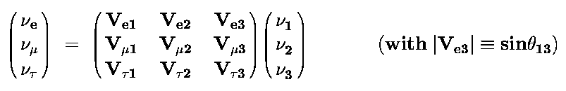
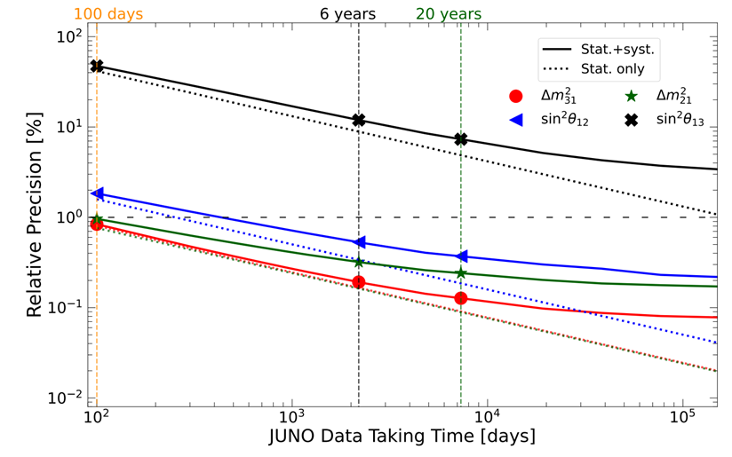
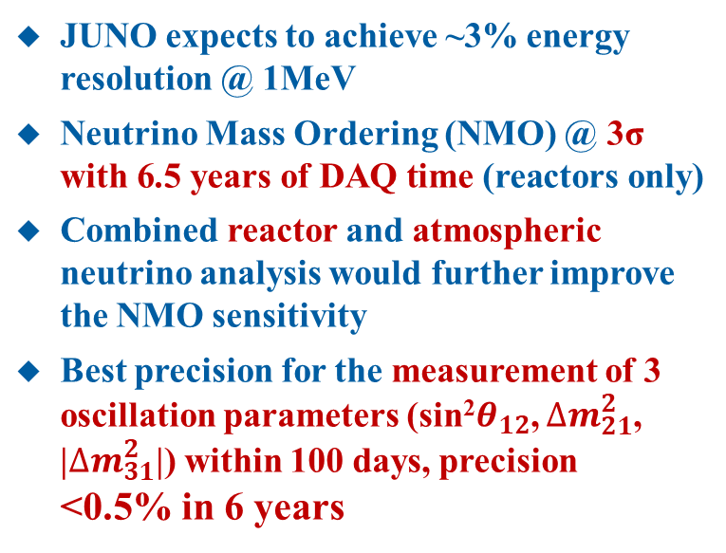
JUNO physics goal
JUNO expects to achieve ~3% energy resolution @ 1MeV
Neutrino Mass Ordering (NMO) @ 3σ with 6.5 years of DAQ time (reactors only)
Combined reactor and atmospheric neutrino analysis would further improve the NMO sensitivity
Best precision for the measurement of 3 oscillation parameters (sin²$θ_{12}$, $∆m_{21}^{2}$, |$∆m_{31}^{2}$|) within 100 days, precision <0.5% in 6 years
Neutrino Oscillation
Mixing matrix(PMNS)：
Known parameters：θ₂₃, θ₁₂, θ₁₃, |Δm²₃₂| , Δm²₂₁
Unknown parameters: sign of Δm²₃₂, CP phase δ
1998 Atm. ν osc. θ_{23,} |Δm²₃₂|
2002 Solar ν osc. θ_{12,} Δm²₂₁
2012 reactor ν osc. θ₁₃
Determine Neutrino mass ordering*
Precisely measure solar oscillation parameters
* We already know ν1 lighter than ν2, which is the lightest neutrino, ν1 or ν3?
Chin.Phys.C 46 (2022) 12, 123001
Notes:
In Neutrino world, we already know v1 lighter than v2, which is lightest neutrino, v1 or v3? JUNO is expected to give this answer in next few years. This is main physics goal of JUNO. Also JUNO can precisely measure solar oscillation parameters.

Slide 6
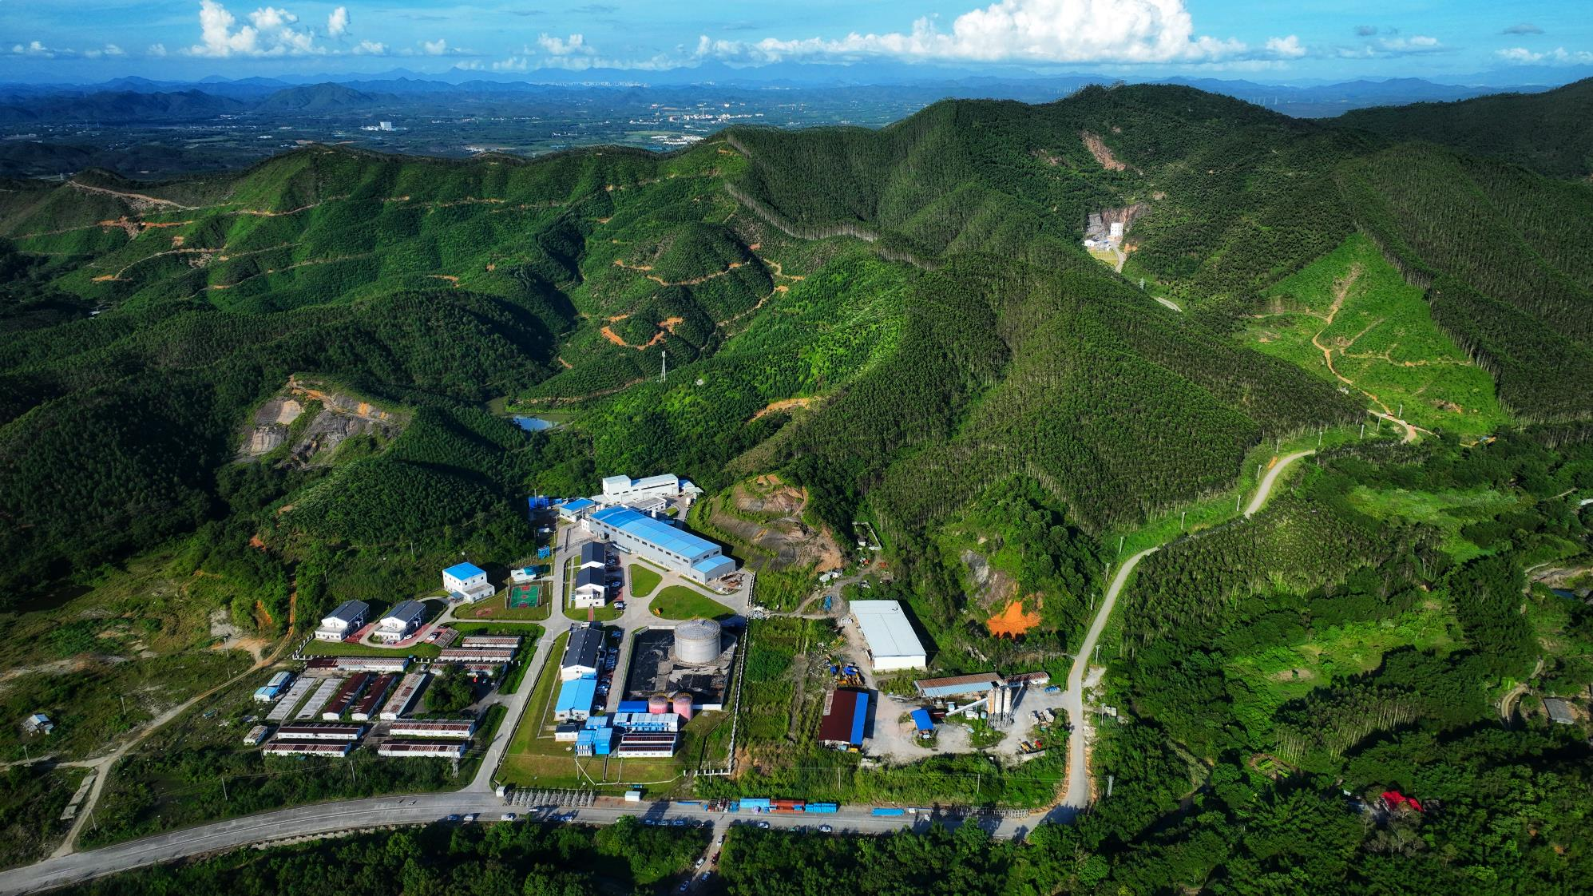
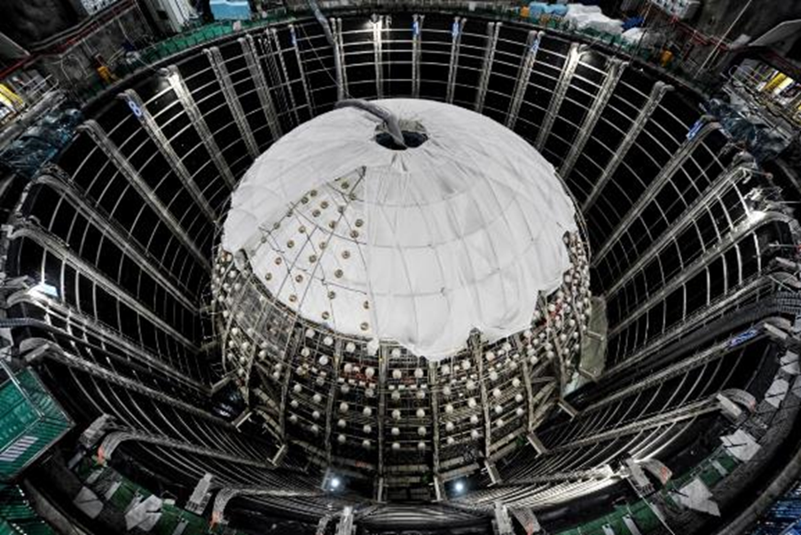
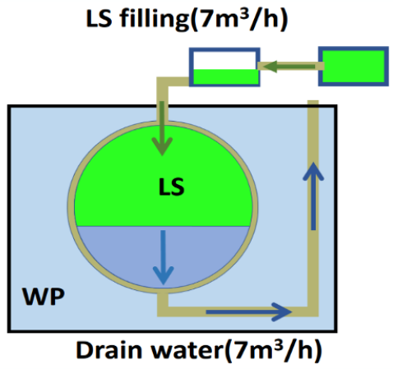
Status of JUNO
Surface buildings / campus
Office / Dorm
Surface Assembly Building
LAB storage (5 kton)
Water purification / Nitrogen
Computing
Power station
Cable train
2015: Civil construction started
2024 : installation finished
2024.12 : Water + LS Filling
  Expect to finish by summer
  Start data taking soon

Slide 7
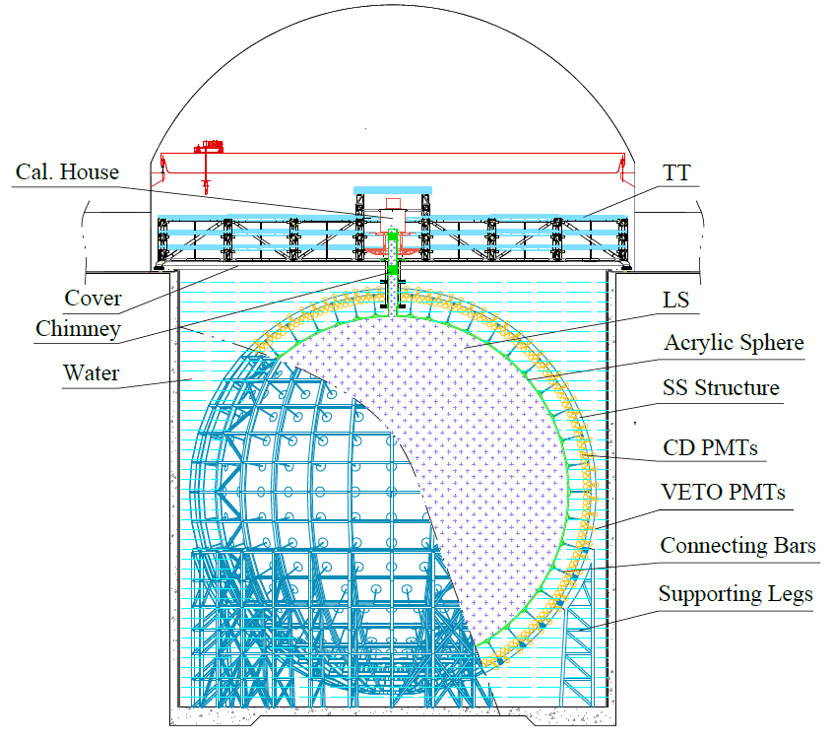
JUNO Detector
20 kton liquid scintillator, >30K PMTs, 700m underground
Designed to achieve 3% energy resolution at 1 MeV
Acrylic Sphere:
  Inner Diameter (ID): 35.4 m
  Thickness:12 cm
Stainless Steel (SS) Structure:
  ID: 40.1 m, Outer Diameter (OD): 41.1 m
  17612 20-inch PMTs, 25600 3-inch PMTs
Water pool:
  ID: 43.5 m, Height: 44 m, Depth: 43.5 m
  2400 20-inch PMTs
Top Tracker (TT)
35 kton
water
OSIRIS
Online Scintillator Internal Radioactivity Investigation System
20 kton LS
Central Detector (CD)
A dedicated pre-detector to measure radioactivity levels of the LS
20 tons of LS in 3m-by-3m acrylic vessel, 76 MCP-PMTs, 3m of water shielding
Notes:
JUNO central detector is 20 kton LS surrounded by 35 kton’s water. LS is instrumented with greater than 30K different type of PMTs . CD PMTs directed inwards, VETO PMTs directed outwards

Slide 8
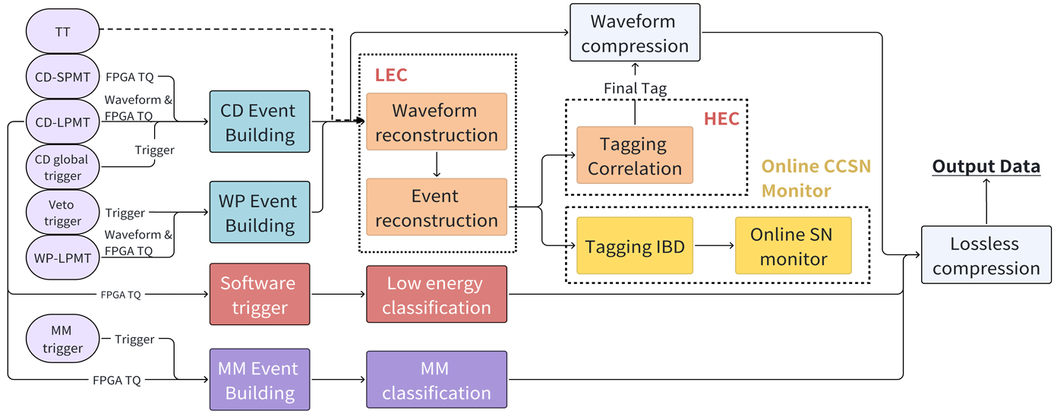
DAQ with Online Event Classification (OEC)
low-level event reconstruction
Expect low signal rate (~60/day) with large background
To preserve event correlation, can’t cut much background with trigger
OEC enables saving All events after global trigger + control data volume
  Event classification with LEC and HEC
  Event compression, throw away waveform of uninteresting events
Expect to greatly reduce data volume
high-level event reconstruction
Readout data
~ 40.7GB/s
Storage data
~ 60MB/s, ~2PB/year
Notes:
JUNO expect to have low signal rate with large background. To preserve event correlation, global trigger can’t cut much background. OEC is introduced to enable saving all events after global trigger and control data volume with event classification and event compression. OEC can shrink event size by throwing away waveform. Totally the data rate is expected to reduce from 40GB/s to 60MB/s

Slide 9
JUNO distributed computing infrastructure (DCI)

Slide 10
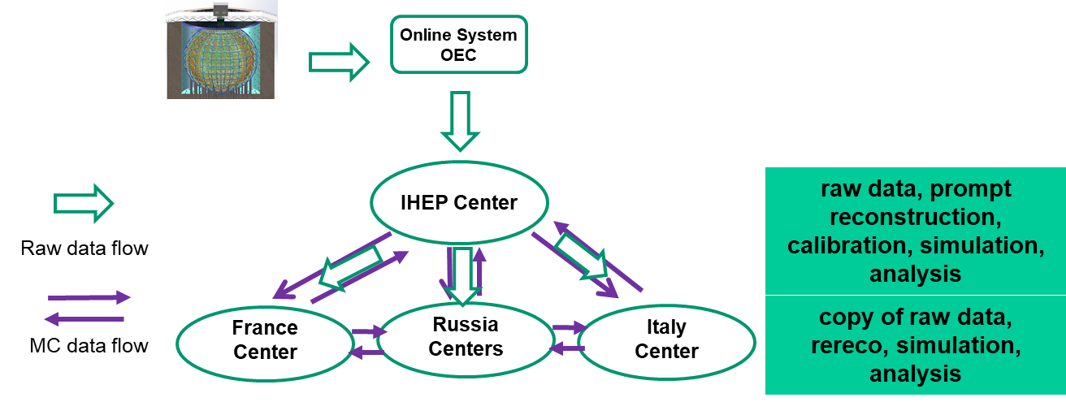
Computing Model
Five data centers joined: IHEP, CC-IN2P3, INFN-CNAF, JINR, MSU (~6000 CPU cores, >10PB disk)
Raw data flows from Online to IHEP which then distributes to other centers
KUP (Keep up production, 1st reconstruction)* and Calibration run in IHEP
MC Simulation, PP(Physics Production, 2nd reconstruction) and Analysis run in data centers

Slide 11
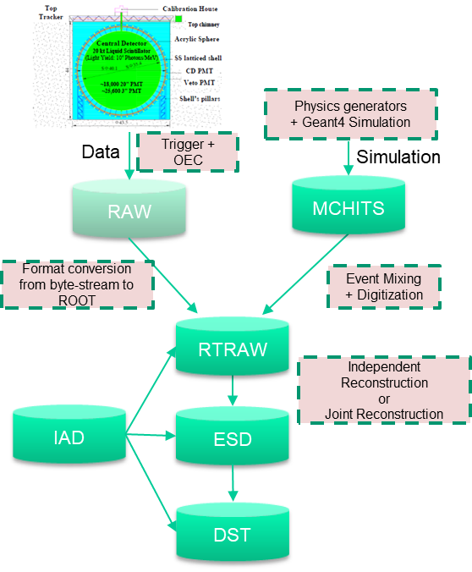
Offline data type
  MCHITS (Monte-Carlo Simulated Hits Data)
  ROOT format
  RAW (Raw Data from DAQ and OEC)
  Byte-stream format
  RTRAW (ROOT RAW)
  ROOT format (with EvtNavigator), Sorted;
  ESD (Event Summary Data)
  ROOT format (with EvtNavigator), contains CalibEvt, RecEvt
  DST (Data Summary Type)
  Contains information of physical events, flexible definition and file format, Does not contain relationships
  IAD (Indexed Analysis Data) (Auxiliary data)
  Make selections efficient without loading big datasets. Contains the address to the RAW/ESD and the necessary physics variables
  RAW and RTRAW have similar event size, and ESD 1/3 size. RAW is directly saved to tape, and RTRAW stay in disk for two years before archiving in tape
Notes:
Here are data types used in offline. MCHITs(Monte-Carlo simulated Hits Data) and RAW data, which will be transformed into ROOT format of RAW data – RTRAW . ESD and IAD will be produced by reconstruction from RTRAW, and every data centers has one copy of ESD data and IAD data.

Slide 12
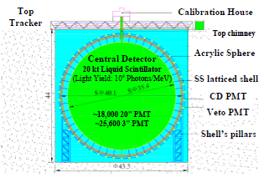
Planned data rate and data processing flow
JUNO onsite
IHEP
JUNO Data centers
RAW data Volume: ~2 PB/year
RTRAW data Volume: ~2 PB/year
one year data reconstructed within 2 months
Tape
Tape
~40 GB/s
Trigger + OEC
RAW
(t/q, waveform)
2 Gbps network (dedicated)
RAW
(t/q, waveform)
100 Gbps network (LHCONE)
RAW
(t/q, waveform)
DAQ Event Rate: 1kHz
Data Volume:
~60 MB/s
Each file size:
5 GB/file
N (Events) per file: 83,333 (=5GB / 60MB/s * 1kHz)
RTRAW
RTRAW
Sampling + Reconstruction
Reconstruction
Reconstruction
(new calibration)
ESD
(KUP)
IAD
(KUP*)
IAD
(PP)
ESD
(PP*)
Data Quality Monitoring
Delay: ~half a day
Delay: ~hour
First Reconstruction
Second Reconstruction
* KUP: Keep up production PP: Physics Production

Slide 13
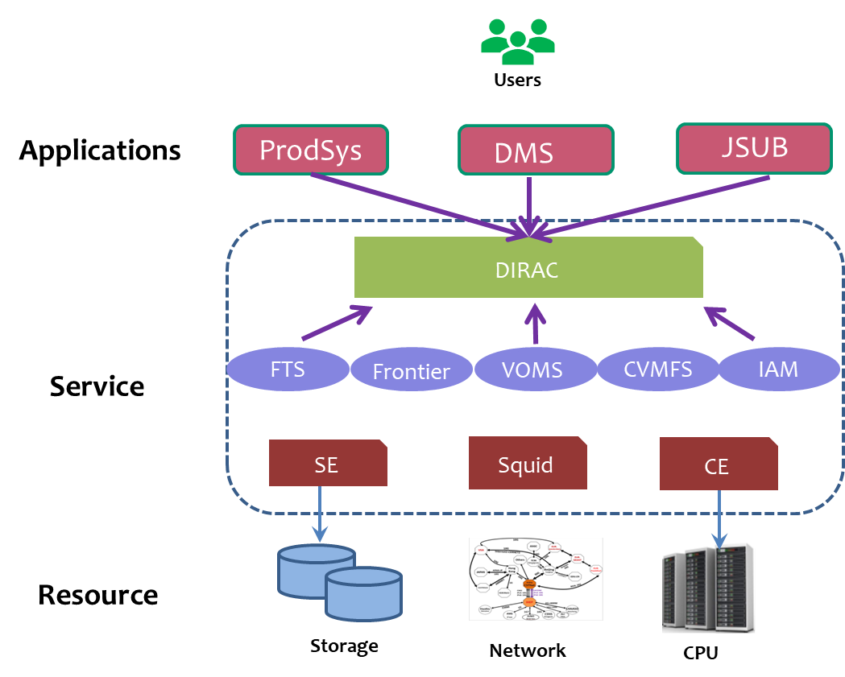
Distributed Computing Infrastructure (DCI)
JUNO DCI was built based on DIRAC, use both WMS and DMS
Use WLCG middleware as much as possible
Develop JUNO-oriented application systems
  Data production system (ProdSys)
  Data analysis tool (JSUB)
  Raw data transfer system
  Data operation tools
WMS: Workload management system, DMS: Data management system

Slide 14
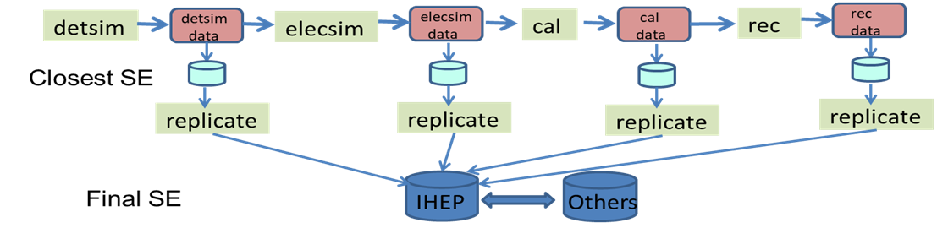
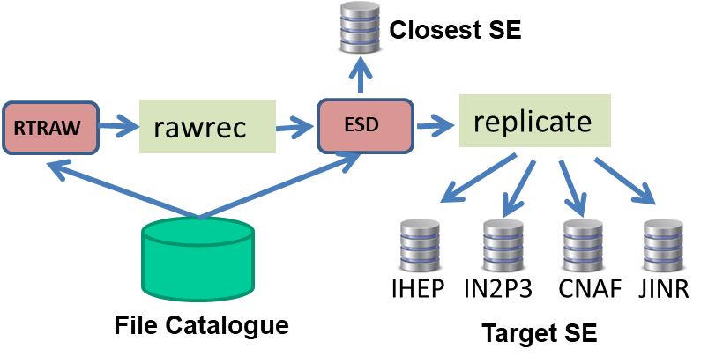
ProdSys: JUNO Data production system 1/2
Production tasks are composed of several steps which can be connected with data
  Detector simulation (detsim), Electronics simulation (elecsim) , PMT Reconstruction (cal), Event Reconstruction (rec), Replication of output to destination SEs (replicate)
ProdSys is implemented as a data-driven pipeline system, which
  create production jobs and submit JUNO production tasks in grid env
  Manage workflow and dataflow in tasks automatically

Slide 15
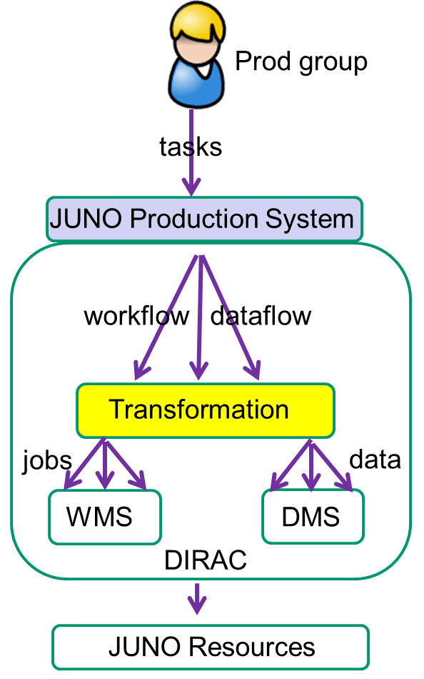
ProdSys: JUNO Data production system 2/2
ProdSys is implemented based on DIRAC
  Frontend Accept user requests and create JUNO workflow and dataflow
  Transformation system (TS) Transform JUNO workflow and dataflow into a pipeline
  DIRAC File Catalogue (DFC) Provide query of metadata and file status to connect pipeline
  Jobs and file transfers are submitted to DIRAC WMS and DMS
Already in simulation production, extensible for other types of production

Slide 16
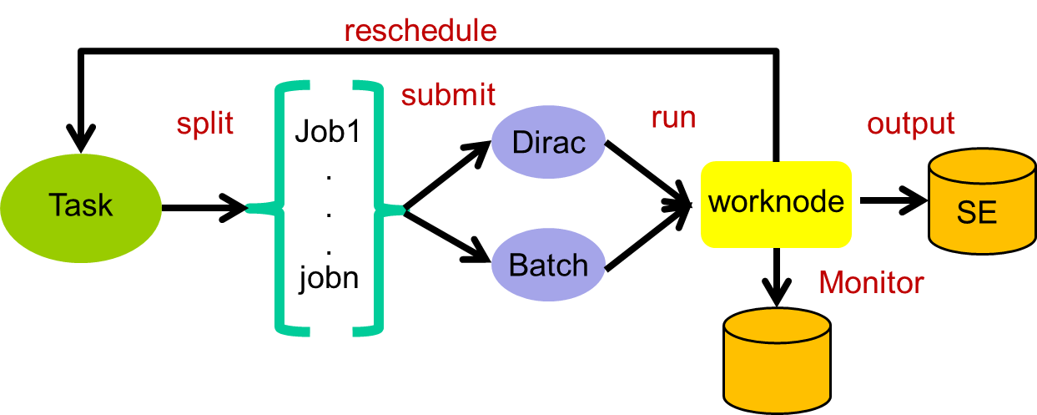
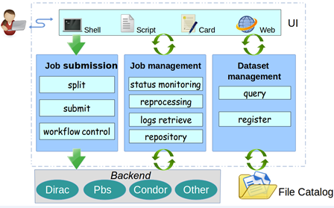
JSUB: user job submission tool
Goal
  Ease process of physics analysis and simulation for users
  Automatically take care of life cycle of user analysis
Main functions
  Job splitting and submitting, Job management, dataset operations, backends, UI with YAML configuration file
Main features
  Extensible with multi-experiments and multi-backends
  Support fast submission with DIRAC parameteric job submission feature
  Support flexible splitters with multi parameters to split tasks into subjobs

Slide 17
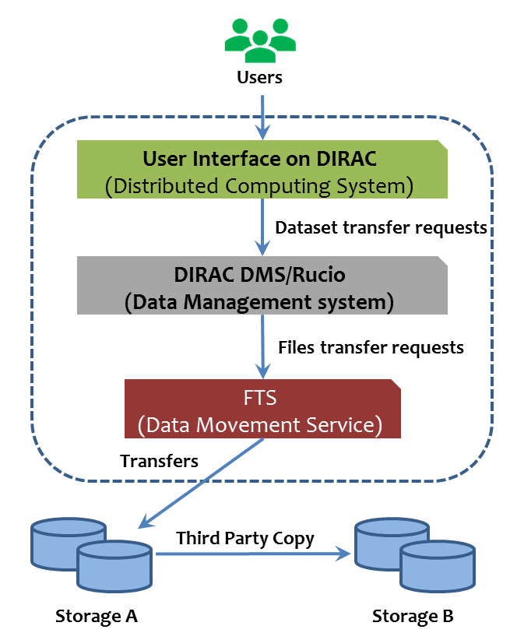
Data management system (DMS)
Take care of data access and movement
  Provide a global data view
  Create and manage dataset
  Submit and manage transfer requests
Main components：DIRAC DMS + FTS + operation tools
  DFC: metadata and replicas catalogue
  Request Management System and Transformation System: split dataset into file transfers and arrange in queue
  Operation tools: massive cleaning, registering, replicating and archiving, consistency check

Slide 18
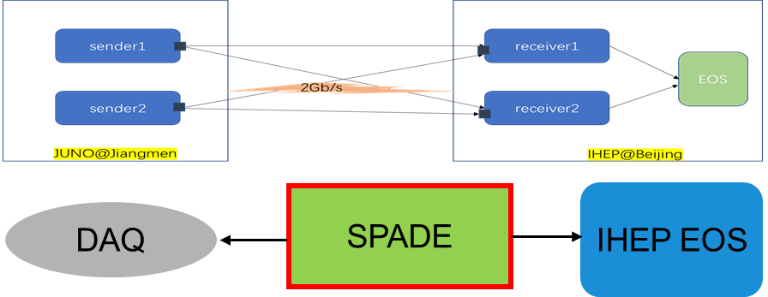
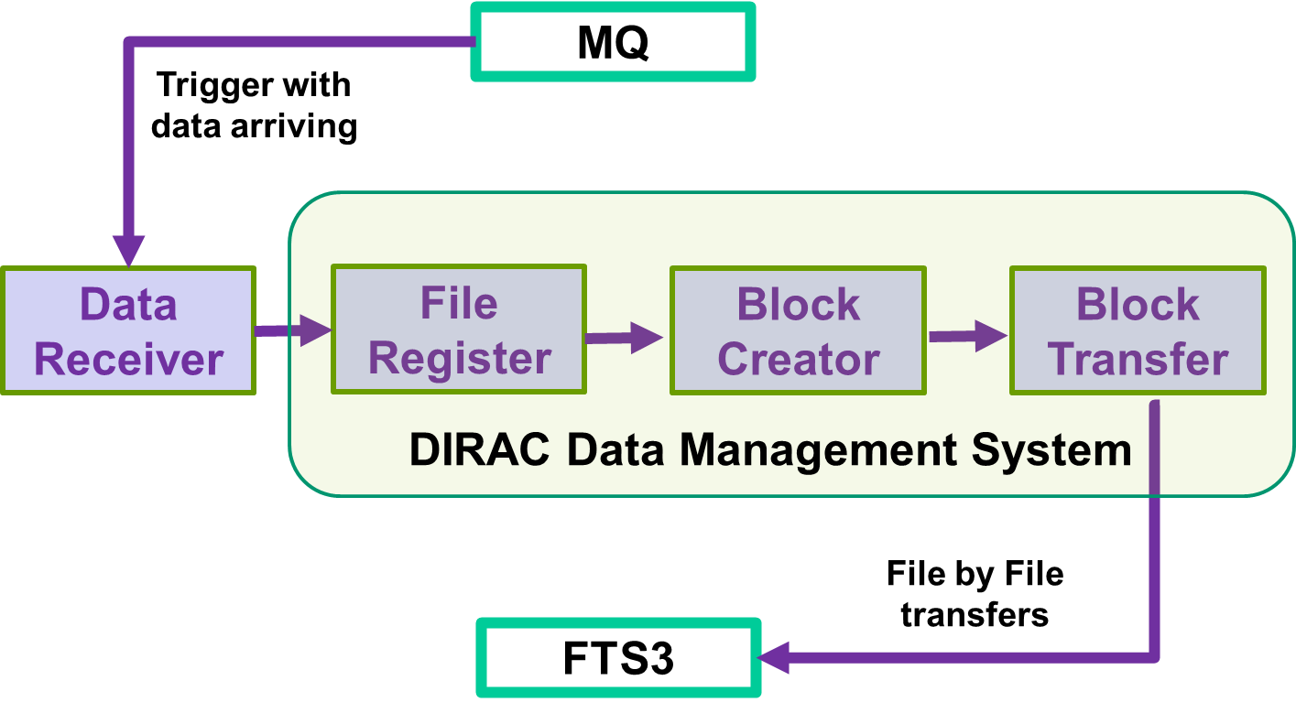
Raw data distribution 1/2
Online => IHEP (SPADE, non-grid transfer)
  2Gbps dedicated line
  100TB onsite local disk cache, ~20 days data
  SPADE is also used for other IHEP experiments
IHEP => data centers (grid transfer)
  Automatic system developed on DMS
  FTS takes care of file-level replications
  Monitoring dashboard combines messages from FTS and DIRAC (ElasticSearch+Grafana)
Notes:
SPADE can have easier and direct control, and we already have many year reliable experience with it

Slide 19
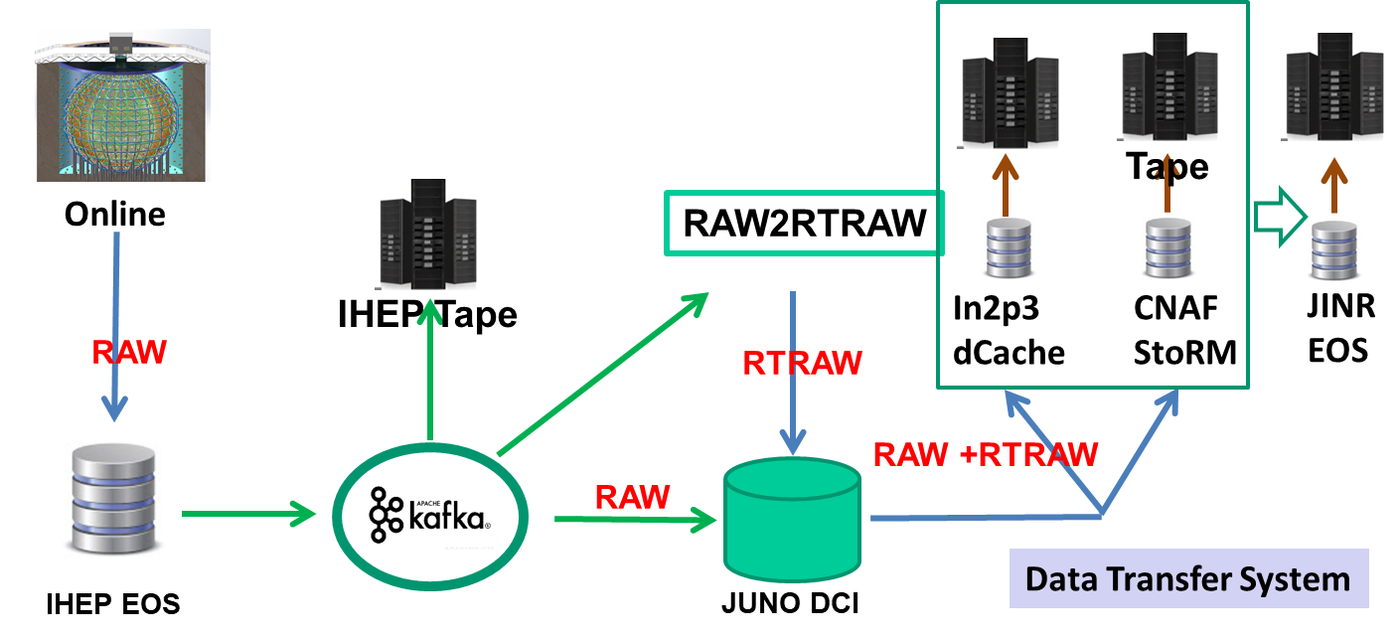
Raw data distribution 2/2
Two replicas of raw data, data distribution policy plans to be
  One in IHEP, one in Europe
  Route: Online => IHEP => CNAF, IN2P3, JINR
A message-driven system based on Kafka is introduced to allow smooth communications among raw-related activities in IHEP

Slide 20
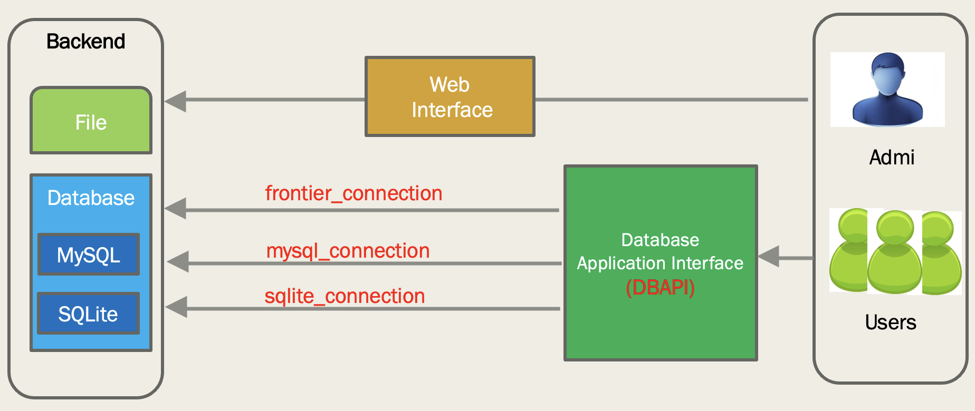
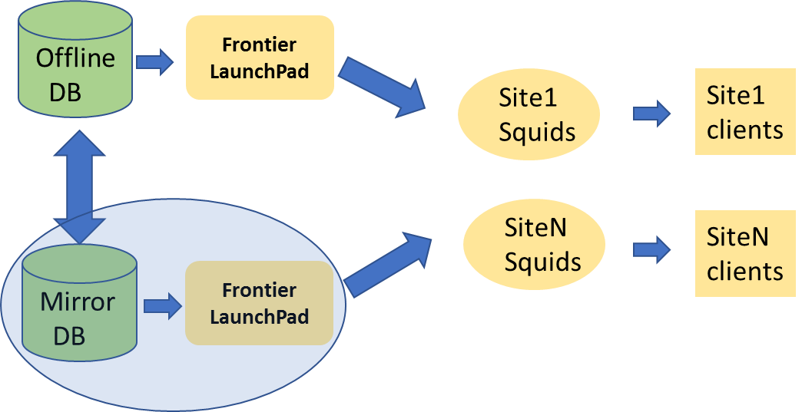
Offline Condition DB access with Frontier/Squid
Conditions Data and Parameter data are stored in offline DB
  Meta data stored in MySQL
  Payloads managed in CVMFS
  support SQLite for OEC (online event classification)
Frontier/squid cache provides efficient access
  Help avoid high load in central DB and speed up access to DB
  Frontier DB and server deployed in IHEP with backup in JINR

Slide 21
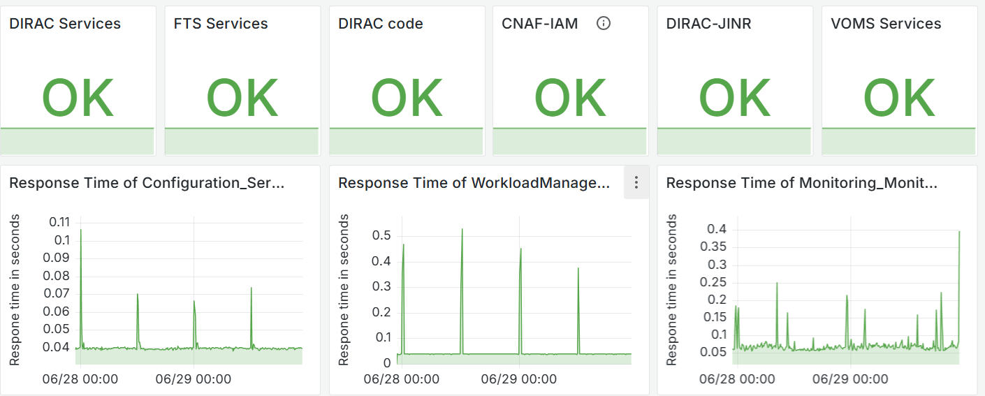
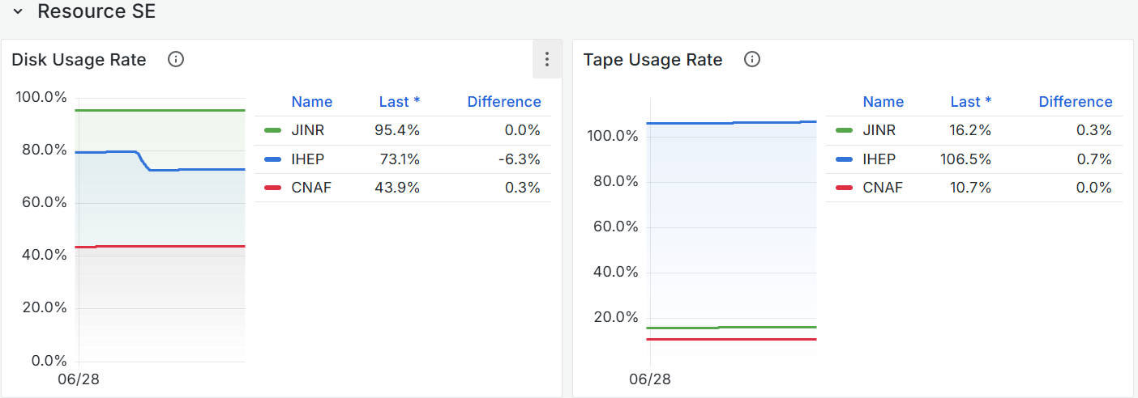
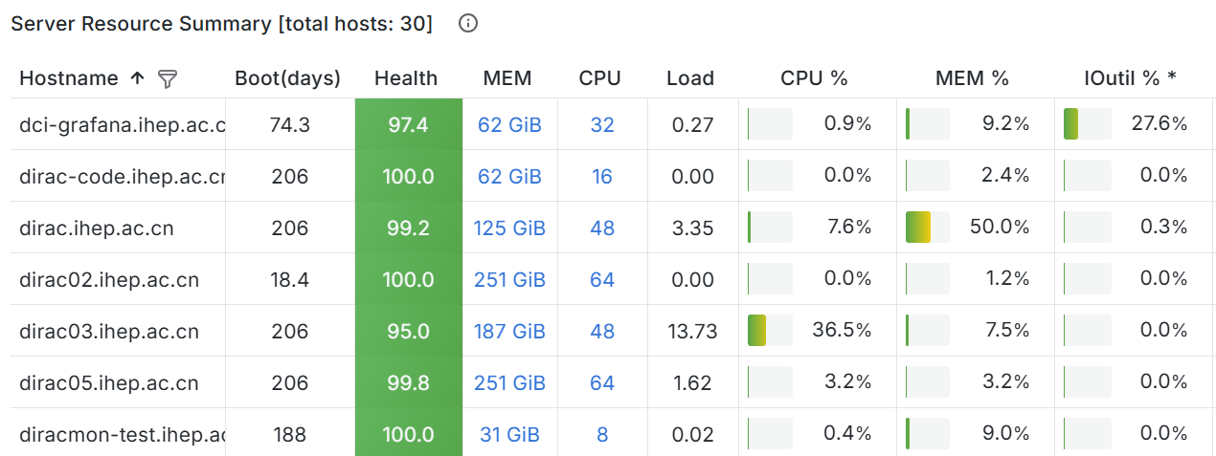
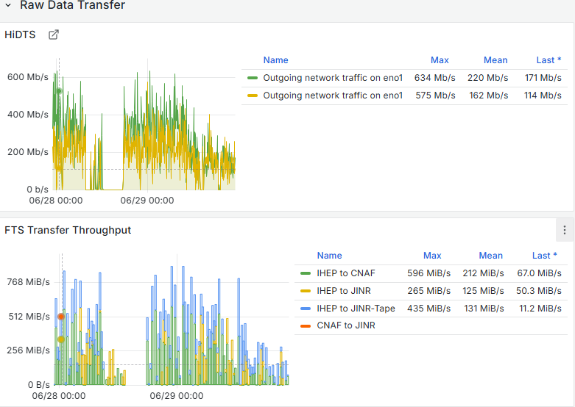
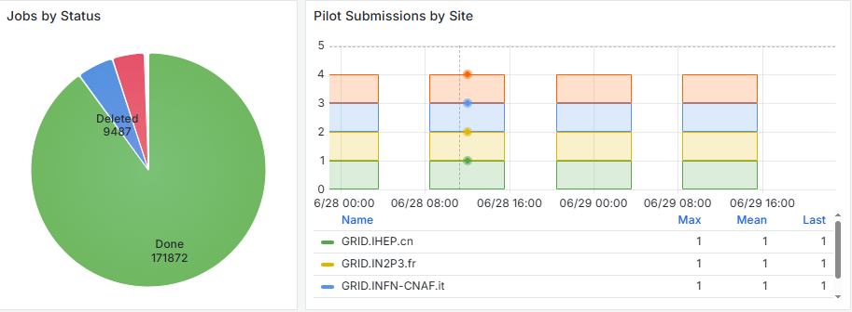
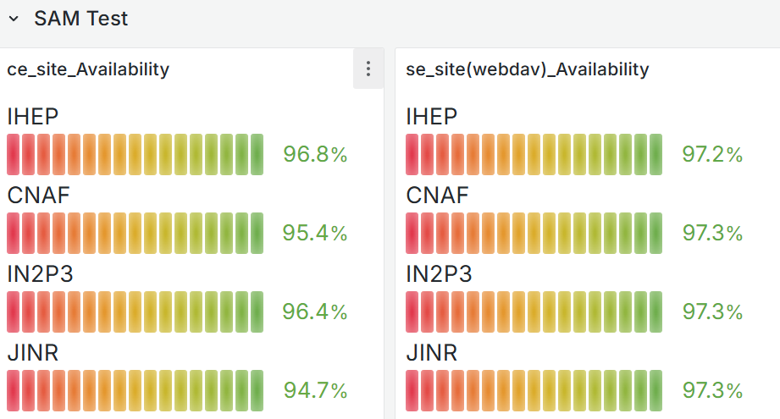
Monitoring
Monitoring infrastructure and dashboard has been built up using ES+Grafana
Basic metrics for shifters are ready: Server, Service, Resource, Site, Transfer, Job
Xiao Han’s talk in the afternoon has more details on monitoring
Server
Service
Resource
Site
Transfer
Job

Slide 22
Data challenges
Notes:
Tune and verify the system, make sure everything is working for data taking

Slide 23
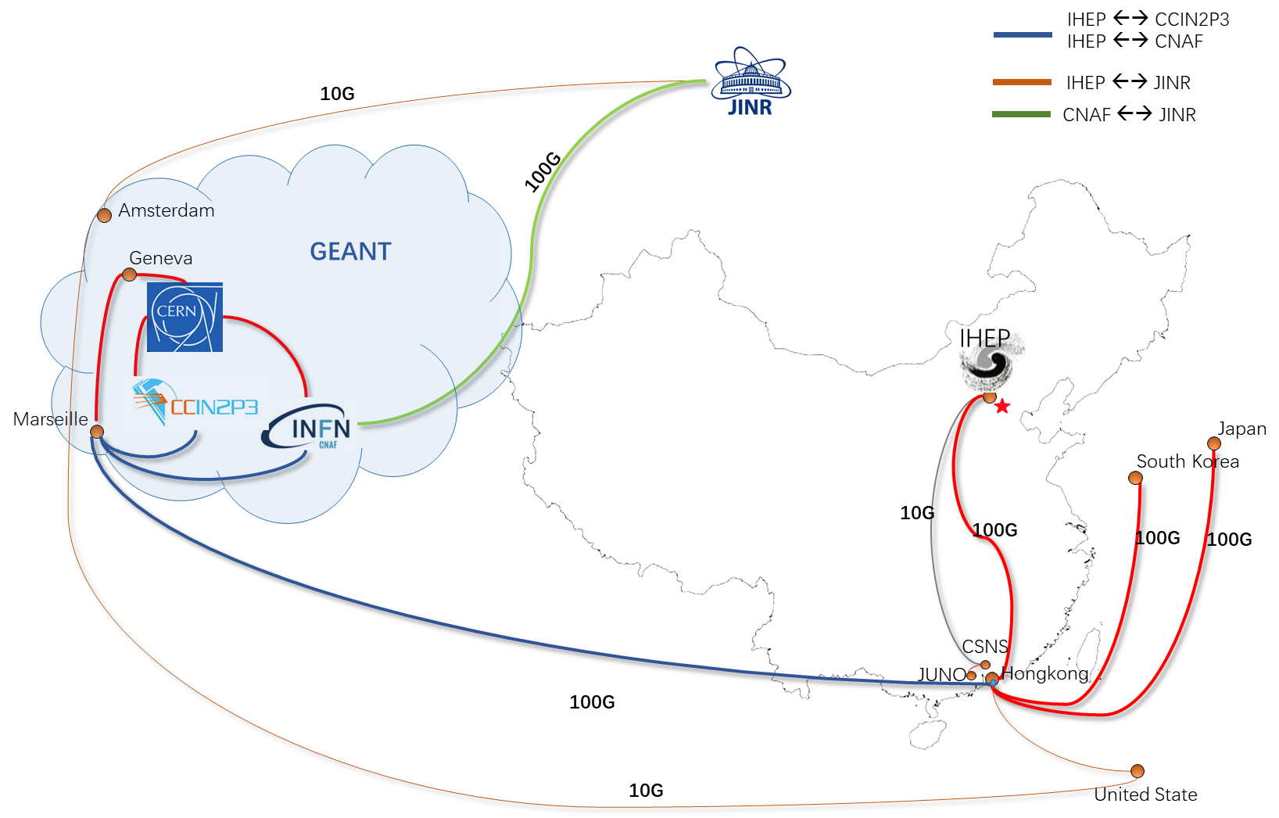
International network
JUNO joined LHCONE in April, 2021
IHEP ⬄ Europe upgraded to 100Gbps in 2023
  LHCONE 80Gbps (JUNO up to 35Gbps), LHCOPN 20Gbps
IHEP ⬄ JINR is 10Gbps, CNAF⬄ JINR is 100Gbps

Slide 24
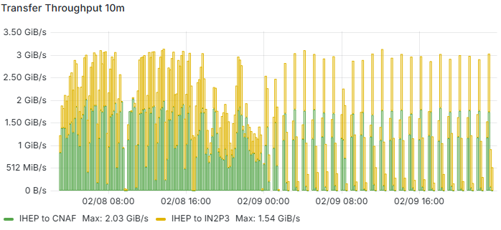
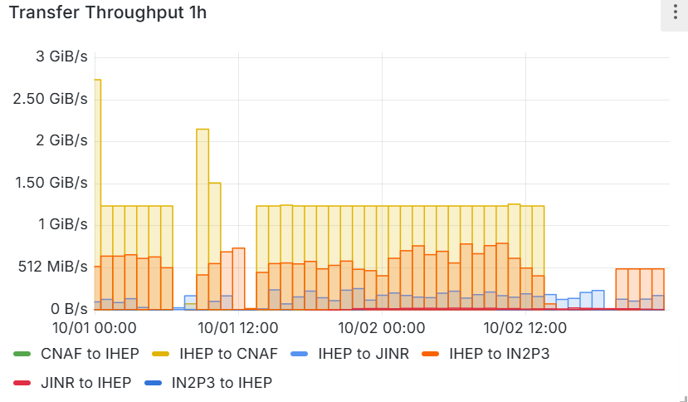
Network data challenges before data taking
100Gbps Tests (DC24)
  Use HTTP TPC, RHEL9, X509
  5GB file, planned JUNO raw data size
  Inject each hour at 512-1280MB/s for each site
  Routes: IHEP => CNAF, IN2P3, JINR
Target total 30Gb/s reached
  IHEP =>CNAF, IN2P3 reached 10-20Gb/s
  IHEP =>JINR got 2Gb/s maximum
  CNAF=>JINR reached 10Gb/s

Slide 25
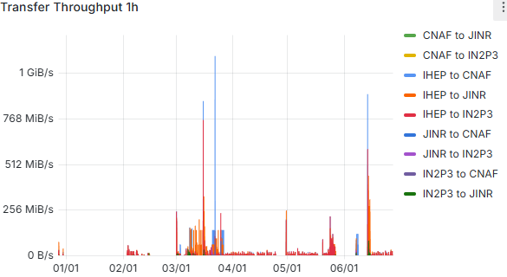
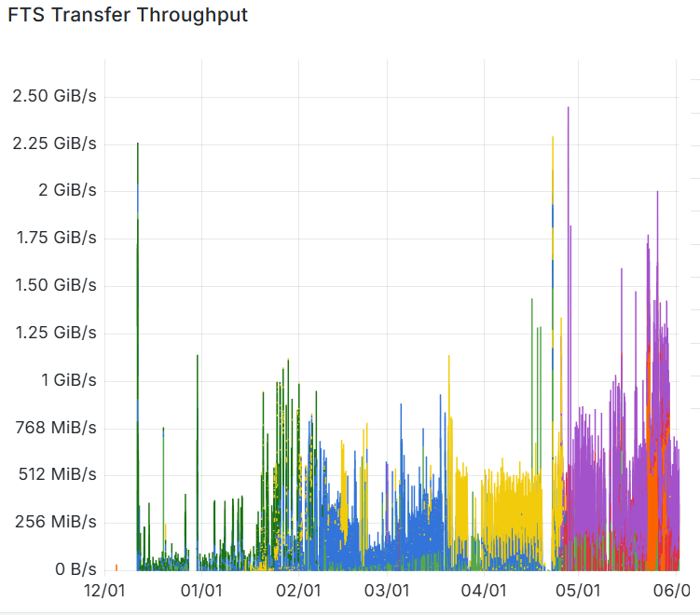
Raw data transfer in commissioning
Small account of commissioning data transferred intermittently since beginning of 2024
  Tuning and testing the whole system
Raw data transfer for mini real data collection began at the end of 2024 during water and LS filling
  Total data rate for international links doubled compared to the plan
  Requirements increasing from approximately 150 MB/s to over 300 MB/s
The channel from IHEP to JINR is facing challenges
  Temporarily solved by changing route from IHEP -> JINR to IHEP->CNAF->JINR

Slide 26
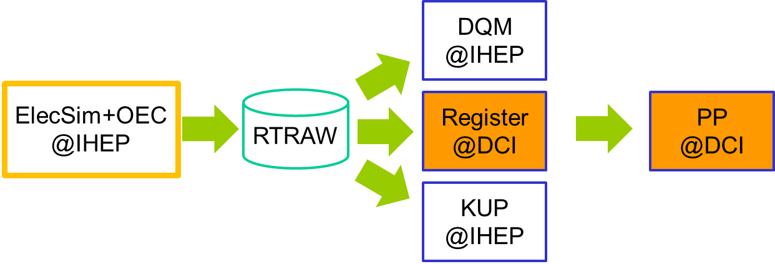
RTRAW chain tests 1/2
Produce RTRAW from ElecSim and OEC
DCI Received RTRAW metadata from MQ
Data transfer system register and replicate RTRAW from IHEP to data centers
ProdSys create and schedule Physics Production(PP) tasks in DCI
In PP jobs, Frontier/Squid is used to access offline database remotely

Slide 27
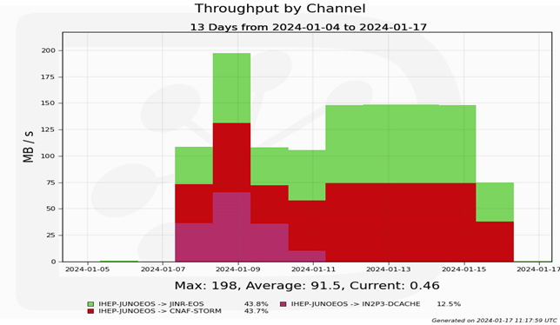
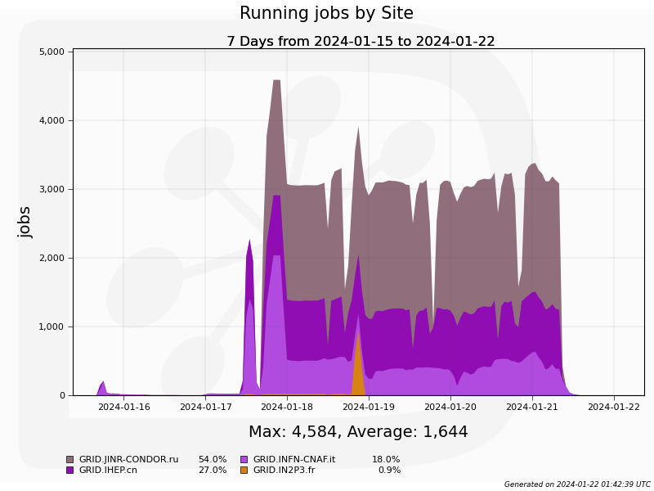
RTRaw chain tests 2/2
100K RTRAW files (~1GB/file, ~103TB total)
  registered in DFC and replicated to data centers using raw data transfer system
  Take three days, no issues
Total ~100K PP jobs run in four data centers
  110HepSpec06 days, no DCI issues
25TB output ESD transferred to data centers
Significant traffic to the central DB reduced with Frontier/Squid caches

Slide 28
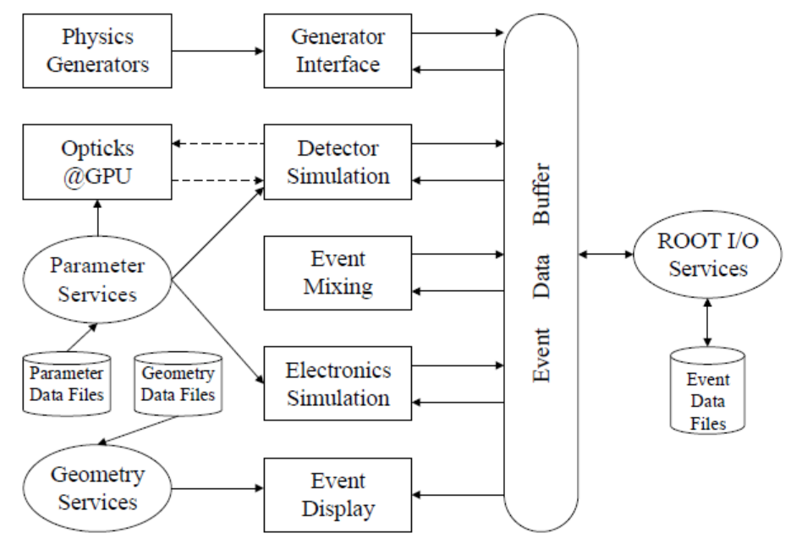
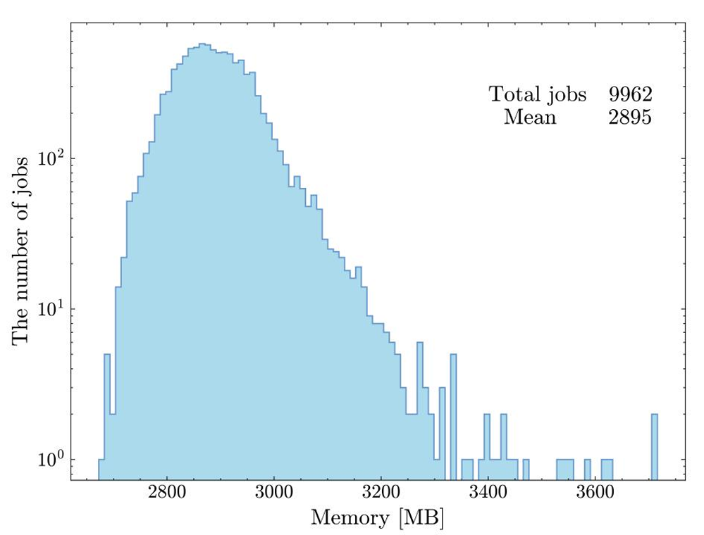
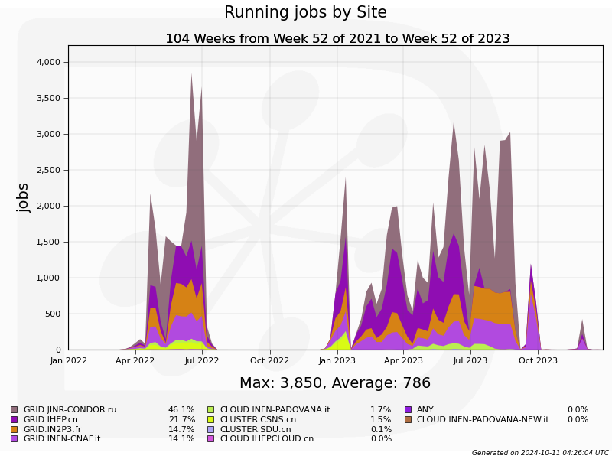
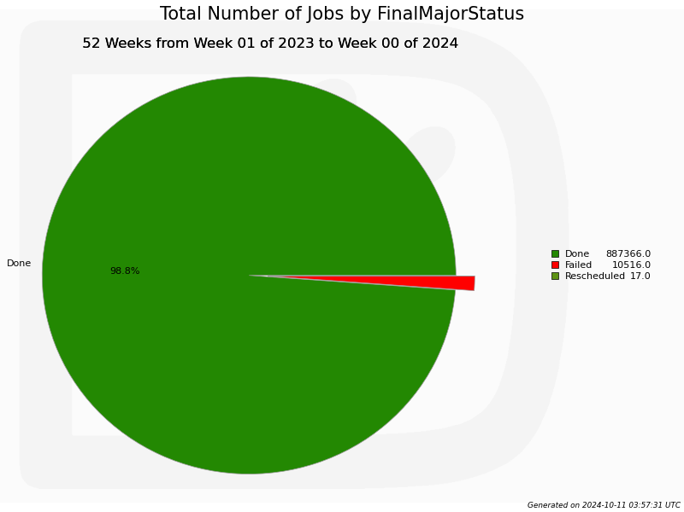
MC production
Detector Simulation:
  IBD: ~60 /day
  Radioactivity: MHz
  Atmospheric neutrino: hundreds per year
  Muon flux in LS: 4 Hz
Simulation of millions of optical photons present challenges in both memory and CPU time
Memory consumption of Muon simulation
High Energy:
Lots of light
Simulation data production tests done with ProdSys
  Simulate signal + background to mimic real data
  90% success rate, most failures from muon and atmospheric neutrino
  productions excluding high energy reached ~99%

Slide 29
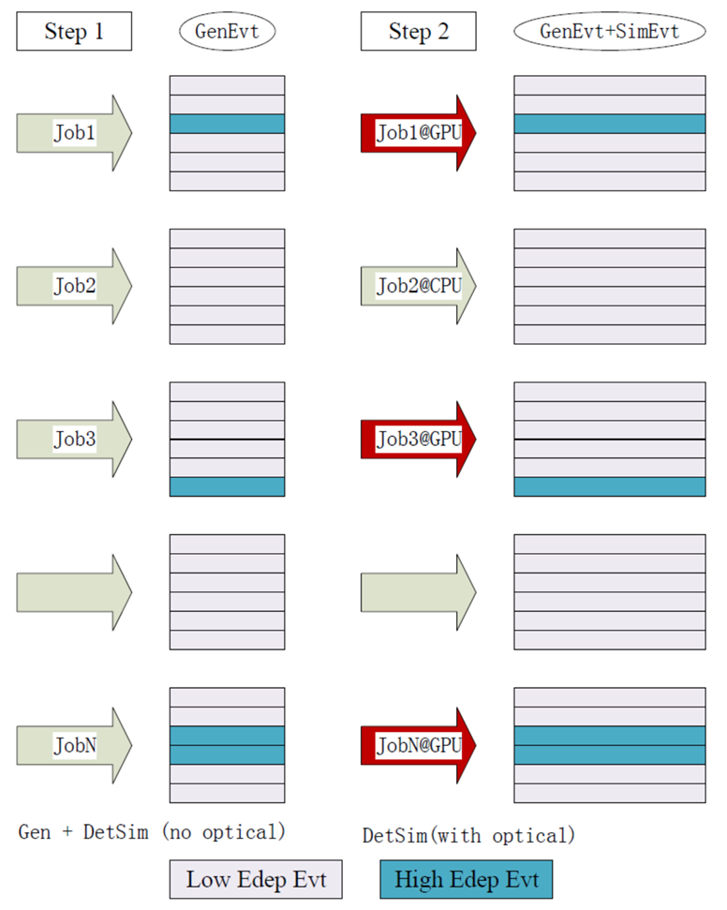
Parallelized MC production
To solve CPU and Memory problems
  Opticks@GPU speeds up simulation of high energy events
    JUNO muon simulation is highly limited by optical photons, with 99% CPU time consumed by photon simulation
    GPU processing with Opticks very beneficial with overall simulation speedups of 80-90x and reduce memory
  Multi-threaded DetSim implemented to decrease memory
    Greatly reduce memory footprint below 2GB/core
Implementation of CPU and GPU combine production in plan
  First preselection stage without optical to decide where jobs should run
  Second stage to submit jobs to proper CPU or GPU
  Efficient usage of GPU resource is a challenging part

Slide 30
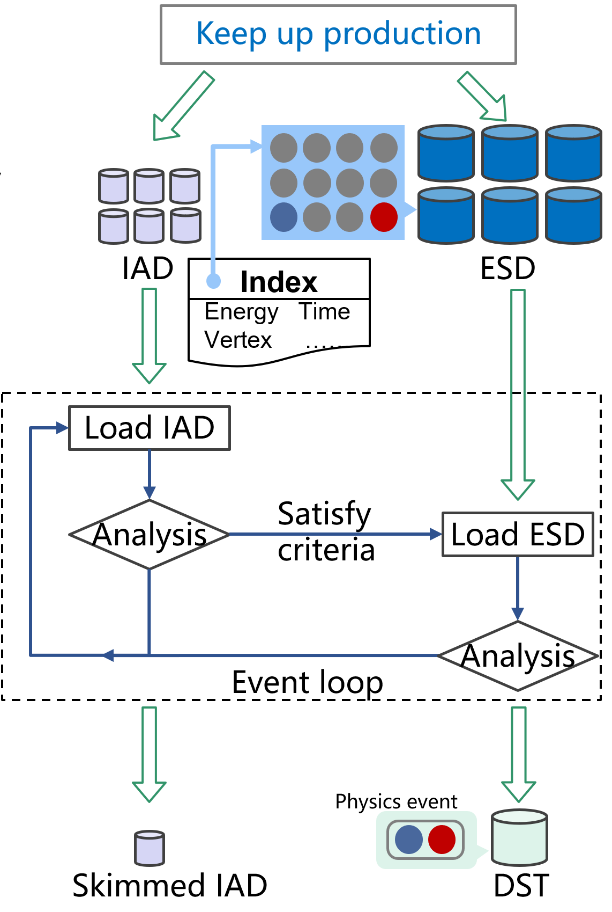
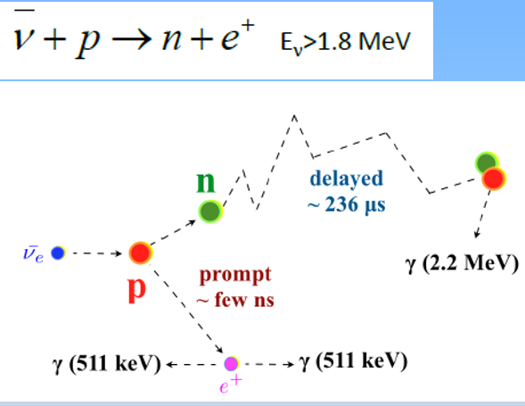
Analysis
Challenges of data analysis
  Event correlated in different time window
  Rare signals with large amount of backgrounds
Data analysis with IAD is proposed
  1. perform event pre-selection with IAD based on its key variables
  2. navigate back to the associated ESD and perform further selection
  Time correlation analysis could apply in both steps
Analysis facility for efficiency enhancement is both intriguing and demanding
prompt signal and delayed signal
within varying time window

Slide 31
Summary
JUNO is in LS filling, first data coming soon!
JUNO distributed computing system is operational
Data challenges: found bottlenecks and improved full chain
DCI has already been used for commissioning data transfer and MC simulation, the support of physics production and analysis could be next focus
Many improvements needed on operations, monitoring and management
Look forward to closer collaborations with JINR Group!
Notes:
Resource, ML and AI, analysis facility

