Slide 1

Methods of transformation of information signals for solving problems of crisis situation assessment
Ulizko Mikhail
Dubna, 2025

Slide 2

Prerequisites
An information signal is a text, video, and audio message that is dissiminated in a given information field.
A crisis situation is an unpredictable and critical escalation of contradictions, problems, or conflicts that disrupts the normal order of things, threatens the security, stability, and normal functioning of society, and requires immediate measures to resolve and overcome it*.
public
media
situation
* - Semenova V. N. Klassifikaciya krizisnyh situacij i osobennosti ih formirovaniya. M.: Moskovskij gosudarstvennyj tekhnicheskij universitet grazhdanskoj aviacii, 2013. S. 97–100 [In Russian]

Slide 3
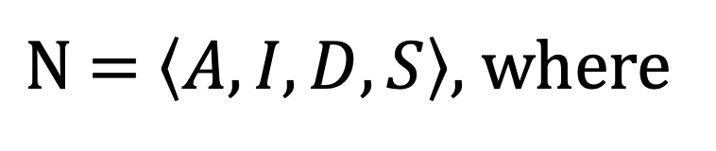
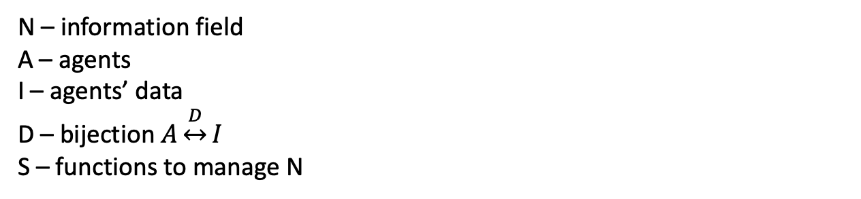
Model of an information field
$\text{N} \text{= }〈A, I,D, S〉,$ where
N – information field
A – agents
I – agents’ data
D – bijection $A\underset{↔}{D}I$
S – functions to manage N
Agents are:
users,
channel,
group,
community.
Agents’ data:
data (messages, feedback, reactions),
metadata (of both agents and their messages).
Agents can:
create message,
get message,
propagate message.

Slide 4
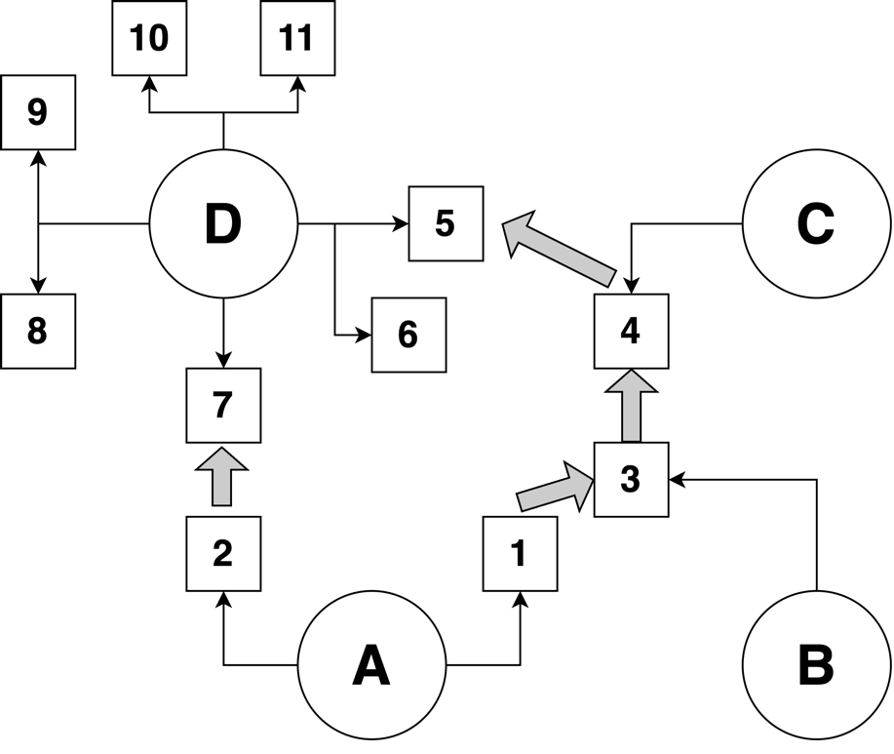
Example of Information field
Nodes:
А, B, C, D – agents
1, 2, …, 11 – messages
Edges (arcs):
A -> 1 – agent А created message 1
1 -> 3 – message 3 is a reaction for message 1

Slide 5
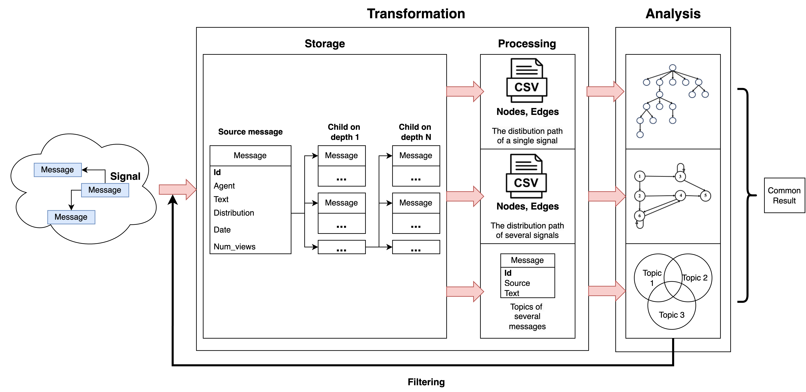
Data processing pipeline
Information field
Signal characteristics:
Agent id.
Message id.
Message text.
Time.
Views number.

Slide 6
Data processing pipeline
Information field
Signal characteristics:
Agent id.
Message id.
Message text.
Time.
Views number.

Slide 7
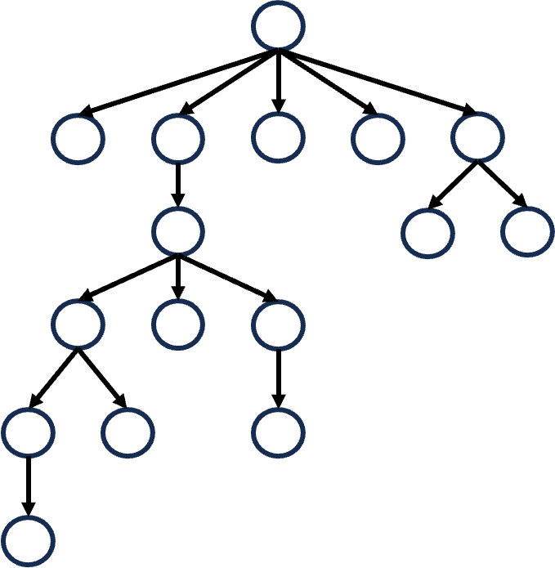
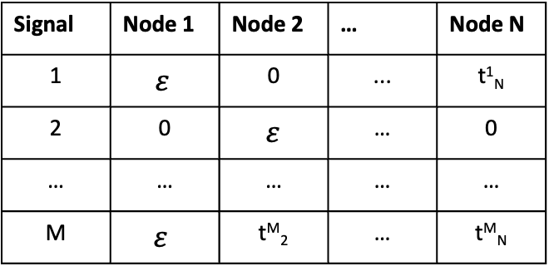
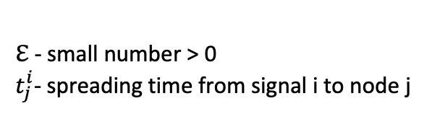
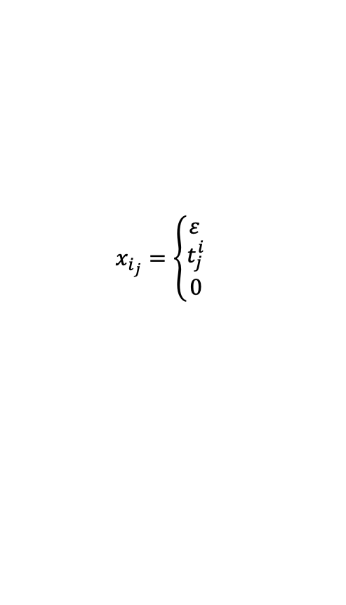
Dissemination path of a single message
Analysis of path
Path dissemination comparison
Critical path – consequence of nodes (agents) in dissemination path providing:
max coverage,
max depth,
max distribution speed.
а) unlabelled graph
б) labelled and weighted graph
Transform distribution path to:
Signal | Node 1 | Node 2 | … | Node N
1 | $$ε$$ | 0 | ... | t¹_{N}
2 | 0 | $ε$ | … | 0
… | … | … | … | …
M | $$ε$$ | t^{M}₂ | … | t^{M}_{N}
$$x_{i_{j}}=\left\{\begin{aligned}ε \\ t_{j}^{i} \\ 0\end{aligned}\right.$$
, node j – source of signal i
, node j – not source of signal i
, node j is not a part of signal i
Metrics – Levenshtein distance for string graph representation
ℇ - small number > 0
$t_{j}^{i}$- spreading time from signal i to node j

Slide 8
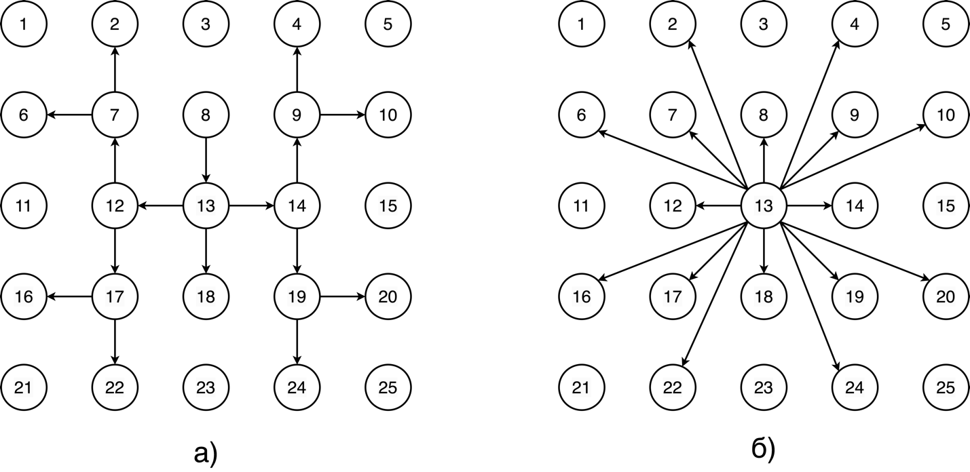
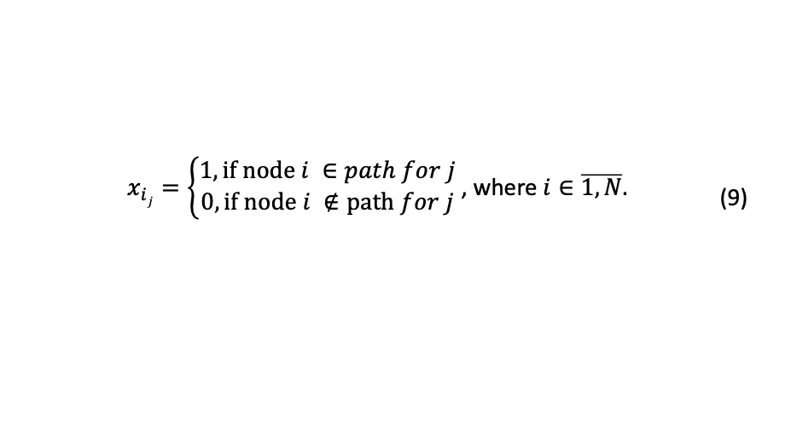
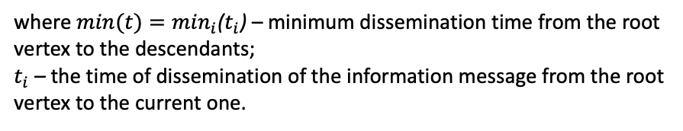
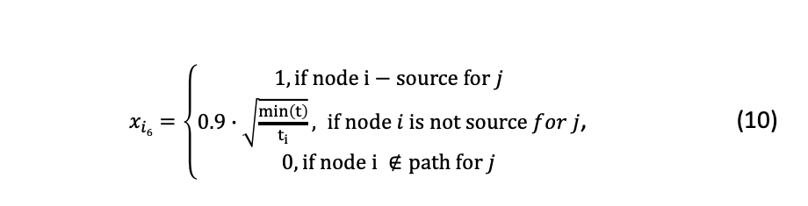
Labelled graph vectorizing
Dissemination nature
Graph vectorizing
For signal j:
a) for not weighted graph
$x_{ij}=\left\{\begin{aligned}1, if node i ∈path for j \\ 0, if node i ∉path for j\end{aligned}\right.$ , where $i∈\overline{1,N}.$ | (9)
$x_{i6}=\left\{\begin{aligned}1, if node i−source for j \\ 0.9∙\sqrt{\frac{\min\left(t\right)}{t_{i}}}, if node i is not source for j \\ 0, if node i ∉path for j\end{aligned}\right.$, | (10)
b) for weighted graph
where $min(t)=\min_{i}$($t_{i}$) – minimum dissemination time from the root vertex to the descendants;
$t_{i}$ – the time of dissemination of the information message from the root vertex to the current one.
cascading
broadcast
Cases are equivalent in terms of vectorizing.
Solving the sparse matrix problem :
Dimension reduction (autoencoder).
Clustering.
Visualization.

Slide 9
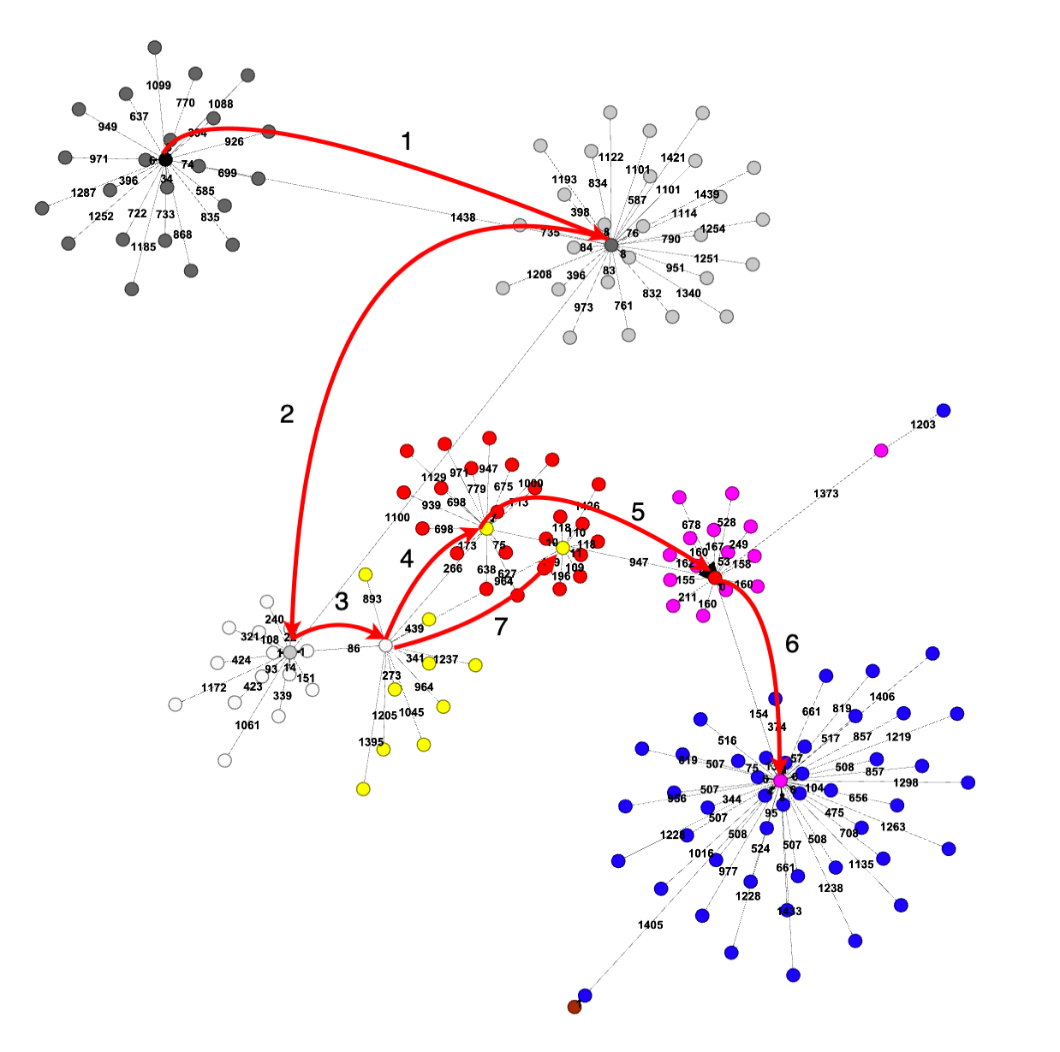
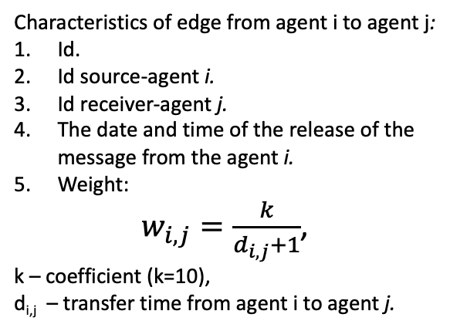
Dissemination path of a single message
а) graph representation of the information signal
Characteristics of agent j of the information signal i:
Id.
Agent.
The depth of the signal path i on which agent j is reached.
Propagation time from the original source to the current node.
Characteristics of edge from agent i to agent j:
Id.
Id source-agent i.
Id receiver-agent j.
The date and time of the release of the message from the agent i.
Weight:
$w_{i,j}=\frac{k}{d_{i,j}+1}$,
k – coefficient (k=10),
d_{i,j} – transfer time from agent i to agent j.
Key theses:
Critical path contains 7 nodes,
Average degree for significant nodes – 12,
Distribution time between agents: from 1 minute to 1 day.
б) string representation of the information signal
Recursive construction of a string representation.
Calculating the editorial distance between graphs.

Slide 10
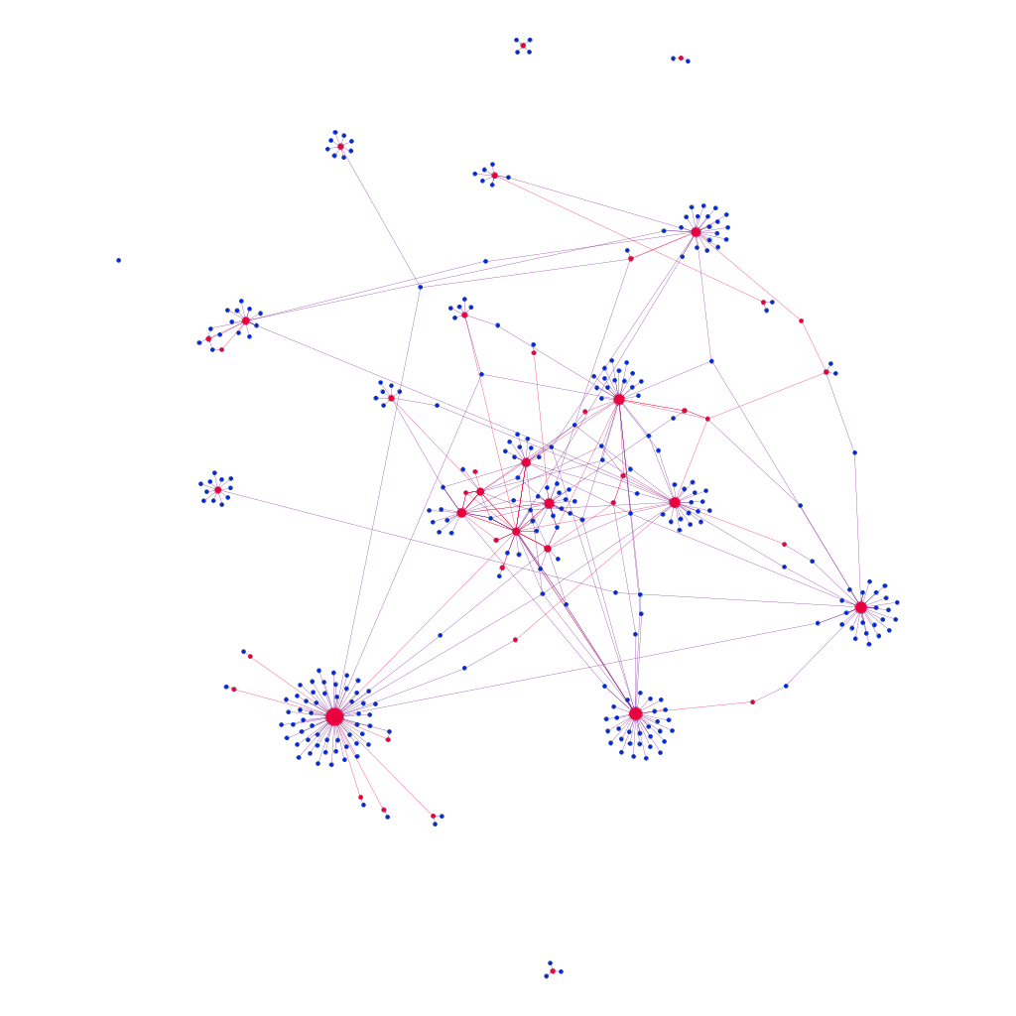
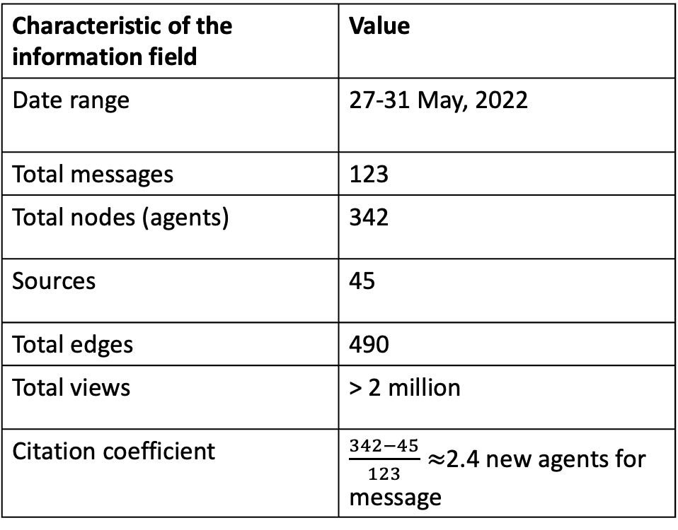
Dissemination of several messages – agents’ interactions field
Characteristic of the information field | Value
Date range | 27-31 May, 2022
Total messages | 123
Total nodes (agents) | 342
Sources | 45
Total edges | 490
Total views | > 2 million
Citation coefficient | $\frac{342−45}{123}≈$2.4 new agents for message

Slide 11
Types of objects (nodes and agents)
B
A
Network types:
A – main dissemination network
B – isolated network
C – agent’s network
Agents:
Source
Aggregator
dissemination link
Dead end agent
In terms of math:
In-degree > 1
Out-degree > 1
In-degree and out-degree > 1
In-degree = 1
C
Noise – nodes that are dead ends or part of an isolated network, and their adjacent edges.
* - arc (V_{i}, V_{j}) means that agent V_{i} cites agent V_{j}

Slide 12
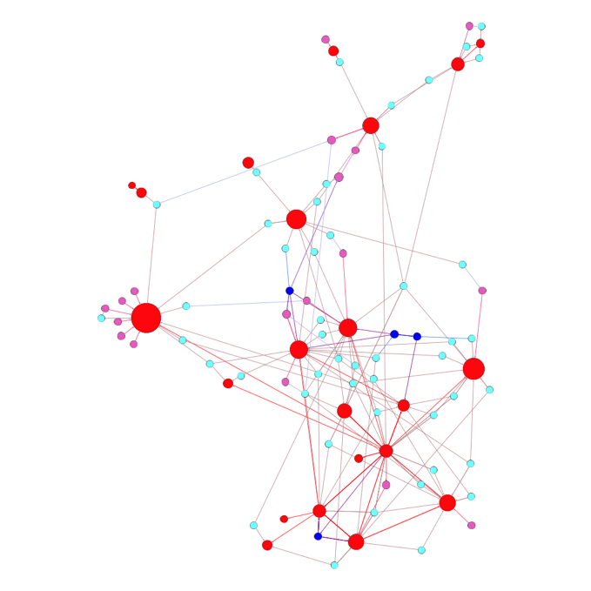
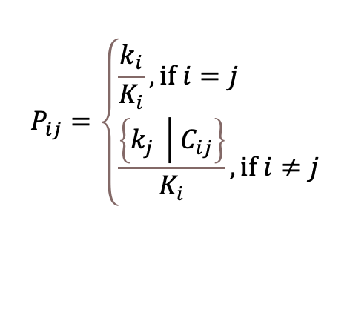
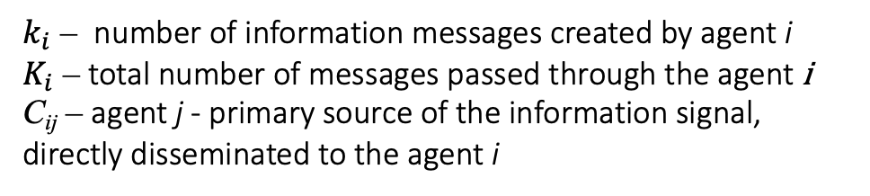
Active Information Dissemination Network
Active Information Dissemination Network– agent interaction network without noise.
Transforming the active distribution network to a Markov chain:
$$P_{ij}=\left\{\begin{aligned}&\frac{k_{i}}{K_{i}}, if i=j \\ &\frac{\left\{k_{j} \left| C_{ij}\right.\right\}}{K_{i}},if i≠j\end{aligned}\right.$$
(16)
$k_{i}$ – number of information messages created by agent i
$K_{i}$ – total number of messages passed through the agent i
C_{ij} – agent j - primary source of the information signal, directly disseminated to the agent i
Colors:
Red – source
cyan – aggregator
purple – dissemination link
blue – aggregator and dissemination link

Slide 13

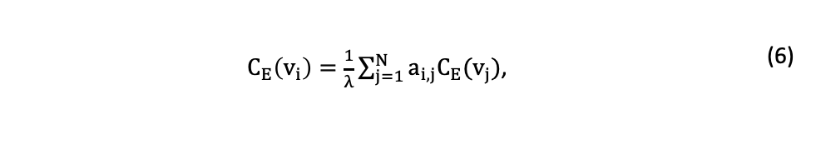

Identifying the most significant network objects
Visual
Analytical
Node centrality C(x) equals:
node degree / weighted node degree.
degree of closeness to other nodes according to the formula (4):
where d(x,y) – distance between x and y;
Betweenness centrality C_{b}x according to the formula (5):
where σ_{y,z} – number of shortest paths between nodes y and z;
σ_{y,z(}x) – number of shortest paths between nodes y and z passing through the node x.
Eigencentrality according to the formula (6):
where C_{E}(vi) – degree of influence of the node vi;
A = ||ai,j|| – adjacency matrix of the original network;
C_{E} – eigenvector of the matrix А;
λ – real number (the eigenvector C_{E} corresponding to the maximum eigenvalue is selected λ).
$$C\left(x\right)=\frac{1}{\sum_{y}{d(x,y)}}$$ | (4)
$C\left(x\right)=C_{b}\left(x\right)=\sum_{y≠x≠z}{\frac{σ_{y,z}(x)}{σ_{y,z}}}$, | (5)
$C_{E}\left(v_{i}\right)=\frac{1}{λ}\sum_{j=1}^{N}{a_{i,j}C_{E}(v_{j})}$, | (6)
1. Graph layout
2. Graph coloring

Slide 14
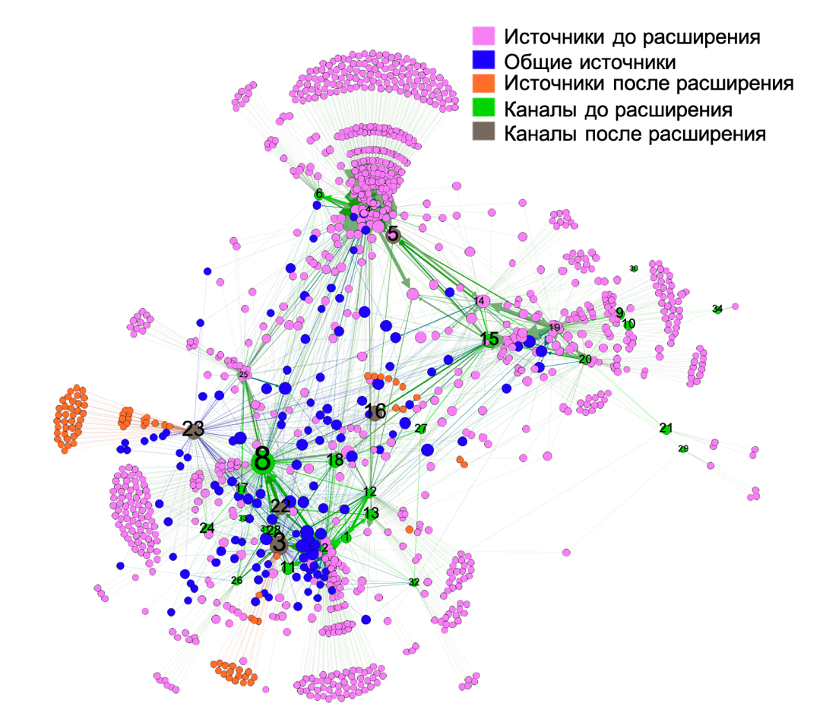
Evaluation of the agent interaction network
Agent characteristics:
Id.
Name.
Type (source, aggregator, dissemination link, dead end node).
Datetime of appearance in the network.
Characteristics of the edge from agent i to agent j:
Id.
Id of source i.
Id of receiver j.
Datetime of repost to agent j.
Вес:
  1 – accounting for multiple messages during visualization;
  W_{ij} = the number of information signals in the path of which there is a link from j to i.
Key theses:
agents “8”, “3”, “23” are opinions leaders,
number of deadlocks is over 50%,
iterative search for opinion leaders is possible.

Slide 15
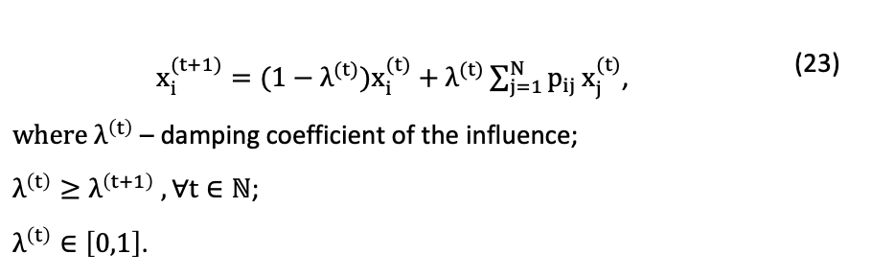
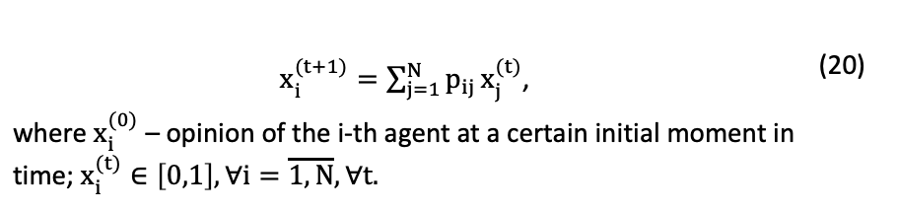
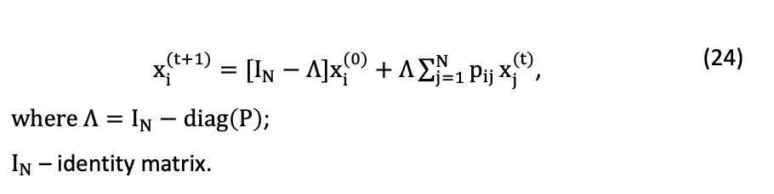
Determining the opinions of agents on the network
Theoretical description
Modeling resuls
Calculating the final opinions of agents on the network:
Example – the division of the Orthodox Church
a) dynamic opinion formation
Algorithm for calculating agent opinions:
1. Calculating the initial opinions of agents.
2. Calculation of the stochastic influence matrix P.
2.1. Converting K information signals into M edges.
2.2. Construction of an adjacency matrix for an arc-weighted digraph. The weight of the arc (X-Y) is equal to the number of arcs (X-Y) among M arcs. The weight of the arc (X-X) is equal to the number of its own published information messages.
2.3. Calculation of the matrix P – normalization of the adjacency matrix by rows.
3. Calculation of the agents' final opinion using the formula (20), (23) or (24).
$x_{i}^{(t+1)}=\sum_{j=1}^{N}{p_{ij}}x_{j}^{(t)}$, where $x_{i}^{(0)}$ – opinion of the i-th agent at a certain initial moment in time; $x_{i}^{(t)}∈\left[0,1\right], ∀i=\overline{1,N}, ∀t.$ | (20)
b) damping influence
$x_{i}^{(t+1)}={(1−λ}^{(t)})x_{i}^{(t)}+λ^{(t)}\sum_{j=1}^{N}{p_{ij}}x_{j}^{(t)}$, $where λ^{\left(t\right)}$ – damping coefficient of the influence; $λ^{\left(t\right)}≥λ^{\left(t+1\right)} , ∀t∈ℕ$; $λ^{\left(t\right)}∈\left[0,1\right]$. | (23)
c) objects that are insensitive to influence
The results show that using formula (20) to recalculate the agent's opinion allows a larger number of agents to reach consensus, and formula (23) allows agents to remain "colored" (positive or negative) in their opinion to the maximum extent.
$x_{i}^{(t+1)}=[I_{N}−Λ]x_{i}^{(0)}+Λ\sum_{j=1}^{N}{p_{ij}}x_{j}^{(t)}$, $where Λ=I_{N}−diag\left(P\right)$; $I_{N}$ – identity matrix. | (24)

Slide 16
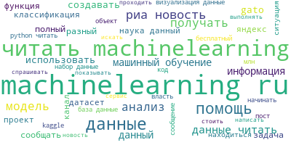
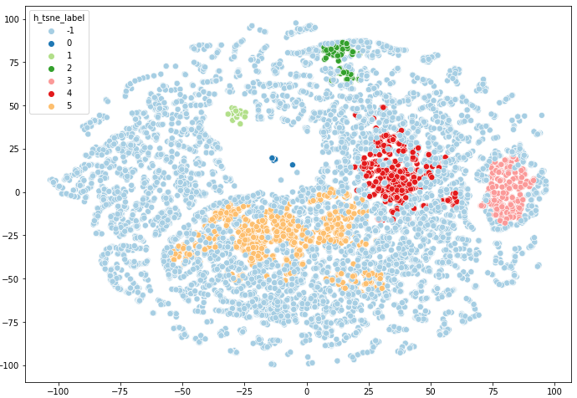
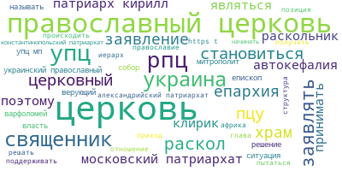
An active thematic information dissemination network
Network’s properties:
1. Information field consists of several topics.
2. information field contains from 1 to several sources.
Topic 1
Topic 1
Topic 2
Clustering
Visualization
Topic 3
Topic 2
Visualizing messages/topics together
Visualizing topic separately

Slide 17
tasks of information dissemination network assessment
Activity* of agents
Сводная таблица агентов и тематик
 | Agent 1 | Agent 2 | Agent 3 | Agent 4 | Agent 5
Total | 4591 | 619 | 493 | 8535 | 7475
With text | 3953 | 122 | 492 | 7901 | 6404
Repost | 1785 | 497 | 1 | 4979 | 2543
 | Agent 1 | Agent 2 | Agent 3 | Agent 4 | Agent 5
Topic 1 | 117 | 8 | 324 | 6165 | 3
Topic 2 | 57 | 952 | 220 | 85 | 0
Topic 3 | 441 | 140 | 674 | 12 | 18
Topic 4 | 646 | 22 | 2340 | 86 | 1
Topic 5 | 323 | 48 | 513 | 8 | 3
Topic 6 | 919 | 2 | 1543 | 21 | 1
Key theses:
Agents 1, 4, 5 – have the highest activity.
Agent 2 cites messages without text.
Agent 3 trust only to himself.
Agents 2,4 are aggregators.
Key theses:
Agents 1, 3 writes on several topics.
Agents 2, 4 writes on one topic.
Agent 4 is a leader of topic 1.
Agent 5 is not representative.
Topics 4-6 are correlated.
* Activity is a number of published messages

Slide 18
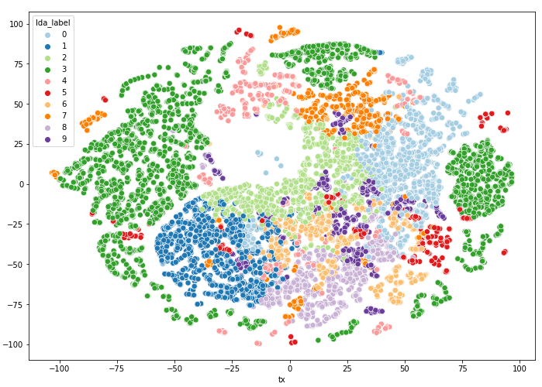
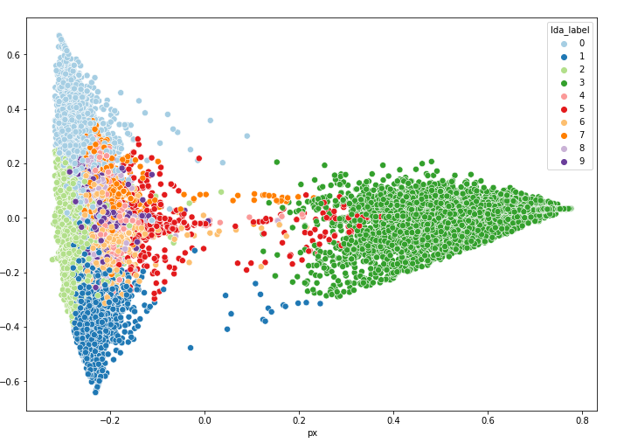
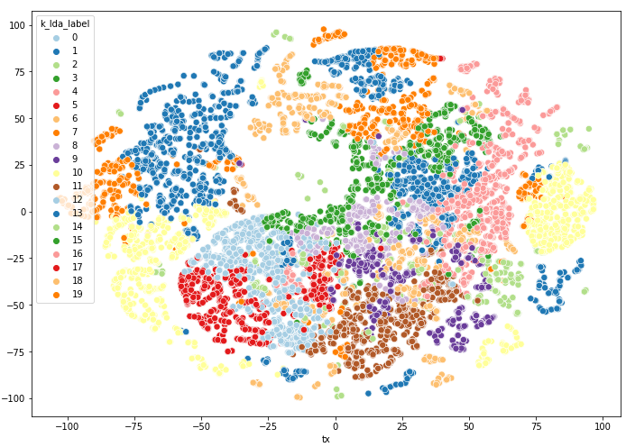
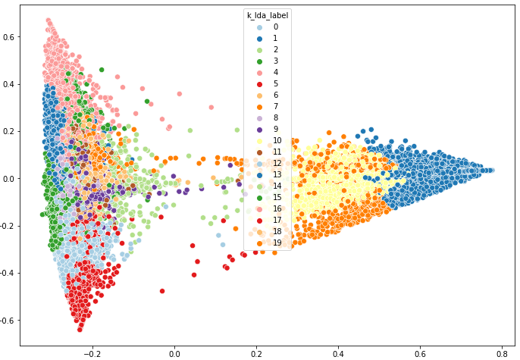
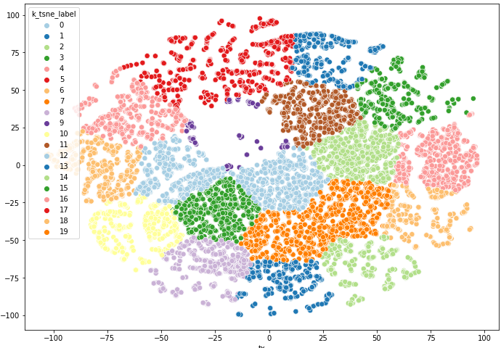
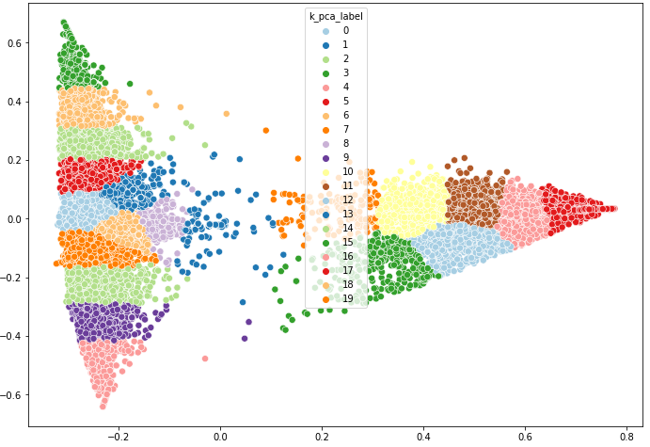
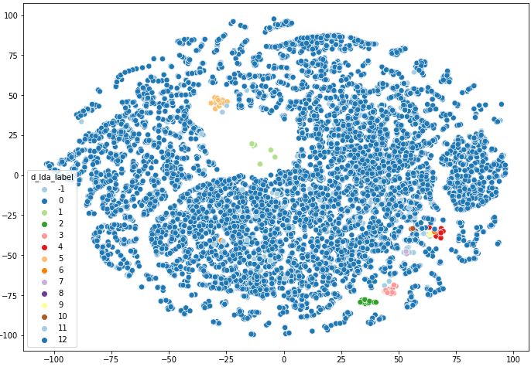
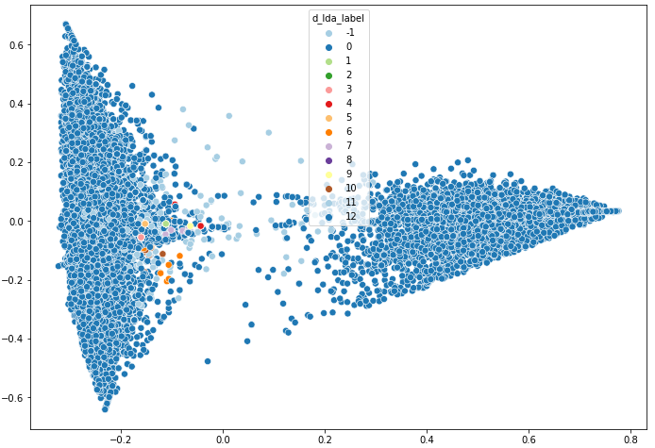
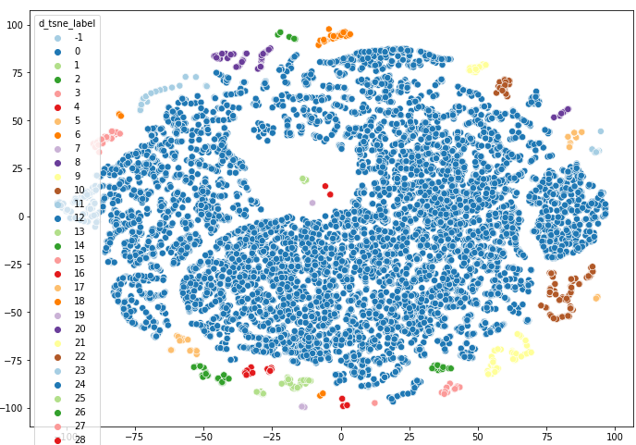
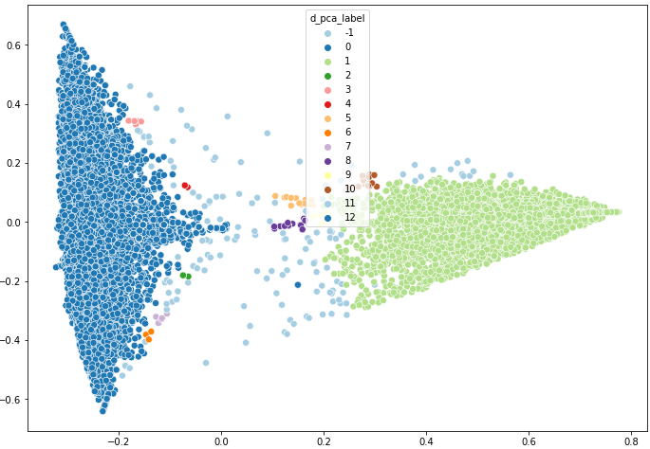
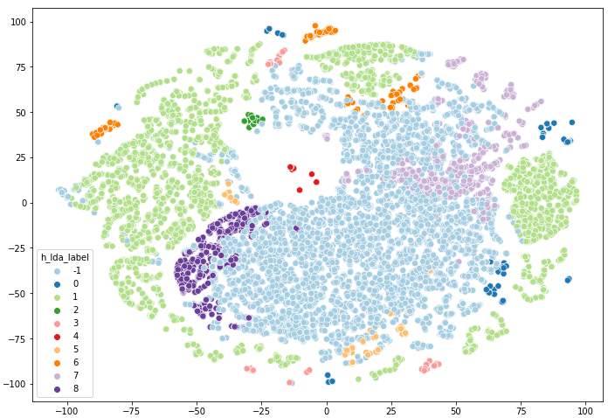
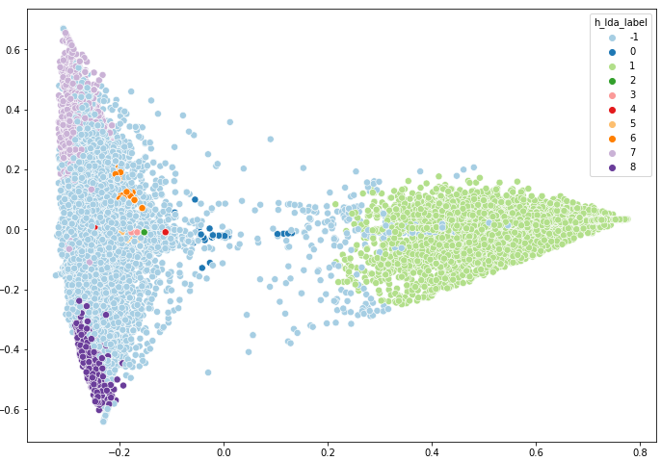
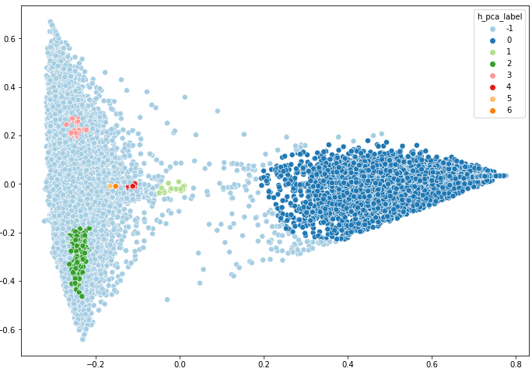
Clustering results
LDA (t-SNE)
LDA (PCA)
K-means (t-SNE)
K-means (PCA)
t-SNE + K-means
PCA + K-means
DBSCAN (t-SNE)
DBSCAN (PCA)
t-SNE + DBSCAN
PCA + DBSCAN
HDBSCAN (t-SNE)
HDBSCAN (PCA)
t-SNE + HDBSCAN
PCA + HDBSCAN

Slide 19
Conclusion
The assessment of the crisis situation analysis is reduced to the analysis of the information field in three directions: consideration of individual information signals, information signals in aggregate and thematic focus.
Methods of information signal transformation have been developed to consider individual information signals, information signals in combination, and thematic focus..
Data processing software has been developed to solve analytical problems of detecting the most significant agents for assessing influence and publication activity.
The research requires future work in terms of summing up the results of three separate parts

Slide 20
Methods of transformation of information signals for solving problems of crisis situation assessment
Q & A
Ulizko Mikhail
Dubna, 2025

