Slide 1
11th International Conference "Distributed Computing and Grid Technologies in Science and Education" (GRID'2025)
Systems Approach to Developing a Learning Environment in AI Engineering
By Evgenia Cheremisina, Anna Milovidova, Elena Kirpicheva
Institute of the system analysis and management, Dubna State University
July 11, 2025

Slide 2
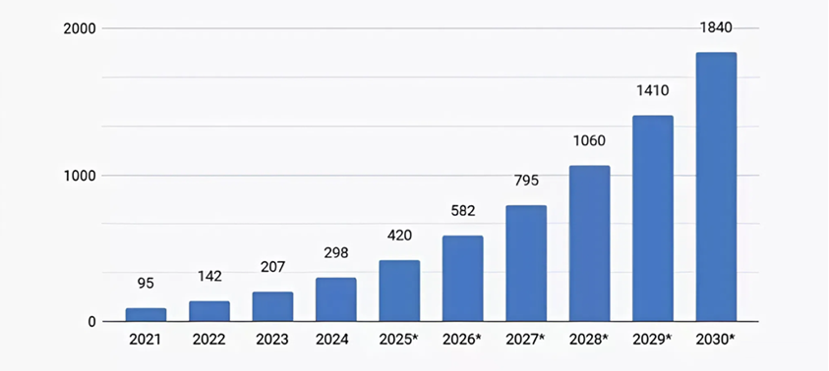
Global AI Market Size (2021-2030)
*In billions of USD, *— forecasted values
Искусственный интеллект в России: динамика рынка, ключевые тренды и перспективы роста — https://marketing.rbc.ru/articles/15893/

Slide 3
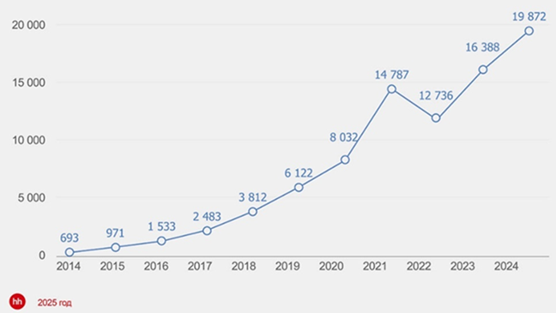
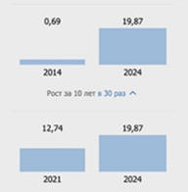
Dynamics of Active Job Openings in Data Analysis and Machine Learning
Russia, 2014–2024
Active Job Openings (thousands)
Growth by 2.5 Times Over the Past 4 Years
Динамика активных вакансий в сфере анализа данных и машинного обучения в России за 10 лет —
https://expertjob.ru/blog/dinamika-vacancy-v-sfere-ml-data-scientist-v-rossii-2014-2024

Slide 4
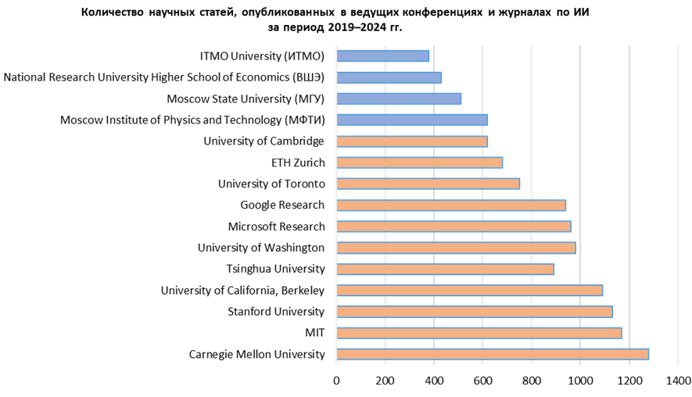
Number of Scientific Articles Published in Leading AI Journals (2019–2024)
CSRankings: Computer Science Rankings — https://csrankings.org/#/fromyear/2010/toyear/2025/index?all&ru

Slide 5
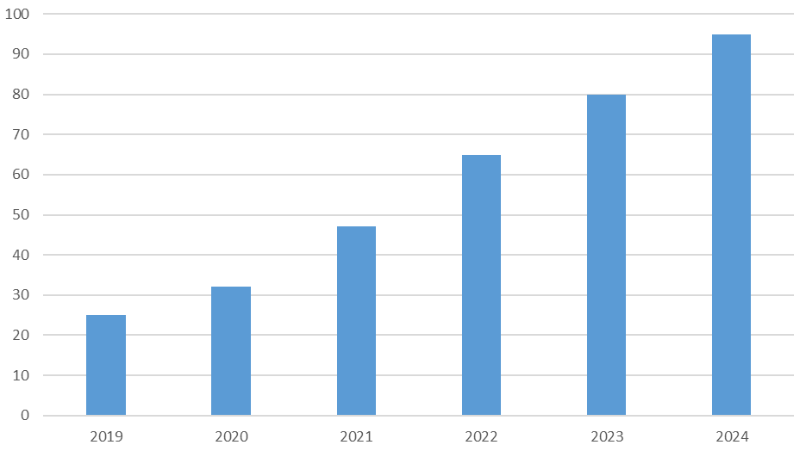
Number of Universities Offering AI Programs (2019-2024)
Национальная стратегия развития искусственного интеллекта на период до 2030 года (ред. 2023 г.). Сборник нормативных документов —http://publication.pravo.gov.ru/Document/View/0001202310110001

Slide 6
Additional Competencies for an Artificial Intelligence Systems Developer
Ability to classify and identify AI-related tasks, and to select appropriate methods and tools for their solution.
Proficiency in developing and testing software components of AI systems.
Capability to perform conceptual modeling and knowledge formalization in AI systems.
Application of machine learning methods and relevant tools for their implementation.
Development and maintenance of AI systems based on neural network models and methods.
Data collection, preprocessing, and development of big data analytics systems for AI applications.
Design and implementation of digital AI sub-technologies.

Slide 7
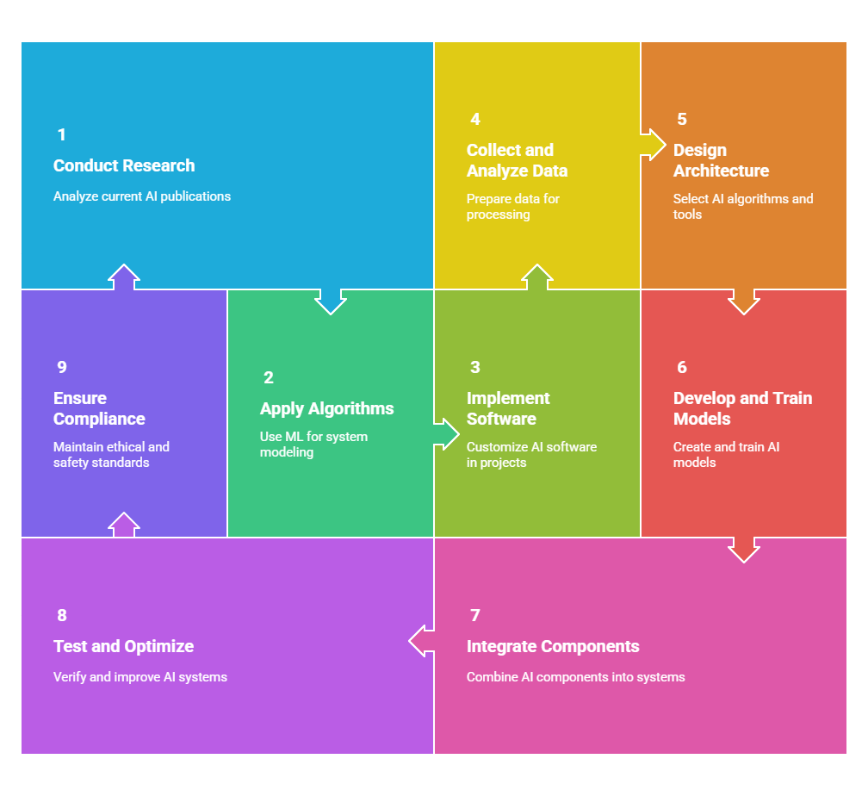
Graduate Competencies
In 2023, University “Dubna” introduced a new Bachelor's program in Computer Science and Engineering, specializing in Artificial Intelligence Systems Engineering — designed to prepare students for careers in cutting-edge AI technologies.

Slide 8
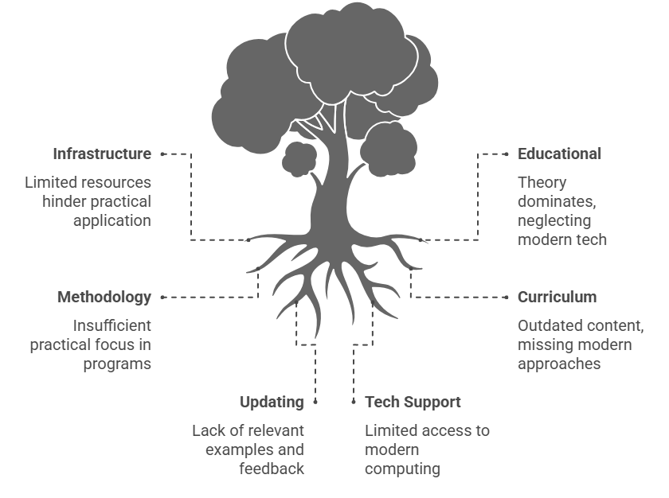
Problem Identification

Slide 9
Analysis of Real Job Requirements for IT Specialists in the Field of AI
Required Skills | Frequency of Mention
Programming experience in Python | 95%
Knowledge of machine learning and deep neural networks | 90%
Experience with libraries such as TensorFlow, PyTorch, Scikit-learn, Keras | 90%
Understanding of data processing and analysis methods | 85%
Data visualization skills | 80%
Experience in solving tasks related to natural language processing (NLP) and computer vision (CV) | 85%

Slide 10
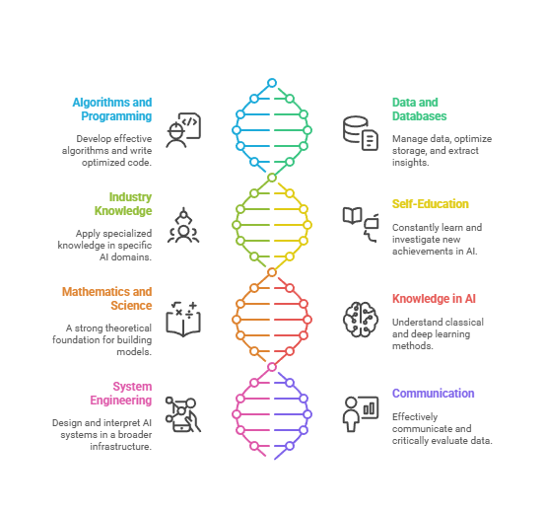
Key Skills and Responsibilities

Slide 11
Systemic Approach to Learning AI Systems Engineers
The learning of AI systems engineers is based on a systemic approach that integrates multiple levels of requirements and practices:
Macroscopic Environment:
Alignment with labor market demands (analysis of real job postings) and federal educational standards set by the Ministry of Education ensures relevance and compliance with national priorities.
Microscopic Environment:
Engagement with technological partners through real-world case studies, tools, and platforms fosters industry-oriented learning and practical skill development.
Internal Academic Practices:
Teaching is enhanced through faculty expertise, the implementation of project-based learning, the integration of AI engineering research into the curriculum, and the use of a virtual computer lab that provides access to modern software tools and simulation environments regardless of students’ physical location.
This integrated approach ensures that graduates possess both theoretical foundations and practical competencies demanded by the evolving field of artificial intelligence.

Slide 12
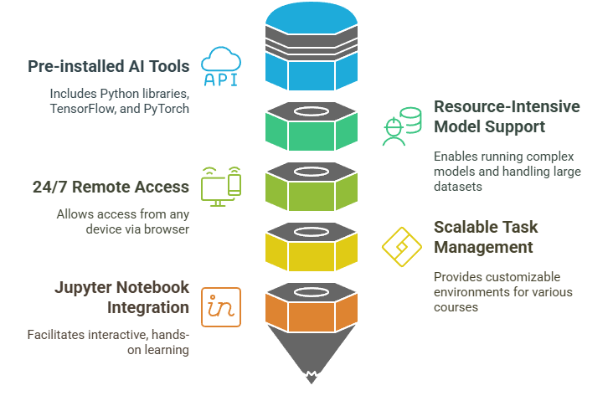
Educational Infrastructure Built on a Virtual Computer Laboratory
The Virtual Computer Lab (VCL) is a cloud-based infrastructure that provides students and instructors with access to a preconfigured environment for learning and practical work in artificial intelligence technologies. The lab runs on high-performance computing resources and is accessible via a web interface without the need to install software locally.
The VCL is integrated into the educational process and enables effective delivery of practice-oriented assignments, including case studies in neural networks, data analysis, and computer vision.

Slide 13
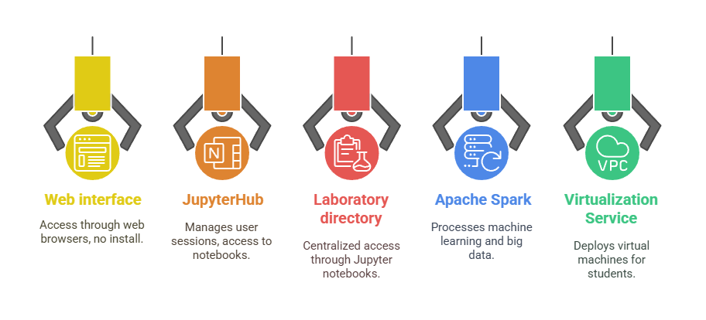
System Components

Slide 14








Technology Stack
Python
The primary programming language for developing and training AI models
TensorFlow
A framework for building and training neural networks
PyTorch
A deep learning library with dynamic computational graphs
OpenCV
A library for image processing and computer vision
YOLO
An algorithm for fast object detection in images and videos
Rasa
A platform for building intelligent chatbots
Apache Spark
A framework for distributed computing and big data processing
Keras
A high-level API for rapid prototyping of neural networks

Slide 15
Example Cases
Case | Achievement Indicators
1. Neural Network Basics (Perceptron, Activation Functions) | Understanding the structure of simple neural networks; ability to implement a perceptron in Python; proficiency in classification methods
2. Gradient Descent and Optimization | Knowledge of model training principles; ability to implement gradient descent and visualize the optimization process
3. Backpropagation | Understanding of backpropagation; ability to manually compute gradients and train two-layer networks
4. Overfitting and Activation Functions | Knowledge of overfitting causes; ability to select activation functions and evaluate model generalization
5. Dropout, BatchNorm, LeNet-5 | Knowledge of regularization methods and CNNs; ability to implement convolutional networks and improve their robustness
6. Deep CNNs and Transfer Learning | Knowledge of transfer learning; ability to adapt pre-trained models to new tasks
7. YOLO for Object Detection | Knowledge of YOLO architecture; proficiency in real-time object detection tools
8. Text Analysis with Transformers | Knowledge of BERT and transformer models; proficiency in using Hugging Face for text processing and classification
9. Chatbot Development (Rasa) | Understanding of dialogue system principles; ability to implement logic-driven chatbots with Rasa
10. Generative Models (NST, Fine-tuning) | Knowledge of generative approaches; proficiency in Neural Style Transfer and model fine-tuning
11. LSTM and GRU for Texts | Knowledge of RNN architectures; proficiency in applying them for text analysis and generation
Big Data Processing (Apache Spark, Hadoop) | Knowledge of distributed computing; proficiency in using Big Data tools for AI tasks

Slide 16
Pilot Testing and Feedback Collection
Based on 1,064 responses:
Overall User Satisfaction Score: 87.5%
Highlights:
• Strong approval of structure and clarity
• Suggested enhancements collected

Slide 17
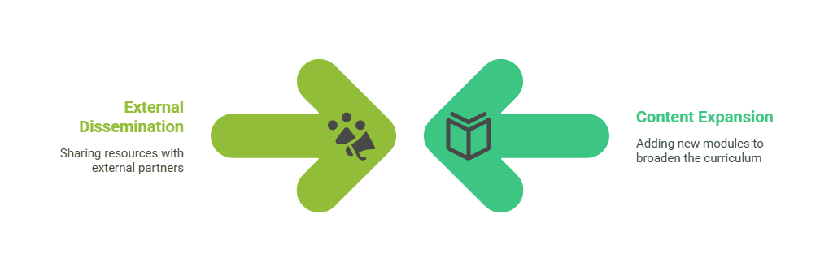
Advantages of the Learning Infrastructure Based on a VCL
🔗 Bridges the gap between theory and practice. Enables students to apply their knowledge to real-world tasks
🌐 Web-based access. No need to install software — accessible directly via browser
🎓 Unified learning environment. Equally available to students and instructors, streamlining interaction
📈 Scalable and flexible. Easily extendable — new tasks and modules can be added
📍 24/7 remote access. Work from anywhere and on any device
🧩 Versatile application. Suitable for various disciplines, courses, and training formats

Slide 18

📩 Let’s connect
📧 Contact: Milanna@uni-dubna.ru, +7-968-931-04-85
We welcome partnerships, feedback, and discussion on the future of AI systems engineering education.

