Slide 1
Virtual multi-tier storage system
Evgeniy Ibatullin and Alexander Bogdanov
St. Petersburg University, St. Petersburg, Russia
11-я международная конференция «Распределенные вычисления и Grid-технологии в науке и образовании» (GRID’2025) ЛИТ им. М.Г. Мещерякова, ОИЯИ, г. Дубна, 10 июля 2025 года

Slide 2
Changing field of BigData
To keep up with business requirements, data storage systems are under continuous development.
Today’s systems are capable of:
Using distributed computing
Working with both structured and unstructured data
Providing reliable data storage
However, they lack the ability to integrate widely distributed data sources across multiple organizations.

Slide 3
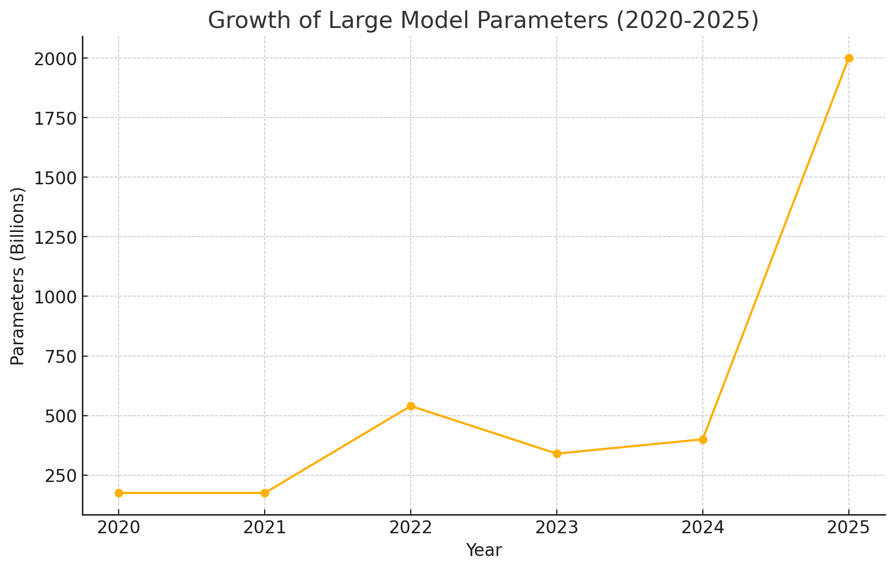
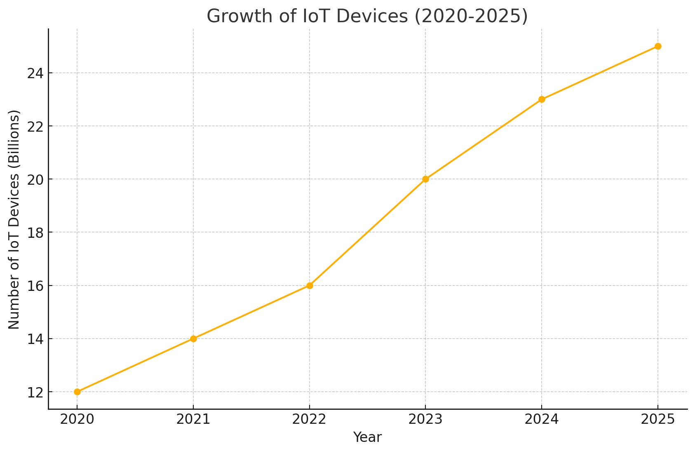
Are we keeping pace with Big Data growth?
Data consumer
Data provider

Slide 4
What is a DataMesh?
It is a multilayer system with logical virtualization, enabling consumers to access data without knowing the internal architecture or storage locations.

Slide 5
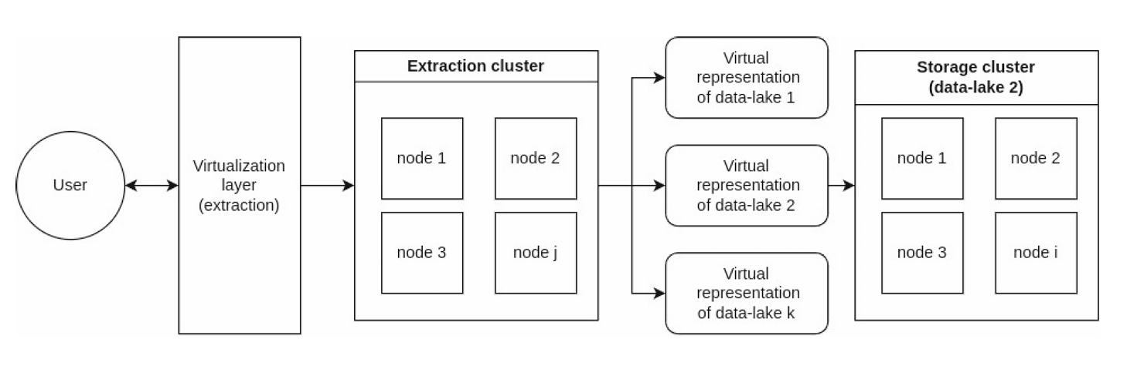
Example of a simple DataMash
Representation of the DataMesh architecture

Slide 6
Key technologies
Cloud technologies:
Container clusters are the most agile and adaptive solution, replacing virtual machines.
Cluster managers automate management to ensure high availability.
Microservice architecture let us provide necessary modules to system when needed
Multi layer systems:
Grid system demonstrate how to integrate processes across organizations.
Hierarchical storage systems have proven more scalable than simple distributed systems.
Logical Virtualization allows us to hide system layers from consumers.

Slide 7
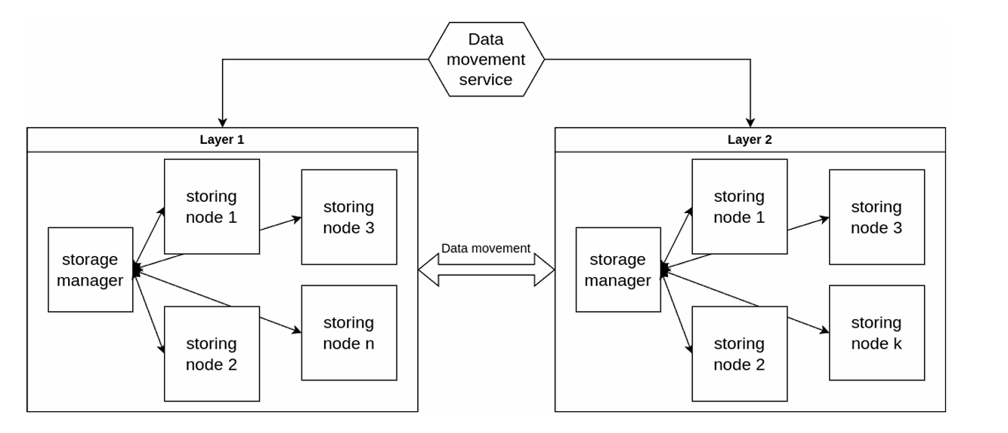
Example of data-site
Architecture of a node inside of DataMash

Slide 8
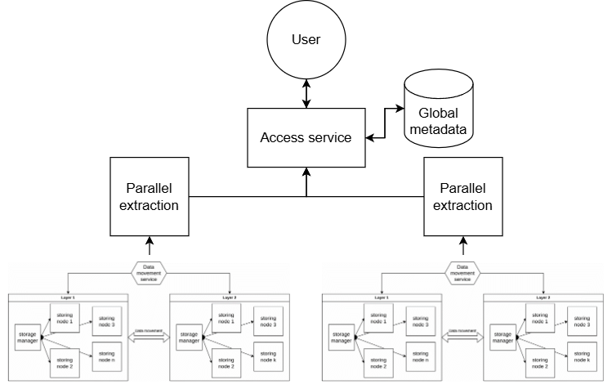
How do integrate nodes into DataMash
We introduce another level of logical virtualization that unites each independent storage system into a single, large‑scale storage fabric.
Practical DataMesh architecture

Slide 9
The benefits of the system
This system is based on proven cloud technologies, making it agile and highly available.
Each layer can be implemented with any technology that meets specific requirements.
The system is highly reconfigurable to fit any organization’s needs.
The system is designed to support massive data volumes without depending on a single data representation.

Slide 10
World is changing
There are new demands in data storage systems we want to satisfy, such as international experiments and large language models.
We believe the evolution of big data is moving toward grid and cloud technologies, hence our storage systems must adapt accordingly.

Slide 11
Conclusion
By building upon established technologies while introducing novel integration approaches, this architecture paves the way for more comprehensive, efficient, and adaptable data processing ecosystems.

