Slide 1
11th International Conference
"Distributed Computing and Grid Technologies in Science and Education"
(GRID’2025)
The Structure of a distributed System for Ensuring Reliable Security in IoT
Evelyne Hakizimana
Saint Petersburg State University
10th , July, 2025

Slide 2
The Problem Statement
The rapid expansion of the Internet of Things (IoT) in Africa has brought breakthrough advances in the security of distributed systems management.
However, this growth has also brought unparalleled security vulnerabilities, and distributed denial of service (DDoS) attacks have become a key threat to the IoT ecosystem.
Existing detection systems are often not adaptive, lack distribute(parallel) response, and struggle with unknown threats.
There is a need for an intelligent, parallel, and scalable solution to secure IoT ecosystems against evolving DDoS threats.

Slide 3
Objectives of the Study
Develop an adaptive intelligence framework for parallel detection of DDoS attacks in IoT environments.
Integrate advanced machine learning models including LSTM(Long Short-Term Memory), SOM(Self-Organizing Map), and ART(Adaptive Resonance Theory) to improve detection performance.
Evaluate the system using standard metrics like F1-score, precision, and recall.
Compare the proposed framework with existing detection methods to assess effectiveness.
Address the unique security challenges of emerging IoT markets, especially in resource-constrained regions like Africa.

Slide 4
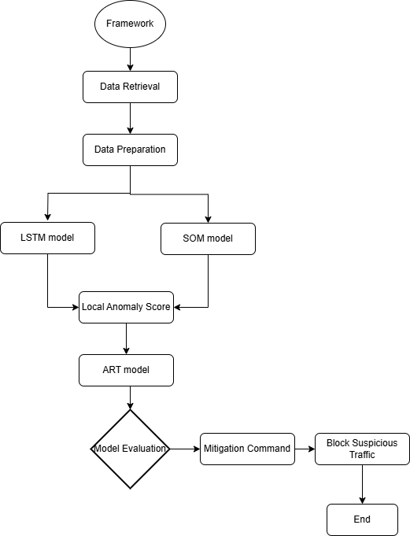
Methodology (Overview & Key Algorithms)
Long Short-Term Memory
LSTM can distinguish between malicious and genuine communication by applying temporal features it has learned.
Self-Organizing Map
SOM maps network behaviour to identify anomalies in our distributed system security; outliers signify DDoS attacks, while typical activity forms clusters.
Adaptive Resonance Theory
A neural network model called ART was created for reliable pattern identification and categorization. It enables the system to adapt to novel patterns without losing sight of previously acquired information.

Slide 5
Detection Workflow & Evaluation
1. Parallel Processing at the Edge
Each IoT device independently analyses its own traffic in parallel.
LSTM detects time-based anomalies; SOM clusters behaviour patterns.
Fast local detection with no raw data transmission ensures privacy and low latency.
2. Distributed Detection Architecture
Devices send only alerts (not data) to the central system if local anomaly scores exceed a threshold.
Reduces bandwidth use, avoids bottlenecks, and ensures fault tolerance.
3. Centralized Threat Verification
A central ART model correlates alerts from multiple devices.
Detects large-scale attacks vs isolated issues; adjusts sensitivity dynamically to reduce false positives.
4. Distributed Mitigation Response
Upon attack confirmation, mitigation commands are sent out.
Each device executes localized actions (e.g., isolation, filtering).
Ensures resilience, scalability, and uninterrupted protection.

Slide 6
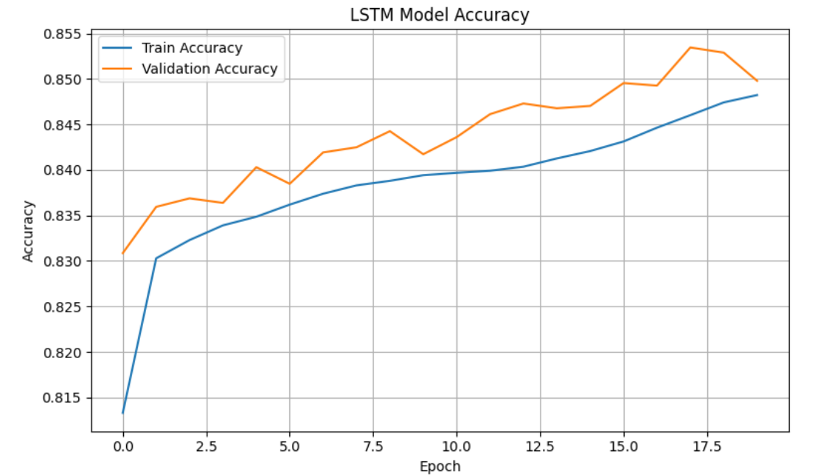
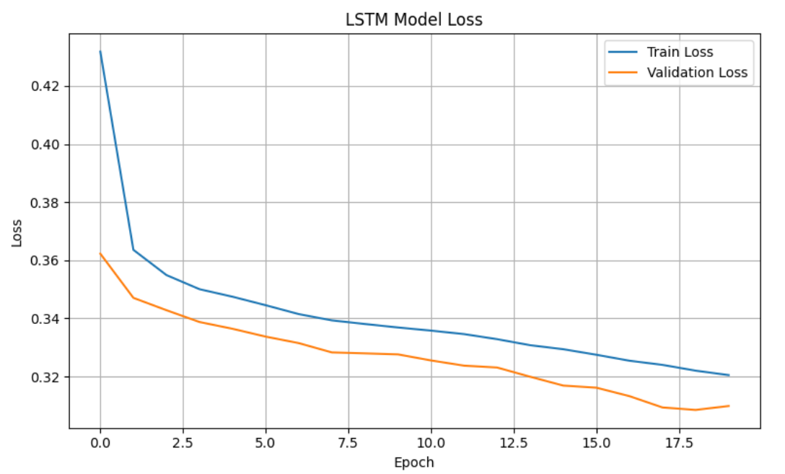
  Accuracy and Loss of LSTM model

Slide 7
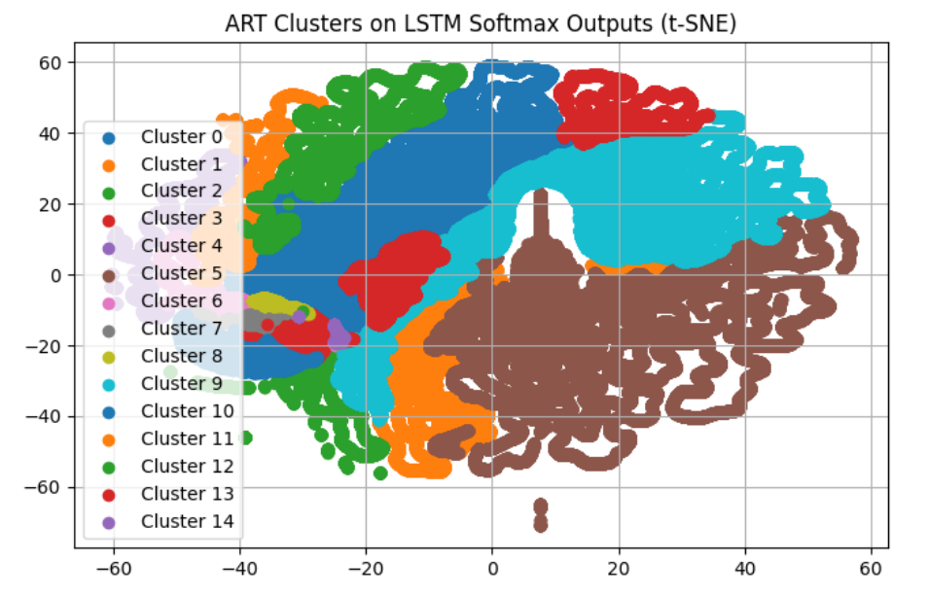
ART Clusters on LSTM SoftMax Outputs

Slide 8



Conclusion
Challenges Faced
Dynamic and Evolving Attack Patterns
Parallel Processing Constraints
Integration Complexity.
Lessons Learned
Hybrid Approaches Yield Better Results
Preprocessing is Crucial
Adaptivity Enhances Resilience
Evaluation Metrics Must Be Balanced
Future Work
Broader Deployment Across IoT Domains
Integration with Automated Mitigation Systems
Model Optimization for Edge Devices

Slide 9
“Every connected device is a door; without a lock, it’s an invitation.”
“The smarter our devices become, the more careful we must be.”
Thank you for your attention!

