Slide 1

Hybrid Continuous Authentication System Based on Risk Analysis and Keystroke Biometrics
by Iurii Matiushin, Saint Petersburg State University
and Vladimir Korkhov, PhD, Saint Petersburg State University

Slide 2
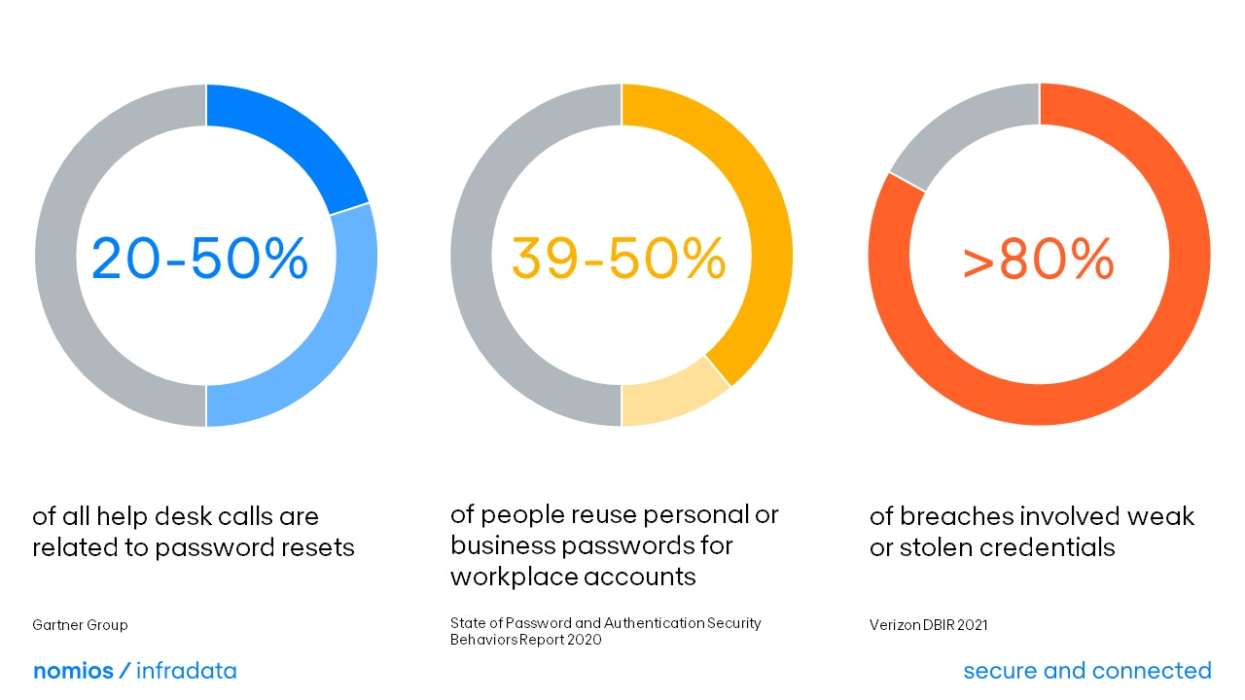
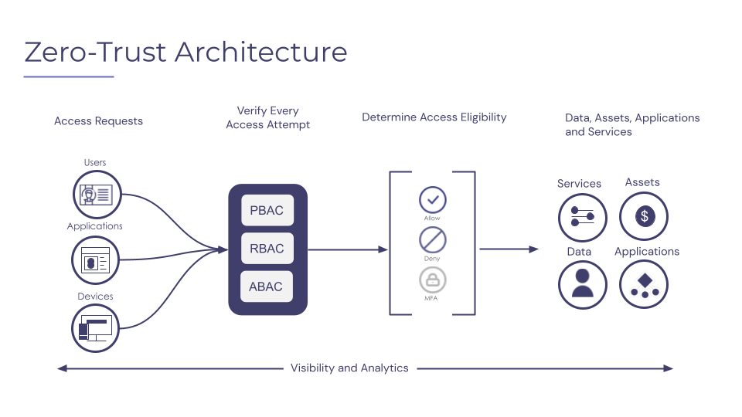
Introduction & motivation
The authentication challenge: most security breaches involve compromised authentication. Traditional methods (passwords, PINs) are no longer sufficient.
Zero Trust: “never trust, always verify” – assume no user or device is trustworthy by default.
Continuous authentication (CA): authenticate not just once, but throughout the session.
https://www.nomios.com/news-blog/password-problem
https://www.skyflow.com/post/what-is-zero-trust

Slide 3
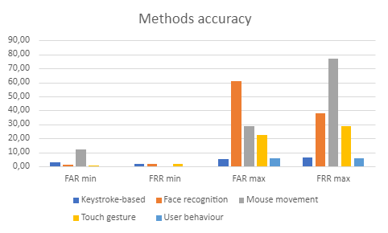
CA methods
Multiple approaches to continuous authentication have been developed.
Our prior research identified keystroke recognition and user behavior-based (risk-based) authentication as especially accurate.
Developing hybrid authentication methods is a promising direction, especially when faced with a variety of new attacks on CA systems.
Matiushin, I., Korkhov, V. (2023). Continuous Authentication Methods for Zero-Trust Cybersecurity Architecture. In: Gervasi, O., et al. Computational Science and Its Applications – ICCSA 2023 Workshops. ICCSA 2023. Lecture Notes in Computer Science, vol 14109. Springer, Cham. https://doi.org/10.1007/978-3-031-37120-2_22

Slide 4
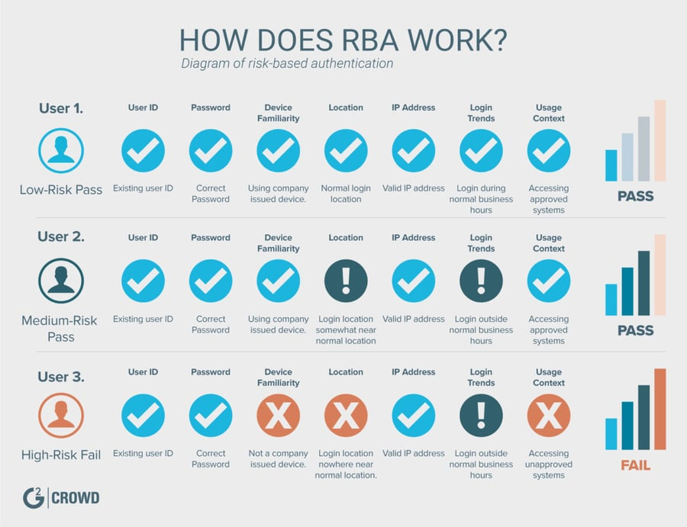
Risk-based authentication
Risk-based authentication (RBA) analyzes contextual signals for each login: location, device fingerprint, IP address, time, etc.
A risk score is computed from these features. If it exceeds a threshold, the system steps up (e. g. requires OTP or blocks access).
Advantages: runs in the background (better usability) and can learn from past behavior (improves over time).
Freeman, D. M., Jain, S., Dürmuth, M., Biggio, B., & Giacinto, G. (2016). Who Are You? A Statistical Approach to Measuring User Authenticity. In Proceedings of the Network and Distributed System Security Symposium (NDSS 2016).
https://learn.g2.com/trends/risk-based-authentication

Slide 5
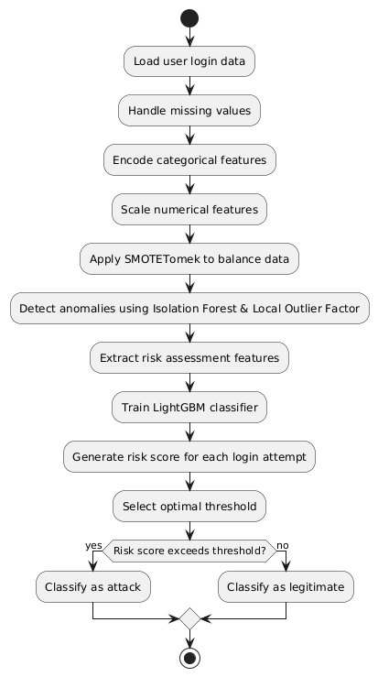
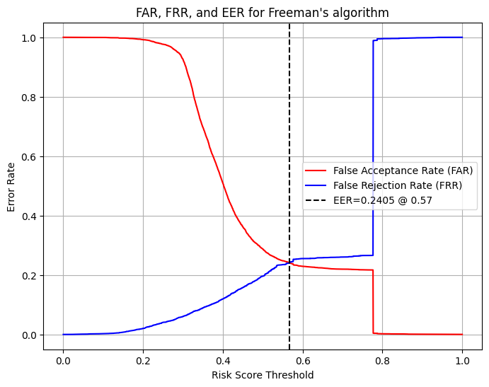
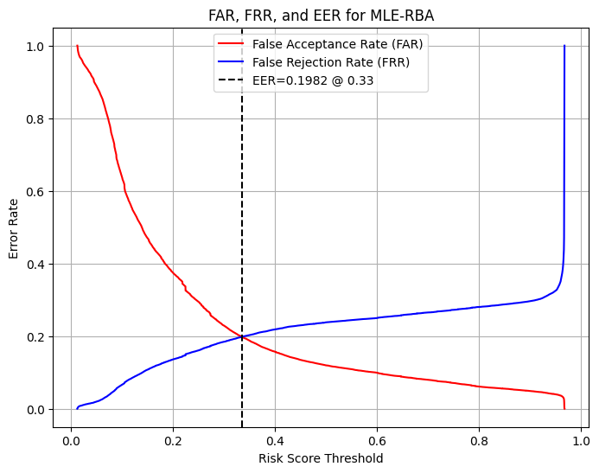
Our MLE-RBA algorithm
Based on Freeman et al.’s 2016 work, we have developed a machine learning-empowered RBA algorithm (MLE-RBA).
MLE-RBA uses feature engineering, anomaly detectors (IF & LOF), and a LightGBM classifier to calculate risk scores and adaptively tune risk threshold.
EER (Equal Error Rate): the error rate when false accept rate = false reject rate
Testing on a real-world login dataset shows improved performance.
Original (Freeman) RBA EER
MLE-RBA flowchart
MLE-RBA’s EER

Slide 6
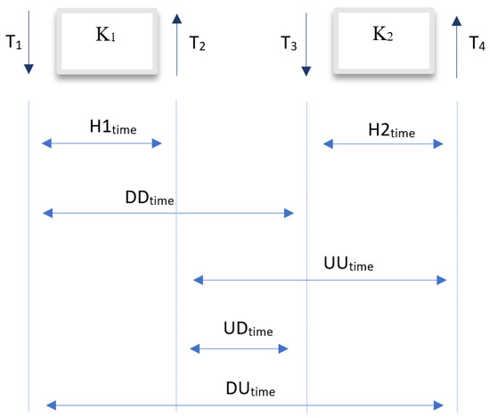
Keystroke recognition
Identifies users by their unique typing patterns.
Key features:
  Dwell time – duration a key is pressed
  Flight time – interval between consecutive keys
Works on any standard keyboard.
Passive, non-intrusive method.
Difficult to mimic or spoof reliably.
Wyciślik Ł, Wylężek P, Momot A. The Improved Biometric Identification of Keystroke Dynamics Based on Deep Learning Approaches. Sensors. 2024; 24(12):3763. https://doi.org/10.3390/s24123763

Slide 7
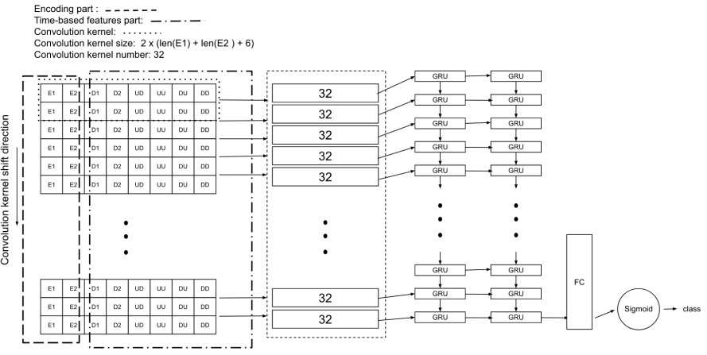
Free-text keystroke
Works with natural text input (no fixed phrases).
Builds a user-specific typing profile over time.
Continuously compares new input to profile.
Detects anomalies as deviations in typing behavior.
Supports real-time re-verification during a session.
Enables ongoing security without disrupting the user.
Li, J., Chang, HC., Stamp, M. (2022). Free-Text Keystroke Dynamics for User Authentication. In: Stamp, M., Aaron Visaggio, C., Mercaldo, F., Di Troia, F. (eds) Artificial Intelligence for Cybersecurity. Advances in Information Security, vol 54. Springer, Cham. https://doi.org/10.1007/978-3-030-97087-1_15

Slide 8
Our approach
Idea: fuse contextual risk-based authentication with typing behavior to verify the user throughout the session.
Risk fusion: both signals feed into one risk engine. If either signal is high risk, trigger step-up auth. If both RBA and keystroke show above-average risk, their combination is treated as high risk.
Smart re-verification: only challenge the user (e.g., ask for MFA) when combined risk is high, minimizing disruptions.
Novelty: first-of-its-kind integration of ML-based context analysis with continuous keystroke biometrics in one system – aligning with Zero Trust (“always verify”).

Slide 9
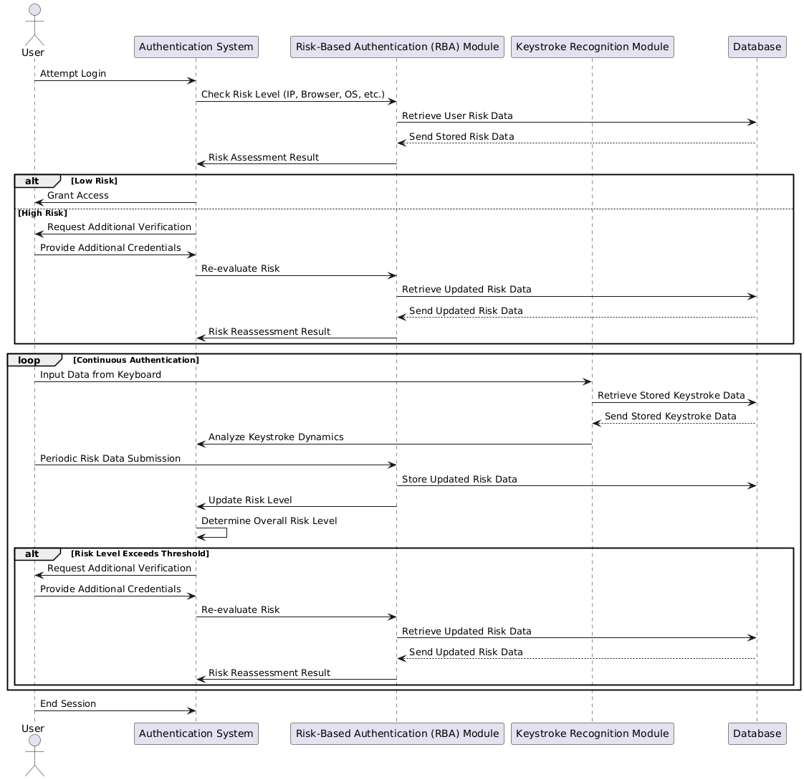
Hybrid auth system
Client: Captures context & keystrokes.
Server:
  MLE-RBA module: computes context risk score using ML model.
  Keystroke module: computes anomaly score from typing data.
  Fusion engine: combines scores and decides if risk threshold is exceeded.
Database: user data, keystroke profiles, and session risk logs.

Slide 10
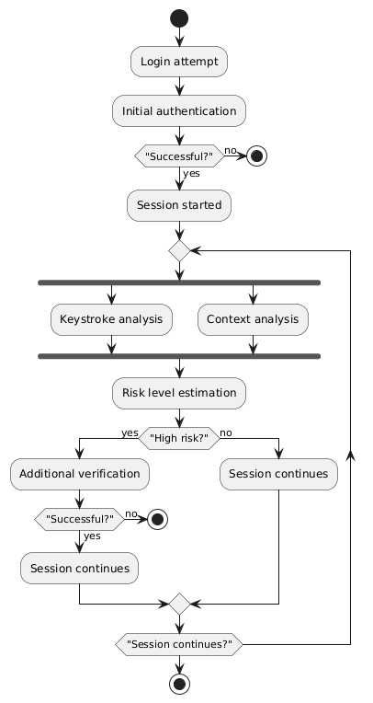
Hybrid auth workflow (1)
Login Phase: user enters credentials → MLE-RBA checks context.
  Low risk login → access granted;
  High risk login → immediate MFA challenge (step-up).
Continuous monitoring: as user interacts with the system, keystroke data flows to server continuously.
  Keystroke module compares to profile → updates risk score in real time.
  Context can be re-checked on certain triggers or if environment changes.

Slide 11
Hybrid auth workflow (2)
Risk evaluation loop: fusion engine regularly evaluates combined risk.
  Risk high: prompt for additional auth during session (e.g., ask user to re-verify). If failed or ignored → end session.
  Risk low: no action, session continues seamlessly.
Session end: if user logs out or inactivity timeout, session ends normally.

Slide 12
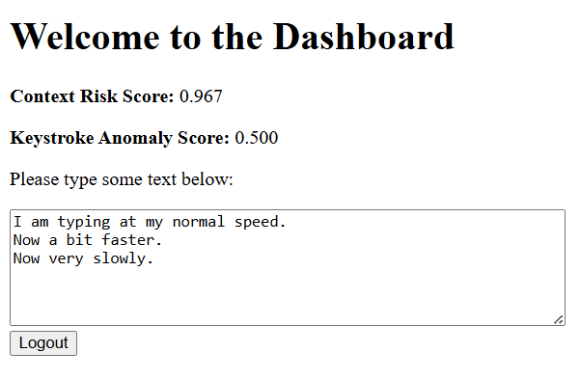
Practical implementation
RBA module: MLE-RBA module implemented and tested.
Keystroke integration: web app captures timing data via JavaScript (e.g., every few seconds). Baseline profiles stored per user; Python backend computes similarity.
Risk fusion engine: simple rule-based (OR logic) with tunable thresholds.
Development status: integrating components, calibrating thresholds, user trials planned; full system testing ongoing.

Slide 13
Conclusions & future work
A new approach to hybrid continuous authentication is proposed – combining keystroke recognition with ML-empowered risk-based authentication.
A novel RBA algorithm has been designed, implemented, and successfully tested.
A hybrid system’s architecture is designed, with practical implementation underway.
Future directions:
  Refining fusion with ML
  Expanding to other biometrics
  User evaluation & testing
  Real life deployment

