Slide 1
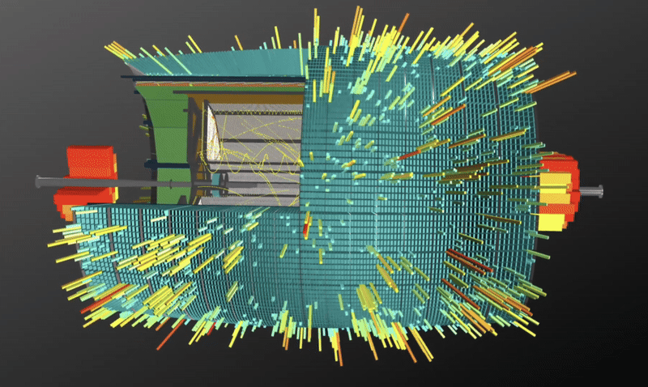
Modern web technologies in event display development for MPD experiment at NICA
Krylov Alexander, GRID'2025

Slide 2
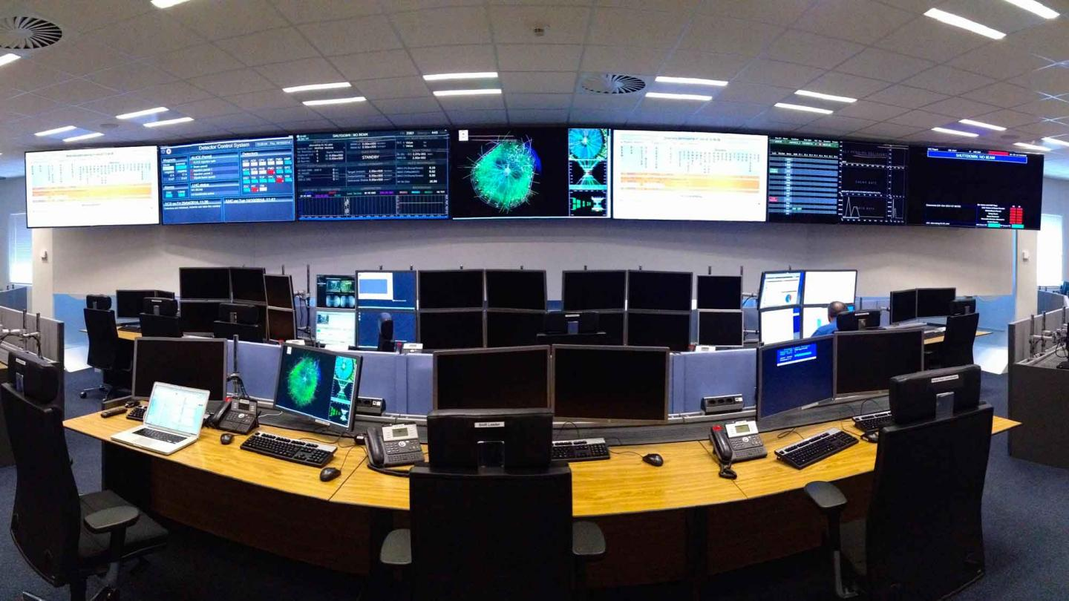
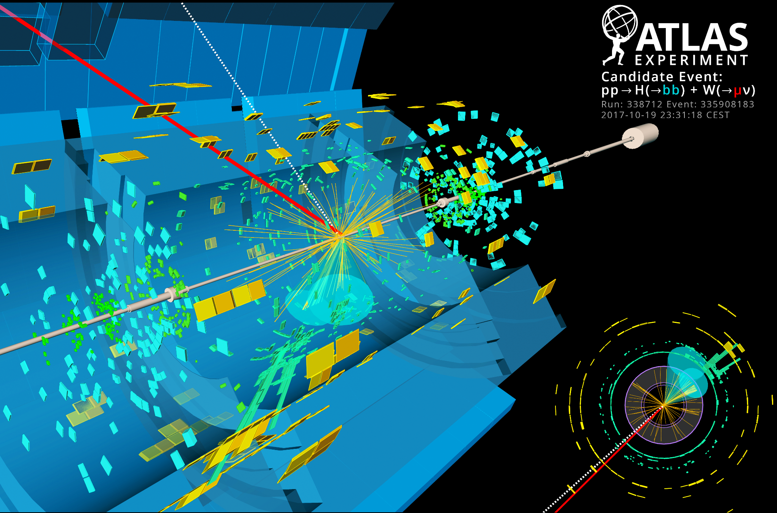
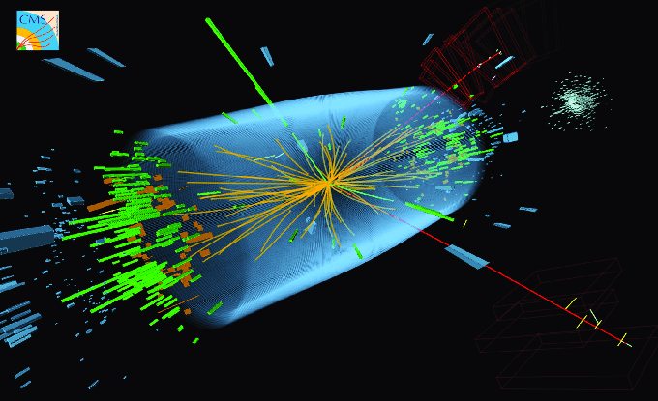
Visualization in HEP Experiments
Online monitoring of experiment running .
Event view in physics analysis of experimental data.
Web 3D representation on any modern devices (even smartphones).
ALICE experiment control room
CMS (Higgs boson)

Slide 3
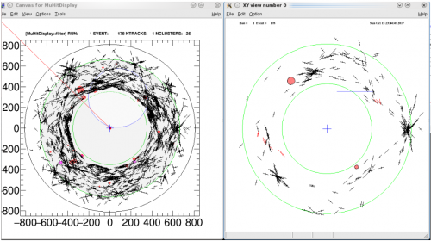
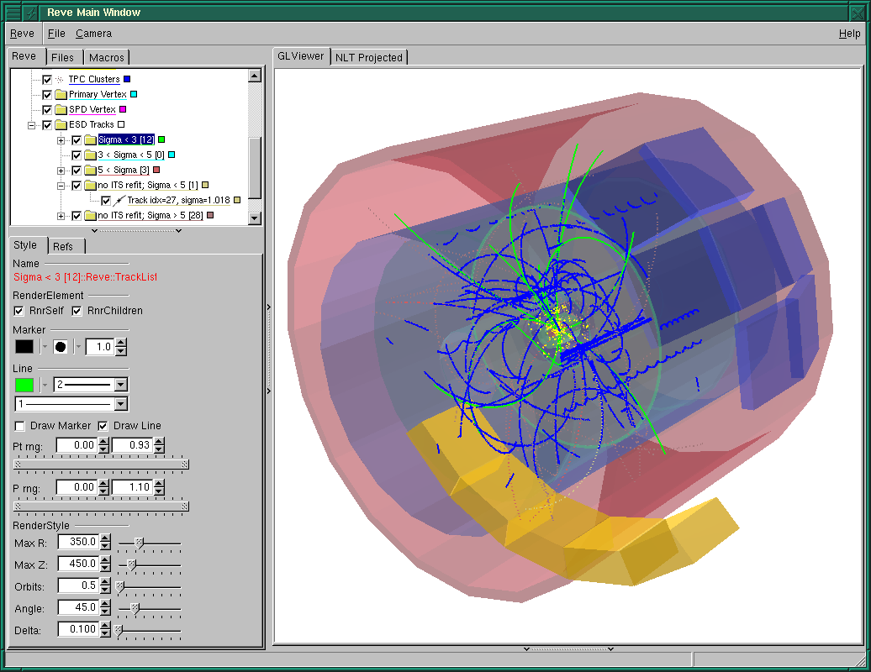
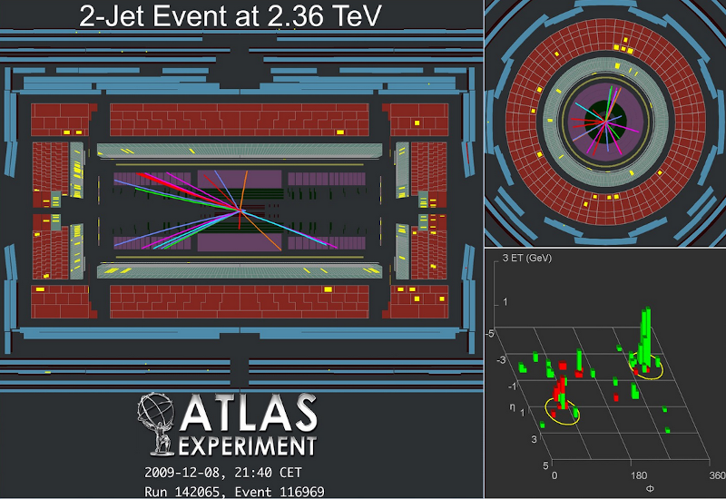
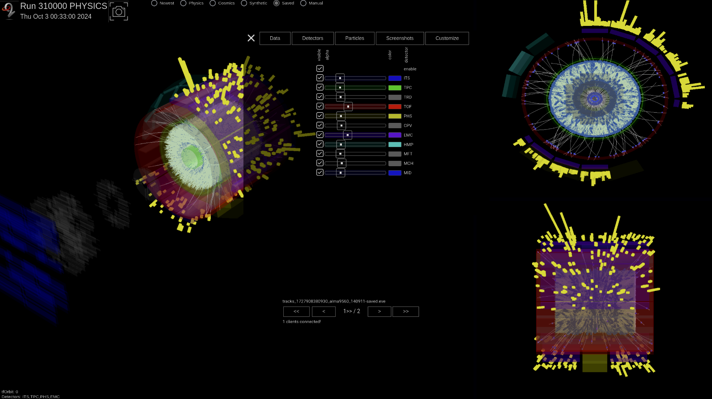
Event displays development
Mu2E
Period | Event Display technologies
until 2005 | Simple 2D visualizations; primarily used for detector testing
2007–2010 | Development of the ROOT EVE library
2010–2017 | Interactive 3D displays using C++/OpenGL
2017 - now | Web-based versions with improved detail and user interfaces (WebGL + Three.js)
ALICE
ATLAS
ALICE

Slide 4
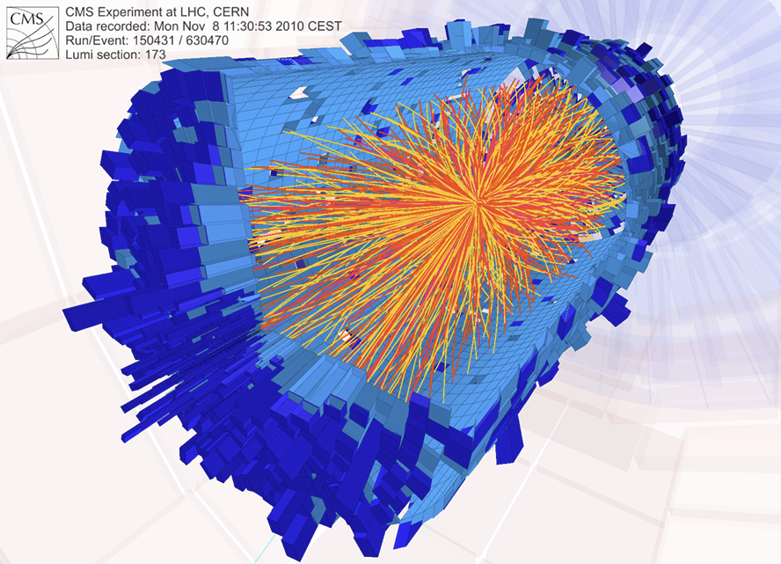
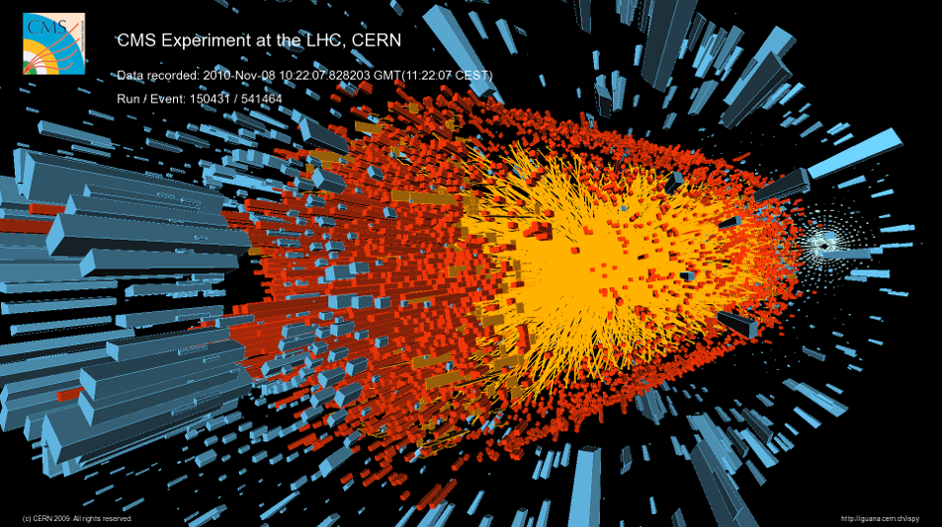
Event Displays at LHC
CMS Fireworks event display
C++, OpenGL (2008)
CMS iSpy event display
JavaScript, WebGL (2017)

Slide 5
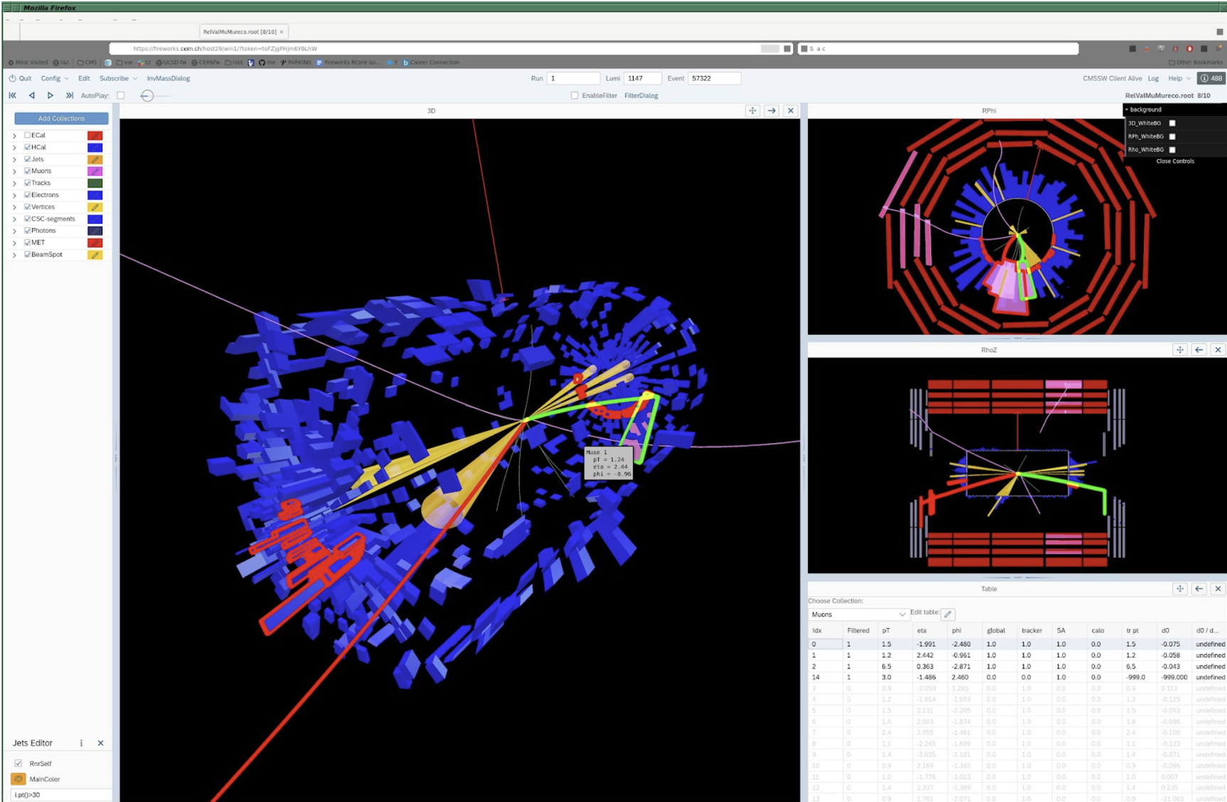
Event Displays at LHC
ALICE AliEve event display
C++, OpenGL (2008)
ALICE O² event display
JavaScript, WebGL (2024)

Slide 6





Web technologies stack
JavaScript is a high-level, interpreted, dynamically typed programming language that corresponds to the ECMAScript specification.
NodeJS/Bun high-performance JavaScript runtime, offering faster startup times and execution.
WebGL enables GPU-accelerated rendering, making it ideal for complex 3D visualizations.
React framework optimizes UI rendering with its virtual DOM, improving performance in dynamic applications.
Notes:
javascript
Общее JavaScript engine

Slide 7
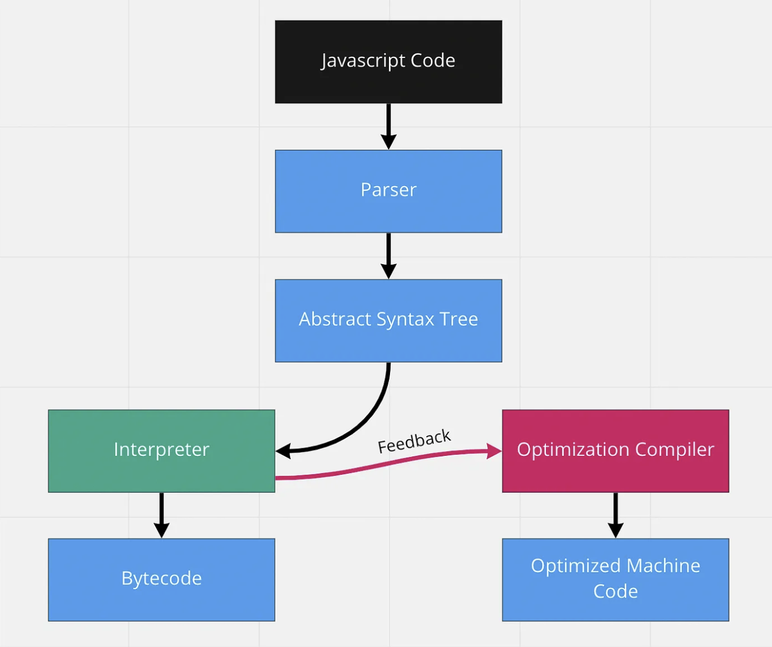
Javascript engines
The JavaScript engines is a high-performance JavaScript and WebAssembly engines. It powers browsers, Node.js, and other JavaScript runtimes by compiling JavaScript into machine code for faster execution.
Engines pipeline ensures JavaScript runs efficiently by dynamically optimizing code during execution.

Slide 8
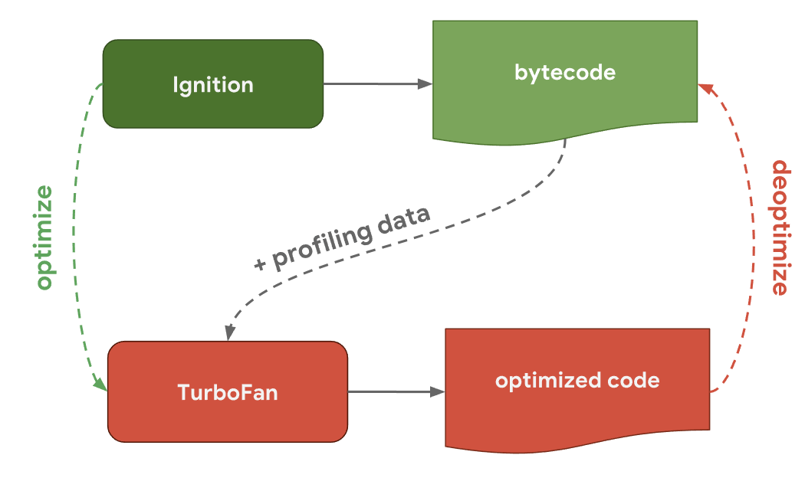
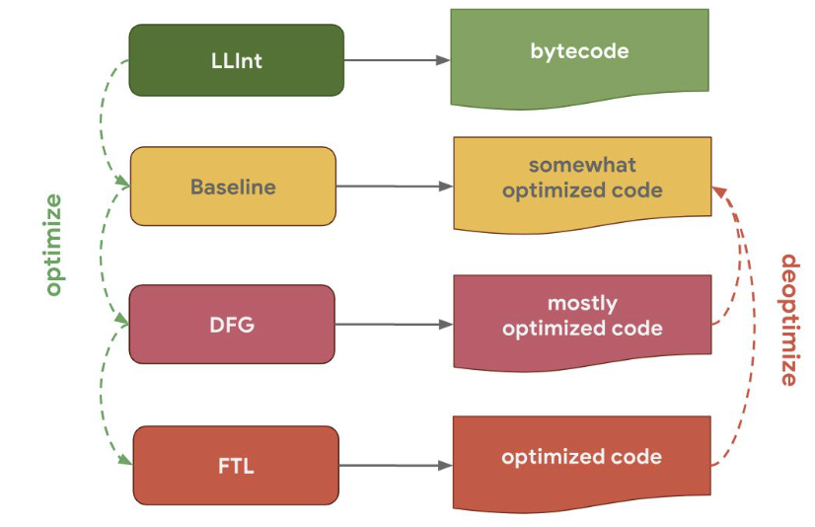
V8 and JavascriptCore engines
Google created V8 for its Chrome browser, and both were first released in 2008.
In 2017, V8 shipped a brand-new compiler pipeline, consisting of Ignition (the interpreter) and TurboFan (the optimizing compiler)
Apple created JavaScriptCore for its Safari browser in 2003.
As of the 2010s, its compiler pipeline includes LLInt (the Low-Level Interpreter), a Baseline JIT, DFG (Data Flow Graph JIT), and FTL (Fourth Tier LLVM-based JIT).
V8 engine
JavaScriptCore engine

Slide 9
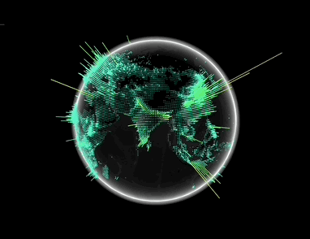
WebGL and Three.js
WebGL and Three.js play a crucial role in creating interactive 3D visualizations:
WebGL: Provides a powerful API for rendering 2D and 3D graphics in the browser.
Three.js: A library that simplifies the use of WebGL, making it easier to create complex visualizations with less code.
WebGL technology 3D demonstration (https://demo-globe-lagarsoft.vercel.app)

Slide 10
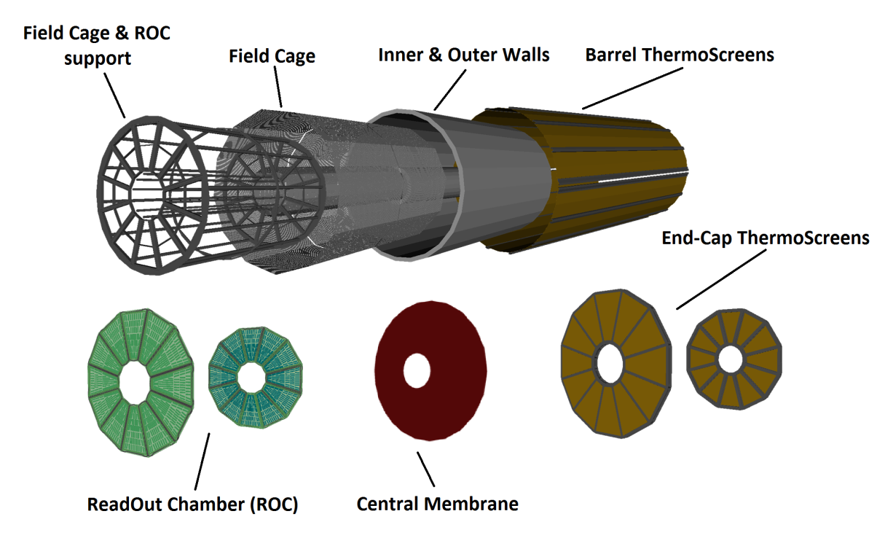
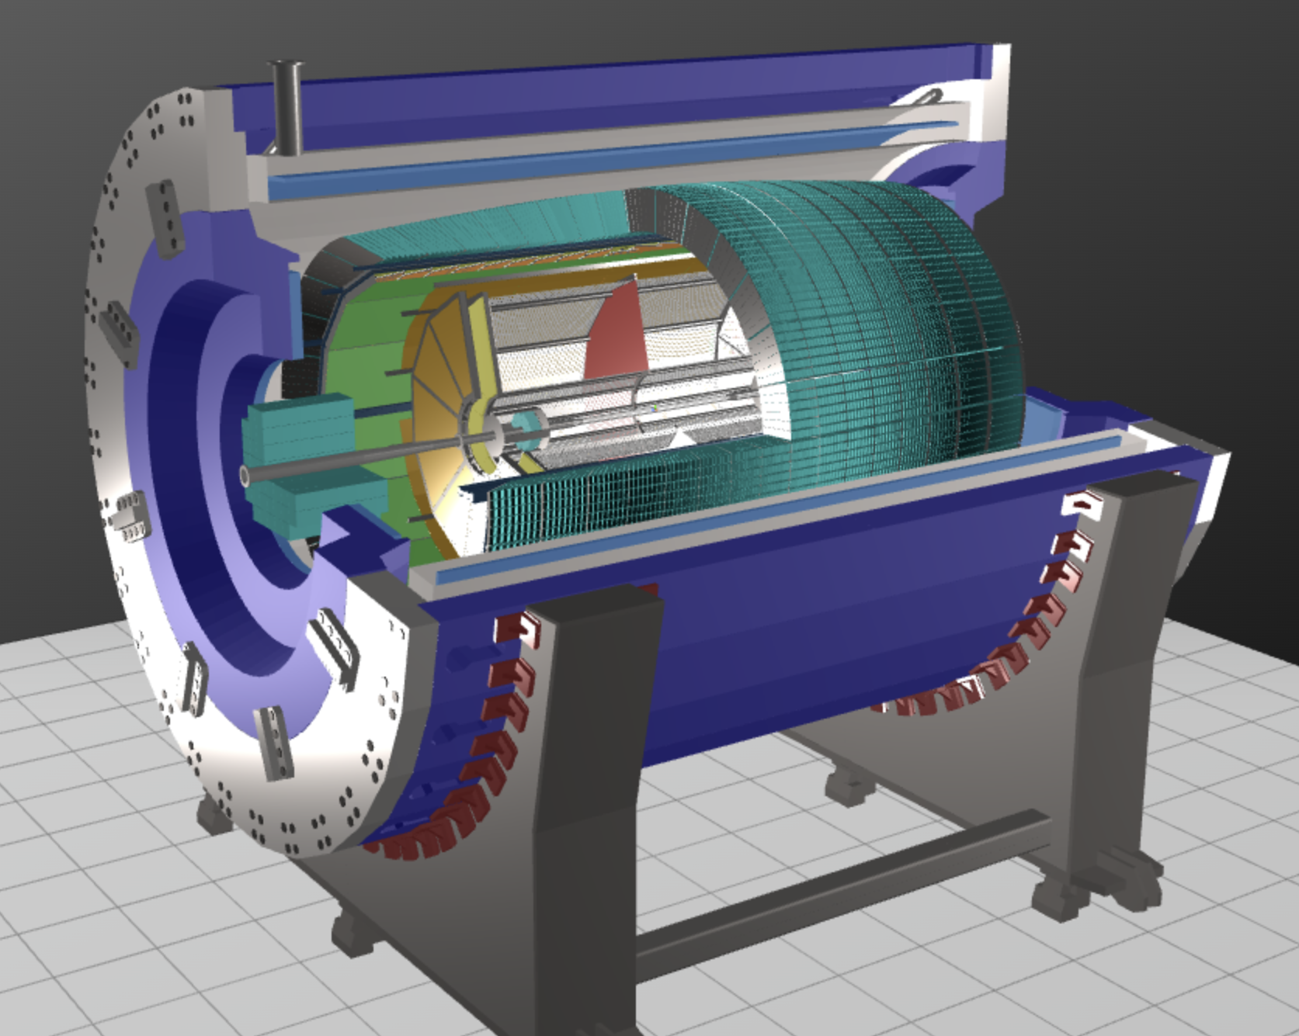
MPD Geometry
For MPD geometry GLTF/GLB format is used.
glTF stands for Graphics Library Transmission Format. It’s a JSON-based format developed by the Khronos Group to describe 3D scenes and models.
TPC detector parts in GLTF format
Event display MPD geometry
Notes:
kronos group

Slide 11
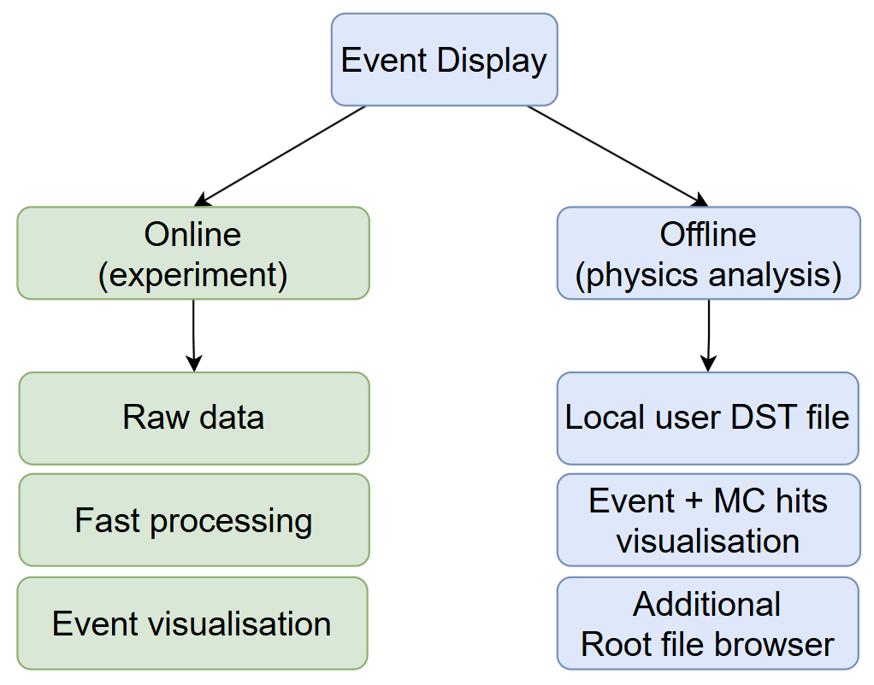
Different task of the event display
Event Display will work during experiment and also in offline mode.
Online (experiment):
Raw experiment data as input
Fast clustering
Current event visualisation
Offline:
Local DST files as input
Choosed event visualisation
Additional Root File Browser

Slide 12
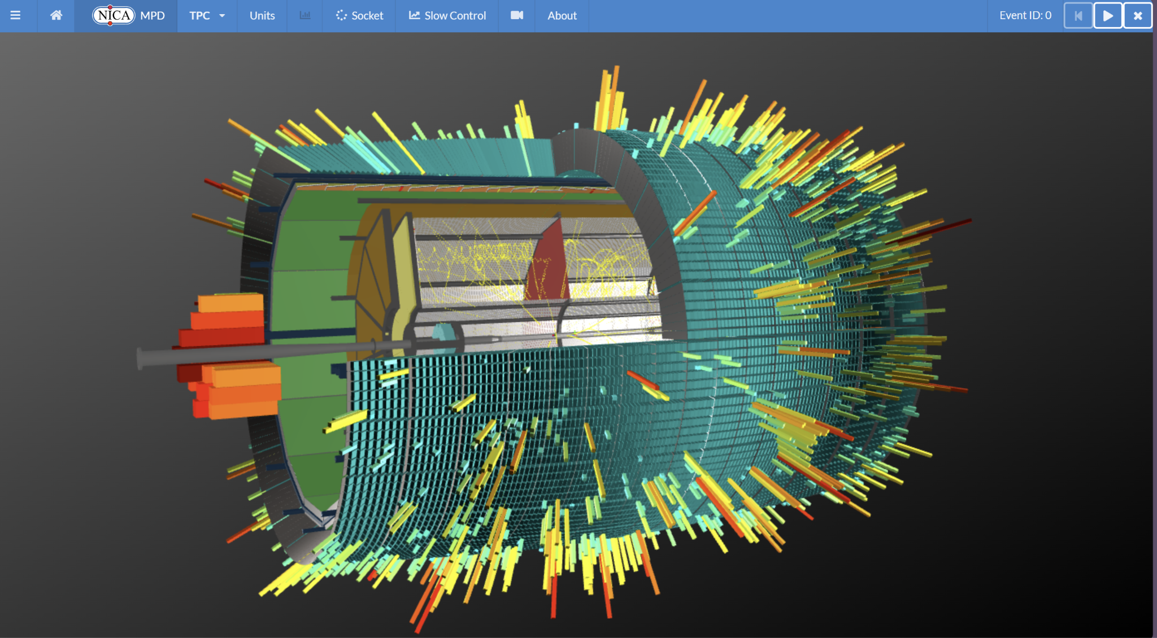
MPD Event display (Experiment)
Online prototype of event display for MPD.
Technologies:
NodeJS - runtime environment
Node-API - root file reader interface on server side
React - user interface
WebGL+ThreeJS - 3D graphics

Slide 13
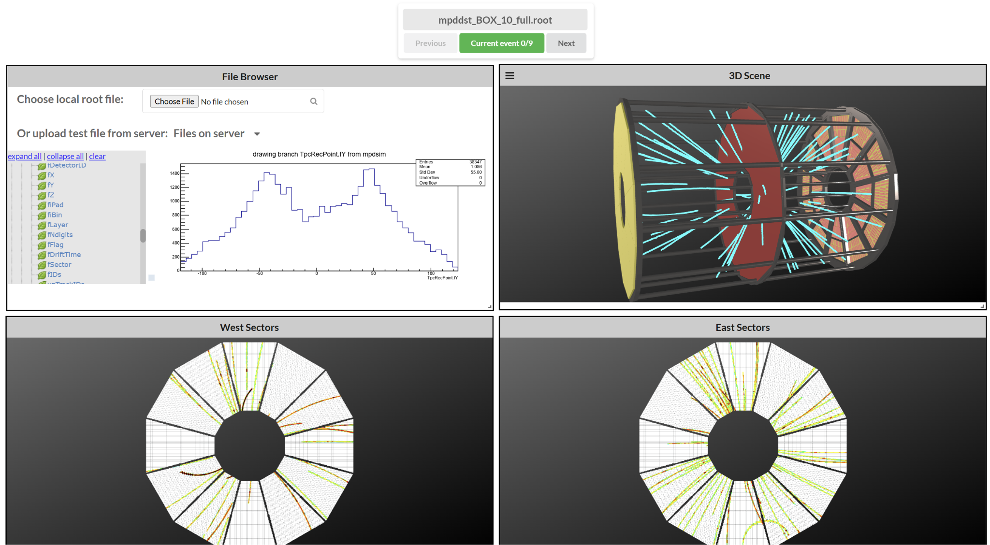
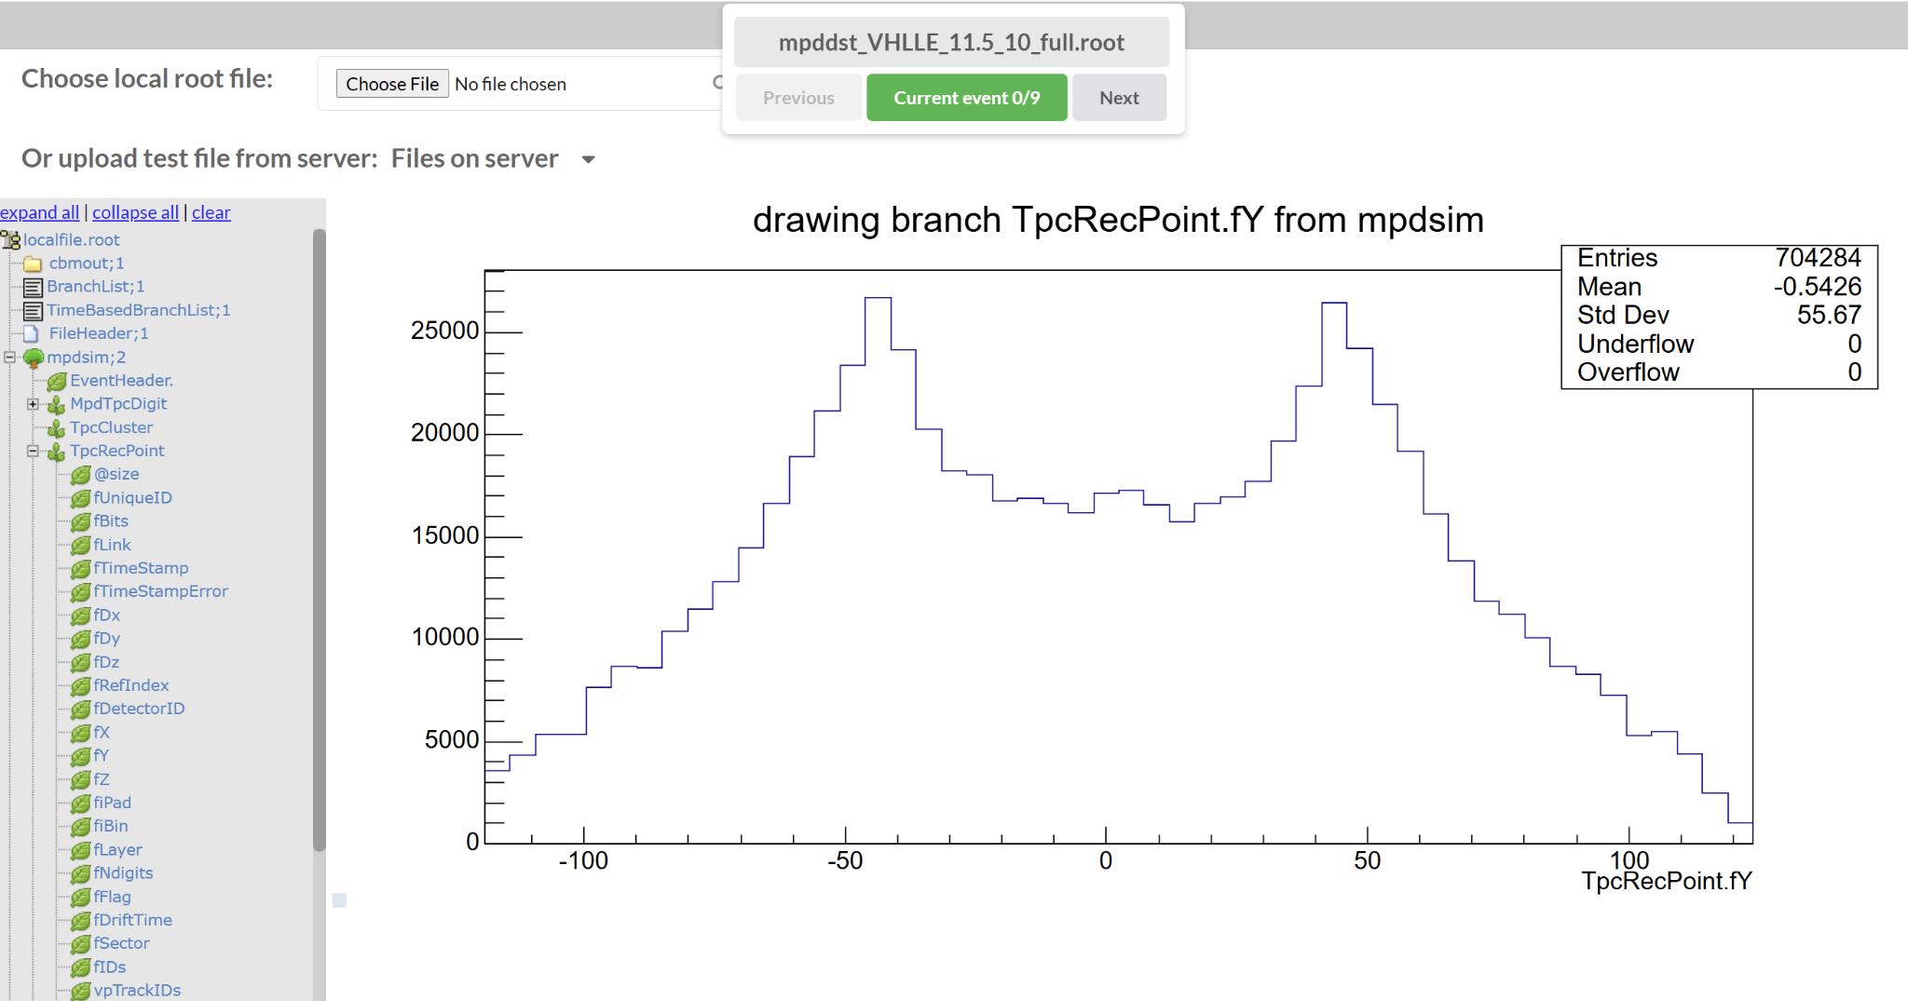
MPD Event viewer (Offline)
Offline DST file viewer.
Developed for the TPC detector so far.
Technologies:
Bun - runtime environment
React - user interface
WebGL+ThreeJS - 3D graphics
JSROOT - root file reader and histograms visualization
Notes:
добавить картинок

Slide 14
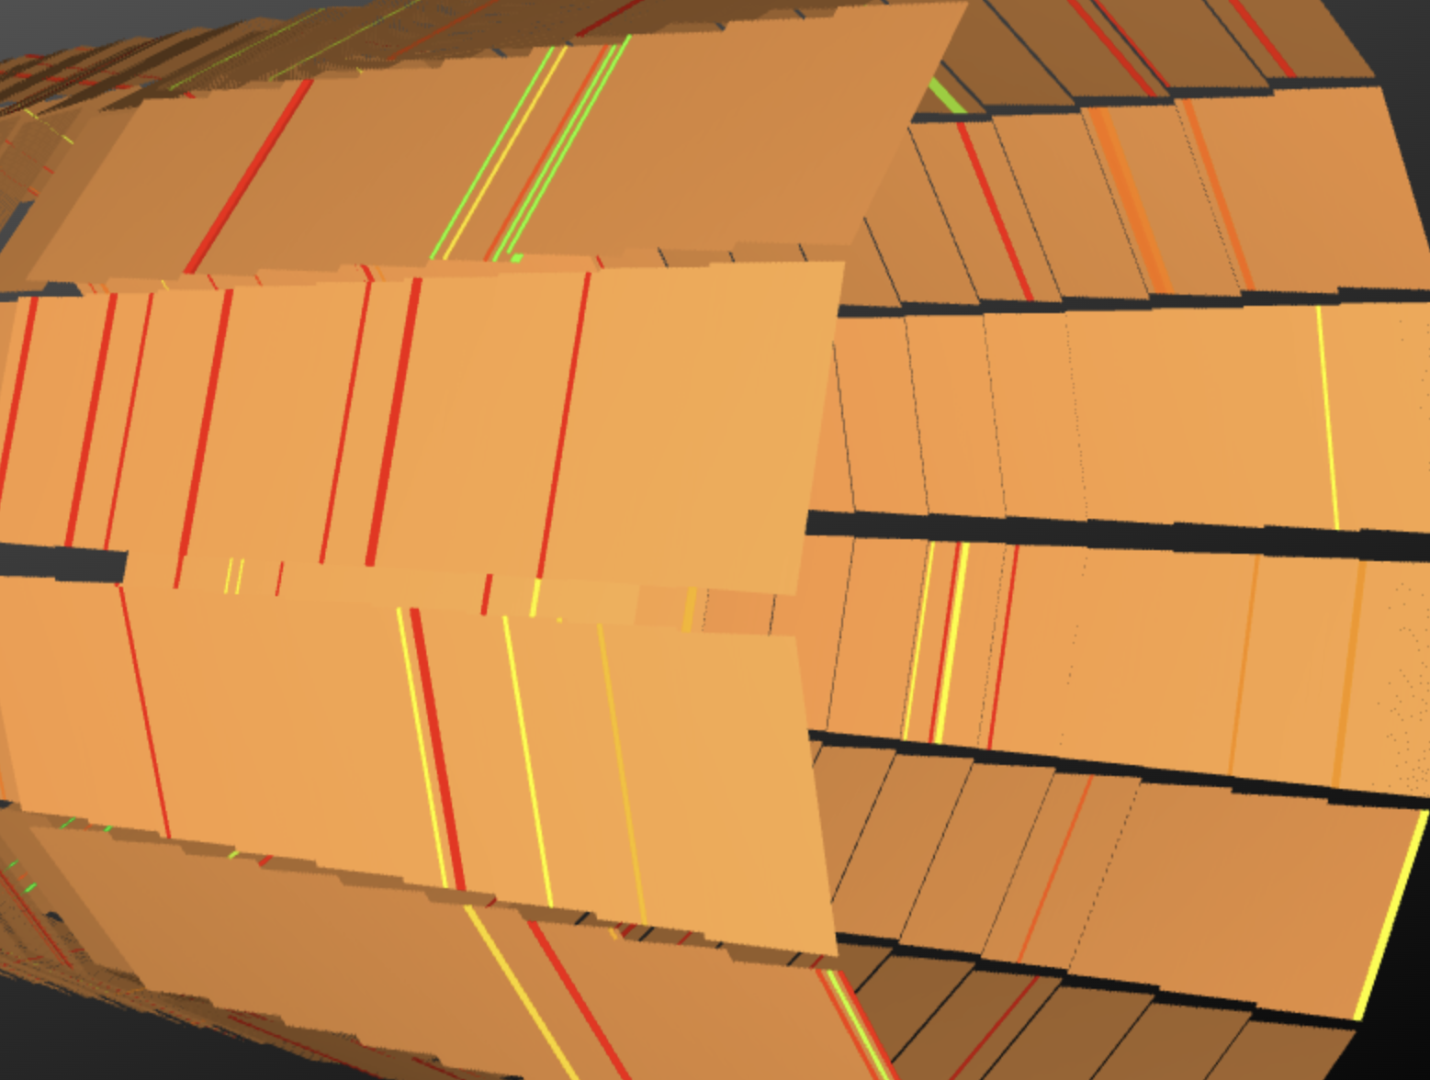
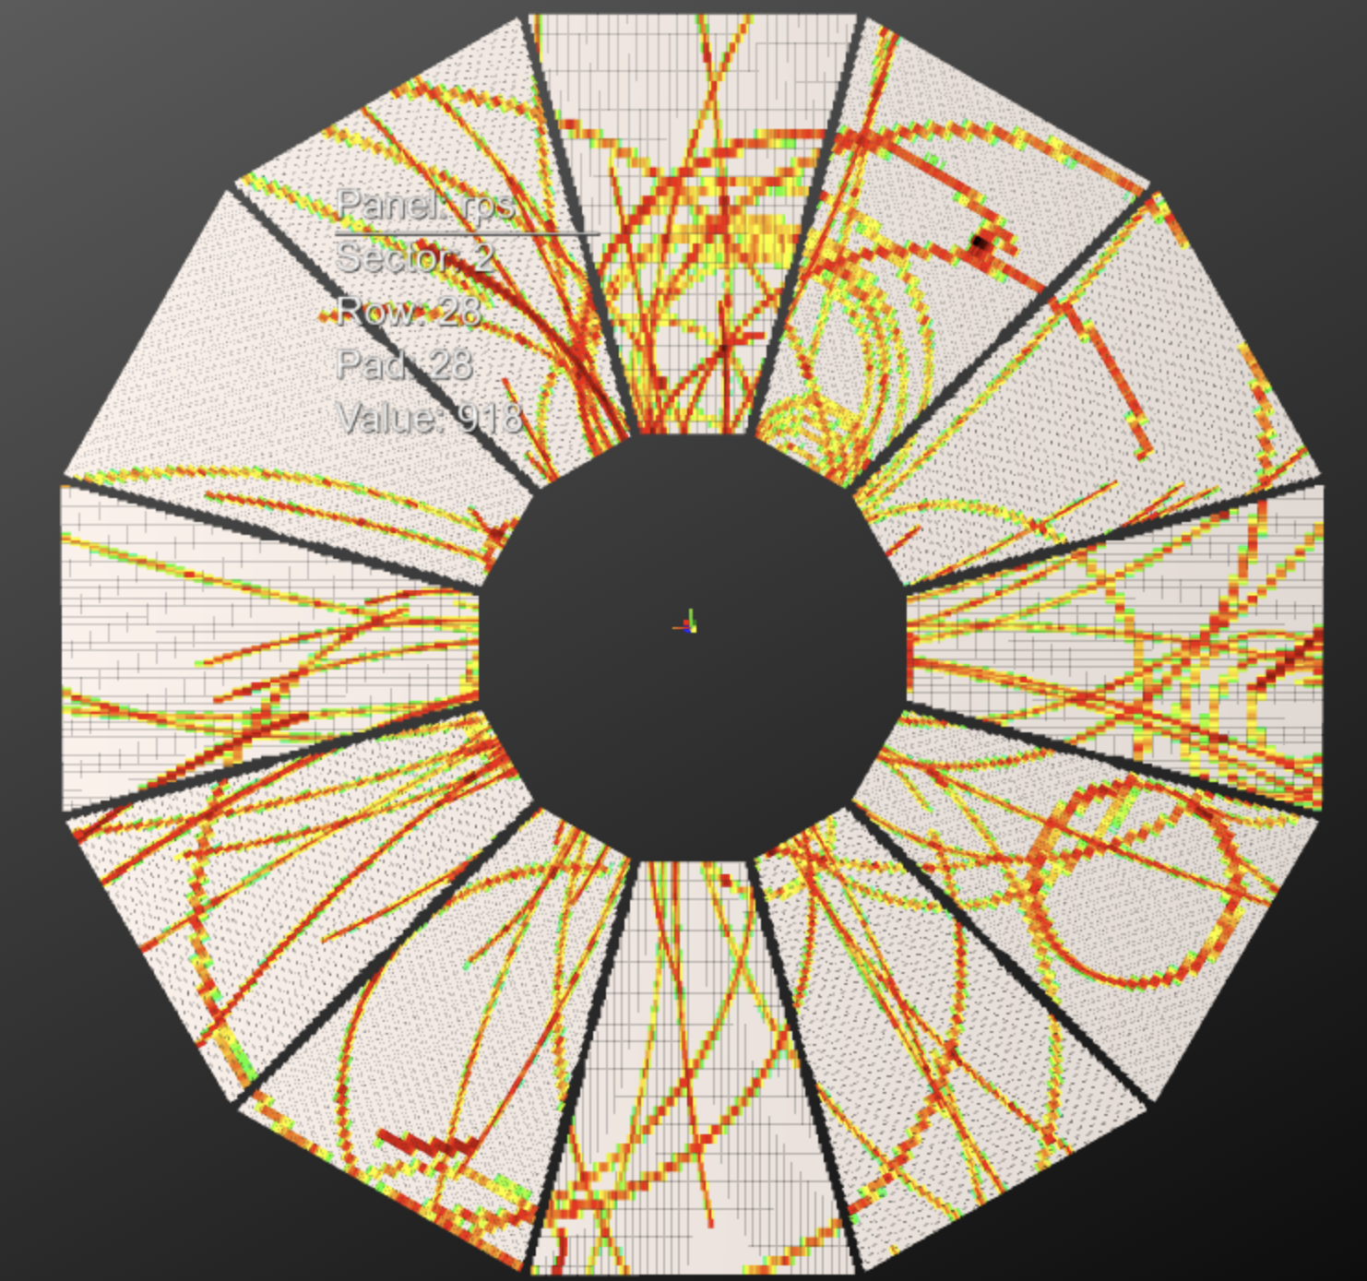
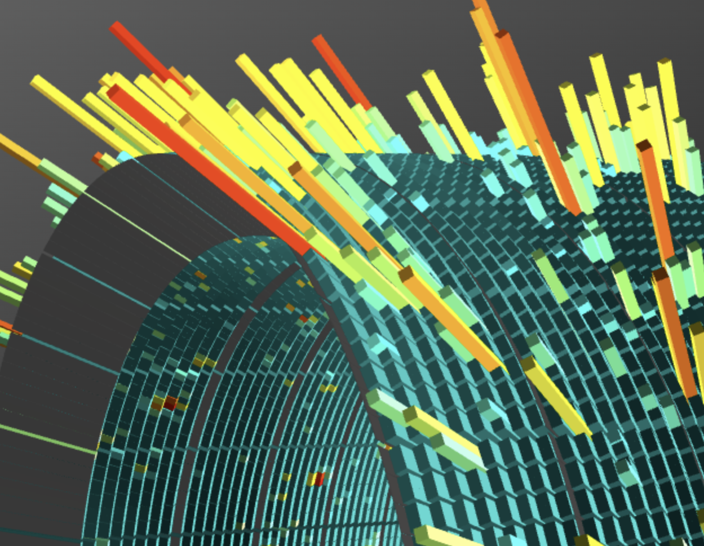
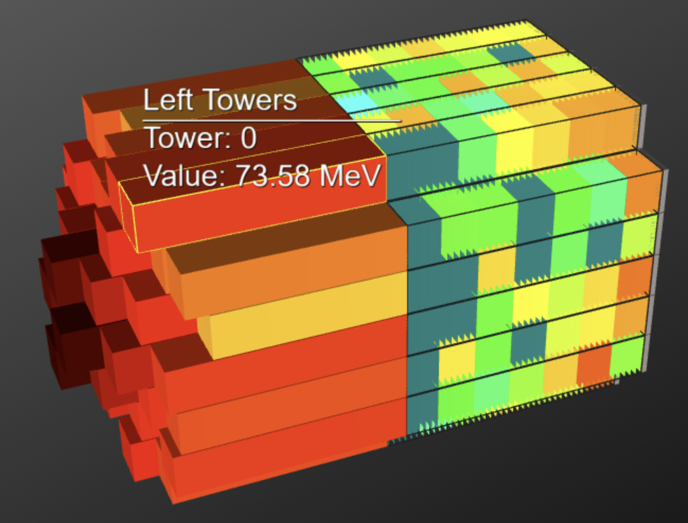
MPD detector responses (Event display)
TOF sensors (strips)
TPC endcap sensors (pads)
ECal sensors (towers)
FHCal sensors (towers)

Slide 15
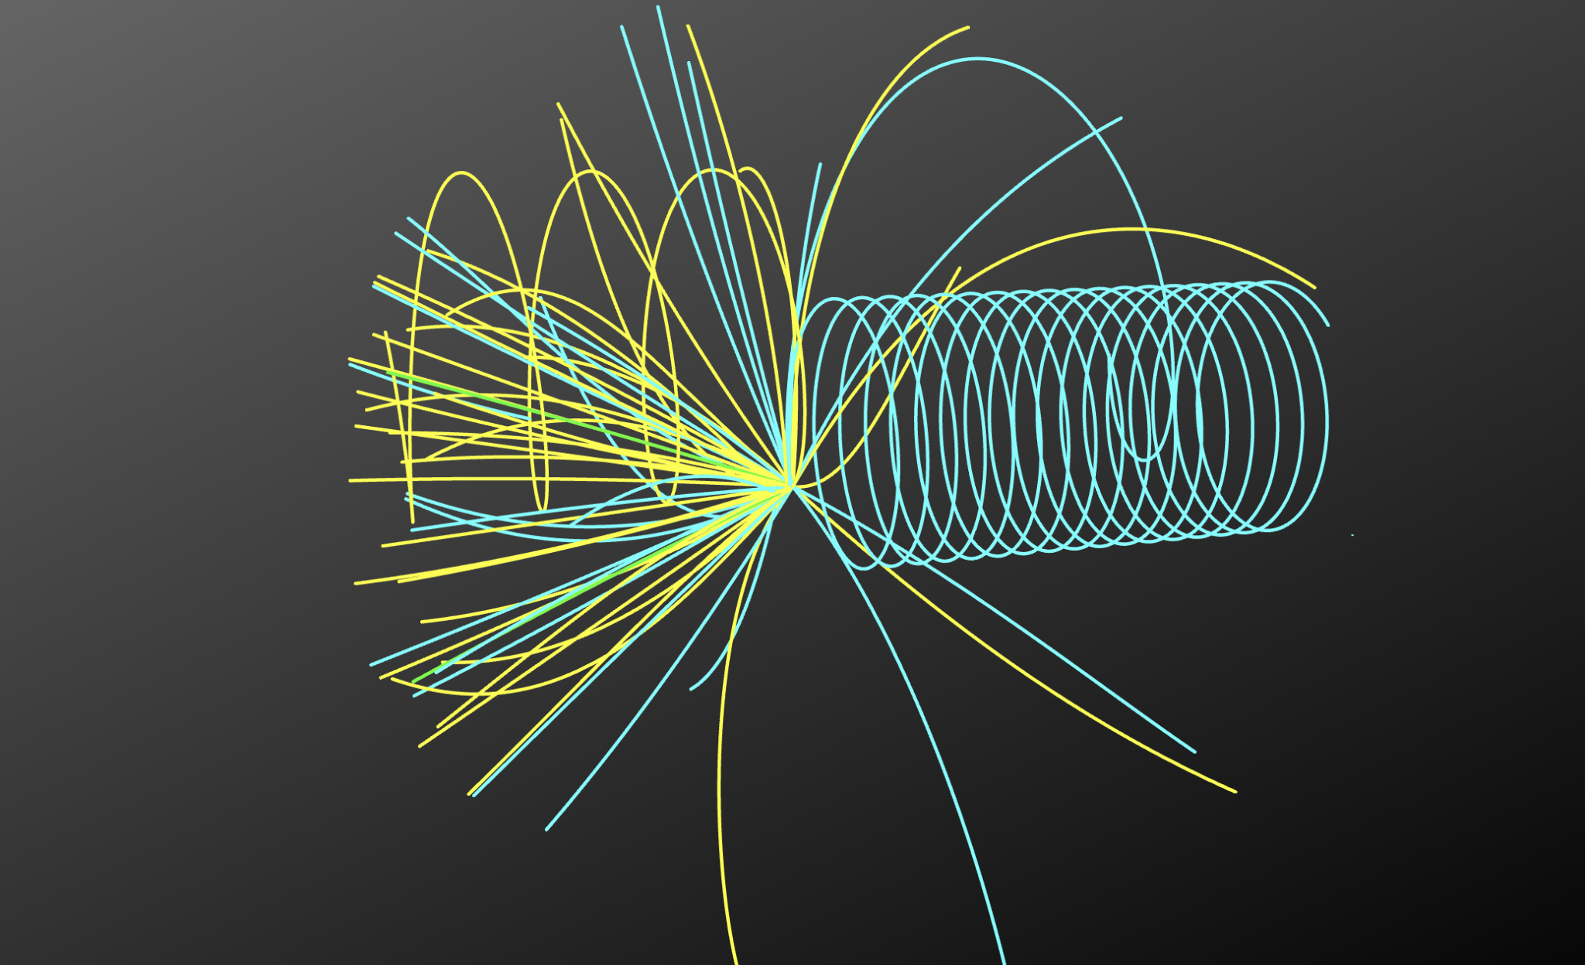
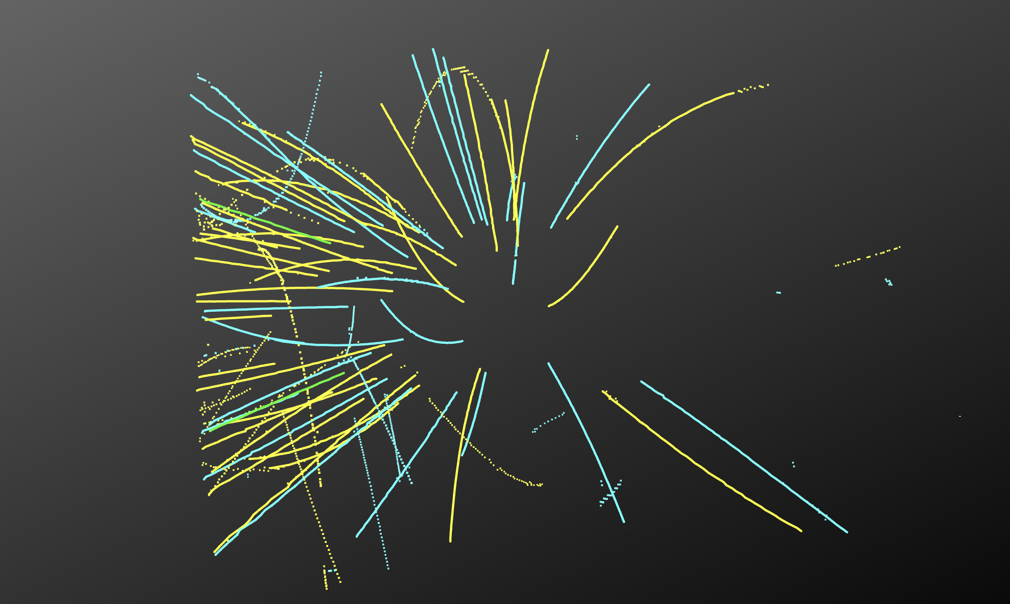
TPC tracks visualization (Event Viewer)
MonteCarlo tracks (MC)
Reconstructed tracks
Notes:
+MC сравнение треков

Slide 16
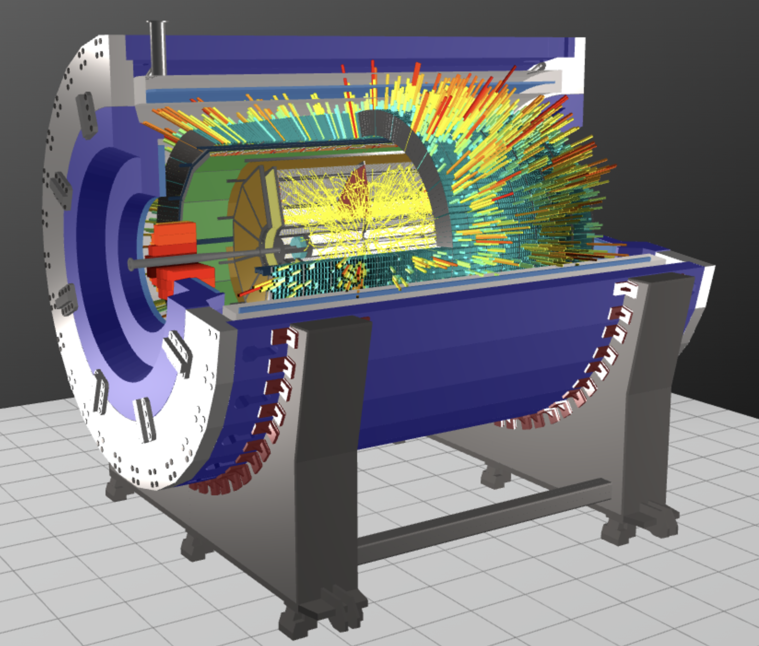
Conclusion
Event display is developed for the MPD experiment at NICA collider and is ready for implementation in real experiment.
Event display possibilities:
MPD geometry (TPC, TOF, ECal, FHCal)
Sensors response (pads, strips, towers)
TPC hits visualization
Event viewer provides the ability to visualize data for physics analysis such as:
Reconstructed hits/tracks
DST file histograms.

Slide 17
Thank you for your attention

Slide 18
Comparison with Legacy Technologies
Criteria | Traditional Stack (C++/ROOT/OpenGL) | Modern Web Technologies (TypeScript/Bun/WebGL)
Performance | High runtime efficiency with compiled code and hardware-level graphics. | Lowe runtime efficiency due to work
Development Complexity | Not easy debugging, and maintenance challenges. | Rapid development cycle, hot-reloading.
Portability & Accessibility | Requires dedicated installations and specific environments. | Runs on any modern browser; highly portable and accessible.
User Interface | More utilitarian, less flexible in terms of modern design trends. | Modern, responsive designs with rich interactive capabilities.
Maturity & Reliability | Established and robust over decades of scientific use. | Rapidly evolving; community-driven with continuous updates.

Slide 19
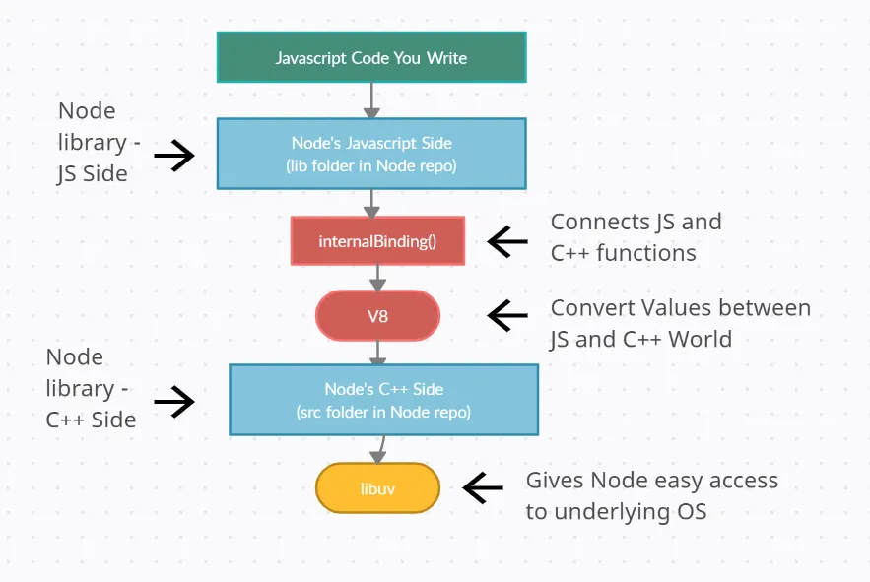
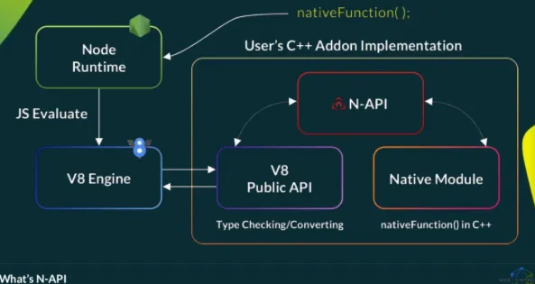
Node-API

Slide 20
The Role of Visualization in HEP Experiments
Visualization plays a vital role in high-energy physics providing online monitoring of experiment running .
3D representation enhances pattern recognition, aids in the identification of rare topologies, and provides immediate feedback on detector performance.
ALICE experiment control room (CERN)

Slide 21
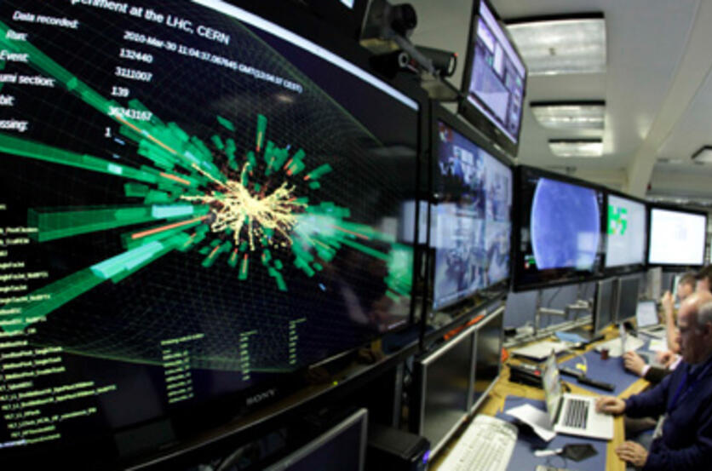
Event Displays in High-Energy Physics
Event displays are crucial in high-energy physics as they allow researchers to interpret and analyze particle collision events. They provide a visual representation of complex data, making it easier to understand the outcomes of experiments.

Slide 22
OpenGl event displays
Pros
Cons
Hardware Acceleration: Offers a high-performance, cross-platform solution for real-time 3D rendering.
Maturity: Years of use in scientific visualization mean a robust and well-understood ecosystem
Limited interactivity: Often static and less engaging for users.
Performance issues: Slower rendering times and less efficient data handling.
Compatibility: Difficulties in integrating with modern web environments and tools.

Slide 23
Modern web technologies
Pros
Cons
Accessibility: run in standard browsers across various devices;
Ease of Integration: The web stack simplifies deployment and incremental updates;
Flexibility and Extensibility: easier integration with real-time data streams. This leads to more interactive features and easier customization of visualization dashboards.
Performance Overhead: the abstraction layers of JavaScript and browser constraints may introduce overhead;
Relative Maturity: web technologies might not yet match the long-term optimization and robustness;
Increase of man-hours: greater capabilities require more man-hours

Slide 24
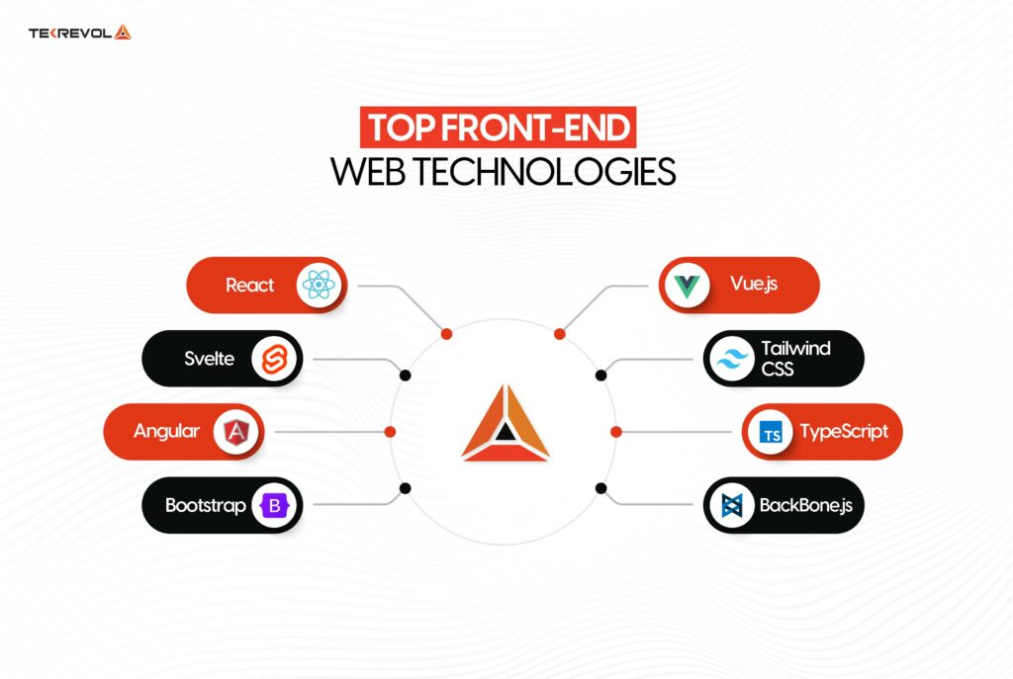
Overview of Modern Web Technologies
Modern web technologies such as React, Bun, and Three.js are transforming the development of event displays. These tools enhance user experience and performance, making it easier to create interactive and visually appealing applications.

Slide 25


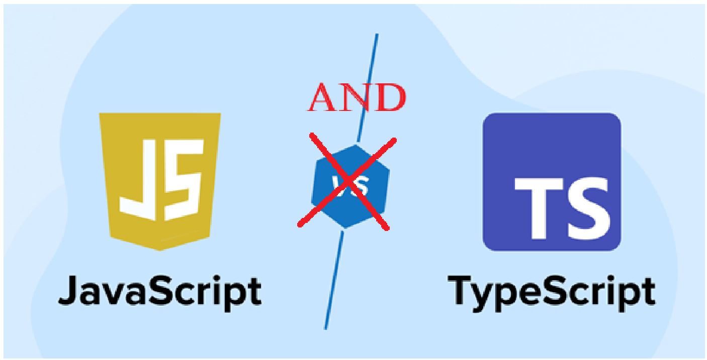
TypeScript/JavaScript for Event Displays
Using TypeScript and JavaScript offers several advantages:
Strong typing: TypeScript provides type safety, reducing errors during development.
Wide adoption: JavaScript is a widely used language, ensuring a large community and resources.
Browser compatibility: Both languages are designed for web environments, facilitating seamless integration.

Slide 26
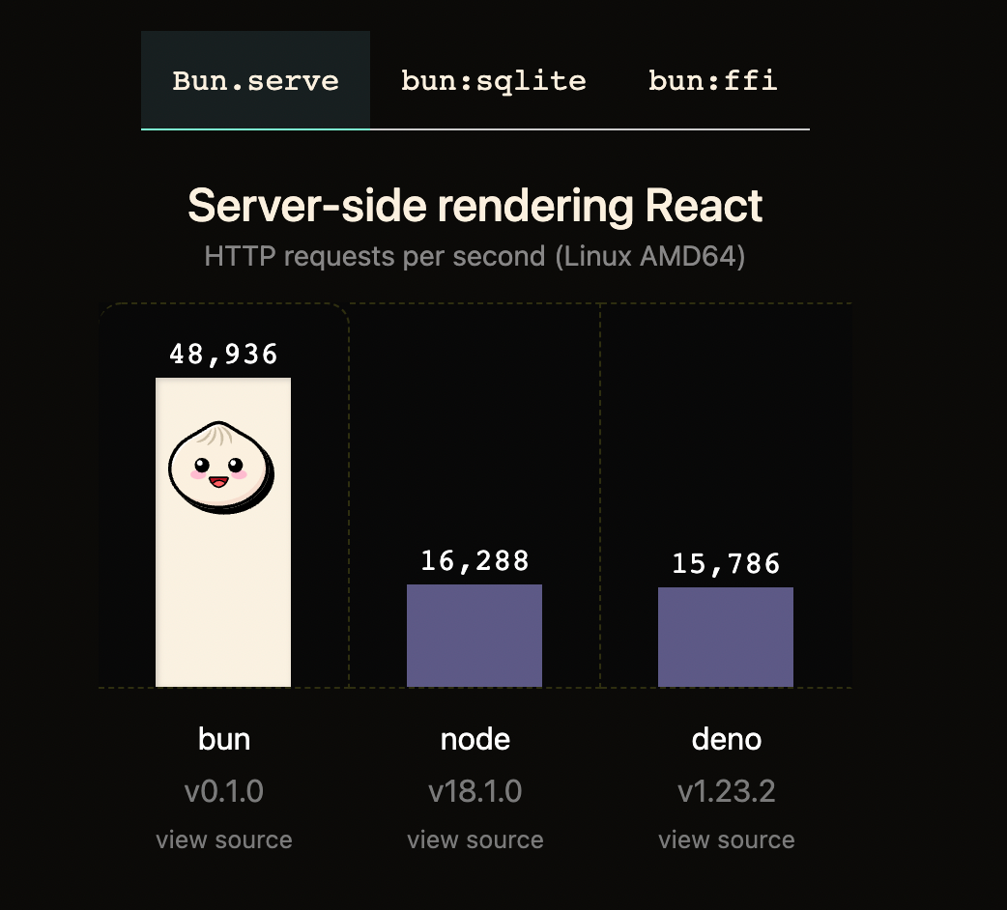
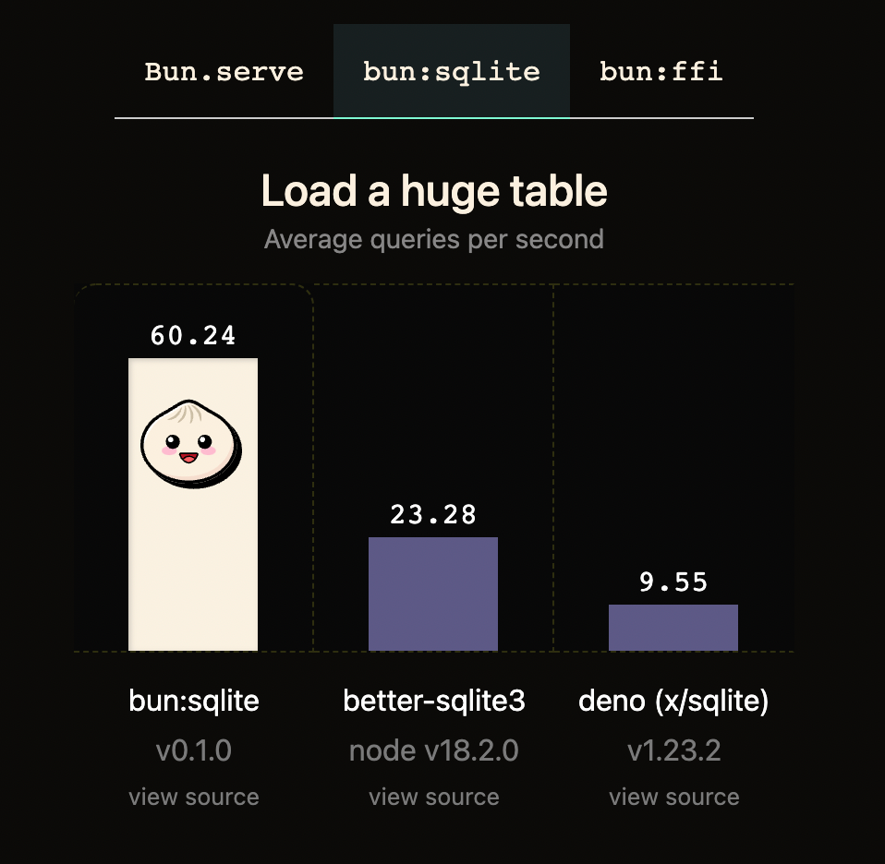
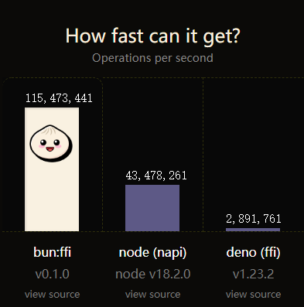
Bun framework
Bun is a modern JavaScript runtime designed to be fast and efficient. It serves as an alternative to Node.js and Deno, offering built-in tools for package management, bundling, and testing.
Bun is gaining popularity among developers looking for a lightweight and high-speed alternative for JavaScript applications

Slide 27
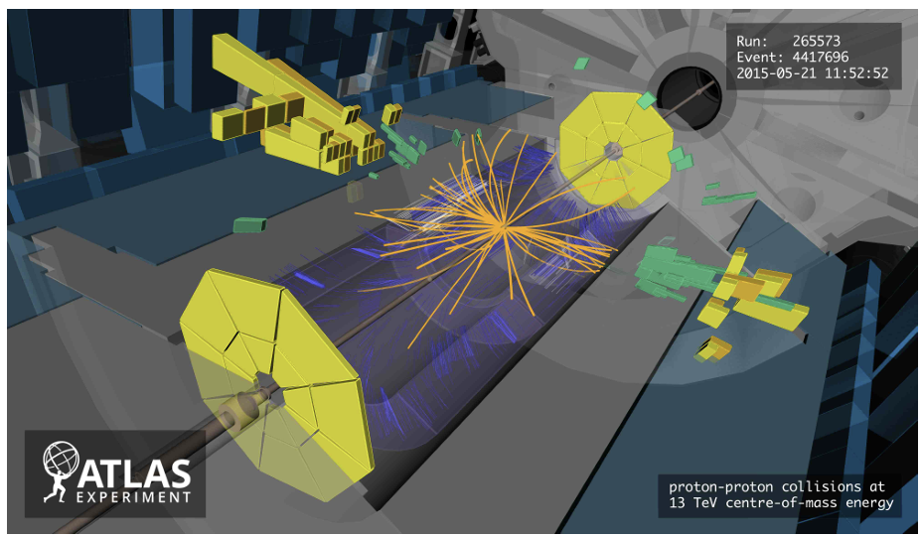
Event Displays technologies
ATLAS Atlantis event display
C++/Java, OpenGL
CMS iSpy event display
JavaScript, WebGL

Slide 28
Conclusion
Modern web technologies have grown in popularity recently because they offer a rare combination of accessibility, flexibility, and performance.
Furthermore, the compatibility of web applications with cloud services, databases, and modern analysis makes them especially suited for large-scale, data-driven experiments like MPD.

