Slide 1
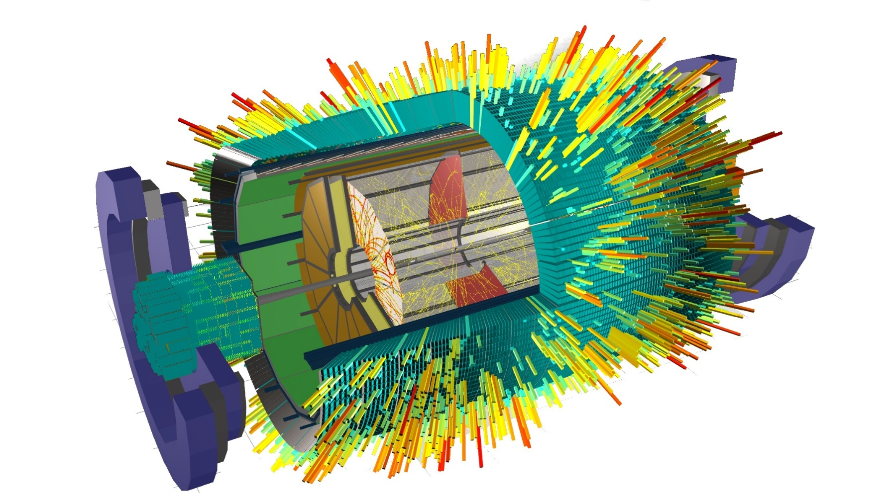
Software Development & Computing for the MPD Experiment
HNATIC Slavomir
on behalf of the
MPD Software Development & Computing Team

Slide 2

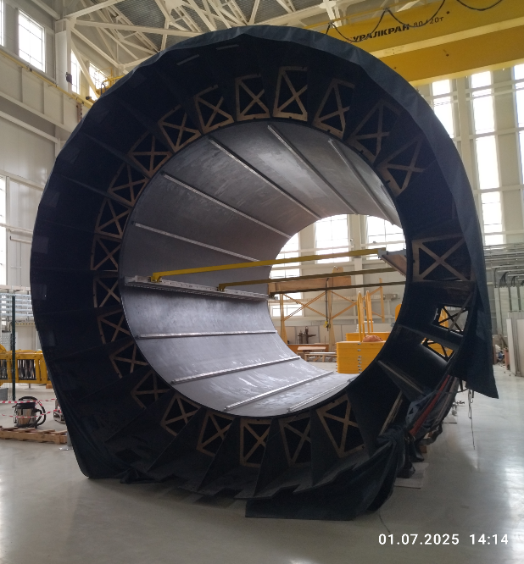
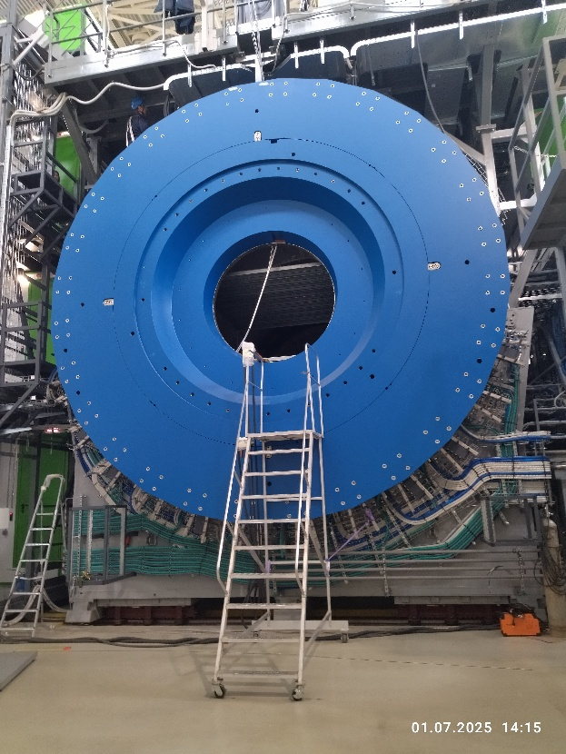
OUTLINE
Big Picture
Online Software
Detector Calibration
Data Processing
Offline Software
Computing
Future

Slide 3
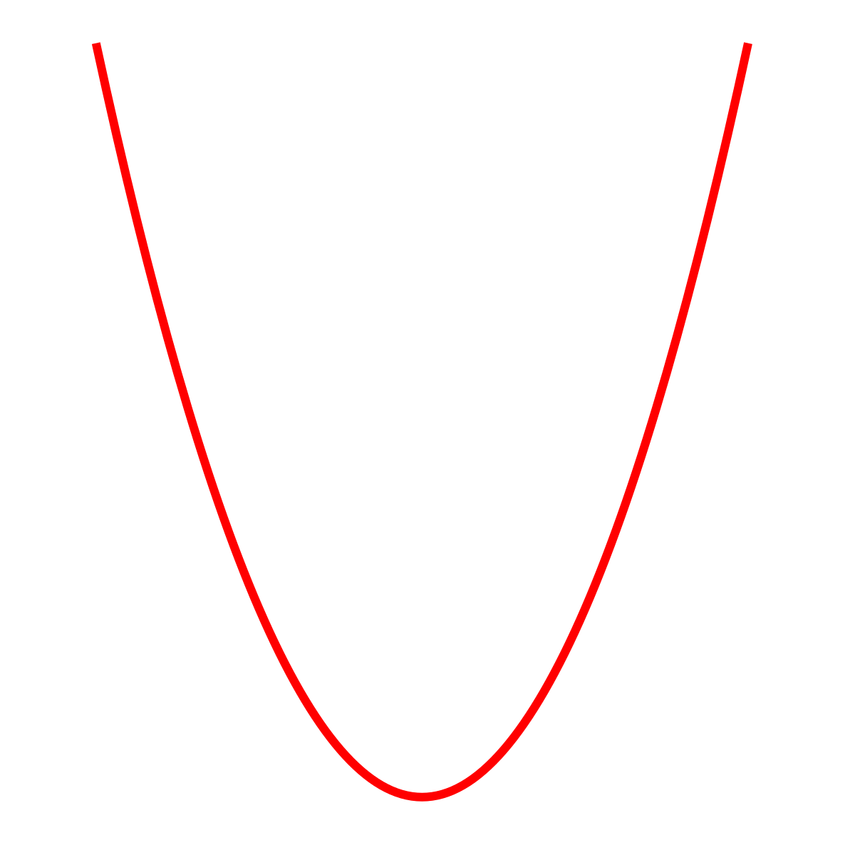
SIMULATION & EXPERIMENT CHAIN
Simulation
Experiment
Monte-Carlo generators
(UrQMD, VHLLE, PHSD, SMASH, ...)
Physics analysis
Particles
Particles
Tracks
PID
Offline
MC points
Tracking
Detectors hits
Detectors hits
Online
Detectors response
Detectors clustering
Detectors digits
Experiment raw data

Slide 4
SOFTWARE & COMPUTING ECOSYSTEM
NICADIST
separate build system
dependencies handling
R & D
Project Management &
Support/User Interaction
GITLAB
codebase
CI
testing
SUPPORT
helpdesk
telegram
channel
WEBSITE
howtos
docs
general info
CVMFS
software distribution
unified environment
MPDRoot
MPD experiment
TPC installation: Beginning of 2026
ANALYSIS
SIMULATION
RECONSTRUCTION
Mass Production
DETECTOR CALIBRATION
alignment
noise level
digitalization delay
drift velocity
trigger latency
ONLINE EVENT DISPLAY
experiment visualization
QA
PWG REQUESTS HANDLING
DIRAC INTERWARE
Computing Infrastructure
(MICC & friends)
      supercomputer
      clusters
      storage systems
DATA
storage & retrieval
adjustnment
clustering

Slide 5
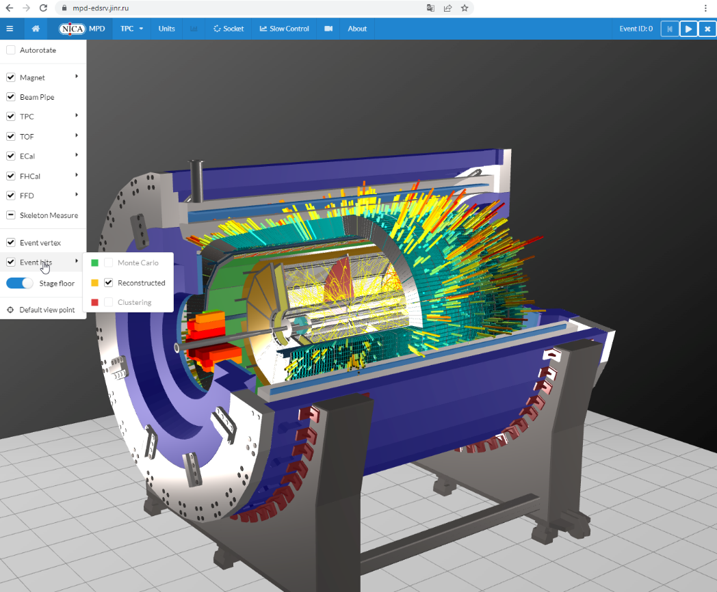
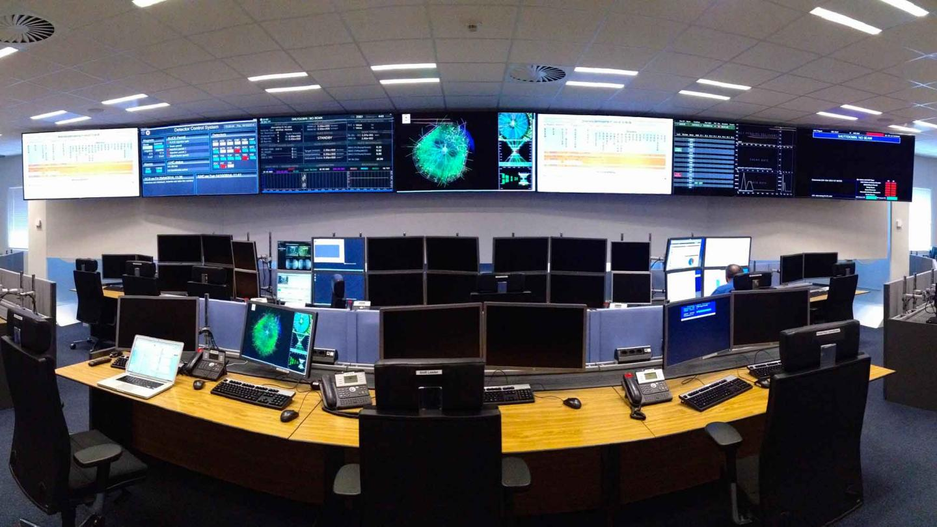
MPD EXPERIMENT VISUALIZATION
MPD EVENT DISPLAY
https://mpd-edsrv.jinr.ru/
powerful feature-rich professional grade software for the visualization of MPD experiment
superfast webGL 3D-graphics technology at its core
compatible with any web browser
More information:
A. Krylov, Modern Web Technologies in Event Display Creation for High-Energy Physics
FEATURES
modular interactive “on-click” geometry
target online visualization capability 1 event per sec
(once experiment running),
currently played from root files
fast TPC hit reconstruction
MC tracks visualization
reconstructed hits/tracks (from DST file)
ALICE experiment control room

Slide 6
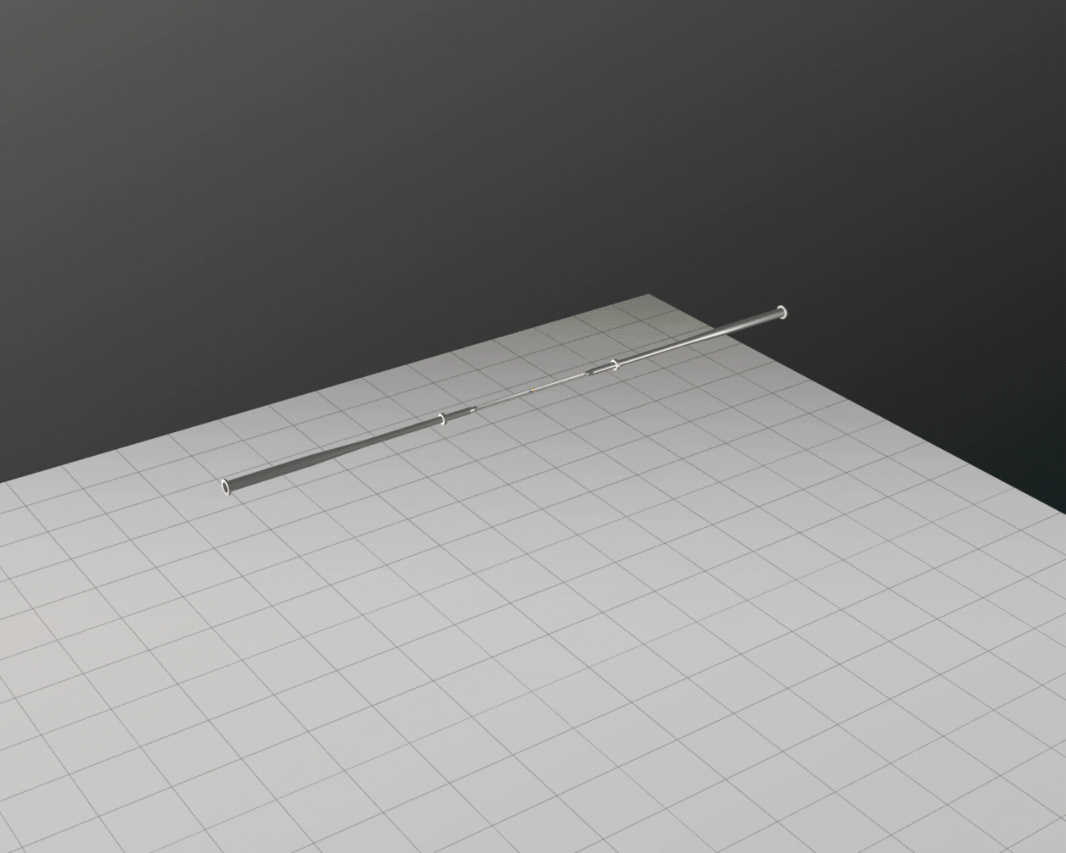
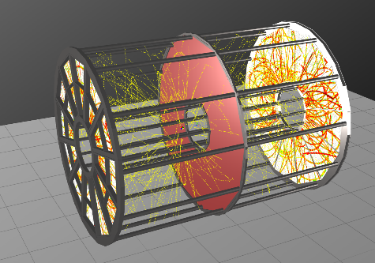
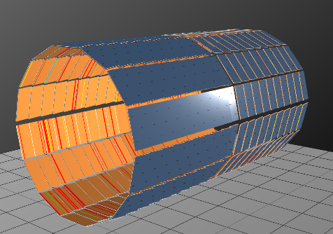
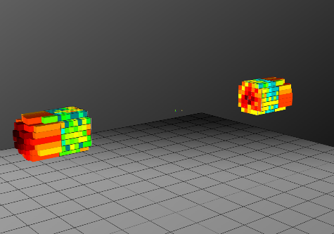
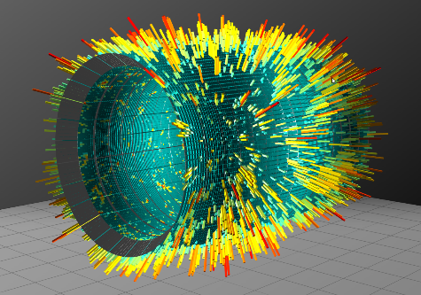
MPD EXPERIMENT VISUALIZATION

Slide 7
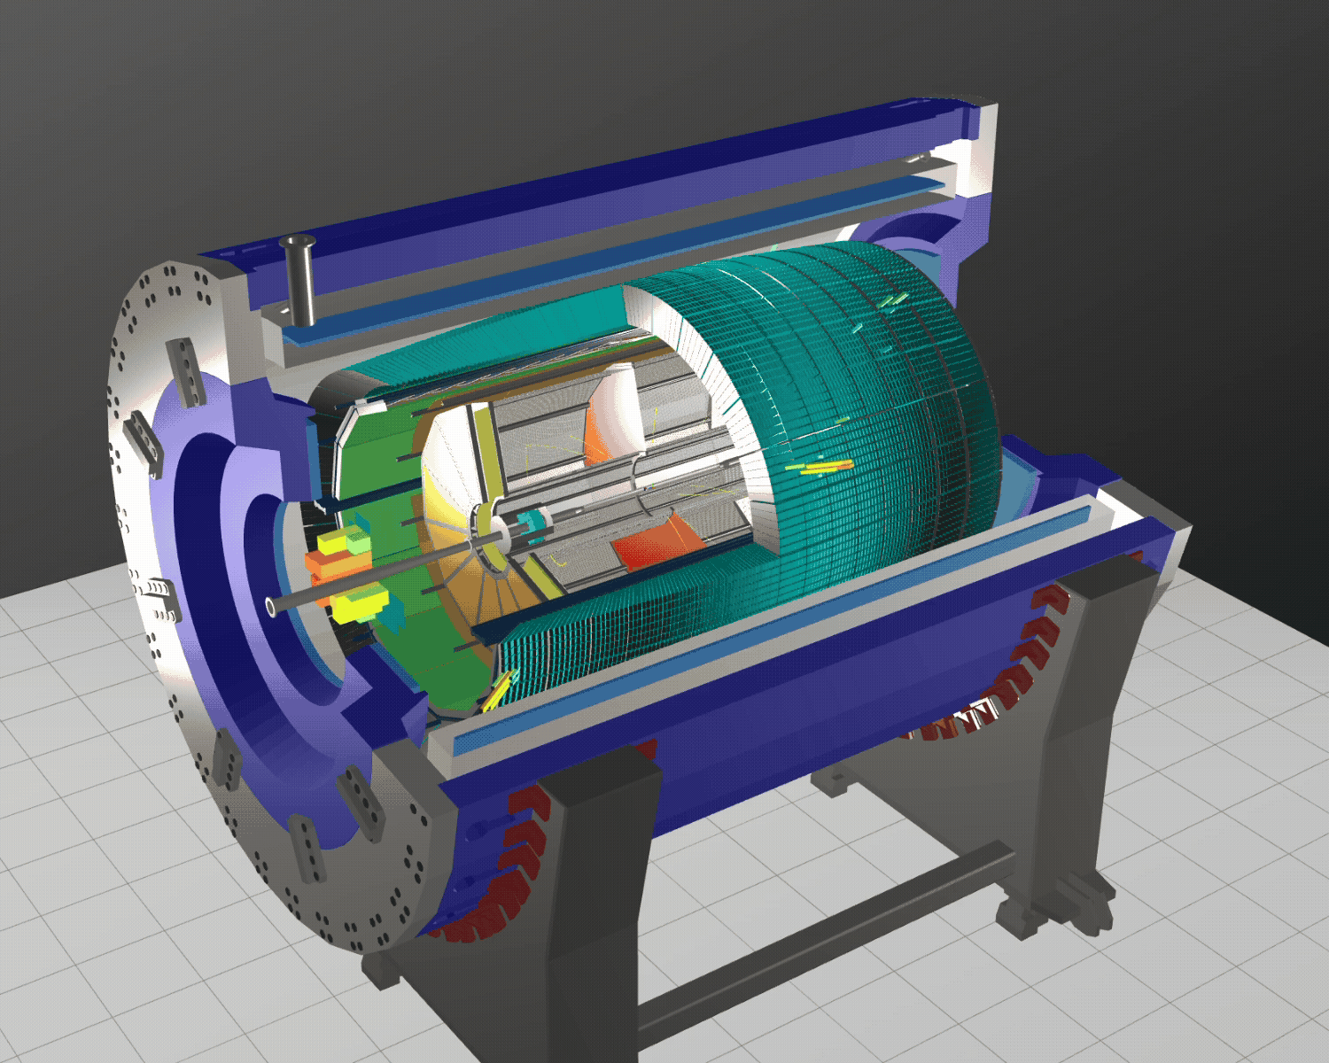

MPD EXPERIMENT VISUALIZATION
Online QA Histograms
Inner pads ADC distribution per sector – 24
Outer pads ADC distribution per sector – 24
Inner pads ADC distribution per timebucket – 24
(per sector)
Outer pads ADC distribution per timebucket – 24
(per sector)
Inner pads ADC distribution for current event – 24
(per sector)
Outer pads ADC distribution for current event – 24
(per sector)
General clusters information – 6
Total number of TPC QA histograms – 150

Slide 8
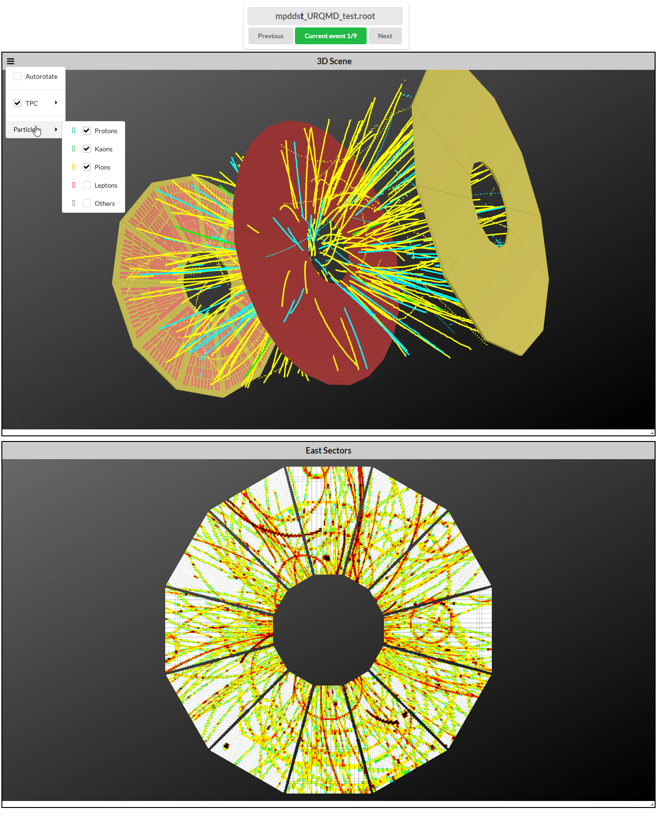
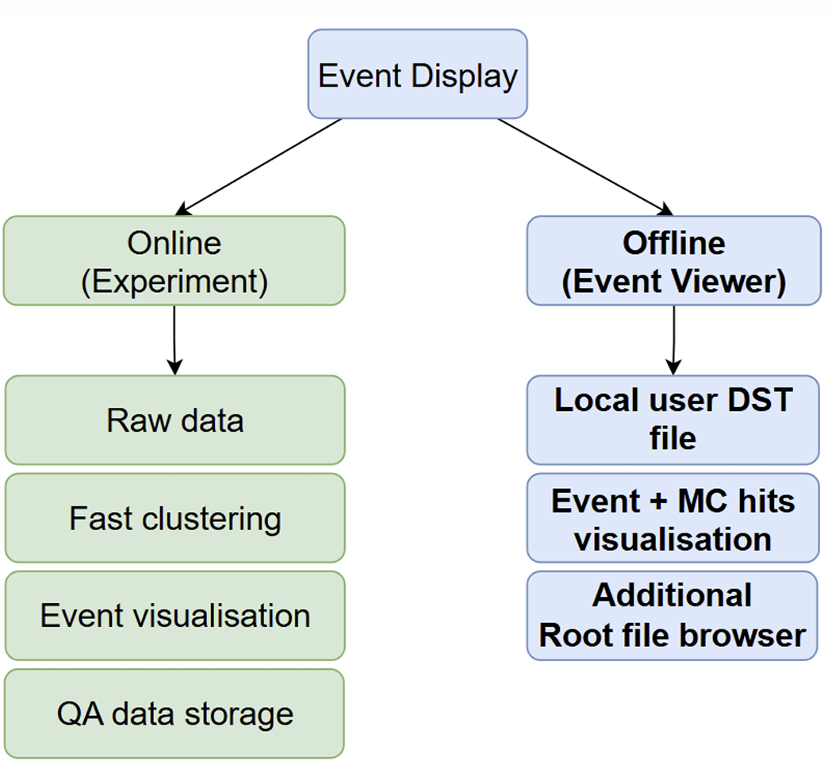
MPD EXPERIMENT VISUALIZATION

Slide 9
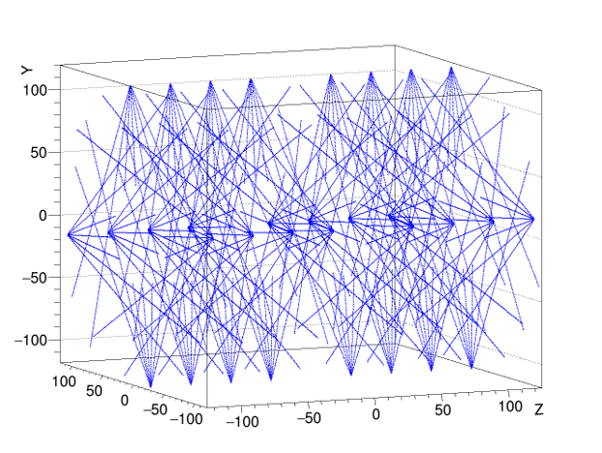
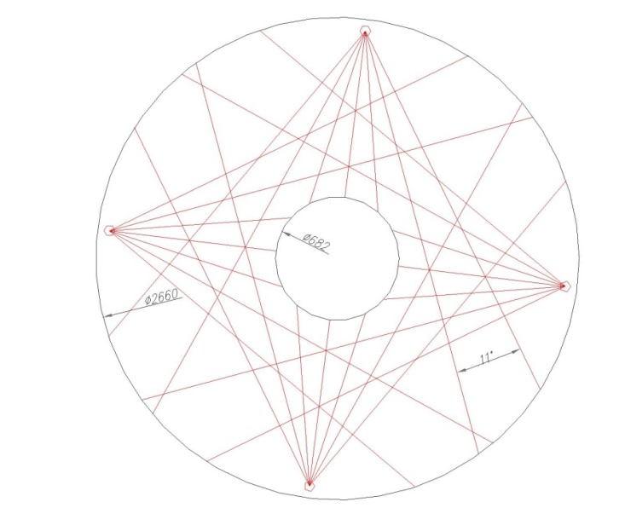
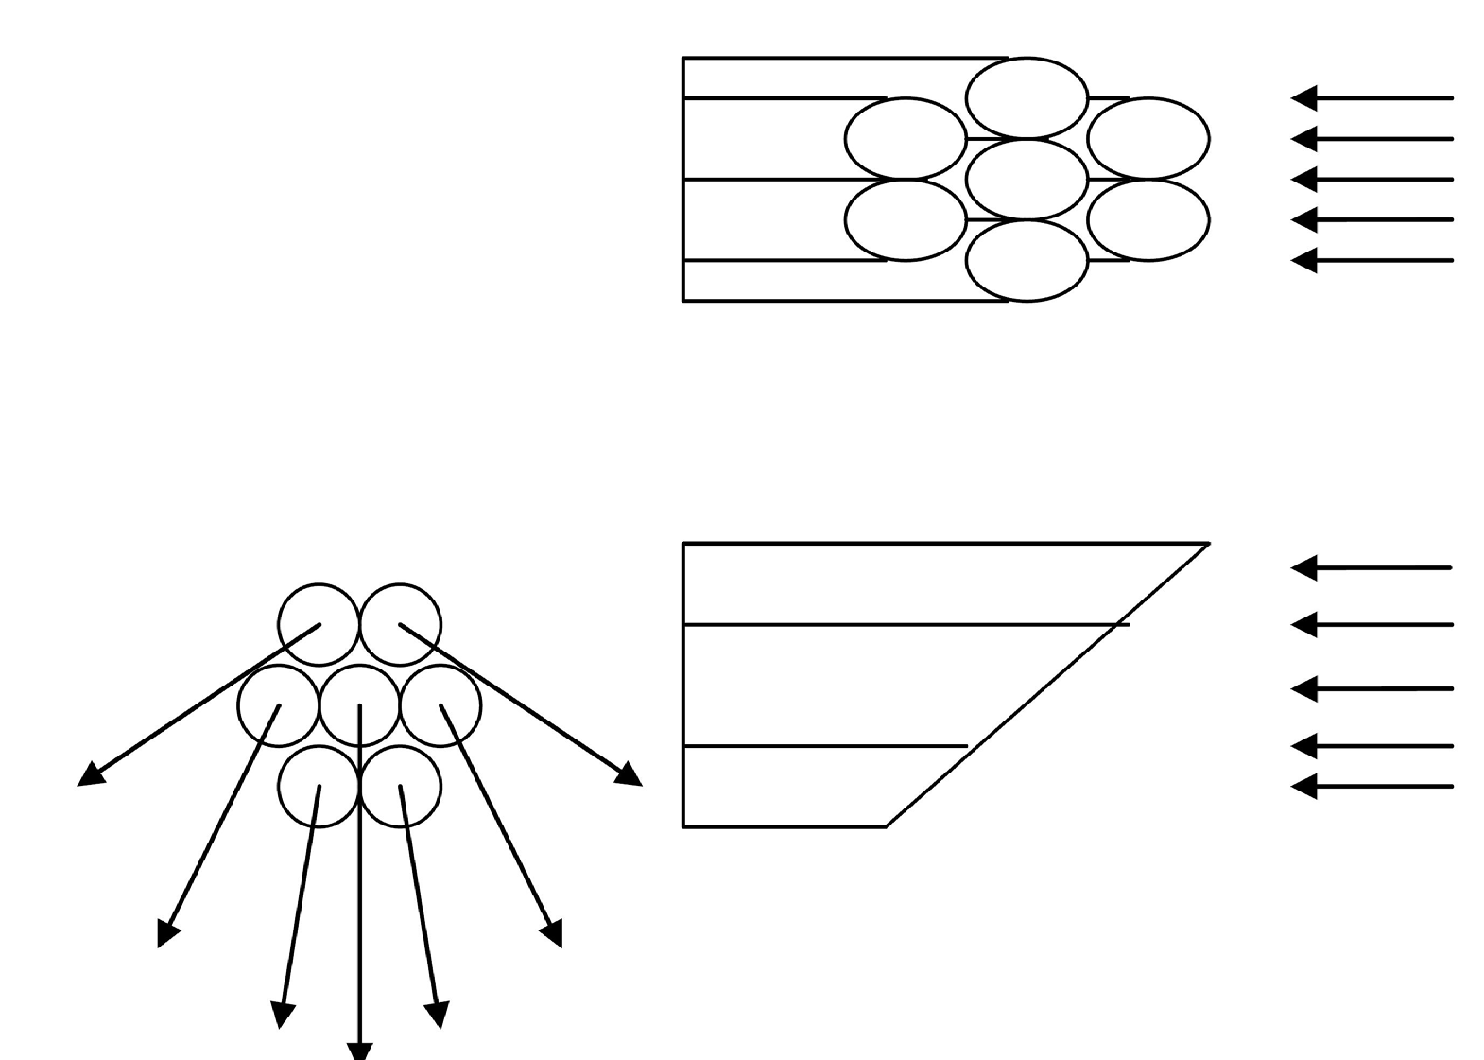
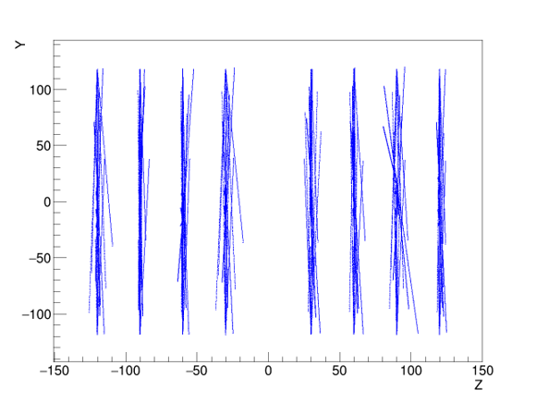
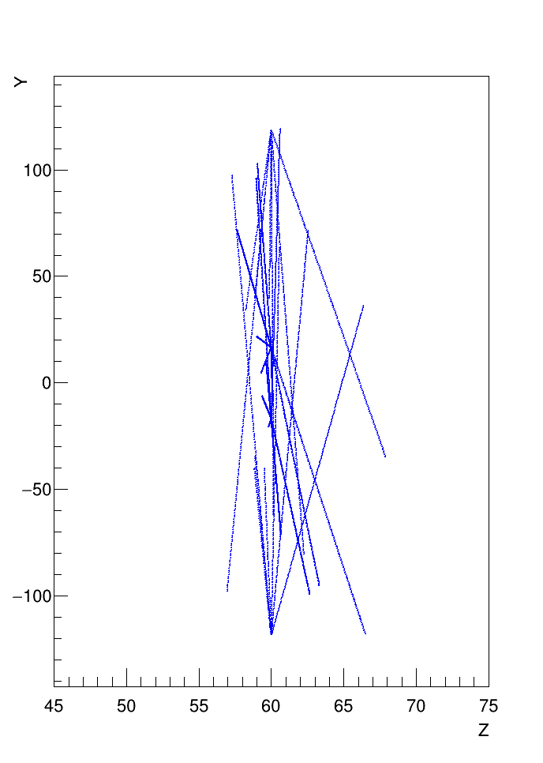
TPC LASER CALIBRATION
UV laser system to provide “tracks”
with known position to get drift velocity
  Two pulsed lasers
  ~1mm diameter
  112 “tracks” in each half of the TPC
    4 planes of laser beams
A.Bychkov

Slide 10
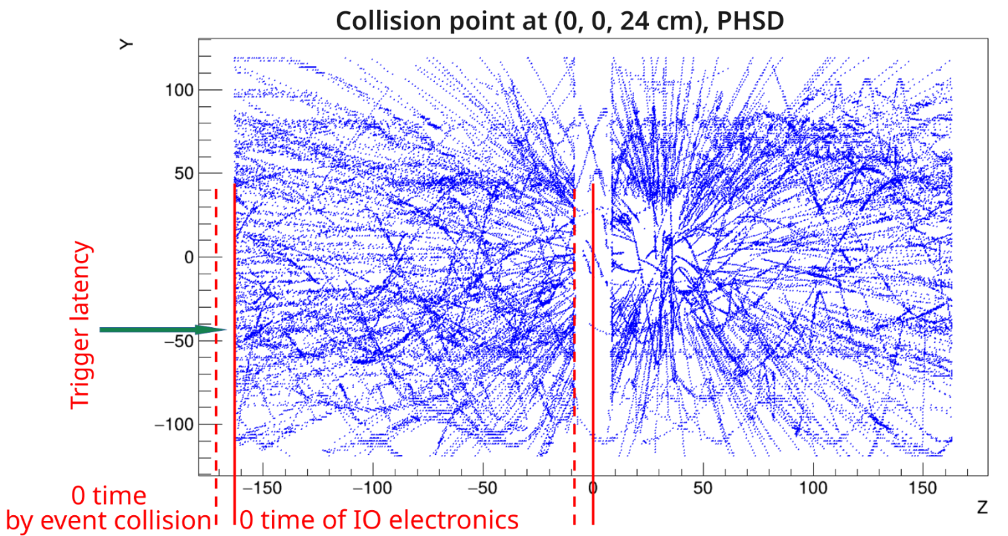
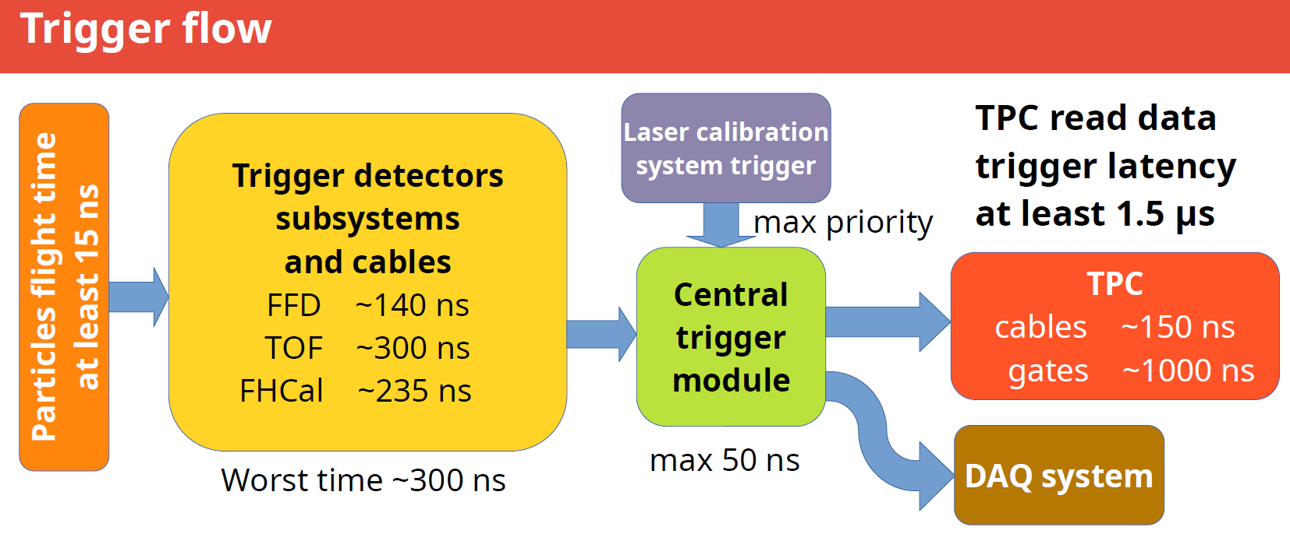
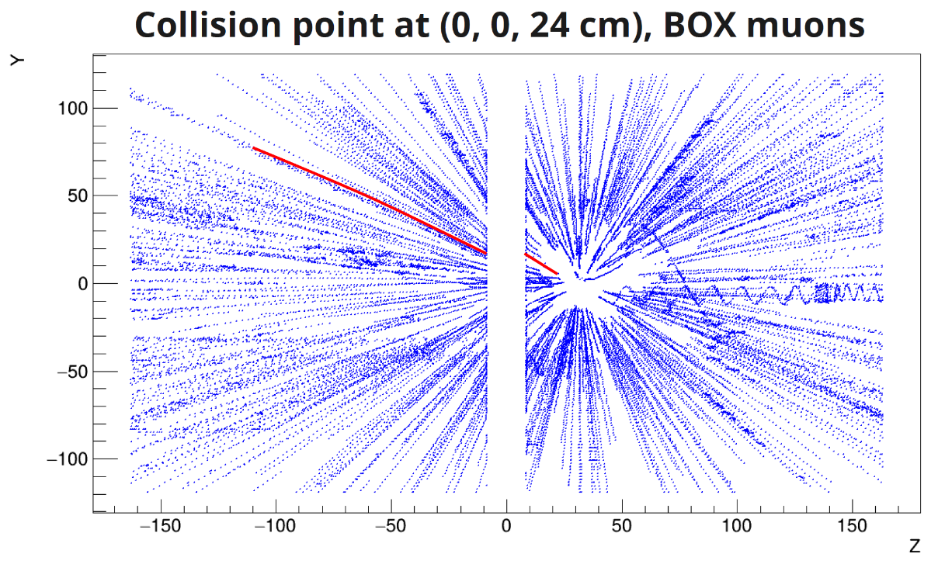
TRIGGER LATENCY
“Implementation of Task for Calibration of MPD TPC Electron Drift Velocity”
Bychkov, A.V., Rogachevsky, O.V., Hnatic, S.
PEPAN Letters, 2024
A.Bychkov

Slide 11
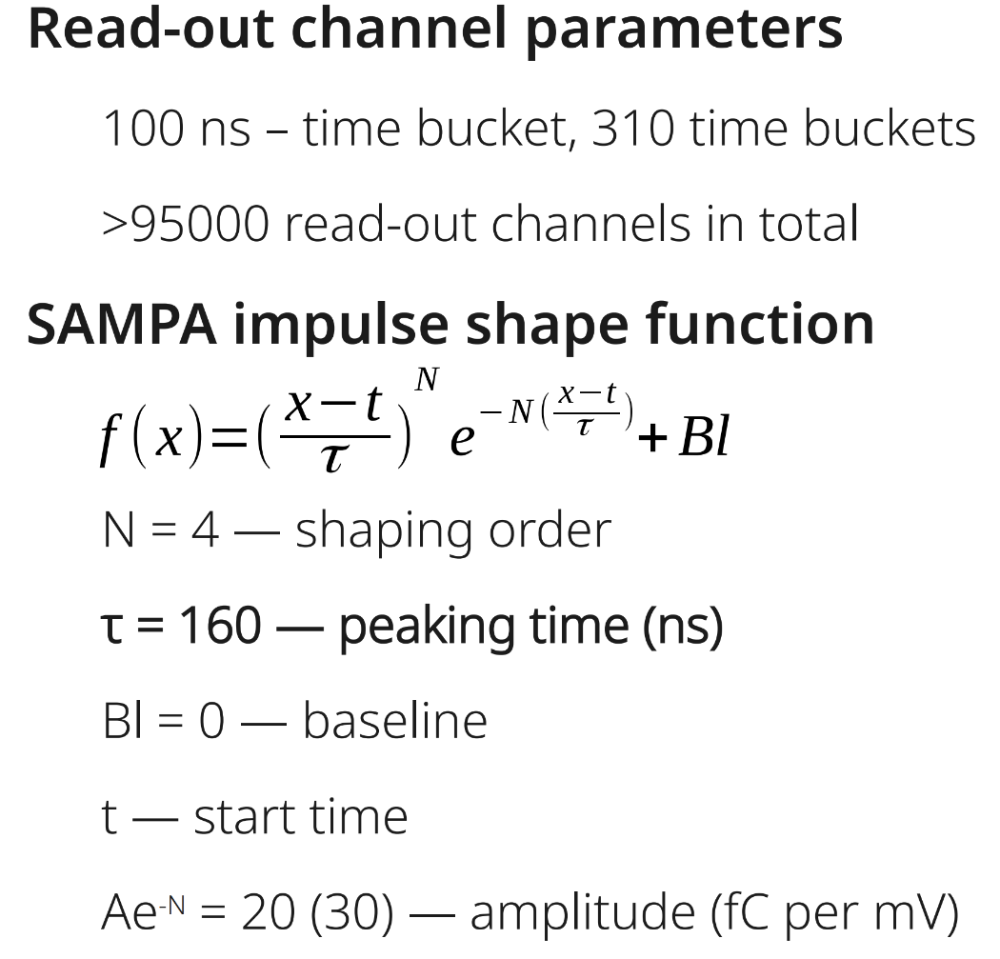
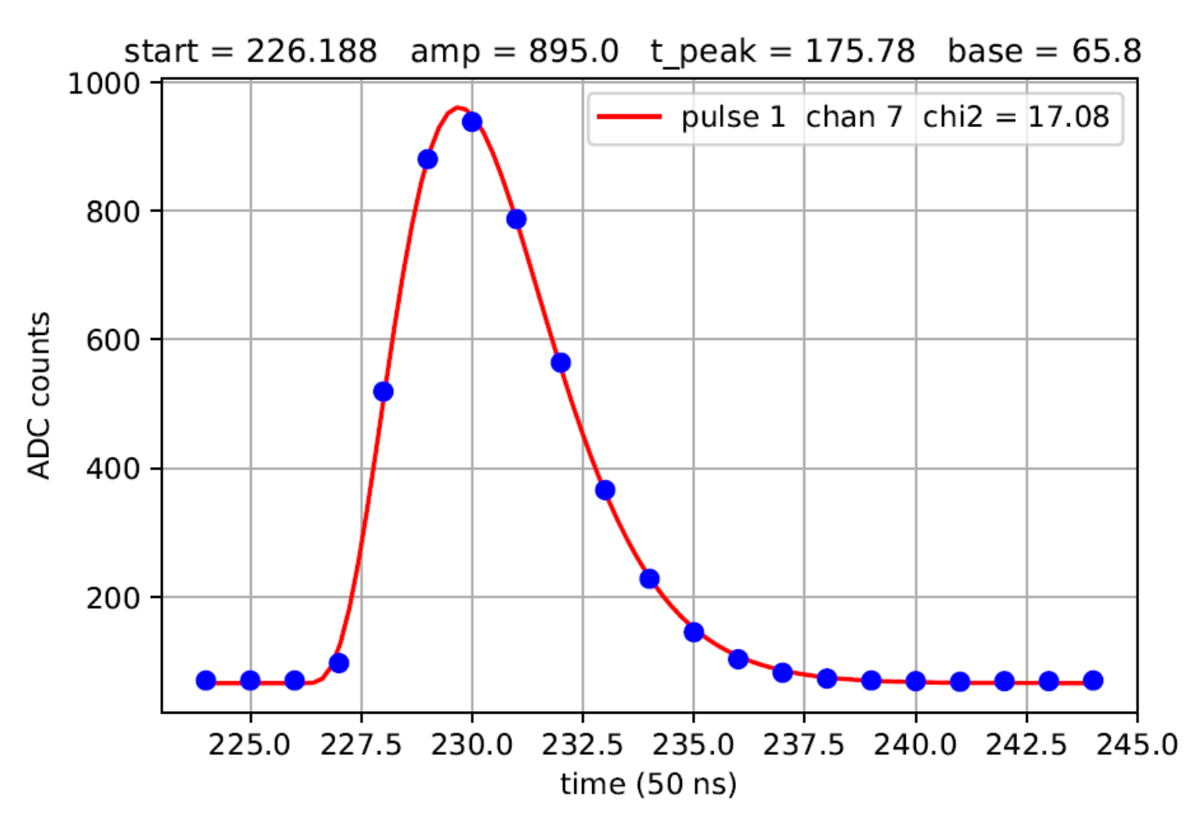
ELECTRONICS RESPONSE CALIBRATION
- realistic SAMPA digitizer was developed
A.Bychkov

Slide 12
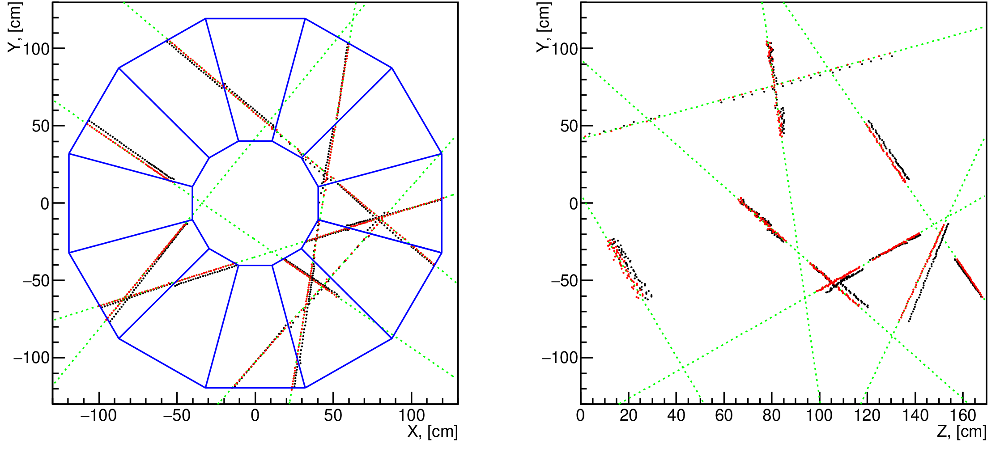
TPC SECTORS ALIGNMENT
Green points – simulated muon tracks
Black points – misaligned hits
Red points – aligned hits
misaligned detector giving misaligned data
mathematical model with 144 input parameters
determine transformation for data alignment
“Influence of Misalignment on Track Reconstruction in the
Time Projection Chamber of the MultiPurpose Detector”
V.A.Kuzmin
Moscow University Physics Bulletin, Vol. 80, No 3., 2025

Slide 13
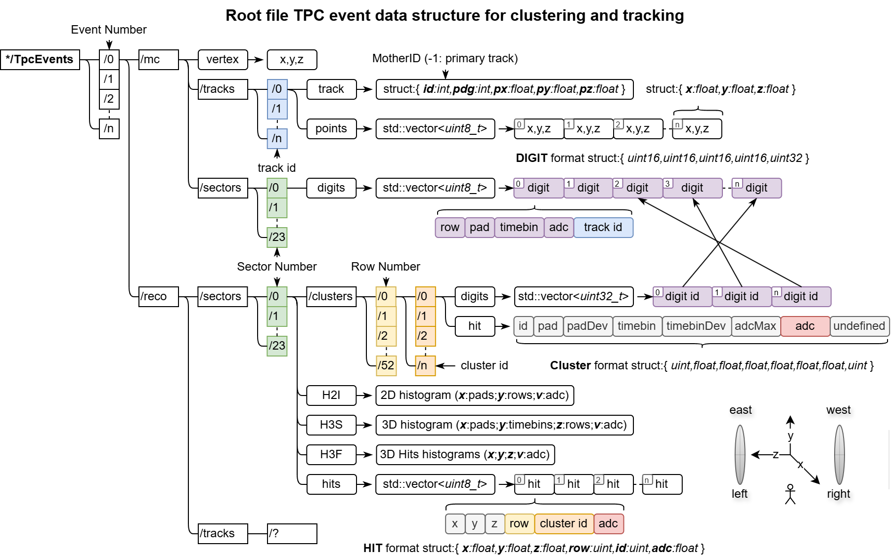
INPUT DATA STRUCTURE
Experiment
SAMPA data
detector calibration parameters
noise information
no mc branch

Slide 14
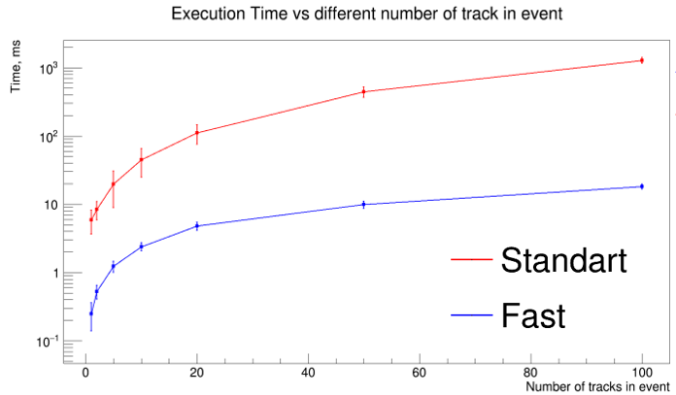
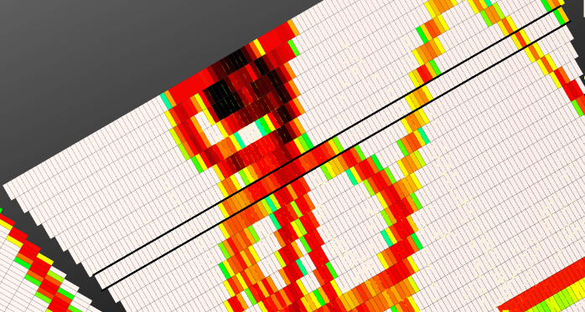
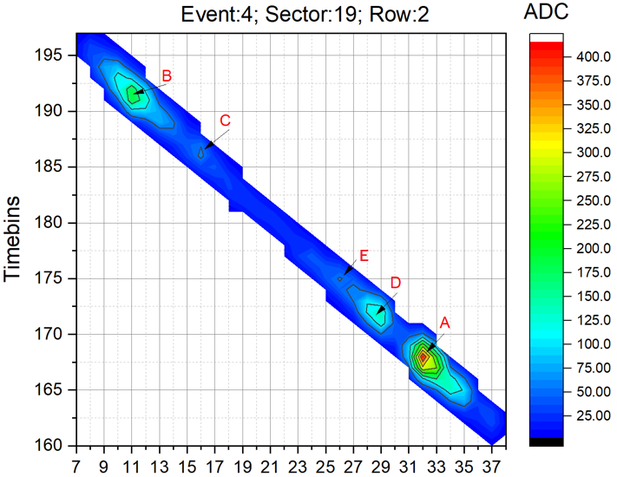
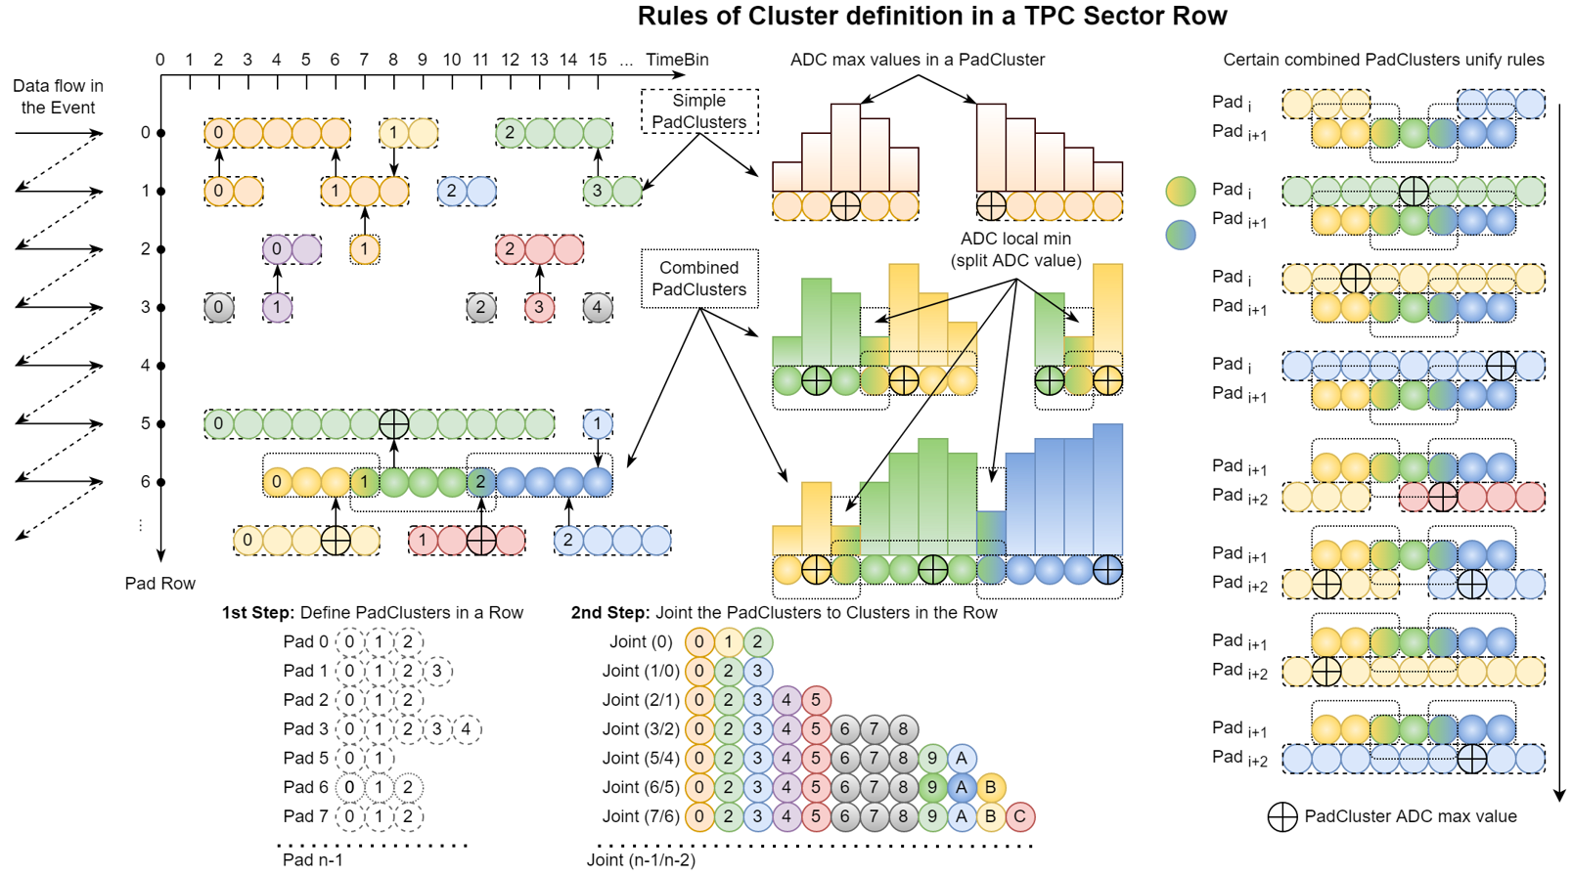
CLUSTERING & HIT EXTRACTION
FAST CLUSTERING
Unique algorithm
24 threads (POSIX threads library)
~100 times faster than standard clustering !
V.Krylov, A.Krylov

Slide 15
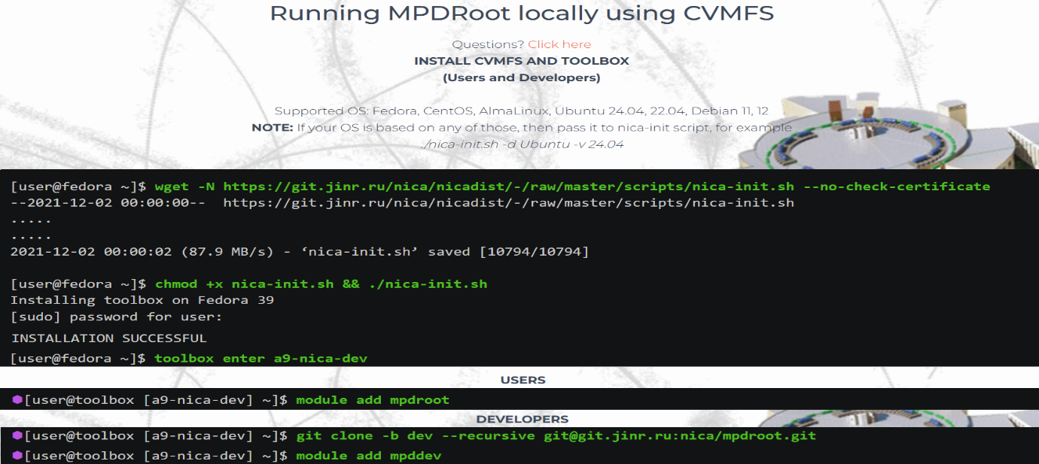
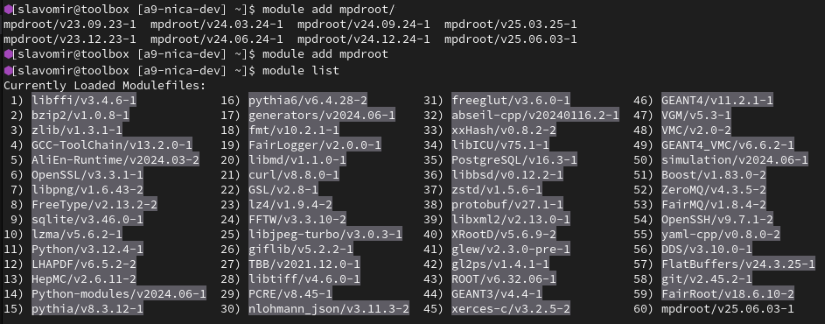
MPDROOT: USER PERSPECTIVE
INSTALLATION
https://mpdroot.jinr.ru/running-mpdroot-on-local-machine-using-cvmfs/
ENVIRONMENT & DEPENDENCIES
the environment & dependency tree for the same mpdroot or mpddev versions are identical
no compatibility issues by definition
RELEASES
release schedule: every 3 months
“module add mpdroot” loads latest mpdroot/v25.06.03
old releases can be loaded using specifier
every release is coupled to its own dependency tree
USER SUPPORT
- service desk at http://mpdroot.jinr.ru/q-a/

Slide 16
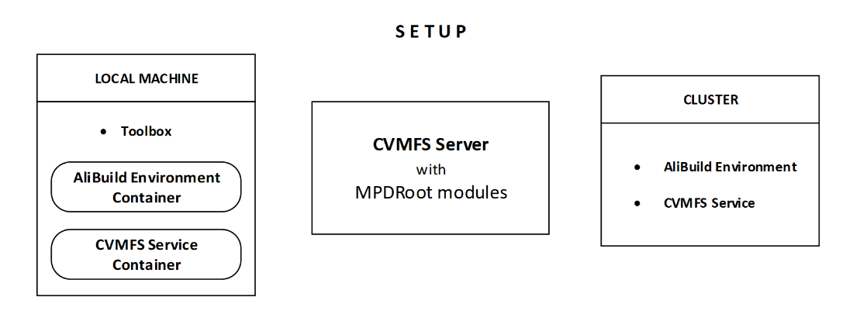
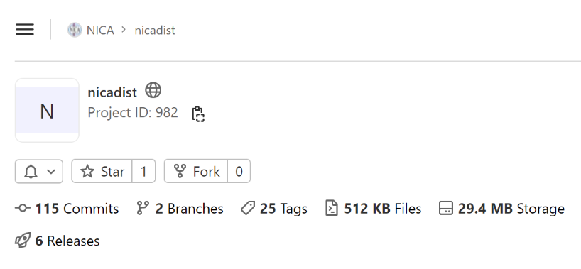
BUILD & DEPLOYMENT SYSTEM
NICADIST project
build system decoupled
modular build
builds packages from sources &
keeps track of their dependencies
sophisticated solution of
“dependency hell”
inspired by ALICE project
Quick, user-friendly installation
Unified environment for users and developers,
guaranteed compatibility
No build & configuration for users
Less support required
Easy updates, less maintenance
“Unified Software Development and Analysis Environment for MPD Experiment at NICA Collider”
Busa J. Jr., Hnatic S., Korenkov V., Rogachevsky O., Vala M., Vrlakova J.
Modern Information Technologies and IT-education , 2022

Slide 17
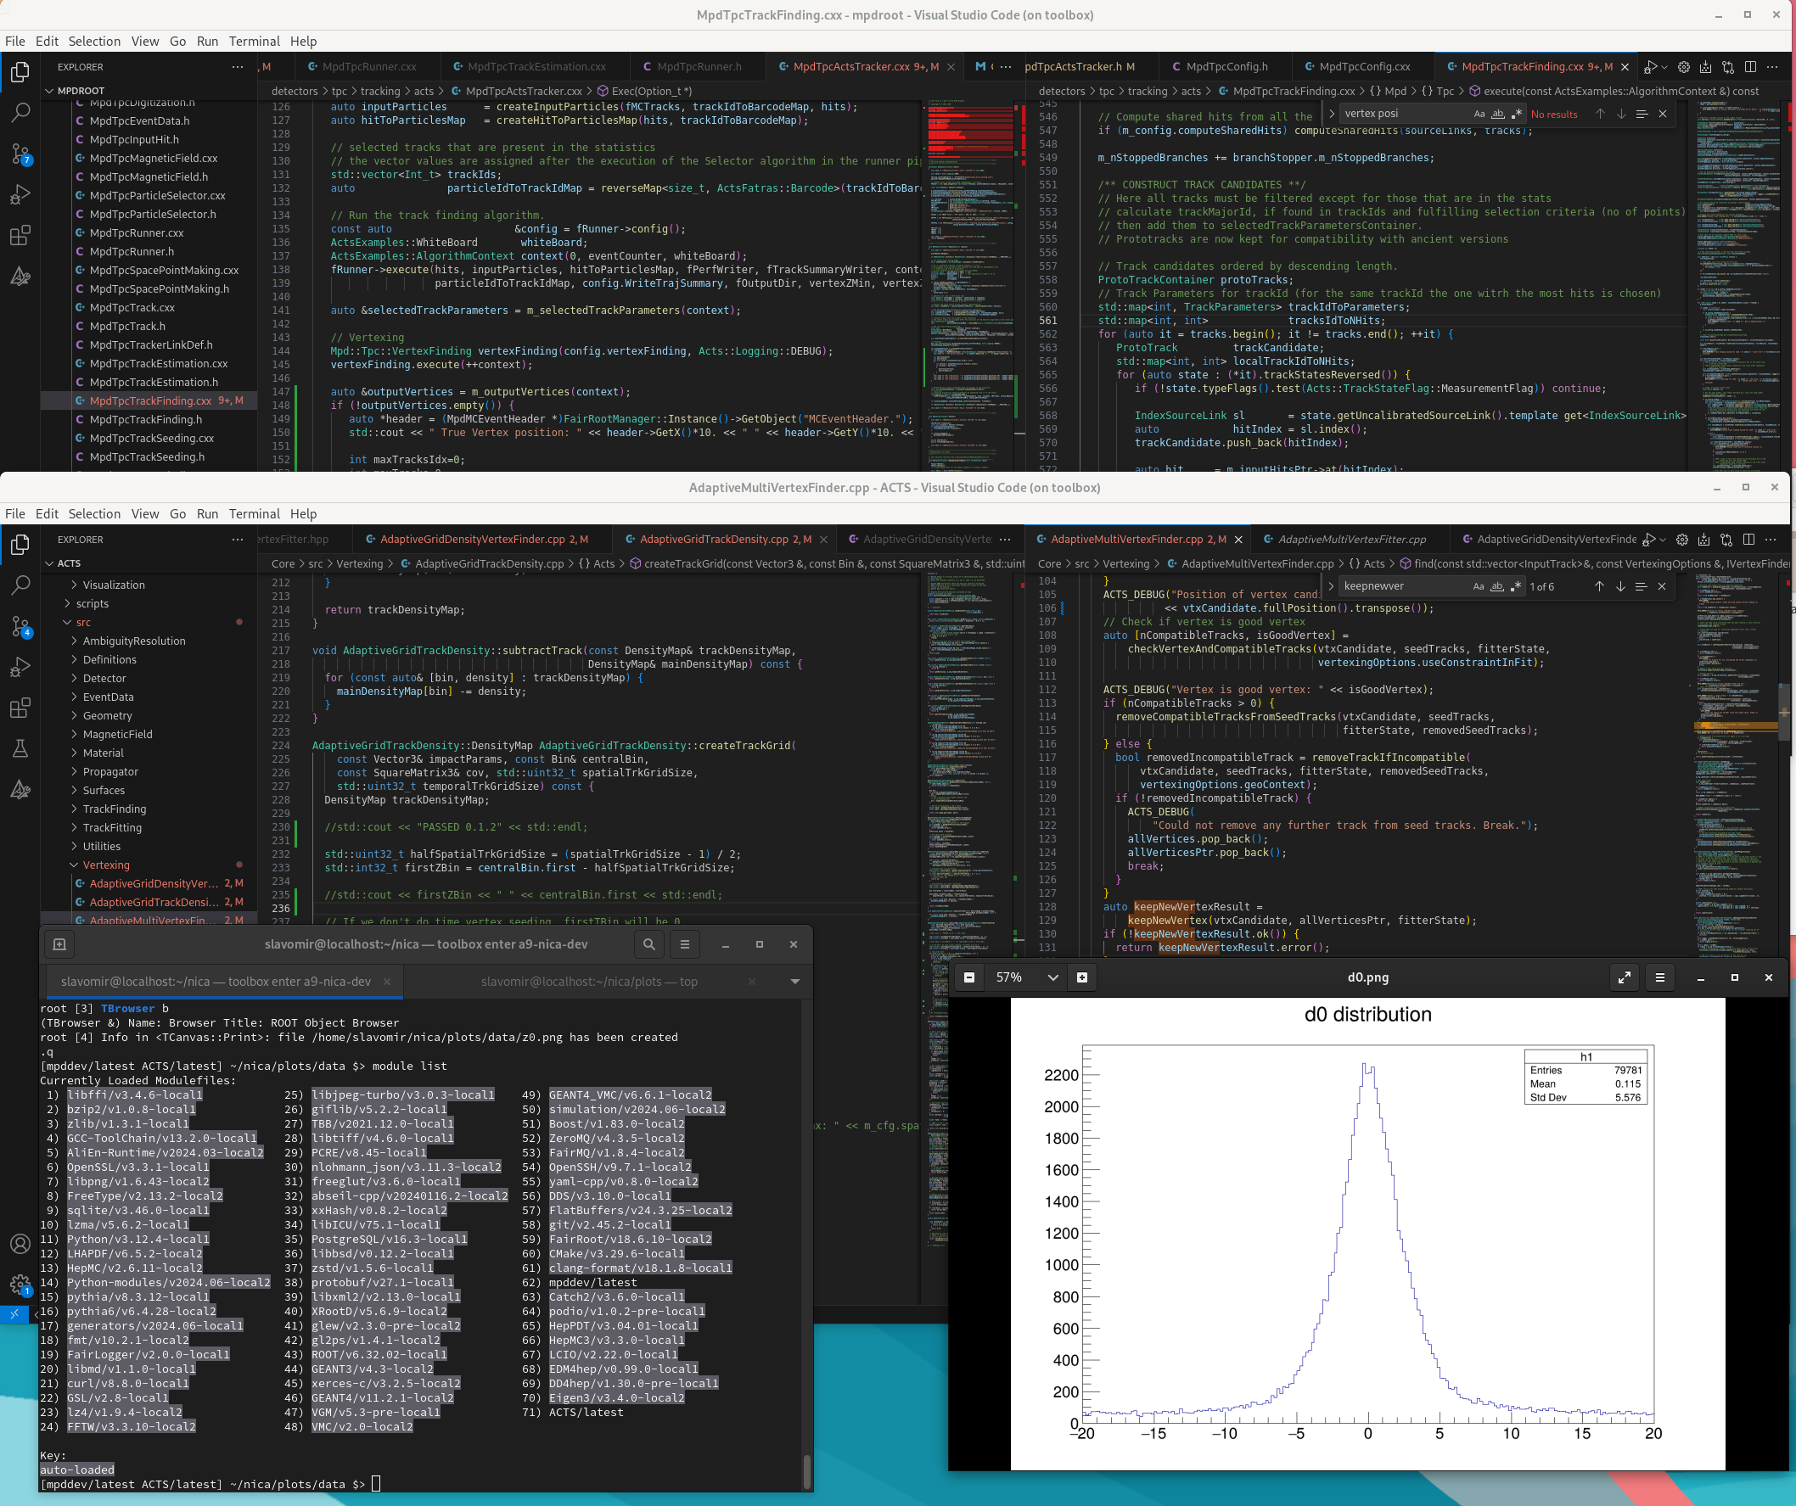
MIGRATION, CUSTOM PACKAGES
Environment
Virtual machine with full build (alibuild)
71 packages (currently)
All source codes can be debugged
(ACTS, FairRoot, ROOT,….)
Recompilation intelligently done by alibuild
Patching dependencies
Custom features needed for MPD outside of MPDRoot
Effective development otherwise impossible
Lack of documentation
Overall complexity

Slide 18
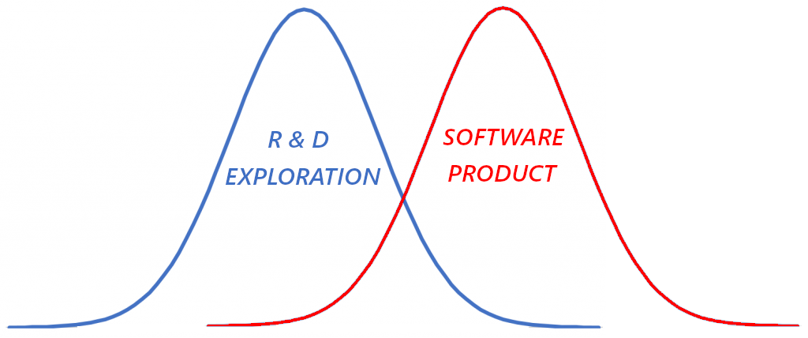
SD BEST PRACTICES
“…the profession in which a knowledge of the mathematical and natural sciences gained by study, experience, and practice is applied with judgment to develop ways to utilize, economically, the materials and forces of nature for the benefit of mankind.”
-- Accreditation Board of Engineering & Technology (www.abet.org)
SEPARATION OF CONCERNS
thinking of software entity attributes in isolation, while keeping in mind, they’re part of the whole
E.Dijkstra “On the role of scientific thought” (1974)
CORE INFLUENCES
size / scaling
structural complexity
software defects
uncertainty
human variation
synergy
Technology Development =
Scientific Theory + Engineering Practice + Economy
SWEBOK v4 (2025, computer.org)
International ISO Standard
specifying the guide to
Software Engineering Body of Knowledge
COCOMO II (COst COnstructive MOdel)
mo Most rigorous statistical analysis of past software projects from historical data
Roadmap for Effective Software Development
ACTIVITIES FOCUS

Slide 19

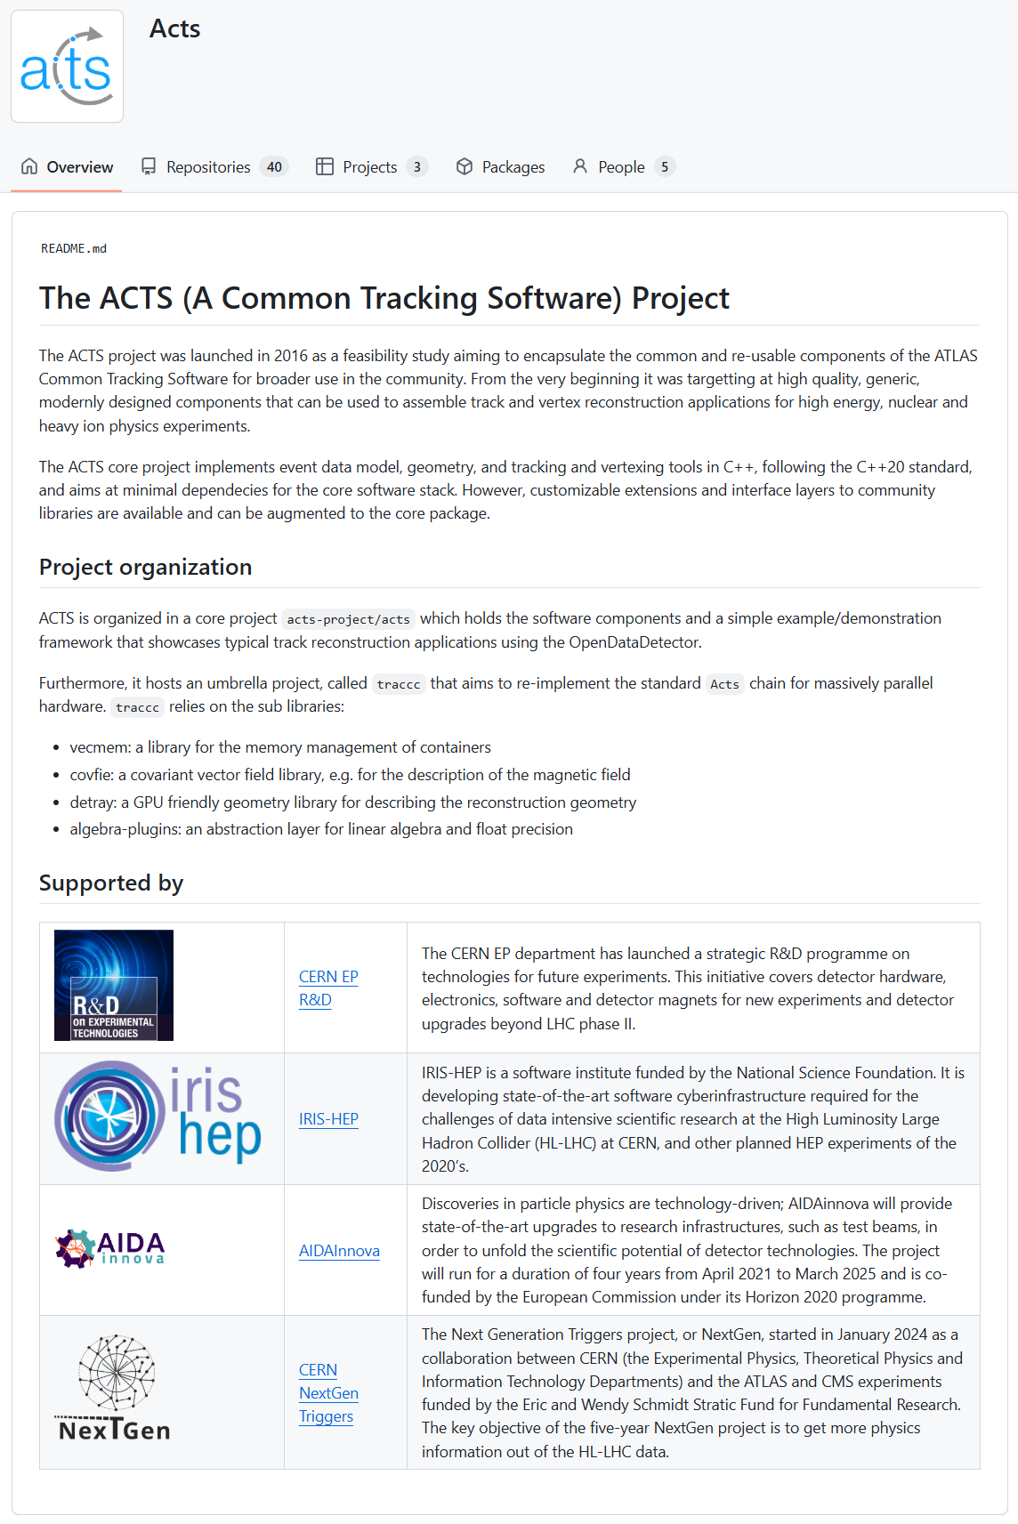
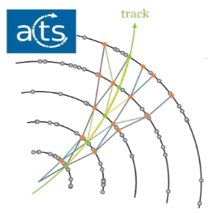
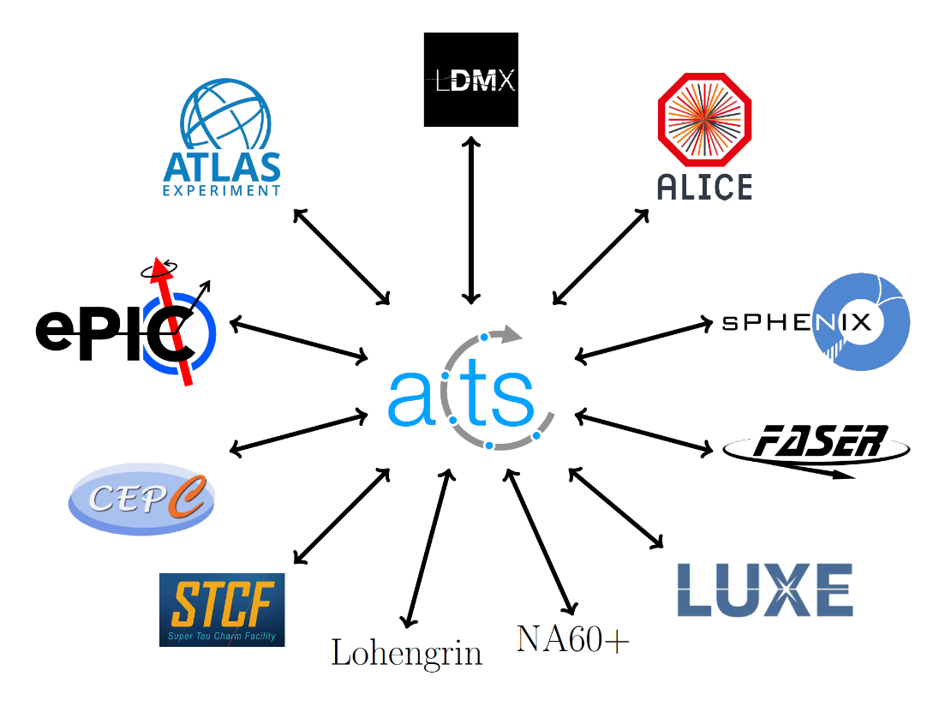
ACTS: A COMMON TRACKING SYSTEM
Track Finding with Combinatorial Kalman Filter
uses KF on multiple branches
Vertex Finding
“The ACTS Project”
A. Salzburger et al.
ACTS for Nuclear Physics, Berkeley, 2025

Slide 20
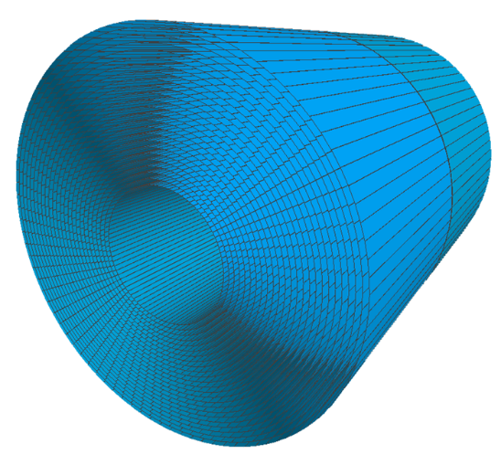
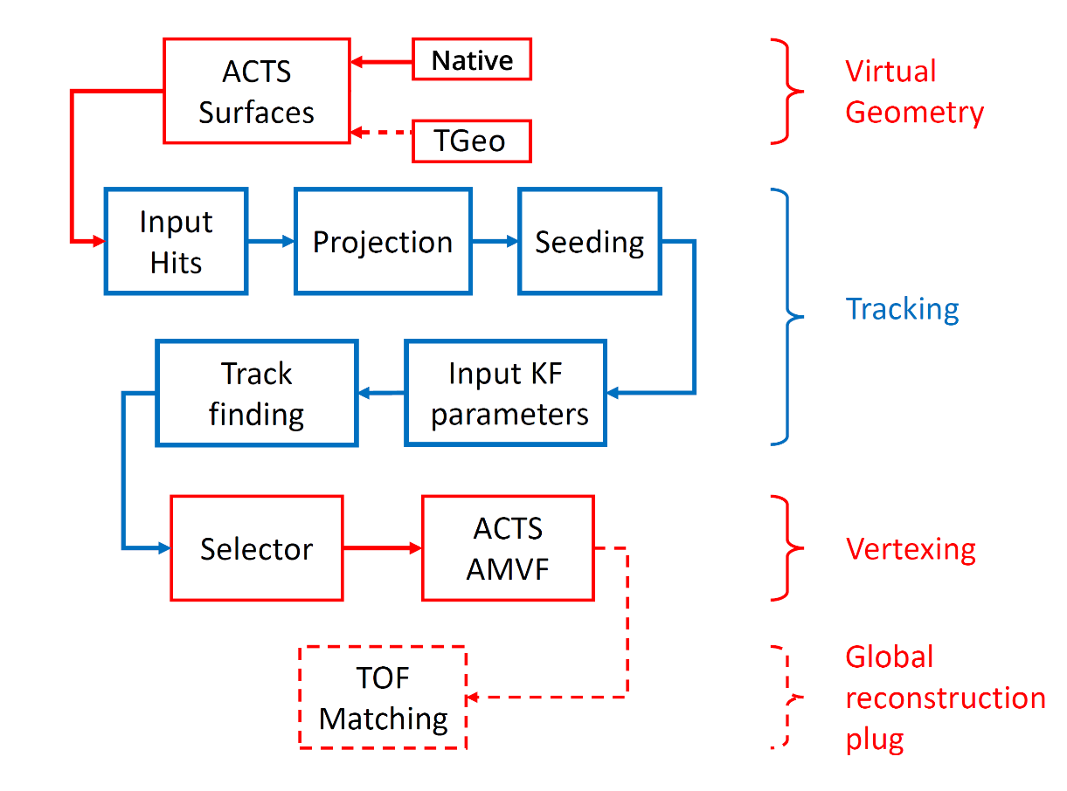
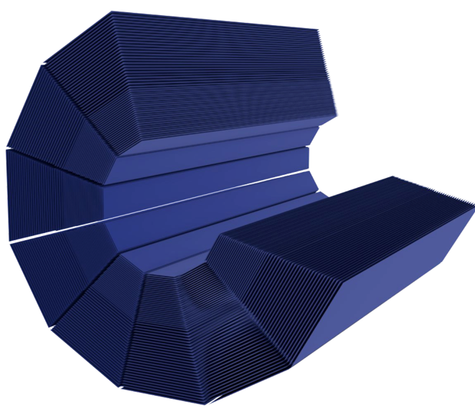
ACTS IN MPDROOT
Cylindrical virtual geometry
Sectors & Layers
Implemented by parsing the ROOT
TGeo geometry and converting the
TGeoNode volume into Acts Surface
heavy, phased out
J.D. Osborn et al.
“Implementation of ACTS into sPHENIX Track Reconstruction.”
Computing and Software for Big Science, 2021
Native MPD TPC geometry
24 Sectors & 53 Padrows
no conversion:
Volumes & Surfaces are created
and glued together directly
faster, lightweight, in testing
ACTS pipeline in MPDRoot

Slide 21
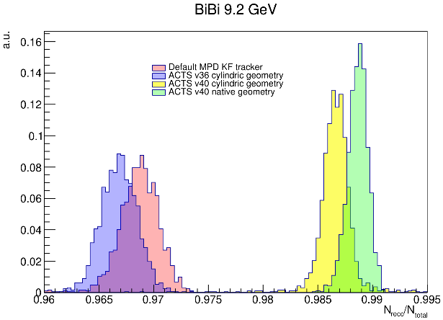
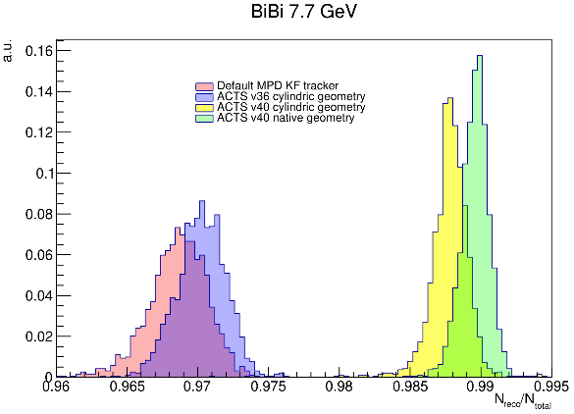
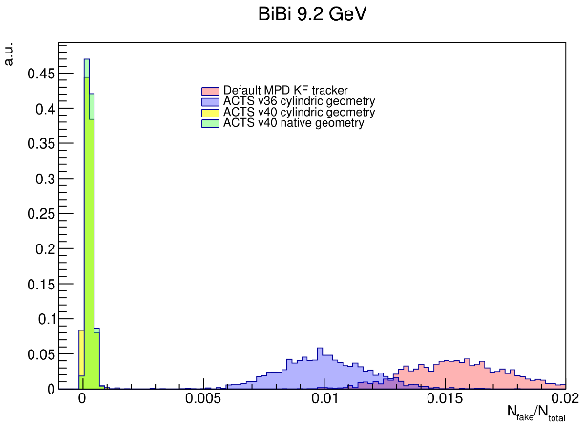
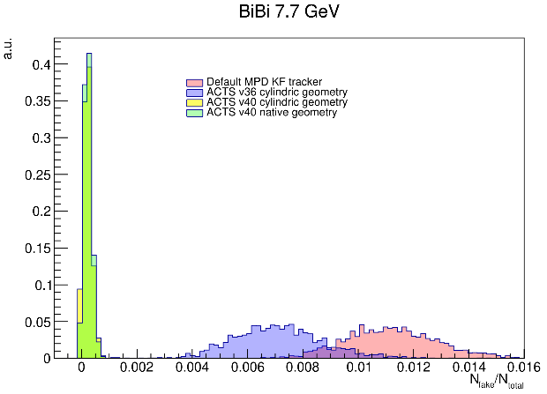
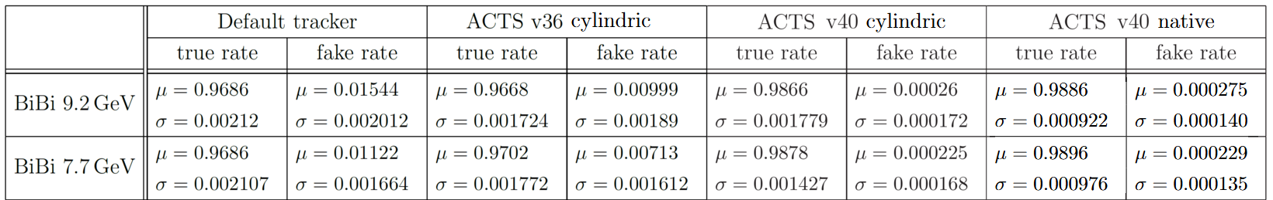
TRACKING EFFICIENCY
Standard clustering
UrQMD, 200000 events
9 minimum hits per track
P_t > 0.1 GeV
CKF enhancements: much better efficiency, far less fakes
Native geometry: more efficiency improvement
Efficiency
Fake rate
“Implementation of ACTS into MPDRoot”
S. Hnatic, J. Busa Jr., A. Bychkov, A. Krylov, V. Krylov, A. Moshkin, O.Rogachevsky
MMCP ‘24 Proceedings, PEPAN

Slide 22
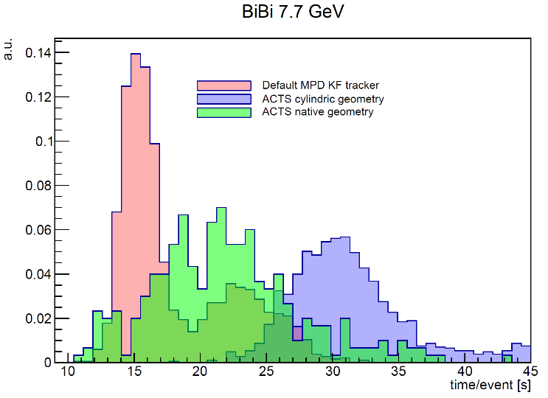
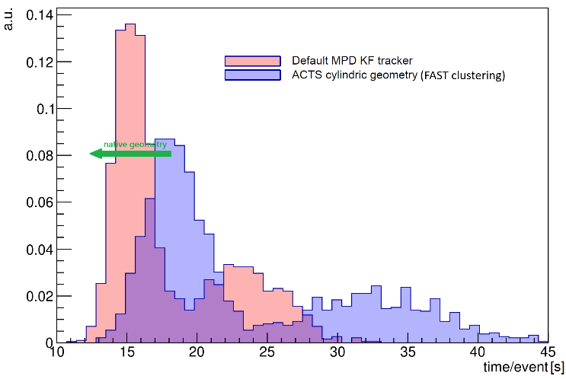
TRACKING SPEED
STANDARD + DEFAULT KF | µ = 18.12 s / event | σ = 4.28 s / event
STANDARD + ACTS cylindric geometry | µ = 31.12 s / event | σ = 2.27 s / event
STANDARD + ACTS native geometry | µ = 21.95 s / event | σ = 5.60 s / event
FAST clusterhitfinder – initially written for online event display processing
STANDARD + DEFAULT KF | µ = 18.12 s / event | σ = 4.28 s / event
FAST + ACTS cylindric geometry | µ = 23.41 s / event | σ = 7.48 s / event
FAST + ACTS native geometry | ? | ?
FAST v0.2.0 (2023y) + ACTS cylindric geometry … 25% speedup, efficiency issues
FAST v2.0.8 (2025y) + ACTS native geometry … port ready soon (~1 month of work),
new combo should be superior in all aspects: speed, efficiency, resource usage, maintainability

Slide 23
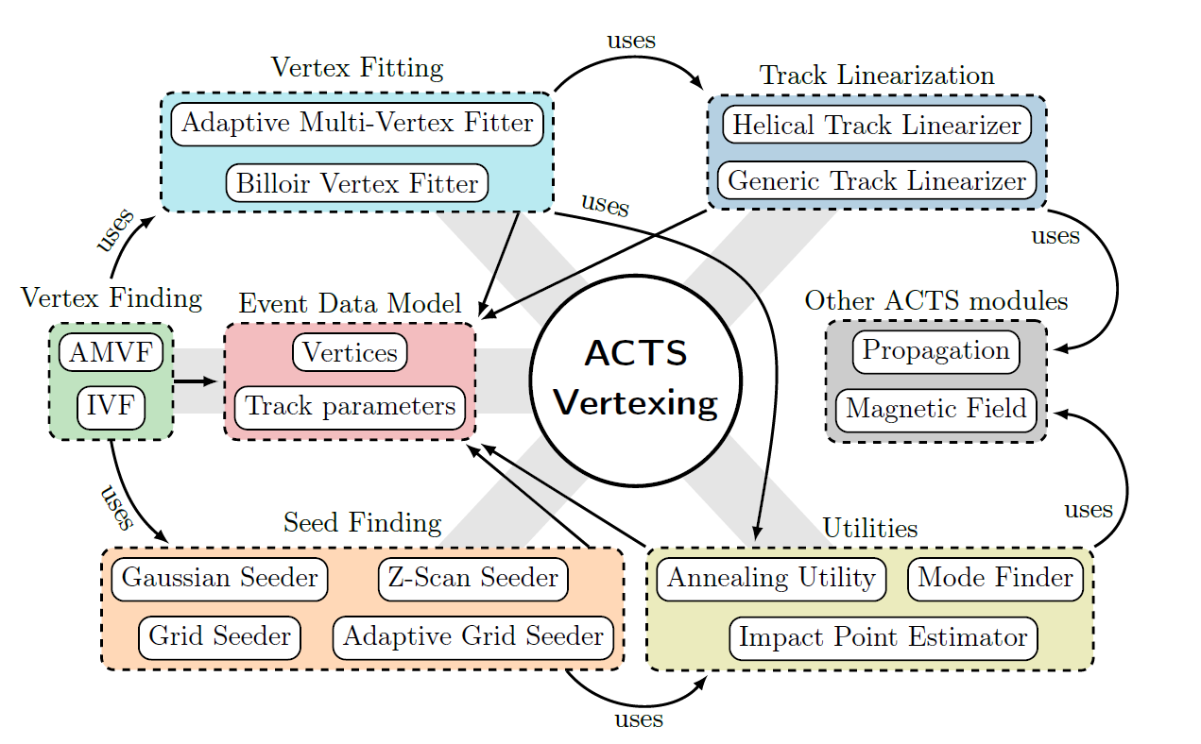






ACTS PRIMARY VERTEXING
ACTS VERTEXING SUITE
PERIGEE TRACK PARAMETRIZATION
Track selection: |d_0| < 2mm
Schlag S. “Advanced algorithms and software for primary vertex reconstruction and search for flavor-violating supersymmetry with the ATLAS experiment.” Dissertation, Johannes Guttenberg-Universitaet Mainz, 2022.
- many tunable parameters
1000 events, BOX generator
X-X
Y-Y
Z-Z
true
true
true

Slide 24



MASS PRODUCTION
Generator | PWG | Coll. | $$\sqrt{s}$$ | # of events(${10}^{6}$) | Reco
UrQMD | PWG4 | AuAu | 11 | 15 | +
 |  | BiBi | 9 | 10 | +
 |  |  | 9.46 | 10 | +
 |  |  | 9.2 | 135 | +
 | PWG2 | AuAu | 11 | 10 | +
 | PWG3 | AuAu | 7.7 | 10 | +
 |  | BiBi | 7.7 | 10 | +
 |  |  | 9 | 15 | +
 |  | pp | 9 | 10 | +
 |  | BiBi fix target | 2.5 | 12 | +
 |  | BiBi fix target | 3.0 | 12 | +
 |  | BiBi fix target | 3.5 | 12 | +
 |  | XeW fix target | 2.5 | 15 | +
 |  | XeXe fix target | 2.5 | 15 | +
 | PWG1 | BiBi | 9.2 | 76 | +
DCM-SMM | PWG1 | BiBi | 9.2 | 2 | +
PHQMD | PWG2 | BiBi | 8.8 | 15 | +
 |  |  | 9.2 | 61 | +
 |  |  | 2.4/3.0/4.5 | 10/10/2 | -
vHLLE-UrQMD | PWG3 | BiBi | 11.5 | 15 | +
 |  | AuAu | 11.5 | 15 | +
 |  | AuAu | 7.7 | 20 | +
 |  | BiBi | 9.2 | 48 | +
Smash | PWG1 | BiBi | 9.46 | 10 | +
 |  | ArAr | 4/7/9/11 | 20/20/20/20 | -
 |  | AuAu | 4/7/9/11 | 20/20/20/22 | -
 |  | XeXe | 4/7/9/11 | 20/20/20/20 | -
 |  | CC | 4/7/9/11 | 20/20/20/20 | -
 |  | pp | 4/7/9/11 | 50/50/50/50 | -
JAM | PWG3 | AuAu | 3/3.3/3.5/3.8/4.0/4.2/4.5/5 | 40/40/40/40/40/40/40/40
DCM-QGSM-SMM | PWG3 | AuAu | 4/9.2 | 5/5 | +
 |  | AgAg | 4/9.2 | 5/5 | +
 |  | BiBi | 4/9.2 | 5/6 | +
PHSD |  | BiBi | 9/9.2 | 25 | +
Total |  |  |  | 1453 | 609
MPD Monte-Carlo DB stats
http://db-nica.jinr.ru/mpdmc
Total amount of generated data is around 1.8 PB, 39 mass productions were done.
Moshkin A., Pelevanyuk I., Alexandrov I., Alexandrov E.

Slide 25















MPD COMPUTING
UNAM
MICC basic facility
NICA offline cluster 1000 cores(limit for users)
GOVORUN up to 3260 cores in last production
Tier1 1500 cores
Tier2 1000 cores
Clouds(JINR and JINR Member States) 70 cores
UNAM(Mexico University) 100 cores
National Research Computer Network of Russia
(now resources from SPBTU and JSCC) 672 cores
Mass production storages integrated
in Dirac File Catalog have size 9,2 PB.
More information:
Kutovskiy,N., Mitsyn, V., Moshkin, A. et al. Integration of Distributed Heterogeneous Computing Resources for the MPD Experiment with DIRAC Interware. Phys. Part. Nuclei 52, 835–841 (2021)
V. Korenkov et al 2023 J. Phys.: Conf. Ser. 2438 012029
NICA cluster
LIT EOS
Govorun
Cloud
Tier-1
Tier-2
Mephi cluster
Lustre
Ultra-fast storage
Polytech
MSC

Slide 26
NEAR FUTURE
  TRACKING
  Fast clustering v2.0.8 ACTS integration
  Global integration
  Testing & feedback from analysis groups
  EXPERIMENT NEXT YEAR
  Online QA histograms
  Microservices, k8s
  Digitizer integration
  Event viewer
  Detector calibration
  SOFTWARE DEVELOPMENT
up to date with latest packages
(Acts, ROOT, … )
regular release schedule
automated tests
cleanup
refactoring

Slide 27
MPD Software Development & Computing Team
Rogachevsky O. …………………………………………………….... Coordinator
Krylov V. …………………………………………………………………………… Clustering, Microservices
Krylov A. ………….……………………………………………………………… MPD Event Display
Bychkov A. …………………………………………………………….……… Detector Simulation
Kuzmin V. …………………………………………………………………….. Detector Alignment
Moshkin A., Pelevanyuk I.…..…………………………Distributed Computing
Alexandrov E., Alexandrov I. ……….……………Databases
Busa J. ……………….……………………………………………………………… Build System
Hnatic S. ………………………….………………………………………….… Architecture, Tracking
Acknowledgements to MLIT JINR, VBLHEP JINR

Slide 28
Thank You !
Q & A

