Slide 1
Magnetic field mapper for MPD detector magnet
XV Collaboration Meeting of the MPD Experiment at the NICA Facility
E. Antokhin, BINP, Novosibirsk.
15-17 April, 2025
Dubna, Russia.

Slide 2
Specification for mapping system
Using one 3D Hall sensor (HE444).
Covering all area inside TPC region.
Accuracy 0.3 Gauss.
Measuring positions in X, Y, Z with laser tracker.
Measuring inclination angle of carriage respect to solenoid axis with laser tracker.
Measuring time 1 sec for one point.
.

Slide 3
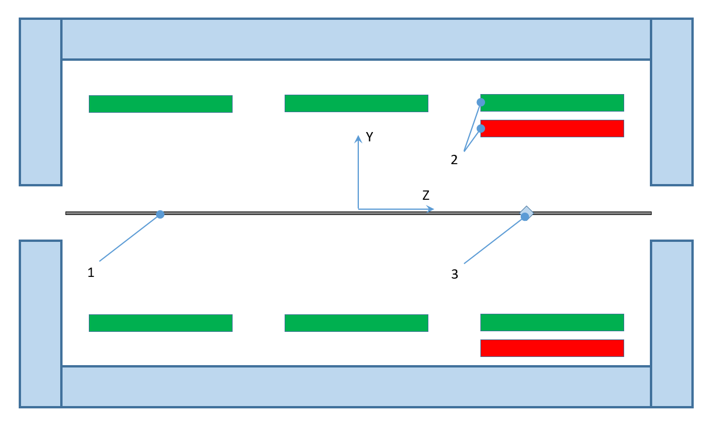
Magnetic field uniformity change due to SC central coil shift 5 mm
Acceptable shift of coil section is 5 mm

Slide 4
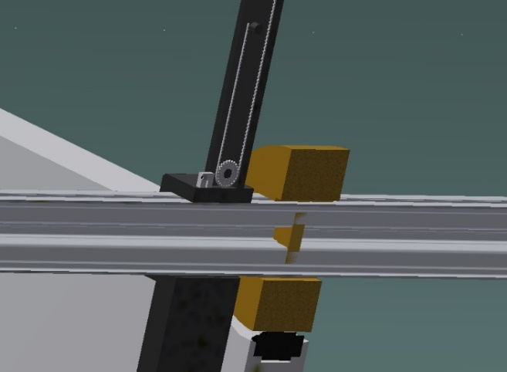
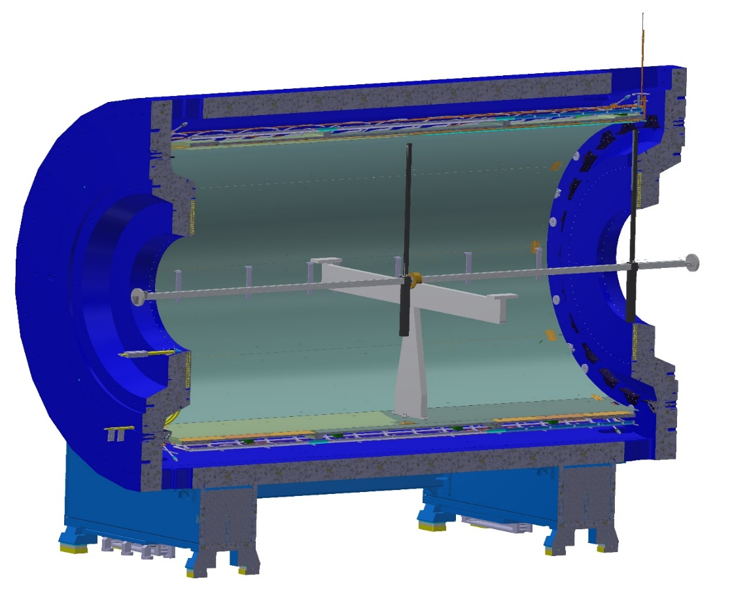
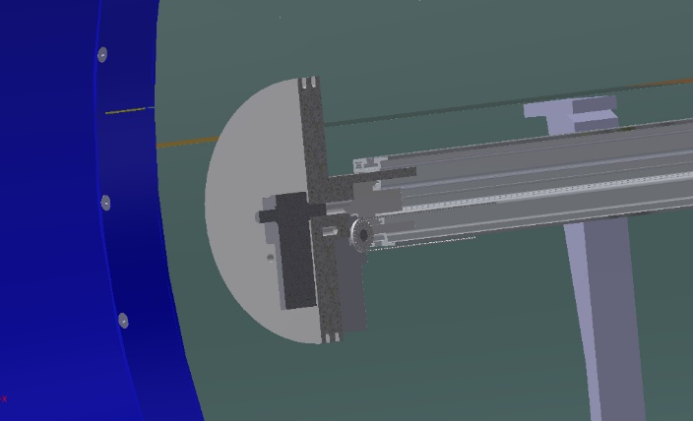
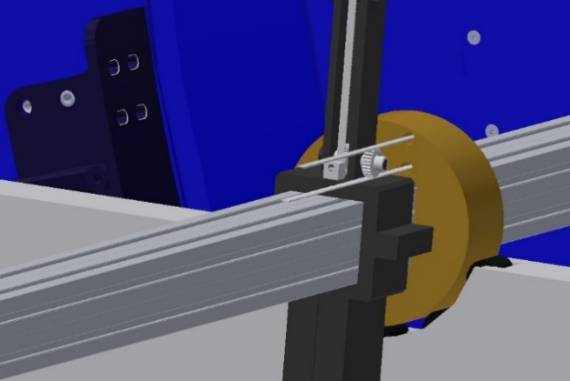
Our proposal for MPD magnet
.

Slide 5
Our proposal for MPD magnet. Mapper specification.
Parameter | Value
Length of movement for Z | 9 m (2 × 4.5 m)
Length of movement for R | 0.1 – 2.2 m
Rotation of measurement block | 360 deg.
Accuracy of movement for Z | 50 microns
Accuracy of movement for R | 50 microns
Accuracy of rotation | 0.2 deg.
Hall 3D sensor | НЕ444, HE Hoeben Electronix,
Hall 3D sensor accuracy | 0.1 Gs
Hall 3D sensor accuracy total (with accuracy of laser tracker and temperature correction) | 0.3 Gs
Sag of guide line | 4 mm
Weight of mapper | 60 kg
Reading time per one measurement | 1 sec
.

Slide 6
Status of project
Mapper had been assembled and under test and final adjustment for servodrivers and software.
Calibration for Hall sensor and thermal stabilization had done.
Measurement with laser tracker had done.
Measurement of full system for Earth magnetic field starts this week.

Slide 7
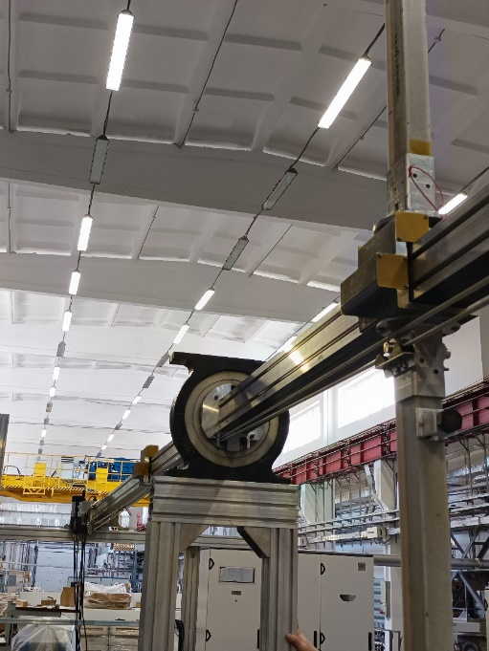
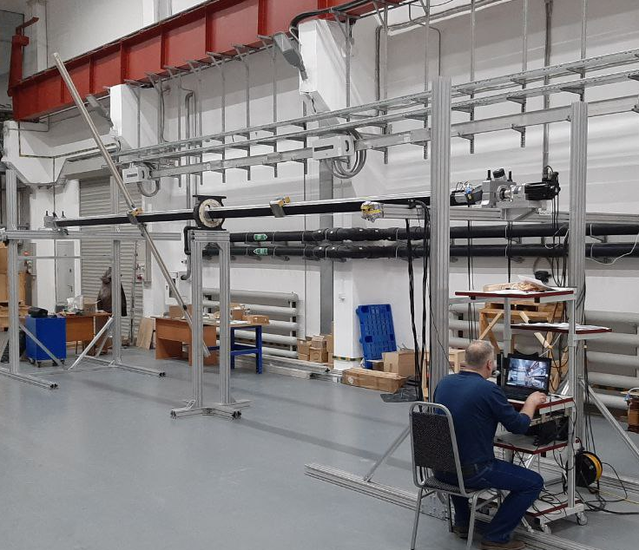
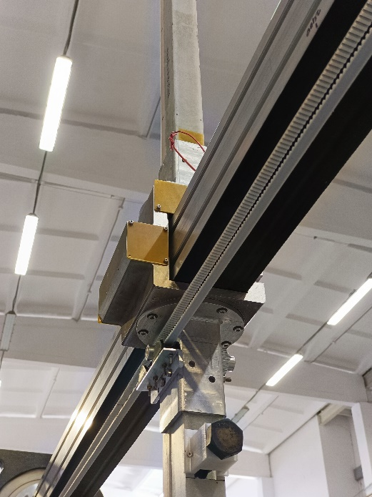
Status of project. Assembly/tests mechanics.
Mechanics is according specified requirements

Slide 8
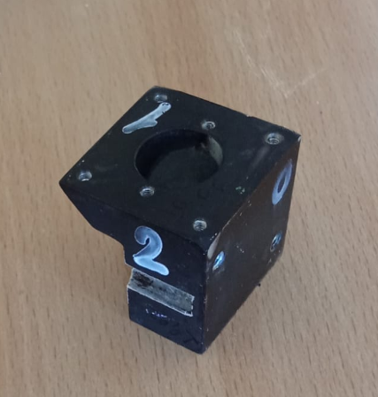
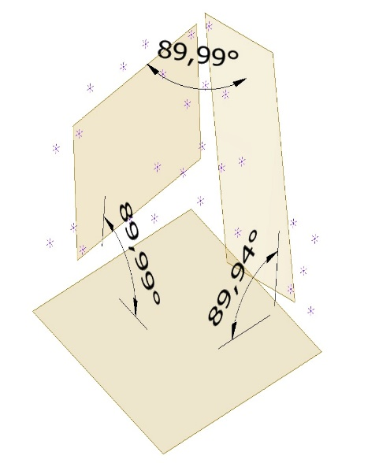
Measuring block with thermal stabilization.
Measurement aluminum base with thermal stabilized 3D Hall sensor.
Temperature range is 20-35 C deg.
Temperature stability is ± 0.05 deg.

Slide 9
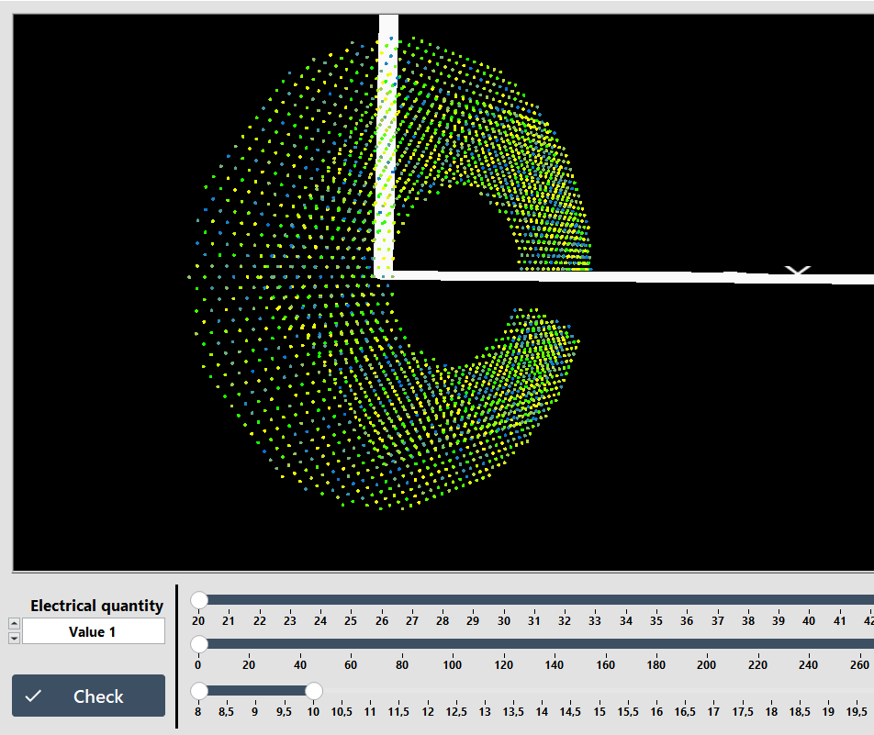
Сontrol software testing.
Test of software is in process for uniform steps and smooth moving.

Slide 10
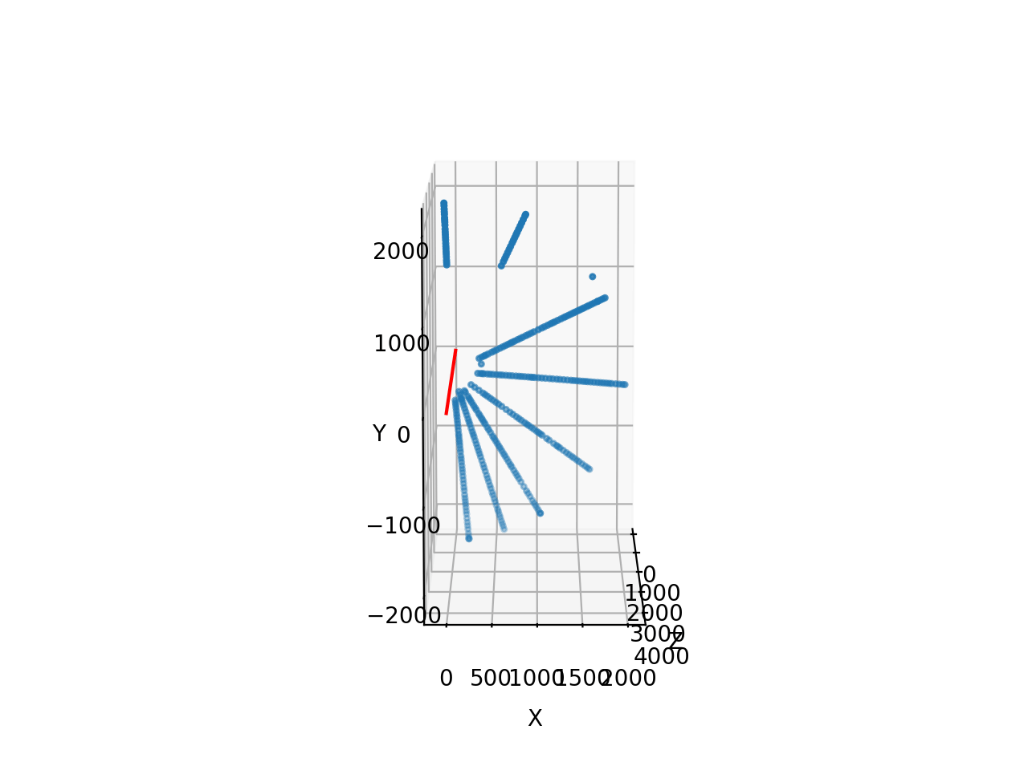
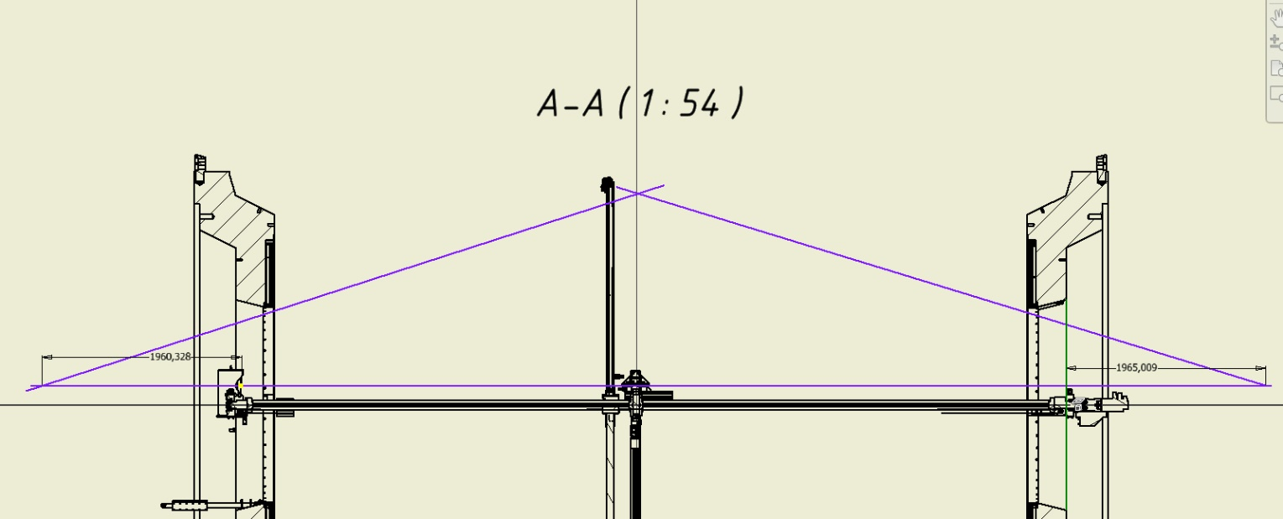
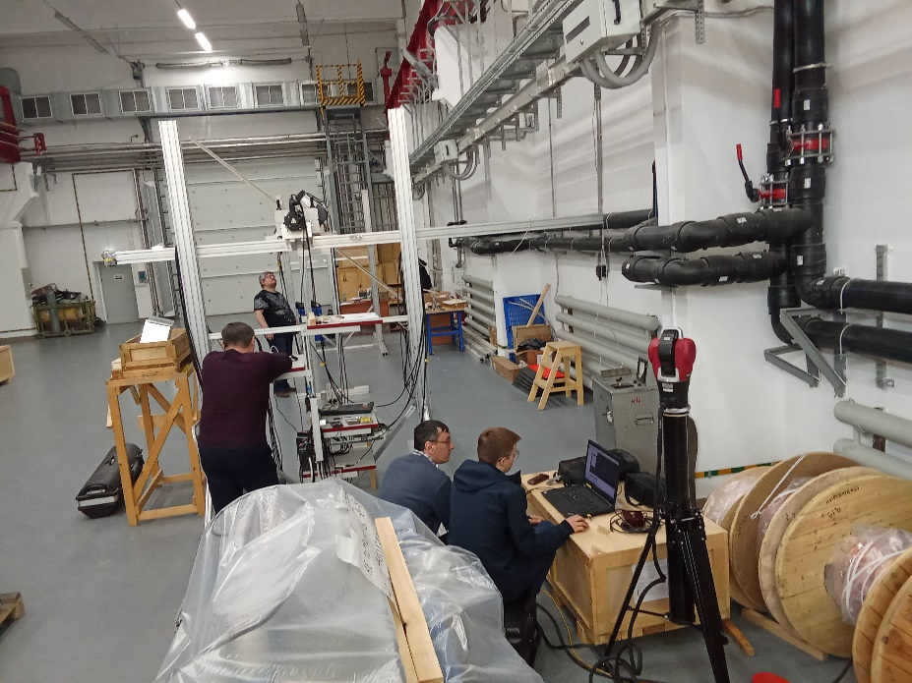
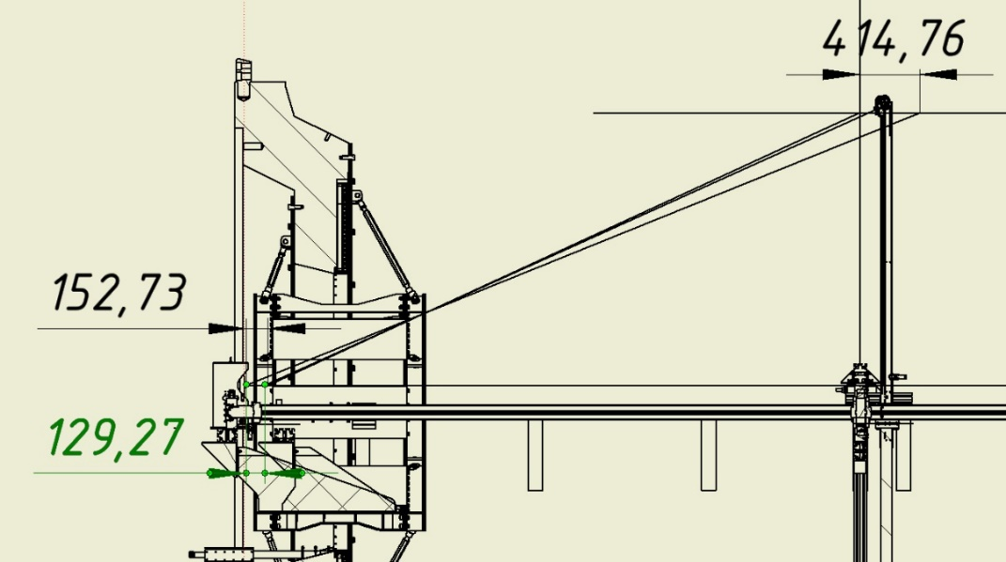
Laser-tracker test.
Laser beam is stable when measuring block moves.
Confirmation for radial rod rigidity, flatness and vibration calming time

Slide 11
Field mapping scheme.
Determining the magnetic axis: a) Fourier series expansion, b) solving the inverse problem.
2. Setting the actual position of the SC coil in 3D magnetostatic code.
3. Finding the values TRIM coil currents to improve uniformity in the TPC region

Slide 12
Milestones of MPD assembling in the year 2025
1 | January 13th- 30th | Solenoid and Correction Coils Power Supplies control system tests
2 | January 25th – February 21st | Solenoid Safety regimes of emergent energy evacuation working out Development of algorithms of cooling on base of experience with manual regime
3 | February 1st – February 27th | Solenoid Power cable temperature isolation inside of the Chimney
4 | March 3^{d} – April 7th | Cooling down of the Solenoid to the working temperature 4K
5 | April 7th -April 25th | Development procedure of current supplying to the Solenoid, training
6 | March April 16th – 25th | Installation stationary Hall probes (both INP Novosibirsk and Belorussia)
7 | April 1st - April 26th | Final test of the Field Mapper at Novosibirsk
8 | May 1st | Arrival Mapper to the JINR
9 | May 1^{th.} – May 18th | Installation Magnetic Field Mapper, Calibration, preparation for measurements of Field
10 | May 19th - July 30th | Magnetic field measurements on nominals: 0.2Т, 0.3Т, 0.4Т, 0.45Т, 0.5Т, 0.55Т Magnetic field uniformity adjustment in TPC region
11 | June 15th | TPC mechanical body is assembled, leak test and HV test are finished
12 | August 1st – August 6th | Support Frame installation
13 | August 4th – August 22^{d} | Installation FHCal into poles
14 | August 4th – September 25th | Ecal installation
15 | August 20th – September 30th | Installation TOF modules (access from both sides )
16 | November 1st – November 23^{d} | TPC installation
17 | June 22^{d} – November 30th | Cabling
18 | December 4th – December 14th | Beam pipe installation
19 | December 22^{d} | Moving to the beam line
20 | December 30th | Readiness for Data taking

Slide 13
Thank you for attention

