Slide 1
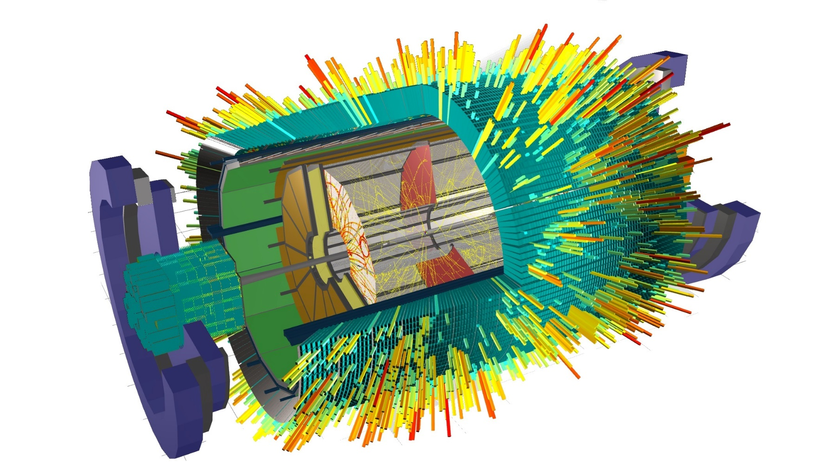
Progress of ACTS implementation in MPDRoot
HNATIC Slavomir MPD Software Development Team

Slide 2
OUTLINE
Quick Recap
Software Development summary
ACTS in MPDRoot
Geometry
Tracking performance
Clustering input
Vertexing
Global integration
Near future

Slide 3
QUICK RECAP (October 2024)
IF YOU THINK YOU CAN ASSIST US
Read the issues in Gitlab
https://git.jinr.ru/nica/mpdroot/-/issues
NICADIST
separate build system
dependencies handling
R & D
Project Management &
Support/User Interaction
GITLAB
codebase
CI
testing
SUPPORT
helpdesk
telegram
channel
WEBSITE
howtos
docs
general info
CVMFS
software distribution
unified environment
MPDRoot
MPD assembly
TPC installation: Autumn 2025
ANALYSIS
SIMULATION
RECONSTRUCTION
Mass Production
ONLINE EVENT DISPLAY
experiment visualization
slow control
DATA STORAGE & RETRIEVAL
PWG REQUESTS HANDLING
DIRAC INTERWARE
DETECTOR CALIBRATION
alignment
noise level
digitalization delay
Computing Infrastructure
(MICC & friends)
supercomputer
clusters
storage systems

Slide 4
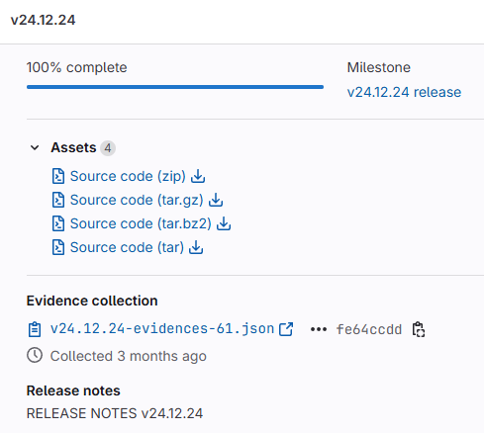
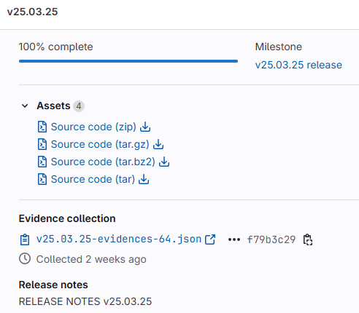
RELEASES SINCE OCTOBER 2024
MOST IMPORTANT STUFF
New features
Analysis updates (physicists)
ACTS v40, v38.1, v38.1-ckf ports
ACTS port refactorings, adjustments, fixes, custom patches
DETAILED INFO in RELEASE NOTES
git.jinr.ru/nica/mpdroot/-/releases
Latest dependencies
ROOT ……… 6.32.06
GCC ………….13.2.0
Boost ……….1.83.0
FairRoot .… 18.6.10
GEANT4 .… 11.2.1
Python …... 3.12.4
GSL ………….2.8
Fedora 41

Slide 5
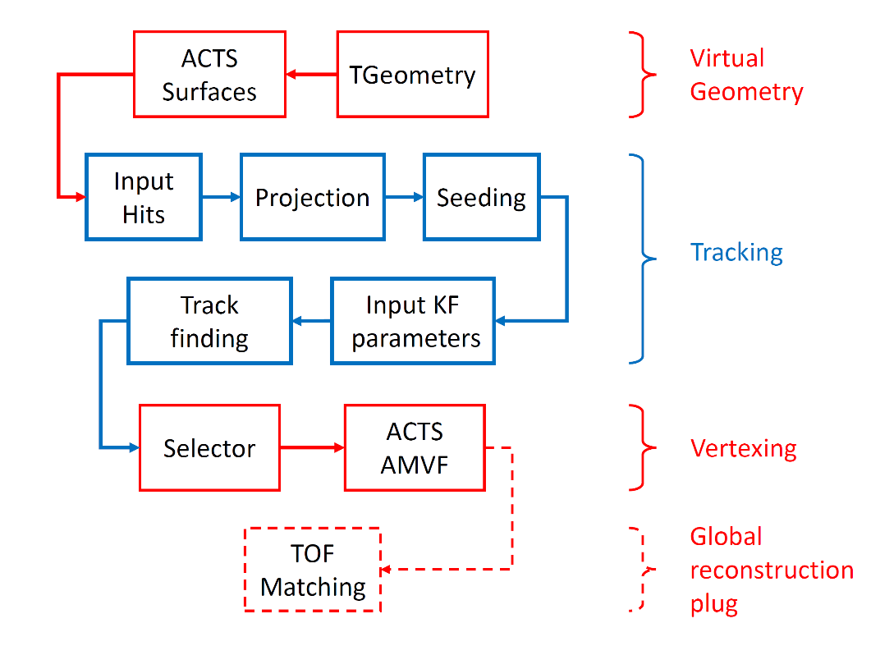
ACTS TRACKER
CORE CONCEPTS
- Modern C++
- Performance focus: - compile time polymorphism (templates) - thread safe design
- configurable algorithms
How to run in MPDRoot: toolbox enter a9-nica-dev module add mpddev ACTS build mpdroot’s dev branch
runReco.C with ETpcTracking::ACTS
Rapidly developed (frequent API changes) - about 2 new releases per month
ACTS pipeline in MPDRoot

Slide 6
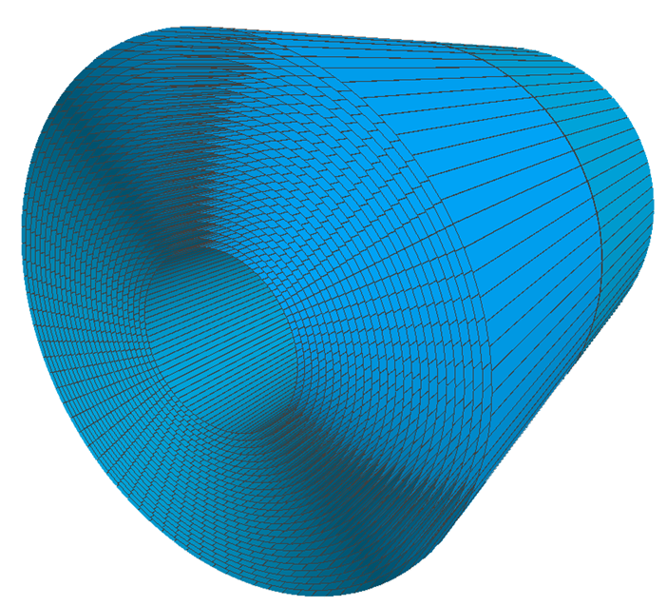
ACTS GEOMETRY
CURRENT STATUS
Cylindrical virtual geometry
Sectors & Layers
Implemented by parsing the ROOT TGeo geometry and converting the TGeoNode volume into Acts Surface
MAJOR ISSUES
poor conversion code (TGeoDetector)
slowing down calculations
memory consumption
requires writing patch for ACTS on each new release
frequently breaks down when other, seemingly nonrelated parts of ACTS geometry are rewritten
mystical bugs, taking lots of time to investigate & fix
does not significantly affect the tracking accuracy (the only positive thing)
J.D. Osborn et al. “Implementation of ACTS into sPHENIX Track Reconstruction.” Computing and Software for Big Science, 2021

Slide 7
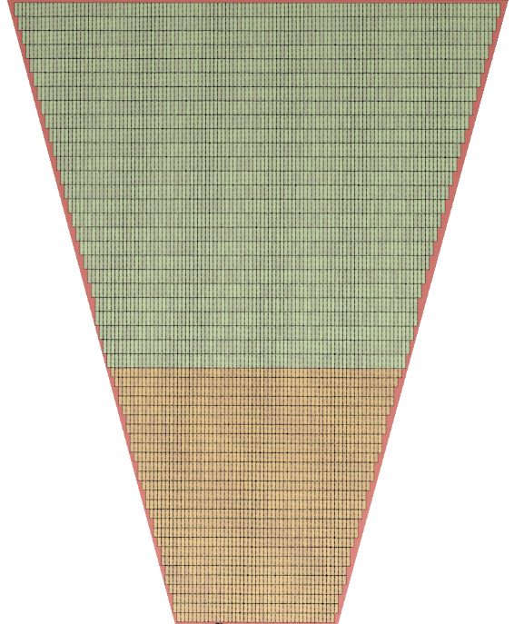
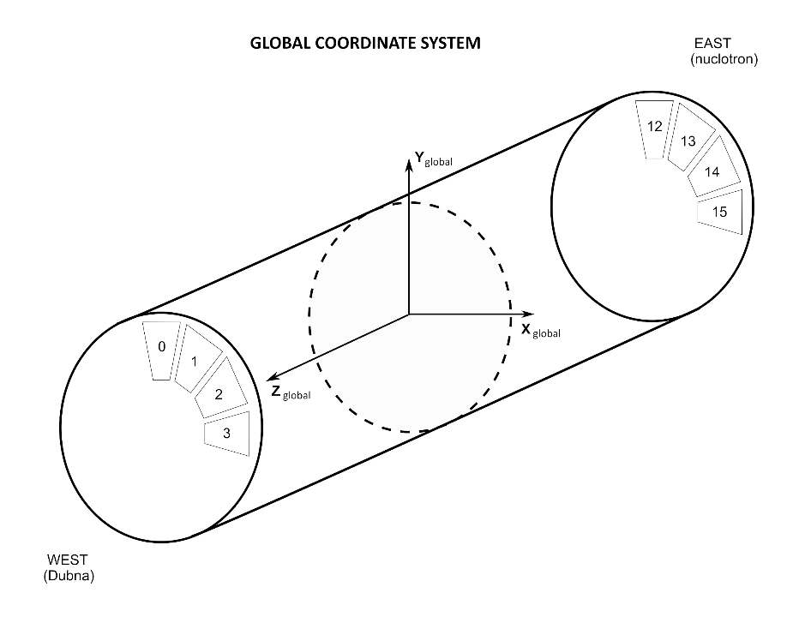
ACTS GEOMETRY
SOLUTION
Getting rid of TGeo conversion is INEVITABLE for the real experiment
creating surfaces and volumes on our own
gluing them together
generating tracking geometry & plugging it into tracker
some geometry R&D work already done by E.Kryshen & N.Burmazov (Thursday talk)
must start from zero, can use some ideas (code not portable due to our technical reqs)
TPC sector padrow based virtual geometry ideal
Cylindrical geometry without TGeo conversion will still likely resolve all the worst geometry issues we have atm

Slide 8
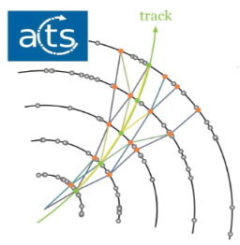
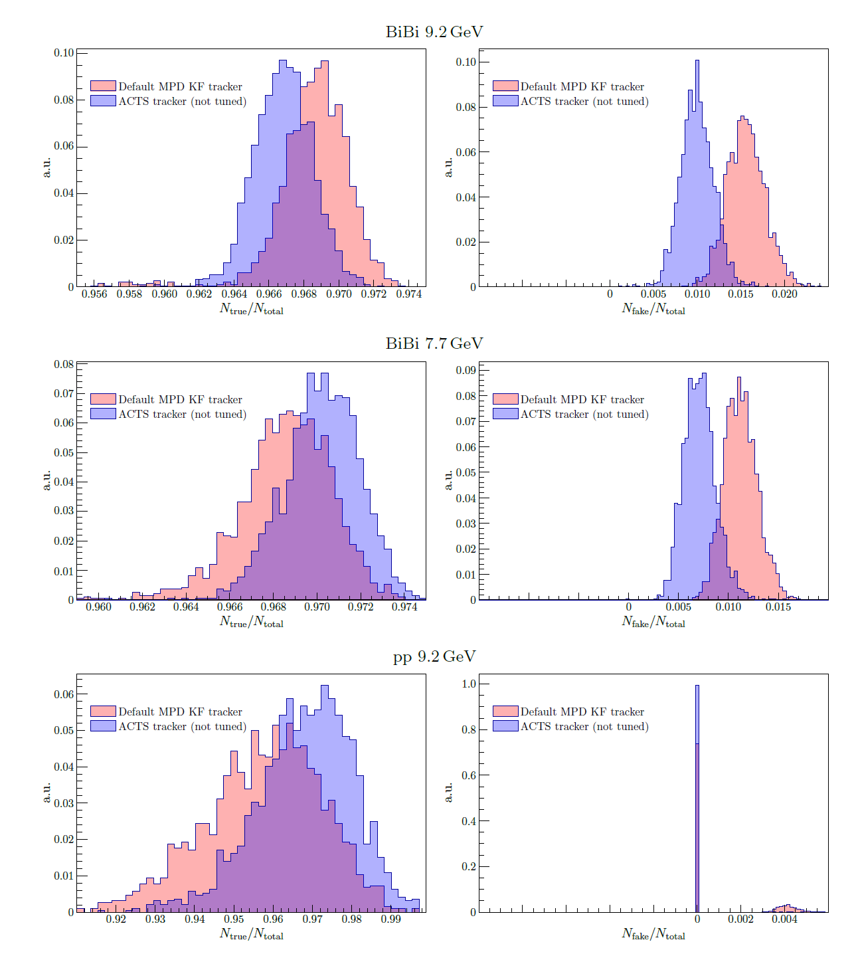
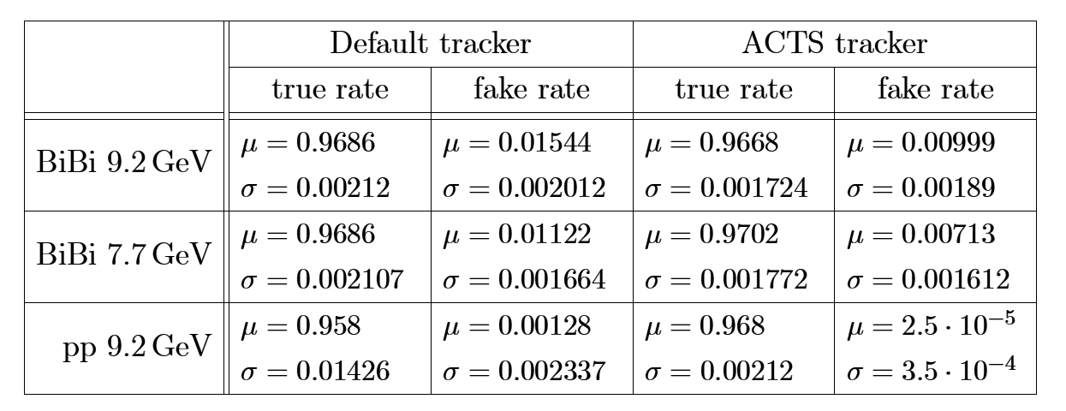
TRACKING PERFORMANCE
MLEM clustering; ACTS v36.0.0
UrQMD
200000 events (2000 runs, 100 events per run)
9 minimum hits per track
P_t > 0.1 GeV
“Implementation of ACTS into MPDRoot”
S. Hnatic, J. Busa Jr., A. Bychkov, A. Krylov, V. Krylov, A. Moshkin, O.Rogachevsky
MMCP ‘24 Proceedings, PEPAN

Slide 9
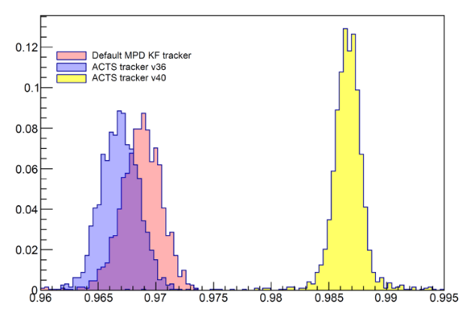
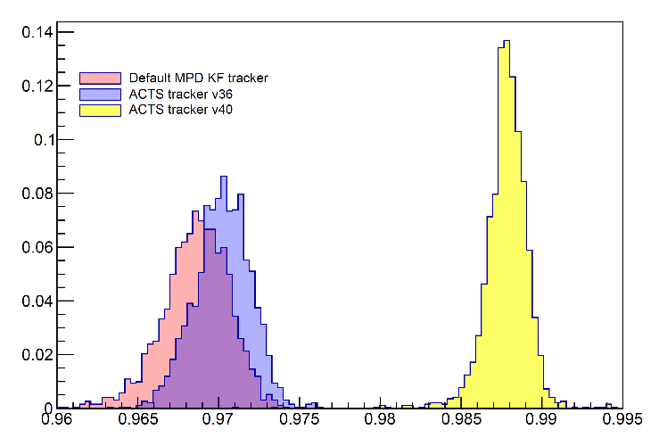
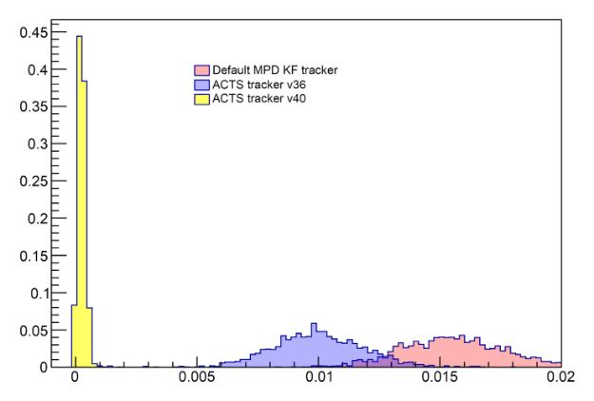
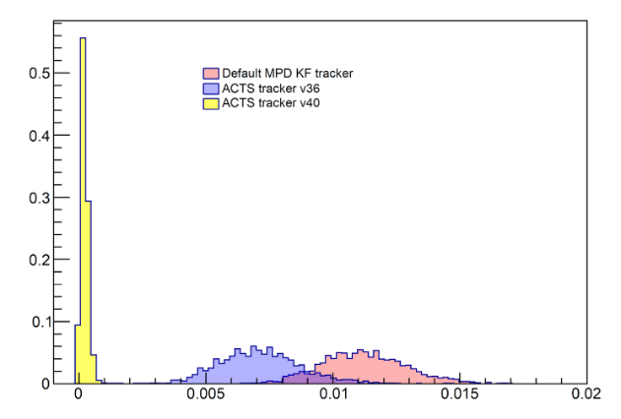
TRACKING IMPROVEMENT: v36 vs v40
CKF enhancements: better efficiency, far less fakes
Efficiency
Fake rate
BiBi 9.2 GeV
BiBi 7.7 GeV
BiBi 9.2 GeV
BiBi 7.7 GeV

Slide 10
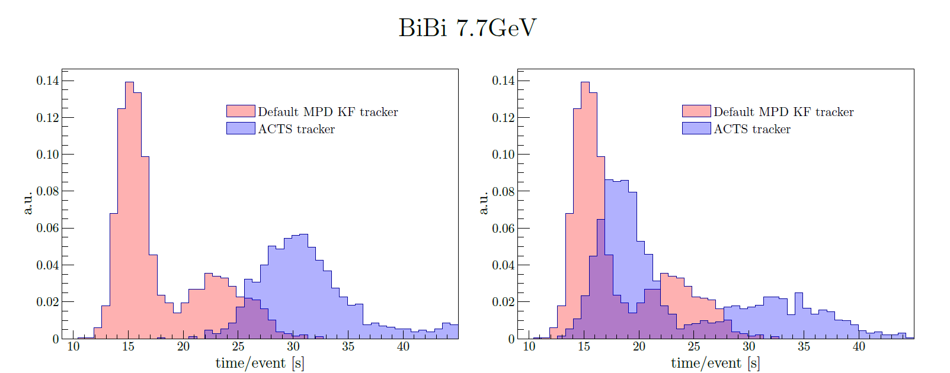
COMPUTING SPEED
Fast clusterhitfinder by V.Krylov – initially written for online event display processing
MLEM + DEFAULT KF | µ = 18.12 s / event | σ = 4.281 s / event
MLEM + ACTS v36 | µ = 31.12 s / event | σ = 2.273 s / event
FAST (v0.2.0b) + ACTS v36 | µ = 23.41 s / event | σ = 7.481 s / event
FAST (v0.2.0b) + ACTS v36 … lower efficiency than MLEM + DEFAULT KF
FAST v2.0.8 + ACTS v40.0.0 port - ready in ~1month … should have higher efficiency
ACTS calculation speed should be faster with native geometry

Slide 11
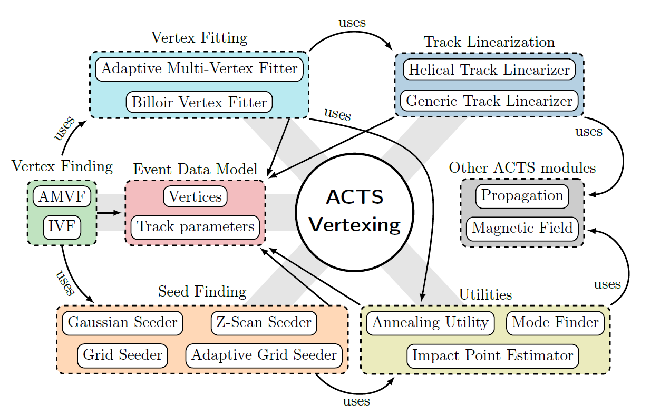
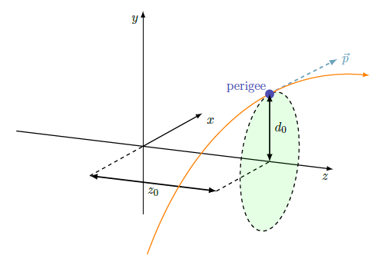
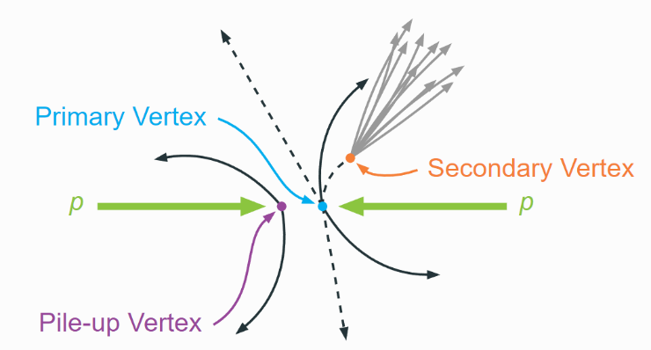
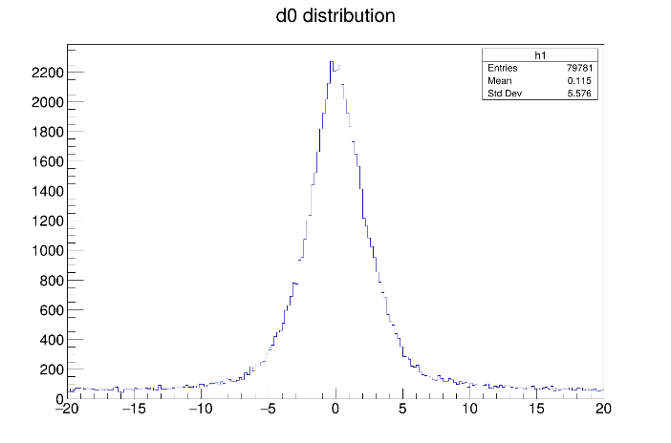
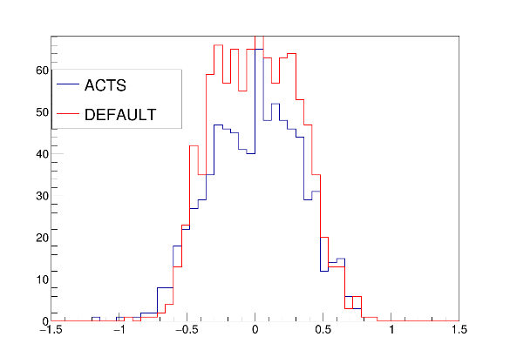
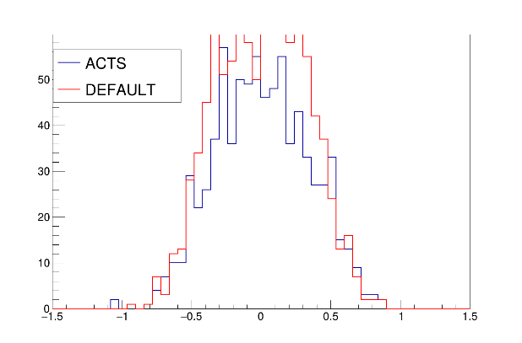
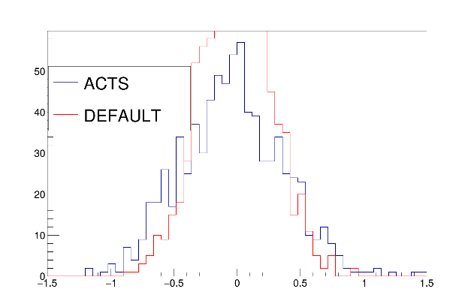
PRIMARY VERTEXING
ACTS VERTEXING SUITE
PERIGEE TRACK PARAMETRIZATION
Track selection: |d_0| < 2mm
- many tunable parameters
1000 events, BOX generator
X-X
Y-Y
Z-Z
true
true
true

Slide 12
GLOBAL INTEGRATION
TPC outputs
MATCHING
TOF inputs
CURRENT TOF MATCHING STATUS
no generic API access
tight coupling to old classes (no good)
inputs taken only as MpdTpcKalmanTrack type
brings MpdKalmanFilter, MpdKalmanHit etc with it….
ACTS TRACKING OUTPUT API
TrackProxy class
reference surface
track parameters at reference surface (loc0,loc1, theta, phi, q/p, t)
momentum, charge, direction vector
hits, chi2, etc…
Need for generic API for TOF Matching
its inputs must be independent from tracker implementation!

Slide 13
FUTURE
NEXT 2-3 MONTHS
Fast clustering v2.0.8 ACTS integration
New ACTS geometry
AFTERWARDS
TOF matching (finalize integration into global reco)
Testing & feedback from physicists
MISC
Investigate & fix crashes on cluster
Disconnected tracks
Statistics visualization
SOFTWARE DEVELOPMENT
up to date with latest packages (Acts, ROOT, … )
regular release schedule
automated tests
cleanup
refactoring

Slide 14
Thank You !
Q & A

Slide 15
MPD Software Development & Computing Team
Rogachevsky O. …………………………………………………….... Coordinator
Krylov V., Krylov A. ………….…………………………………… Online MPD Event Display
Moshkin A., Pelevanyuk I. ………………………….. Mass Production
Bychkov A. …………………………………………………………….……… Detector Simulation
Kuzmin V. …………………………………………………………………….. Detector Alignment
Podgainy D., Zuev M.………………………………………... Supercomputing
Alexandrov E., Alexandrov I. ………………..…. Databases
Balashov N. ……………………………………………………..………… Gitlab Support
Belyakov D. …………………..............................................…. Network Infrastructure
Belecky P., Kamkin A., Hnatic S...……..….. Acts Tracker
Busa J. ……………………………………………………………………………… Build System
Hnatic S. ………………………….………………………………………….… Architecture

