Slide 1
TOF Status
Notes:
Good morning, colleagues! The report is related to the status of the time-of-flight system of the MPD.

Slide 2
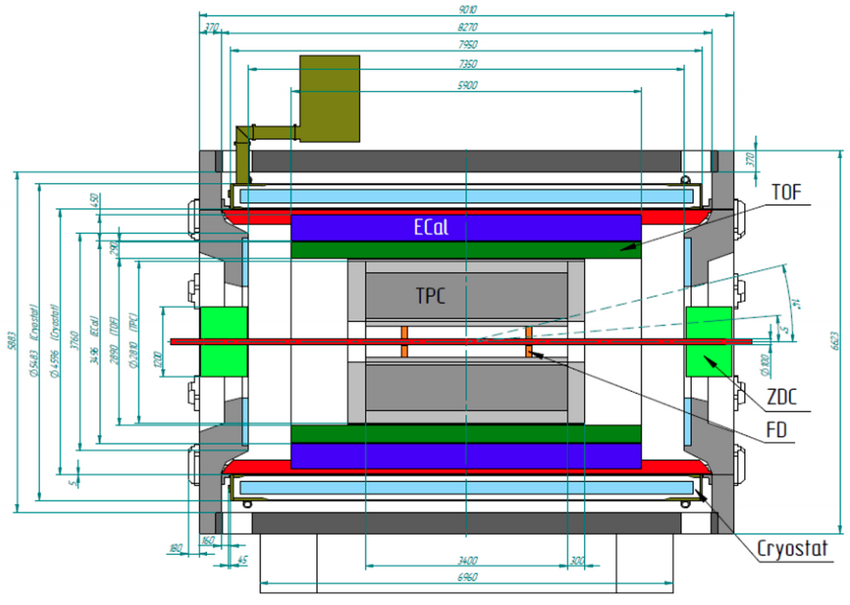
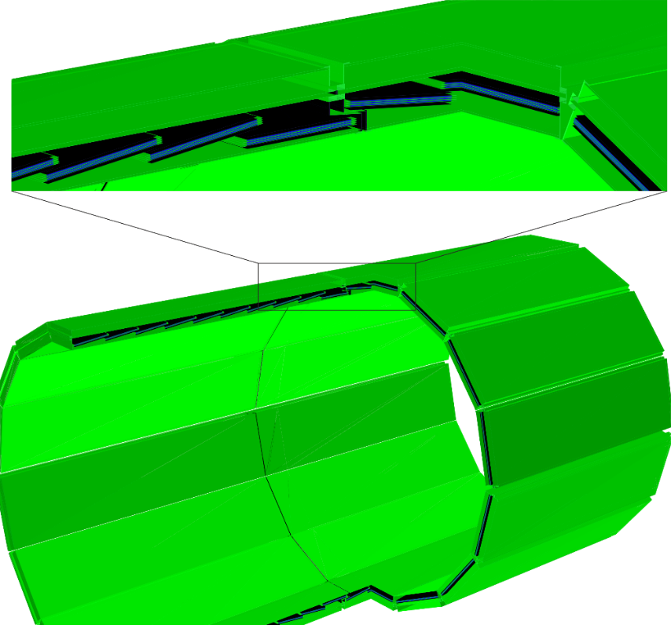
Time-of-Flight system in the basic configuration of MPD
L ≈ 6 m, d ≈ 3 m, $\left|η\right|<$ 1.44
 | Number of detectors | Number of readout strips | Sensitive area, m² | Number of FEE cards | Number of FEE channels
MRPC | 1 | 24 | 0.192 | 2 | 48
Module | 10 | 240 | 1.848 | 20 | 480
Barrel (28 modules) | 280 | 6720 | 51.8 | 560 | 13440
TOF Barrel (MPDRoot geometry)
Notes:
The TOF system is cylinder with length of 6 meter and diameter of 3 meters assembled of 28 modules.
Each module contains 10 MRPC detectors. Totally the TOF consists of 280 MRPCs.
Area – about 50 square meters. The total number of electronics channels is 13440.

Slide 3
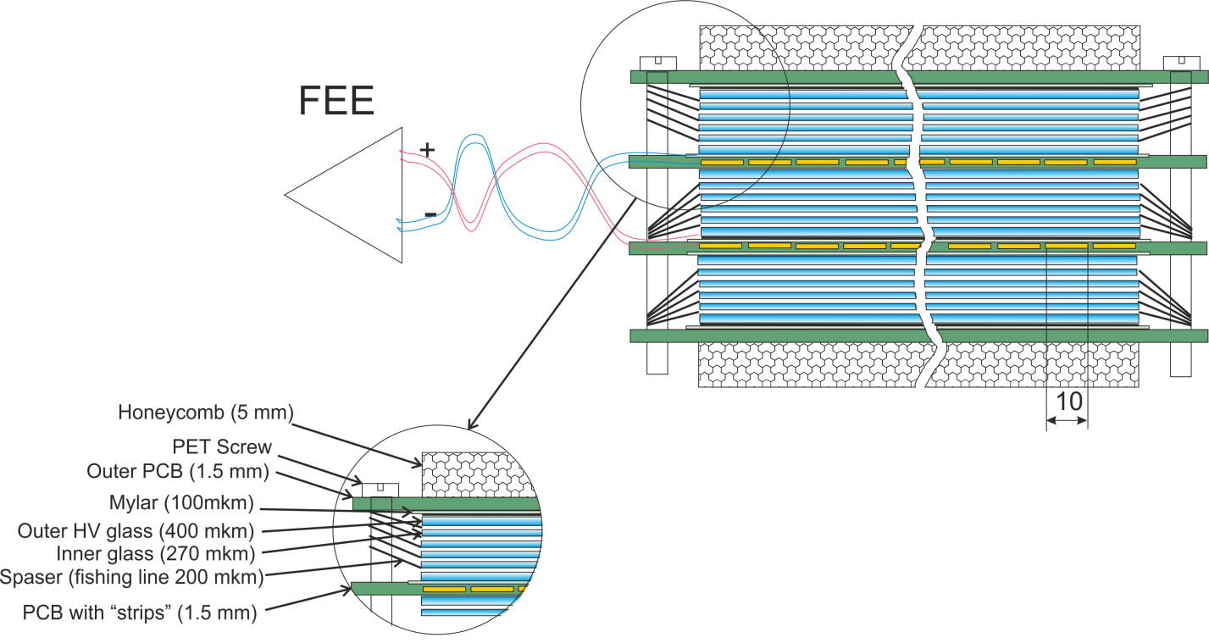
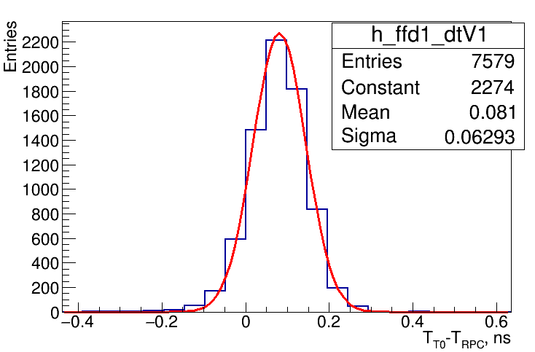
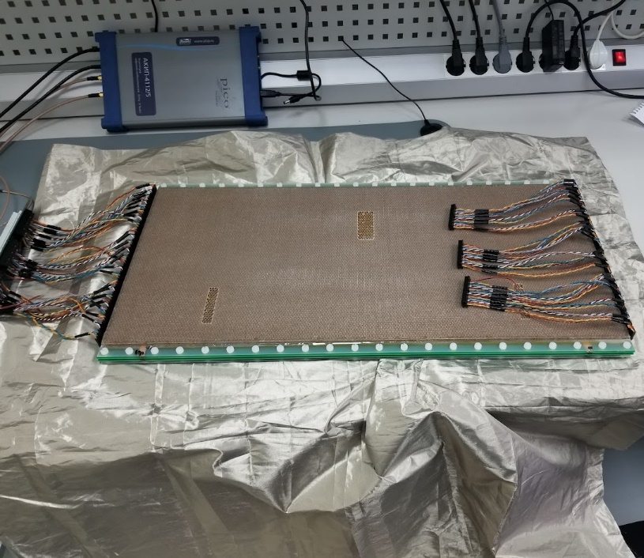
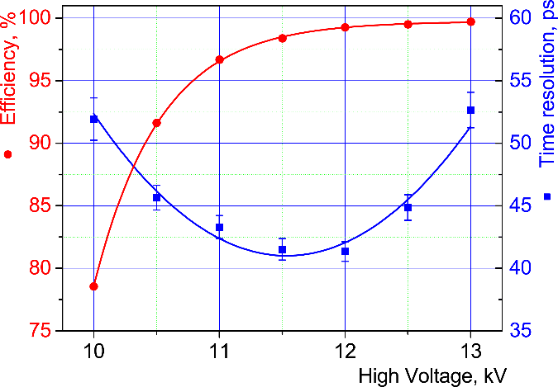
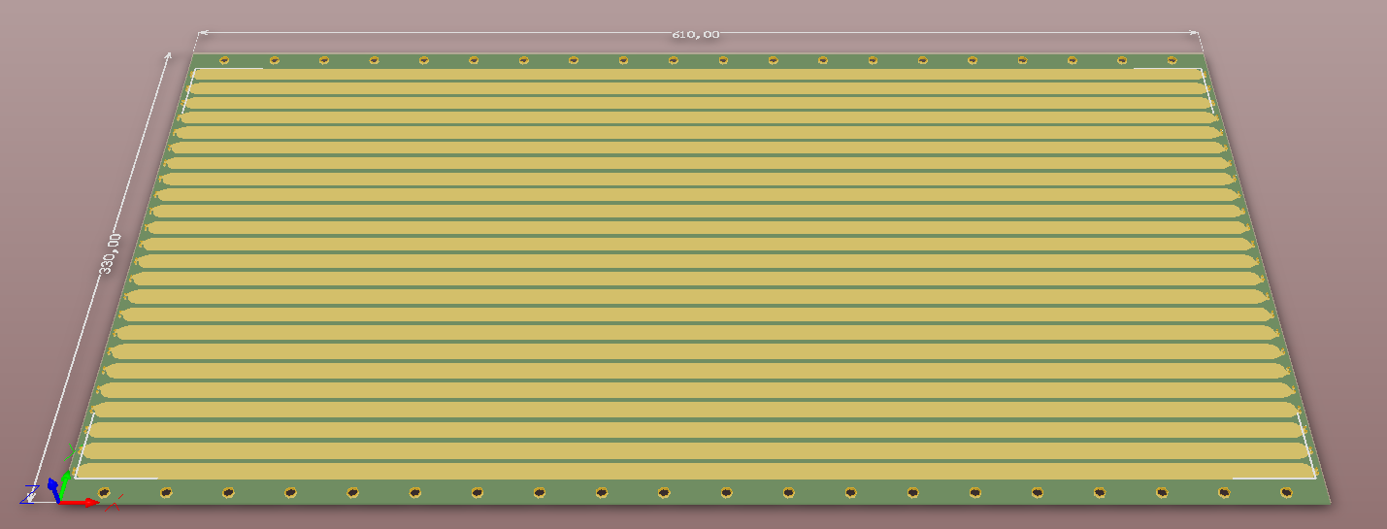
MPD TOF MRPC design
Gas mixture: C₂H₂F₄/SF₆/iC₄H₁₀ (90/5/5)
$\sqrt{{63}^{2}−{47}^{2}}≅4$2 ps
3-stack 15-gaps MRPC
The best measured time resolution
24 strips with both side readout for position determination along strip
300
640
MRPC readout strips
Efficiency vs applied HV
Notes:
The main element of the TOF system is MRPC detector. We use original 3-stack design of MRPC with active area of 640 by 300 mm.
Signals readout from both sides of 24 readout strips with width of 10 mm. It provides position resolution of about 7 mm along and across strip.
The best achieved time resolution is about 40 ps with standard electronics. Mean time resolution for all produced detectors is around 50 ps.

Slide 4
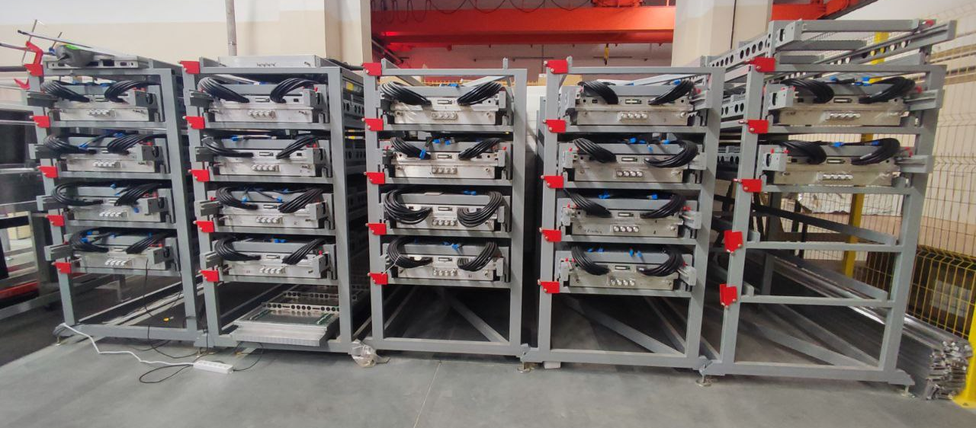
Progress of the TOF detectors and modules assembling
All 28 (100%) TOF MPD modules are already assembled, tested and stored
We are ready for TOF installation into the MPD power frame
Notes:
The production of the TOF modules was completed a year ago. Since they have been stored in these racks and on the cosmic test stand.
This year we additionally re-checked and upgraded all assembled modules. And currently we make some spare TOF modules.
So... We are ready for installation of modules into the MPD.

Slide 5
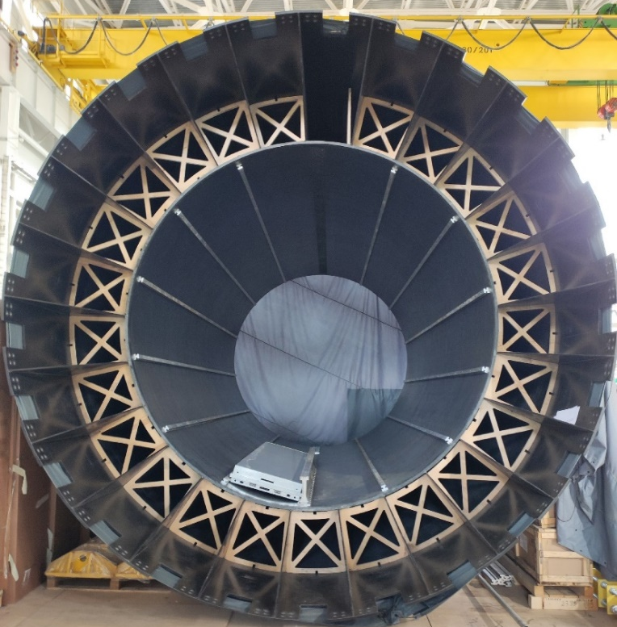
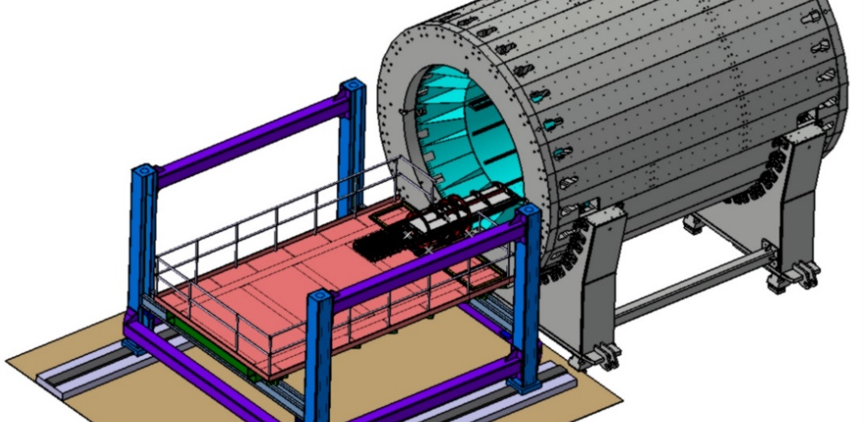
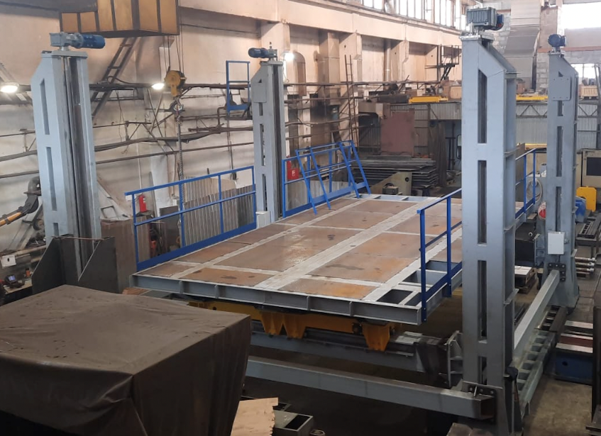
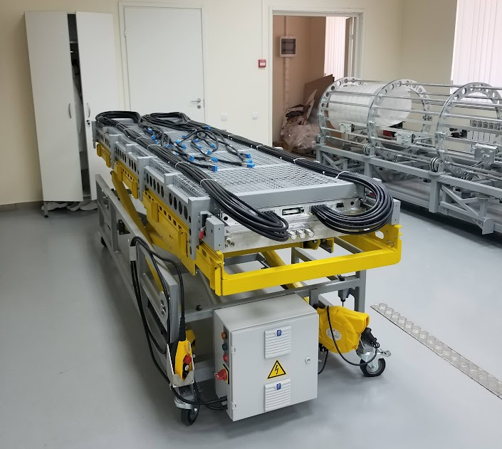
TOF installation
TOF module
on the rails
MPD Power Frame
Lifting platform
The lifting cart and installation bench are ready for TOF integration
Notes:
Concerning integration of the TOF to the MPD. All installation equipment is already tested and stored in the Laboratory.
The installation procedure can be described as follows.
TOF modules in racks are delivered to the MPD hall, where they are unloaded from the rack and loaded onto a lifting cart.
The lifting cart is moved by the crane to a lifting platform on which the installation device is previously fixed.
Using rotating mechanism and a moving the lifting platform, the rails of the installation device are aligned with the TOF rails in the power frame.
After this, the module is manually rolled into the frame and fixed.

Slide 6
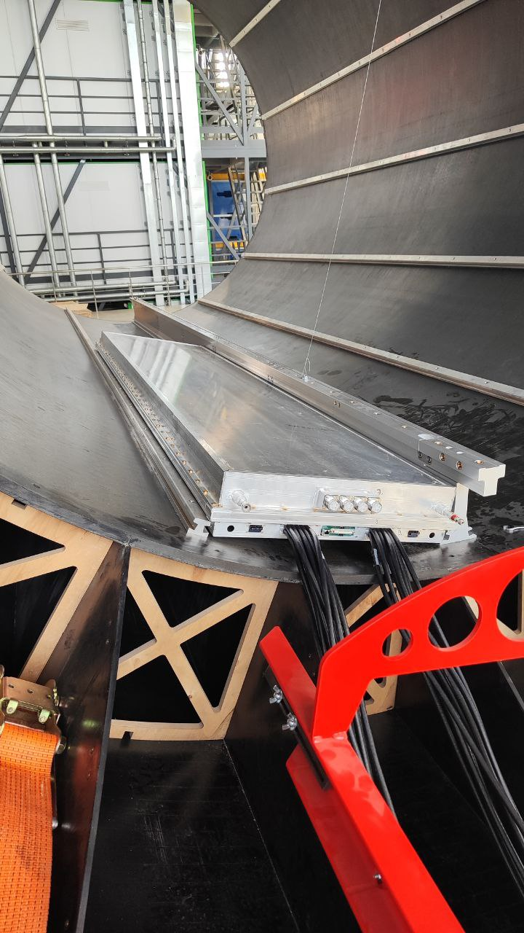
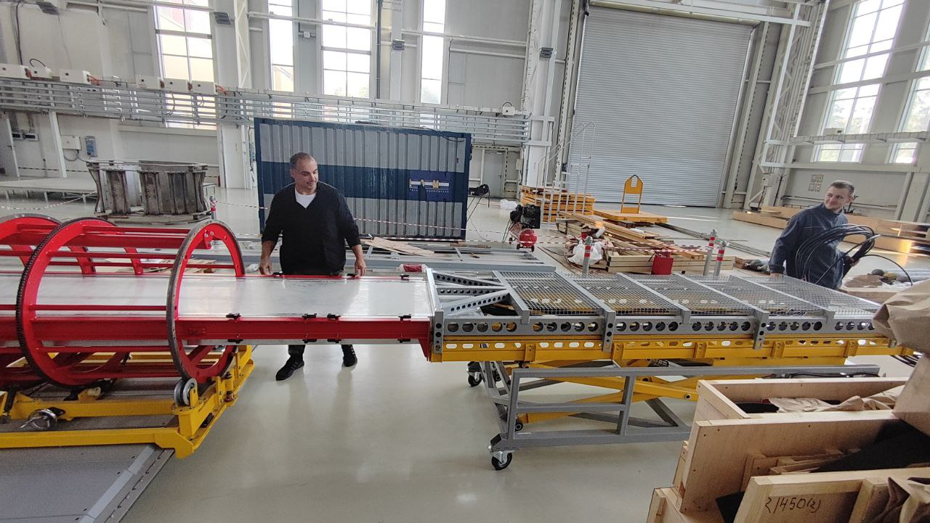
TOF installation
Notes:
This procedure was tested on a full module with all cables while the power frame is located on the floor of the MPD hall.
The installation was successful, although some design flaws in the modules were identified, which are now being corrected.

Slide 7
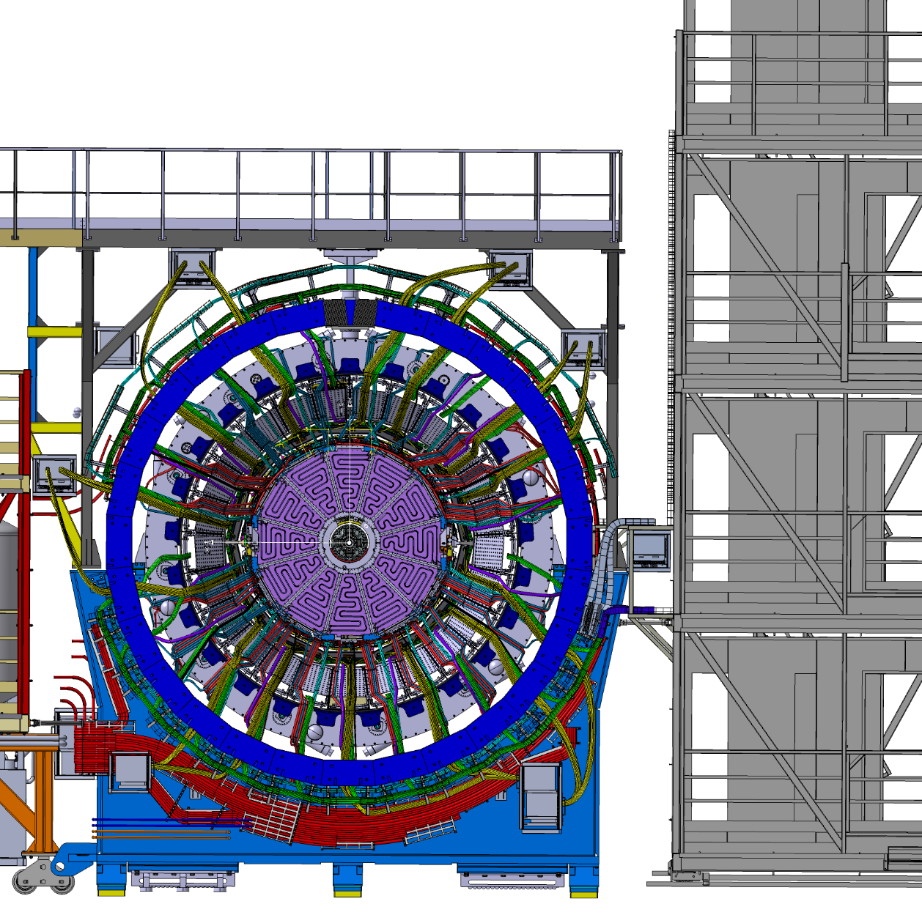
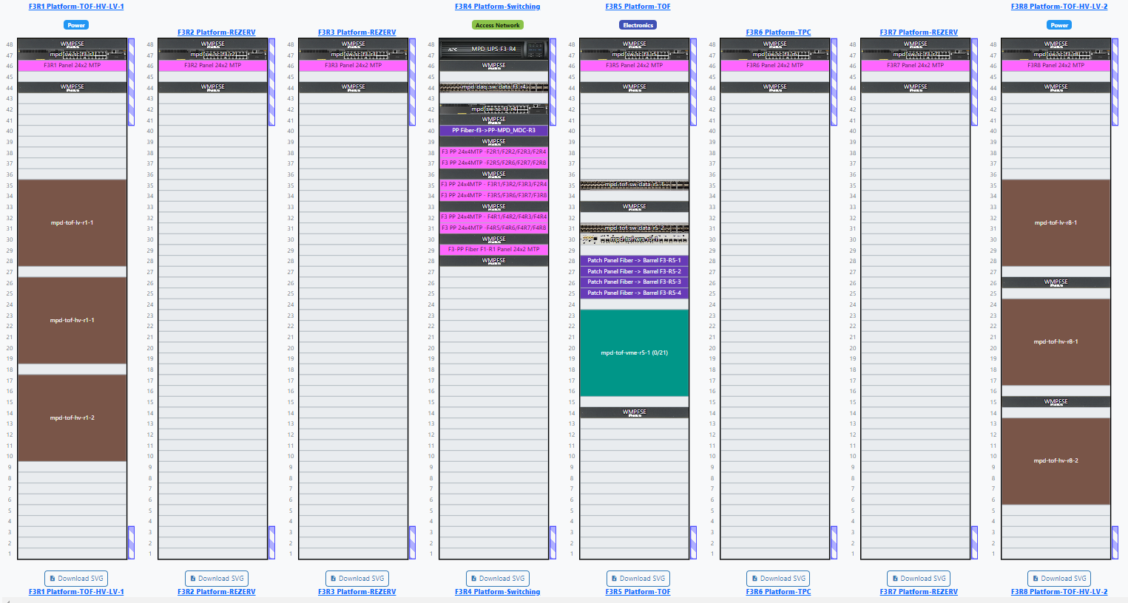
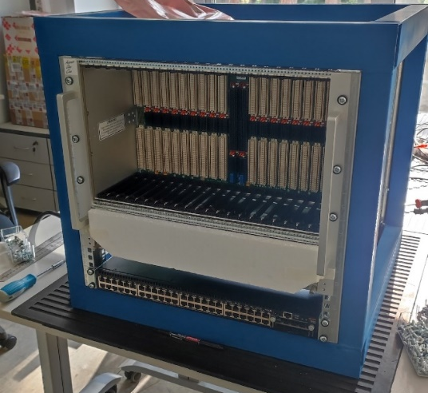
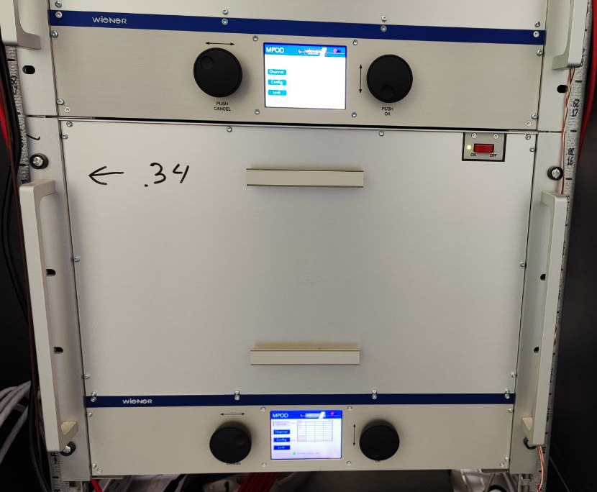
TOF readout and power crates & cables
3rd flor of the MPD platform
TOF
HV&LV
TOF
HV&LV
TOF Gas distribution system
Reserve
for stage 2
DAQ & Control
TOF VXS crate
MPod power crate
Notes:
Before the installation of TOF modules we have time to install service equipment, assembly the gas system, and time for cabling and tubing.
The project for laying out of the communications and the position of the service equipment already is almost complete.

Slide 8
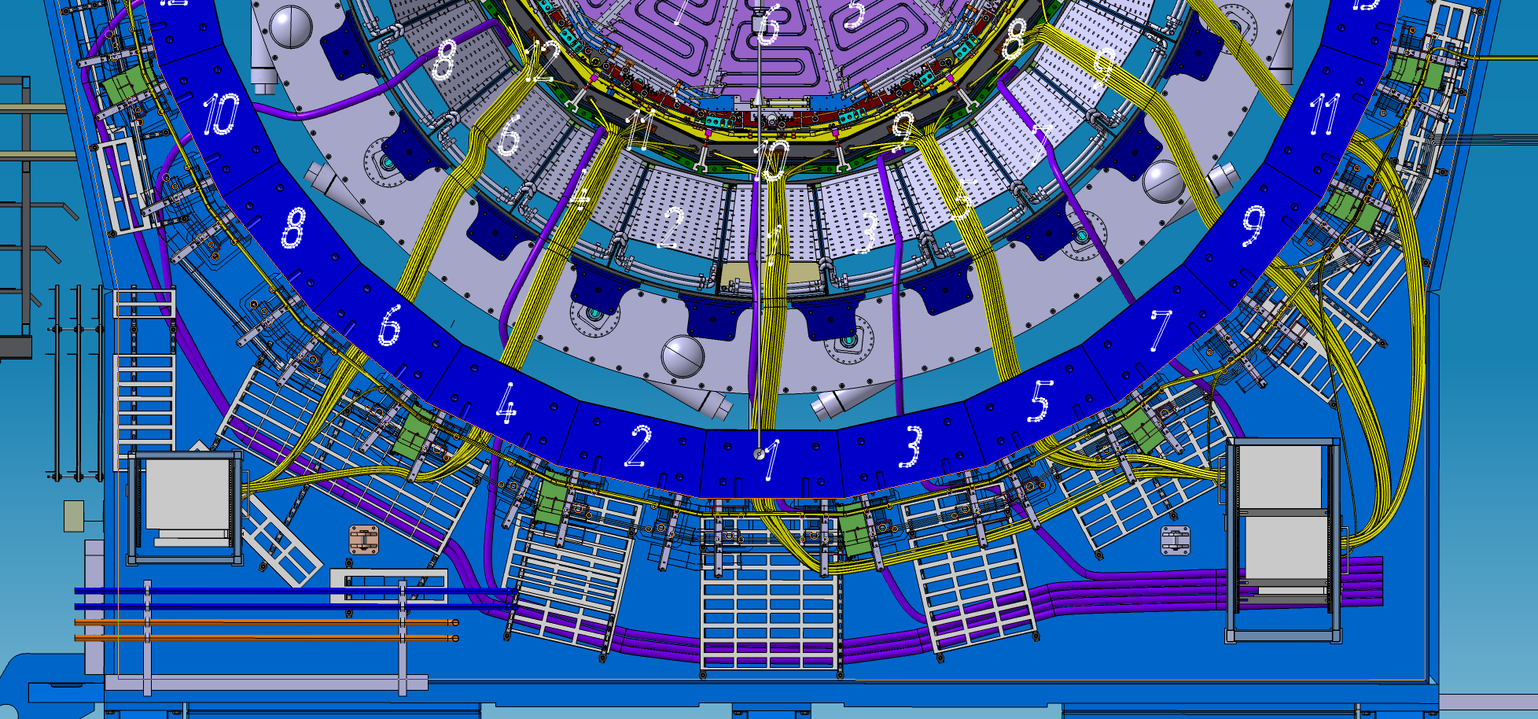
TOF readout and power crates & cables
Two racks for three VXS crates are welded to the MPD yoke
High-voltage distributors mounted on the MPD cable tray supports
Notes:
Part of equipment are already installed on MPD.
For example, two iron racks for VXS readout crates was welded on the MPD yoke base.
And 14 of 28 HV distributors are already mounted on the cable tray supports.

Slide 9
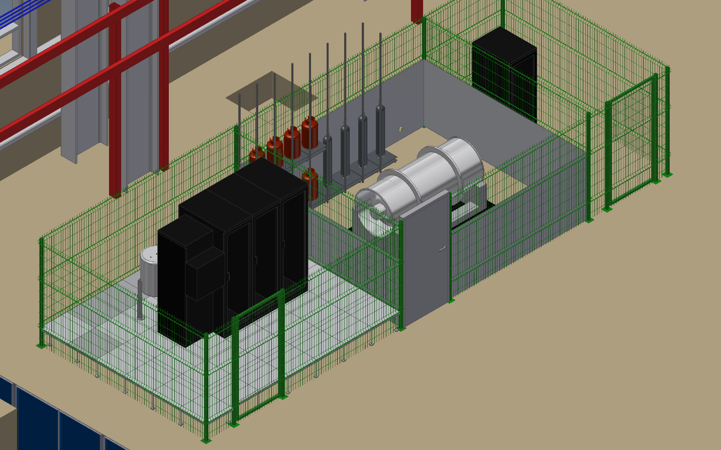
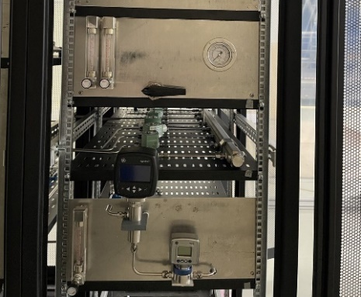
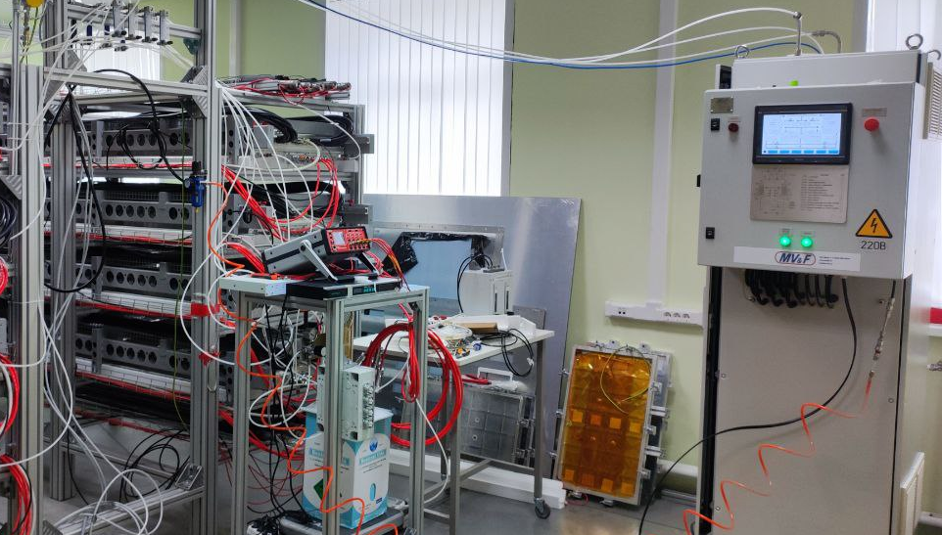
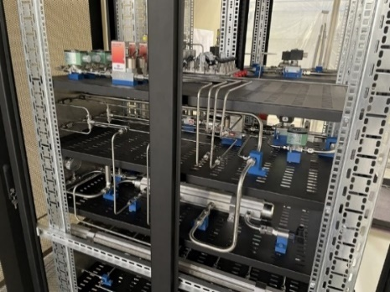
Gas system for the TOF in the MPD hall
Freon cylinder (1000 kg)
Automatic and control (rack #1)
Gas mixture purifier (rack #4)
Mixer and analyzer (racks #2, 3)
Notes:
At the last collaboration meeting, I presented this slide with plans for assembling the most complex TOF service system - the gas system.
As you can see, we have all the equipment for the system in store, but we can't put it all together.

Slide 10
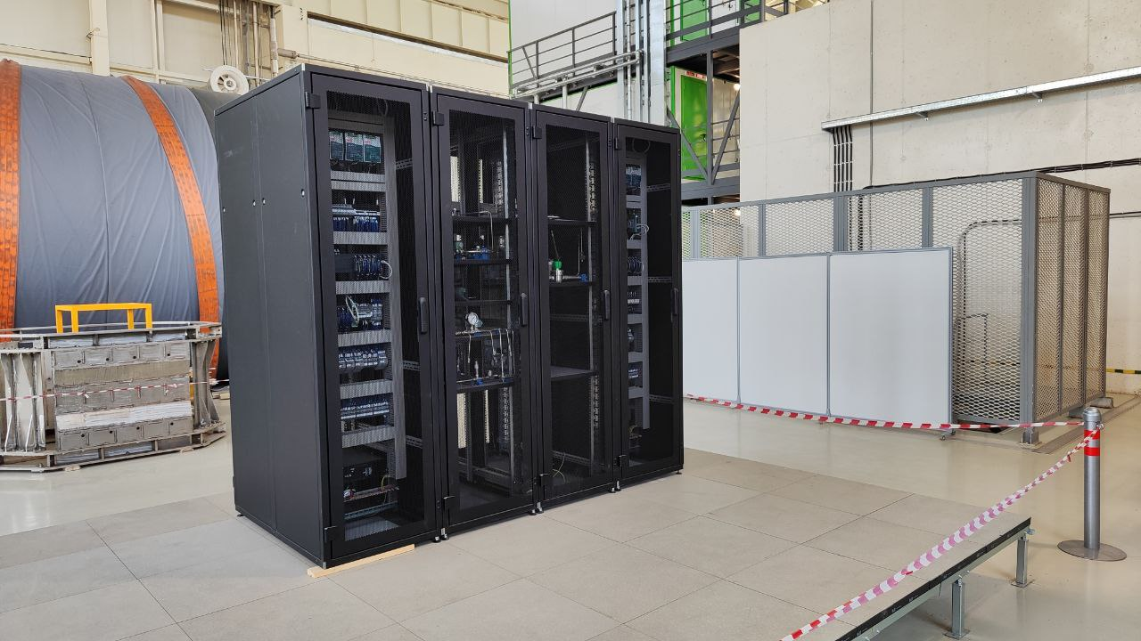
Gas system for the TOF in the MPD hall
Notes:
At the moment, only the raised floor has been assembled, on which the racks with gas system equipment are located.
Assembly was suspended for several reasons. First, a leak was discovered from the electromagnetic valves, so they had to be completely replaced with pneumatic valves.
By the way, they were delivered just yesterday.

Slide 11
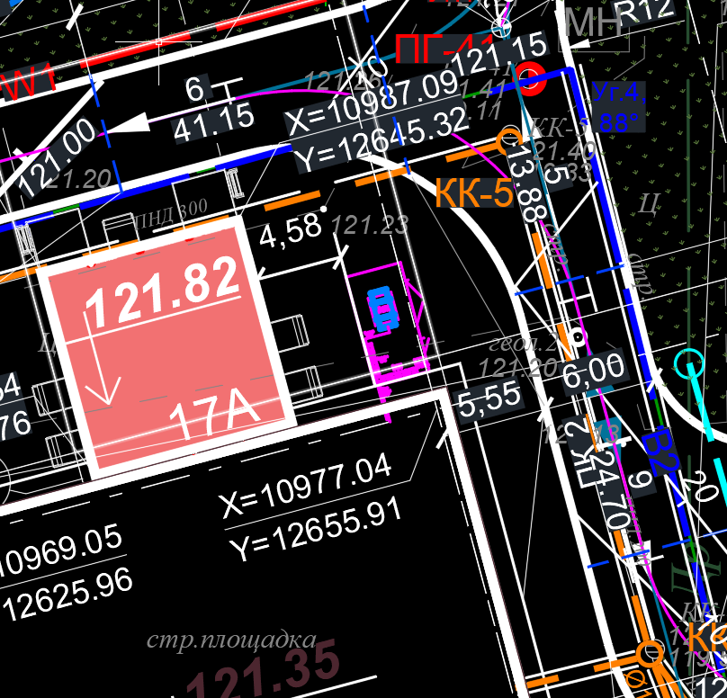
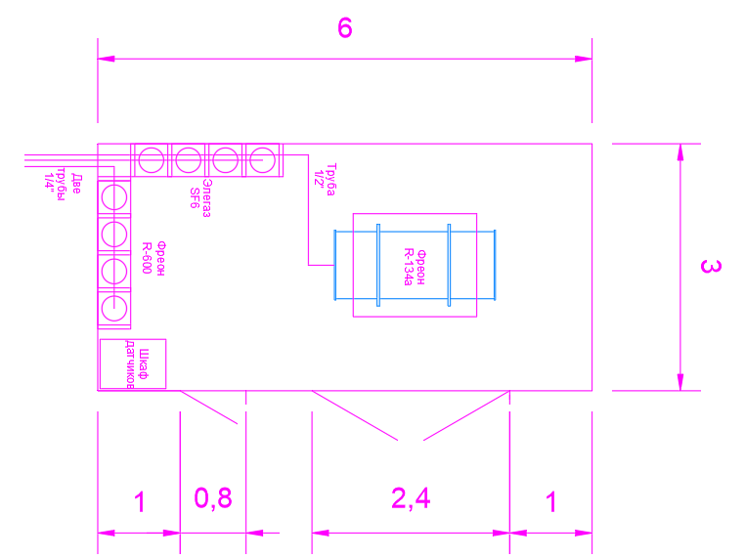
Outdoor gas supply container (optional)
A technical project is being developed
Notes:
Another reason for the delay is the impossibility of placing gas supply cylinders due to construction approvals of the NICA building.
The project for placing gas cylinders in a separate house outside the MPD building is in the process of being developed.

Slide 12
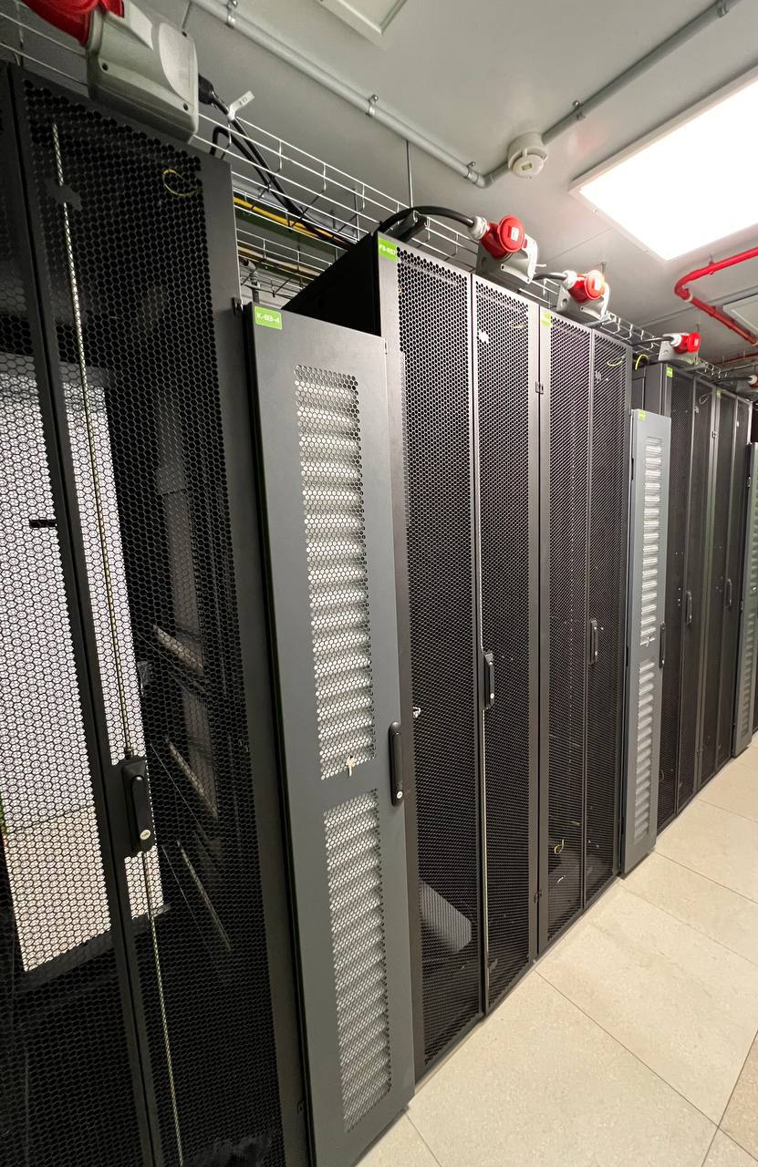
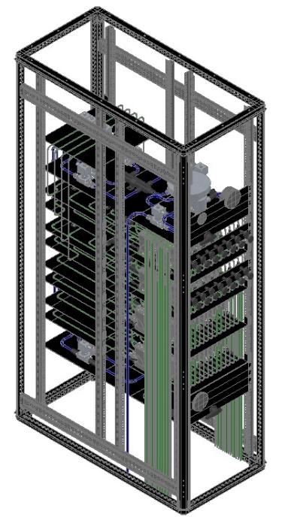
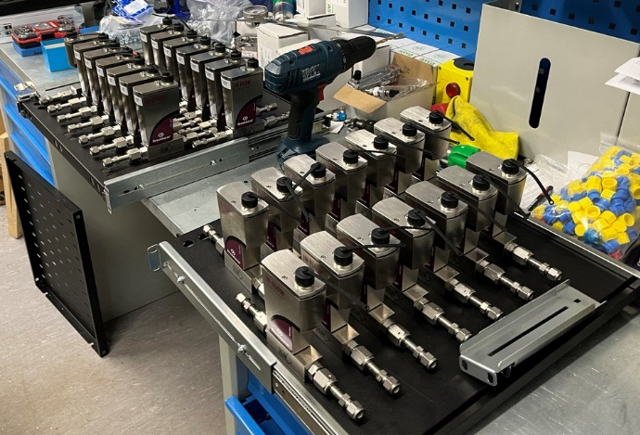
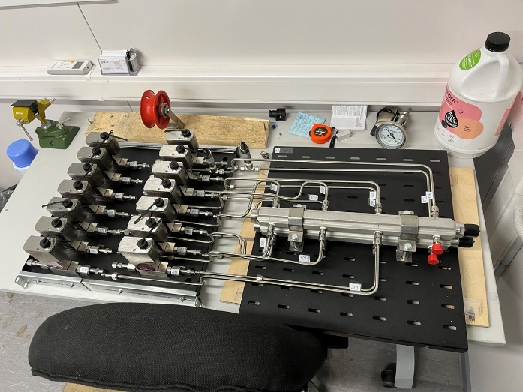
Gas distribution system for the TOF in the MPD Electronics Platform
Distribution control rack
3-rd floor (rack #2, 3 )
Gas distribution rack
Notes:
We also were unable to install the gas distribution system on the northern electronic platform MPD because it was not commissioned.
But all the equipment has long been ready for assembly.

Slide 13
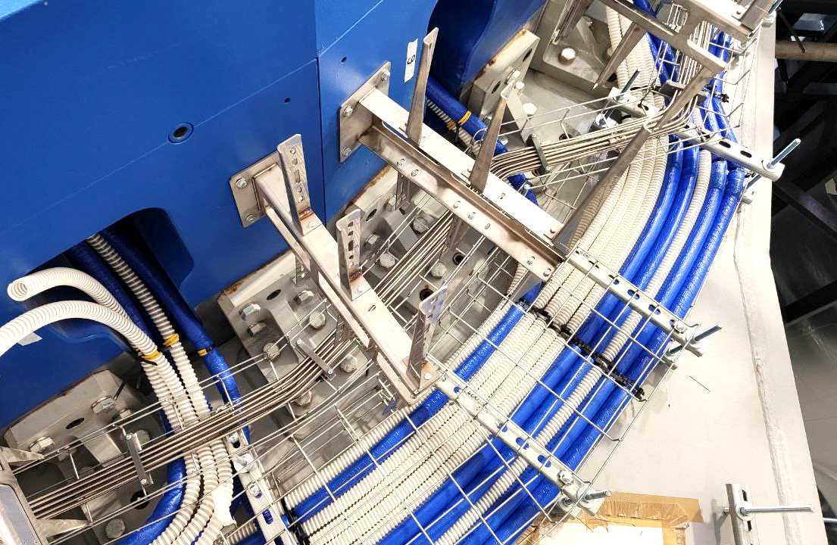
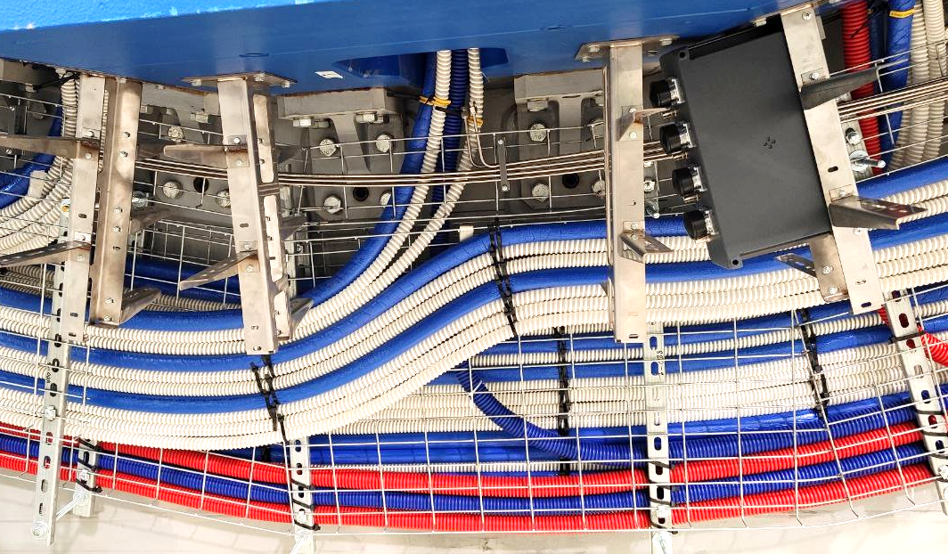
Gas distribution tubes on the MPD yoke
Notes:
The only thing that was possible to do was to lay the bottom half of the gas distribution pipes along the MPD.

Slide 14
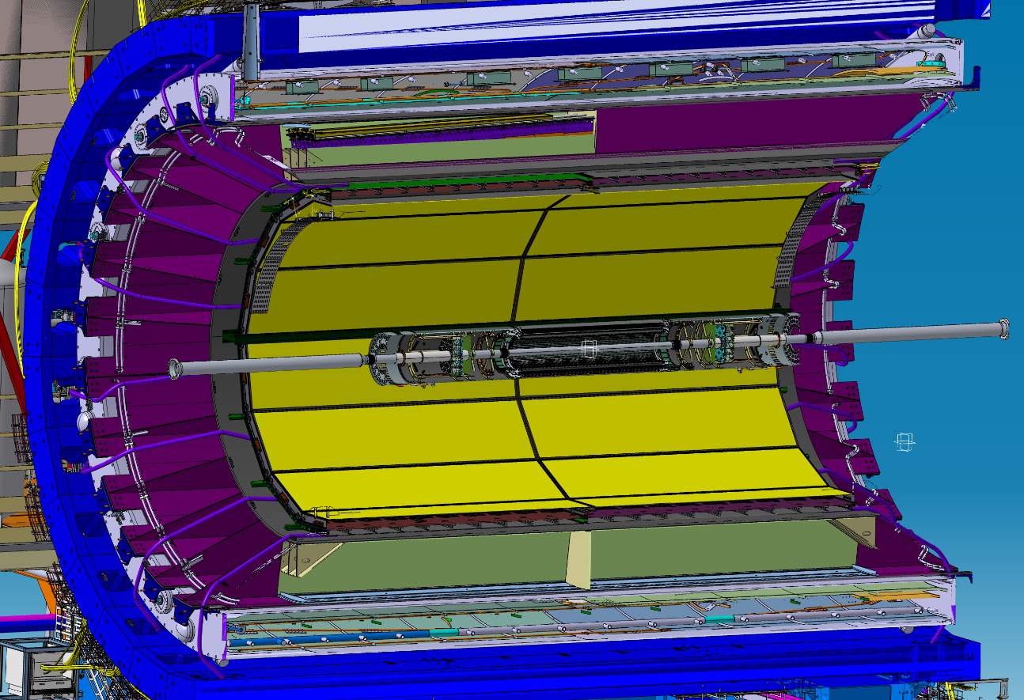
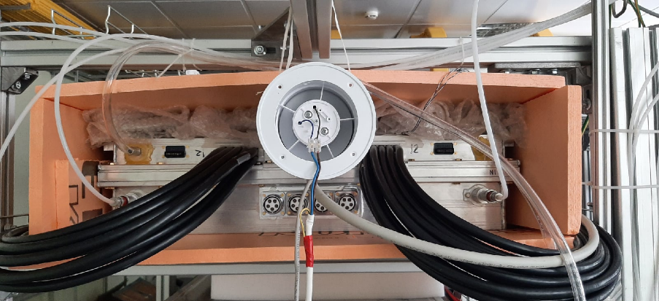
Conception of the TOF air cooling system
TOF subsystems power consumption
Part | Power, W
Power of FEEs with LV cables heating | 1150
LV modules, crates | 400
Power of Readout Electronics (TDC) | 4200
Power of HV modules | 600
Power of slow control devices | 800
Power of the gas system | 1000
Total | 8000
41W/module
100 Nm³/hour fan
~33°C
FEE power ON
FEE power ON
Cooling ON
FEE power OFF
~23°C
~23°C
24 hours
Notes:
Finally, we have returned to the idea of ​​air cooling of TOF modules. As you can see, the heat dissipation is quite small.
So a regular fan with a capacity of only 100 cubic meters per hour can remove this heat from the module by simply pumping air between the module and the MPD power frame.
To minimize the temperature gradient at the east and west ends of MPD, it was decided to alternate the air direction from module to module.

Slide 15
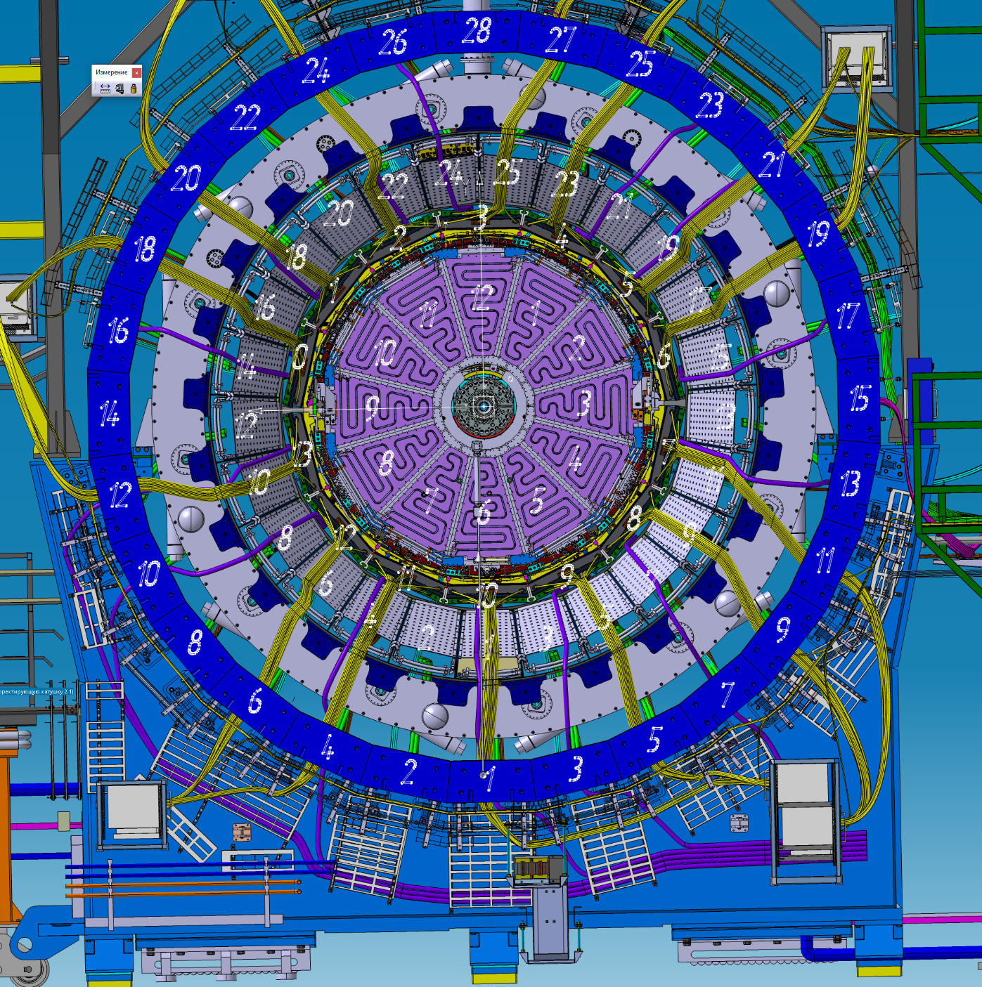
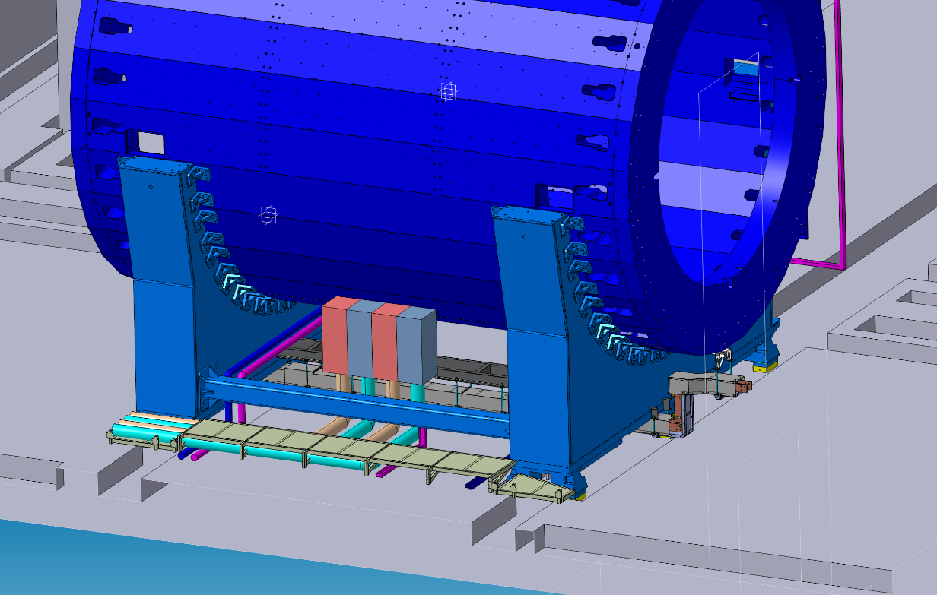
Conception of the TOF air cooling system
Notes:
At the moment, the air cooling system project is being developed jointly with the ECal group.
It is proposed to place the air preparation equipment somewhere in the MPD pit, and the air flow distribution manifolds under the magnet yoke on the side of the electronic platform.
We have already laid part of the air tubes, since after laying the TPC water cooling pipes, this will not be possible.

Slide 16
Schedule of TOF commissioning in accordance with the overall concept of MPD integration
Mar-May 2025 – building of TOF gas system area in the MPD hall
Apr-May 2025 – design of the TOF air cooling system (together with the ECal group)
Apr-June 2025 – assembling of the TOF gas system in the MPD hall and on the electronics platform
June-July 2025 – commissioning of the TOF gas system
July-Aug 2025 – assembling of the air cooling system
July-Aug 2025 – organizing of the TOF modules installation area and assembling of equipment
Aug-Sept 2025 – TOF modules installation into the MPD power frame
Oct-Nov 2025 – cabling, tubing, commissioning.

Slide 17
Thank you for the attention!

