Slide 1
TPC detector DST event viewer
Alexander Krylov (LHEP)
Email: avkrylov@jinr.ru
Oleg Rogachevsky (LHEP)
Viktor Krylov (LNP)

Slide 2
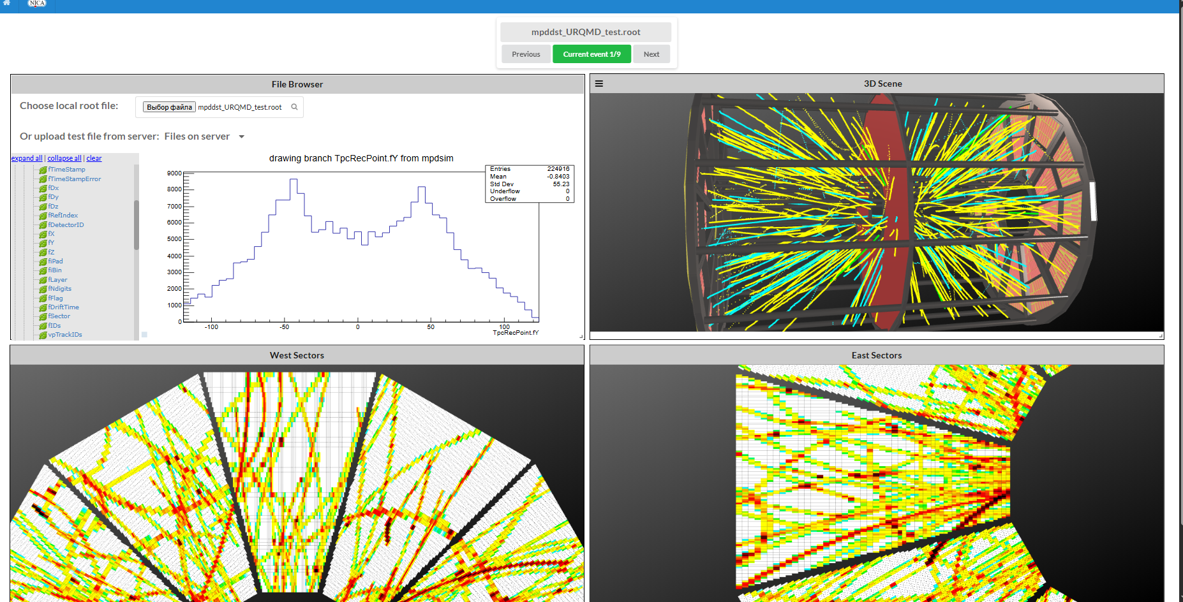
Introduction
There are various methods for monitoring the engineering, network and computer systems of the experiment. As a rule, they have a common name for all - Event Display . The operator of the facility must receive comprehensive information about the progress of the experiment in a clear and intuitive form.

Slide 3
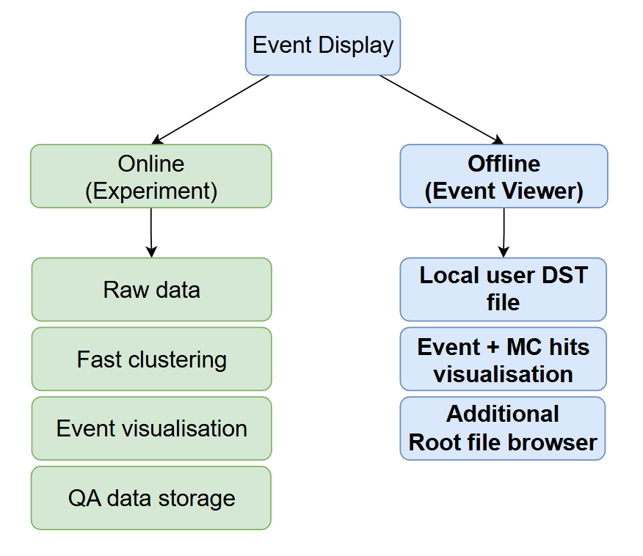
Introduction
Event Display will work during experiment and also in offline mode.
Experiment (online):
Raw experiment data as input
Fast clustering
Current event visualisation
Storting QA data histograms
Offline:
Local DST files as input
Choosed event visualisation
Additional Root File Browser

Slide 4
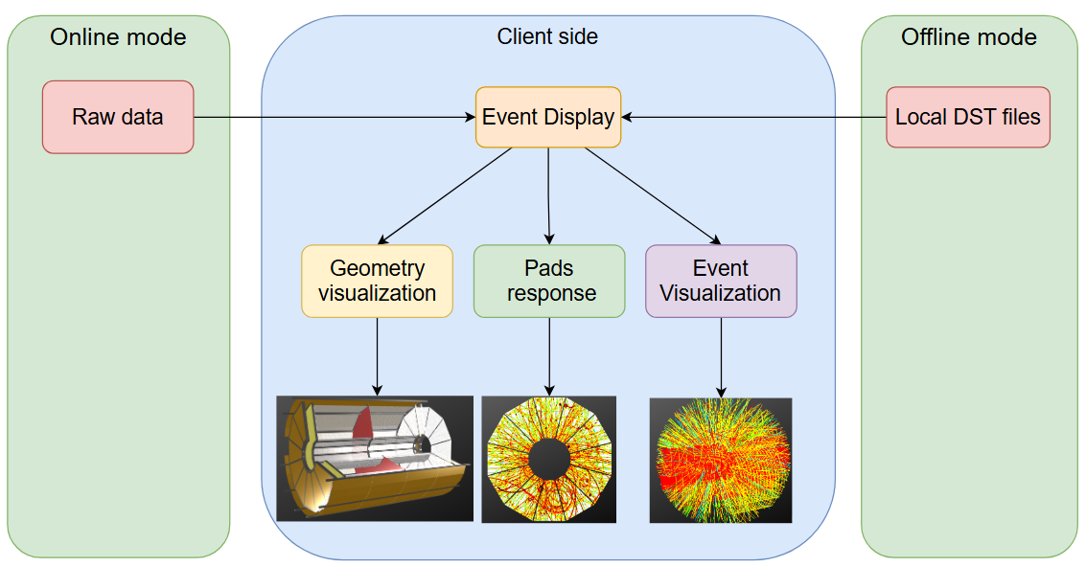
Event Display client side
All the geometry and event visualisation is done on the client side;
Client Side presents this data through interactive components like sensor information and event visualization.
As a result, during offline work, the client does not have to wait for the file to be uploaded to the server and can start working with it immediately

Slide 5
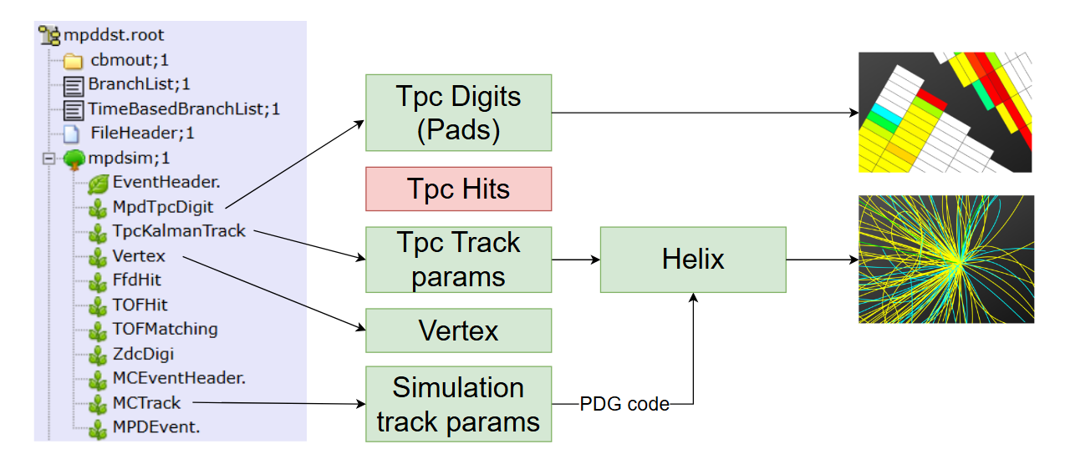
Current mpddst format

Slide 6
Full mpddst format

Slide 7
Add reconstructed hits
To add TPC reconstructed hits add line
tpcClus->SetPersistance(kTrue)
In runReco.C macros
runReco.C macros for mpdroot v25.03.25

Slide 8
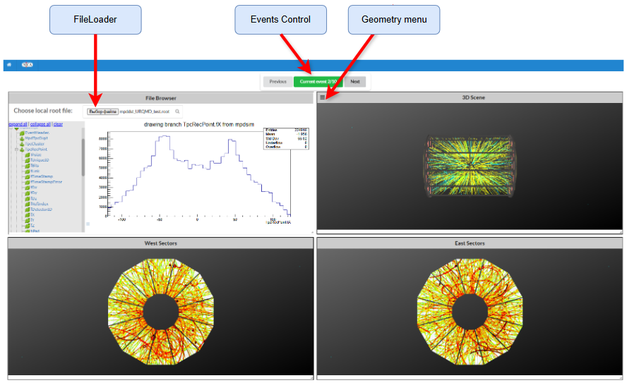
Event Viewer design

Slide 9
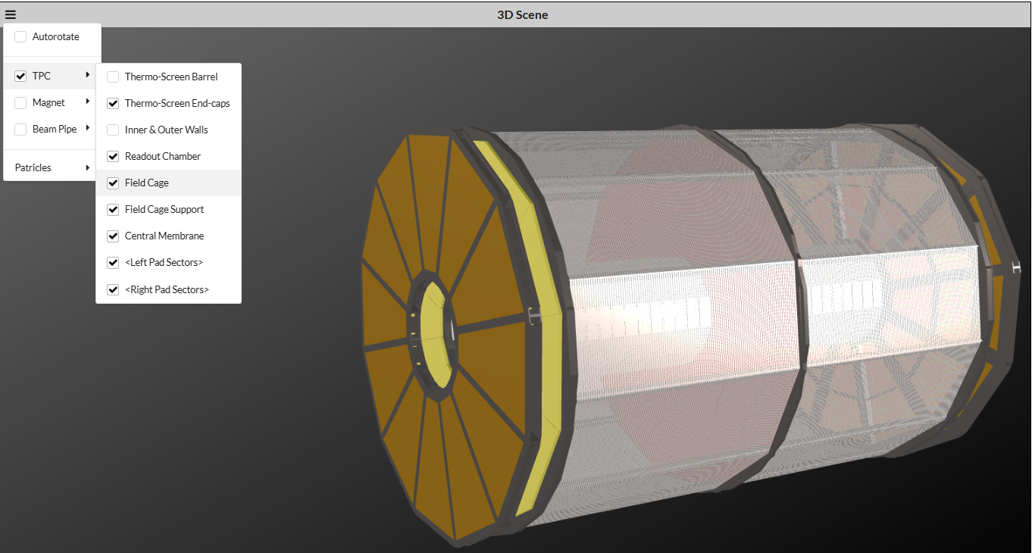
Detector geometry visualisation
Detector geometry stores on server side and is received by the client upon the first connection.
Geometry are simplified for drawing speed purposes.
Different part of detector can be enabled and disabled at the user request.
Also 3D scene has a possibility to move and rotate viewpoint in all 3 axes.

Slide 10
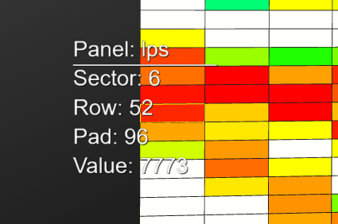
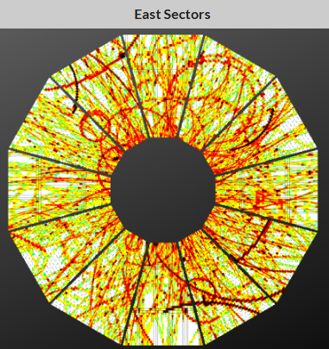
TPC pad response
TPC pads for west and east endcup sectors.
Each TPC pad has cumulative charge value for the whole event.
User can zoom in (wheel) and move (right mouse pressed) through the different sectors and see the choosed pad information (left ctrl pressed)

Slide 11
TPC Hits visualisation
TPC Hits – reconstructed 3D points inside TPC detector
Can be visualised ONLY if TpcRecPoint branch are in DST file.
Hits are visualized for one event.

Slide 12
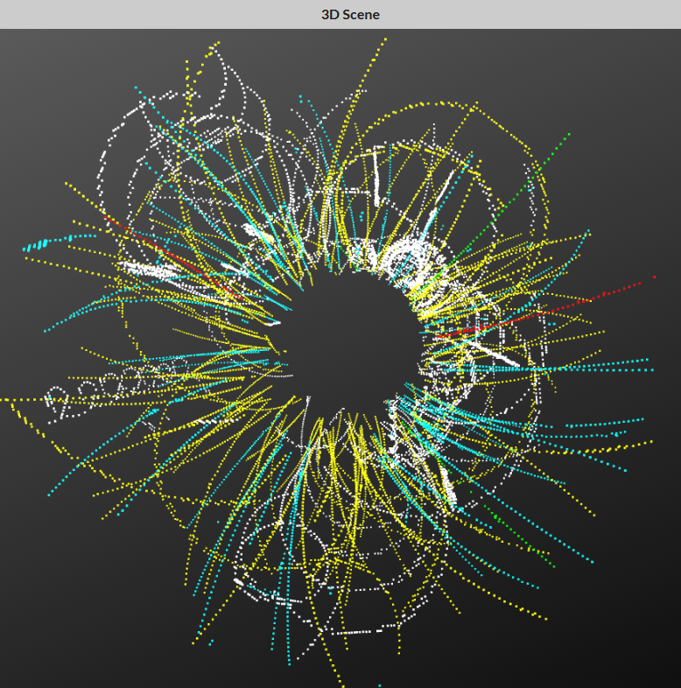
TPC Hits additional MC information
While using simulation data reconstructed TPC hits has reference to MonteCarlo track (MCTrack branch) they are from.
Using that information it is possible to distinguish different patricles by its pdg code and visualize it in different colors.
Used colors:
Protons (2212) -> cyan
Pions (211) -> yellow
Kaons (321) -> green
Leptons (11, 13) -> red
Other -> white

Slide 13
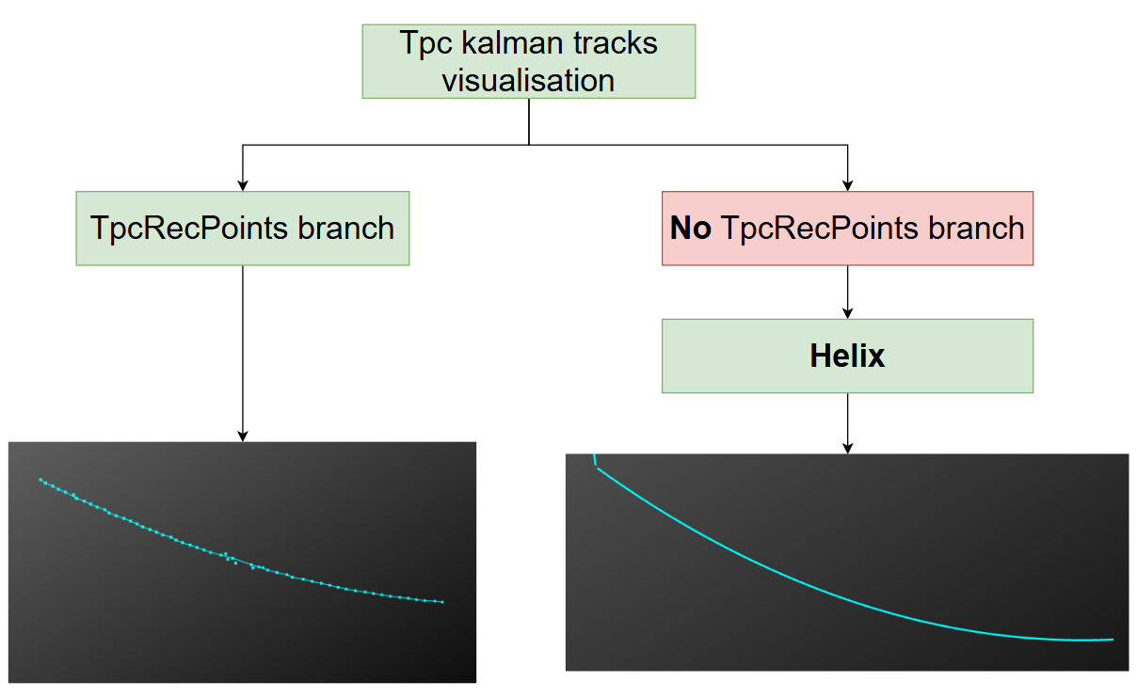
TPC Tracks visualisation
TPC tracks – reconstructed kalman tracks inside TPC detector (TpcKalmanTrack branch).
Two methods to draw tracks:
If TPC hits (the TpcRecPoints branch) are enabled, then each Kalman track has its own hits, which are used to construct it as a line;
If no TPC hits included, to visualize each Kalman track its Helix representation is used.
During offline work there are information about pdg code of the reconstructed track. That information is used to distinguish different particles by colors (same as for TpcHits).

Slide 14
TPC Tracks visualisation
TPC tracks using Helix
TPC tracks by reconstructed TPC Hits

Slide 15
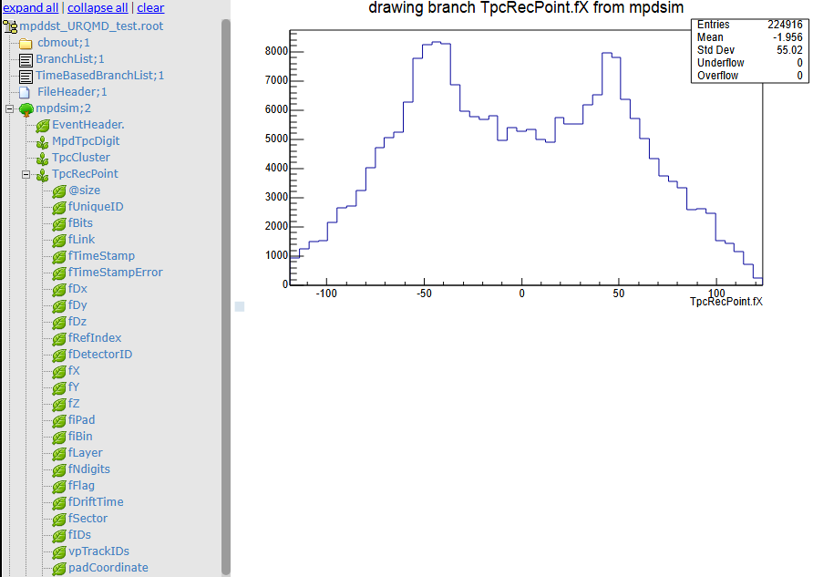
Root browser usage
JSROOT library has the possibility to create root type FileBrowser for local client files;
Browser can visualise histograms and TTree branches information;
It is done with the help of HierarchyPainter and d3.js library.

Slide 16
Used web technologies
 | New | Old
FrontEnd | React + TypeScript | React + JavaScript
BackEnd | Bun | NodeJs
Server | Bun.serve | Express
Bundler | Bun | WebPack
DataBase | Bun:sqlite | None
Connection | Bun.ws | WebSocket
Store | Redux toolkit | Redux
Graphics | ThreeJS + JSROOT | ThreeJS

Slide 17
Server side data handling (next step)

Slide 18
Summary
The client side of the event display has been updated to the newest technologies: BUN, Typescript and Modern Redux.
At the moment it was implemented fully for the TPC detector. Other detectors will be added later.
Now the event display works with local DST files, using the JSROOT.
It is available from the mpdroot site (mpdroot.jinr.ru -> MPD visualization -> MPD Event Viewer).

Slide 19
MPD Software Development & Computing Team
Rogachevsky O. Coordinator
Krylov V., Krylov A. Online MPD Event Display
Moshkin A., Pelevanyuk I. Mass Production
Bychkov A. Detector Simulation
Kuzmin V. Detector Alignment
Podgainy D., Zuev M. Supercomputing
Alexandrov E., Alexandrov I. Databases
Balashov N. Gitlab Support
Belecky P., Kamkin A. Acts Tracker
Busa J. Build System
Hnatic S. Architecture

Slide 20
Thank you for your attention!

Slide 21
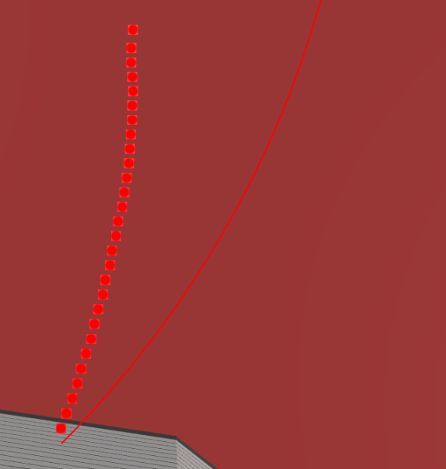
Helix inaccuracy
Helix representation of track does not take into account perticles ionization energy loss in TPC gas;
It means that track built by Helix function will not match with the original track exactly.
Sometimes that discrepancies can be quite big.

Slide 22
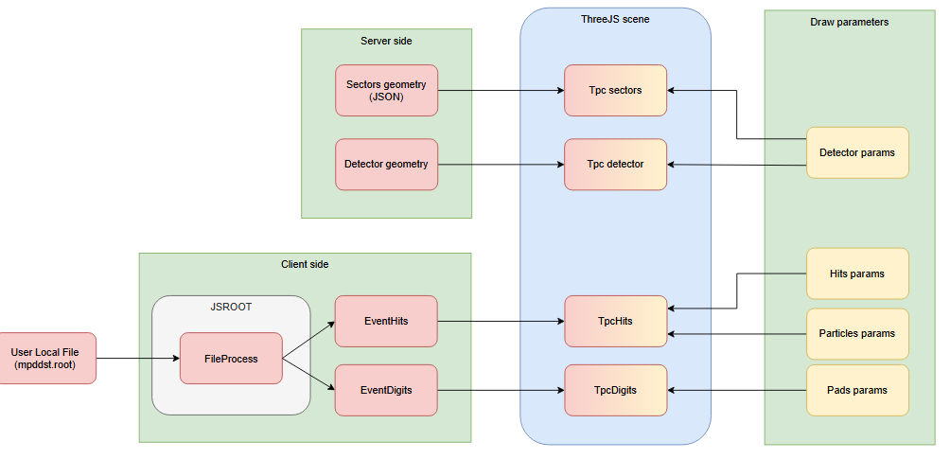
Client data flow scheme

Slide 23
Event Broker

Slide 24
QA monitoring (server data only)

Slide 25
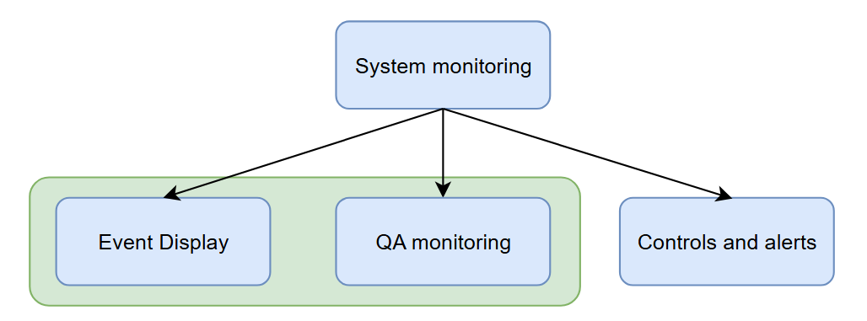
Introduction
Event Display focuses on visualizing individual particle collision events or interactions within detectors.
QA monitoring ensures the operational health and performance of the entire experimental setup, including detectors, electronics, and data acquisition systems.

