Slide 1


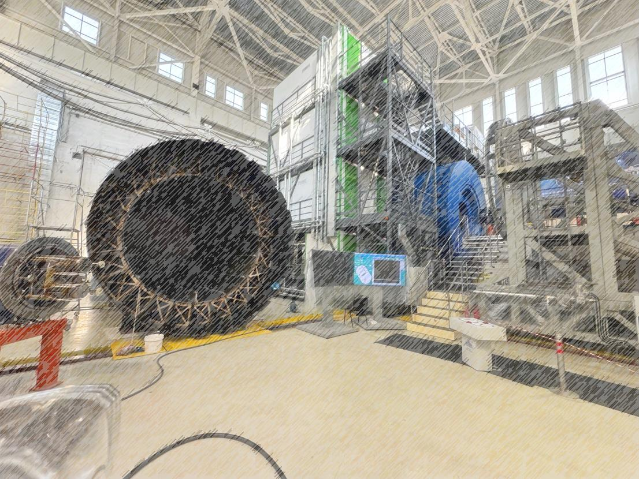
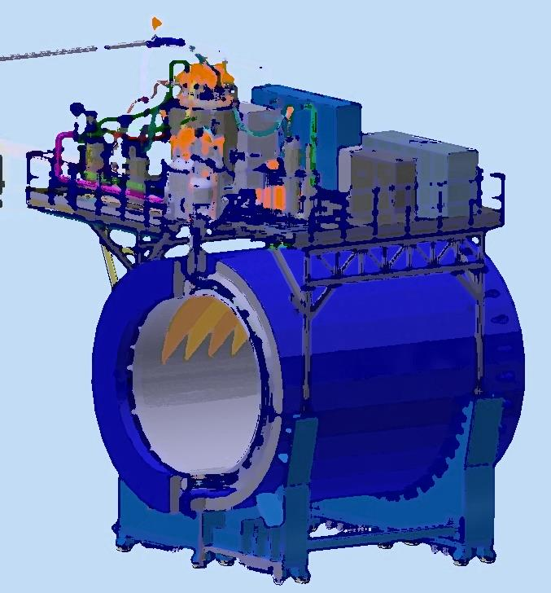
Status of the solenoid start-up
NICA Days and XV Collaboration Meeting of the MPD Experiment at NICA
15-17/04/2025
From drawing
to detector
Speaker: K. Mukhin
JINR, LHEP 2025

Slide 2
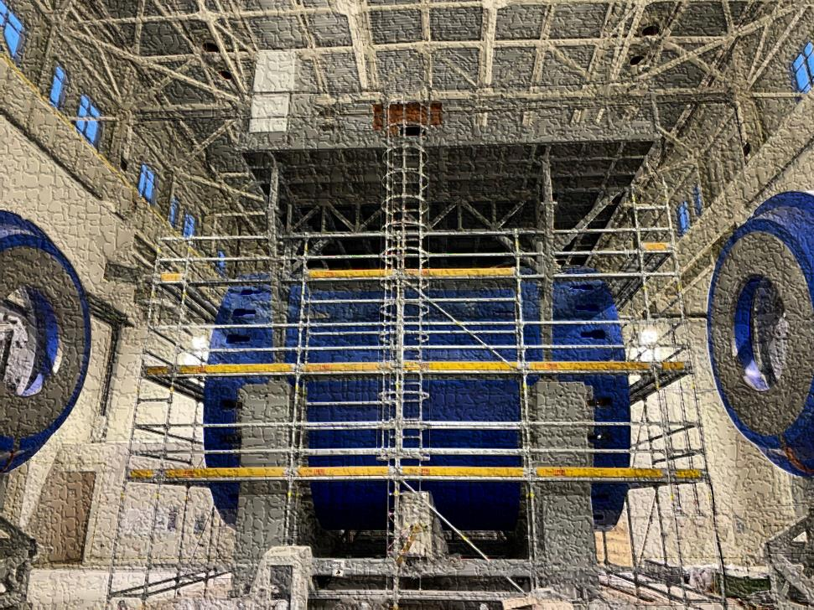
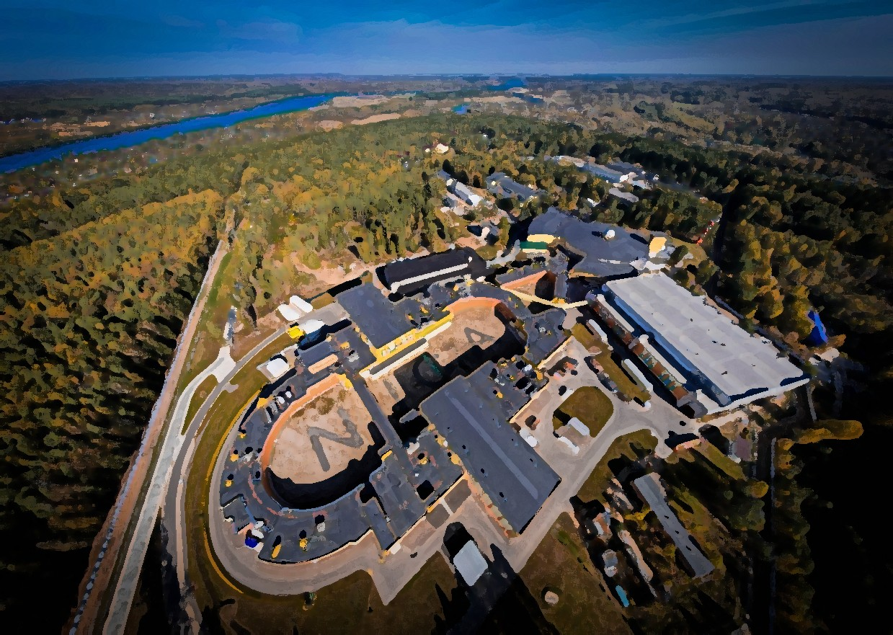
Plan of talk
Magnet construction and some parameters
Cryogenic infrastructure
- Cooling to operation temperature (4,5K)
Engineering systems of the detector MPD
- Power supply system
- SC coil training
- Water cooling system
- Magnetic field mapper
and stationary gauges
Timeline and risks

Slide 3
Chapter 1
Magnet construction and parameters

Slide 4
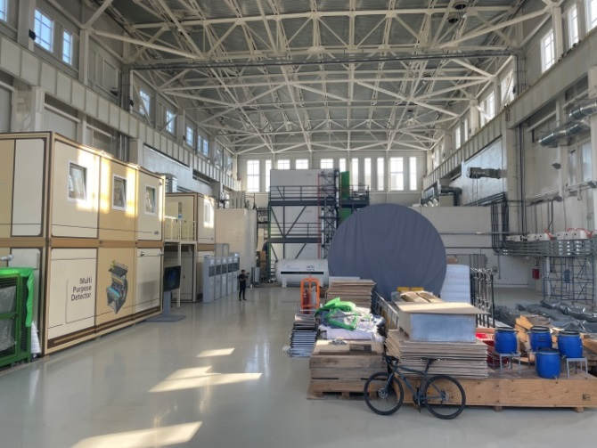
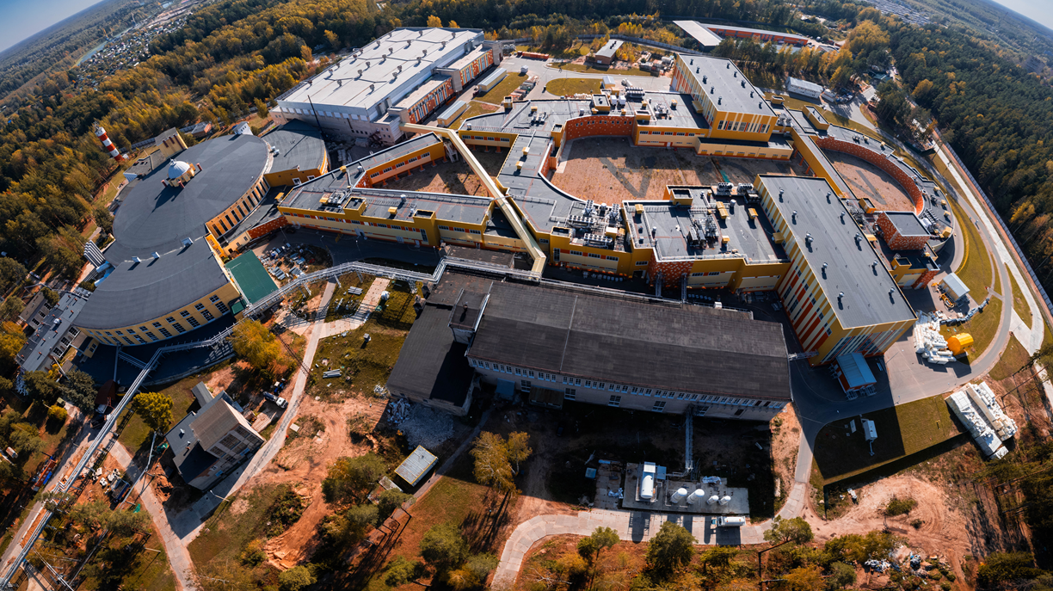
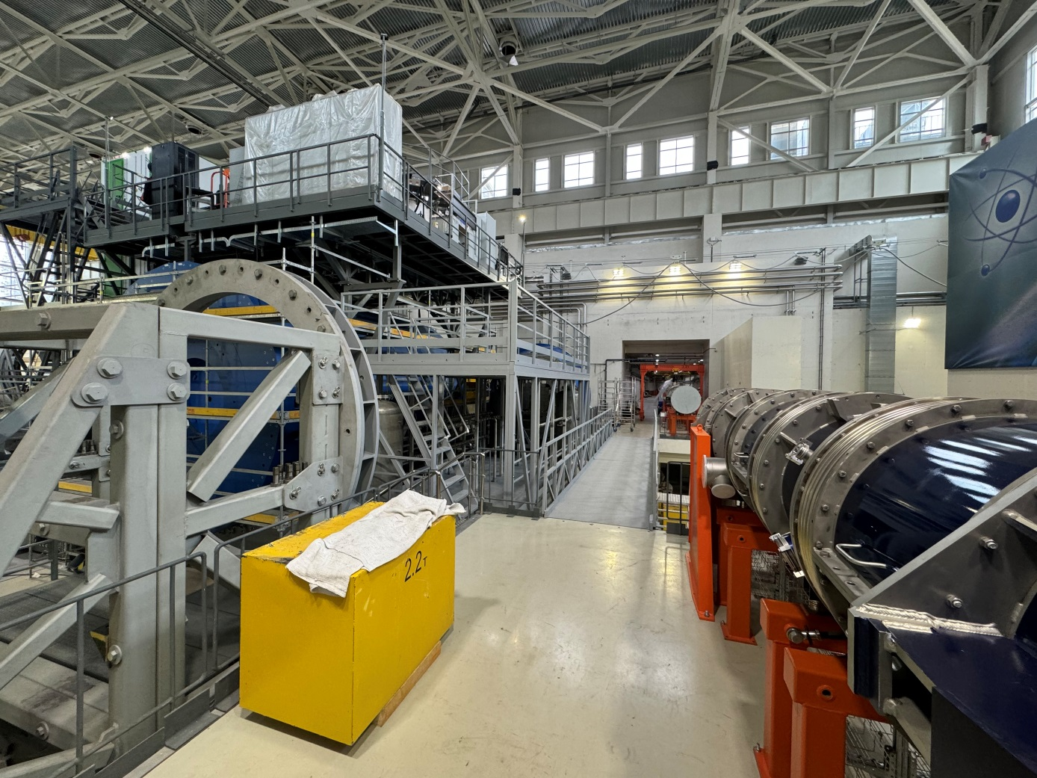
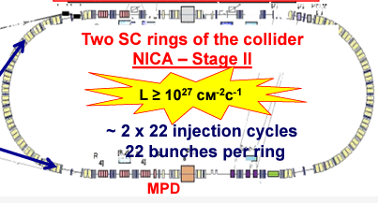
MPD in NICA complex
BM@N
SPD
Booster
Nuclotron
N I C A
MPD

Slide 5
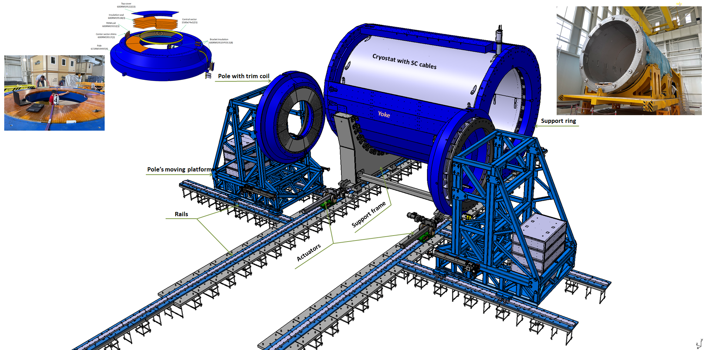
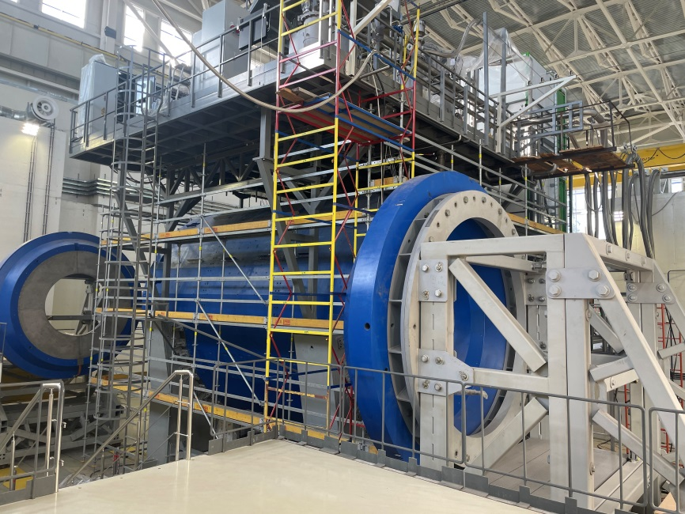
MPD magnet construction
Parameters of the magnet
Magnetic field | 0,57 T
Cryostat weight and size (diameter/length) mm | 66 tons 5443/7910
Yoke weight and size (diameter/length) mm | 630 tons 6583/8970
Current Voltage | 1790 A 10V
Each pole weight | 45 tons
Total weight with support equipment | 800 tons

Slide 6
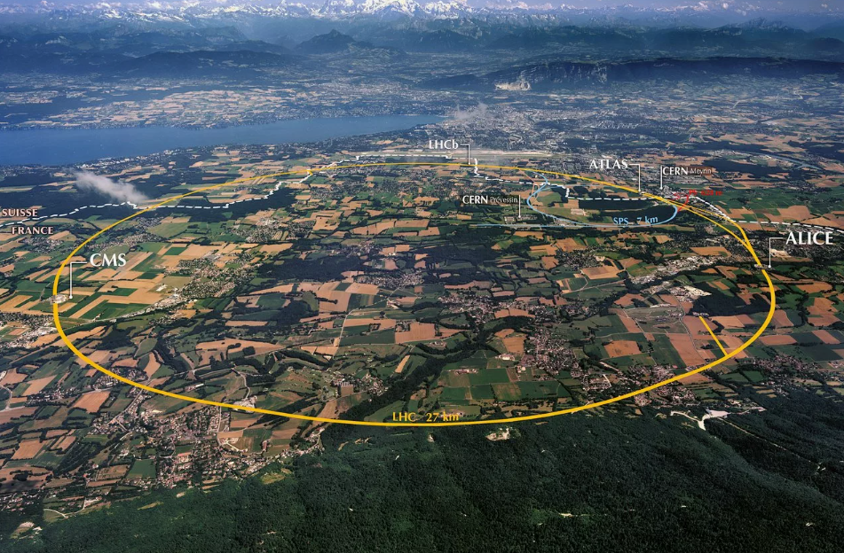
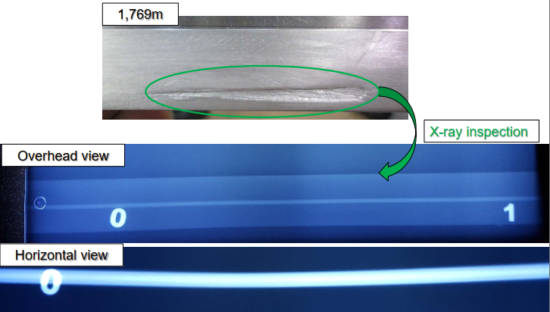
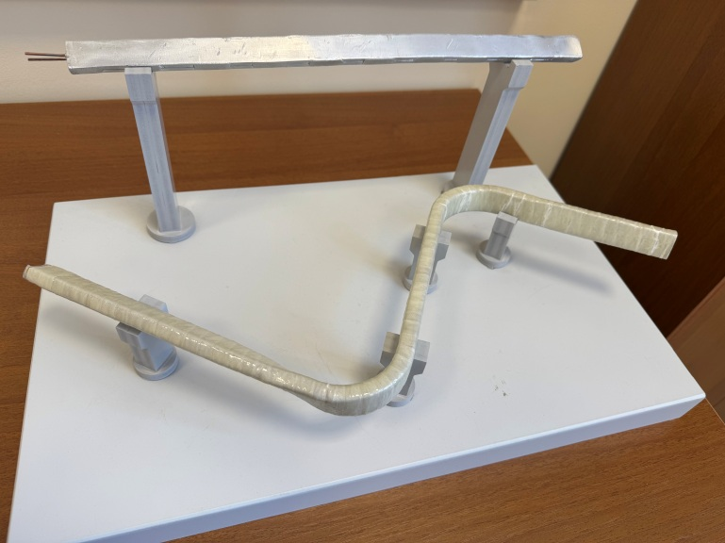
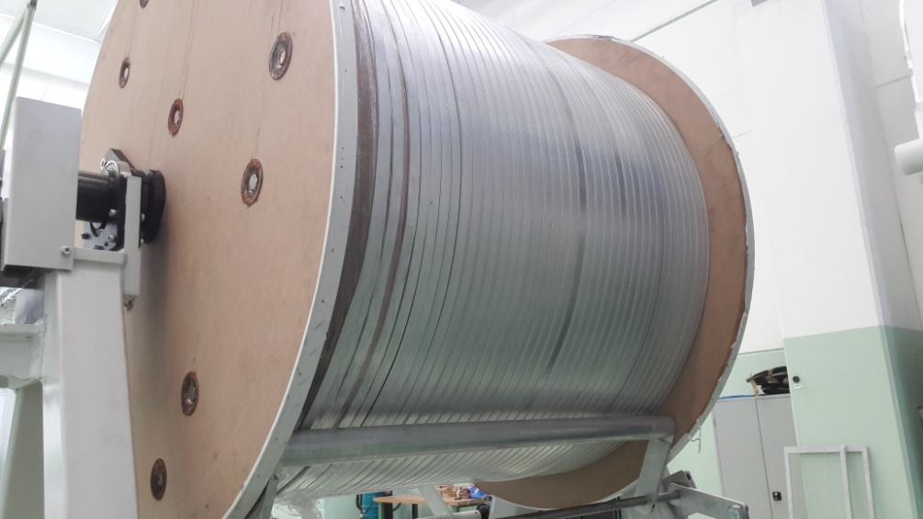
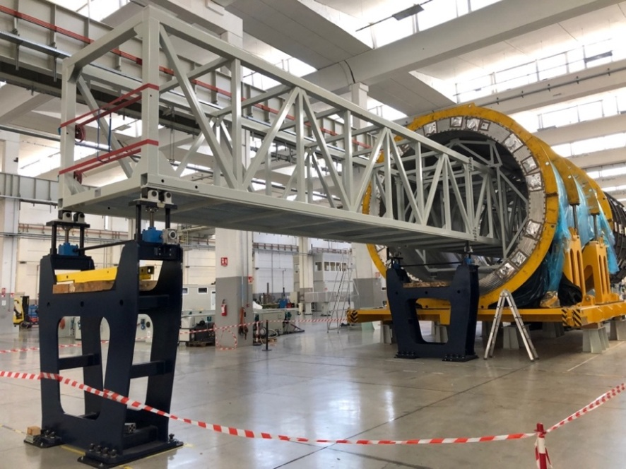
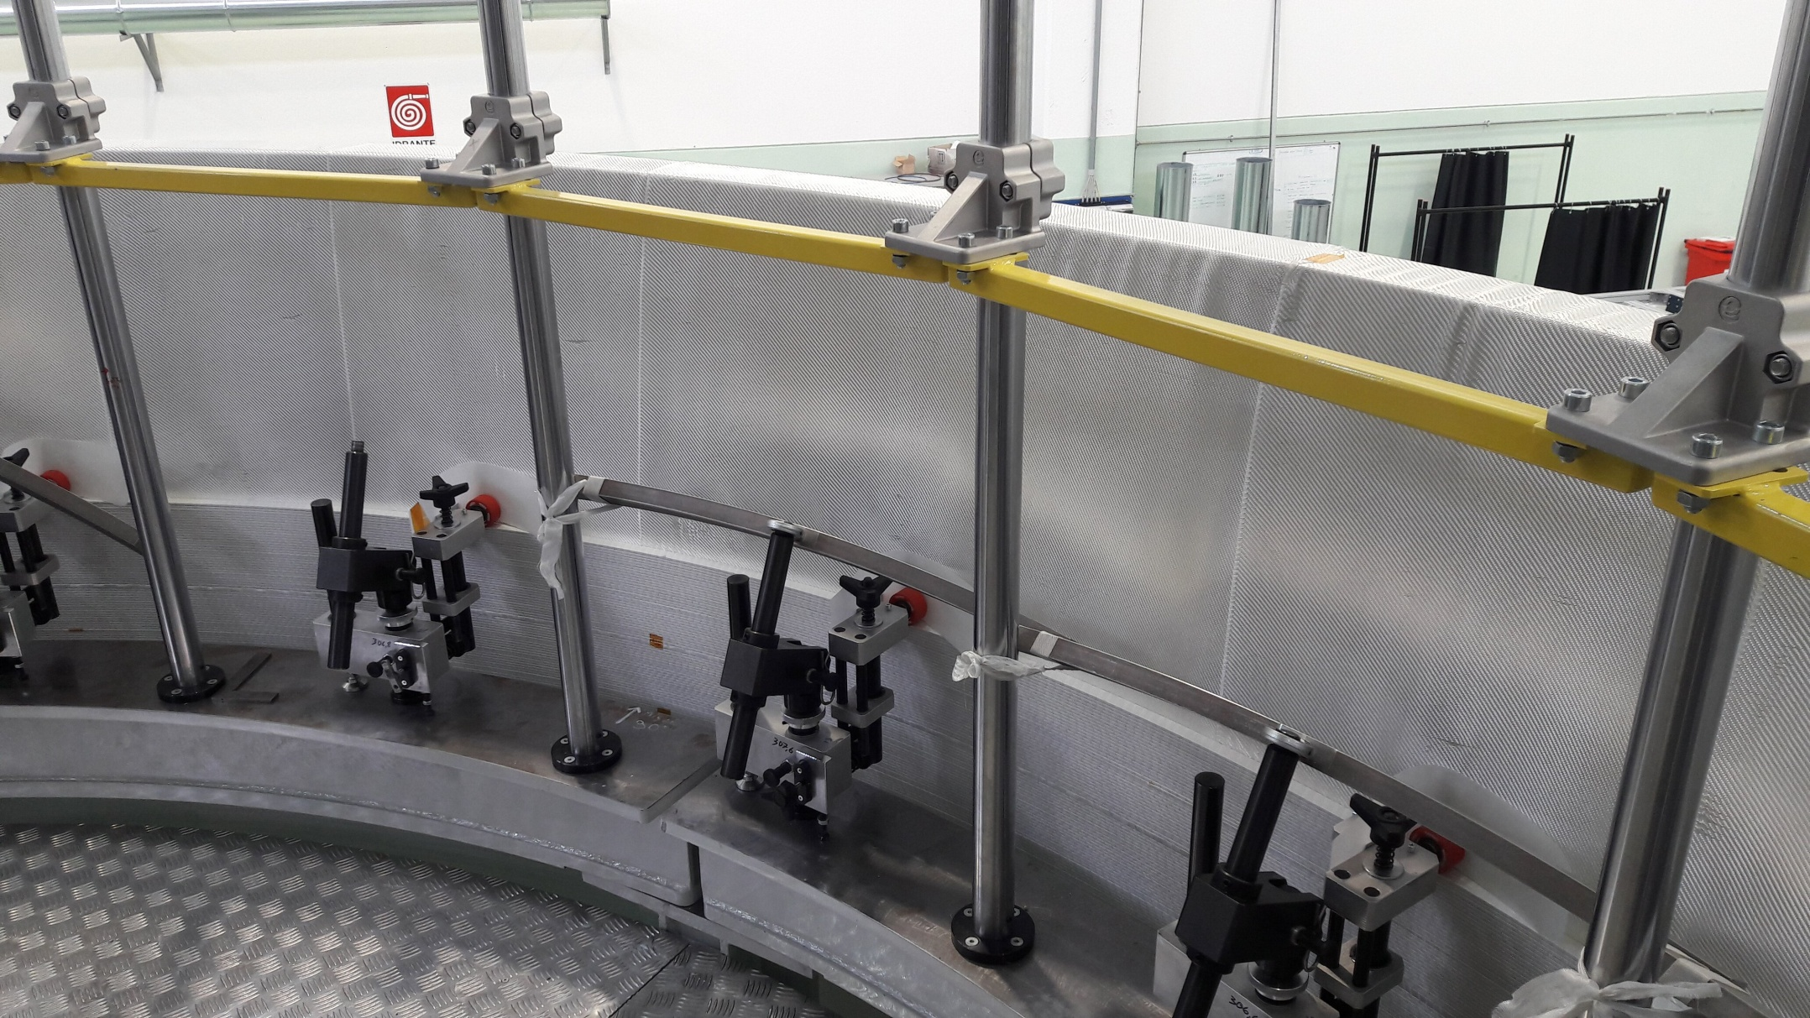
Superconductor cable
Original SC cables for MPD
Winding and tests of SC cable in ASG
LHC 27 km
SC cables parameters
SC Materials – NbTi/Cu.
Cable composition is pure aluminum matrix (4,1 x 20 mm) and inside string of Cu/SC ratio 0,9/1 (d – 1,5 mm).
Insulation – kapton tape, glass tape and epoxy resin.
Critical current (1,2 T, 4,5 K) – 6,9 kA
Cable length - 27 km.
Cable weight – 6,3 tons

Slide 7
Chapter 2
Cryogenic infrastructure.
Cooling to operation temperature (4,5K)

Slide 8
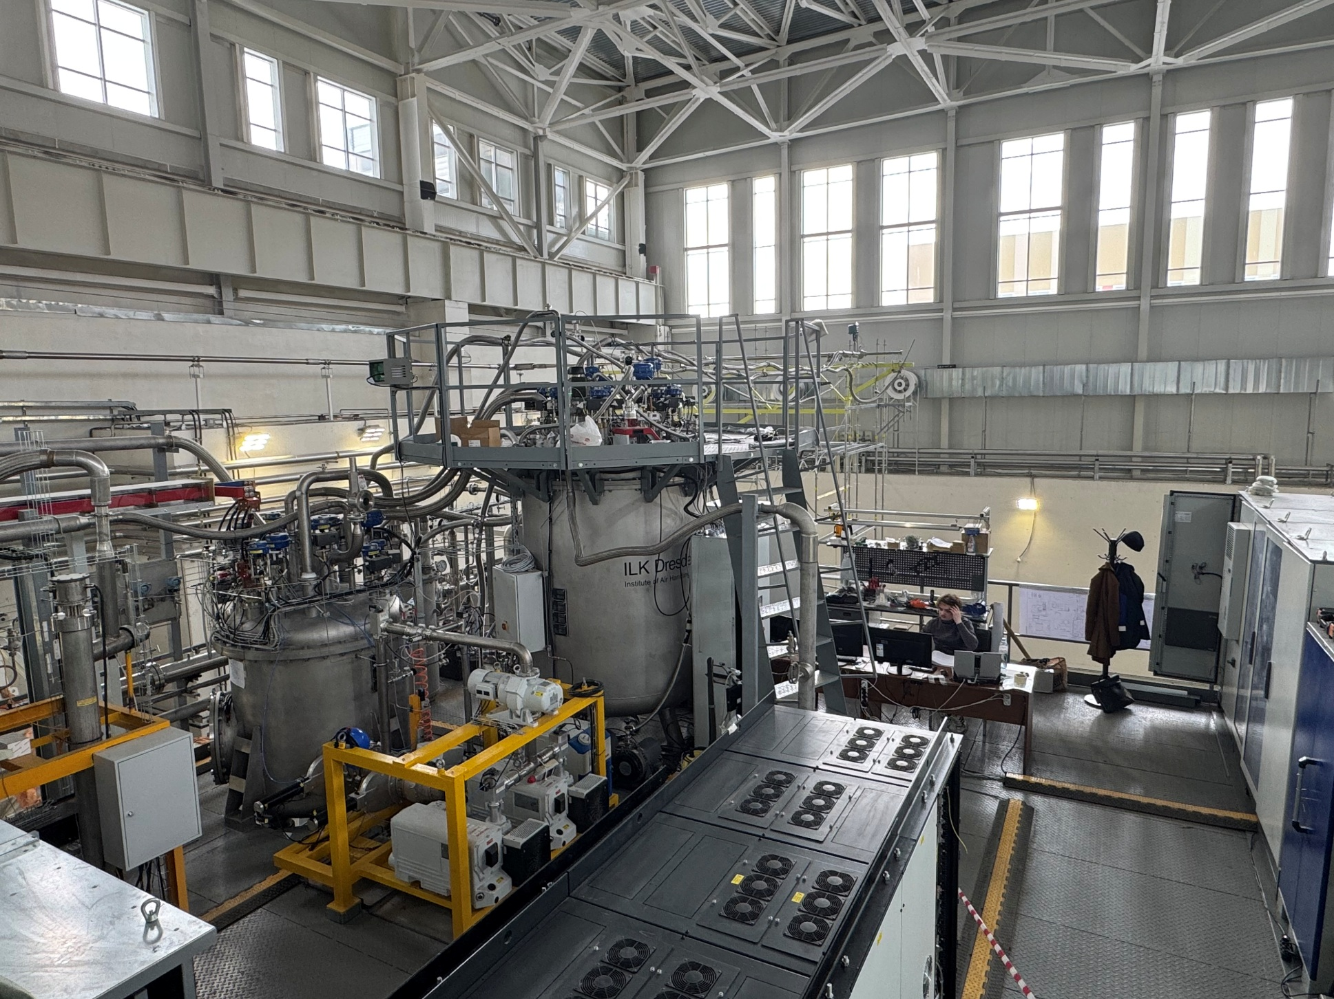
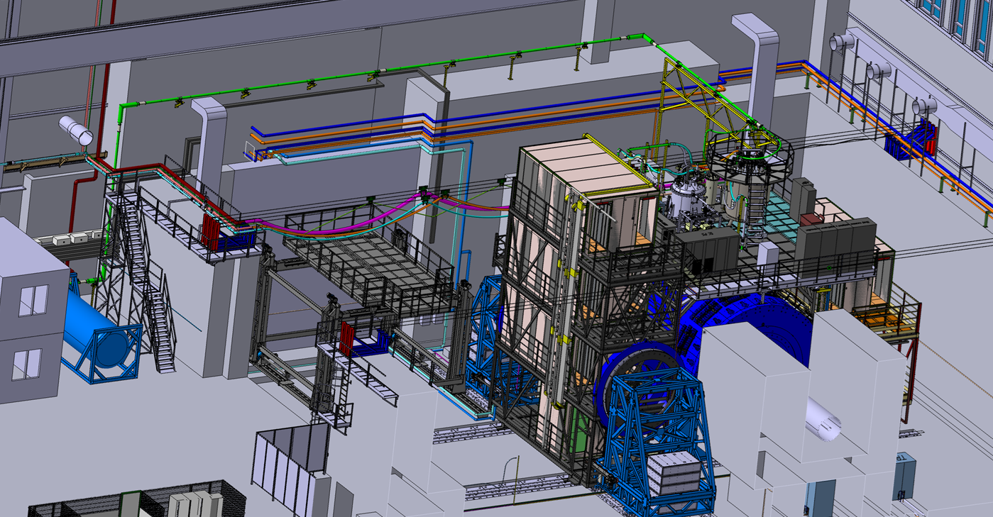
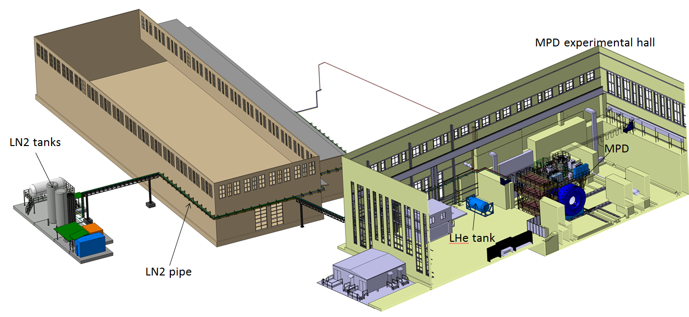
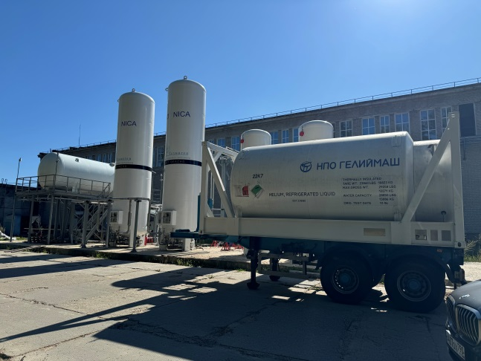
Cryogenic infrastructure
Control Dewar
Refrigerator
NTCS (Nitrogen temperature correction system)
LN2 and LHe heaters
LHe pipe
Cryogenic flexible connection pipes
LN2 Tanks (2 pc)
LHe Tanks (2 pc)
LN2 transfer pipe 120 m
Warm pipes for He, N2 and instrumentation Air
Flexible warm pipes
Support system for flexible pipes
Temporary pipes for cooling by temporary scheme

Slide 9
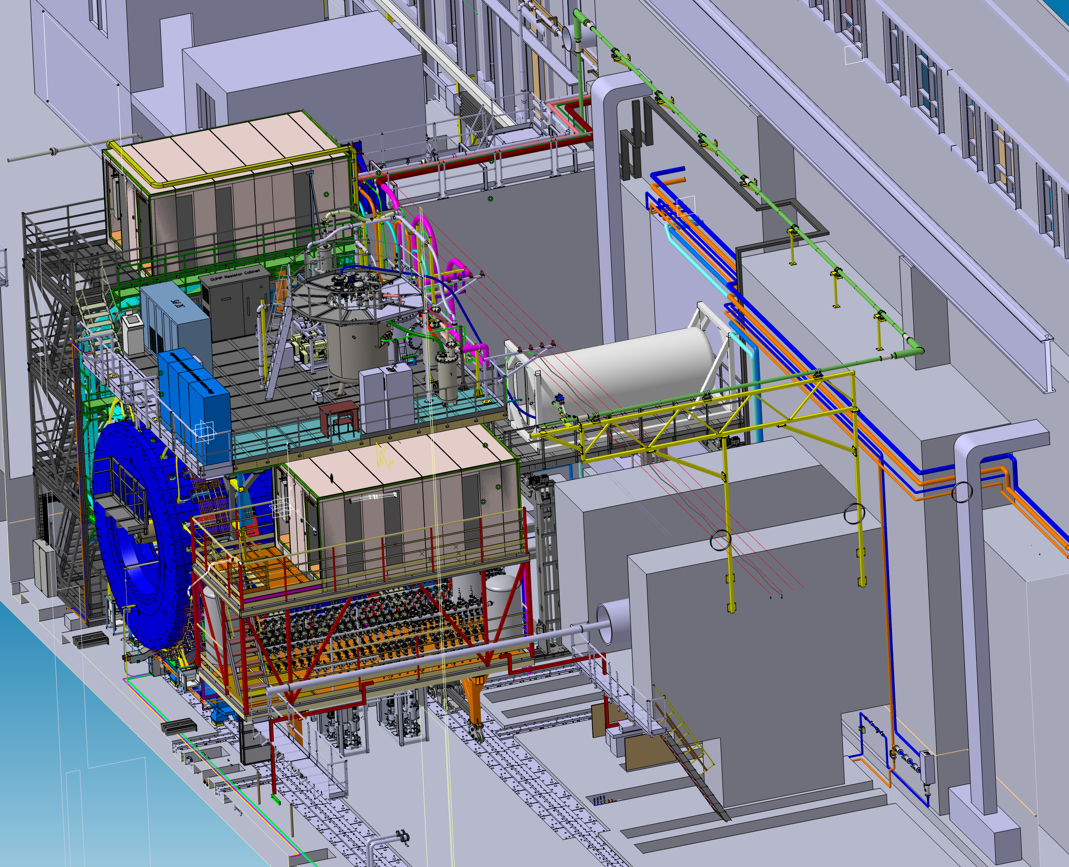
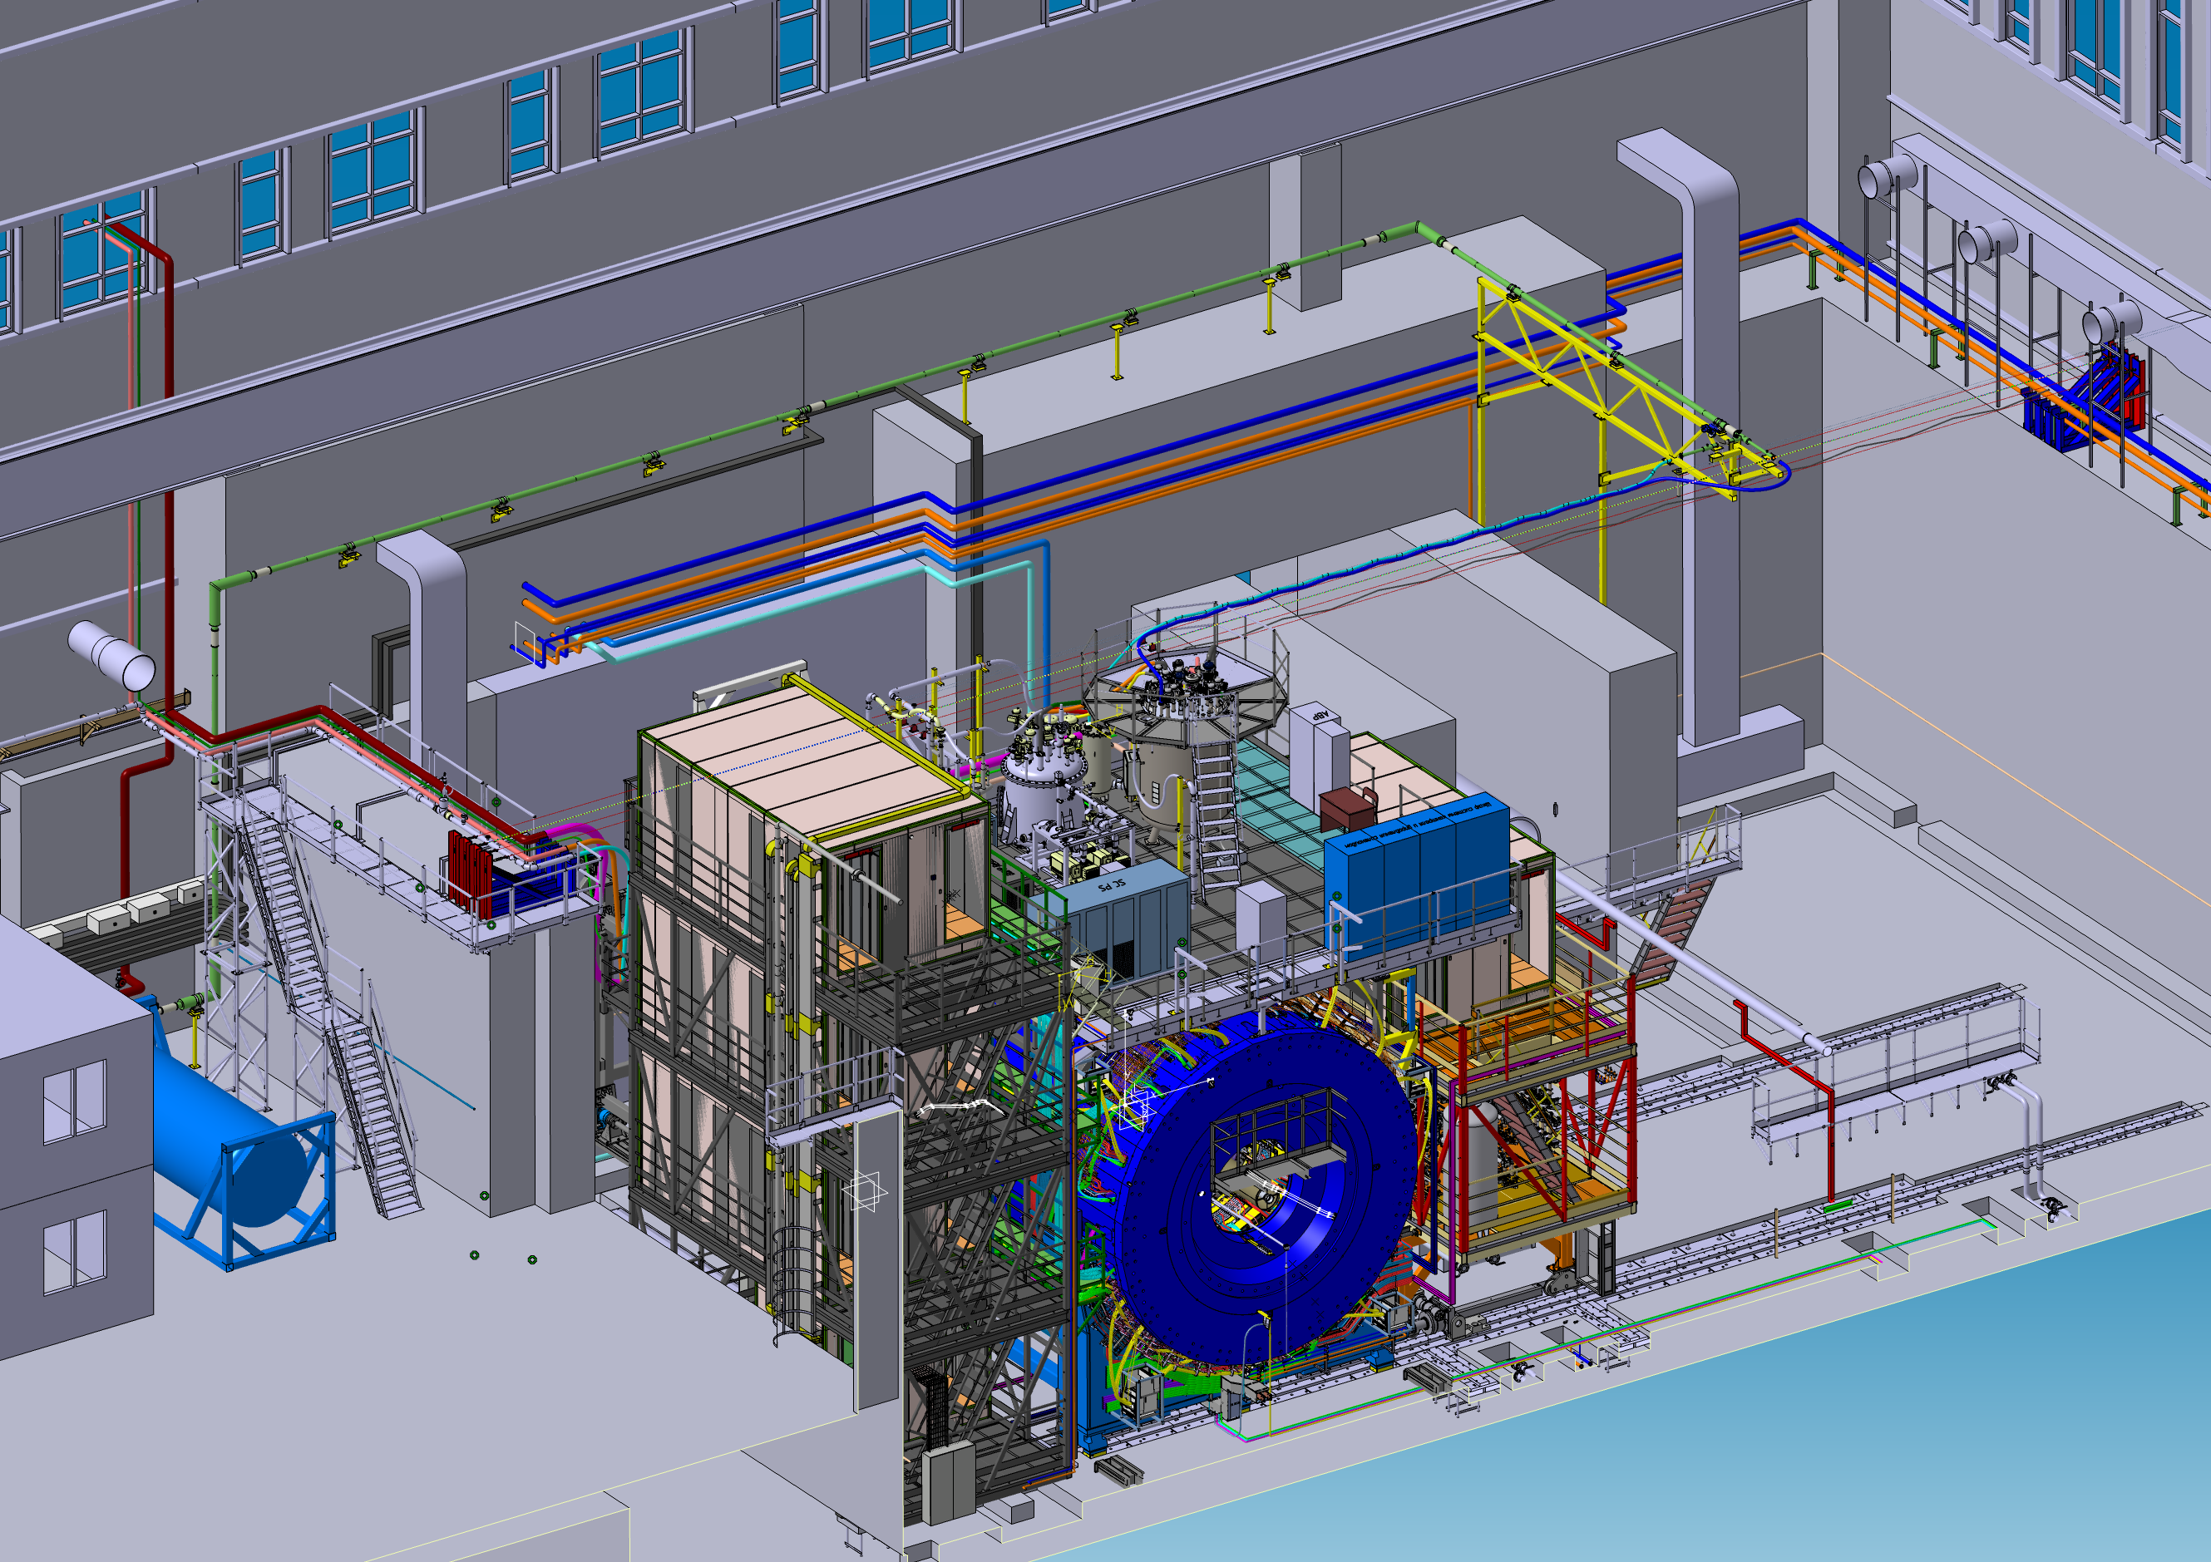
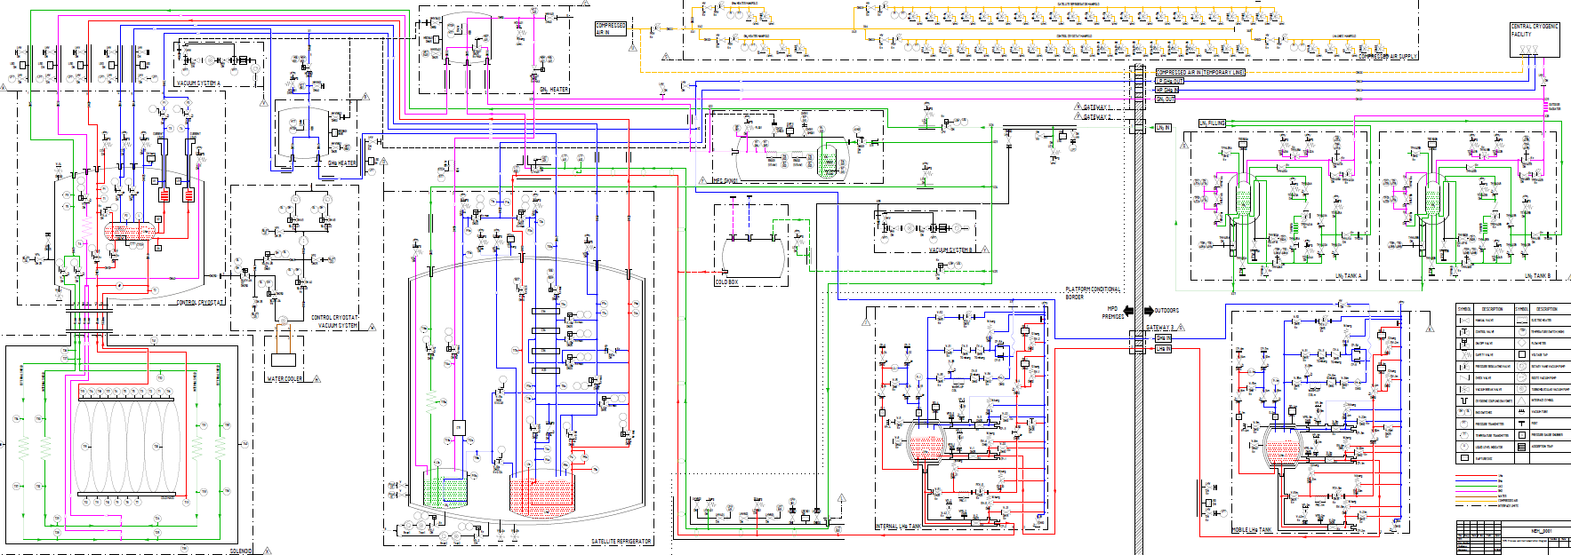
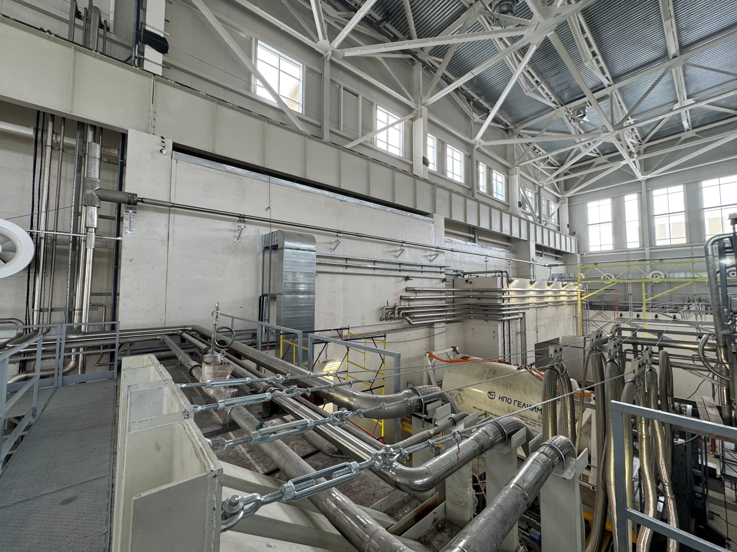
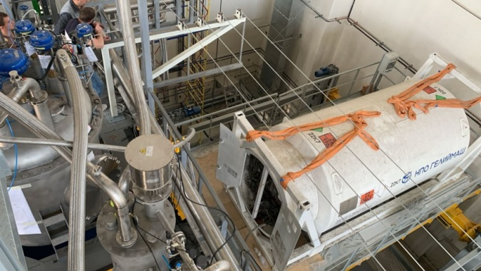
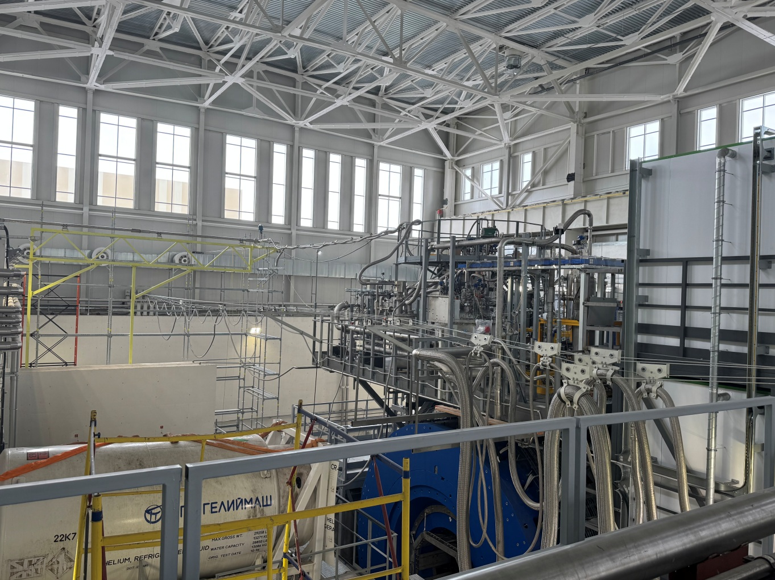
Scheme of cooling down to 4,5 K

Slide 10
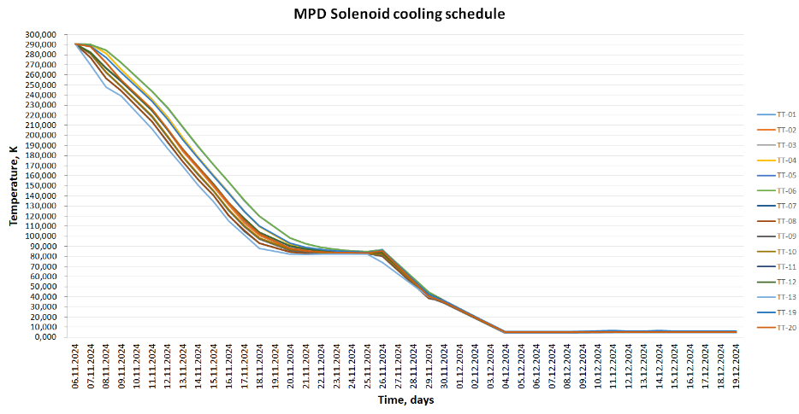
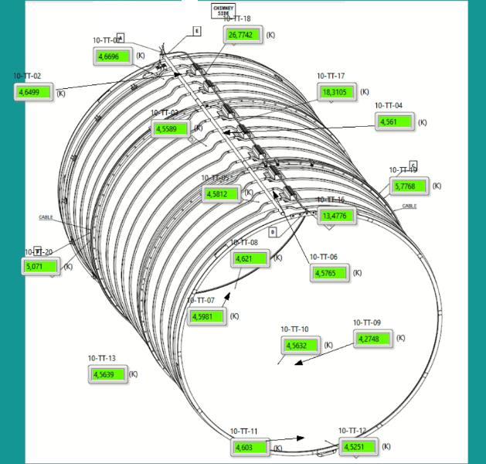
Cooling process scheduled
Total cooling time – 28 days
Nitrogen mode – 14 days
Transient mode – 6 days
Helium mode – 8 days

Slide 11
Conclusions of cooling to 4,5K
Successful cooling solenoid by 4,5 K.
No cold leak in thermal shield and LHe circle.
Obtained cooling parameters of cryogenic equipment can be accept and are consistent with a manual (1 - 1,5K/h).
Heat load into solenoid are consistent by project and low then 100 W.
Cooling time from room temperature to 80 K take’s about 15 days, from 80 K to 4,5K 8 days.
Main LHe pipe was developed and installed in to MPD Hall
From the March 2025 for present day solenoid MPD operation temperature (4.5K) for power supply tests.

Slide 12
Chapter 3
Engineering system of the detector MPD
Engineering systems of the detector MPD
- Power supply system
- SC coil training
- Water cooling system
- Magnetic field mapper
and stationary gauges

Slide 13
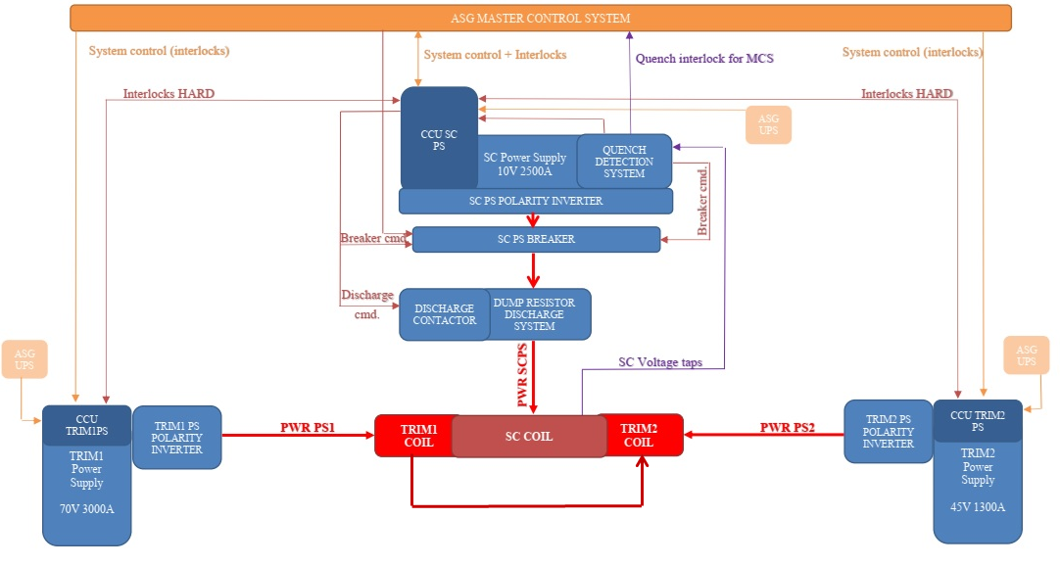
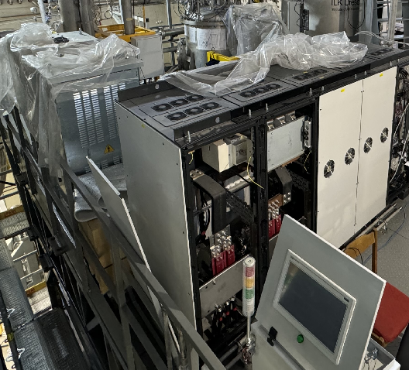
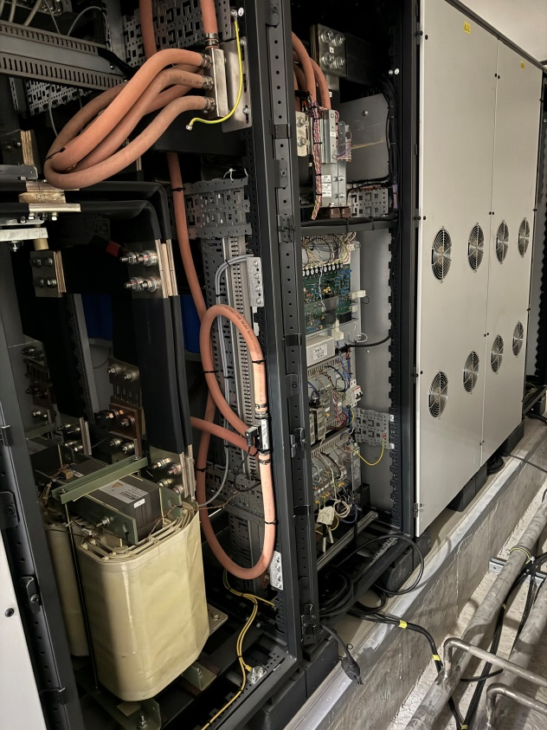
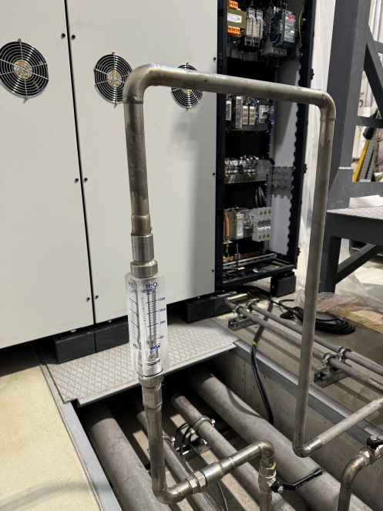
Power supply system

Slide 14
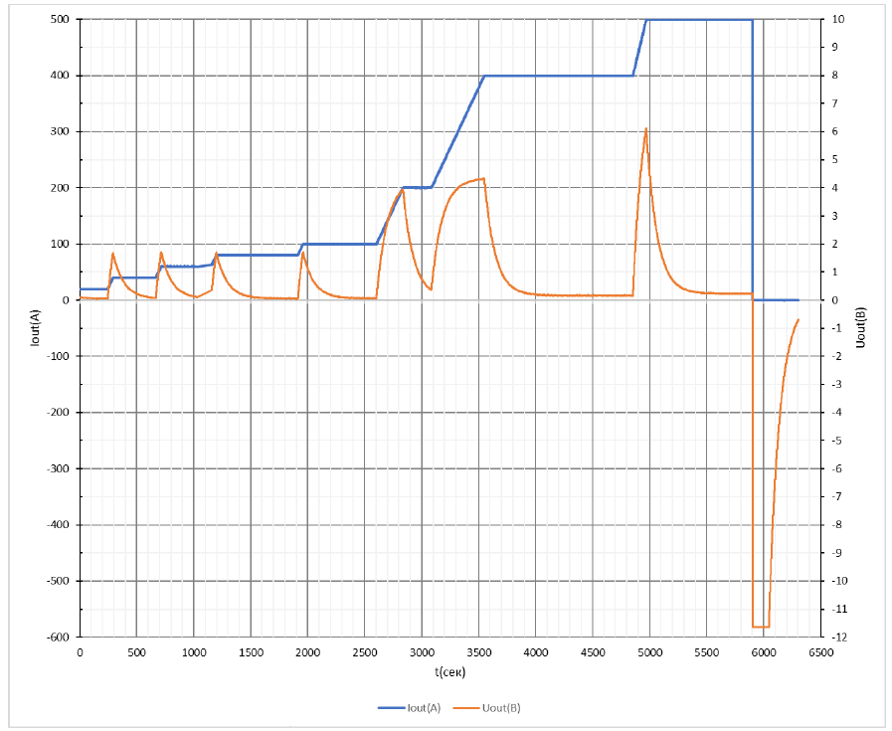
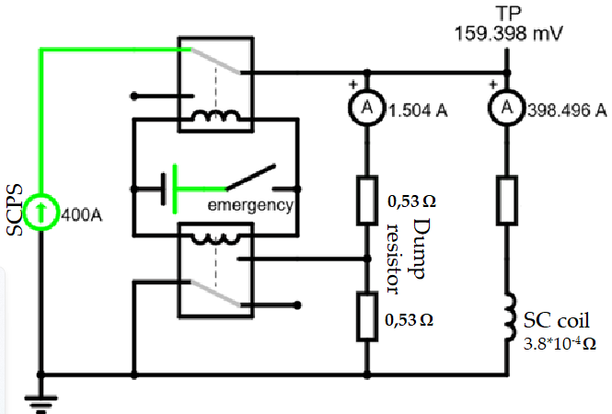
SC power supply test and the first current in to SC coil
SCPS test to 500A in CS coil and emergency stop
Test scheme
Emergency stop
Voltage drop
Inductance of coil – 8,6 H
Nominal current – 1760 A
Number of turns – 1674
Magnetic field – 0,57 T

Slide 15
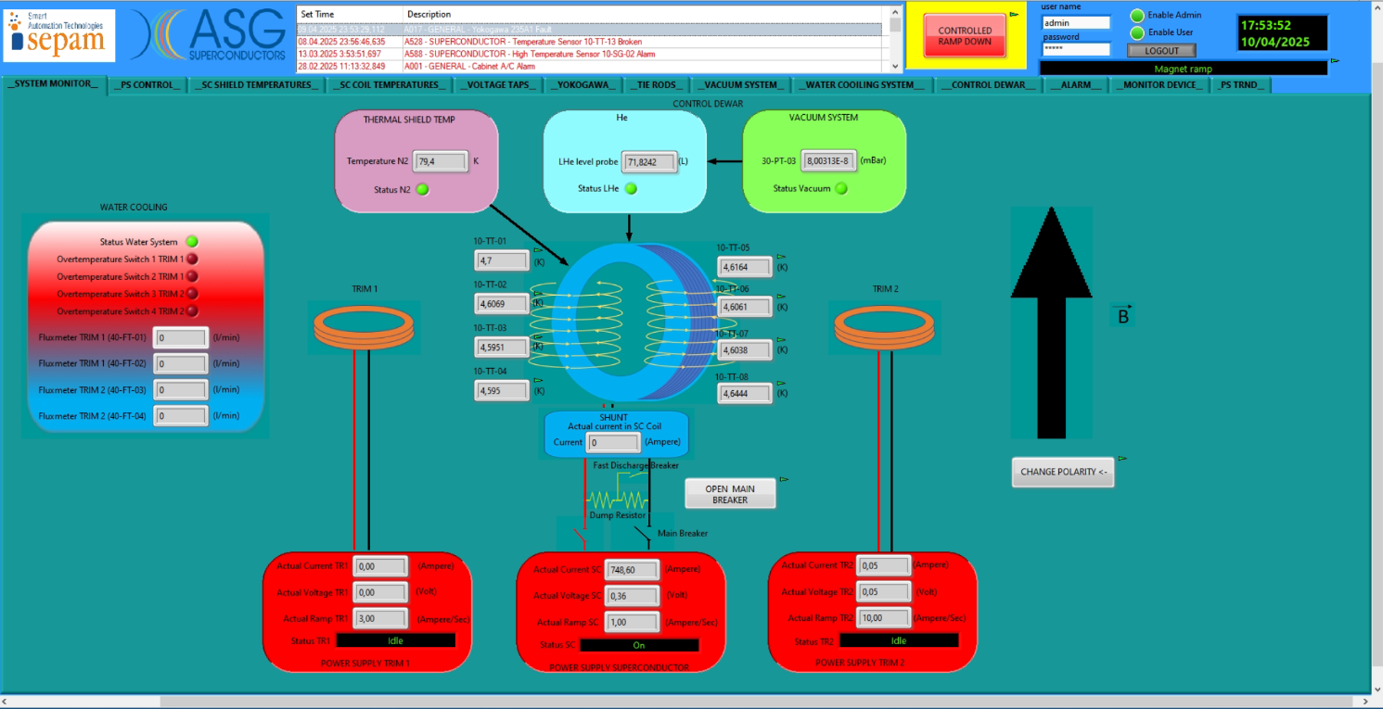
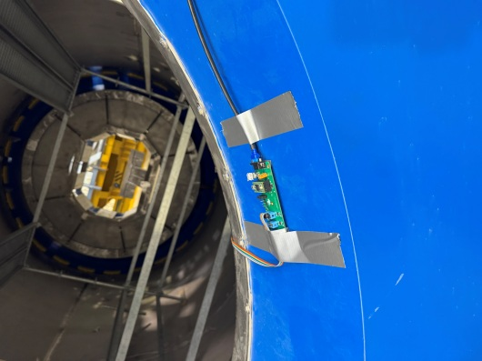
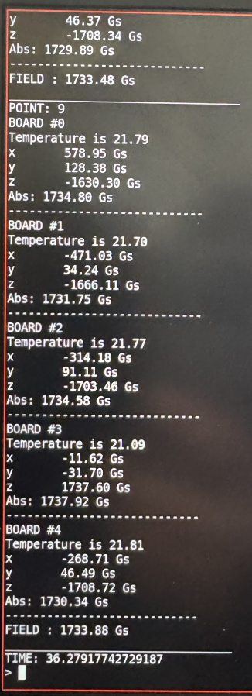
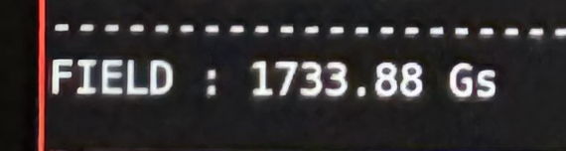
SC coil training
700A
750A
300A
400A
500A
600A
0
100A
200A
0,107 T
0,135 T
0,16 T
0,188 T
0,221 T

Slide 16
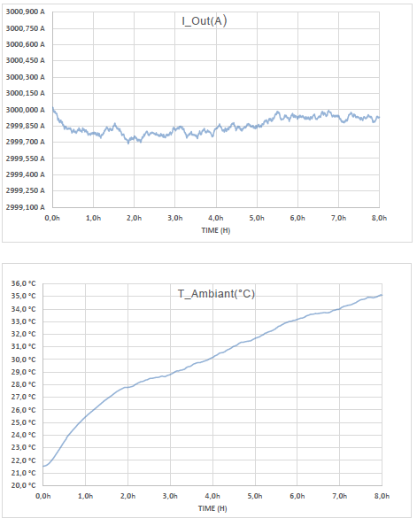
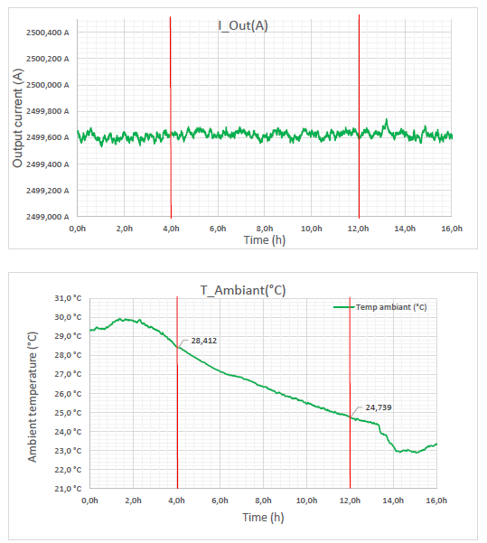
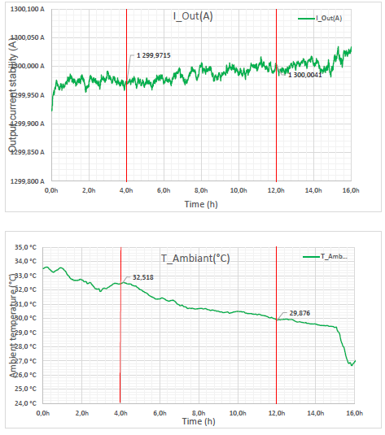
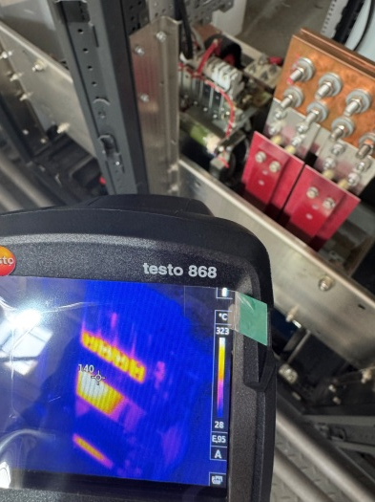
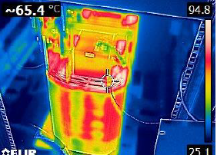
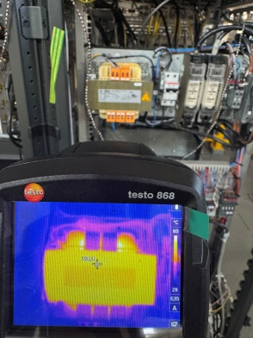
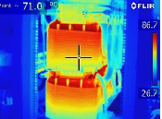
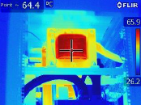
Factory test of power supplies
Power supply of TRIM1
I = 3000A V= 70V
Power supply of solenoid I = 2500A V= 10V
Power supply of TRIM2
I = 1300A V= 45V
140
53

Slide 17
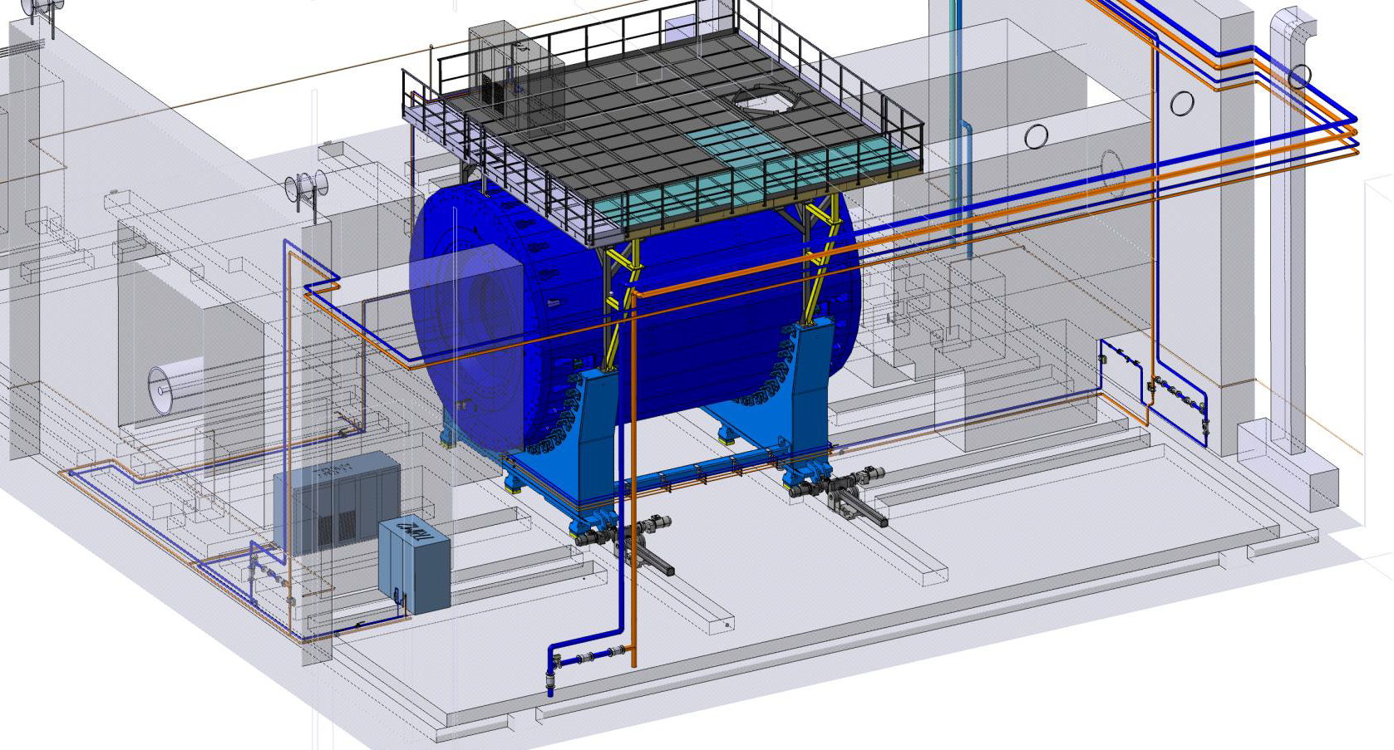
Water cooling system
Cooled equipment
TRIM COIL 1
1076 l/h water in 25⁰C out 55⁰C
TRIM COIL 2
2210 l/h water in 25⁰C out 55⁰C
POWER SUPPLY of SOLENOID
1800 l/h water in 25⁰C out 35⁰C
POWER SUPPLY of TRIM 1
720 l/h water in 25⁰C out 35⁰C
POWER SUPPLY of TRIM2
720 l/h water in 25⁰C out 35⁰C

Slide 18
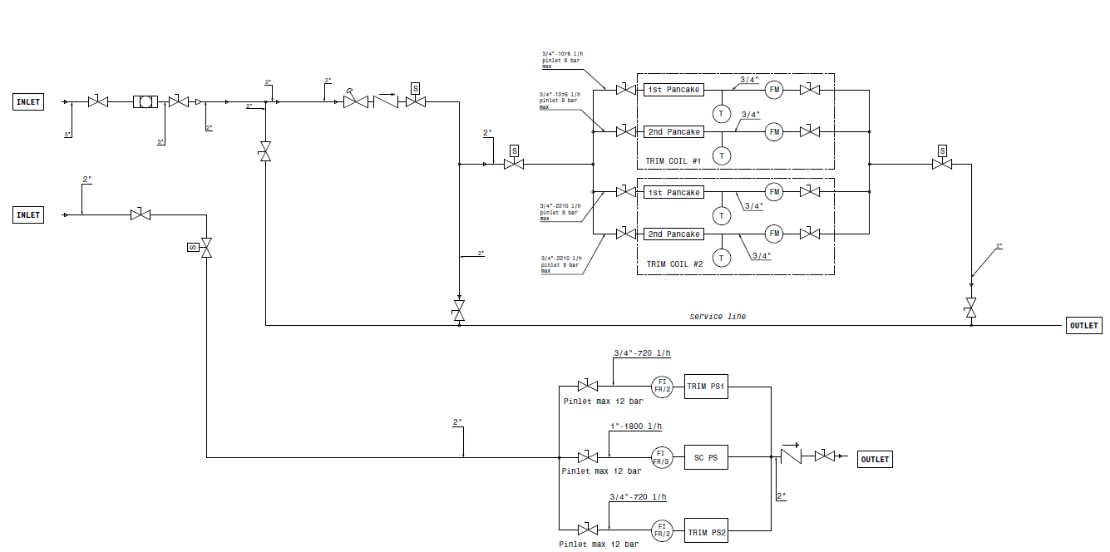
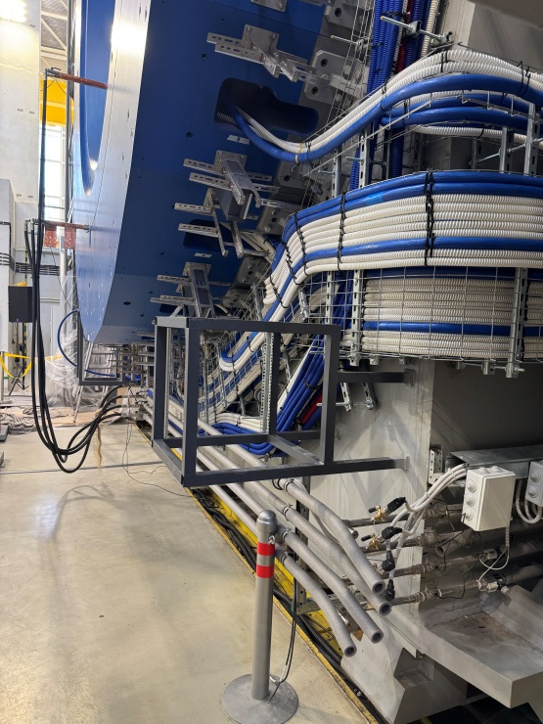
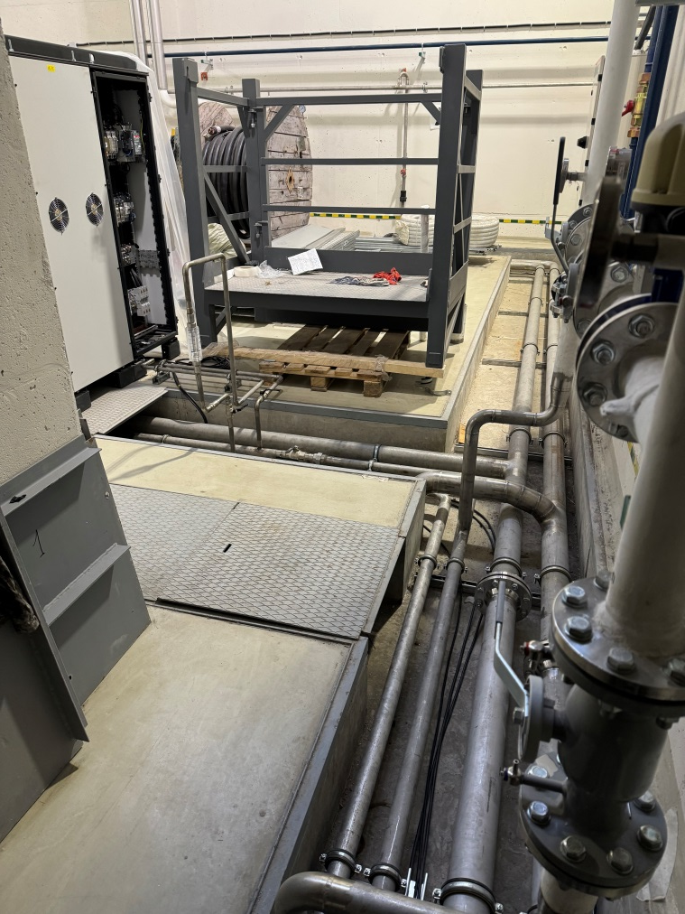

Cold water system scheme
Controlled parameters
Temperature of TRIM coils
Flow rate of TRIM coils
Flow rate of Power supplies

Slide 19







Colling water system of NICA complex
Water cooling consumers
Electrical power of the collider
MPD detector and subdetectors
Cryogenic and vacuum systems
Electron cooling systems
SPD detector
Dry cooling
Water cooling system including 4 similar cooling centers. Cooling center is complicated and uses 4 different coolants. Three operation options are available depending on the ambient temperature. This scheme allows obtaining stable temperature at the collider and detector equipment in the whole operation range regardless of the season.
Cooling system parameters
Index number of cooling center | 1 | 2 | 3 | 4
Cooling capacity | 1335 kW | 1540 kW | 1290 kW | 453 kW
Refrigerant | Antifreeze, still water, freon, purified water
Number of consumers | 10 | 10 | 9 | 2
Range of water temperature | 18 - 30⁰C | 15 - 55⁰C | 15 - 25⁰C | 18 - 24⁰C
Operation modes* | Dry cooling, cooling machine, mix mode
* depends on consumers
** depends on ambient temperature

Slide 20



Magnetic field measuring and control
Volume field mapper measuring device
Calculation and experimental current for optimal field configuration
*Drawing of mapper by S. Gerasimov
*Computing calculation table data by E. Antokhin

Slide 21

Stationary magnetic field monitor
40 – sensors evenly distributed over the inner surface of the solenoid.
36 – sensors (16 on 200 mm. from end face of solenoid and 4 in the center)

Slide 22
Timeline and risk
February 2025 – present day – Solenoid at temperature 4,5 K
April – May 2025 – The training of a superconducting coil involves the input of current up to 1000 A for a short time (300-500 A for several days). Tests of quench protaction system and storage energy evacuation on low current.
Until end of April 2025 – Finalizing mechanical and magnetic test of a mapper in INP
Until May 20th – Shipment all components of a magnetic field mapper from INP (Novosibirsk) to JINR and start assembling it in the solenoid.
May 2025 – Starting measuring of the magnetic field from 1000 Gs including determination of magnetic axis and coil position depends of current.
May – June 2025 – Magnetic field measurement.
Further increase in current is impossible without cooling the water.
Checking the operability of current leads at high current (electrical connections and thermal contact). At currents over 500 A, the temperature of the SC cables increases

Slide 23

Thank you for attention

