Slide 1
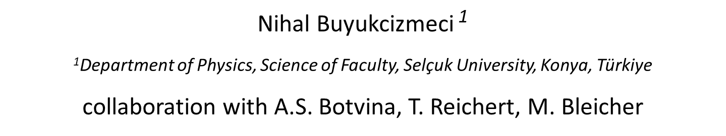
Fragment and Nuclei Production in Heavy-Ion Collisions
XV Collaboration Meeting of the MPD Experiment at NICA
April 15-17, 2025, Dubna, Russia
Nihal Buyukcizmeci $\text{1}$
$\text{1}$Department of Physics, Science of Faculty, Selçuk University, Konya, Türkiye
collaboration with A.S. Botvina, T. Reichert, M. Bleicher
This research is supported by the TÜBİTAK 124N105 project.
Nihal Buyukcizmeci Dubna-2025 1

Slide 2
INTRODUCTION
• Production of initial nucleons
- The Ultra-relativistic Quantum Molecular Dynamics Model (UrQMD)[1,2,3]
- The Dubna Cascade Model (DCM) [4]
Fragments, Clusterization of baryons and deexcitation
- The Statistical Multifragmentation Model (SMM)[5],
- New PSG and HYG methods for dynamical stage in SMM.
• Results for nuclei and single/double hypernuclei, comparison with the STAR experimental data
• Conclusions
[1] N. Buyukcizmeci, T. Reichert, A. S. Botvina, and M. Bleicher, Eur. Phys. J. A 61, 23 (2025).
[2] N. Buyukcizmeci, T. Reichert, A. S. Botvina, and M. Bleicher, Phys. Rev. C 108, 054904 (2023).
[3] Apiwit Kittiratpattana, Tom Reichert, Nihal Buyukcizmeci, Alexander Botvina, Ayut Limphirat, Christoph Herold, Jan Steinheimer, and Marcus Bleicher, Phys. Rev. C 109, 044913 (2024)
[4] V. D. Toneev, K. K. Gudima, Nucl. Phys. A 400, 173 (1983).
[5] A. S. Botvina, N. Buyukcizmeci and M. Bleicher, Phys. Rev. C 106, 014607 (2022).
Nihal Buyukcizmeci Dubna-2025 2
Notes:
We study transport model simulations to determine nuclei and hypernuclei formation at high energies. Previously, we have initiated to analyse nuclei formation at different energies by using hybrid models as in Refs.[1,3].

Slide 3
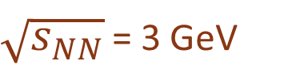
STAR exp.: Central Au+Au collisions at
$\sqrt{s_{NN}}$ = 3 GeV
[5] M. S. Abdallah et al., STAR Collaboration, Phys. Rev. Lett. 128, 202301 (2022)
[6] Hui Liu for STAR Collaboration, Acta Phys. Polon. B, Proc. Suppl. 16, 1–A148 (2023).
Au
Au
Hybrid approaches are successful for the description of dynamics
DCM+CB, URQMD, PSG (primary hot nuclei)
DCM+SMM, URQMD+SMM, PSG+SMM (final cold nuclei)
Nihal Buyukcizmeci Dubna-2025 3

Slide 4
The Ultra-relativistic Quantum Molecular Dynamics Model (UrQMD)
The UrQMD includes up to 70 baryonic species (including their antiparticles), as well as up to 40 different mesonic species, which participate in binary interactions. In the present calculations the hard Skyrme type equation of state is used which allows for the attraction between baryons.
Conservation of the net-baryon number, net-electric-charge, and net-strangeness as well as the total energy and momentum are taken into account.
The produced particles can be located at all rapidities, however, the considerable part is concentrated in the midrapidity region.
At the time of t=20–40 fm/c the strong interactions leading to the new particle formation are practically stopped (such as saturation). In that time-moment we consider the relative coordinate positions and velocities of the produced baryons.
We select the nuclear clusters according to the coordinates and velocities proximity, was suggested in Refs. [1,2,4], and we call it a clusterization of baryons (CB).
[7] M. Bleicher et al., J. Phys. G 25, 1859 (1999),
[8] S.A. Bass et al., Prog. Part. Nucl. Phys. 41, 255 (1998).
Nihal Buyukcizmeci Dubna-2025 4

Slide 5
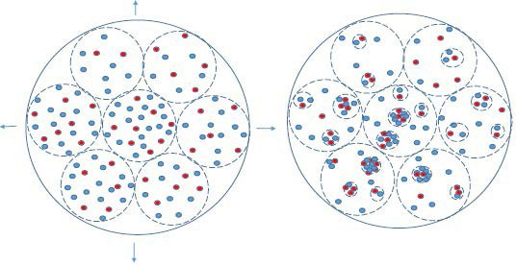
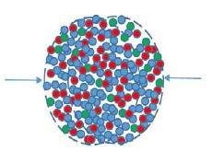
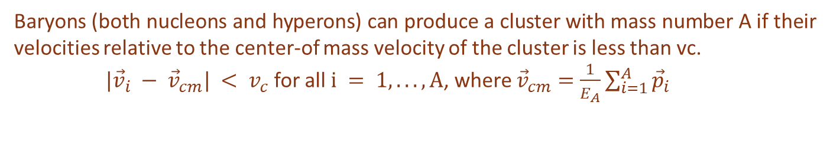
CENTRAL COLLISIONS
Nuclear system expands to low densities and passes the density around 0.1-0.3 of normal nuclear density, which corresponds to the freeze-out adopted in the statistical models.
Baryons can still interact and form nuclei at this density.
We divide the nuclear matter into clusters in local chemical equilibrium and apply SMM to describe the nucleation process in these clusters.
Baryons (both nucleons and hyperons) can produce a cluster with mass number A if their velocities relative to the center-of mass velocity of the cluster is less than vc.
$|{\vec{v}}_{i} − {\vec{v}}_{cm}| < v_{c}$ for all $i = 1, ...,A$, where ${\vec{v}}_{cm}=\frac{1}{E_{A}}\sum_{i=1}^{A}{{\vec{p}}_{i}}$
dynamical expansion Baryonic clusters in after collision/compress. local equilibrium (freeze-out)
nuclei formation inside the clusters - SMM
Nihal Buyukcizmeci Dubna-2025 5

Slide 6
New methods in SMM:
The dynamical stage can be simulated with the Phase Space Generation (PSG) and HYdrodynamical-like Generation (HYG) methods. They provide very different momenta distributions of baryons which cover the most important limits expected after this stage.
Phys.Rev.C 103 (2021) 064602
Phys.Rev.C 106 (2022) 014607
Buyukcizmeci, Ergun, Botvina and Bleicher, submitted to PRC (2025)
Methods are well- tested from Fermi energies, intermediate energies up to 3A GeV energies, we continue analyses to improve for higher energies.
Selection of primary clusters (at low freeze-out density) by using the coalescence of baryon (CB) model (Phys. Lett. B742, 7 (2015)): according to their velocities │Vi– V0│≤Vc and coordinates │Xi – X0│≤Xc.
Statistical formation of nuclei inside these clusters with SMM: de-excitation of the excited clusters. The excitation energy (or local temperature) of such clusters is important characteritics for the nuclear matter.
Nihal Buyukcizmeci Dubna-2025 6

Slide 7

$\sqrt{s_{NN}}$ = 3 GeV
Comparison of coordinate distribution according to the center of collision of initial protons produced with DCM (time independent) and UrQMD (t=20 and 40 fm/c) models :
Nihal Buyukcizmeci Dubna-2025 7

Slide 8
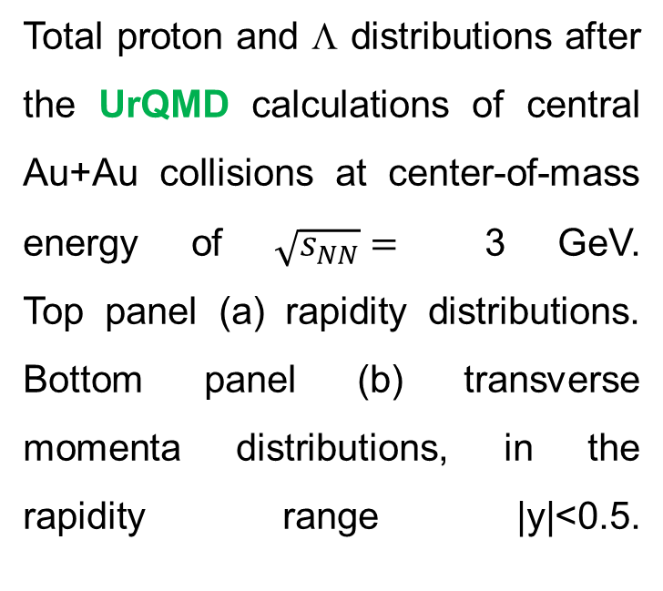
Total proton and Λ distributions after the UrQMD calculations of central Au+Au collisions at center-of-mass energy of $\sqrt{s_{NN}}=$ 3 GeV.
Top panel (a) rapidity distributions. Bottom panel (b) transverse momenta distributions, in the rapidity range |y|<0.5.
Initial protons and Λ’s
[1] N. Buyukcizmeci, T. Reichert, A. S. Botvina, and
M.Bleicher, Phys. Rev. C 108, 054904 (2023).
Nihal Buyukcizmeci Dubna-2025 8

Slide 9
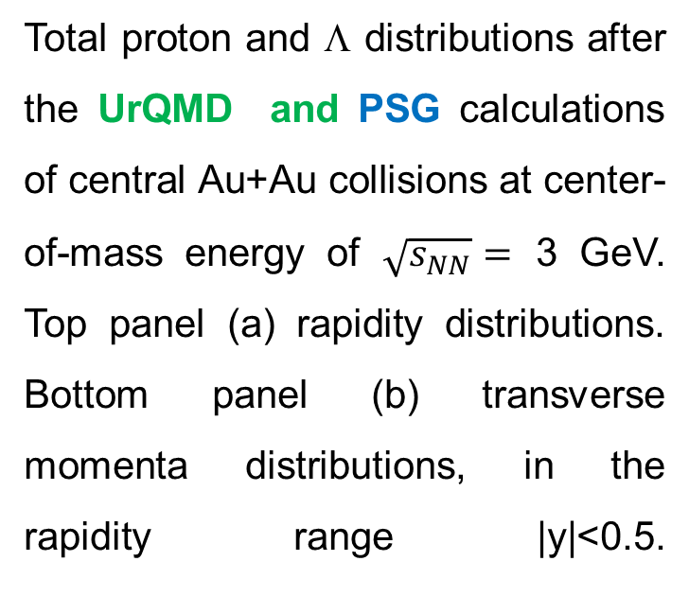
Initial protons and Λ’s
Total proton and Λ distributions after the UrQMD and PSG calculations of central Au+Au collisions at center-of-mass energy of $\sqrt{s_{NN}}=$ 3 GeV.
Top panel (a) rapidity distributions. Bottom panel (b) transverse momenta distributions, in the rapidity range |y|<0.5.
Nihal Buyukcizmeci Dubna-2025 9

Slide 10
Figure 2: Calculated distributions of local nuclear clusters (per event) formed from dynamically produced baryons after UrQMD and the clusterization (CB) procedure by using the selection of the baryons with the velocity and coordinate proximity. Top panel (a) mass distributions of the cluster with the velocity parameter vc=0.14c. Middle panel (b) mass distributions of the cluster with the velocity parameter vc=0.22c. Bottom panel (c) average excitation energy of the clusters versus their mass number. The times for stopping the UrQMD calculations and vc parameters are shown in the panels.
Yields of nuclei and hypernuclei and excitation energies
Nihal Buyukcizmeci Dubna-2025 10

Slide 11
hot baryon clusters
Mass
distributions
Excitation
energies
The calculations are performed with the PSG, UrQMD and DCM to generate baryons
in central Au+Au collisions, vc = 0.22c is applied for the identification of hot clusters.
Nihal Buyukcizmeci Dubna-2025 11
Notes:
UrQMD is done for the 'cascade' version, but DCM has permanent nuclear potentials which keep the spectator nucleons together.

Slide 12
Figure 3: Rapidity (a) and transverse momentum per nucleon (b) (integrated over all rapidities) distributions of the excited baryon clusters, which have the mass numbers from A=2 to 8. Yields are per event.
Light nuclei and hypernuclei:
A=2-8
N. Buyukcizmeci, T. Reichert, A. S. Botvina, and
M.Bleicher, Phys. Rev. C 108, 054904 (2023).
Nihal Buyukcizmeci Dubna-2025 12

Slide 13
Comparison with the STAR data
N. Buyukcizmeci, Yu Lebed, A. S. Botvina, Physics of Particles and Nuclei Letters, 21(5) (2024) 983-986.
Nihal Buyukcizmeci Dubna-2025 13

Slide 14
Comparison of light hypernuclei with the STAR data
N. Buyukcizmeci, Yu Lebed, A. S. Botvina, Physics of Particles and Nuclei Letters, 21(5) (2024) 983-986.
Nihal Buyukcizmeci Dubna-2025 14

Slide 15
STAR presents new data! Let’s see!
Nihal Buyukcizmeci Dubna-2025 15

Slide 16
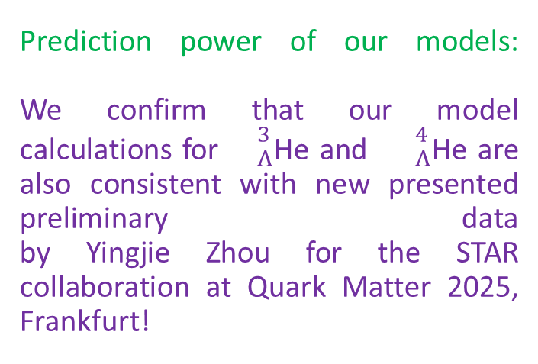
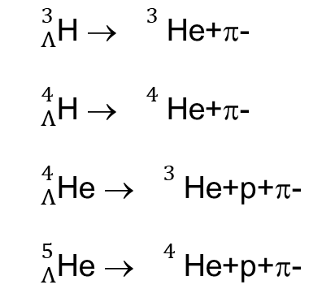
Prediction power of our models:
We confirm that our model calculations for ${}_{Λ}^{3}$He and ${}_{Λ}^{4}$He are also consistent with new presented preliminary data by Yingjie Zhou for the STAR collaboration at Quark Matter 2025, Frankfurt!
${}_{Λ}^{3}$H →${}_{}^{3}$He+π-
${}_{Λ}^{4}$H →${}_{}^{4}$He+π-
${}_{Λ}^{4}$He →${}_{}^{3}$He+p+π-
${}_{Λ}^{5}$He →${}_{}^{4}$He+p+π-
Nihal Buyukcizmeci Dubna-2025 15

Slide 17
New exotic light nuclei
and hypernuclei (exp. data is updated from QM2025), double-hypernuclei.
[1] N. Buyukcizmeci, T. Reichert, A. S. Botvina, and M. Bleicher, Eur. Phys. J. A 61, 23 (2025).

Slide 18


Comparison with the STAR data for light nuclei and hypernuclei
P, d, t, ${}_{}^{3}$He and ${}_{}^{4}$He
${}_{Λ}^{3}$H and ${}_{Λ}^{4}$H
[2] N. Buyukcizmeci, T. Reichert, A. S. Botvina, and M. Bleicher, Phys. Rev. C 108, 054904 (2023).
Nihal Buyukcizmeci Dubna-2025 16

Slide 19
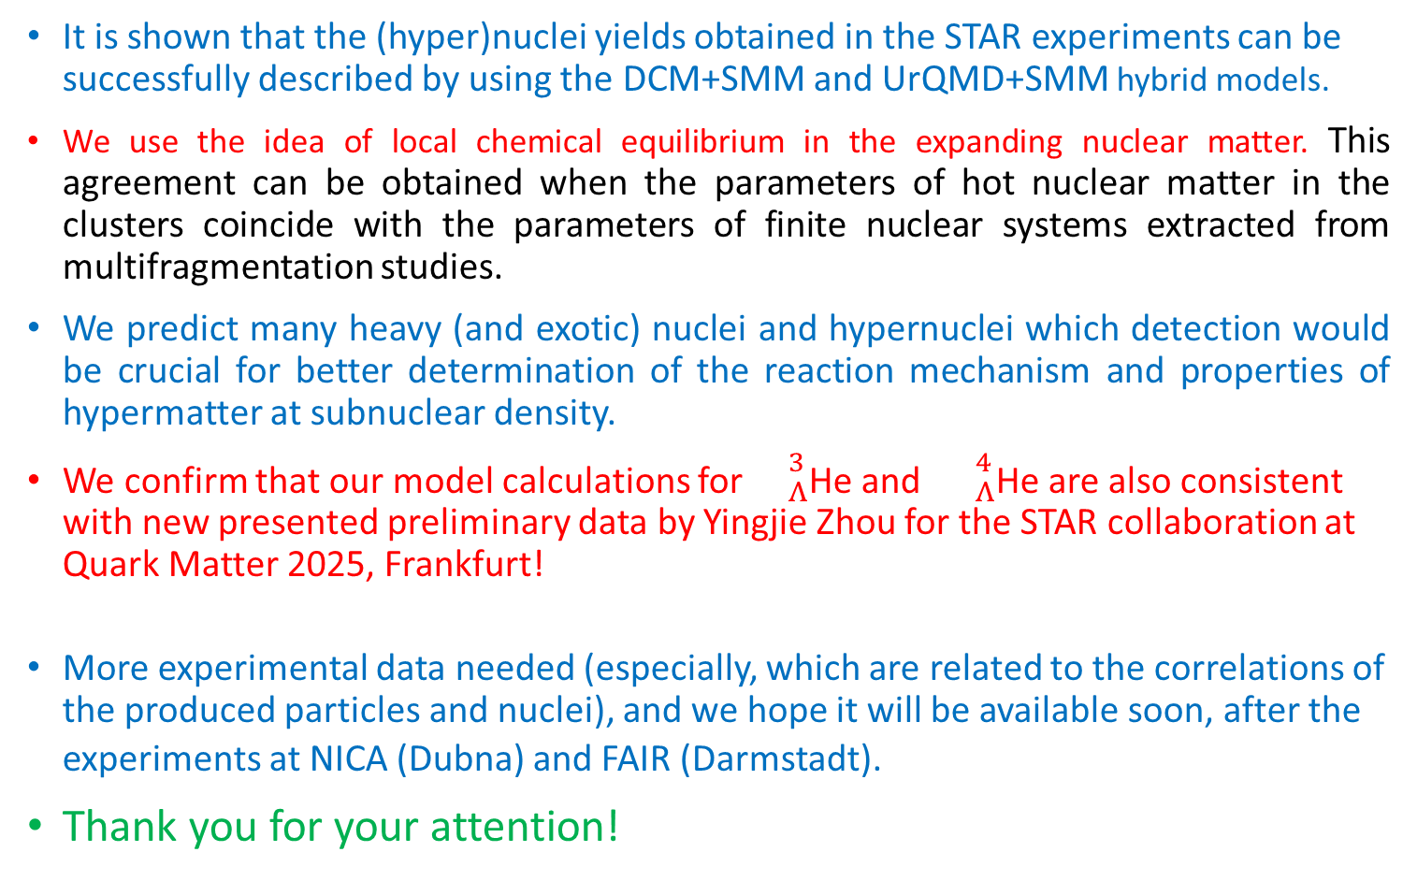
CONCLUSIONS
It is shown that the (hyper)nuclei yields obtained in the STAR experiments can be successfully described by using the DCM+SMM and UrQMD+SMM hybrid models.
We use the idea of local chemical equilibrium in the expanding nuclear matter. This agreement can be obtained when the parameters of hot nuclear matter in the clusters coincide with the parameters of finite nuclear systems extracted from multifragmentation studies.
We predict many heavy (and exotic) nuclei and hypernuclei which detection would be crucial for better determination of the reaction mechanism and properties of hypermatter at subnuclear density.
We confirm that our model calculations for ${}_{Λ}^{3}$He and ${}_{Λ}^{4}$He are also consistent with new presented preliminary data by Yingjie Zhou for the STAR collaboration at Quark Matter 2025, Frankfurt!
More experimental data needed (especially, which are related to the correlations of the produced particles and nuclei), and we hope it will be available soon, after the experiments at NICA (Dubna) and FAIR (Darmstadt).
Thank you for your attention!
Nihal Buyukcizmeci Dubna-2025 17

Slide 20
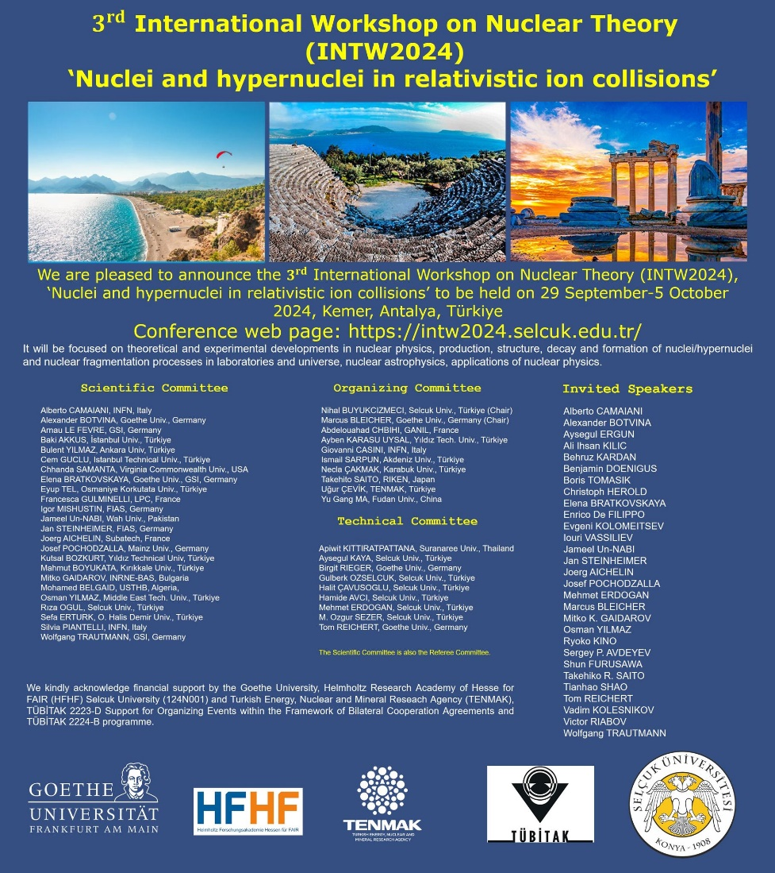
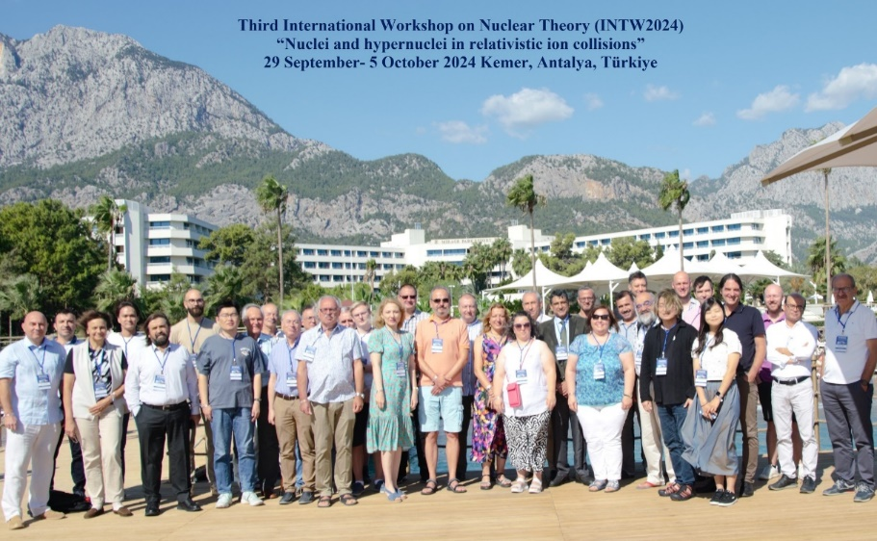
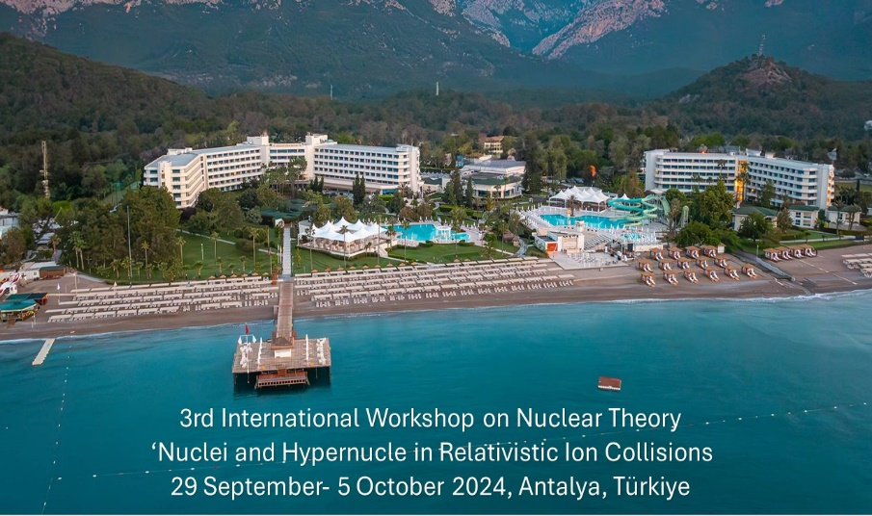
INTW2026 will be in Antalya, Türkiye!
Follow and join us! https://intw2026.selcuk.edu.tr/ (web not active yet!)
https://intw2024.selcuk.edu.tr/

