Slide 1
State of MPD DCS and plans for 2025
State 2025.04
S.Sergeev

Slide 2
MPD DCS structure
Run type DB
Diagnostics tools
Predefined set of RUN types
State
Client
RC/CDCS
Shift leader
Client
Command
FFD DCS
…………
TPC DCS
TOF DCS
ECAL DCS
DAQ
LV
HV
Laser
Cooling
…………
Command –> set run type
State – actual subdetector state
Off, StdBy, NotRdy,
Rdy, Wrng, Error,…
Client
Server
Client
Config DB
Client
HW

Slide 3
Interfaces actual state
Agreed with subdetector teams and tested
Solenoid -> MS4D -> DIM -> CDCS
DAQ -> DIM -> CDCS
ITS -> WINCC OA -> DIM -> CDCS
TPC -> MS4D -> DIM -> CDCS
FFD -> home-made hw/sw -> DIM -> CDCS
ECAL -> Tango -> DIM -> CDCS
TOF-> Tango -> DIM -> CDCS
fHCAL -> DIM -> CDCS
Lumi -> Tango -> DIM -> CDCS

Slide 4
DCS framework
Central DCS application – prototype runs
Subdetector root node - prototype runs
Has GUI
Adjustable for subdetector architecture
Joins Linux and Windows computers
Converter local files <->DIM – final version runs
Hardware Server Emulator – runs
DIMTree - DIM address space browser (runs at Windows and Linux)
Started TPC integration. During this process the Root node application to be modified

Slide 5
TPC DCS
OPC UA
TPC DCS Root Node
CDCS/RC
DIM
In progress
LV
HV
Cooling
Gas
Laser
PostGre SQL
MasterScada 4D
CAEN
CAEN
HV
Custom
Custom
Custom
CAEN
Linux
Windows
Linux
LVDB
IV
Windows
Windows
Interface MasterScada_4D <-> DIM ready

Slide 6
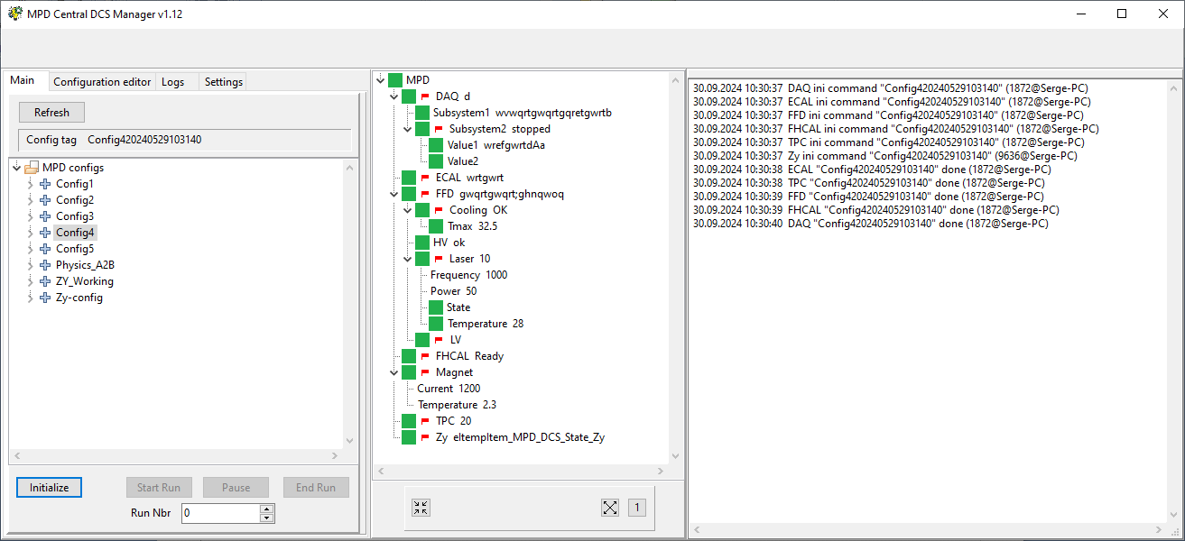
CDCS manager I

Slide 7
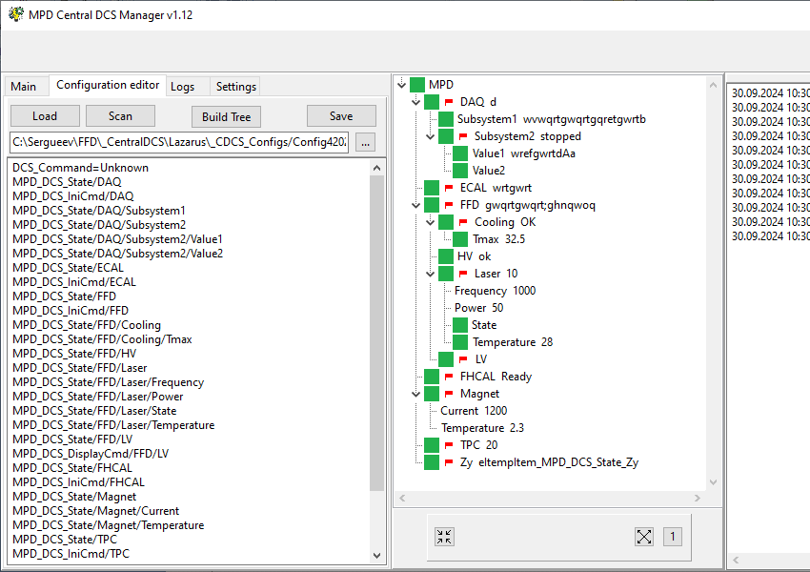
CDCS manager II

Slide 8
SubDetector Root Node I
Receives states of subdetector subsystems using DIM Info Services
Builds resulting subdetector state
Receives commands from CDCS.
Parses CDCS commands and converts to subdetector subsystems commands.
Sends commands to subdetector subsystems using DIM Command Services
GUI for configuration command editing
Adjustable for MPD subdetectors

Slide 9
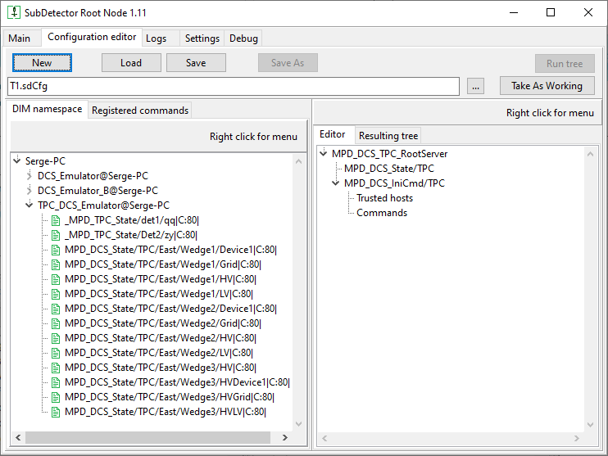
Root Node, DIM item selector

Slide 10
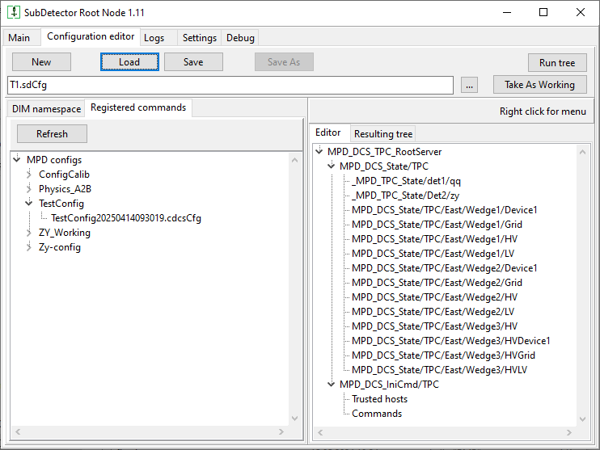
Root Node, Command selector

Slide 11
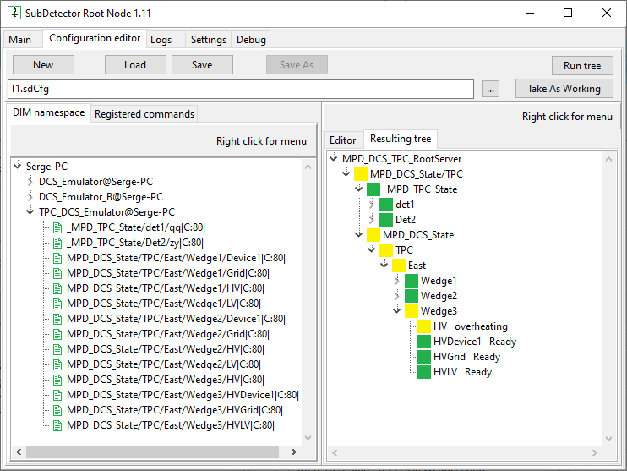
Root Node, Test run

Slide 12
Disk file to DIM Converter
Reads local files containing subsystem state with refresh period ~1 sec. Converts content of file to DIM Info item
Checks “heart beat” and generates OFF state if no data refresh occurred during predefined time
Receives DIM commands from subdetector Root Node and records command content to a disk file
One file – one DIM item
One subdetector could run Converter copies at different computers
To be ready in mid-November for Windows and by the end for Linux

Slide 13
Safety issues
Each DIM command contains a process ID and a name of a computer issued the command (Command Source ID, CSID)
Root node has a possibility to create a list of trusted hosts which could send a command
Each command service should check a CSID of a command
The CDCS publishes its CSID and root nodes could get it in a real time mode
The Root Node also publishes its CSID and hardware servers also could get it in a real time mode
DIM protocol does not allow to have two items with the same name in a common name address space so there is no simple way to send a command by mistake

Slide 14
Plans for 2025
TPC integration
Other subdetectors?
Migration of CDCS manager to Linux
Modification of the RootNode application for Linux (to have common version for both Windows and Linux)

Slide 15
Thank you
State 2024.10.01

Slide 16
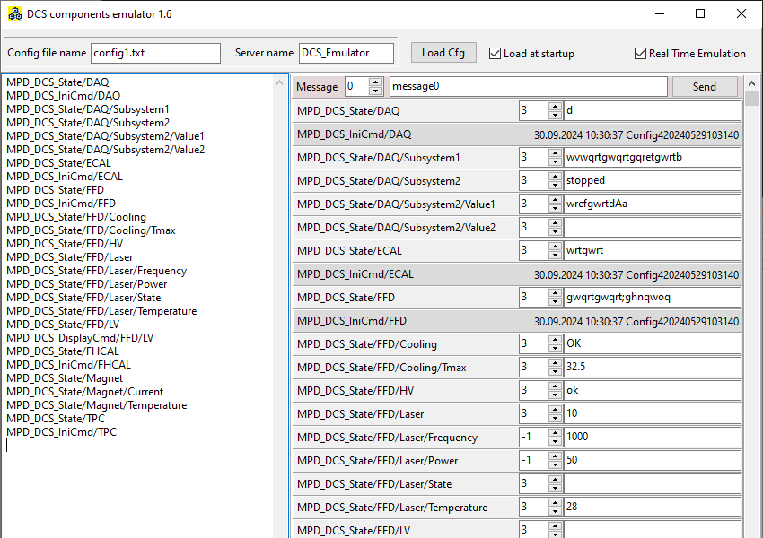
DCS emulator

Slide 17
CDCS interface I
Draft 2024.05.10
RC/CDCS subscribes to published by subdetectors state InfoItems with names
MPD_DCS_State/<subdetector name>
Run configuration contains subdetectors list used in a run
RC/CDCS sends run type name (text) to all CommandItems of subdetectors being in a list. CommandItems should have a name like
MPD_DCS_IniCmd /<Subdetector name>

Slide 18
CDCS interface II
Draft 2024.05.10
Each subdetector DCS root node could (should?) have a CommandItem with name
MPD_DCS_DisplayCmd/<subdetector node name>
A command received by this CommandItem should start diagnostic tool (see below)
DAQ should have additional Info/Command items to provide vital information to/from the RC/CDCS (to be discussed with DAQ team)

Slide 19
CDCS interface III
Draft 2024.05.10
RC/CDCS has a CommandItem MPD_DCS_Messages to receive messages from subsystems/subdetectors
Format of message should be like (to be discussed)
<subdetector name>_<severity level>_<message text>
<severity level> defines a way to process the message
0 -> just to show in a window. Could be scrolled by messages arriving later
1 -> stays at the screen until confirmed
2 -> stays at the screen until confirmed + sound alarm if not confirmed during defined time (1 min as an example)
3 -> stays at the screen until confirmed + instant sound alarm
All messages have a text content

Slide 20
States and colors
Draft 2024.05.10
State=-1, Item does not have a state, no color to be displayed
State=0, OFF - any of sub-elements does not respond
State=1, StdBy – any of sub-elements is in stand-by mode
State=2, NotRdy – any of element is in transition state (Time-out should be implemented)
State=3, Ready – all elements are OK
State=4, Wrng – any of elements is in Warning state
State=5, Error – any of elements is in Error state
State=6, Ignrd – node in Partitioned state

Slide 21
Extended display (to be discussed)
Draft 2024.05.10
A subdetector should provide a set of diagnostics tools stated by a CommandItem
MPD_DCS_DisplayCmd/<subdetector name>
This should be an application running at a CDCS PC or a web-page running AJAX script (?). The web server could be provided by a CDCS. Page content should be developed by the subdetector team and could be located at a common disk space
Start parameters are defined in the CommandItem command content

Slide 22
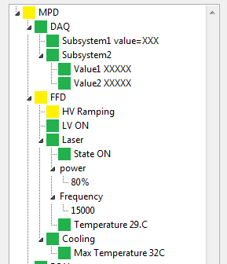
Extra parameters interface
Draft 2024.05.10
MPD state is built using 1-st level nodes
“MPD_DCS_State/DAQ”, content=“3”
“MPD_DCS_State/DAQ/Subsystem1”,
content=“3_value=XXX”
“MPD_DCS_State/DAQ/Subsystem1/Value1”,
content=“3_XXXXX”
“MPD_DCS_State/FFD/Laser_power”,
content=“-1”
“MPD_DCS_State/FFD/Laser_power/”,
content=“-1_80%”
Obligatory
Extra info to display in the tree, defined by subsystem/subdetector

