Slide 1
Calculation of self-shielding correction for Neutron activation experiments at IREN facility using PHITS and MCNP6

Slide 2
Neutron self-shielding factors?
The Neutron self-shielding Factor is a correction factor that accounts for the effect of neutron absorption within the activation sample itself, which causes the neutron flux inside the sample to be non-uniform compared to the external flux.
The self-shielding effect depends on several factors:
neutron absorption cross-section of the element,
sample’s shape,
elemental composition
is strongly influenced by the spatial and energy distribution of the neutron field
This effect must be calculated separately for thermal and epithermal neutrons due to their distinct energy distributions.

Slide 3
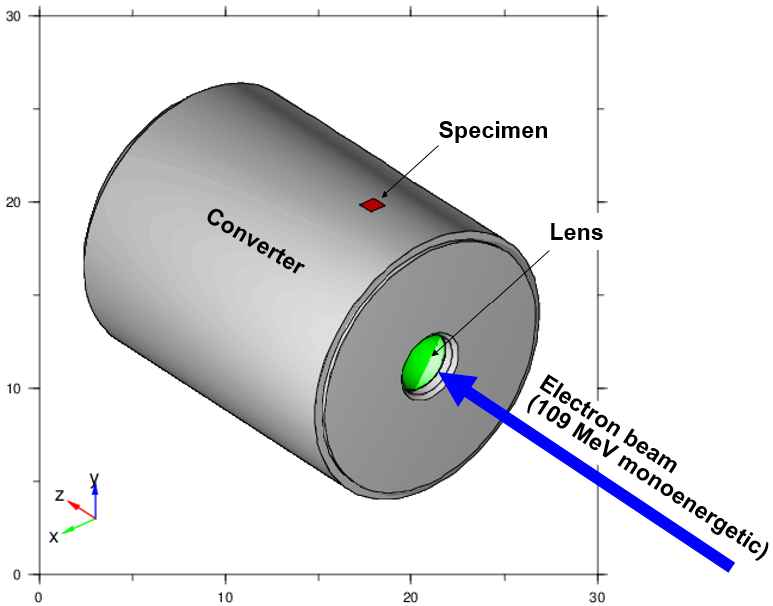
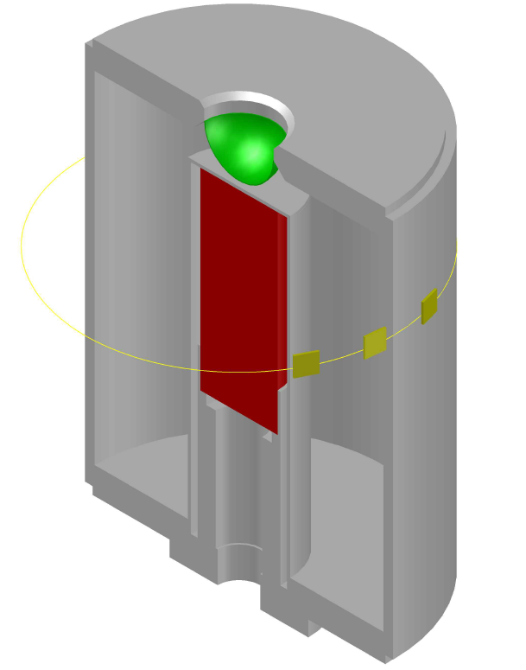
IREN Converter Structure
Aluminium
Tungsten target to produce Neutron
Fill with water to slow down neutrons
Electron beam

Slide 4
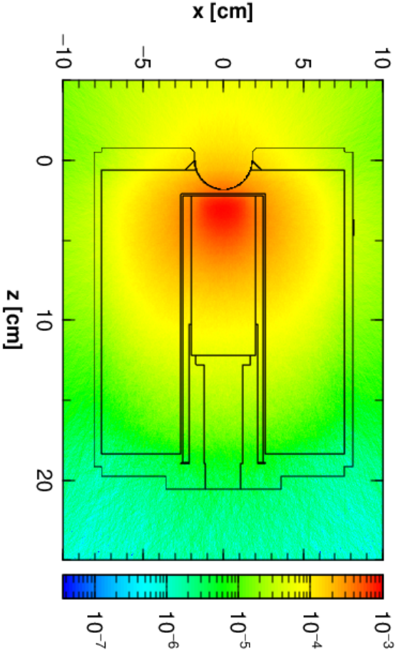
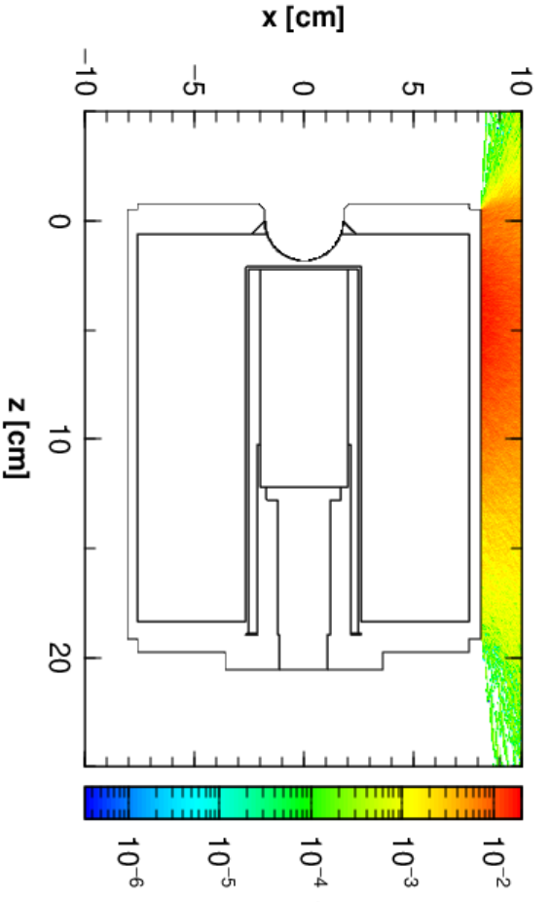
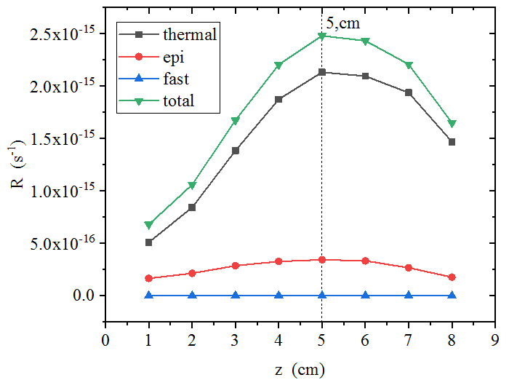
Neutron flux distribution in IREN
Fig 2b&c: Neutron flux distribution
Fig 2a: The reaction rate calculated for ⁶³Cu at 5cm position

Slide 5
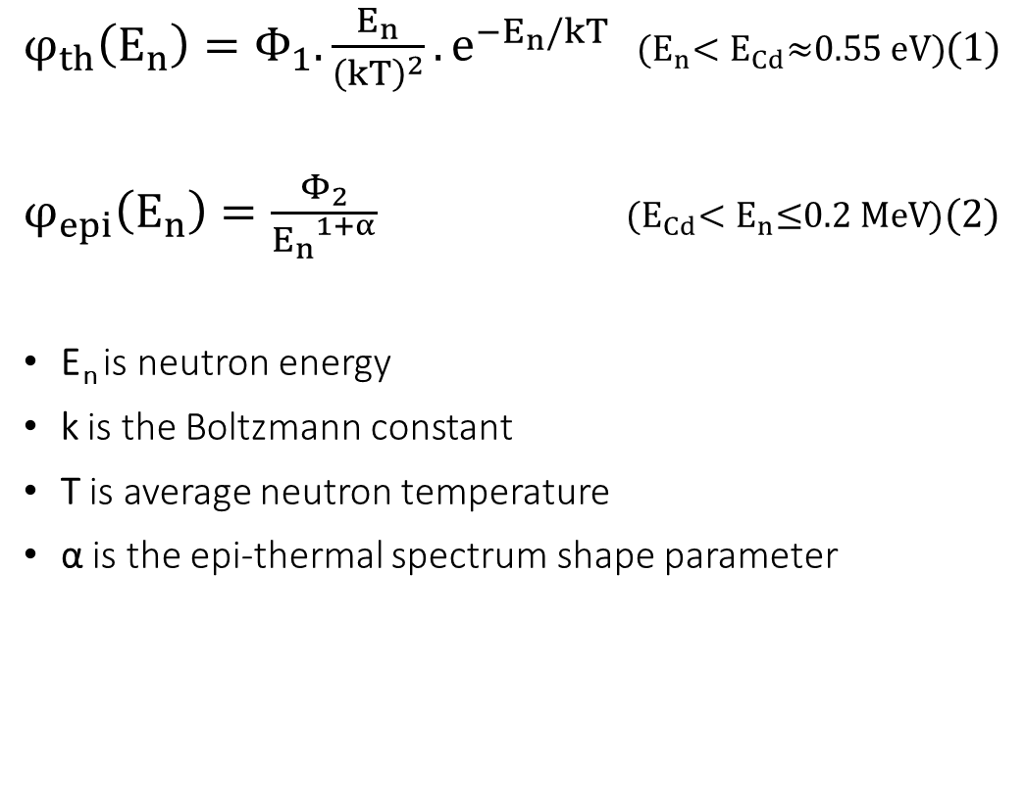
Neutron energy spectrum regions
$φ_{th}\left(E_{n}\right)=Φ_{1}.\frac{E_{n}}{{\left(kT\right)}^{2}}.e^{−E_{n}/kT}$ ${(E}_{n}<E_{Cd}\text{≈}\text{0.55 }\text{eV}\text{)}$(1)
$φ_{epi}\left(E_{n}\right)=\frac{Φ_{2}}{{E_{n}}^{1+α}}$ ${(E}_{Cd}<E_{n}\text{≤}\text{0.2 }\text{MeV}$)(2)
E_{n} is neutron energy
k is the Boltzmann constant
T is average neutron temperature
α is the epi-thermal spectrum shape parameter
Fig 3: Neutron flux spectrum through surface 1x1cm at 5cm position

Slide 6
Neutron self-shielding factors
Table 1: Comparative reports on calculating G-factors for diverse parametric conditions using MCNP simulations
Author, year | Neutron source geometry | Neutron energy spectrum | Specimen geometry | Specimen material | Evaluated G-factor
Salgado et al., 2004 | // beam, iso. field | Epithermal (monoenergetic, 1/E) | Foil | ²³²Th, ¹⁹⁷Au and ⁵⁶Fe | G_{res}, G_{res*}
Goncalves et al., 2002; Goncalves et al., 2001* | // beam, iso. field | Around resonance region (1/E) | Foil, wire | ⁵⁹Co, ⁶³Cu, ¹⁹⁷Au, ¹¹⁵In, ⁵⁵Mn, ¹⁸⁵Re | G_{res}
Goncalves et al., 2001** | // beam, iso. field | Epithermal, around resonance region (1/E) | Foil, wire | Au, Co, Mn | G_{res}
Goncalves et al., 2004 | // beam, iso. field | Around resonance region (1/E) | Cylinder | ⁵⁹Co, ⁶³Cu, ¹⁹⁷Au, ¹¹⁵In, ⁵⁵Mn, ¹⁸⁵Re | G_{res}
Martinho et al., 2003 | iso. field | Around resonance region (1/E) | Foil, wire, sphere | ⁵⁹Co, ⁶³Cu, ¹⁹⁷Au, ¹¹⁵In, ⁵⁵Mn, ¹⁸⁵Re | G_{res}
Martinho et al., 2004 | iso. field | Thermal (Maxwellian) | Foil, wire, sphere, cylinder | Al, Au, Cd, Co, Cu, Eu, Gd, In, Ir, Mo, Ni, Pb, Pt, Rh, Sc, Sm, Ta | G_{th}
This work | Spatial and spectral fidelity to the electron-beam-driven neutron source |  | Foil | Au, Cu, W, Zr | G_{th}, G_{epi}

Slide 7
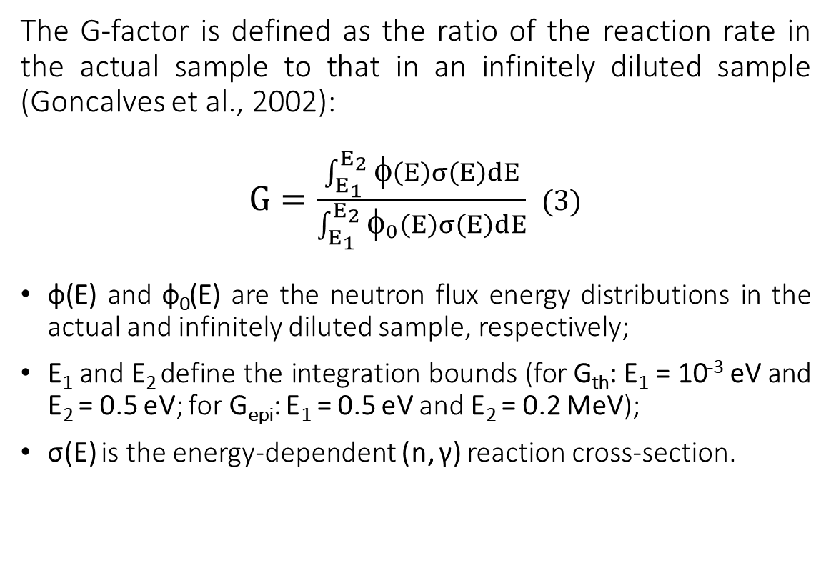
Neutron self-shielding factors
The G-factor is defined as the ratio of the reaction rate in the actual sample to that in an infinitely diluted sample (Goncalves et al., 2002):
$G=\frac{\int_{E_{1}}^{E_{2}}{\text{φ}\left(E\right)σ\left(E\right)dE}}{\int_{E_{1}}^{E_{2}}{φ_{0}\left(E\right)σ\left(E\right)dE}}$ (3)
ф(E) and ф₀(E) are the neutron flux energy distributions in the actual and infinitely diluted sample, respectively;
E₁ and E₂ define the integration bounds (for G_{th}: E₁ = 10⁻³ eV and E₂ = 0.5 eV; for G_{epi}: E₁ = 0.5 eV and E₂ = 0.2 MeV);
σ(E) is the energy-dependent (n, γ) reaction cross-section.
Table 2: Samples used in experiments and simulations
Foil | Density (g/cm³) | Dimension (mm) | Isotopes
Au | 19.32 | 10x10x0.1 | ¹⁹⁷Au (100%)
Cu | 8.96 | 10x10x0.5 | ⁶³Cu (69.15%), ⁶⁵Cu (30.85%)
W | 19.3 | 10x9x0.35 | ¹⁸⁰W (0.12%), ¹⁸²W (26.5%), ¹⁸³W (14.31%), ¹⁸⁴W (30.64%), ¹⁸⁶W (28.43%)
Zr | 6.51 | 10x9x0.1 | ⁹⁰Zr (51.45%), ⁹¹Zr (11.22%), ⁹²Zr(17.15%), ⁹⁴Zr (17.38%), ⁹⁶Zr (2.8%)

Slide 8
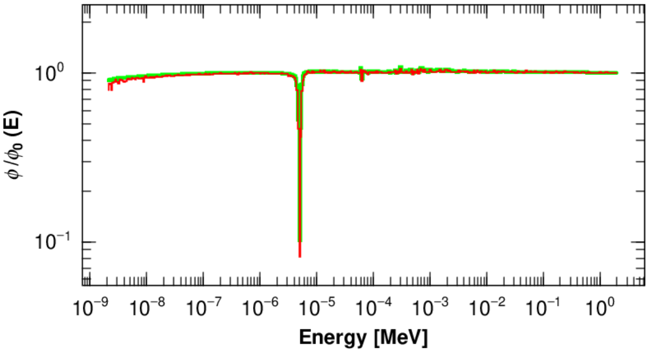
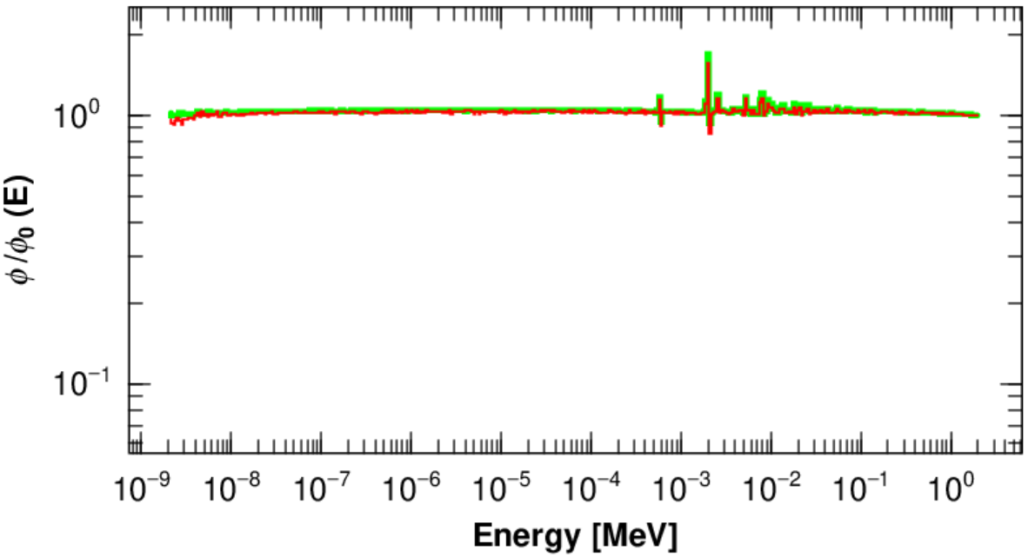
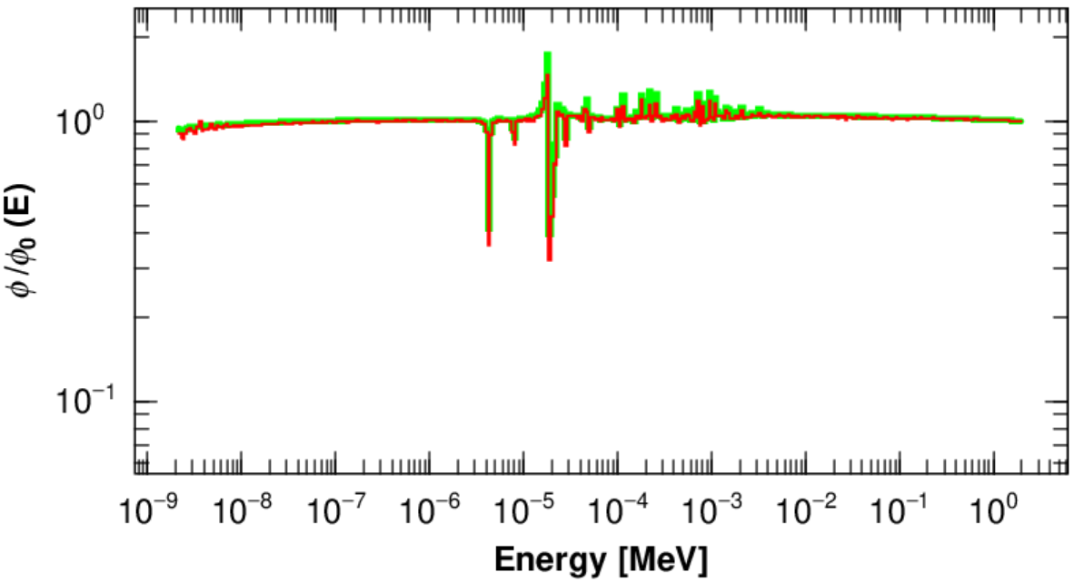
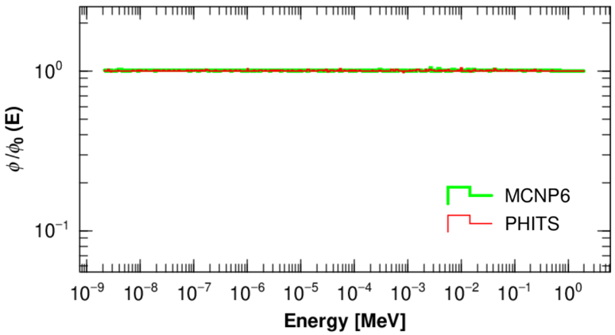
Transmission function (ф/ ф₀(E))
a)Au
b)Cu
c)W
d)Zr

Slide 9
Results & Discussion
Table 3: Comparison of Neutron self-shielding factor results from 2 simulations
Isotopes | Gth |  |  | Gepi
 | PHITS | MCNP | Diff_Gth | PHITS | MCNP | Diff_Gepi
197Au | 0.962±0.006 | 0.974±0.004 | 1.2% | 0.337±0.009 | 0.360±0.001 | 6.3%
63Cu | 1.018±0.016 | 1.026±0.014 | 0.8% | 0.979±0.030 | 0.988±0.009 | 1.0%
94Zr | 1.003±0.014 | 1.006±0.007 | 0.2% | 1.004±0.043 | 1.007±0.006 | 0.4%
96Zr | 1.003±0.007 | 1.006±0.005 | 0.2% | 1.001±0.076 | 1.009±0.004 | 0.7%
186W | 0.982±0.007 | 0.989±0.004 | 0.7% | 0.496±0.016 | 0.541±0.002 | 8.4%

Slide 10
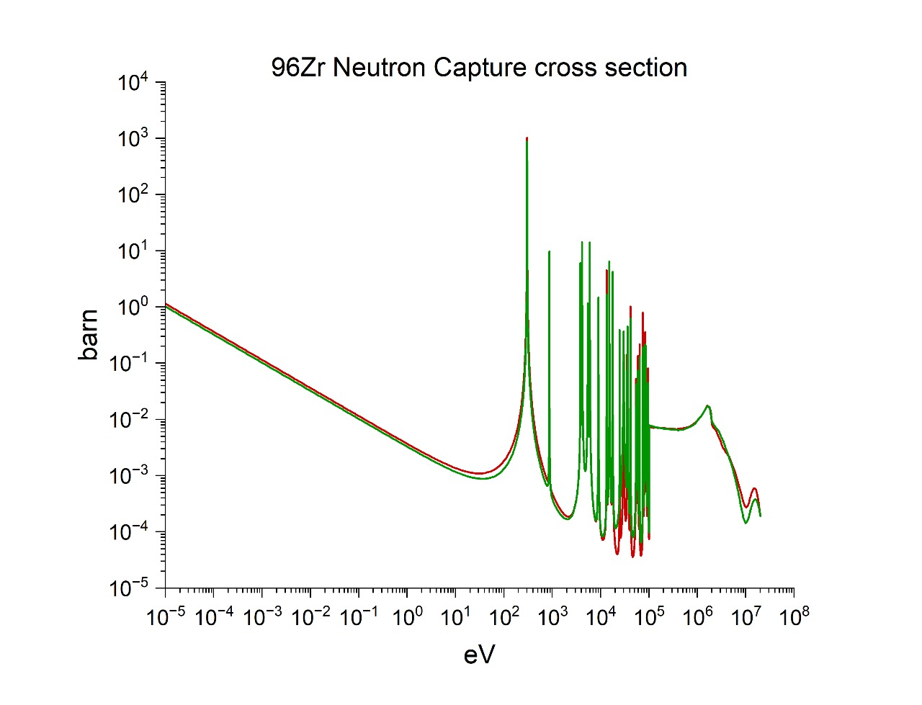
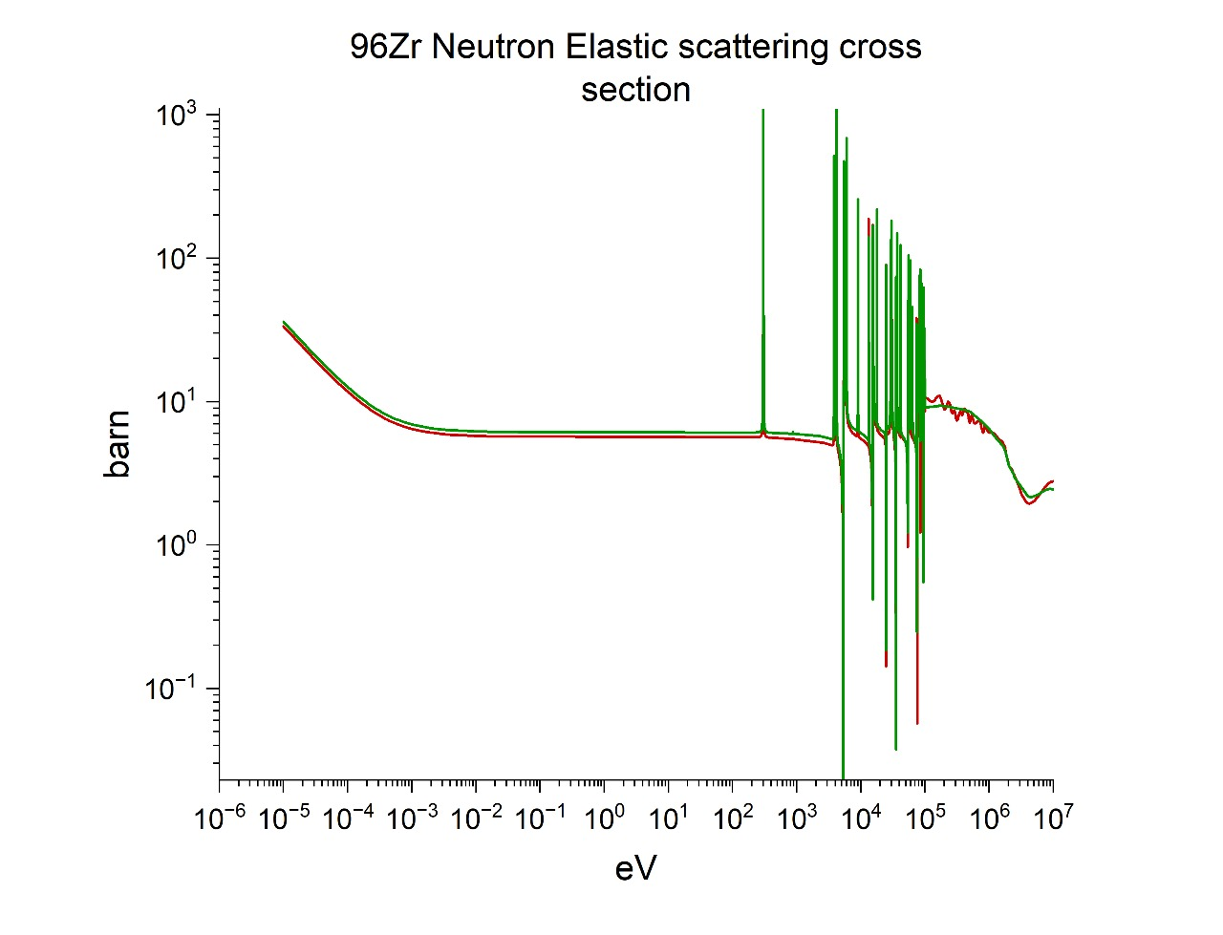
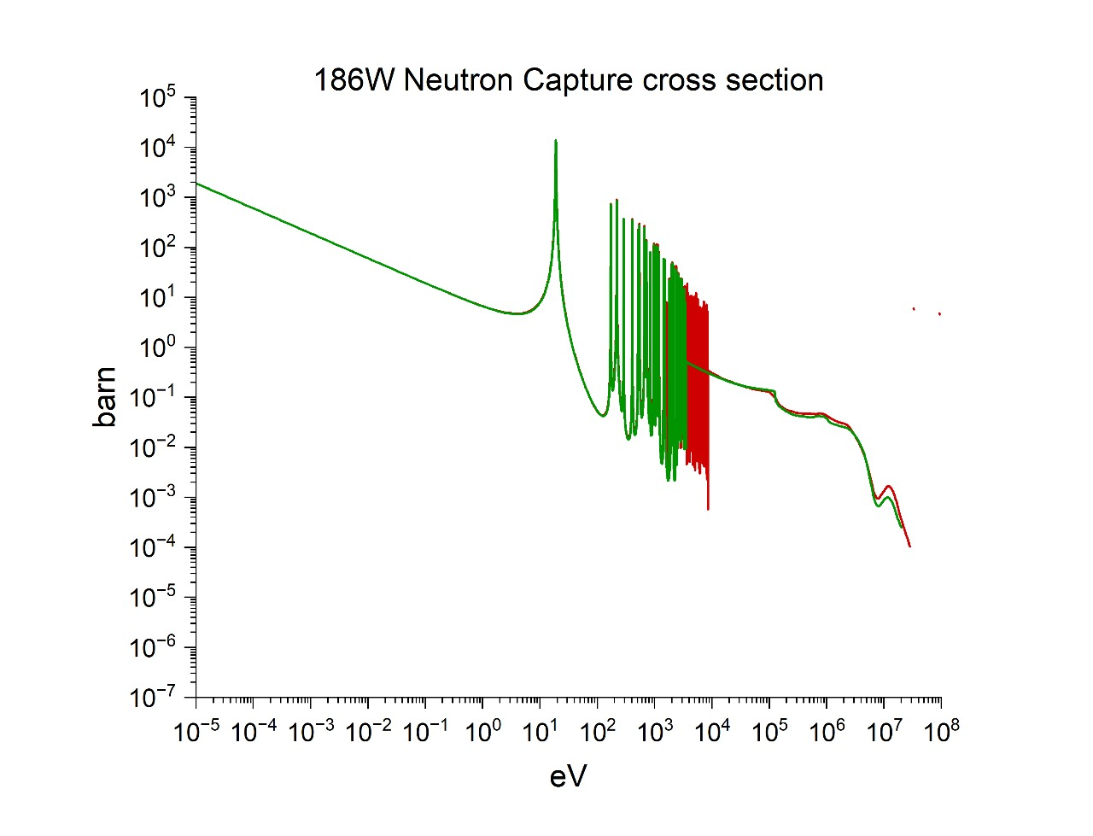
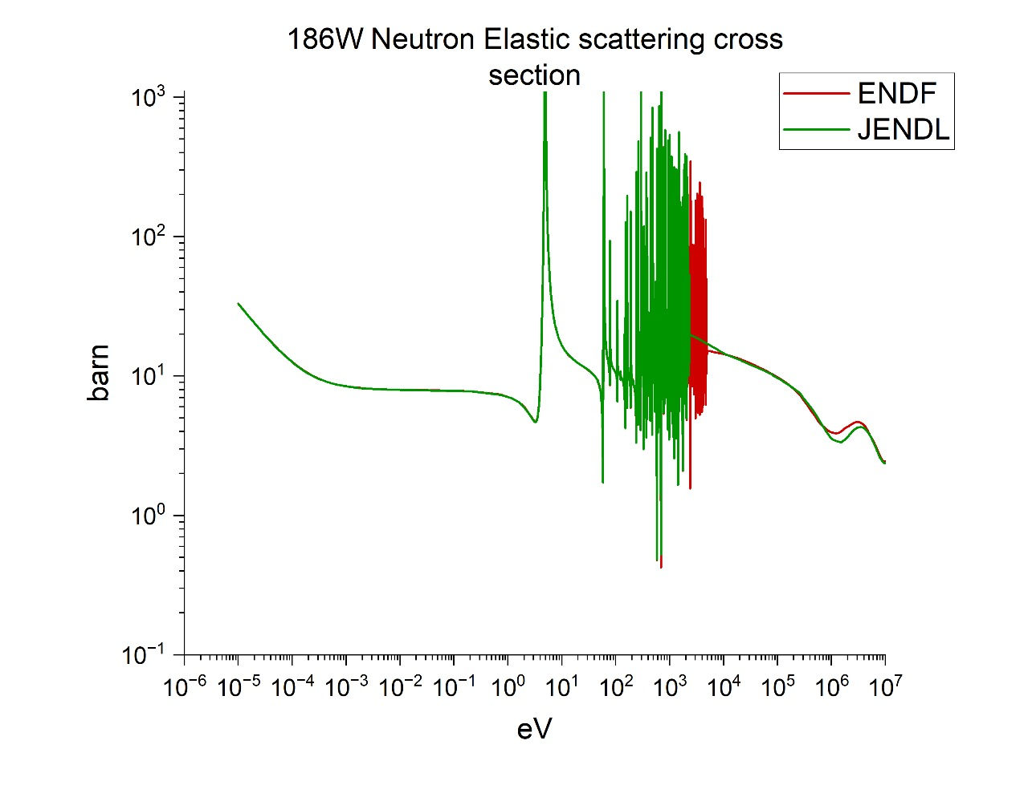
Results & Discussion
Fig: Comparison of neutron section between ENDF and JENDL
a)
b)
c)
d)

Slide 11
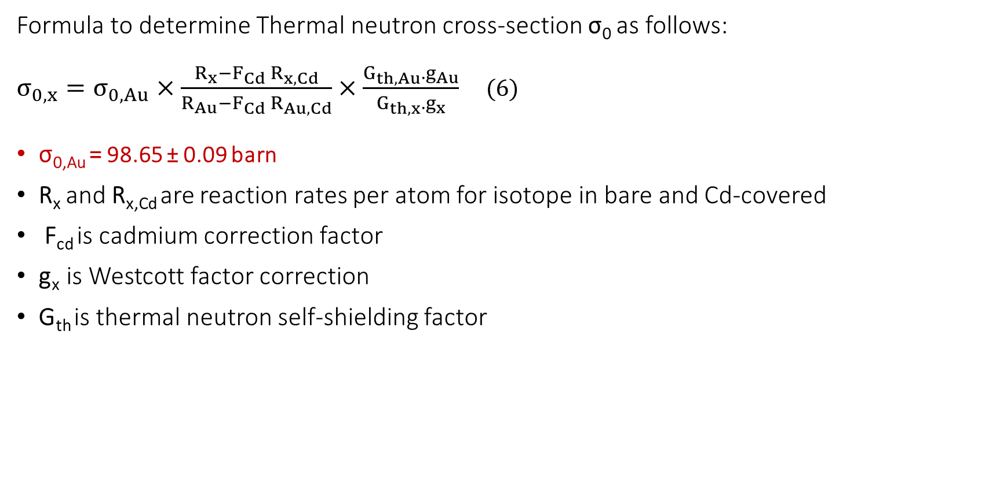
Thermal neutron cross-section
Formula to determine Thermal neutron cross-section σ₀ as follows:
$σ_{0,x}=σ_{0,Au}×\frac{R_{x}−F_{Cd}{ R}_{x,Cd}}{R_{Au}−F_{Cd}{ R}_{Au,Cd}}×\frac{G_{th,Au}.g_{Au}}{G_{th,x}.g_{x}}$ (6)
σ_{0,Au} = 98.65 ± 0.09 barn
R_{x} and R_{x,Cd} are reaction rates per atom for isotope in bare and Cd-covered
F_{cd} is cadmium correction factor
g_{x} is Westcott factor correction
G_{th} is thermal neutron self-shielding factor

Slide 12
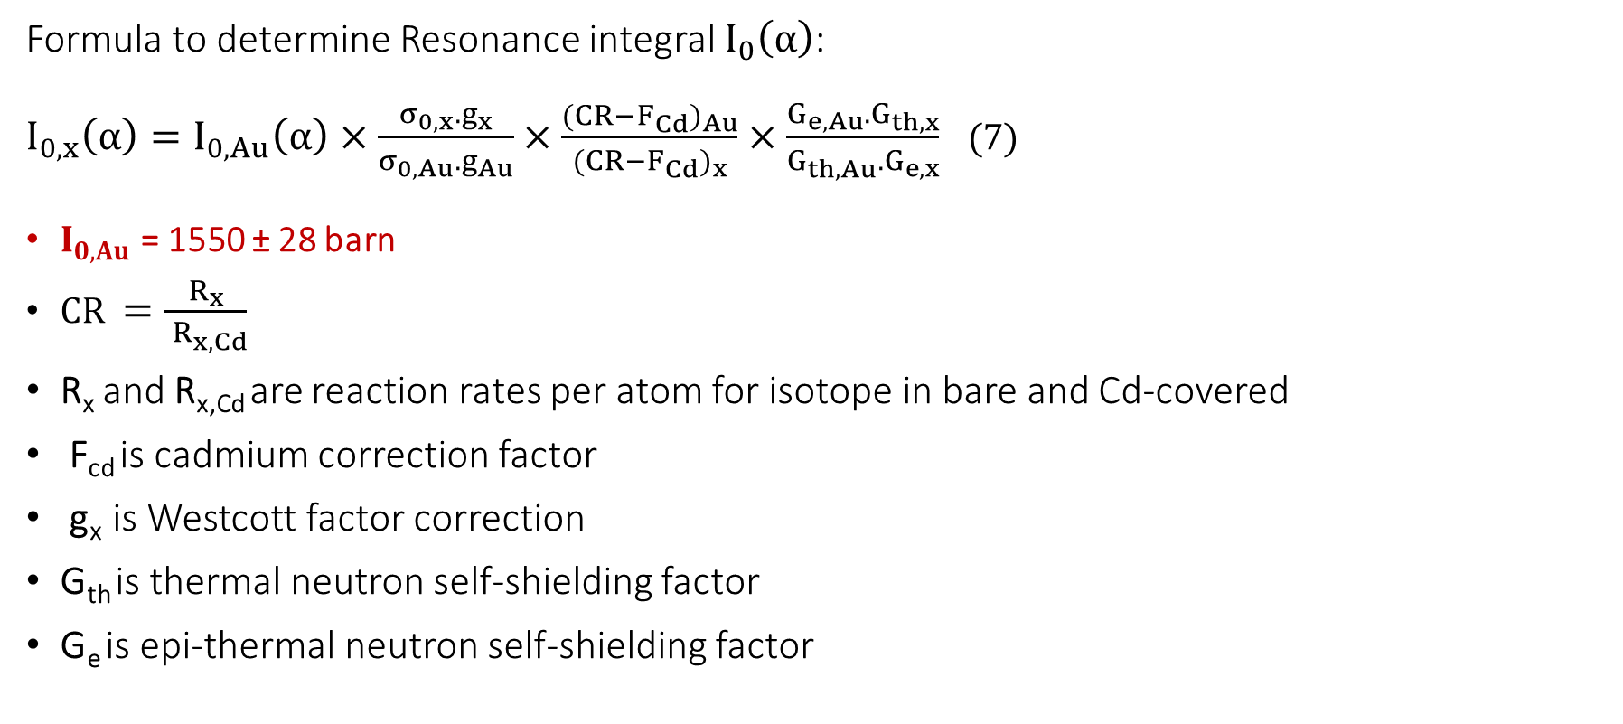
Resonance integral
Formula to determine Resonance integral $I_{0}\left(α\right)$:
$I_{0,x}\left(α\right)=I_{0,Au}\left(α\right)×\frac{σ_{0,x}.g_{x}}{σ_{0,Au}.g_{Au}}×\frac{{(CR−F_{Cd})}_{Au}}{{(CR−F_{Cd})}_{x}}×\frac{G_{e,Au}.G_{th,x}}{G_{th,Au}.G_{e,x}}$ (7)
$I_{0,Au}$ = 1550 ± 28 barn
$CR =\frac{R_{x}}{{ R}_{x,Cd}}$
R_{x} and R_{x,Cd} are reaction rates per atom for isotope in bare and Cd-covered
F_{cd} is cadmium correction factor
g_{x} is Westcott factor correction
G_{th} is thermal neutron self-shielding factor
G_{e} is epi-thermal neutron self-shielding factor

Slide 13
Results & Discussion
Fig a: Comparison of neutron cross-section σ_{o} of ¹⁸⁶W(γ,n)¹⁸⁷W reaction
This work: σ_{o} = 40.659 ± 1.936 (barn)
Fig b: Comparison of resonance integral I_{o} of ¹⁸⁶W(γ,n)¹⁸⁷W reaction
MCNP: I_{o} = 417.50 ± 36.796 (barn)
PHITS : I_{o} = 406.75 ± 36.796 (barn)
Difference: 2.6%

Slide 14
Conclusion
PHITS v3.21 uses JENDL-4.0 nuclear data library (Shibata et al., 2011).
MCNP6.1 uses ENDF/B-VII.1 (Kulesza et al., 2022).
The Gth values obtained from the two computational codes show a discrepancy of less than 1.2%, indicating good agreement and reliability of the results.
The observed differences in neutron self-shielding factors in the epithermal region, particularly for ¹⁹⁷Au (6.3%) and ¹⁸⁶W (8.4%), are primarily caused by significant difference in the neutron cross sections between the nuclear data libraries employed.
Results and calculations are still being updated.

Slide 15
THANKS FOR YOUR ATTENTION

Slide 16
Transmission function (ф/ ф₀(E))
a)Au
b)Cu
In the φ/φ₀(E) spectrum of gold − a high neutron absorber (Fig.a), a pronounced dip (φ/φ₀ = 0.08) occurs at the energy groups of 4.75–5.0 eV, corresponding to the strong resonance absorption of ¹⁹⁷Au (27×10³ barns at 4.9 eV) (Shibata et al., 2011). Depression in the thermal energy region reflects the dominance of absorption cross-section over that of scattering (σ_{γ} > σ_{s}) herein.
In the φ/φ₀(E) spectrum of copper (Fig.b), minimal spectral variation is observed except near 1.9–2.1 keV, where φ/φ₀ peaks at 1.42 (1.9–2.0 keV) before declining to 0.85 (2.0–2.1 keV). As a neutron scatterer (σ_{s} > σ_{γ}) (Shibata et al., 2011), this behavior arises from resonance self-shielding, whereas neutrons near resonance energies undergo multiple scattering, delaying absorption until energy loss shifts them below resonance thresholds (Goncalves et al., 2002).

Slide 17
Transmission function (ф/ ф₀(E))
c)W
d)Zr
The transmission spectrum φ/φ₀(E) for tungsten (Fig.c) exhibits complex energy-dependent behavior due to contributions from its isotopic composition (¹⁸⁰W, ¹⁸²W, ¹⁸³W, ¹⁸⁴W, and ¹⁸⁶W). Pronounced dips in φ/φ₀, attributed to resonance absorption, occur at the energy groups of 4.0−4.25 eV (φ/φ₀ = 0.33), 18−19 eV (φ/φ₀ = 0.36), 19−20 eV (φ/φ₀ = 0.38), 20−21 eV (φ/φ₀ = 0.59), and 21−22 eV (φ/φ₀ = 0.54). Localized increases in φ/φ₀, similarly to copper’s behavior, arise from neutron scattering moderation effects prior to absorption below resonance energies.
For zirconium (Fig.d), φ/φ₀ ∼ 1 across all energy groups, indicating negligible self-shielding. This neutrality stems from zirconium’s low absorption and scattering cross-sections. A 0.1 mm zirconium foil thus introduces minimal perturbation to the neutron field, validating its use as a reference material in irradiation geometries where self-shielding corrections are unnecessary.

Slide 18
Neutron self-shielding factor in isotropic neutron field
Table 2: Comparison of Neutron self-shielding factor in isotropic neutron field
Isotopes | Gth |  |  | Gepi
 | MATSSF Code (Trkov et al. 2009) | MCNP | Diff_Gth | MATSSF Code (Trkov et al. 2009) | MCNP | Diff_Gepi
197Au | 0.8837±0.0084 | 0.8648±0.0242 | 2.1% | 0.2142±0.009 | 0.2777±0.0123 | 22.8%
94Zr | 0.9997±0.0015 | 0.9975±0.0032 | 0.2% | 0.9812±0.0018 | 1.0062±0.0223 | 2.5%
96Zr | 0.9997±0.0015 | 0.9975±0.0032 | 0.2% | 0.9773±0.0018 | 0.9972±0.0715 | 2.0%
186W | 0.9168±0.0017 | 0.9120±0.0192 | 0.5% | 0.2524±0.0023 | 0.3588±0.0215 | 29.7%

Slide 19

Reaction rate
$R_{th,x}=Φ_{th}.σ_{0,x}.G_{th,x}.g_{x}$ (4)
$R_{e,x}=Φ_{e}.I_{0,x}\left(α\right).G_{e,x}= F_{Cd}{ R}_{x,Cd}$ (5)
R_{th,x} and R_{e,x} are reaction rates per atom for isotope in the thermal and epi-thermal energy regions of neutrons

