Slide 1
Development of a Tunable Monochromatic X-ray Source for Pixelated Semiconductor Detector Calibration
Speaker: Truong Hoai Bao Phi^{a,b}
ª Institute of Physics, Vietnam Academy of Science and Technology, Hanoi
^{b} Dzhelepov Laboratory of Nuclear Problems, JINR, Dubna
baophinuclear@gmail.com
Alushta Conference - June 8-15, 2025
Notes:
Hello everyone! I’m Phi, a researcher at the Vietnam Academy of Science and Technology (VAST), currently based at the Dzelepov Laboratory of Nuclear Problems. (JINR).
This year, our conference is dedicated to the research and infrastructure facility of the institute. So I would like to bring to you our latest achievement in development of a tunable monochromatic X-rays source, designed for precise energy calibration of pixelated semiconductor detectors.
/həˈloʊ ˈɛvriˌwʌn! aɪm fi, ə riˈsɜrtʃər æt ðə ˌvjɛtˈnɑːm əˈkædəmi əv ˈsaɪəns ənd tɛkˈnɑləʤi (væst), ˈkɜrəntli beɪst æt ðə ˈdzɛləpɑːv læˈbɔrəˌtɔri əv ˈnukliər ˈprɑbləmz (ˈʤaɪənɑr). ðɪs jɪr, ˈaʊər ˈkɑnfərəns ɪz ˈdɛdəˌkeɪtɪd tə ðə riˈsɜrtʃ ənd ˈɪnfrəˌstrʌkʧər fəˈsɪləti əv ði ˈɪnstəˌtut. ɪts maɪ ˈplɛʒər tə brɪŋ tə ju ˈaʊər ˈleɪtəst əˈʧivmənt ɪn dɪˈvɛləpmənt əv ə ˈtunəbəl ˌmɑnəˈkroʊmætɪk ˈɛksreɪ sɔrs, dɪˈzaɪnd fɔr priˈsaɪs ˈɛnərʤi ˌkæləˈbreɪʃən əv ˈpɪksəˌleɪtɪd ˌsɛmikənˈdʌktər dɪˈtɛktərz./

Slide 2
Table of contents
Introduction
Source design
Operating principle, structural components of developed source, control system.
Performance measurements
Results on beam energy, monochromaticity.
Conclusions
Notes:
My talk is divided into four parts:
Introduction, Source design, Performance Measurements and Conclusions.
/maɪ tɔːk təˈdeɪ ɪz dɪˈvaɪdɪd ˈɪntuː fɔː pɑːts:
ˌɪntrəˈdʌkʃn, sɔːs dɪˈzaɪn, pəˈfɔːməns ˈmeʒəmənts ən kənˈkluːʒnz./

Slide 3
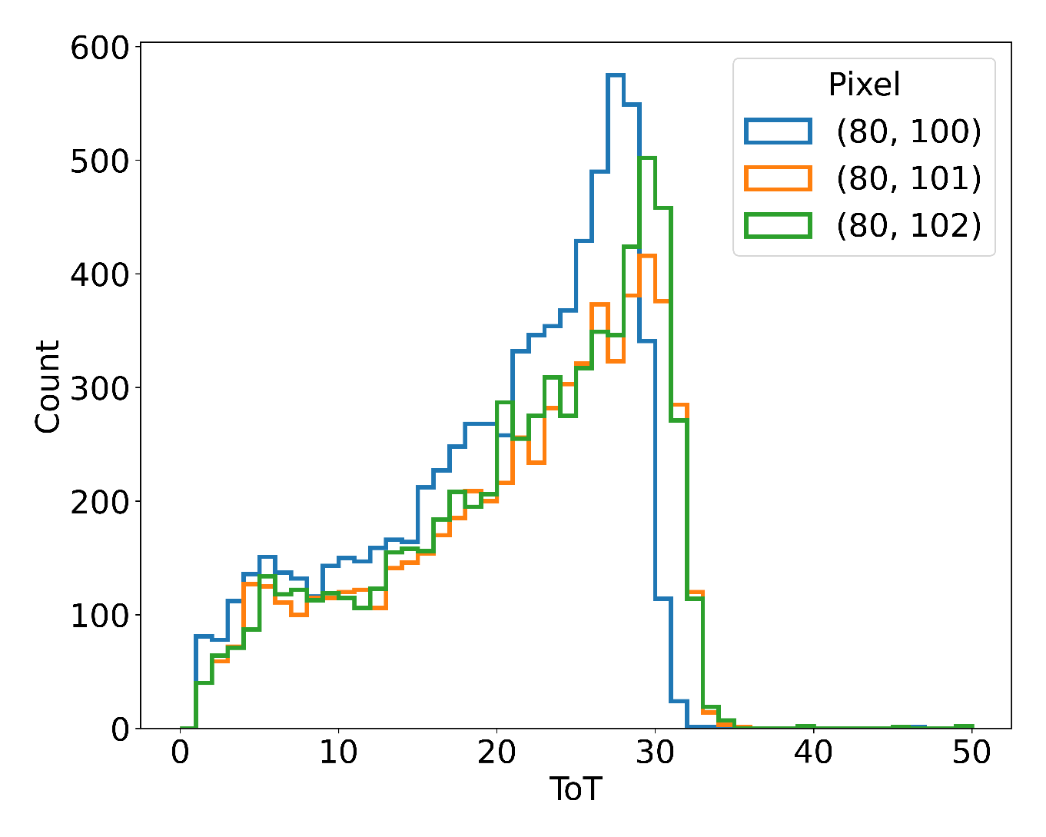
Introduction
Pixel response non-uniformity degrades the performance of pixelated semiconductor detectors, particularly in energy-resolving applications.
Solution: Per-pixel energy calibration.
Sources: isotopes, fluorescence
In medical applications, we focus on detecting quanta with energies below 100 keV.
This study aims to develop a tunable device capable of generating a monoenergetic quanta beam at a user-defined energy.
E = 30 keV
Energy spectra of 3 pixels with the same quanta energy
Truong Hoai Bao Phi
Alushta Conference - June 8-15, 2025
3/11
Notes:
Pixel response non-uniformity is a well-known challenge in pixelated detectors.
The solution of this is the per-pixel energy calibration.
Currently, we have two conventional X-ray sources for detector calibration:
Radioactive isotopes and Metal-target fluorescence. But these source have their own disadvantages.
In this stude we aim to develop a tunable device capable of generating a monoenergetic quanta beam at a user-defined energy below 100 keV.
/ˈpɪksl̩ rɪˈspɒns ˌnɒnjuːnɪˈfɔːməti ɪz ə ˌwelˈnəʊn ˈtʃælɪndʒ ɪn ˈpɪksəleɪtɪd dɪˈtektəz.
əz ʃəʊn ɪn ðɪs ˈfɪɡə, wen ˌɪreɪdiˈeɪtɪd baɪ ə ˈθɜːti kiːˈiː ˈeksreɪ biːm, θriː ˈdɪfrənt ˈpɪksəlz ɪɡˈzɪbɪt dɪˈstɪŋkt ˈspektrəl rɪˈspɒnsɪz.
ðiːz ˌveəriˈeɪʃn̩z dəˈrektli ˈɪmpækt dɪˈtektə pəˈfɔːməns.
ðə səˈluːʃn̩ ɪz ðə pəˈpɪksl̩ ˈenədʒi ˌkælɪˈbreɪʃn̩.
ˈkʌrəntli, wi hæv tuː kənˈvenʃənl̩ ˈeksreɪ ˈsɔːsɪz fə dɪˈtektə ˌkælɪˈbreɪʃn̩:
ˌreɪdiəʊˈæktɪv ˈaɪsətəʊps prəˈvaɪd ˈsteɪbl̩ ɪˈmɪʃn̩ laɪnz bʌt wɪð ˈveri ləʊ flʌks,
ˈmetl̩ ˈtɑːɡɪt ˌflʊəˈresns ˈɒfəz ˈhaɪər ɪnˈtensəti bʌt ðɪs ˈmeθəd ɪz ˈlɪmɪtɪd tuː fɪkst ˌkærəktəˈrɪstɪk ˈenədʒiz.
ˌædɪʃənəli, ɪn ˈmedɪkl̩ ˌæplɪˈkeɪʃn̩z, wi ˈfəʊkəs ɒn dɪˈtektɪŋ əv ˈkwɒntə wɪð ˈenədʒiz bɪˈləʊ ˌwʌn ˈhʌndrəd kiːˈiː.
səʊ, ɪn ðɪs ˈstʌdi wi eɪm tə dɪˈveləp ə ˈtjuːnəbl̩ dɪˈvaɪs ˈkeɪpəbl̩ əv ˈdʒenəreɪtɪŋ ə ˌmɒnəʊɪˈnɜːtɪk ˈkwɒntə biːm ət ə ˈjuːzə dɪˈfaɪnd ˈenədʒi bɪˈləʊ ˌwʌn ˈhʌndrəd kiːˈiː./

Slide 4
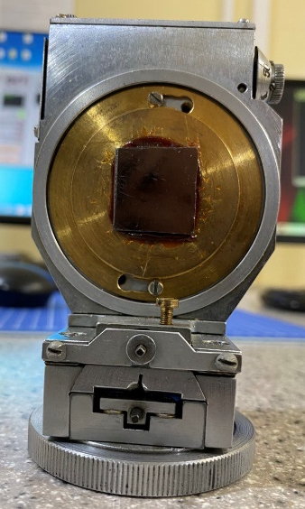
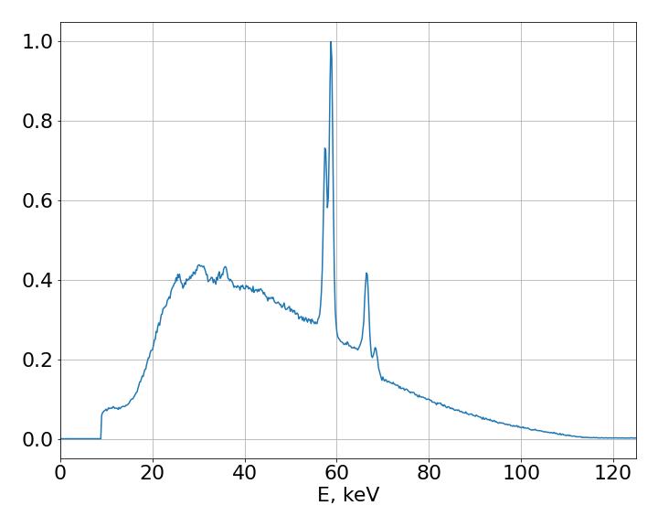
Operating principle
Bragg’s law
Pyrolitic graphite
crystal structure
n ⋅ λ = 2d ⋅ sinθ
Typical continuous spectrum of a X-ray tube
(1)
Truong Hoai Bao Phi
Alushta Conference - June 8-15, 2025
4/11
Notes:
The operating principle of our source is simple:
We use a pyrolytic graphite crystal to monochromatize radiation from a standard X-ray tube. According to Bragg’s law, by precisely adjusting the incident beam angle, we can select any desired energy from the continuous spectrum.
Pyrolytic graphite is a man-made material, it has a layered crystal structure, so it fits this application.
/ði ˈɒpəreɪtɪŋ ˈprɪnsəpl̩ əv ˈaʊə sɔːs ɪz ˈsɪmpl̩:
wi juːz ə ˌpaɪrəˈlɪtɪk ˈɡræfaɪt ˈkrɪstl̩ tə ˌmɒnəˈkrɒmətaɪz ˌreɪdiˈeɪʃn̩ frɒm ə ˈstændəd ˈeksreɪ tjuːb. əˈkɔːdɪŋ tə ˈbræɡz lɔː, baɪ ˈprɪsaɪsli əˈdʒʌstɪŋ ði ˈɪnsɪdənt biːm ˈæŋɡl̩, wi kən sɪˈlekt ˈeni dɪˈzaɪəd ˈenədʒi frəm ðə kənˈtɪnjuəs ˈspektrəm.
ˌpaɪrəˈlɪtɪk ˈɡræfaɪt ɪz ə ˈmæn meɪd məˈtɪəriəl, ɪt hæz ə ˈleɪəd ˈkrɪstl̩ ˈstrʌktʃə, səʊ ɪt fɪts ðɪs ˌæplɪˈkeɪʃn̩./

Slide 5
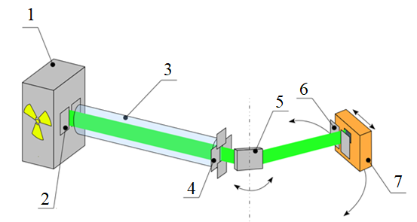
Structural components
1. X-ray tube
(anode: W, U=60-120kV, I=10-350uA)
2. Primary slit
(3-6mm)
3. Primary collimator
(copper tube: d = 30mm, D = 36mm, L = 56cm)
4. Secondary slit
(0-2mm horizontal, 0-3mm vertical)
5. Crystal
(graphite lattice)
6. Secondary collimator
(0-5mm horizontal)
7. Detector
(any portable detectors)
2
5
6
7
4
1
3
Truong Hoai Bao Phi
Alushta Conference - June 8-15, 2025
5/11
Notes:
To implement this principle, we designed a modular system with following components:
An X-ray tube for generating the initial polychromatic beam
Several slits and collimators were applied for beam shaping and background reduction
Motorized goniometer with pyrolytic graphite crystal - enables accurate energy selection via angle adjustment
The system's modular design allows any portable detector to be integrated for different applications
/tu ˈɪmplɪment ðɪs ˈprɪnsəpl̩, wi dɪˈzaɪnd ə ˈmɒdjələ(r) ˈsɪstəm wɪð ˈfɒləʊɪŋ kəmˈpəʊnənts:
– ən ˈeksreɪ tjuːb fə ˈdʒenəreɪtɪŋ ði ɪˈnɪʃl̩ ˌpɒlɪkrəˈmætɪk biːm
– ˈsevərəl slɪts ən ˈkɒlɪmeɪtəz wər əˈplaɪd fə biːm ˈʃeɪpɪŋ ən ˈbækɡraʊnd rɪˈdʌkʃn̩
– ˈməʊtəraɪzd ˌɡəʊniˈɒmɪtə wɪð ˌpaɪrəˈlɪtɪk ˈɡræfaɪt ˈkrɪstl̩ – ɪˈneɪbl̩z ˈækjərət ˈenədʒi sɪˈlekʃn̩ ˈvaɪə ˈæŋɡl̩ əˈdʒʌstmənt
– ðə ˈsɪstəmz ˈmɒdjələ(r) dɪˈzaɪn əˈlaʊz ˈeni ˈpɔːtəbl̩ dɪˈtektə tə bi ˈɪntɪɡreɪtɪd fə ˈdɪfrənt ˌæplɪˈkeɪʃn̩z/

Slide 6
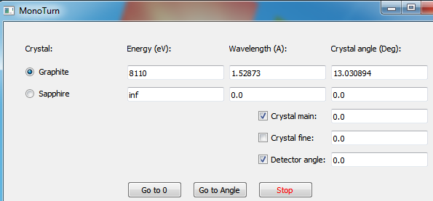
Control system
4 motors for:
1. Rotational motion of the crystal
(1⁰ = 4710 steps)
2. Precise rotational motion of the crystal
(1⁰ = 55940 steps)
3. Rotational motion of the detector (1⁰ = 431 steps)
4. Translational motion of the detector
(1mm = 400 steps)
Control software:
- Input: one of 3 parameters: energy (eV), wavelength ($Å$) of the expected output beam, crystal rotation angle ($deg$).
- Runs motors to rotate crystal and detector to needed angles
Truong Hoai Bao Phi
Alushta Conference - June 8-15, 2025
6/11
Notes:
To obtain the required energy, we need to rotate the crystal and the detector to angles, calculated by the Bragg’s law. To do this precisely, we set 4 step motors and a control software. A combination of precise hardware and user-friendly software gives us repeatable, hands-free energy selection across our entire operating range
/tu əbˈteɪn ðə rɪˈkwaɪəd ˈenədʒi, wi niːd tə ˈrəʊteɪt ðə ˈkrɪstl̩ ən ðə dɪˈtektə tə ˈæŋɡl̩z, ˈkælkjəleɪtɪd baɪ ðə ˈbræɡz lɔː. tu duː ðɪs prɪˈsaɪsli, wi set fɔː stɛp ˈməʊtəz ən ə kənˈtrəʊl ˈsɒftweə. ɪn ðɪs ˈsɒftweə, wi ˈentə wʌn əv θriː pəˈræmɪtəz: ˈiːðə ˈenədʒi ɪn iːˈviː ɔː ˈweɪvleŋθ ɪn ˈæŋstrəm ɔː ˈkrɪstl̩ rəʊˈteɪʃn̩ ˈæŋɡl̩ ɪn dɪˈɡriː. ðə ˈsɒftweə wɪl ˈkælkjəleɪt ðə rəʊˈteɪʃn̩ ˈæŋɡl̩z əv ˈkrɪstl̩ ən dɪˈtektə, ðen ˈkɑːməndz ˈməʊtə ˈmuːvmənt ən ˈverɪfaɪz ˈevriθɪŋ ɪz ˈpɜːfɪktli əˈlaɪnd. ðɪs ˌkɒmbɪˈneɪʃn̩ əv prɪˈsaɪs ˈhɑːdweə ən ˈjuːzə ˈfrendli ˈsɒftweə ɡɪvz ʌs rɪˈpiːtəbl̩, ˈhændz fri ˈenədʒi sɪˈlekʃn̩ əˈkrɒs ˈaʊər ˈentɑɪə ˈɒpəreɪtɪŋ reɪndʒ./

Slide 7
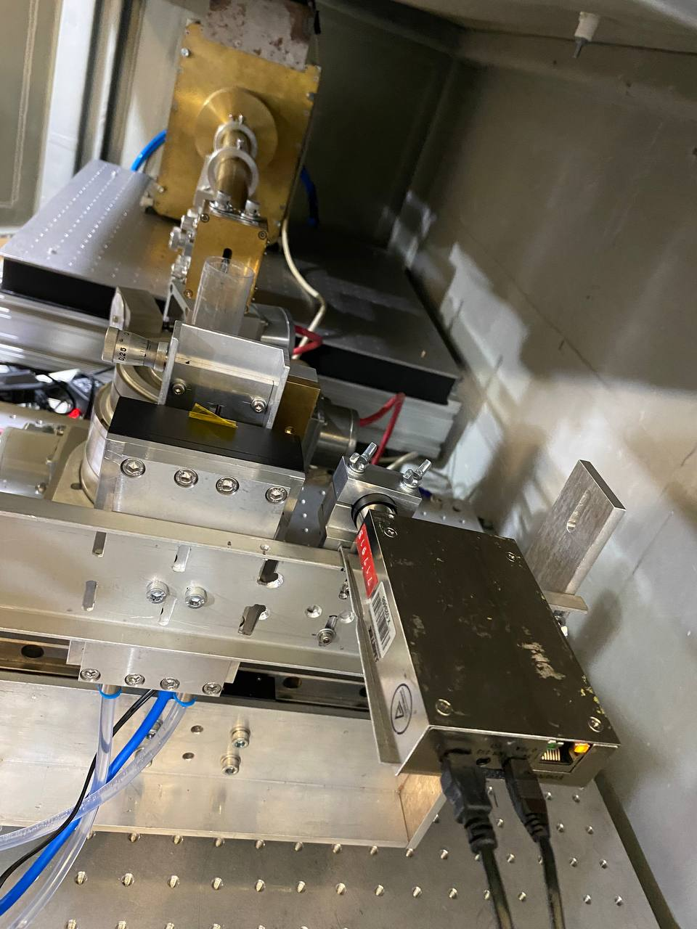
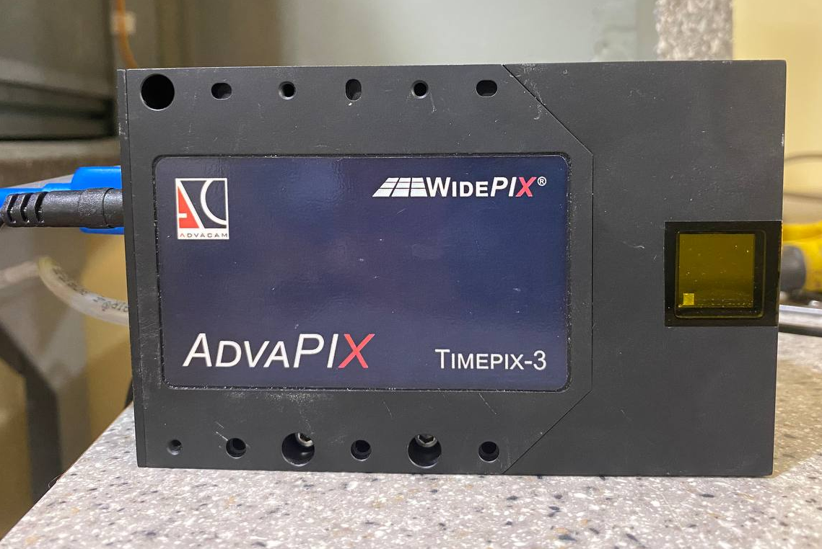
Performance measurements
Detectors:
Timepix3 GaAs:Cr – beam profile
X-123CdTe Spectrometer
Truong Hoai Bao Phi
Alushta Conference - June 8-15, 2025
7/11
Notes:
To carry out the measurement of main characteristics of the output beam we integrated 2 detectors into our system.
Detector Timepix3 is used in order to define the output beam profile.
A spectrometer with fine energy resolution is used for measuring the spectrum of output beam.
/tu ˈkæri aʊt ðə ˈmeʒəmənt əv meɪn ˌkærɪktəˈrɪstɪks əv ði ˈaʊtpʊt biːm, wi ˈɪntɪɡreɪtɪd tuː dɪˈtektəz ˈɪntuː ˈaʊə ˈsɪstəm. dɪˈtektə ˈtaɪmpɪks θriː ɪz juːzd ɪn ˈɔːdə tə dɪˈfaɪn ði ˈaʊtpʊt biːm ˈprəʊfaɪl. ə spekˈtrɒmɪtə wɪð faɪn ˈenədʒi ˌrezəˈluːʃn̩ ɪz juːzd fə ˈmeʒərɪŋ ðə ˈspektrəm əv ˈaʊtpʊt biːm./

Slide 8
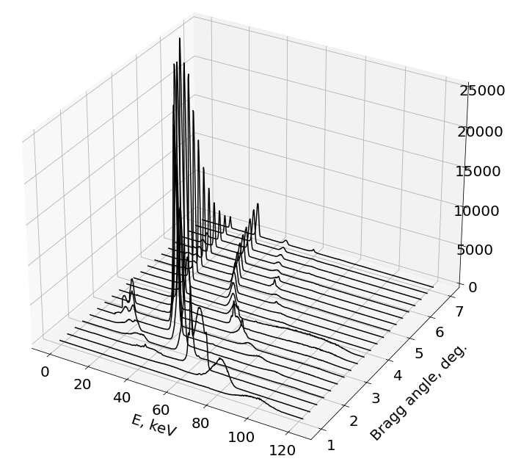
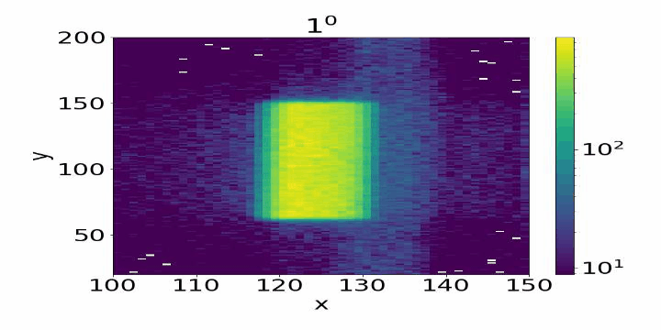
Performance measurements
Bragg angle:
Main peaks
Peaks of higher order
Escape peaks
Beam profile (left) and energy spectra (right) of the output beam obtained at Bragg angles from 1 to 7 degrees
(X-ray tube voltage 120 kV, current 50 μA, exposure time 100 s)
Truong Hoai Bao Phi
Alushta Conference - June 8-15, 2025
8/11
Notes:
The beam profile remains stable across Bragg angles of 1° to 7°, as you can see in the left figure. In this configuration, the beam size is 1x5mm2.
The energy spectra in the right figure show sharp main peaks, as required, along with higher-order diffraction peaks. These peaks correspond to n > 1 in the Bragg’s formula. If unwanted, these higher-order peaks can be suppressed by lowering the X-ray tube voltage.
Escape peaks, resulting from X-rays of sensor material leaving the sensor volume, are also visible but do not correspond to true beam energies.
/ðə biːm ˈprəʊfaɪl rɪˈmeɪnz ˈsteɪbl̩ əˈkrɒs ˈbræɡ ˈæŋɡl̩z əv wʌn tə ˈsevən dɪˈɡriːz, əz ju kən siː ɪn ðə left ˈfɪɡə. ði ˈenədʒi ˈspektrə ɪn ðə raɪt ˈfɪɡə ʃəʊ ʃɑːrp meɪn piːks, əz rɪˈkwaɪəd, əˈlɒŋ wɪð ˈhaɪər ˈɔːdə dɪˈfrækʃn̩ piːks. ðiːz piːks ˌkɒrɪˈspɒnd tə n ɡreɪtə ðən wʌn ɪn ðə ˈbræɡz ˈfɔːmjələ. ɪf ʌnˈwɒntɪd, ðiːz ˈhaɪər ˈɔːdə piːks kən bi səˈprest baɪ ˈləʊərɪŋ ði ˈeksreɪ tjuːb ˈvəʊltɪdʒ. ɪˈskeɪp piːks, rɪˈzʌltɪŋ frɒm ˈeksreɪz əv ˈsensə məˈtɪəriəl ˈliːvɪŋ ðə ˈsensə ˈvɒljuːm, ɑːr ˈɔːlsəʊ ˈvɪzəbl̩ bʌt duː nɒt ˌkɒrɪˈspɒnd tə truː biːm ˈenədʒiz./

Slide 9
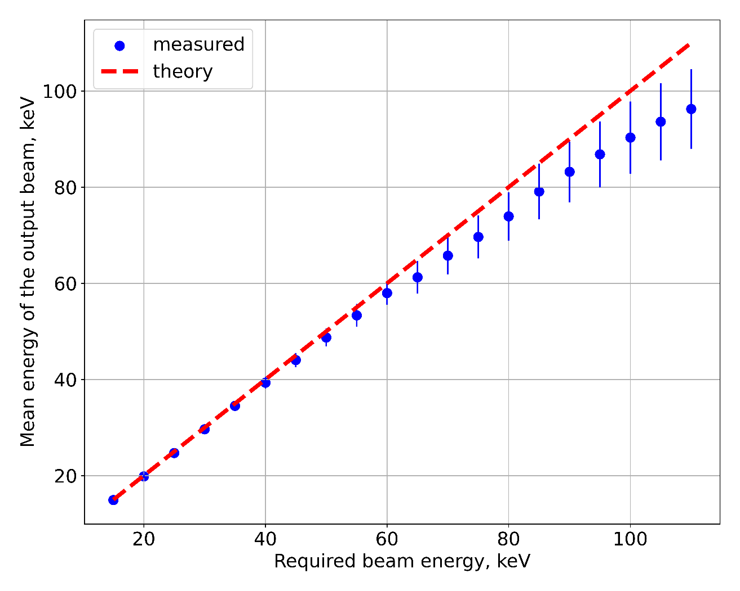
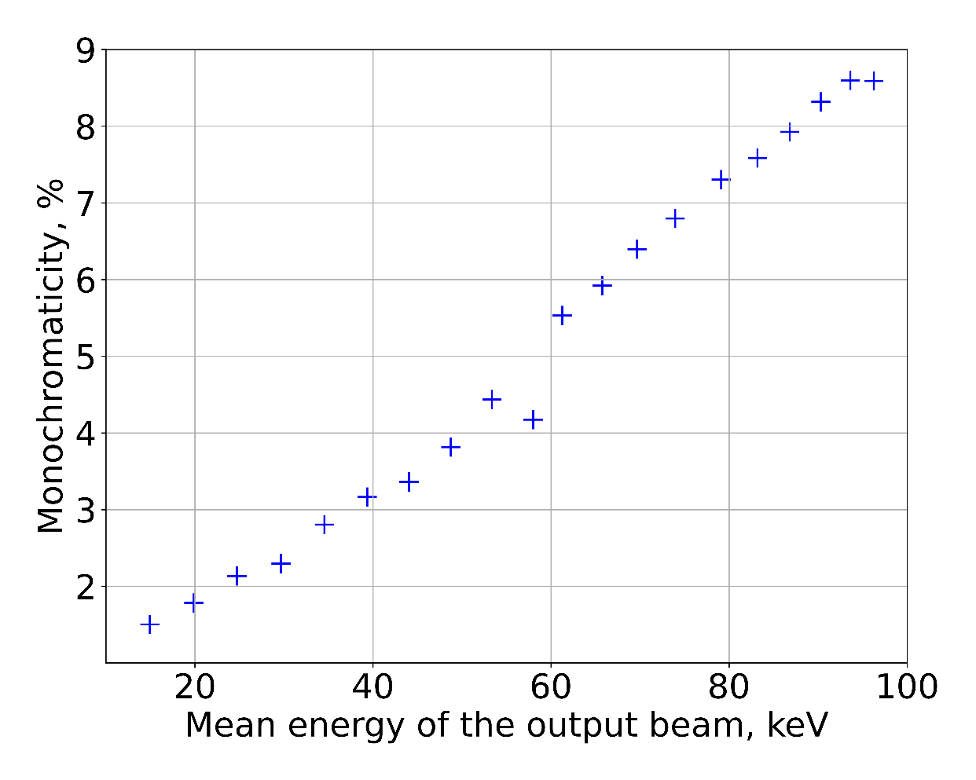
Performance measurements
$\frac{∆E}{E}=\frac{\sqrt{σ^{2}−σ_{det}^{2}}}{E_{mean}}$
Truong Hoai Bao Phi
Alushta Conference - June 8-15, 2025
9/11
Notes:
From the output beam’s energy spectra, we calculated the mean energy and monochromaticity of the main peaks. Below 60 keV, the mean energy matches theoretical predictions well. Between 60–100 keV, a slight discrepancy arises due to mechanical calibration—an easily correctable issue.
Monochromaticity ranges from ~1.5% at lower energies to ~9% at 100 keV.
/frɒm ði ˈaʊtpʊt biːmz ˈenədʒi ˈspektrə, wi ˈkælkjəleɪtɪd ðə miːn ˈenədʒi ən ˌmɒnəˌkrəʊməˈtɪsəti əv ðə meɪn piːks. bɪˈləʊ ˈsɪksti kiːˈiː, ðə miːn ˈenədʒi ˈmætʃɪz ˌθɪəˈretɪkl̩ prɪˈdɪkʃn̩z wel. bɪˈtwiːn ˈsɪksti tə ˈwʌn ˈhʌndrəd kiːˈiː, ə slaɪt dɪsˈkrepənsi əˈraɪzɪz duː tə mɪˈkænɪkl̩ ˌkælɪˈbreɪʃn̩—ən ˈiːzəli ˈkɒrɪktəbl̩ ˈɪʃuː. ˌmɒnəˌkrəʊməˈtɪsəti ˈreɪndʒɪz frɒm əˈraʊnd wʌn pɔɪnt faɪv pəˈsent ət ˈləʊə ˈenədʒiz tə əˈraʊnd naɪn pəˈsent ət ˈwʌn ˈhʌndrəd kiːˈiː./

Slide 10
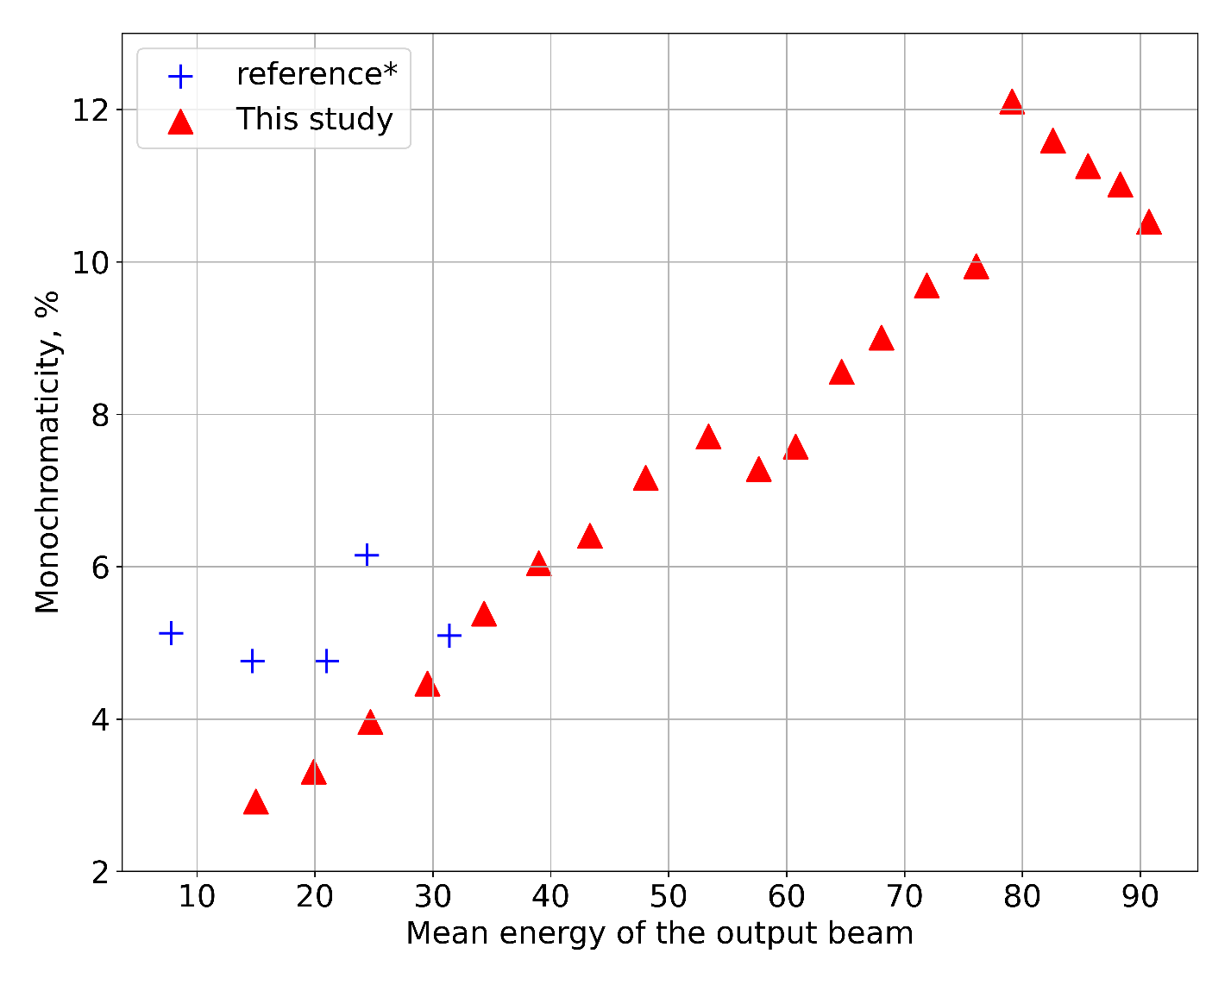
Performance measurements
Comparison with a similar source*:
*S. Velardita et al 2025 JINST 20 T05003
Beam profile 3x3mm²
Truong Hoai Bao Phi
Alushta Conference - June 8-15, 2025
10/11
Notes:
To compare our source with existing alternatives offering similar functionality, please refer to the next figure. Our system operates across a broader energy range and in energy range up to 30 keV our source delivers superior monochromaticity for a 3×3 mm² beam profile.
/tə kəmˈpeə(r) ˈaʊə(r) sɔːs wɪð ɪɡˈzɪstɪŋ ɔːlˈtɜːnətɪvz ˈɒfərɪŋ ˈsɪmɪlə(r) ˌfʌŋkʃəˈnæləti, pliːz rɪˈfɜː(r) tə ðə nekst ˈfɪɡə(r). ˈaʊə(r) ˈsɪstəm ˈɒpəreɪts əˈkrɒs ə ˈbrɔːdə(r) ˈenədʒi reɪndʒ ənd ɪn ˈenədʒi reɪndʒ ʌp tə ˈθɜːti kiːˈiː ˈaʊə(r) sɔːs dɪˈlɪvəz suːˈpɪəriə(r) ˌmɒnəkrəʊməˈtɪsəti fə(r) ə θriː baɪ θriː ˈmɪlɪmiːtə skweəd biːm ˈprəʊfaɪl./

Slide 11
Conclusions
A tunable monochromatic X-rays source was developed, covering soft to hard X-ray energies: 15–100 keV, with monochromaticity 1.5–9%.
The resulting monochromatic beam enables precise energy calibration of pixelated semiconductor detectors.
As an institutional X-ray platform, this facility can be used for calibration of gamma spectrometers and energy-resolved imaging - particularly valuable for materials science and biomedical studies.
Truong Hoai Bao Phi
Alushta Conference - June 8-15, 2025
11/11
Notes:
In conclusion, we have developed a tunable monochromatic X-ray source covering 15-100 keV with 1.5-9% monochromaticity, which is particularly suitable for energy calibration of pixelated semiconductor detectors. As an institutional X-ray platform, this facility can be used for calibration of gamma spectrometers and energy-resolved imaging - particularly valuable for materials science and biomedical studies.
/ɪn kənˈkluːʒn̩, wi həv dɪˈveləpt ə ˈtjuːnəbl̩ ˌmɒnəkrəˈmætɪk ˈeksreɪ sɔːs ˈkʌvərɪŋ ˈfɪftiːn tə ˈwʌn ˈhʌndrəd kiːˈiː wɪð wʌn pɔɪnt faɪv tə naɪn pəˈsent ˌmɒnəˌkrəʊməˈtɪsəti, wɪʧ ɪz pəˈtɪkjələli ˈsuːtəbl̩ fə ˈenədʒi ˌkælɪˈbreɪʃn̩ əv ˈpɪksəleɪtɪd ˌsemikənˈdʌktə dɪˈtektəz. æz ən ˌɪnstɪˈtuʃənəl ˈɛksreɪ ˈplætfɔrm, ðɪs fəˈsɪləti kæn bi juzd fɔr ˌkælɪˈbreɪʃən əv ˈɡæmə spɛkˈtrɑmɪtərz ænd ˈɛnərdʒi-rɪˈzɑlvd ˈɪmɪdʒɪŋ - pərˈtɪkjələrli ˈvæljuəbl fɔr məˈtɪriəlz ˈsaɪəns ænd ˌbaɪoʊˈmɛdɪkəl ˈstʌdiz./

Slide 12
Thanks for your attention!

