Slide 1
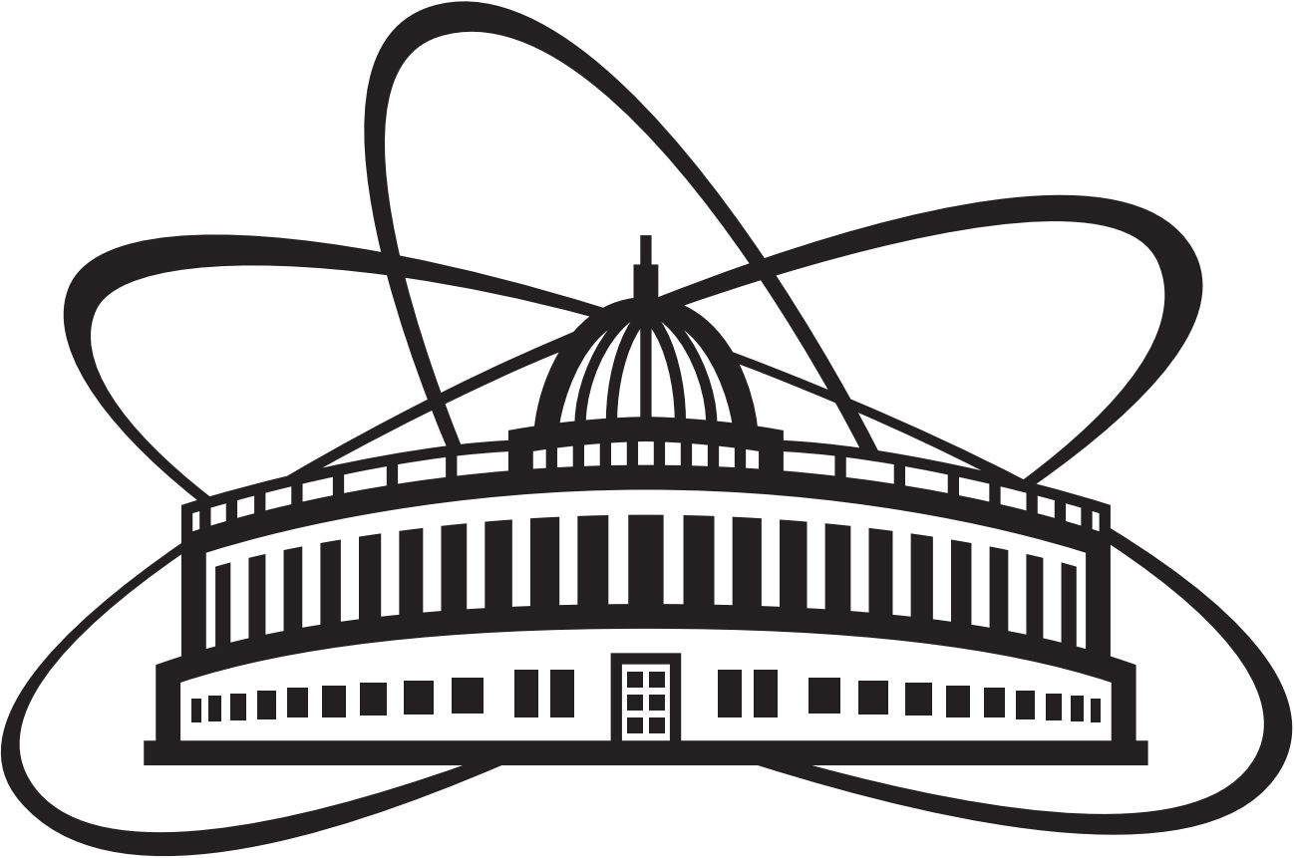


Research capabilities of the Frank Laboratory of Neutron Physics in the field of materials science and cultural heritage
Bulat Bakirov^{1,2}
¹Frank Laboratory of Neutron Physics, Joint Institute for Nuclear Research
²Institute of Archaeology, Russian Academy of Sciences

Slide 2
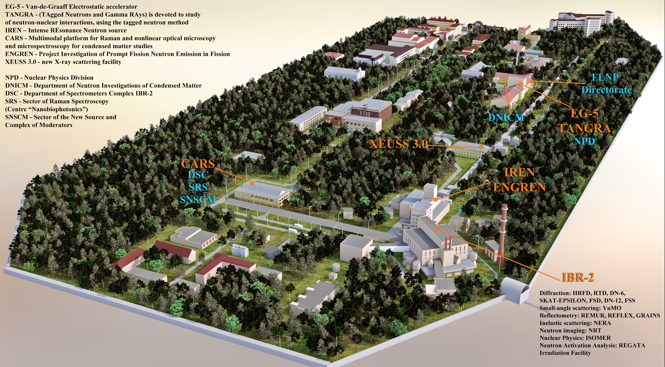
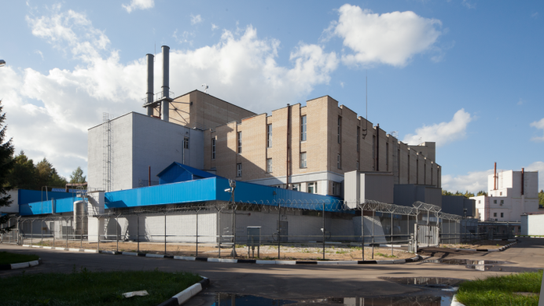

Slide 3
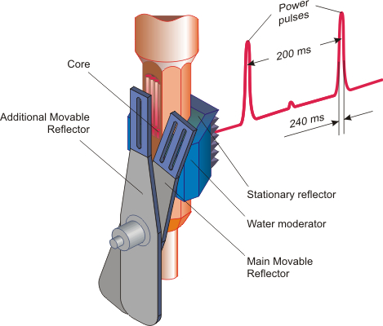
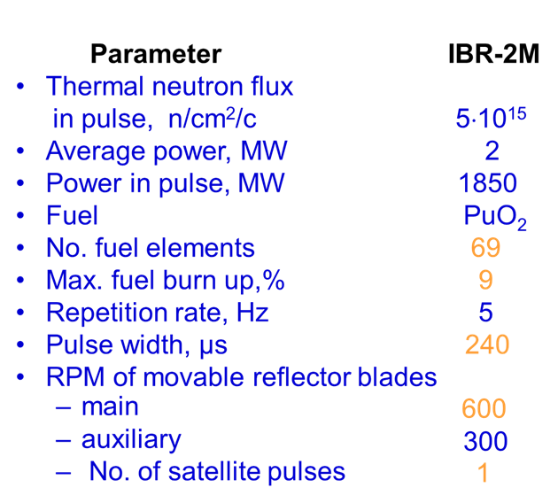
IBR-2M high-flux pulsed reactor
240 μs
3

Slide 4
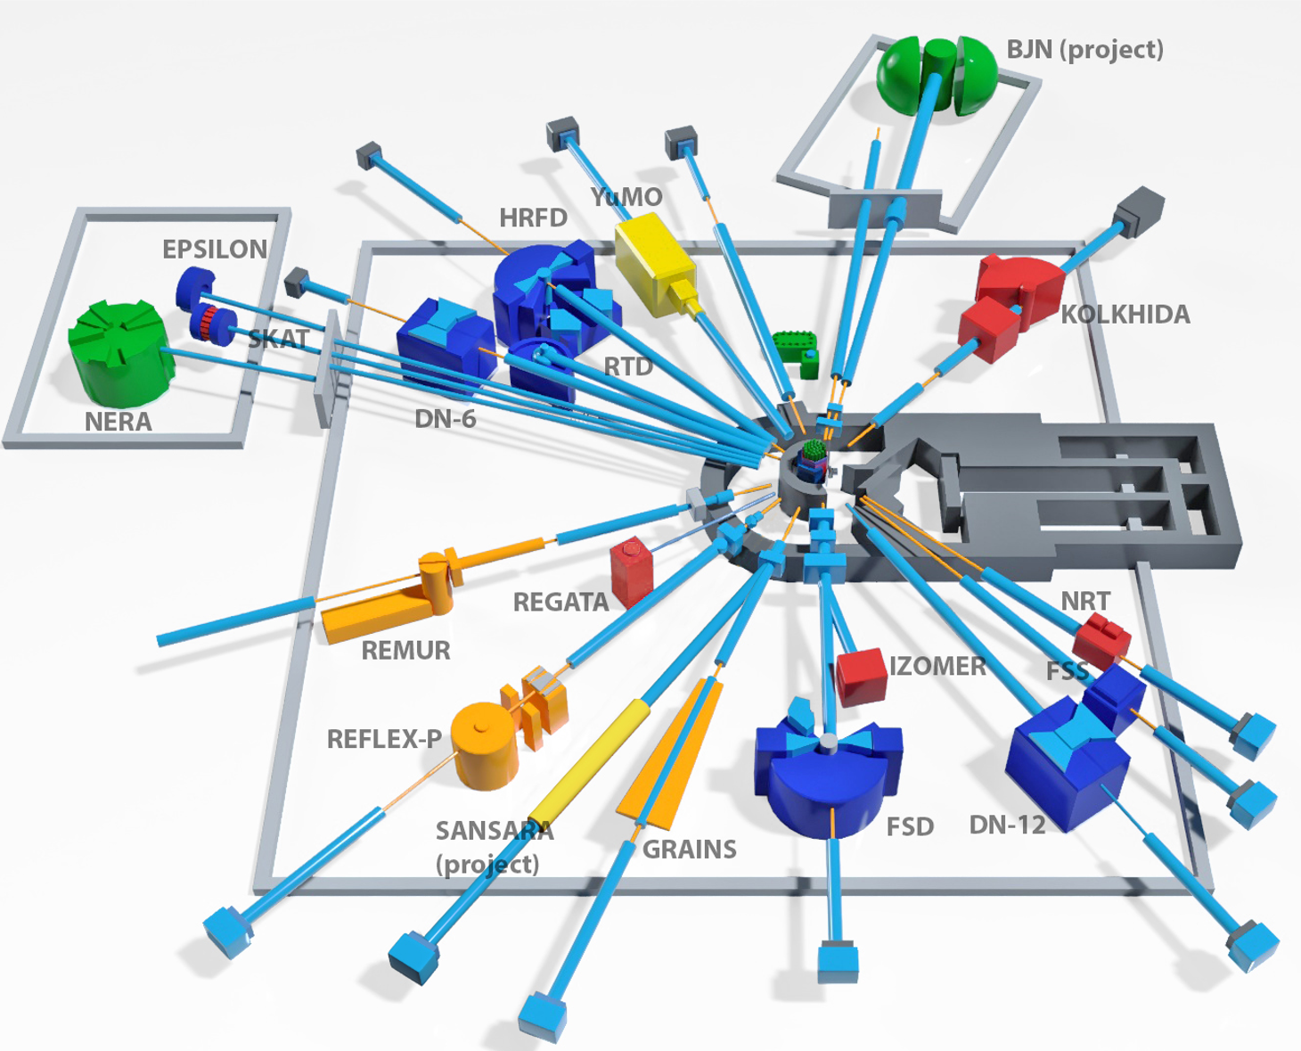
IBR-2M Spectrometers Complex
Diffractometers:
HRFD, DN-6, RTD, DN-12, FSD, SKAT, Epsilon, FSS
Reflectometers:
REMUR, REFLEX, GRAINS
Small Angle Scattering Spectrometer:
YuMO
Inelastic Neutron Scattering Spectrometers:
NERA
Radiography and Tomography:
NRT
New Instruments:
SANSARA (in development)
INS spectrometer in inverted geometry BJN (new project)
4

Slide 5
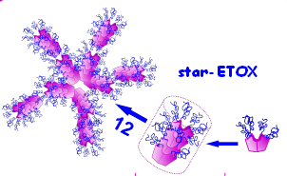
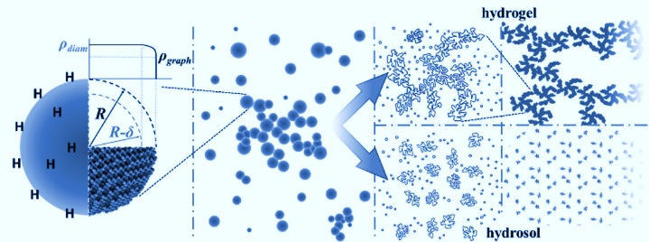
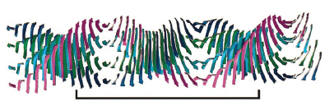
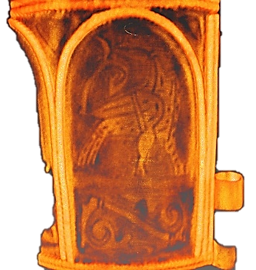
The priority research directions at the IBR-2 instruments:
Condensed Matter Physics and Materials Science;
Physics of Nanosystems and Nanoscale Phenomena;
Physics of Complex Liquids and Polymers;
Biophysics and Pharmacology;
Applied Materials and Engineering Sciences.
5

Slide 6
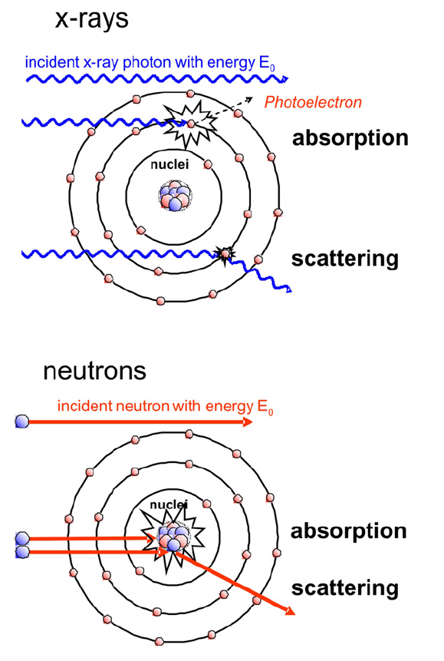
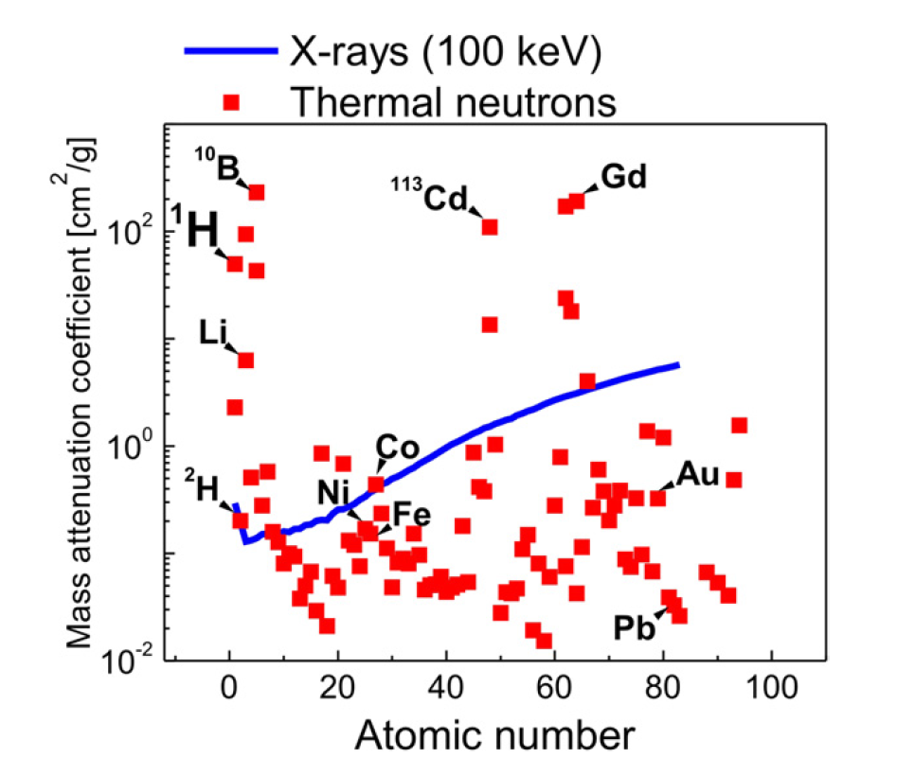
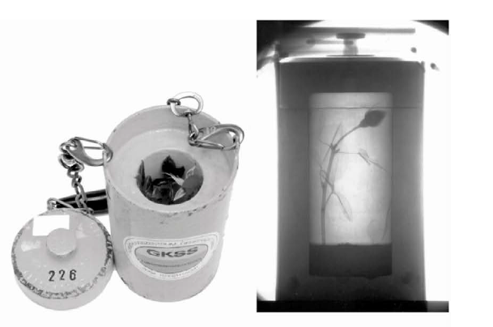
Properties of neutrons
Neutrons are weakly interacting neutral particles that penetrate deep into most materials, so they can be used for non-destructive interior imaging of large objects.
The scattering or absorption of neutrons by atomic nuclei varies randomly in the periodic table. This makes neutron imaging highly complementary to X-ray imaging.
The scattering or absorption can also vary significantly between isotopes of the same chemical element. The contrast of particular materials in an image can therefore be enhanced by substituting one isotope for another.
6

Slide 7
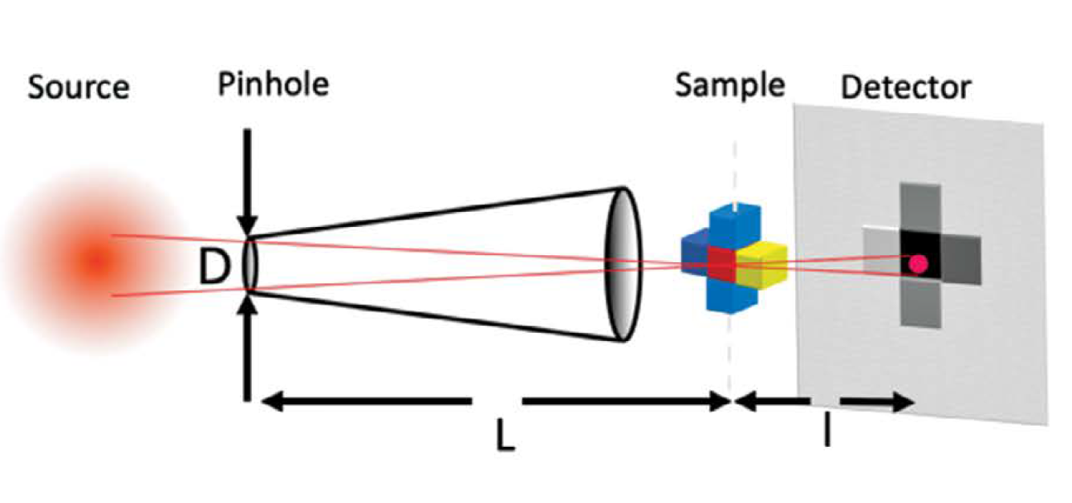
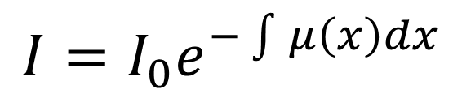
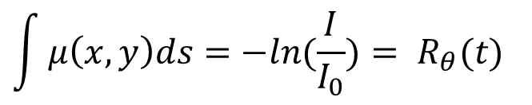

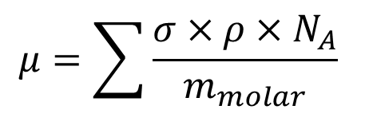
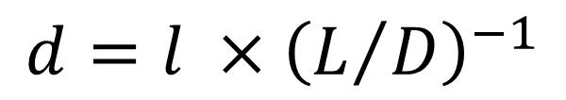
Neutron tomography
$$I=I_{0}e^{−\int{μ\left(x\right)dx}}$$
I ‒ transmitted neutron intensity
I₀ ‒ incident neutron intensity
x ‒ thickness
μ ‒ attenuation coefficient
$$μ=\sum{\frac{σ×ρ×N_{A}}{m_{molar}} }$$
$$σ=σ_{abs}+σ_{coh}+σ_{inc}$$
L ‒ distance between input aperture and sample
D ‒ aperture diameter
$$\int{μ\left(x, y\right)ds=−ln⁡(\frac{I}{I_{0}}})= R_{θ}(t)$$
$R_{θ}\left(t\right)$‒ the Radon transform of the function $μ\left(x, y\right)$
Spatial resolution
$$d=l ×{\left(L/D\right)}^{−1}$$
Conventional Reconstruction Methods:
Fourier transformation (FBP, DFR)
Solving a system of equations (SIRT, SART etc.)
AI
7

Slide 8
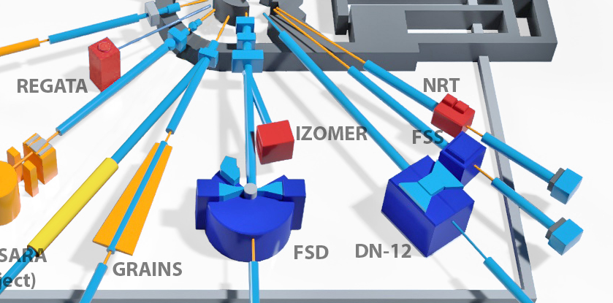
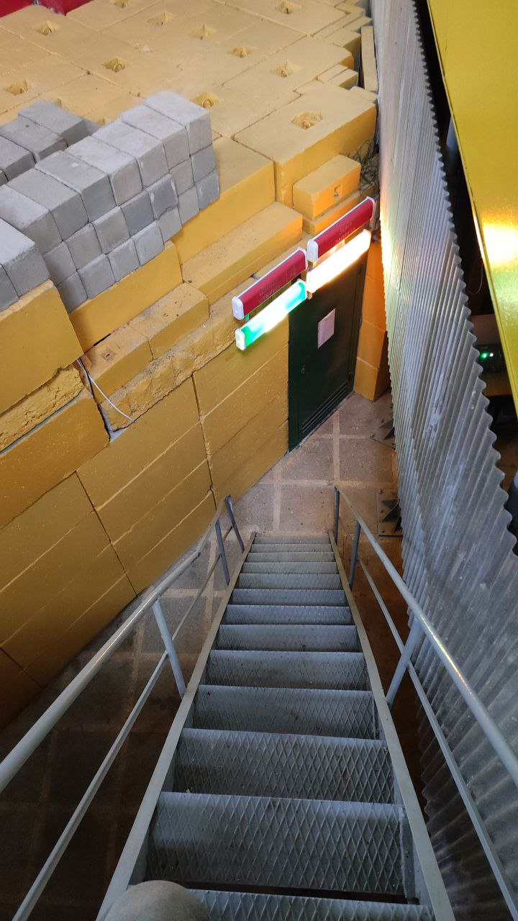
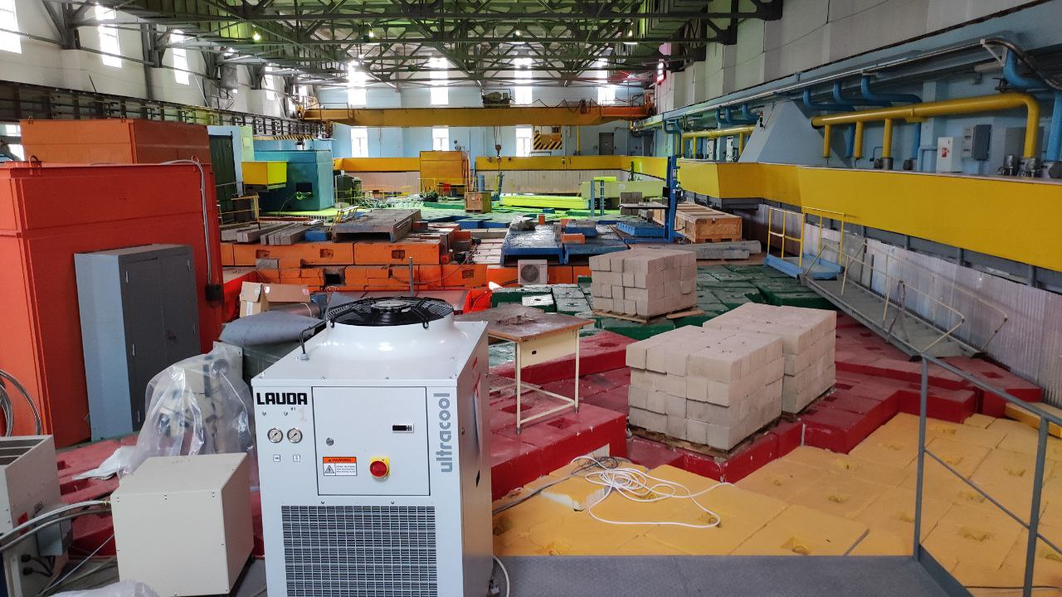
Neutron tomography at the IBR-2 reactor
8

Slide 9
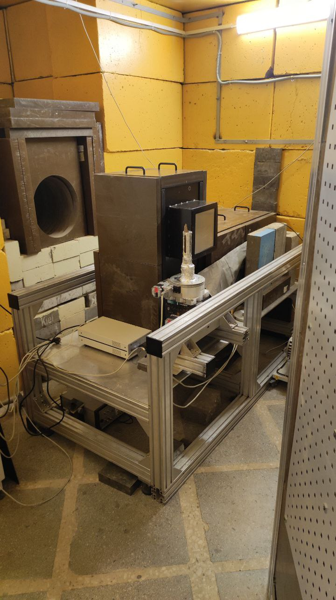
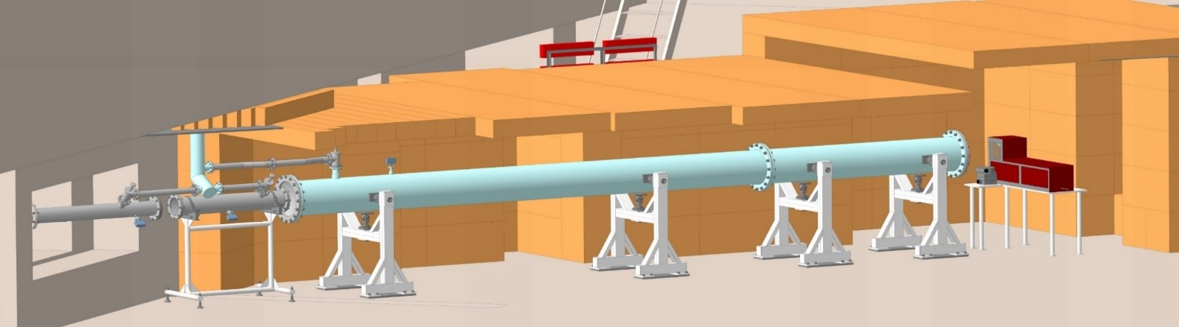
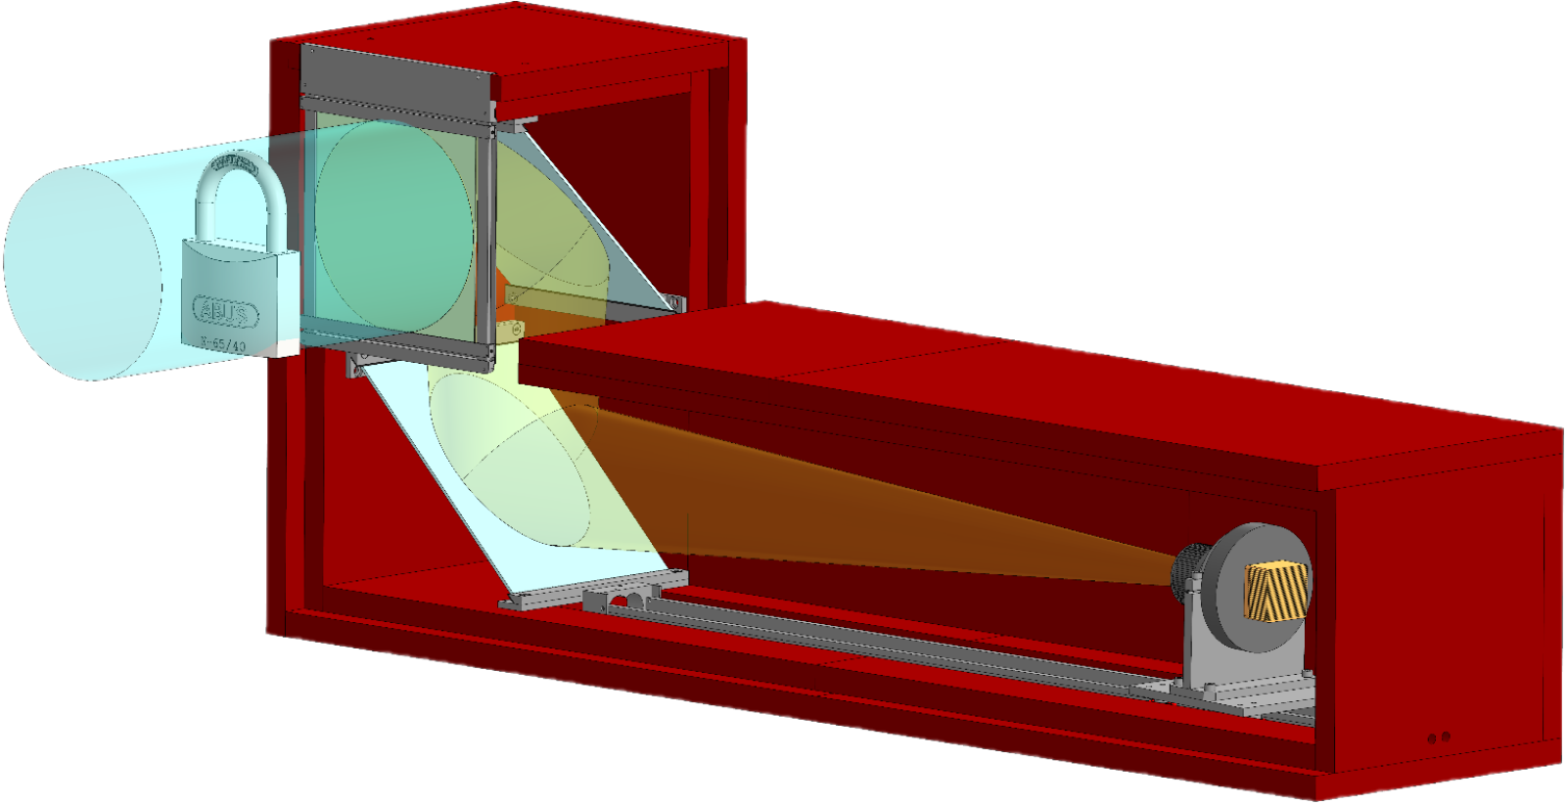
Neutron tomography at the IBR-2 reactor
Neutron beam flux ‒ 5.5×10⁶ n/cm²/s
L/D ratio ‒ 200-2000
Field of view ‒ 20x20 cm²
14th beamline
Neutron radiography and tomography (NRT) experimental station
9

Slide 10
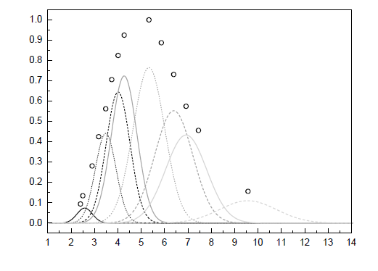
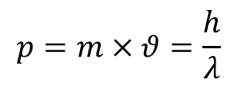
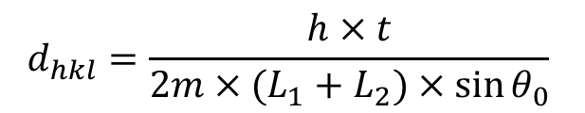

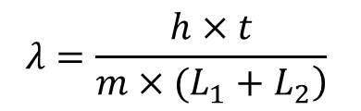
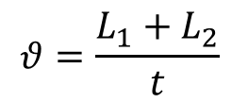
Time of flight method (TOF)
Neutron momentum (wave-particle behavior):
$$p=m×θ=\frac{h}{λ}$$
Velocity from experimental setup:
$$θ=\frac{L_{1}+L_{2}}{t}$$
Thus, the neutron wavelength is:
$$λ=\frac{h×t}{\left.m×(L_{1}+L_{2}\right)}$$
Bragg's law:
$$2×d_{hkl}×\sin{θ_{0}}=λ$$
1) Pulsed neutron source
2) Moderator
3) Flight path of the primary beam
4) Sample
5) Detector
6) Time analyzer
7) RW memory
Putting all the ratios together, we get:
$$d_{hkl}=\frac{h×t}{2m×(L_{1}+L_{2})×\sin{θ_{0}}}$$
10

Slide 11
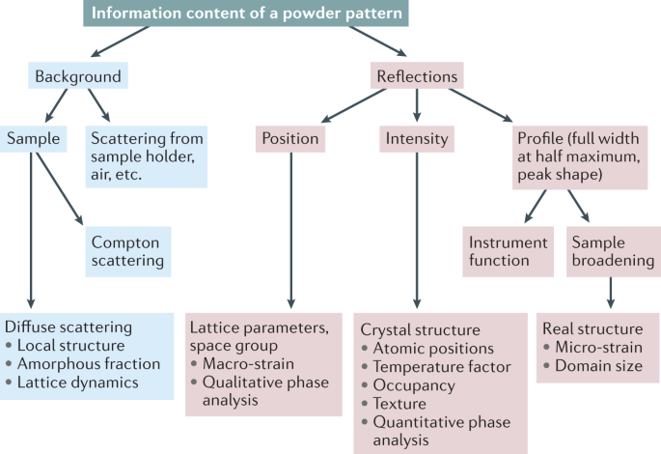
Rietveld refinement
The Rietveld method fits a calculated profile to experimental data.
It employs the non-linear least squares method.
11

Slide 12
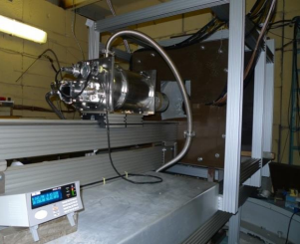
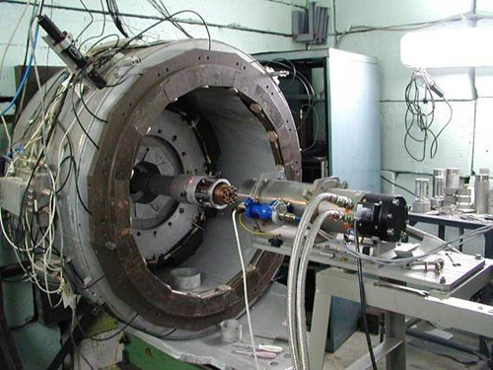
DN-6 and DN-12
DN-6
Parameters | DN-6 | DN-12
Neutron flux at sample position | ~3×10⁷ n/cm²/s | ~1.5×10⁶ n/cm²/s
Distance: Moderator-sample Sample-detector | 30.5 m 0.5 m | 26.0 m 0.4 m
Resolution Δd/d (d=2 Å) | 2θ=90°: 0.025 | 2θ=90°: 0.022
Exposition time per pressure point | 2-48 h | 12-36 h
Sample volume | 0.01-2 mm³ | 2 mm³
Pressure range | 50 Gpa (diamond anvils) 8 Gpa (sapphire anvils) | 8 Gpa (sapphire anvils)
DN-12

Slide 13
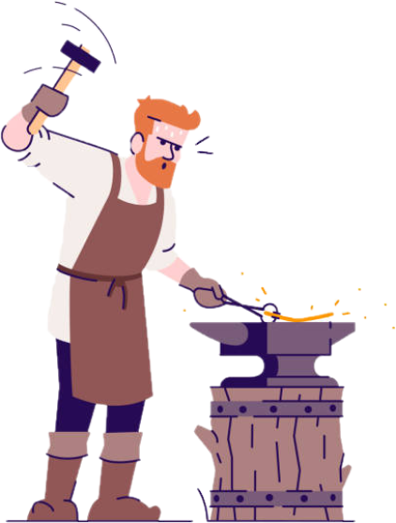
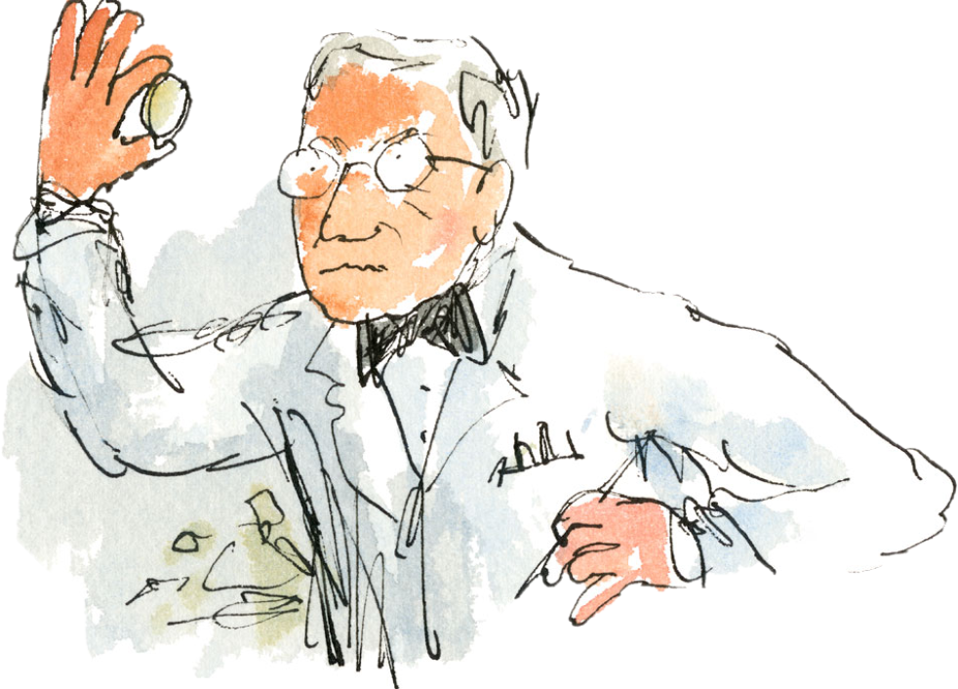

Cultural Heritage Studies
Production Technology
Restoration and Preservation
Economic Development
13

Slide 14
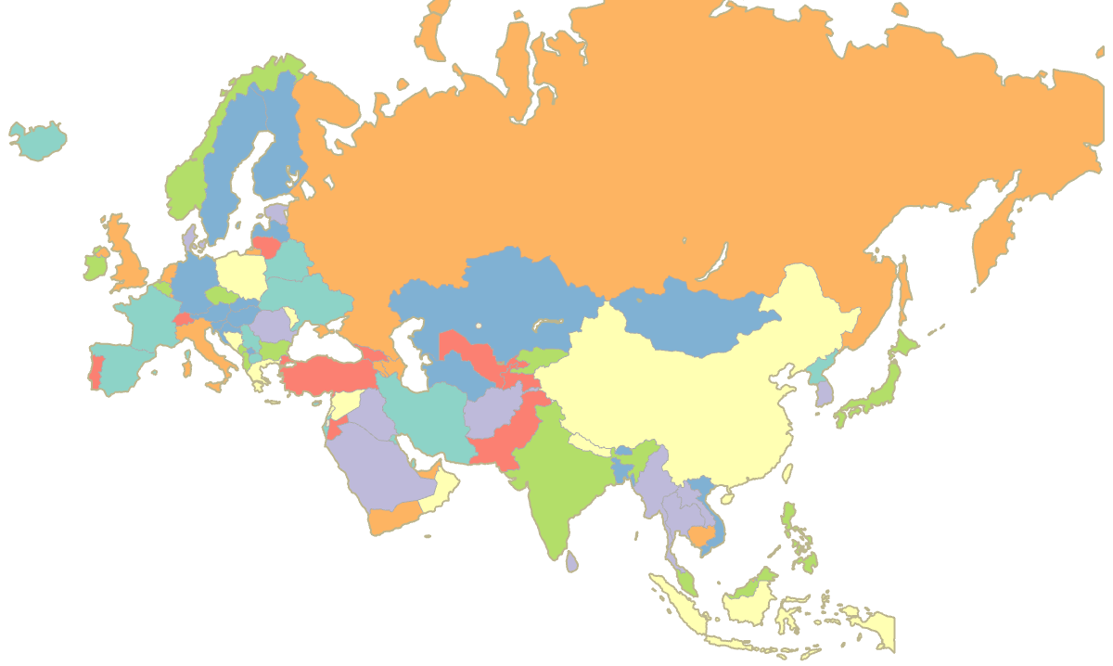
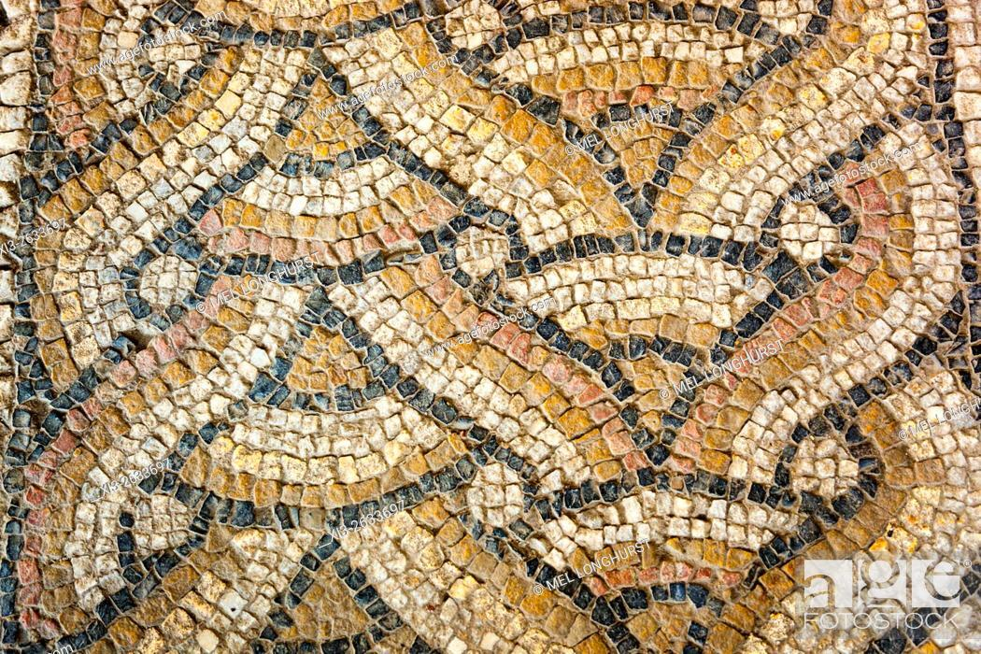
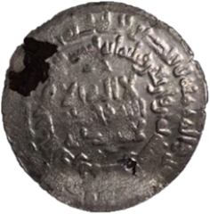
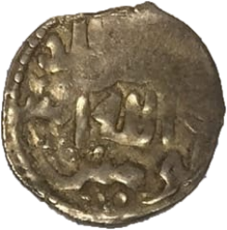
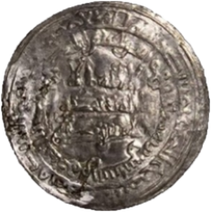
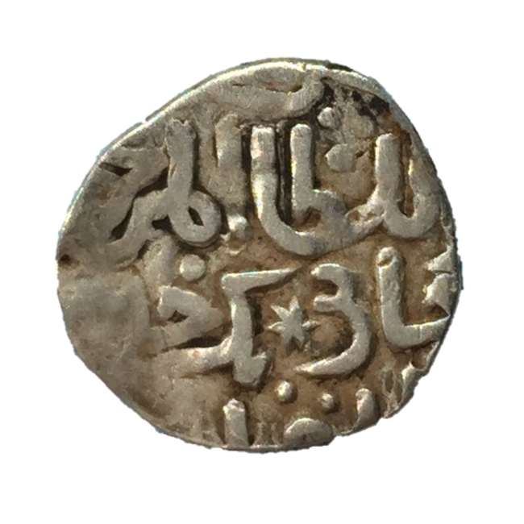
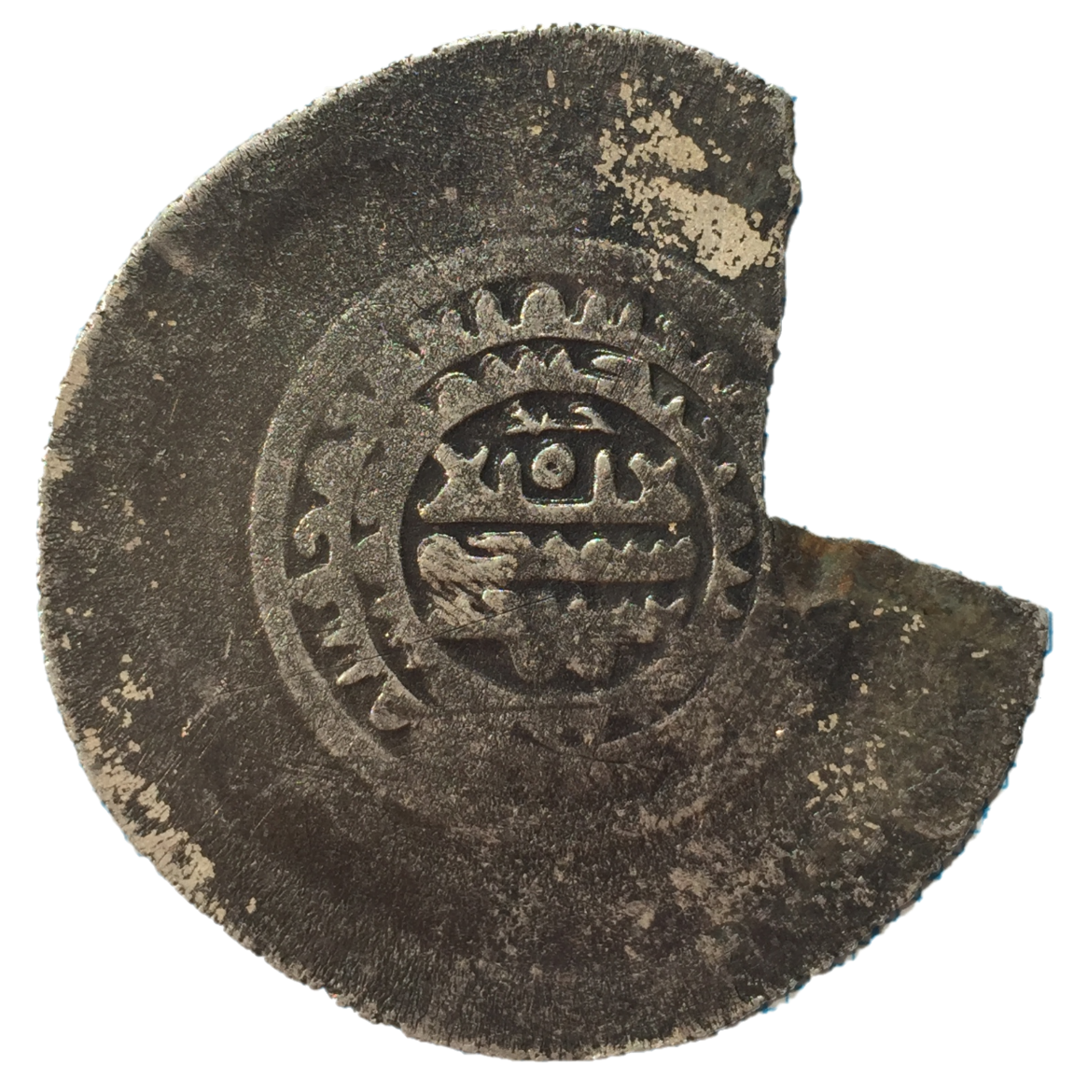
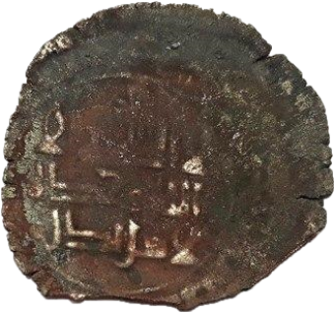
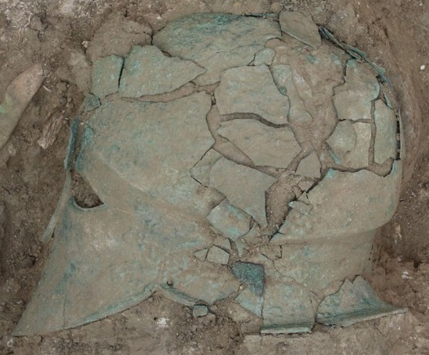
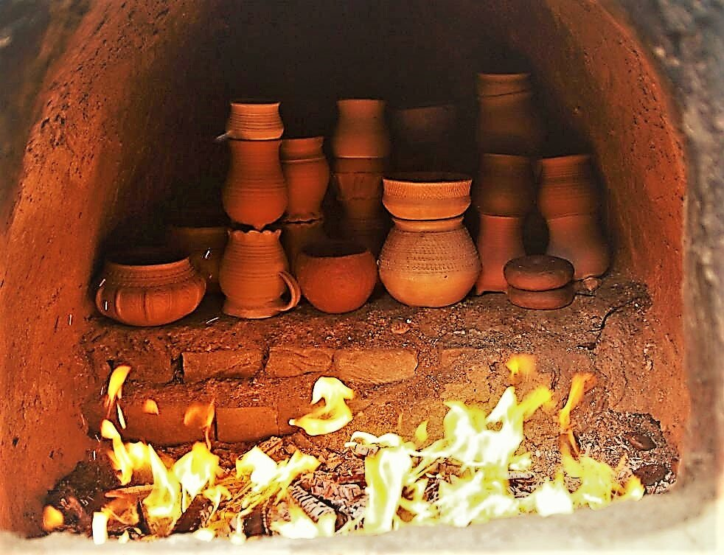
14

Slide 15
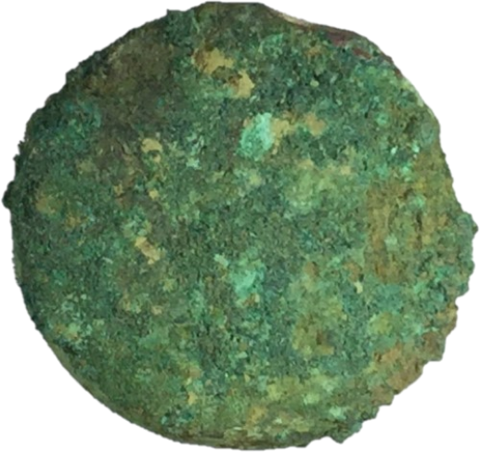
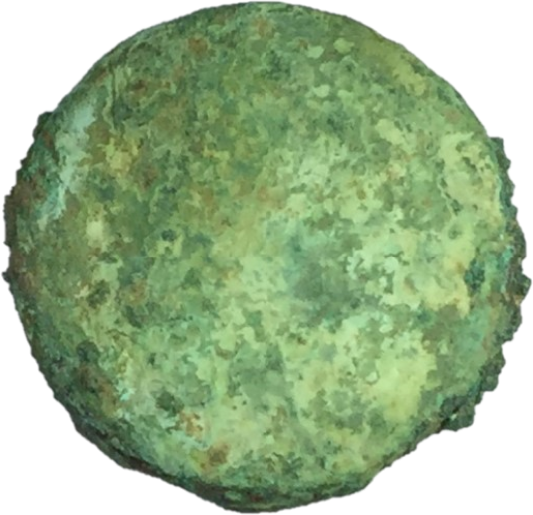
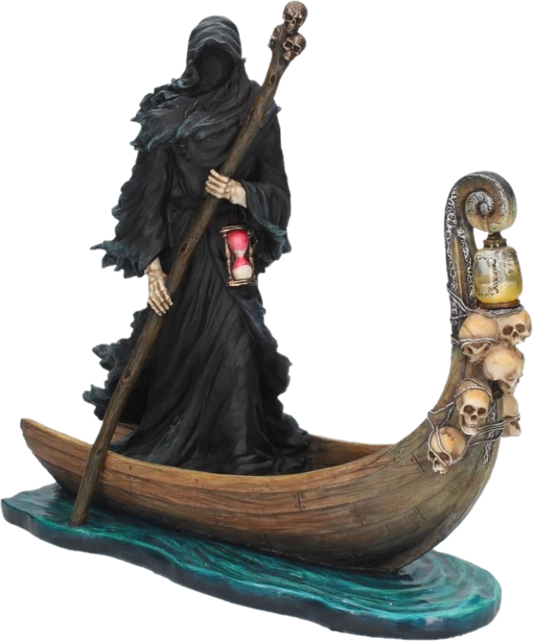
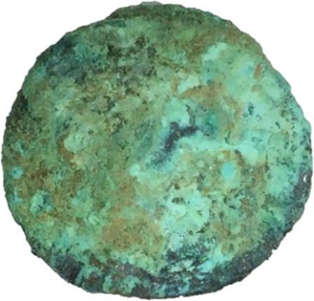
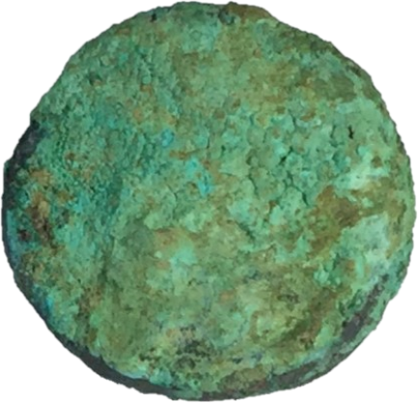
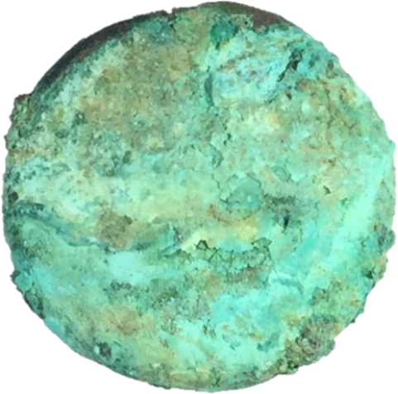














Antique Bronze Coins from the Necropolis Volna-1 in Krasnodar Region
1
2
3
4
5
6
7
8
‒ Necropolis Volna-1
20 mm
9
Photos of coins.
15

Slide 16




Neutron Diffraction Studies of Antique Copper Coins
Tin content in coins calculated from the bias of the unit cell parameters.
Neutron diffraction spectra of coins and pure copper.
16

Slide 17


Surface Reconstruction
Bakirov, B., Saprykina, I., Kichanov, S. et al. Phase Composition and Its Spatial Distribution in Antique Copper Coins: Neutron Tomography and Diffraction Studies. J. Imaging. 2021, 7, 129.
17

Slide 18


Roman mosaic (IV century AD)
in Constanta (Romania)

Slide 19






Roman mosaic
10 mm
Ion, R.M., Bakirov, B.A., Kichanov, S.E. et al. Non-Destructive and Micro-Invasive Techniques for Characterizing the Ancient Roman Mosaic Fragments. Appl. Sci. 2020, 10, 3781.
19

Slide 20





General view of the Bulgar hillfort

Slide 21



Coins of Volga Bulgaria
No copper phase
Copper content: ~10 %
Copper content: ~50 %
21

Slide 22



I don’t have enough silver!
Copper phase localization
Medieval king
22

Slide 23



Ancient pottery of Kazakhstan
Sample photos
23

Slide 24








Neutron tomography of pottery
Bronze Age
cm⁻¹
0.7
Iron Age
Medieval
Medieval
0.3
Iron Age
Bronze Age
Bakirov, B.A., Zhomartova A.Zh., Kichanov, S.E. et al. Non-Destructive Neutron Structural Studies of Ancient Ceramic Fragments of the Cultural Heritage of the Republic of Kazakhstan. J. Phys. Funct. Mater. 2022, 6(1), 56–70.
24

Slide 25




The required number of projections for reconstruction
Shepp-Logan phantom reconstructed from:
Shepp-Logan phantom – a standard test image
9 projections
72 projections
360 projections
The number of radiographic projections satisfying the Nyquist–Shannon theorem
25

Slide 26





Implementation of the convolutional neural network
Building blocks of the convolution neural network.
Input
Output
Convolution
Normalization
+
Activation
Skip Connection
Visualization of convolution and deconvolution layers.
Computations were held on the basis of the HybriLIT heterogeneous computing platform (LIT, JINR).
26

Slide 27





Implementation of the convolutional neural network
Training dataset
U-net
architecture
Data from 40 experiments
56000 input images
56000 target images
27

Slide 28




Determination of the required number of projections
– U-net trained on 36 projections
Structural similarity index measure (SSIM)
– U-net trained on 72 projections
– U-net trained on 144 projections
– unexpected number of projections is fed to the input of U-net trained on 72 projections
28

Slide 29





The results of training a CNN
360
projections
360
72
U-net
72
72
72 + U-net
difference
Bakirov B., Kichanov S. E., Kozlenko D. P. (2025). Convolutional neural networks for reconstruction of neutron tomography from incomplete data. Nuclear Instruments and Methods in Physics Research Section B: Beam Interactions with Materials and Atoms, 563, 165682.
29

Slide 30


30

