Slide 1
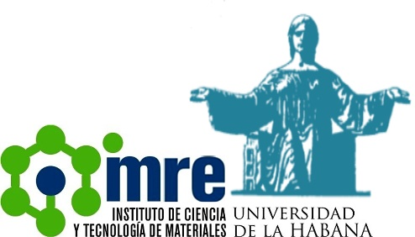
A study of the defect formation of CuO nanostructures under He⁺ ion irradiation
S. Fortuné Fábregas
silviafortune@jinr.ru
Photovoltaic Laboratory, Institute of Materials Science and Technology of the University of Havana (IMRE-UH), Vedado, 10 400 Plaza de La Revolución, Havana, Cuba.
Sector of Nuclear-Physical Materials Science and Ion-Implantation Nanotechnologies (SNPMSIIN), Frank Laboratory of Neutron Physics, (FLNP), Joint Institute for Nuclear Research (JINR), 141 980 Dubna, Moscow oblast, Russia.

Slide 2
Content
Introduction
CuO properties
Experimental technique
CuO nanostructures synthesis
CuO nanostructures irradiation
Results
CuO spin coating. SEM, Raman and XRD.
CuO irradiated. XRD, DBS and PALS.
Conclusions

Slide 3
1. Introduction. CuO properties.

Slide 4
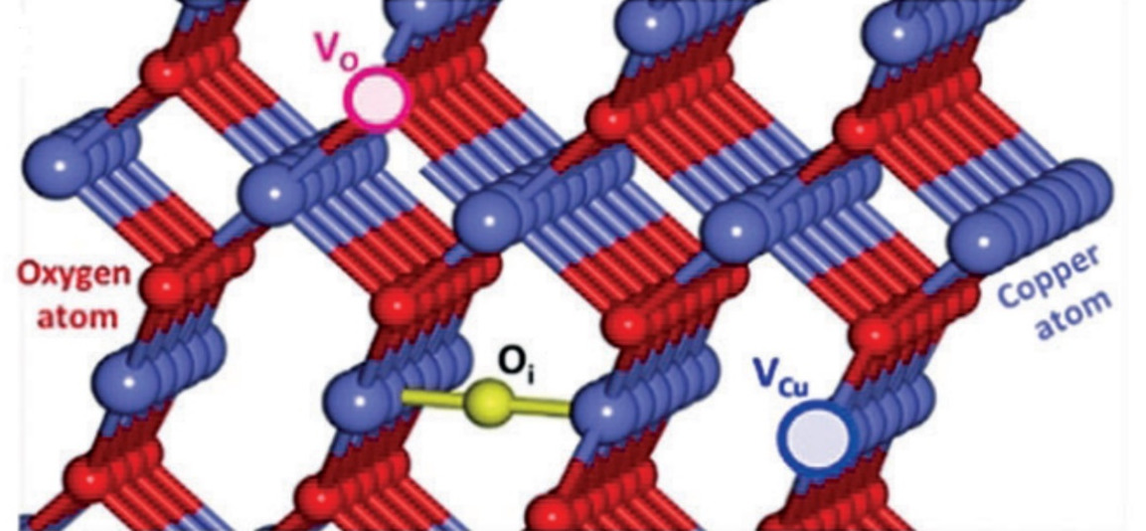
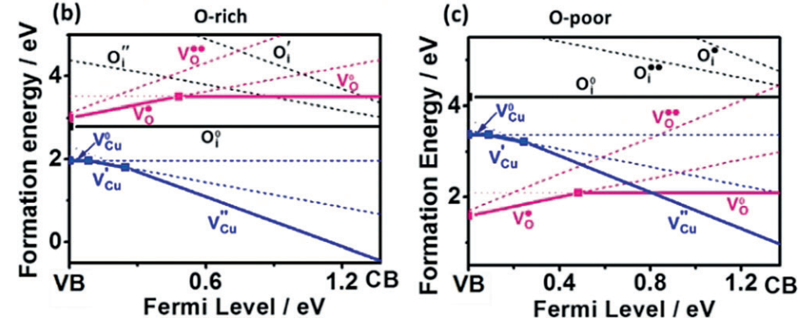
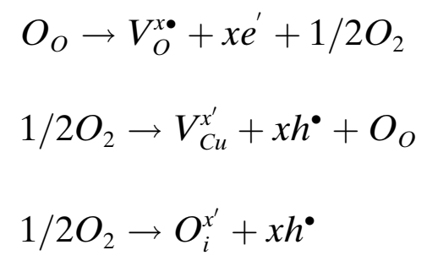
1. Introduction. CuO properties.
Properties:
Non-toxic and abundant in the Earth's crust.
Easy to obtain by low-cost techniques.
p-type semiconductor with a narrow bandgap of 1.2-2.16 eV.
Low hole mobility 0.1-10 $\frac{{cm}^{2}}{V∙s}$
Electronic conductivity 1.05·${10}^{−2}$ and 6.30 ·${10}^{−2}{\text{(Ω }∙\text{cm}\text{)}}^{− 1}$.
The dominant defects in CuO are the copper vacancies (V_{Cu}).
Types of defects in CuO
V_{O}
O_{i}
V_{Cu}
Defect reactions:
How to modify CuO properties?
thermal treatments,
doping,
nanocompounds,
irradiation.
[Wang, 2019]

Slide 5
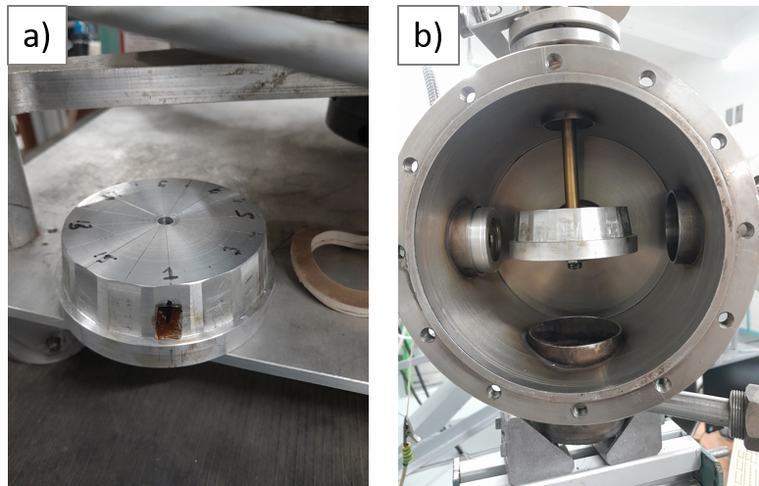
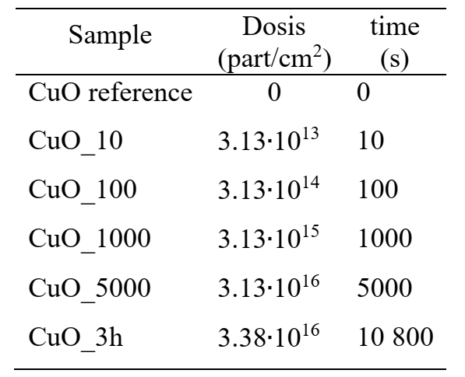
2. CuO nanostructures synthesis and irradiation
Sample holder and irradiation
CuO irradiated samples parameters

Slide 6
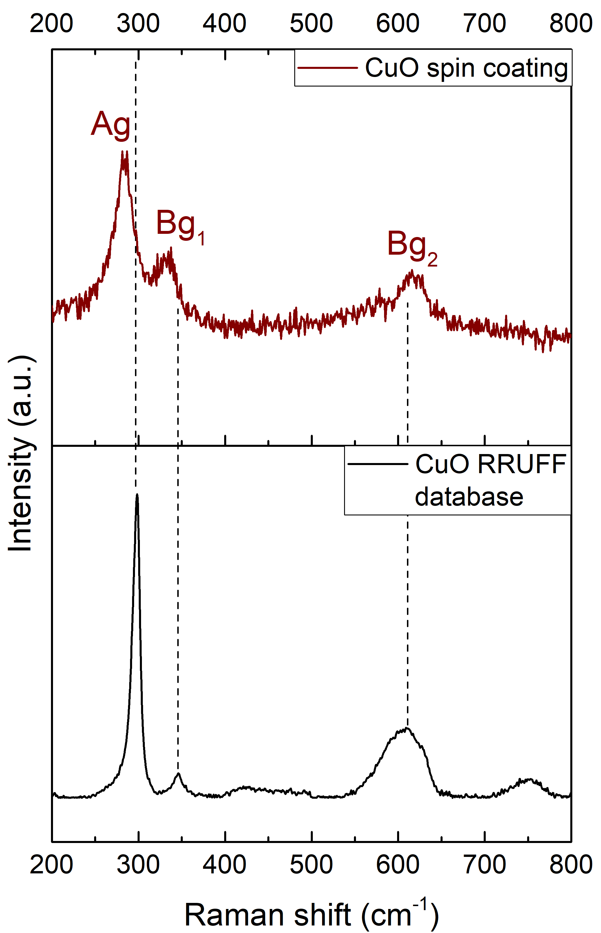
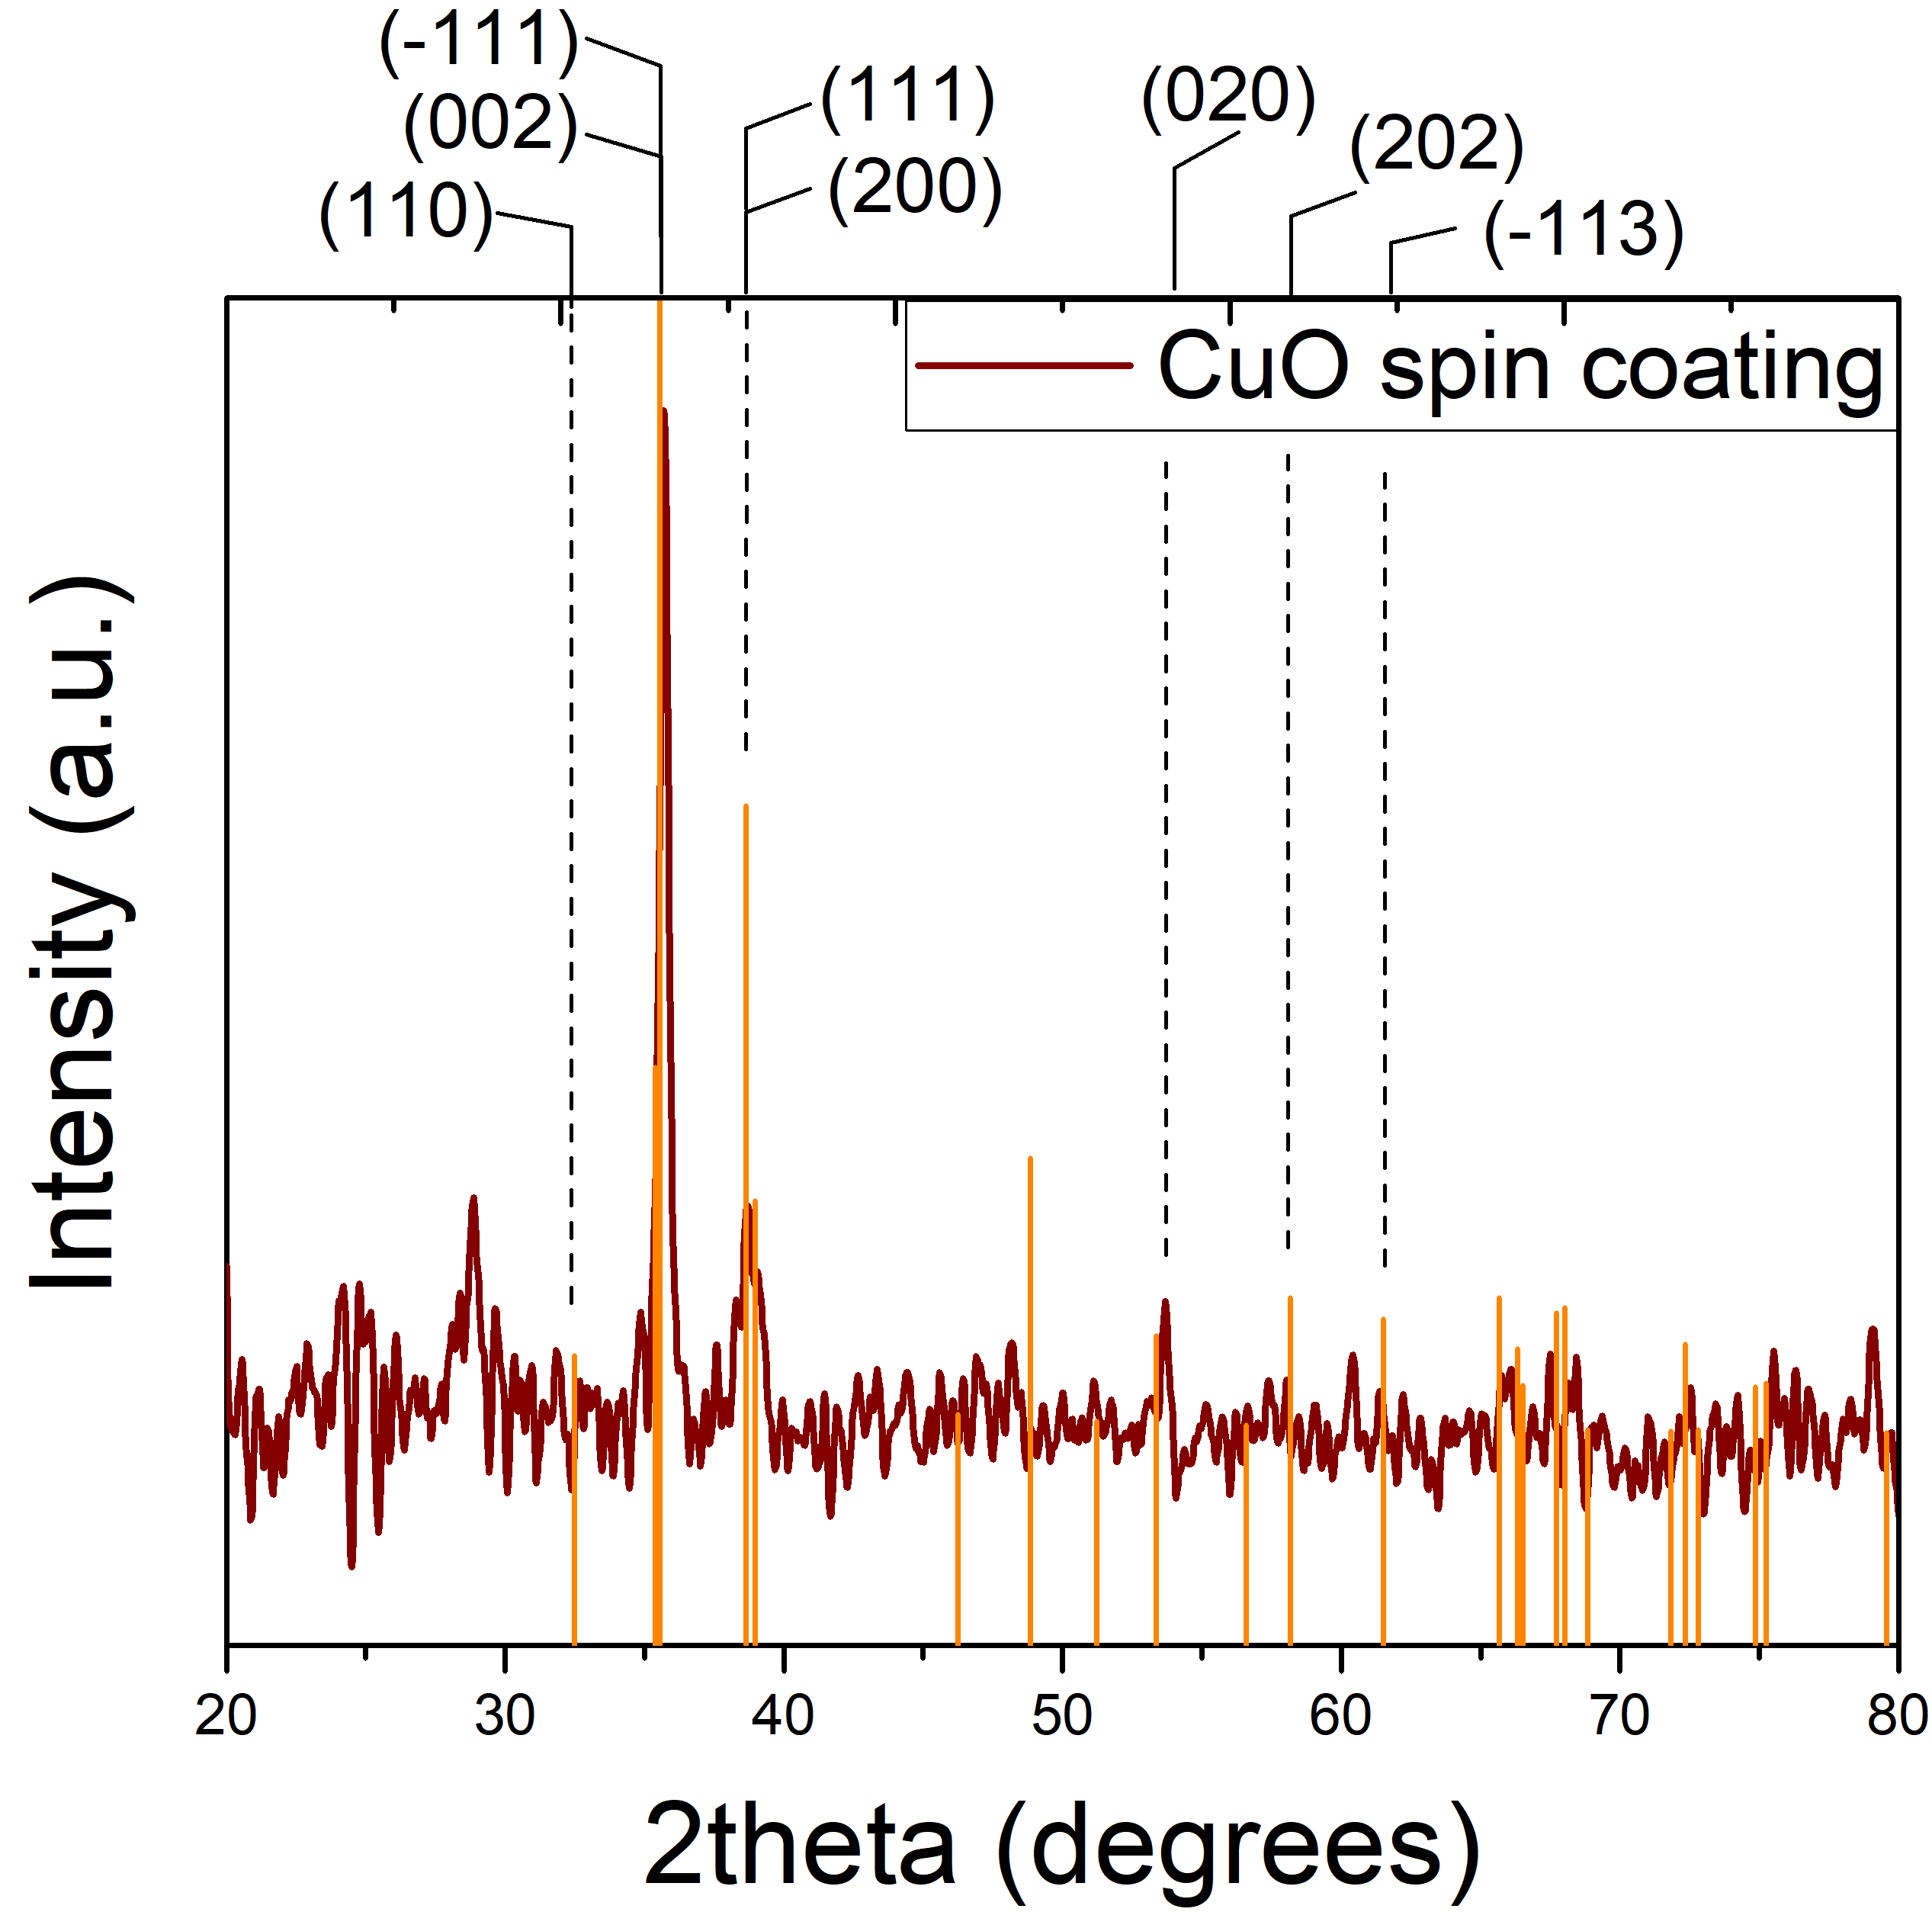
3.1. CuO nanostructures
Raman spectroscopy
XRD
SEM
CuO structures with elongated morphology.
CuO nanostructures diameter was calculated to be (64 ± 1) nm.
CuO nanostructures height was estimated to be about 430 nm.
Raman spectroscopy and XRD confirm the presence of CuO with a monoclinic structure in the samples.
The XRD pattern shows a preferential orientation in the direction [001].
Notes:
-Spin higher verticality
-Spin higher apparent porosity
-Spin higher crystalline quality

Slide 7
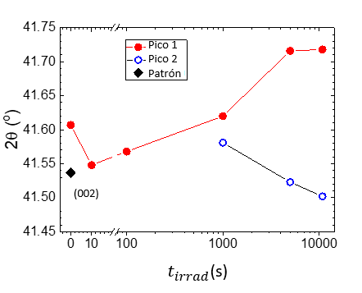
3.2.1. CuO irradiated nanostructures: XRD
XRD difractograms of the irradiated samples
Deconvoluted diffraction maxima (11-1)(002)
Crystallite size and strain
Increase in dosis produce bigger crystallites and more strain.
2theta decreses at ${\text{t}}_{irrad}$ <10 s dosis.
2theta increases at higher dosis.
Cristalline lattice under tensión.
2nd peak shift to low 2theta at higher dosis: cristal lattice locally tenses.
Notes:
2cita desciende a dosis correspondientes a ${\text{t}}_{irrad}$ <10 s hasta aproximarse al valor de patrón estándar.
A dosis elevadas la posición angular aumenta, esto sugiriendo la compresión de la red.
2cita desciende a dosis correspondientes a ${\text{t}}_{irrad}$ <10 s hasta aproximarse al valor de patrón estándar.
A dosis elevadas la posición angular aumenta, esto sugiriendo la compresión de la red.
El incremento de la irradiación produce el aumento del tamaño de cristalita.
La distribución de microtensiones aumenta

Slide 8
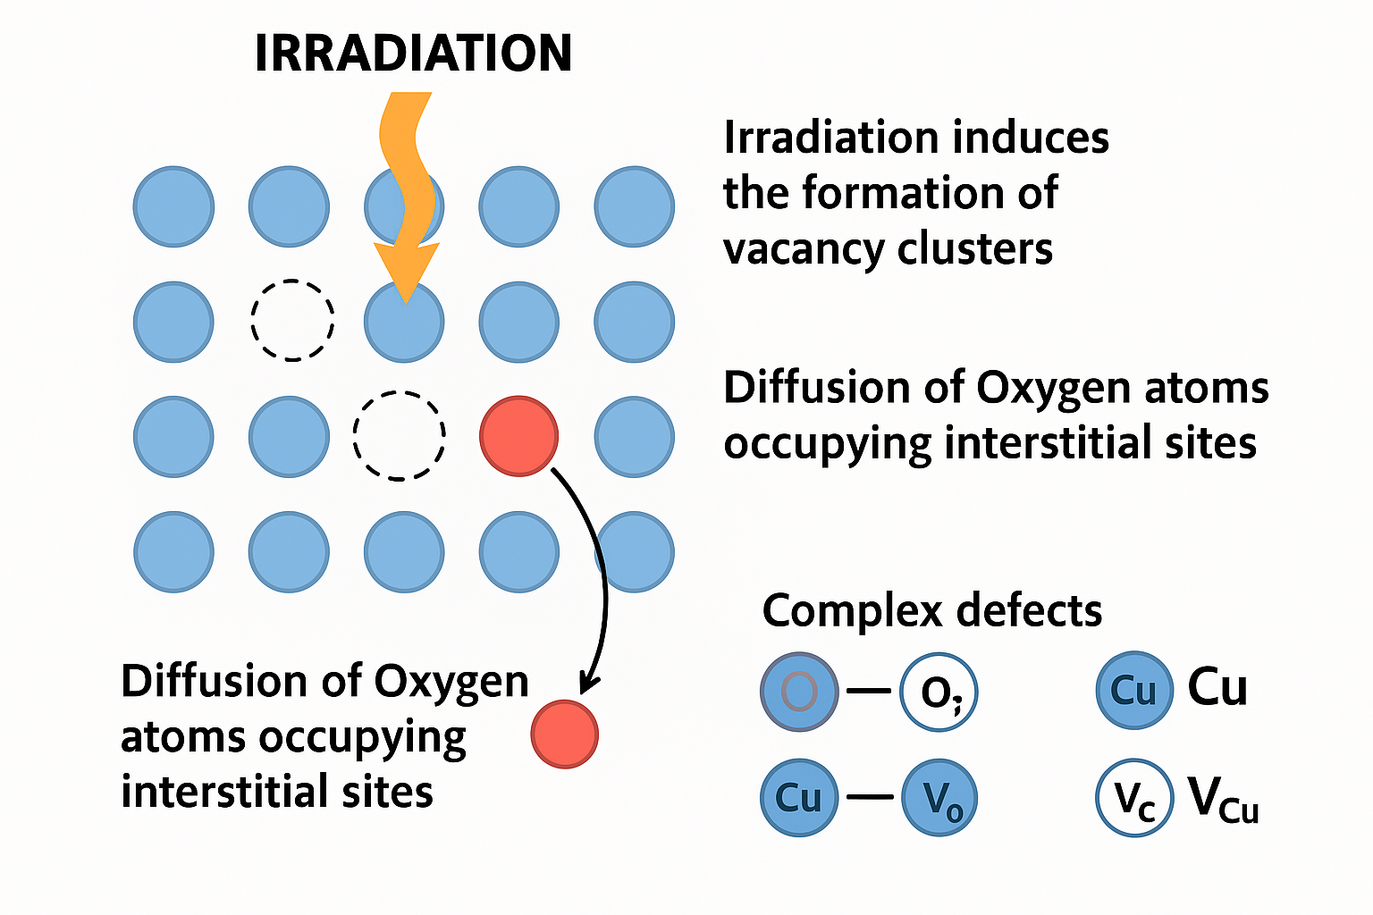
3.2.1. CuO Irradiated nanostructures: XRD
Influence of the irradiation in the lattice:
formation of vacancy clusters.
diffusion of Oxygen atoms from their original positions in the lattice, occupying interstitial sites (O_{i}).
complex defects such as Cu-$V_{O}$ or Cu${−V}_{Cu}$.
Notes:
Irradiation induces the formation of vacancy clusters.
Under the thermal environment of irradiation, the diffusion of Oxygen atoms from their original positions in the lattice is stimulated, occupying interstitial sites (Oi).
Irradiation also produce complex defects such as Cu-$V_{O}$ or Cu${−V}_{Cu}$.

Slide 9
3.2.2. CuO Irradiated nanostructures: DBS
S and W parameters
The increase in S parameter indicates that the number of monovacancies ($V_{Cu}$, $V_{O}$), in the material increases.
Low doses: defects are generated by irradiation.
High doses: punctual defects form clusters.
Competition between:
Irradiation and the CuO lattice recovery.
Notes:
A bajas dosis los defectos se generan por la irradiación.
El incremento de S indica que aumenta el número de monovacancias ($V_{Cu}$, $V_{O}$), en el material.
A dosis elevadas los defectos puntuales forman clústeres.

Slide 10
3.2.2. CuO Irradiated nanostructures: DBS
Correlation between S and W
The inequality between regions 1 and 2 is due to the considerable difference between their slopes (trapping fractions).

Slide 11
3.2.3. CuO Irradiated nanostructures: PALS
CuO positron lifetimes
Intensities
Average and bulk lifetimes
These lifetimes correspond to $V_{Cu}$.
At higher ${\text{t}}_{\text{irrad}}$ $τ$ decreases until 0.205 ns.
${\text{τ}}_{\text{2}}≥$ 0.893 ns are correlated with vacancy clusters present on the surfaces of the nanostructures.
${\text{I}}_{\text{1}}$ → 90-91.7 %: $V_{Cu}$ predominant defect.
${\text{I}}_{\text{1}}$ shows similar behavior to ${\text{τ}}_{\text{1}}$, except in CuO 3h. This indicates that the defect concentration does not increase.
defects associated to ${\text{I}}_{\text{2}}$ large in size but low in concentration.
${\text{τ}}_{\text{ave}}$ and ${\text{τ}}_{\text{bulk}}$ exhibit a similar behavior to ${\text{τ}}_{\text{1}}$y ${\text{τ}}_{\text{2}}$.
${\text{τ}}_{\text{ave}}$ and ${\text{τ}}_{\text{bulk}}$ decreases about a 35% at higher dosis due to a decrease of superficial and bulk vacancies.

Slide 12
3.2.3. CuO Irradiated nanostructures: PAS
Influence of the irradiation in the lattice:
Increase of monovacancies ($V_{Cu}$, $V_{O}$), with the dosis.
Formation of punctual defect clusters.
$V_{Cu}$ predominant defect.
Higher dosis: decrease of superficial and bulk vacancies.
CuO nanostructures conductivity increase!!

Slide 13
4. Conclusions
This work exposed the results of the structural and morphological analysis and the evolution of defects in irradiated copper (II) oxide nanostructures. For this purpose, CuO was subjected to helium ion irradiation treatment. This process led to novel results regarding the influence of irradiation on CuO nanostructures. Specifically, concerning to structural variations, since the irradiated samples show novel results because the defects induced by irradiation compete with the recovery of the crystal lattice. Besides, this irradiation produce a large amount of $V_{Cu}$ the type of defect that is predominant and produce holes, increasing the CuO conductivity. This improvement contributes to produce better CuO nanostructured layers for optoelectronics applications.

Slide 14
A study of the defect formation of CuO nanostructures under He+ ion irradiation
S. Fortuné Fábregas
silviafortune@jinr.ru
Photovoltaic Laboratory, Institute of Materials Science and Technology of the University of Havana (IMRE-UH), Vedado, 10 400 Plaza de La Revolución, Havana, Cuba.
Sector of Nuclear-Physical Materials Science and Ion-Implantation Nanotechnologies (SNPMSIIN), Frank Laboratory of Neutron Physics, (FLNP), Joint Institute for Nuclear Research (JINR), 141 980 Dubna, Moscow oblast, Russia.

Slide 15
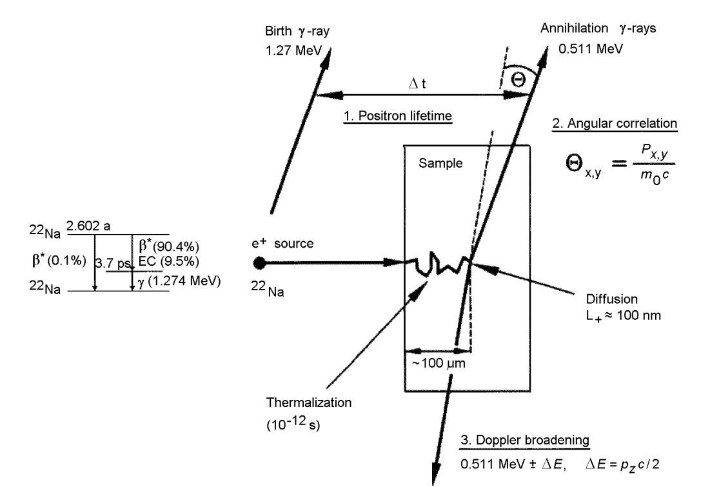
Principio de detección de defectos en PAS
Esquema de los procesos posteriores a la implantación del e+
Bases de PAS
[Chiari y Fujinami, 2019 and Zhu 2007]
Notes:
The detection of defects by positrons is based on the fact that positrons may be trapped by lattice defects [52]. This is because a positron is strongly repelled by ion cores in the lattice as a result of their positive charge; thus, the absence of a positive charge in a vacancy provides an attractive potential that traps positrons at this site.
Because of the repulsive force exerted by the positive nuclei, the positron occupies the interstitial regions in the lattice, which is the reason behind its long diffusion length (more than 100 nm)

Slide 16
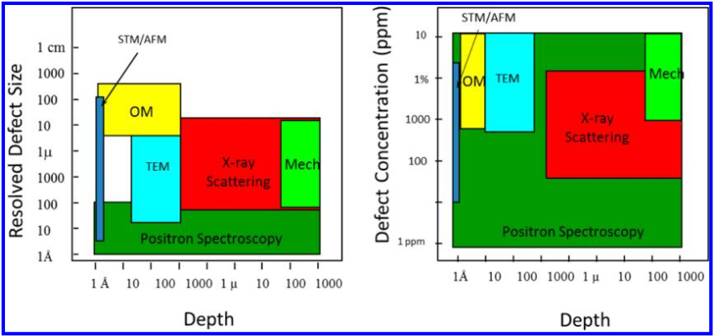
PAS advantages
It is the only technique that can identify vacancies of atomic dimensions and provides information about:
size,
structure and
concentration (${10}^{−7}$).
not destructive,
not sensitive to lattice parameter variations,
does not measure the effect that defects produce on the properties of materials and
higher resolution than TEM.
TEM: transmission electron microscopy, STM: scanning tunneling microscopy, AFM: atomic force microscopy, OM: optical microscopy, Mech: mechanical method
[Jean, 2013]

Slide 17
5. Introduction to PAS. Positron. History
2 quanta $γ$ emission
1928: Dirac predicts the positron.
1932: Anderson discovers the positron in a cloud chamber.
1940: PAS is used to study:
Fermi surface in metals and semiconductors.
Electron density functions.
1960: positron trapping is discovered.
Applications:
Astrophysics
Particle physics
Biomedicine
Materials Science
[Eldrup, 1995]

Slide 18
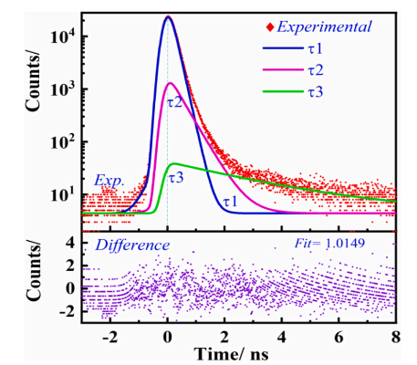
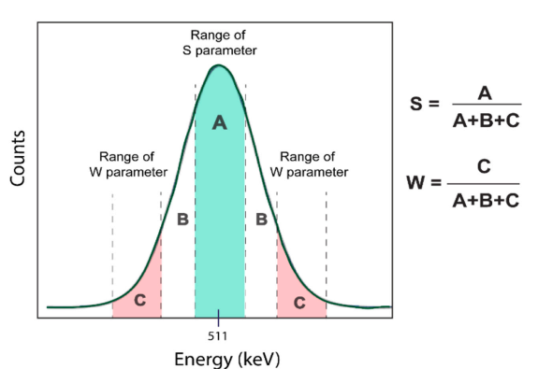
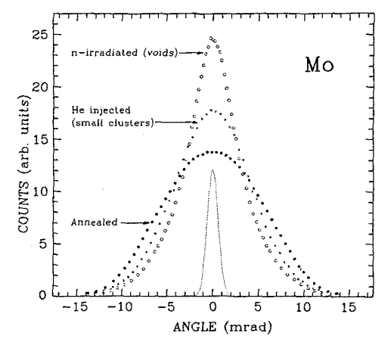
Types of PAS
Positron Annihilation Lifetime Spectroscopy
(PALS)
Doppler Broadening Spectroscopy (DBS)
Angular Correlation of Annihilation Spectroscopy
(ACAR)
ΔE (Doppler shift)
$∆E=\frac{cp_{z}}{2}$ , 511 eV
ΔΘ
$\text{Δ}{\text{Θ}}_{x,y}=\frac{p_{x,y}}{mc}$ , 511 eV
[Eldrup, 1995]
[Selim, 2021]
[Selim, 2021]
Softwares: PAFIT [Olsen] y LT [Kansy]
Software: SP [Dryzek]
Notes:
These photons carry distinctive information about the electron density and states at the annihilation site. Measurement of the time, energy, and angular spectra of the annihilation radiation allow us to extract this information, and has been developed into three independent techniques
Se usan desde 1940

Slide 19
Tipos de Espectroscopía de aniquilación positrónica (PAS)
Tipos de PAS
Positron Annihilation Lifetime Spectroscopy
(PALS)
Doppler broadening spectroscopy (DBS)
Angular correlation of annihilation radiation (ACAR)
ΔE (Doppler shift)
$∆E=\frac{cp_{z}}{2}$ , 511 keV
ΔΘ
$\text{Δ}{\text{Θ}}_{x,y}=\frac{p_{x,y}}{mc}$ , 511 keV
Each type of defect has a characteristic positron lifetime.
Information about the size and structure of the defect.
Doesn´t provide information about the size of the defects.
Qualitative information on changes about defect types based on the S-W correlation.
Information about the electronic structure.
More detailed information than PALS.
More complex processing.
[Eldrup, 1995 y Selim, 2021]
Notes:
These photons carry distinctive information about the electron density and states at the annihilation site. Measurement of the time, energy, and angular spectra of the annihilation radiation allow us to extract this information, and has been developed into three independent techniques
Se usan desde 1940

Slide 20
Materials and methods. Equipment
Characterization technique | Equipment | Institution | Country
SEM | Tescan Vega | IMRE | Cuba
Raman | Horiba Jobin-Yvon LabRAM, Horiba (iHR320) | IJL,INRS | France, Canada
XRD | Diffractometer PANanalytical EMPYREAN Co K_α1=1.78892 nm | JINR | Russia
FTIR | Bruker Tensor 27 | IMRE | Cuba
RBS, Irradiación | Van der Graaff accelerator | JINR | Russia
Positron annihilation (PAS) |  | JINR | Russia

Slide 21
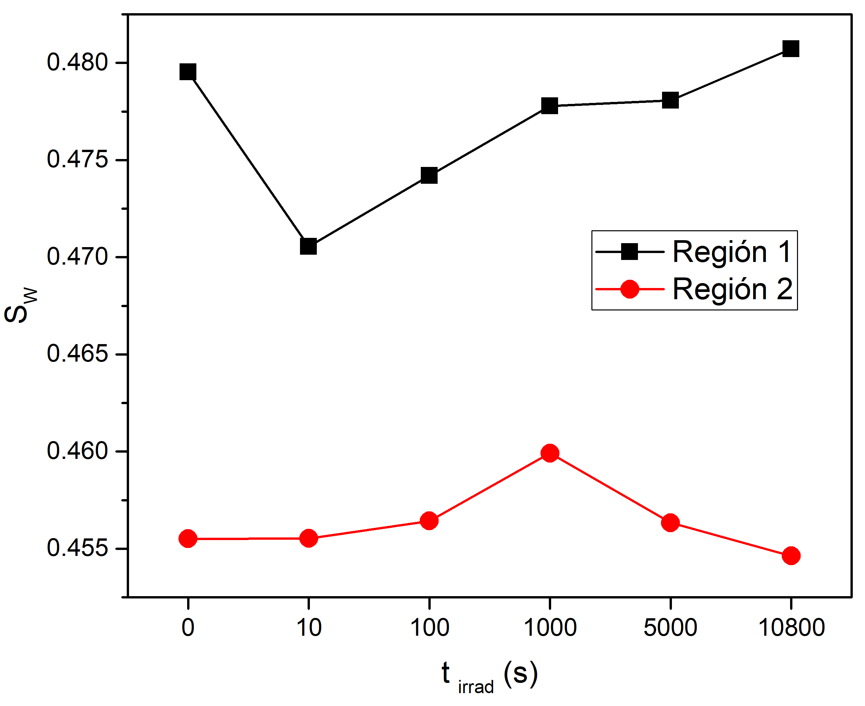
CuO Irradiated nanostructures: DBS
Region 1
Region 2
Parámetro S y ${\text{t}}_{\text{irrad}}$
En la Región 1 la concentración de las monovacancias aumenta continuamente.
En la Región 2, S solo disminuye luego de 1000s sugiriendo la reducción por los que las dimensiones de los clústeres de defectos complejos y la recuperación de la red.
Los clústeres de monovacancias se disocian formando defectos complejos Cu$−V_{O}^{+}$ o Cu$−V_{Cu}^{−}$.
Inicialmente se forman muchas monovancias, las cuales se aglomeran y luego forman clústeres.

Slide 22
6. Referencias bibliográficas

