Slide 1
ALUSHTA-2025
JINR Association of Young Scientists and Specialists Conference
06 - 2025
Small Size Alternative Fast Neutron Detector
based on Helium-4 gas Using PHITS Monte Carlo Simulation
Hai C. V. ^{1, 2} , Nga C. T. B. ²
¹ Joint Institute for Nuclear Research, Russia
² Faculty of Nuclear Engineering, Da Lat University, Vietnam
Speaker: Cao Van Hai
Position: Engineer
Laboratory: Frank Laboratory of Nuclear Physics
Alushta - June, 09th 2025
Notes:
Good morning, everyone. My name is [Cao Van Hai]. I come from Laboratory of Nuclear Physics
Today, I will present Small Size Alternative Fast Neutron Detector
based on Helium-4 gas Using PHITS Monte Carlo Simulation

Slide 2
Frank
Laboratory of
Neutron Physics
JINR Association of Young Scientists and Specialists Conference
06 - 2025
1. Introduction
Traditional methods usually use the moderator for fast neutrons to thermal energies, then they absorbed in Helium-3 detectors
Moderator
Helium-3 detector
By this way brings some limitations: limited supplier, limited reserves, high cost
Alushta - June, 09th 2025

Slide 3
Frank
Laboratory of
Neutron Physics
JINR Association of Young Scientists and Specialists Conference
06 - 2025
1. Introduction
Another cheaper, larger reserves gas is proposed is Helium - 4
It will ionize and excite near gas atoms, producing scintillation light in the VUV region, 80 nm ~ 16 eV - about 15 000 photons per Mev.
He’
n
He
recoil nucleus
High gamma rejection efficiency, fast scintillation
Elastic scattering
n’
Alushta - June, 09th 2025
Notes:
Fast neutrons interact with He-4 nuclei via elastic scattering (n+4He→n′+4He∗).The recoil nucleus ionizes and excites surrounding gas atoms, producing scintillation light in the VUV region, 80 nm ~ 16 eV - around 15 000 photons per Mev.

Slide 4
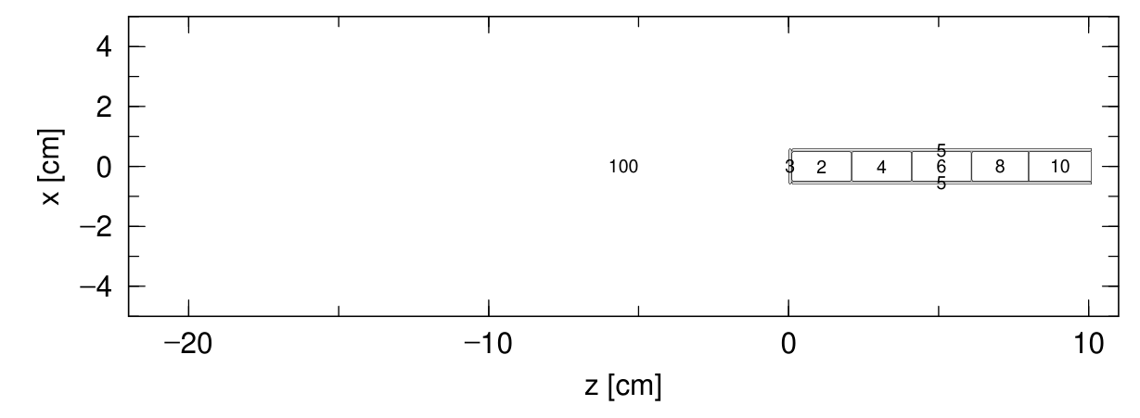
Frank
Laboratory of
Neutron Physics
JINR Association of Young Scientists and Specialists Conference
06 - 2025
2. Description of detector in PHITS
Table 1: Description parameters
Inside Diameter | 1 cm
Outside Diameter | 1.2 cm
Length of sensitive volume | 10 cm
Window thickness | 1 mm
Material | 6061 (T6) Aluminum alloy
Gas - filled | Helium-4
Pressure | 20 – 50 – 80 atm
Table 2: 6061 (T6) parameters
Aluminum | 98.15 %
Magnesium | 0.9 %
Silicon | 0.6 %
Copper | 0.25 %
Chromium | 0.1 %
Alushta - June, 09th 2025

Slide 5
JINR Association of Young Scientists and Specialists Conference
06 - 2025
Frank
Laboratory of
Neutron Physics
3. Result
20 atm
50 atm
80 atm
Fig. 1 Pressure dependence on efficient detection
Alushta - June, 09th 2025
Notes:
The results show that the higher the tube pressure, the greater the interaction efficiency of neutrons with the detector, proportional to the density of helium-4.

Slide 6
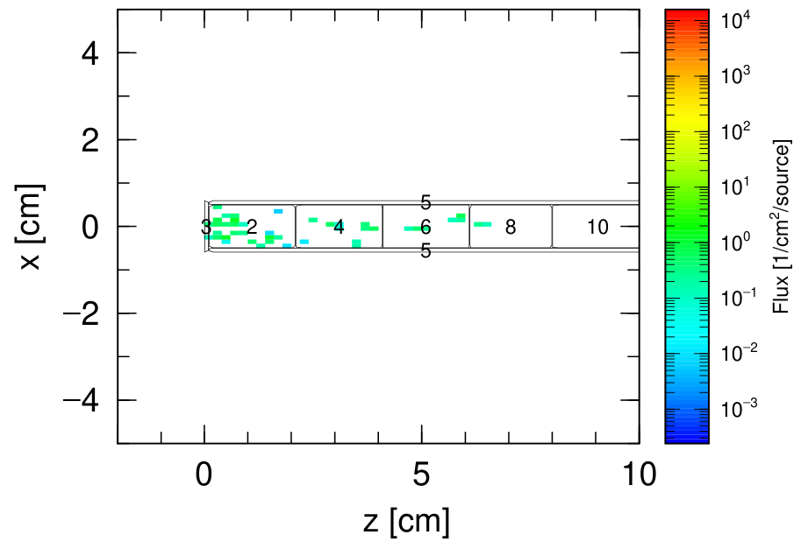
JINR Association of Young Scientists and Specialists Conference
06 - 2025
Frank
Laboratory of
Neutron Physics
3. Result
Fig. 3 The interaction of neutron in detector
Fig. 2 Detector response sensitive length
Alushta - June, 09th 2025

Slide 7
JINR Association of Young Scientists and Specialists Conference
06 - 2025
Frank
Laboratory of
Neutron Physics
4. Expand the issue to consider
Wavelength Shifter: Nitrogen, Sodium Salisylic
How to light collected?
DETECTOR
PMT
High gain, Fast response time, large sensitive area.
Big size, high voltage, magnetic sensitive, expensive, high power,….
SiPM
Compact size, low operating voltage, insensitive magnetic fields low power, cheap.
Dark current, temperature sensitive,
Photosensor
Alushta - June, 09th 2025

Slide 8
Frank
Laboratory of
Neutron Physics
JINR Association of Young Scientists and Specialists Conference
06 - 2025
Thank you for your attention!
Alushta - June, 09th 2025

