Slide 1
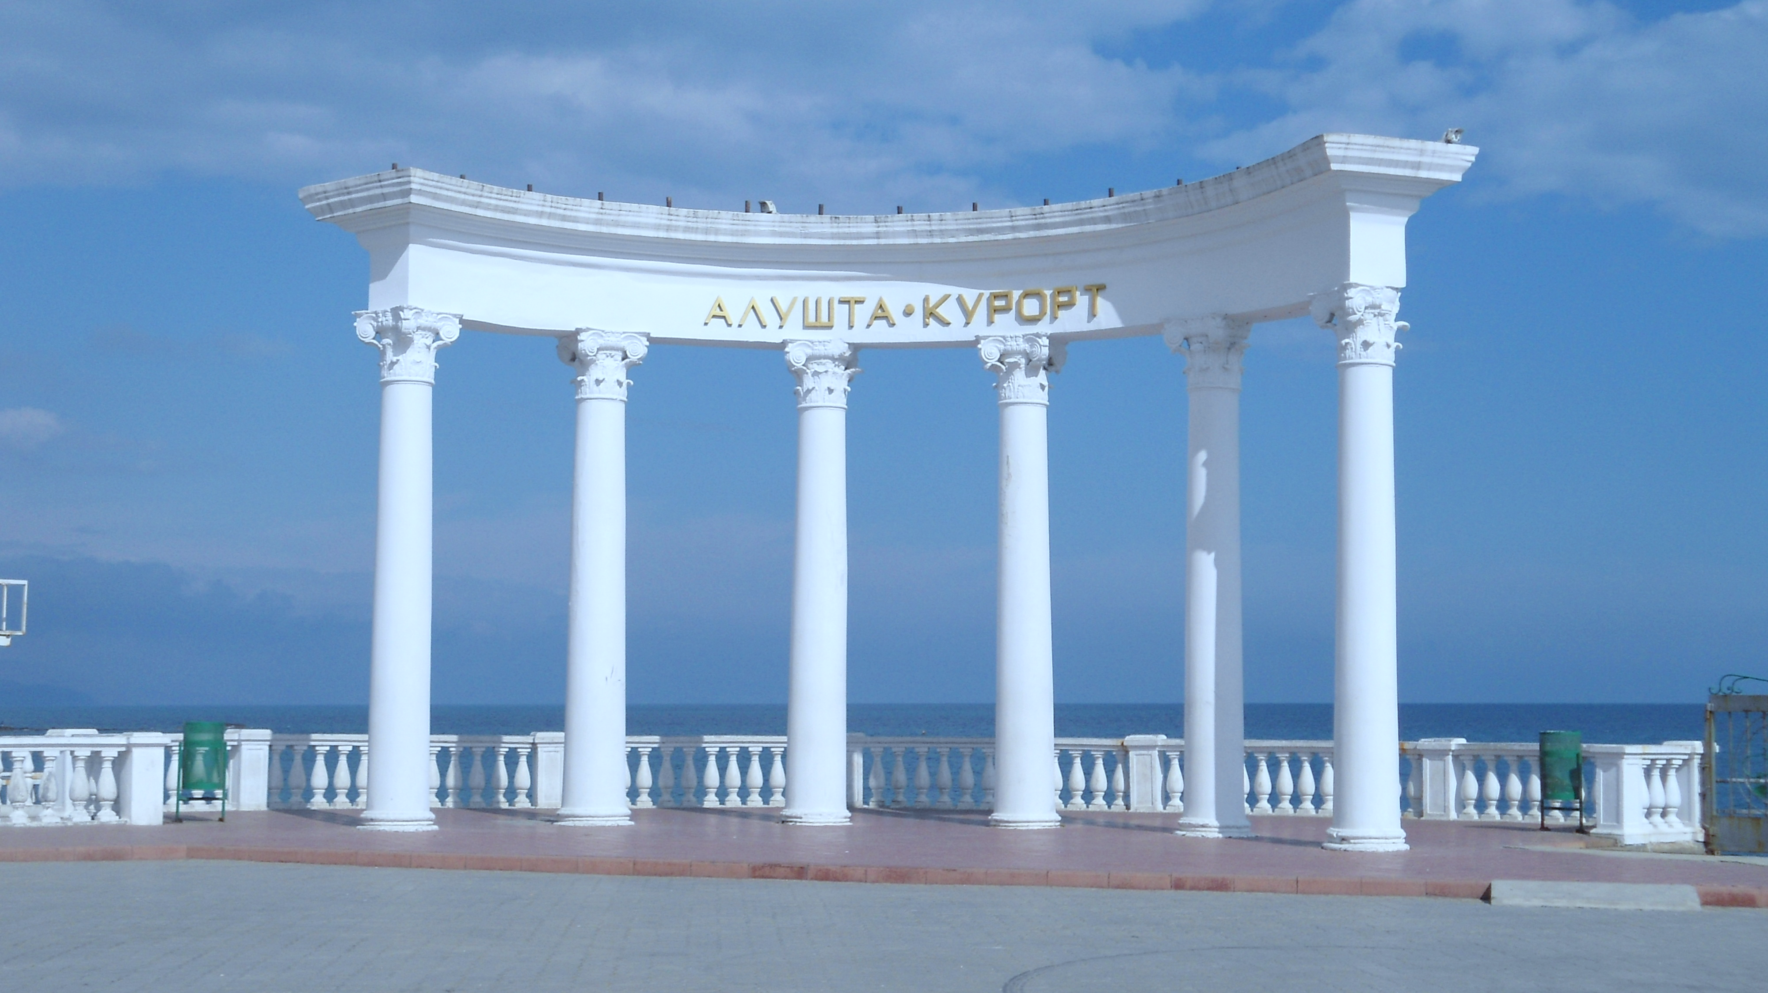
Power feedback model of the IBR-2M reactor
JINR Association of Young Scientists and Specialists Conference "Alushta-2025"
M.M. Podlesnyy*, E.P. Shabalin, I.V. Kushnir, Y.A. Vdovin, A.E. Verhoglyadov
Joint institute for Nuclear Research, Dubna, Russian Federation
*e-mail: podlesny@phystech.edu
June 8-15, 2025

Slide 2
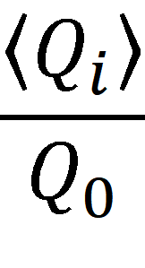
Pulse reactor dynamics modeling
ρ_{out}
Reactivity disturbance
Block of kinetics
Settings
ρ_{ac}
Q_{i}(t)
Automatic controller
Q_{i}
Boundary conditions
ρ_{tr}
Thermal elasticity
ρ_{ax}
Method
Thermal expansion
ρ_{pfb}
ρ_{na}
k_{i}, t_{i}
Coolant
Power feedback

Slide 3
“The physical nature of self-oscillations of pulse reactors has not been sufficiently studied, but there are some experimental data. For example, despite the differences, there are some common patterns in the manifestations of self-oscillations of both reactors (IBR-2 and IBR-2M).”
JINR Preprint P13-2021-11

Slide 4
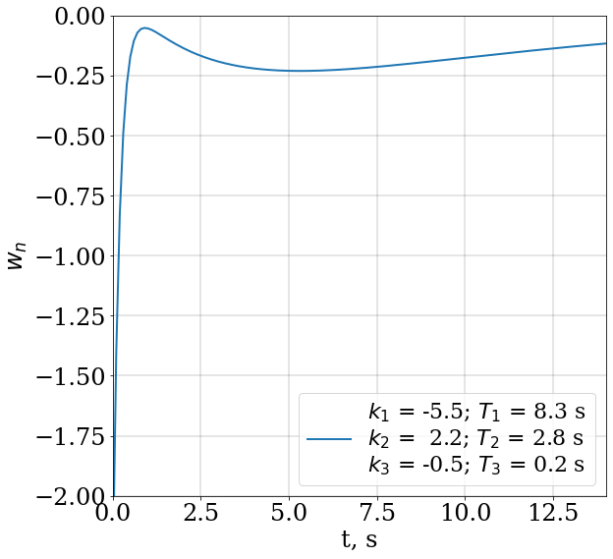
Presence of a positive component in reactivity
The Power feedback $w\left(t\right)$ ^{[1]}
$$w\left(t\right)=\sum_{i=1}^{3}{\frac{k_{i}}{T_{i}}exp\left(−\frac{t}{T_{i}}\right)}$$
^{[1]} А.К. Попов. Анализ устойчивости импульсного реактора ИБР-2 при девятипараметрической модели мощностной обратной связи. Сообщения ОИЯИ. 1996

Slide 5
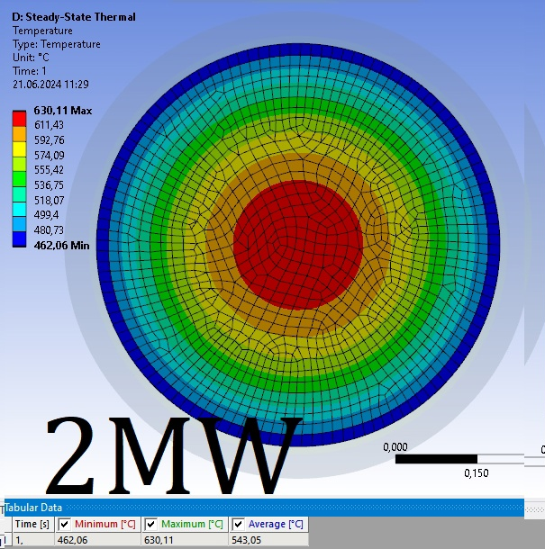
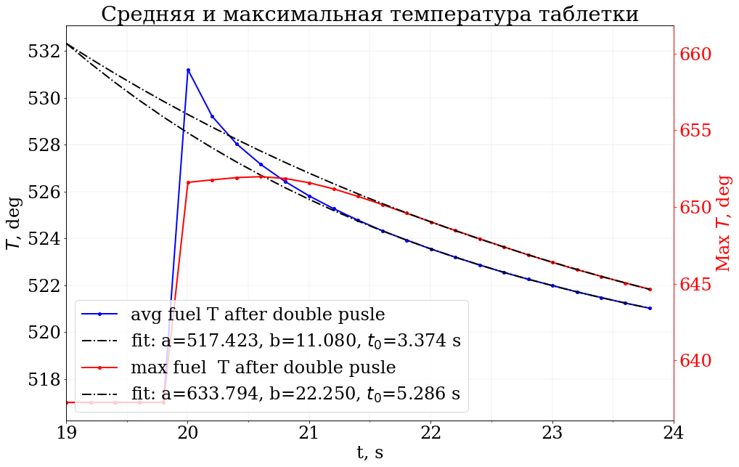
Study of thermomechanical processes affecting the dynamics of the reactor (IBR-2)
Axial expansion of fuel and change in pellet shape due to spatial temperature distribution in fuel
Temperature distribution inside the fuel
Schematic representation of the shape of the pellets in the fuel element
Dependence of average and maximum fuel temperature in a tablet on temperature

Slide 6
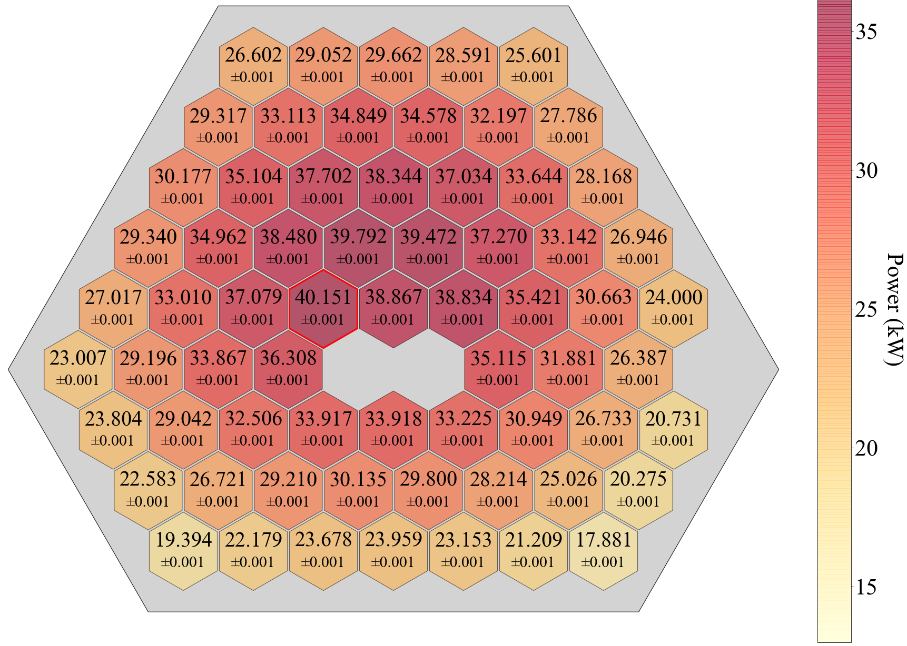
Presence of energy release gradient
Assumption: Bending of the construction elements?
Energy release in the IBR-2M core
Coefficient of unevenness of energy release by fuel assemblies = 1.71

Slide 7
Bending of the construction elements
Thermal expansion law:
T₁ < T₂
$$\frac{∆L}{L}=α∆T,$$
where $∆L$ – extension of the rod length $L$,
$α$ – thermal expansion coefficient [1/К],
$∆T$ – heating magnitude (T₁–T₀)
$${∆L}_{1}$$
$${∆L}_{2}$$
T₀
T₁
T₂
$$E⋅I⋅\ddot{y}=M\sim {(T}_{2}−T_{1})$$
y

Slide 8
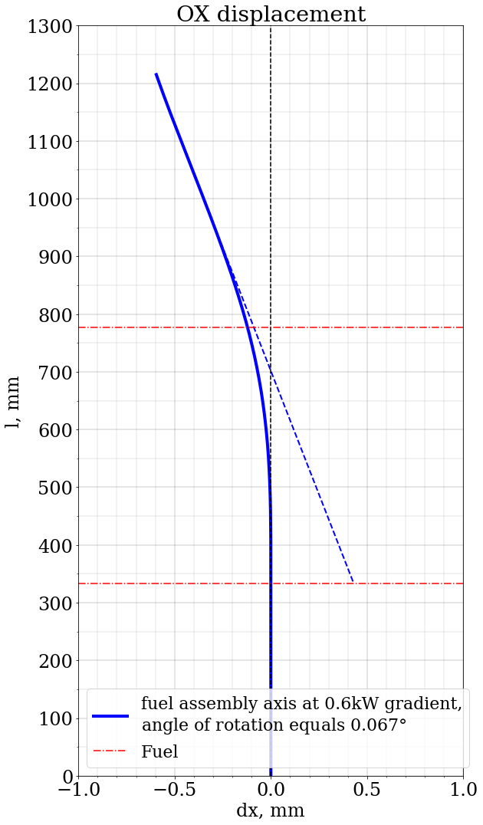
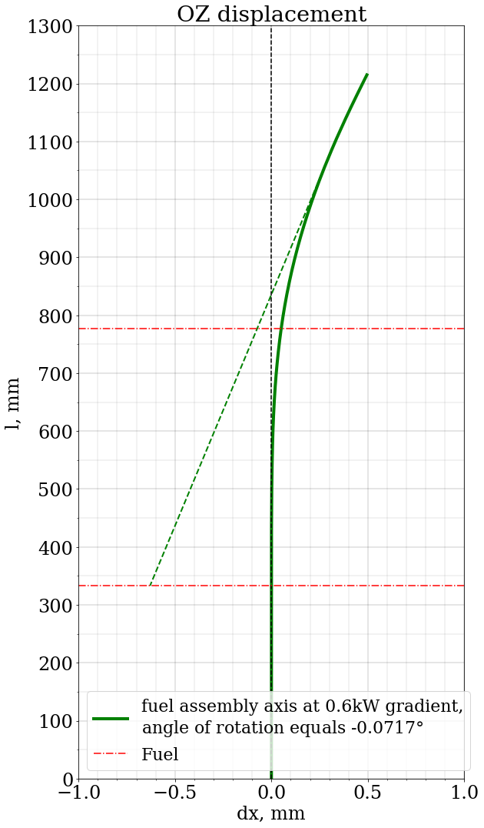
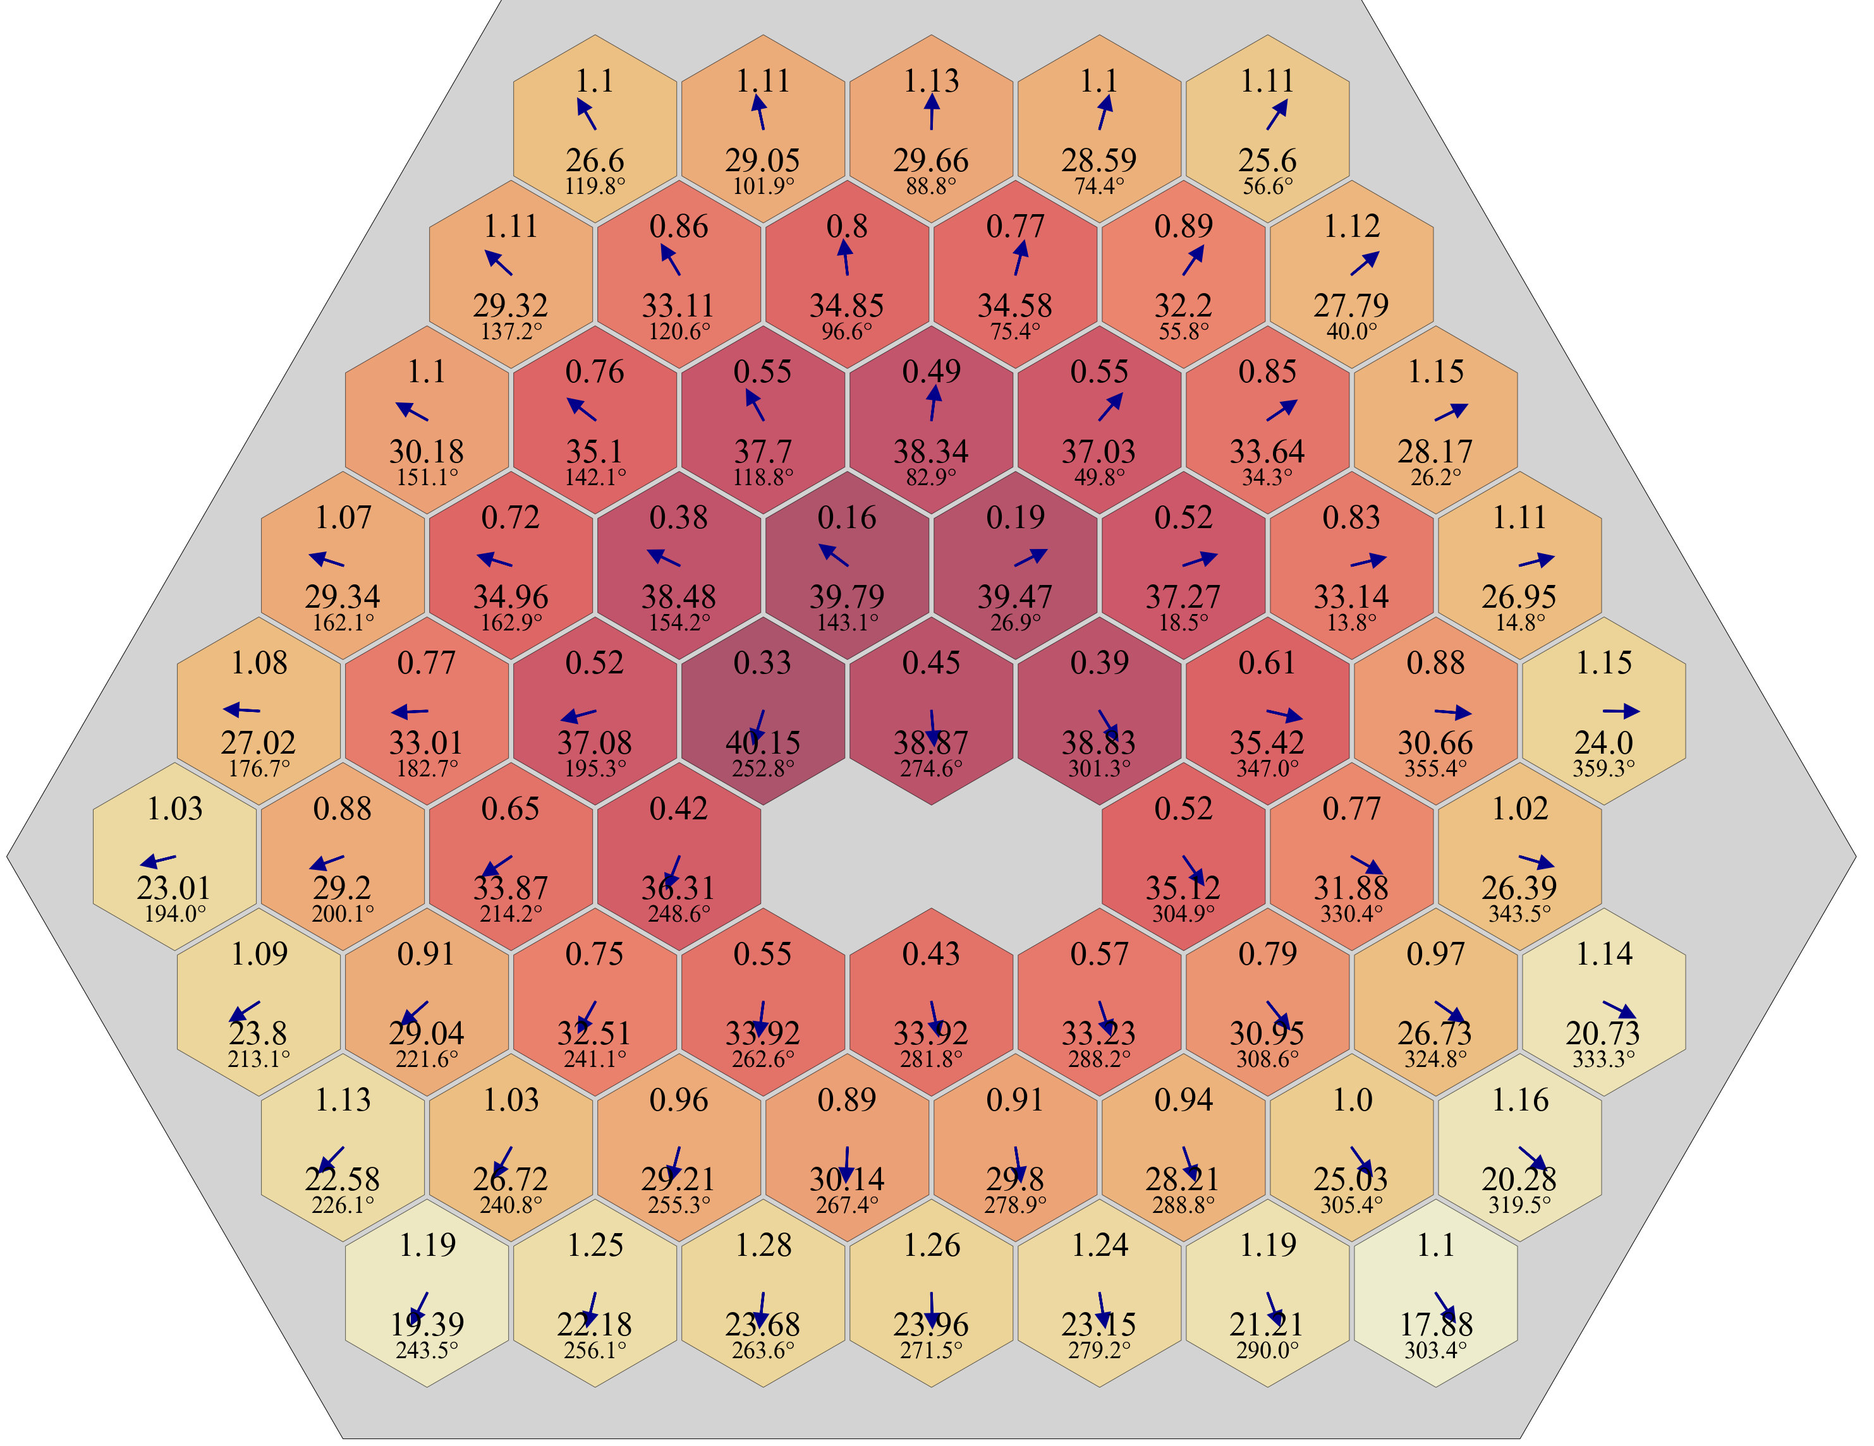
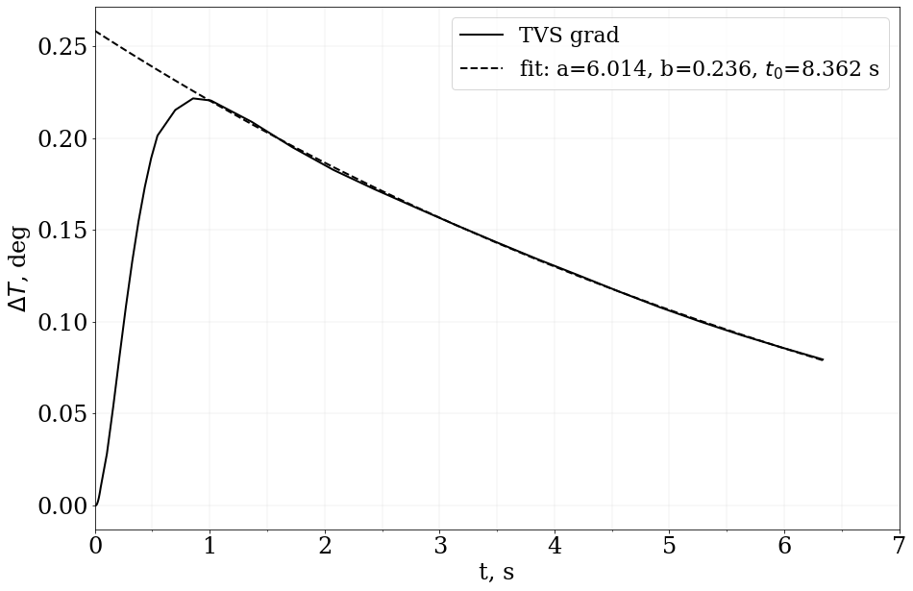
Study of thermomechanical processes affecting the dynamics of the reactor (IBR-2)
deformation of the fuel assembly due to temperature gradient
Deformation of the fuel assembly in the gradient direction (OX) and in the perpendicular direction (OZ)
3D model of a fuel assembly
Magnitude and direction of energy release gradients
Coolant temperature at the end of the reactor core
bends direction of the fuel assemblies
Dependence of the temperature gradient on the fuel assembly wall on time after a single pulse

Slide 9
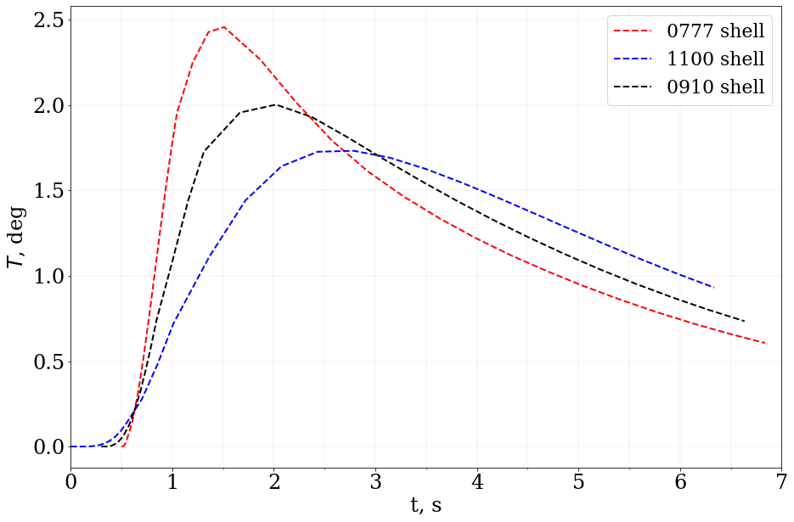
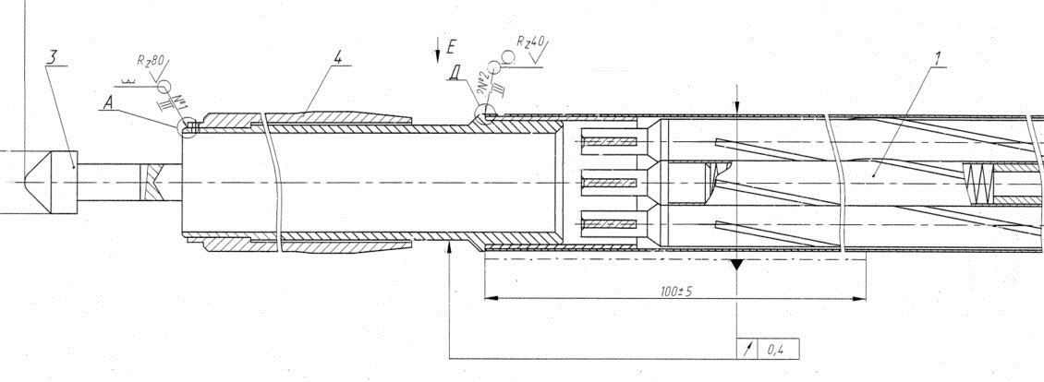
Study of thermomechanical processes affecting the dynamics of the reactor (IBR-2)
expansion of fuel assemblies in the upper part due to changes in the coolant temperature
Fuel assembly top nozzle drawing
Change in the temperature of the fuel assembly walls in different parts after a single pulse (heating of fuel by 13 deg)

Slide 10
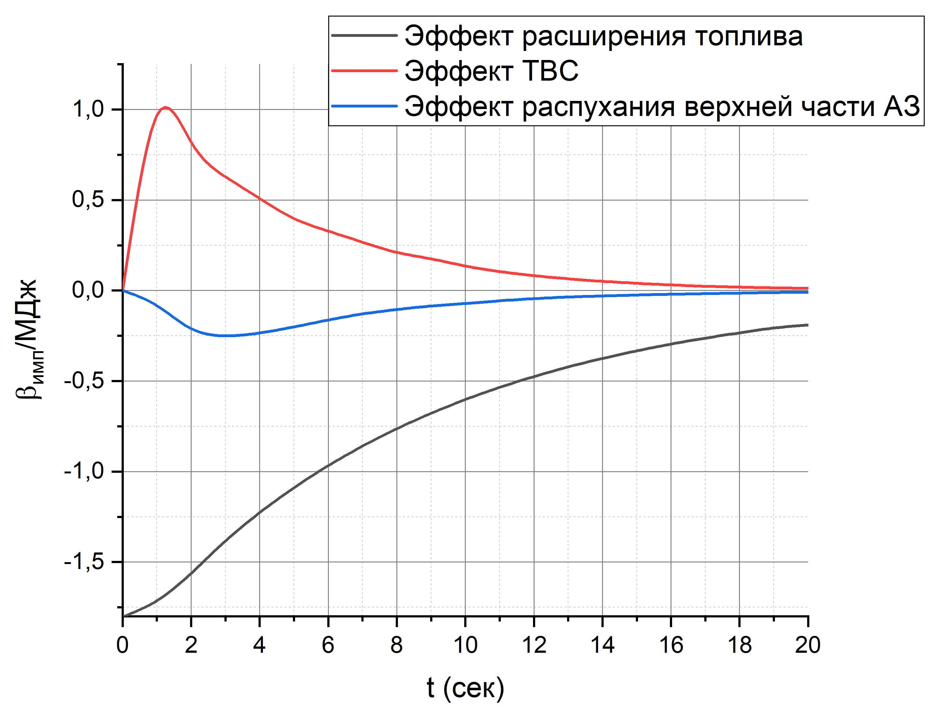
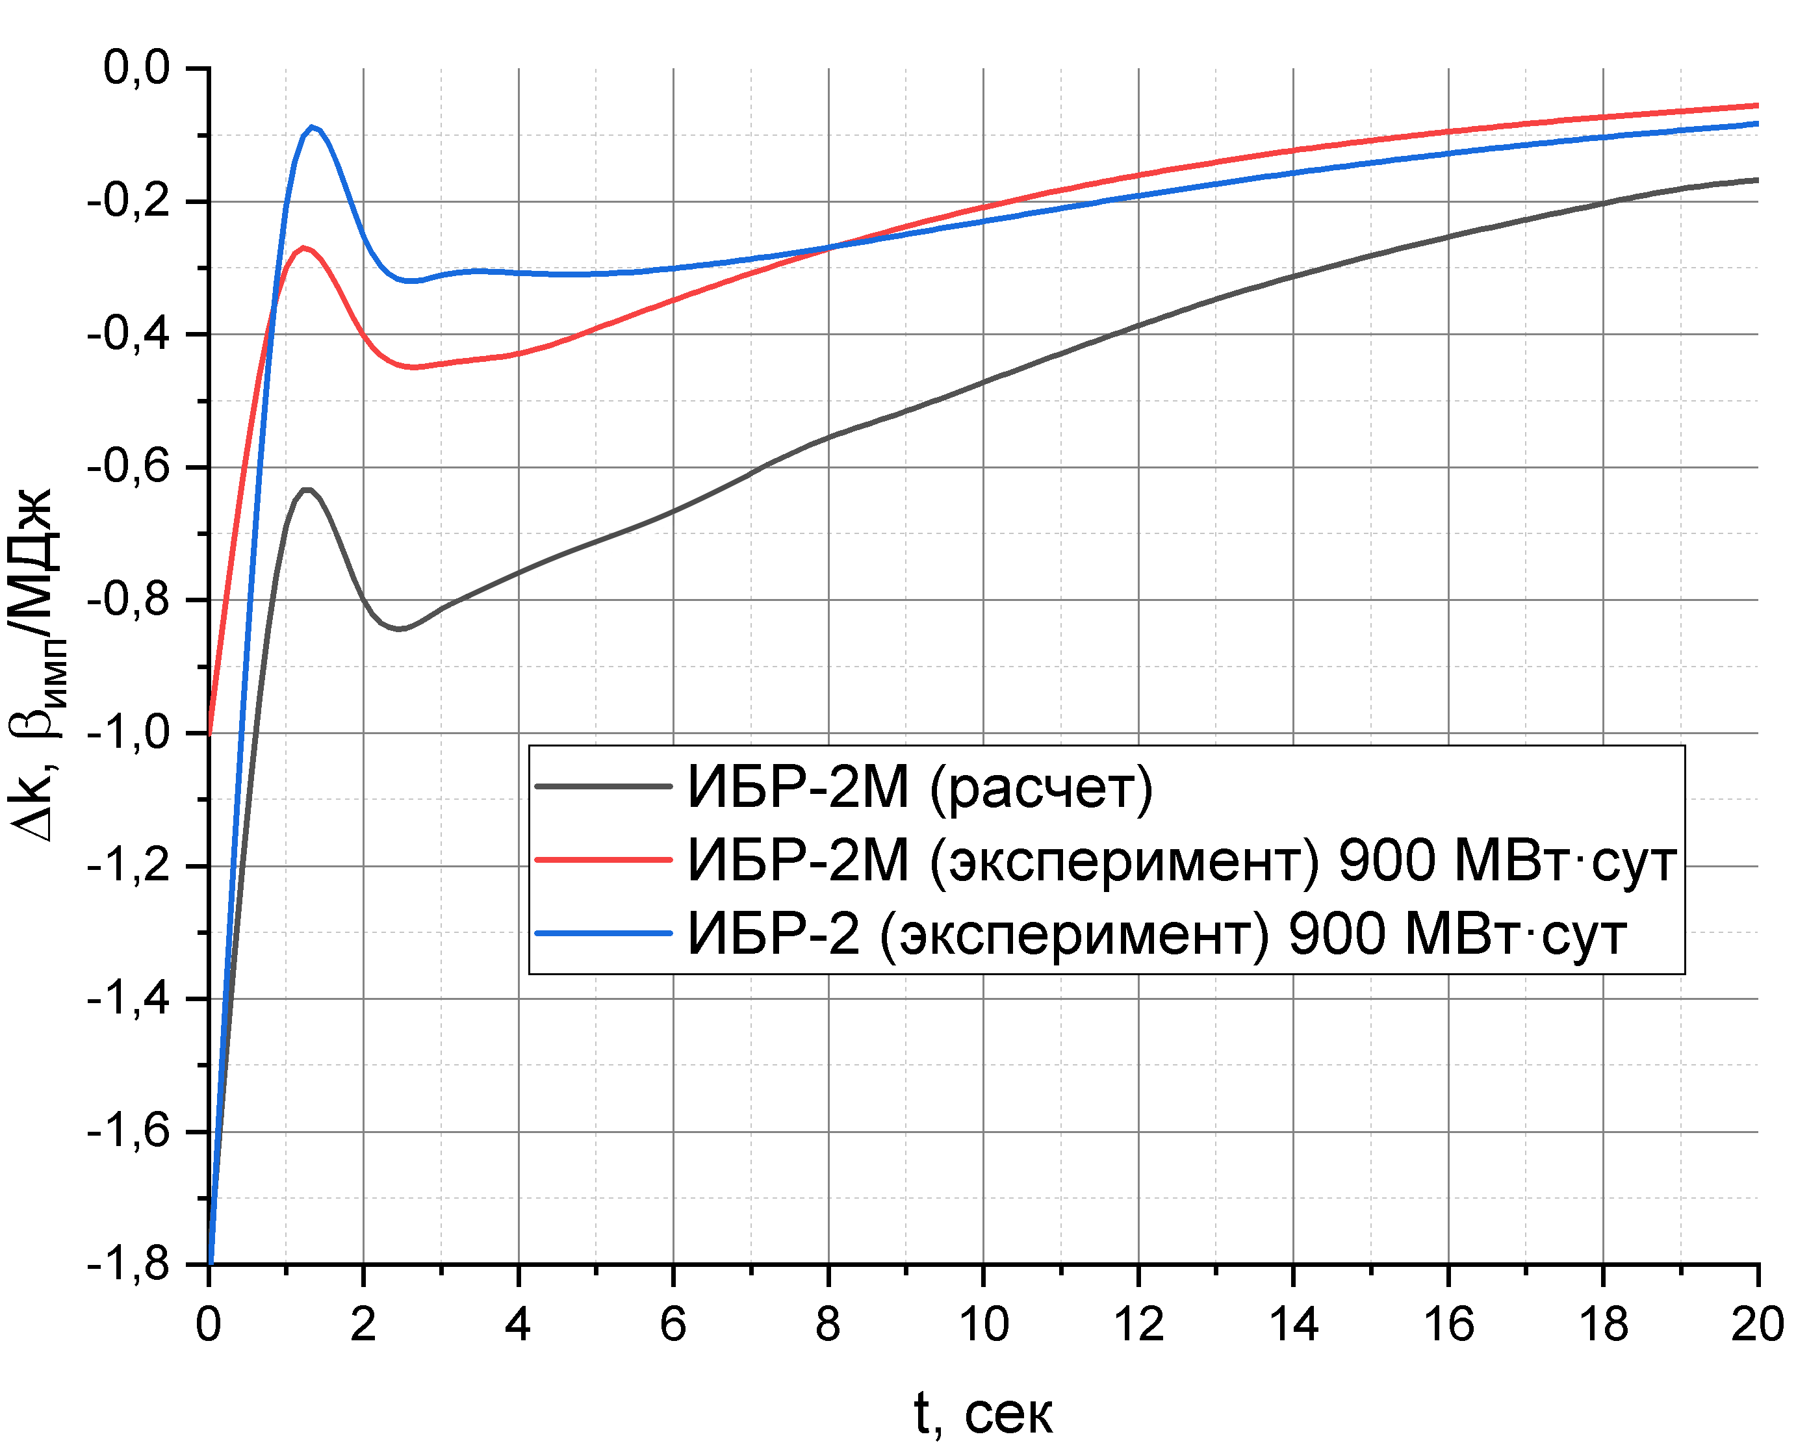
Power feedback function
Fuel expansion
Upper part FA bending
FA expansion

Slide 11
Future plans
Model refinement (Creation of the JINR-NIKIET working group)
Processing of archived experimental data from the IBR-2M reactor based on a new feedback model (in progress)
Building a dynamics model of the IBR-2 reactor taking into account bending of fuel assemblies (JINR, NIKIET)

Slide 12
Thanks for your attention!
JINR Association of Young Scientists and Specialists Conference "Alushta-2025"
June 8-15, 2025

