Slide 1
Investigation of the effect of the microstructure of positive electrodes of chemical current sources on their functional characteristics
Researcher of
Frank Laboratory of Neutron Physics.
Scientific and Experimental Department of Neutron Research of Condensed Matter
Sector No. 2 of Neutron Optics /Group No. 3 GRAINS
Yerdauletov Meir

Slide 2
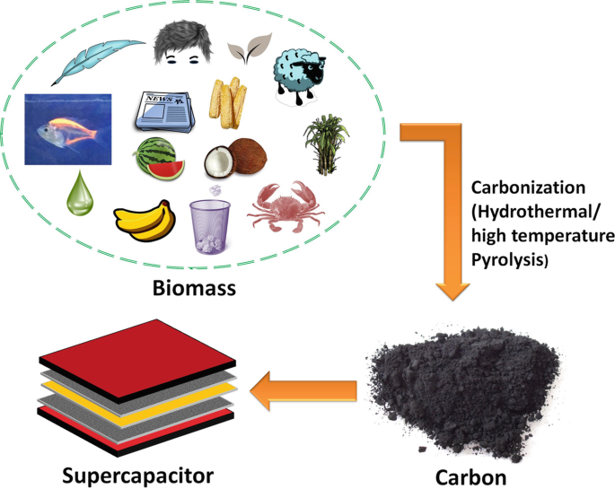
Aim: Improvement of existing, search and development of new energy-intensive and efficient rechargeable chemical current sources
TASKS:
The increasing demand for sustainable and efficient energy storage materials has led to significant research into utilizing waste biomass for producing activated carbons.
To study the impact of the structural properties of activated carbons derived from various biomasses
The spectroscopic analyses reveal the structural transformations and functional group changes during carbonization and activation, which are critical for understanding the performance of the resultant activated carbons.
Possibility of using activated carbon from biowaste Carrying out work on prototyping energy storage systems based on them

Slide 3
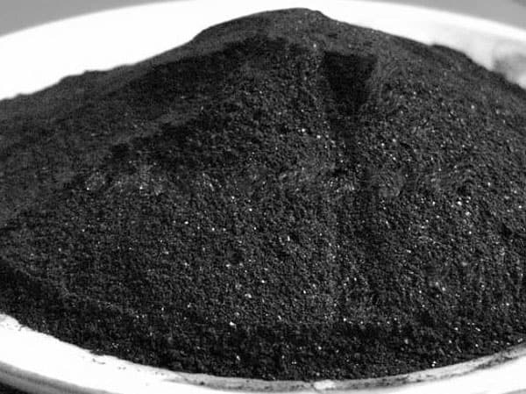
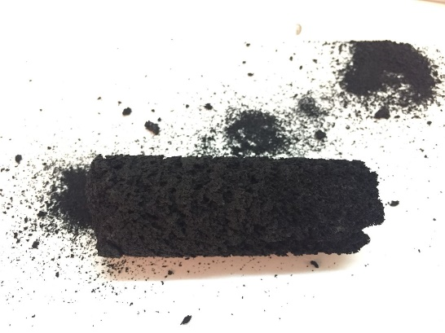
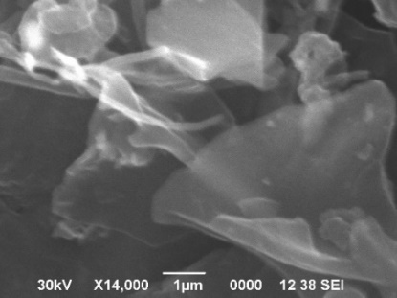
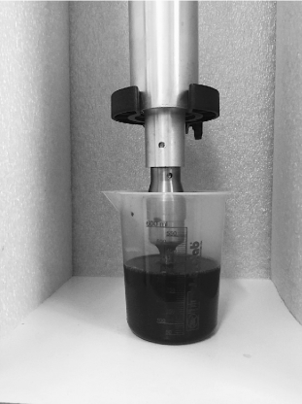
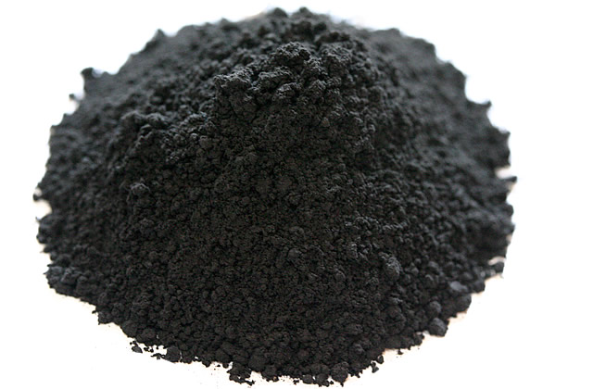
Synthesis and production of electrode materials from biowaste
Carbonization
500 °C (1.5h)
Chemical activation with
KOH 850 °C (2h)
Activated WS, BS
Carbonized WS, BS
Stirring
Ultrasonication
Washing
Filtering
Vacuum Drying
Porous carbon with
few-layer graphene

Slide 4
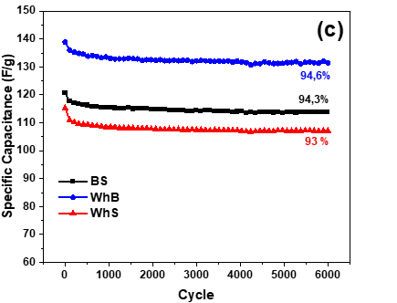
Characterization of Activated Carbon from WB, WS, BS for Enhanced Energy Storage Devices
Figure 3. SEM images of activated carbon derived from (a) wheat bran; (b) wheat straw; (c) barley straw. The SEM images show a mix of sheet-like formations and irregularly shaped particles. The particle size ranges a few hundred micrometers
Figure 4. Electrochemical characteristics of supercapacitor electrodes obtained from barley straw, wheat straw and wheat bran: (c) cyclic stability test at 1 A/g from 0.4 to 1.5 V.
Meir Yerdauletov, et al //Molecules 2024, 29 (5029)

Slide 5
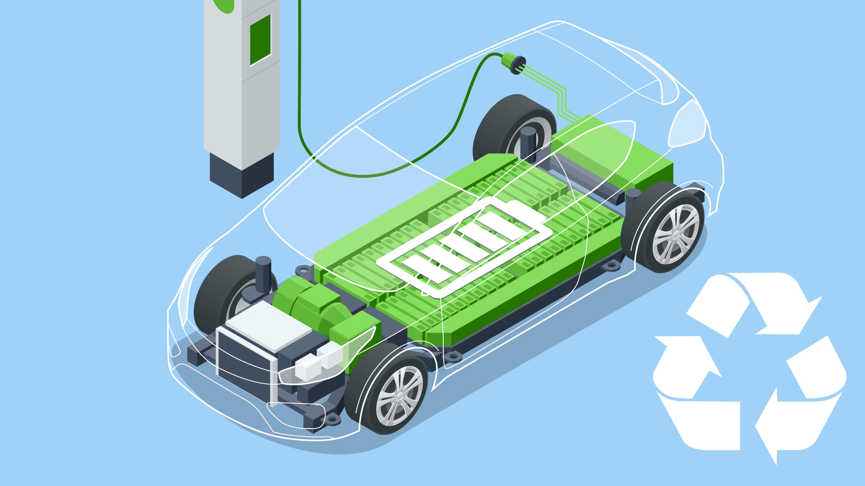
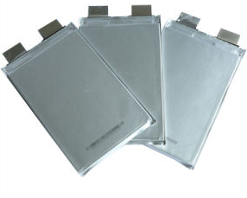
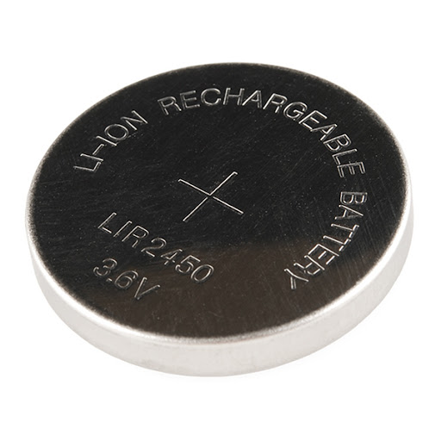
Conclusions
Among the tested materials, wheat bran-derived activated carbon exhibited the highest specific capacitance and energy density, making it a promising candidate for high-performance energy storage devices
These findings underscore the importance of selecting appropriate biomass sources and optimizing activation processes to enhance the electrochemical performance of supercapacitors
This study provides valuable insights into the sustainable production of advanced materials for energy storage, promoting the development of efficient and eco-friendly supercapacitors.

Slide 6
2023
2024
Meir Yerdauletov, et al //Molecules 2023, 28(15), 5818;
Meir Yerdauletov, et al //Molecules 2024, 29 (5029)

Slide 7
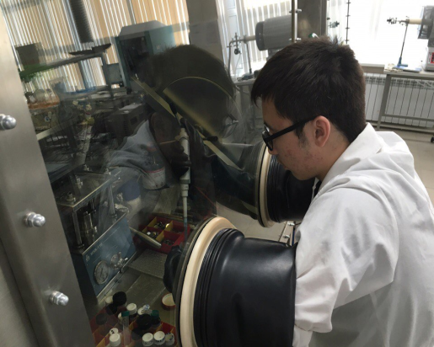
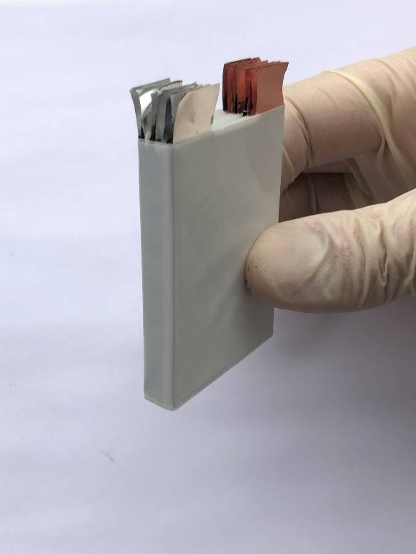
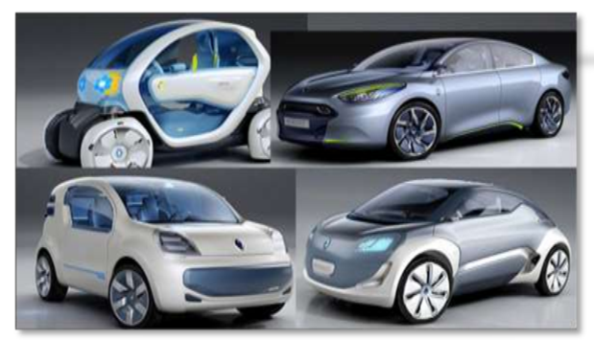
FUTURE PLANS
Improvement of existing, search and development of new energy-intensive and efficient electrochemical energy storage devices of a new generation. Carrying out advanced research in the field of obtaining new analytical materials
Obtaining new unique scientific data on the microstructure of electrode coatings and the internal structure of batteries based on small-angle neutron scattering methods, as well as neutron radiography and tomography, real-time diffraction.
The development of science and technology criteria for the creation of electrolytes, electrode coatings and the design of lithium-ion batteries, allowing operation in very low temperatures (as low as -40C).
The implementation of the work will also contribute to building cooperation with leading scientific groups in JINR Dubna and Kazakhstan

Slide 8
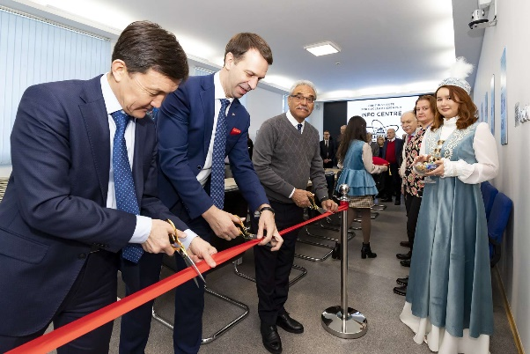
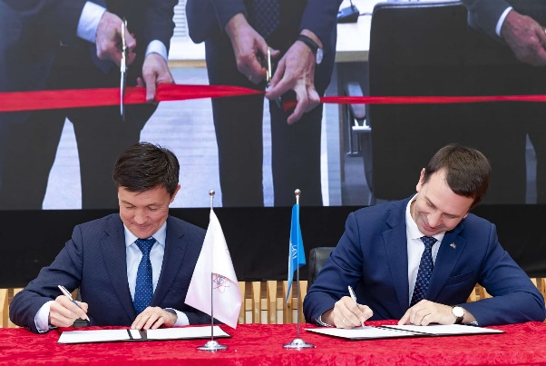
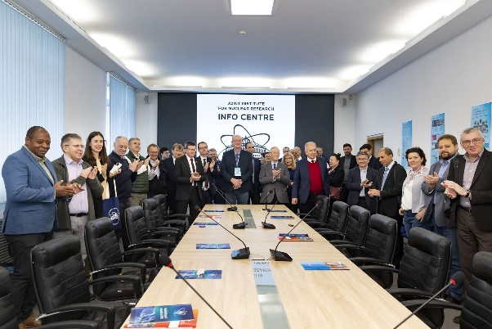
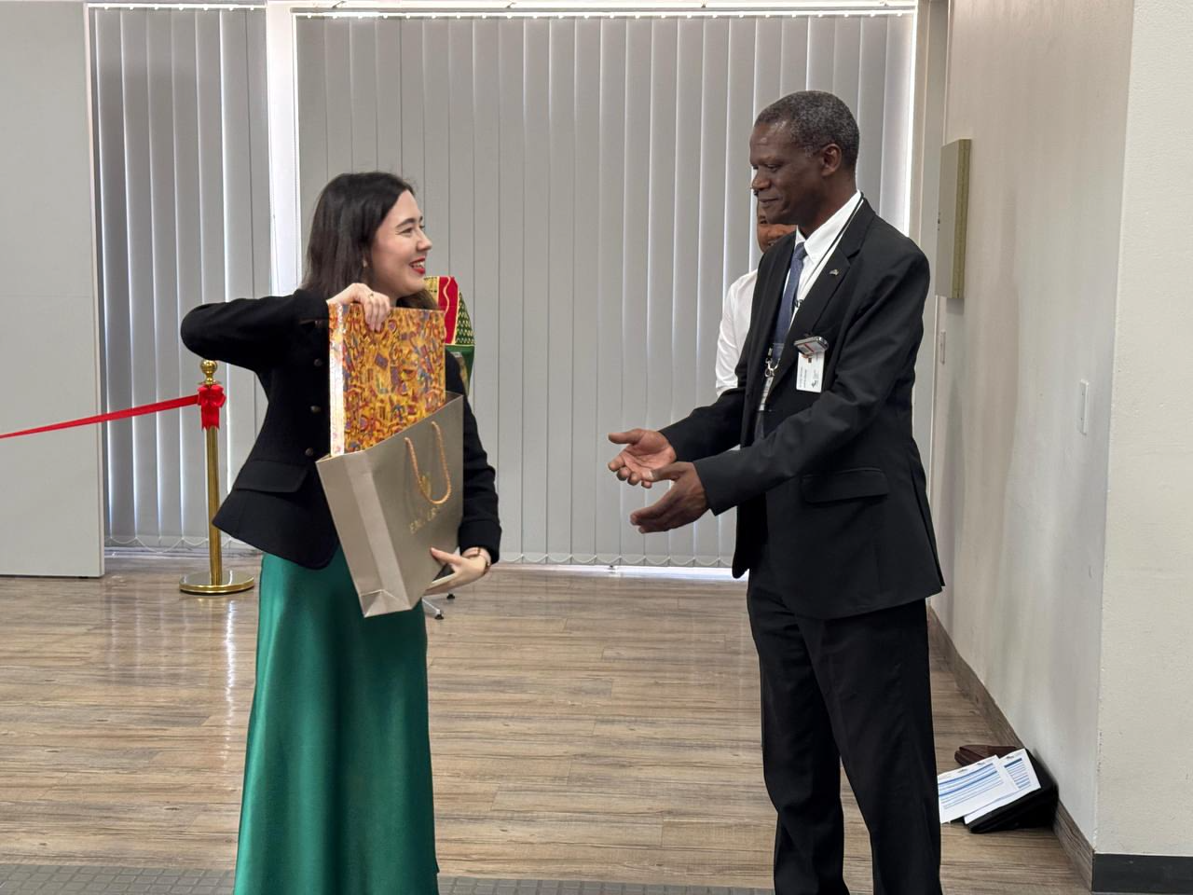
Organization: Popularization of Science
JINR INFROMATION CENTER IN INP
Main objectives
Popularization of science:
Organizing lectures, exhibitions, competitions,
Publishing popular science materials, video lectures, and podcasts for students and schoolchildren.
Highlighting Kazakh Scientists' Contributions:
Promoting the role of Kazakhstan's researchers in international collaborations, including JINR projects, through media, seminars, and social platforms.
Fostering Scientific Cooperation:
Building partnerships with universities and research organizations,
Supporting educational programs, internships, and schools for students and teachers.
Mentoring and Research Collaboration:
Scientific projects, thesis supervision, and guidance on research work for students and schoolchildren.
Results: 2024 year
Organization of online and offline lectures in schools and universities of Kazakhstan.
Development of social networks for popularization of scientific activity.
Coverage of the activities of Kazakhstan National group employees in mass media.
Organization of events for schoolchildren and students with a focus on JINR activities.
Support of educational programs on the basis of leading universities of Kazakhstan (KazNU, ENU, VKSU, etc.).
Participation in joint research and educational initiatives.

Slide 9
Thank you for your attention

