Slide 1
Zhomartova Ayazhan
Junior Researcher of
Frank Laboratory of Neutron Physics
Scientific adviser: Kichanov Sergey

Slide 2
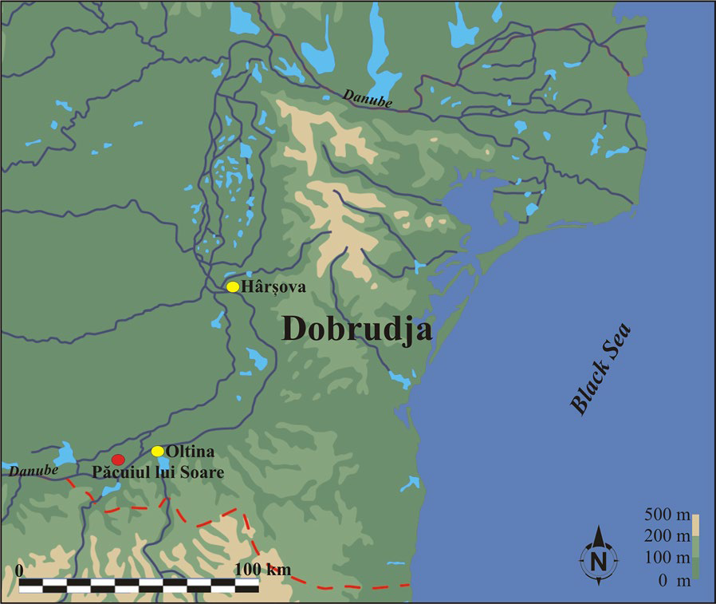
Archaeological expeditions
Dobrudja
cultural and historical province of modern Romania
bordered on the north and west by the Danube river and on the east by the Black Sea.

Slide 3
Archaeological expeditions

Slide 4
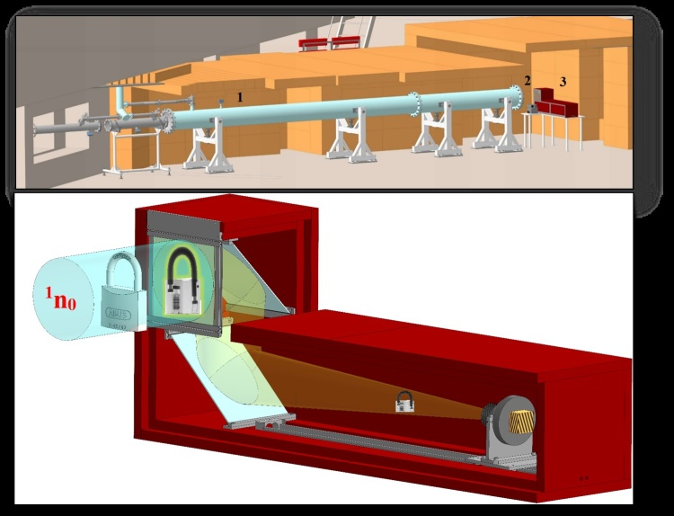
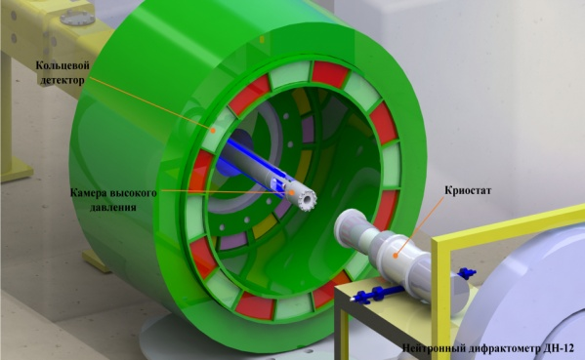
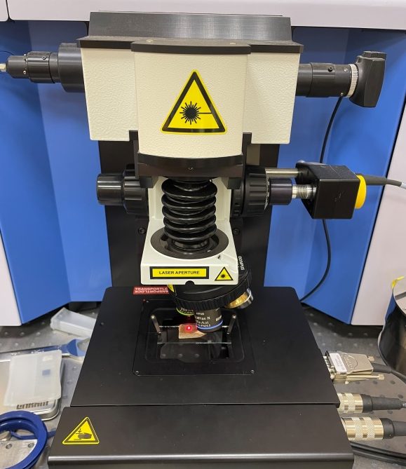
Experimental methods
Neutron tomography
Neutron diffraction
Raman spectroscopy

Slide 5
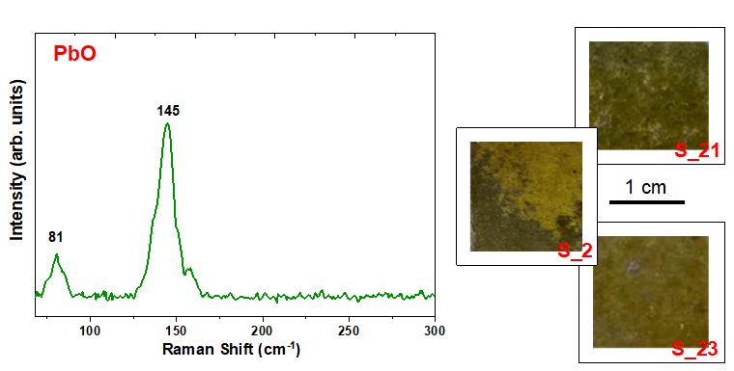
Raman spectroscopy data
Raman spectra obtained from several points of the surface and corresponding to different phases of the studied pottery fragments. The observed Raman wavenumbers of most intense Raman peaks are labeled.
The observed main phases of the ceramic fragments: the Raman spectroscopy data

Slide 6
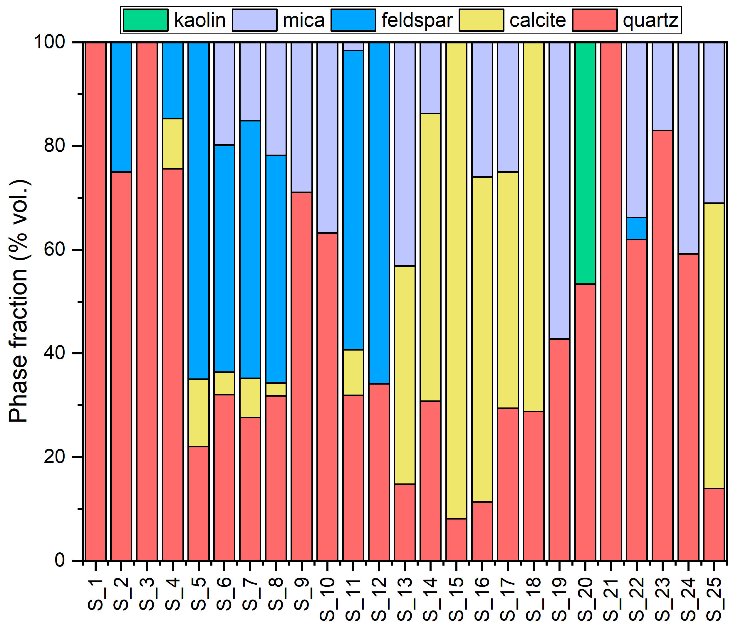
Neutron diffraction data
The comparison diagram of the phase fractions of ceramic fragments based on the neutron diffraction data.
Selected neutron diffraction patterns of the several studied ceramic fragments.

Slide 7
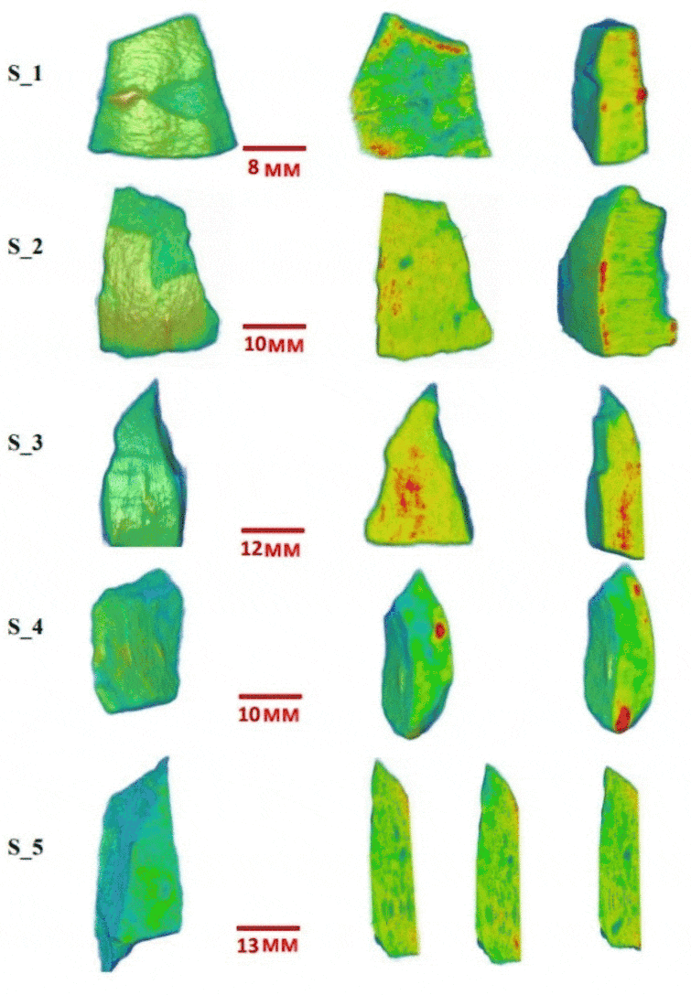
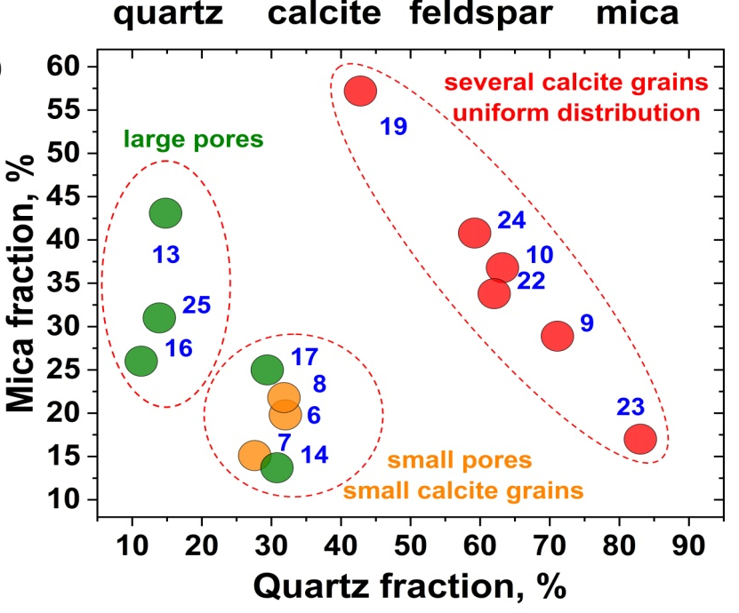
Structural markers of Romanian ceramics
Grouping of samples based on neutron diffraction and tomography data.

Slide 8
The hierarchical tree for ceramic samples as result of the Cluster analysis
1
3
only kitchen utensils
local vessels with a glazed surface
imported amphora-shaped jars for transporting and storing food
locally produced jugs with white mass in the cut
2
4
A.Zh. Zhomartova, B.A. Abdurakhimov, C. Talmațchi, S.E. Kichanov, D.P. Kozlenko, M. Bǎlǎșoiu, G. Talmațchi, C. Șova, M.C. Belc, The systematic structural studies of some Byzantine ceramic fragments from Dobrudja region of Romania: Raman spectroscopy, neutron diffraction, and imaging data // Archaeometry. – 2024.

Slide 9
Conclusion
Not only can the phase composition of ceramic fragments indicate the source of the raw material, but also some structural features observed using neutron tomography can serve as necessary structural markers for assumptions about the place of manufacture of ceramics or the chemical processes occurring during annealing.
For the first time, a grouping of ceramic material from the archaeological complex of Dobruja (Romania) was carried out based on neutron tomography and diffraction data
According to neutron tomography data, it was established that samples with the presence of calcite phases in the composition have an uneven distribution, and with the absence of calcite have a fairly uniform spatial distribution.
Using cluster analysis, four large groups of ceramic samples were identified.

Slide 10
Thank you!
Do you have any questions?
zhomartova@jinr.ru
+79850516669

