Slide 1
SCIENCE ART at JINR: THE INTERSECTION OF SCIENCE AND ART
VARVARA FUFAEVA

Slide 2
What is science art?
This is an art movement that combines scientific and creative approaches, often exploring the interaction between both. It may include various forms of expression such as
visual art;
installations;
performance;
media art;
etc.
and may be related to various fields of science.
While I'm telling you the story, please take the survey.

Slide 3
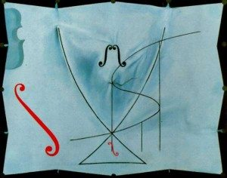
SCIENCE ART «What is it all about?»
Dali painted his last painting.
You can recognize a row of S-shaped figures that remind us of his famous moustache, as well as a violin and the symbol of integrals in mathematics, as a tribute to René Thom, the founder of catastrophe theory.
When the artist died, some of the books lying by his bedside were Ghyka’s «The Geometry of Art and Life», Schrödinger’s «What is Life?» and Stephen Hawking’s «A Brief History of Time».
The Swan’s Tail, Dali, 1983

Slide 4
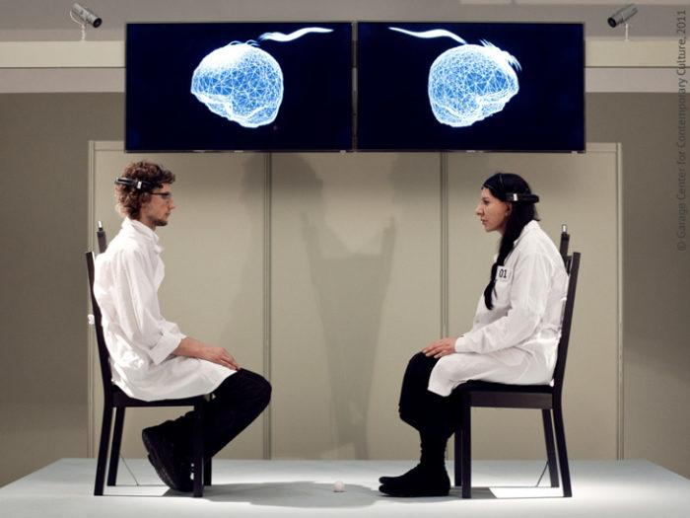
SCIENCE ART «What is it all about?»
And why do scientists need THIS…
It can bring:
Explanation of complex topics through images and emotions
A different perspective on research
Promotion of research
M. Abramović performance «Measuring the Magic of the Gaze» (2011)

Slide 5
Date-data modification
This is the conversion of data into sound. When using this technique, the significant properties of these data are indicated by sound characteristics — for example, different pitch, volume, tempo, rhythm. Gazprom Neft scientist and geophysicist Alexander Butorin has created a music album based on recordings of seismic waves.
The composition of the physical processes of the Purovsky oil field, digitized underground at a depth of three kilometers, has been transformed.
More examples of scientists' data unification

Slide 6
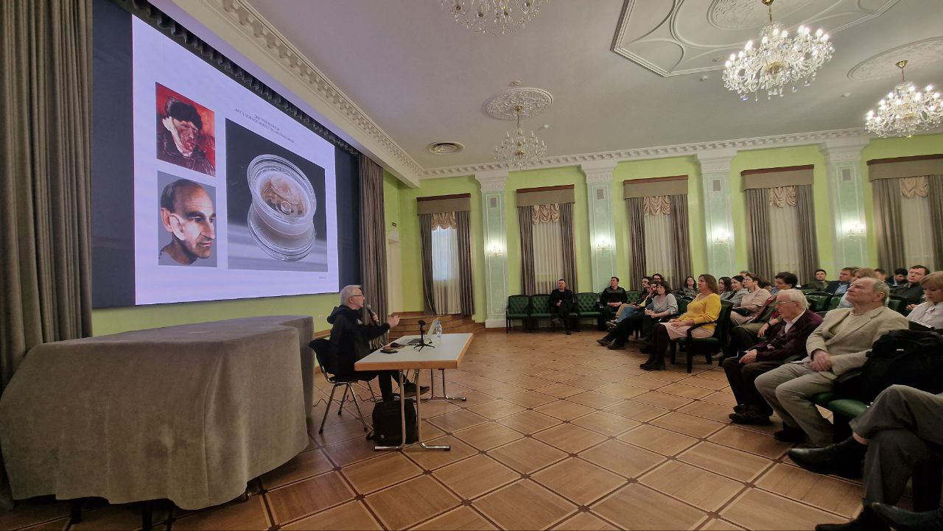
JINR & Art
Two lectures by leading curators of contemporary art were held at the House of Scientists,
cooperation agreements were signed with ITMO (ART&Science) and MISIS ART Tech,
a course of lectures on fundamental physics was given to the 2nd year master`s students of ITMO ART&Science,
the final paper was completed with JINR's consulting support.

Slide 7
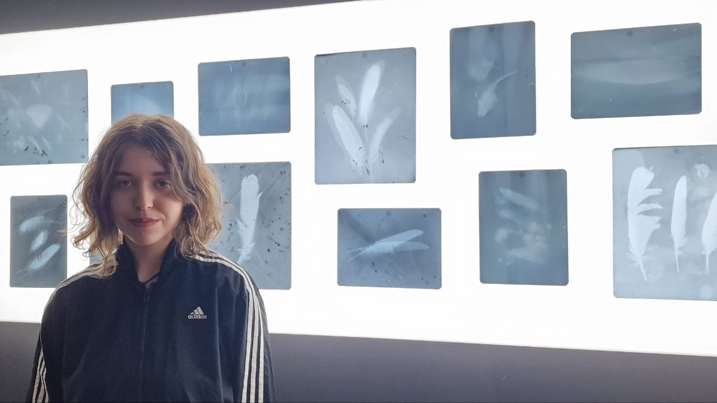
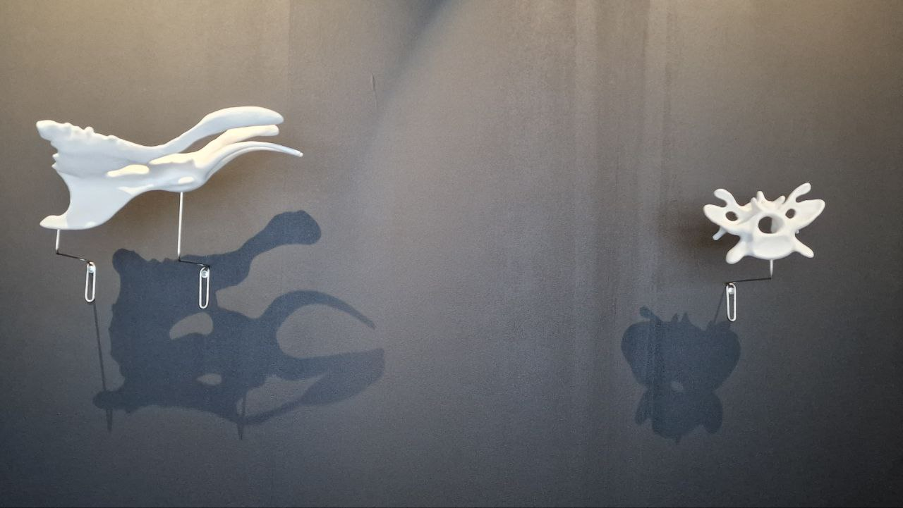
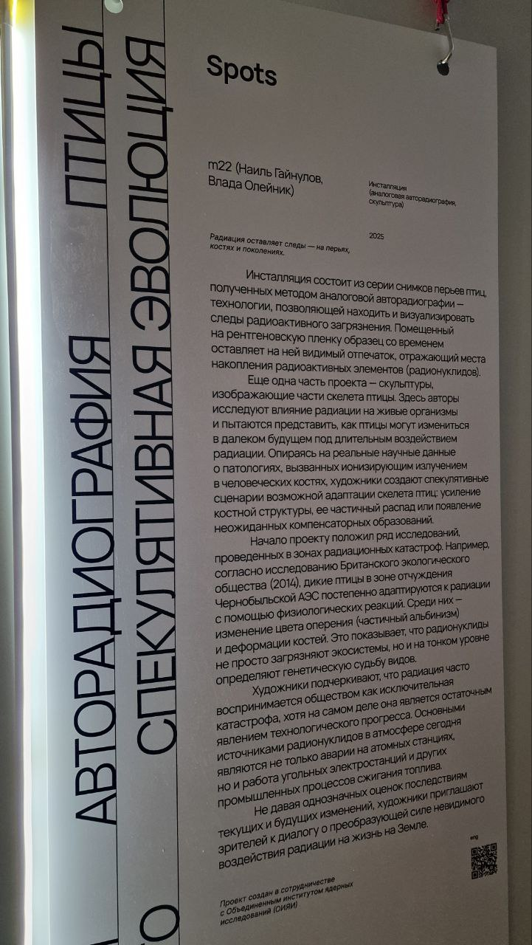
JINR & Art

Slide 8
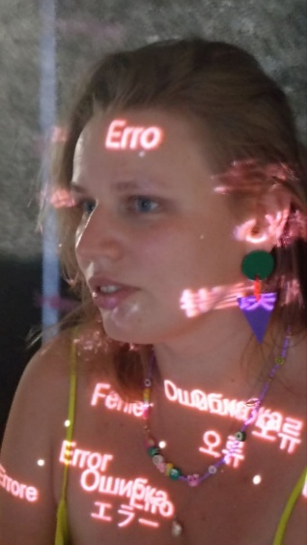
JINR & Art
Installation-performance:Unknown: A map of the Unknown Author: Katarina Commer. Participants of the performance: participants of the Science Art workshop and visitors of the exhibition.
This is an audiovisual installation written in the JavaScript programming language, blurring the boundaries of human knowledge. The visualization data was taken from an experiment on the synthesis of superheavy elements. We see how signals are moving between sensors encounter unavoidable interference and errors, symbolizing the vast and unexplored territories of science. The soundtrack consists of recordings made with a Zoom H5 recorder made at JINR. The sounds of working machines, conversations, and human movements are processed into mysterious elements that create an atmosphere of derealization and become similar to the process of synthesizing elements.

Slide 9
Thank you for your attention!
Contact me (Varvara): fufaeva@jinr.ru And join us at Dubok tonight at 22.00 to talk about science art.

