Slide 1
JINR Association of Young Scientists and Specialists Conference "Alushta-2025"
8–15 June 2025
Spin transparency mode of deuterons in the entire energy range at the Nuclotron/JINR
Butenko Elizaveta
LHEP JINR engineer

Slide 2
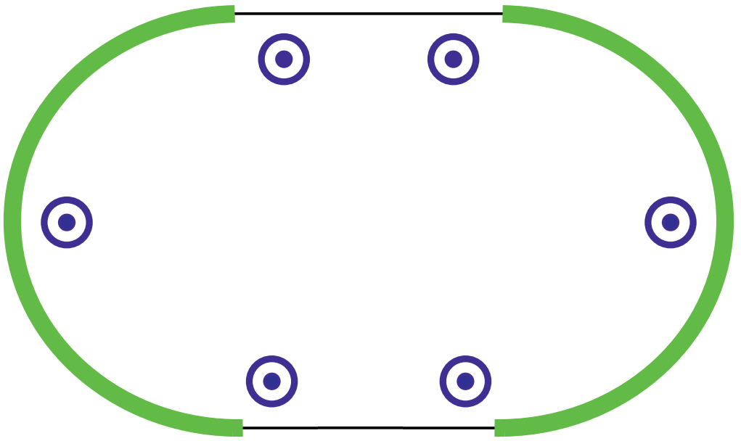
Spin dynamics of deuteron at NICA
In the NICA Collider with vertical guiding field the stable deuteron polarization oriented along vertical direction.
How to provide longitudinal polarization?
Transverse field integral to rotate spin by angle $φ_{⊥ }$
$$B_{⊥}L=Bρ \frac{φ_{⊥ }}{γ\text{G}}$$
$$ν=γ\text{G}$$
$$B_{⊥}L≈70 T∙m$$
at 13.5 GeV/c ($φ_{⊥ }$= π/2)
Longitudinal field integral to rotate spin by angle $φ_{∥ }$
$$B_{∥}L=Bρ \frac{φ_{∥}}{1+\text{G}}$$
Stable polarization
direction at NICA
$$B_{∥}L≈80 T∙m$$
at 13.5 GeV/c ($φ_{⊥ }$= π/2)
To restore closed orbit for deuterons, the characteristic field integral for a helix spin rotator is about 500 T·m
Alushta-2025
Butenko Elizaveta
2/8

Slide 3
Spin Transparency mode at NICA
$$ν=0$$
SN
half solenoid snake for spin transparency mode
SN
weak solenoid for longitudinal polarization at SPD (spin navigator)
In the entire energy range up to 13.5 GeV/c requires 4$×$80 = 320 T·m
Not enough free space
Alushta-2025
Butenko Elizaveta
3/8

Slide 4
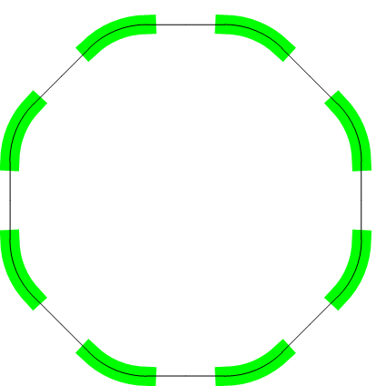
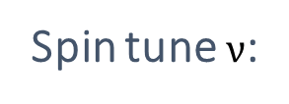
New Nuclotron
The main task: provide ST-mode in the New Nuclotron to control deuteron polarization direction in the entire energy range
Proposed solution:
8 solenoids
One per superperiod
Sol
Sol
Sol
Spin tune $ν$:
$$\cos{\frac{πν}{8}}\text{=}\cos{\frac{πγ\text{G}}{8}}\cos{\frac{φ_{sol}}{2}}$$
Sol
Sol
$(φ_{sol}$ - spin solenoid angle)
Sol
Sol
Stable polarization direction (n-axis)
Sol
$$\vec{n}= \frac{\cos{\frac{φ_{sol}}{2}}\sin{\frac{πγ\text{G}}{8}}{\vec{e}}_{y}\text{+}\sin{\frac{φ_{sol}}{2}{\vec{e}}_{z}}}{\sqrt{1−\cos^{2}{\frac{πγ\text{G}}{8}}\cos^{2}{\frac{φ_{sol}}{2}}}}$$
Alushta-2025
Butenko Elizaveta
4/8

Slide 5
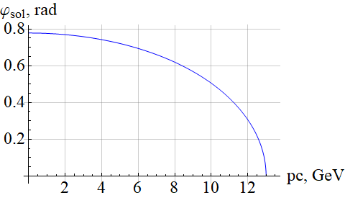
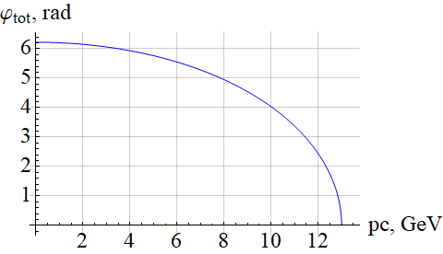
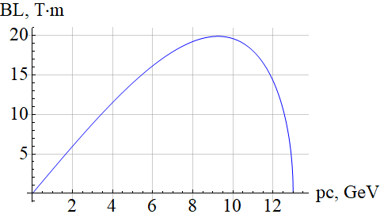
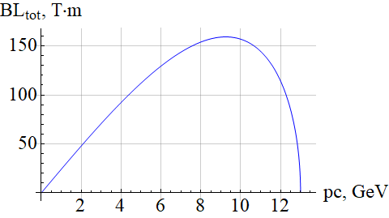
Integrals of solenoids fields for ST-mode
One solenoid
All solenoids
Alushta-2025
Butenko Elizaveta
5/8

Slide 6
Spin navigator
The navigator tune $ν_{N}$ and the induced polarization direction ${\vec{n}}_{N}$ will be determined by the vector sum of the partial fields of weak solenoids
$$δ{\vec{φ}}_{z2}$$
$2πν_{N} \vec{n}$
$$φ_{y}$$
$$φ_{y}$$
$$δφ_{z2}$$
$$δφ_{z1}$$
Detector
$$δ{\vec{φ}}_{z1}$$
$$ν_{N}=\frac{1}{2π}\sqrt{δφ_{z1}^{2}+δφ_{z2}^{2}+2δφ_{z1}δφ_{z2}\cos{φ_{y}}}$$
Detector
$$δB_{z1}$$
$${ \vec{n}}_{N}=\frac{\left(δφ_{z1}+δφ_{z2}\cos{φ_{y}}\right) {\vec{e}}_{z}+δφ_{z2}\sin{φ_{y}{\vec{e}}_{x}}}{2πν_{N}}$$
$$δB_{z2}$$
$δB_{zi}$ is a small field
variation of the solenoid
Inducing $δB_{z1}$ and $δB_{z2}$ simultaneously provides any polarization direction at $(z, x)$ plane
Alushta-2025
Butenko Elizaveta
6/8

Slide 7
Summary
A scheme for controlling the polarization of deuterons in the modernized structure of the Nuclotron in the spin transparency mode is proposed:
any direction of polarization in the Nuclotron plane, including longitudinal
operation at the whole energy range
implementation of a multiple spin-flip system for deuterons during the experiment
the possibility of conducting experiments on external and internal targets
the total integral of the longitudinal field 160 T⋅m is two times smaller than used for two solenoidal snakes in the ST-mode at NICA
Alushta-2025
Butenko Elizaveta
7/8

Slide 8
Thank you for your attention

