Slide 1
«The facility for manufacturing of HTS cables and solenoids»
XIV Annual Scientific Conference of Young Scientists and Specialists "Alushta-2025" June 8 – 15, 2025
Matuykhanov E.S.

Slide 2
Features and Benefits of HTS
High critical temperature
Сheap and convenient cooling
Higher electromagnetic fields when cooled with liquid helium
High resistance to thermal variations
Alushta-2025
Matyukhanov E.S.
2/11

Slide 3
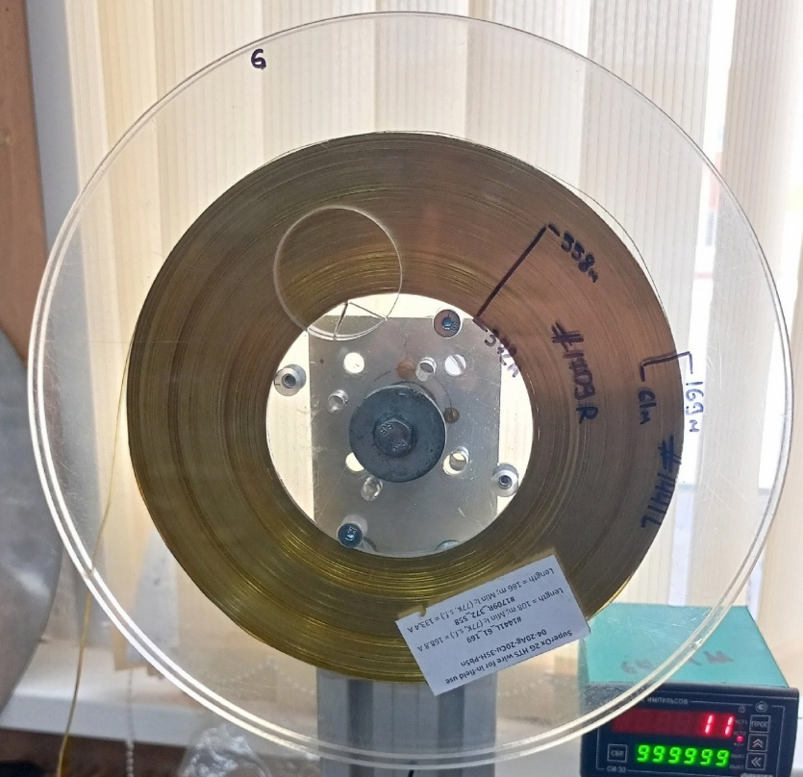
HTS tape structure
Ag – electrical contact and protection
RBCO - superconductivity
Hastelloy – base
Alushta-2025
Matyukhanov E.S.
3/11

Slide 4
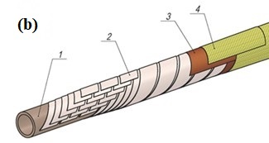
HTS cable structure
1 – Hollow tube (cooling channel)
2 – HTS tapes
3 – Isolation
4 – Bandage
Alushta-2025
Matyukhanov E.S.
4/11

Slide 5
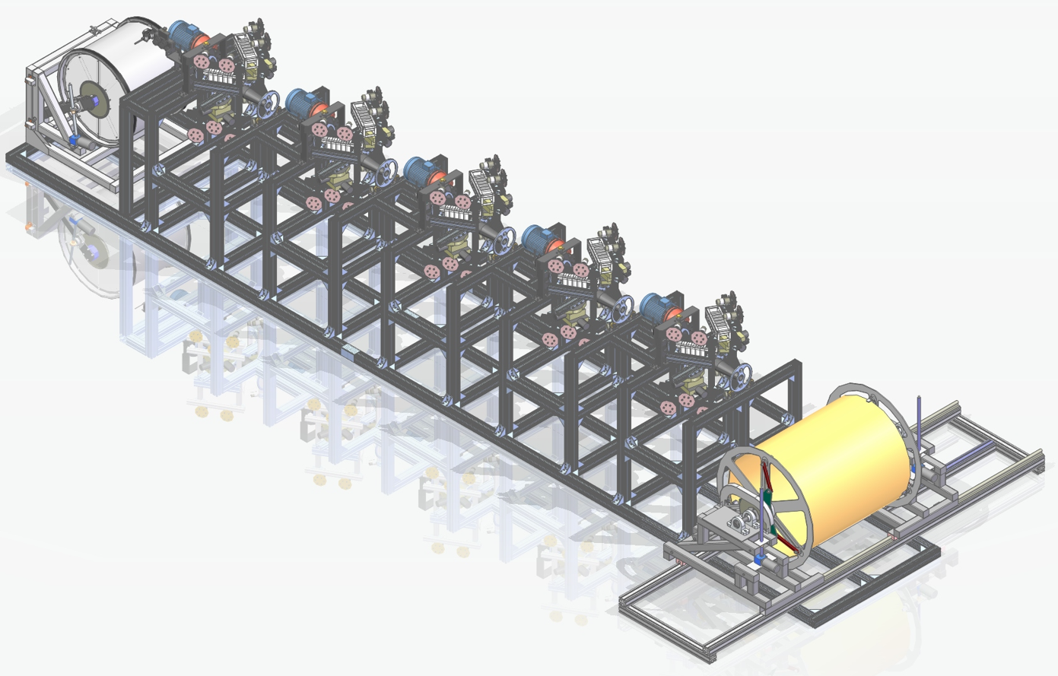
The facility for manufacturing of HTS cables and solenoids
Wrapping stations
First bobbin
Second bobbin
Alushta-2025
Matyukhanov E.S.
5/11

Slide 6
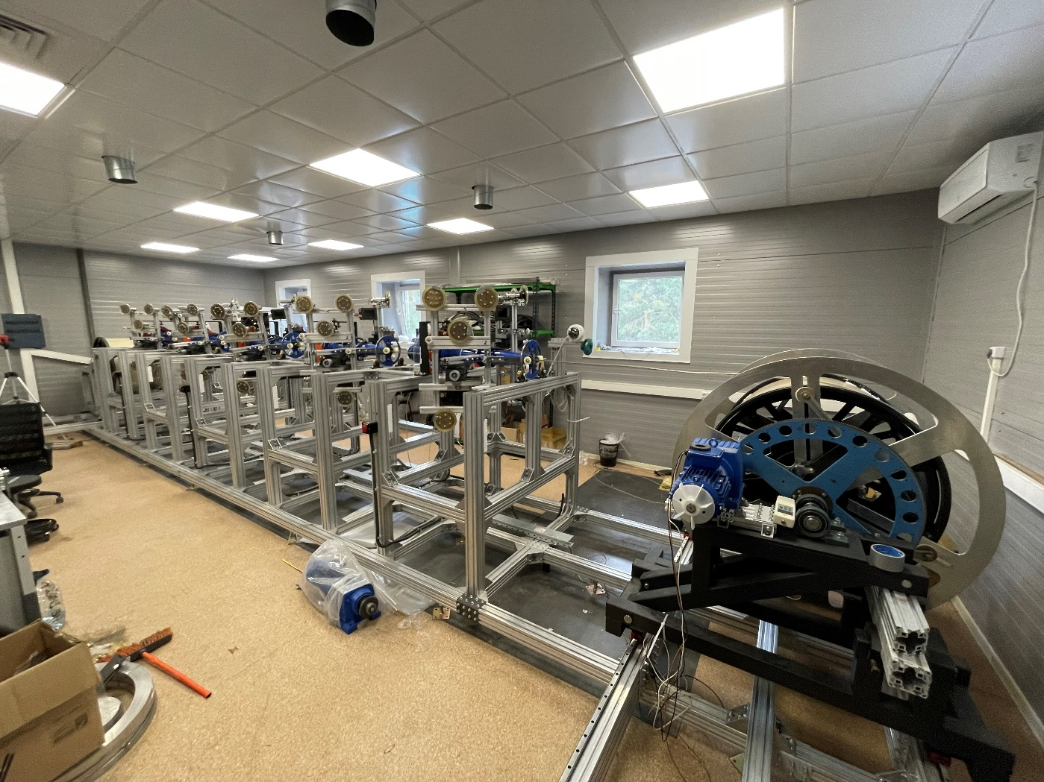
Features of the facility
Flexible tapes tension system
Universal facility (cables and solenoids)
5 wrapping stations
Bandaging of solenoid frames
Сable impregnation
AI defect detection
Alushta-2025
Matyukhanov E.S.
6/11

Slide 7
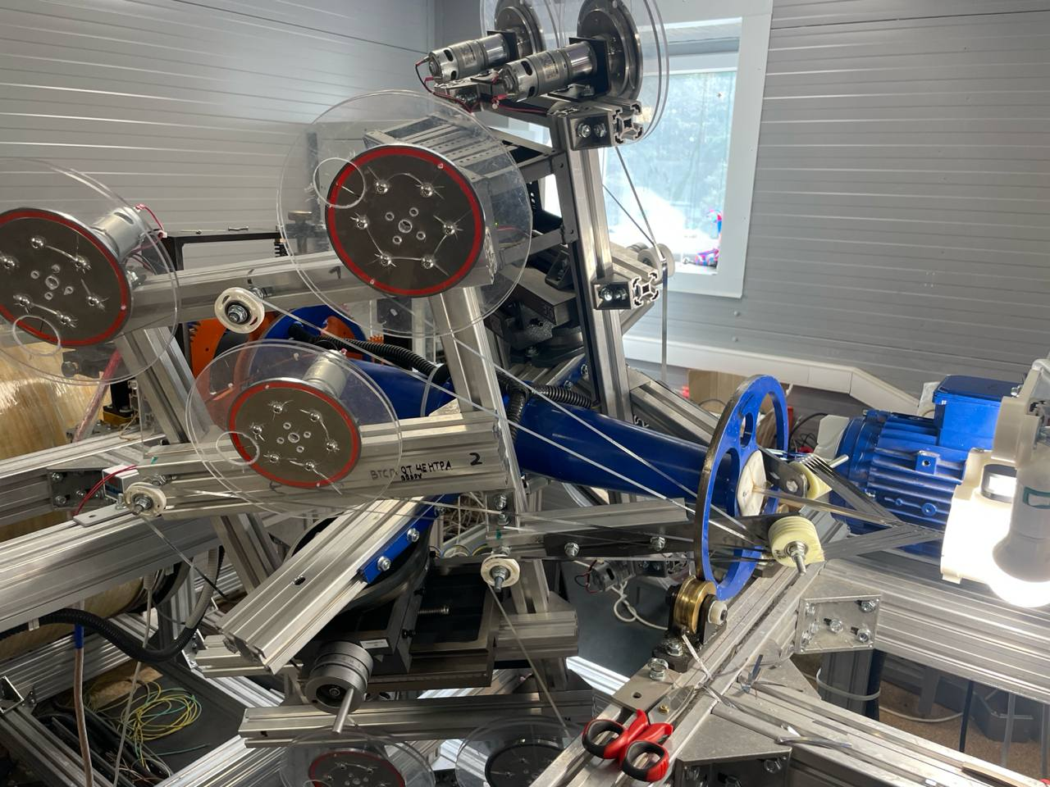
Flexible tapes tension system
Alushta-2025
Matyukhanov E.S.
7/11

Slide 8
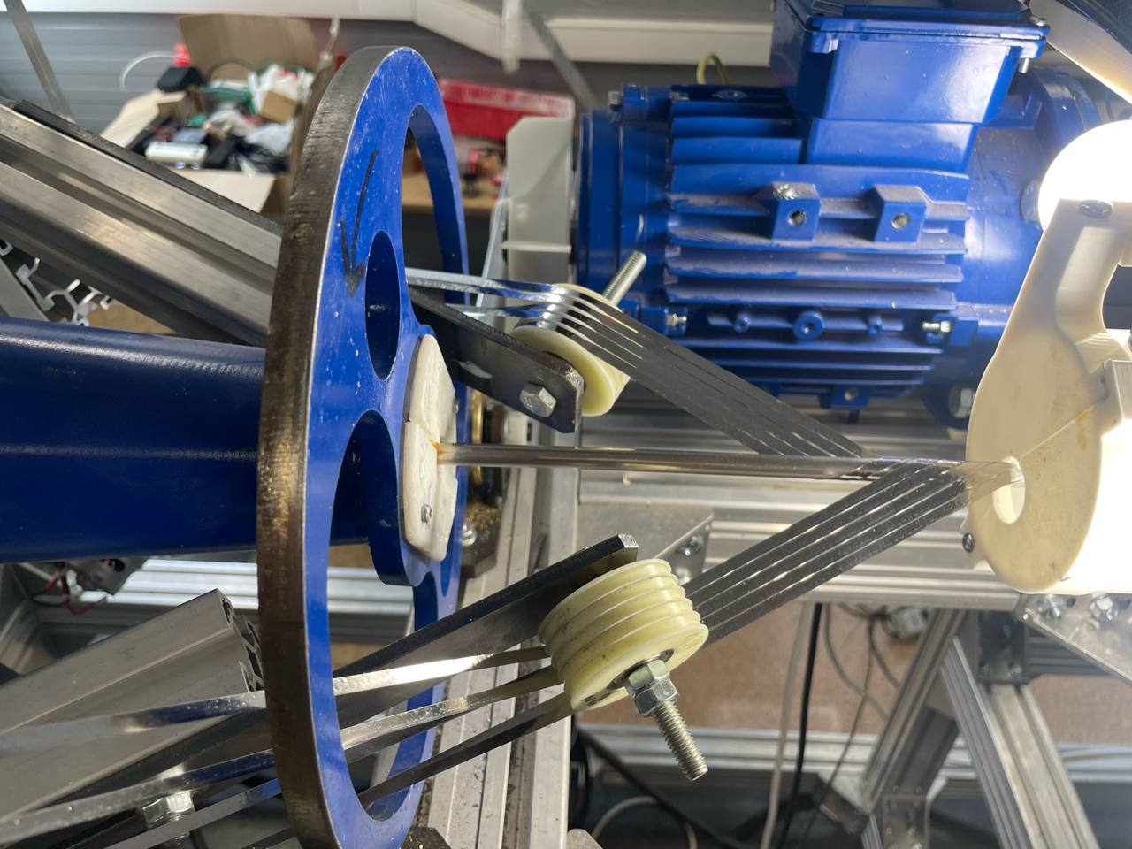
Several wrapping stations
Alushta-2025
Matyukhanov E.S.
8/11

Slide 9
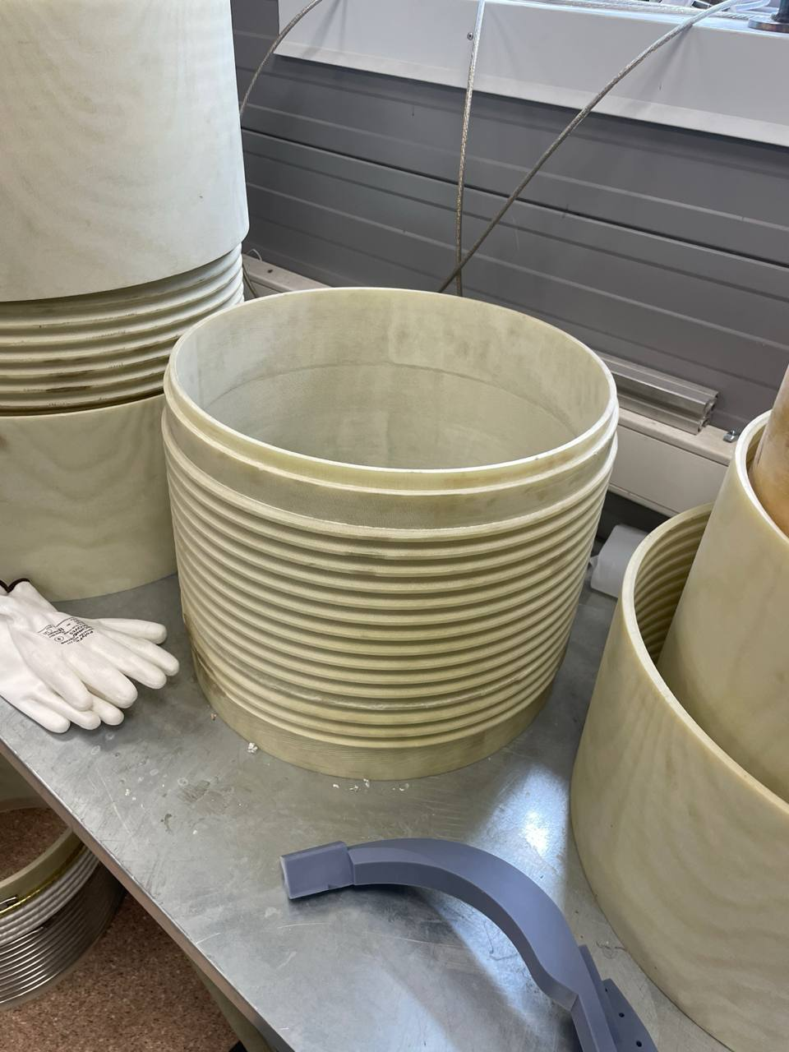
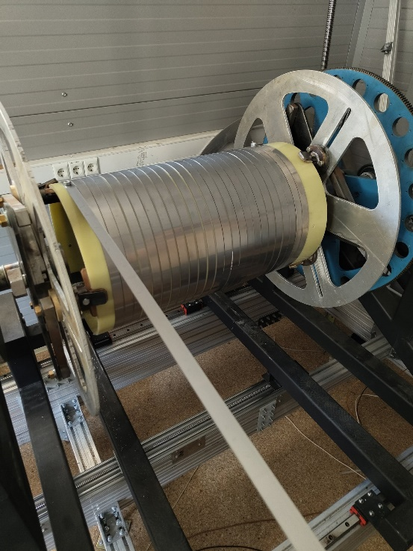
Possibility to wind on frames
Alushta-2025
Matyukhanov E.S.
9/11

Slide 10
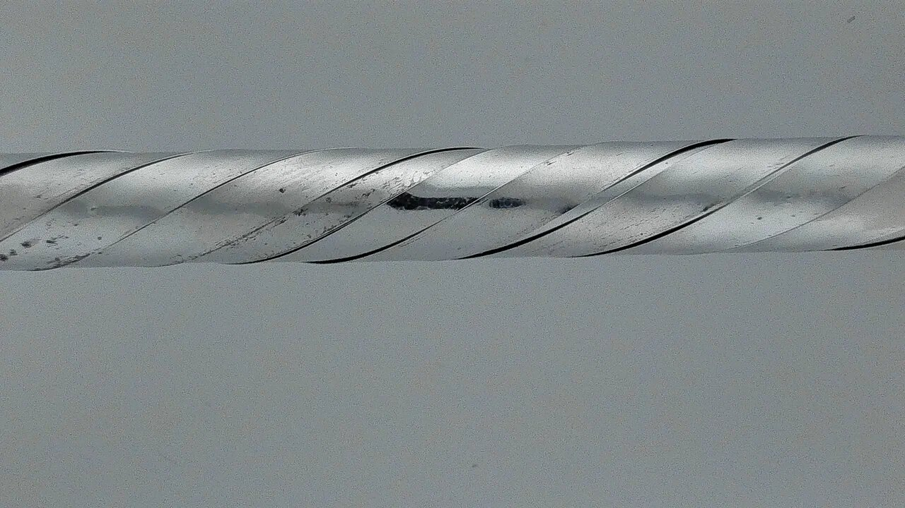
AI defect detection
Alushta-2025
Matyukhanov E.S.
10/11

Slide 11
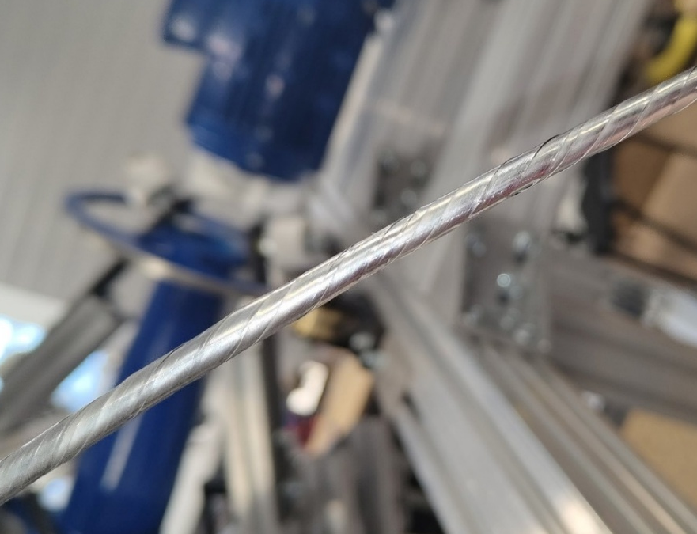
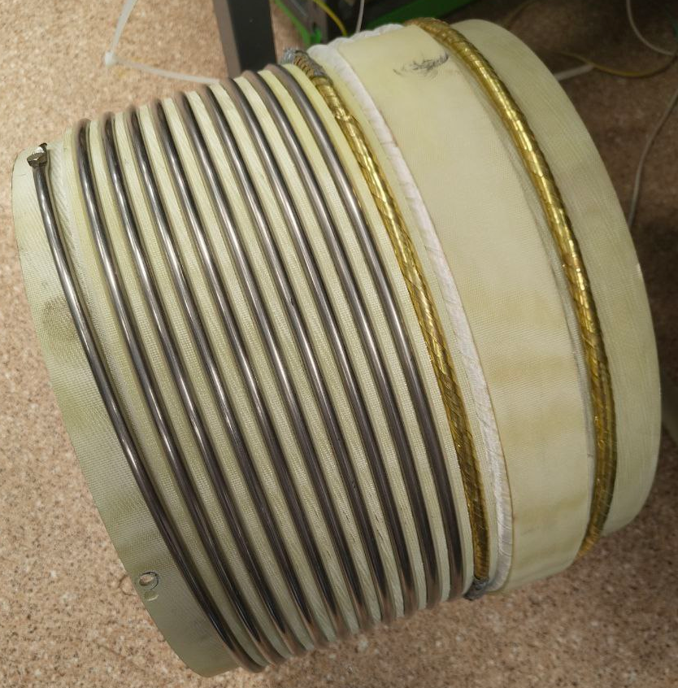
Manufactured cables
Impregnated HTS cables
HTS cable
Bandaged and impregnated HTS cables
Solenoid
Alushta-2025
Matyukhanov E.S.
11/11

Slide 12
Thanks for you attention!

