Slide 1
Distributed control system for the BM@N experiment
Alushta-2025
I. Osokin
on behalf of Slow Control group:
V. Dronik, V. Shutov, R. Nagdasev, D. Egorov
10.06.2025

Slide 2
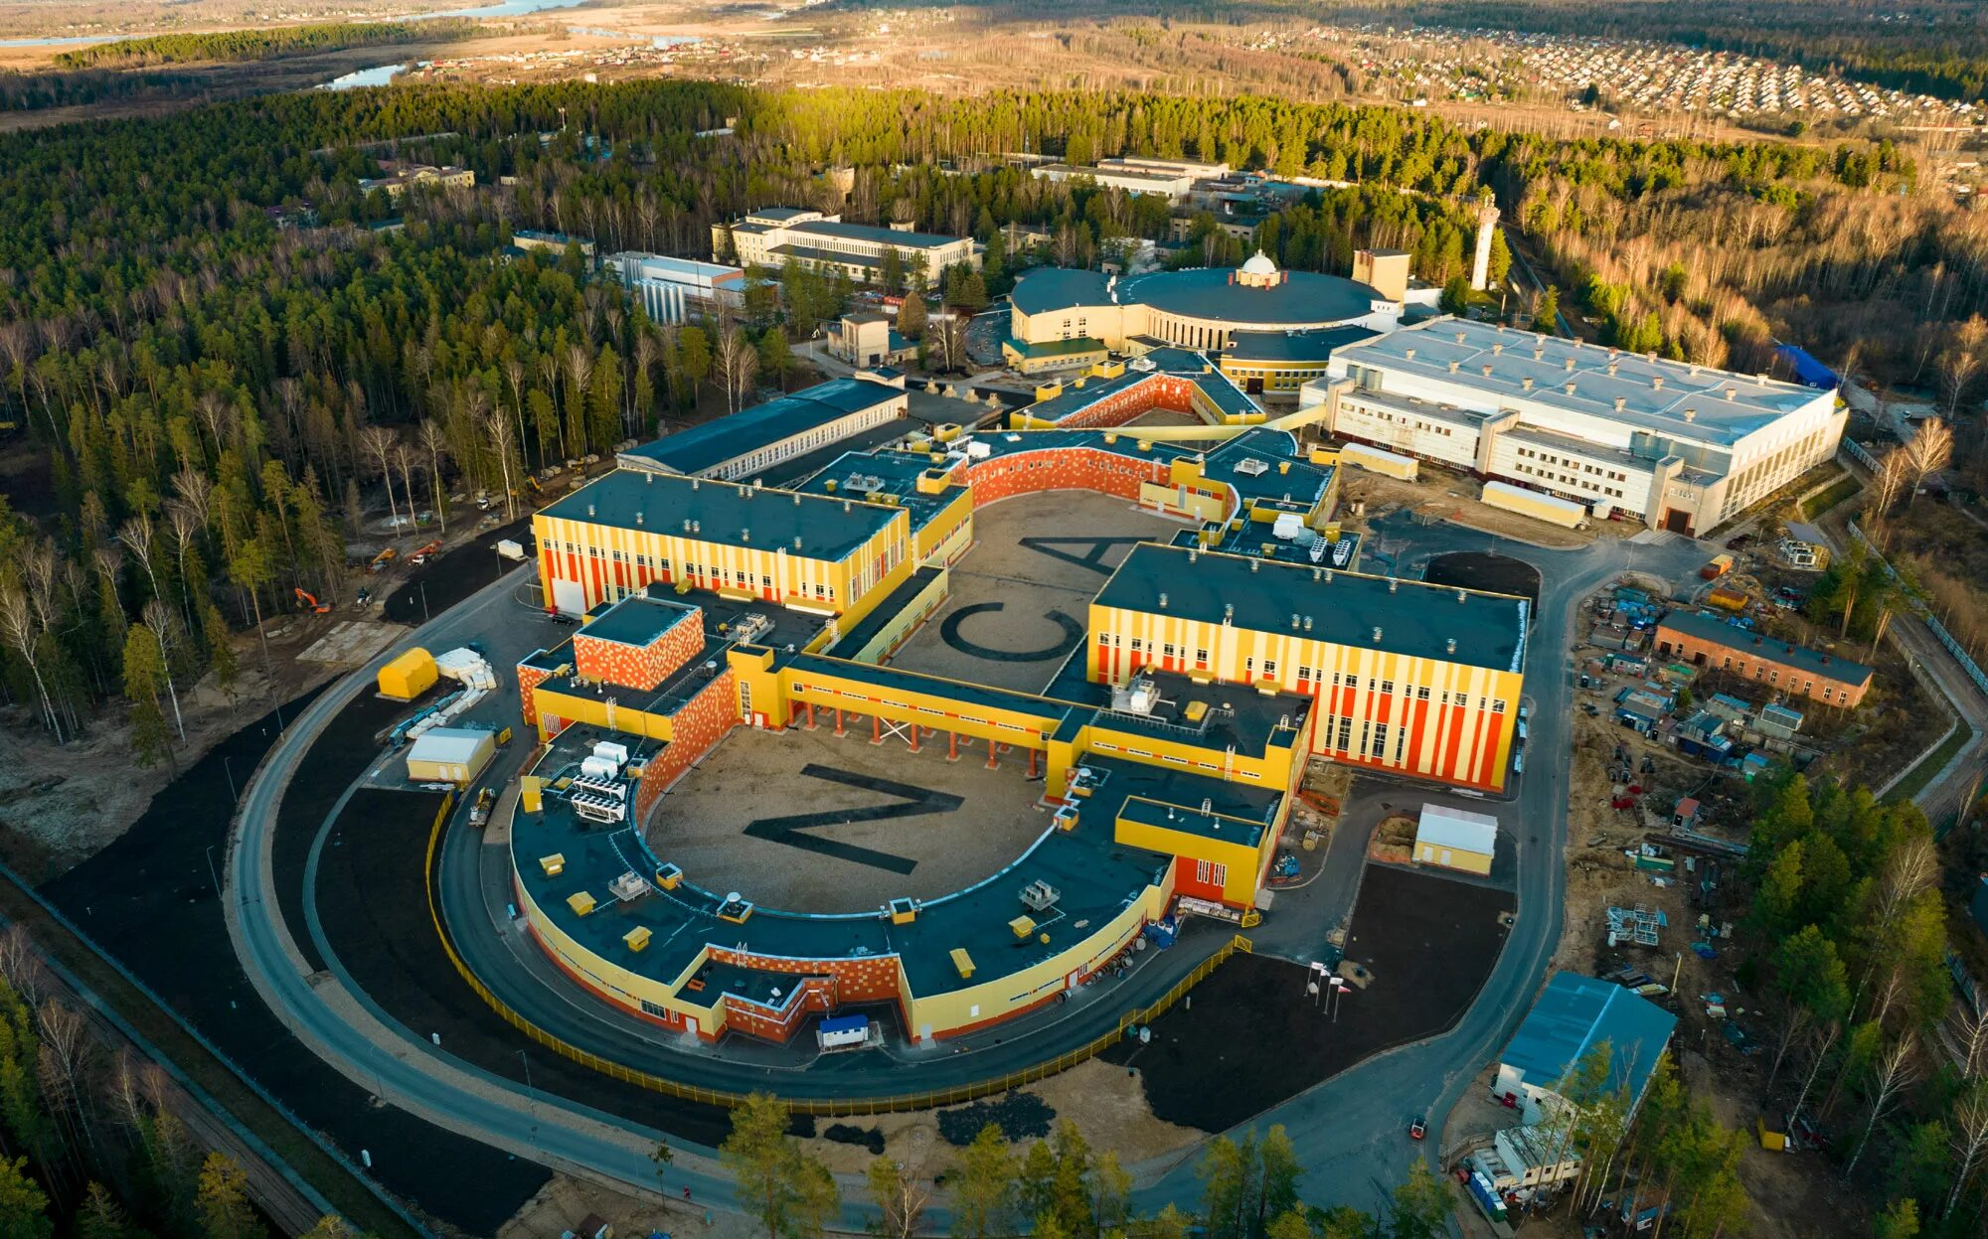
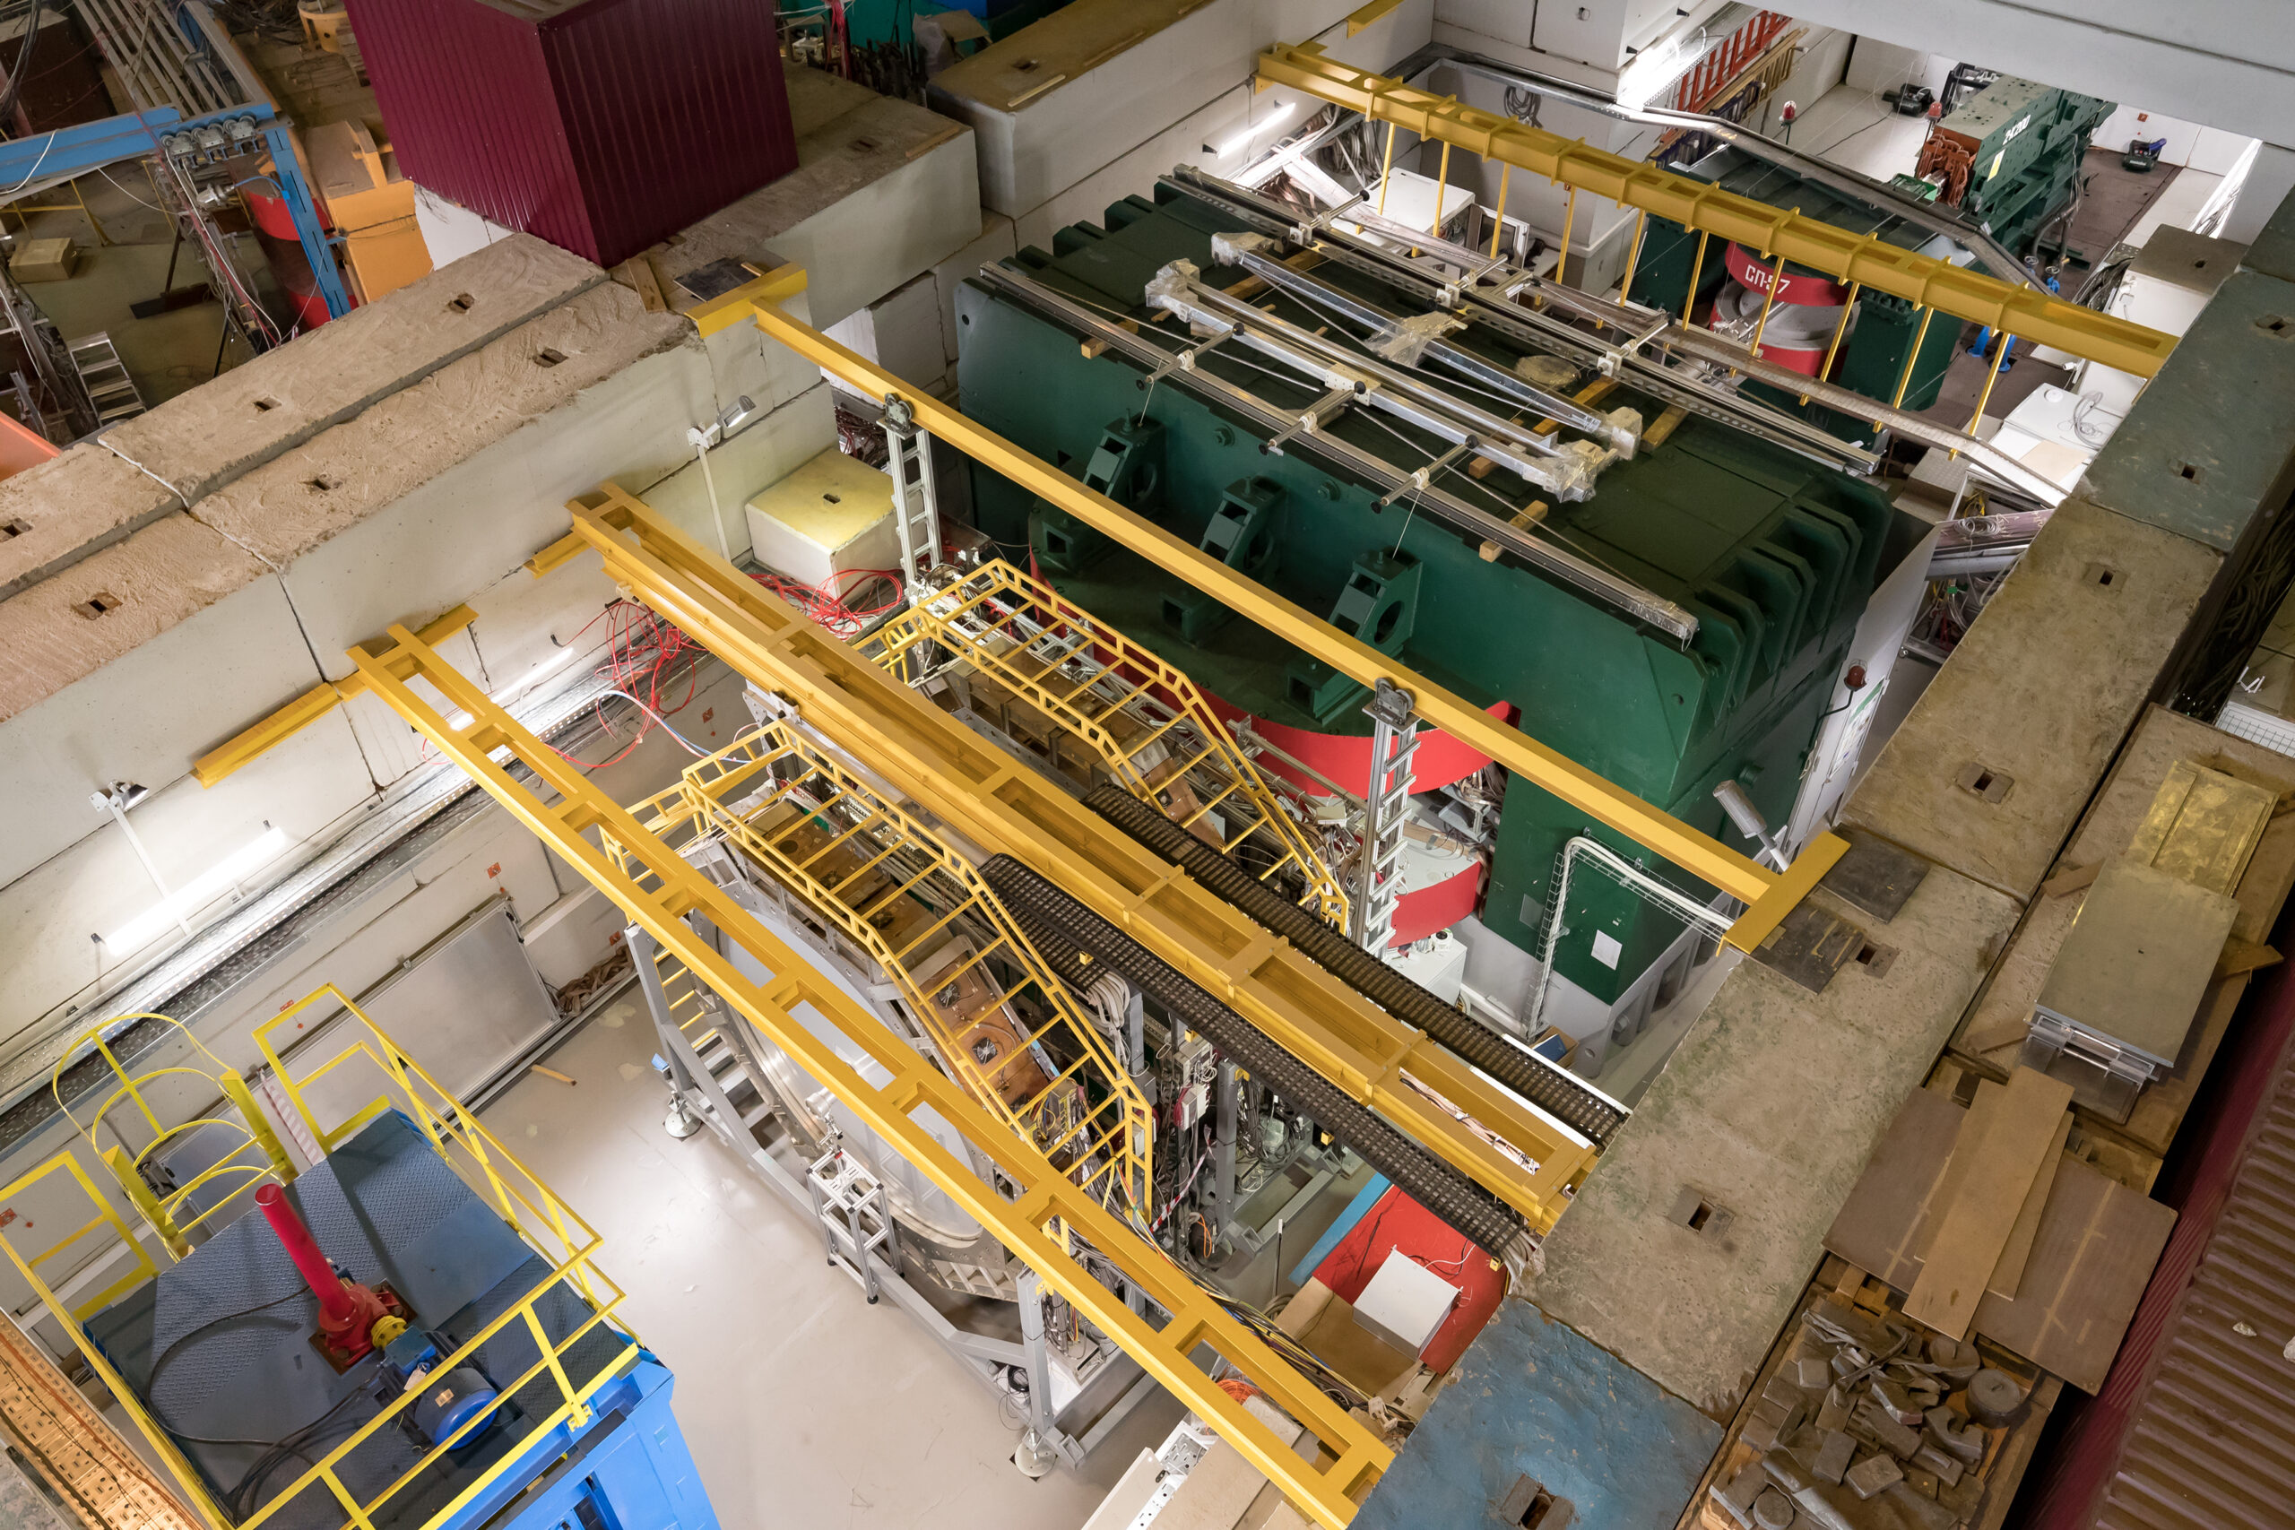
BM@N Experiment
BM@N experiential hall:
BM@N building in NICA complex

Slide 3
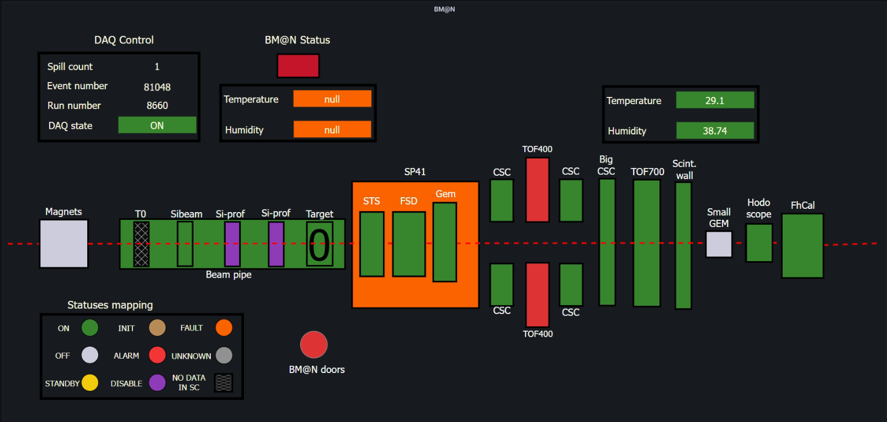
BM@N subsystems

Slide 4
What is Slow Control?
Monitoring of the experimental hardware;
Centralized control of the Slow Control equipment (LV, HV, gas flow etc.);
Archiving historical Slow Control data;
Alarm system.
Not a Slow Control:
Main data stream (data taking);
Event builder (reconstruction)/event display;
Data quality;
Run control.

Slide 5
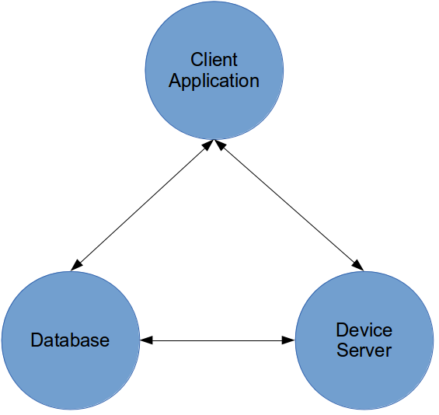
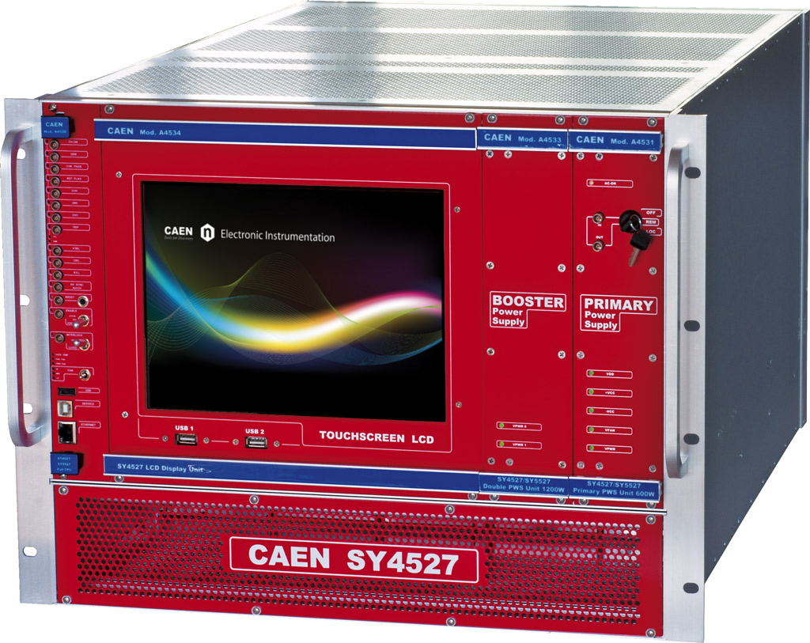
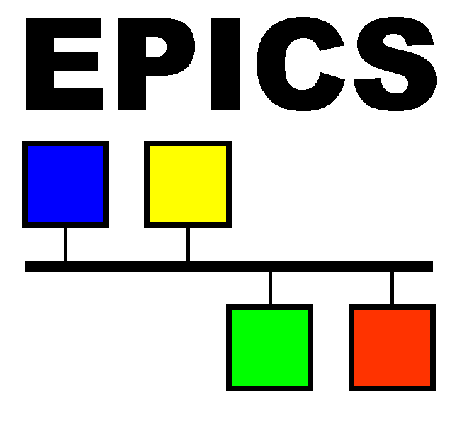
What is Slow Control?
Monitoring and controls for users
Data and command exchange
Tango-based Slow Control System has performed well in previous runs and will be used in the forthcoming run
What and how read from server?
DCS analogs:

Slide 6
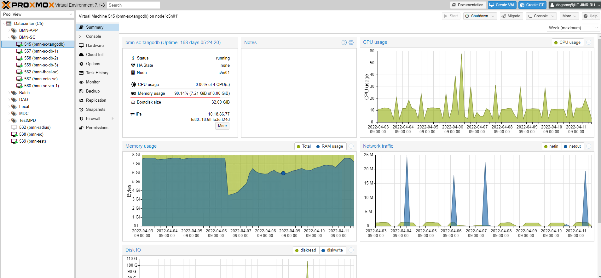
Infrastructure – computing, devices, interfaces
At present time the service layer tasks uses existing MPD/BM@N computing farm. Virtualization is done using PROXMOX Virtual Environment.
All centralized services are running on dedicated VM’s
Front-end layer includes a wide variety of devices which are uses different buses and protocols, such as PXI, Ethernet, RS-485, RS232 etc.

Slide 7
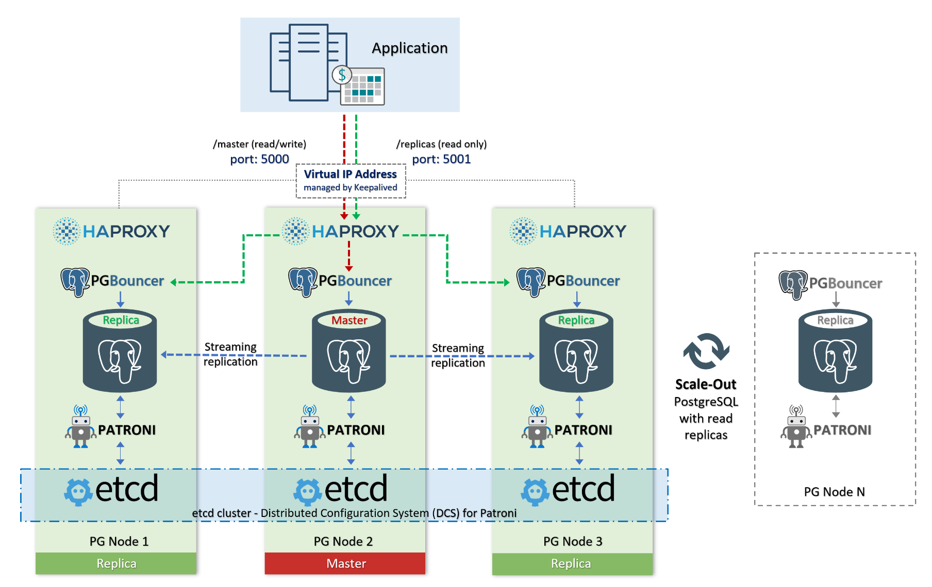
Database cluster

Slide 8
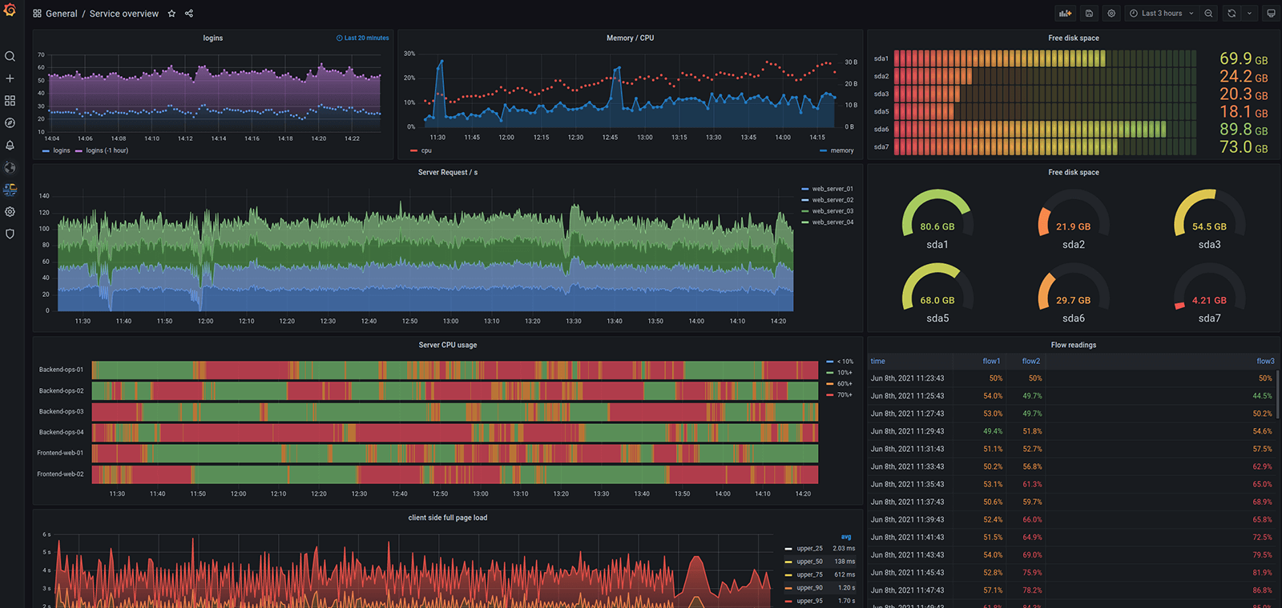
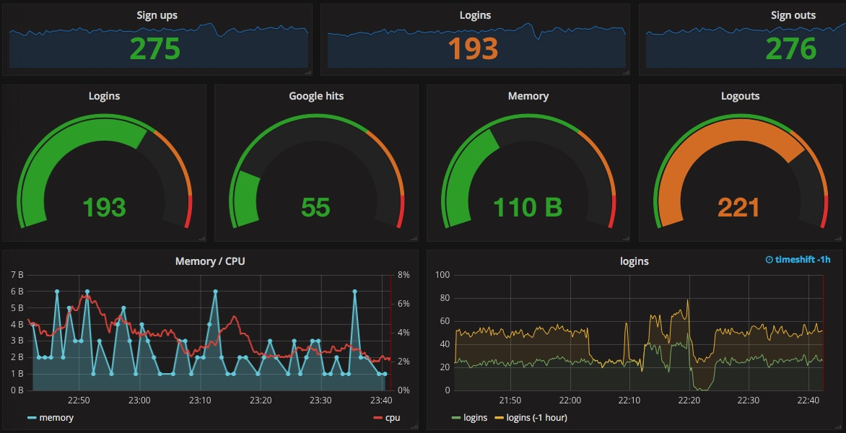
Data visualization
Grafana is a free software data visualization system focused on IT monitoring systems data. It is implemented as a "dashboard" style web application with charts, graphs, tables, alerts.

Slide 9
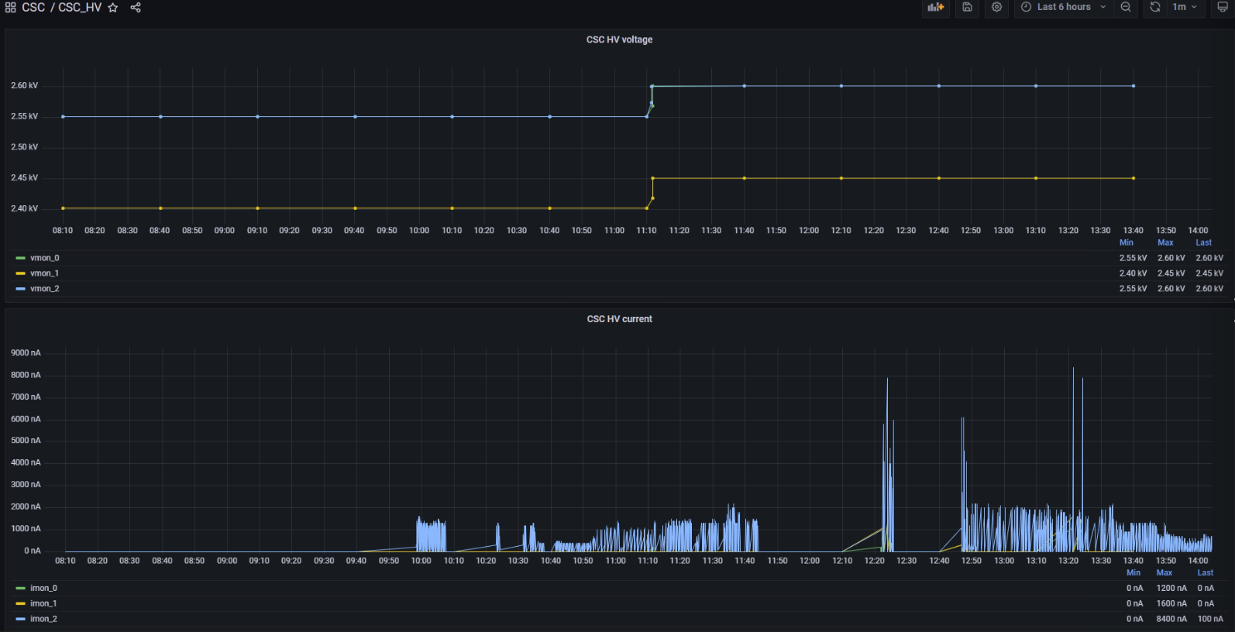
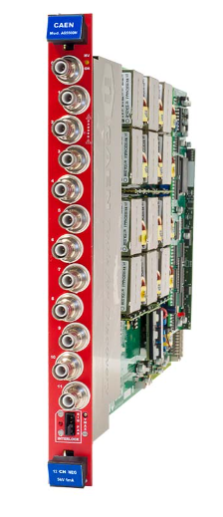
HV system of FSD, GEM, BT
TCP/IP
Historical
DataBase
TANGO device server

Slide 10
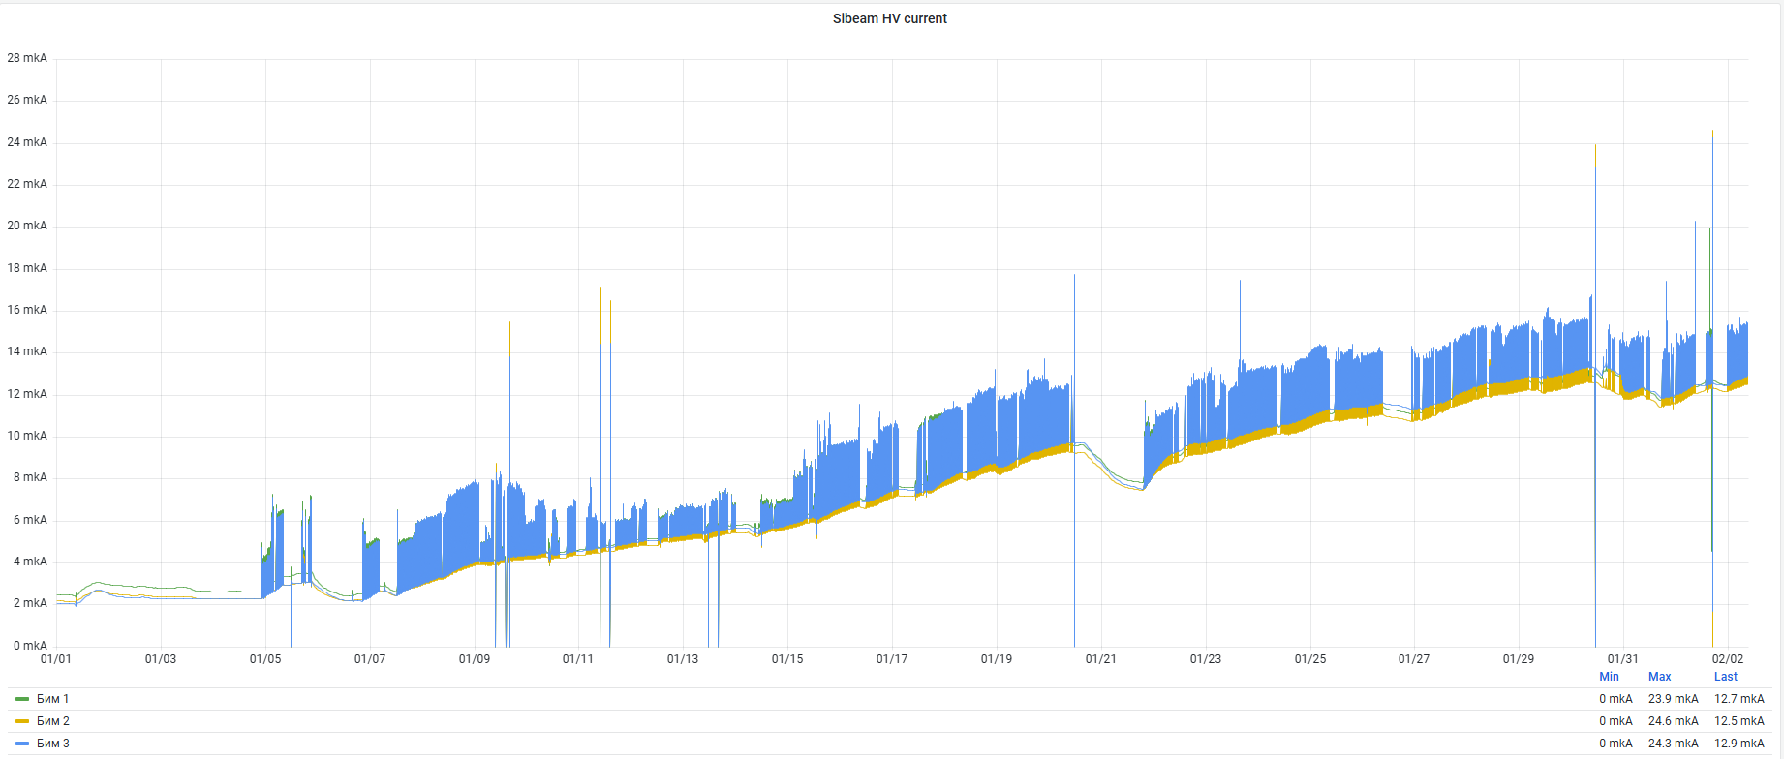
HV system of FSD, GEM, BT
The average value
of the dark current at the beginning of the session is 0.761 µA, measured at a temperature of
+22.5°C; the average value of the dark current at the end of the session, for a reason radiation damage, is 12.7 µA,
The change in detector currents at three beam tracker stations during the 2022-2023 session is shown.

Slide 11
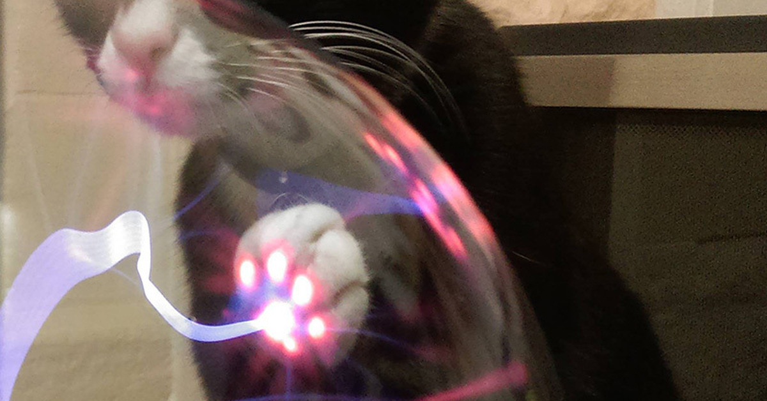
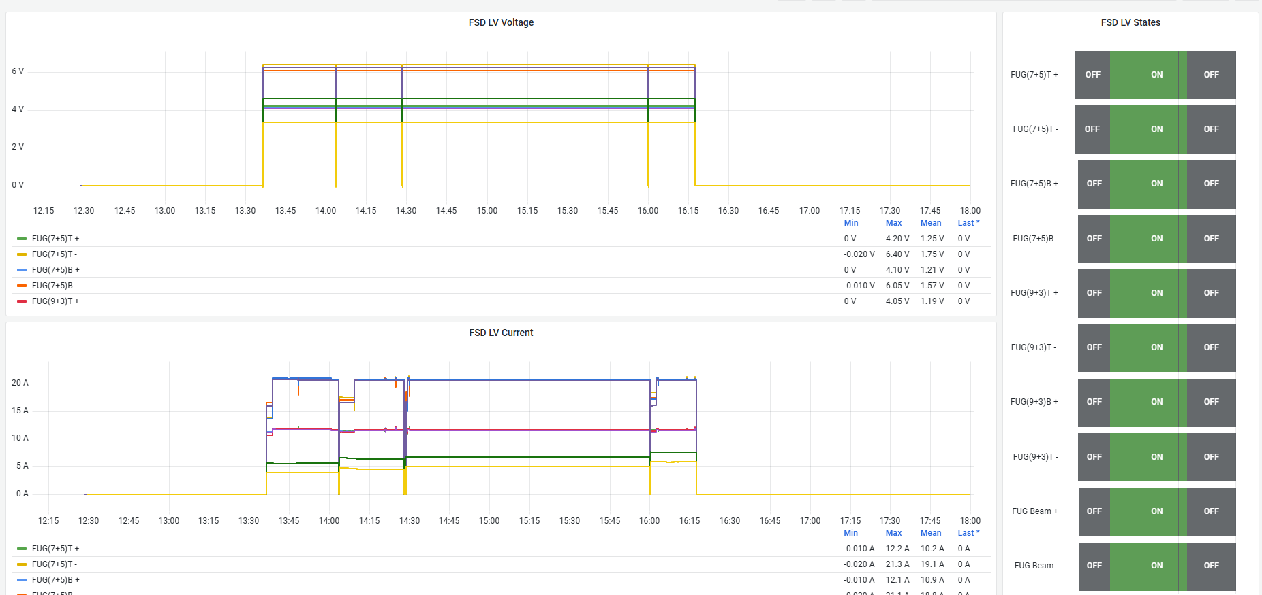
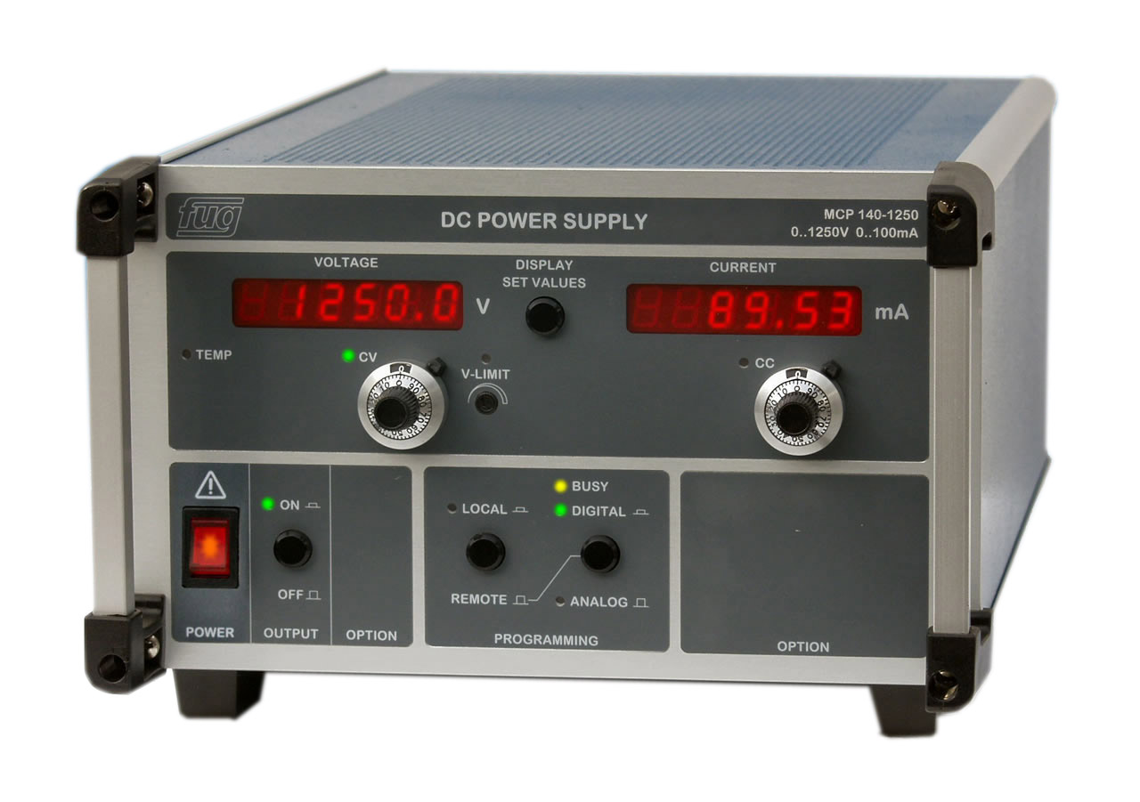
LV system of FSD, GEM, BT
Historical
DataBase
TANGO device server
TCP/IP

Slide 12
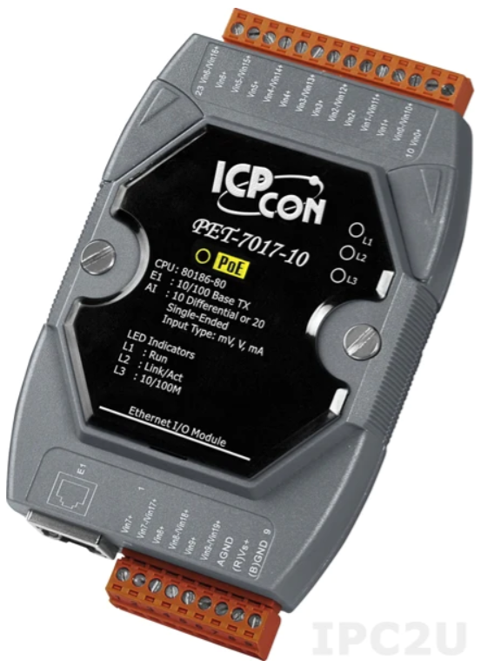
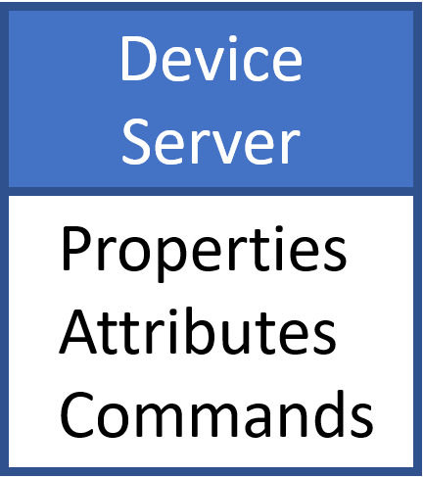
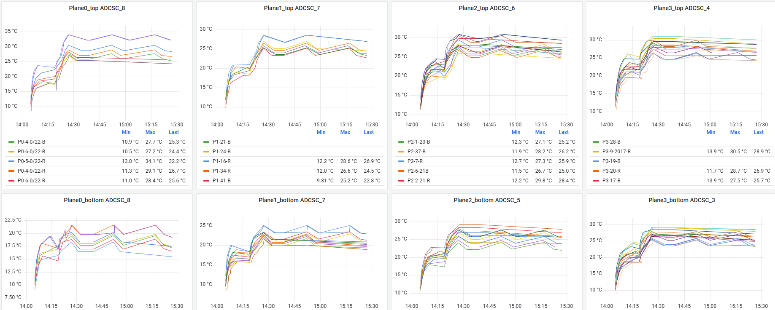
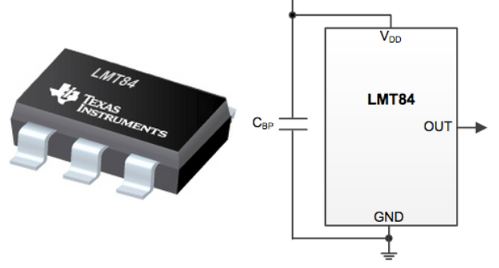
FSD FEE temperature
HDB
TCP/IP
TCP/IP

Slide 13
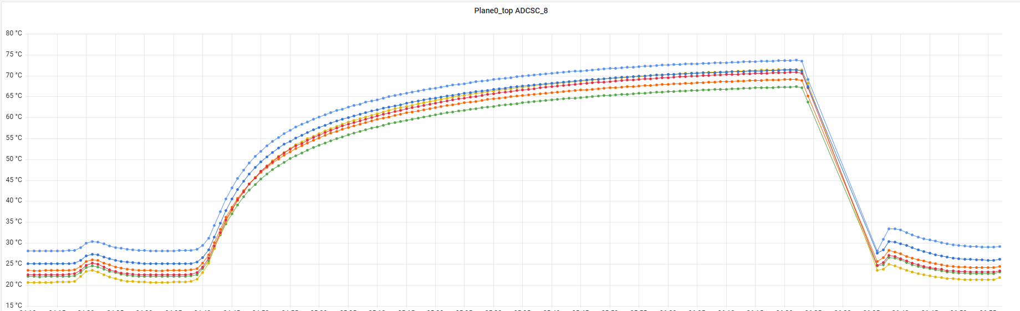
FSD Autoswitch system
Temperature heating over 80˚C
Increasing dark currents of silicon detectors

Slide 14
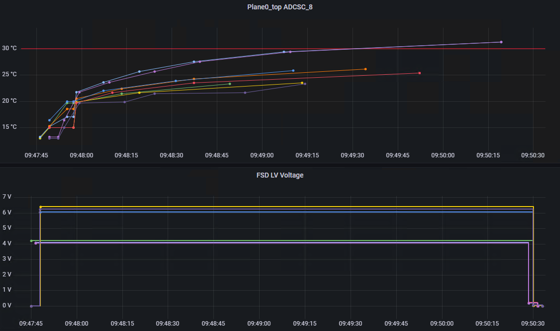
FSD Autoswitch system
Temperature threshold
Delayed automatic
LV shutdown

Slide 15
FSD Autoswitch system
Temperature threshold
Delayed automatic
LV shutdown

Slide 16
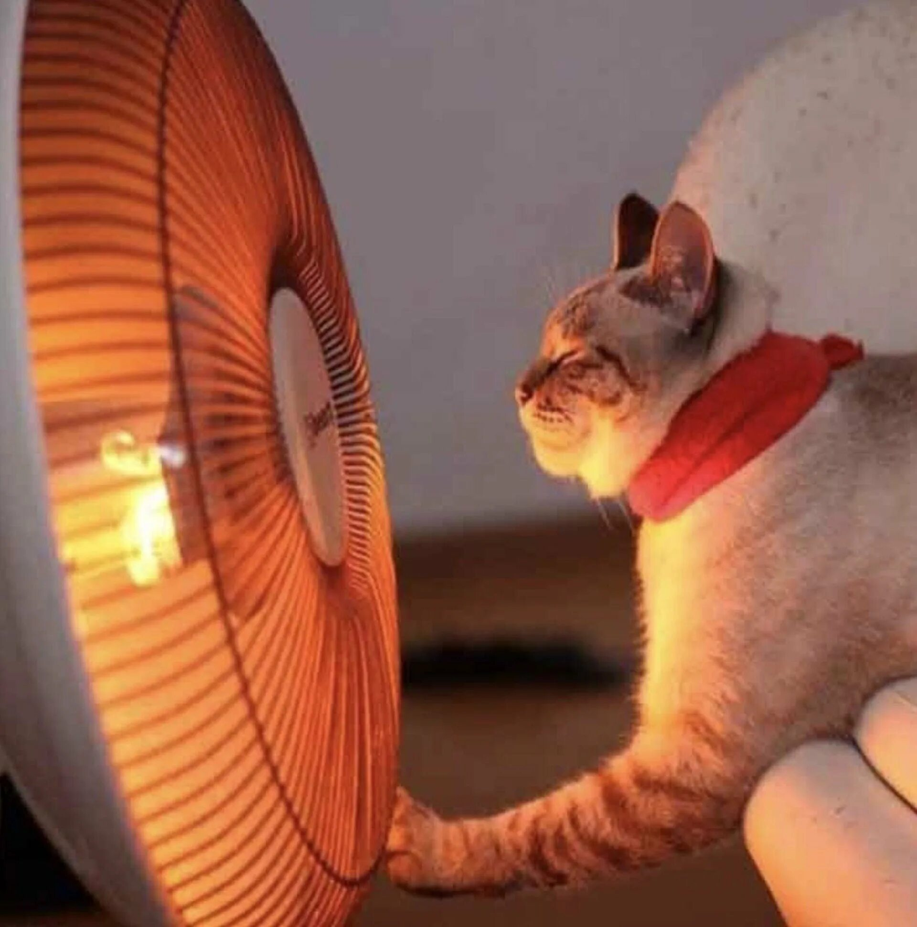
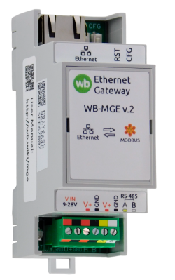
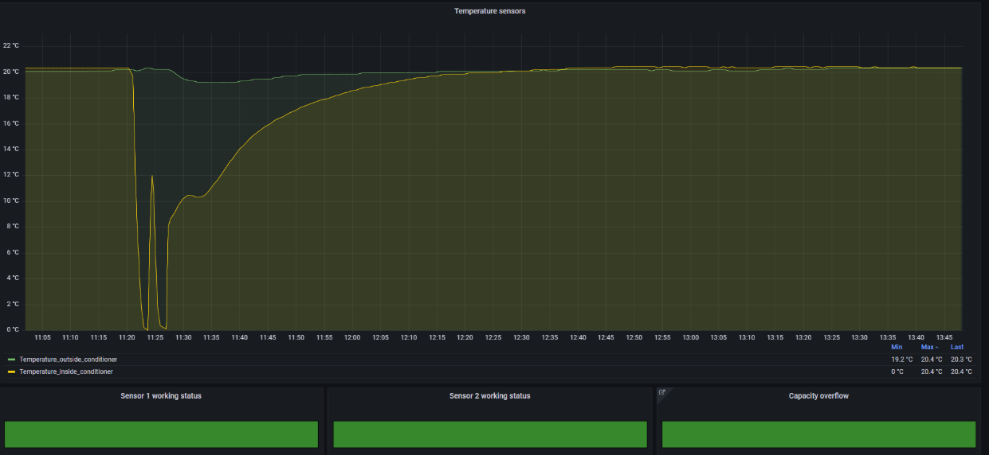
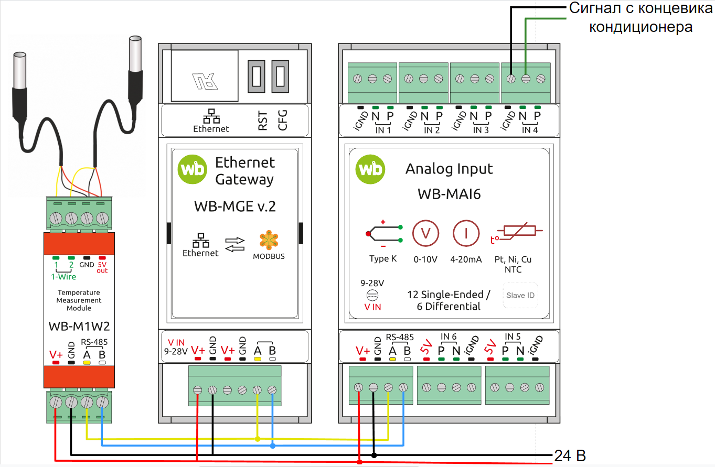
FSD Conditioner monitoring
Historical
DataBase
TCP/IP
TANGO device server
MAI6 & WB M1W2 Measurement modules
Modbus RTU

Slide 17
Conclusions
Thank You for attention!

Slide 18
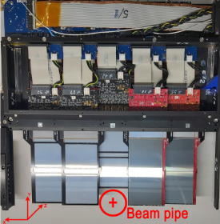
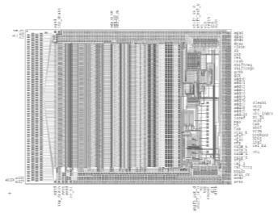
FSD – Forward Silicon Detector
63
63
639
n+ side
0
0
p+ side
639
126
ASIC VATAGP7.2 (5 chips on each side of module)
Number of CSA: 128 channels Dynamic range: ±30 fC
Peaking time (slow/fast shaper): 500 ns/ 50ns Noise (ENC): 70e +12e/pF (typ.) Voltage supply: +1,5 V, -2,0 V
Gain from input to output buffer: 16,5 µA/fC Output Serial analog multiplexer clock speed: 3,9 MHz
Power dissipation per channel: 2,2 mW
FEE board
Pitch Adapter (n+) side
Number of channels: 640 Value of poly-Si resistors: ≈ 1 MΩ
Value of integrated capacitors: ≈ 120 pF Capacitor working voltage: 100 V Capacitor breakdown voltage: >150 V Manufactured by ZNTC (Zelenograd)
Coordinate plane from double side Si-modules
7/12
Notes:
(сделать обозначения и показать стрелками)

Slide 19
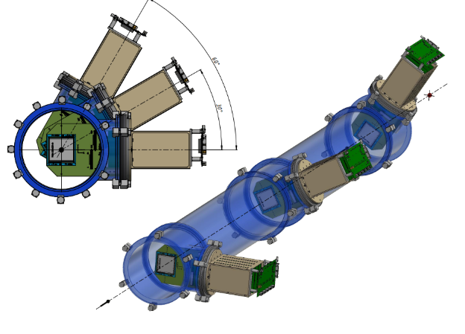
SiBT – Silicon Beam Tracker
SiBT 3
SiBT 3
SiBT 2
SiBT 1
SiBT 2
SiBT 1
16/20

