Slide 1
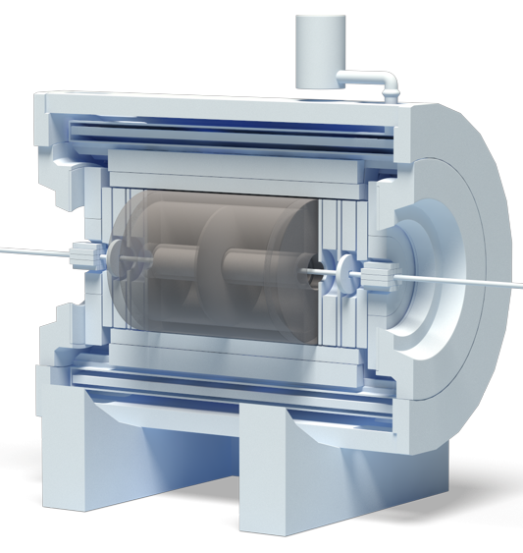
JINR Association of Young Scientists and Specialist Conference “Alushta-2025“ Remote access and synchronization subsystem of electronics cards for the TPC/MPD Detector of the NICA project
Denis Potapov, an engineer of the
TPC/MPD group, VBLHEP, JINR
Alushta, 2025

Slide 2
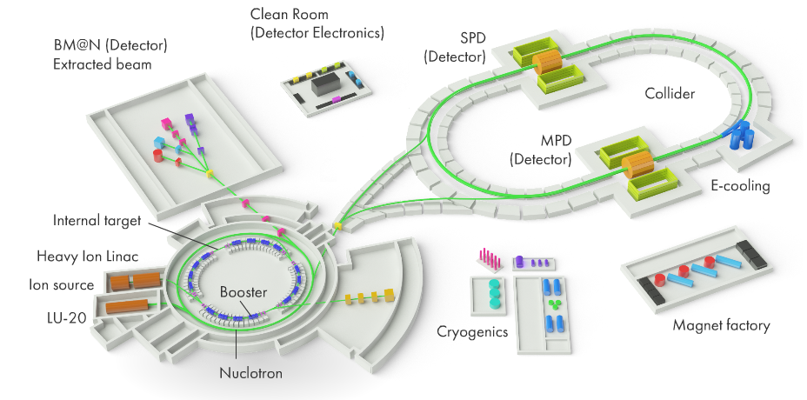
NICA Complex
Multi Purpose Detector (MPD) Hall
General scheme and photo of the NICA complex
https://nica.jinr.ru/
https://mpd.jinr.ru/

Slide 3
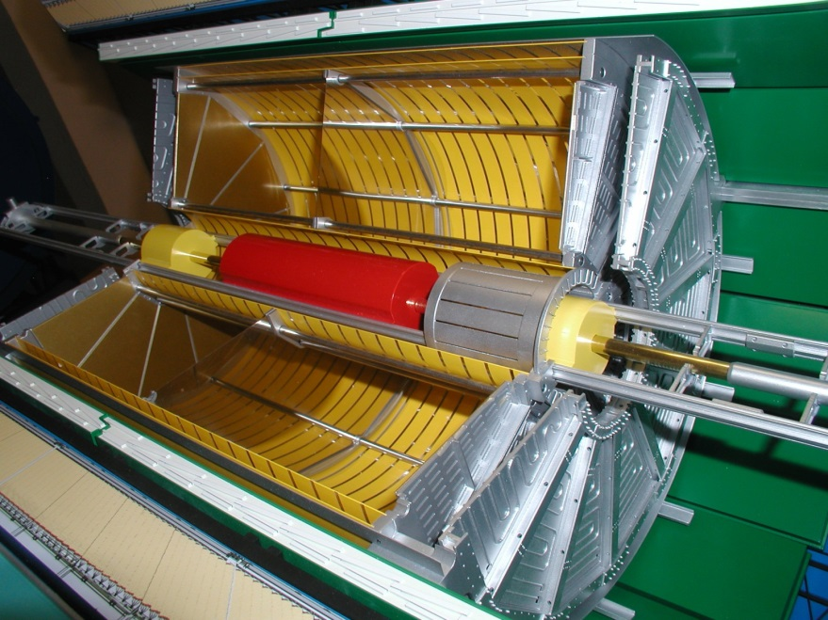
TPC/MPD Detector of NICA Complex
1. Front-End Cards (FECs) position;
2. End cap thermal screen;
3. Read-Out Chamber (ROC) based on MWPC;
4. High Voltage (HV) electrode;
5. Field cage position.
3
4
5
2
1
MPD mockup
Time-Projection Chamber (TPC)

Slide 4
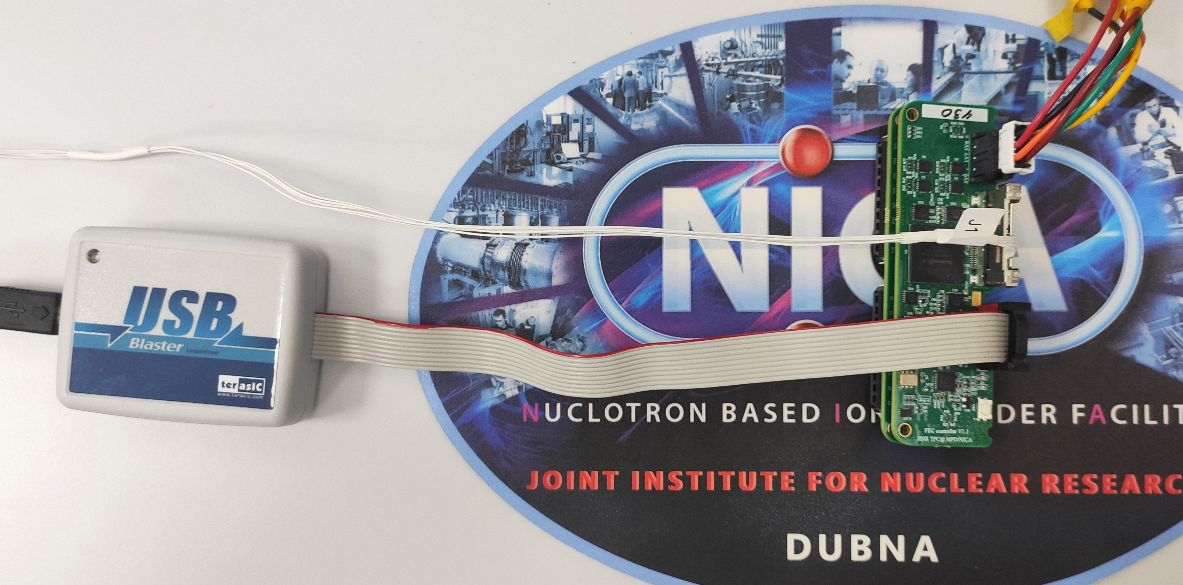
FECs integration on ROC
FEC connection
for access & synchronization
Micro coaxial cables assemblies
24 ROCs –
1488 FECs –
95 232 ch.
JTAG programmer
FEC assembly
Test setup of 62 FECs on 1 ROC
SAMPA FEC
FEC controller

Slide 5
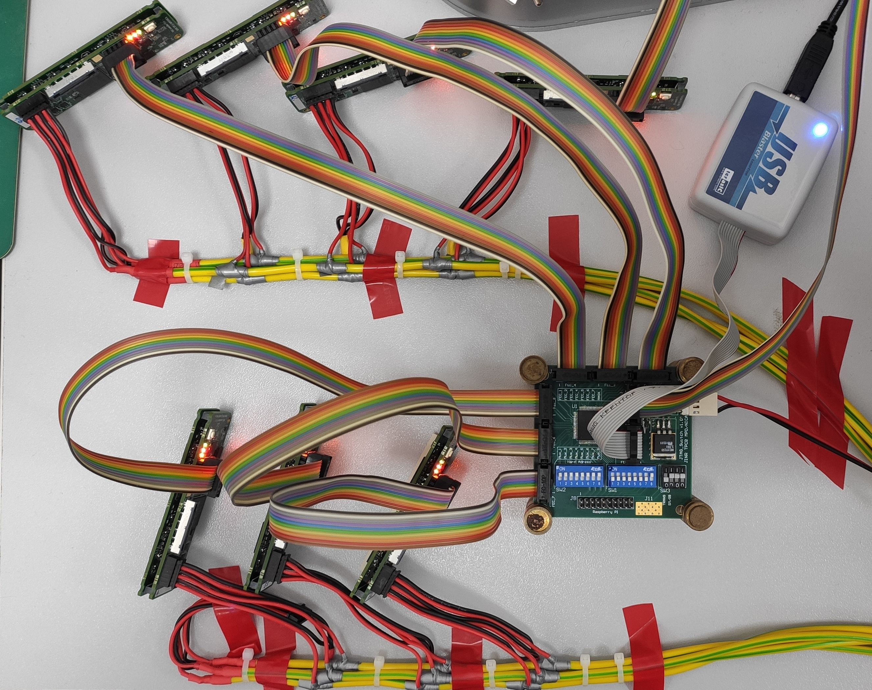
Prototype of remote access unit
Tested prototype
This remote access prototype unit uses JTAG (up to x7 FECs) for:
FPGA reprogramming;
FPGA debugging;
An additional channel for accessing the digital part of the Data acquisition subsystem (DAQ).
Test setup for remote access prototype unit

Slide 6
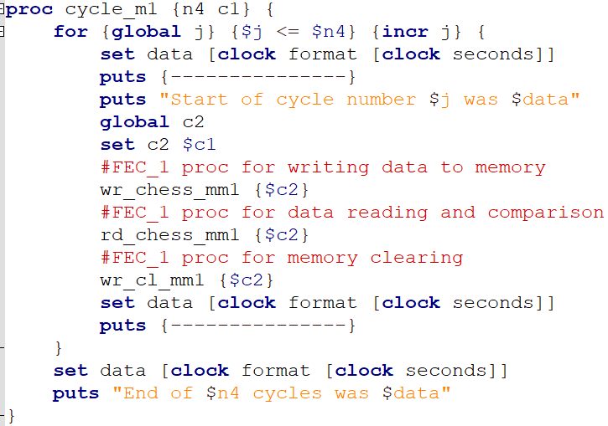
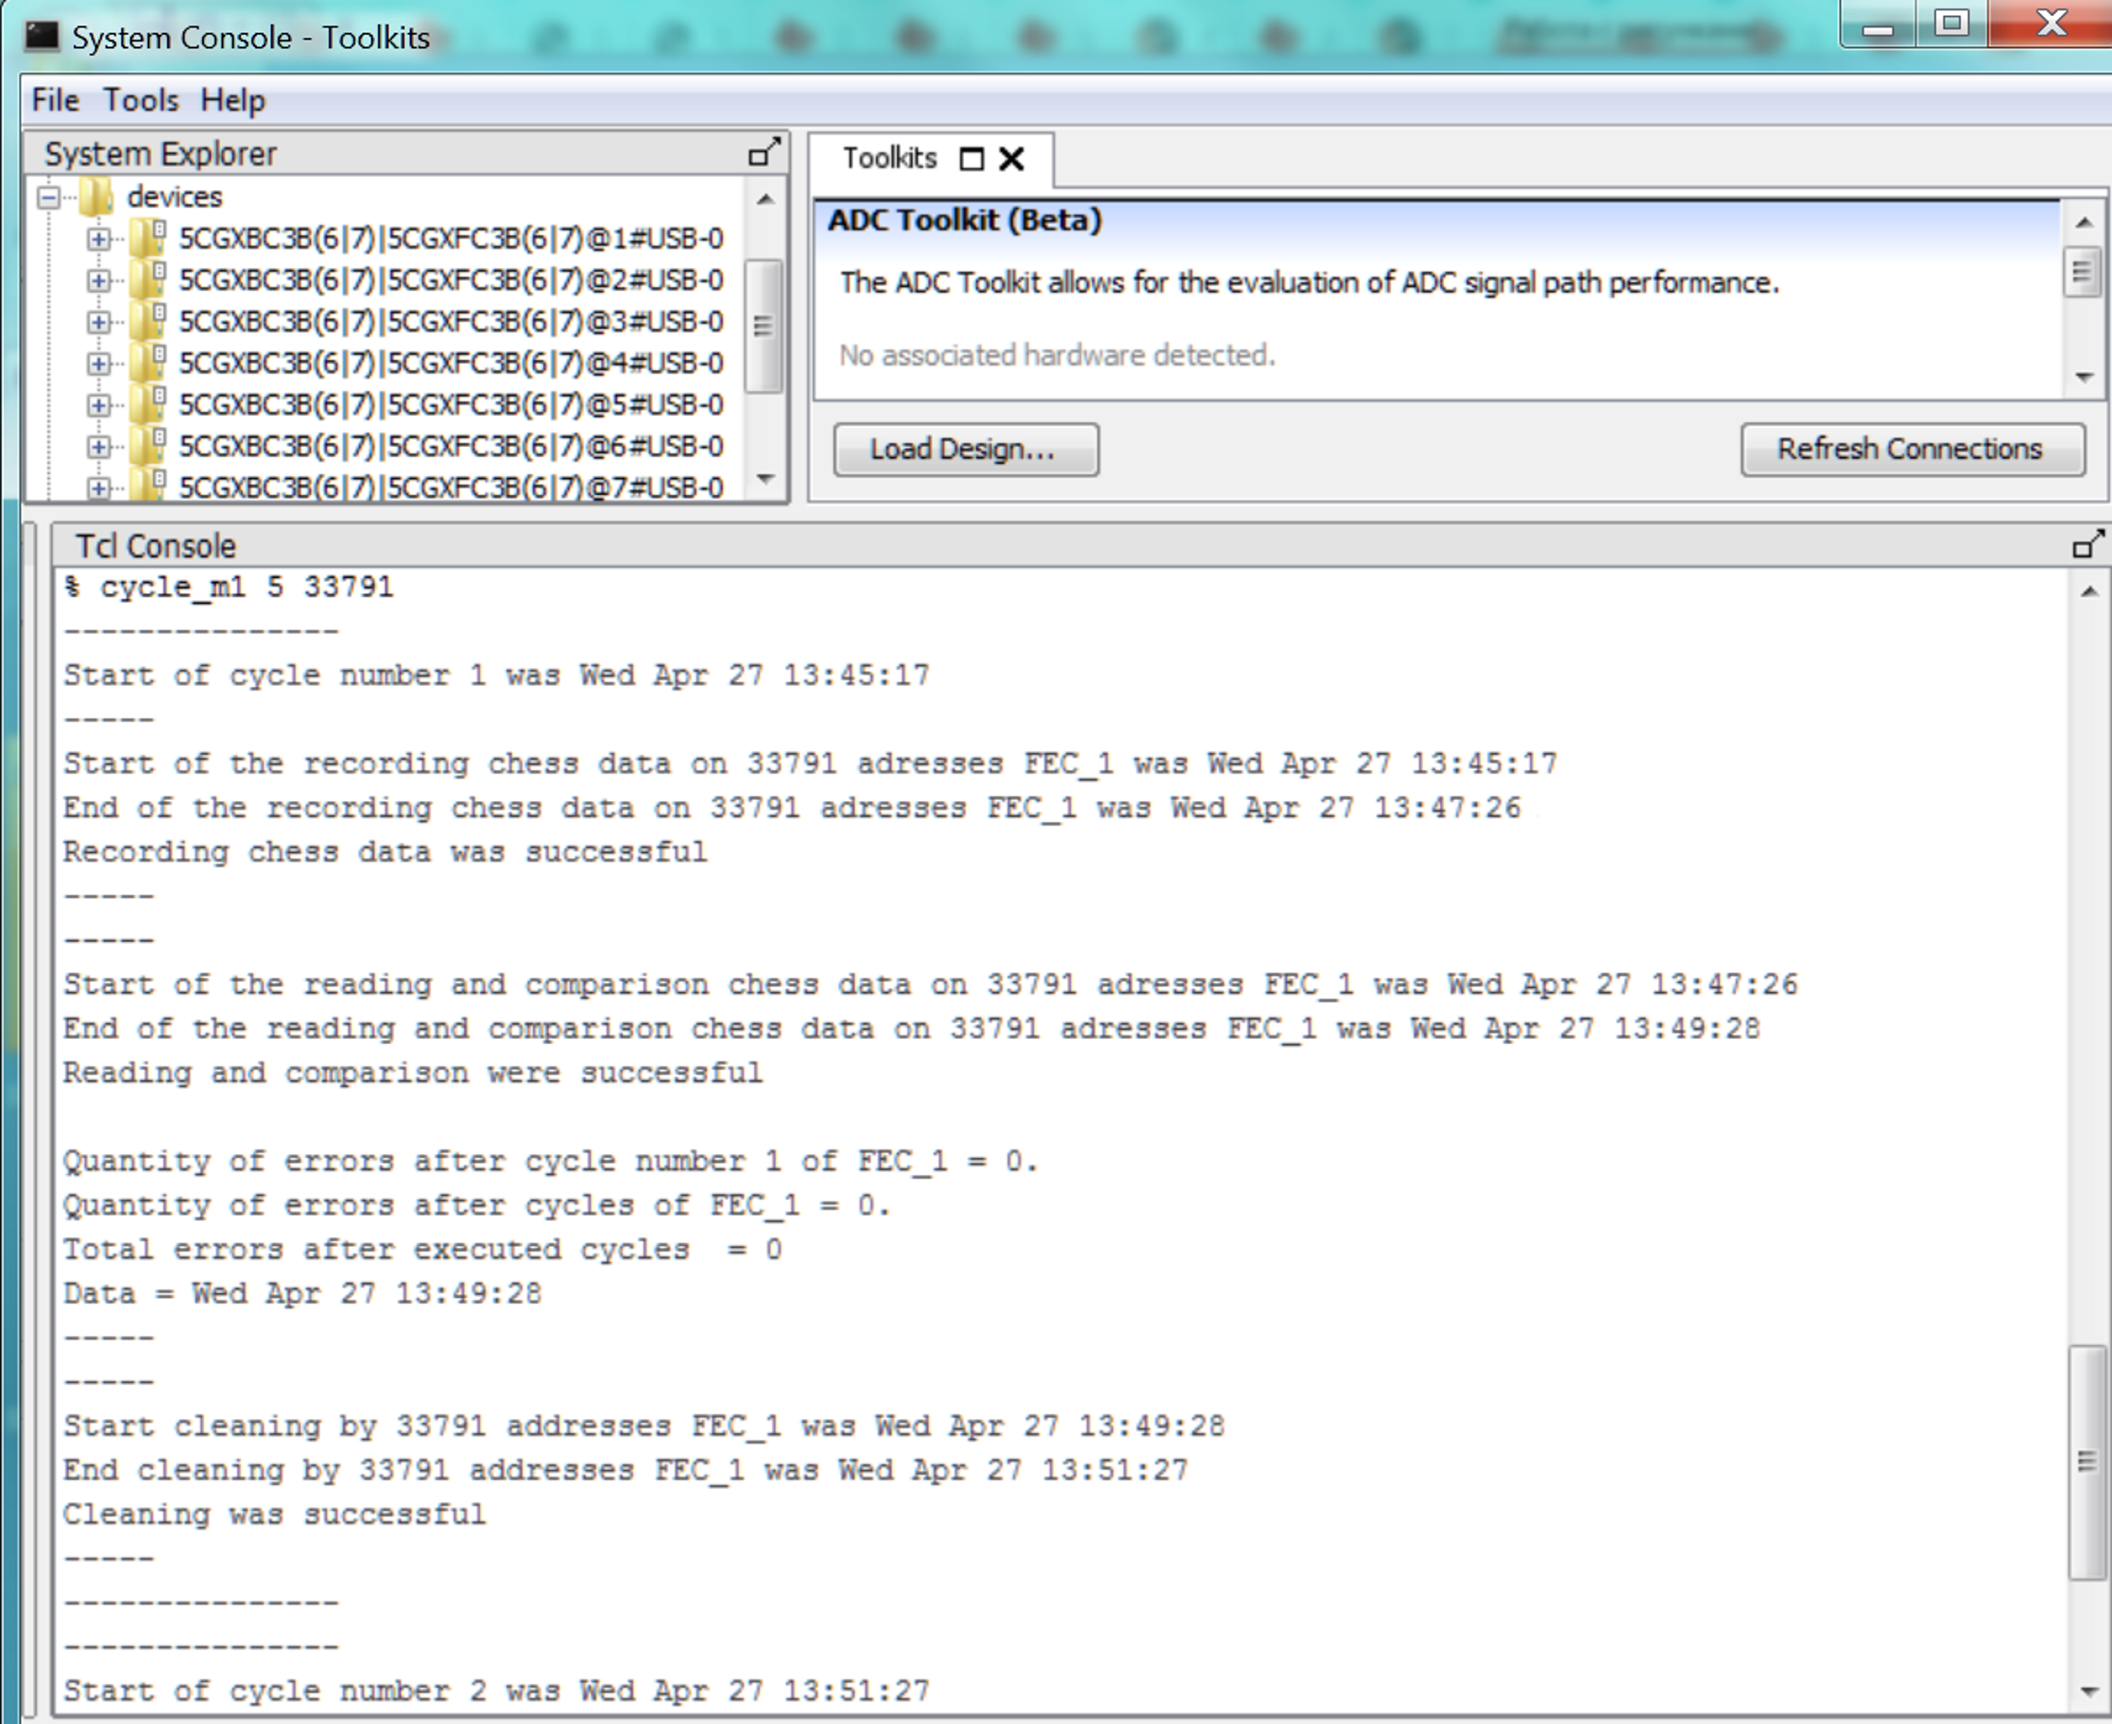
Testing of prototype remote access unit
Procedure for verifying the data in RAM memory of FPGA
System Console window in Quartus

Slide 7
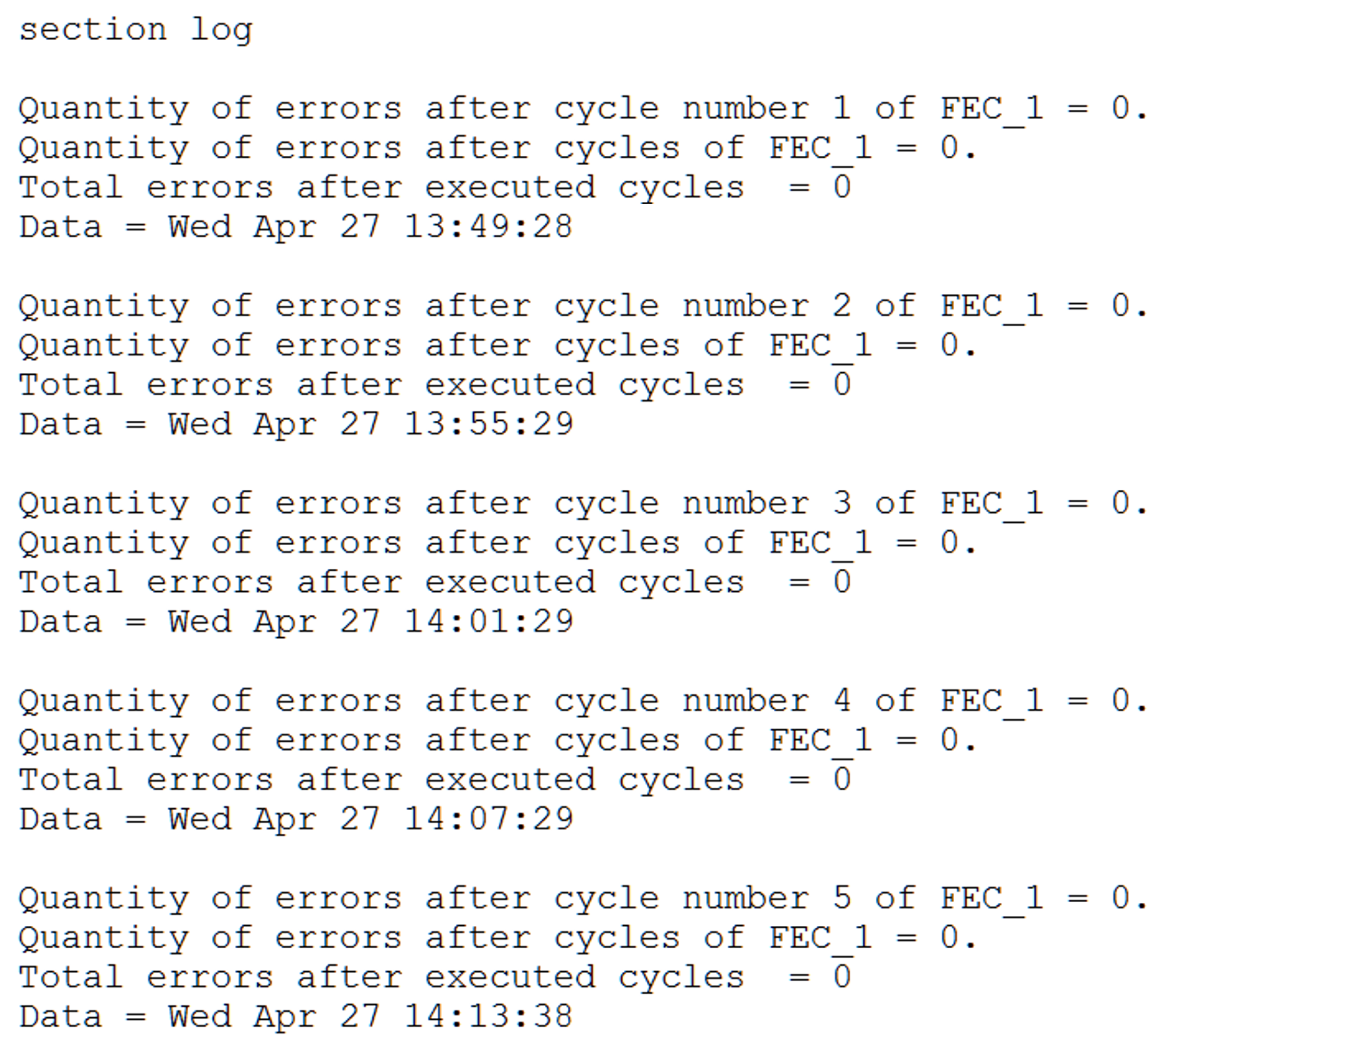
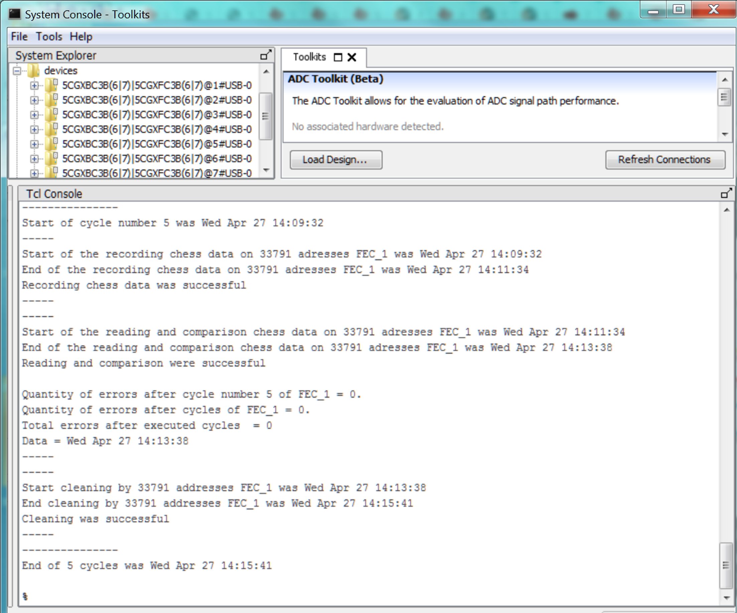
Testing of prototype remote access unit
Errors recording file
during the procedure execution
System Console window in Quartus

Slide 8
Block diagram of remote access unit for Control & Synchronization Subsystem
FEC_1
JTAG
JTAG
Out con. (JTAG)
JTAG
FPGA
JTAG programmer
Out con. (JTAG)
7-port multidrop microchip
JTAG via LVDS
6
JTAG via LVDS
…
…
6
FEC_6
JTAG Switch
Out con. (JTAG)
JTAG
FPGA
JTAG
Tested prototype
Remote access module for 1 ROC chamber

Slide 9
Block diagram of remote access unit for Control & Synchronization Subsystem
FEC_1
JTAG
JTAG
Converter Optic - LVCMOS
Out con. (JTAG)
JTAG
FPGA
JTAG programmer
7-port multidrop microchip
JTAG via LVDS
6
JTAG interface
via optic
…
…
6
FEC_6
JTAG Switch
Out con. (JTAG)
JTAG
FPGA
JTAG
JTAG
7-port multidrop microchip
Total 62 cards FEC
+ 1 controller RCU
on ROC (+3 reserve)
11
…
…
JTAG Switch
FEC_61
Outside
MPD magnet
Inside
MPD magnet
JTAG
7-port multidrop microchip
Out con. (JTAG)
JTAG
FPGA
JTAG via LVDS
6
…
…
JTAG Switch
6
RCU
Remote access module for 1 ROC chamber
Out con. (JTAG)
JTAG
FPGA

Slide 10
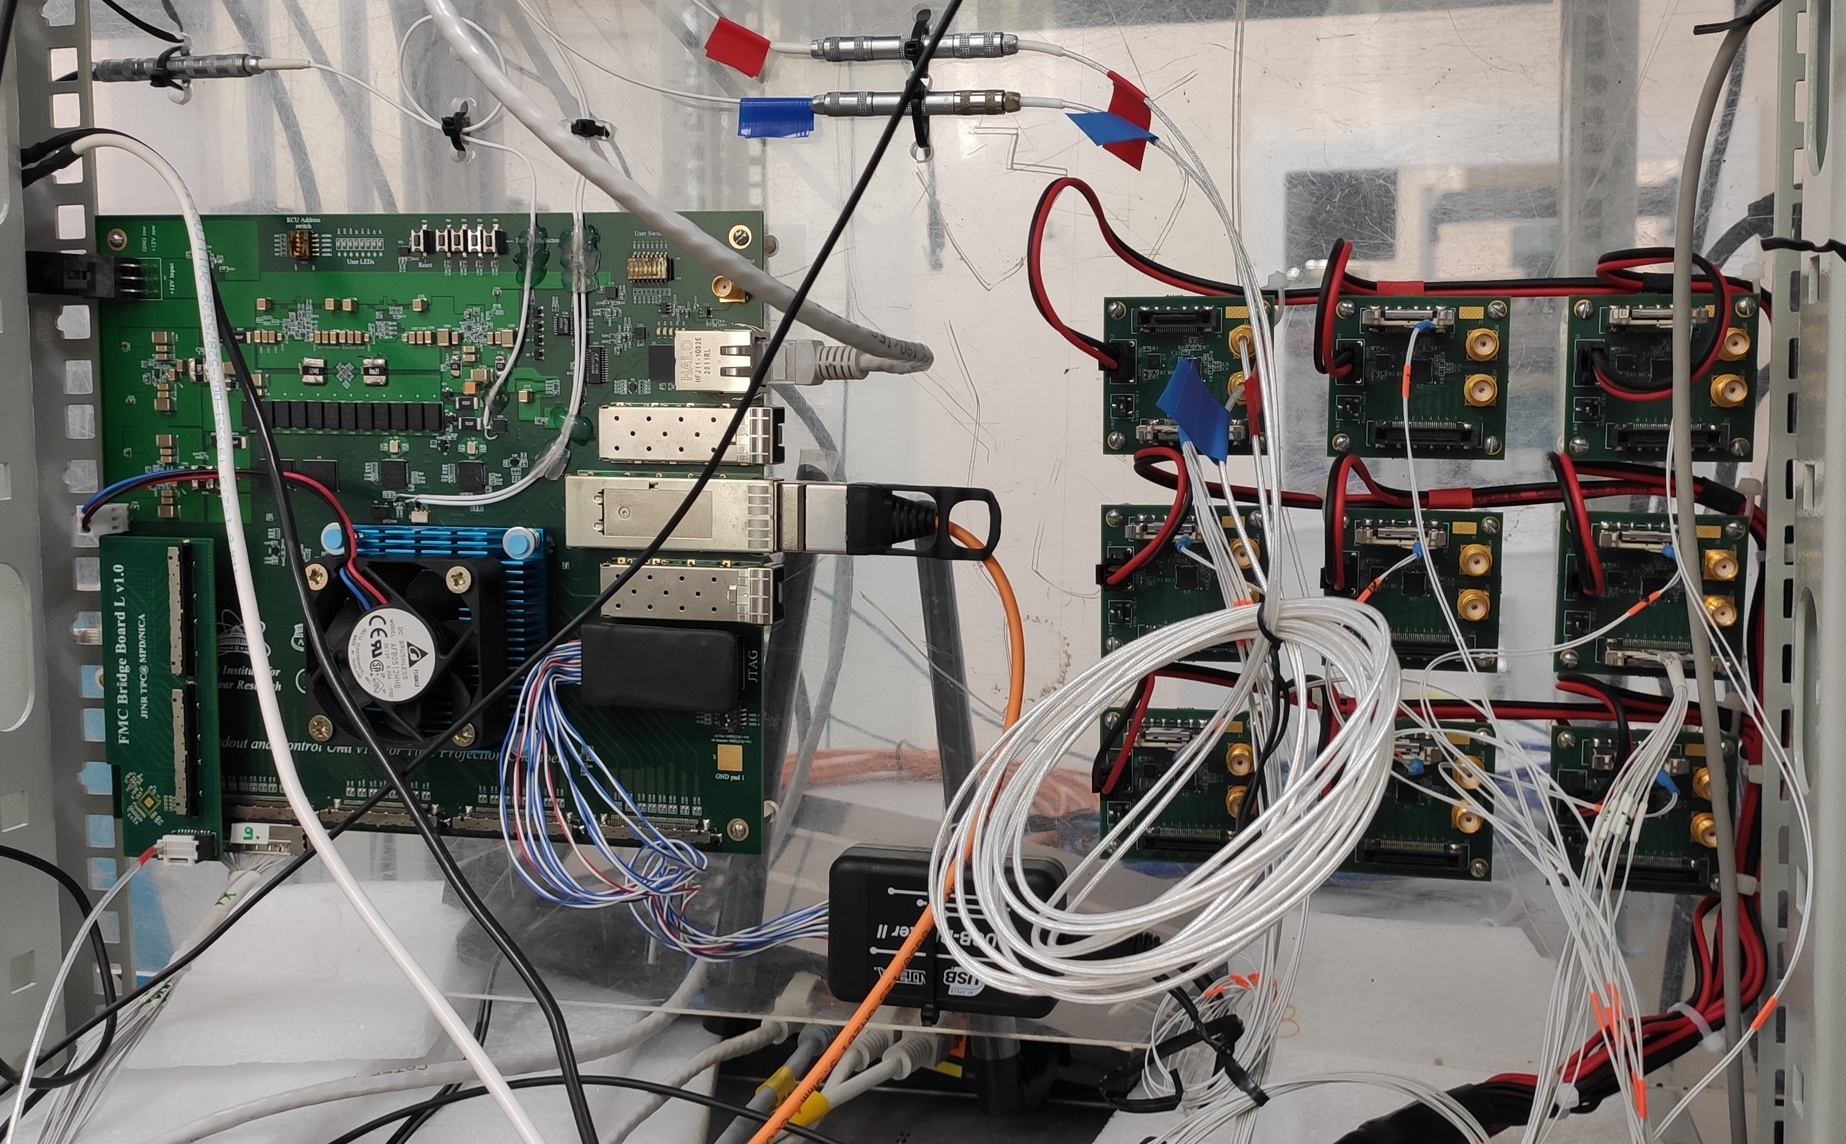
Prototype of synchronization unit
Readout and Control Unit (RCU)
Tested prototype
This synchronization prototype unit fanout transceiver reference clock to 62 FECs from 1 RCU (1 ROC sync.)
Synchronization unit of Subsystem will fanout 5 external signals to FECs:
3 types reference clocks;
Data trigger;
Reset.
Test setup for synchronization prototype unit

Slide 11
Block diagram of synchronization unit for Control & Synchronization Subsystem
Input con.
(LVDS)
LVDS
Up to 8 cards FEC
TR_REFCLK
8xTR_REFCLK
Controller
RCU
Synchrosignal multiplication microchip
Output con.
(LVDS)
LVDS
Synchrosignal multiplication microchip
Synchrosignal multiplication microchip
8
8
…
…
LVDS
Total 62 cards FEC
on ROC (+2 reserve)
LVDS
Synchrosignal multiplication microchip
Output con.
(LVDS)
8xTR_REFCLK
Up to 8 cards FEC
Tested prototype
Synchronization module for 1 ROC chamber

Slide 12
Block diagram of synchronization unit for Control & Synchronization Subsystem
Input con.
(LVDS)
LVDS
Up to 8 cards FEC
TR_REFCLK
8xTR_REFCLK
Controller
RCU
Synchrosignal multiplication microchip
Output con.
(LVDS)
ADC_CLK
LVDS
8хADC_CLK
FRST
8хFRST
REFCLK
Synchrosignal multiplication microchip
8хREFCLK
Synchrosignal multiplication microchip
8
8
…
…
8хTRG
TRG
LVDS
Total 62 cards FEC
on ROC (+2 reserve)
5
Optical links
LVDS
Synchrosignal multiplication microchip
Output con.
(LVDS)
8xTR_REFCLK
Up to 8 cards FEC
8хADC_CLK
External
sync. unit
8хFRST
8хREFCLK
Inside
MPD magnet
8хTRG
Synchronization module for 1 ROC chamber

Slide 13
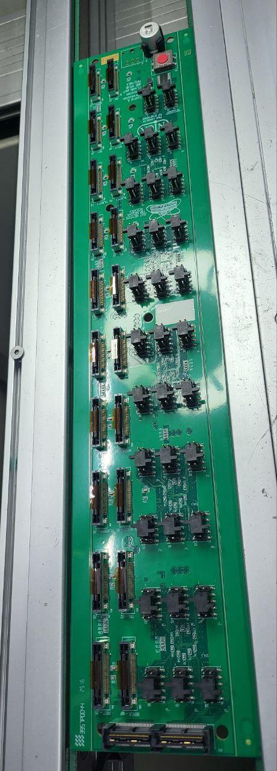
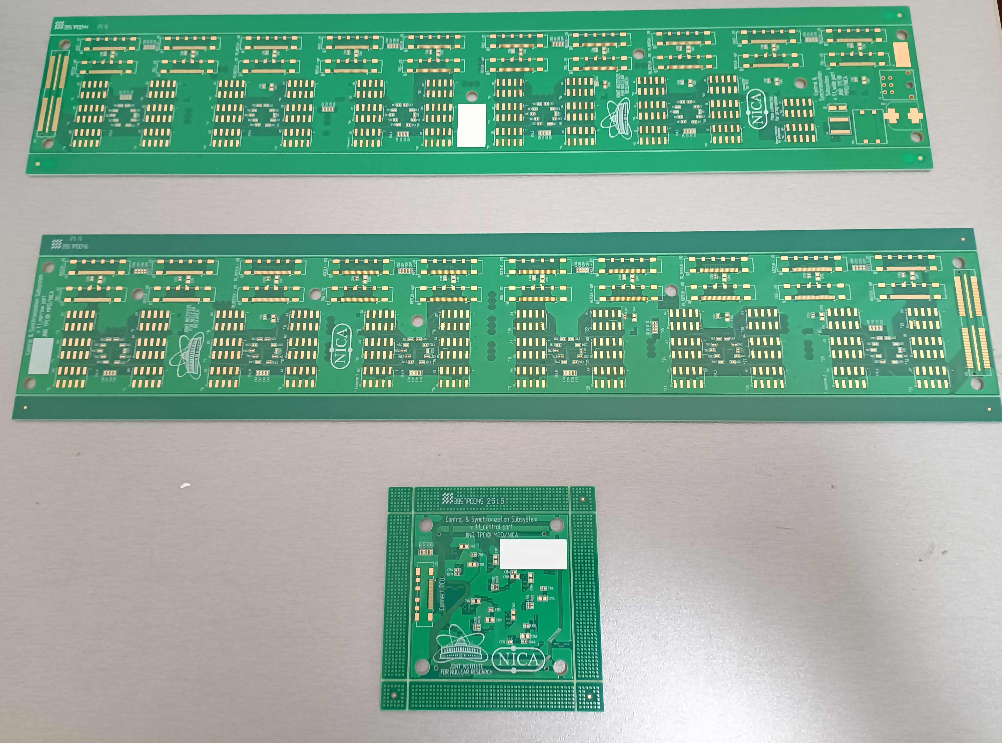
Control & Synchronization Subsystem_v1.1
(CSS_v1.1) is produced
3D model and photo of device CSS_v1.1
(top view). Size is 810 x 60 mm
Location of CSS_v1.1 on TPC

Slide 14
Conclusion
Comprehensive tests of prototypes of remote access and synchronization units have been carried out;
Electrical scheme of control & synchronization system has been developed;
Tracing of PCB control & synchronization system has been completed;
Subsystem is being manufactured
Future plans:
Perform full-featured device testing

Slide 15
JINR Association of Young Scientists and Specialist Conference “Alushta-2025“ Remote access and synchronization subsystem of electronics cards for the TPC/MPD Detector of the NICA project
Denis Potapov, an engineer of the
TPC/MPD group, VBLHEP, JINR
Alushta, 2025

Slide 16
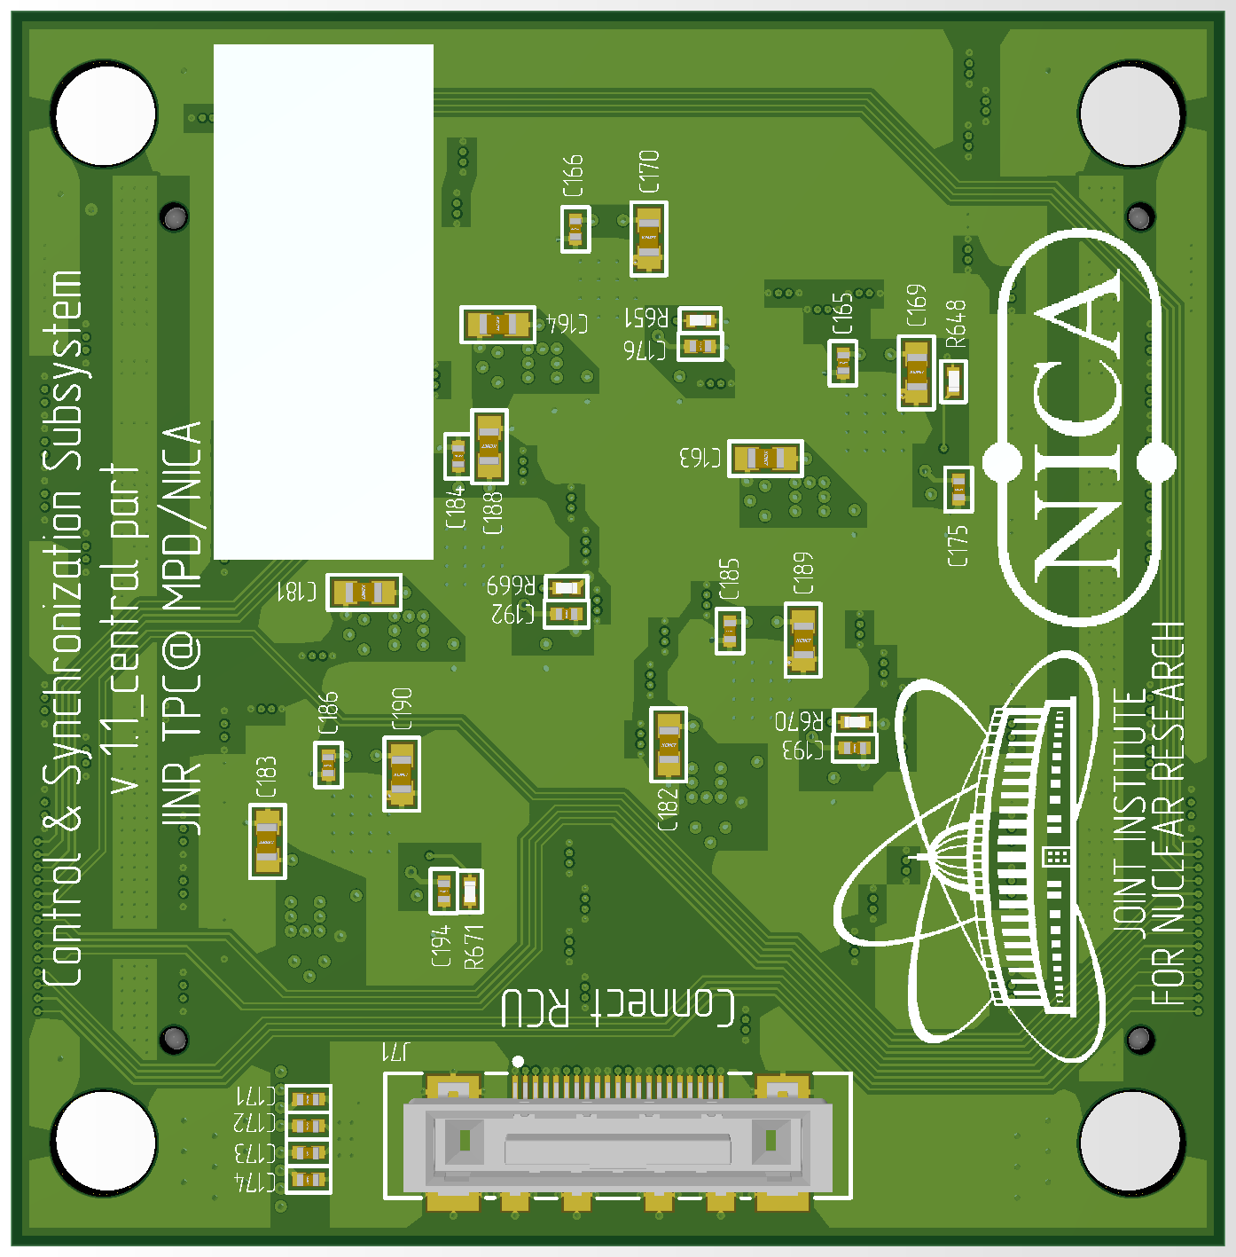
Control & Synchronization Subsystem is designed
3D model of device Control & Synchronization System(top view). Size is 810 x 60 mm
Location of control & synchronization system on TPC
JTAG over LVDS. Сable length is about 2m

