Slide 1
Quench protection and monitoring systems for pulsed HTS inductive energy storage SMES Ilya Donguzov on behalf of the team

Slide 2
SMES
2
SMES (Superconducting Magnetic Energy Storage)
Parameter | Value
Inner diameter | 400 mm
Outer diameter | 960 mm
Height | 900 mm
Number of layers | 14
Operating current | 6.7 kA
Inductance | 120 mH
Stored energy | 2.74 MJ
Operating temperature | 30 K
Refrigerant | Neon
Purposes:
Decreasing pulsations of superconducting magnets operating current
Reducing inductive load influence to the city’s power grid
Minimizing of energy consumption

Slide 3
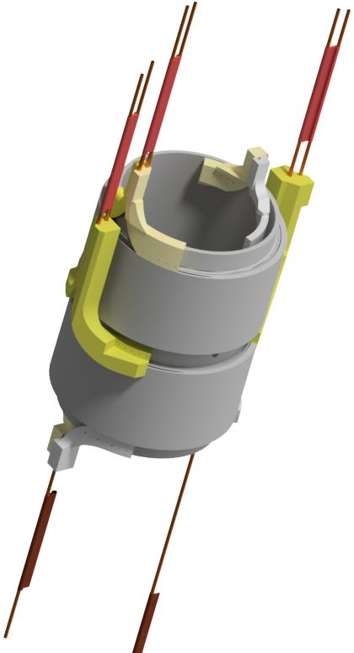
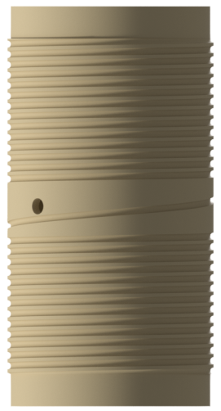
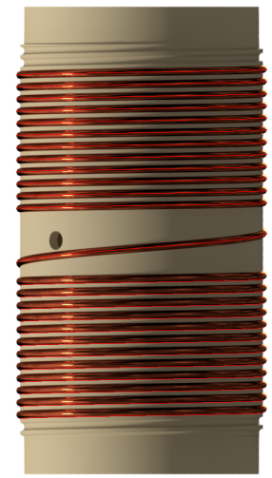
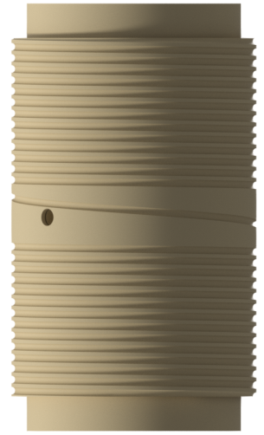
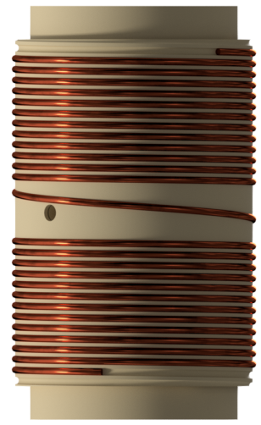
Model SMES
3
Model SMES
Parameter | Value
Inner diameter | 290 mm
Outer diameter | 459 mm
Height | 500 mm
Number of layers | 4
Operating current | 13 kA
Inductance | 1,79 mH
Stored energy | 163 kJ
Operating temperature | 4.5 – 50 K
Refrigerant | Helium
7
The assembly consistency of one section of the model solenoid
Purposes:
Testing technologies of production and assembling of such type HTSC solenoids.
Achieving the same proportions of mechanical deformations like at SMES

Slide 4
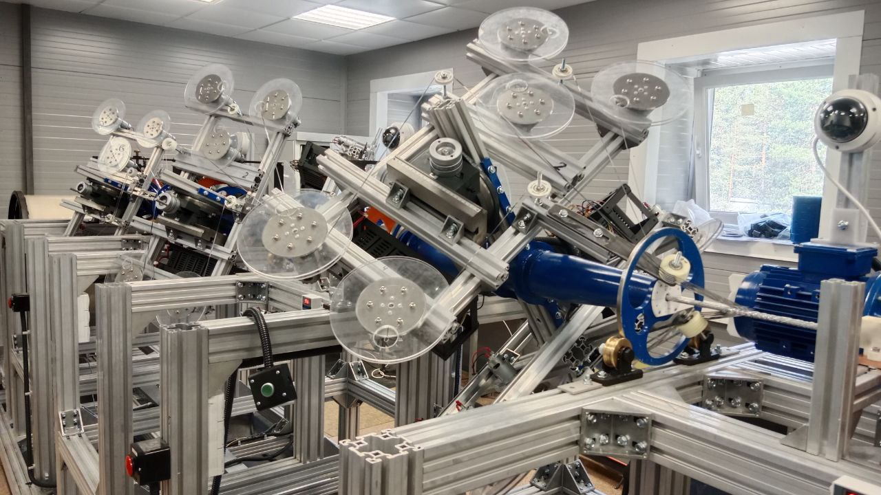
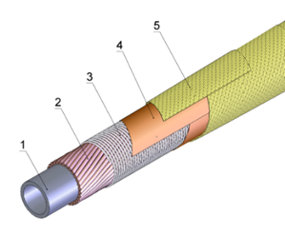
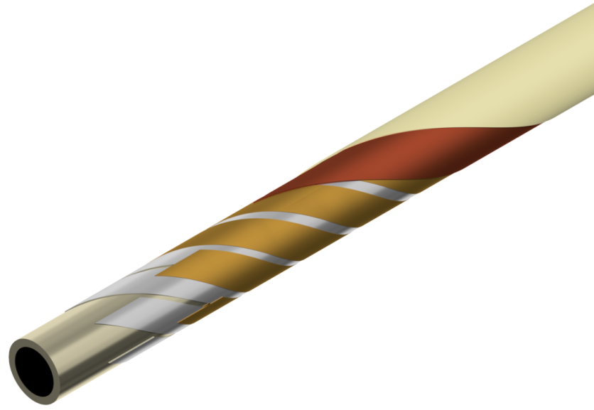
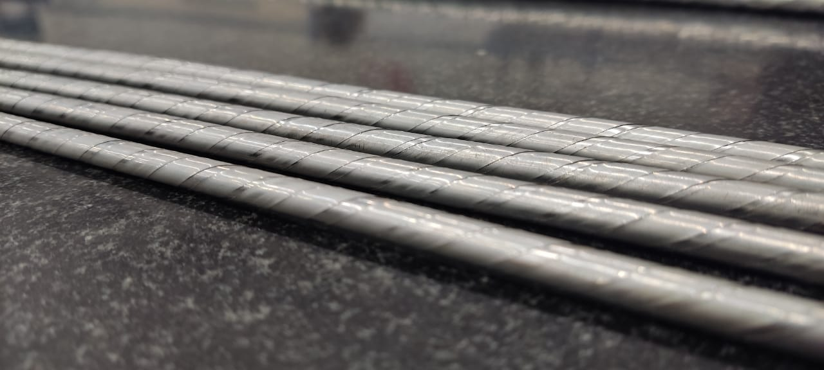
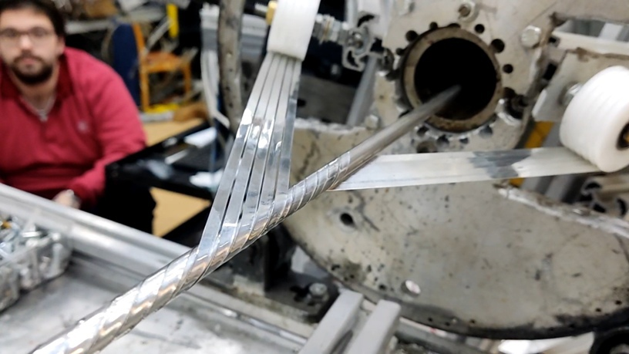
HTSC cable
4
Cu-Ni tube
Strands of the superconductor
Ni-Cr wire
Kapton tape
Fiberglass tape
Nuclotron type tubular cable – created in 1979 and first tested in 1980 at JINR
Cable machine
Cu-Ni tube
Brass tape
HTSC tape (SuperOx)
Kapton tape
Fiberglass tape
HTSC cable SMES
HTSC cable
Winding HTSC tapes on a tube

Slide 5
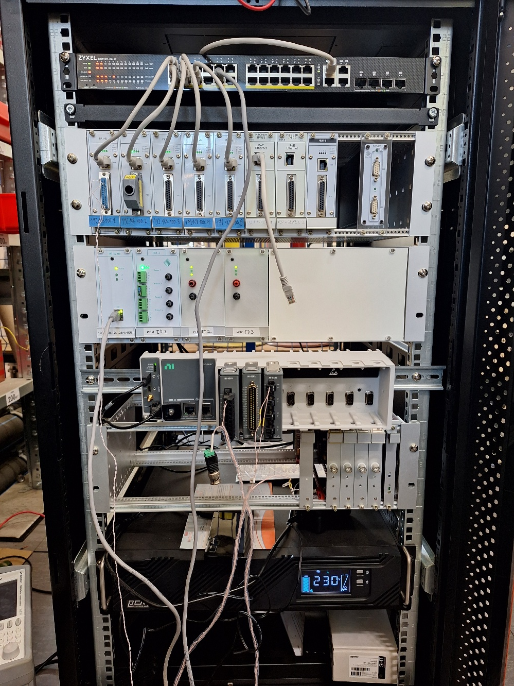
Monitoring and protection systems
5
5-channel temperature monitoring system
Power sources and ADC for strain gauge system
Quench Protection System for HTS cables
Backup Protection System

Slide 6
Electrical connection of the cable
6
Voltage output circuit for the model solenoid

Slide 7
Quench detection system
7
cRIO-9057
Current sensor LEM ITZ - 16000
ADC NI-9202
± 10В
Layers
Current value
Booster
Nuclotron
Energy evacuation switch
DAC NI-9263
± 10В
Booster
Model SMES
Energy evacuation signal
Nuclotron
ADC NI-9238
± 0.5В
Current leads, bridges
Current source
RS-485
MOXA
PC
Ethernet

Slide 8
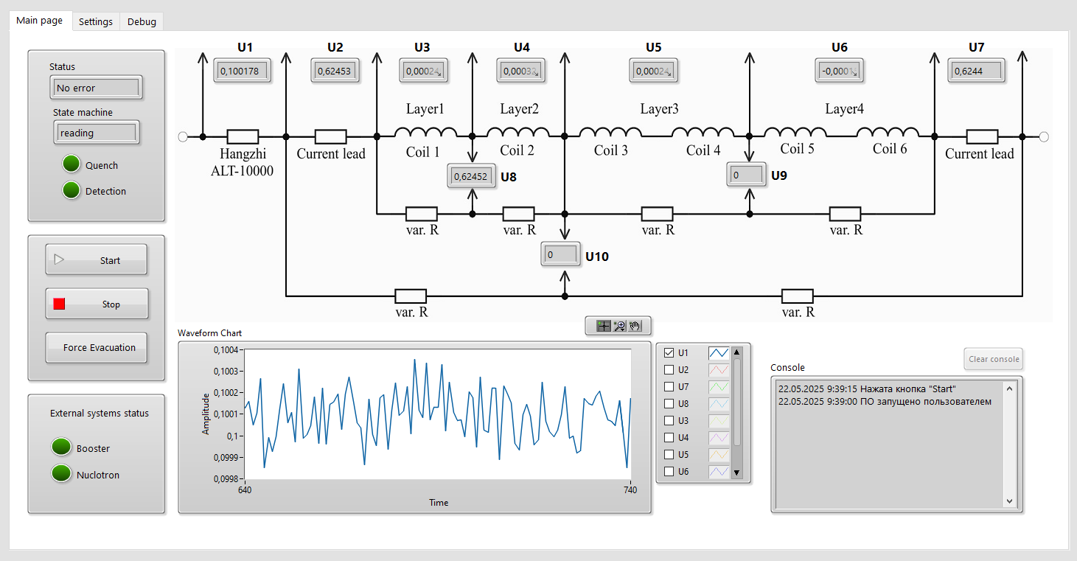
Software
8
The real-time system enables program execution with guaranteed response time.
The system is implemented using a finite state machine (FSM) pattern - this allows describing the system's behavior through a finite set of states and transition rules between them.
The FPGA provides hardware-level high-speed operation, enabling parallel signal reading and generation with minimal latency

Slide 9
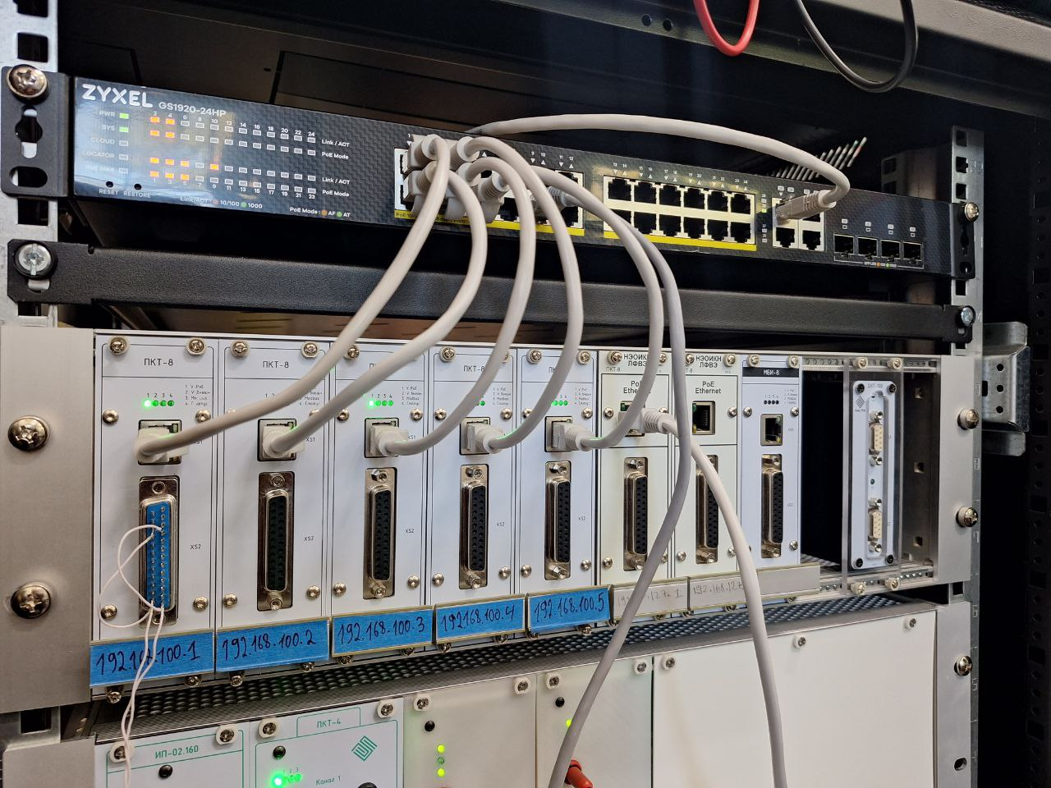
Thermometry system
9
Current source +
Chanel 1 +
Chanel 1 –
Chanel 2 +
Chanel 2 –
Chanel 8 +
Chanel 8 -
Current source -
5-channel temperature monitoring system
Connections of temperature sensors
Measuring range: 4 - 300 K;
Accuracy: ± 0,3 % in the range up to 30 K;
Number of voltage measurement channels: 8;
ADC bit rate: 24 bits;
Built-in current source: 10, 100 мкА;
Supply +24 DC / PoE.

Slide 10
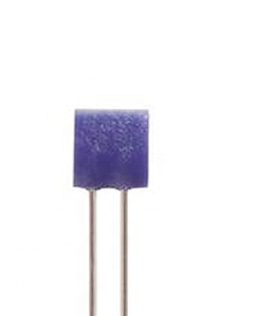
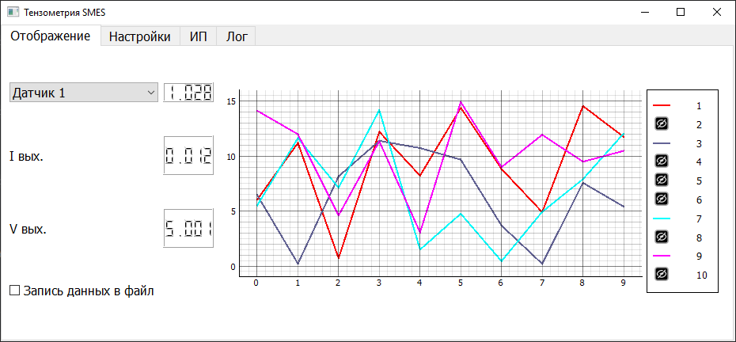
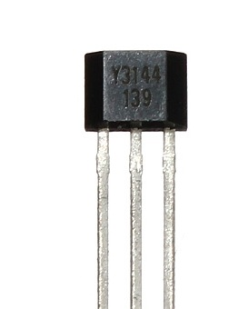
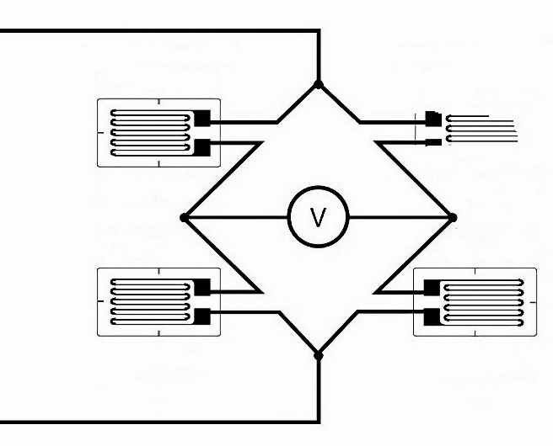
Strain gauge system
10
Solenoid surface
STRAIN GAUGE
CFLA-1-350-17
Hall
Sensor
CFLA
PT-1000
At a deformation of 0.1%, a resistance change of 0.735 Ω at room temperature will follow
Operating temperature range - -269 - +250 ⁰С
Rated resistance - 350 Ω
The length of the measuring grid - 1 mm
The width of the measuring grid - 1.6 mm
Magnetic field calibration of strain sensors in cryogenic environments
Algorithmic correction of magnetic field artifacts and temperature-induced errors
R_fixed
Power supply
Amplifier
ADC
PC
Software interface of the strain measurement system
R_fixed
R_fixed

Slide 11
Conclusion
11
A system to protect the HTS cable from quench has been developed. Currently, it is undergoing debugging and testing. The system will be ready for operation at the autumn of 2025.
A temperature monitoring system has been developed and is ready for operation.
The functional diagram of the strain measurement system has been developed. System testing is scheduled for summer 2025, with deployment expected by autumn of 2025.

Slide 12
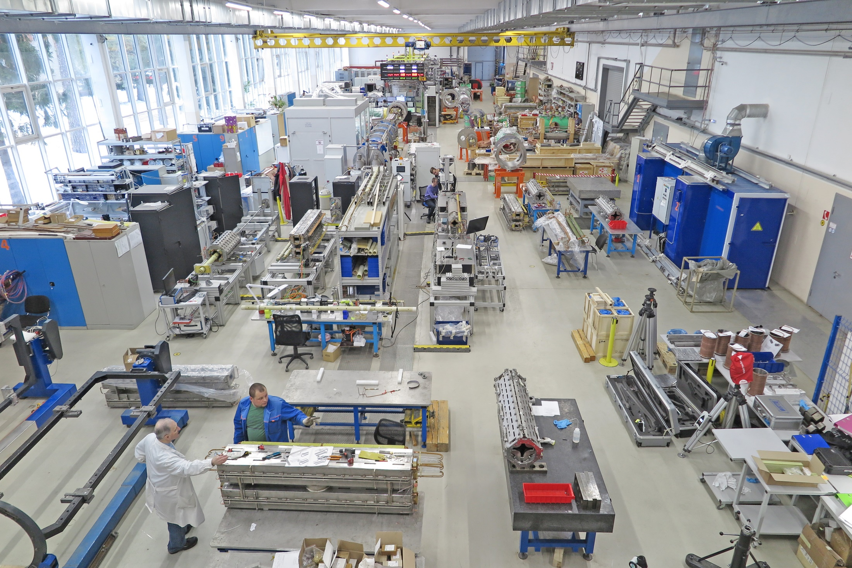
Quench protection and monitoring systems for pulsed HTS inductive energy storage SMES Ilya Donguzov, donguzov@jinr.ru
Thank you for your attention!

Slide 13
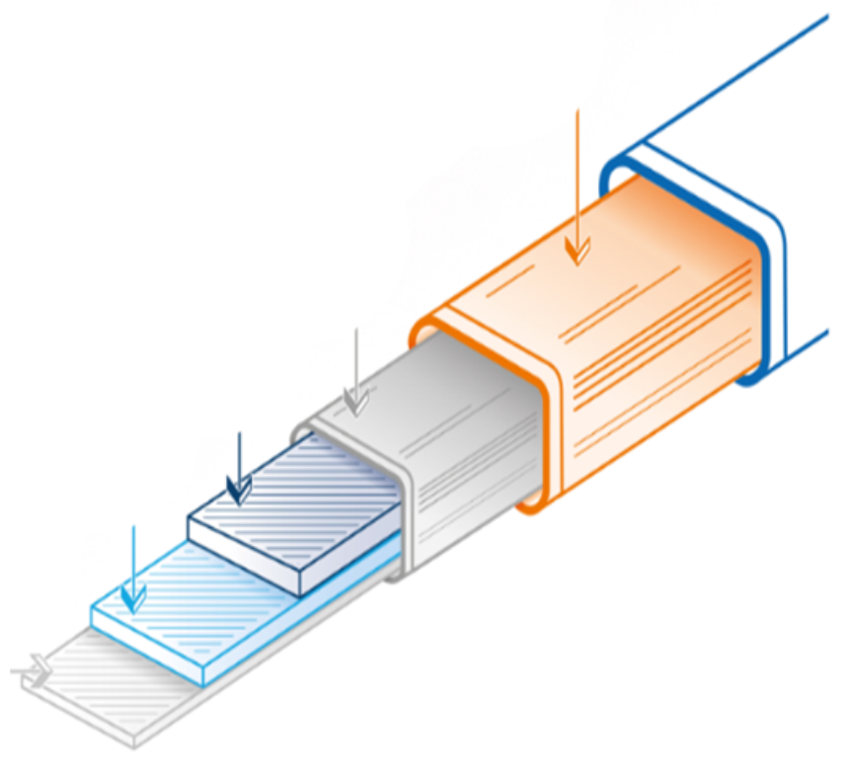
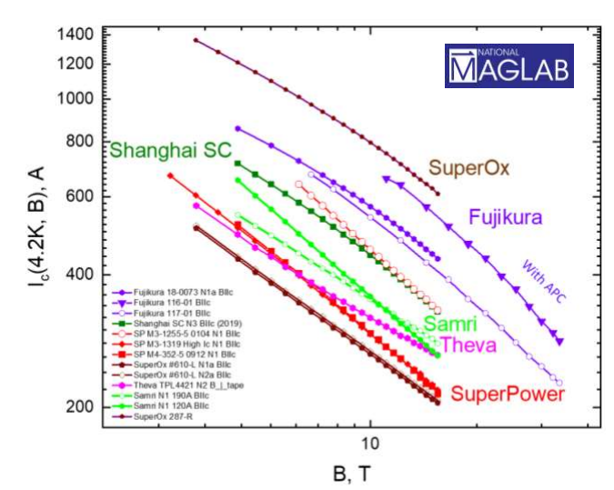
Superconductor
5
ReBCO tape (rare-earth barium copper oxide tape)
Cu
Ag
HTC
Buffer layer
Hastelloy
The structure of the HTS tape
Parameter | Unit | Meaning
Conductive layer |  | ReBCO
The width of the conductor | mm | 4
The Thickness of the conductor | um | 100
Substrate material |  | Hastelloy C276
The thickness of the substrate | um | 100
Crit. current (77 K), | A | 100-150
Layer thickness Ag | um | 1-10
Layer thickness Cu | um | 0-100
Tapes from different manufacturers

Slide 14
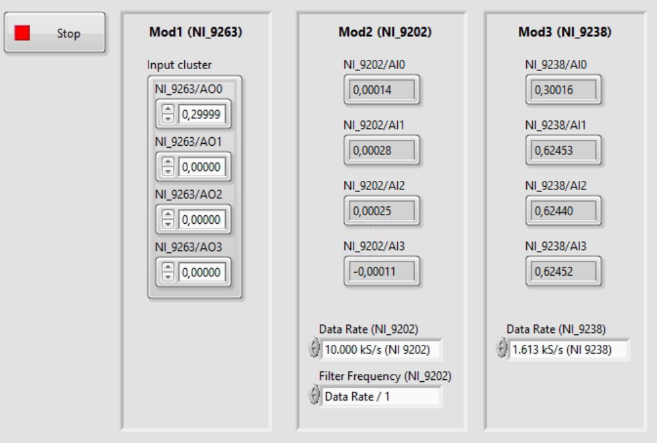

Slide 15
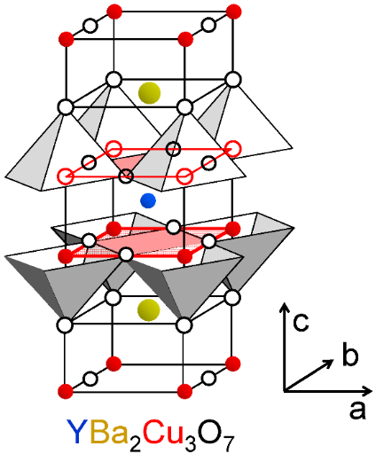

Slide 16
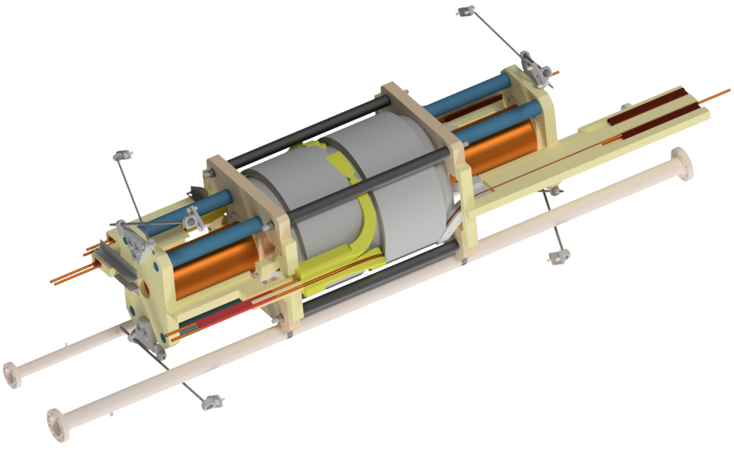

Slide 17
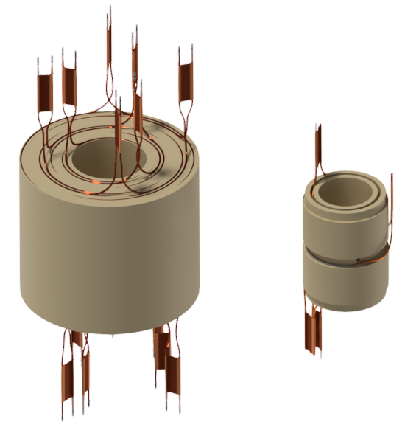
900 mm
500 mm
459mm
960 mm

