Slide 1
Methods of electron cooling friction force measurement suitable for NICA Booster synchrotron
Daniil K. Chumakov
NICA Dispatch Service, LHEP JINR/Диспетчерская служба NICA ЛФВЭ ОИЯИ
National Research Tomsk Polytechnic University
AYSS-2025
Alushta, Russia

Slide 2
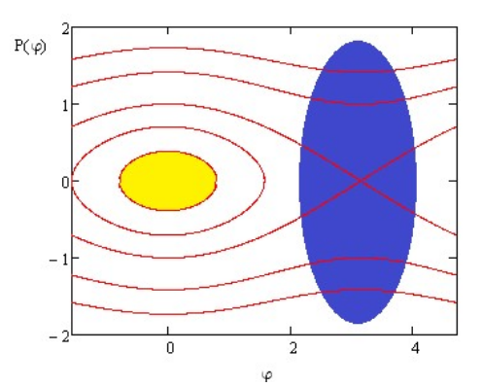
Why do we need cooling
Intensity of beam is crucial for colliders at each stage;
NICA Booster is the first stage after linac;
Tasks of NICA Booster [1]:
Accumulate ions (up to 10x);
Form required phase volume of beam;
Accelerate intense beam to 578 MeV/nucleon;
Strip accelerated particles to bare nuclei on stripping foil.
Scheme of repeated single-lap injection [2]
Beam fills in available phase space;
No accumulation using only magnetic optics – we need dissipative force;
Cooling exploits such forces, reduces volume of beam in phase space;
Injection → Cooling→Phase space reduced →Repeat;
Circulating beam accumulates until diffusion power exceeds cooling power
[1] NICA Booster: a new-generation superconducting synchrotron. DOI: 10.3367/UFNe.2021.12.039138
[2] Acceleration in Booster and Nuclotron, V. Lebedev, September, 2023
1

Slide 3
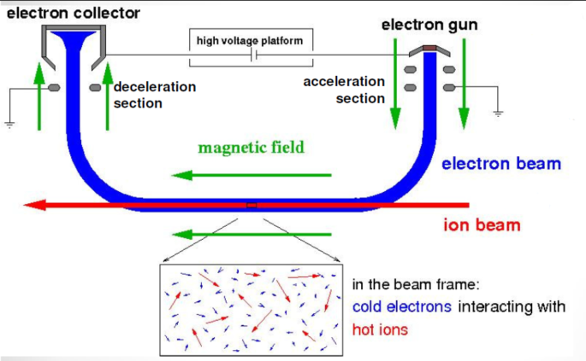
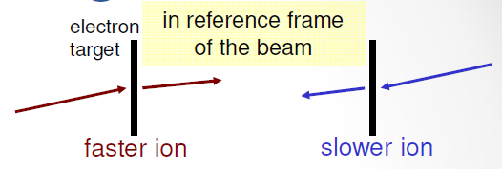
Idea of electron cooling
Proposed by G.I. Budker in 1966;
Equal mean velocities of ion and electron beams;
Two beams move together;
Beam temperatures: $k_{B}T_{∥,⊥}=m{\left\langle v_{∥, ⊥}\right\rangle }^{2}$;
$⟨v⟩$ is RMS velocity.
Effective method of particle oscillations damping in proton and antiproton rings // Atomnaya energiya. 1967, 22, pp. 346-348
Electron beam by design has lower $T$;
We move to beam rest frame →
Analogy: particle loses extra energy in foil;
“Foil” is electron beam:
Slow ion in lab frame gains momentum;
Fast ion in lab frame loses momentum;
In both cases – resulting momentum is closer to mean
Scheme of ions cooling process with electron beam [3]
[3] Beam Cooling. M. Steck. CAS Advanced Acc. Phys., London, 2017
2

Slide 4
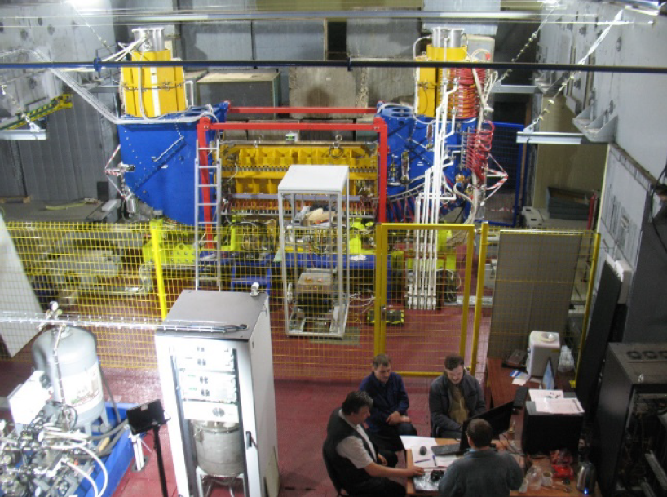
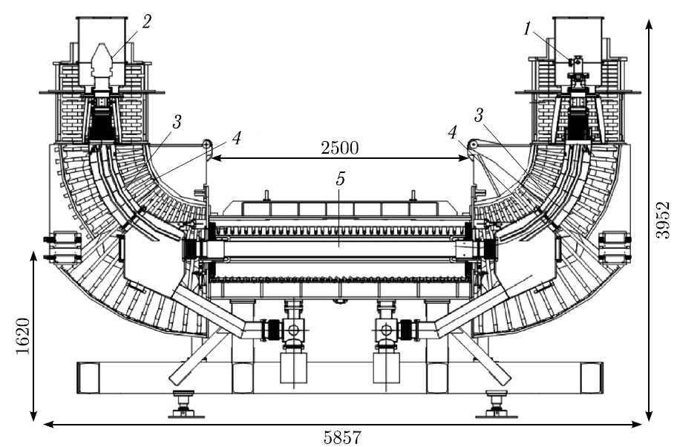
NICA Booster electron cooling system
Developed by BINP (Novosibirsk, Russia);
Designed to cool ions at injection energy (3.2 MeV/nucleon) and at energies up to 90 MeV/nucleon;
Electron beam diameter 28 mm;
Cooling section length 2.5 m;
Practical parameters at ion energy 3.2 MeV/nucleon:
Electron energy 1.856 keV;
Electron current 25 $÷$50 mA;
Magnetic field 0.075 $÷$ 0.1 T;
Temperatures of electron beam (in eV scale):
$T_{⊥}=0.12$ eV only due to cathode temperature;
$T_{∥}=8.28⋅{10}^{−5}$ eV due to acceleration and beam density;
Top: NICA Booster electron cooler after installation [4]
Down: NICA Booster electron cooler scheme: 1 – electron gun, 2 – electron collector, 3 – electric field plates in electron beam turning section, 4 – longitudinal magnetic field solenoids, 5 – ion beam cooling section [5]
[4] Commisioning of electron cooling system of NICA Booster. doi: 10.18429/JACoW-RUPAC2018-TUPSA22
[5] First Experiments on Electron Cooling of Ion Beam in the NICA Booster. doi: 10.1134/S1547477124700122
3

Slide 5
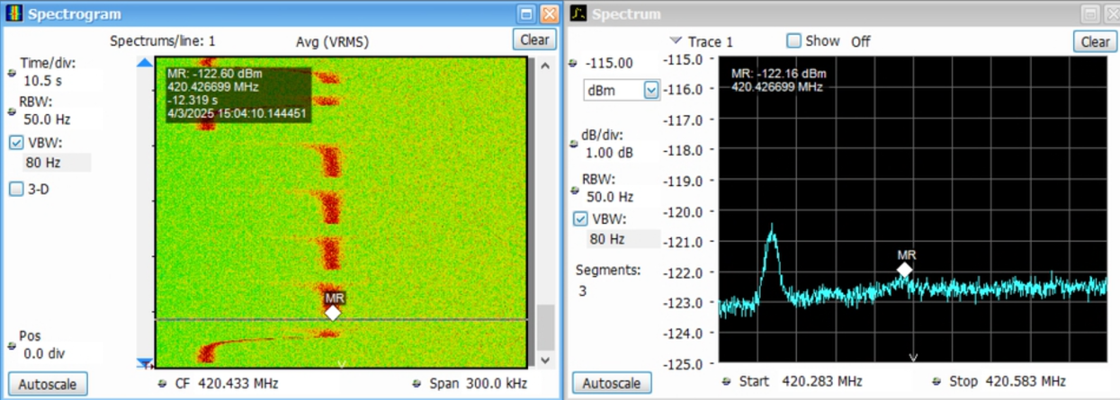
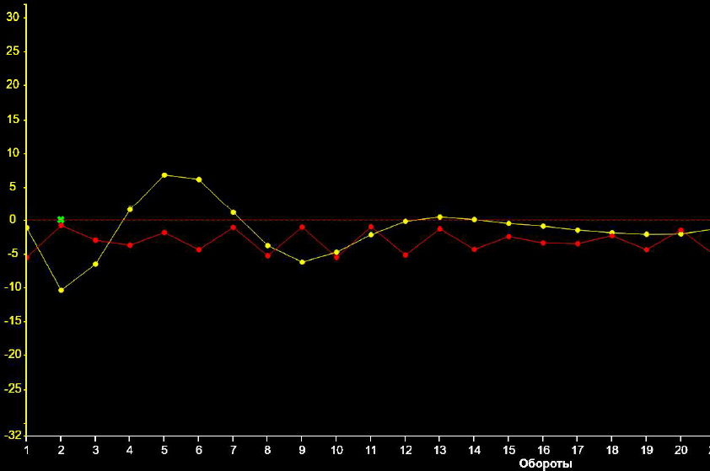
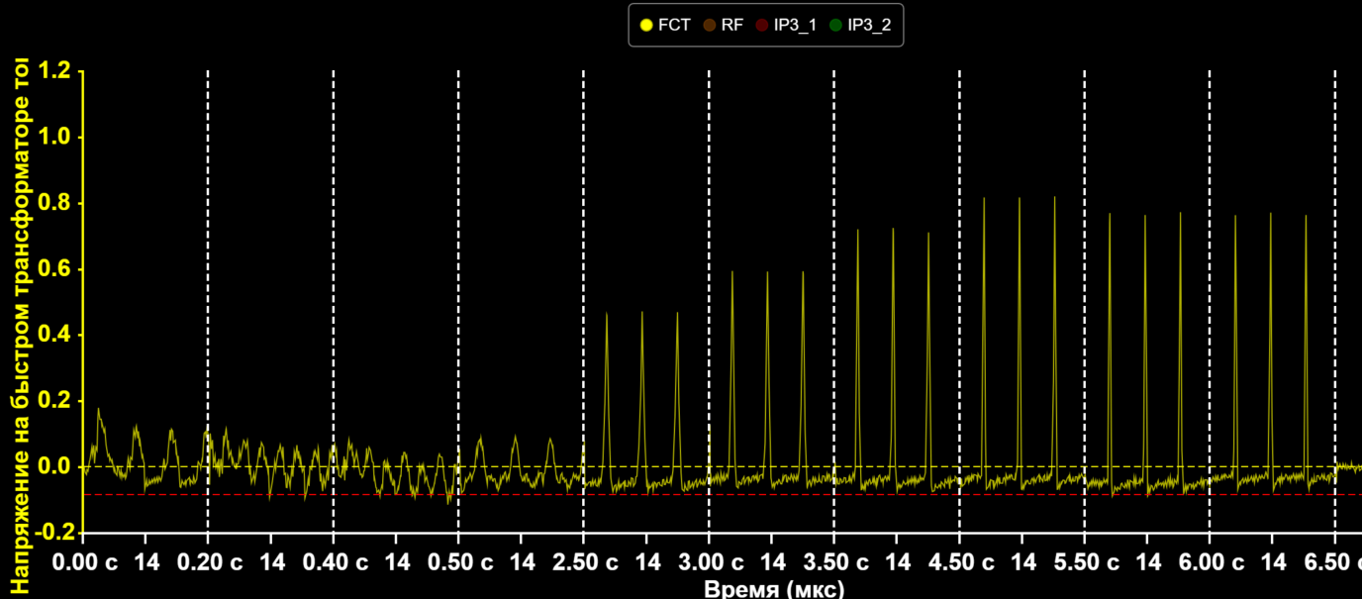
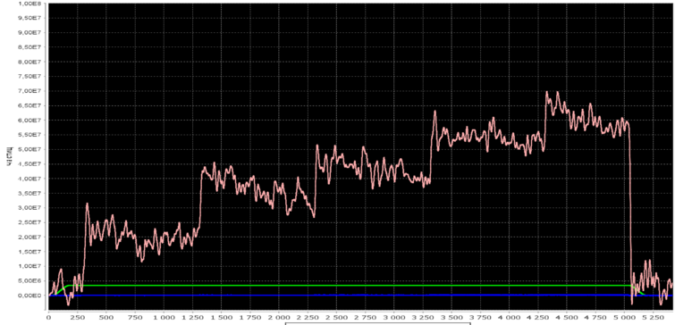
NICA Booster beam diagnostics
Experimental tasks:
Electron and ion beam alignment;
Longitudinal cooling control (force, time);
Transverse cooling control (force, time);
Beam accumulation and lifetime control.
Why measure cooling force/cooling time?
Fokker-Planck equation: evolution of beam particle distribution
$$\frac{∂f}{∂t}=∑_{m,n} \frac{∂}{∂v_{m}}\left(−f\frac{F_{m}}{M}+\frac{∂\left(fD_{mn}\right)}{∂v_{n}}\right);$$
$f=f\left(r,v,t\right);F=\frac{M_{i}\left\langle Δv\right\rangle }{Δt}$; $D_{mn}=\frac{\left\langle Δv_{m}Δv_{n}\right\rangle }{Δt}$
Schottky spectrometer (2), (3)
24 beam position monitors
(BPMs): (1), (3)
Fast current transformer (FCT): (2), (4)
Position of electron and ion beams at start and end of cooling section
IPM or Ionization profilometer (X,Y, 32 channels per direction): (3), (4)
E-Cooling system BPMs: (1)
Parametric current transformer: (4)
[5] First Experiments on Electron Cooling of Ion Beam in the NICA Booster. doi: 10.1134/S1547477124700122
[6] Beam diagnositcs at NICA injection complex. E.Gorbachev et al. RuPAC23
4

Slide 6
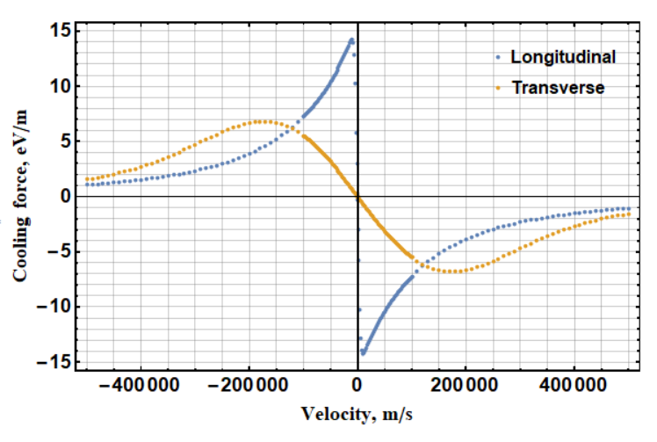
Theoretical models of friction force
Dissipative force dependent on relative velocity $F(u)=F(v_{i}−v_{e})$;
Maximum force at $|u|=\left\langle v_{e∥, ⊥}\right\rangle$ from $k_{B}T_{e∥,⊥}=m{\left\langle v_{e∥, ⊥}\right\rangle }^{2}$;
Electrons distribution at source: symmetric Maxwell distribution;
After acceleration: highly anisotropic Maxwell distribution with $T_{∥}≪T_{⊥}$;
Derives from binary Coulomb collisions [7] & collective effects [8] in plasma.
$$F\left(u\right)=−\frac{Z^{2}e^{4}n_{e}}{4πε_{0}⋅ε_{0}⋅m_{e}}\int{L_{C}\left(u\right)⋅f\left(v_{e}\right)\frac{u}{{\left|u\right|}^{3}}d^{3}v_{e}}$$
$L_{C}$ is Coulomb logarithm that limits impact parameters
$\int_{b_{min}}^{b_{max}}{\frac{db}{b}}=L_{C}=\ln{\frac{b_{max}}{b_{min}}}$
Electron cooling force for ¹²⁴Xe²⁶⁺ ions for Booster parameters at 3.2 MeV/nucleon.
Electron beam temperatures are on Slide 3.
Magnetic field of solenoid changes electron-ion kinematics [9]
… suppresses $⊥$ degree of freedom for electrons at $b>b_{Larm}$
At $b>b_{Larm}$ collisions are adiabatic w.r.t. Larmor gyration
[7] Development of ion cooling methods. I.N. Meshkov 10.3367/UFNr.2018.01.038297
[8] Electron cooling. A. Sorensen et al. doi: 10.1016/0167-5087(83)91288-7
[9] The limits of electron cooling. N.S. Dikanskii. et al. Preprint 88-61, BINP
5

Slide 7
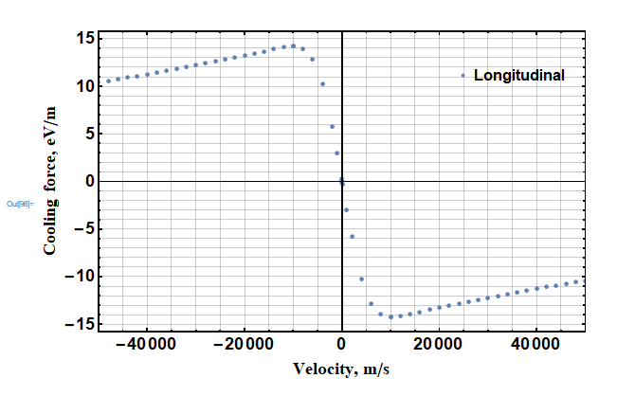
Longitudinal force measurement methods
High $u$
Low $u$
High $u$
Two regions of $F(u)$: linear (low $u$) and non-linear (high $u$)
Dynamic methods are for non-linear region
Static methods are for linear region
Dynamic methods – evolution of value after single impact
Static methods – continuous impact, comparison of values
Longitudinal force measurement
Low $u_{∥}$
High $u_{∥}$
Static
Dynamic
RF phase shift
Stochastic heating
Energy jump
Induction accelerator
Barrier RF
6

Slide 8
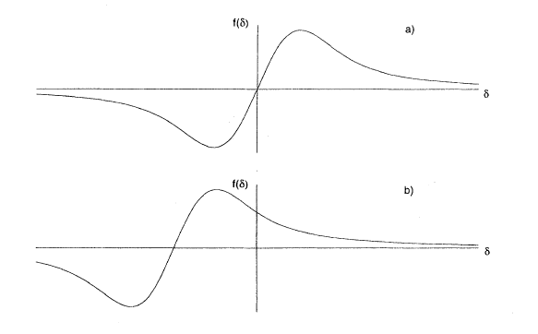
Longitudinal force: energy jump
Only coasting & pre-cooled beam
$$F_{∥}\left(t\right)=\frac{dp\left(t\right)}{dt}$$
Fast change of electrons energy
Electrons shift energy of ions to equilibrium
Energy change ↔ revolution frequency change
Measure $Δf\left(t\right)$ with Schottky spectrometer
$$F_{∥}\left(t\right)=γA\frac{E_{0}}{c^{2}}\frac{1}{hη}\frac{C_{acc}^{2}}{L_{cool}}\frac{df\left(t\right)}{dt}$$
$$u\left(t\right)=βc\frac{Δp}{p}=\frac{C_{acc}}{η}\frac{Δf\left(t\right)}{h};$$
$$Δf\left(t\right)=f\left(t\right)−f_{0}$$
420.427 MHz
Works well only for $Δv_{e}>{10}^{4}$m/s
420.312 MHz
change in energy
$$F_{∥}(u)$$
Spectrogram of Schottky noise for coasting beam of ¹²⁴Xe²⁶⁺ at 36.7 MeV/nucleon. The signal frequency is shifted with heterodyne.
Formulae for cooling force evaluation are from [10-12]
$C_{acc}$ - accelerator circumference, $L_{cool}$ - cooling section length, $h$ - chosen revolution frequency harmonic, $η$ – phase slip factor, $E_{0}=938$MeV
Let $E_{e0}$=19993 eV ↔ $E_{i0}$=36.7 MeV/n
$E_{e1}$=20004 eV↔ $E_{i1}$=36.72 MeV/n
$ΔE_{e}$ =11 eV ↔ $Δu=u_{1}−u_{0}=2.1⋅{10}^{4}$ m/s
Cooling force $F\left(δ\right), δ=δp/p_{0}$ for
aligned mean $v_{e}$ and $v_{i}$
$v_{e}$ shifted w.r.t. $v_{i}$ [13]
[10] Experimental studies of the magnetized friction force. DOI: 10.1103/PHYSREVE.73.066503
[11] Electron cooling at CRYRING with an expanded electron beam. DOI: 10.1016/S0168-9002(97)00249-0
[12] Longitudinal electron cooling experiments at HIRFL-CSRe. DOI: 10.1016/j.nima.2015.10.095
[13] Effects of a nonlinear damping force in synchrotrons with electron cooling. DOI: 10.1103/PhysRevE.51.4947
7

Slide 9
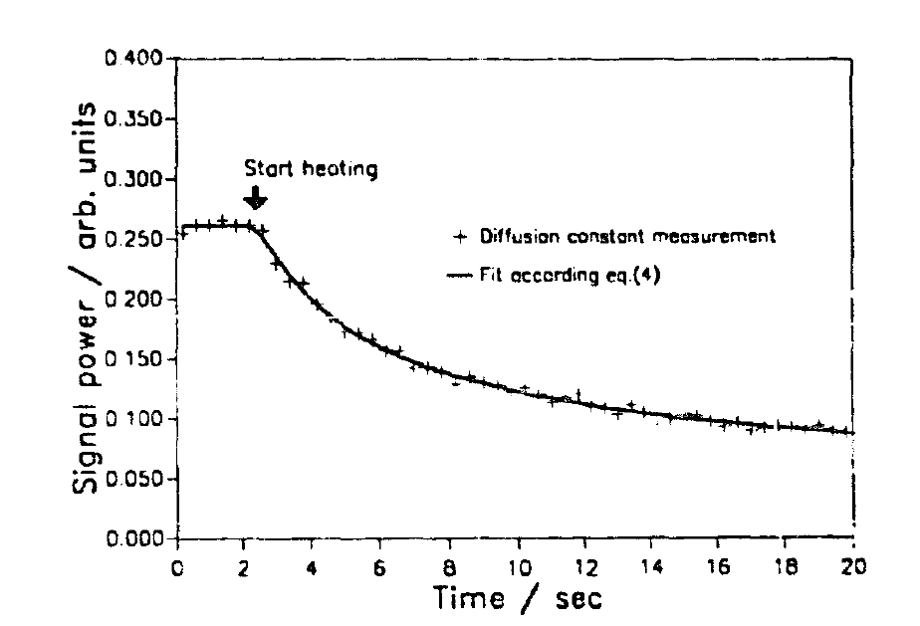
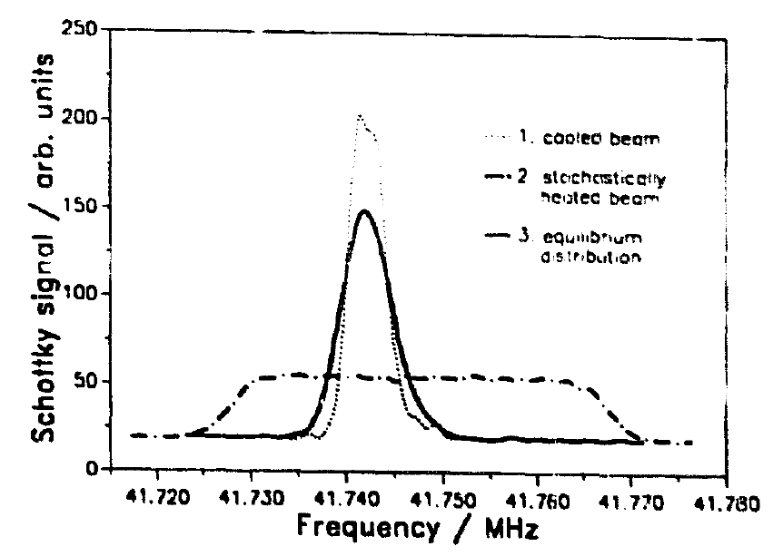
Longitudinal force: linear region
RF phase shift
Stochastic heating
Bunched beam
RF cavity $f$ change → synchrotron oscillations
$\frac{dE}{dt}{\left.​\right|}_{RF}=−\frac{dE}{dt}{\left.​\right|}_{cool}$
Synchronous phase is shifted by $Δφ_{s}$
$Δφ_{s}$ measured by FCT or phase discriminator
Fokker-Planck equation: $\frac{∂Ψ}{∂t}=\frac{∂}{∂v}\left(−F\left(v\right)Ψ\left(v\right)+D\frac{∂Ψ}{∂v}\right)$
Coasting beam, pre-cooled;
RF noise on RF gap at $f=hf_{0}$ with controlled power;
Cooling switched on – equilibrium reached;
Schottky spectrometer measures equilibrium distribution for each case.
$$F_{∥}=\frac{ZeU_{rf}\sin{Δφ_{s}}}{L_{cool}}$$
$$u\left(t\right)=\frac{C_{acc}}{η}\frac{Δf\left(t\right)}{h};$$
At equilibrium: $F_{∥}\left(v\right)=D\frac{∂Ψ/∂v}{Ψ\left(v\right)}∝D_{E}\frac{∂Ψ{\left(f\left(v\right)\right)}/∂f}{Ψ\left(f\left(v\right)\right)}$
Left: heating fit;
Right: equilibrium distributions for cooled; heated; heated+cooled beam
Hopf
bifurcation
Cartoon cooling force with blue lines as bifurcation points at $\left|u\right|=0.97⟨v_{e∥}⟩$ [13]
Diffusion power: from fit [14] or $D_{E}=\frac{f_{0}^{2}q^{2}e^{2}}{2}G^{2}E^{2}\frac{dP_{src}}{df}Z_{ex}$ [15]
Before bifurcation point: oscillations damping
After – oscillations amplification
[13] Effects of a nonlinear damping force in synchrotrons with electron cooling. DOI: 10.1103/PhysRevE.51.4947
[14] Electron cooling forces for highly charged ions in the ESR. DOI: 10.1016/S0168-9002(97)00027-2
[15] Further results and evaluation of electron cooling experiments at LEAR. DOI: 10.1016/0168-9002(90)91818-V
8

Slide 10
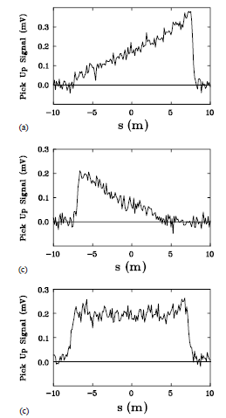
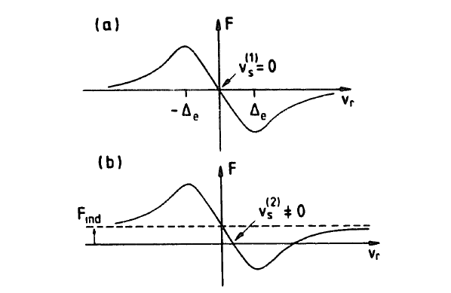
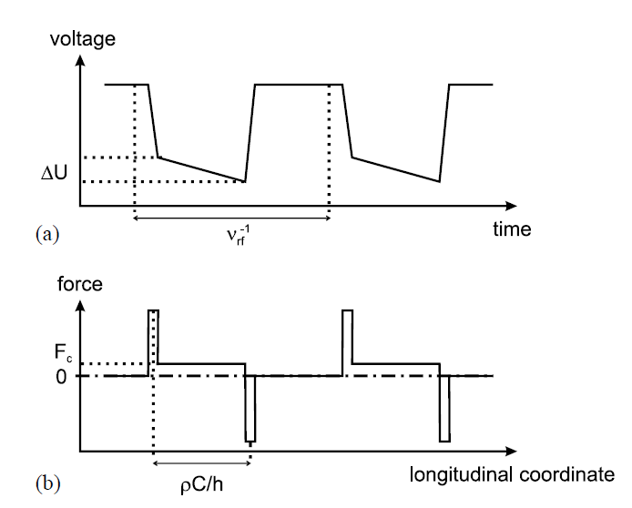
Longitudinal force: linear region - 2
Induction accelerator
Barrier buckets
Coasting beam
Constant acceleration to counterbalance cooling force power [16];
Similar to energy jump method, but $E_{ion}$ changes;
Total force $F_{cool}+F_{ind}$ shifts stable point $F=0$;
$F_{ind}$ is well known; find new stable point.
Measure $Δf\left(t\right)$ with Schottky spectrometer.
RF barrier buckets with slope instead of IndAc [17];
Change slope of $U$ or bunching frequency $f_{RF}$;
$F_{BB}=−F_{cool}$;
$F_{BB}=−\frac{hl_{eff}}{ρC_{acc}^{2}}eΔU$;
Control with FCT, BPM (intensity mode), Schottky spectrometer.
Force acting on ion without $F_{ind}$ (a)
and with $F_{ind}$ (b), stable point is shifted
Beam signal from BPM for:
a) $F_{BB}<F_{cool}$; b) $F_{BB}>F_{cool}$; c) $F_{BB}=F_{cool}$ [17]
Form of barrier buckets potential energy (a) and corresponding force (b) [17]
[16] An induction accelerator for the Heidelberg test storage ring TSR. DOI: 10.1016/0168-9002(92)90230-2
[17] New method to measure the friction force of electron coolers in heavy-ion storage rings. DOI: 10.1016/S0168-9002(02)02142-3
9

Slide 11
Transverse force measurement methods
Monitor betatron oscillations damping time with BPM & transverse Schottky spectrometer;
Measure beam size with ionization profilometer.
Right after injection:
high $dp/p$,
fast decoherence due to chromaticity
Suppress chromaticity to 0
Pre-cool the beam to get small $dp/p$
Excite the oscillations with kicker
Dominant damping due to cooling, not chromaticity!
$u∝$ amplitude of kick
Transverse force measurement
X
Decrease dp/p (precooling)
V
Suppress chromaticity
Kick the beam
Low $u_{⊥}$
High $u_{⊥}$
x’
Beam center-of-mass right after kick
… and after some turns due to chromaticity [18]
Betatron oscillations damping
Fokker-Planck solution
Cooling shifts to center, not smears
х
[18] Transverse force measurement. A. Sidorin, NICA operators meeting
10

Slide 12
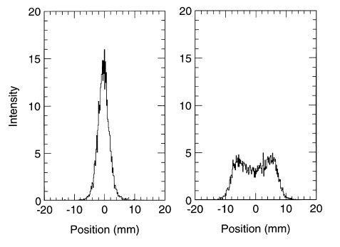
Transverse force measurement methods - 2
Stronger kick gives larger $u_{⊥}$ from $v_{i⊥}≡\dot{x}={\dot{x}}_{0}\cos{θ}$;
Kicked pencil beam: an oscillator with external force $F_{⊥}(u)$;
Oscillator energy change: $ΔE=\int_{0}^{2π}{F_{⊥}\left(\dot{x}−δ\dot{x}\right)\cos{θ}dθ}$;
Change the angle of electron beam – change $v_{e⊥}≡δ\dot{x}$;
Hopf bifurcation point can be observed:
on IPM: two-sided beam profile (see right pic. on this slide)
on Schottky spectrometer: increase in signal power
Before bifurcation oscillations are damped, $ΔE<0$
After bifurcation oscillations are amplified, $ΔE>0$
Measure damping time;
Force can be extracted from $ΔE$ or from Fokker-Planck solution
Left - profile of cooled ion beam with aligned electron beam;
Right – with misaligned electron beam after bifurcation point [19]
[19] Studies of electron cooling with a highly expanded electron beam. DOI: 10.1016/S0168-9002(99)01121-3
11

Slide 13
Outline
Short cooling time is good for accumulation of beam;
BUT: avoid overcooling → growth of instabilities, loss of beam;
NICA Booster Schottky spectrometer is suitable for $E_{ion}>$ 30 MeV/n (sensitivity);
For injection energy (3.2 MeV/n) – FCT is the only choice;
For transverse cooling – ionization profilometer monitor (IPM) is OK for all cases;
You need to know Twiss $β$ at IPM and in electron cooling section;
The easiest methods for $∥$ force measurement – RF shift + energy jump;
In principle, Booster RF system allows barrier buckets after additional works [20];
For IndAc-like measurements one need finer amplitude tuning on RF cavity;
Try $⊥$ cooling after chromaticity correction, injection optimization;
Instrumentation allows presented methods
… and tuning of electron cooling system for needs of beam accumulation
[20] Private communication with A.Volodin, LHEP JINR
12

Slide 14
Summary on measurement methods
Longitudinal force measurement
Transverse force measurement
Low $u_{∥}$
High $u_{∥}$
Decrease dp/p
Static
Dynamic
Suppress chromaticity
RF phase shift
Energy jump
Induction accelerator
Kick the beam
Low $u_{⊥}$
High $u_{⊥}$
Barrier RF
Betatron oscillations damping
Fokker-Planck solution
Stochastic heating
13

Slide 15
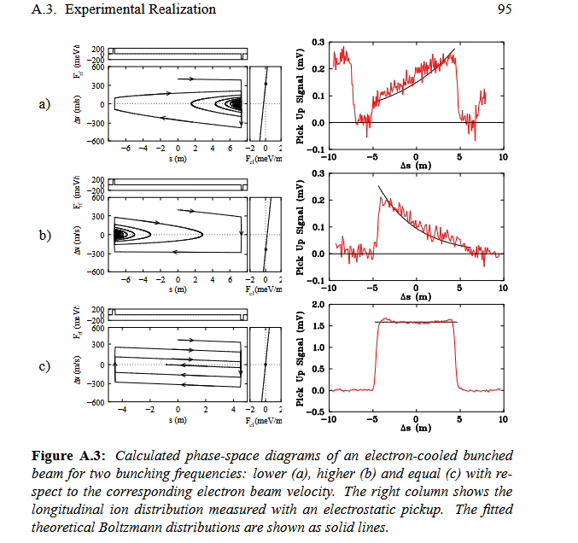
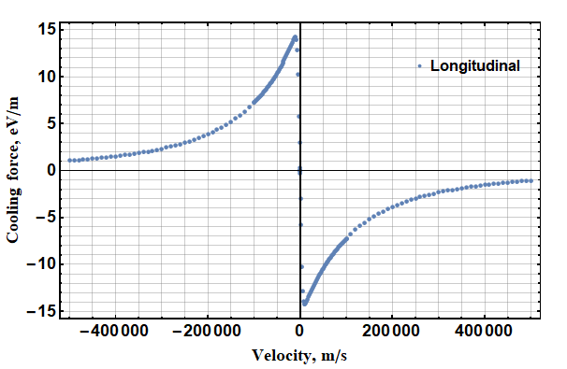
Extra info
Cartoon representing ranges of force to be measured with energy jump method
Mechanism of ion bunching in barrier bucket methods for misaligned and well-aligned force [17,21].
BPM signal is fitted with Boltzmann distribution with barrier bucket potential
[21] Laser cooling of fast stored ion beams to extreme phase-space densities. Dissertation of Udo Eisenbarth, 2001
14

