Slide 1
Development of a temperature controller for cryogenic systems at the NICA accelerator complex
Dzugaev Maxim
Technic, LHEP JINR
«ALUSHTA 2025»

Slide 2
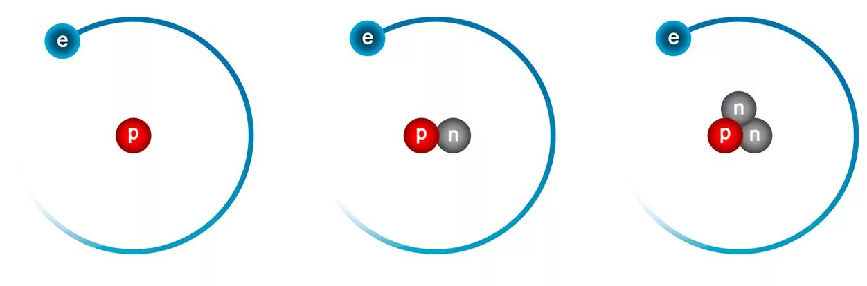
A long time ago…
in 2022
To conduct experiments on the BM@N installation, targets with a unique ratio of the working substance and the substance from which the target is made were needed. The requirement to have a minimum number of background events is a basic requirement for precision research. To implement the set physical program, a new cryogenic target is being created with hydrogen, deuterium and helium in a liquid state using cryocooler cooling. One of the main tasks in creating a cryogenic target using cryocooler cooling is to maintain a set temperature in the mode of recondensation of evaporating vapors of liquid hydrogen, deuterium or helium and a constant level of these liquids in the vessel.
t = 20,28 K

Slide 3
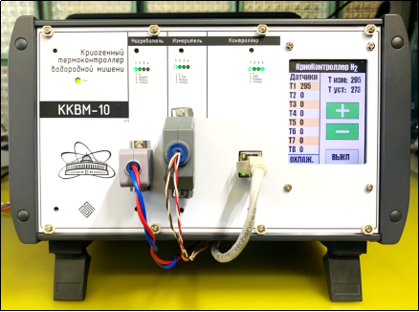
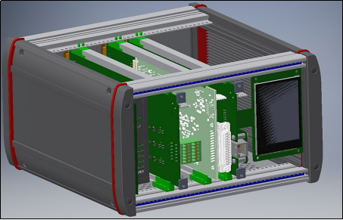
1-st generation of temperature controller
The refrigeration unit in use does not have a power control system and operates continuously. In the mode of hydrogen liquefaction and target filling, the entire refrigeration capacity produced by the cryocooler is used. Further, in the mode of maintaining the level of liquid hydrogen, much less refrigeration power is required, Excessive cooling capacity can cause hydrogen crystallization. The task of maintaining the set temperature and liquid level is solved by compensating for the excessively produced refrigerating power by an electric heater.

Slide 4
The main block diagram
Ethernet
Load
Temperature sensors
3U 19 inches
RS-485
Master Module
Heater Module
(< 100W)
Meas Module (2 chanells)
Power supply 500W
Display
~220V

Slide 5
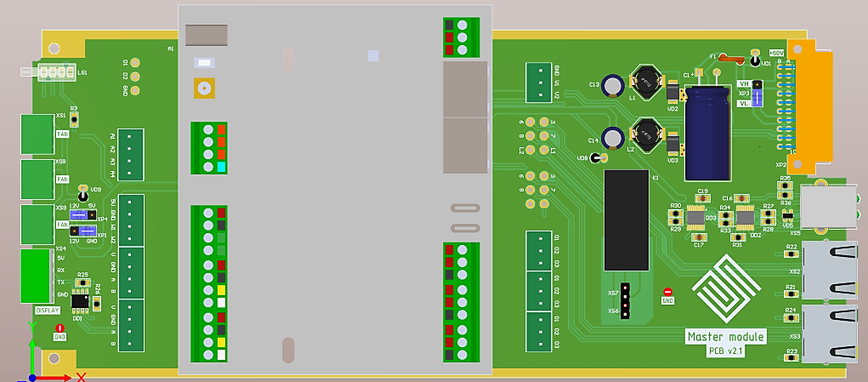
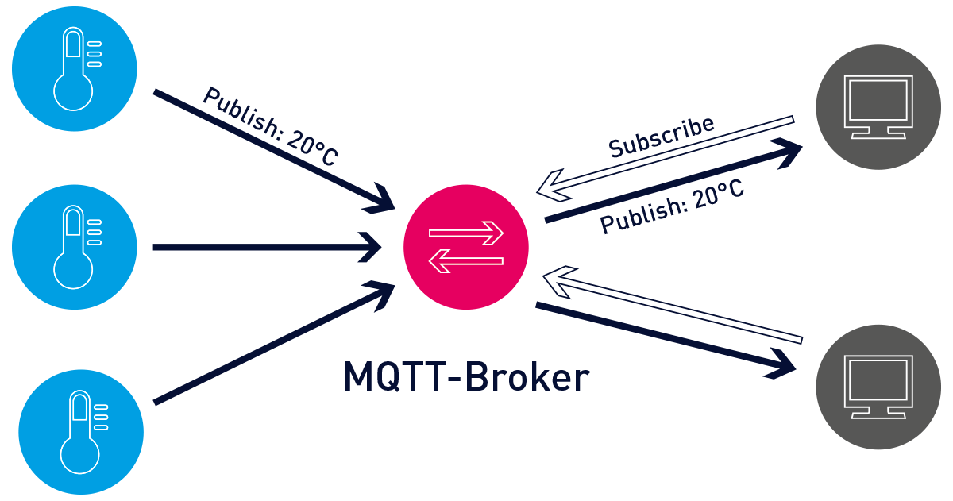
Master Module
Wirenboard
Power Supply 60V -> 12V & 5V
Fans
Fan control
RS-485
Ethernet
Display
Heater
Meas
Master

Slide 6
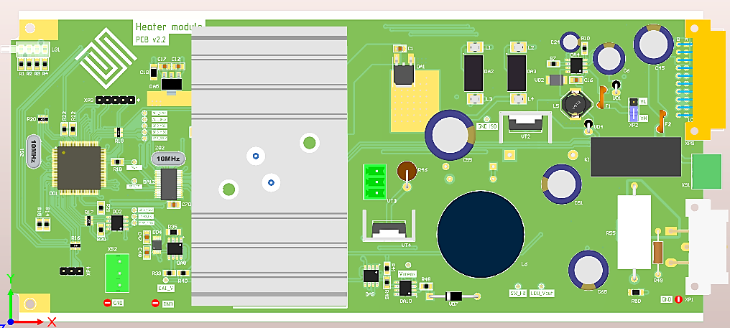
Heater Module
MCU
PWM
Pulse converter
Power Supply 60V -> 12V & 5V
p
ADC
< 48V
DAC 0-5V
Linear converter
Temperature stabilization accuracy – 1 mK ± 0,1 %.
Channel power – to 100 W.
Maximum output voltage – 50 V.
Maximum output current – 2 А.
Accuracy of measurement of output current, voltage – not worse ± 0,3 %.
Recommended heater resistance – from 25 to 100 Ohm.
< 45V
Current measure
< 100W
Load output

Slide 7
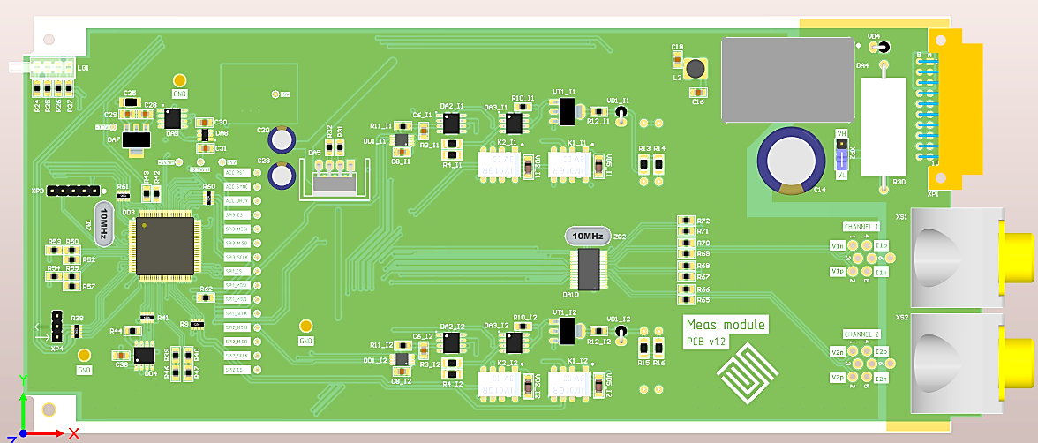
Meas Module
The range of measured temperatures is from 1.5 to 310 K (determined by the type of sensor).
The relative error of temperature measurements does not exceed ± 0.1% (determined by the sensor error in a certain range).
The bit depth of the ADC is 24 bits.
The measurement frequency is 10 Hz.
The range of the current source is from 100 nA to 1 mA.
The relative error of the current source does not exceed ± 0.1% in the range to 1 µA.
MCU
p
ADC
V+ V-
V+ V-
Current source 100n-1mA
I+
DAC 0-5V
R1
I-
DAC 0-5V
Current source 100n-1mA
I+
I-
R2

Slide 8
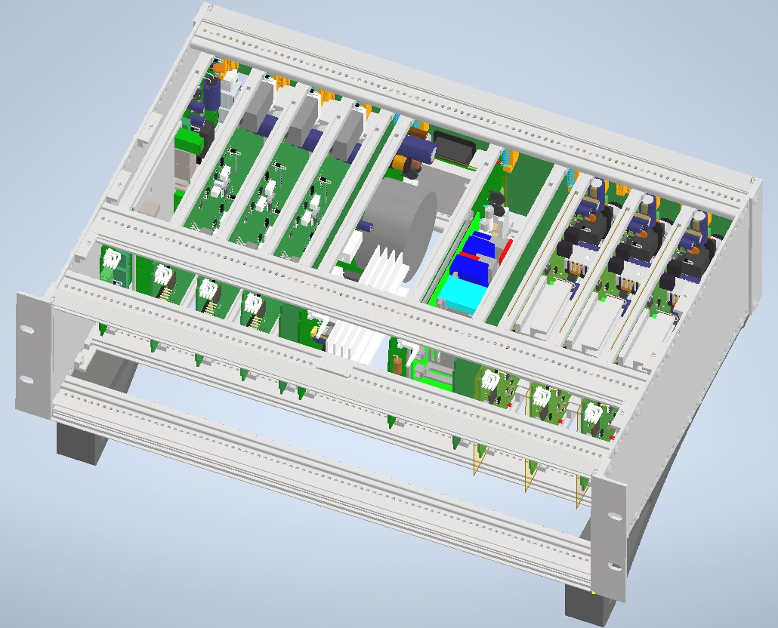
Why module system?
The modular system allows you to assemble different configurations for different needs (tasks) In the standard version, the 3U 19 inches crate can accommodate 3 meters and 3 heaters, the number of which may vary.

Slide 9
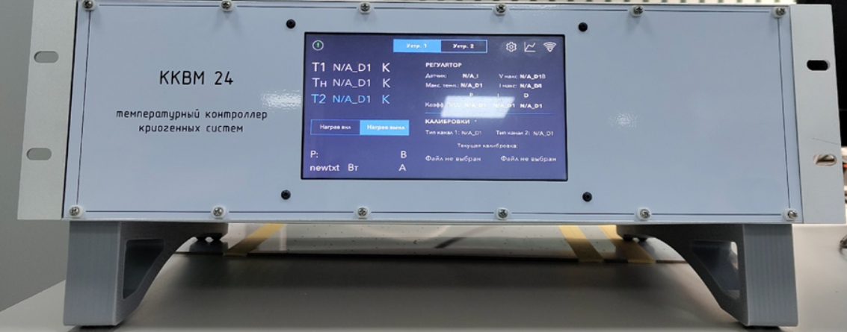
It’s not a model, it’s real !

Slide 10
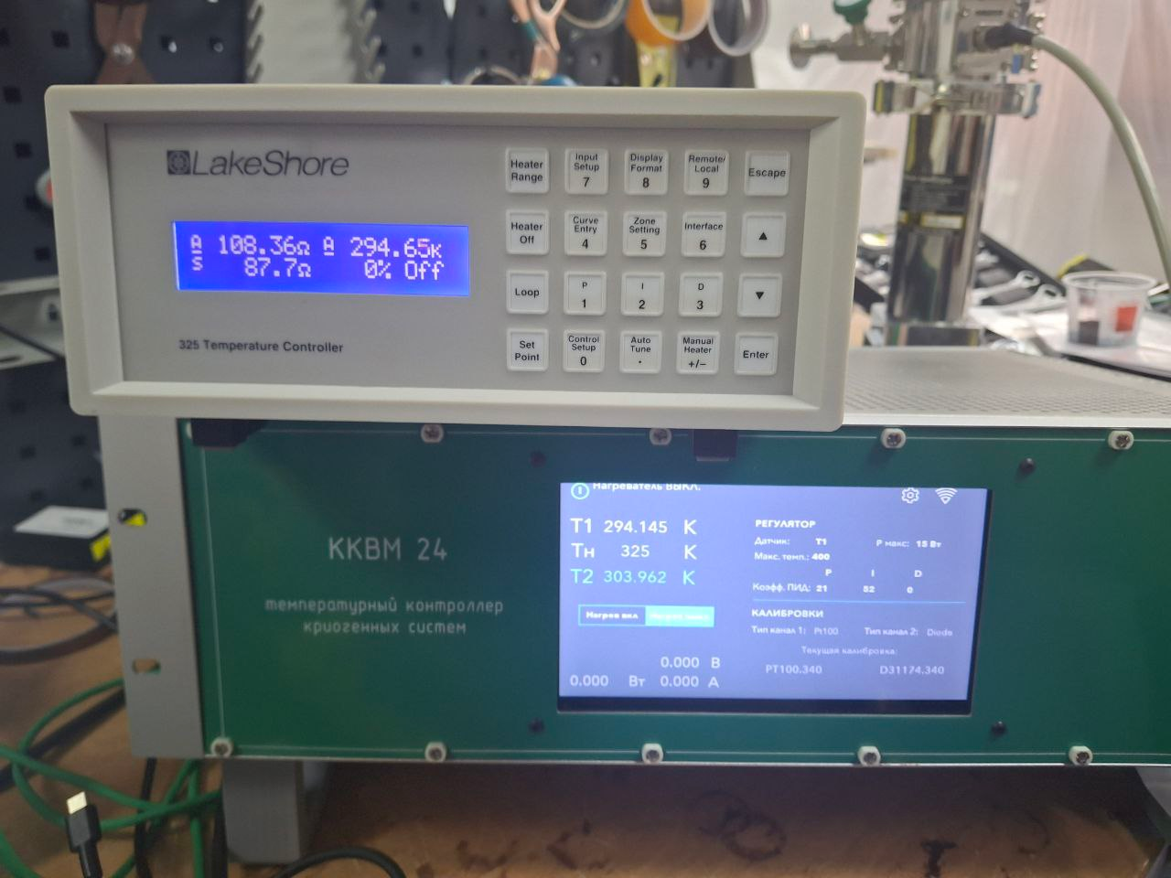
And we test it
PT-1000
Resistance |  | Temperature |  | Delta
Lakeshore | ККВМ | Lakeshore | ККВМ
1020,0000 | 1019.5772 | 278,26 | 278,164 | 0,096
1099,5000 | 1099.5483 | 298,83 | 298,687 | 0,143
235,2000 | 235.19552 | 85,009 | 84,987 | 0,022
99,2000 | 99.27473 | 51,992 | 51,953 | 0,039
51,4000 | 51.41354 | 35,979 | 35,973 | 0,006
34,1000 | 34.09416 | 28,027 | 28,021 | 0,006
2477,1000 | 2477.11177 | 675,01 | 675,003 | 0,007
PT-100
Resistance |  | Temperature |  | Delta
Lakeshore | ККВМ | Lakeshore | ККВМ
3,4100 | 3,4107 | 28,036 | 28,026 | 0,01
7,9100 | 7.90675 | 46,006 | 45,99 | 0,016
32,0800 | 32,0800 | 105,02 | 104,998 | 0,022
63,0100 | 62.98445 | 180,09 | 180,011 | 0,079
131,6100 | 131.55432 | 354,99 | 354,834 | 0,156
182,0300 | 182.04251 | 489,97 | 490,02 | -0,05
247,7000 | 247.69421 | 674,98 | 674,958 | 0,022
293,0800 | 293.08706 | 809,98 | 809,79 | 0,19

Slide 11
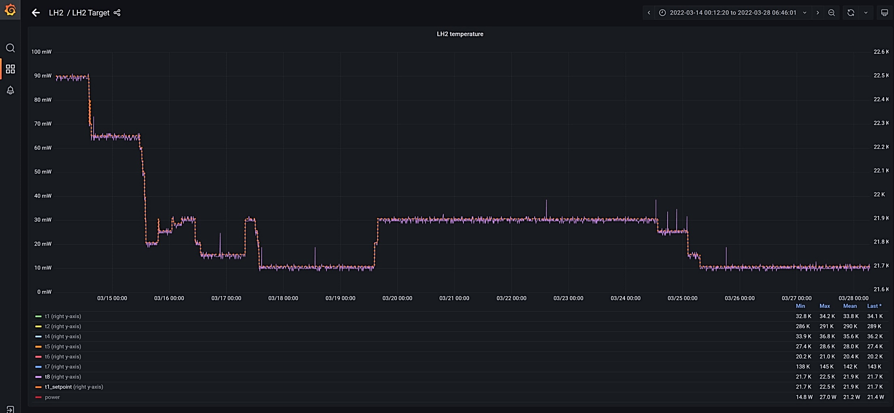
Some graphic

Slide 12
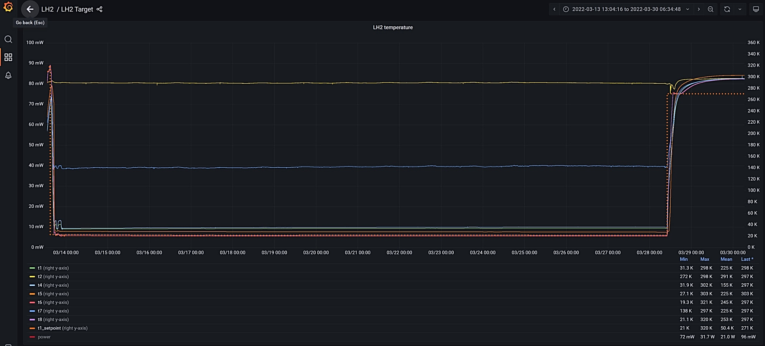
More graphics

Slide 13
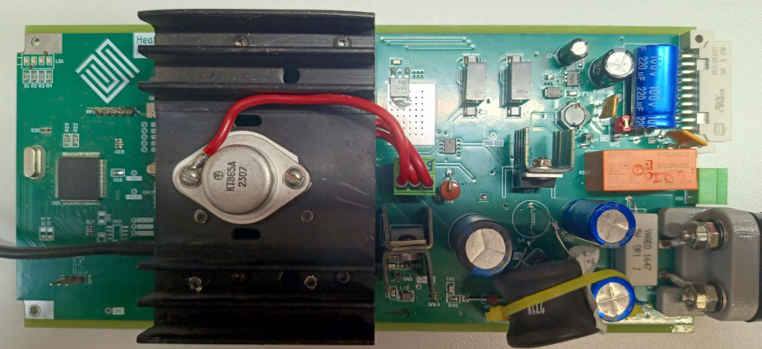
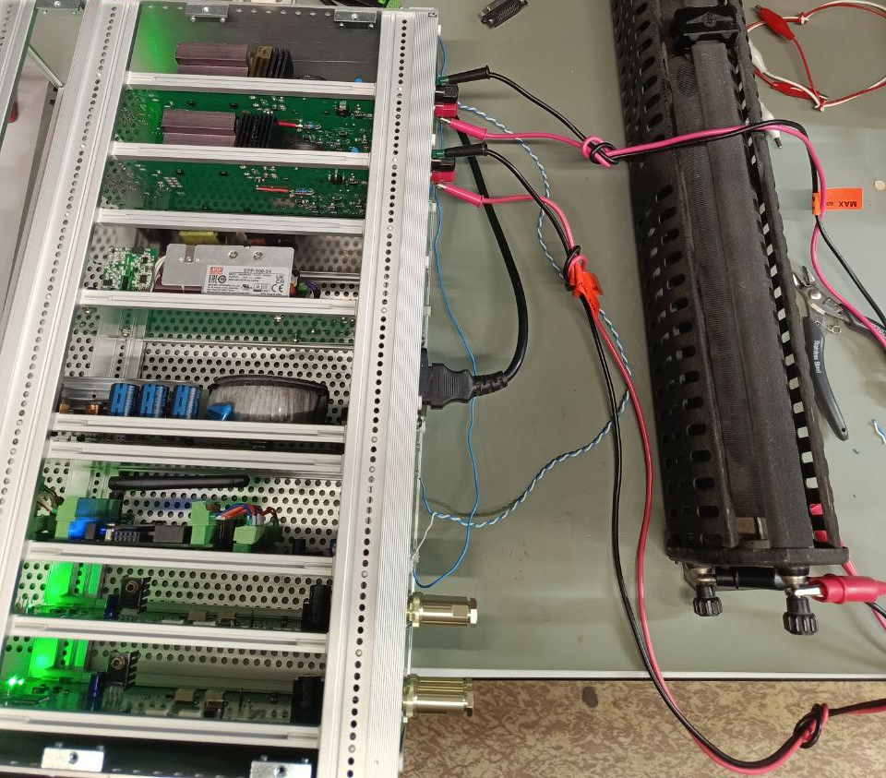
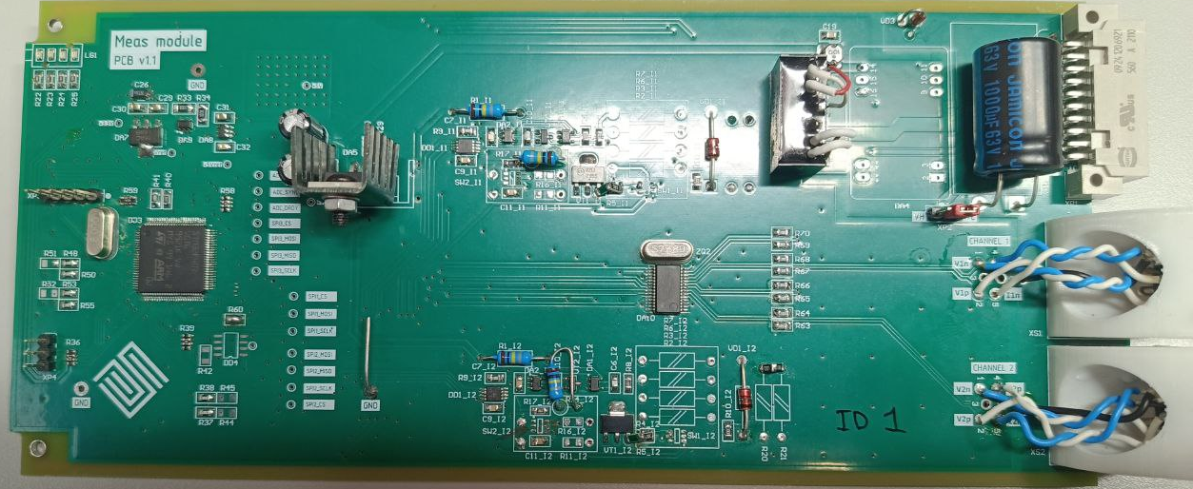
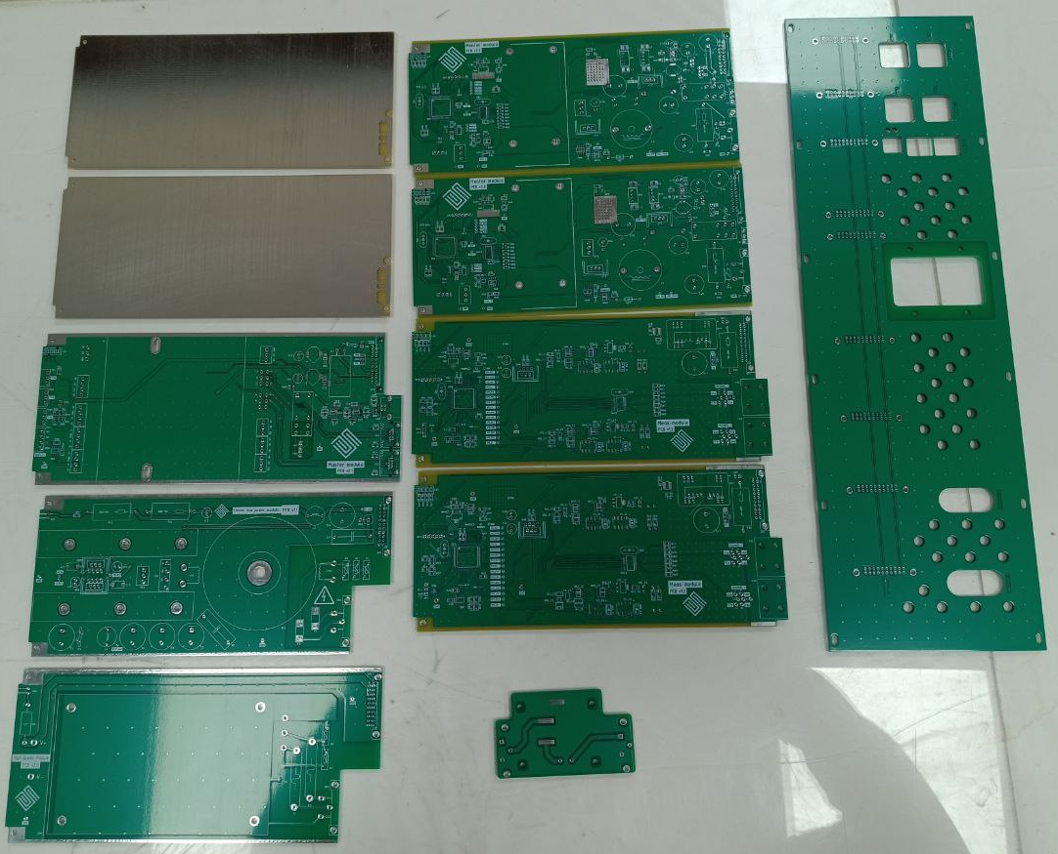
Conclusion

Slide 14
Thank you for your attention!

