Slide 1
Automation of
BM@N Run9 data processing on a DIRAC distributed infrastructure
AYSS Alushta-2025
Konstantin Gertsenberger, Igor Pelevanyuk
LHEP
MLIT

Slide 2

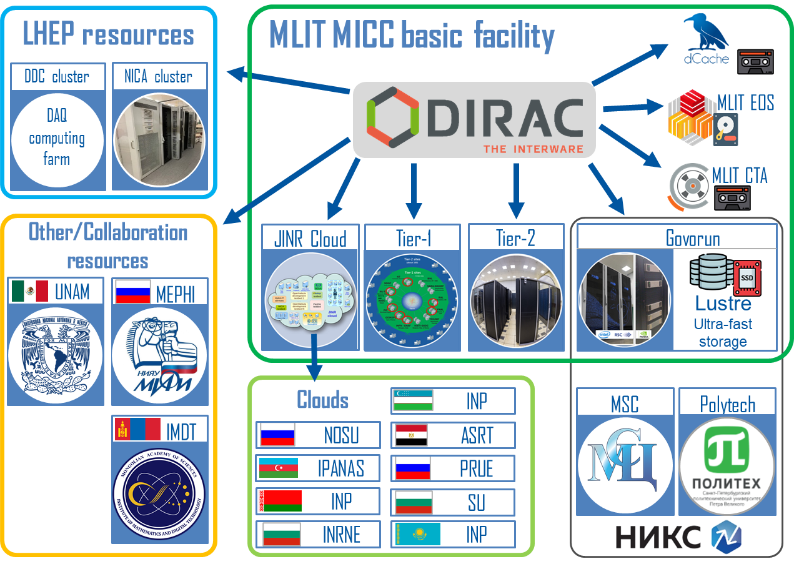



What do we have from BM@N run8
1. Form input file list
Input
2. Configure production
Config
3. Form executable
Production Manager
Job.sh
4. Launch jobs
DIRAC distributed infrastructure
Files: 31306
Size: 436 TB
Size: ~ 25 TB
Size: ~ 66 TB
Total values:
Jobs: 31306
Jobs: 31306
RawToDigi
DIGI
DigiToDst
DST
Per file values:
1 file: ~14 GB
1 job: ~1 hour
1 file: ~0.8 GB
1 job: ~12 hour
1 file: ~2.2 GB
Standard production flow:
Register data
Test software
Launch distributed processing
Detect issues, Analyze performance
Full run8 data production takes around 8 days!

Slide 3
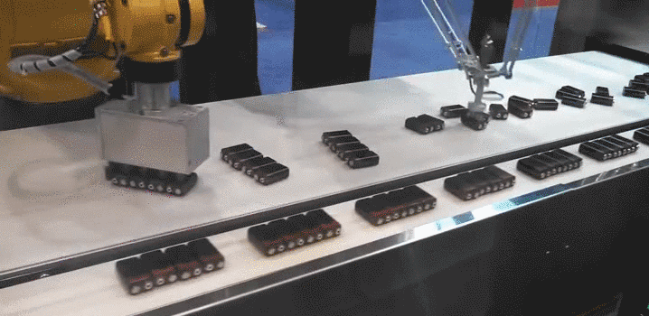
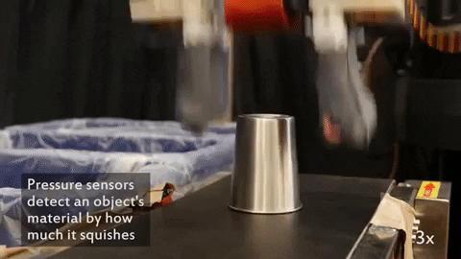
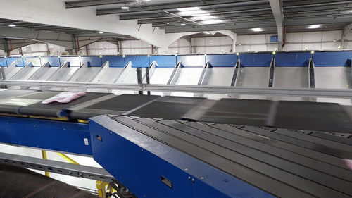
Why to automate run9 data processing?
Not to save time – data taking happens not so often.
Not to avoid errors – we do not encounter them during jobs submission.
But to reliably deliver data for physics analysis as soon as we can during data taking!

Slide 4
Transformation system
Transformation is a mechanism in DIRAC to start job when new file appear.
Interface to DB
Transformation Manager
Keep track of transformations
Transformation agent
TransformationDB
Detect new files
InputData agent
Submit new jobs
WorkflowTask agent
All components were installed and tested.
The code of WorkflowTask agent was changed in order to pass input file name as a parameter to the job.

Slide 5
Automated approach
1. Form input query
Job.sh
JOB 1
Job.sh
JOB 2
Job.sh
JOB N
input1
input2
inputN
2. Configure production
5. Jobs initiation and submission to queue
Config
3. Form executable
Runs on DIRAC server
Production Manager
Transformation task
4. Setup transformation
Job.sh
Job.sh
Config
Special transformations were developed to initiate jobs:
RawToDigi – when RAW file appears this job:
Download RAW file.
Generate DIGI from RAW file.
Upload DIGI to storage system.
Upload DIGI to NICA cluster.
DigiToDST – when DIGI file appears this job:
Download DIGI file.
Generate DST from DIGI file.
Upload DST to storage system.
Upload DST to NICA cluster.
Run only on Tier1.
Govorun and NICA cluster are also possible as a fallback solution.
Run only on Tier2.
Govorun, NICA cluster, Tier1 are possible as fallback solution

Slide 6




Automation schema
Detection of a new files rely on the files meta data
RawToDigi query: {type=raw, run_number=9}
DigiToDst query: {type=digi, run_number=9}
For 1 file – 1 job is started
DIRAC FileCatalog
EOS NCX
1
MLIT CTA
MLIT EOS
2
DIGI
3
DST
New raw file discovery
RawToDigi
New digi file discovery
DigiToDst

Slide 7
Corner cases
What if jobs profile change from run8?
Do not activate automation until we check RawToDigi and DigiToDst jobs.
What if RAW file size will be enormous, like 100 GB?
Do not submit jobs automatically for files bigger than 16 GB.
What if one of computing resources is not sustaining the load or unavailable for any reason?
Do not restrict job submission to a computing resource, but rather require
resource to have a special tag: rawtodigi, digitodst.
With that approach it is possible to change destination of waiting jobs manually.

Slide 8


Here should be some plots with jobs submitted by Run9 automation …
… but date of the data taking was postponed.
But, we know from physicist what to do in that cases…
… simulate!

Slide 9
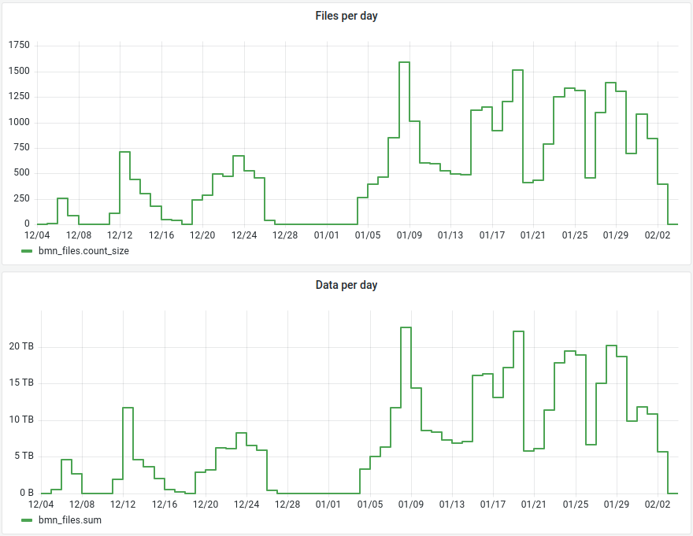
BM@N Run8 data taking
Total files: 31306
Total raw size ~ 436 TB

Slide 10
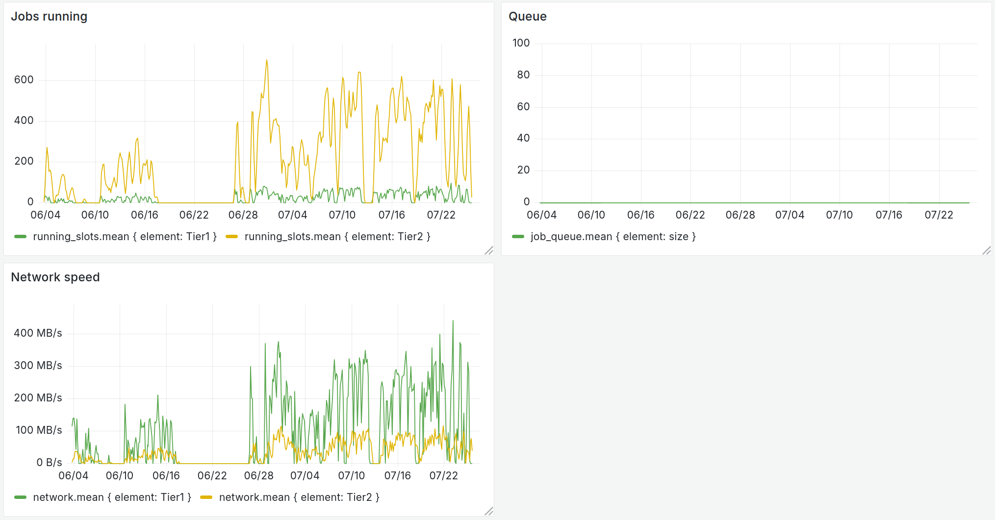
Simulation plots
What if previous data taking was automated?
Data rate from Run8 was taken analyzed and used to simulate the same data flow to the system.

Slide 11
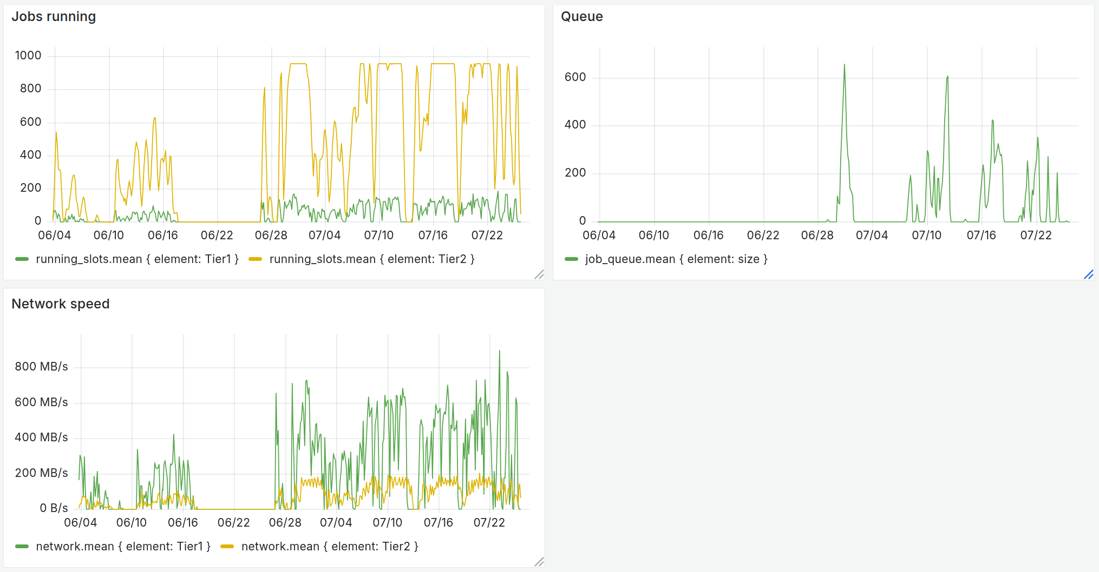
Simulation plots
What if the intensity doubled?
Occasional queues during most intense data taking periods.
Solution: allow Tier1 to process part of DigiToDst jobs

Slide 12
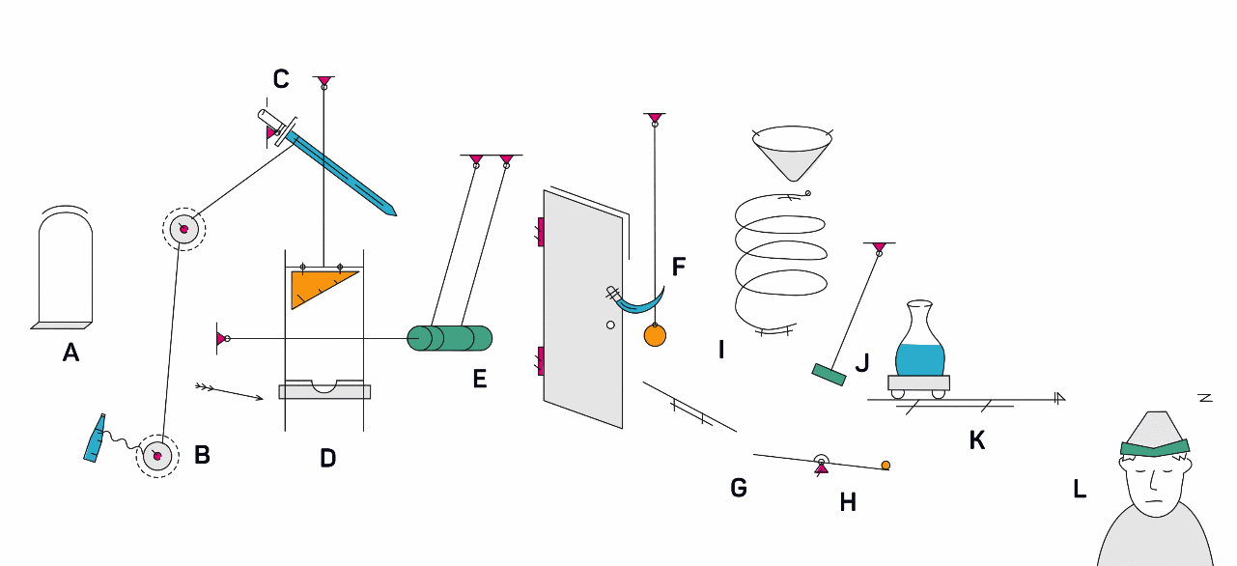
Conclusion
Meaningful metadata information was introduced.
Automation schema was developed and tested.
Basic simulation was performed.
Now waiting for data taking.
Thank you for attention!

