Slide 1
JINR Association of Young Scientists and Specialists Conference "Alushta-2025"
Dynamics Of Il-1β, Arginase, And iNOS Levels
In Mouse Brain Homogenate Following Proton Irradiation At The Bragg Peak In The Short And Long-term
Nguyen Bao Ngoc , Lobachevsky P.N. , Vinogradova O.O., Vinogradova V.S.
Alushta, June ${12}^{th}$ 2025

Slide 2
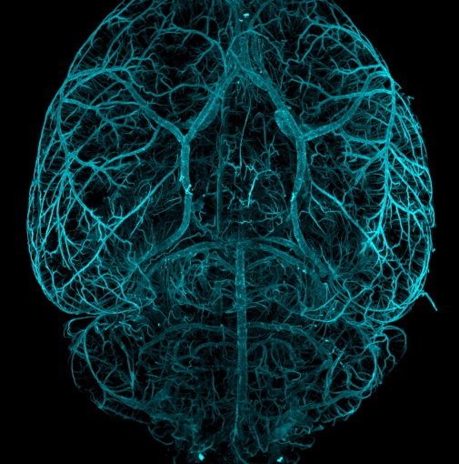
01
Introduction
02
Methods & materials
Contents
03
Results
04
Conclusion
2

Slide 3
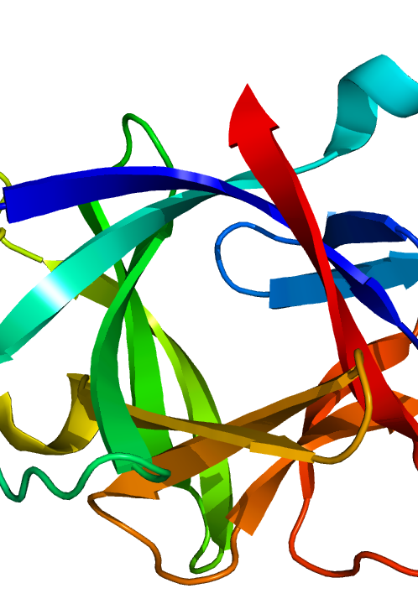
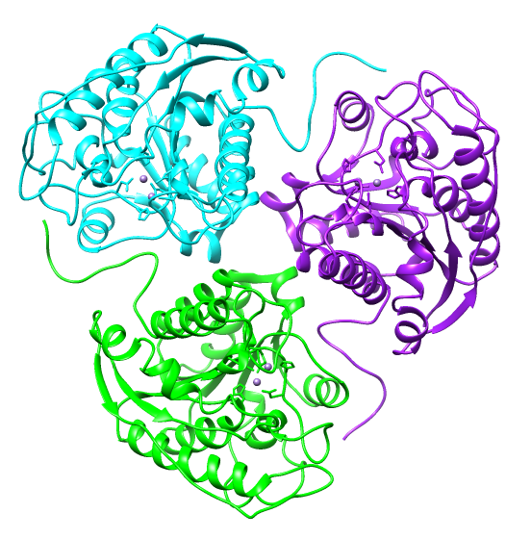
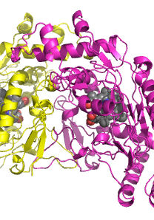
Introduction
Proton therapy is a precise form of radiation treatment that targets tumors by using the Bragg peak, limiting damage to healthy tissues.
CNS is sensitive to radiation-induced damage and inflammation.
Our aim was to study how the levels of these biomarkers change after proton exposure.
IL-1β and iNOS: markers of acute inflammation.
Arginase-1: marker of tissue repair.
IL-1ꞵ
Arginase
iNOS
3
Notes:
Proton therapy is a precise form of radiation treatment that targets tumors by utilizing the Bragg peak, limiting damage to healthy tissue. However, the central nervous system is highly sensitive to radiation.
"Neuroinflammation is the brain immune response to injury, involving glial cell activation and the release of pro-inflammatory cytokines like IL-1β and TNF-α. Initially, this aims to repair damage—but if prolonged, it can harm neurons instead.
→That’s why Measuring cytokine levels post-irradiation provides insight into the extent of neuroinflammation and potential therapeutic targets
We focused on three biomarkers:
IL-1β and iNOS, which are associated with acute inflammation,
and Arginase I, which indicates tissue repair.
`

Slide 4
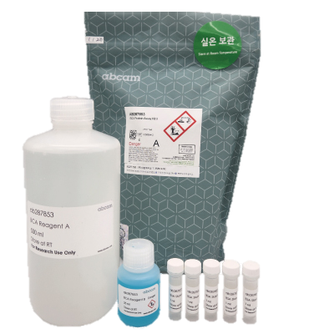
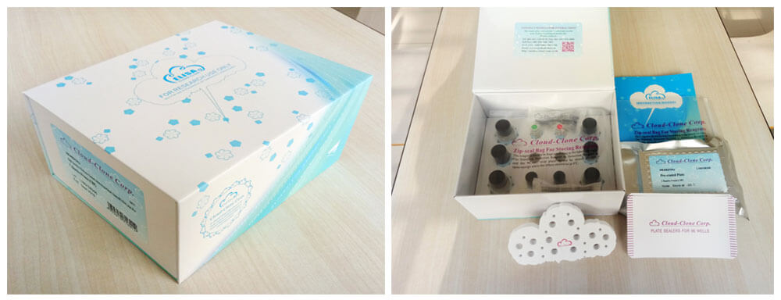
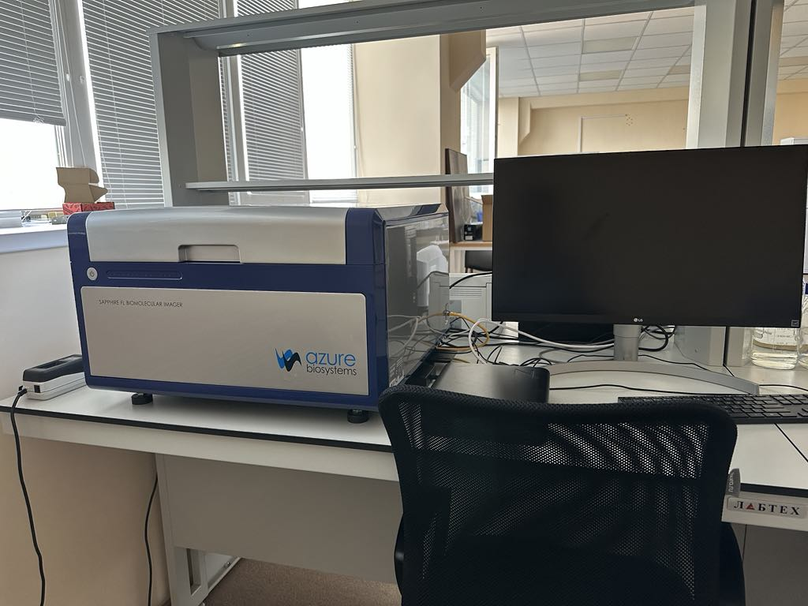
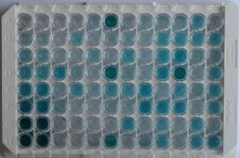
🔬Methods and materials
1. Animal Models
2. Irradiation
Mouse strains: ICR and C57BL/6
Irradiated at the Bragg peak with proton doses: 2, 5, and 10 Gy using the Phasotron accelerator
3. Brain collection
Brain tissue collected post-irradiation
Time points: 24h, 48h, 2 months, 6 months, 12 months.
4. Protein & Cytokine Quantification
Total Protein Quantification using BCA assay (Abcam)
5. Measurement with Azure Biosystems Sapphire Biomolecular Imager
Cytokines & enzyme (IL-1β, Arg-1, iNOS): ELISA kits
Absorbance measured at 488 nm
6. Data Processing & Statistical Analysis
4
Notes:
We used mice as our animal model. Their brains were irradiated with proton doses of 2, 5, and 10 Gy at the Bragg peak.
Total protein was quantified using the BCA assay from Abcam, and cytokine levels — IL-1β, Arg-1, and iNOS — were measured using ELISA kits.
The absorbance was detected at 488 nm using the Azure Biosystems Sapphire Biomolecular Imager, and all data were normalized and analyzed with p < 0.05 as the threshold for significance.

Slide 5
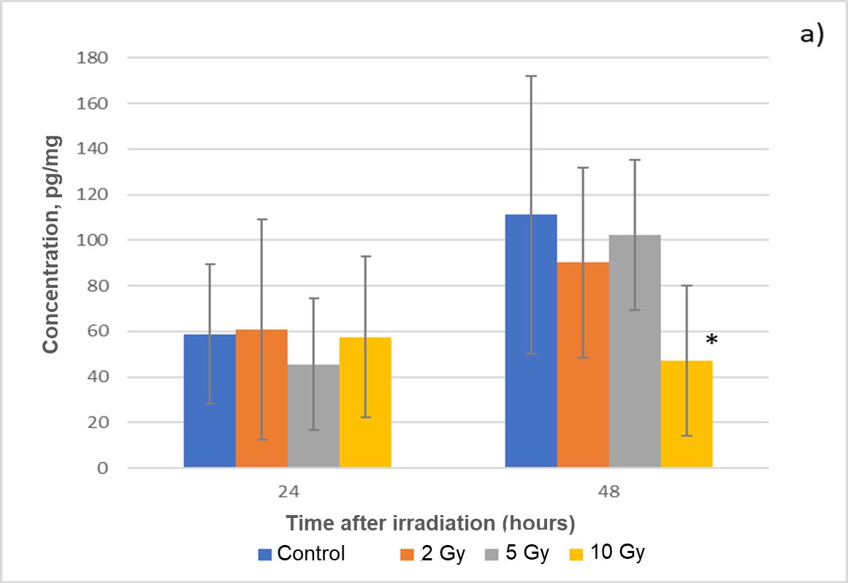
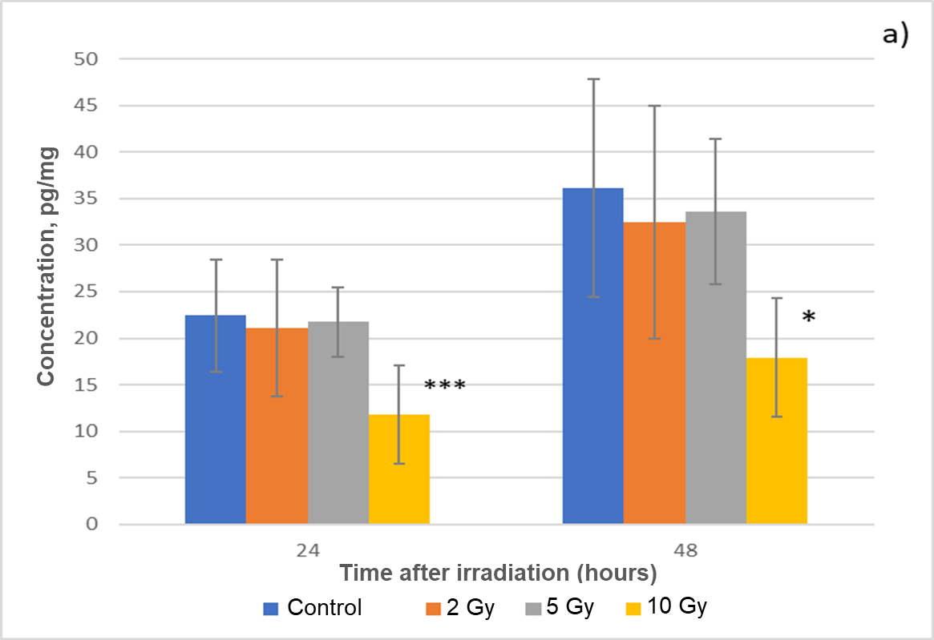
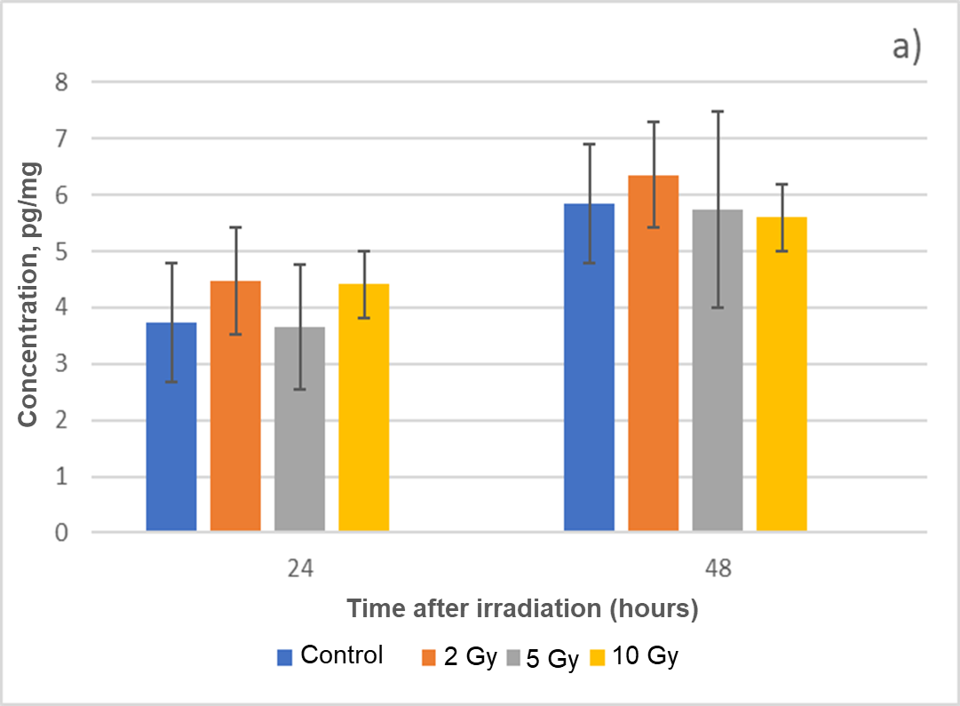
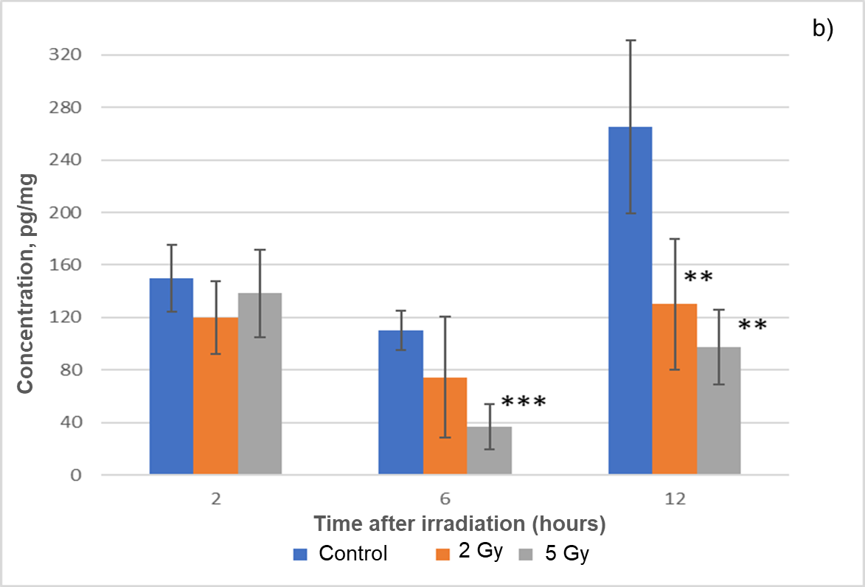
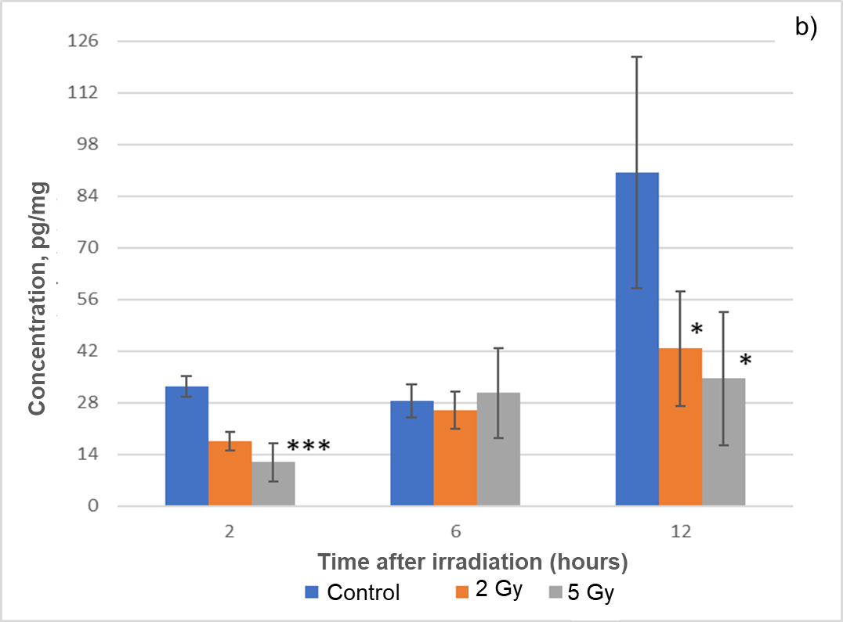
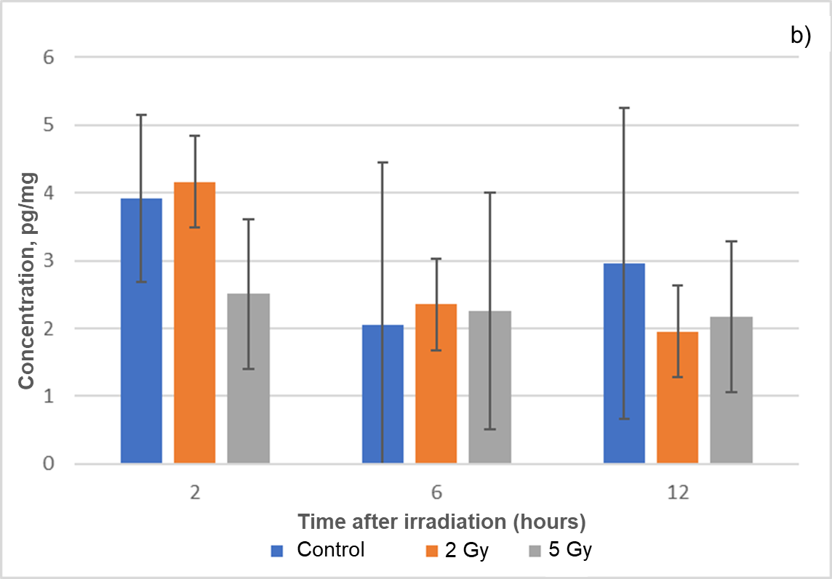
🧪Results
IL-1β
Arginase I
iNOS
Short –term
Long –term
5

Slide 6
🧪Results
IL-1β
Short-Term: Within the first 48 hours, IL-1β levels remain near normal at 24 hours but significantly decline at 10 Gy by 48 hours, indicating an immediate high-dose inhibitory effect. This may reflect early suppression of ìnlammation due to high dose radiation stress.
Long-Term: From 2 to 12 months, IL-1β levels gradually declined with increasing dose, showing the most substantial reductions at 6 and 12 months. The persistent decrease may rèlect lasting dysfunction of microglia or chronic suppresstion of cytokine production
Short –term
Long –term
Asterisks (*) on the graph indicate statistically significant differences. For example, * means p < 0.05, ** means p < 0.01, and *** means p < 0.001 .
6
Notes:
Let’s start with IL-1β. In the short term, at 48 hours, we observed a significant drop at 10 Gy, indicating an early anti-inflammatory effect at high dose. In the long term, IL-1β levels continued to decrease dose-dependently, especially after 6 and 12 months. This suggests a sustained suppression of inflammation.
Asterisks (*) on the graph indicate statistically significant differences. For example, * means p < 0.05, ** means p < 0.01, and *** means p < 0.001 . This helps us identify which radiation doses caused reliable changes in the biomarkers.

Slide 7
🧪Results
Arginase I
Short –term
Short-Term: Within 24–48 hours at 10 Gy, Arginase I levels decline significantly, indicating an acute stress response disrupting enzyme regulation.
Long-Term: At 2 and 12 months after irradiation, the continued suppression of Arginase I suggests enduring molecular changes that may impact brain repair and immune homeostasis.
Long –term
Asterisks (*) on the graph indicate statistically significant differences. For example, * means p < 0.05, ** means p < 0.01, and *** means p < 0.001 .
7
Notes:
For Arginase I, we saw a significant decrease within 48 hours at 10 Gy. This shows an acute disruption in repair pathways. In the long term, the suppression continued, which may indicate long-lasting molecular damage affecting tissue repair and immune balance.

Slide 8
🧪Results
iNOS
Short –term
Short-Term: iNOS levels showed no significant changes between control and irradiated groups. Although there was a slight increase at 48h, the variations were small and not dose dependent.
Long-Term: iNOS expression remained relatively stable over time, with no consistent trends or significant differences; variability was high.
Long –term
Asterisks (*) on the graph indicate statistically significant differences. For example, * means p < 0.05, ** means p < 0.01, and *** means p < 0.001 .
8
Notes:
Interestingly, iNOS levels did not show major changes in either short or long term. There was a slight increase at 48 hours, but it wasn’t statistically significant or dose-dependent. Overall, iNOS remained relatively stable, with high variability.

Slide 9
🧠 CONCLUSION
Our findings demonstrate that proton irradiation at the Bragg peak induces significant, dose dependent alterations in neuroinflammatory markers in mouse brains:
IL-1β and Arginase I levels were significantly reduced after high-dose exposure, both in the short and long term.
iNOS levels remained unchanged, suggesting limited involvement in this specific radiation-induced response.
These results suggest that:
Radiation exposure disrupts both pro- and anti-inflammatory pathways, potentially impairing the brain ability to regulate immune balance.
IL-1β and Arginase I are sensitive and reliable biomarkers for monitoring neuroinflammation and could be used in assessing CNS risks from radiotherapy or space radiation.
Further investigation is needed to explore cellular localization, recovery dynamics, and potential neuroprotective interventions.
9

Slide 10
Thank you for your attention

Slide 11
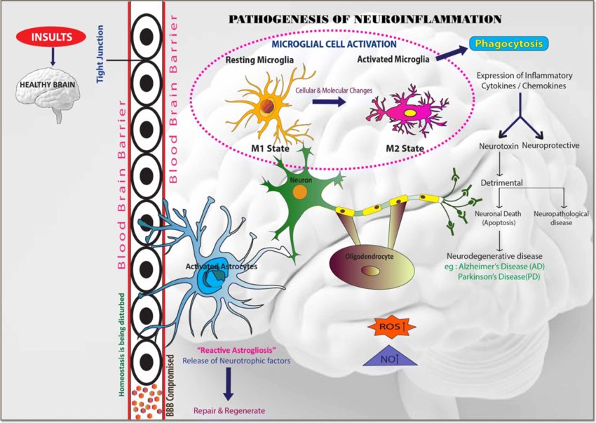
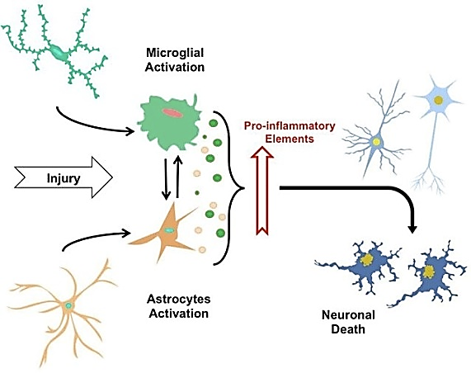
Neuroinflammation and Irradiation-Induced Immune Response
🧠 Neuroinflammation response
☢️ Cranial irradiation effect
Source: Motalleb M, et al. (2021). Diagram of the pathogenesis of neuroinflammation. ResearchGate.
Source: Han W, et al. (2017). Effects of irradiation on the brain: Acutely, irradiation induces cell death and microglial activation. ResearchGate.
Measuring cytokine levels post-irradiation provides insight into the extent of neuroinflammation and potential therapeutic targets
4
Notes:
This slide is highlights the core mechanisms of neuroinflammation and radiation effects on the brain.
"Neuroinflammation is the brain immune response to injury, involving glial cell activation and the release of pro-inflammatory cytokines like IL-1β and TNF-α. Initially, this aims to repair damage—but if prolonged, it can harm neurons instead.
[🧠 point to image 1] In the first diagram, we see how glial cells, especially microglia, are activated after brain injury. They release cytokines and attract immune cells from the blood. If not controlled, this inflammation can become chronic and neurotoxic.
[☢️ point to image 2] With cranial irradiation, this pathway becomes more intense. Radiation triggers acute microglial activation and a surge in cytokines like IL-1β and IL-18. Over time, inflammation persists, microglia are lost, and neural damage worsens.
That’s why measuring cytokine levels after irradiation is crucial—it helps us evaluate inflammation and identify targets for protective interventions, such as those modulating nitric oxide or arginase activity."
Based on these mechanisms, we conducted an experiment to measure IL-1β, arginase, and iNOS levels after proton irradiation. Let’s look at our study design.

Slide 12
What is the p-value?
The p-value (probability value) is a statistical indicator that helps determine whether the observed difference between groups occurred by chance, assuming there is no real difference (null hypothesis is true).
It is commonly used in hypothesis testing to compare a control group and an experimental group (e.g., Control vs. 10 Gy).
$$t=\frac{\overline{x_{1} − x_{2}}}{\sqrt{\frac{s_{1}^{2}}{n_{1}}+ \frac{s_{2}^{2}}{n_{2}}}}$$
“P-value helps us determine whether the differences observed are statistically meaningful. A small p-value (typically < 0.05) means the difference is unlikely due to chance, and is considered statistically significant.”
Symbol | Corresponding p-value | Interpretation
* | p < 0.05 | Statistically significant
** | p < 0.01 | Very statistically significant
*** | p < 0.001 | Highly statistically significant
ns | p ≥ 0.05 | Not significant
Symbol | Meaning
x̄₁, x̄₂ | Mean of each group
s₁, s₂ | Standard deviation of each group
n₁, n₂ | Sample size of each group
Notes:
In our analysis, we used p-values to determine whether the observed differences between groups were statistically significant.
A p-value tells us the probability that a result occurred by chance. The smaller the p-value, the more confident we are that the effect is real.
In this study, we considered p < 0.05 as statistically significant. You may also notice asterisks on the graphs:
means p < 0.05, ** means p < 0.01, and *** means p < 0.001. These symbols help highlight where meaningful differences occurred between groups.

Slide 13
Mouse line | Time after irradiation | Type of irradiation | Irradiation dose (groups) | Number of individuals in the group
CB57L/6 | 24 hours | p+ at the Bragg peak | Control | 8
 | -//- |  | 2 Gy | 8
 | -//- |  | 5Gy | 8
 | -//- |  | 10 Gy | 8
CB57L/6 | 48 hours | p+ at the Bragg peak | Control | 8
 | -//- |  | 2 Gy | 8
 | -//- |  | 5Gy | 8
 | -//- |  | 10 Gy | 8
ICR-1 | 2 months | p+ at the Bragg peak | Control | 4
 | -//- |  | 2 Gy | 5
 | -//- |  | 5Gy | 5
ICR-1 | 6 months |  | Control | 7
 | -//- |  | 2 Gy | 7
 | -//- |  | 5Gy | 7
ICR-1 | 12 months |  | Control | 6
 | -//- |  | 2 Gy | 7
 | -//- |  | 5Gy | 8
Notes:
This table summarizes the experimental design used in our study.
Two mouse strains were used: C57BL/6 for the short-term analysis, and ICR for the long-term time points.
For the C57BL/6 group, brain samples were collected at 24 and 48 hours after proton irradiation at the Bragg peak. Each time point included a control group and a 5 Gy group, with 8 animals per group.
For the ICR mice, we analyzed brains at 2 months and 12 months post-irradiation. The groups included control, 2 Gy, and 5 Gy, with 4 to 8 animals per group depending on the condition.
This setup allowed us to evaluate both the short- and long-term effects of proton radiation on brain inflammation.

Slide 14
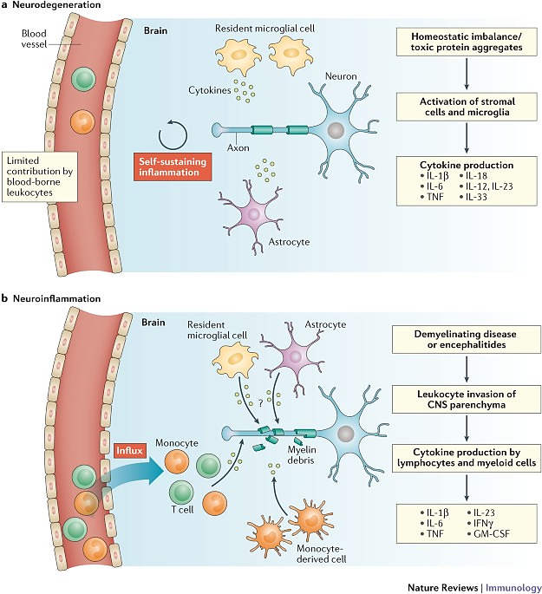
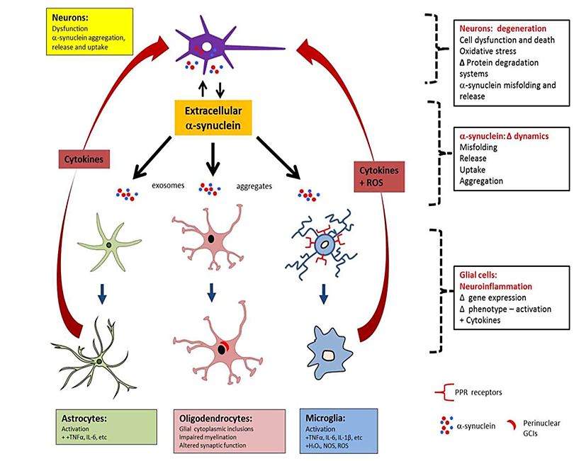
Arginine pathway regulation
Immune polarization
Martinez FO, Gordon S. (2014). The M1 and M2 paradigm of macrophage activation: Time for reassessment. PMC.
Durante W. (2007). Arginase: A critical regulator of nitric oxide synthesis and vascular function. ResearchGate.
Notes:
Supplementary – Immune Modulation”
(Chỉ trình bày khi được hỏi hoặc cần mở rộng)
"Besides cytokine release, another important mechanism in radiation-induced inflammation is the balance between nitric oxide production and its regulation.
[Chỉ vào phần Arginase vs iNOS] Arginase and inducible nitric oxide synthase (iNOS) both use L-arginine as a substrate. Arginase converts it into ornithine and urea, while iNOS uses it to produce nitric oxide (NO), a molecule that can be highly damaging in excess. So, they compete for the same substrate, and this competition determines whether the inflammatory response escalates or is controlled.
[Chuyển sang phần Th1/Th2 polarization] Additionally, this balance is regulated by helper T cells: Th1 cells stimulate iNOS and drive pro-inflammatory activity, while Th2 cells promote arginase expression and contribute to anti-inflammatory, tissue-repairing functions. This mechanism helps explain how immune responses after irradiation may vary, and why measuring enzymes like iNOS and arginase can give us deeper insights into the inflammatory state of the brain."

