Slide 1
Comparative analysis of behavioral reactions and physiological parameters of mice under proton exposure and aging
Sakharova.S.K, Severyukhin Yu.S., Kolesnikova I.A., Utina D. M., Pronskikh E.V., Molokanov A.G.

Slide 2
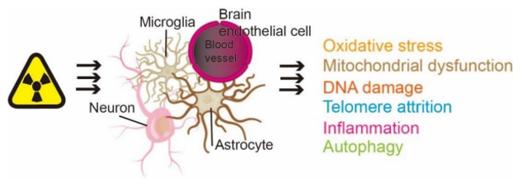
Relevance of the research
“the effects caused by ionizing radiation are similar to those of normal aging.”
Cle´ ment, G.R. (2020)
“There is significant post-radiotherapy accelerated aging in patients who have undergone radiotherapy.”
Huisman, S. I. (2022)
“exposure to galactic cosmic rays resembles a variety of terrestrial disorders, including normal neurological aging...”
Cle´ ment, G.R. (2020)
«Of 306 Chernobyl-affected workers, 81% of men and 77% of women showed signs of accelerated aging.»
Yablokov, A.V(2009)
Wang, Q. Q., Yin, G., Huang, J. R., Xi, S. J., Qian, F., Lee, R. X., Peng, X. C., & Tang, F. R. (2021). Ionizing Radiation-Induced Brain Cell Aging
no data about functional and behavior changes

Slide 3
Object and subject of the study
Object of study: 4 groups of mice (control, irradiated at a dose of 1 Gy, 5 Gy and old mice).
Subject of the study: behavioral reactions and physiological parameters of mice.

Slide 4
Aim and Objectives
Aim: to carry out a comparative analysis of changes in behavioral reactions and physiological parameters of mice under accelerated proton irradiation and aging.
Objective:
Evaluation of behavioral responses of old mice and mice irradiated with protons at doses of 1 Gy and 5 Gy in the T-maze test system.
Evaluation of behavioral responses of old mice and mice irradiated with protons at a dose of 1 Gy and 5 Gy in an Open Field facility.
Analysis of physiological parameters (body weight, thymus weight, spleen weight, bone marrow karyocyte count) of all groups of mice.

Slide 5
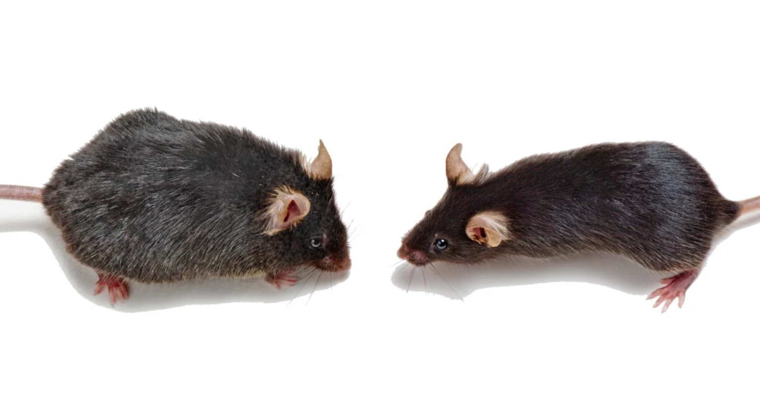
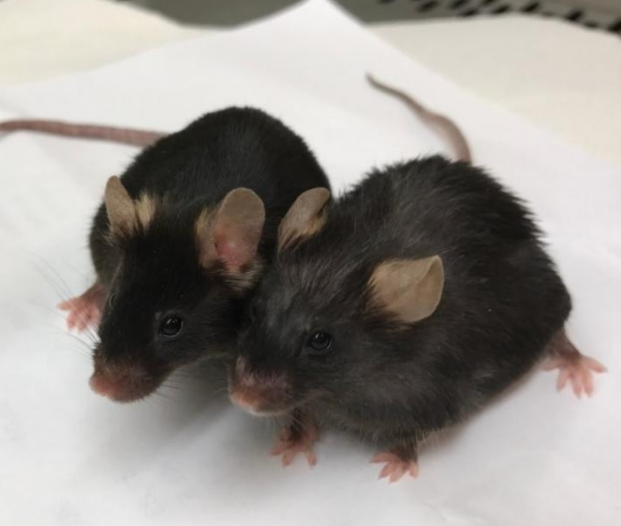
Experimental part 1.Animals
C57Bl/10 females. Age 10 months at the time of irradiation.
C57Bl/10 females. Age 19 months at the time of irradiation of the first group (old mice).
Average body weight: 26.2 g.

Slide 6
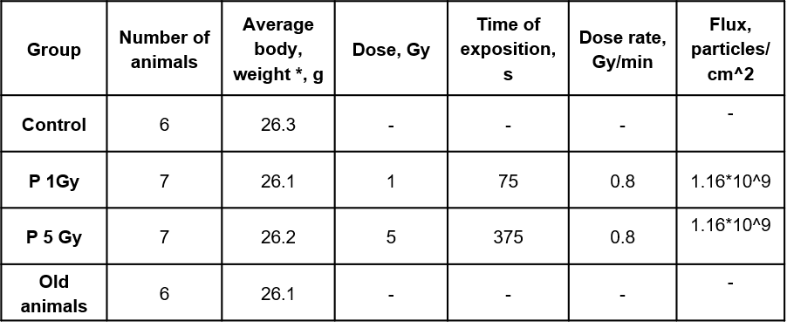
Experimental part
2. Irradiation
Table 1: Irradiation characteristics.
* At the time of exposure

Slide 7
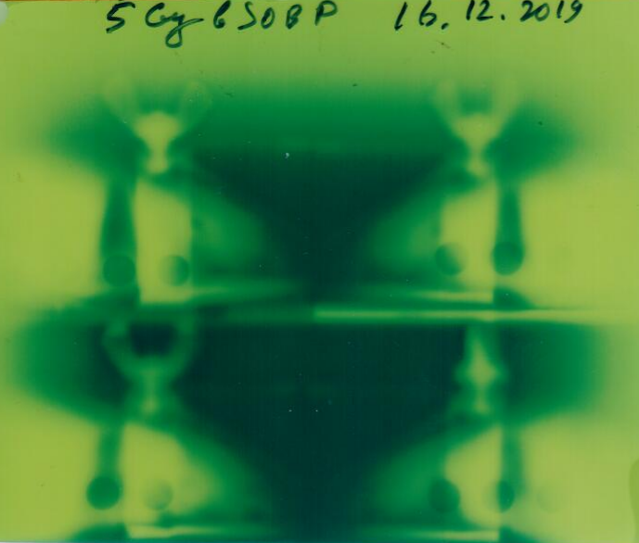
Fig.1. Arrangement of animal containers during irradiation.
Fig.2. Depth dose distribution of the proton beam used. The beam was modified and the extended Bragg peak was used.
Fig.3. Image on the radiochromic film installed behind the containers. The light areas are the zones in which complete absorption of particle energy has taken place.

Slide 8
Experimental part 3. Behavioral response research
Open Field test TS0501-MG (OpenScience, Russia)
On days 10 and 30 after irradiation, the differences and dynamics of orientation and exploratory behavior were assessed and the level of emotional reactivity was monitored.
On the 29th day after irradiation, the values of the index of spontaneous alternation in the T-maze were evaluated.
T-maze test TS0701-M
(OpenScience, Russia)
Fig.4. Behavioral facilities.

Slide 9
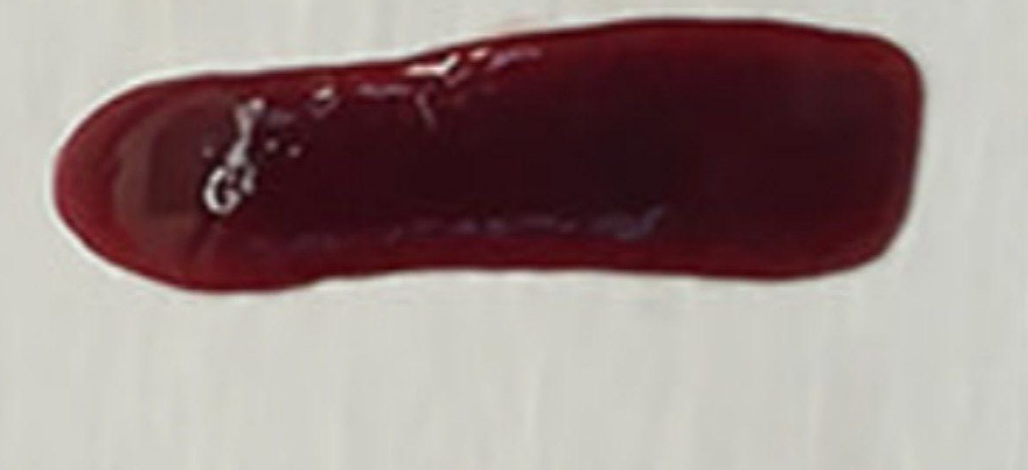
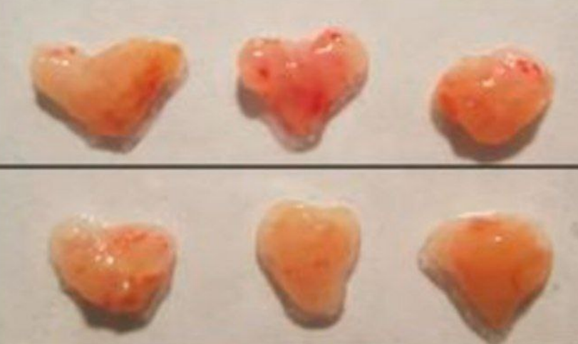
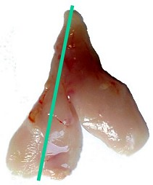
Experimental part 4. Physiological parameters
On the 30th day after irradiation, cervical dislocation and autopsy were performed, followed by collection of biological material for further study: spleen, thymus and bone marrow cell suspension.
Mouse spleen
Mouse thymuses

Slide 10
Experimental part 5. Statistic
To assess the differences between the mean values of the indicators, the methods of analysis of variance Welch's ANOVA and Kraskel-Wallis test were used and further pairwise comparison. The 𝜒^2 test was used to evaluate differences between groups in the spontaneous alternation test. An error probability of p < 0.05 was considered sufficient to conclude that the differences were statistically significant.

Slide 11
Results 1. Study of short-term memory and motor asymmetry
Table 2. Results of the spontaneous alternation test.
Group | Alteration | Re-enterings | Total
Control | 3 | 3 | 6
1 Gy | 6 | 1 | 7
5 Gy | 4 | 3 | 7
Old mice | 6 | 0 | 6
Total | 19 | 7 | 26
$χ^{2}$=p=0.151
Table 3: Results of motor asymmetry assessment.
Group | Left | Right | Total
Control | 3 | 9 | 12
1 Gy | 9 | 5 | 14
5 Gy | 6 | 8 | 14
Old mice | 6 | 6 | 12
Total | 24 | 28 | 52
$χ^{2}$=p=0.246

Slide 12
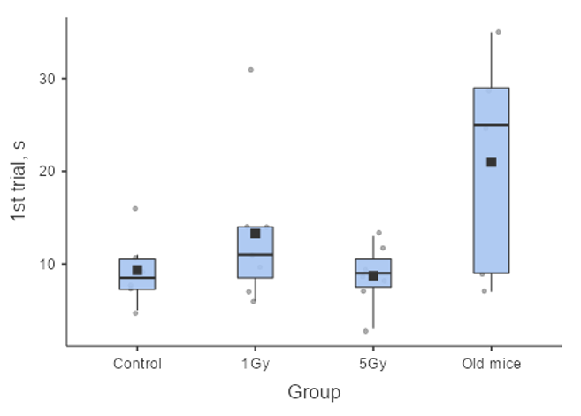
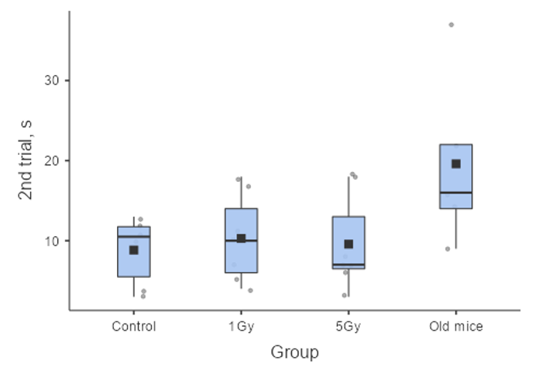
Results
Fig.5. Arms selection time in the T-maze test.

Slide 13
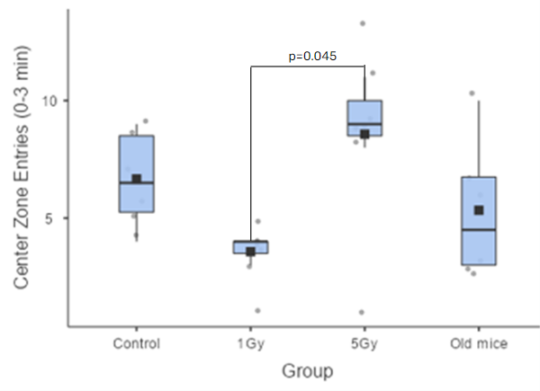
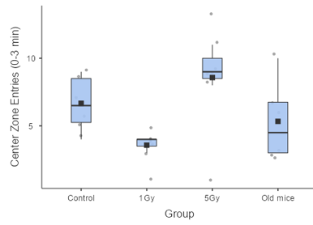
Results 2. Assessment of orienting and exploratory behavior and anxiety level
Fig.6. Number of center zone entries in the Open Field test system on day 10 after irradiation for the first 3 minutes of testing.

Slide 14
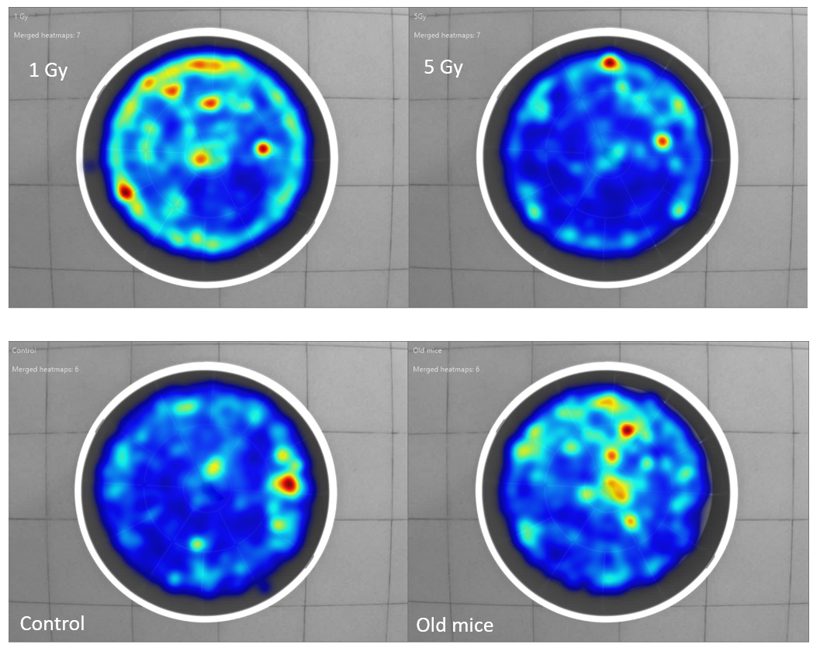
Results
Fig.7. Integral heat map.

Slide 15
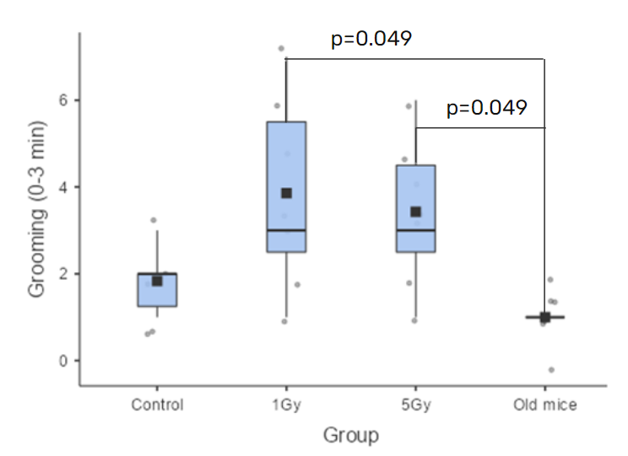
Results
Figure 8. Number of grooming acts in the Open Field test system on day 30 after irradiation for the first 3 minutes of testing.

Slide 16
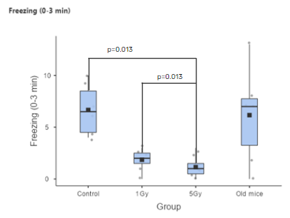
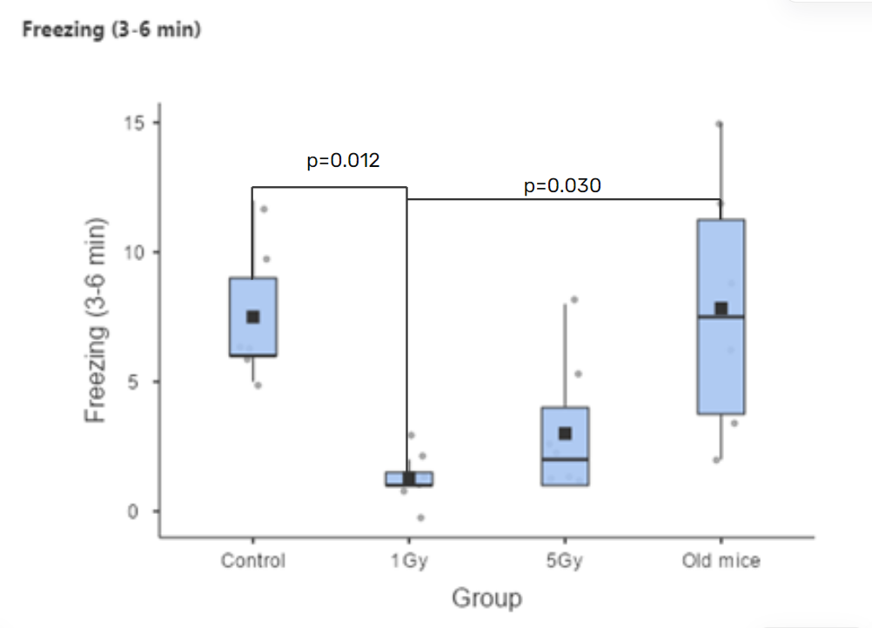
Results
Figure 9. Number of freezing acts in the Open Field test system on day 30 after irradiation for the first and last 3 minutes of testing.

Slide 17
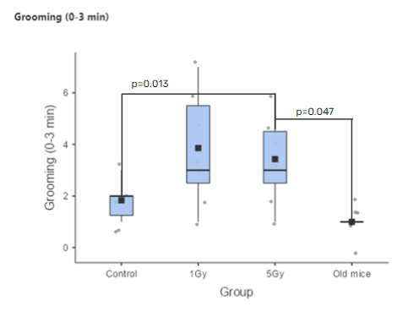
Results
Figure 10. Number of mink learning acts in the Open Field test system on day 30 after irradiation for the last 3 minutes of testing.

Slide 18
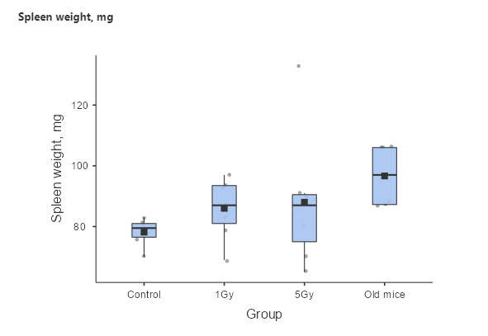
Results 3. Physiological parameters
Fig.11. Body weight of all groups of animals after irradiation
Fig.12. Spleen weight of all groups of animals after irradiation

Slide 19
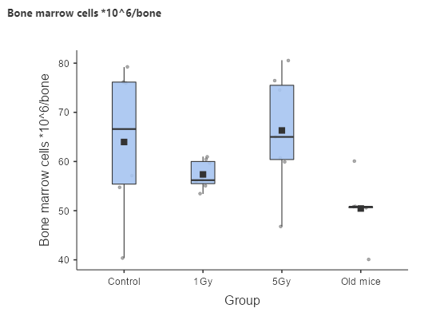
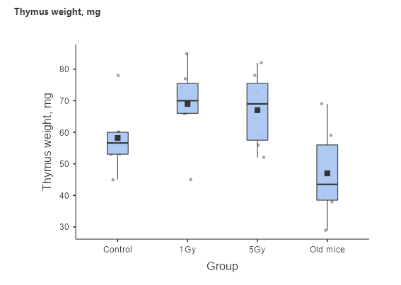
Results 3. Physiological parameters
Fig.13. Number of nucleus-containing bone marrow cells in all groups of animals after irradiation.
Fig.14. Thymus mass of all groups of animals after irradiation.

Slide 20
Conclusions
At exposure of protons in the extended Bragg Peak at doses of 1 and 5 Gy on the brain of mice, there are mainly observed disturbances of behavioral reactions on 30 days after irradiation in the “Open Field” facility related to anxiety and adaptation (acts of grooming and freezing, escape reaction).
The observed effects do not correspond to behavioral changes characteristic of older mice.

Slide 21
Thank you for your attention!

