Slide 1


“Time- correlated single photon counting” technique in optical spectroscopy of MgAl2O4
LE THI PHUONG THAO
The XIV Annual Scientific Conference of Young Scientists and Specialists “Alushta”

Slide 2
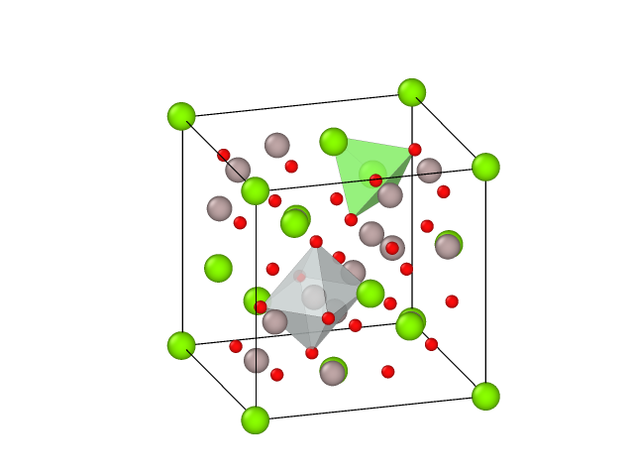
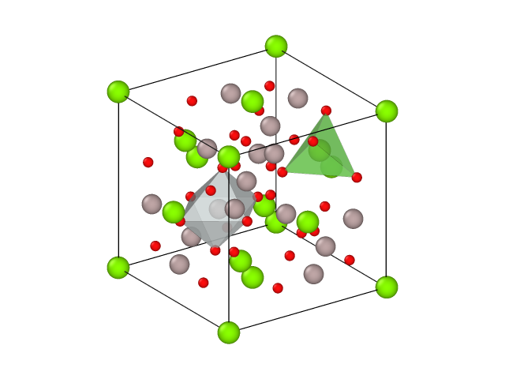
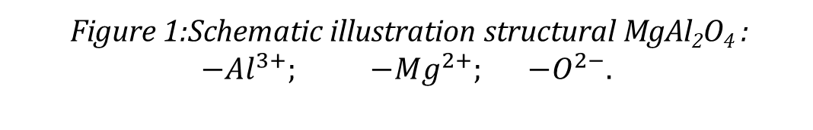
Introduction
MgAl₂O₄
Wide band-gap (~9 eV);
High hardness (16 GPa);
Thermal stability (T_{melt} = 2135 ˚C);
Low density ~ 3.58 g·cm⁻³;
High transparent in the visible and infrared wavelength regions;
Excellent radiation resistance.
Magnesium Aluminate spinel
Mg-Al spinel as a mixed double oxide MgO.nAl₂O₃
A face-centered cubic structure formed by closely packed oxygen ions.
For stoichiometric MgAl₂O₄:
high thermal stability
radiation resistance
chemical inertness
1/8 (Mg²⁺) of the tetrahedral sites
1/2 octahedral ones are filled by Al³⁺ in each unit cell.
A promising material in optical applications at nuclear power devices, lazer technology and in space.
Host for inert matrix fuels in light water reactors
Transmutation target for minor actinides and long life fission products
Diagnostic/optical windows of fusion devices (ITER, DEMO..)
Aerospace engineering
Laser technology
Figure 1:Schematic illustration structural MgAl₂O₄ :
$${−Al}^{3+}; {−Mg}^{2+}; {−O}^{2−}.$$

Slide 3
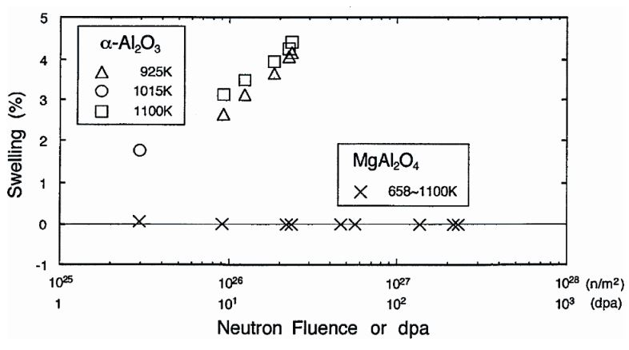
Highly resistant to radiation damage
Clinard et al, and Tucker et al
using fast neutron
No amorphization
Zinkle et al.
using Al and Mg ions
at T of 25-800ºC
the damage dose of ~ 100 dpa
Figure 2: C. Kinoshita. Microstructural evolution of Irradiated ceramics
Spinel retained crystallinity and exhibited small swelling and amorphization was not observed

Slide 4



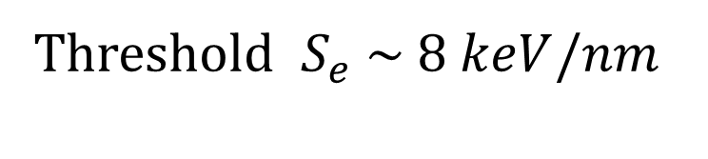
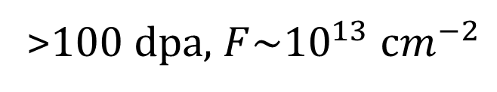
Swift- heavy ion
SHIs irradiation of spinel:
E > 1 MeV/nucleon
High-density electronic excitation
Ion tracks
Amorphization
$$S_{e} \sim 20 keV/nm$$
Threshold ${ S}_{e} \sim 8 keV/nm$
(dE / dx )_{Total} = (dE / dx )_{e} + (dE / dx )_{n}
~ 99%
~ 1%
>100 dpa, ${F\sim 10}^{13} {сm}^{−2}$
$$S_{e}$$
$$S_{n}$$
Research gold
Motivation
Study radiation-induced defects in MgAl₂O₄ irradiated by swift heavy ions with optical spectroscopy methods _ Photoluminescence and study nature and behaviour of these defects by using Time-collerated single photon counting (TCSPC).
Information about radiation defects induced by swift heavy ions in spinel has been lacking, especially in the range of high ionization energy losses.
Almost data about radiation damages in spinel was obtained don’t provide information about point defect and its behaviour.
Notes:
At the same time, irradiated with heavy ion…

Slide 5
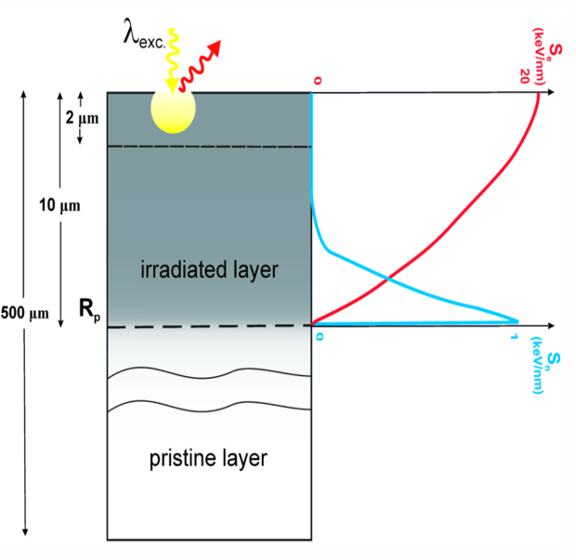
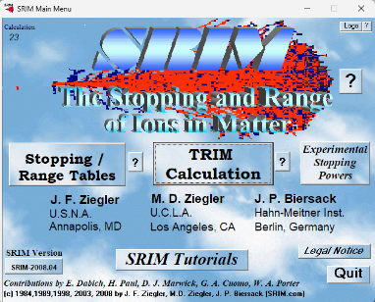
SHIs irradiation parameters
A single crystal of stoichiometric MgAl₂O₄:
Thickness: 500um
IC-100 cyclotron in JINR
Ions | Energy (MeV) | S_{e} (keV/nm) | S_{n} (keV/nm) | R_{P} (μm) | Ion fluence (cm⁻²)
Xe | 152 | 21.040 | 0.099 | 11.46 | 10 ¹⁰ - 10 ¹³
Figure 4: Values of electronic and nuclear stopping power were evaluated by SRIM simulation.
Figure 3: Schematic imaging of the PL measurements in 152 MeV Xe ion irradiated spinel showing the size of probed volume in comparison with thickness of the whole irradiated layer

Slide 6
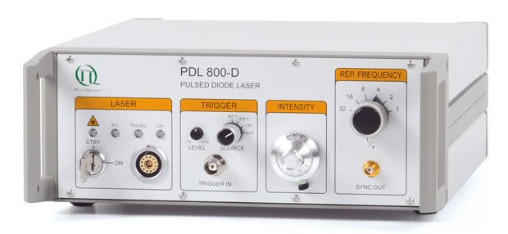
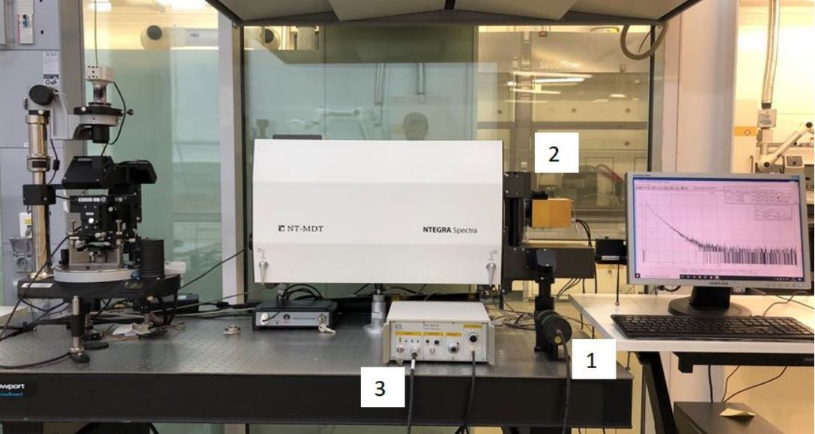
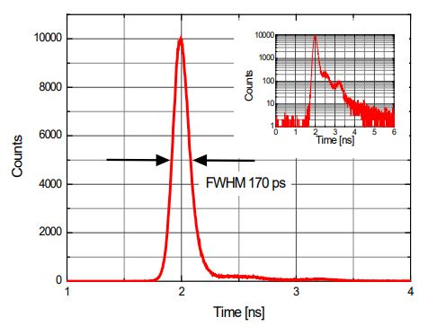
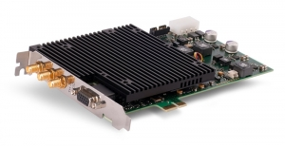

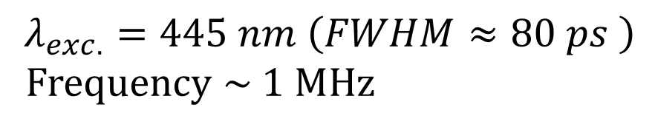
Measurement Setup
$$λ_{exc.}=445 nm \left(FWHM≈80 ps \right)$$
Frequency ~ 1 MHz
Figure 5: Setup for measurement of the photoluminescence kinetics.
1 – Head of the pulse laser,
2 – Photomultiplier Detector Assembly (PMA 175),
3 – Picosecond Diode Laser driver (PDL800-D).
$$\text{TDC} \text{TimeHarp} \text{260}$$
Notes:
To

Slide 7
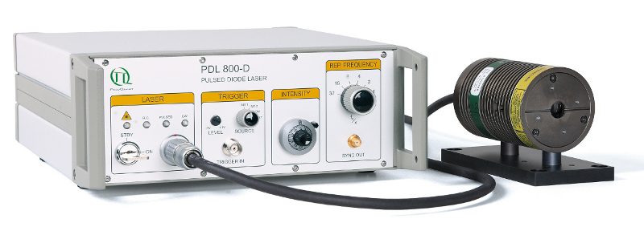
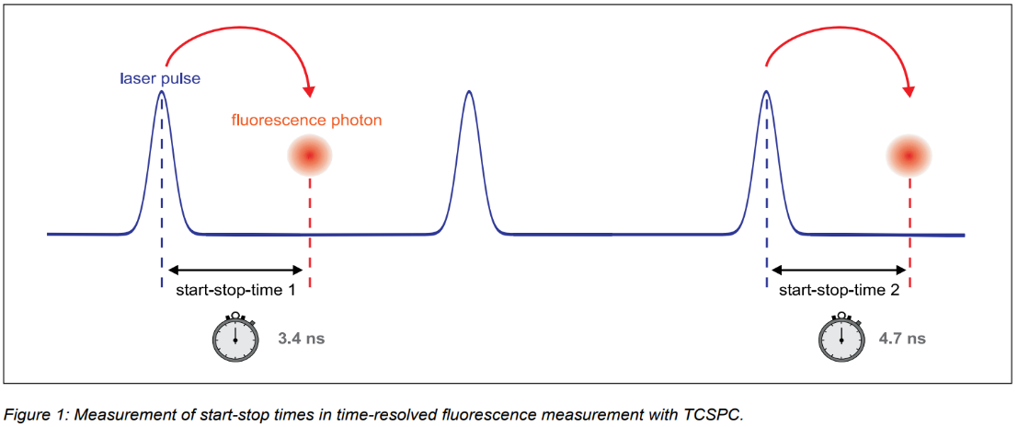
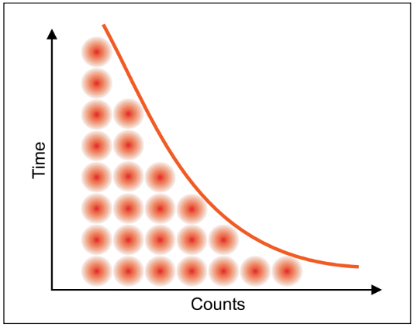
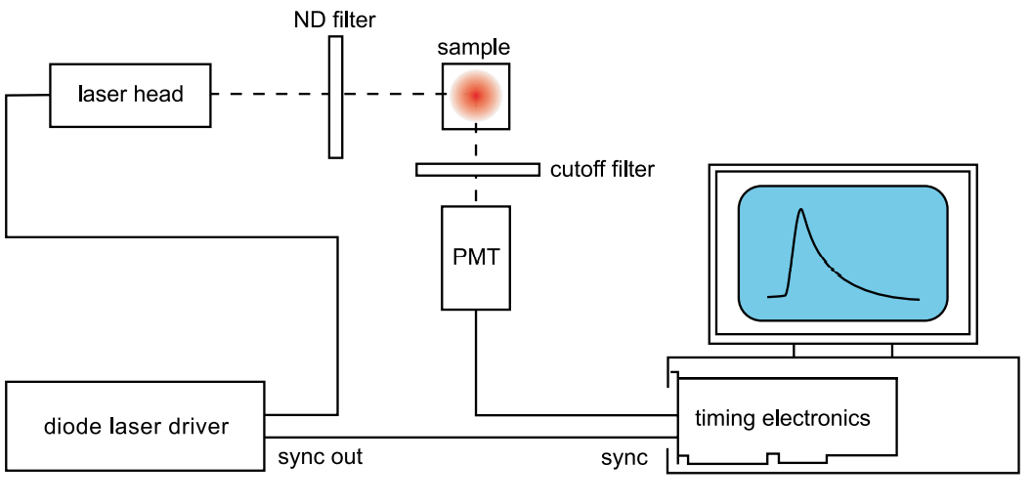
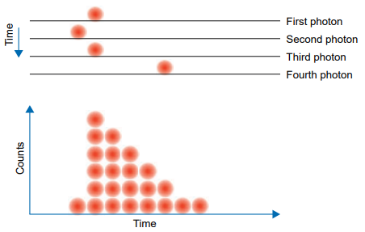
Time-Correlated Single Photon Counting (TCSPC)
a)
Start
Picosecond Pulsed Diode Laser Driver
(PDL 800-D)
Stop
b)
TimeHarp 260
Figure 6: a)Measurement/histogram of start-stop time in time-resolved fluorescence measurement with TCSPC
b) The schematic experimental set-up
Notes:
The principle of TCSPC
Thêm hình trong file zalo, giải thích cơ chế theo trong chú thích bên cạnh
high sensitivity, time resolution
The time resolution of this system was about 200ps

Slide 8
Results
Photoluminescence kinetic measurement
Reduction of the decay time with ion influence is due to growing contribution of non-radiative processes that quench the luminescence
In spectral range of 475-660 nm emission wavelength
The charge-transfer processes between defects or defect-impurity site
Figure 7: Photoluminescence decay curves from Xe ion irradiated MgAl₂O₄ (excitation wavelength 445 nm) as function of wavelength (a) and ion fluence (b). IRF – instrumental response function.

Slide 9
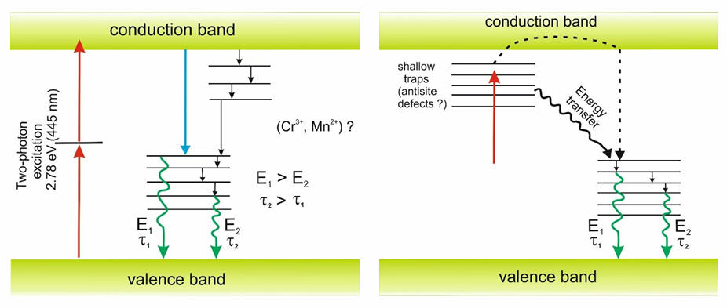
Conclusion
The measurements of the photoluminescence decay curves indicated lifetime increases with emission wavelength increasing in spectral range of 475-660 nm and decreases with ion fluence increasing.
It is suggested that reduction of the decay time with ion fluence is due to growing contribution of nonradiative processes that quench the luminescence yield.
The dependence of characteristic lifetimes on registration wavelength is explained by the peculiarities of the charge-transfer processes between defects or defect impurity sites in radiative de-excitation.
Figure 8: Possible mechanisms of the photoluminescence process showing the variation of lifetime with spectral position.

Slide 10
Thank you
Email: letxi@jinr.ru
lethiphuongthao114@gmail.com

Slide 11
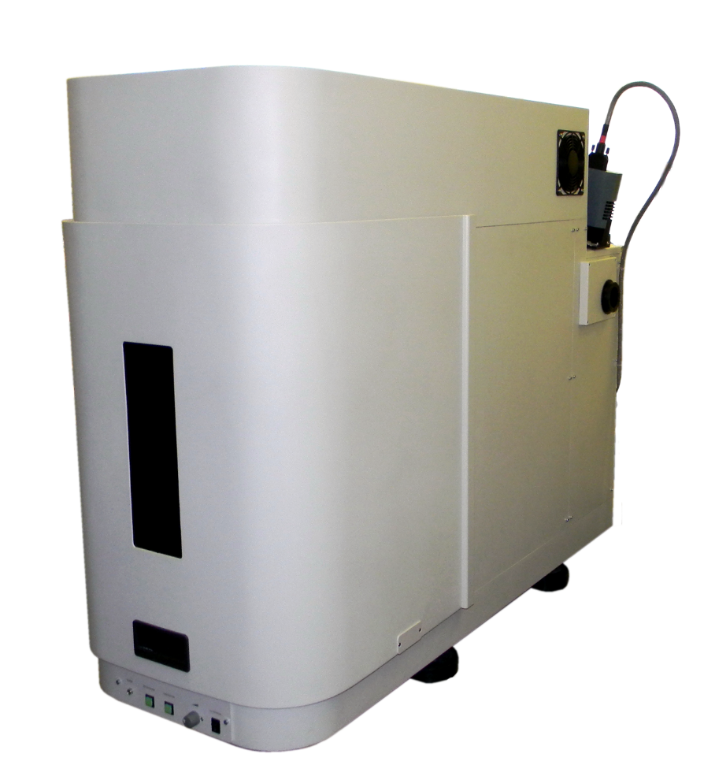
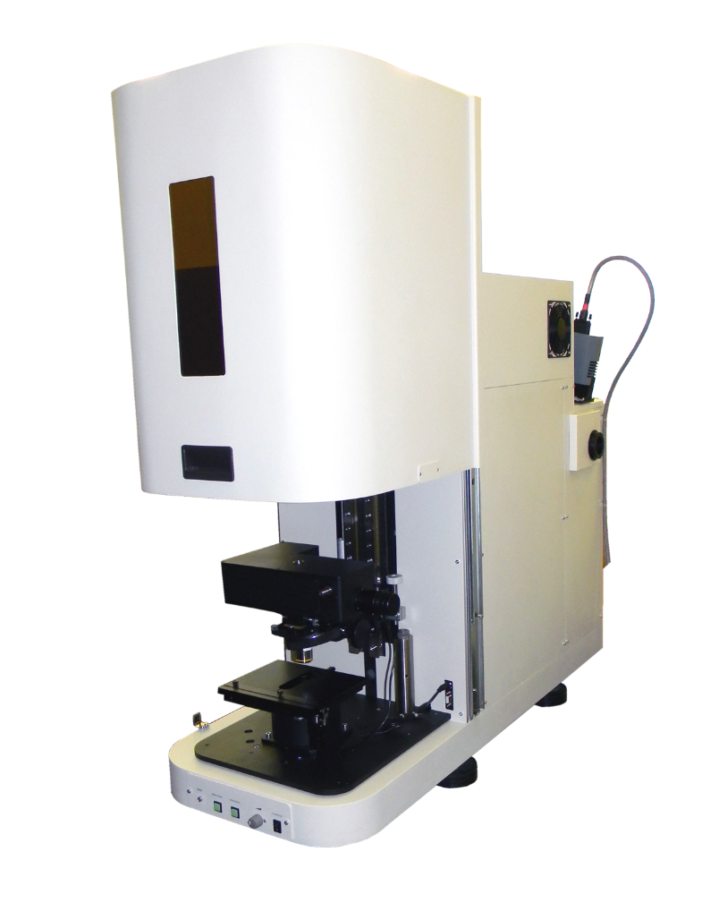
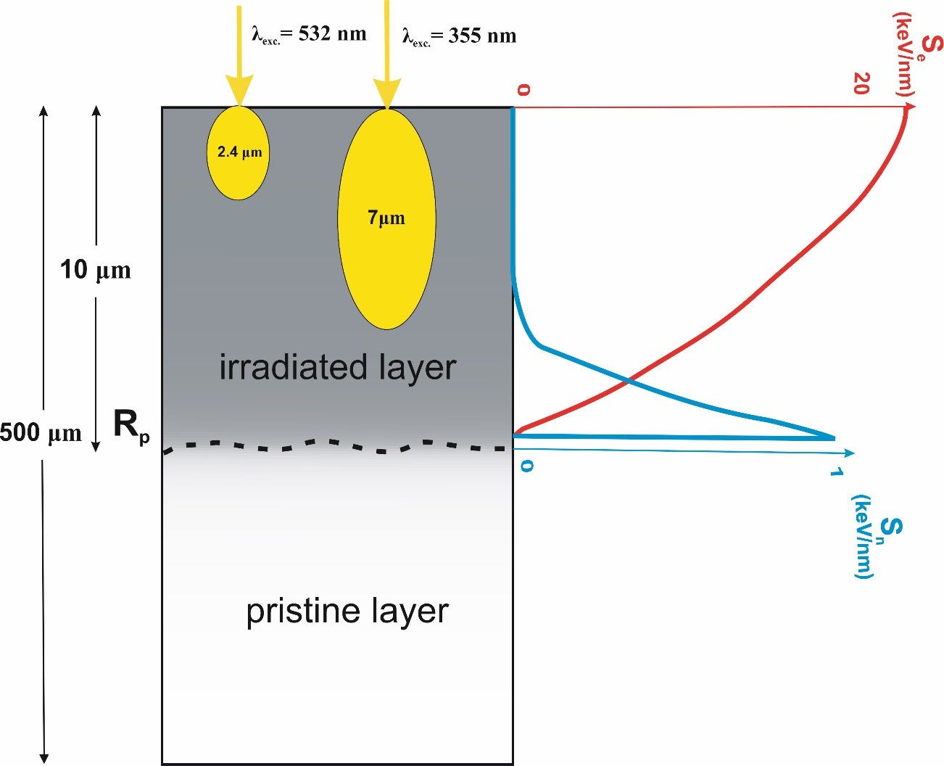
UV (355 nm)
Blue (473 nm)
Green (532 nm)
Registration of the
emission by Peltier-cooled CCD-matrix Andor Technology DU401A-BV
*Belarusian State University (Minsk, Belarus)
Micro Raman spectrometer Nanofinder High End (LOTIS TII Japan-Belarus)
combined with a 3D scanning confocal microscope

Slide 12

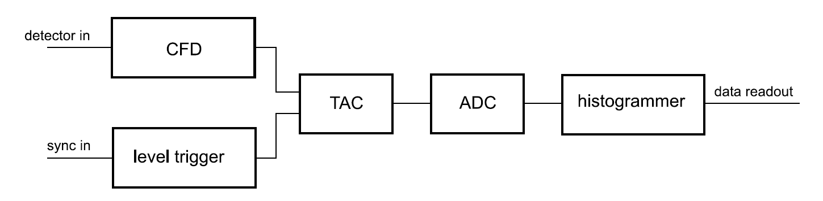
Basic Principles Behind the TCSPC Electronics
Time Harp 260
Block diagram of a traditional TCSPC system
CFD = Constant Fraction Discriminator;
TAC = Time to Amplitude Converter;
ADC = Analog to Digital Converter.

Slide 13
1,9 eV
Figure : Spectral content of the photoluminescence from single crystalline MgAl₂O₄ before and after irradiation with 152 MeV Xe ions.

Slide 14
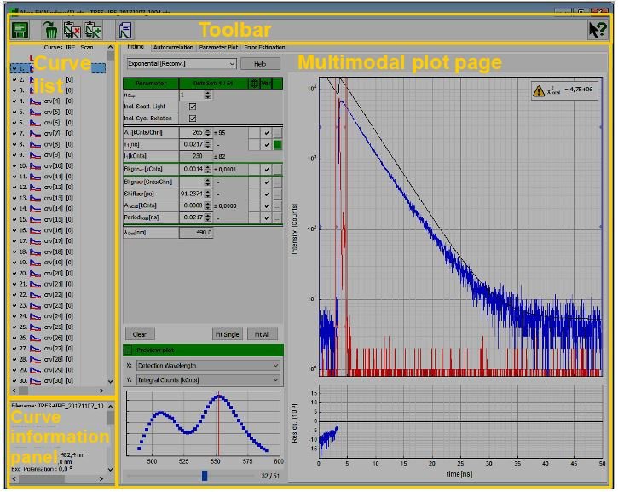
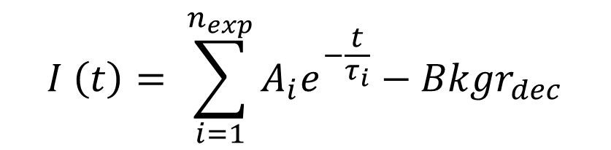
$$I \left(t\right)= \sum_{i=1}^{n_{exp}}{A_{i}e^{−\frac{t}{τ_{i}}}−{Bkgr}_{dec}}$$
Notes:
Thedecaycurveswereanalyzed usingEasyTau2software

Slide 15
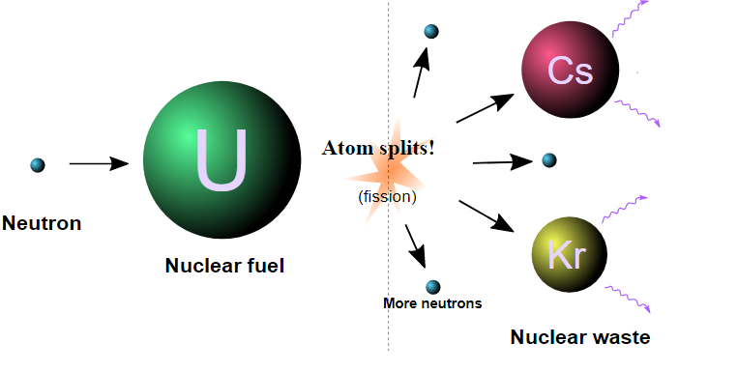
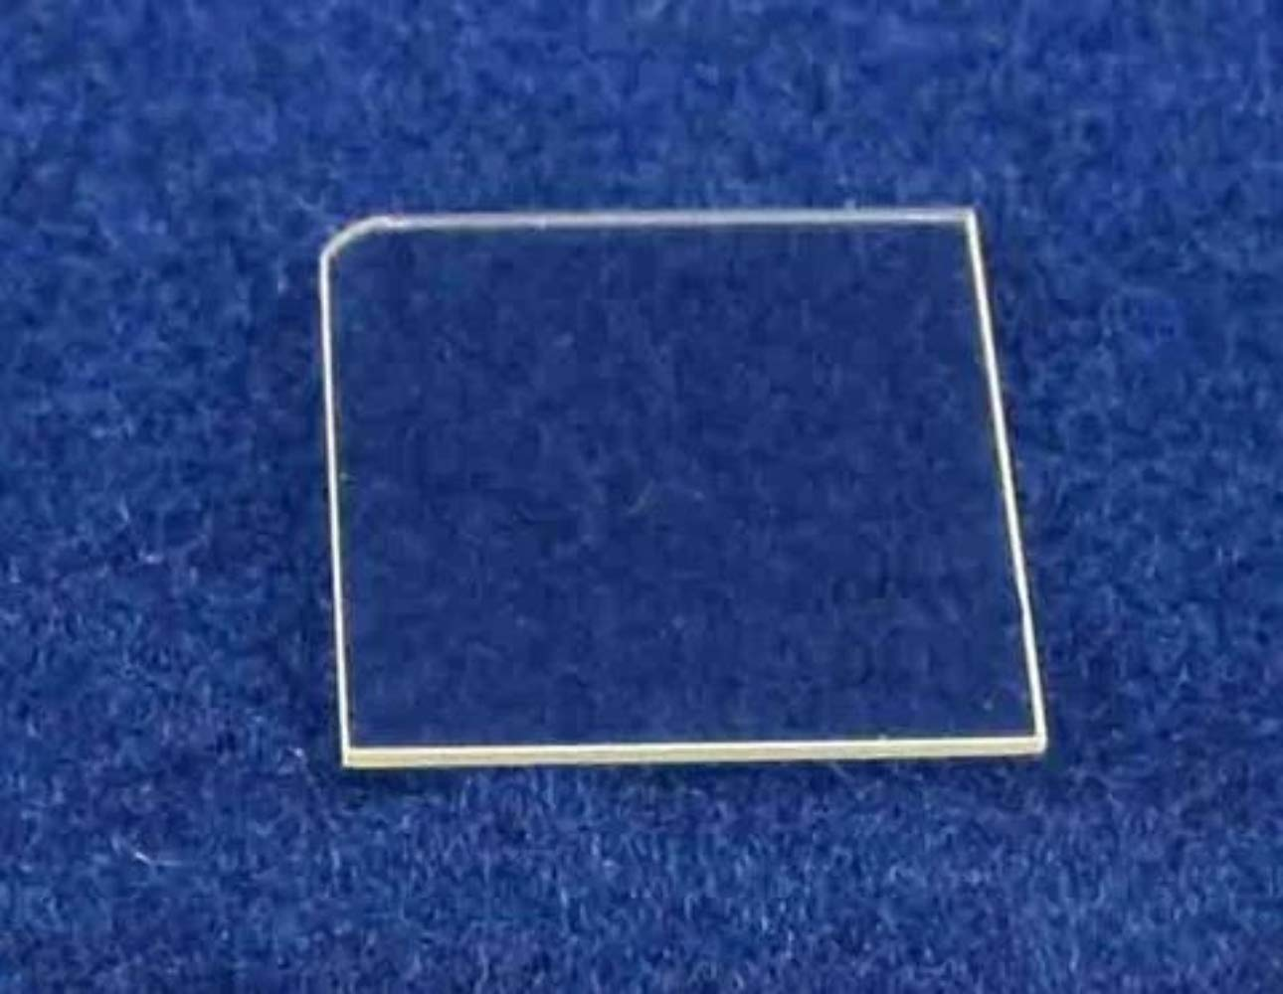
Modelling the impact of actinide fission fragments
Irradiation
Swift heavy
ions
Neutrons
Electrons
E~ 70 – 100 MeV
Sample
Anion vacancies
F, F⁺ and
aggregate
F₂, F₂²⁺ color centers
Anti-site defects
Al³⁺׀_{Mg}²⁺,
Mg²⁺׀_{Al}³⁺
Cation
vacancies
V centers

