Slide 1
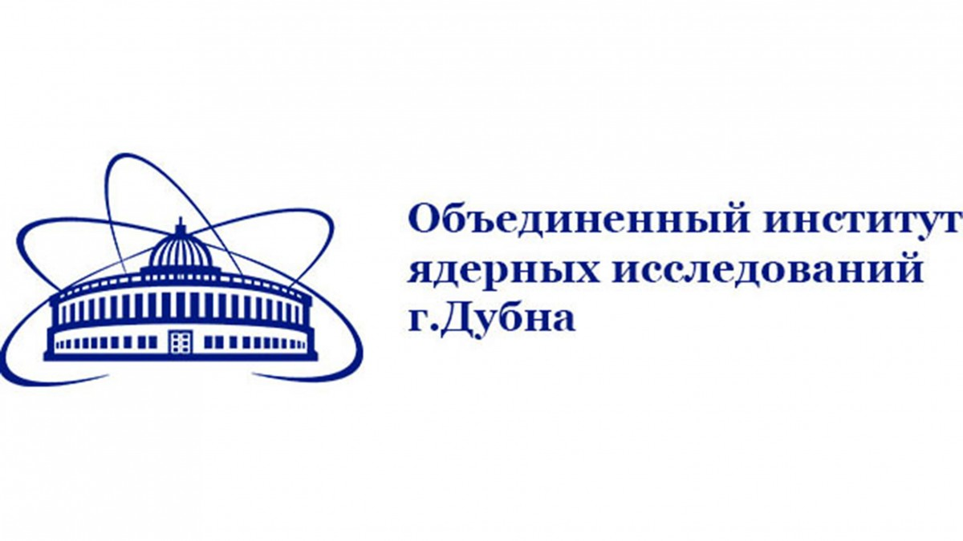
Description of the work of special ventilation and accumulation of liquid radioactive waste
Introduction
Zudin A.
FLNR
1/12

Slide 2
Обоснование
Cyclotron is a complex machine that require special safety measures during operation.
Special attention is paid to the system of ventilation and accumulation LRW, because radioactive gases , aerosols and contaminated water are formed during the operation
The operation of cyclotron requires a special approach to ensure radiation safety.
The main sources of LRW and polluter air:
-Laboratory analyses using radioactive isotopes
-Working with radioactive samples
-Flushing of equipment after handing radioactive materials
-Waste solutions and reagents
FLNR
2/12

Slide 3
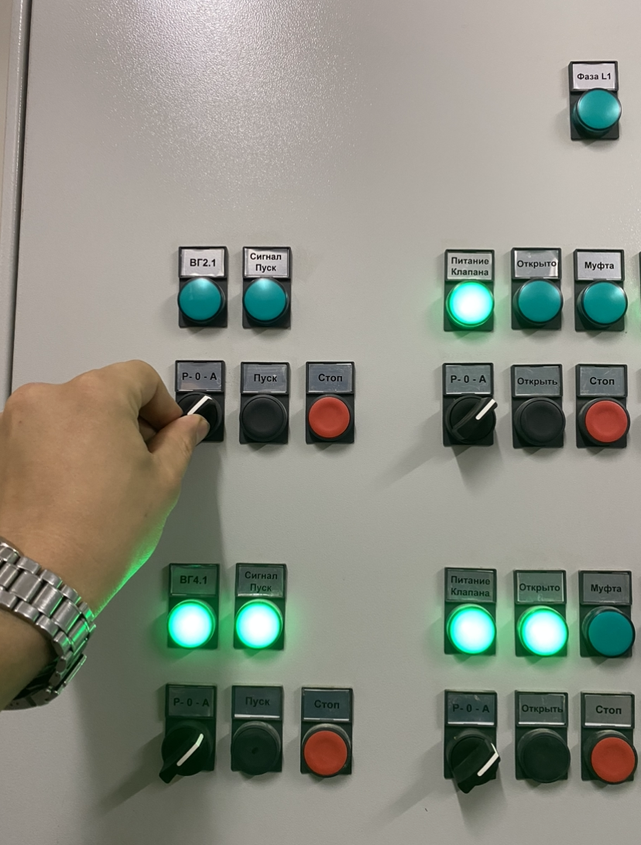
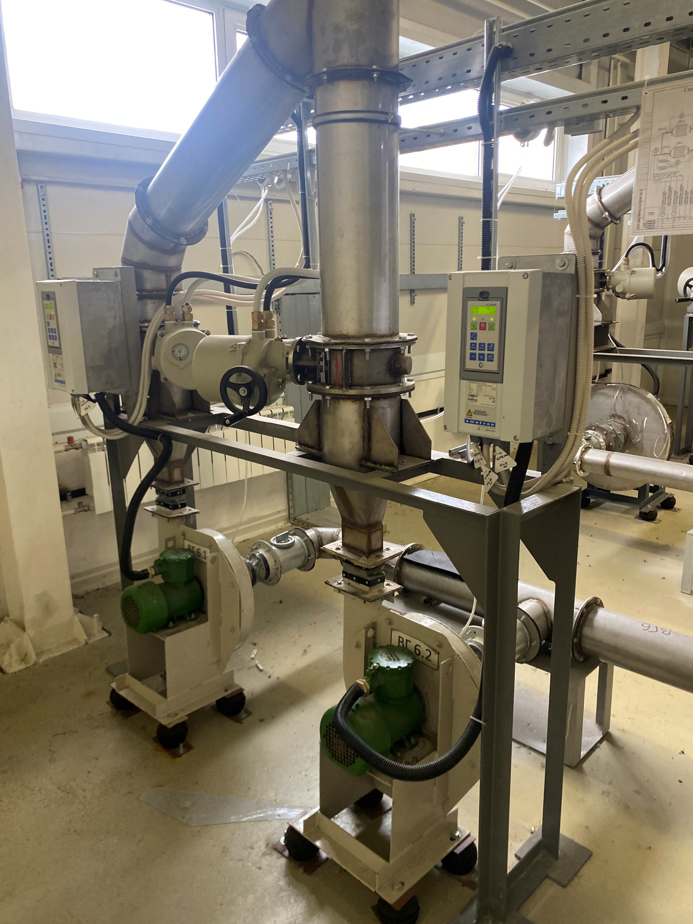
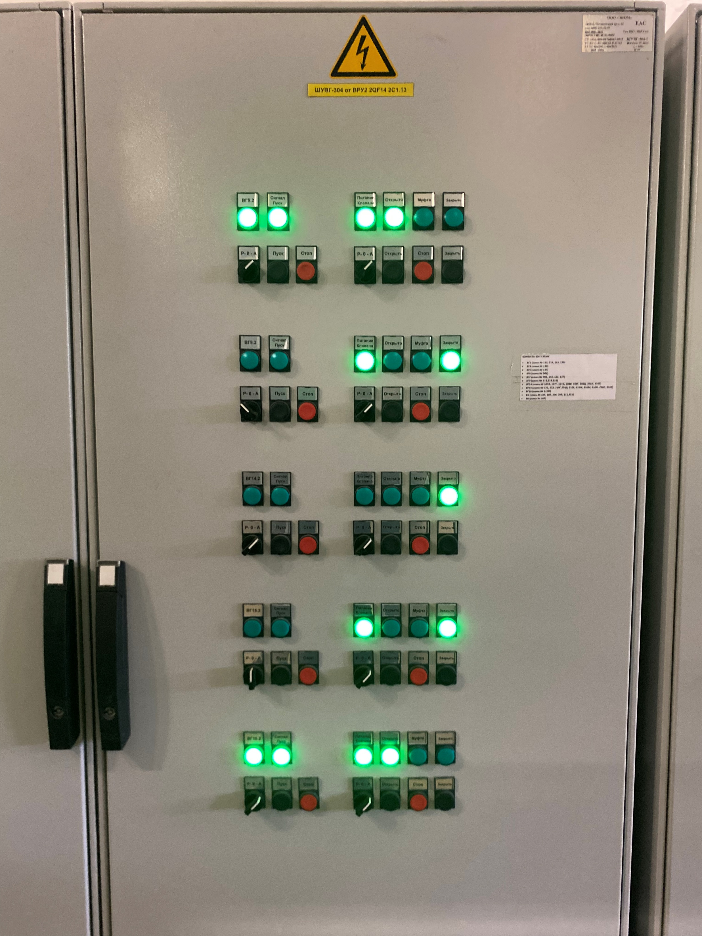
ventilation
fans
mode control panel
FLNR
3/12

Slide 4
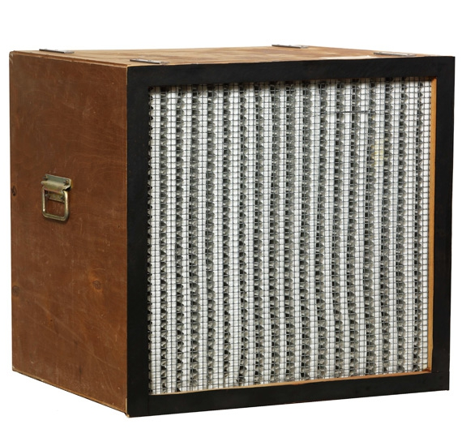
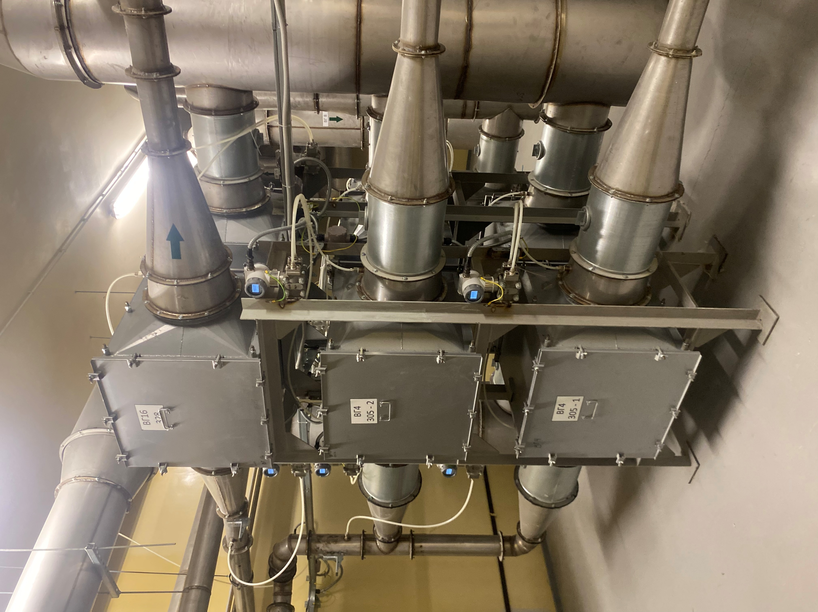
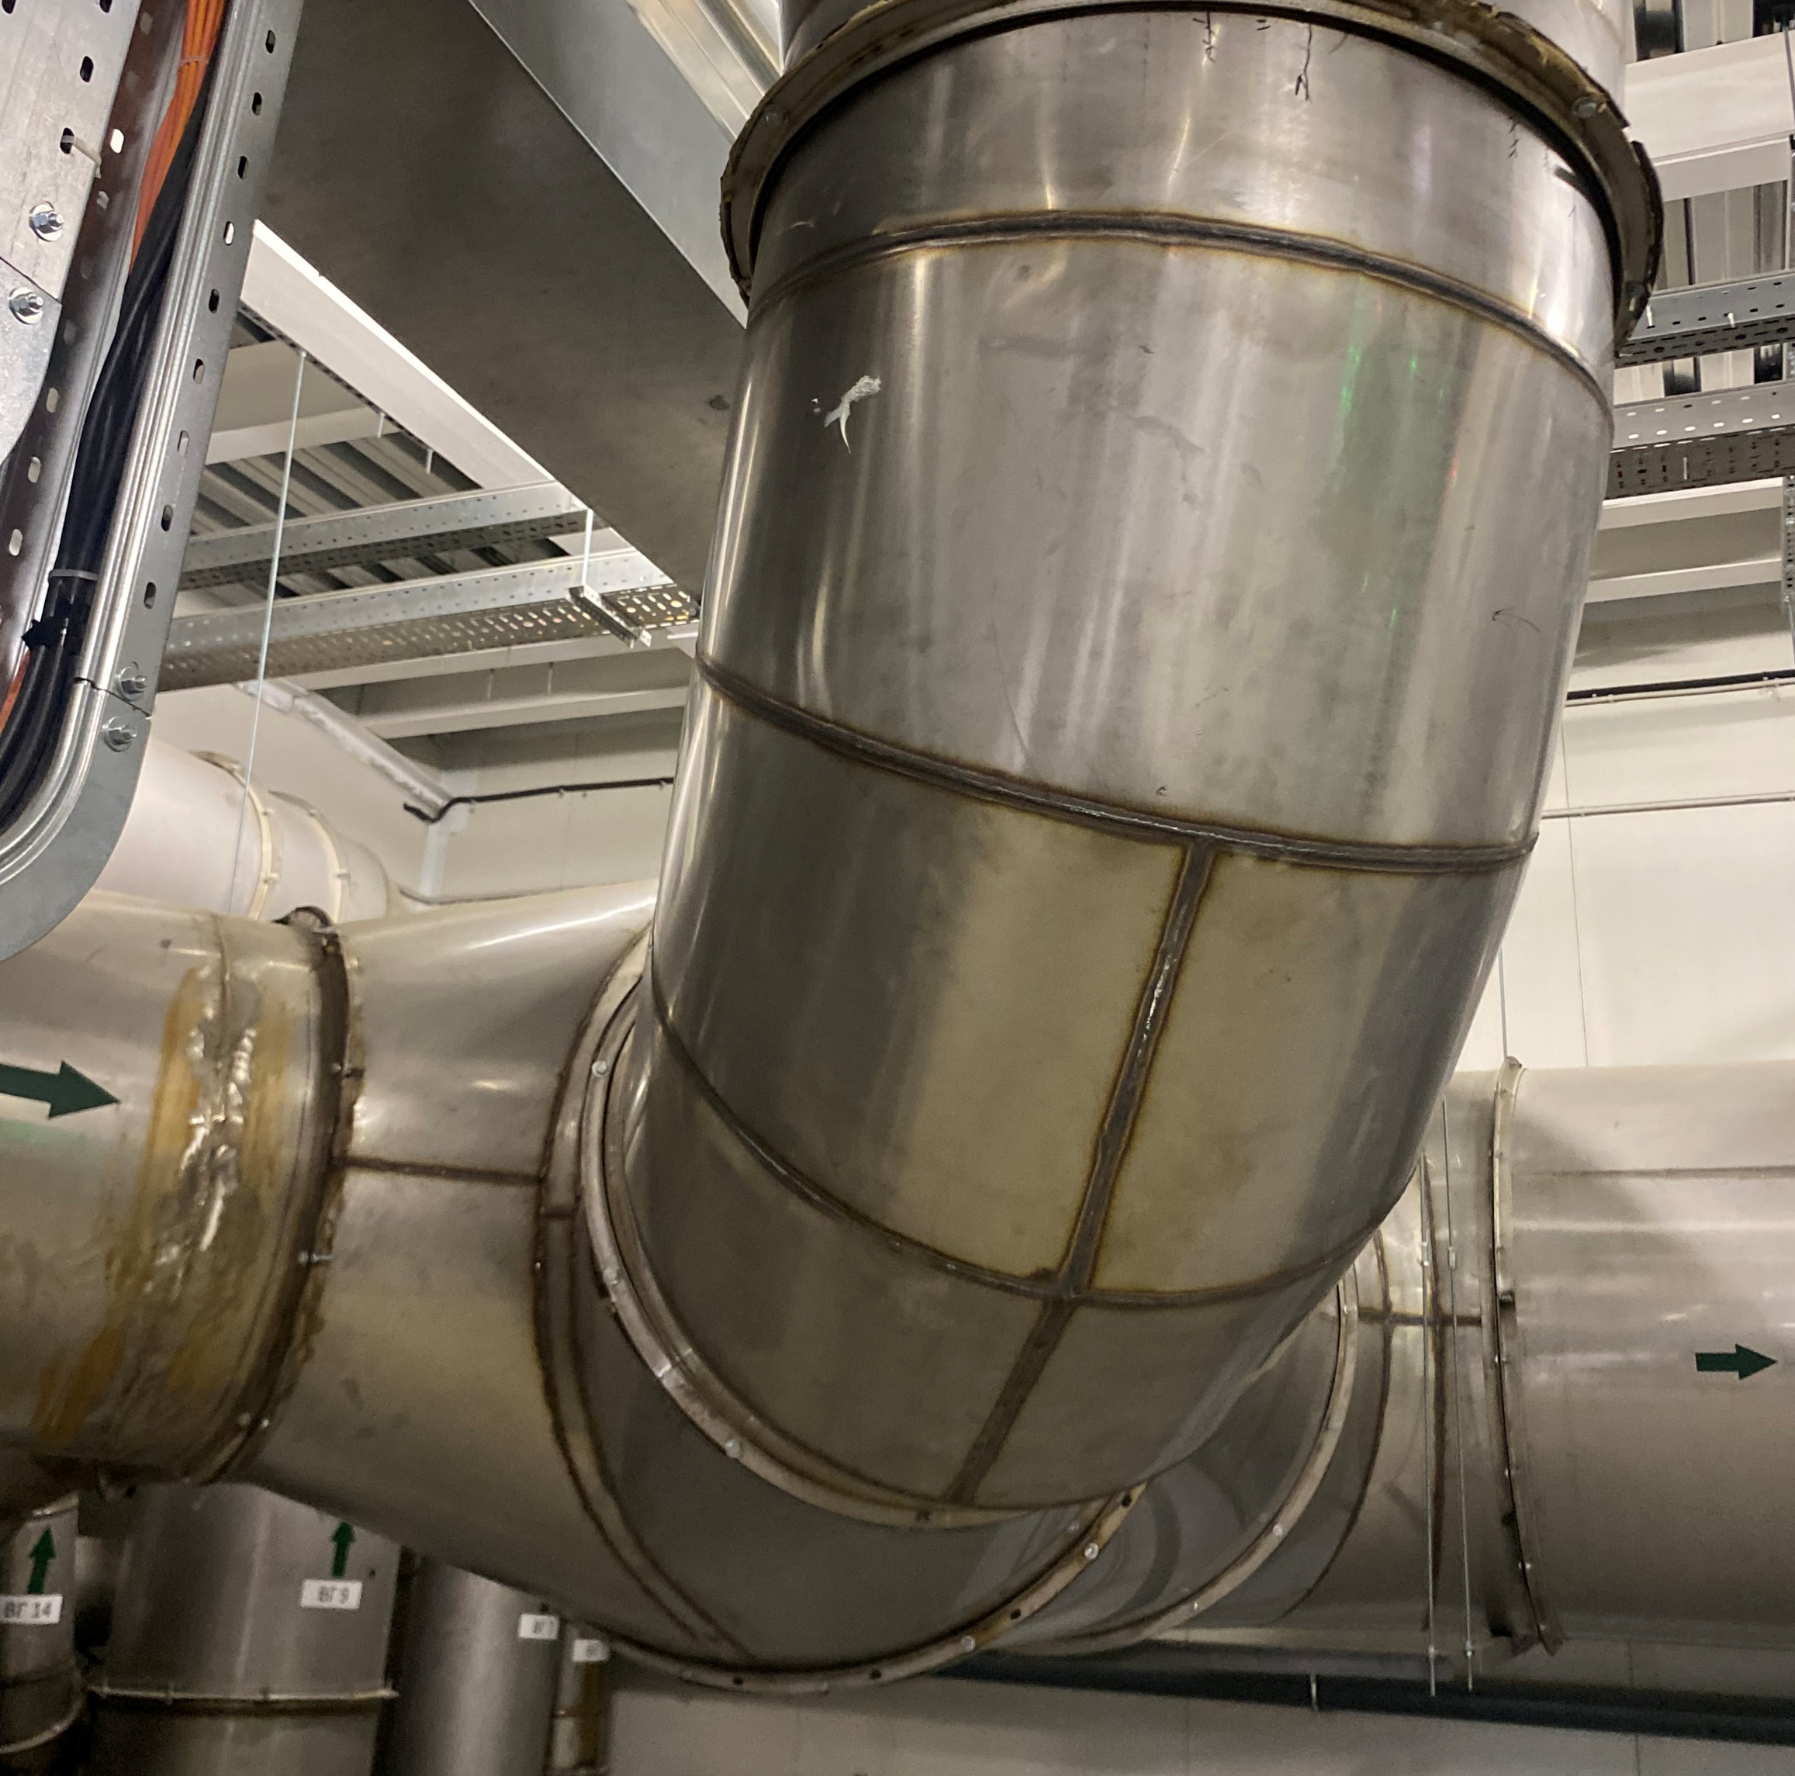
ventilation
Filter FAB3500-D
Pressure sensor
Stainless steel air ducts
FLNR
4/12

Slide 5
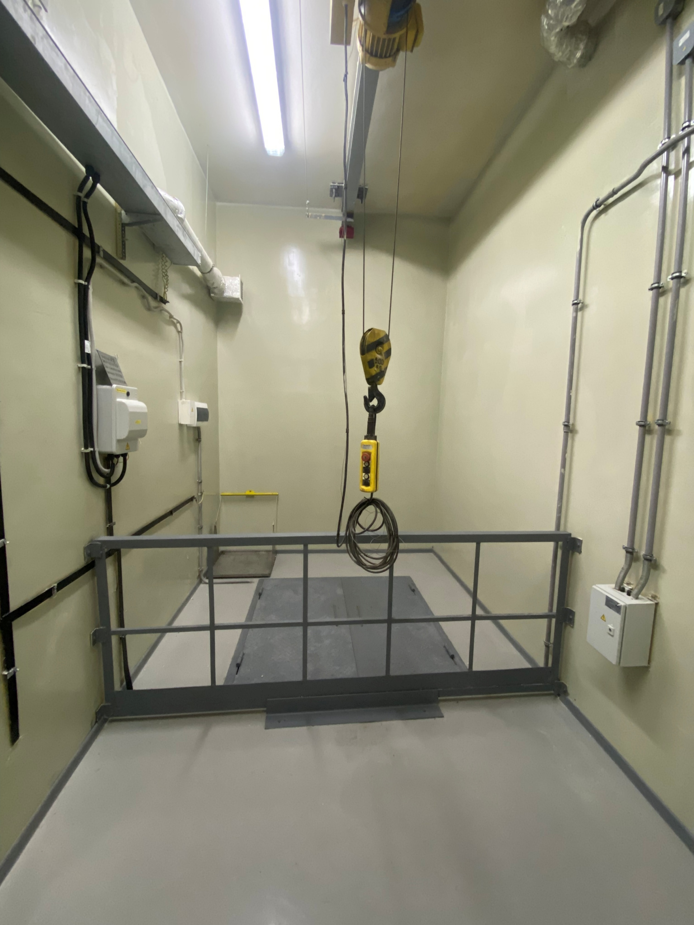
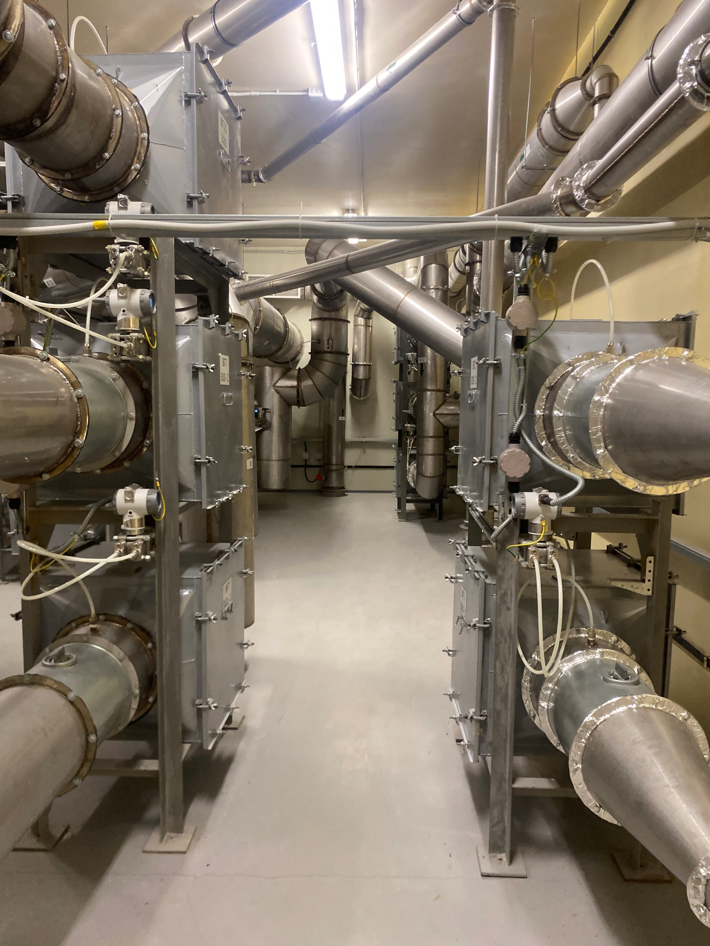
ventilation
ventilation
Shipping room
FLNR
5/12

Slide 6
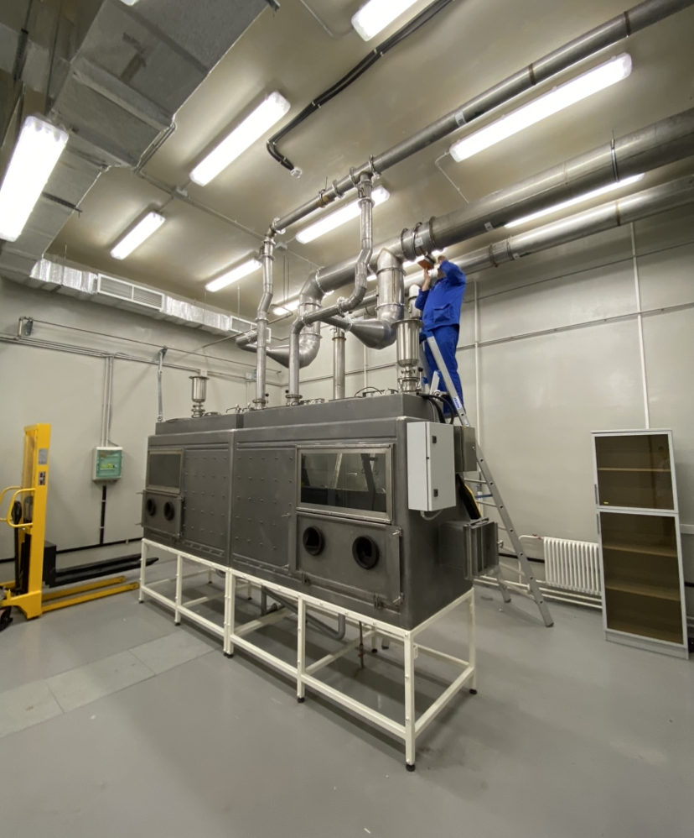
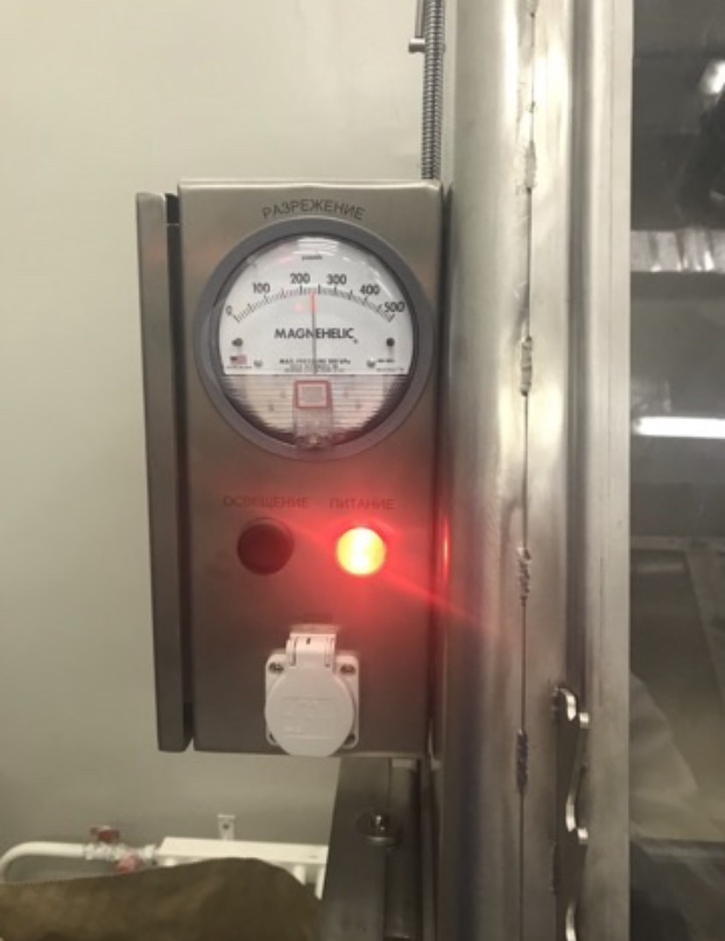
ventilation
Chemical laboratory boxes
manometer
FLNR
6/12

Slide 7
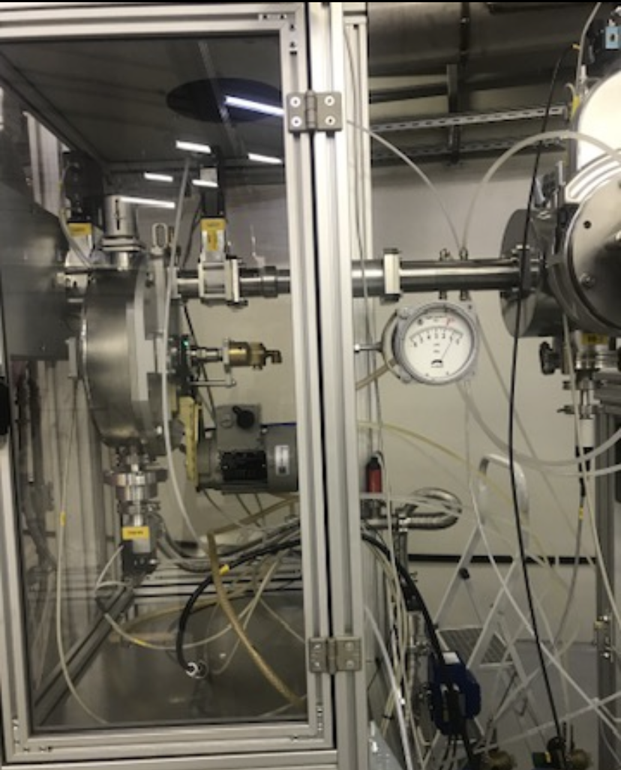
ventilation
Target boxing
Target boxing
FLNR
7/12

Slide 8
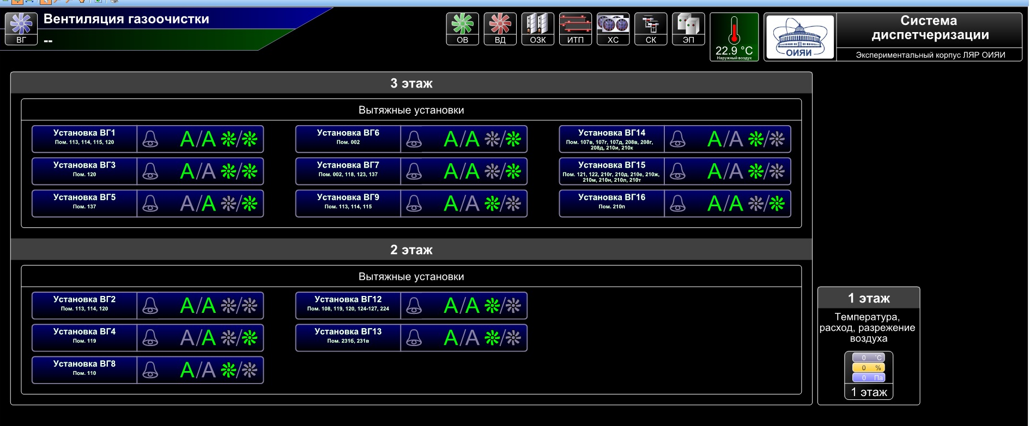
control
Remote control of the gas purification system.
-the fan is in operation
-the fan is stopped
- there are no accidents
- accident
-installation name,
room
FLNR
8/12

Slide 9
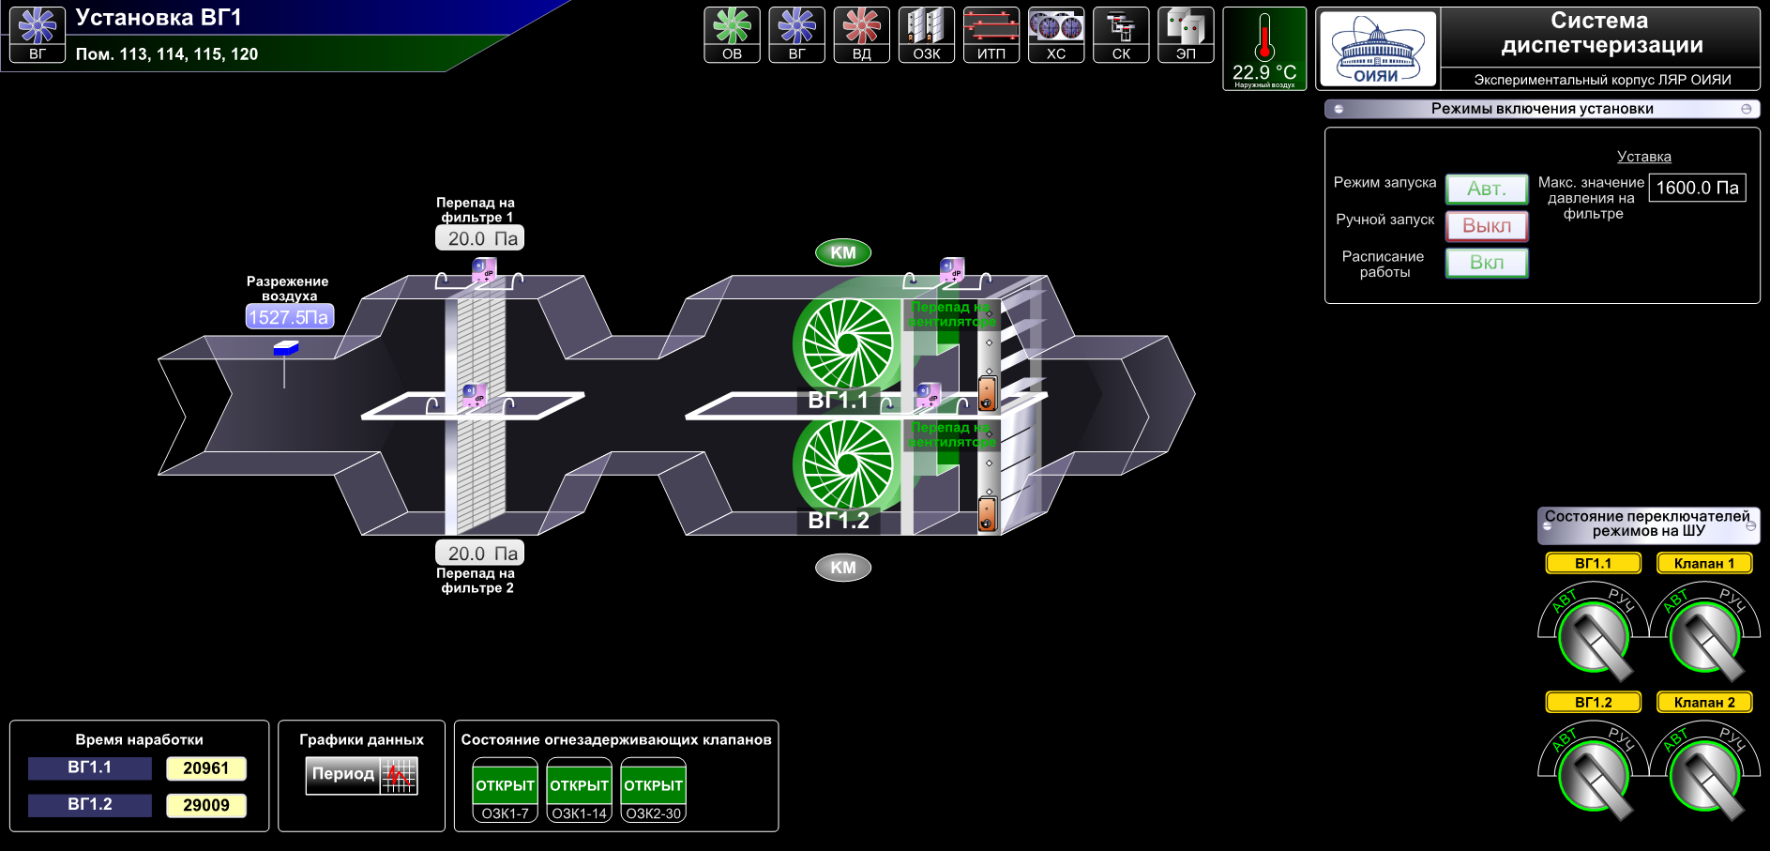
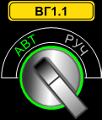
control
-operating
time of the equipment
-schedule
-the status of the mode switches on the control panel
FLNR
9/12

Slide 10
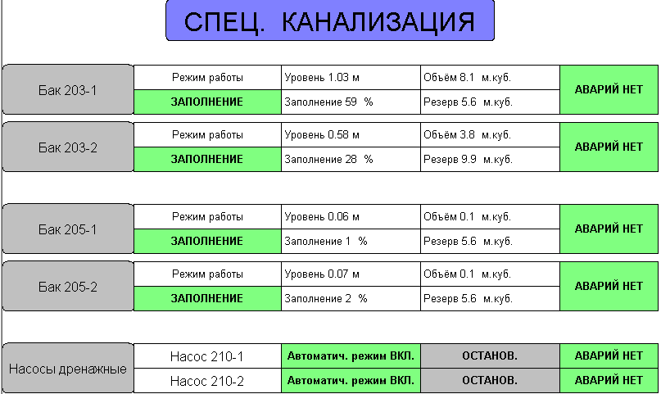
LRW
Remote control of special sewage.
FLNR
10/12

Slide 11
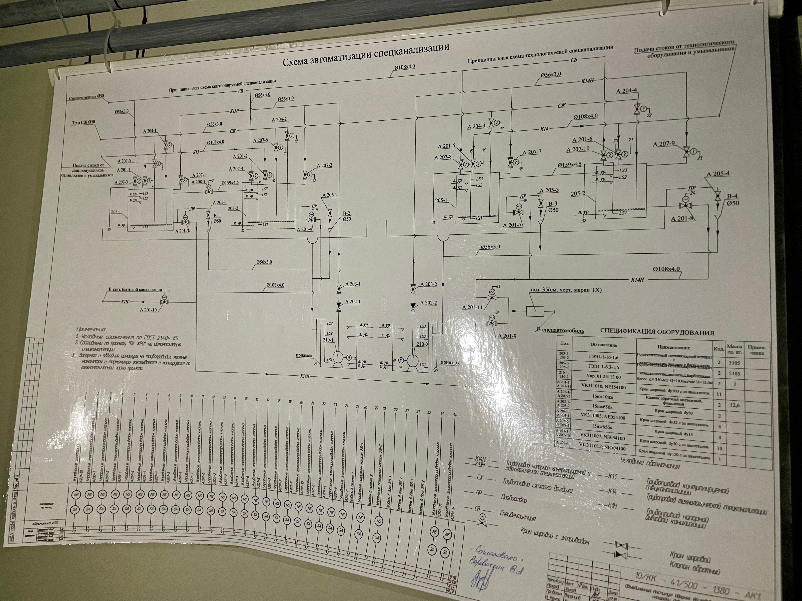
LRW
Equipment diagram
tank 203-1 tab
FLNR
11/12

Slide 12
Thank you=)
Thank you for your attention=)
FLNR
12/12

