Slide 1
ASSOCIATION OF YOUNG SCIENTISTS AND SPECIALIST
ALUSHTA CONFERENCE 2025
Natural Radionuclides in Rice Soils in the Mekong Delta Region, Vietnam: Health Risk, Transfer to Rice, and Long‑Term Accumulation in Topsoil
Speaker: Le Binh An
Email: lebinhan244@jinr.ru
Alushta, Russia 2025

Slide 2
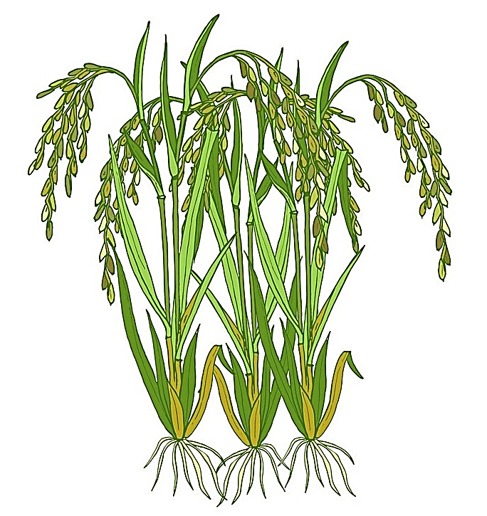
INTRODUCTION
Deposition / volatilization
NORM: naturally occurring radioactive materials.
In an agro-ecosystem, NORM can present in the topsoil, and inputted by agricultural activities, which leads to the increased radioactivity in both soil and rice.
Enhanced levels of NORM in rice may pose potential long-term risks to public health.
Rice is one of the main food sources in Vietnam and the world.
There had not been any surveys on rice and soil in this specific area.
Fertilization
Irrigation
Rice uptake
Water leaching
Radioactive decay

Slide 3
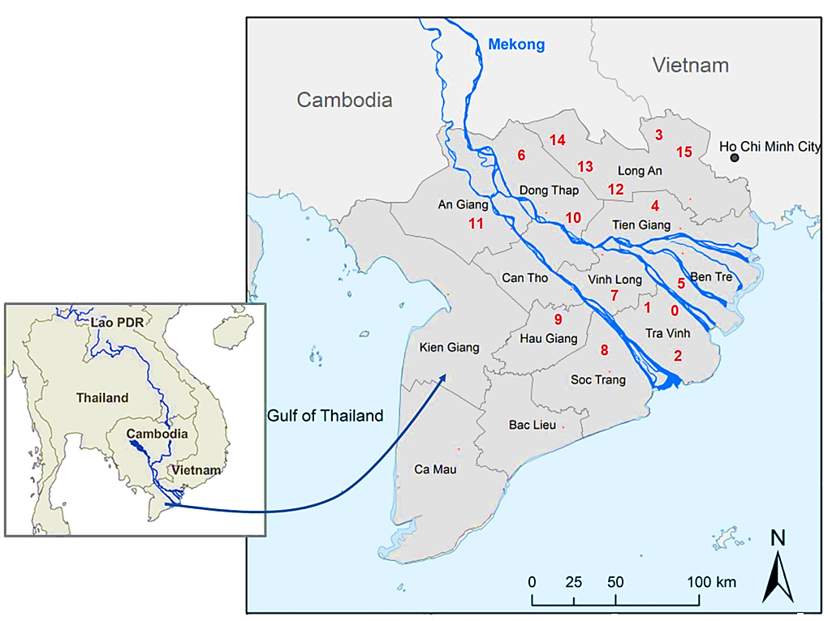
RESEARCH SITE
The present study was performed in Mekong Delta which is the west-southern region of Vietnam.
This is the biggest agricultural region of the country with most of the area of the Mekong
Delta is used for rice cultivation.
There are 16 rice fields in 9 provinces, marked from 0 to 15 on the map.
Location 0 was used to estimate the long-term NORM accumulation.

Slide 4
RESEARCH PROCEDURE
Dose assessment
Rice
Transfer factor
Soil
Sample preparation
Cultivation parameters
Water
Fertilizer
Canadian Center for Environmental Modeling and Chemistry (CEMC)
Long-term accumulation in topsoil
Radioactivity

Slide 5
RADIOACTIVITY IN SAMPLES
Soil-to-rice transfer factors (TF)
Activity in rice grain
TF
=
=
TF predicts the radionuclide contamination in the plant based on the activity concentrations of radionuclides in the soil and in the rice.
Values are within the ranges of TF in the world according to TRS-472 report (IAEA, 2010).
The differences between the TF values are due to some factors such as environments and soil properties.
Activity in soil

Slide 6
ANNUAL EFFECTIVE DOSE
Consumption intake rate of rice grains
Total annual dose
$$D_{E}=I×A×DCF$$
Dose conversion factor of the radionuclide
Ra-226 | K-40 | Th-232 | U-238
Activity concentration of radionuclide in the rice sample
Dose is a quantity of radiation to be taken at a particular time.
Annual effective dose trend: Ra-226 > K-40 > Th-232 > U-238.
Ra-226 contributed a main fraction to the total dose due to the highest DCF.
Highest estimated for rice sample 12 < the exemption mean dose criterion of 0.3 mSv year⁻¹ (UNSCEAR* - 2000).
*The United Nations Scientific Committee on the Effects of Atomic Radiation (1955).

Slide 7
CULTIVATION CHARACTERISTICS
Contribution to total INPUT rate
Irrigation | Fertilization
Contribution to total OUTPUT rate
Volatilization | Leaching | Decay | Rice uptake
90%
0%
Rice uptake: ²²⁶Ra > ²³⁸U > ²³²Th > ⁴⁰K
Decay: ²²⁶Ra > ⁴⁰K > ²³²Th > ²³⁸U
Leaching: ⁴⁰K > ²³⁸U > ²³²Th > ²²⁶Ra
Volatilizing : ⁴⁰K > ²³⁸U > ²³²Th > ²²⁶Ra
Fertilization : ²³²Th > ²²⁶Ra > ⁴⁰K > ²³⁸U
Irrigation: ²³⁸U > ⁴⁰K > ²²⁶Ra > ²³²Th

Slide 8
ESTIMATE ACCUMULATION IN TOPSOIL
Isotope accumulation through years (Bq kg⁻¹)
258
After 25 years of rice cultivation,
Agricultural practices cause a significant increase of K-40 in the topsoil (0–20 cm).
Ra-226 has an insignificant increasing amount.
Activity concentrations of Th-232 and U-238 decrease but with low rates.
Rate values in our study are lower than the rates found by other studies in the world.
K-40
Th-232
-9.1
U-238
0.55
Ra-226
-7.1
years

Slide 9
CONCLUSION
1. NORM and the radiological health risks were assessed for rice and paddy soil samples collected in the Mekong Delta.
2. Activity concentrations of K-40 and Ra-226 in the paddy soil increased due to the long-term rice cultivation in the study area.
3. Irrigation system is the main factor that potentially increases the accumulation rate of radionuclides in the soil.
4. The accumulation rates of radionuclides therefore can be controlled by changing the irrigation conditions such as water source or irrigation rate.
NEXT STEPS
1. Mitigate the radioactivity absorption of rice plants.
2. Immobilize radionuclides in soil medium.

Slide 10
Thank You
For Your Attention

