Slide 1

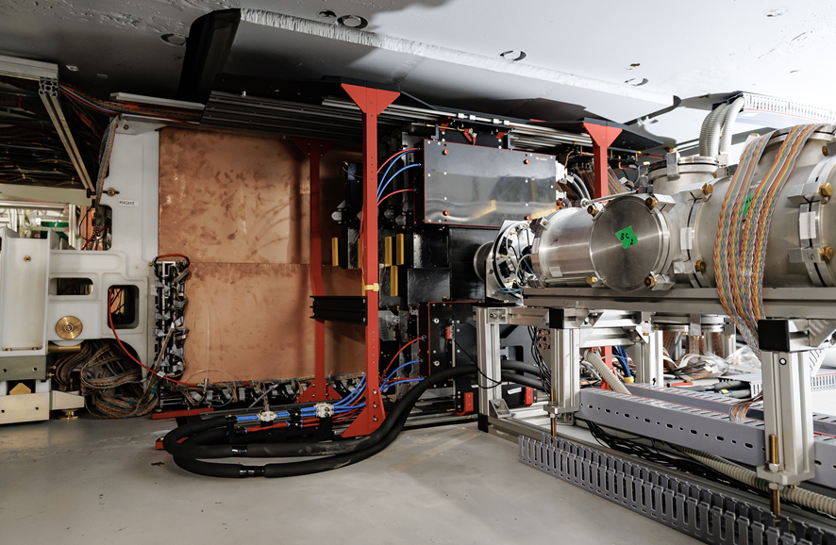
Status of the BM@N experiment
Dubna, May 13, 2025
BM@N experiment

Slide 2
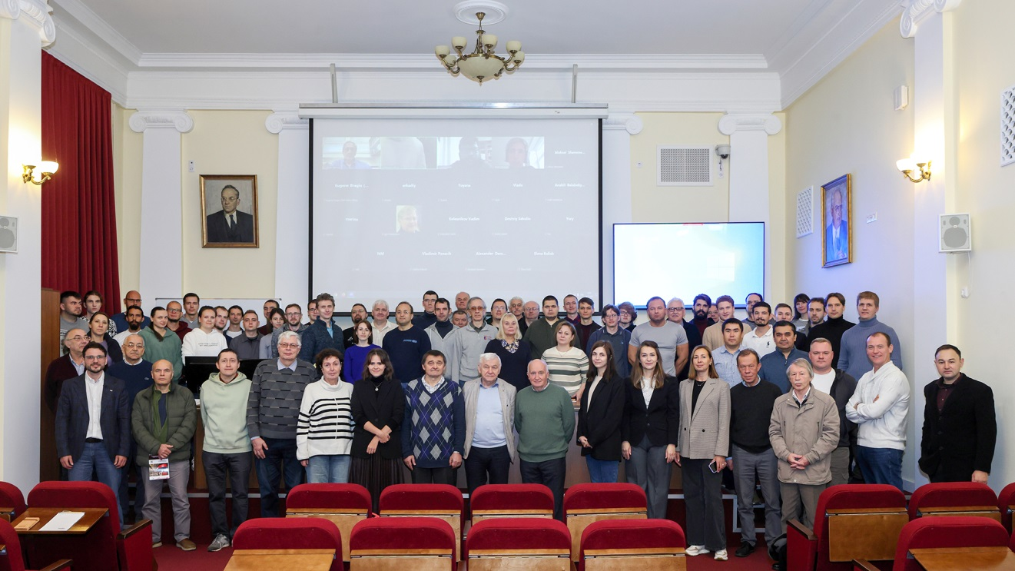
Baryonic Matter at Nuclotron (BM@N) Collaboration:
207 participants from 5 Countries Bulgaria, China, Kazakhstan, Russia & Uzbekistan
13 Institutions & 7 towns Alma-Aty, Dubna, Moscow, Plovdiv, Shanghai, St. Petersburg & Tashkent
University of Plovdiv, Bulgaria
St.Petersburg University
Shanghai Institute of Nuclear and Applied Physics, CFS, China;
Joint Institute for Nuclear Research;
Institute of Nuclear Research RAS, Moscow
NRC Kurchatov Institute, Moscow combined with Institute of Theoretical & Experimental Physics, NRC KI, Moscow
Moscow Engineer and Physics Institute
Skobeltsyn Institute of Nuclear Physics, MSU, Russia
Moscow Institute of Physics and Technics
Lebedev Physics Institute of RAS, Moscow
Institute of Physics and Technology, Almaty
Physical-Technical Institute Uzbekistan Academy of Sciences, Tashkent
High School of Economics, National Research University, Moscow
BM@N experiment
Notes:
BM@N Collaboration composes 5 Countries (Bulgaria, China, Kazakhstan, Russia and Uzbekistan) ,13 Institutions from 7 towns (Alma-Aty, Dubna, Moscow, Plovdiv, Shanghai, St. Petersburg and Tashkent) including 207 participants.

Slide 3
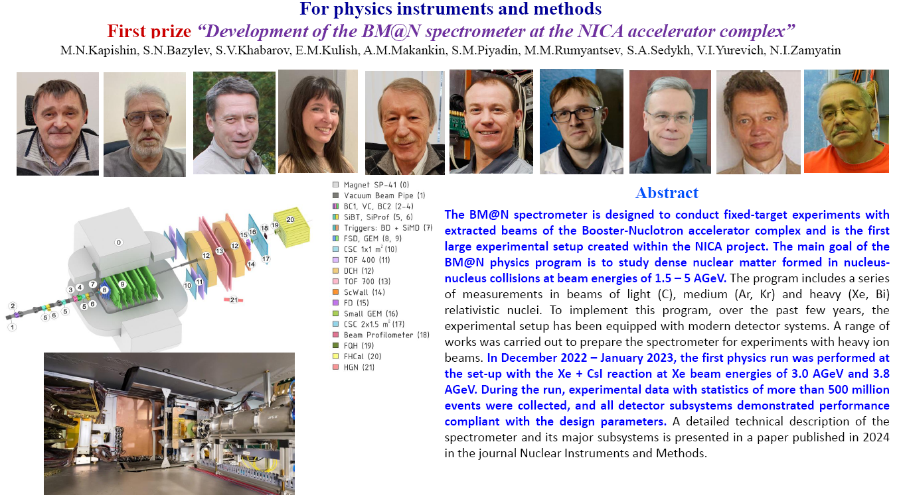
JINR prizes 2024
Second prize:
“Development of the software complex for the implementation of a unified architecture for distributed data processing and storage at the BM@N/NICA experiment”.
Authors: E. Alexandrov, I. Alexandrov, N. Balashov, A. Chebotov, I. Filozova,
K. Gertsenberger, P. Klimai, A. Moshkin, I. Pelevanyuk, G. Shestakova.
Notes:
A number (20) of of the members of the BM@N Collaboration has been awarded by JINR prizes in 2024 for “The development of the BM@N spectrometer at the NICA accelerator complex” and “Development of the software complex for the implementation of a unified architecture for distributed data processing and storage at the BM@N/NICA experiment”.

Slide 4
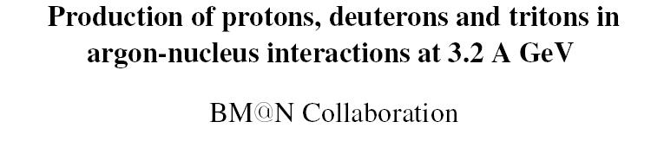
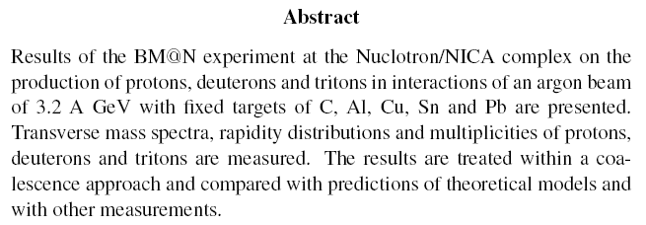
arXiv:2504.02759 → paper submitted to JHEP
Notes:
The paper “Production of protons, deuterons and tritons in argon-nucleus interactions at 3.2 AGeV” has been prepared, put into ArXiv and submitted to the Journal of High-Energy Physics

Slide 5
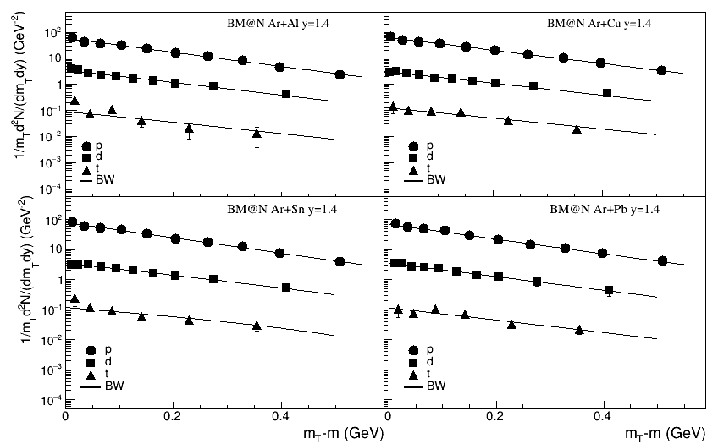
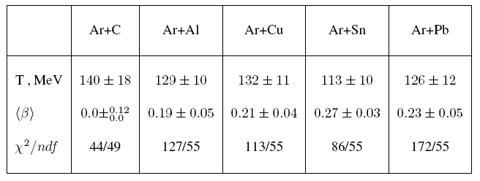
Blast-Wave model fit of p,d,t spectra
Centrality 0-40%
The fitted temperature of ~130 MeV and transverse expansion velocity of ~0.2 c are practically the same for all the targets,
except for a smaller flow indicated for the Carbon target
BM@N experiment
Notes:
The fitted temperature of ~130 MeV and transverse expansion velocity of ~0.2 c are practically the same for all the targets, except for a smaller flow indicated for the Carbon target

Slide 6
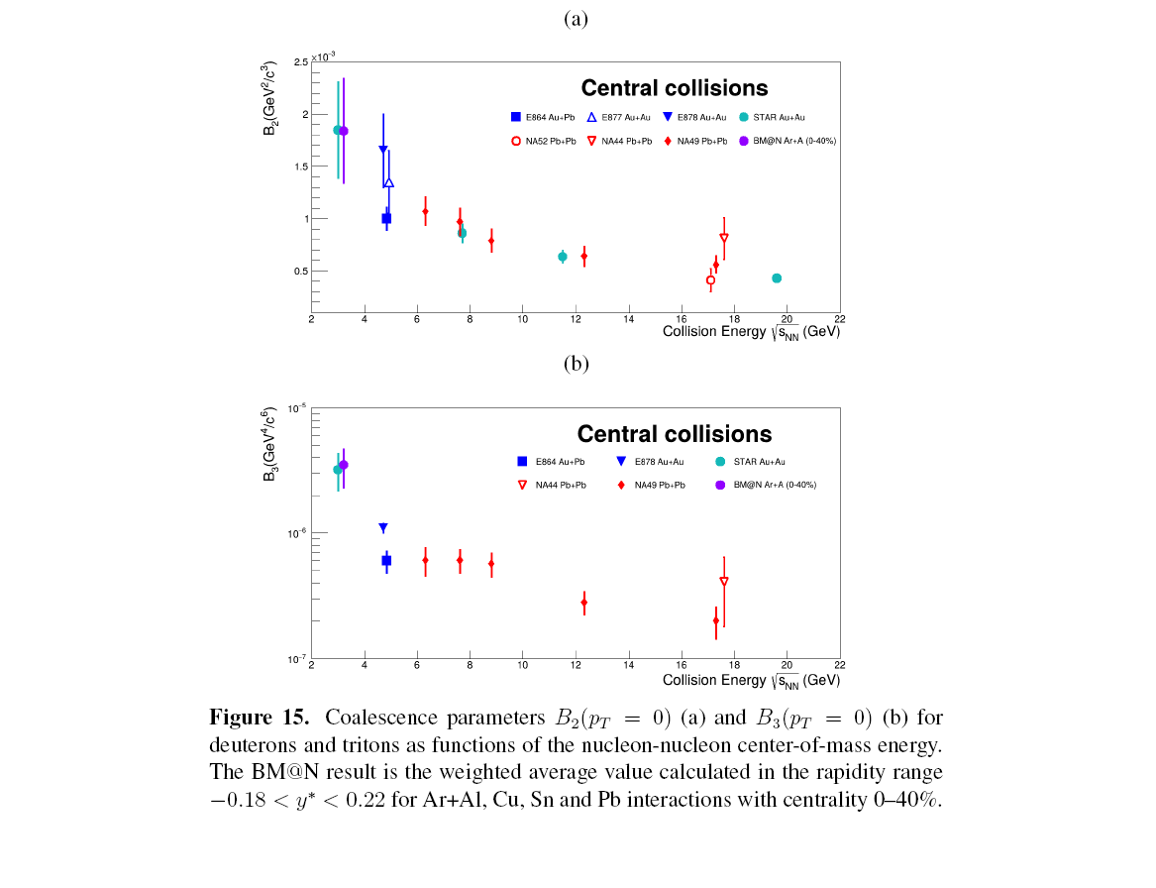
Coalescence parameters B₂ (d) and B₃ (t)
The Coalescence parameters measured by BM@N follow the increasing trend with the decreasing collision energy.
Since these parameters are inversly proportional to the femtoscopic (coalescence) volume for deuterons or volume squared for tritons, this volume shows the opposite trend – increases with the collision energy.
The estimated BM@N coalescence radius of ~2.5 fm at zero pT appears to be practically independent of the target mass.
BM@N experiment
Notes:
The Coalescence parameters measured by BM@N follow the increasing trend with the decreasing collision energy. Since these parameters are inversly proportional to the femtoscopic (coalescence) volume for deuterons or volume squared for tritons, this volume shows the opposite trend – increases with the collision energy. The estimated BM@N coalescence radius of ~2.5 fm at zero pT appears to be practically independent of the target mass.

Slide 7
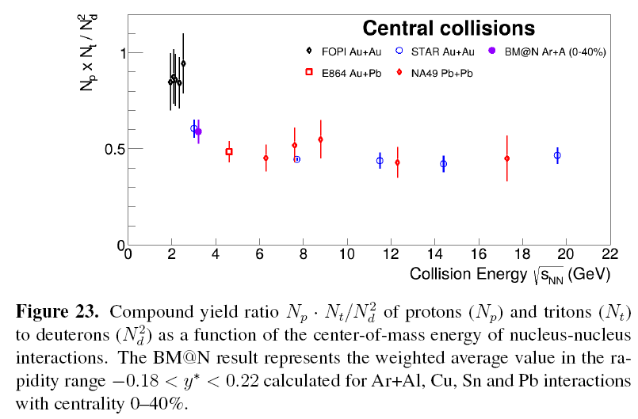
Compound yield ratio N_{p} N_{t} / N_{d}²
In the Coalescence model, the ratio
N_{p} N_{t} / N_{d}² ≈ 0.3 (1 + Δn)
is a measure of the neutron density fluctuation Δn and an irregular increase is expected near the critical point of the phase transition between the quark-gluon and hadron matter.
The measured BM@N ratio agrees with that of STAR and confirms the increase with the decreasing collision energy, expected in the coalescence model.
The search for the critical point however requires a more detailed scan of the BM@N energy region.
BM@N experiment
Notes:
In the Coalescence model, the ratio N_{p} N_{t} / N_{d}² ≈ 0.3 (1 + Δn) is a measure of the neutron density fluctuation Δn and an irregular increase is expected near the critical point of the phase transition between the quark-gluon and hadron matter. The BM@N ratio agrees with that of STAR and confirms the increase with the decreasing collision energy, expected in the coalescence model. The search for the critical point however requires a more detailed scan of the BM@N energy region.

Slide 8
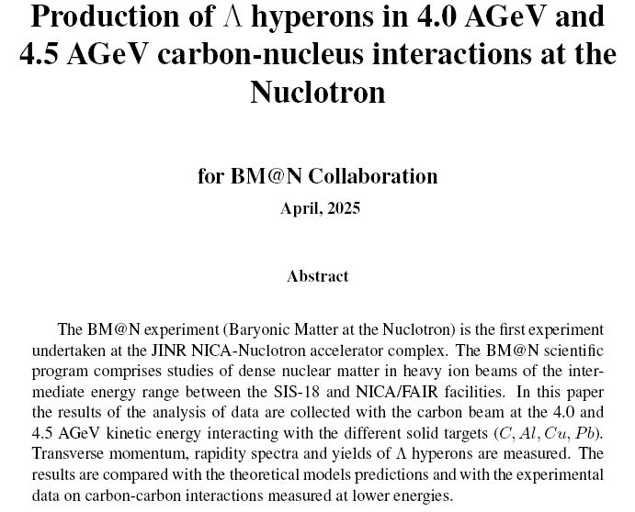
→draft in circulation in the BM@N Collaboration

Slide 9
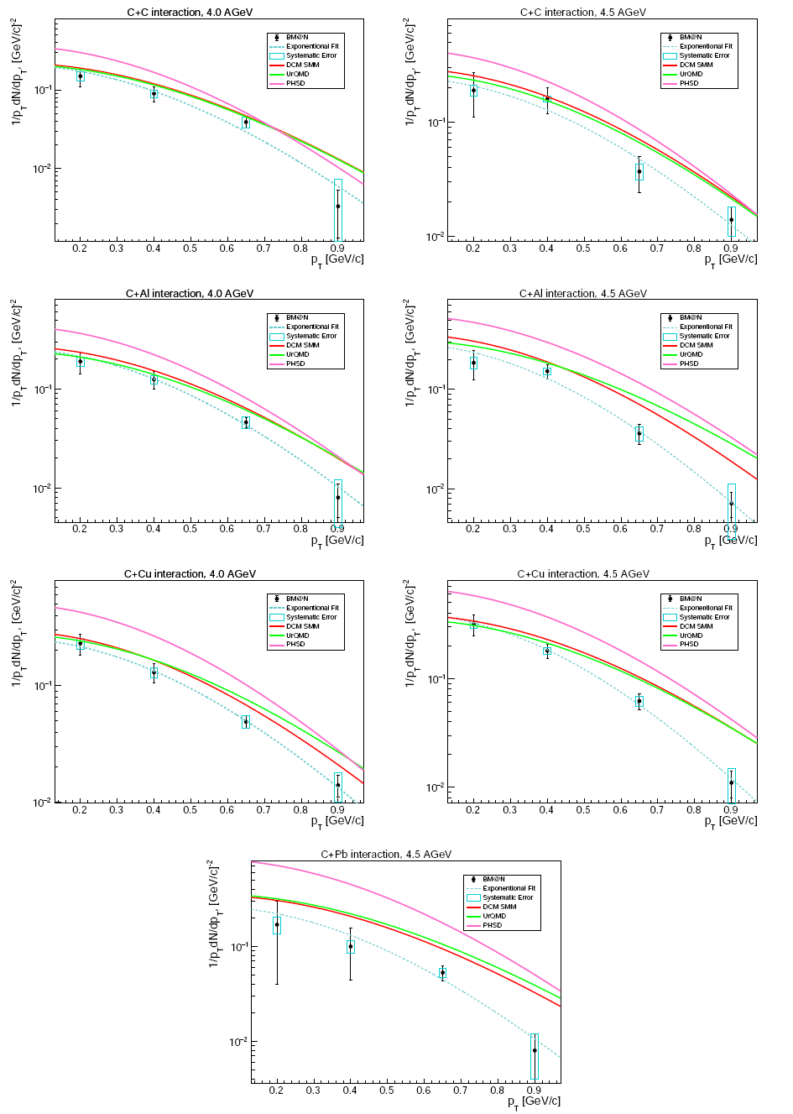
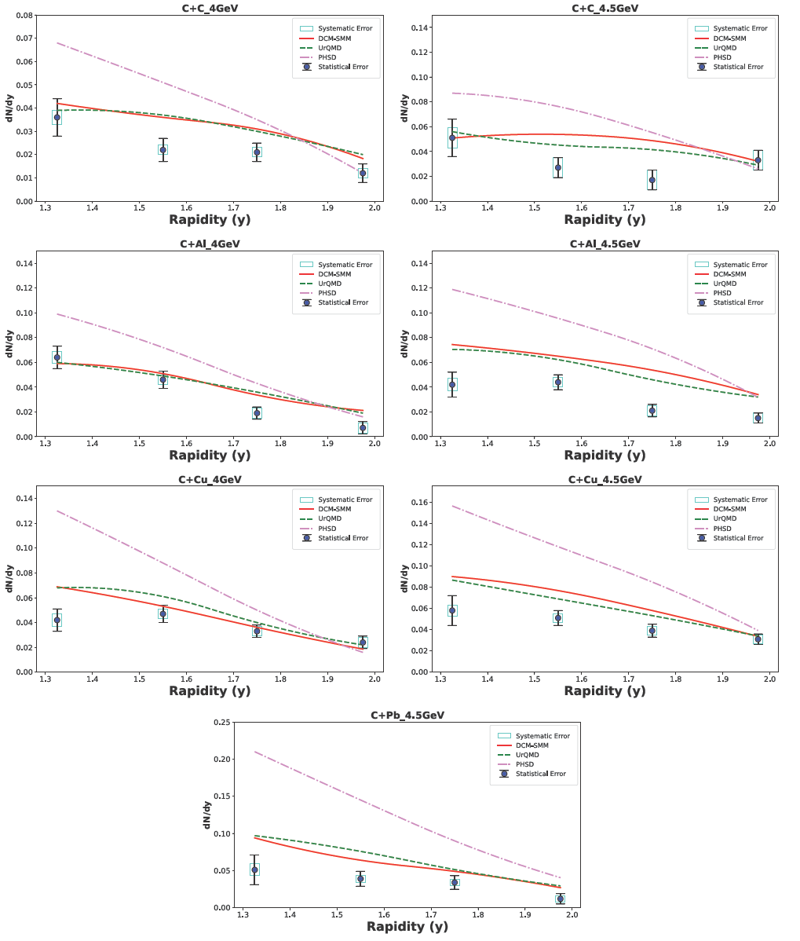
Λ rapidity and p_{T} spectra in C+C, Al, Cu, Pb interactions
The DCM-SMM, UrQMD and PHSD models overestimate the Lambda yields
The measured inverse pT slope (effective temperature) is ~100 MeV
It is practically independent of the target mass
BM@N experiment
Notes:
The measured inverse pT slope (effective temperature) of ~100 MeV is practically independent of the target mass.

Slide 10
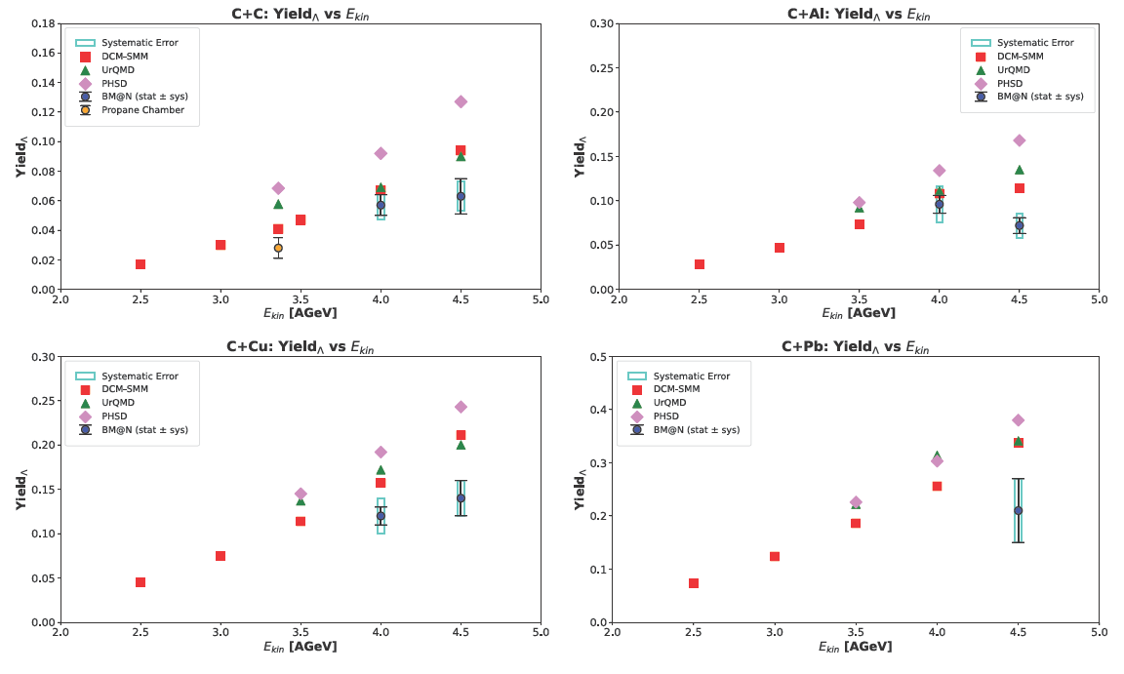
Energy dependence of Λ yields in C+C, Al, Cu, Pb interactions
The BM@N Lambda yields are consistent with the expected increase with the collision energy, except for ~2 s.d. drop on the Aluminium target
BM@N experiment
Notes:
The BM@N Lambda yields are consistent with the expected increase with the collision energy, except for those on the Aluminium target

Slide 11
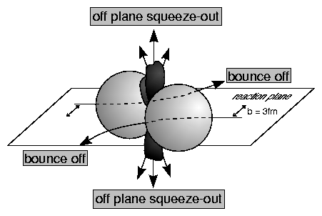
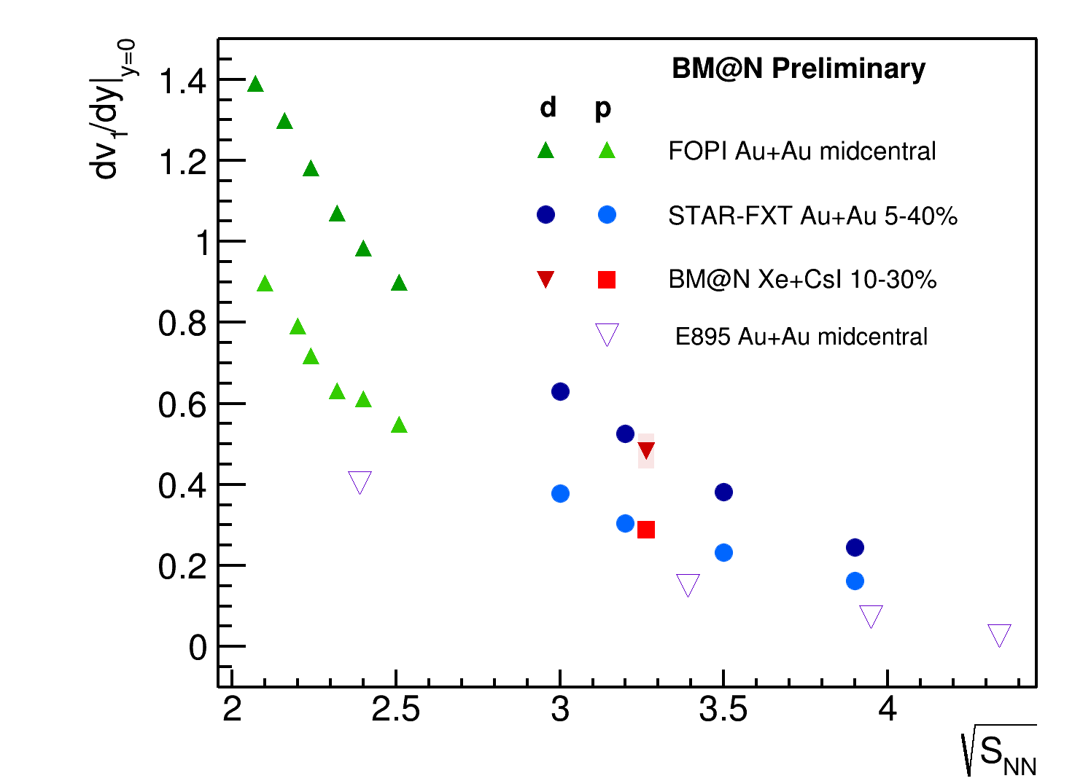
Directed flow of deuterons and protons in Xe+CsI interactions
BM@N Preliminary: MEPhI group
Azimuthal angle distribution: dN/dφ ∝ (1 + 2v₁ cosφ + 2v₂ cos2φ)
→ Directed flow 𝑣1 of protons and deuterons scales with A
(1:2), as expected in the Coalescence model
→ BM@@N result is in line with the STAR FXT Au+Au data
See talk of Mikhail Mamaev
BM@N experiment

Slide 12
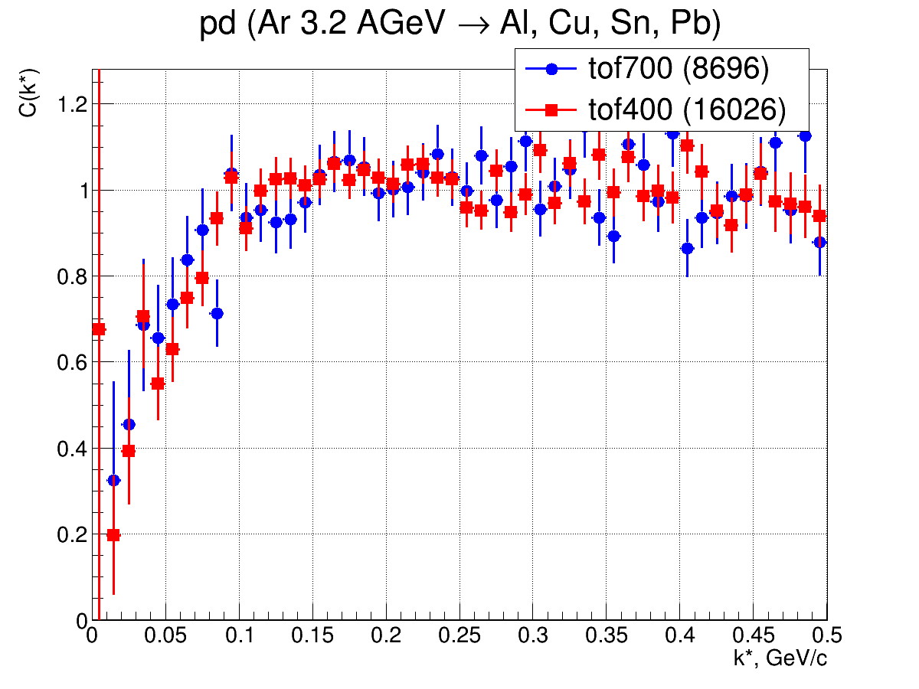
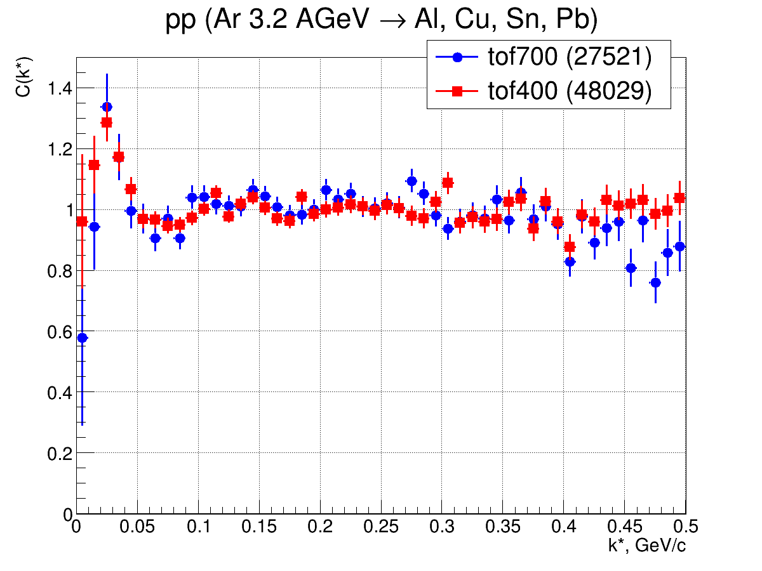
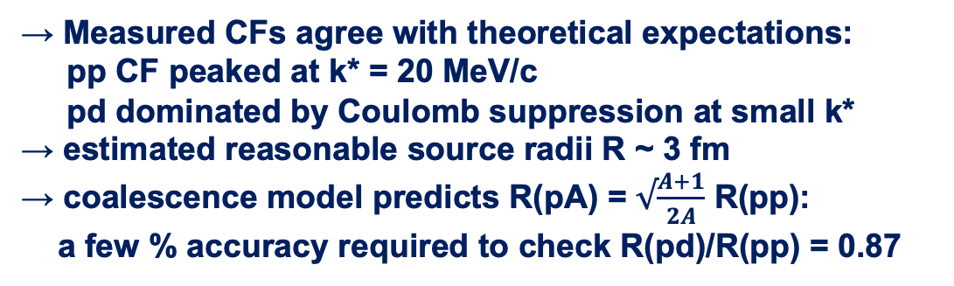
pp & pd femtoscopy in Ar+A collisions
→ Measured CFs agree with theoretical expectations:
pp CF peaked at k* = 20 MeV/c
pd dominated by Coulomb suppression at small k*
→ estimated reasonable source radii R ~ 3 fm
→ coalescence model predicts R(pA) = $√\frac{A+1}{2A}$ R(pp):
a few % accuracy required to check R(pd)/R(pp) = 0.87
See talk of Petr Alekseev

Slide 13
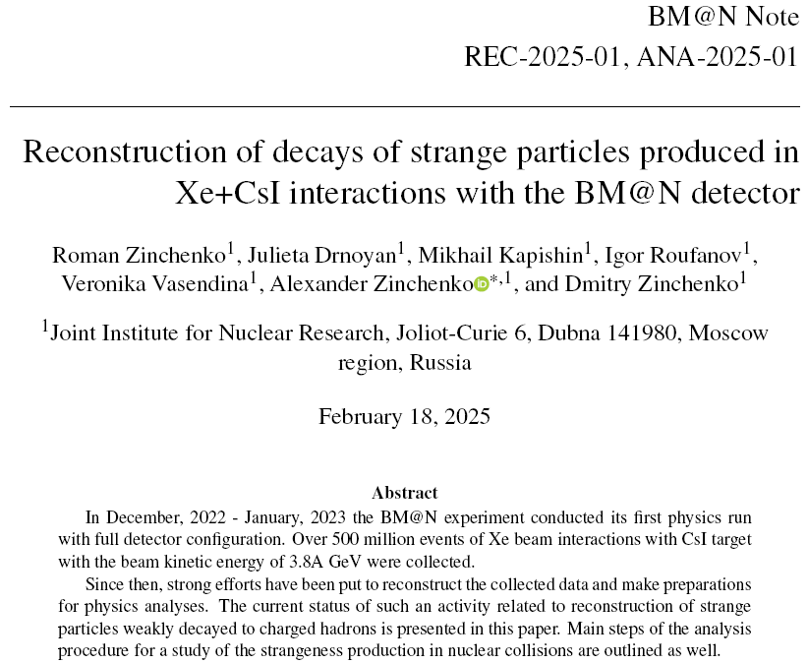
See talk of Alexander Zinchenko

Slide 14
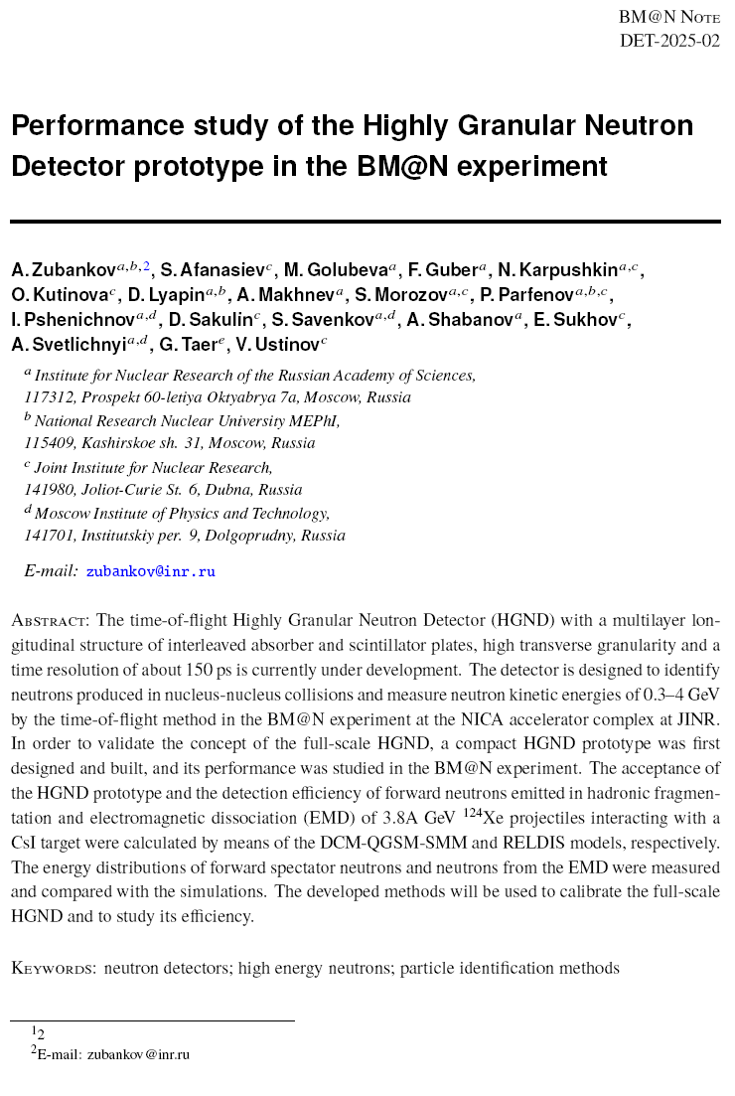
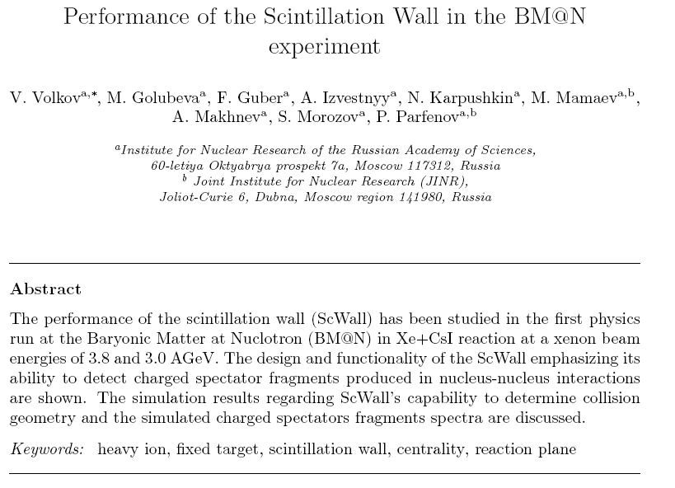
BM@N Note DET-2025-02
See talk of Vadim Volkov
See talk of Alexander Zubankov

Slide 15
Status of data analysis and plans for next physics runs
Topics of current physics analyses:
production of Λ, Ξ- hyperons, K⁰_{S} , K±, π±, φ mesons, light nuclear fragments in Xe+CsI interactions;
collective flow of protons, deuterons, Λ
femtoscopy of protons, deuterons
production of light hyper-nuclei _{Λ}H³ , _{Λ}H⁴
Physics run with the Xe beam in 2025
→ beam energy scan: 2 - 3 AGeV
→ same central tracker configuration based on silicon micro-strip and
GEM detectors
→ additional 1st vertex plane of silicon micro-strip detectors
→ ToF-400 acceptance extended by a factor of 1.5
Preparations for a physics run with the Bi beam
Further development of the central tracker is foreseen:
installation of the additional station of silicon micro-strip detectors
Put into operation a 2-coordinate (X/Y) neutron detector of high granularity to measure neutron yield and collective flow
15
BM@N experiment

Slide 16
BM@N conferences , PhD activities
BM@N presented / submitted talks at conferences in 2025:
Conference of the Nuclear Physics Section of the Russian Academy of Sciences, Moscow, February 2025
Conference Nucleus-2025, St Petersburg, July 2025
26th International Baldin Seminar on High Energy Physics Problems “Relativistic nuclear physics and quantum chromodynamics”, Dubna, September 2025
1 candidate dissertation on the 1st BM@N physical result defended in 2024
10 young scientists and PhD students (LHEP, MEPhI, INR RAS) are doing physics analyses at BM@N for future dissertations
16
BM@N experiment

Slide 17
Thank you
for the attention!
BM@N experiment

Slide 18

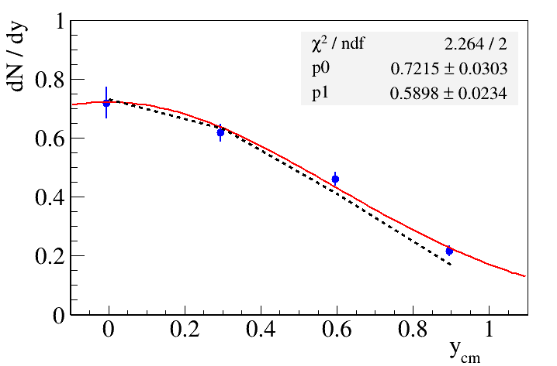
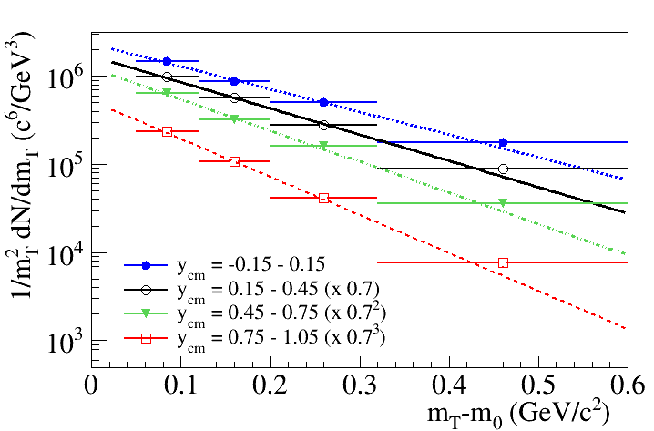
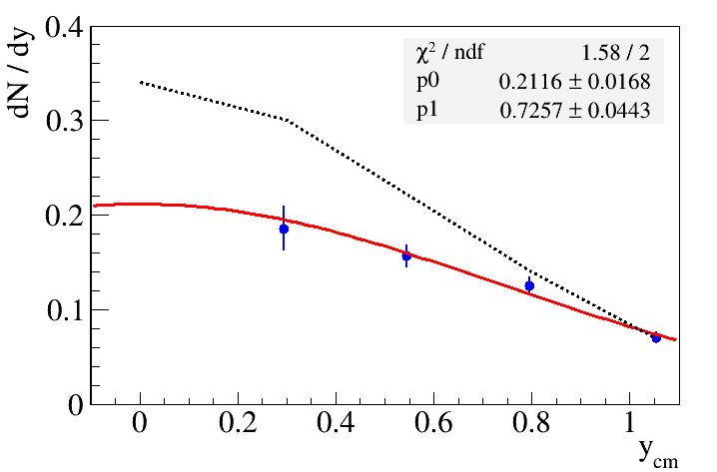
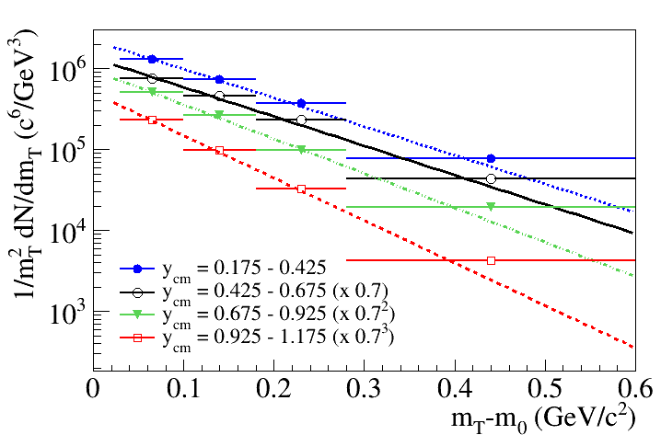
Towards Λ and K⁰_{s} yields in Xe+CsI interactions
A.Zinchenko and team
Rapidity spectra of Λ and K⁰_{s}
compared with DCM-SMM model
y
Transverse mass spectra of Λ and K⁰_{s}
Λ
Λ
DCM-SMM
K⁰_{s}
DCM-SMM
K⁰_{s}
BM@N experiment

Slide 19
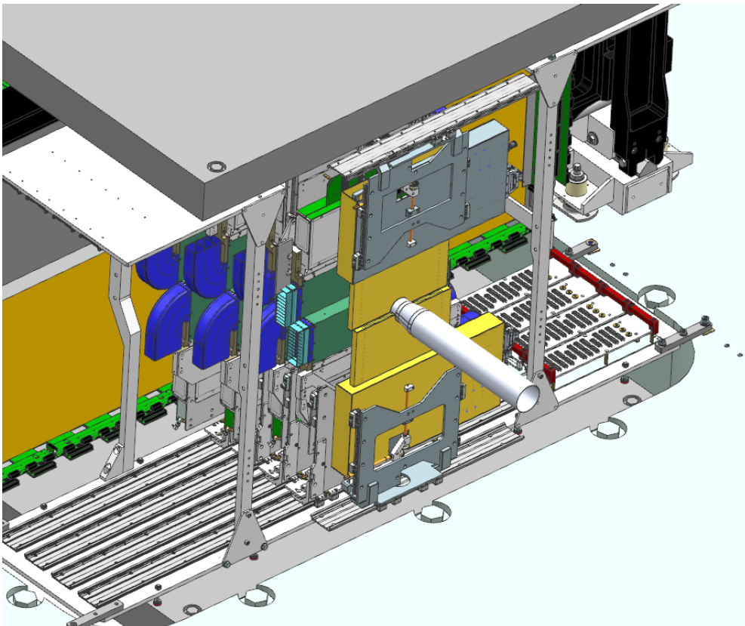
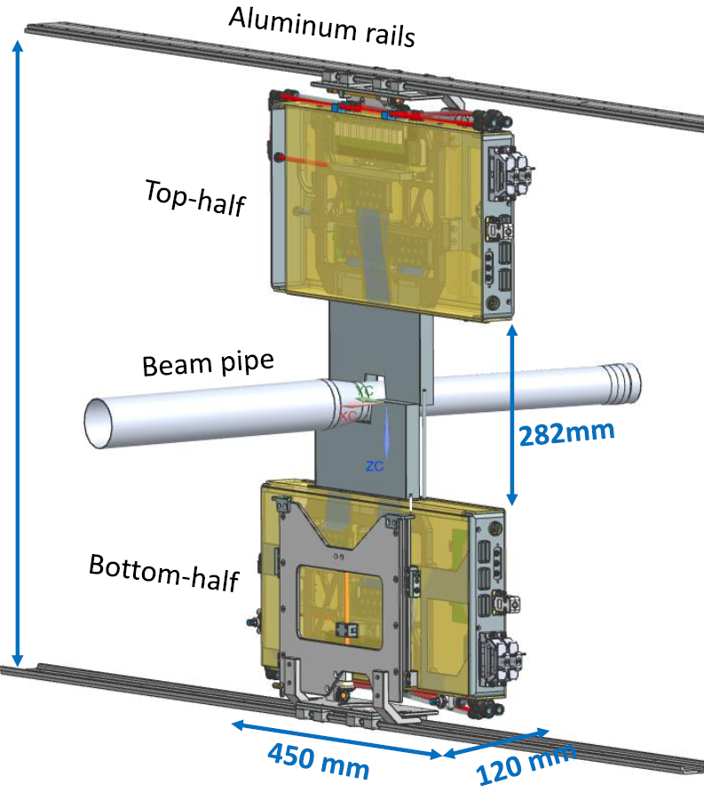
2-coordinate Si-plane based on STS modules
STS group
Si-plane
Plan to install and commission the new Si plane for the next experimental run
BM@N experiment

Slide 20
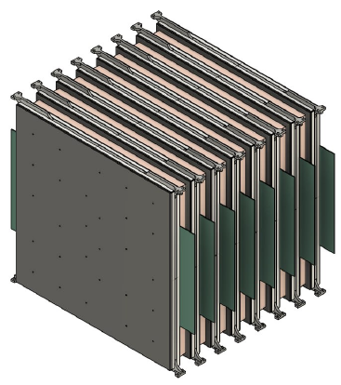
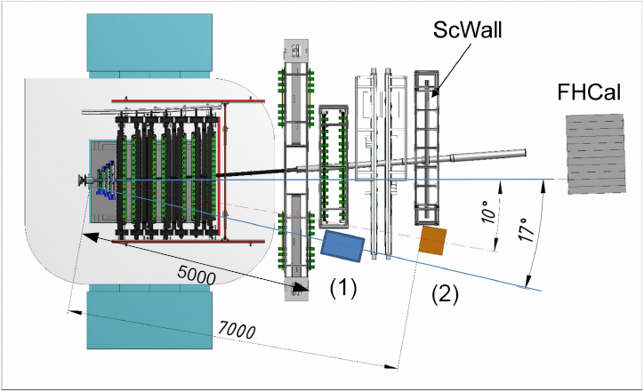
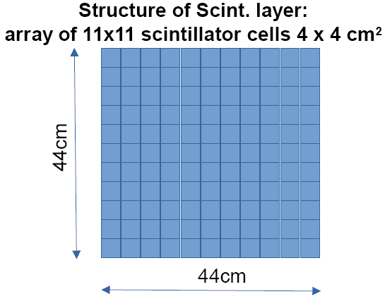
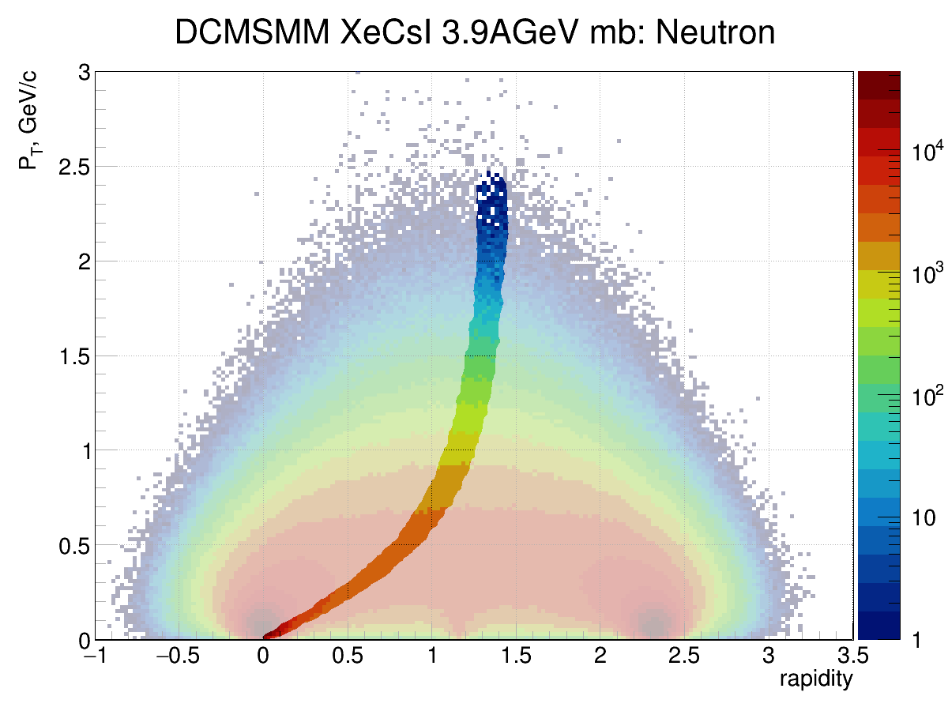
New neutron detector of high granularity
→ plan to install in 2026
INR RAS, LHEP, Kurchatov NRS
44cm
44cm
2 positions of HGN detector at BM@N: at 10º and 17º
Acceptance of HGN detector
HGN detector parameters: 2 sub-detectors with 8 layers each (~1.5 λint)
- 11 x 11 cells in one layer with SiPM read-out
- first layer works as VETO
- next 7 layers: 3cm Cu + 2.5cm scintillator
- FPGA based fast TDC read-out with
additional ToT amplitude measurement
- time resolution of one scint. cell ~ 120ps
- neutron detection efficiency: > 60% @ 1GeV
XeCsI@3.9AGeV
neutrons
mid rapidity
~1.16
BM@N experiment

