Slide 1
Status of phi-meson signal reconstruction in Xe+CsI collisions in the BM@N experiment
Ramin Barak
14th Collaboration Meeting of the BM@N Experiment at NICA, Dubna, 13-15 May 2025

Slide 2
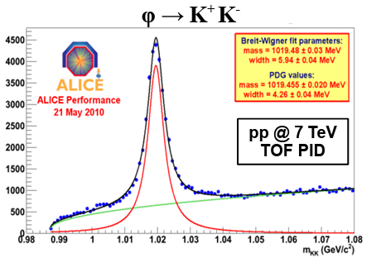
Introduction
Why is $φ\text{(1020}\text{)}$interesting to study?
$φ\text{(1020}\text{)}$is expected to have a small cross-section for interactions with other non-strange particles, and its life time is relatively long (∼41 fm/c), it may keep information of the early stage of the system’s evolution [1].
[2]
[1] J. Phys. G: Nucl. Part. Phys. 32, S373-S380 (2006) DOI: 10.1088/0954-3899/32/12/S46.
[2] efaidnbmnnnibpcajpcglclefindmkaj/https://lss.fnal.gov/conf2/C100715/Preghenella.pdf

Slide 3
Goal
Optimization of the observed signal of $φ\text{(1020}\text{)}$in the experimental data.

Slide 4
Data
Experimental data obtained in the physical session at the beginning of 2023 with a beam energy of 3.8 AGeV, a CsI target and Xe beam.
About 450 million experimental events were analyzed.

Slide 5
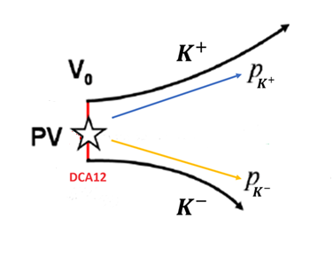
Data processing procedure
Reconstruction of particle tracks was carried out.
Mathematical algorithms were developed and implemented to search for the$φ\text{(1020}\text{)}→ K^{+}+ K^{−}$decay:
shuffling pairs of particles with different signs
calculation of invariant mass
imposing a number of geometric restrictions on the parameters of each pair
DCA12 – the distance between $K^{+}$and $K^{−}$at the decay point of$φ\text{(1020}\text{)}$.
Other restrictions employed:
Constraints on the squared masses of the two products of decay ($K^{+}$and $K^{−}$).
Event topology $φ\text{(1020}\text{)}$

Slide 6
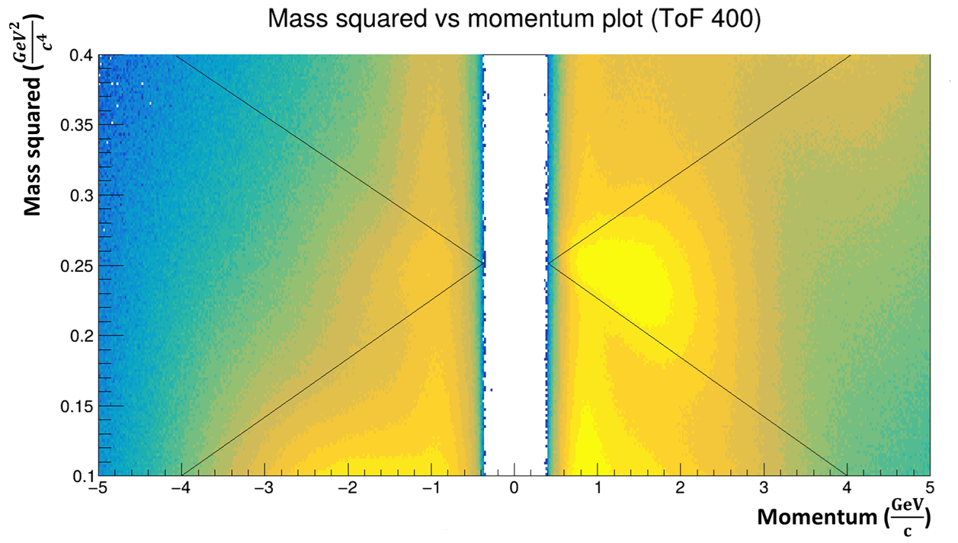
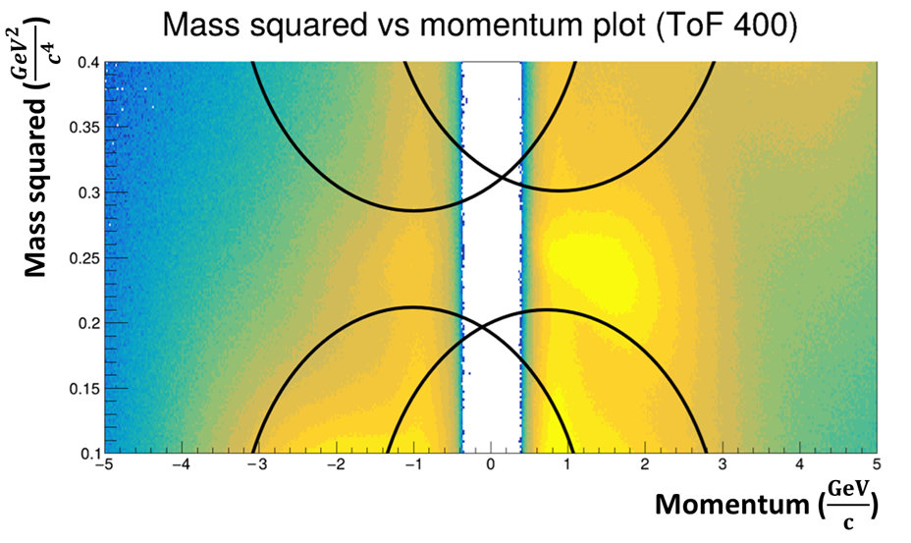
Results
Following two situations with regards to constraints on the squared mass were considered:
Additional constraint used in both cases:
0.0 cm <= dca12 <= 1.0 cm

Slide 7
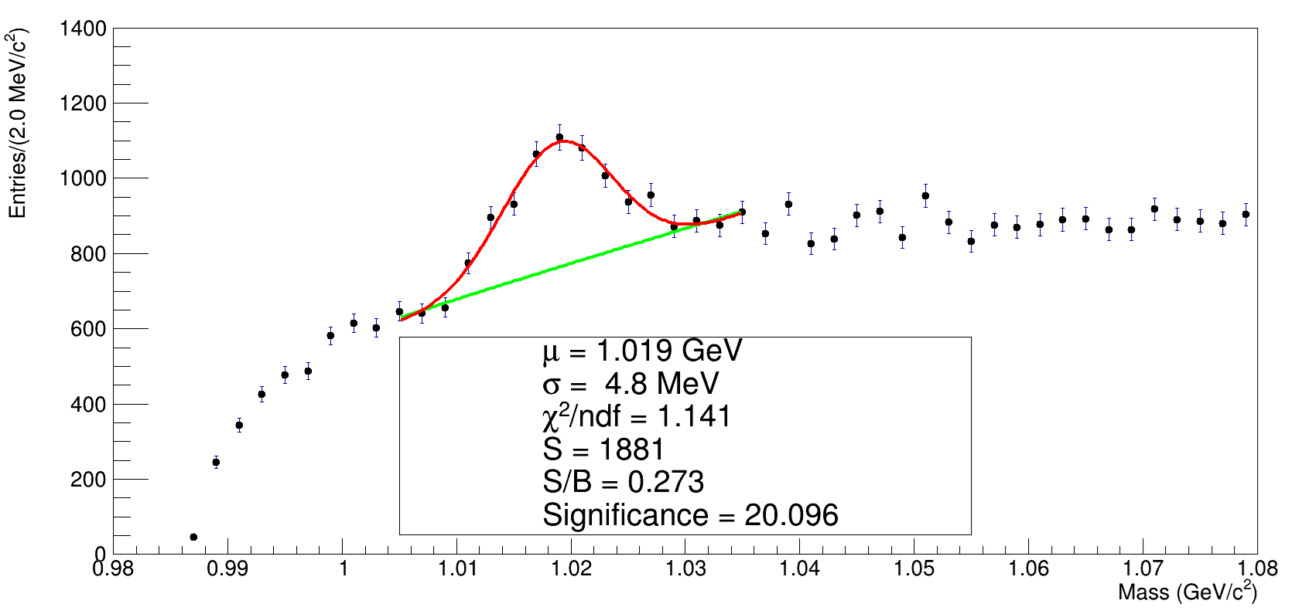
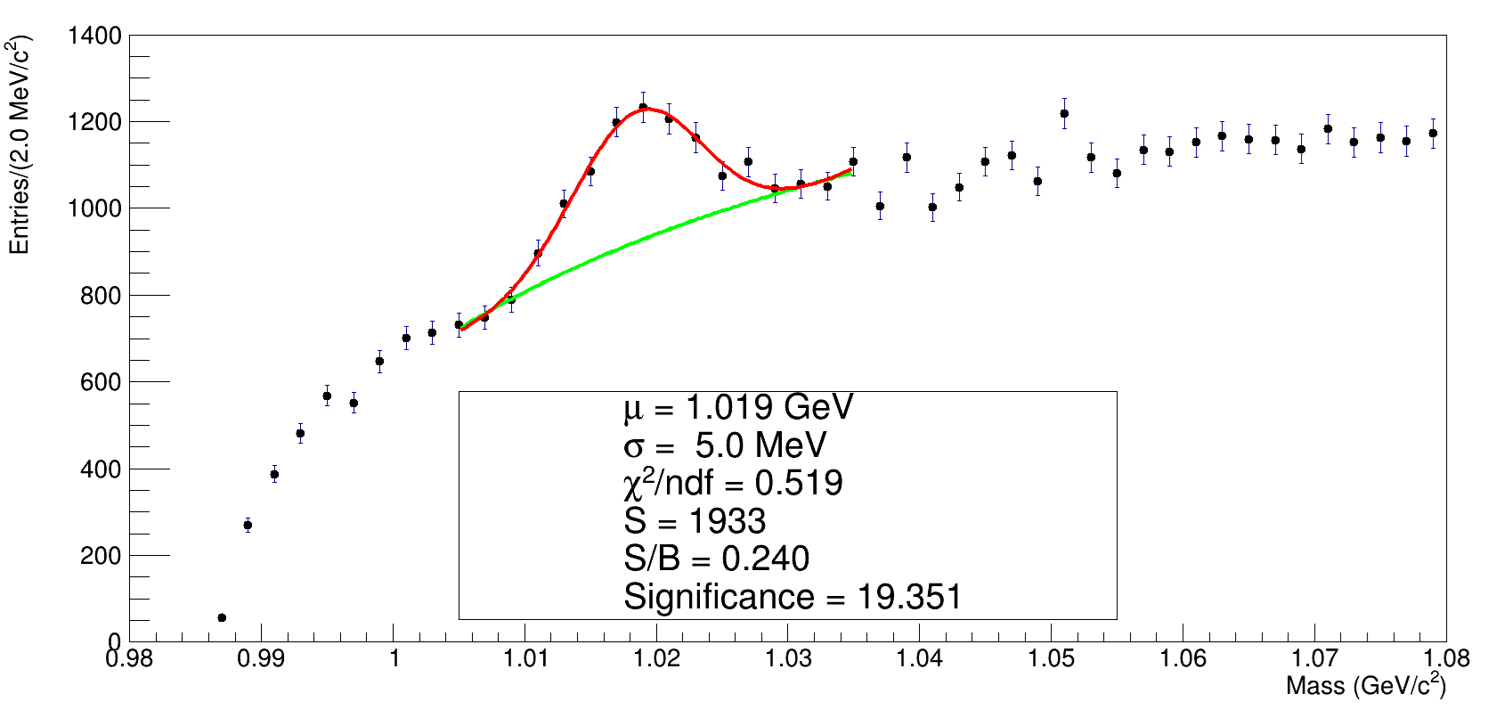
Results

Slide 8
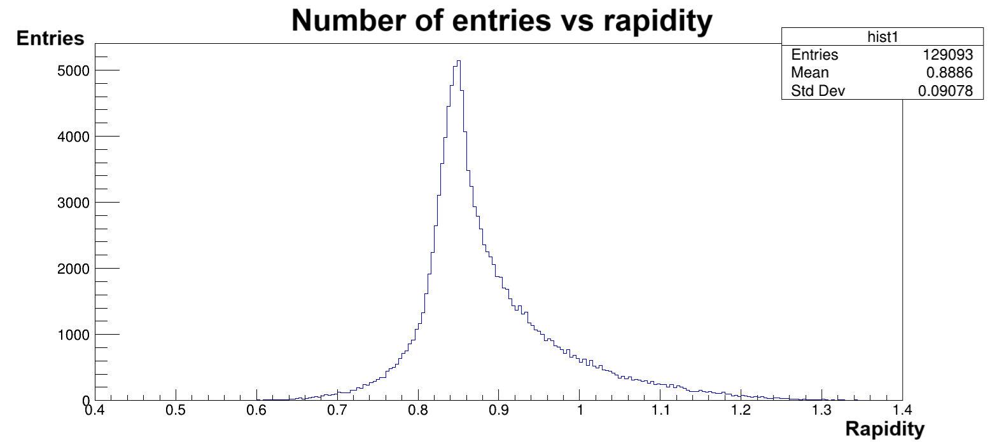
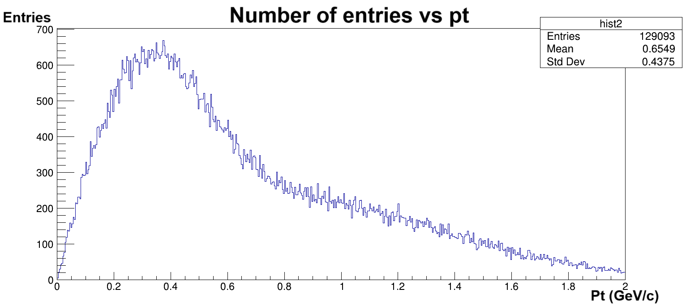
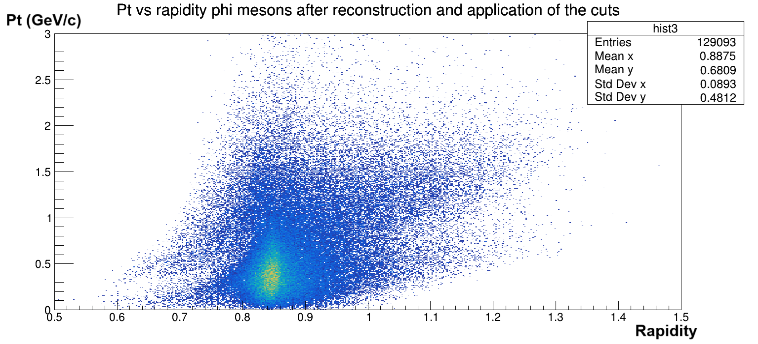
Results
Initial stages of the phase space analysis:

Slide 9
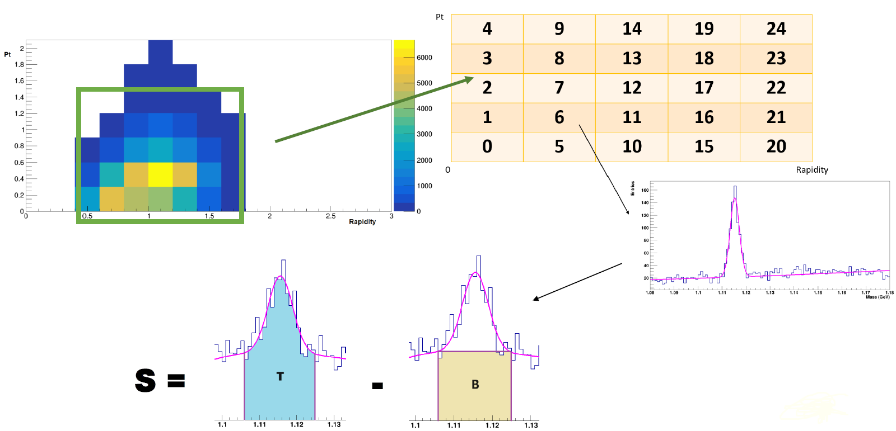
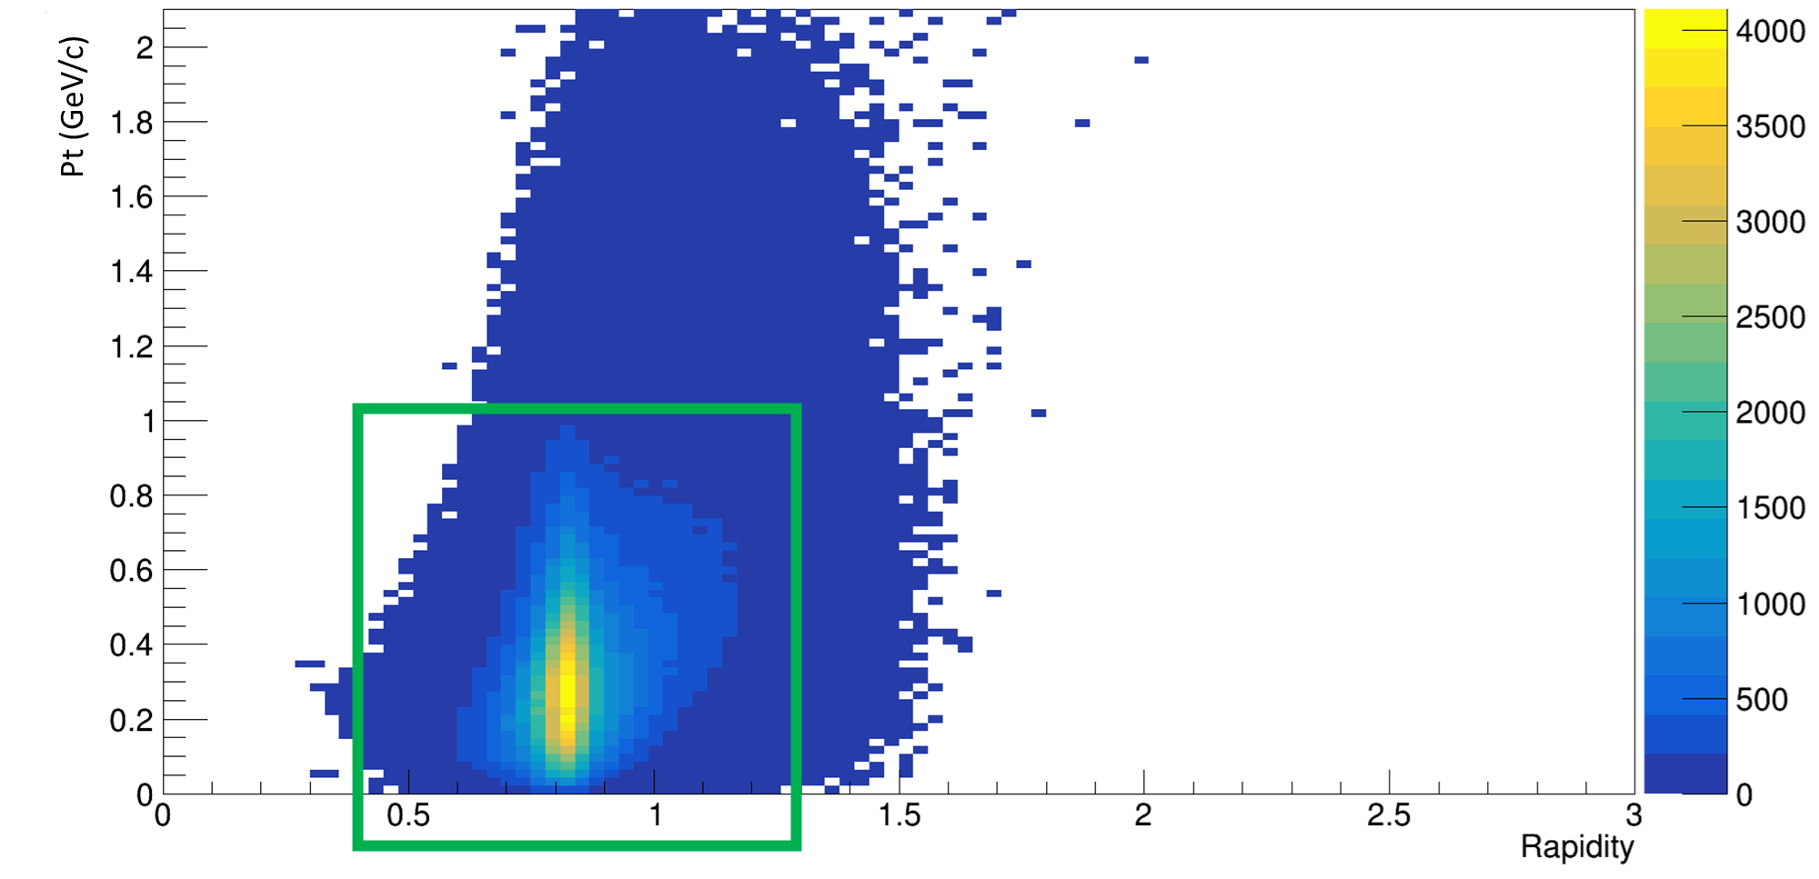
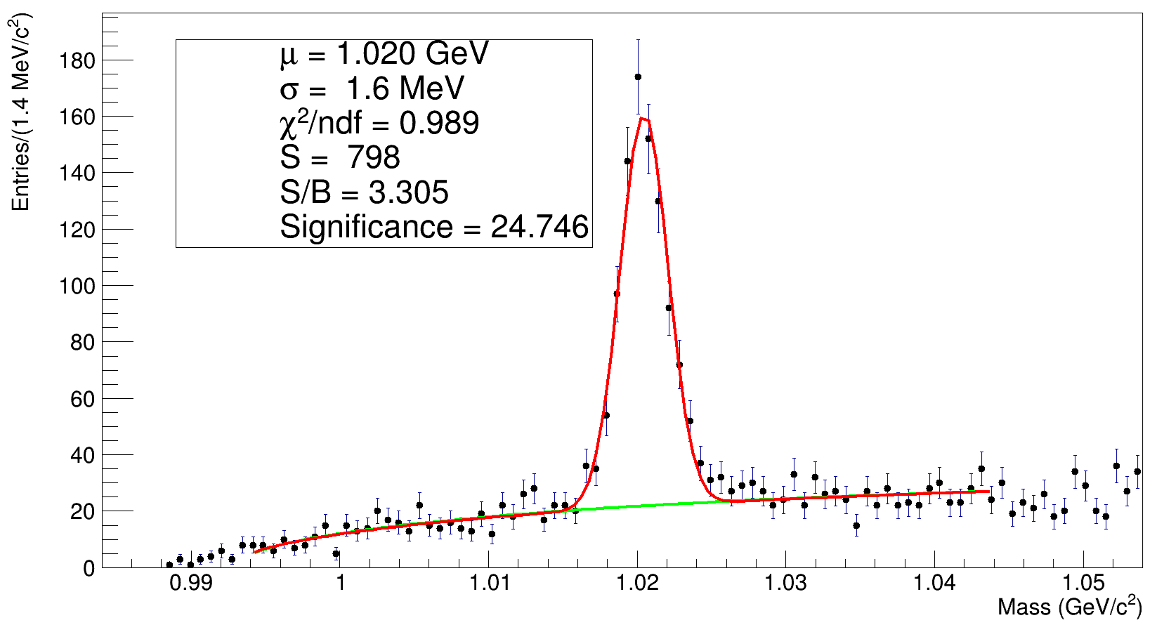
Results

Slide 10
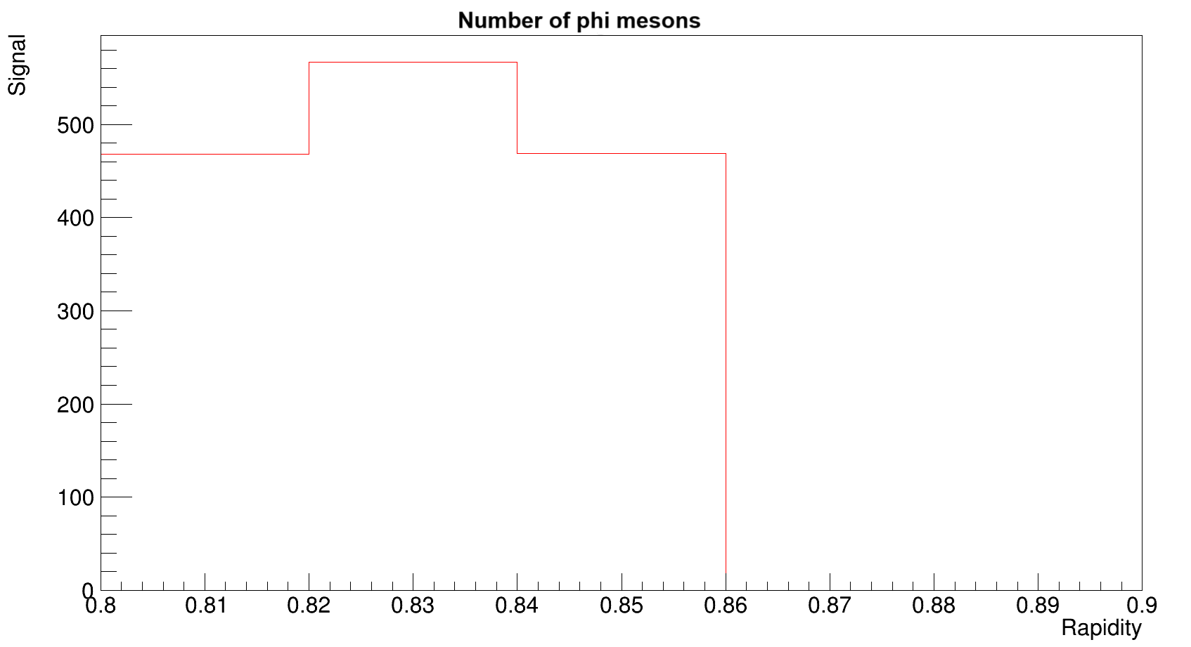
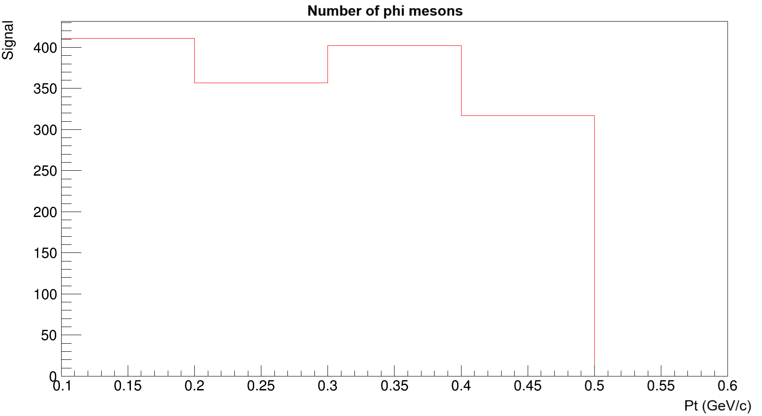
Results

Slide 11
Conclusion and future work
$φ\text{(1020}\text{) }$signal was optimized by assuming constraints based on the ratio between mass squared and momentum.
Phase space analysis was initiated.
Further optimization of the $φ\text{(1020}\text{) }$signal by improving the matching of ToF 400.
Continuation of the phase space analysis.
Estimation of the number of $φ\text{(1020}\text{) }$by combining the results from the experimental case and MC case (reconstruction efficiency).

Slide 12
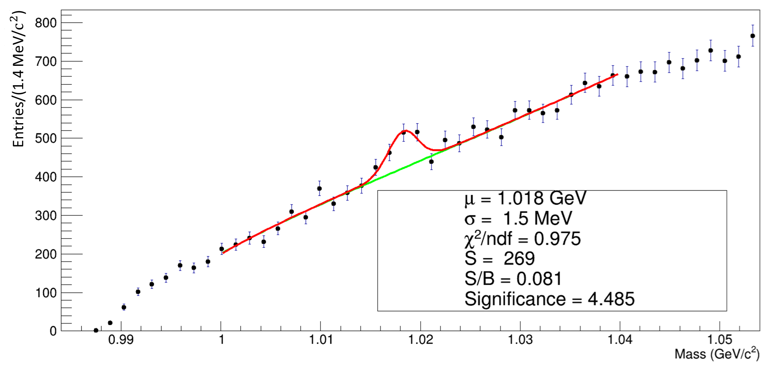
Old Results

Slide 13
Old Results

