Slide 1


Waiting for the beam of relativistic nuclei ¹²⁴Xe at BM@N
N. Zamyatin on behalf of Forward Silicon Detector team
14th Collaboration Meeting of the BM@N Experiment at NICA, 13-15 May 2025

Slide 2


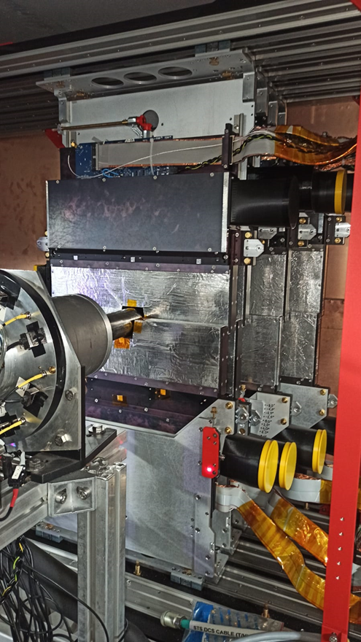
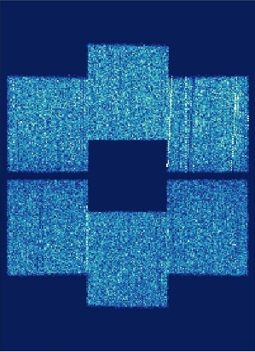
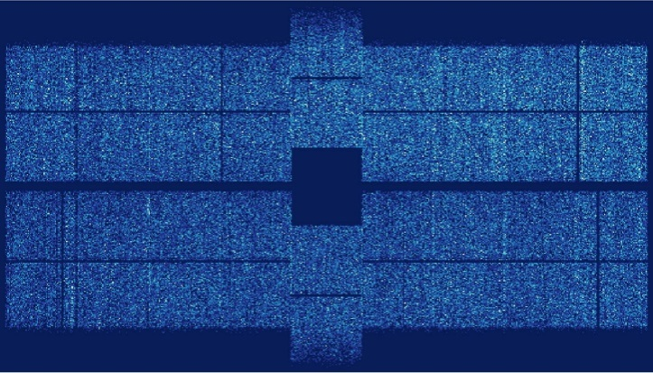
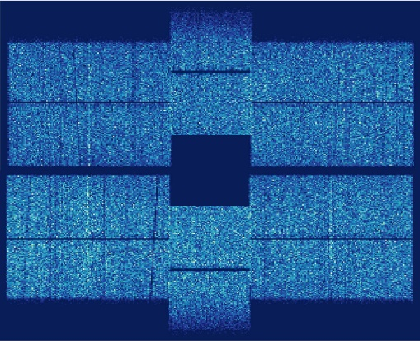
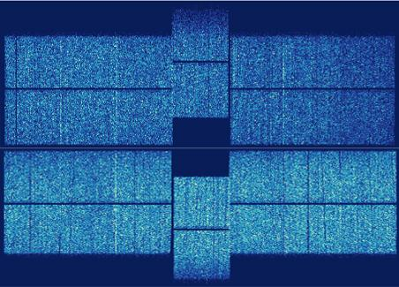
1. FSD на канале BM@N для сеанса май-июнь-2025
station 1
station 4
93643 hit entries
124789 hit entries
111664 hit entries
138624 hit entries
station 2
station 3
201548 hit entries
165513 hit entries
198035 hit entries
319725 hit entries

Slide 3
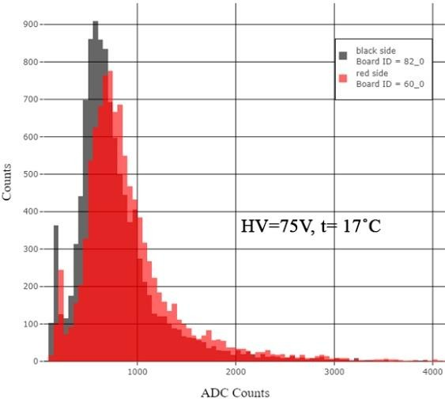
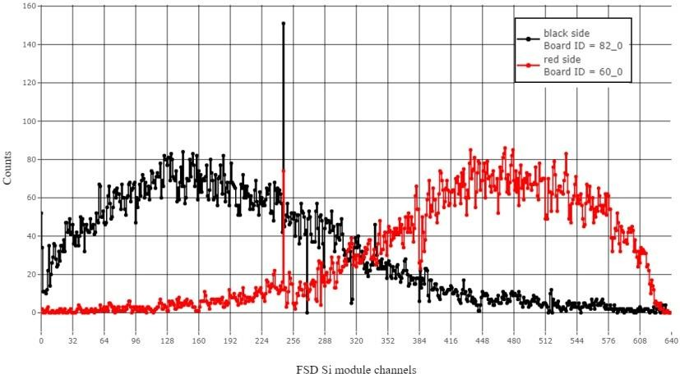
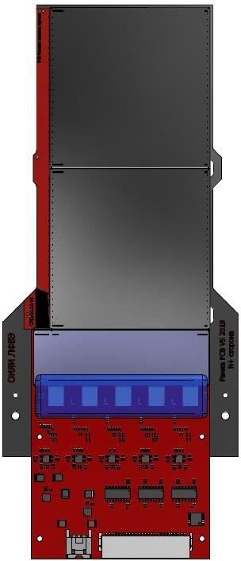
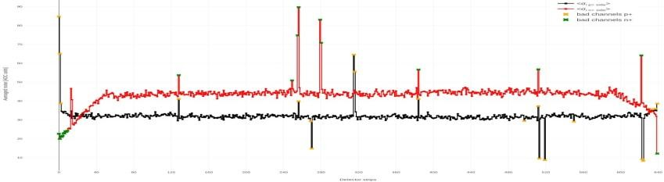
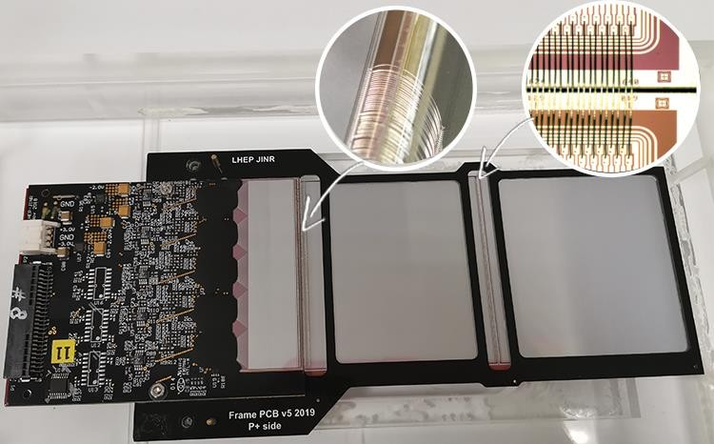
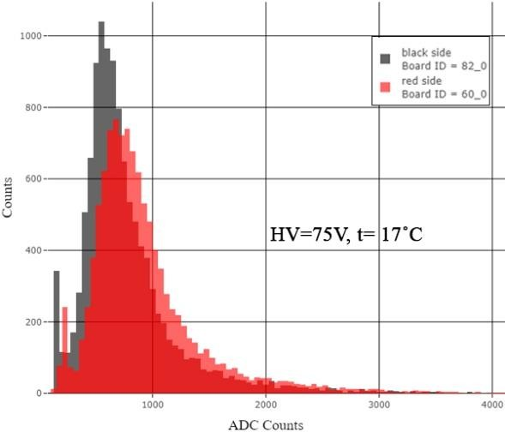
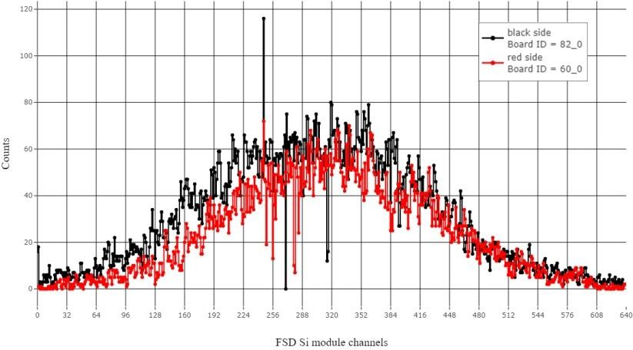

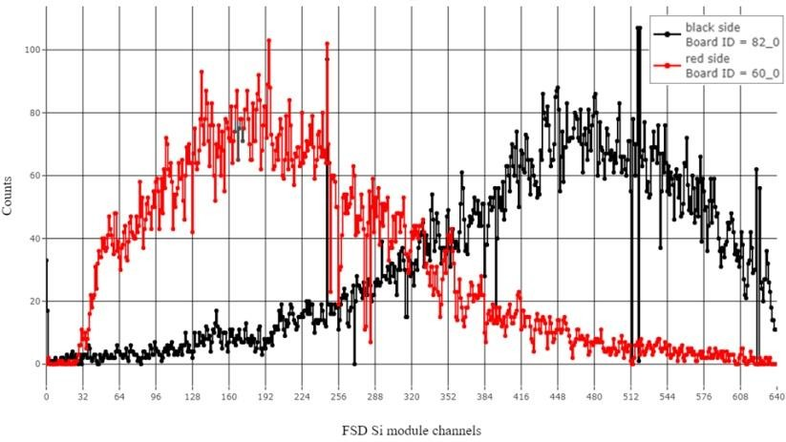
FSD Si module test results
(module #41)
Occupancy distributions in FSD Si module channels after noise suppresion
1
1
β-source positions
1 2 3
Sigma values of each FSD Si module channels at 75 V
2
639
n+ side
0
2
0
p+ side
639
#1 #2 #3 #4 #5
Module view after US- Bonding detectors and PAs, number of US- Bonding – 640, Ø Al wire – 25 μm
3
3
1ch. ADC_{p+} = 45 e, 1 ch.ADC_{n+}= 42 e
Module ID | Dark current (50V), nA | Mean noise (⁺p), ch.ADC | Mean noise (⁺n), ch.ADC | MPV (⁺p), ch.ADC | MPV (⁺n), ch.ADC | S/N p⁺ side | S/N n⁺ side | Bad channels ratio, %
41_0 | 3 584,00 | 36,93 | 50,76 | 536,20 | 578,89 | 14,09 | 13,32 | 0,55
17

Slide 4
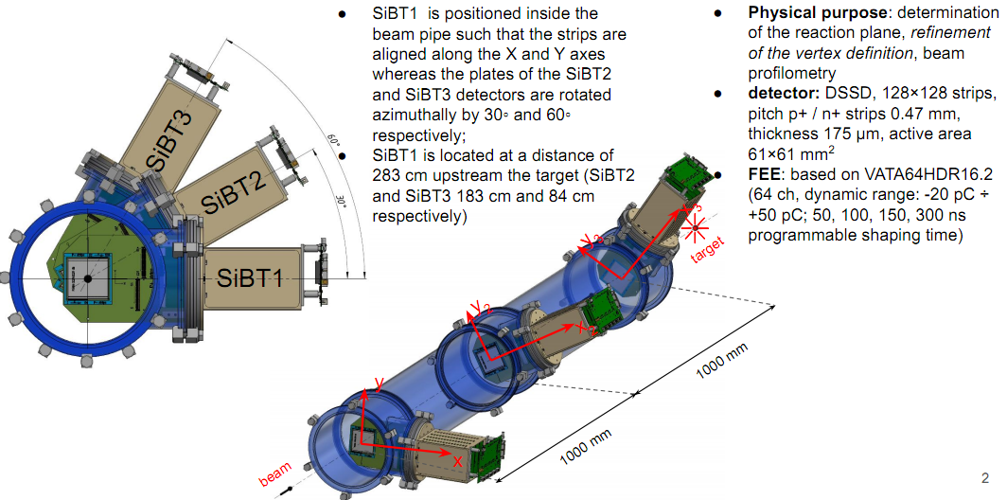
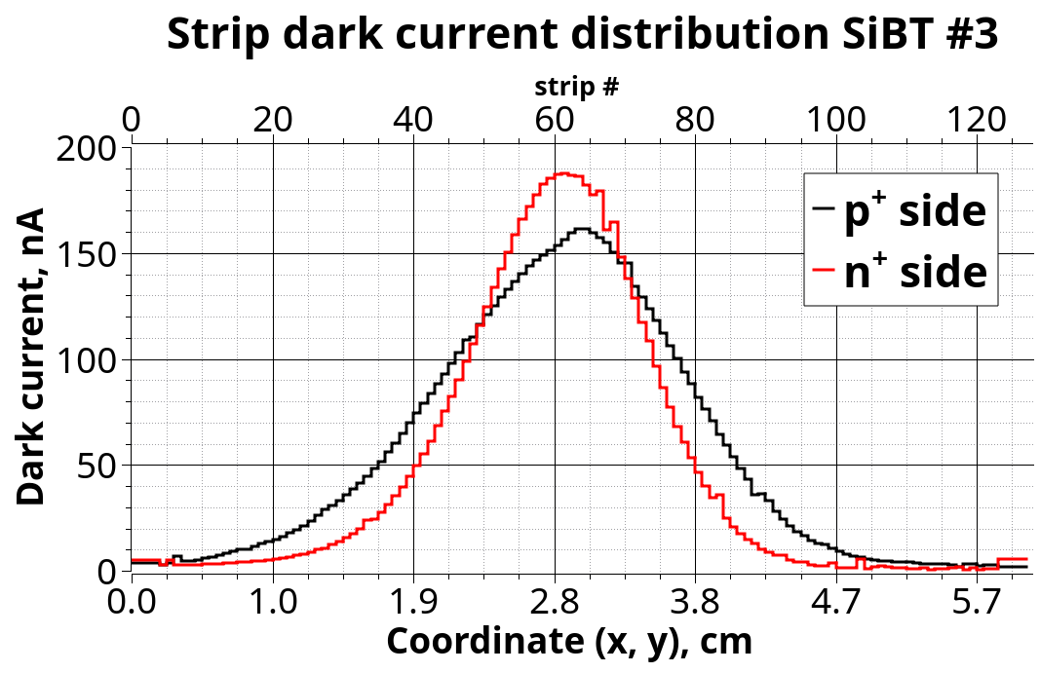
2. Пучковый трекер SiBT1÷SiBT3 к сеансу 2025
Радиационный автограф
пучка ¹²⁴Xe(3.8ГэВ/н) за
сеанс 2022-2023г.

Slide 5
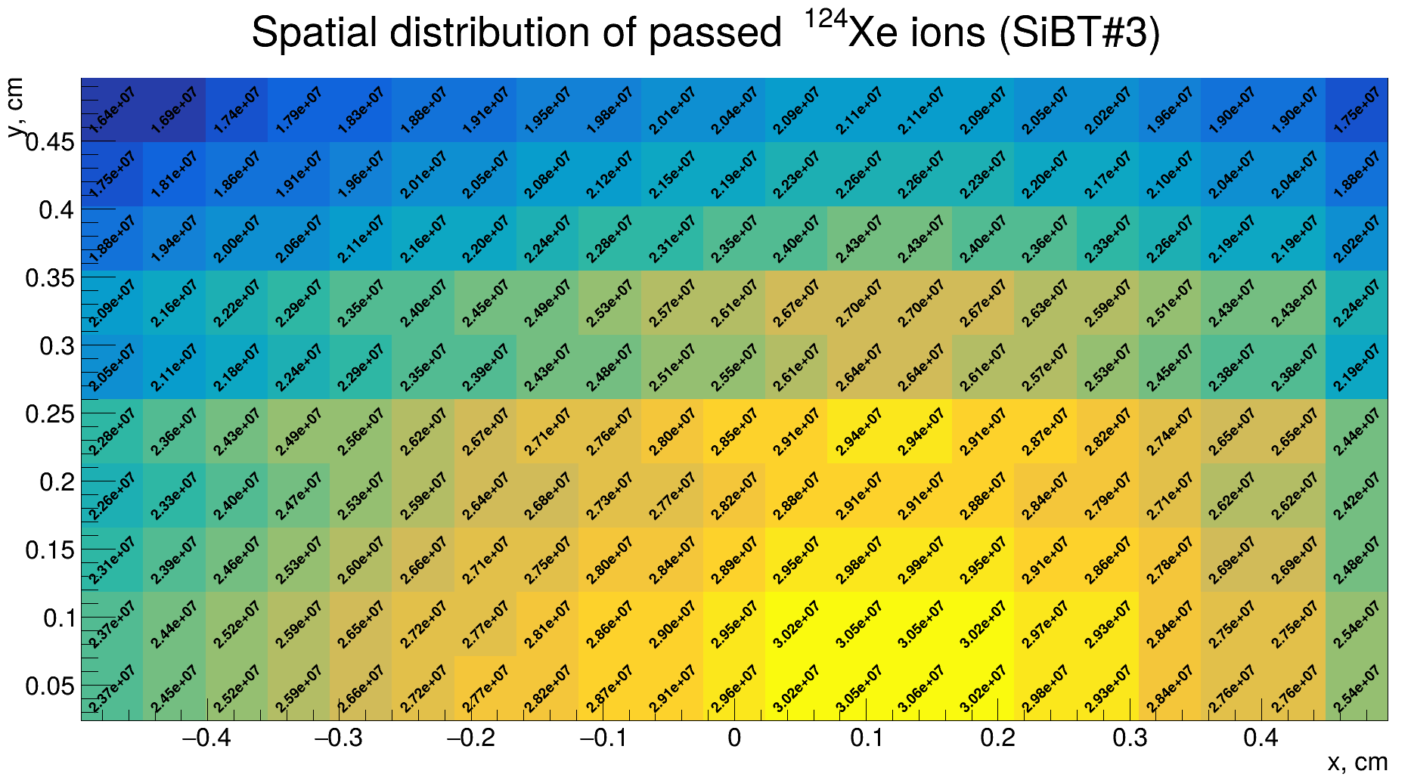
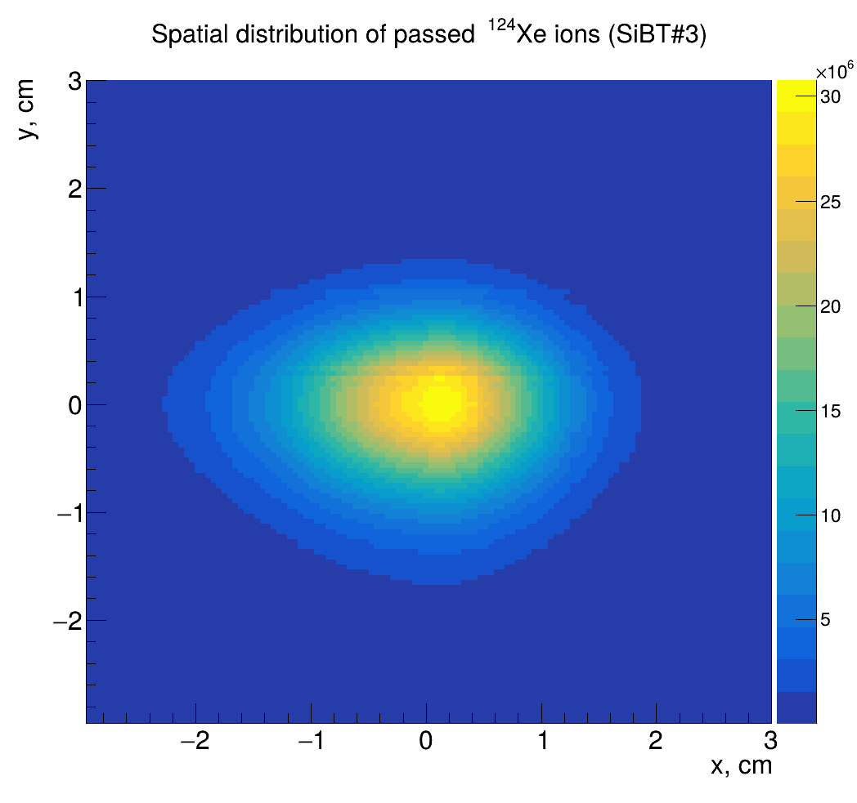
Прогноз на ресурс у ДССД детекторов при интеграле ядер за сеанс N = 4.44×10¹⁰:
¹²⁴Xe(3,8 ГэВ/н): 10 сеансов (N_{Xe} = 4.44×10¹¹), I_{strip}(max) = 2 мкА;
¹⁹⁷Au(3,8 ГэВ/н): 5 сеансов, I_{strip}(max) = 2 мкА;
²⁰⁹Bi(3,8 ГэВ/н): 4 сеанса, I_{strip}(max) = 2 мкА .

Slide 6
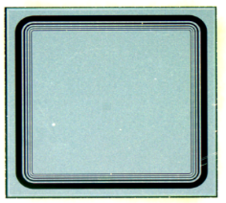
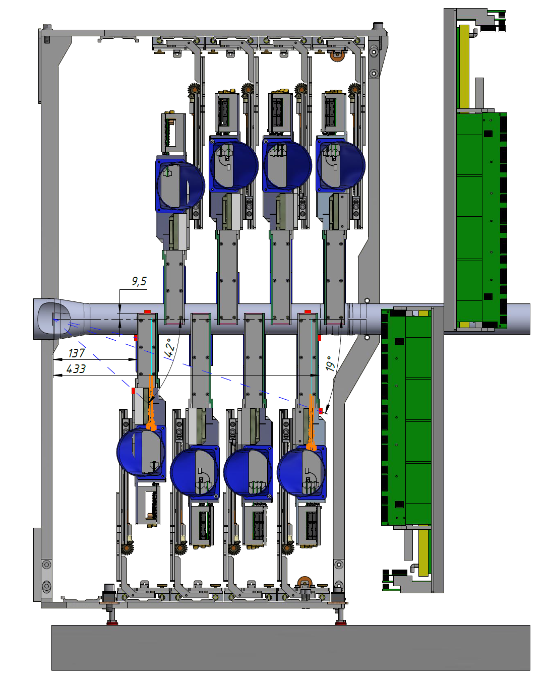
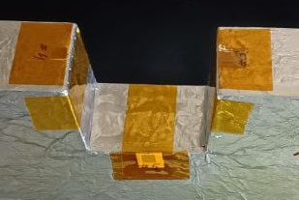
3. Radiation Si-monitors on FSD region for equivalent neutron fluence measurement
Si- pin-detector (rad_monitor) :
- Detectors size: (5×5×0,3) mm³
- Detectors thickness: 300 μm
- Active area: 13 mm²
5mm
5mm
FSD
GEM
ΔI=α_{I}×V×Ф
Y
Z
ΔI = I_{ф} − I₀, (A):
I_{ф} – dark current after irradiation;
I₀ - dark current before irradiation;
α_{I} = (5±0,5)·10⁻¹⁷ (A×cm⁻¹) – radiation damage constant-Si (for neutrons 1MeV at +20°);
V, (cm³) – volume of SCR (spice charge region at U_{fd});
Ф, (cm⁻²) – eq. neutron fluence (1 MeV)
target
Si-det.
FEE

Slide 7
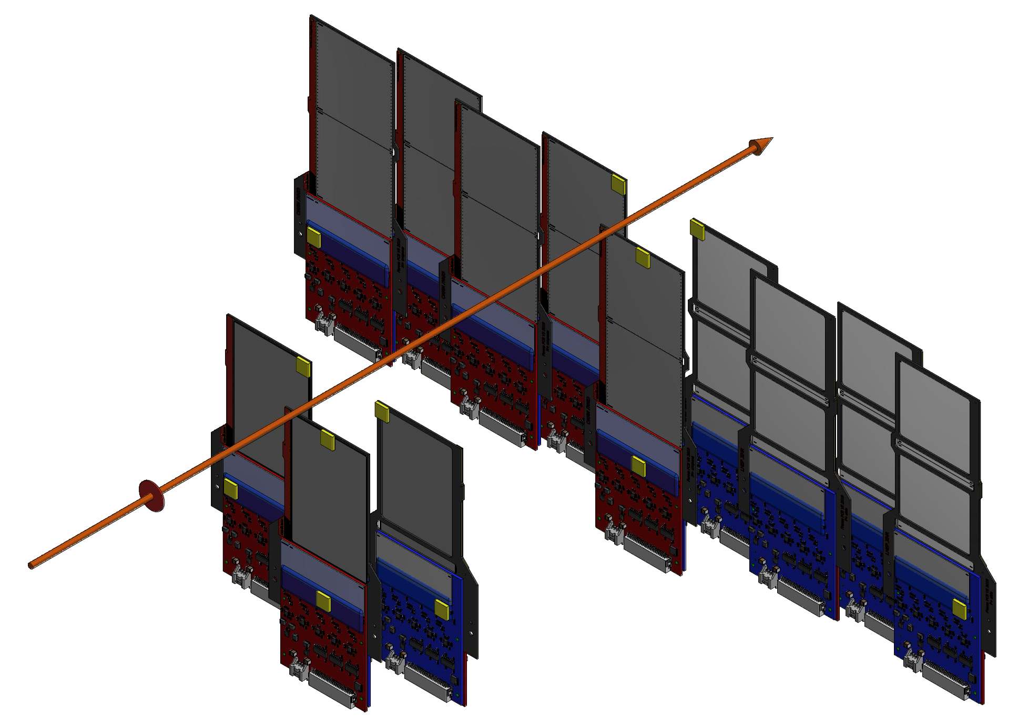
Radiation Si-monitors on FSD region for equivalent neutron fluence measurement
# Si-monitors | L -расстояние от центра мишени до центра Si монитора (мм)
1 | 156
2 | 137
3 | 156
4 | 197
5 | 190
6 | 197
7 | 415
8 | 432
9 | 415
10 | 532
11 | 438
12 | 532
Station #4
beam
7
10
9
8
1
3
L
2
4
11
target
Y
Z
5
6
12
Si-monitors
X
Station #1

Slide 8
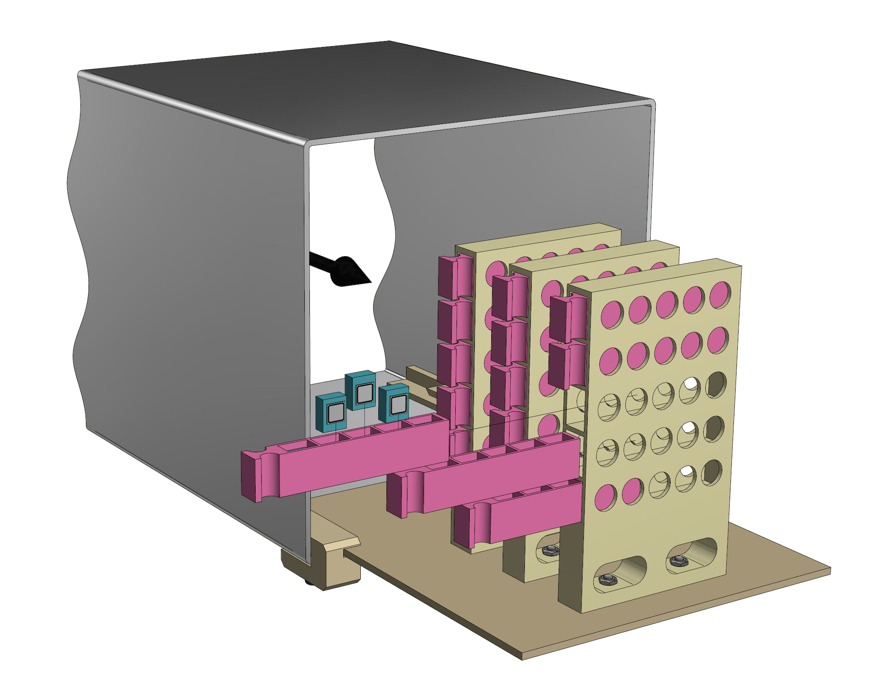
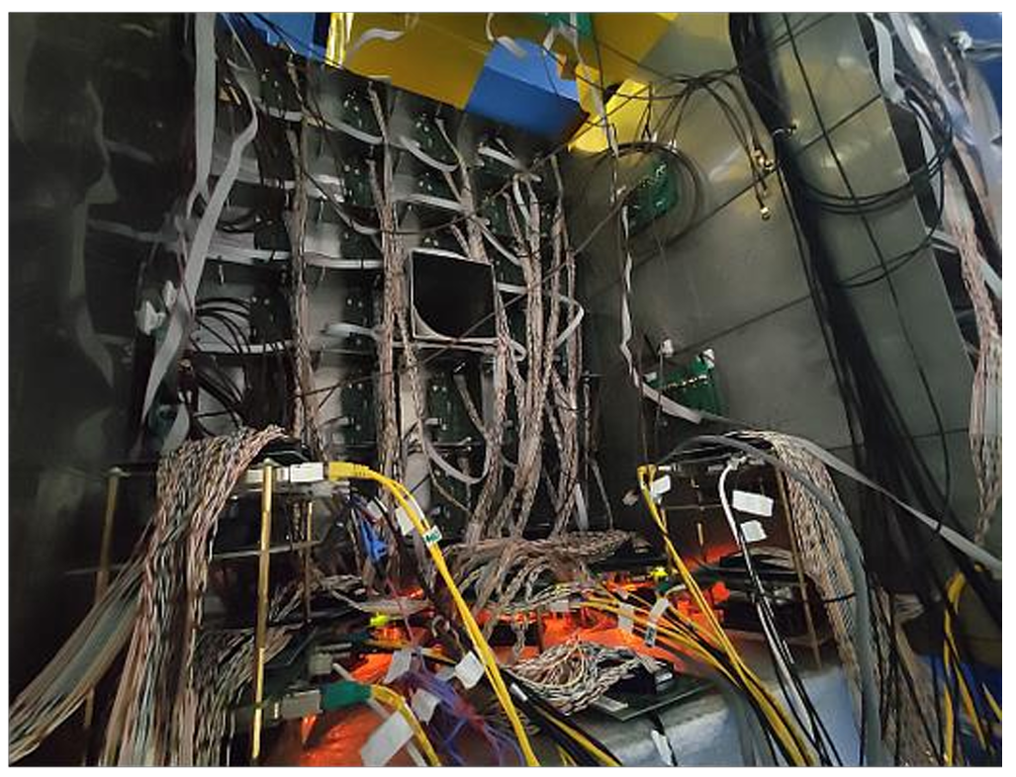
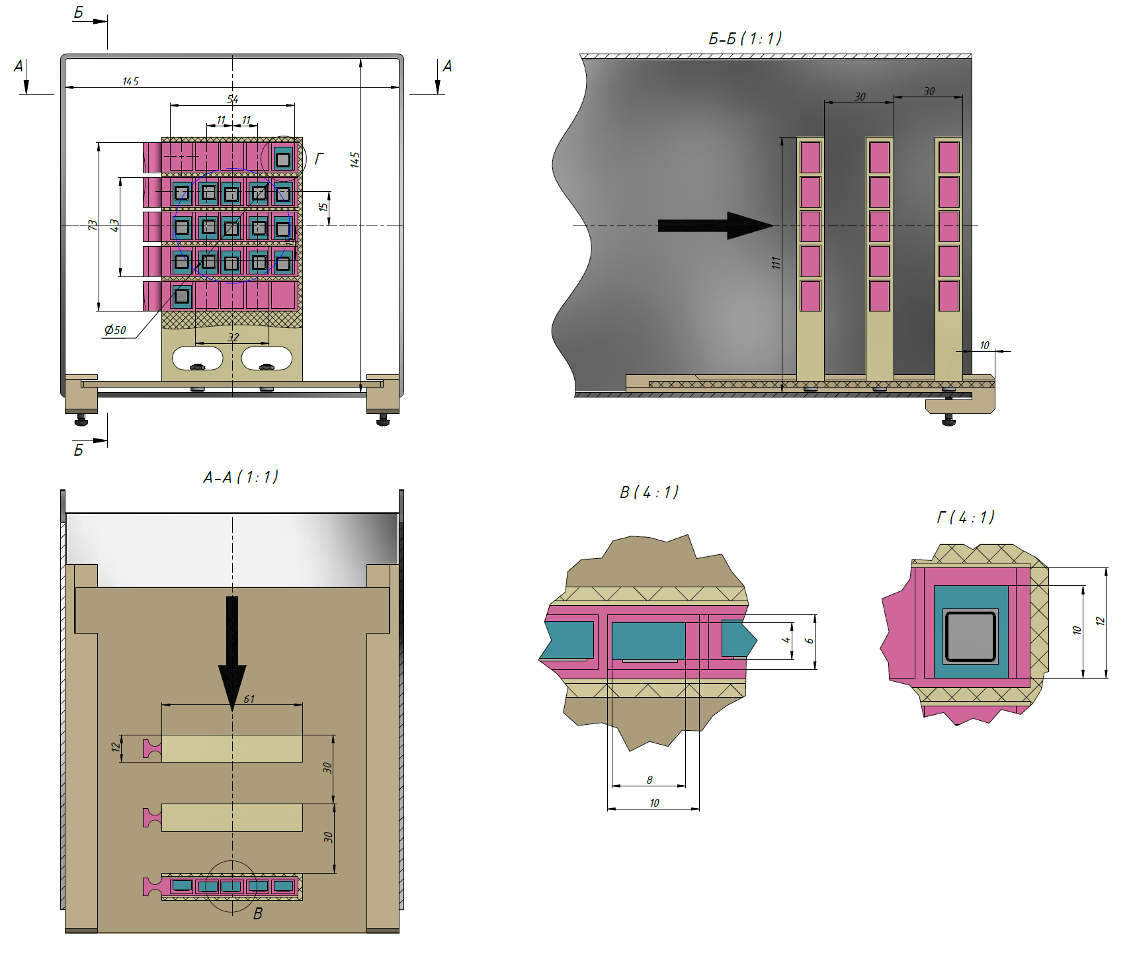
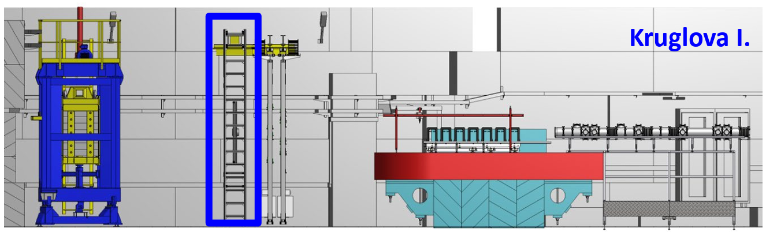
4. Облучение LYSO (ФИАН) crystals
beam
Si-монитор:
S_{activ} – 13mm²
LYSO crystals 8х10х4мм³
Кристаллы Lu₂SiO_{5-z}:Y³⁺:Ce³⁺:Ca²⁺
(Lu_{1.961}Y_{0.037}Ce_{0.00068}Ca_{0.00038}Si₁O_{5-z}, z=0.00038.)
Beam
По инициативе коллег из ФИАН:
Козлов В.А., Завертяев М.В.
и согласованию с сотрудниками ЛФВЭ:
Капишин М.Н., Замятин Н.И. было принято решение облучения на пучке ядер Хе установки BM@N сцинтилляционных кристаллов LYSO
Forward hadron calorimeter FHCal

Slide 9
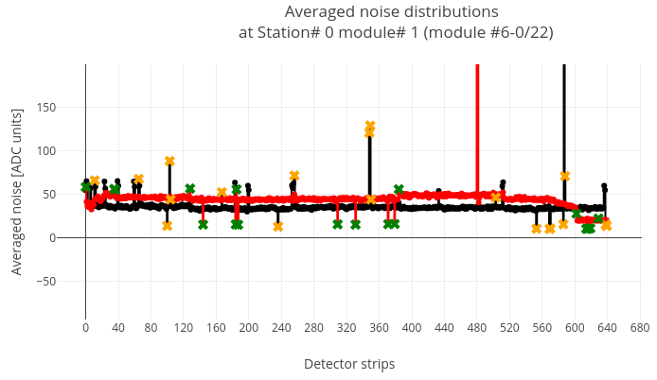
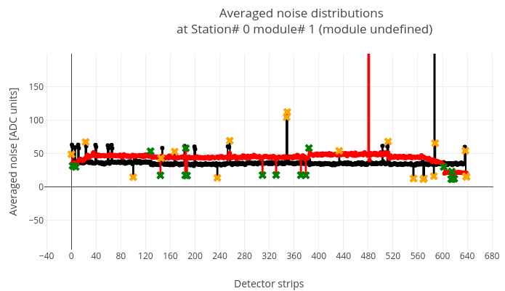
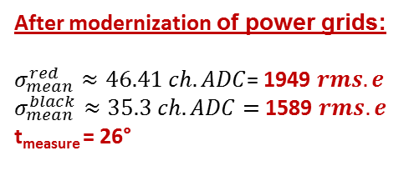
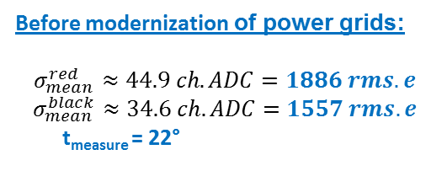
5. Modernization of power grids on BM@N experimental hall (bld.205)
(March 2025)
Run 444 (10.02.2025)
Run 542 (28.04.2025)
Before modernization of power grids:
$$σ_{mean}^{red}≈44.9 ch.ADC=1886 rms.e$$
$$σ_{mean}^{black}≈34.6 ch.ADC=1557 rms.e$$
t_{measure} = 22°
After modernization of power grids:
$σ_{mean}^{red}≈46.41 ch.ADC$= 1949 $rms.e$
$σ_{mean}^{black}≈35.3 ch.ADC=$ 1589 $rms.e$
t_{measure} = 26°

Slide 10
Conclusion
FSD is ready for data taking with relativistic ¹²⁴Xe beam
Coordinate planes position accuracy is 0.3 mm with XYZ axes
SiBT#1÷ SiBT#3 are ready for operation in the direct beam of heavy ions
Level of the FEE FSD pedestal noises did not increase after modernization of power grids (for Semen Piyadin)
Applied R&D:
measurements of the radiation background on the area of FEE and Si-detectors of FSD
Irradiation with Xe ions of the LYSO-crystals (ФИАН)

