Slide 1
Status of the BM@N
Slow Control System
14th Collaboration Meeting of the BM@N Experiment at NICA
I. Osokin, V. Dronik, V. Shutov, R. Nagdasev, D. Egorov
14.05.2025

Slide 2
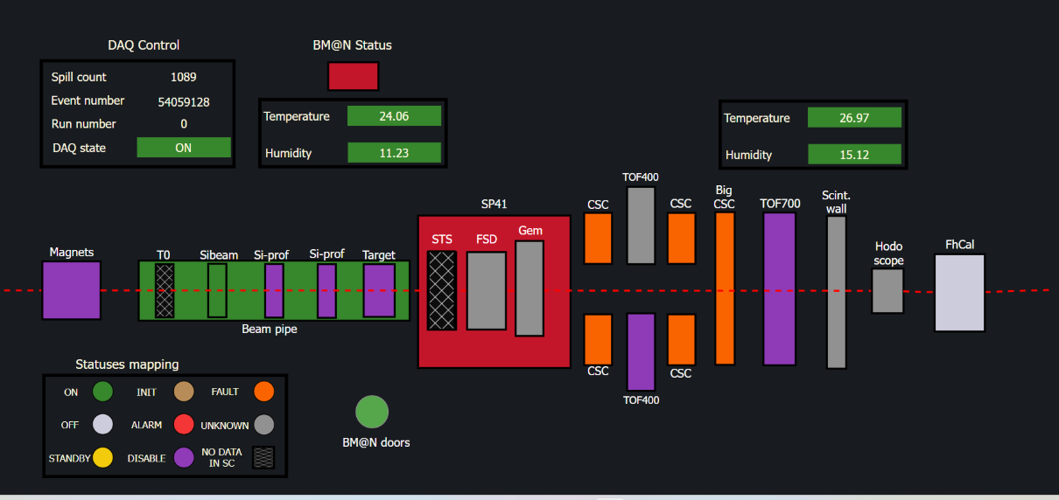
Preparation for the BM@N beam run
Waiting for the full assembly
New additions
New additions
Tested & updated
BM@N detectors dashboard
2/12
Notes:
Most of the BM@N detector systems, such as FSD, Sibeam, GEM, CSC, tof, FhCal and others, are connected to the SC system according to the current BM@N setup and were tested.

Slide 3
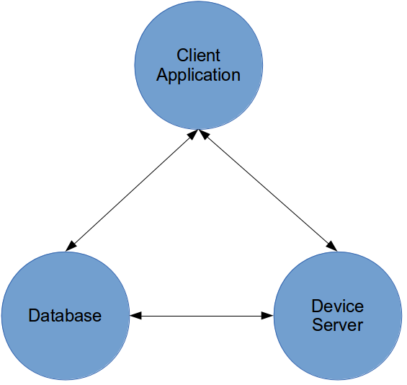
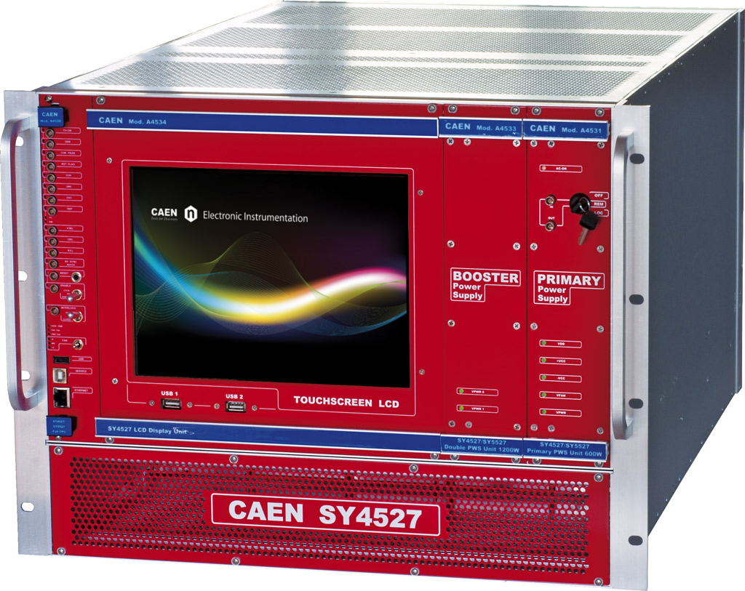
Slow control system
Monitoring and controls for users
Data and command exchange
What and how read from server?
Tango-based Slow Control System has performed well in previous runs and will be used in the forthcoming run
How to connect?
(IP, port, ID, protocol, etc.)
3/12
Notes:
For a slow control system, we use TANGO control system, free open source toolkit.
The system did well during the previous BM@N run №8 and will be used in the the forthcoming beam run .

Slide 4
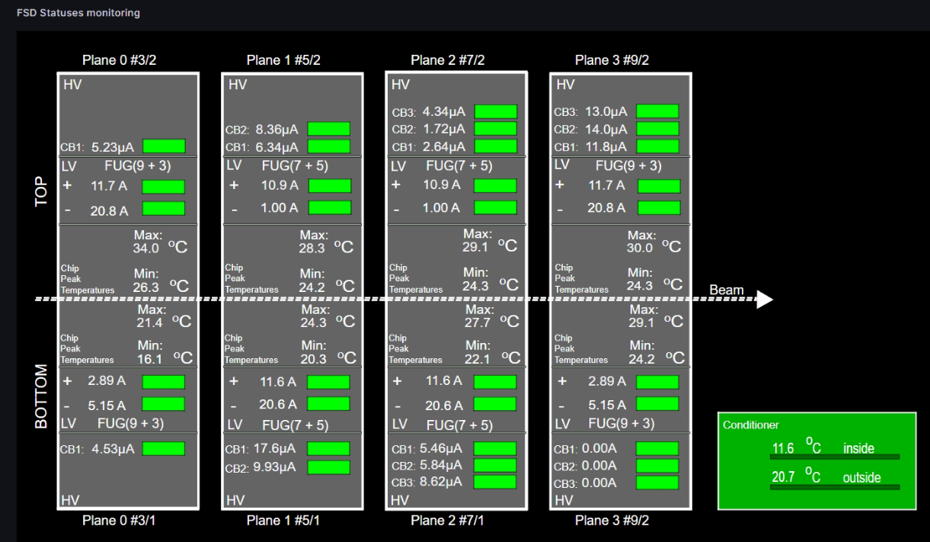
Forward Si detectors
FSD subsystems were tested and added to the dashboard with mappings
.
FSD monitoring dashboard in Grafana
4/12
Notes:
During the preparation of the FSD detector, HV, LV, temperature measurement, and FEE electronics were tested.

Slide 5
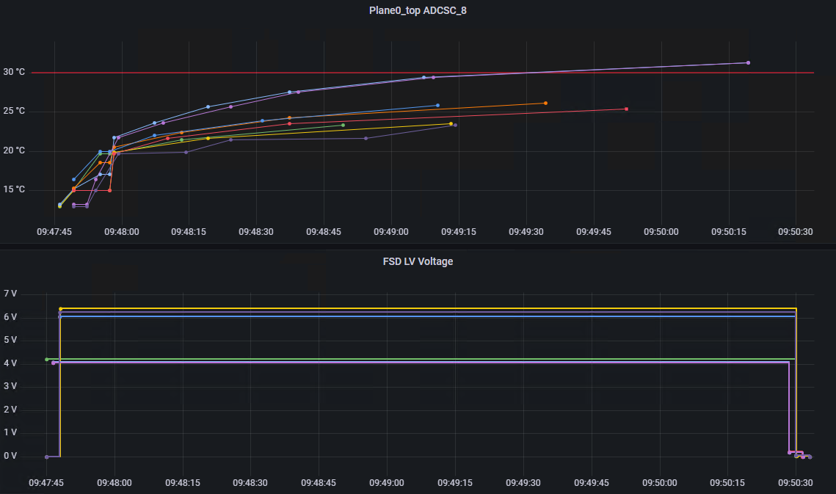
FSD LV autoswitch system
Temperature threshold
Delayed automatic
LV shutdown
5/12
Notes:
Among other things, an autoswitch system was created and tested.
Importance of this system is due to reduce the risk of the human factor. In case of, for example, cooling problems with the FSD detector, the electronics boards may overheat, which can have irreversible consequences.
Now, if the electronics are heated to a temp threshold, the LV system will be immediately turned off.

Slide 6
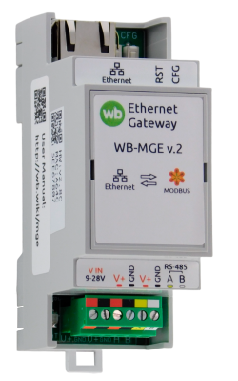
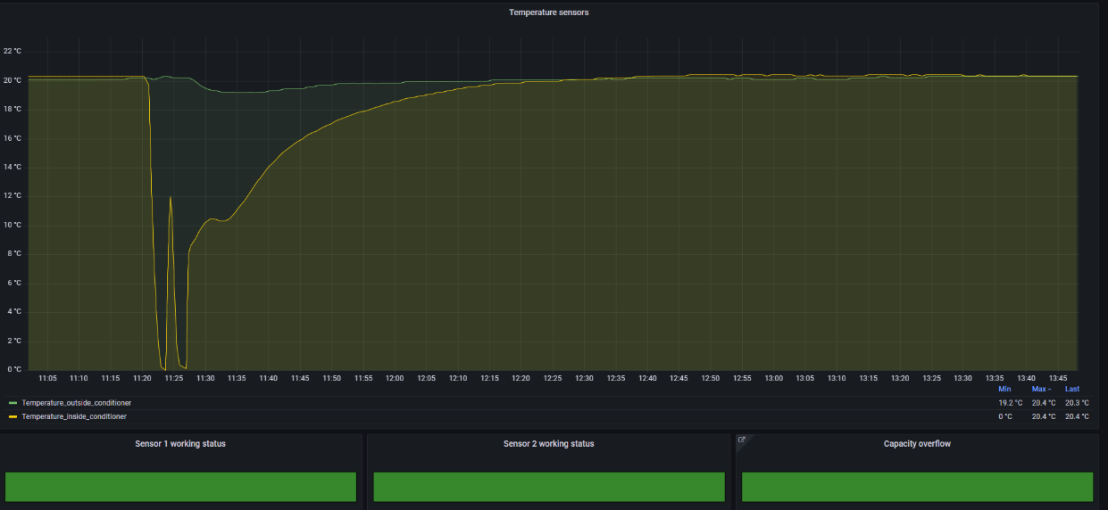
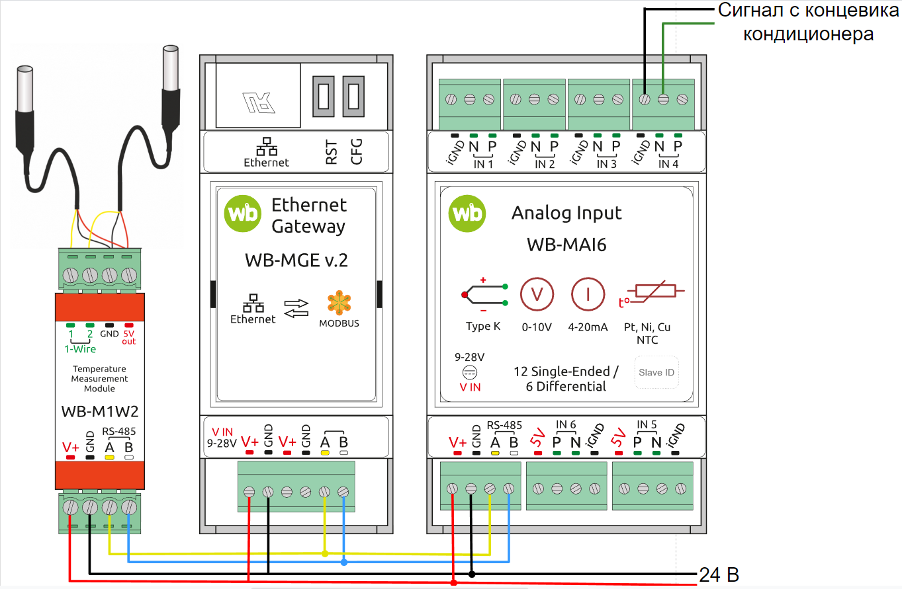
FSD conditioner monitoring
WB-MGE Modbus – ethernet converter
Historical
DataBase
TCP/IP
TANGO device server
MAI6 & WB M1W2 Measurement modules
Modbus RTU
6/12
Notes:
Monitoring of FSD detectors air cooling has also been created
This also increases the reliability of the system and reduces the risks of the working detector in critical conditions.
The WB modules were used as automatization equipment – ADC and interface converter. WB – is Russian based company, produced automatization modules

Slide 7
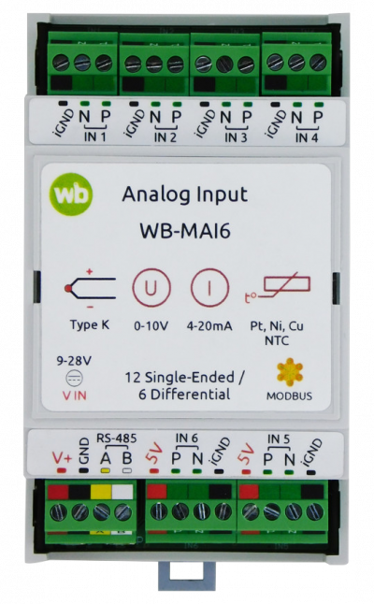
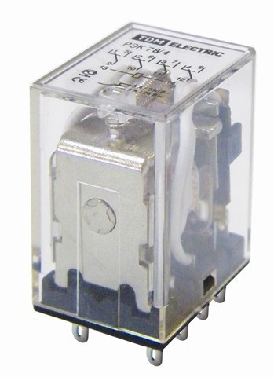
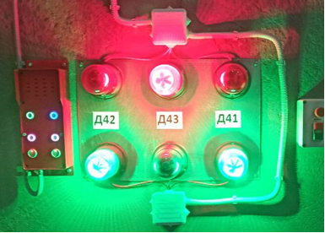
Radiation protection doors monitoring
Electrical relay
Historical
DataBase
TCP/IP
Modbus RTU
TANGO device server
MAI6 Measurement modules
WB-MGE Modbus – ethernet converter
Doors states monitoring in Grafana dashboard
7/12
Notes:
in addition to detector systems there were some another changes The slow control system for monitoring the condition of the radio protection doors in the BM@N experiment hall have been created and now duplicates the state of information board in BMN control room

Slide 8
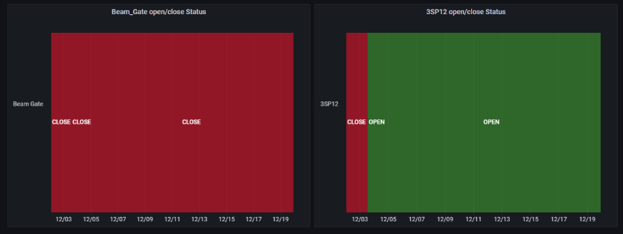
Beam gate & 3SP12 magnets monitoring
Electrical relay
Historical
DataBase
Modbus RTU
TCP/IP
TANGO device server
MAI6 ADC
WB-MGE Modbus – ethernet converter
Beam gate
8/12
Notes:
Monitoring of the state of the beam gate and the 3SP12 magnet was created with a similar way, using WB ADCs connected to relay switches

Slide 9
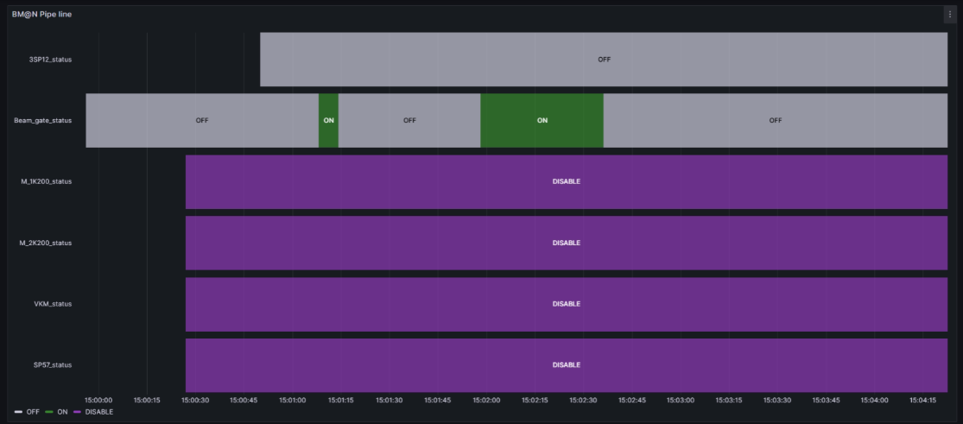
BM@N Magnets
Historical
DataBase
TCP/IP
TANGO device server
NLcon-CED16 Operator’s panel
Data is obtained indirectly through the beam pipe line operator's control panel.
9/12
Notes:
Data about others BM@N magnets, like VKM, SP42 and other, is obtained indirectly through the beam pipe line operator's control panel.

Slide 10
Target monitoring expend
Historical
DataBase
TCP/IP
Modbus RTU
TANGO device server
PT100 temperature sensors
MAI6 Measurement modules
WB-MGE Modbus – ethernet converter
10/12
Notes:
Monitoring of the BM@N target has been expanded. In addition to the existing monitoring of the type of installed target, two temperature sensors were installed to monitor the condition of the target during the beam run

Slide 11
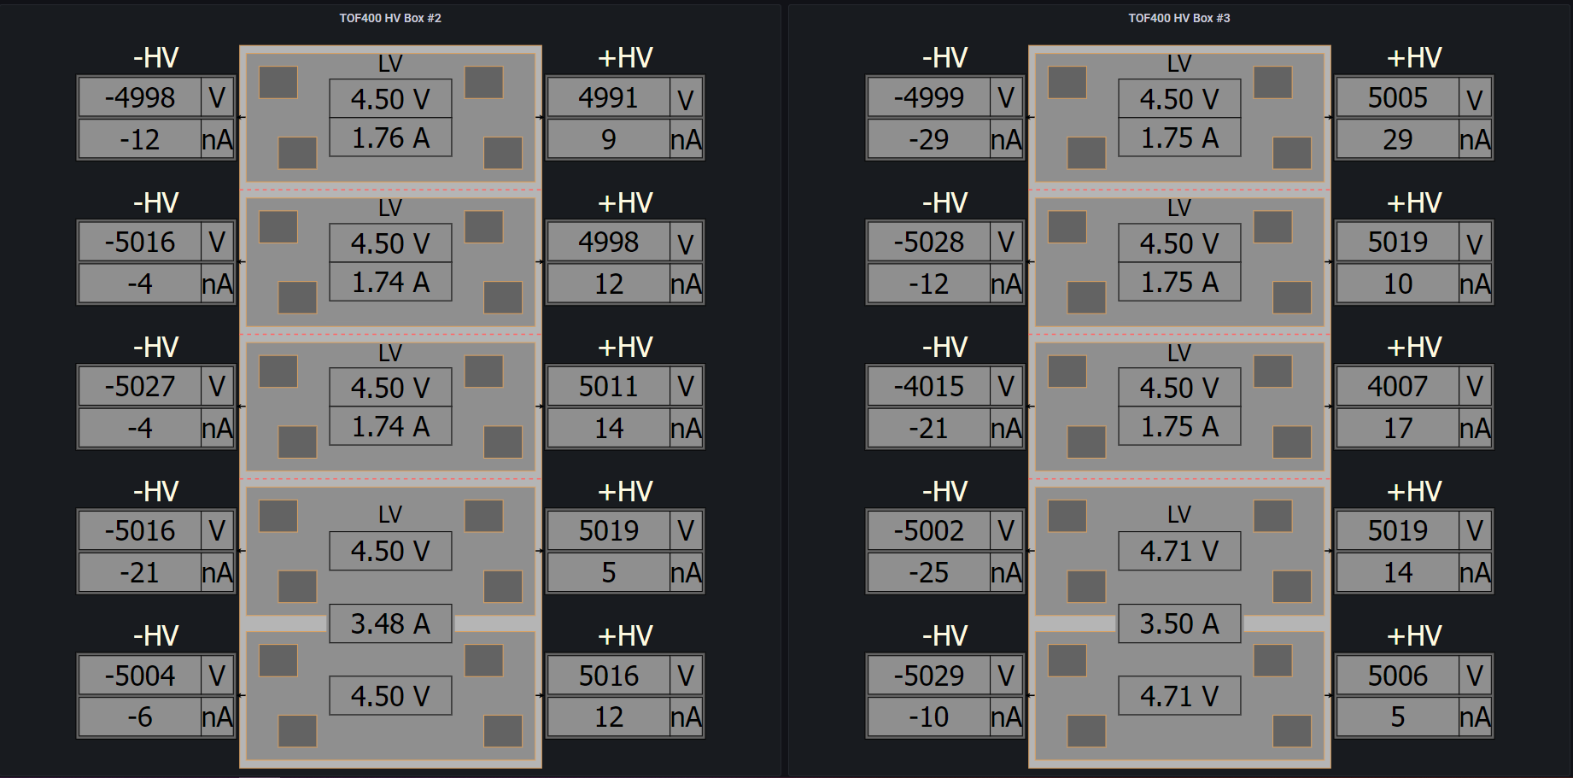
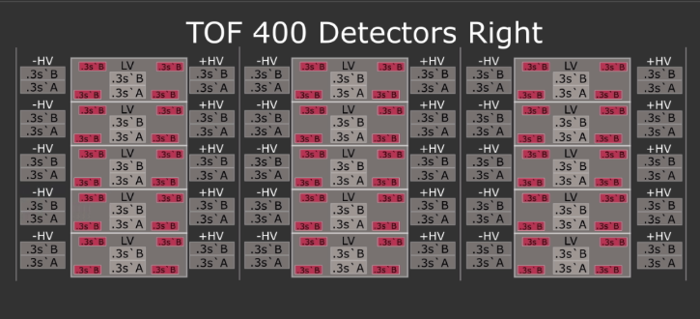
TOF400 upgrade
Currently awaiting the completion of the detector's assembly and configuration processes, as well as the finalization of the mappings.
HV, LV, FEE and Gas systems are tested and integrated in the Slow Control System
11/12
Notes:
Due to the upgrade of the TOF400 detector, the SC system is changing configuration. TOF`s equipments ,like HV, LV and gas system, has been tested, but now we are waiting for the completing the assembly and configuration of the detector and the making of new HV, LV and electronics MAPPINGS.

Slide 12
Thank You for attention
12/12
Notes:
Most of the CSC for BM@N detector systems, such as FSD, Sibeam, GEM, tof, FhCal and others, which are connected to the SC system were tested.

