Slide 1
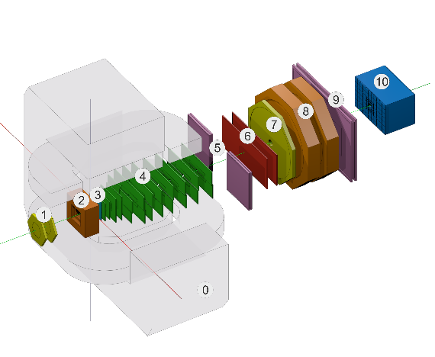
Design of the Data Quality Monitoring system for the BM@N experiment
Igor Alexandrov, Evgeny Alexandrov,Alexander Chebotov, Konstantin Gertsenberger
JINR, MLIT, LHEP
13-15 May 2025
14th Collaboration Meeting of the BM@N Experiment at NICA
Joint Institute for Nuclear Research

Slide 2
Data Quality Monitoring (DQM) and Quality Assurance (QA) : Goals of the systems
Main goals
online and offline data quality check and results visualization
fast automation reaction on data quality problems
histogram creation tool
interface for histograms creation
library with simple implementations of this interface
create flexible tool for online creation, filling, transport and archival of histogram and other monitor elements
create flexible online tool to perform algorithms for automated quality and validity tests
keep the results of the DQM process
create GUI for DQM user
visualization of the histograms and quality test results
alarms in case of bad quality data

Slide 3
DQM & QA systems in LHC experiments: ATLAS
ATLAS: light, flexible (input-output-configuration interfaces, algorithms as plugins)
DQM Core: executes DQ Algorithms (any common operation like histogram comparison, histogram fitting, thresholds application, etc.); has three abstract interfaces for the communication with the external systems
DQM Input (receives histograms, messages, counters)
DQM Output (way of publishing DQ Results produced by the DQ algorithms)
DQM Configuration interface (way of reading configuration info which defines behavior of the DQM Core in a specific environment)
DQ Configuration is described as a hierarchical tree of objects of two different types: DQ Regions and DQ Parameters.
DQ Region
Children (DQ Region or DQ Parameter)
DQ Summary Maker
DQ Parameter
location of the monitoring information (represents the state of a particular detector element)
weight
DQ Algorithm that has to be used
specific parameters and thresholds
reference values or histograms
the actions which have to be taken depending on the results

Slide 4
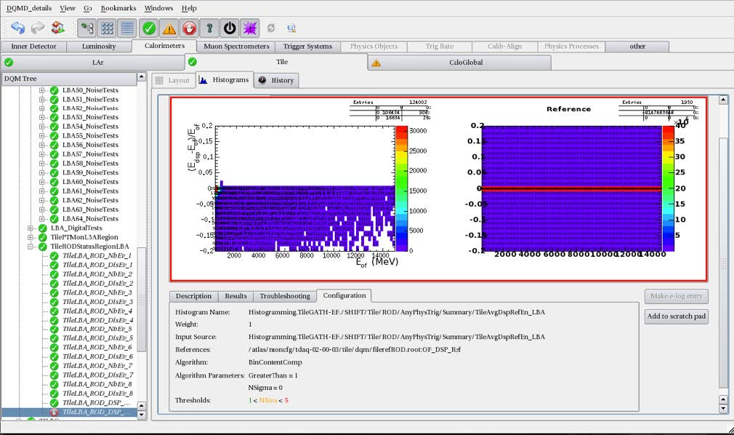
DQM & QA systems in LHC experiments : ATLAS (2)
DQ Algorithm
DQM Framework (DQMF) provides a number of predefined DQ Algorithms
DQ Algorithms are integrated into the DQMF in a dynamic plug-in manner
allows adding new algorithms on the fly without modifying the core software
each DQ Parameter has at least one DQ Algorithm associated with it
executed whenever a piece of info which is associated with that DQ Parameter becomes available
DQ Summary Maker
special implementation of the DQ Algorithm interface that evaluates the DQ Result for a given DQ Region
DQMF Agent
instantiates appropriate implementations of the DQMF generic interfaces (i.e. DQM Input, DQM Output and DQM Configuration)
takes care of starting and stopping the DQM Core engine in appropriate moments
In the online environment the DQ assessment has to be started at start of run event and stopped when the run is finished
DQMF may contain one or more DQMF Agents with each of them responsible for a well defined subset of the whole ATLAS system.
DQ Result
consist of a colored tag and any output that the algorithms might want to attach
If some areas of the detector are disabled, then the corresponding dq results will be black
otherwise, results might be
green (good), yellow (warning), red (bad) or gray (undefined)

Slide 5
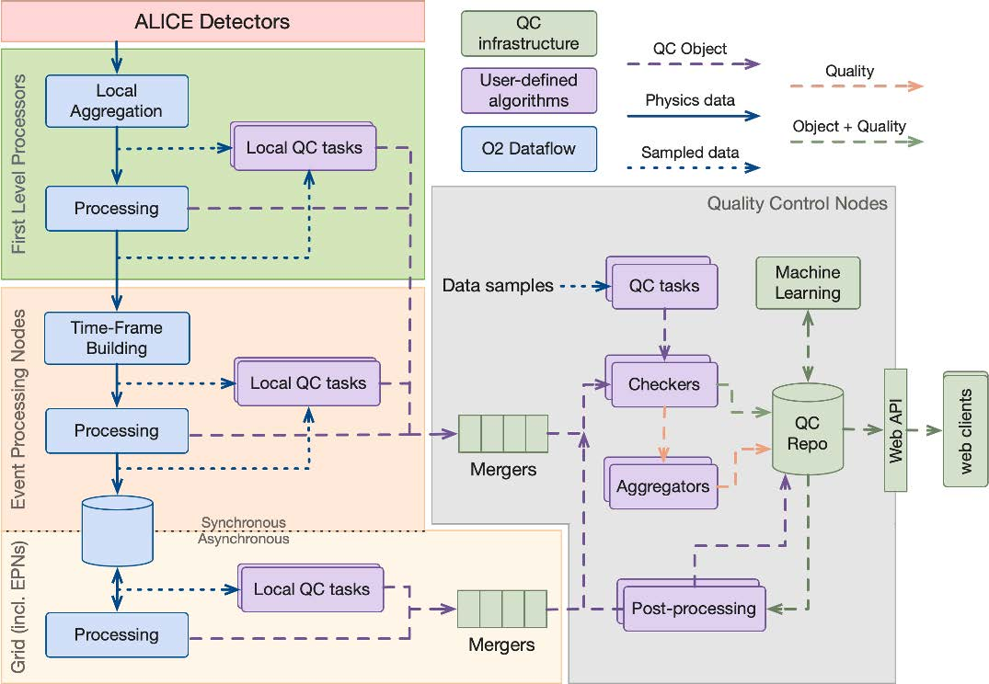
DQM & QA systems in LHC experiments : ALICE
ALICE: DQM + QA = Data Quality Control (DQC)
largest DQC systems worldwide
first in the high energy physics community to leverage the message passing technique and the actor model to such an extent
high-level quality assessment of the 3.5 TB/s data produced by the detector
QC system
multi-step process
sampling the data, usually at a rate of 1%
QC Tasks will then execute user-defined algorithms to process it and generate a QC Object, often a histogram
Given the parallel nature of this processing, with a copy of the task running on each of the hundreds of nodes, these histograms are then merged
merged results are evaluated by a series of Checks to determine one or several Qualities, which can themselves be aggregated to give a general assessment of the health of the data
based on a message passing paradigm where data flows asynchronously through a set of devices connected via buffered channels
channels use ZeroMQ by passing either the whole message payloads or just pointers to the shared memory region
QC Objects and Qualities are stored in Conditions Database

Slide 6
DQM & QA systems in LHC experiments : LHCb
LHCb: collected data are grouped together in runs
LHCb DQ workflow
small subset of the data selected by the trigger is fully-reconstructed on the LHCb Online computing farm
reconstruction produces sets of histograms which allow the (sub-)detector performance to be assessed
these histograms are presented by the Data Quality Monitoring(DQM) software to the DQ shifter
shifter compares whether the run is suitable for physics analysis or not, by comparing it to a reference run previously set by experts.
software package previously used in DQM shifts, was based on dedicated custom C++ code and X Window System. Now implemented “Monet” which is a python based web application that supersedes the Presenter.
Update
using Python as the primary language allows the usage of rich set of libraries provided in the large ecosystem of third-party Python packages. This simplifies both development, as common functionality has already been implemented elsewhere, and maintainability, as the size of the required LHCb specific code is reduced.
for plotting Bokeh libraries provide interactive plots in web browsers, has pythonic interface
RoboShifter: automatic problem detection
predicts probability of given run being bad
decisions made by each tree are summed with weights, representing the importance of each tree
each tree corresponds to a single histogram
possible to compute, for each histogram, its contribution to the probability of the run being bad
histograms with the highest contributions can be presented to DQ shifter as potentially problematic ones.
Machine learning at LHCb: vector Kolmogorov-Smirnov distances btw histograms and their references; AdaBoost algorithm,
track pattern recognition
long track reconstruction
downstream Track Reconstruction (reconstruction of the daughters of long-lived particles)
fake track rejection
topological trigger (HLT2)
jet tagging
charged particle identification

Slide 7
DQM & QA systems in LHC experiments : CMS
CMS: The DQM software is a central tool in the CMS experiment. High-level goal of the system is to discover and pin-point errors - problems occurring in detector hardware or reconstruction software
tools for
creation, filling, transport and archival of histogram and scalar monitor elements
standardized algorithms for performing automated quality and validity tests on value distributions
monitoring systems live online for
the detector, the trigger, and the DAQ hardware status and data throughput,
the online reconstruction
validating calibration results, software releases and simulated data
visualization of the monitoring results
certification of datasets and subsets thereof for physics analyses
retrieval of DQM quantities from the conditions database
standardization and integration of DQM components in CMS software releases
organization and operation of the activities, including shifts and tutorials

Slide 8
DQM & QA systems in LHC experiments : what interesting, some conclusions, considirations on using expirience
All do it or interesting in LHC experiments:
produce some sampling (events go to DQM depending on their frequency after trigger system)
message passing technique (ALICE)
set the rate for DQM input
produce histograms as main input for DQM
but not only histograms can be used for quality check
moving as much as possible to automation of quality assurance
flexibility in check algorithms use (keep in database source of algorithms, their names and parameters, what to be on output, destination etc)
load from library the check algorithm as implementation of interface (ATLAS)
some interfaces have thresholds as parameters in order to create result: bad or good event
some of check algorithms used
empty histogram (threshold what does it mean empty)
counters of subdetectors responses by sectors
Kolmogorov-Smirnov test
moving to rich shifter GUI, mostly web GUI
different base tools/languages for implementation (python as example in ALICE, C++ in ATLAS)
alarms in case of big probability of events bad quality
ALL these experiments suppose to use in RUN4 ML-based quality assessment

Slide 9
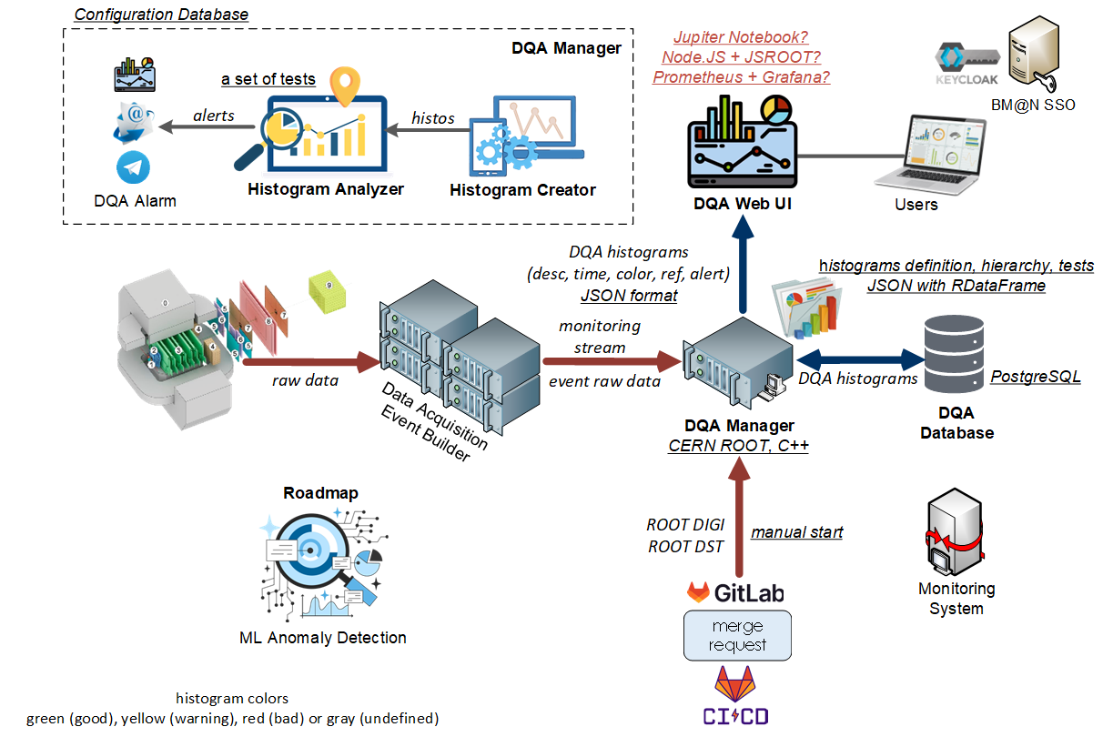
General architecture of the system

Slide 10
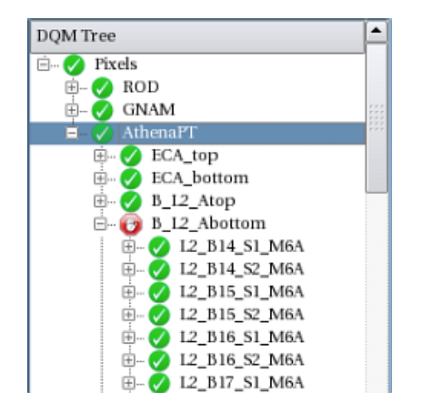
The DQM tree
DQM Configuration keeps set of DQM Tree in
JSON format.
DQ Tree
Histogram producer library (plugins)
Analizer library (plugins)
DQ Region … DQ Region
DQ summary maker
DQ Parameter
Input from sampler
Histogram producer
Algorithm for histogram creation (name of plugin to be loaded and used to produce histograms)
Output with histogram produced - histogram input for tester
Analyzer (quality tester)
histogram input (from previous output)
Algorithm (quality checker algorithm)
Threshold (numbers to understand if histogram good or bad)
Output
result (good, bad, undefined, disable)
DQ Tree path
histogram
DQ Tree
DQ Region
DQ Region
DQ Region
DQ Parameter
DQ Region
DQ Parameter

Slide 11
The DQM framework
digitized events
Configuration manager start correspond DQ setup
Sampler
Histogram creator
Histogram analyzer
DQ configuration
DQ configuration
DQA database
DQ result
Events with correspond rate (ZeroMQ)
Histograms (ZeroMQ)
DQ result
Alerts
Web GUI
DQ configuration

Slide 12
Next steps and conclusion
To be finalized
detailed DQ configuration structure
database scheme
Start the work on
DQM web GUI design
DQM system implementation

Slide 13
Conclusion
Review of LHC experiments DQM and DQA systems is presented
DQM system general architecture and system framework is shown
The structures of the DQA configuration and the result structure are discussed.

Slide 14
BACKUP

