Slide 1
Physics Studies with the CMS experiment and the second phase of detector upgrade for operation in high luminosity conditions (2026-2030)
JINR Theme 02-1-1083-2009
Project Leader: V.Yu. Karjavine
Project Deputy Leader: S.V. Shmatov
Project Scientific Leader: V.A. Matveev
Current projects
CMS. Physics research at the LHC. 02-1-1083-1-2010/2025
CMS detector upgrade. 02-1-1083-2-2010/2026
Scientific and Technical Council of the LHEP JINR
May 15, 2025

Slide 2
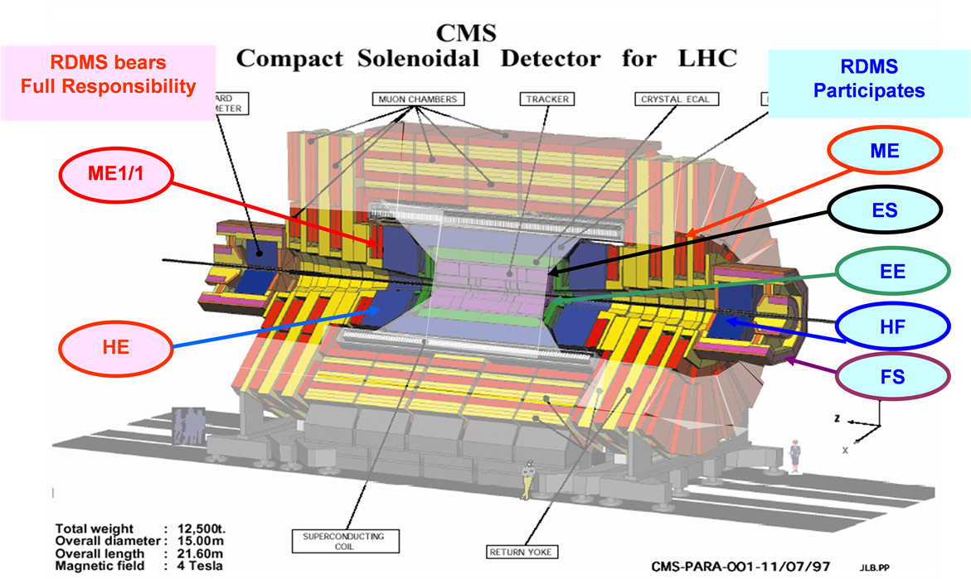
JINR in CMS
The research program was performed within RDMS Collaboration, bringing together physicists from more than twenty institutes from Russia and member states of Joint Institute for Nuclear Research
This days: JINR + Armenia, Belarus, Georgia, Uzbekistan (DMS) + associated personal from SINP MSU, INR, MEPhI, MIPT, LPI, NSU, TSU
JINR researchers have been actively involved in the CMS project
during more then 30 years
carrying out the CMS physics research program
creating detectors for the CMS endcap region, including design, construction, and operation
maintaining the efficient operation of the detector and participating in experimental data taking
The main contribution of JINR was focused on
Endcap Hadron Calorimeter (HCAL)
Forward Muon Station (ME1/1)
Two LHC technical long stops
2013–2015 (Long Stop 1, LS1)
2019–2022 (Long Stop 2, LS2)
dedicated to CMS upgrade - ensuring efficient operation of all systems at the LHC luminosity up to 2×10³⁴ cm^{−2s−1} with a design value of proton-proton collision energy up to 13.6 TeV
2

Slide 3
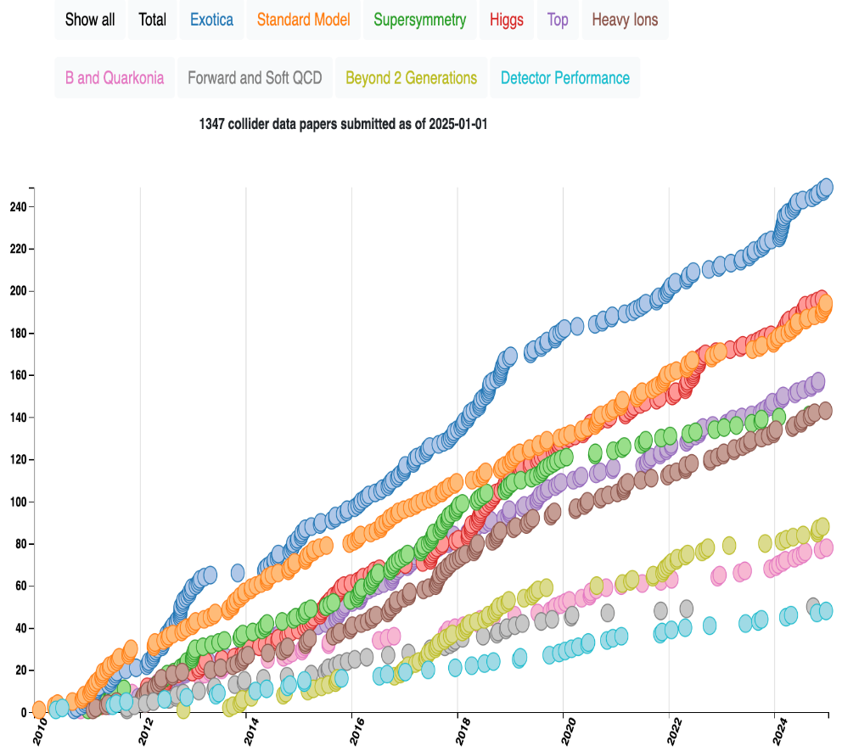
JINR Publications in 2020-2025
The full list of CMS collaboration publications for 2010-2025, authored by JINR representatives (40 authors for this days), includes 425 scientific CMS papers.
JINR physicists made a defining contribution to the preparation of 93 scientific papers including:
14 CMS papers in refereed journal
45 paper in refereed journals
5 chapters in monographs
The results of the work were presented in more than 115 reports at various conferences, workshops, and seminars:
LHCP (2020, 2025), ICHEP (2020), Сессия-конференция СЯФ ОФН РАН (2020, 2024, 2025), Lomonosov Conference on Elementary Particle Physics (2021, 2023), NUCLEUS (2021, 2022, 2024), PANIC (2021), QFTHEP (2022), GRID (2021), CHEP-Yerevan (2023), LHC Days in Split (2024), Ломоносовские чтения (2024), SILAFAE (2024), etc
2 doctoral dissertations, 1 candidate dissertation
CMS publications statistics
1373 papers based on collision data (RUN-1/RUN-2/RUN3) submitted so far.
30 papers published so far in 2025
~40 talks by young scientists
3

Slide 4
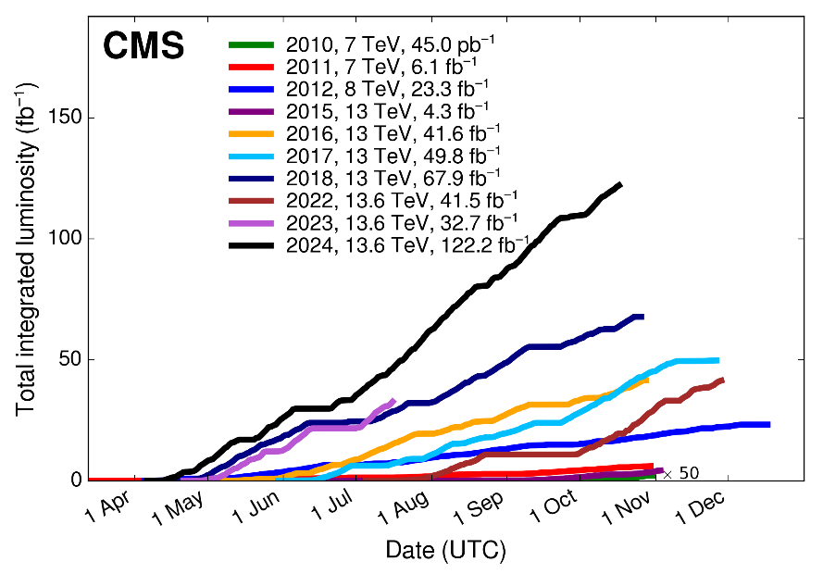
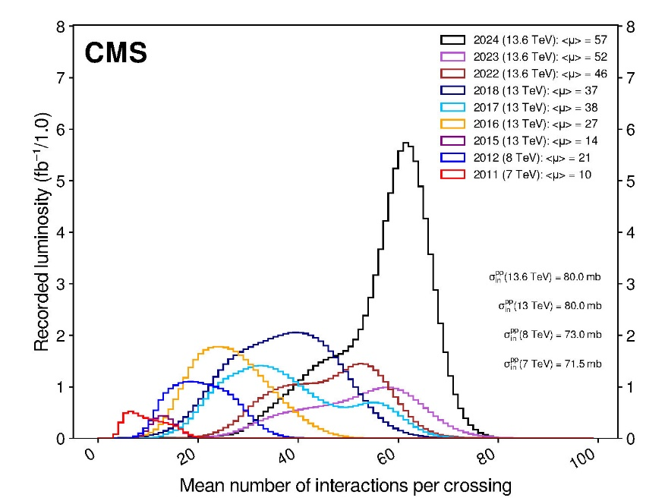
LHC Timeline and Data That We Have
Σ ≈ 390 fb⁻¹
L_{inst} = 2.1×10³⁴ cm⁻²s⁻¹
L_{iinst} = 7.5×10³⁴ cm⁻²s⁻¹
We are here
CMS Dataset RUN2
~163 fb⁻¹ of proton-proton collisions @ 13 TeV is delivered
151.78 fb⁻¹ is recorded by CMS (data-taking efficiency ~93% )
CMS Dataset RUN3
196.35 fb⁻¹ is already delivered @ 13.6 TeV during the RUN3
180.84 fb⁻¹ is recorded by CMS (data-taking efficiency ~92% )
number of pp interactions per beam crossing (PU): ⟨μ⟩ = 57 for 2024
~260 fb⁻¹ it is expected @ 13.6 TeV for the end of the RUN3 (450 fb⁻¹, in total for RUN1/2/3)
pPb and PbPb Runs
CMS Data Quality Information
https://twiki.cern.ch/twiki/bin/view/CMSPublic/DataQuality
4

Slide 5
Goals and Tasks of the Project
The main goals of the project
development and implementation of a research program for precision testing of the Standard Model (SM) and searches for new physics beyond SM (BSM)
maintenance and upgrade of the CMS experiment to ensure its efficient operation in HL–LHC mode, including participation in the construction of High Granularity Calorimeter (HGCal) and of the CMS endcap forward muon station ME1/1
Main five tasks which are define the project structure
development and realization of the CMS physics research program focused on searches for new physics beyond the Standard Model, studies of Higgs boson properties, and other SM tests
CMS detector upgrades for HL–LHC operation, including participation in the construction of the High-Granularity Calorimeter (HGCal) and upgrade of the CMS Endcap Muon system detector
investigation of detectors performances, providing of the control their operational reliability and data taking quality
development of methods and algorithms for physical object reconstruction and event selection
development of software for the distributed data processing and analysis system based on grid technologies, ensuring reliable and uninterrupted operation of JINR grid infrastructure for the CMS experiment (Tier-1 and Tier-2 centers)
5

Slide 6
JINR Team Obligations
Participants: 60 from JINR; 12 from JINR member-states (DMS), 20 members
of JINR associated personnel
11 young researchers: 6 PhD Students from JINR, 5 PhD Students from DMS.
Authors: 23 from JINR and 3 from DMS (21 paid by JINR and 5 unpaid PhSt. ),
19 of JINR associated personnel (unpaid by JINR)
Participation in CMS upgrade
Phase1 upgrade of HCAL and Endcap Muon system
Phase2: Construction of the High Granularity Calorimeter. Endcap Muon system upgrade.
Participation in physics analysis and software development
CMS duties executed by JINR physicists
HCAL Technical Coordination
Co-convening the CMS Generator group
CMS data managers for Tier-1 and Tier-2 sites.
Deputy Chairman of the CMS Conference Committee
Participation in Analysis Review Committee (ARC)
and Institutional publication review (IR).
Members of institution and collaboration boards.
JINR team obligations in 2025
Detectors maintenance and operation
JINR Tier-1 and Tier-2 centers robust operation
Experimental Physics responsibilities (EPR), due for an author is 4.0 months tasks (including shifts), 165.5 FTE-months in 2025, central shifts – 9.51
JINR EPR 2024 results
Work Due: 96.91, Work + Shifts: 109.88
Central Shifts – 11.55, EPR Shifts – 6.881
EPR Works – 103.0
Ratio done/expected: 1.13
6

Slide 7
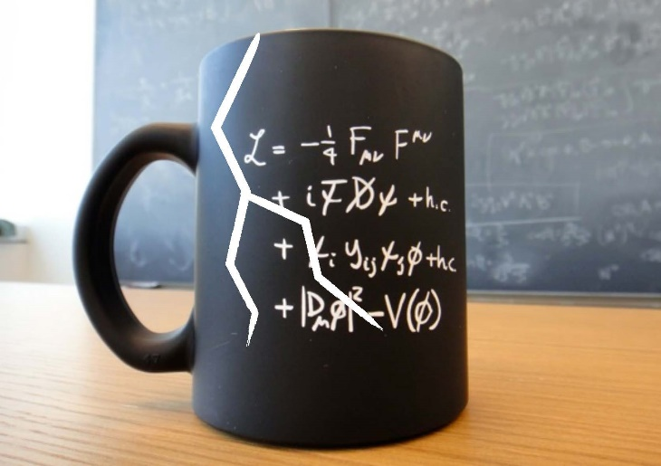
JINR areas of activity in the CMS physics analysis
Searching for Physics Beyond the Standard Model
Channels with a pair of leptons (extended gauge models, scenarios with additional spatial dimensions, models with dark matter, testing of lepton universality, search for LFV processes, etc.)
Channels with a pair of leptons/b-quarks and missing transverse energy ET
(dark matter, extended Higgs sector)
Multiple jet/lepton/photon production (microscopic black hole scenarios)
Testing the predictions of the Standard Model (EWK and QCD processes)
Precision measurements of the characteristics of the Drell-Yan process
(cross-sections, angular characteristics)
Discovery and study of the properties of the Higgs boson (4l, 2b)
Study of the characteristics of QCD jets (cross-sections, fragmentation functions, etc.)
B-physics
Heavy Ion Physics
Multiple particle production
Algorithms and Software
Development of algorithms for high-momentum muons reconstruction. Muon hit reconstruction and segment builder.
7

Slide 8
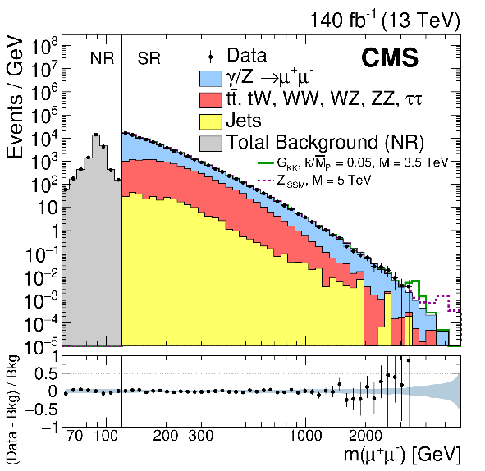
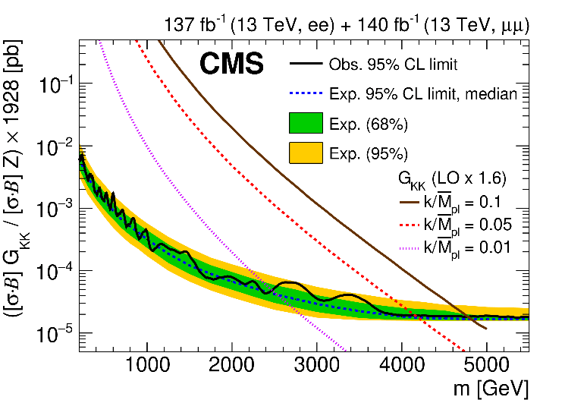
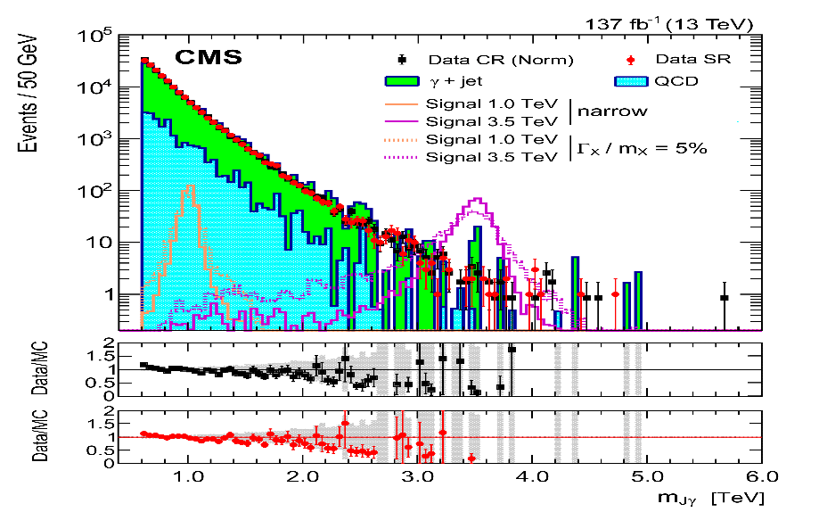
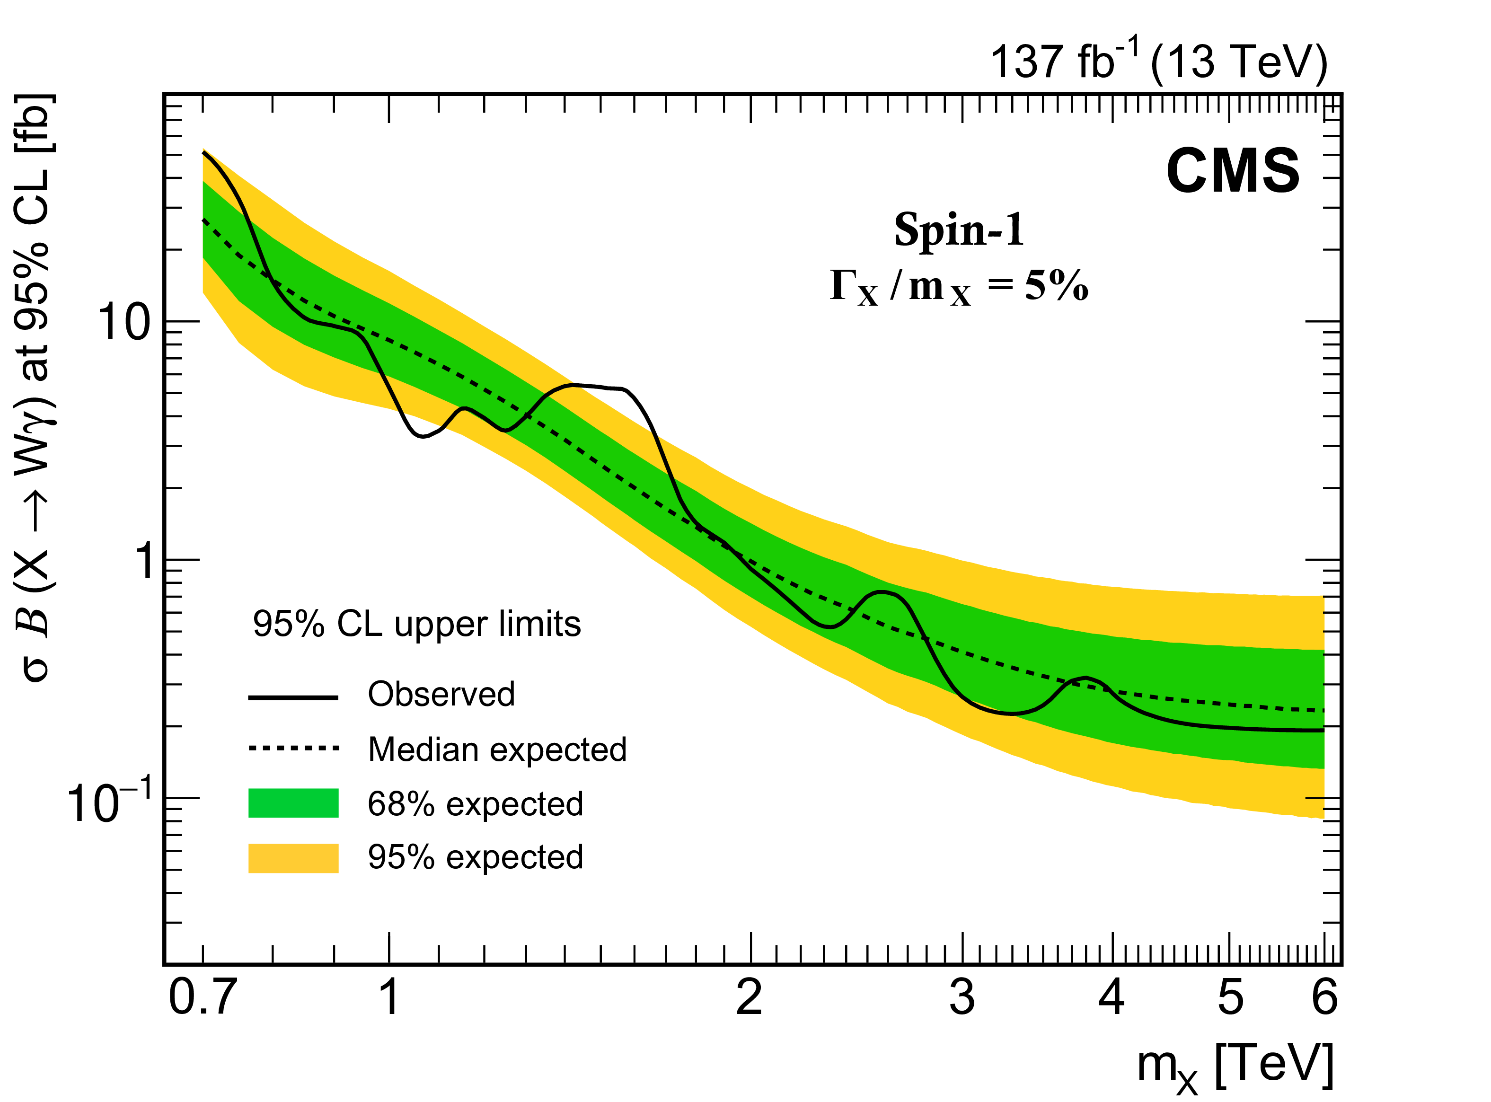
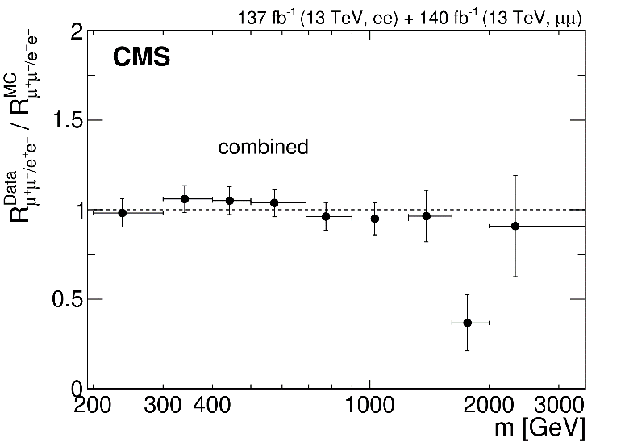
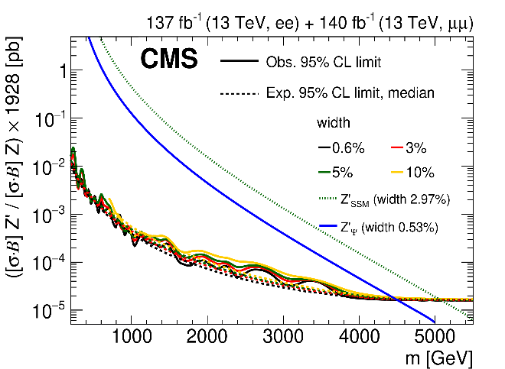
Searches for Heavy Resonances
New Physics (Z′/Z_{KK}/G_{KK}) contributions to SM processes
Dileptons, full RUN2 data
JHEP 07 (2021) 208
PLB 826 (2022) 136888
Wγ, full RUN2 data
RS1 graviton
Lepton flavor universality
Z’ boson
Benchmark heavy scalar (vector) triplet bosons with masses between 0.75 (1.15) and 1.40 (1.36) TeV are excluded at 95% CL
8

Slide 9
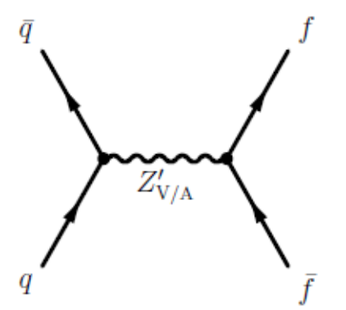
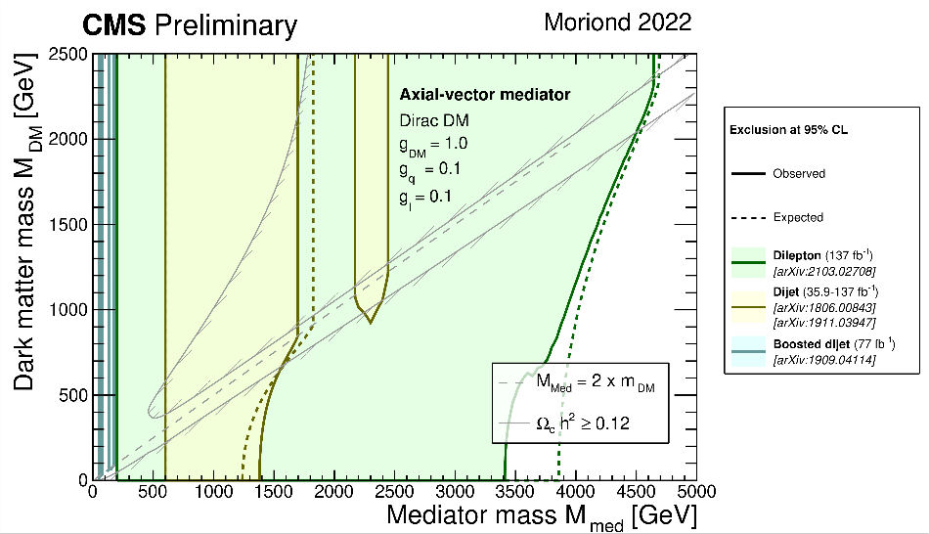
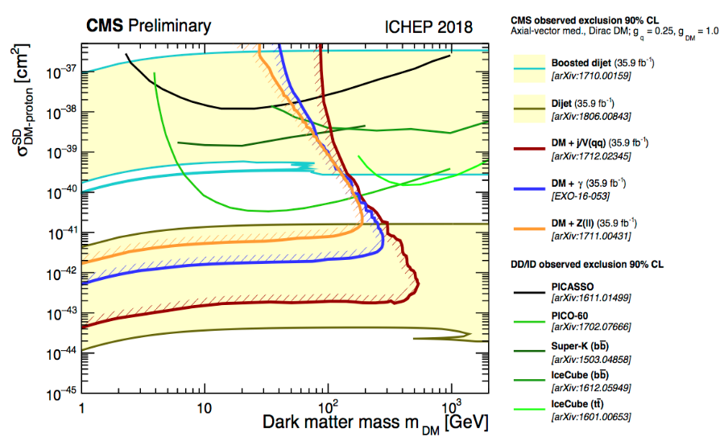
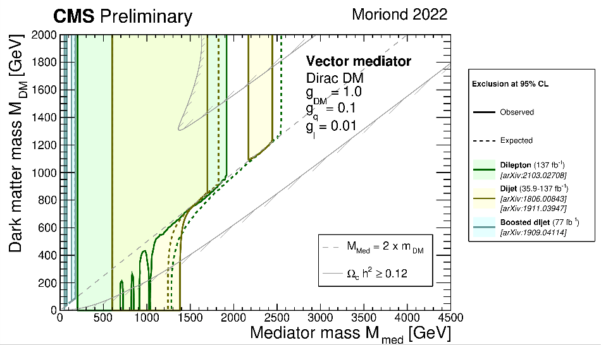
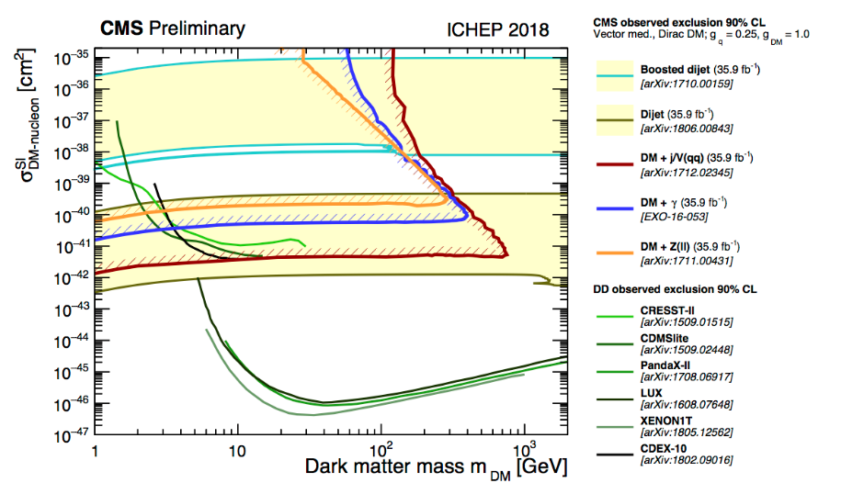
Reinterpretation: Dark Matter Searches in Dijets+Dileptons
We consider a model that assumes the existence of a single DM particle that interacts with the SM particles through a spin-1 mediator, which can be either a vector or axial-vector boson.
V/VA
vector mediator with small couplings to leptons, g_{DM} = 1.0, g_{q} = 0.1, g_{l} = 0.01
axial-vector mediator with equal couplings to quark and leptons: g_{DM} = 1.0, g_{q} = g_{l}= 0.1
g_{q}
g_{q}
9

Slide 10
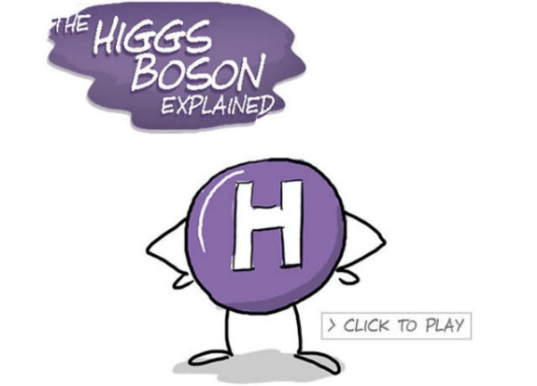
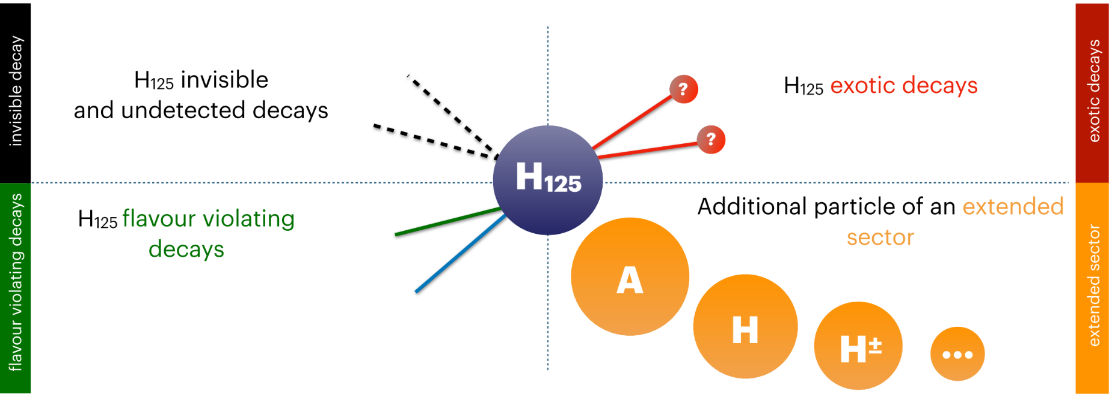
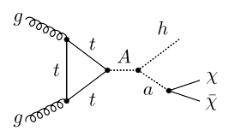
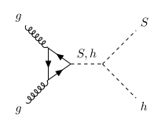
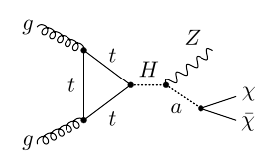
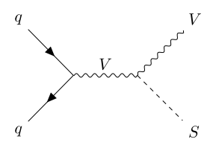
Higgs Boson as a Tool to Search for the New
“New“ physics objects ⇒ new decay channels!
combinations of physics objects (leptons/photons/jets) and Missing Transverse Energy (MET)
h (→ bbar) + a (→ χχ) = bbar + MET
Z + a (→ χχ) = Z (→ ll) + MET
10

Slide 11
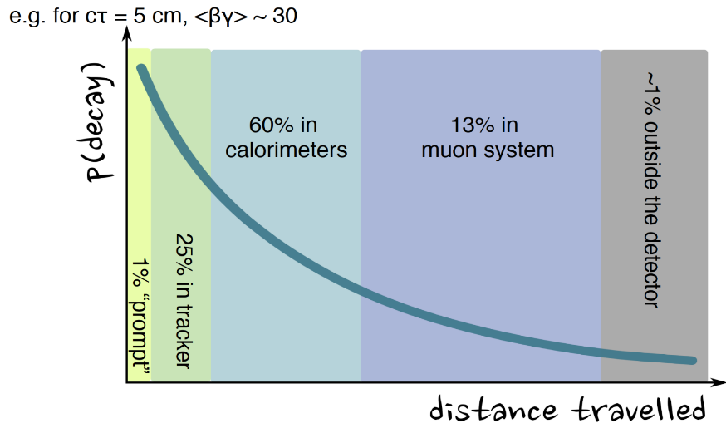
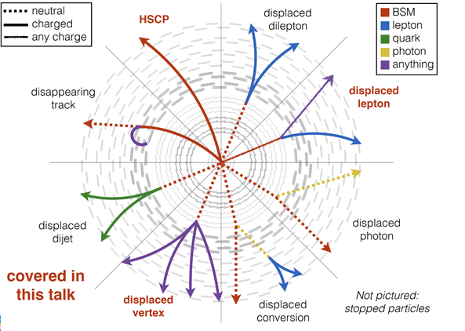
Direct Search for Beyond the Standard Model
New (unconventional) topologies!
a proper lifetime cτ₀ is greater than or comparable to the characteristic size of the (sub)detectors
small cτ₀ that comparable to the inner tracker size, no displaced tracks → “standard” prompt decay
intermediate cτ₀ → LLP
very large/infinite large cτ₀ → stable particles, “standard” MET signatures
LLPs may have decay lengths up to several meters, hence traveling through the inner detector layers without leaving any trace
11

Slide 12
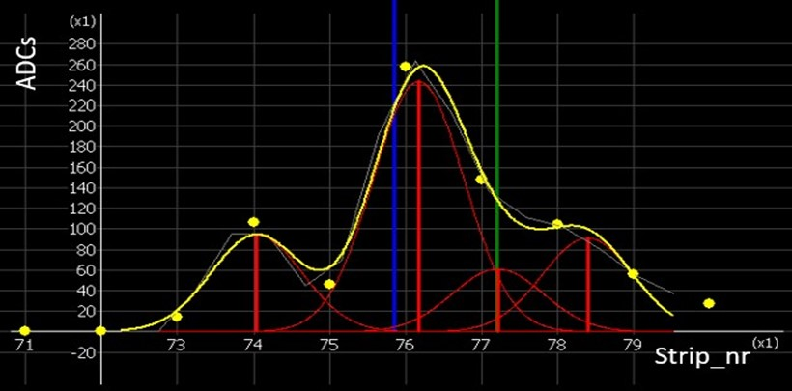
New Algorithms and Selection Methods
Muon reconstruction and Selection
high-momentum muons reconstruction and triggering, including AI methods
muon tracks reco for HGCal testing and study of an efficiency of HGCal sensor elements
Hits and track segments in Cathode Strip Chambers, CSC
HGCal based algorithms
particle-flow algorithms for reconstruction of energy flows (information
from all detector systems) ⇒ MET reco
jet structure, charged particle multiplicity inside jets
Simulation of Physics Processes and Detector Facility
data cards of model parameters for the number of physics generators (EGM, dark matter scenarios, extended Higgs sector, Drell-Yan production, etc)
full chains of MC mass production
HGCal test facilities
HGCal working release in CMSSW
12

Slide 13
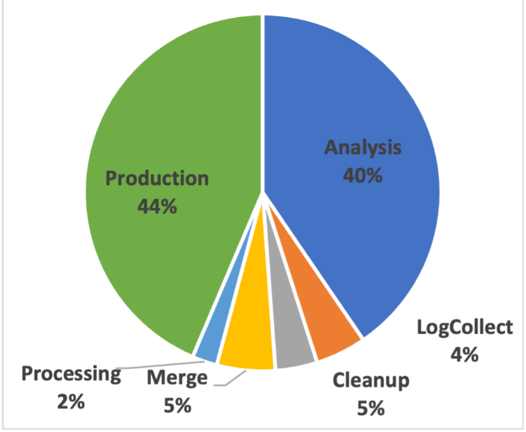
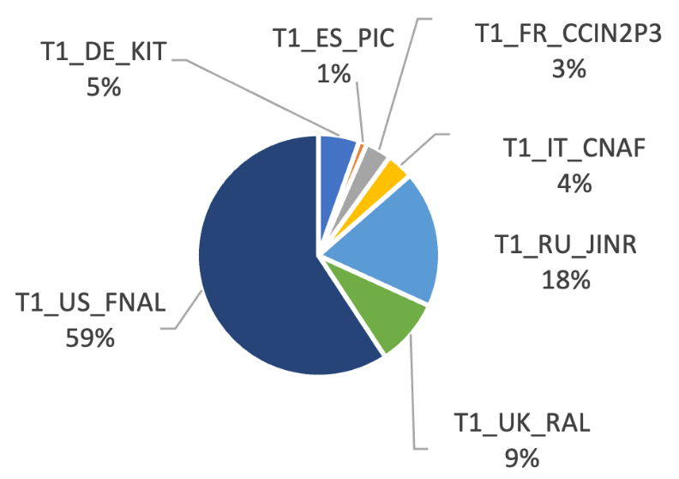
JINR in WLCG/CMS Computing
JINR grid Tier-1 and Tier-2 centers extensively used for processing and storing CMS data, ensuring 100% availability and reliability of services.
More than 2.1 billion events were successfully processed by JINR Tier-1 in 2024.
13

Slide 14
JINR contribution to CMS Phase 2 Upgrade
CMS Phase-2 upgrade task: reliable work of detectors in the High Luminosity LHC operation mode (HL-LHC) at energy 13.6 TeV and instantaneous luminosity L= 5-7×10³⁴сm⁻²с⁻¹
Participation in High Granularity Calorimeter (HGCal) project.
Design and construction of the HGCAL silicon and scintillator cassettes test facility
Development of the HGCAL LV power supply system prototype
Participation in the Endcap Muon system upgrade.
Cathode Strip Chambers upgrade and maintenance during LS3 long shutdown period.
Design and construction of the new ME1/1 Patch Panel.
Design and construction of new tooling for ME1/1 CSC assembly and installation
CSC longevity study and searches for eco friendly gas mixtures R&D.
14

Slide 15
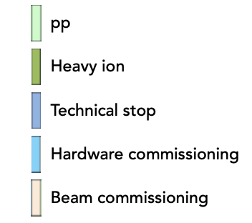
New LS3 Schedule
Three identified risks for CMS
๏ readiness of detectors for installation
๏ readiness of infrastructures to commission the detectors
๏ very dense LS3 program and with high person-power needs
15

Slide 16
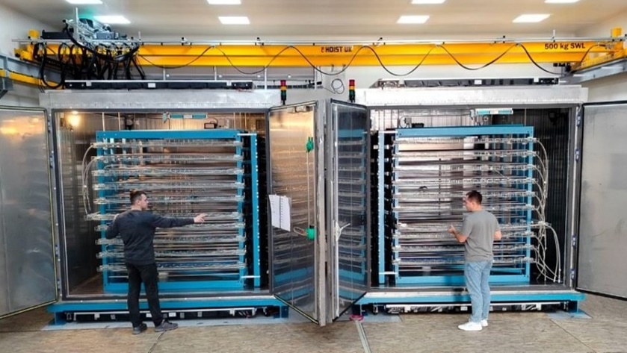
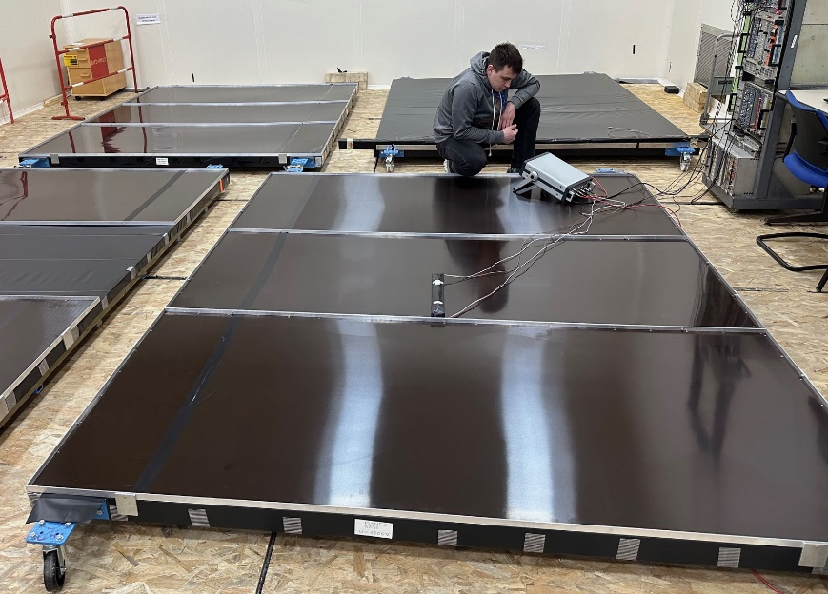
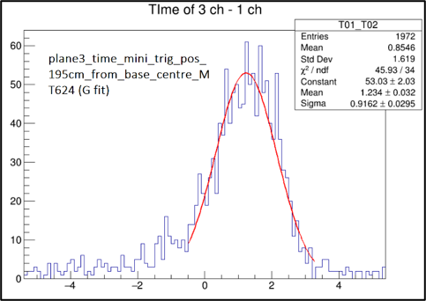
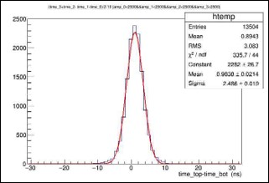
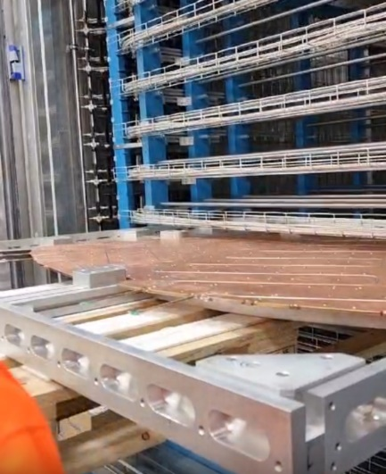
Setup for HGCal Cassettes Testing
2 Cold rooms were assembled at SX5 CERN
Commissioning of the scintillation trigger planes.
σ_{1 plane}~0.9 ns
Cassette on the supporting frame
Test setup includes:
Racks for cassettes
(inside cold rooms)
Supporting frames for cassettes
Scintillation trigger planes
(on top and bottom of rooms)
Readout electronics
Plane efficiency of ~98%.
1 plane time resolution ~0.9 ns.
Time resolution of 2 planes ~3ns.
σ_{2 plane}~2.4 ns
Triggers frequency in the fourfold coincidence mode: 130-160 Hz
- corresponds to ~3000 triggers per 1cm² in 10 days
- matches with the simulation: 10 days cassettes test cycle
required minimum 1000 triggers per 1cm²
Plan to have the test facility is ready for operation by the middle of 2025
16

Slide 17
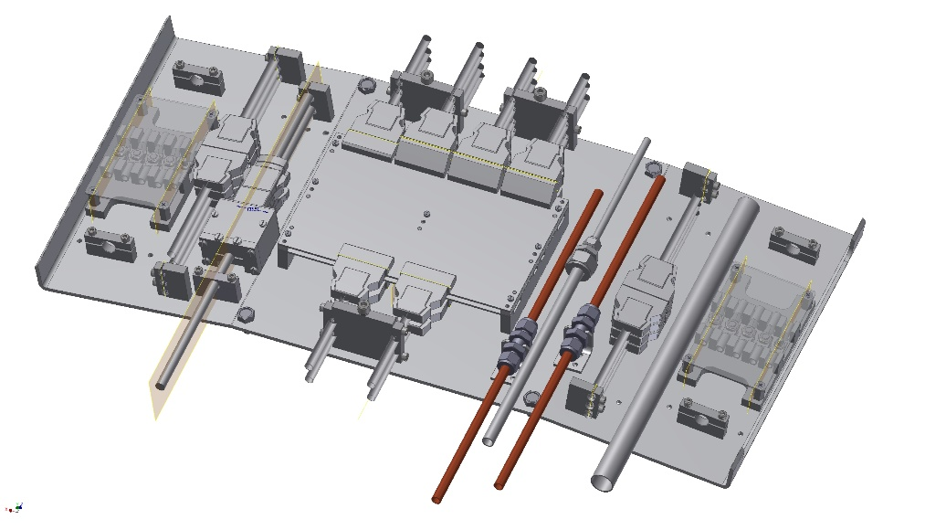
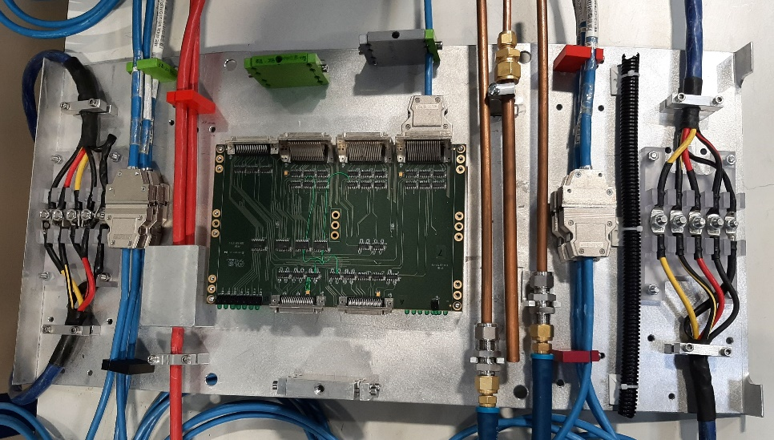
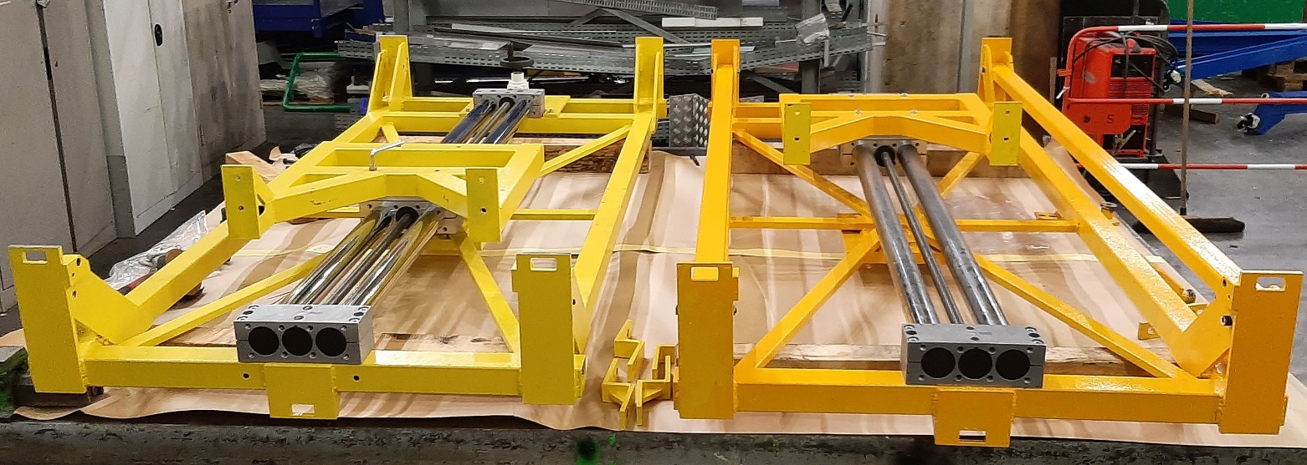
ME1/1 Preparation to the Phase-2 CSC Upgrade in LS3
ME1/1 Patch panel
3d model
Prototype
ME1/1 Patch Panel redesigned to fit more rigid envelope for endcap detectors cables and services in the CMS Phase-2 configuration
80% parts for 36 ME1/1 PP have been constructed
Loading machines
ME1/1 two loading machines for extraction/installation of ME1/1 CSCs were constructed
17

Slide 18
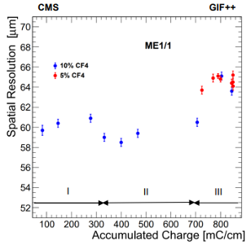
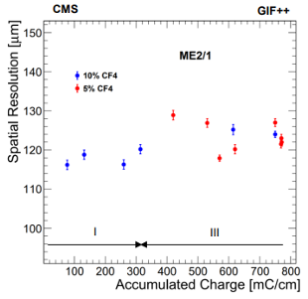
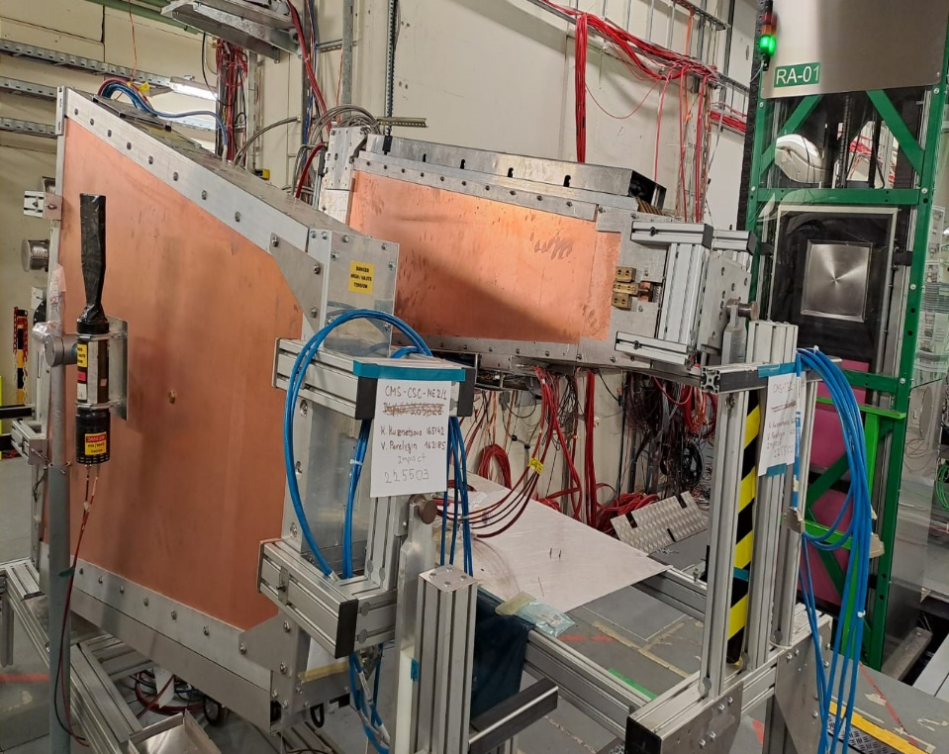
Cathode Strip Chamber Longevity Study @ GIF++
Irradiation setup: ME1/1 and ME2/1 CSCs exposed with the 12 TBq ¹³⁷Cs gamma source
at the GIF++ Facility (HV-ON on 4 layers and HV-OFF on 2 layers kept as reference).
CSCs spatial resolution as a function of the accumulated charge
¹³⁷Cs
ME1/1
ME2/1
2023 Test Beam at GIF++
ME CSCs irradiation setup at GIF++
No aging effects observed so far
The slight degradation of the ME1/1 resolution in period III (2023-2024) is to be investigated
18

Slide 19
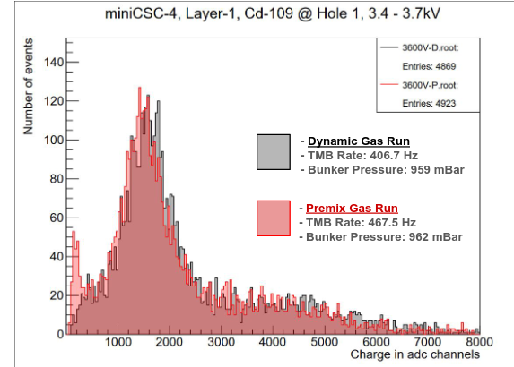
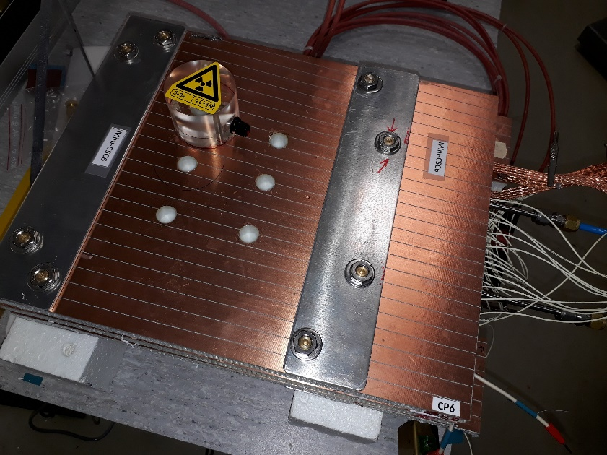
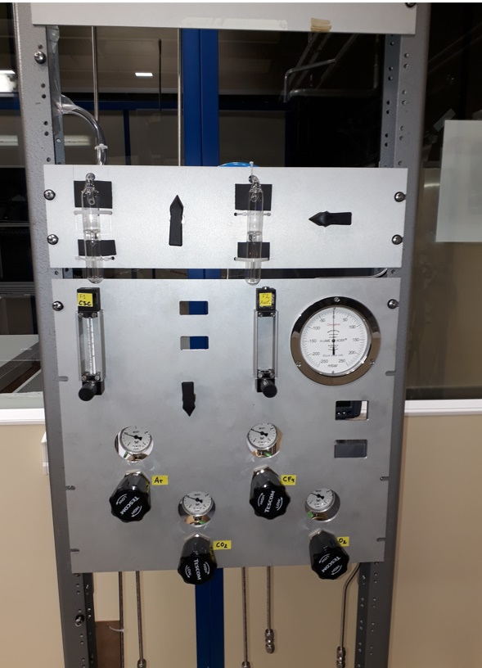
CSC Parameters Study with new gas mixtures
Motivation: CSC use CF4 to protect anode wire from Si deposits, but it’s Global Warning Potential (GWP) is too high: ~ 7000 x CO₂.
Mini-CSC Gas mixer
for four component gas mixtures production has been constructed
Six 2-layer mini-CSCs with sensitive area (30 x 30 cm²) were constructed to study the CSC operation with the new gas mixtures.
Test of the Mini-CSC Gas mixer.
¹⁰⁹Cd spectra measured with mini-CSC with Ar+CO₂ (40/60) gas mixture industrially premixed in cylinder (pink) and produced by the Mini-CSC Gas mixer (grey).
The plot shows a good match of the spectra.
Aging Studies planned:
with recuperated CF₄ , produced at the CMS recuperation factory @ P5:
with HFO1234ze (C₃H₂F₄) as a potential CF₄ alternative (GWP<1).
19

Slide 20
Plan for 2025
Continue RUN-2 and RUN-3 data analysis.
Dimuons, Z + MET, bbar + MET, dimuons + MET to search for the new physics and test the SM.
Continue optimization of the hadronization model for the q/g jet fractions measurement.
Participation in 2025 RUN-3 data taking within JINR responsibilities.
- Participation in shifts.
- Detectors operation and maintenance.
- Detectors performance study.
Participation in Phase-2 HGCAL project.
- Launching of the HGCAL cassettes test facility.
- Powering of the cassette's assembly facilities.
Participation in Phase-2 upgrade of Muon Endcap System.
Preparation to the ME1/1 CSC upgrade during LS3.
Continue of the CSC detectors ageing effects study at GIF ++ facility.
Development and test of algorithms for reconstruction of the muon track segments.
20

Slide 21
Staffing resources
LHEP – 32 (23.3 FTE), LIT – 22 (10 FTE), LTP – 5 (1.9 FTE), JINR Management – 1 (0.1 FTE)
№№ п/п | Category of employees | Core staff Amount of FTE | Associated Personnel Amount of FTE
1. | scientific staff | 24,5 | 15,2
2. | engineers | 7,9 | 0
3. | professionals | 2,5 | 0
4. | employees | 1 | 0
5. | workers |  | 0
 | Total: | 34,5 | 15,2
LHEP: | Aleksakhin V.Yu., Afanasyev S.V., Budkovsky D.V., Bunin P.D., Golunov A.O., Gorbunov I.N., Gorbunov N.V., Golova N.S., Ershov Yu.V., Kamenev A.Yu. Karzhavin V.Yu., Kilchakovskaya S.V., Kobylets L.G. Kozlov D. N., Kurenkov A.M., Kutinova O.V., Lanev A.V., Makankin A.M., Malakhov A.I., Milnov G.D., Perelygin V.V., Sakulin D.G., Smirnov V.A., Sukhov E.V., Ustinov V.V., Shalaev V.V., Shulga S.G., Zarubin A.V., Zhizhin I.A., Zaitsev A.A.
LIT: | S.V. Shmatov, V.V. Korenkov, A.O. Golunov, A.G. Dolbilov, I.A. Kashunin, A. Khvedelidze, O.L. Kodolova, Yu.V. Korsakov, V.V. Mitsyn, A.N. Moibenko, A.N. Nikitenko, N.N. Voytishin, G.A. Ososkov, D.A. Oleynik, V.V. Palchik, A.Sh. Petrosyan, R. Semenov, I. Satyshev, K. Slizhevsky, T.A. Strizh, E.N. Tolochko, V.V. Trofimov
LTP: | Kazakov D.I., Kozlov G.A., Savina M.V., Teryaev O.V., Zykunov V.A.
JINR Management: | Matveev V.A.
21

Slide 22
Cost estimate of the Project
Based on the official commitments of JINR: MoU on the creation of the CMS detector (CERN-RRB-2024-039) and the corresponding addendums: Addendum No. 10 (CERN-MoU-2024-010), Addendum No. 13 (CERN-MoU-2019-008), Addendum No. 14 (CERN-MoU-2019-009), Addendum No. 15 (CERN-MoU-2019-036).
MOU on the participation of JINR in the HGCal CMS project (CMS2020-010).
Main cost items
Common funds
Category A payment (M&O cat. A) for 24 authors: 260 kUSD per year
Category B payment (M&O cat. B): 73 kUSD per year
Deliverables
Equipment deliverables cost: 962 kUSD (792 kUSD for Front-end tileboards and DAQ - contribution to HGCAL CORE and HV cables production for ME1/1 CSCs – In-Kind category B contribution).
Materials cost for Phase-2 upgrade of the muon system and HGCAL: 500 kUSD (80 kUSD в год).
Visits
Visits expenses for 5 years: 3450 kUSD (690 kUSD per year). Including 565 kUSD - will be accounted as In-Kind CORE for the HGCAL, 1070 kUSD - will be accounted as In-Kind category B and 825 kUSD – upgrade works (2460 kUSD in total).
Full estimated cost of the project: 6577 kUSD.
Full amount of contribution in CORE: 1357 kUSD.
22

Slide 23
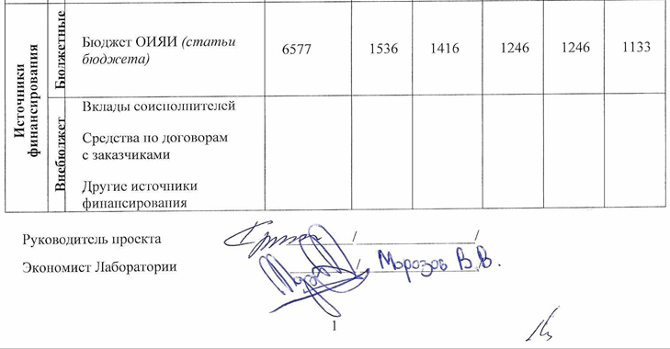
Proposed schedule.
Required resources.
and
Cost estimate
23

Slide 24
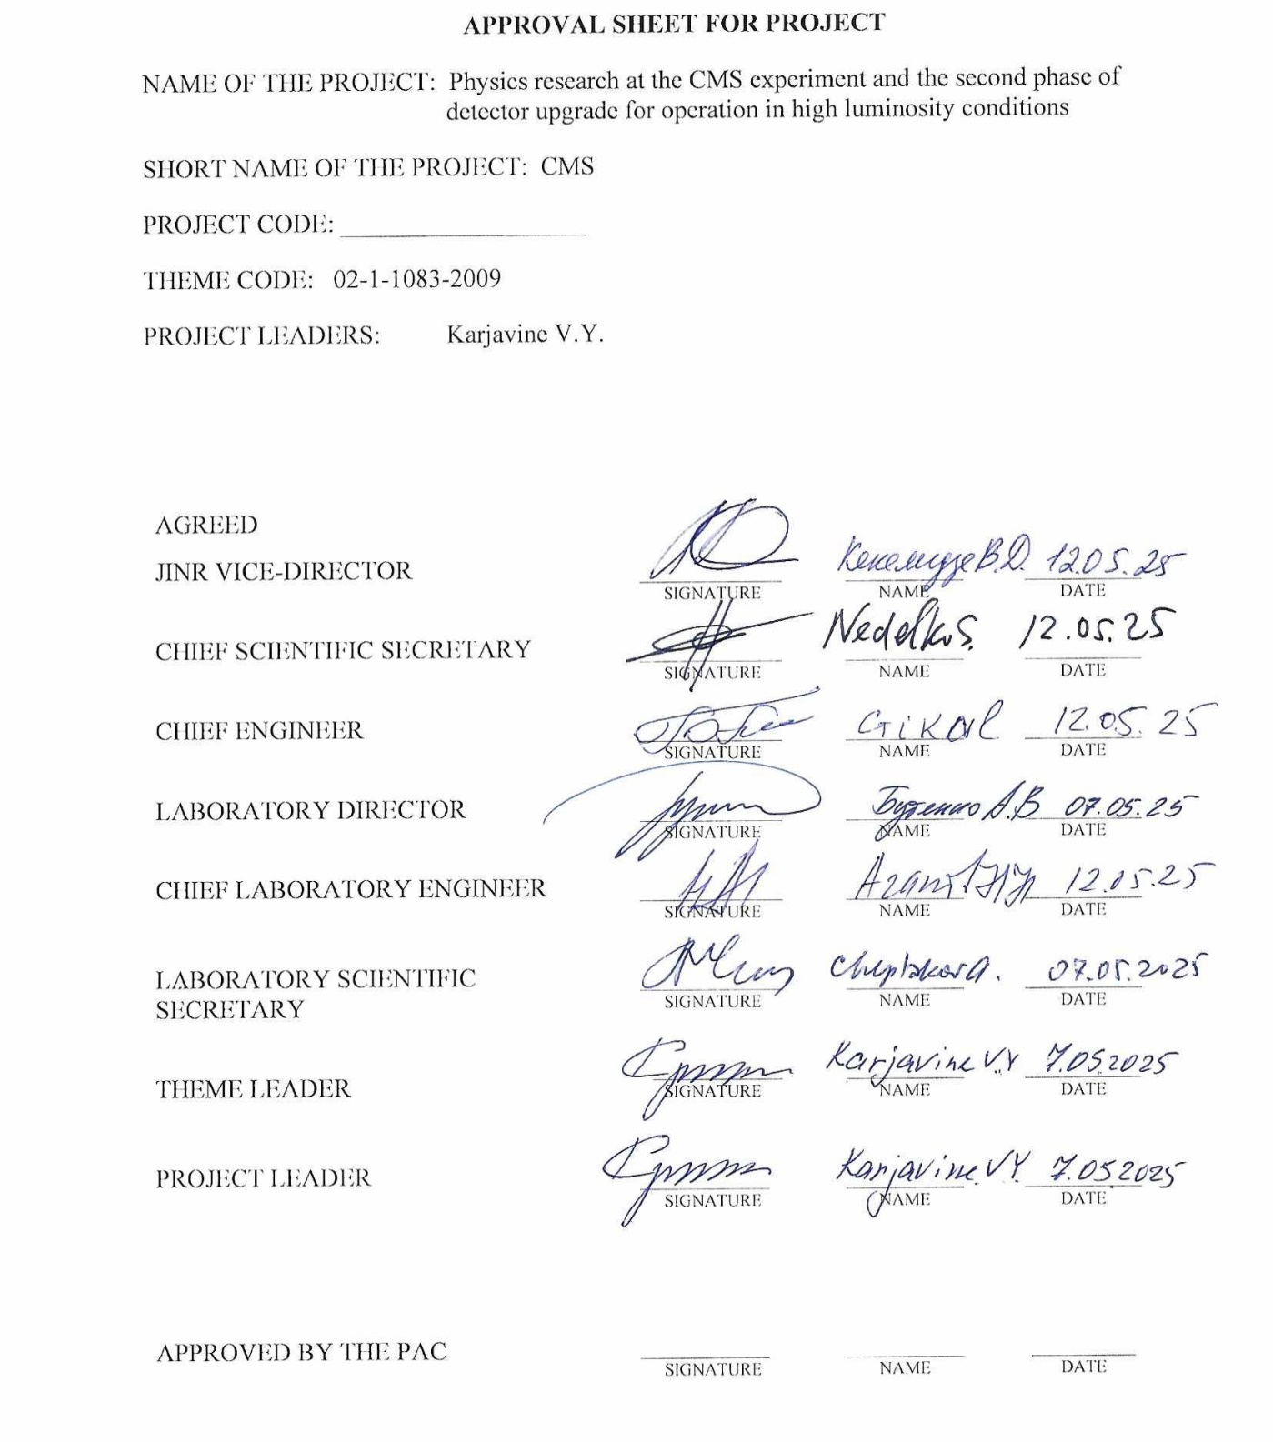

Slide 25
We ask LHEP Scientific Council to support the project
The Physics Studies with the CMS experiment and the second phase of detector upgrade for operation in high luminosity conditions.
for 2026-2030
Thank you for your attention!!!
25

