Slide 1




XVIth International School-Conference
"Actual Problems of Microworld Physics"
(Minsk, Belarus, August 24 – 31, 2025)
Abdullah Mohammad Shehada
On behalf of the MONUMENT collaboration
Laboratory of Nuclear problems, Joint Institute For Nuclear Research (JINR), Russia.
shikhada@jinr.ru
27.08.2025
Monte-Carlo simulations and Nuclear Spectroscopy for Muon Capture Experiments
1
Abdullah Shehada On behalf of the MONUMENT collaboration | Actual Problems of Microworld Physics | 24-31 August 2025 1

Slide 2
List of contents
Short Theoretical introduction.
Advantages of using Monte-Carlo codes like MCNP6.
Steps for Monte-Carlo Simulations.
MONUMENT experiment and Muon-Beam Profile.
Monte-Carlo Simulation of MONUMENT experiment.
Simulations of the Induced Secondary Particles.
Simulations of the Calibration Sources.
Separating Spectrum into its Components and Isotopes Production.
More for Near Future.
2

Slide 3
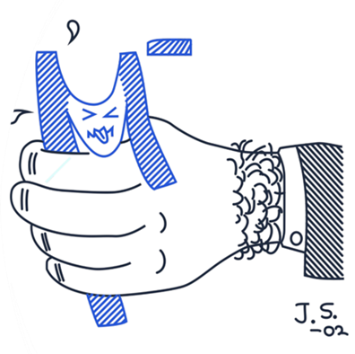
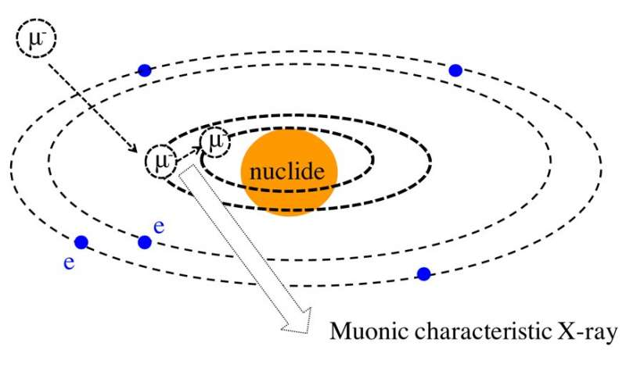
Motivation
MONUMENT: Muon Ordinary capture for the NUclear Matrix elemENTs
  Verification of the accuracy of theoretical calculations of nuclear matrix elements (including for 0νββ-decay)
  Verification of the suppression of the parameter g_{A}
  Obtaining total and partial rates of ordinary muon capture (OMC
  Filling the atlas of meso-X-ray spectra (https://muxrays.jinr.ru/index.html)
  Using OMC to study the astrophysical properties of neutrinos (100Mo)
  (10.1103/PhysRevC.99.024327)
​μ⁻ → e- + ν_{e}+ ν_{μ}
(A, Z) + μ⁻ → (A, Z-1)* + ν_{μ}
→ (A, Z-1) + γ
→ (A-1, Z-1) + γ +n
→ (A-2, Z-1) + γ + 2n → (A-1, Z-2) + γ + n + p
τ_{dec} = 2.2μs
nucleus
m_{μ} = 105,7 MeV
3

Slide 4
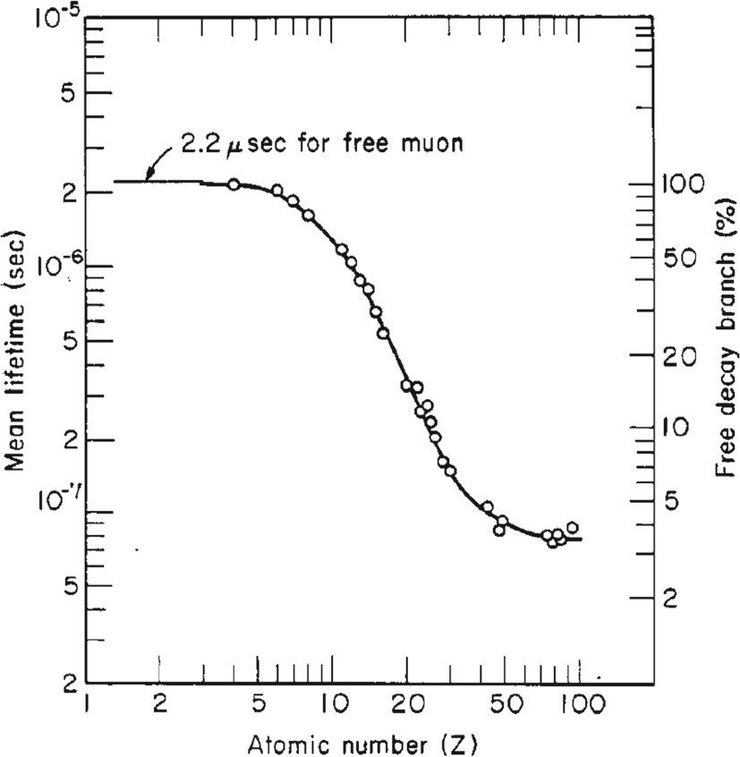
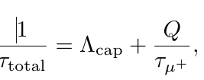
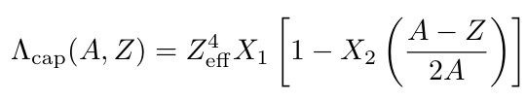
Motivation
MONUMENT: Muon Ordinary capture for the NUclear Matrix elemENTs
The capture rate of the muon capture reaction varies depending on the nucleus forming the muonic atom
where τ_{μ} is the lifetime of the muon ~ 2.2 μs, and Q is a Huff factor, which takes into account a reduction in the muon decay rate due to the atomic binding energy
The capture rate can be expressed by Primakoff formula:
The mean lifetime of negative muons inside a material of atomic number Z and the corresponding percentage of remaining ordinary muon decays.
The parameters X1 and X2 are coefficients obtained from a global fit of the experimental data, where X₁= 170​ s⁻¹ and X₂= 3.125
https://arxiv.org/pdf/2501.05897v2
10.1140/epjp/s13360-020-00777-y
4

Slide 5
List of contents
Short Theoretical introduction.
Advantages of using Monte-Carlo codes like MCNP6.
Steps for Monte-Carlo Simulations.
MONUMENT experiment and Muon-Beam Profile.
Monte-Carlo Simulation of MONUMENT experiment.
Simulations of the Induced Secondary Particles.
Simulations of the Calibration Sources.
Separating Spectrum into its Components and Isotopes Production.
More for Near Future.
5

Slide 6
Advantages of using Monte-Carlo codes like MCNP6
In general, Monte Carlo Transport Codes like MCNP6 plays a pivotal role in simulating and optimizing experiments. Its ability to model particle interactions, complex geometries, and detector systems makes it an indispensable tool for researchers in this field.
MCNP6 facilitates the simulation of muon transport, capture, and decay within target materials.
Additionally, MCNP6 enables the design and optimization of experimental setups by simulating detector responses, energy deposition, background radiation which can be suppressed (including natural background, Compton, Bremsstrahlung and other background-induced radiations when the beam is on), ensuring accurate measurements and reducing systematic uncertainties.
The code is also valuable for studying rare phenomena, such as nuclear recoil effects and isotopic shifts, and for separating contributions from different nuclear isotopes in complex samples. Its versatility and accuracy make MCNP6 an essential tool for advancing muonic X-ray experiments.
6

Slide 7
List of contents
Short Theoretical introduction.
Advantages of using Monte-Carlo codes like MCNP6.
Steps for Monte-Carlo Simulations.
MONUMENT experiment and Muon-Beam Profile.
Monte-Carlo Simulation of MONUMENT experiment.
Simulations of the Induced Secondary Particles.
Simulations of the Calibration Sources.
Separating Spectrum into its Components and Isotopes Production.
More for Near Future.
7

Slide 8
Steps for Monte-Carlo Simulations
1. The geometry and materials of all components of the MONUMENT experiment have been written and constructed employing many codes and softwares: MCNP6 + Phig3D-PHITS + TopMC. As a beginning, simulations were applied to the experiment carried out in 2021 at PSI using BaCO3 target with ~95% enrichment of Ba-136.
2. The full input-files for Monte-Carlo code MCNP6 have been written for different calculations: muon-beam profile simulations; simulations to get all generated-particles during the muon-irradiation; simulations of the background (terrestrial background); the cosmic-rays background; simulations of the generated isotopes in the Target and the Detector and their gamma-intensities; and other related simulations.
3. Getting results (mentioned in the previous paragraph) after processing the data resulting from simulations. The simulated results were compared with the experimental ones.
4. Conducting the simulations using MCNP6 code on the JINR Cluster and Cloud with more Cores and RAMs resources to accelerate simulations (not all types of simulations!).
8

Slide 9
List of contents
Short Theoretical introduction.
Advantages of using Monte-Carlo codes like MCNP6.
Steps for Monte-Carlo Simulations.
MONUMENT experiment and Muon-Beam Profile.
Monte-Carlo Simulation of MONUMENT experiment.
Simulations of the Induced Secondary Particles.
Simulations of the Calibration Sources.
Separating Spectrum into its Components and Isotopes Production.
More for Near Future.
9

Slide 10


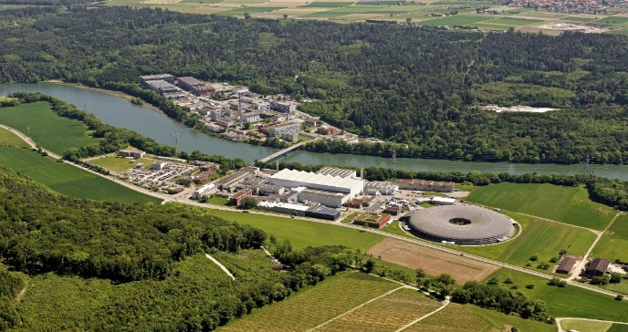
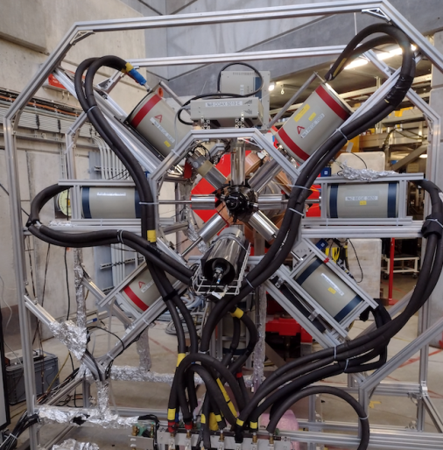
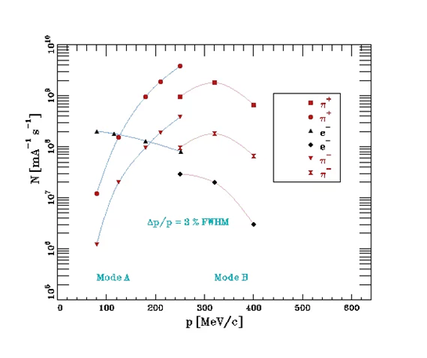
MONUMENT experiment @ πE1 beamline (PSI, Switzerland)
These Pions Produce Muon-Beam
With momentum:
33-40 MeV/c
Purpose | OMC targets (enrichment) | Year/Status
experimental input for DBD NME calculations | ⁷⁶Se (99.97%) | 2021 / analysis and publication
experimental input for DBD NME calculations | ¹³⁶Ba (95.27%) | 2021 / analysis and publication
experimental input for astrophysics investigations with SN | ¹⁰⁰Mo (97.3%) | 2022 / started data analysis
Nuclear spectroscopy, total cap. rates, yields | ^{nat}Mo | 2022 / started data analysis
testing nuclear shell model (SM) calculations | ⁴⁸Ti (99.9%) | 2023 / started data analysis
experimental input for DBD NME calculations, ab-initio calculations | ⁹⁶Mo, ¹²C, ¹³C, ⁵⁶Fe | 2026-2028 / in preparation
10

Slide 11
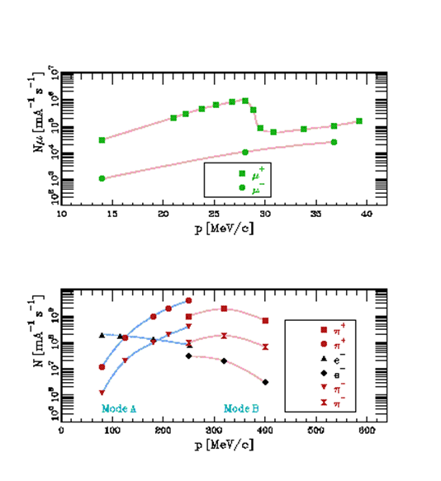
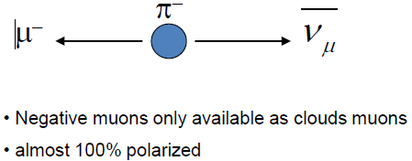
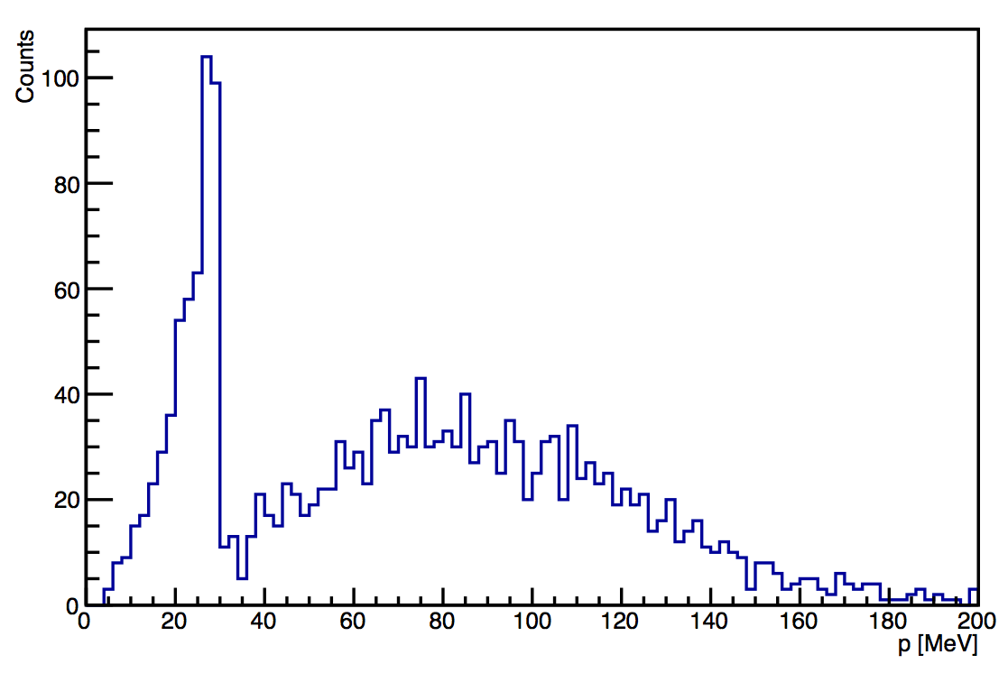
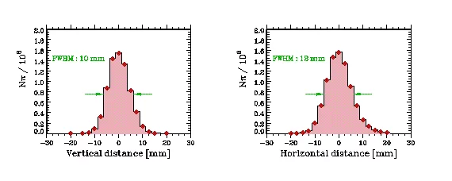
MONUMENT experiment @ πE1 beamline (PSI, Switzerland)
Single pion production at 290 MeV proton energy (LAB)
Low-energy muon beam lines typically tuned to surface μ+ at ~ 28 MeV/c
Note: surface μ —> polarized positively charged
muons (spin antiparallel to the momentum)
Contribution from cloud muons at similar momentum
about 100x smaller
Negative muons only available as cloud muons
Surface muons
Cloud muons
11

Slide 12
List of contents
Short Theoretical introduction.
Advantages of using Monte-Carlo codes like MCNP6.
Steps for Monte-Carlo Simulations.
MONUMENT experiment and Muon-Beam Profile.
Monte-Carlo Simulation of MONUMENT experiment.
Simulations of the Induced Secondary Particles.
Simulations of the Calibration Sources.
Separating Spectrum into its Components and Isotopes Production.
More for Near Future.
12

Slide 13
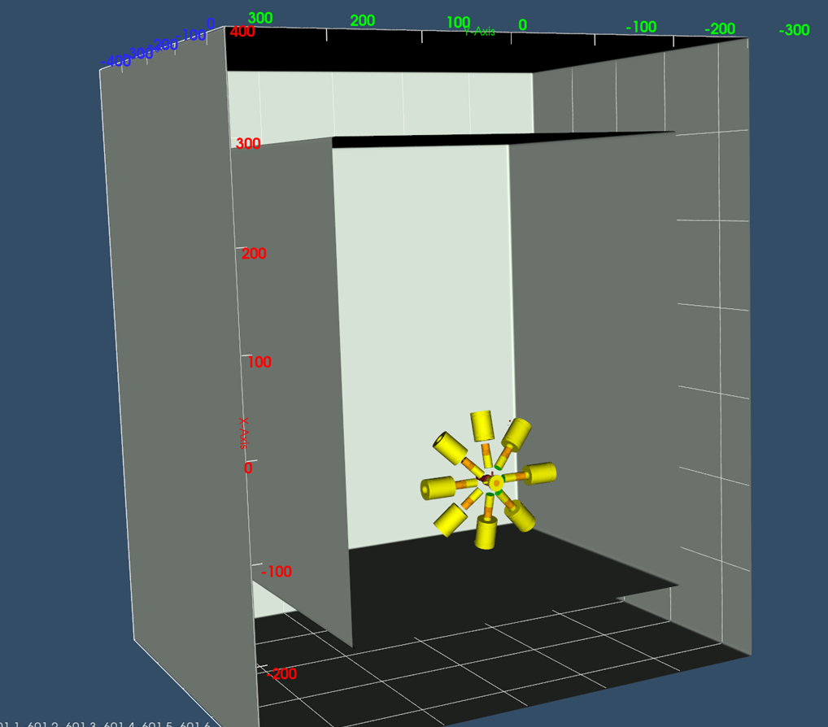
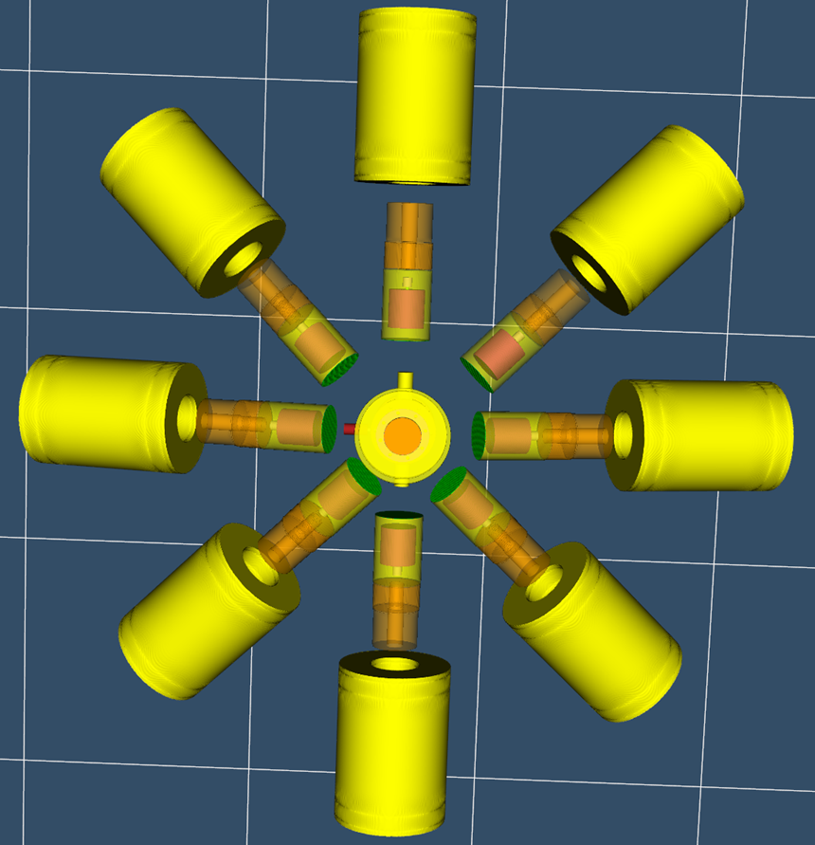
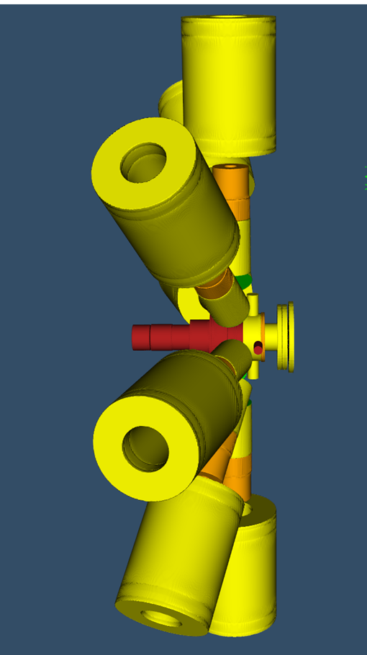
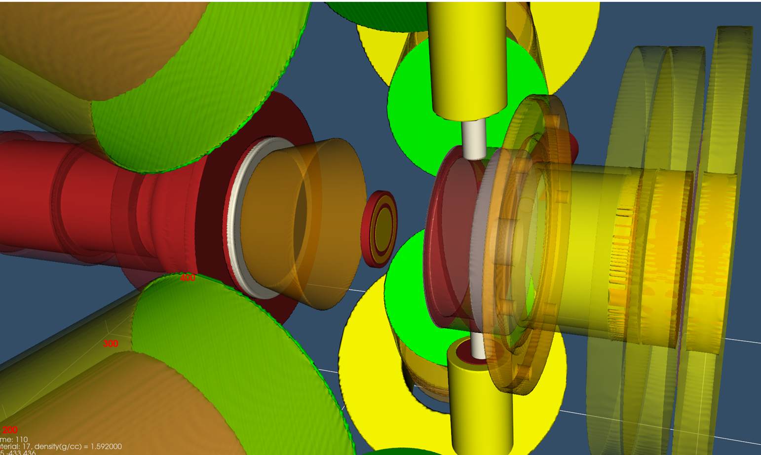
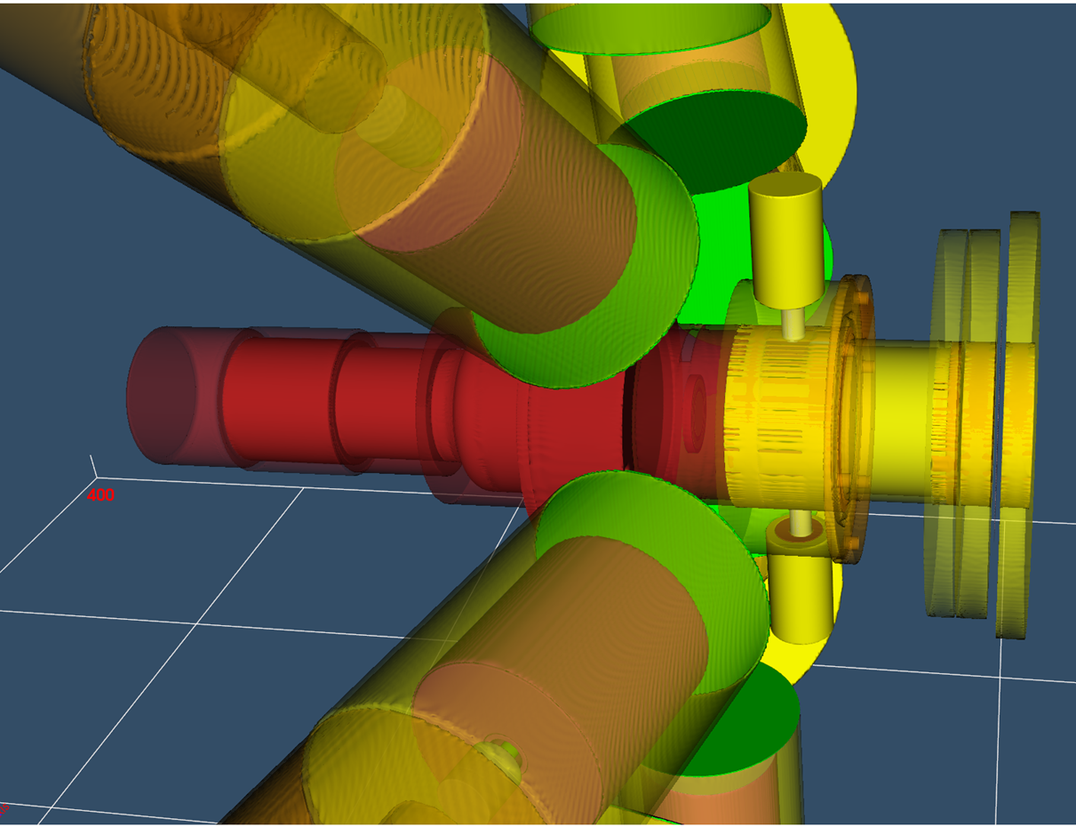
Geometry of MONUMENT-Experiment described in the MCNP-input file and generated using Phig3D-PHITS program.
The following codes and programs were used to obtain the geometry:
MCNP6 (Monte Carlo N-Particle Transport is a general-purpose, continuous-energy, generalized-geometry, time-dependent, Monte Carlo radiation transport code designed to track many particle types over broad ranges of energies and is developed by Los Alamos National Laboratory. )
Phig3D-PHITS (Particle and Heavy Ion Transport code System) is a general purpose Monte Carlo particle transport simulation code developed under collaboration between JAEA, RIST, KEK and several other institutes)
TopMC (Multi-Functional Program for Neutronics Calculation, Nuclear Design and Safety Evaluation, which has been developing by FDS Consortium, China)
13

Slide 14
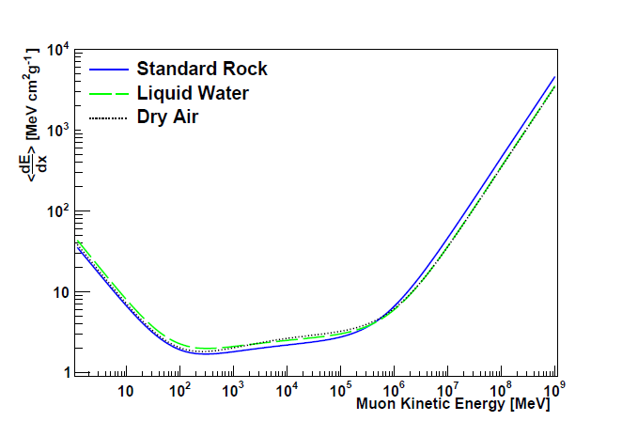
The muon trigger system combined with the target unit consists of:
• An active muon veto counter C0 (10 mm thickness), placed at the entrance of the target enclosure;
• Two thin (0.5 mm) pass-through counters C1 and C2 ;
• The actual target volume surrounded by a cup-like counter C3 .
The four muon counters are defining 𝜇-stop trigger
Ge-Detector
Target
C2
C1
Ge-Detector
The Target Assembly with the
scintillation counters C0, C1, C2 and C3
http://dx.doi.org/10.1103/PhysRevD.98.030001
The stopping power for muons in C1, C2 for 1 mm thickness = 1.5 MeV
14

Slide 15

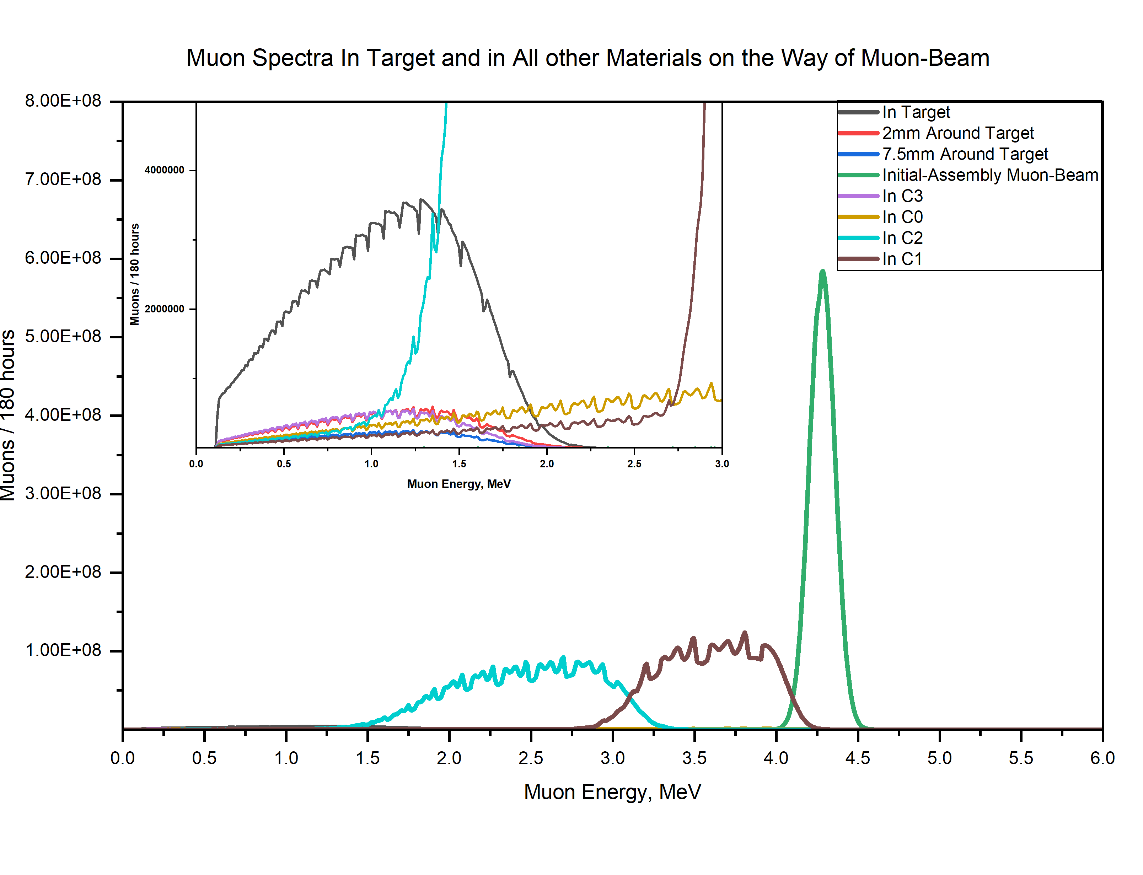
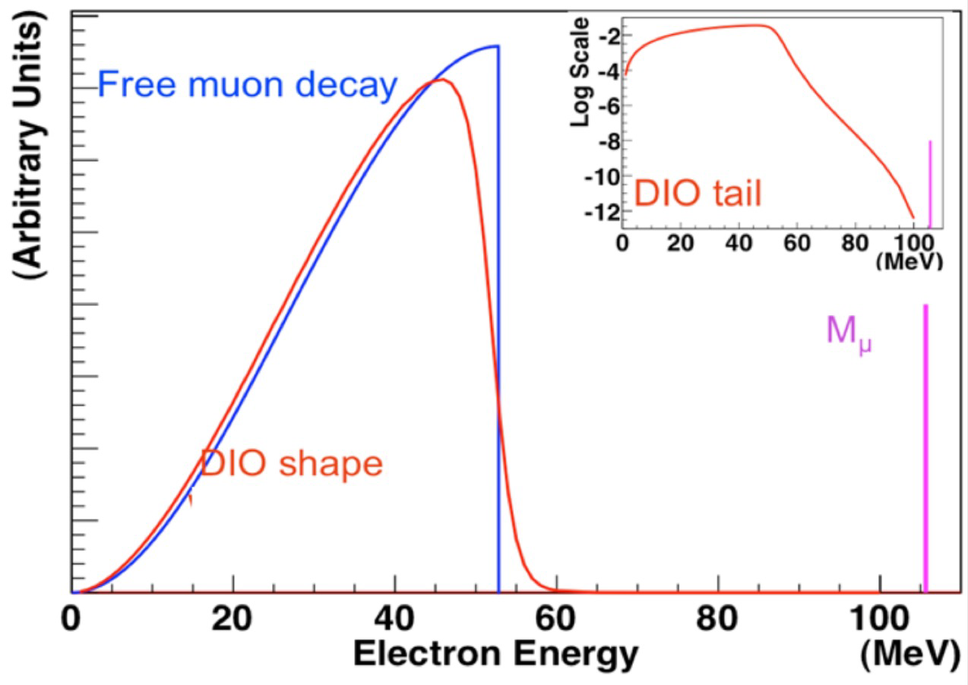
Ge-Detector
Target
C2
C1
Ge-Detector
MC simulation
The muons decreases in numbers after C2 by about 22% (8.1% from the free Muon Decay-on-Flight, and 13.9% lost in the materials before Target), and the muon-energy was shifted by scattering.
15

Slide 16
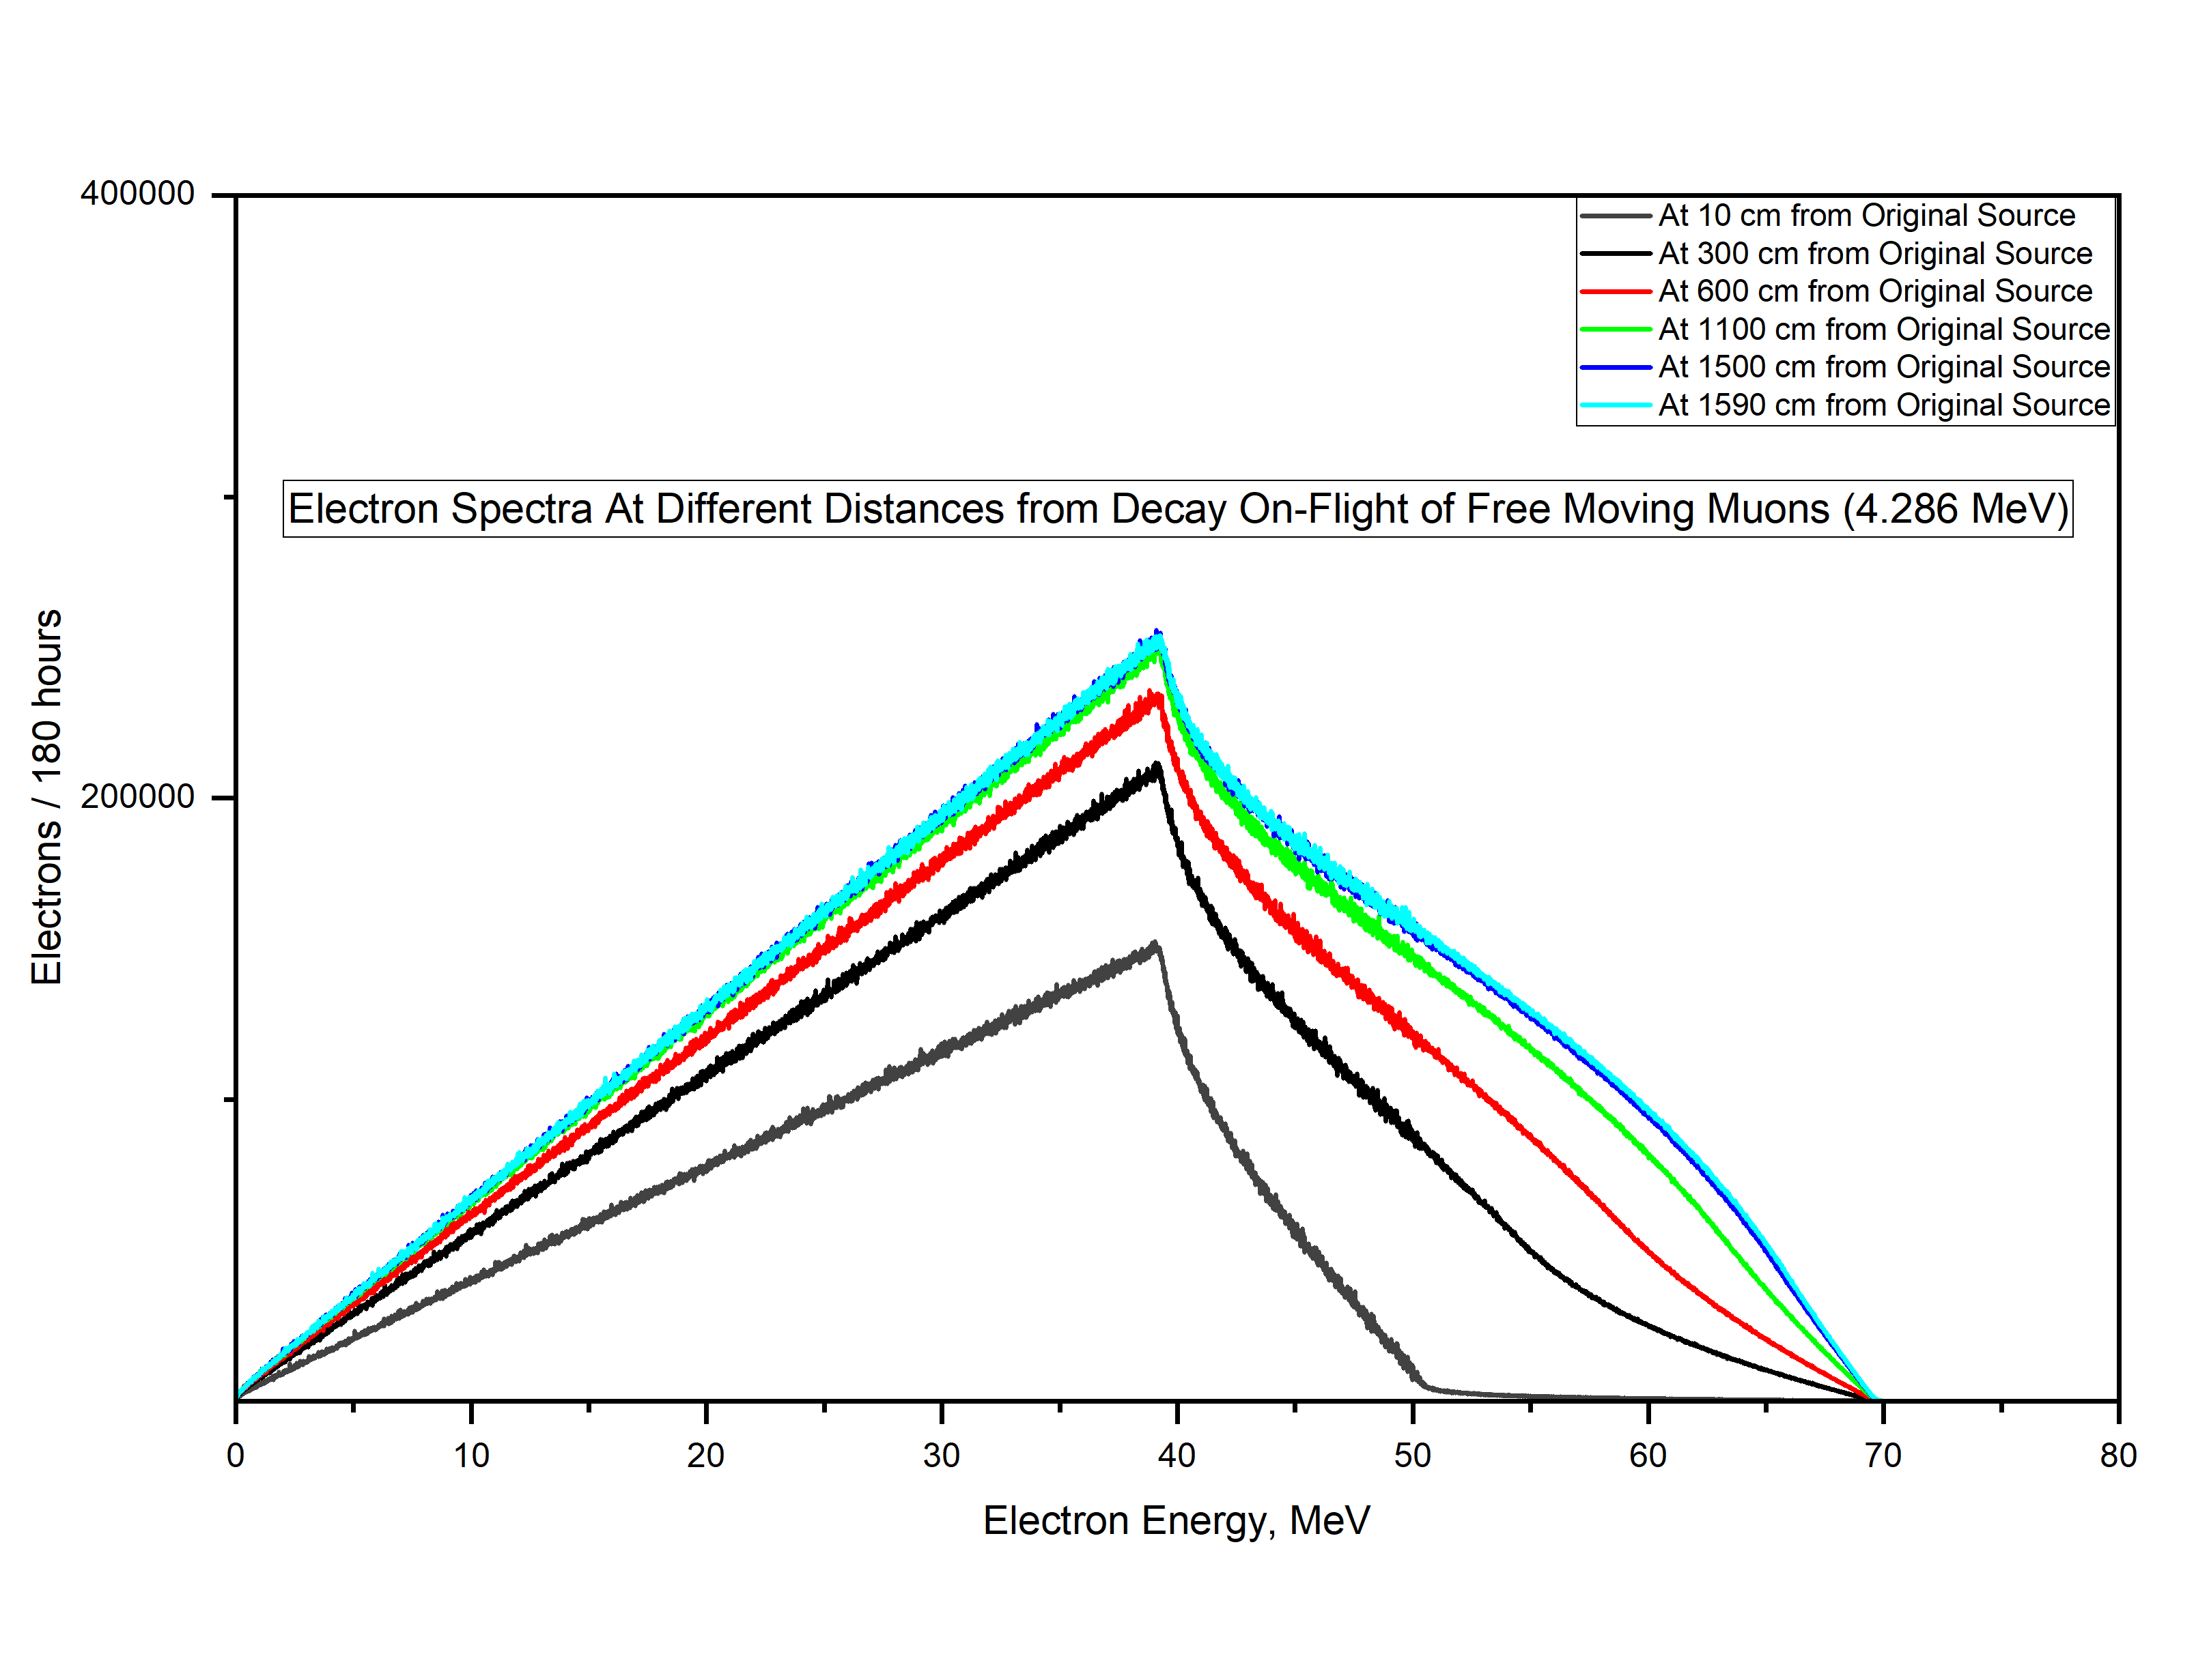
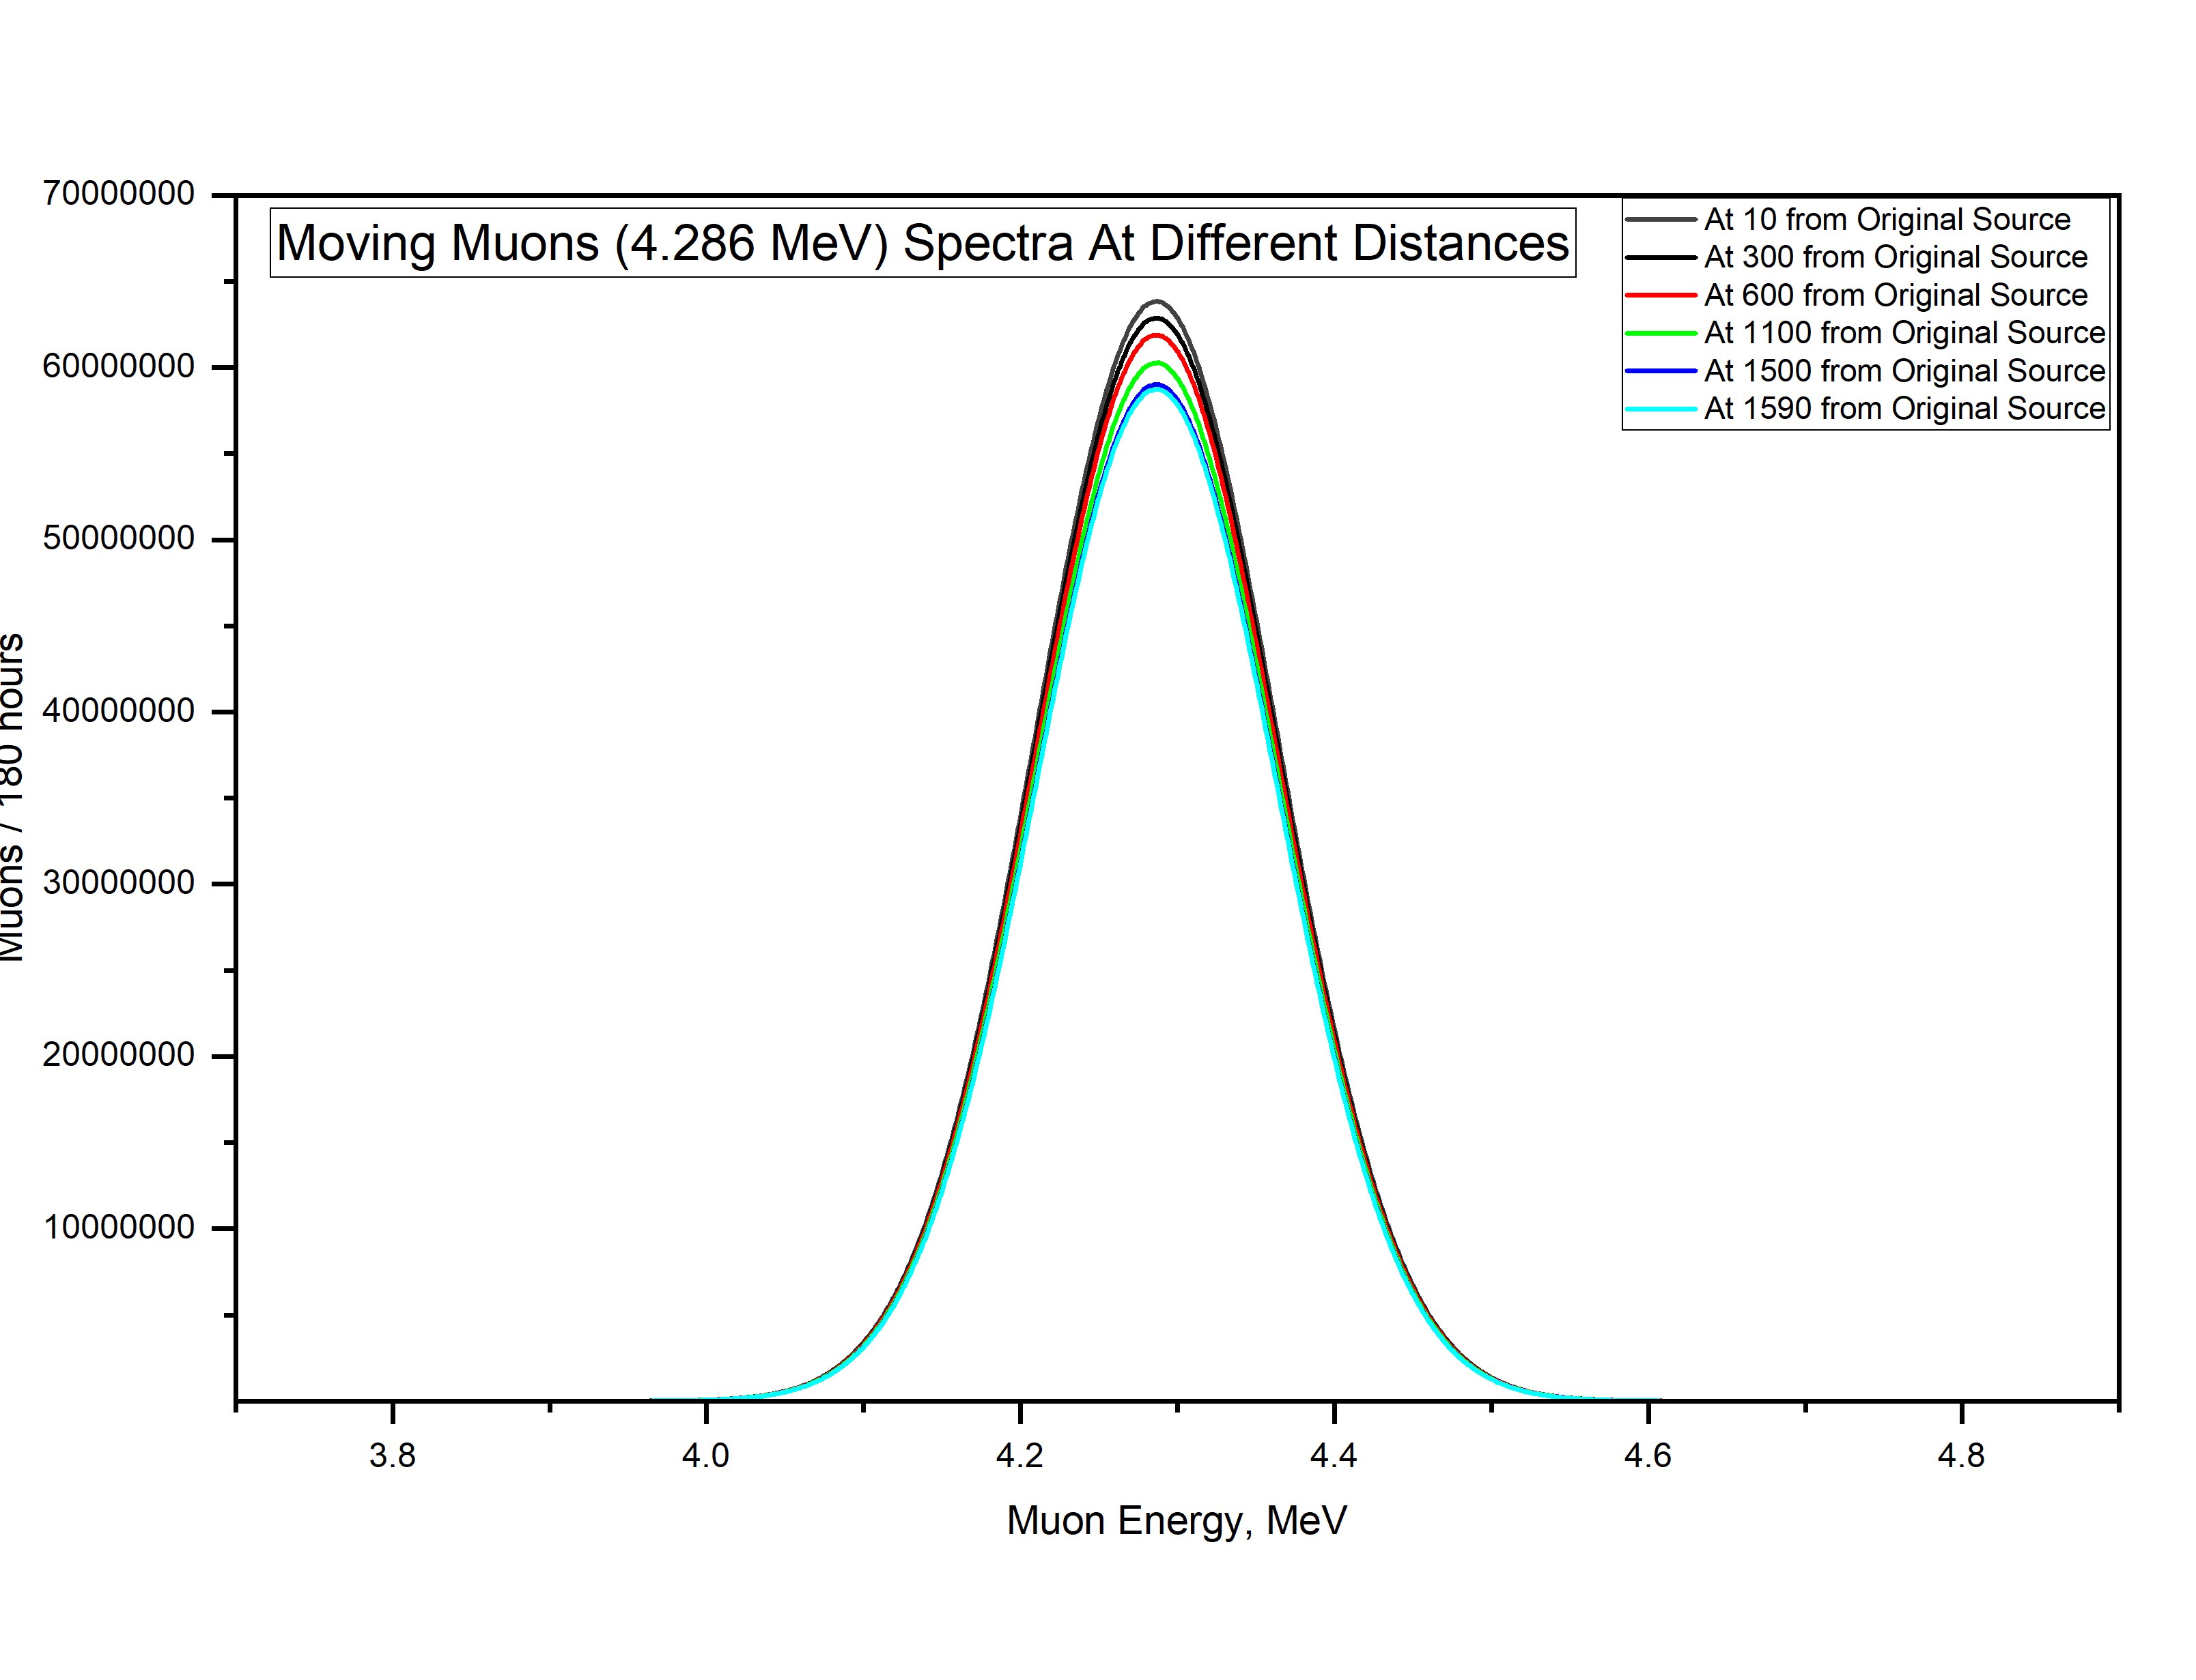


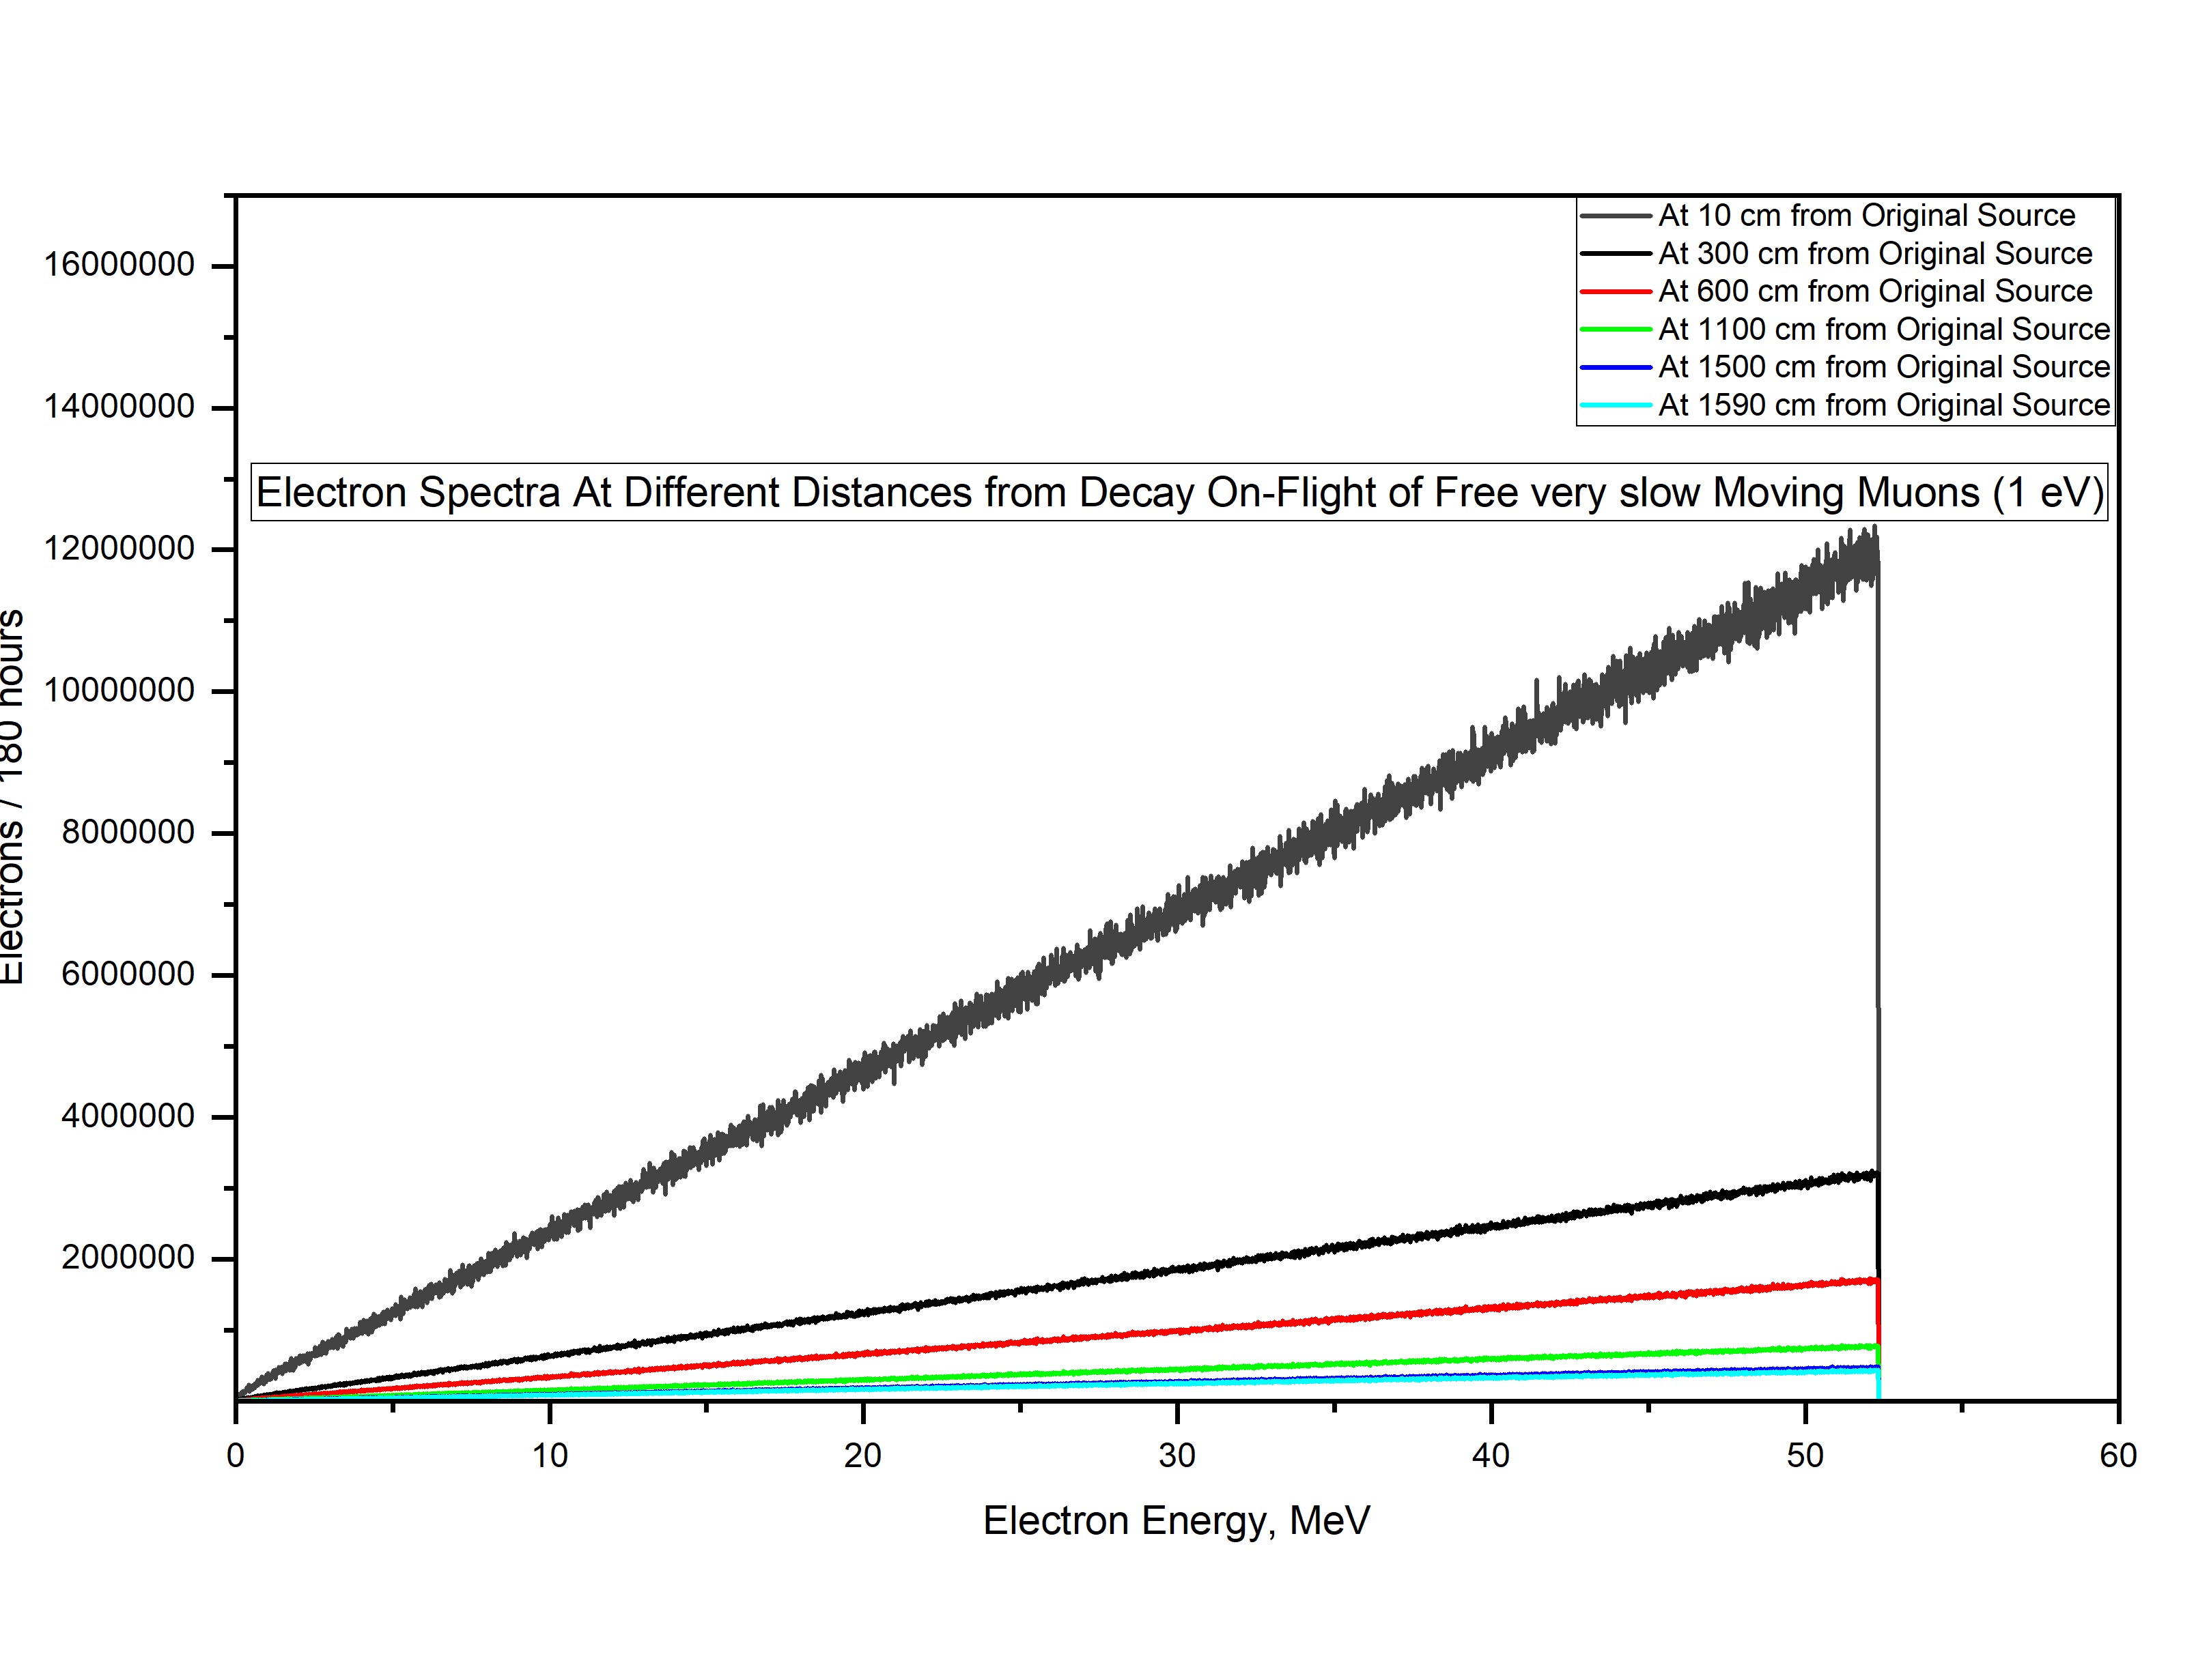


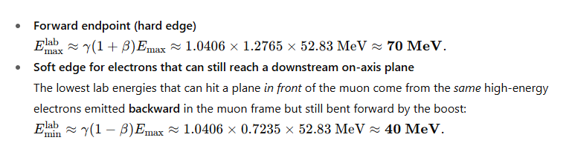
In Vacuum
The probability a muon does not decay during the flight is (Lorentz factor γ≈1.04):
Ge-Detector
In Vacuum
MC simulation
MC simulation
Target
C2
C1
So ≈ 91.9% of the muons survive to the target;
≈ 8.1% decay in flight (In agreement with MCNP result)
Ge-Detector
The two Electrons spectra are different for three tightly-coupled reasons: the Michel spectrum in the muon rest frame, the Lorentz boost to the lab, and the downstream, on-axis detector geometry (distance/acceptance). MCNP6 is showing all three at work:
In Vacuum
1) Start from the same rest-frame physics For an unpolarized muon at rest, the electron energy follows the Michel spectrum​ the electron energy in the muon rest frame:
MC simulation
2) A moving muon boosts energies and collimates angles If the muon moves with 𝛽, 𝛾 the lab energy is:
PDG “Muon Decay Parameters” (2020), Eq. 58.3
Jackson Classical Electrodynamics (3rd ed.)
16

Slide 17
List of contents
Short Theoretical introduction.
Advantages of using Monte-Carlo codes like MCNP6.
Steps for Monte-Carlo Simulations.
MONUMENT experiment and Muon-Beam Profile.
Monte-Carlo Simulation of MONUMENT experiment.
Simulations of the Calibration Sources.
Simulations of the Induced Secondary Particles.
Separating Spectrum into its Components and Isotopes Production.
More for Near Future.
17

Slide 18
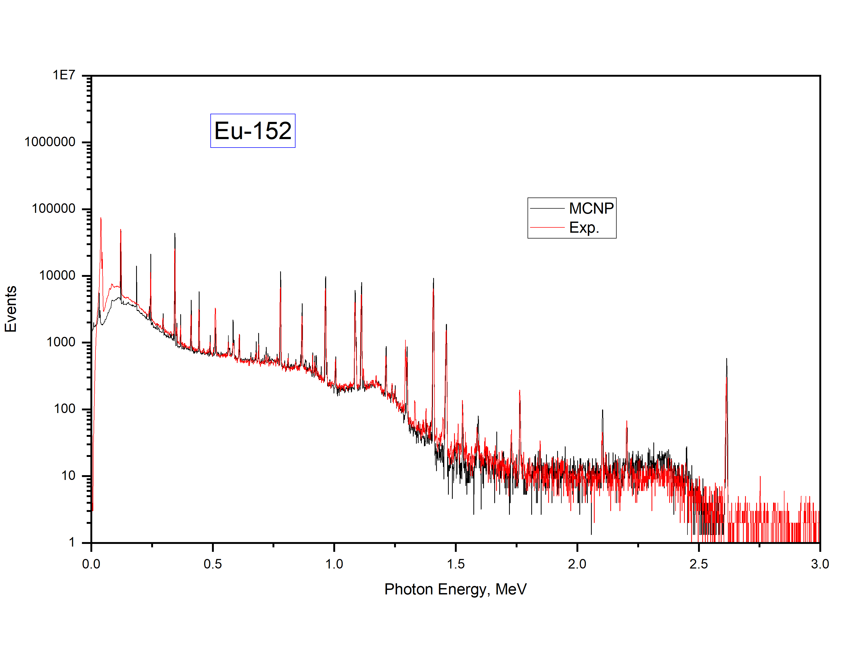
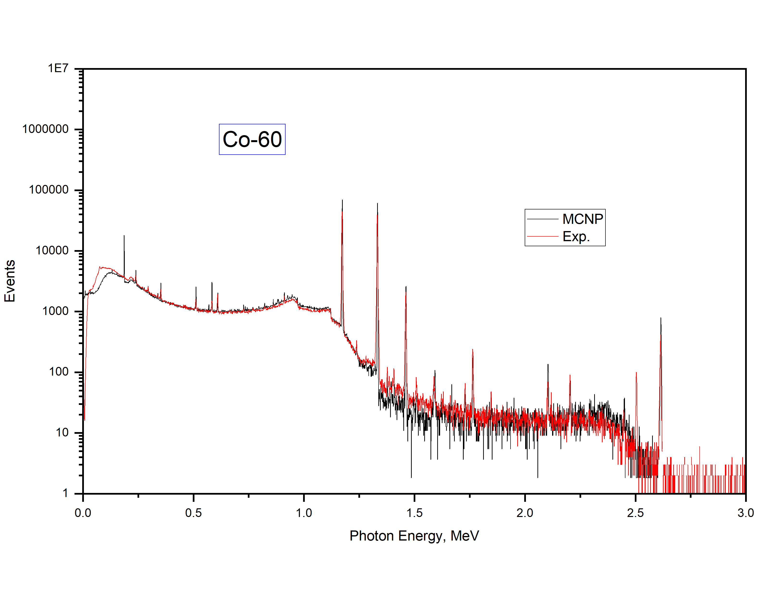
Agreement: Very close, small deviations at low energies (<200 keV) likely due to electronic noise, detector threshold effects, or incomplete modeling of scattering in nearby structures.
What the Comparison Tells us
MCNP6 is accurately modeling:
  Detector geometry and material response.
  Photon transport and interaction physics.
  Energy resolution (a Gaussian Energy Broadening function (GEB) was applied).
Deviations mainly arise from:
  Detector geometry (real detector housing, Endcap distance, real value of active volume, … maybe not accurate as shown in the detector certificate!.
  Pile-up and dead time in experiment not included in MCNP (can be simulated later)
  Statistical fluctuations (both measurement and simulation).
  Coincidence summing effects (very relevant for Eu-152) (can be simulated later).
Together, these calibration checks give confidence that MCNP6 setup can reliably model γ-ray transport and detector response, which is crucial before applying it to more complex muonic x-ray and capture studies.
18

Slide 19
List of contents
Short Theoretical introduction.
Advantages of using Monte-Carlo codes like MCNP6.
Steps for Monte-Carlo Simulations.
MONUMENT experiment and Muon-Beam Profile.
Monte-Carlo Simulation of MONUMENT experiment.
Simulations of the Calibration Sources.
Simulations of the Induced Secondary Particles.
Separating Spectrum into its Components and Isotopes Production.
More for Near Future.
19

Slide 20
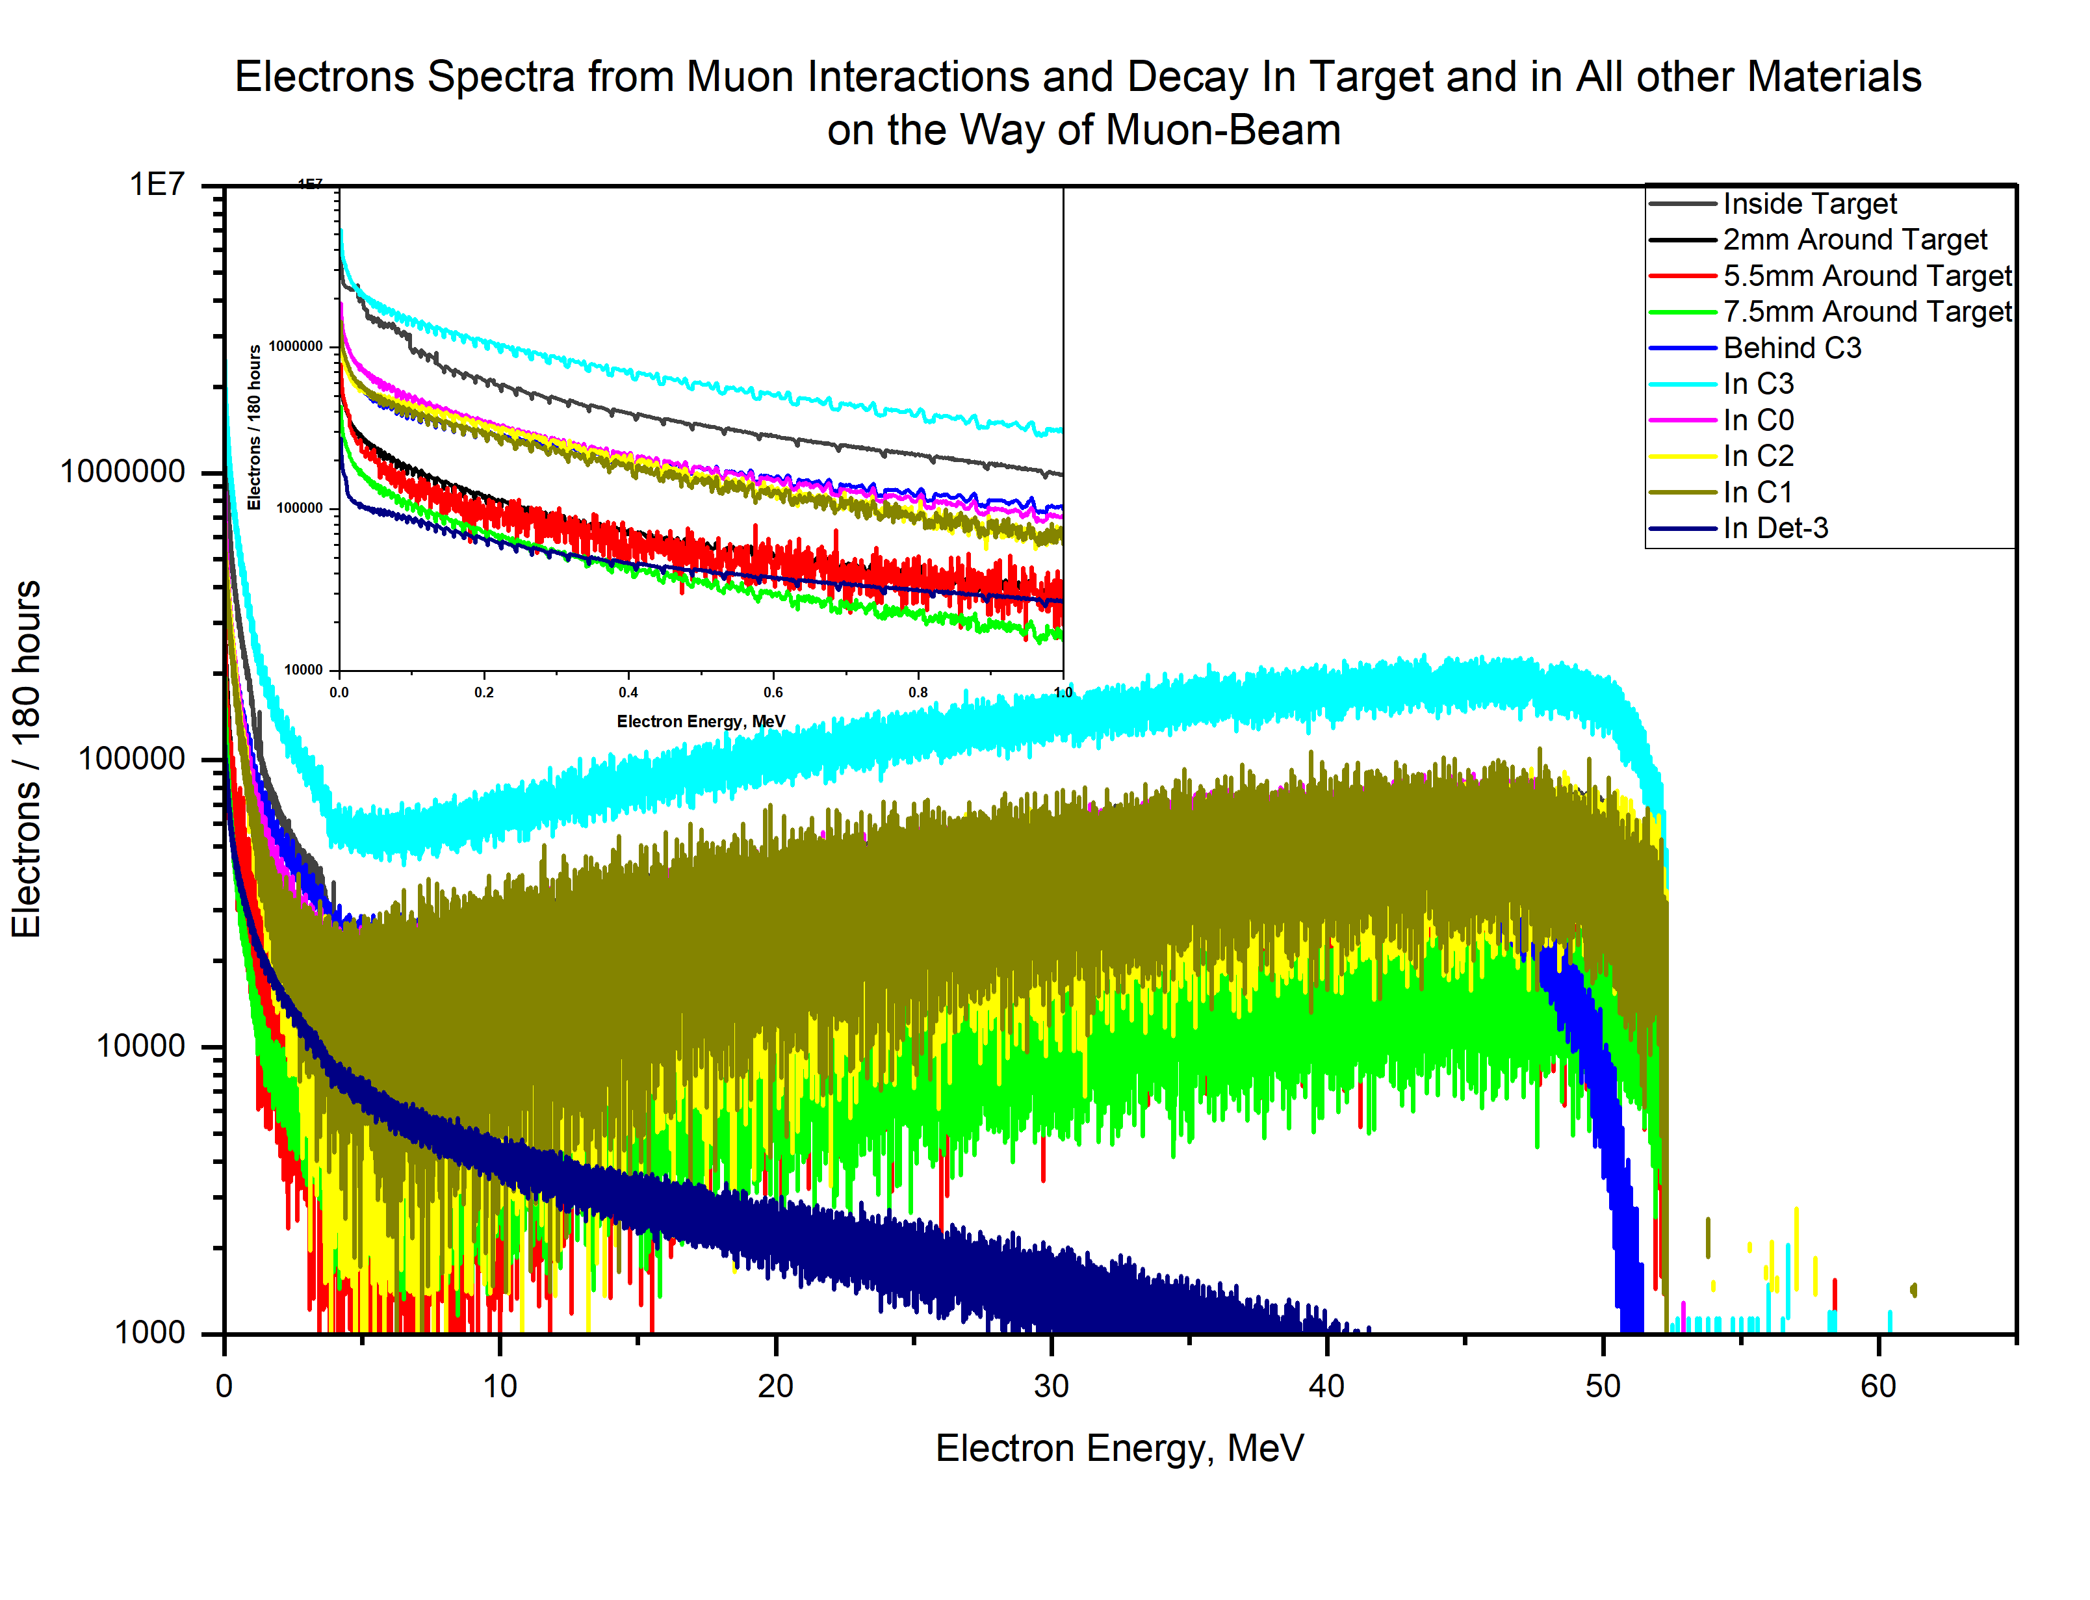
Secondary induced-particles can interact with all parts of the experiment and induce isotopes mainly important at Target and Detector, and can have considerable contributions of background.
Real physics shaping the spectra:
inside BaCO₃_Target: decay-in-orbit (DIO) continuum up to ~52.8 MeV (slightly smeared by binding/recoil) + low-energy electrons from capture de-excitation (conversion/Auger/Compton) → the steep <1 MeV rise. in plastics/Mylar/air: mainly DIO electrons that were born or propagated there, softened by ionization losses and multiple scattering. Differences between “In target / around target / C0-C3 / behind C3 / detector” are just how many μ⁻ stop/decay in each place and how those electrons survive to the tally plane.
Code/transport texture on top of that (the little teeth/ripples):
MCNP6 uses condensed-history charged-particle transport. When the step size and soft–hard split (production cut for δ-rays) change with energy, one can get small, quasi-periodic notches in finely binned spectra. Those aren’t cross-section resonances; they’re numerical/acceptance aliasing and will diminish if we tighten transport parameters or widen bins slightly.
MC simulation
20

Slide 21
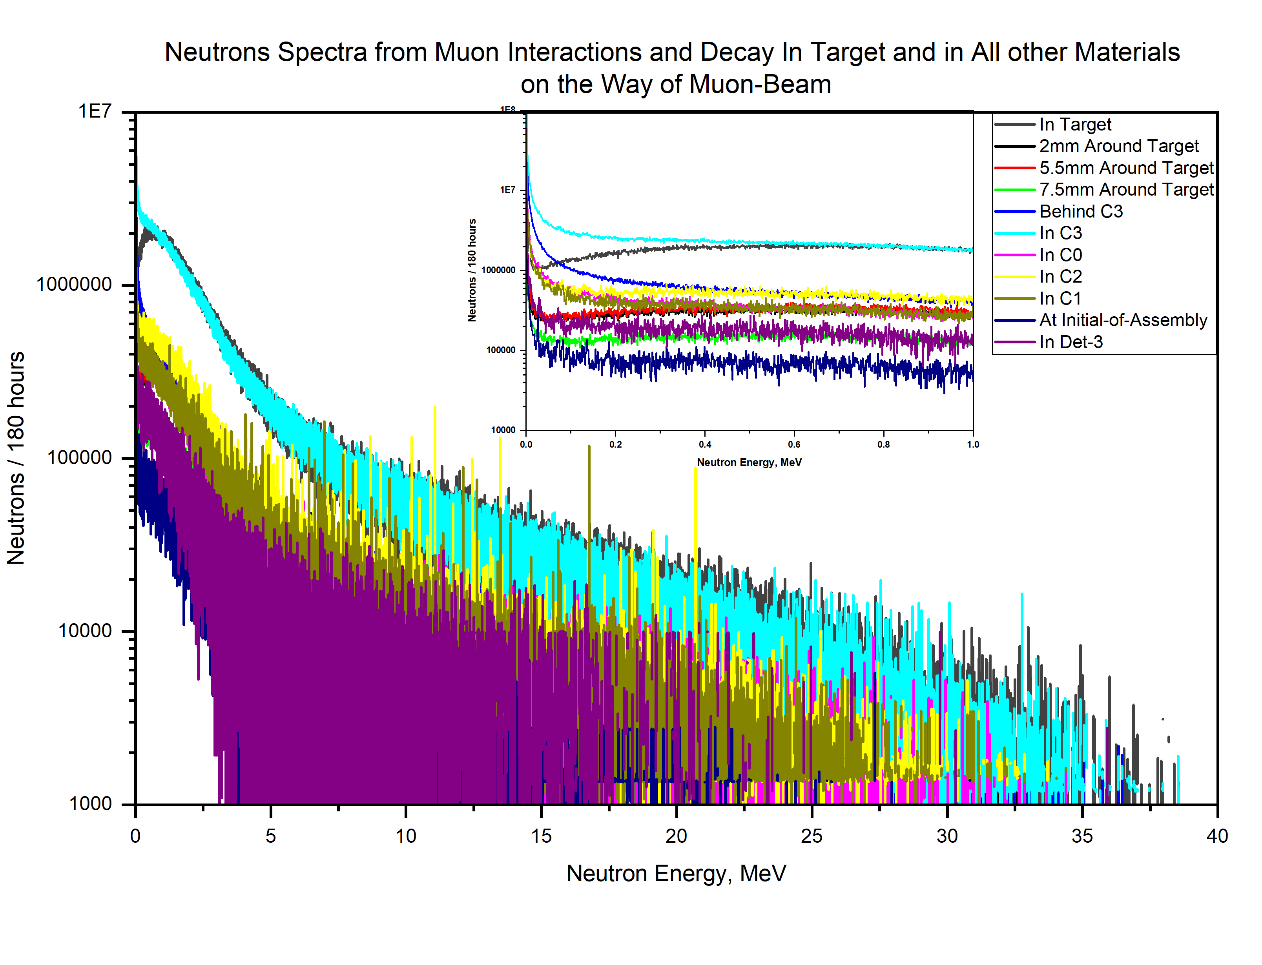
Secondary induced-particles can interact with all parts of the experiment and induce isotopes mainly important at Target and Detector, and can have considerable contributions of background.
Physics mechanisms producing neutrons from stopped μ⁻
Muon nuclear capture (dominant in heavy nuclei like Ba): Reaction: 𝜇⁻ + (𝐴,𝑍) → 𝜈_{𝜇} + (𝐴,𝑍−1)* . The daughter nucleus is highly excited (~15–20 MeV typical excitation energy). De-excitation occurs by emission of neutrons, protons, deuterons, alphas, and γ’s, but neutrons dominate because they are uncharged and have the lowest emission barrier. This is the main source of the broad continuum we see from ~1 MeV up to ~30–40 MeV.
Muon-induced fission-like or pre-equilibrium processes (less likely in Ba but possible): The nuclear excitation can also lead to multi-nucleon emission (2n, np, etc.), which broadens the high-energy neutron tail.
Muon decay in orbit (DIO): Normally produces only an electron and neutrinos, not neutrons. But the electron can induce bremsstrahlung → low-energy neutrons. Contribution is small compared to capture, but sub-MeV neutrons can partly come from this secondary channel.
Secondary reactions in other materials (C0, C1, Mylar, etc.): Fast neutrons emitted in the target can scatter and degrade in surrounding materials. We’ll see this as flattened, softer distributions in “around target / behind C3 / detector” curves.
MC simulation
21

Slide 22
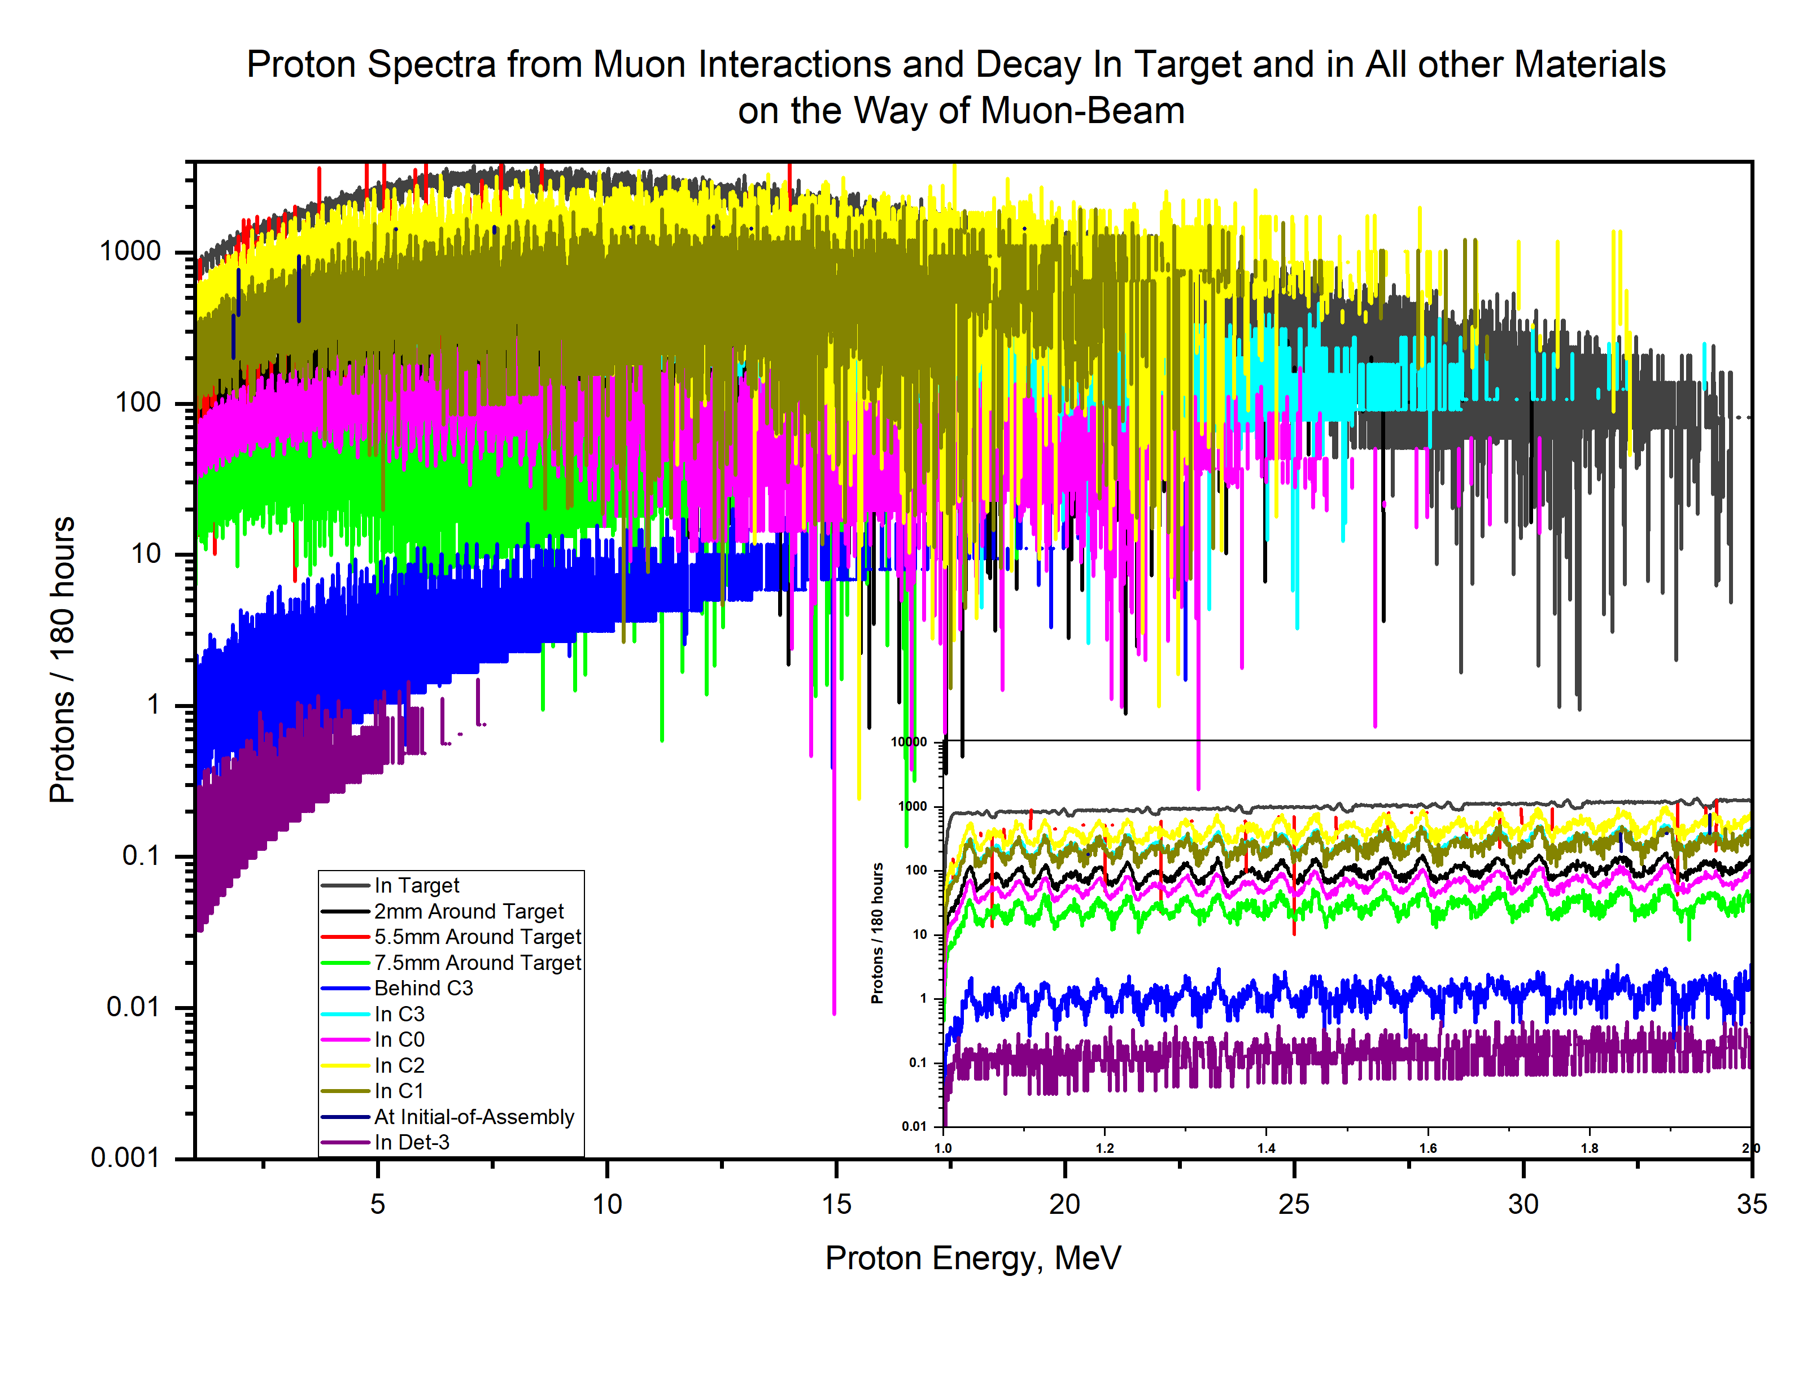
Secondary induced-particles can interact with all parts of the experiment and induce isotopes mainly important at Target and Detector, and can have considerable contributions of background.
Origins of protons from muon interactions:
When a negative muon stops in matter and reaches the
1s-orbit, two main processes happen:
Muon Decay in Orbit (DIO):
𝜇⁻ → 𝑒⁻ + 𝜈^{ˉ}_{𝑒}+ 𝜈_{𝜇} ​This process does not directly produce protons. But the energetic decay electron can induce secondary ionization, delta-rays, or knock-on protons in light materials (like C, O, Mylar). Contribution: small, low-energy protons (a few MeV max).
Muon Nuclear Capture (dominant in Ba):
𝜇⁻ + 𝑝 → 𝑛 + 𝜈_{𝜇} ​Converts a proton in the nucleus into a neutron. The residual nucleus is left highly excited, often above particle emission threshold. It then de-excites by emitting: Neutrons (dominant, as you saw in your neutron spectrum), Protons, Deuterons, tritons, alphas, gammas (smaller fractions). These emitted protons are called muon-induced nuclear evaporation products.
MC simulation
22

Slide 23
List of contents
Short Theoretical introduction.
Advantages of using Monte-Carlo codes like MCNP6.
Steps for Monte-Carlo Simulations.
MONUMENT experiment and Muon-Beam Profile.
Monte-Carlo Simulation of MONUMENT experiment.
Simulations of the Calibration Sources.
Simulations of the Induced Secondary Particles.
Separating Spectrum into its Components and Isotopes Production.
More for Near Future.
23

Slide 24
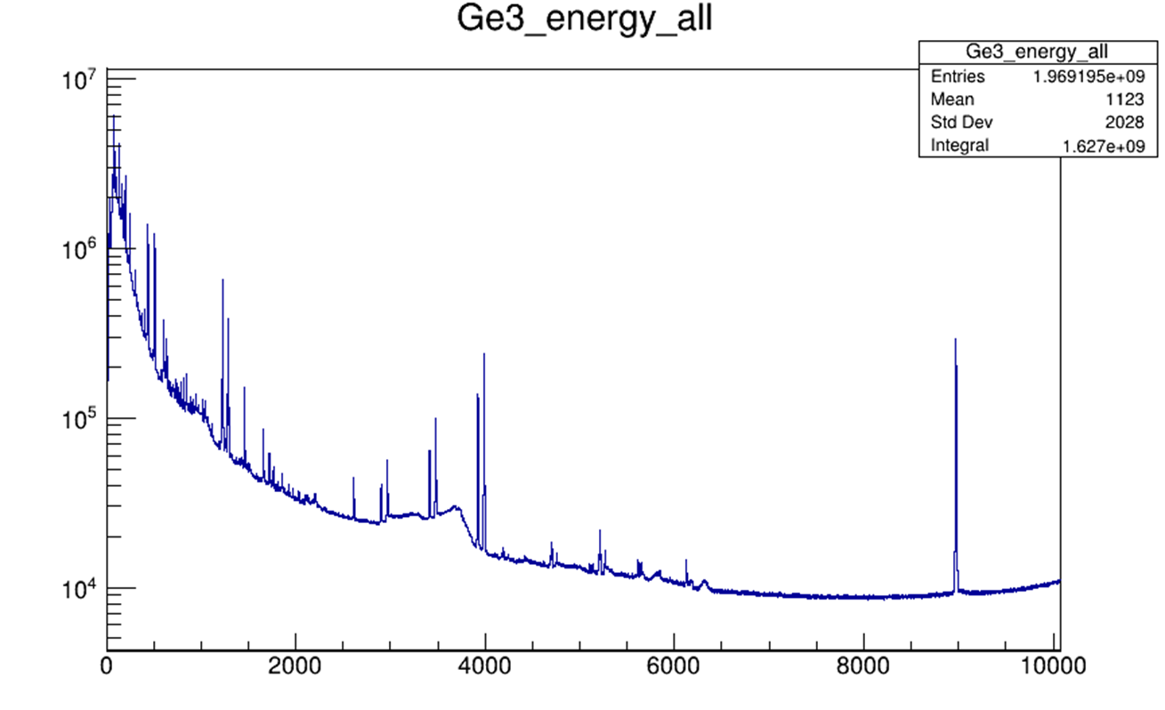
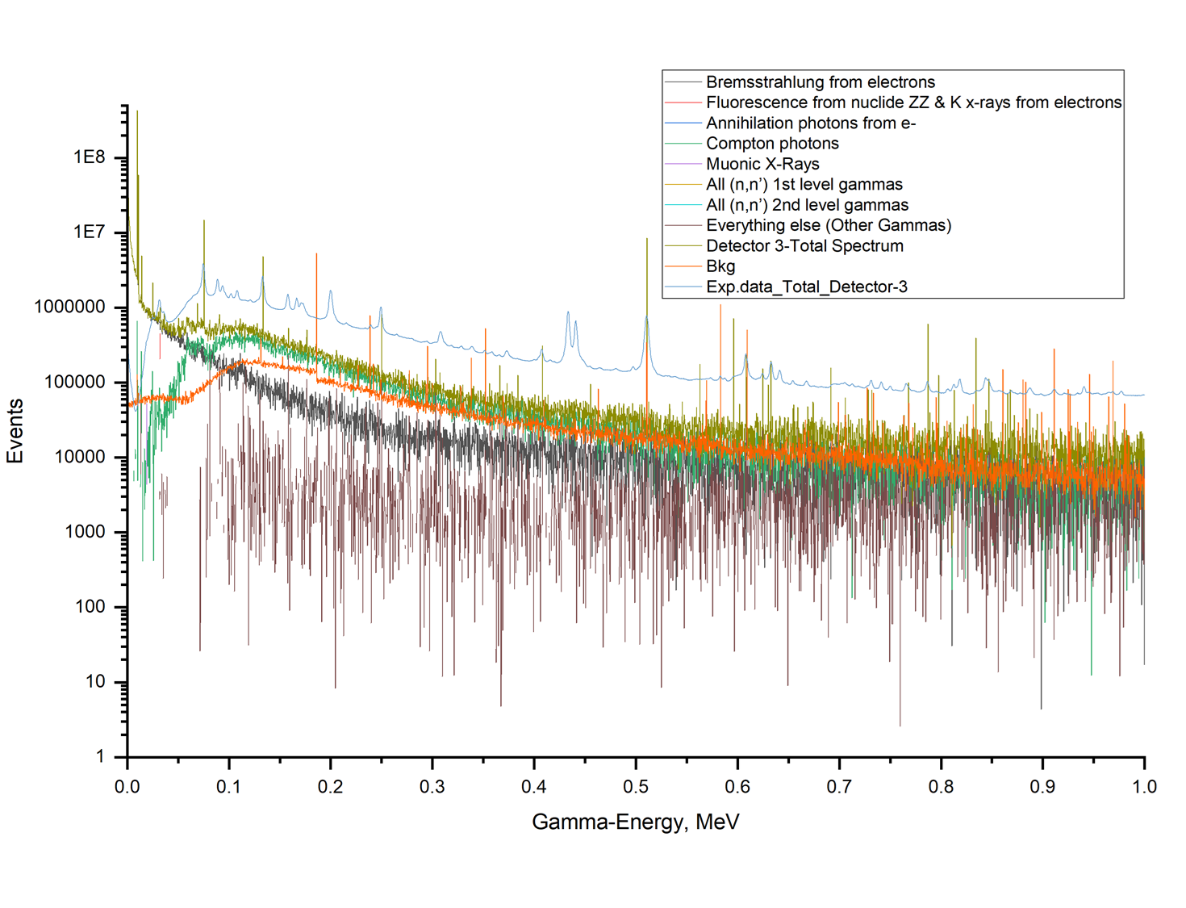
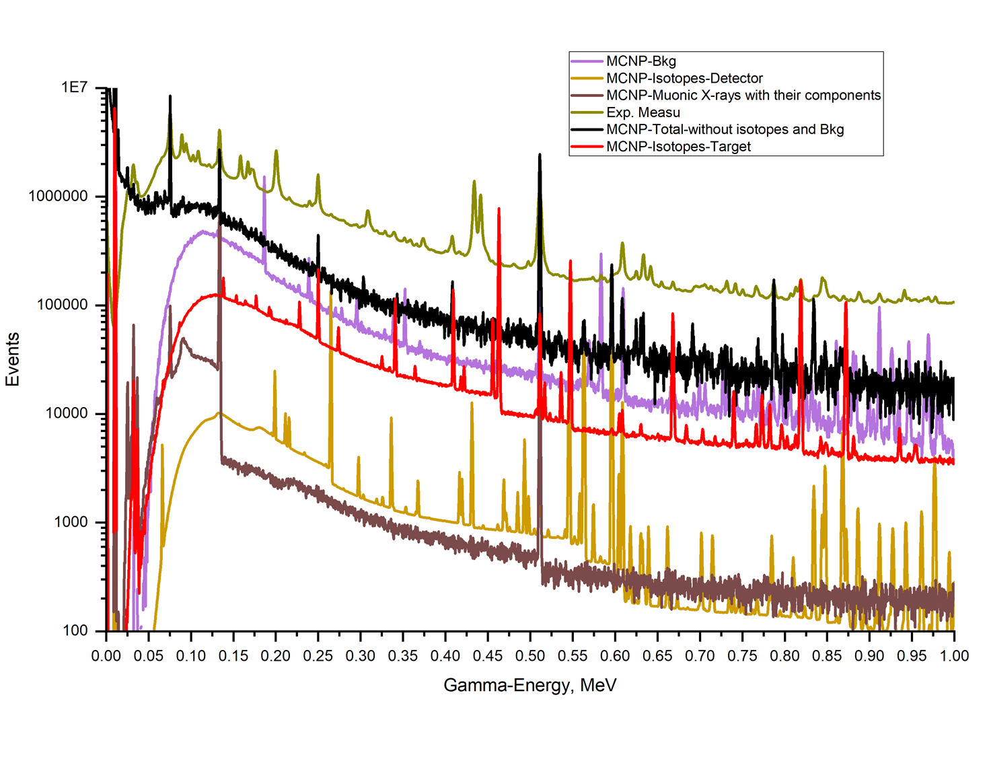
Det-3
MC Spectrum
Measured Spectrum
More Statistics needed, more time
The MCNP events: In the Energy Range [0, 10 MeV]
MC spectrum events = 1.21 x 10⁹
MC Natural Background events = 1.04 x 10⁸
MC Induced Background events = 3.18 x 10⁸
(not included in the spectrum)
MC Sum Events (180 hours) = 1.632 x 10⁹
Exp. Events (180 hours) = 1.627 x 10⁹
24

Slide 25
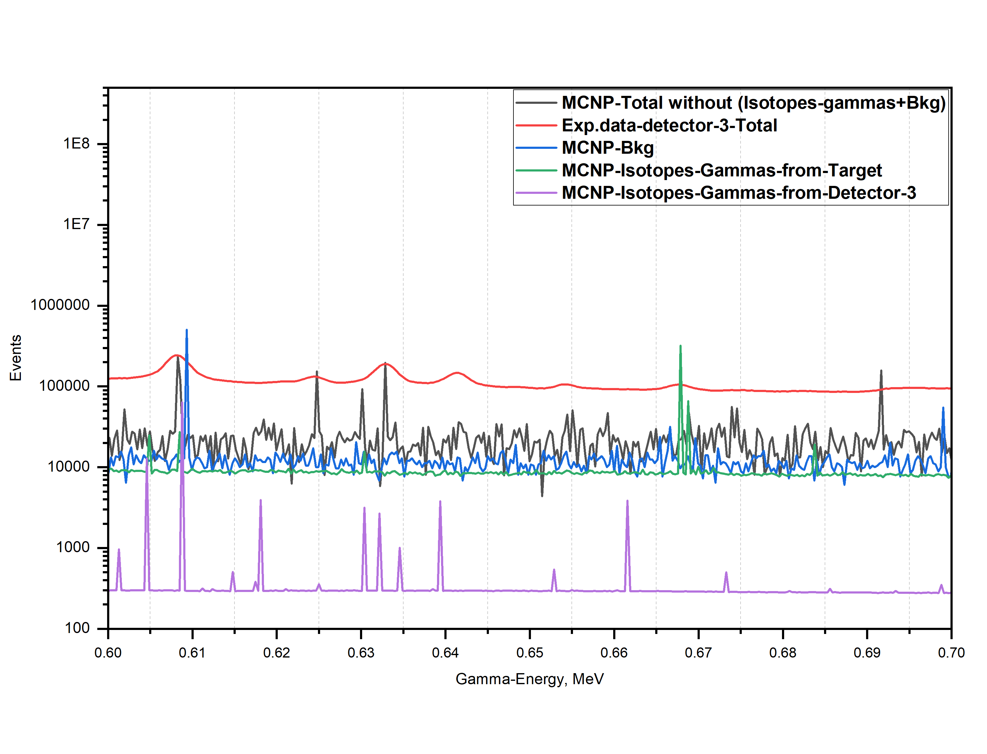
608.2 keV (most probable not (or not all events) from Cs-135 or Xe-135 ?! , but from other-nuclear-interaction induced-gammas (MCNP), and may also from Ga-74, from 608.54 keV peak of (n, n’)2nd level-gamma, and some from Bkg (609.31 keV Bi-214))
25

Slide 26
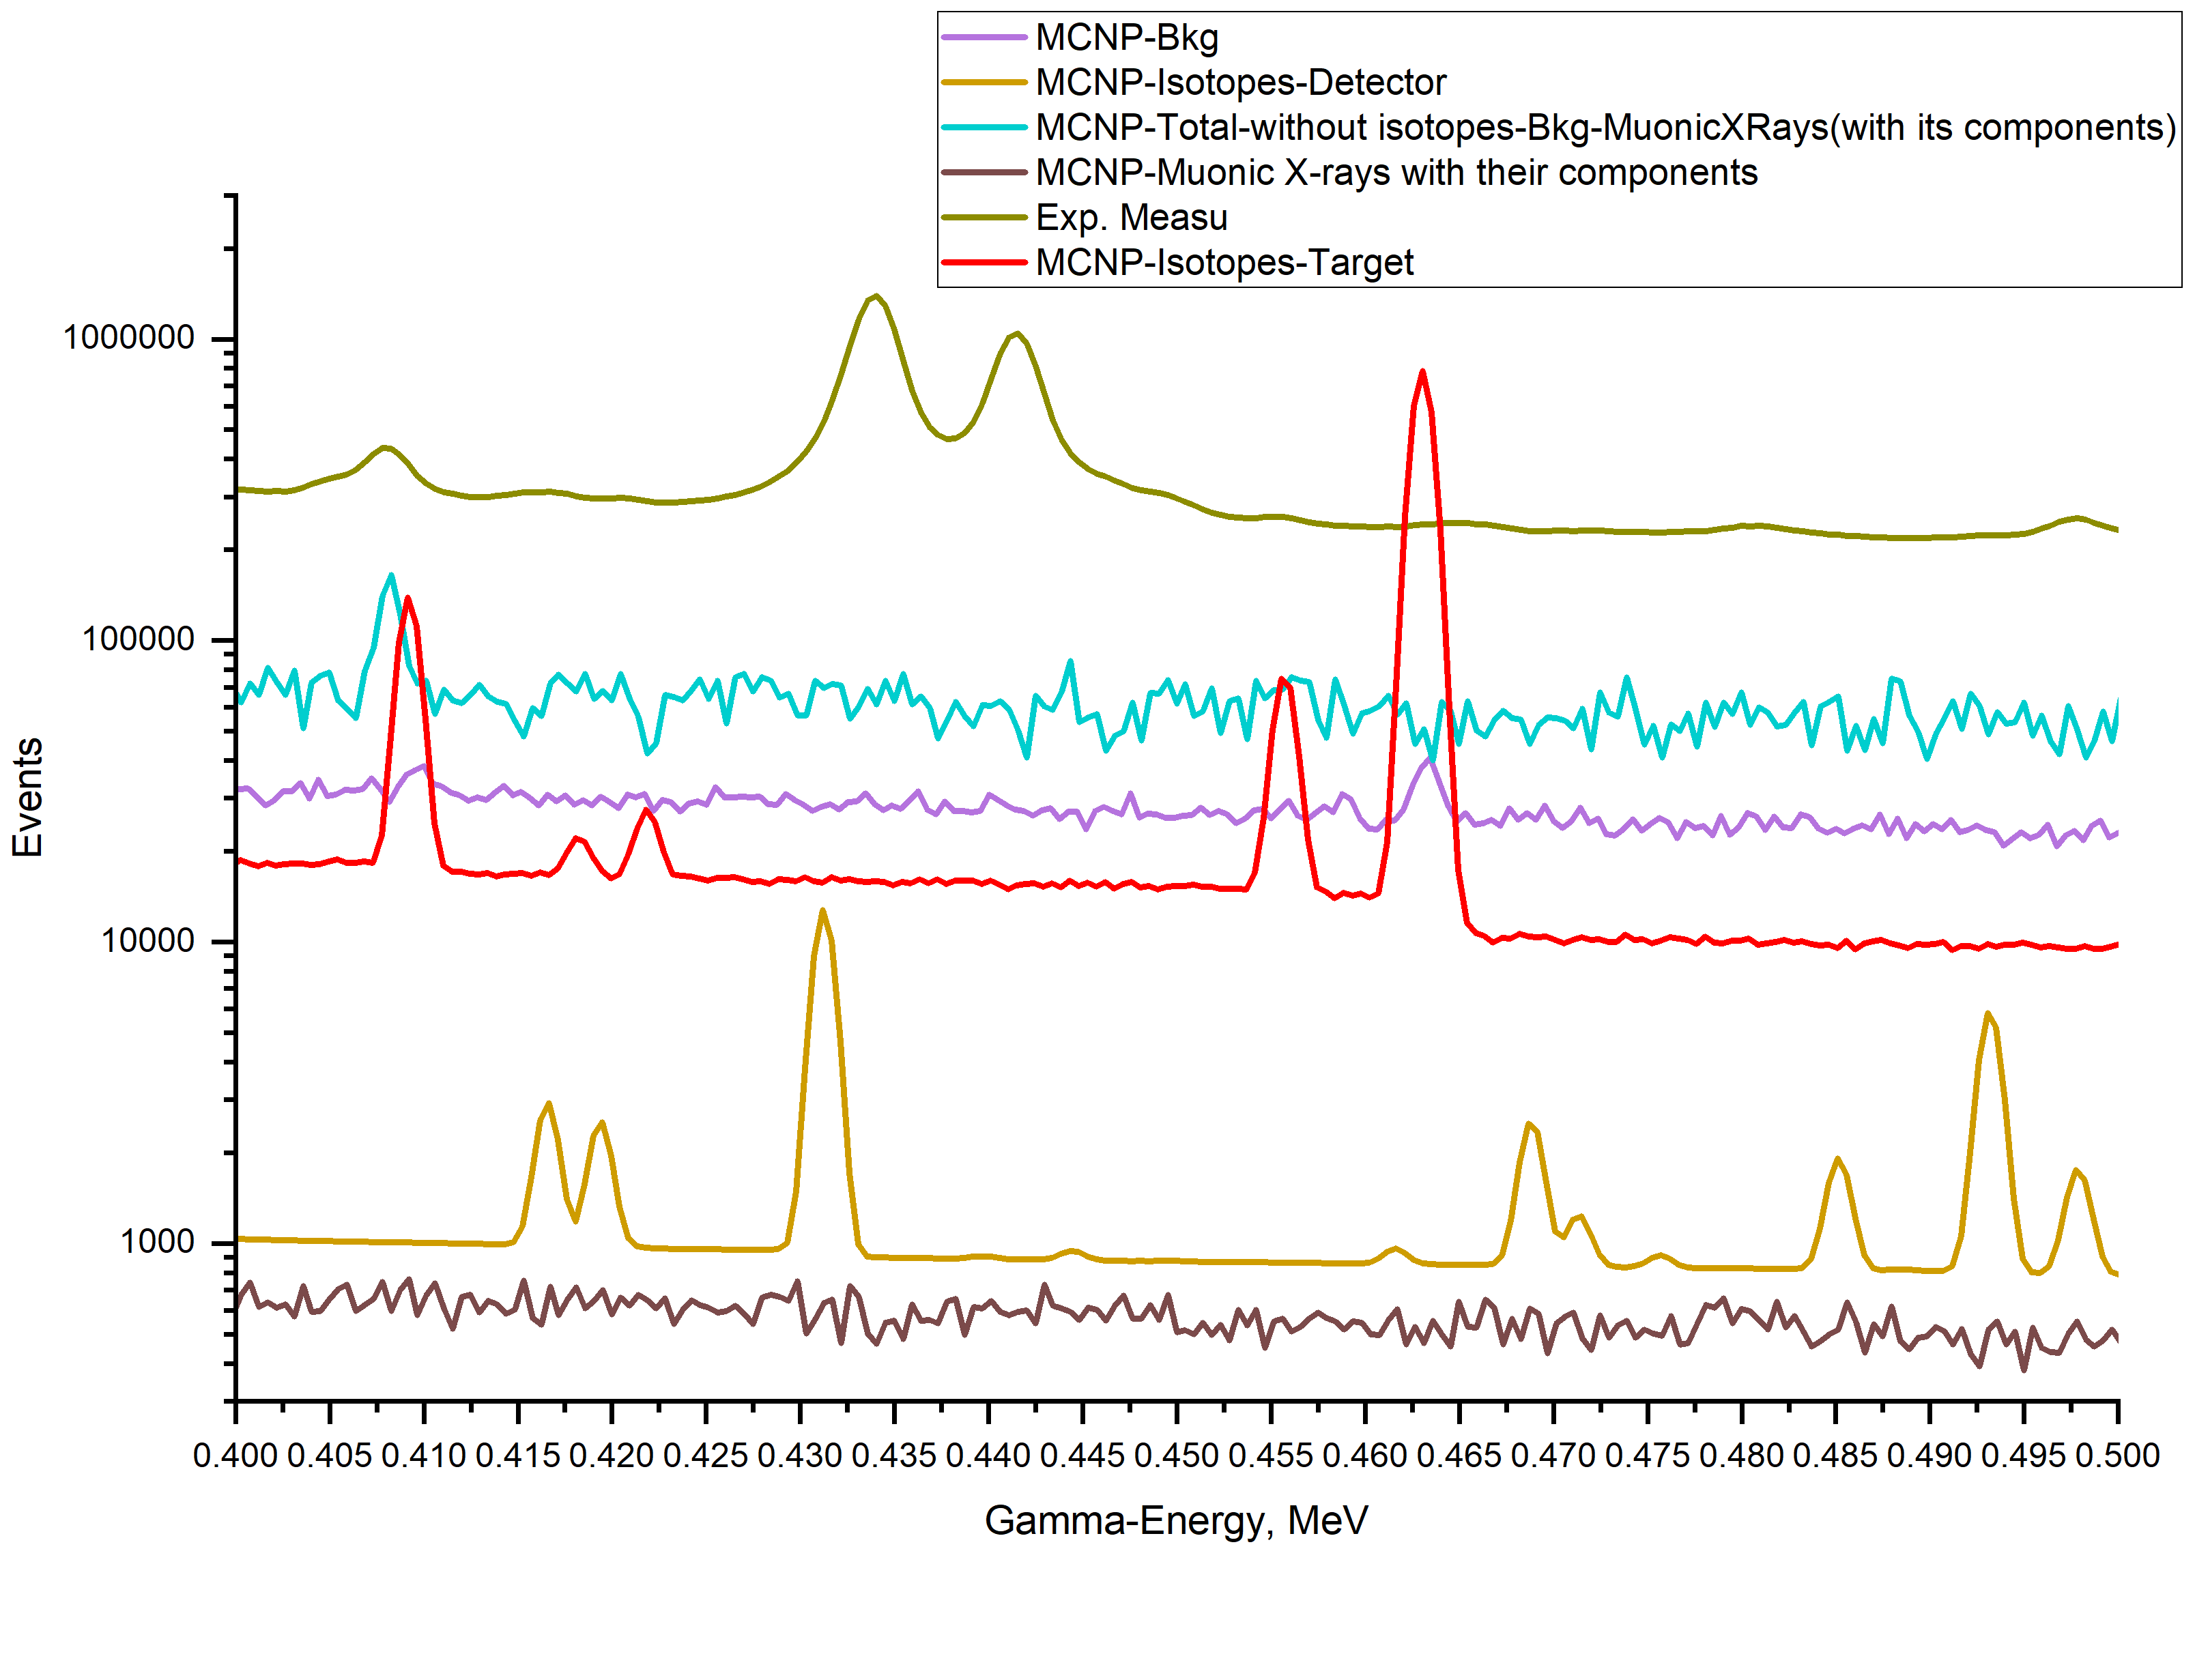
408 keV (not just from Cs-135, but also from other γ from nuclear-reaction like (n, xn’) and some from 409.8 keV; Pa-234 and 409.46 keV; AC-228)
434 keV (Ba-M)
441 keV (Ba-M)
26

Slide 27
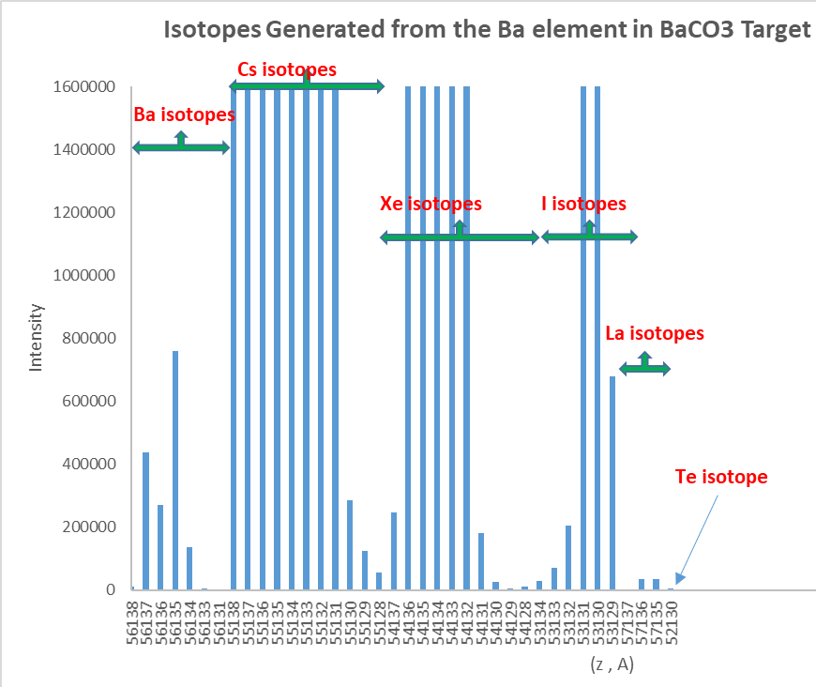
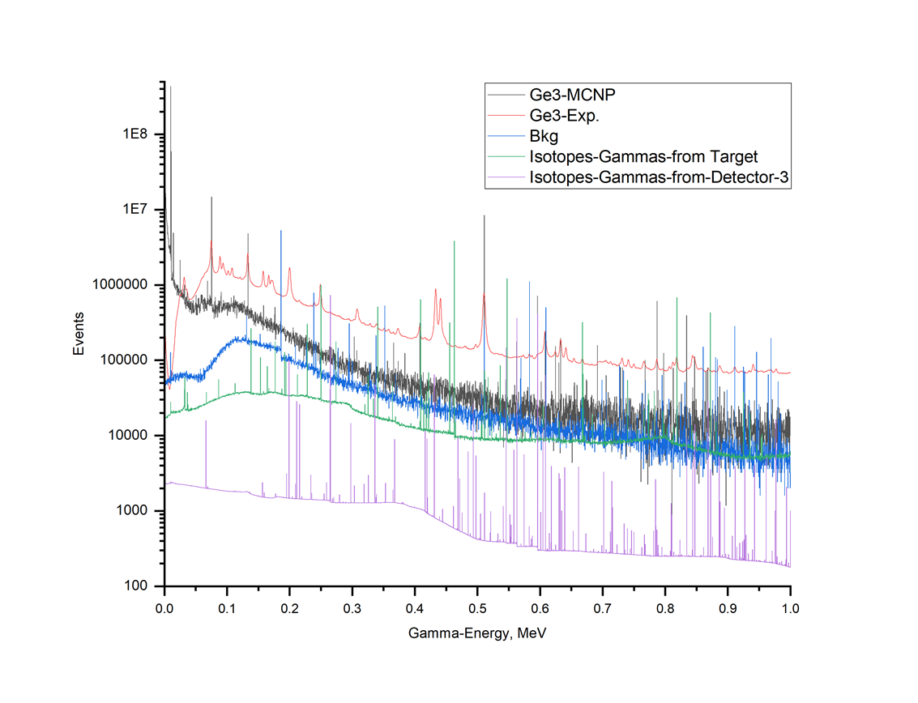
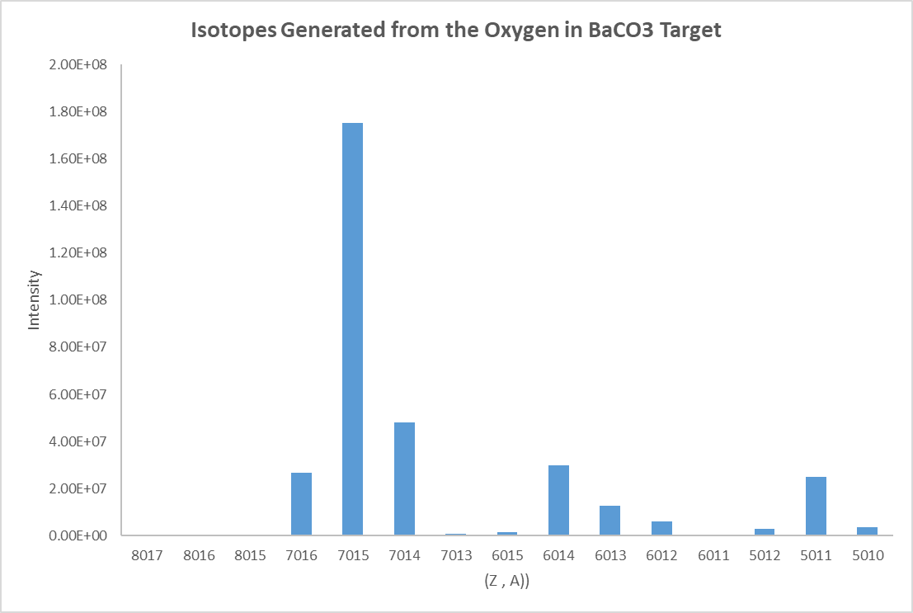
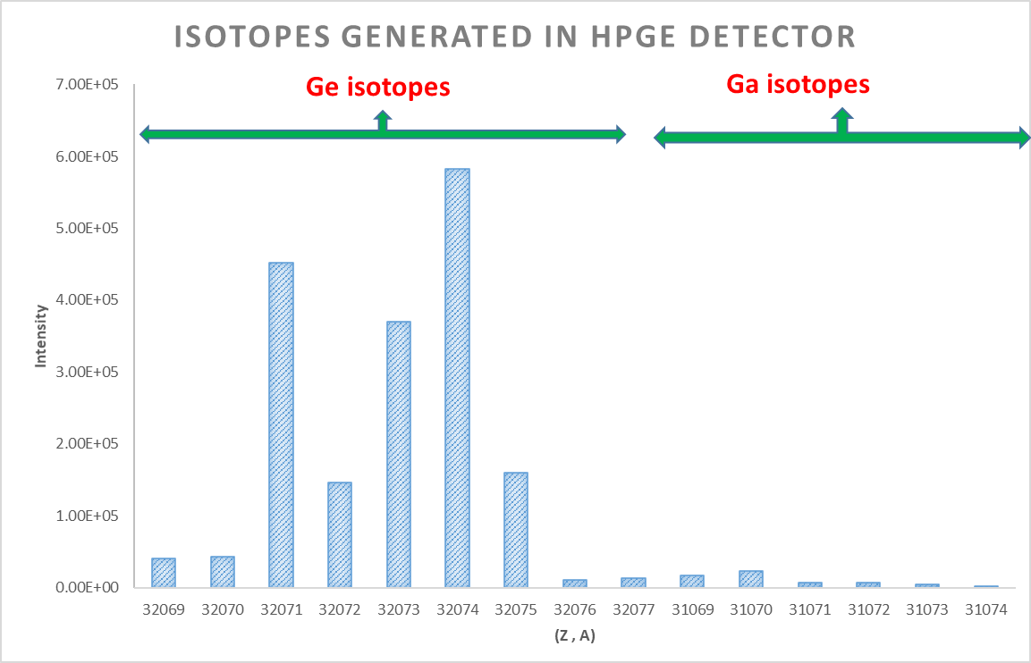
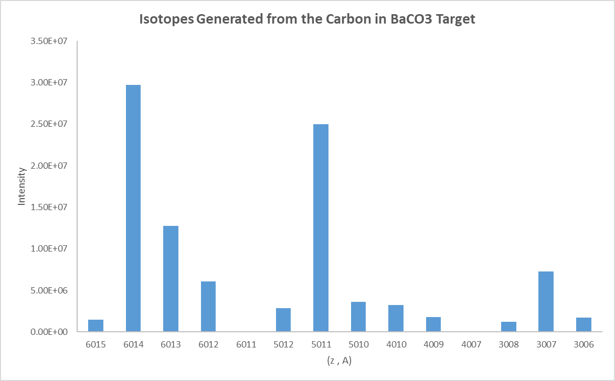
MC simulations of the Isotopes Productions
27

Slide 28
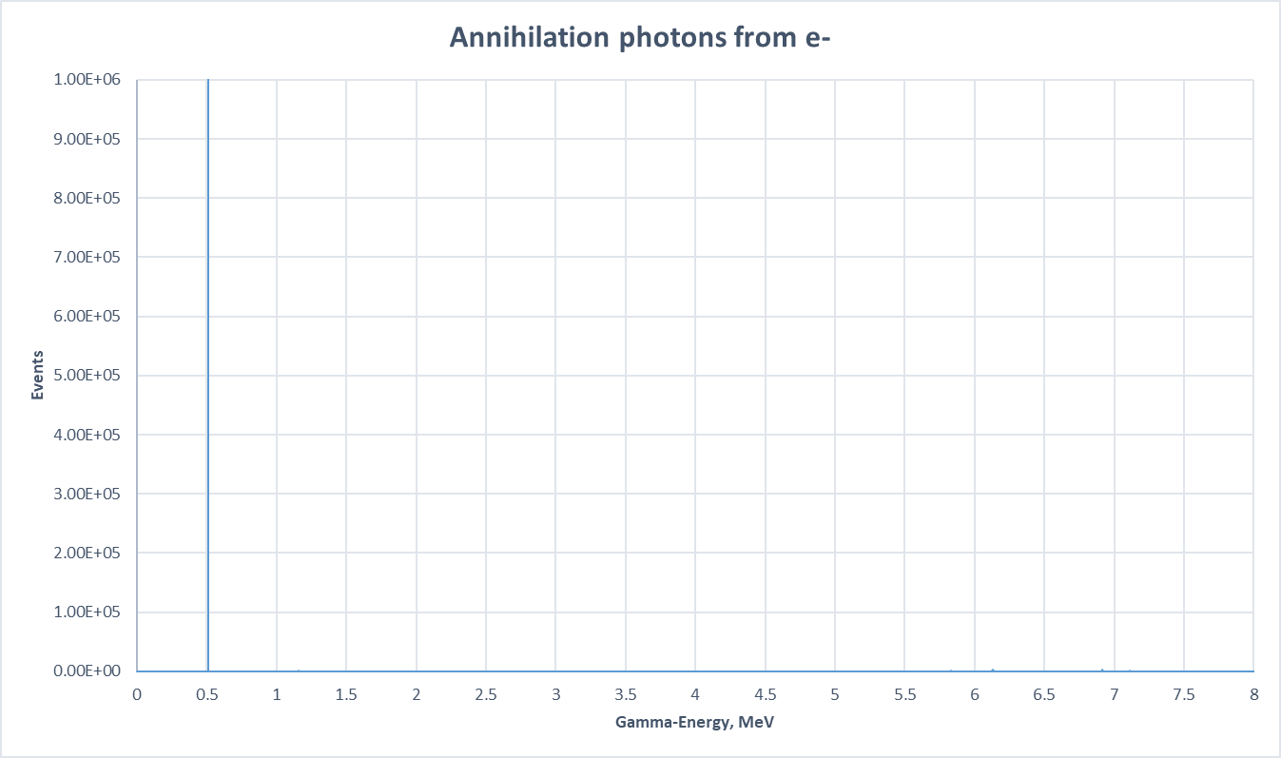
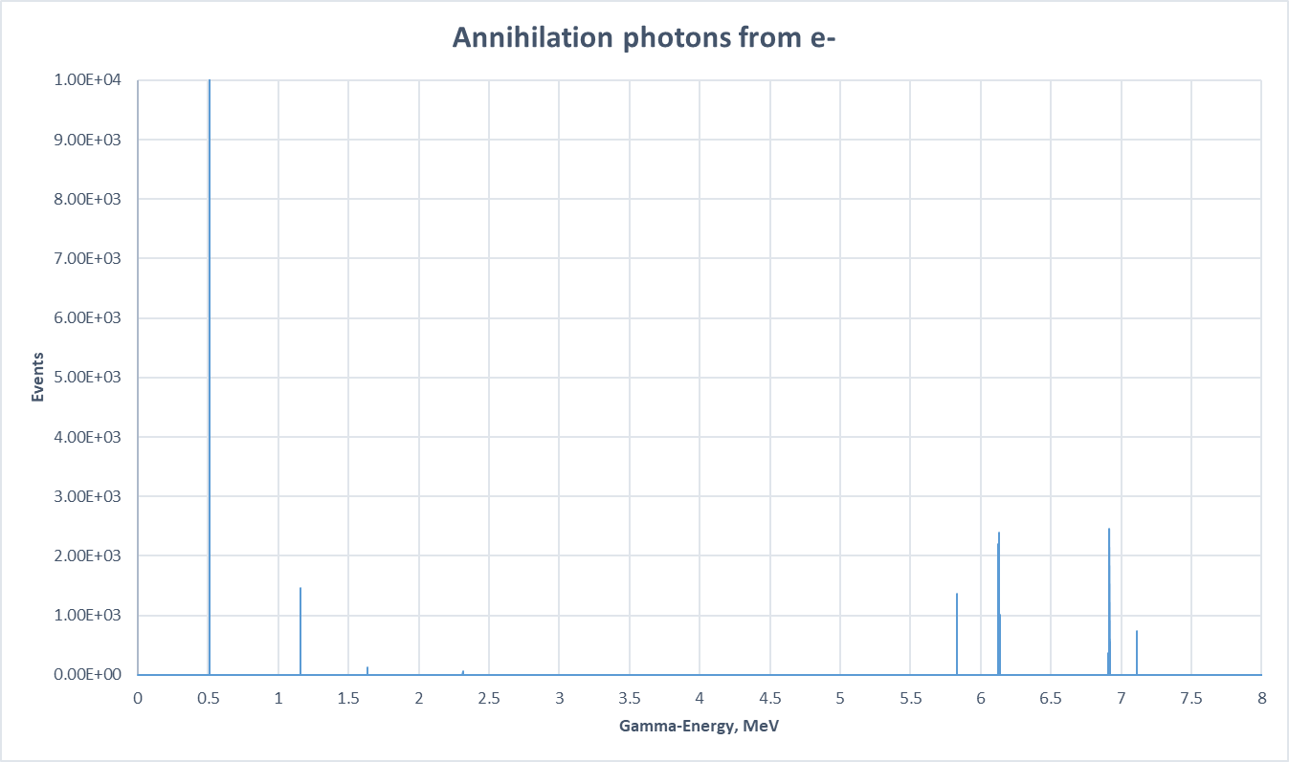
Example of from where some (unexpected !) Gamma-Peaks !
High-energy Michel electrons from muon decay (up to 53 MeV) produce bremsstrahlung photons, some exceeding 11 MeV, leading to pair production.
Positrons with kinetic energies around 5-10 MeV can annihilate, producing photons up to 6-7 MeV.
MCNP6 can simulate this chain:
1- Muon decay to electrons.
2- Bremsstrahlung photon emission.
3- Pair production.
4- Two-photon annihilation with boosted energies.
MC Simulation
1.16 MeV, Events = 1.5 x 10³
2.313 MeV, Events = 63
511keV, Events = 8 x 10⁶
28

Slide 29
List of contents
Short Theoretical introduction.
Advantages of using Monte-Carlo codes like MCNP6.
Steps for Monte-Carlo Simulations.
MONUMENT experiment and Muon-Beam Profile.
Monte-Carlo Simulation of MONUMENT experiment.
Simulations of the Calibration Sources.
Simulations of the Induced Secondary Particles.
Separating Spectrum into its Components and Isotopes Production.
More for Near Future.
29

Slide 30
More for Near-Future:
Allow more physics and MCNP6 tallies to be incorporated into pulses:
  All previous and on-going simulations are Time-independent, and it is very important to do the simulations with Time-Dependent, which is available in MCNP6 code: Time binning; Time Triggering.
  Coincidence/Anti-Coincidence between many detectors.
  Coincidence-Summing Peaks.
  Delayed particles production.
  Detailed exploring muonic X-ray production – MUON/RURP codes included with MCNP6 code.
  Nuclear resonance fluorescence.
  Micro/macro beam pulse option – nesting of time distributions provides accurate beam modeling.
  ROC curve tally option – generates ROC (Receiver Operator Characteristic) curves from signal & noise tallies using batches of samples.
  The possibility of optimizing the Beam-profile and Target to get the same gamma-intensities with less secondary particles which decrease the background, and maybe also with less Target-material used in the experiments and therefor decreasing the costs !.
Start doing simulations for other Targets: Mo-100, Se-76, Ti-48 …
30

Slide 31
THANK YOU FOR YOUR ATTENTION
Q & A

