Slide 1


Analysis of hypernuclei and strange particles in the BM@N experiment
Ramin Barak
on behalf of the BM@N Collaboration
THE XVI-th INTERNATIONAL SCHOOL-CONFERENCE "THE ACTUAL PROBLEMS OF MICROWORLD PHYSICS" Minsk, Belarus, 24 – 31 August, 2025

Slide 2
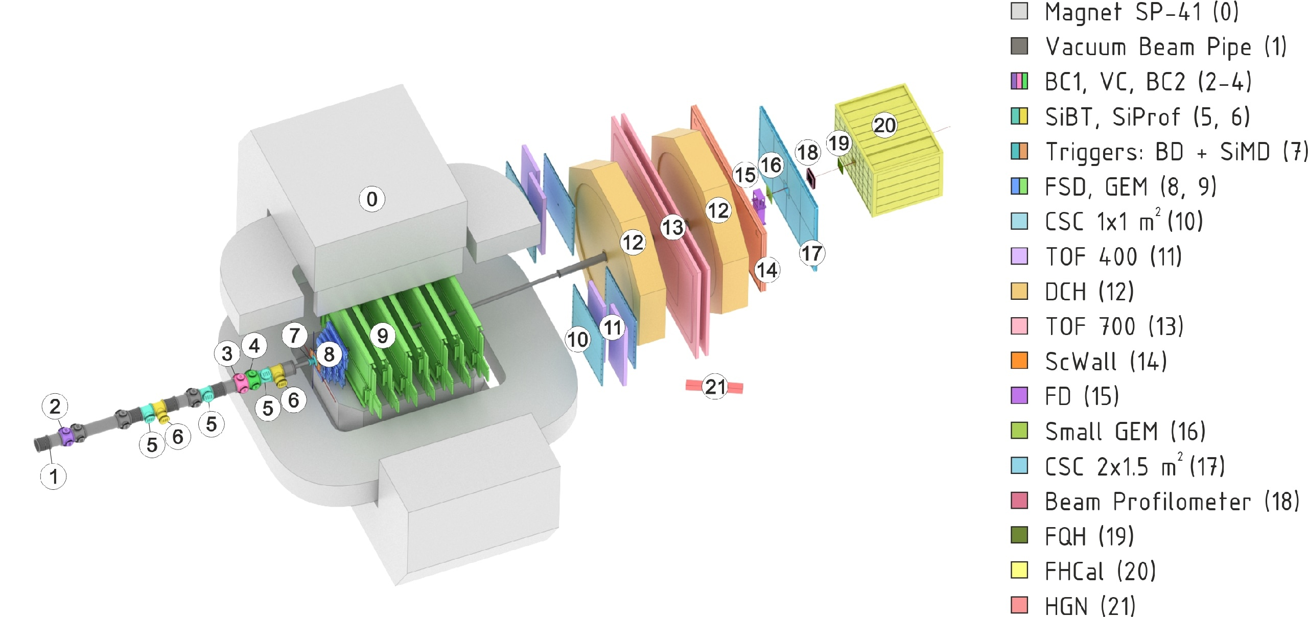
BM@N experiment at the NICA complex
Collisions of elementary particles and ions with a stationary target at energies up to 4 GeV per nucleon.
Studying the properties of dense baryonic matter, the formation of hypermatter, the equation of state of symmetric and asymmetric nuclear matter, collective phenomena...
NICA accelerator complex
Experimental setup of BM@N

Slide 3
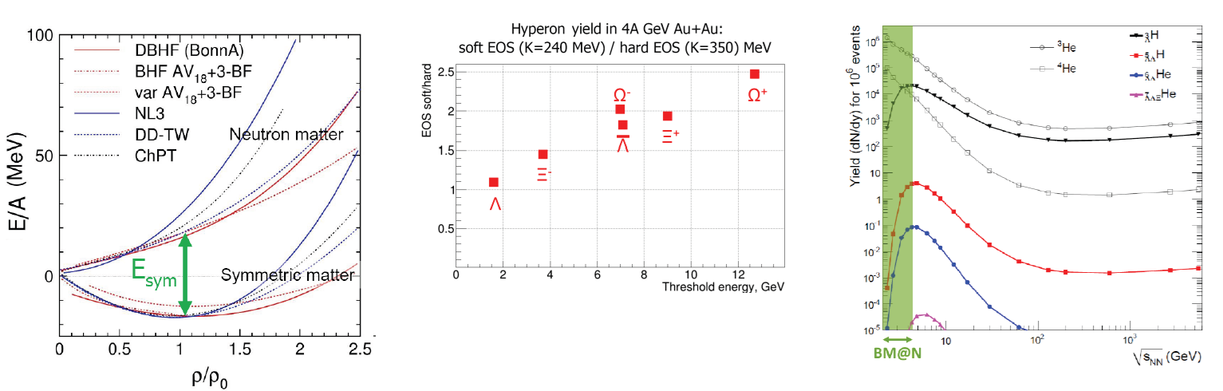
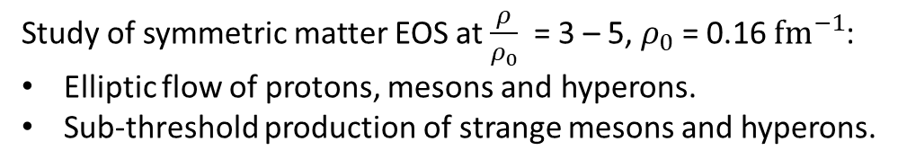
Introduction
Why are strange particles and hypernuclei interesting to study?
$φ\text{(1020}\text{)}$is expected to have a small cross-section for interactions with other non-strange particles, and its life time is relatively long (∼41 fm/c), it may keep information of the early stage of the system’s evolution [1].
Study of symmetric matter EOS at $\frac{ρ}{ρ_{0}}$ = 3 – 5, $ρ_{0}$ = 0.16 ${fm}^{−1}$:
Elliptic flow of protons, mesons and hyperons.
Sub-threshold production of strange mesons and hyperons.
[1] J. Phys. G: Nucl. Part. Phys. 32, S373-S380 (2006) DOI: 10.1088/0954-3899/32/12/S46.
EoS: relation between density, pressure, temperature, energy and isospin asymmetry EA(ρ, δ) = EA(ρ, 0) + Esym(ρ) ・ δ2, where δ = (ρn − ρp)/ρ.

Slide 4

Goal
Observation of strange particle (lambda hyperon, $K_{S}^{0}$, $\text{Ξ}\text{−}$ and $φ\text{(1020}\text{)}$) and hypernuclei signals in the experimental data.

Slide 5
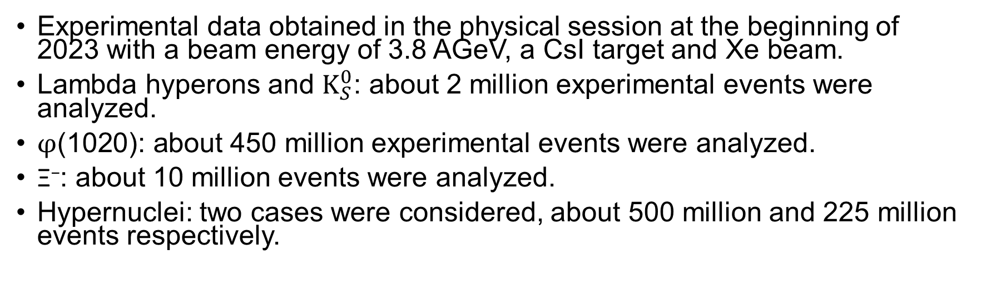
Data
Experimental data obtained in the physical session at the beginning of 2023 with a beam energy of 3.8 AGeV, a CsI target and Xe beam.
Lambda hyperons and $K_{S}^{0}$: about 2 million experimental events were analyzed.
$φ\text{(1020}\text{)}\text{: }\text{a}$bout 450 million experimental events were analyzed.
$\text{Ξ}\text{−}$: about 10 million events were analyzed.
Hypernuclei: two cases were considered, about 500 million and 225 million events respectively.

Slide 6
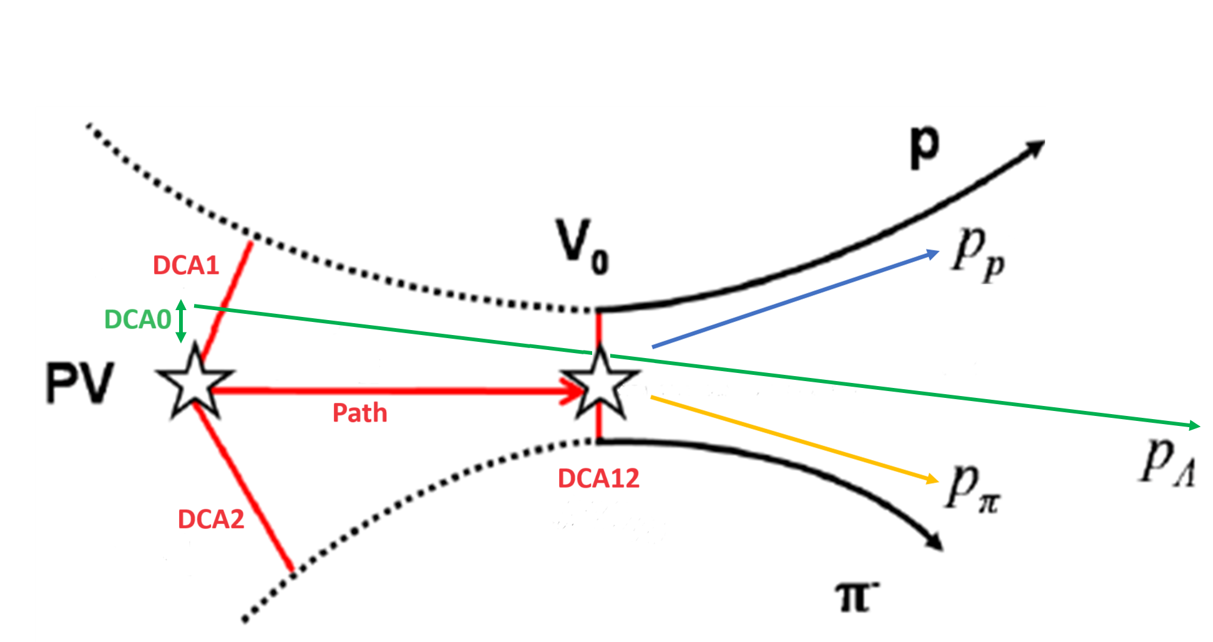
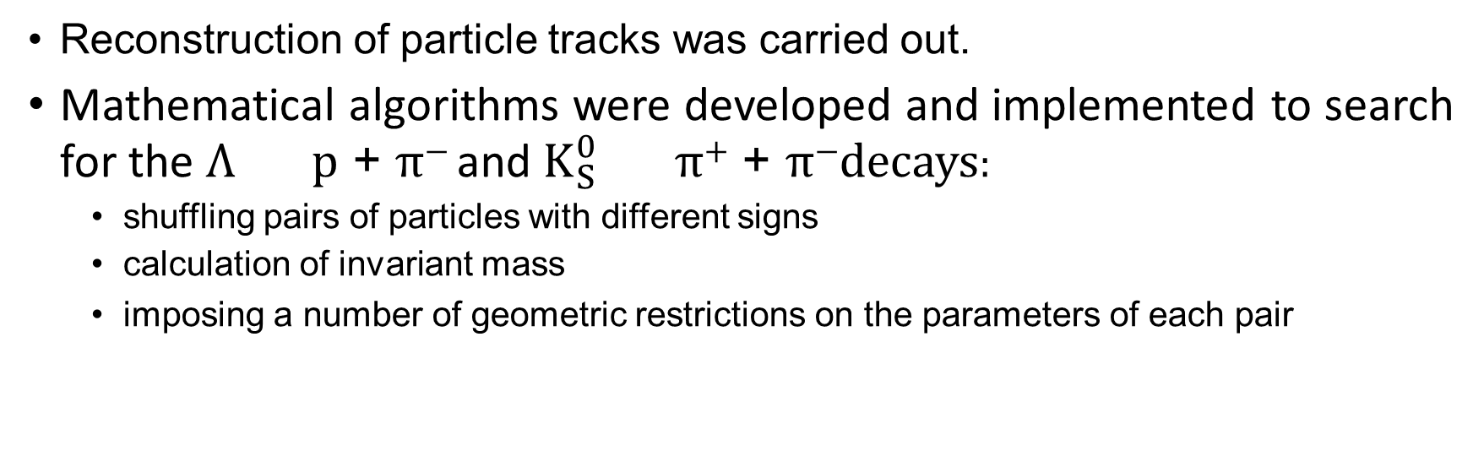

Data processing procedure (Λ and $K_{S}^{0}$)
Reconstruction of particle tracks was carried out.
Mathematical algorithms were developed and implemented to search for the Λ p + π⁻ and $K_{S}^{0}$ π⁺ + π⁻decays:
  shuffling pairs of particles with different signs
  calculation of invariant mass
  imposing a number of geometric restrictions on the parameters of each pair
PV – primary vertex.
Path – the distance traveled by Λ from the primary vertex to the point of its decay.
DCA0 – the distance between the primary vertex and the projection of momentum of Λ.
DCA1 – the shortest distance from the proton to the vertex.
DCA2 – the shortest distance from the negative π-meson to the vertex.
DCA12 – the distance between the proton and the negative π-meson at the decay point of Λ.
Event topology

Slide 7
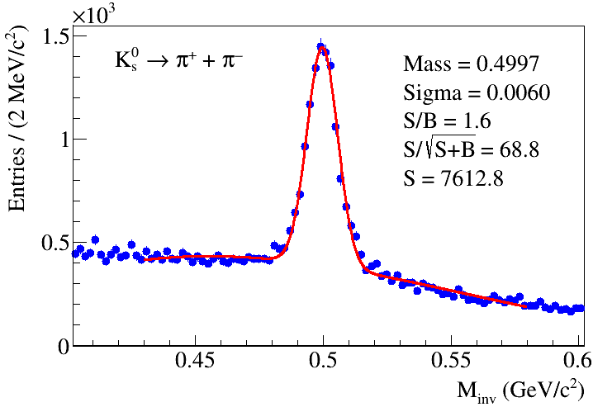
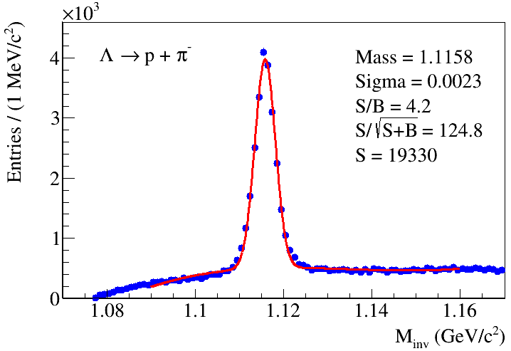
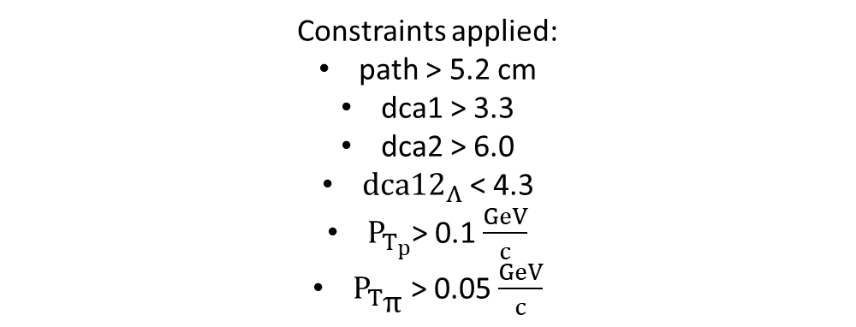

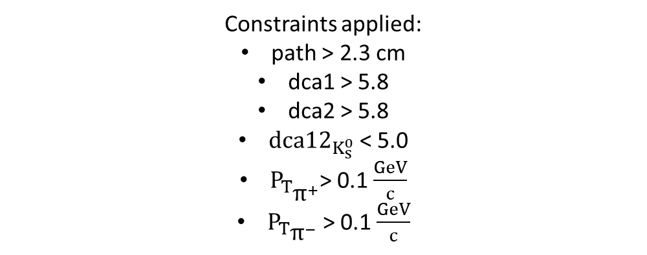
Results (lambda hyperons and $K_{S}^{0}$)
Constraints applied:
path > 2.3 cm
dca1 > 5.8
dca2 > 5.8
${dca12}_{K_{s}^{0}}$ < 5.0
$P_{T_{{\text{π}}^{+}}}$> 0.1$\frac{GeV}{c}$
$P_{T_{{\text{π}}^{−}}}$ > 0.1 $\frac{GeV}{c}$
[4].
Constraints applied:
path > 5.2 cm
dca1 > 3.3
dca2 > 6.0
${dca12}_{Λ}$ < 4.3
$P_{T_{p}}$> 0.1$\frac{GeV}{c}$
$P_{T_{\text{π}}}$ > 0.05 $\frac{GeV}{c}$
[2].
[2] A. Zinchenko (JINR), BM@N collaboration.

Slide 8
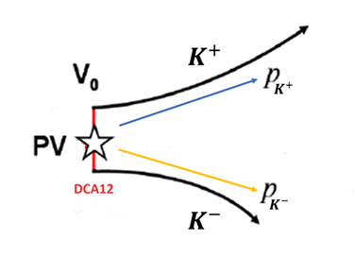
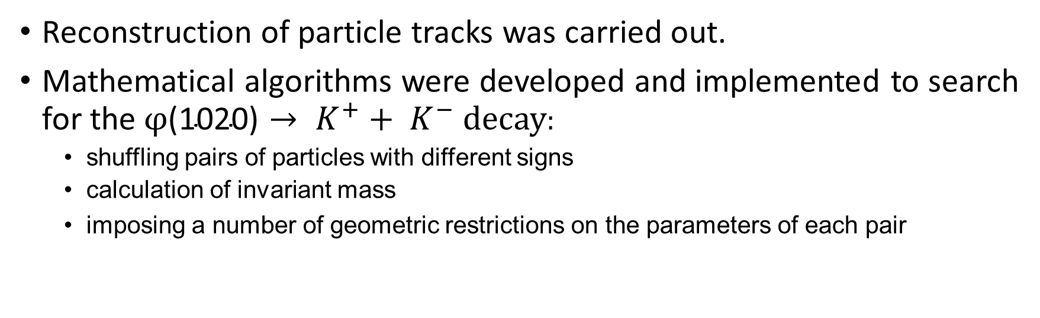

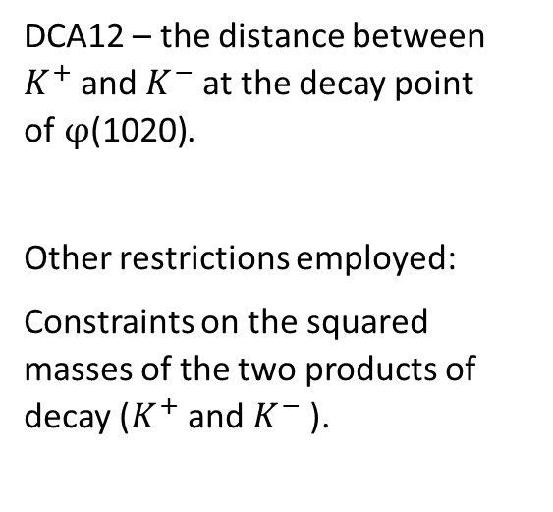

Data processing procedure ($φ\text{(1020}\text{)}$)
Reconstruction of particle tracks was carried out.
Mathematical algorithms were developed and implemented to search for the$φ\text{(1020}\text{)}→ K^{+}+ K^{−}$decay:
  shuffling pairs of particles with different signs
  calculation of invariant mass
  imposing a number of geometric restrictions on the parameters of each pair
DCA12 – the distance between $K^{+}$and $K^{−}$at the decay point of$φ\text{(1020}\text{)}$.
Other restrictions employed:
Constraints on the squared masses of the two products of decay ($K^{+}$and $K^{−}$).
Event topology $φ\text{(1020}\text{)}$

Slide 9
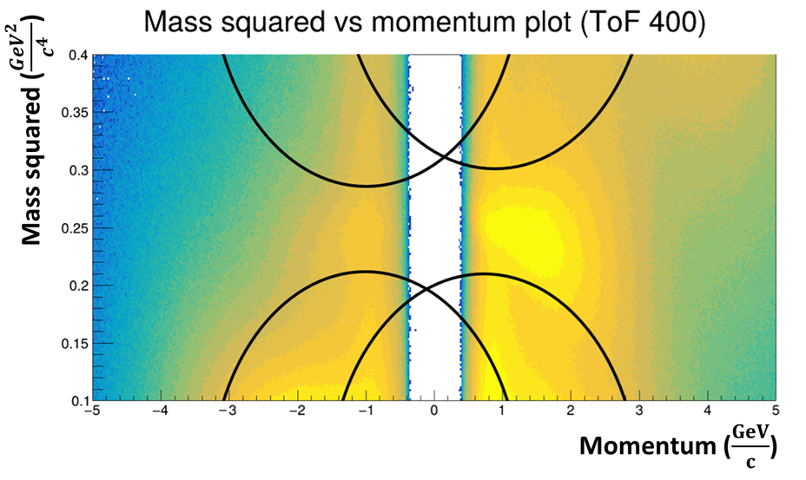
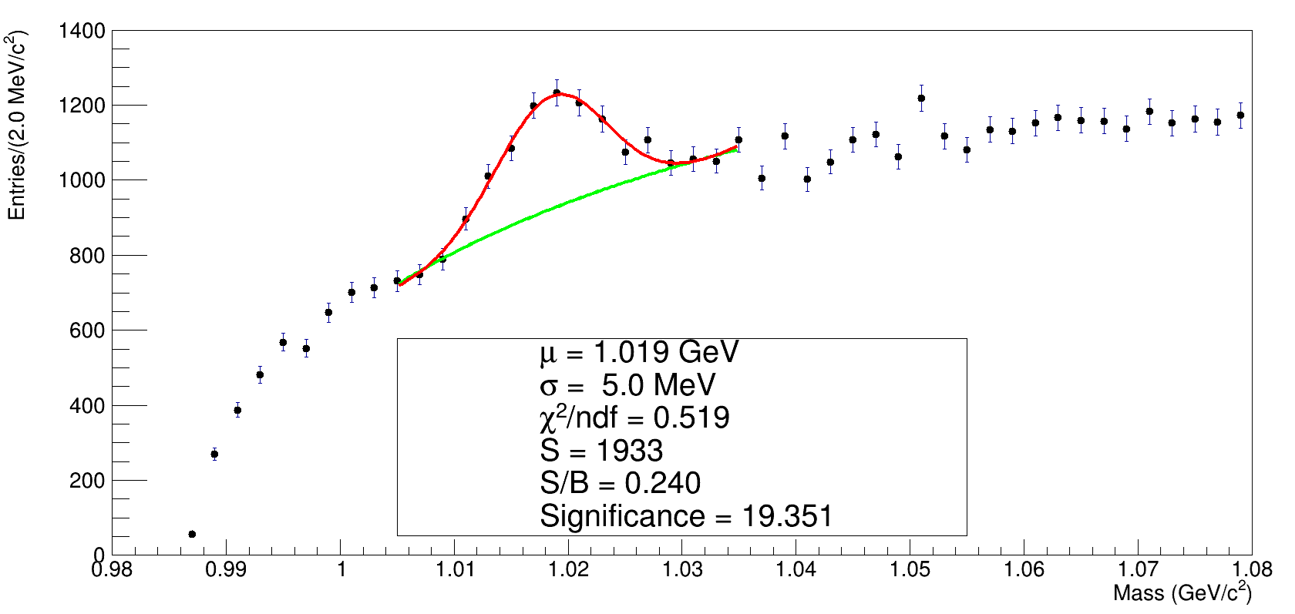

Results ($φ\text{(1020}\text{)}$)
Following situation with regards to constraints on the squared mass was considered:
Additional constraint used :
0.0 cm <= dca12 <= 1.0 cm

Slide 10
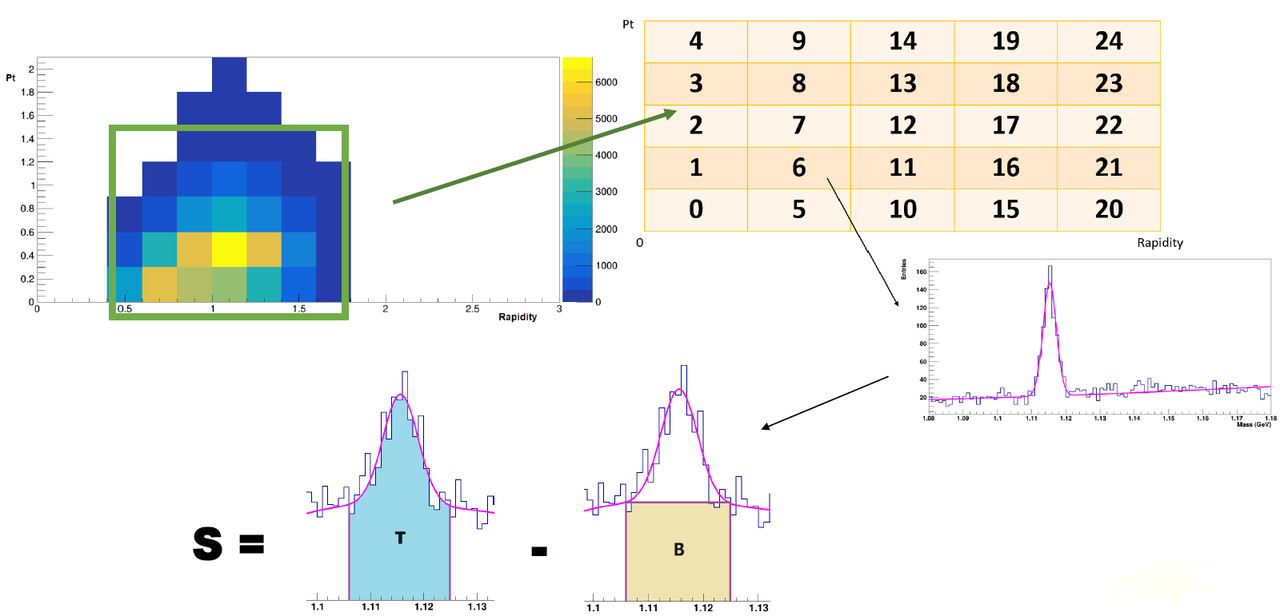
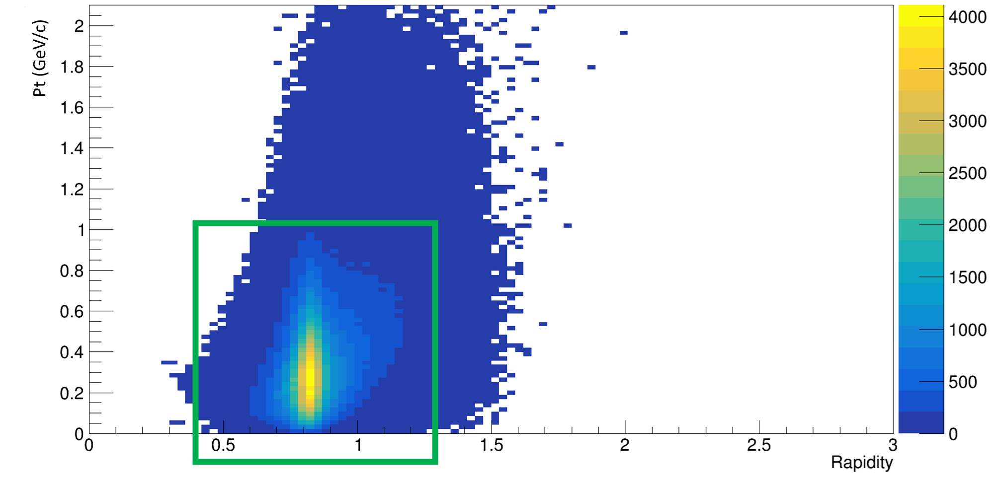
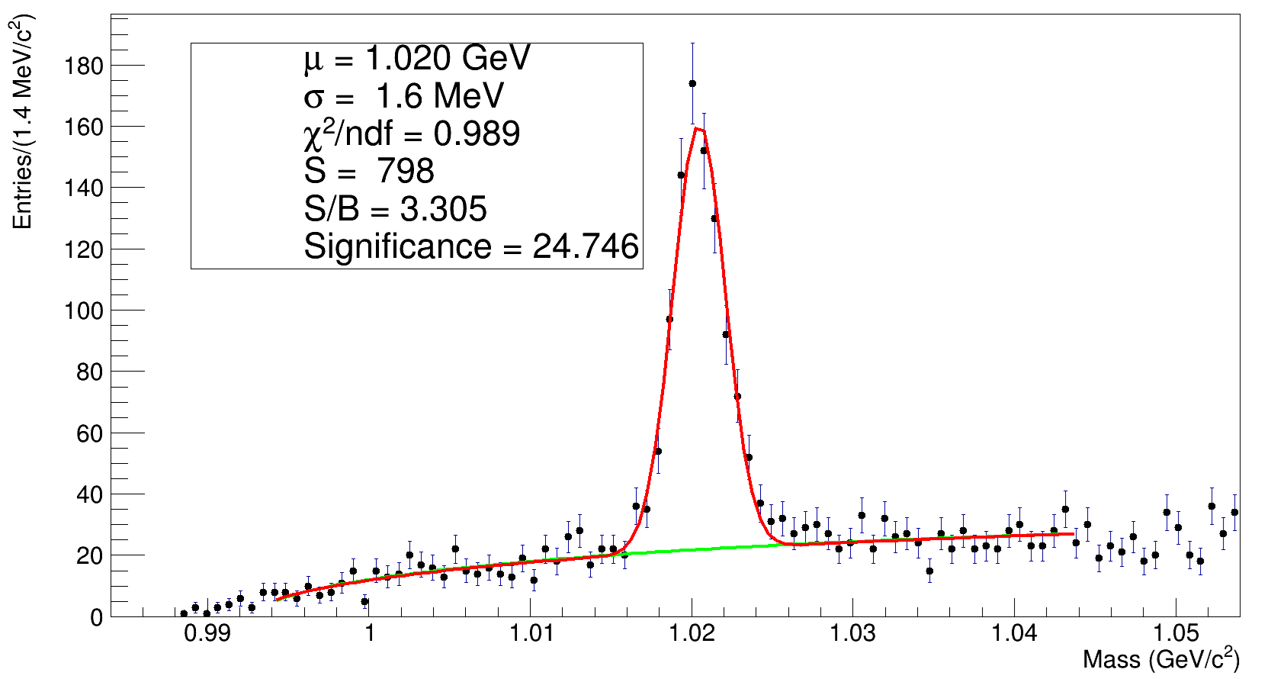

Results ($φ\text{(1020}\text{)}$)
Preliminary phase space analysis

Slide 11
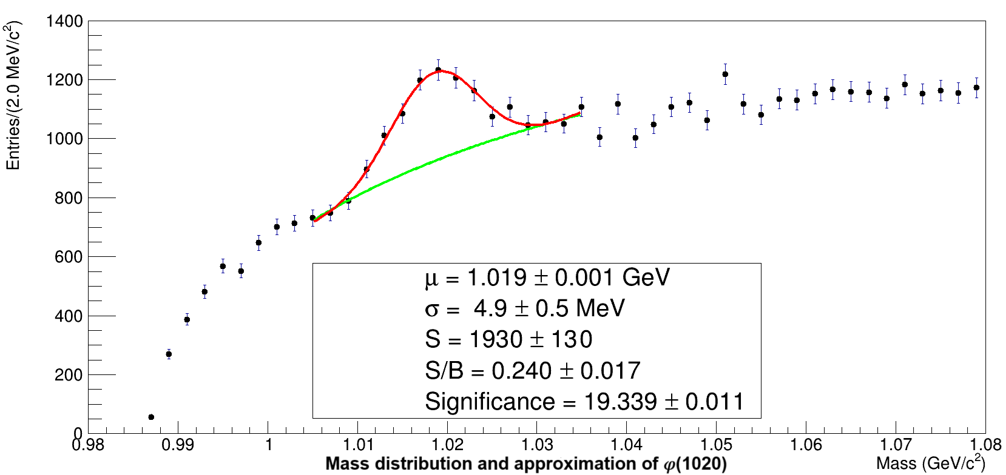
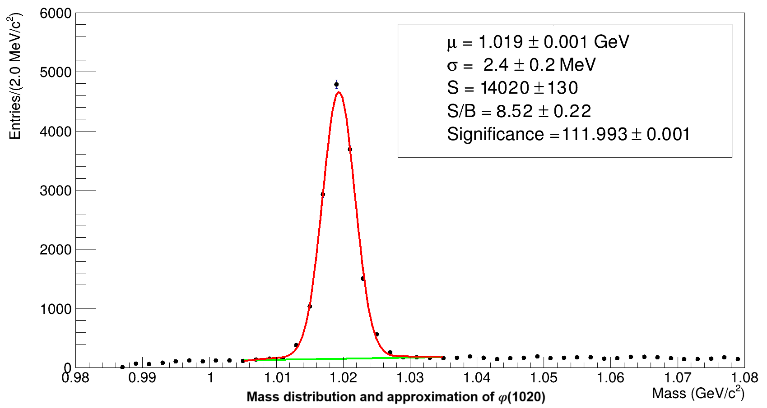

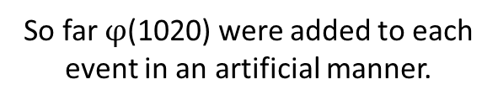
Results ($φ\text{(1020}\text{)}$)
Preliminary phase space analysis
Experimental case
MC case (DCM-SMM [3].)
So far $φ\text{(1020}\text{)}$ were added to each event in an artificial manner.
[3] Baznat M., Botvina A., Musulmanbekov G., Toneev V., Zhezher V. Monte-Carlo Generator of Heavy Ion Collisions DCM-SMM, Physics of Particles and Nuclei Letters 17, 3, 303-324 (2020)

Slide 12
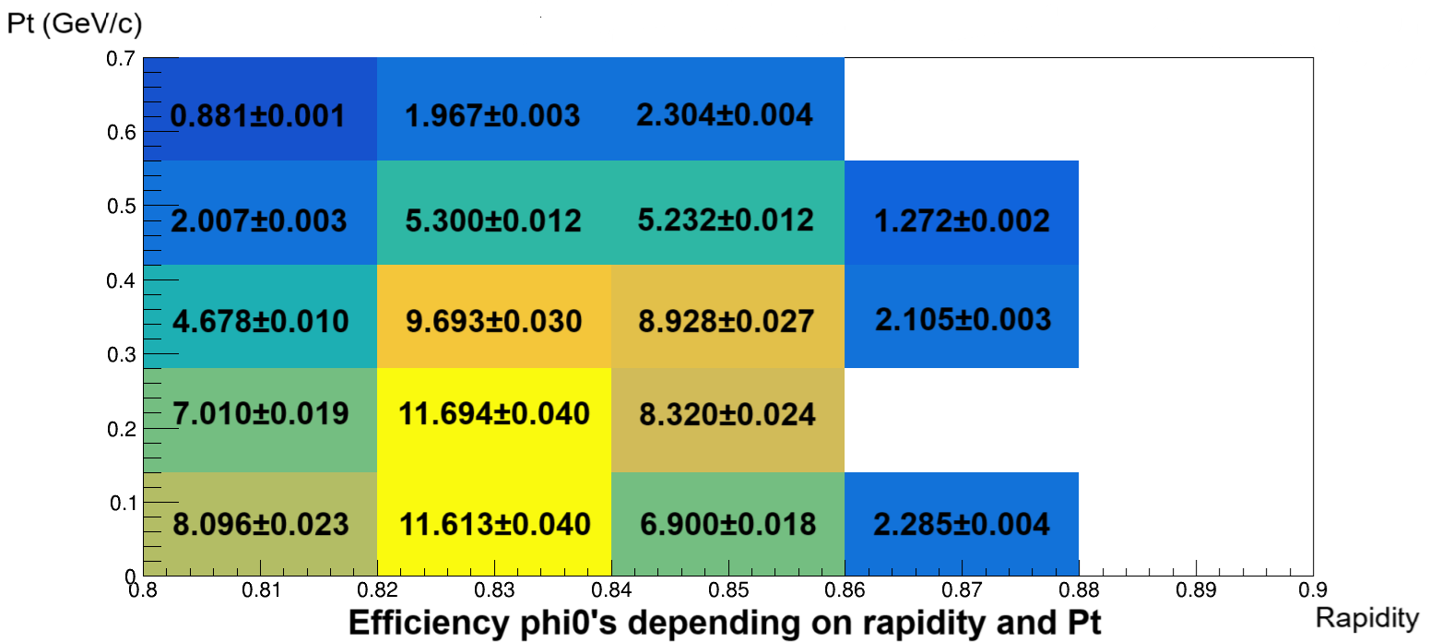
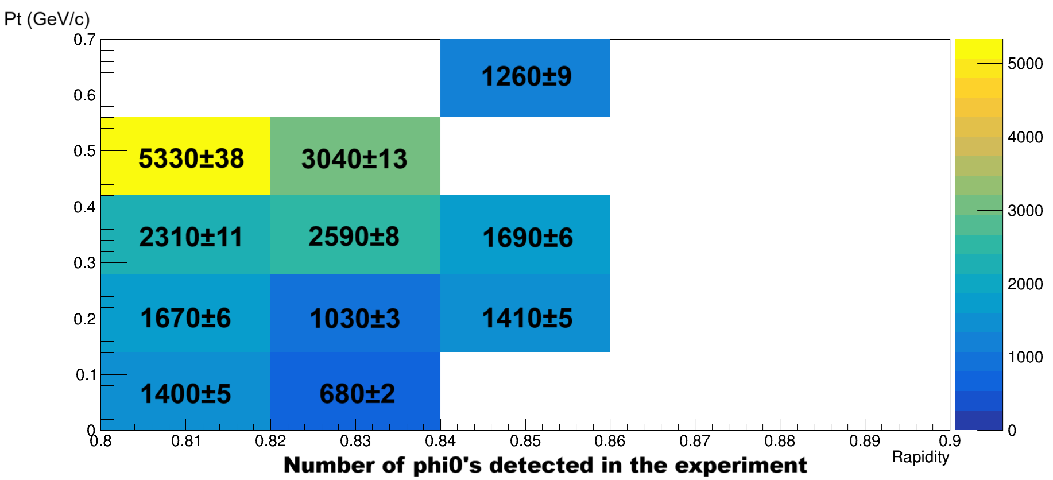




Results ($φ\text{(1020}\text{)}$)
Preliminary phase space analysis
$Efficiency= \frac{N_{reconstructed}}{N_{generated}} ∗$ 100 %
$$N_{exp}= S_{exp} ∗ efficiency$$

Slide 13
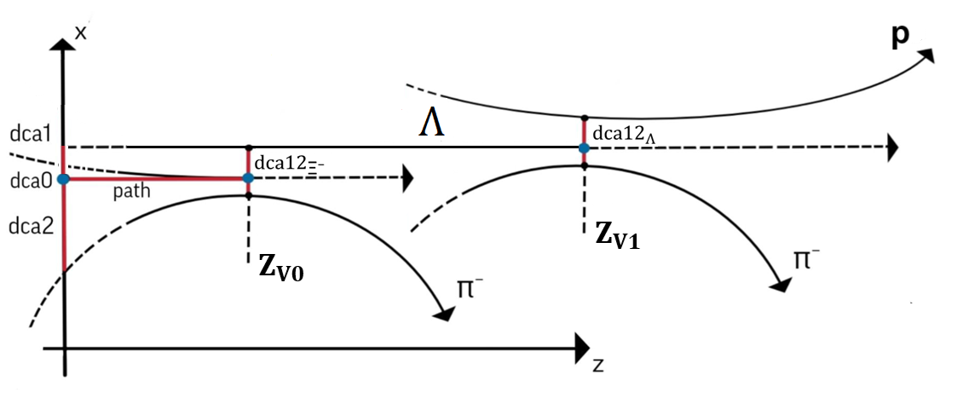

Data processing procedure ($\text{Ξ}\text{−}$)

Slide 14
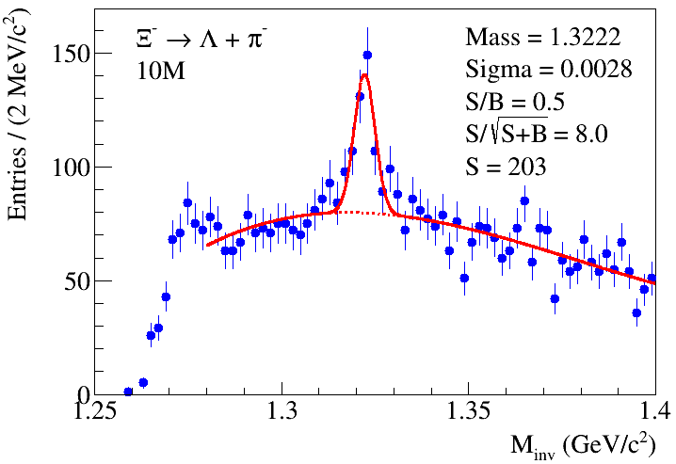

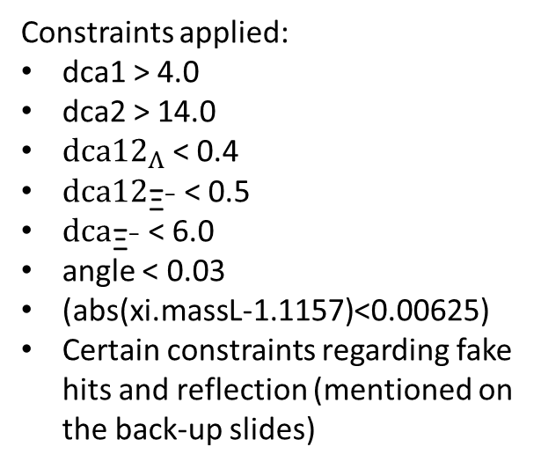
Results ($\text{Ξ}\text{−}$)
Constraints applied:
dca1 > 4.0
dca2 > 14.0
${dca12}_{Λ}$ < 0.4
${dca12}_{\text{Ξ}\text{−}}$ < 0.5
${dca}_{\text{Ξ}\text{−}}$ < 6.0
angle < 0.03
(abs(xi.massL-1.1157)<0.00625)
Certain constraints regarding fake hits and reflection (mentioned on the back-up slides)
[4].
[4]. V. Vasendina, A. Zinchenko (JINR), BM@N collaboration.

Slide 15

Data processing procedure (${}_{Λ}^{3}H$)
[5].
[5] S. Merts (JINR), E. Konstantinova (JINR), (2025, May 15), Status of hypernuclei signal reconstruction in Xe+CsI Collisions in the BM@N experiment, https://indico.jinr.ru/event/5284/contributions/31168/attachments/22219/39231/merts.pdf

Slide 16
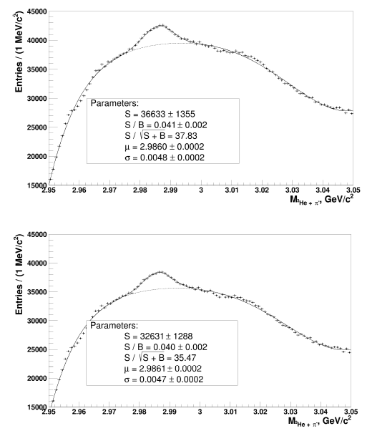

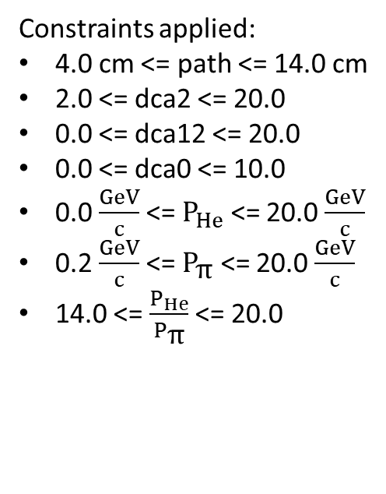
Results (${}_{Λ}^{3}H$)
Experimental data
Two cases were considered:
All available experimental events.
Events starting from a certain run.
Constraints applied:
4.0 cm <= path <= 14.0 cm
2.0 <= dca2 <= 20.0
0.0 <= dca12 <= 20.0
0.0 <= dca0 <= 10.0
0.0 $\frac{GeV}{c}$ <= $P_{He}$ <= 20.0 $\frac{GeV}{c}$
0.2 $\frac{GeV}{c}$ <= $P_{\text{π}}$ <= 20.0 $\frac{GeV}{c}$
14.0 <= $\frac{P_{He}}{P_{\text{π}}}$ <= 20.0
[5].

Slide 17
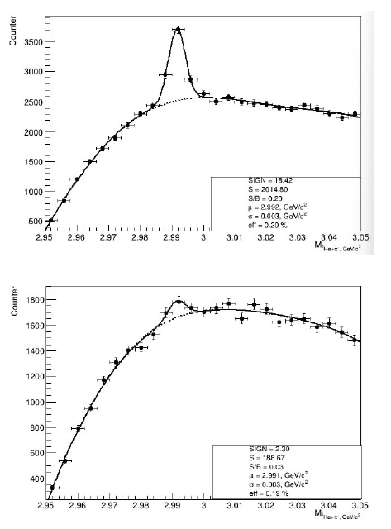

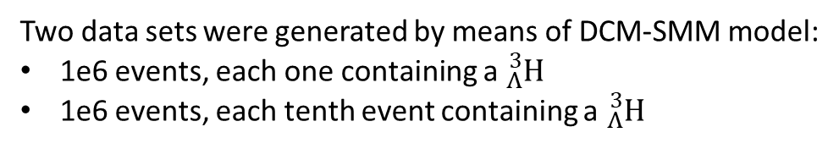
Results (${}_{Λ}^{3}H$)
MC data
Two data sets were generated by means of DCM-SMM model:
1e6 events, each one containing a ${}_{Λ}^{3}H$
1e6 events, each tenth event containing a ${}_{Λ}^{3}H$
Constraints applied:
0.5 cm <= path <= 50.0 cm
0.01 <= dca2 <= 100.0
0.0 <= dca12 <= 8.0
0.0 <= dca0 <= 1.8
2.0 $\frac{GeV}{c}$ <= $P_{He}$ <= 10.0 $\frac{GeV}{c}$
0.2 $\frac{GeV}{c}$ <= $P_{\text{π}}$ <= 1.6 $\frac{GeV}{c}$
4.0 <= $\frac{P_{He}}{P_{\text{π}}}$ <= 21.0
[5].

Slide 18
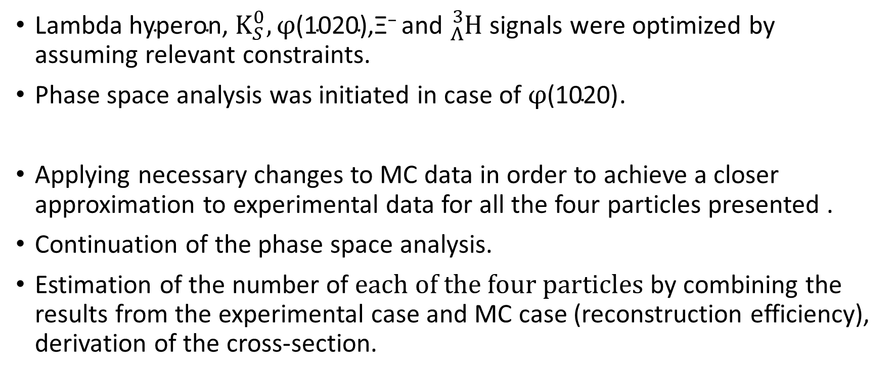
Conclusion and future work
$\text{L}\text{ambda} \text{hyperon}\text{, }K_{S}^{0}, φ\text{(1020}\text{)}\text{,}\text{Ξ}\text{−} \text{and} {}_{Λ}^{3}H$signals were optimized by assuming relevant constraints.
Phase space analysis was initiated in case of $φ\text{(1020}\text{)}$.
Applying necessary changes to MC data in order to achieve a closer approximation to experimental data for all the four particles presented .
Continuation of the phase space analysis.
Estimation of the number of $each of the four particles$by combining the results from the experimental case and MC case (reconstruction efficiency), derivation of the cross-section.

Slide 19
Thank you very much for your attention!

Slide 20
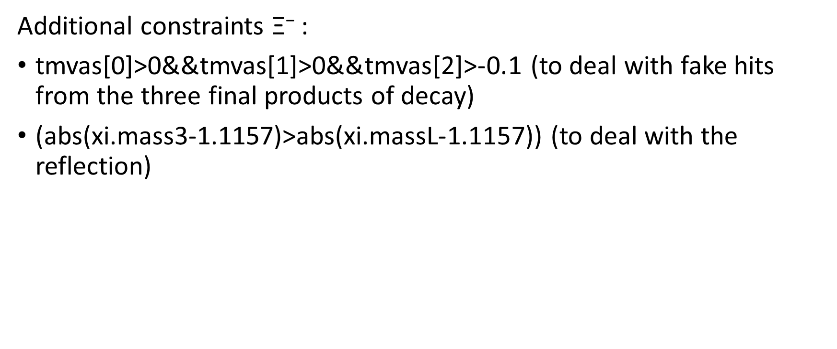
Back-up
Additional constraints $\text{Ξ}\text{−}$ :
tmvas[0]>0&&tmvas[1]>0&&tmvas[2]>-0.1 (to deal with fake hits from the three final products of decay)
(abs(xi.mass3-1.1157)>abs(xi.massL-1.1157)) (to deal with the reflection)

